Slide 1
NightLight: Passively Mapping Nighttime Sidewalk Light Data for Improved Pedestrian Routing
Joseph Breda*, Daniel Campos Zamora*
Shwetak Patel, Jon Froehlich
Notes:
I’m Daniel and I’m Joe
[Daniel] We will be presenting our work: NightLight Passively Mapping Nighttime Sidewalk Light Data for Improved Pedestrian Routing.

Slide 2
Let’s try a quick exercise
Notes:
But before I dive into the paper, I want to try a quick exercise with you all [Go through these quickly at a natural place]

Slide 3
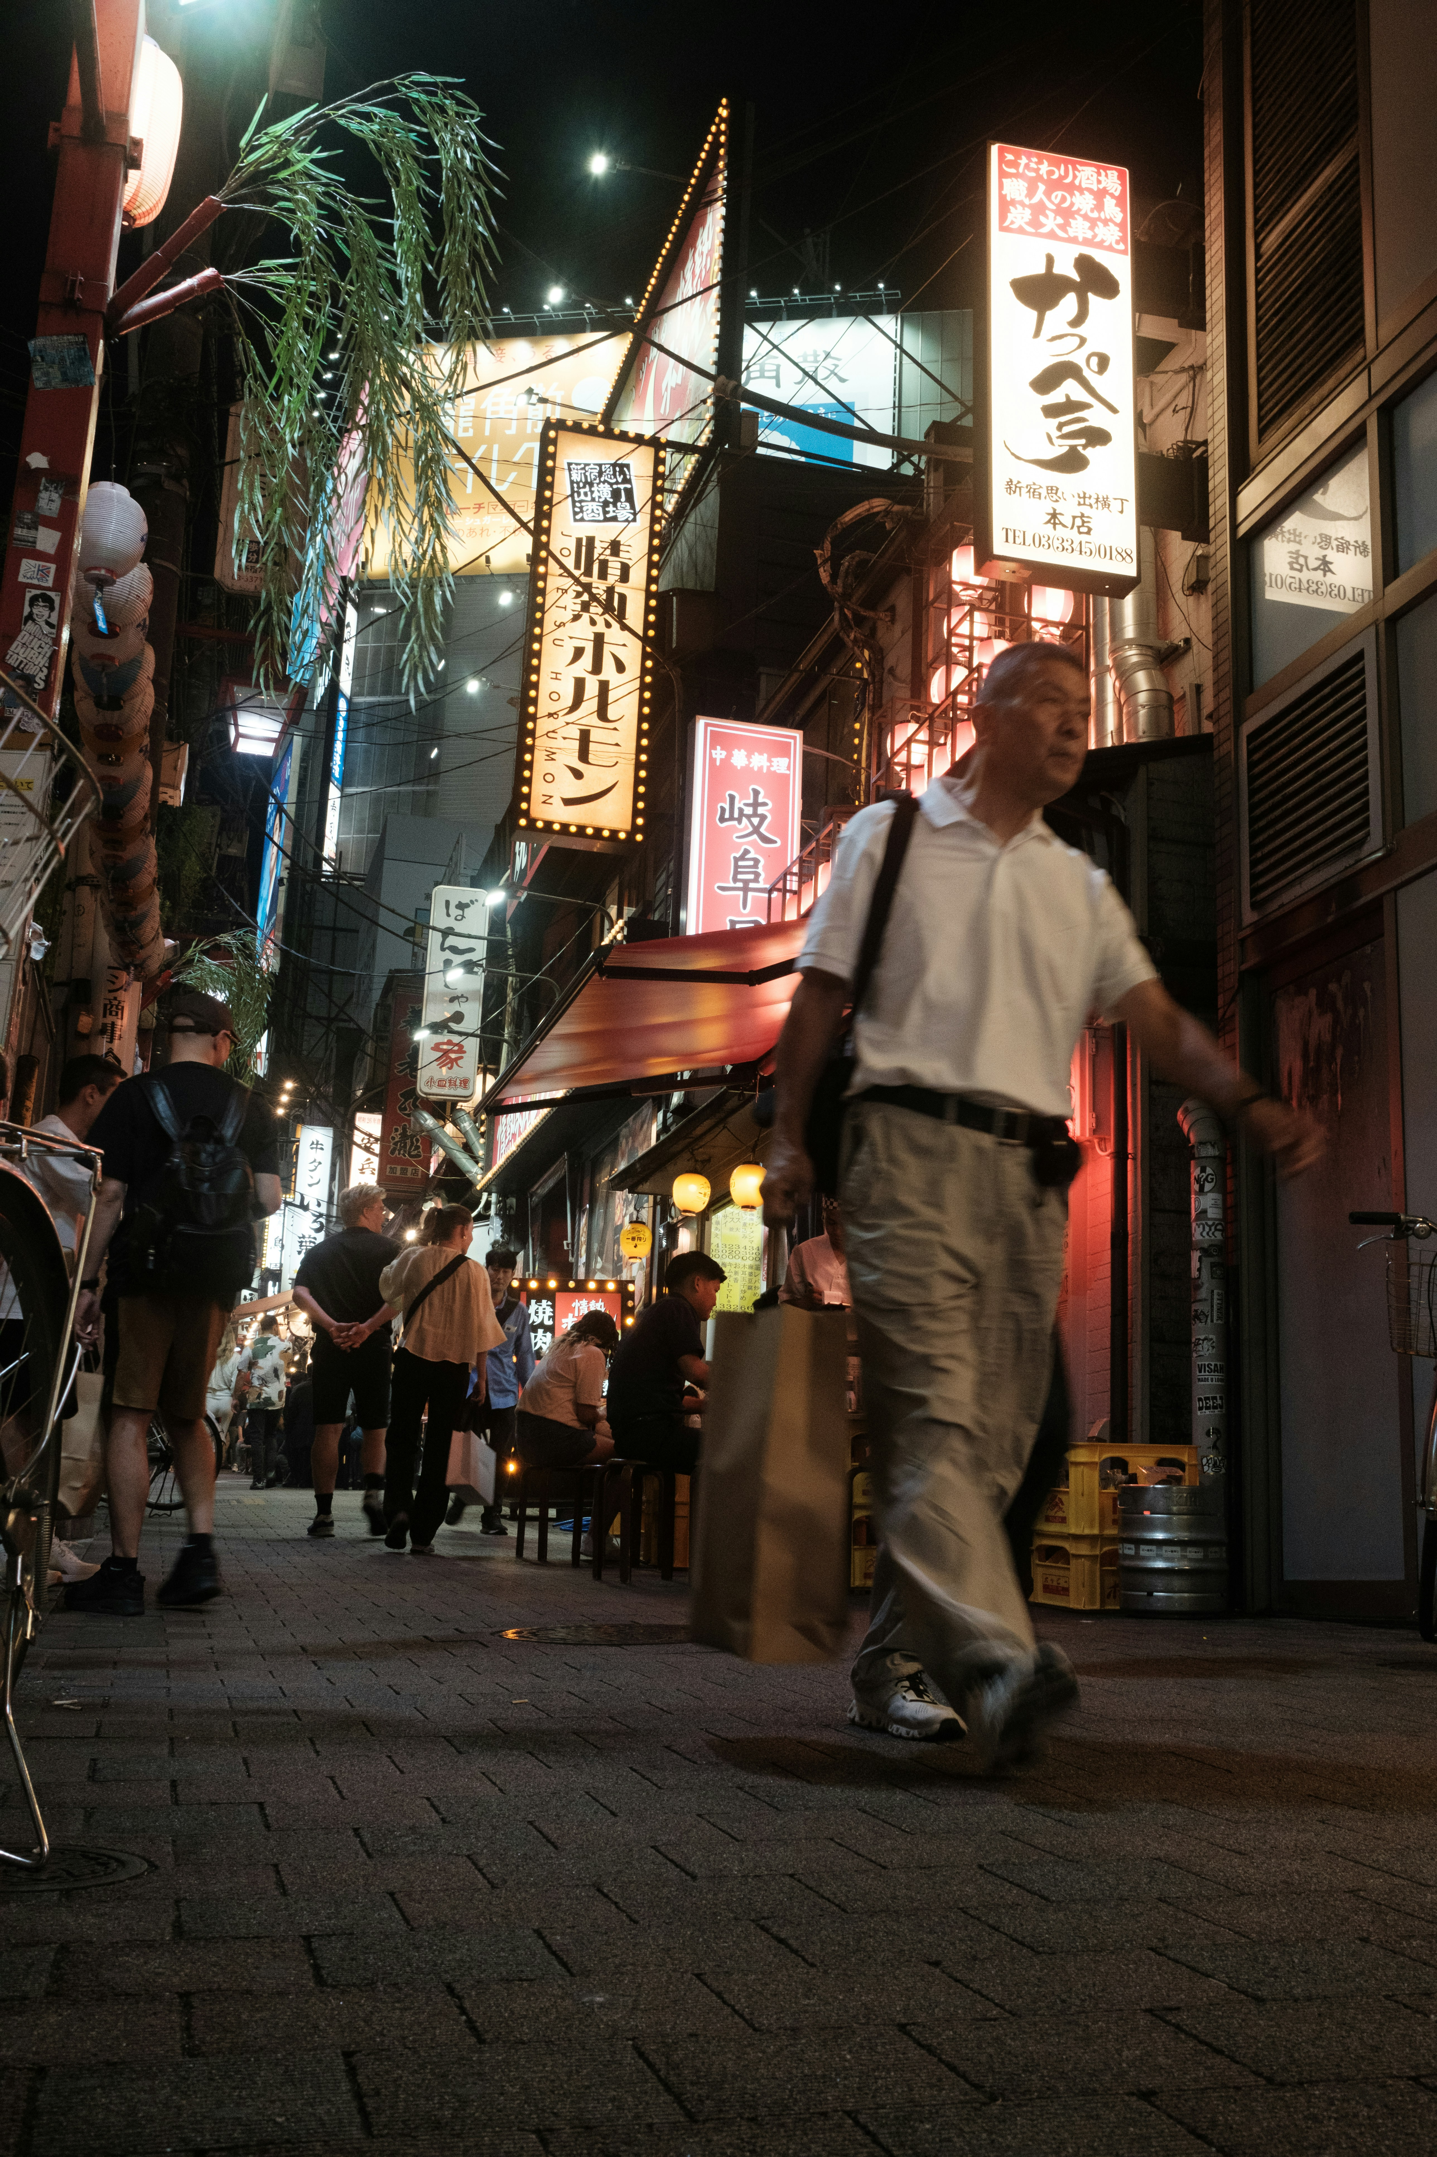
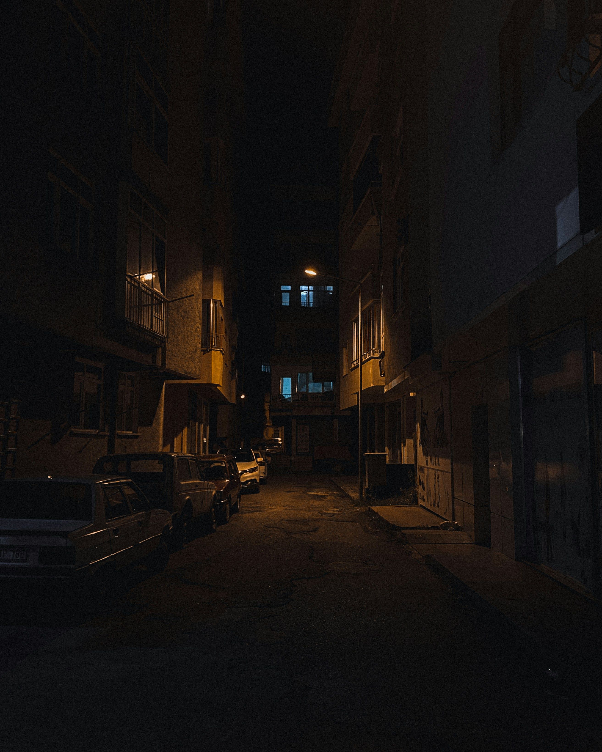
Where would you rather walk?
A
B
Notes:
Which one of these streets would you rather walk on? Raise your hands.

Slide 4
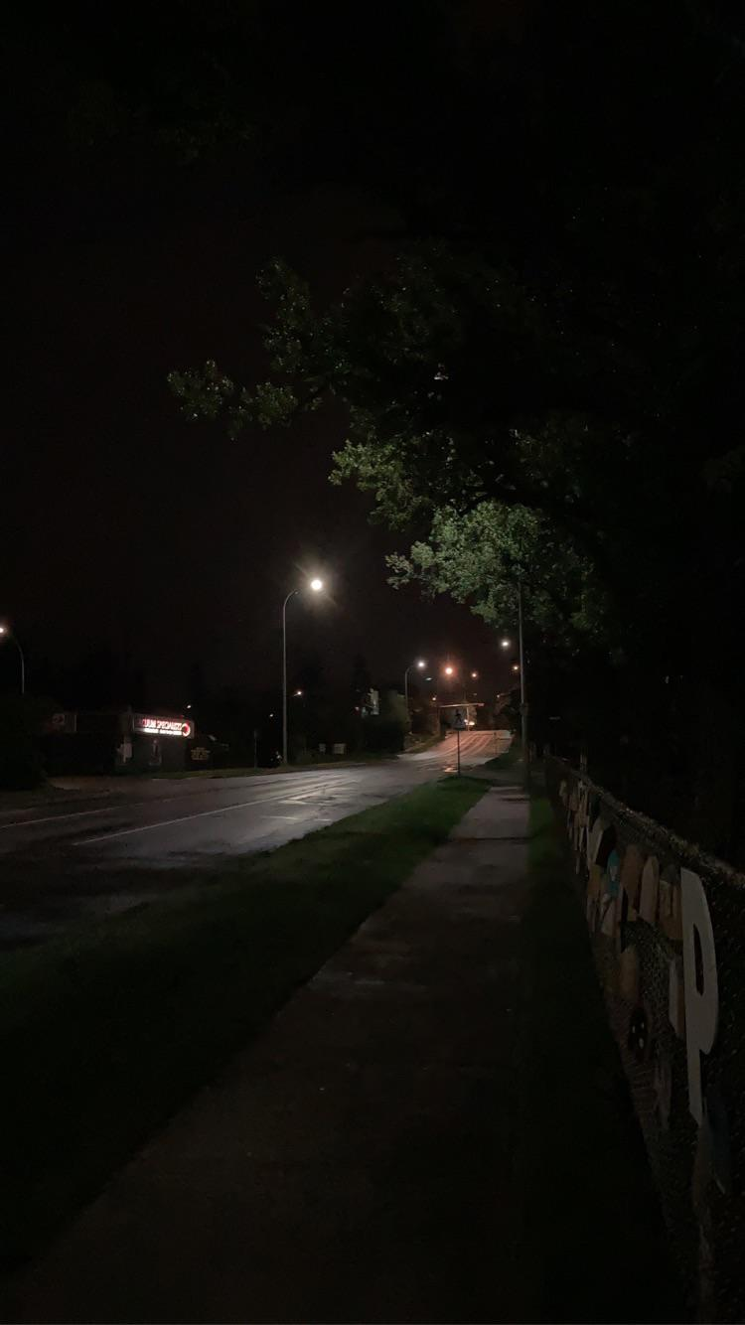
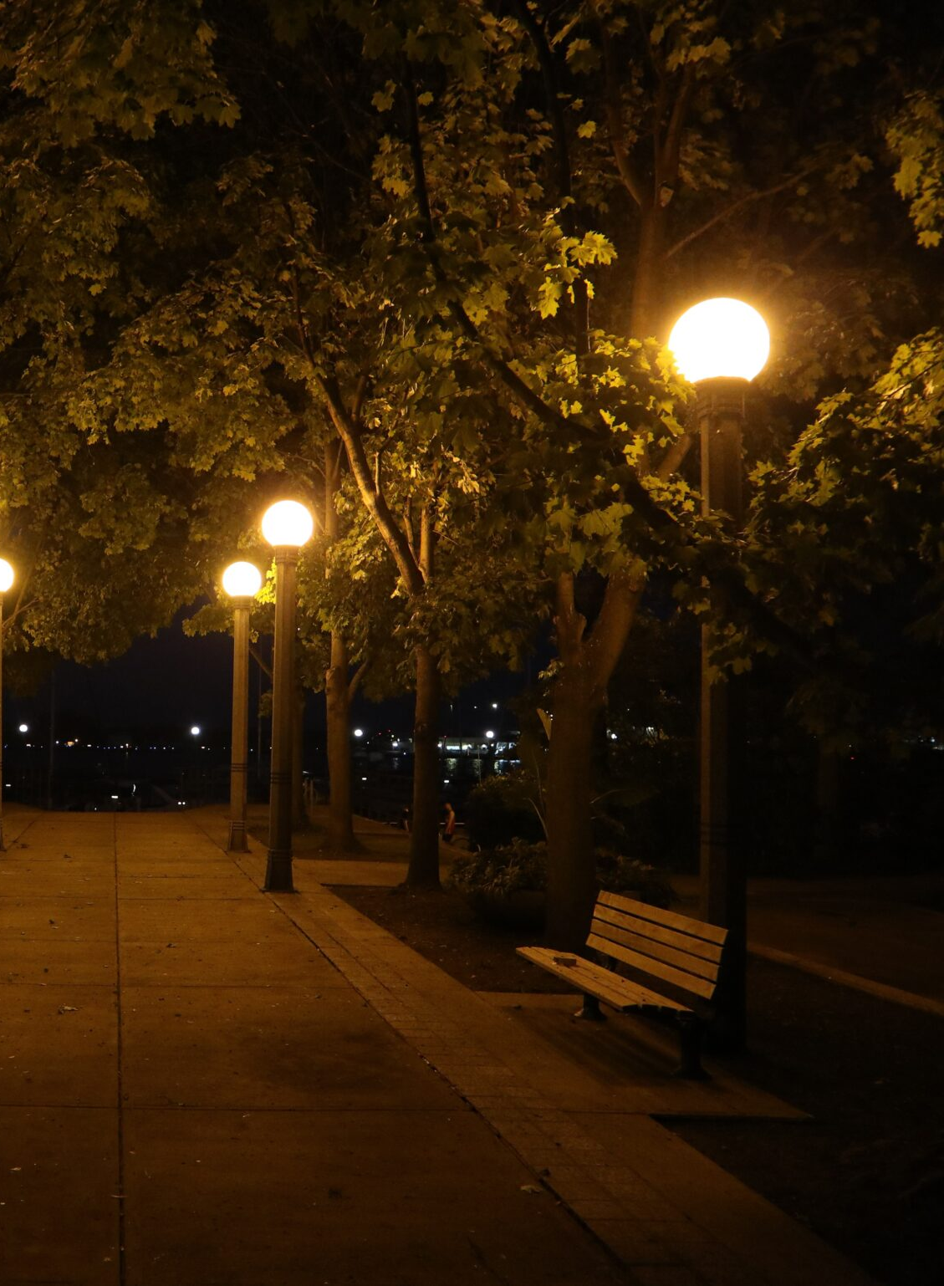
How about between these two?
A
B
Notes:
What about these two empty streets?

Slide 5
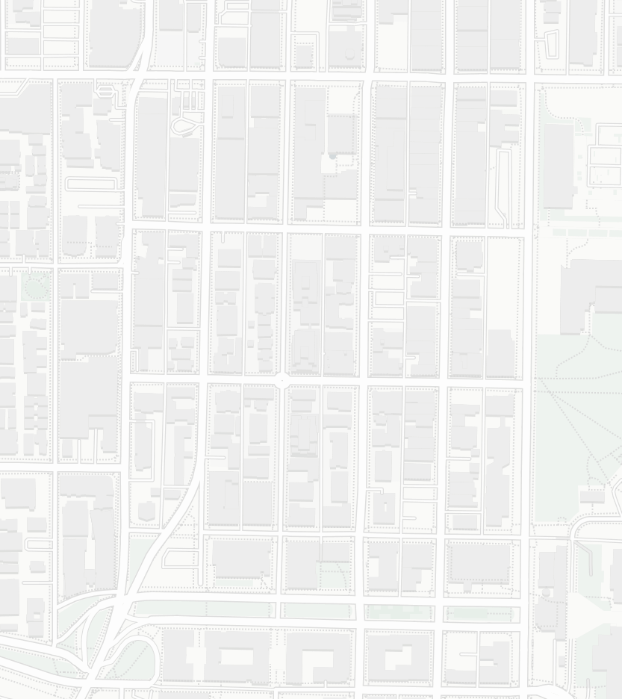
Now just using a map
A
B
Notes:
Just give them an answer

Slide 6
Now just using a map
Chances are this is a harder question.
Information is missing from this map that could inform your route planning.
One of these signals that's missing is lighting conditions.
A
B
Notes:
Now how about these? Chances are this is harder. It's missing important information that could inform your decision, especially considering that you are walking at night.

Slide 7
Walking at Nighttime
Intuitively, people prefer walking on well-light routes.
Without lighting information when planning a route, people can end up in uncomfortable walking environments or simply choose to avoid walking at night altogether.
Unequal and differential impact on various populations.
But walking at night brings different consideration for different populations (i.e., women consider light and safety more).
Without prior knowledge, route planning becomes a challenge.
Walking is good for physical and mental health and sustainability.
J
Notes:
JOE TALKS HERE
Light is important

Slide 8
How is light measured?
Intuitively, people prefer walking on well-light routes.
Without lighting information when planning a route, people can end up in uncomfortable walking environments or simply choose to avoid walking at night altogether.
Unequal and differential impact on various populations.
J
Notes:
this begs the question

Slide 9
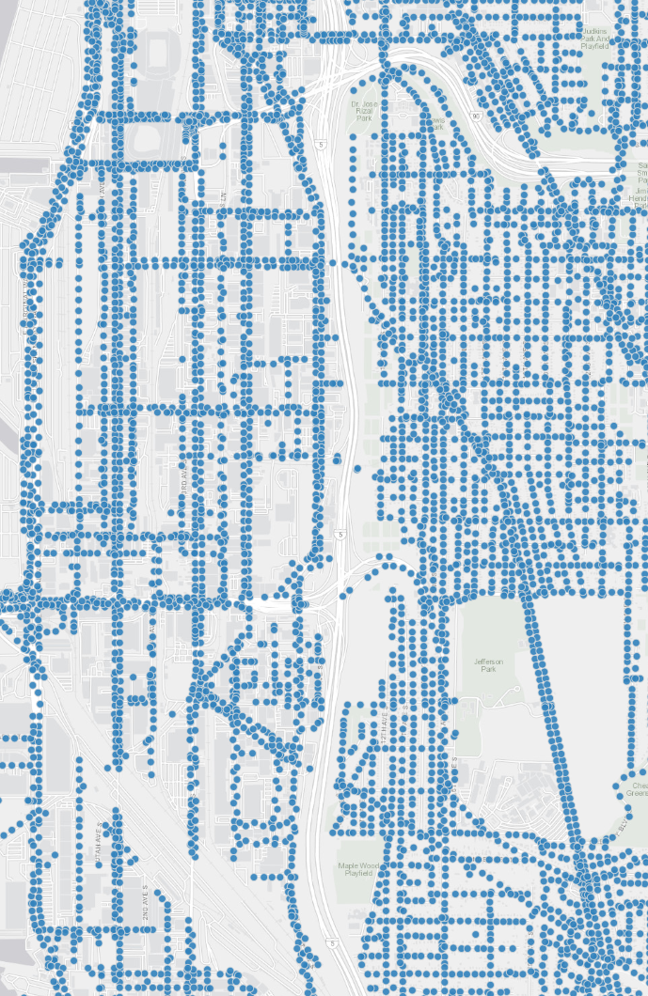
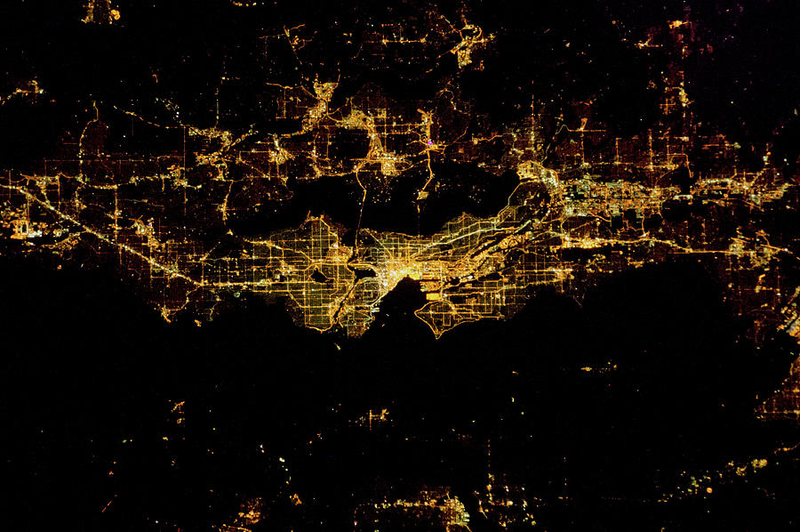
Measuring Light Level
Lighting conditions vary across the city
Satellite Imagery
Municipal Databases
Notes:
Currently city-wide light is measured through satellite imagery or municipal datasets which map streetlight location. However, these ways of measuring light don't work for pedestrian use cases and are designed for infrastructure such as mapping economic activity and maitnanence of light and power infrastructure.

Slide 10
Measuring Light Level
Lighting conditions vary across the city
Captures real conditions but is too coarse
Only maps streetlight
locations
Notes:
Only maps streetlight location and not ambient light from businesses or broken streetlamps.

Slide 11
Measuring Light Level
Lighting conditions vary across the city
These do not capture lighting conditions as experienced by pedestrians
Captures real conditions but is too coarse
and hard to update
Only maps streetlight
locations

Slide 12
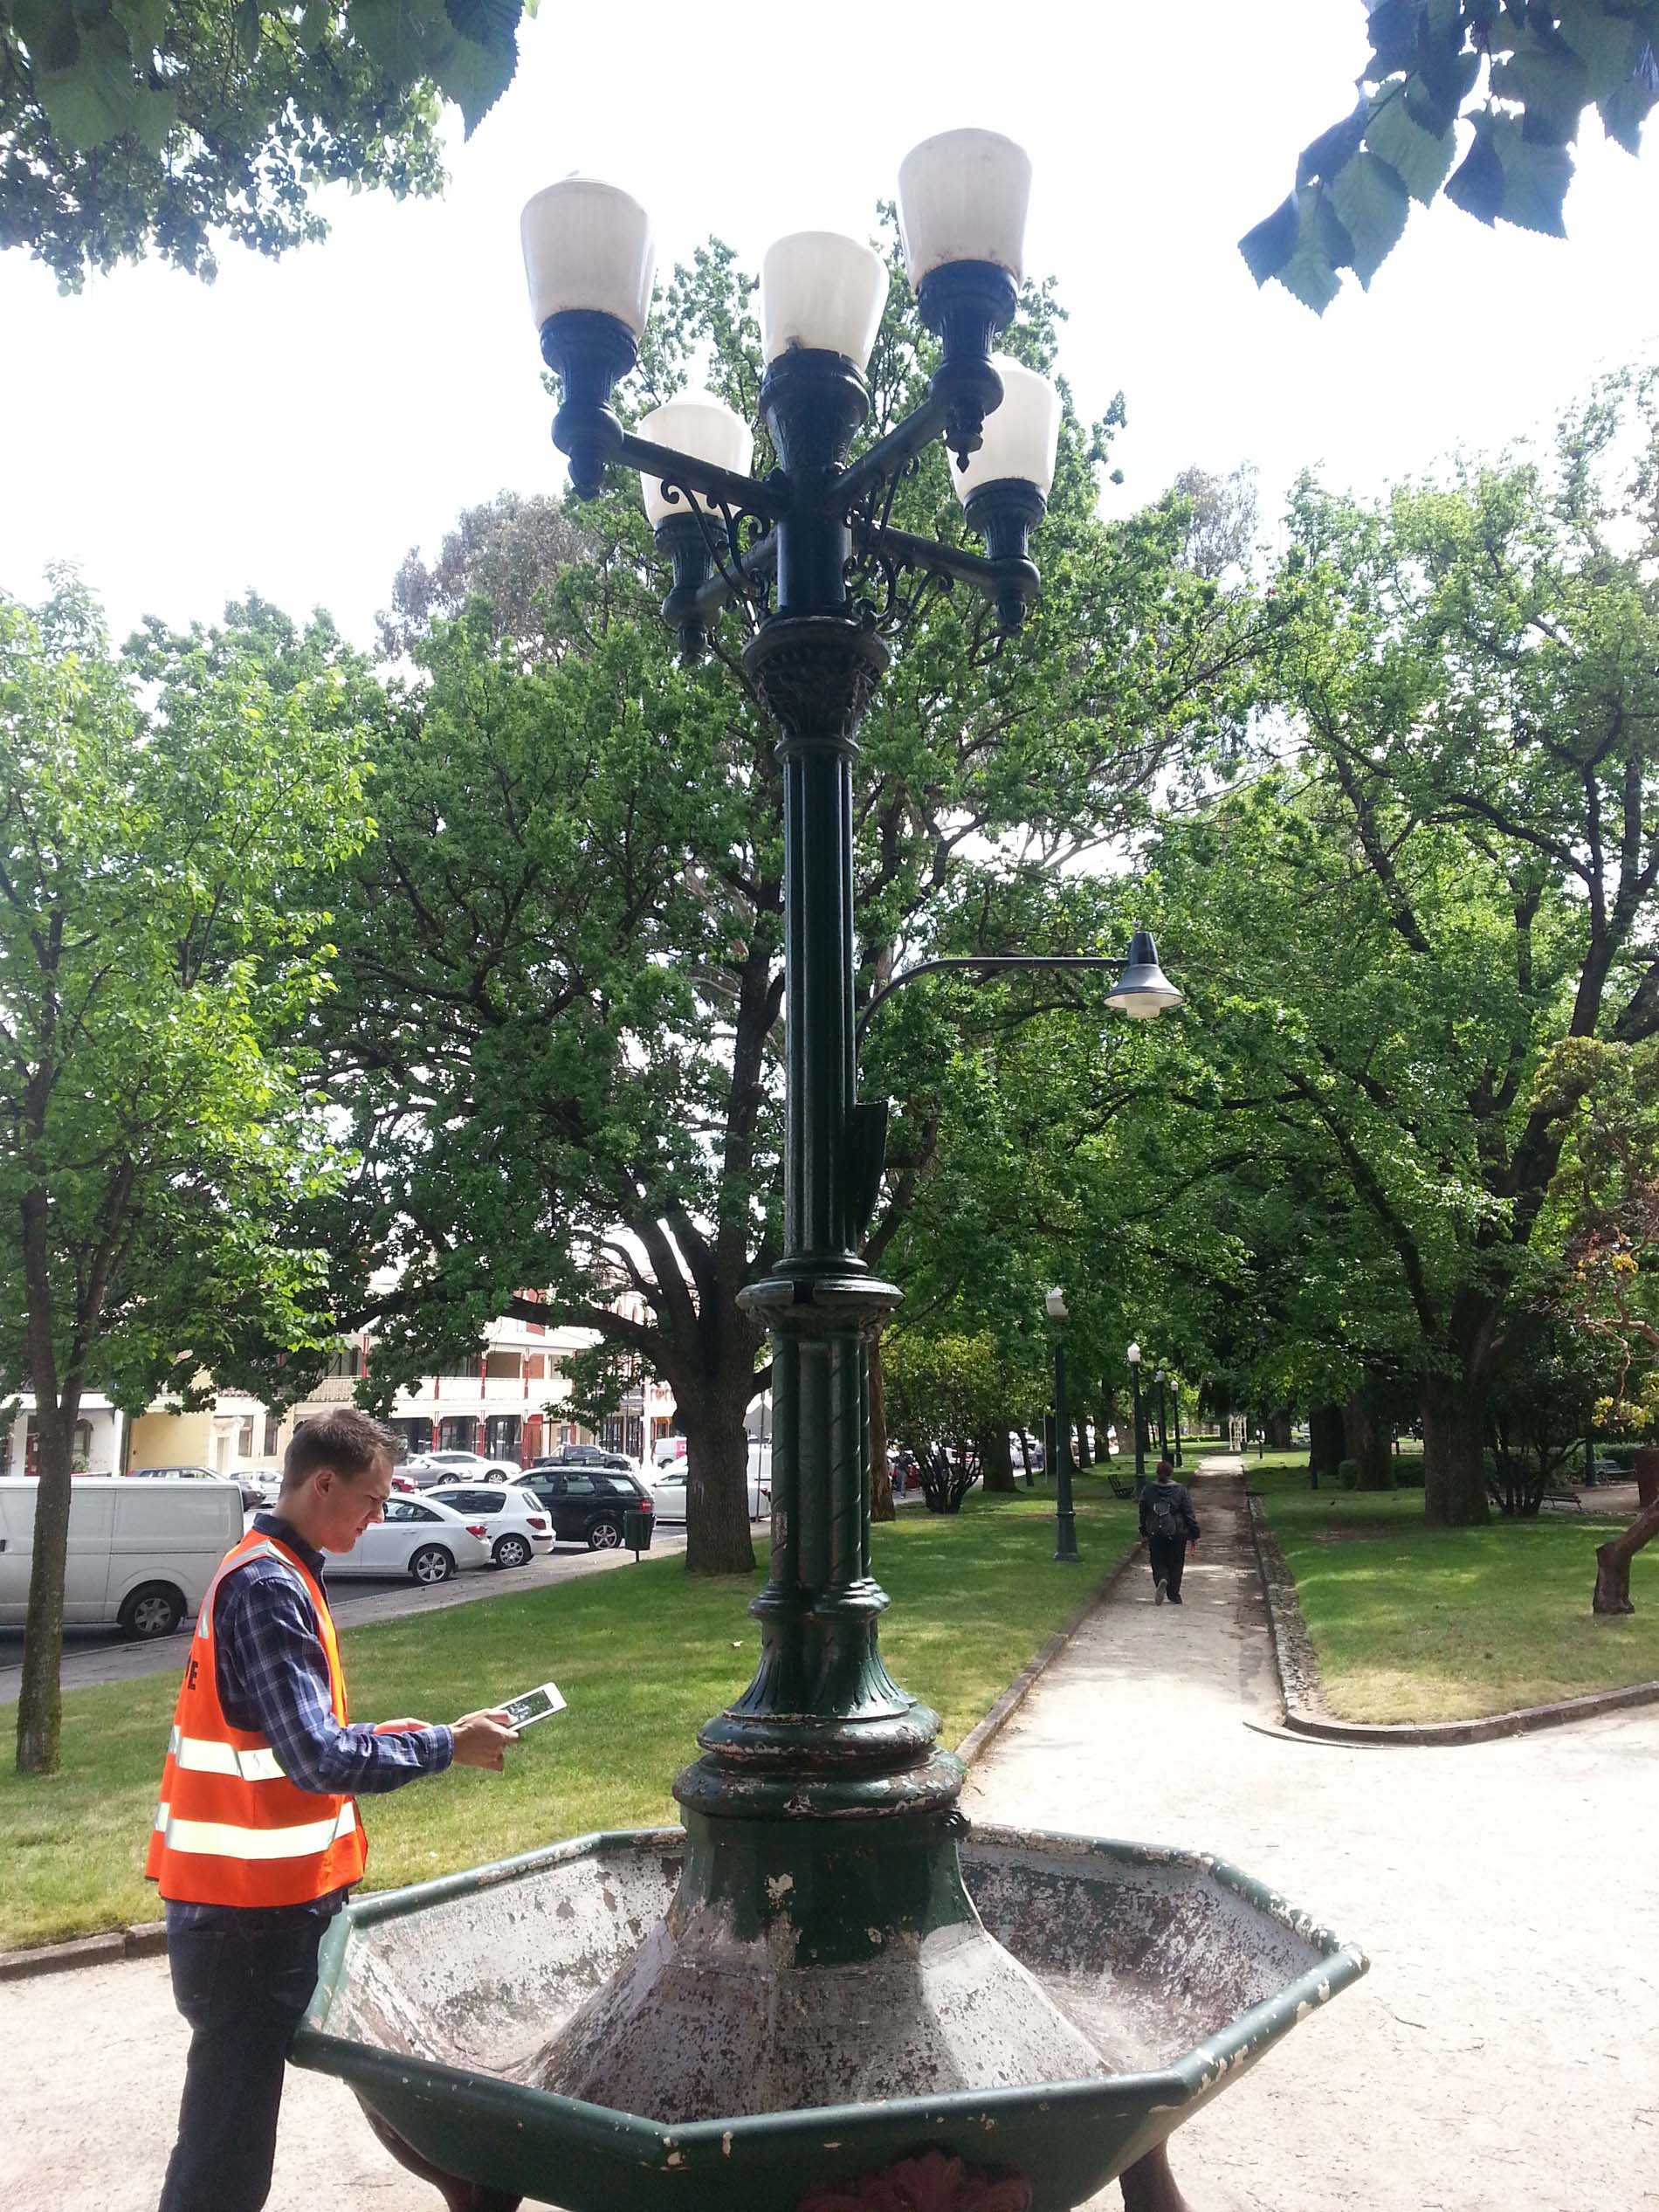
Measuring Light Level
Manual Audits
Handheld light meters to measure light conditions standing on the sidewalk.
This is expensive and time-consuming which makes it hard to scale and keep up to date.
Notes:
Another way municipalities aim to measure experienced light level is through manual auditing.
using handheld light sensors making spot estimates.

Slide 13
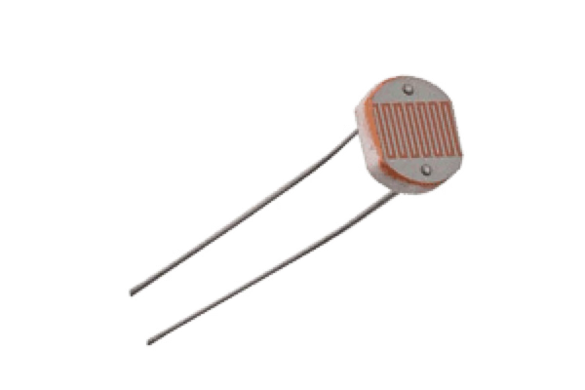
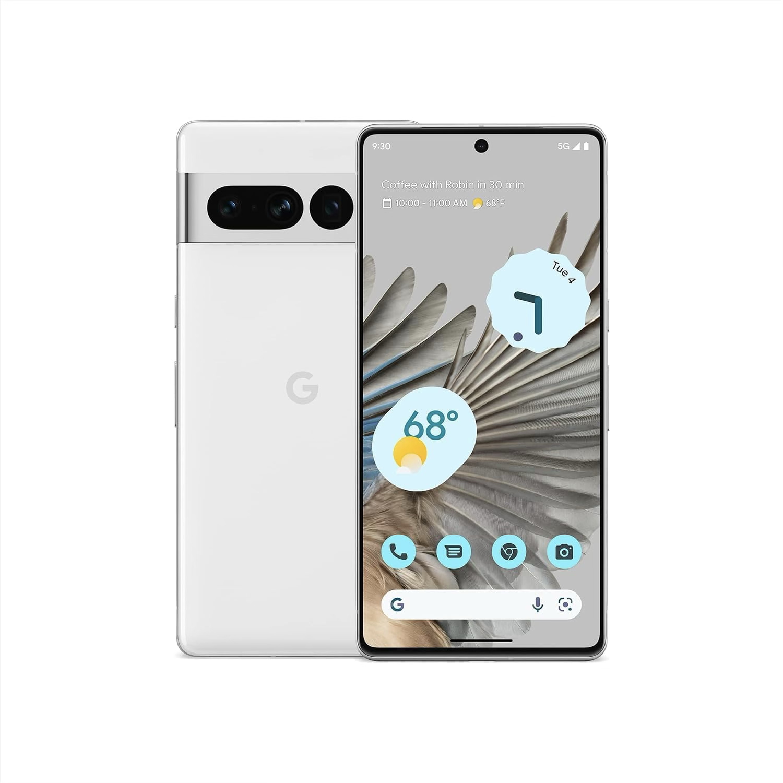
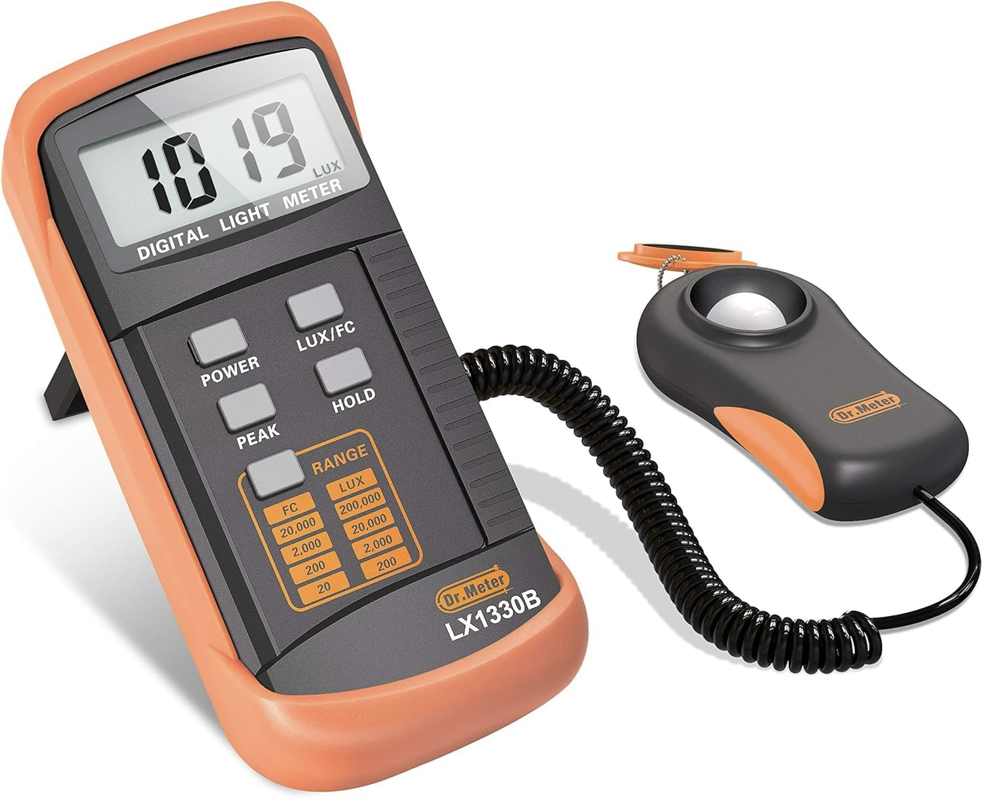
Measuring Light Level
Hardware
Light Sensor
Commercial Light Meter
Smartphone
Processor
Notes:
The same sensors that are in these purpose built devices are in smartphones making them ubiquitous in sidewalk environments

Slide 14
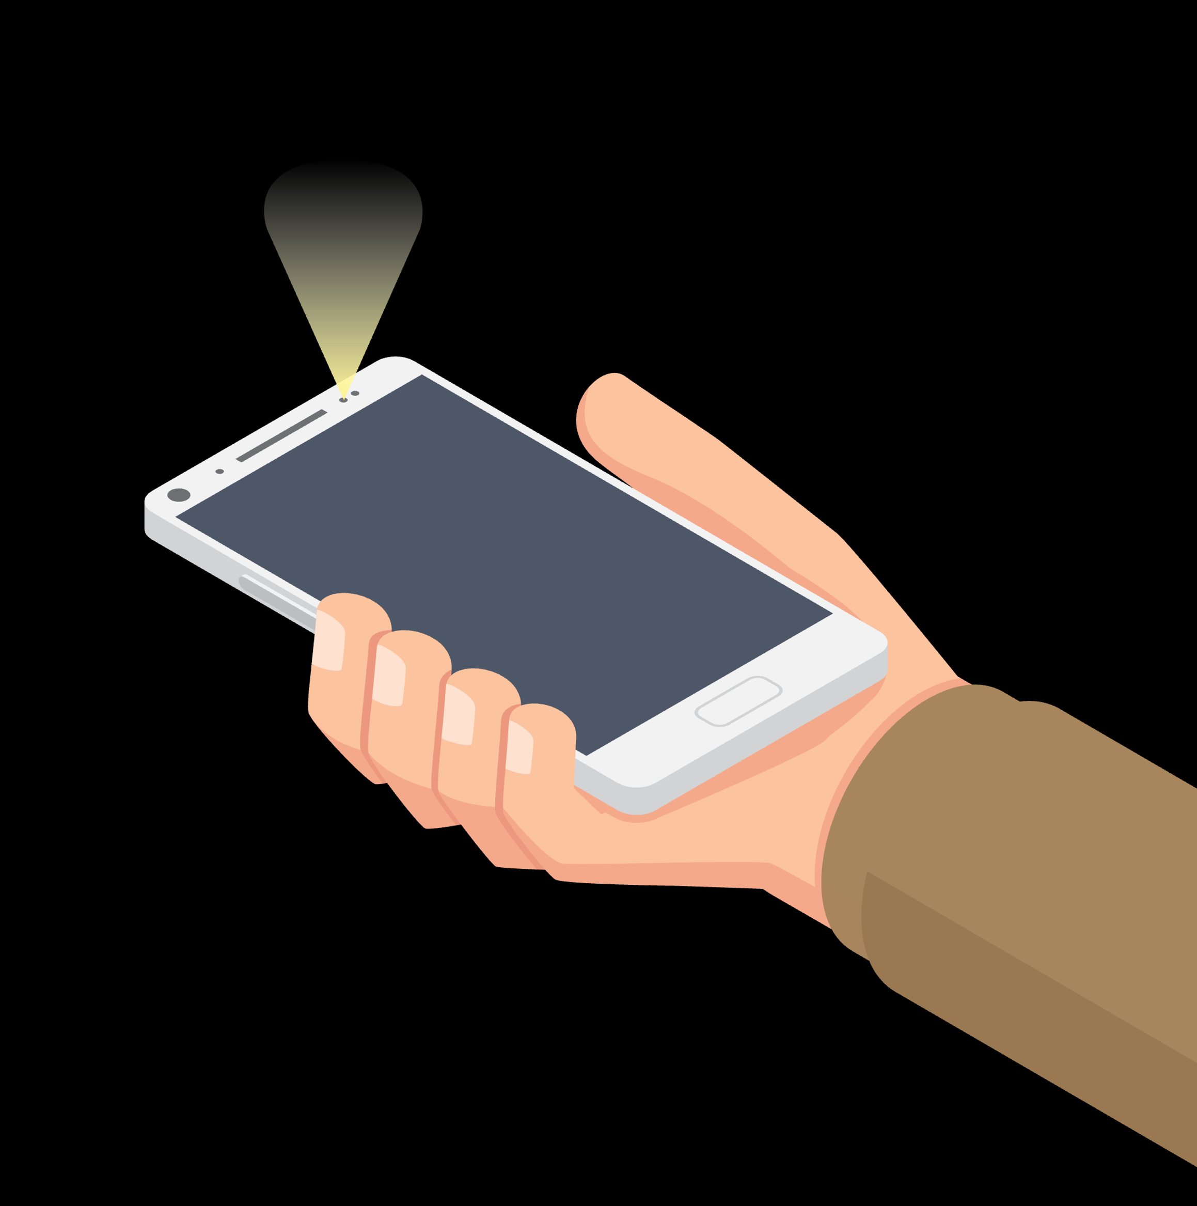
NightLight
Passively Crowdsourcing Light Level Data
Many devices already out there oriented in an ideal way to capture lighting
Notes:
DANIEL TALKS THIS SLIDE
We see this as an opportunity to passively crowdsource lighting conditions.
Especially because when people use these phones to common activities like texting or following map directions, the phones are oriented in an ideal way to capture lighting conditions.

Slide 15
NightLight Validation
Feasibility:
Utility
How does the ambient light sensor (ALS) in smartphones compare to commercial light meters in a lab environment?
Does this hold with real-world lighting conditions on streets?
Can we use NightLight to map lighting conditions across neighborhoods?
How do people use NightLight data to plan their nightime walking routes?
Notes:
So we built an android app to validate two key parts of our approach: First, is to demonstrate the feasibility of using smartphones to aggregate and analyze light data. So...Ask questions
Second is to evaluate the utility of this information to pedestrians. So..ask Questions

Slide 16
Feasibility
In-lab Validation
4 Phones
Controlled sweep using gimbal
Smartphone
Light Panel
Light Meter
Gimbal
3.8m
Notes:
We started by characterizing the ALS in different smartphones to compare them to commercial light meters.
We setup an experiment in a dark room with an adjustable light panel and a gimbal to do a controlled sweep of the phone to see how the readings change across phones and orientations.

Slide 17
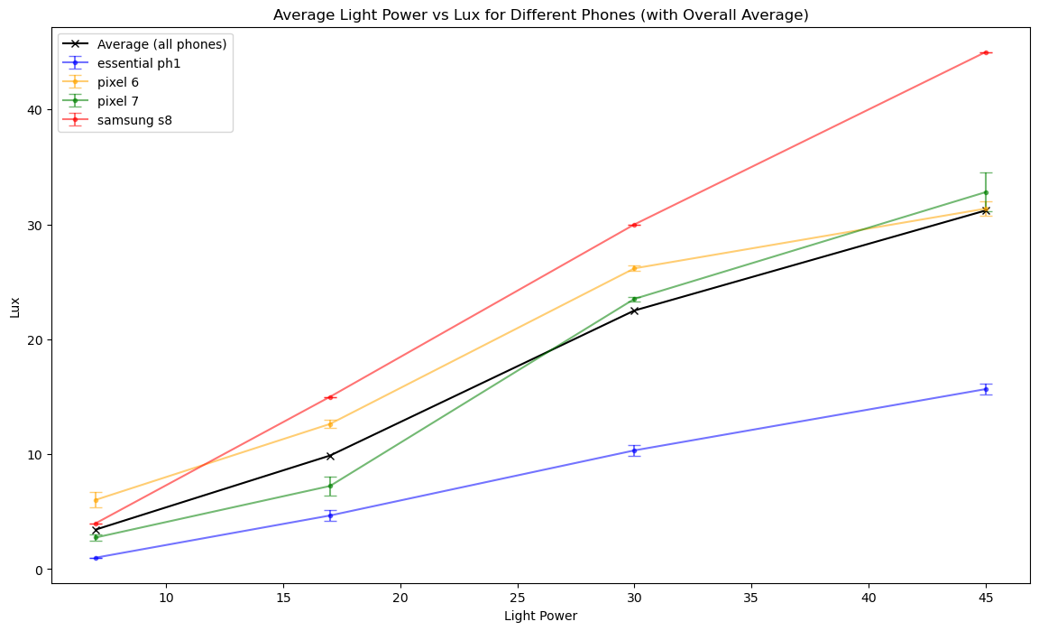
Feasibility
In-Lab Validation
Readings Across Light Intensities
Heatmap of Lux Readings
45
0
Google Pixel 6A
Lux
On aggregate phones perform comparably to commercial light meter
Orientation impacts light readings
Notes:
REMAKE PLOT. We demonstrate that while phones have different offsets and refresh rates, on aggregate they perform comprably to commercial light meters. Also, we show that the orientation has an important impact on the lux readings.

Slide 18
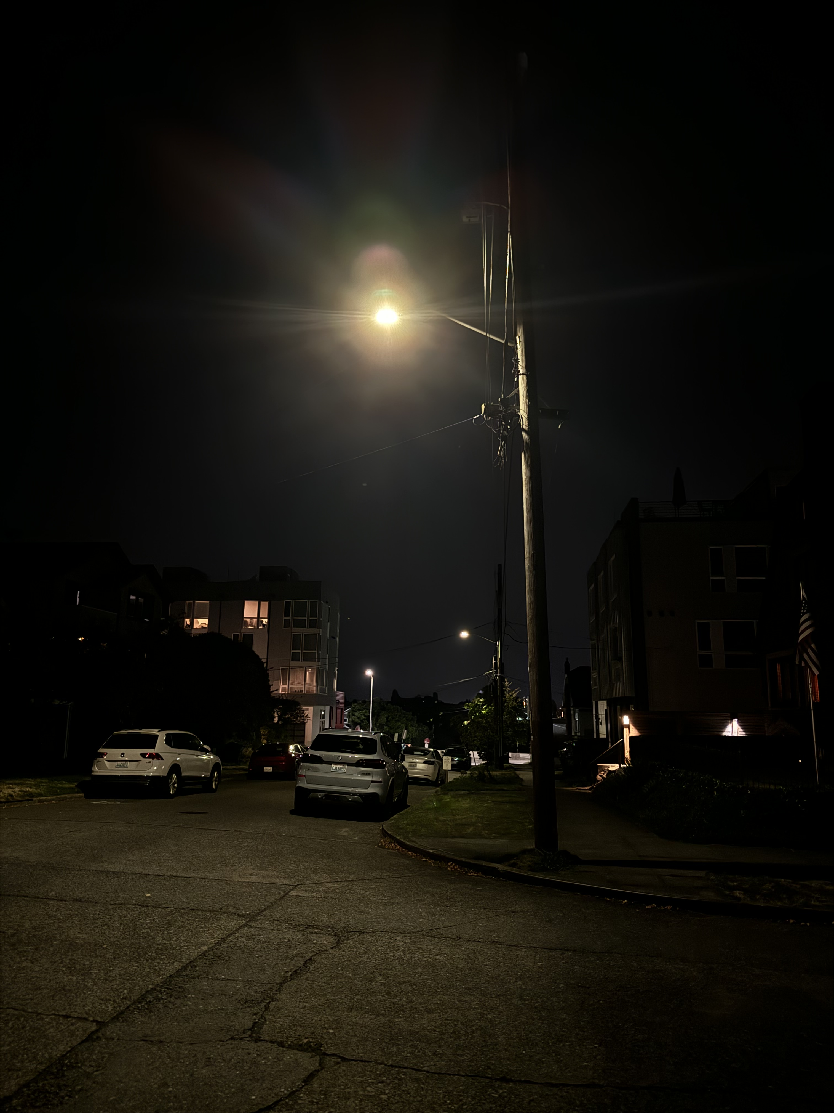
Feasibility:
On-Street Validation
Sample Street
Notes:
JOE TALKS
We then take this onto real streets and show how measured light level correlates with proximity to light sources on the street.
As users walk across the street, lux peaks as the user passes the street lamp, aligning the field of view of the sensor with the light source.

Slide 19
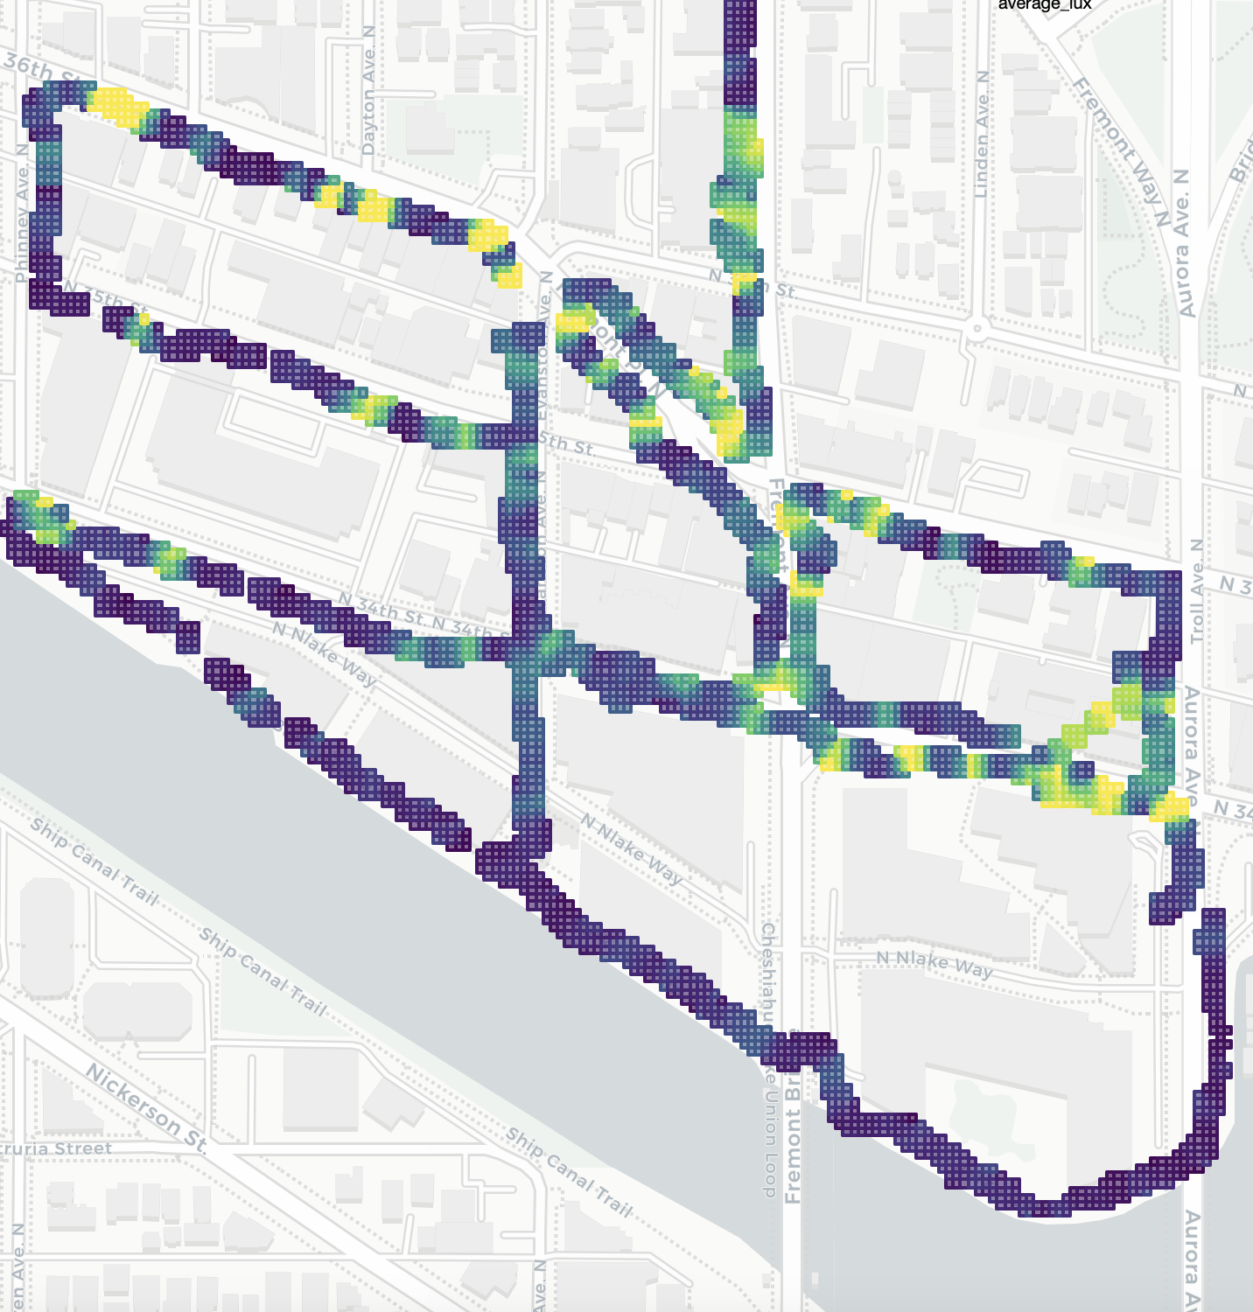
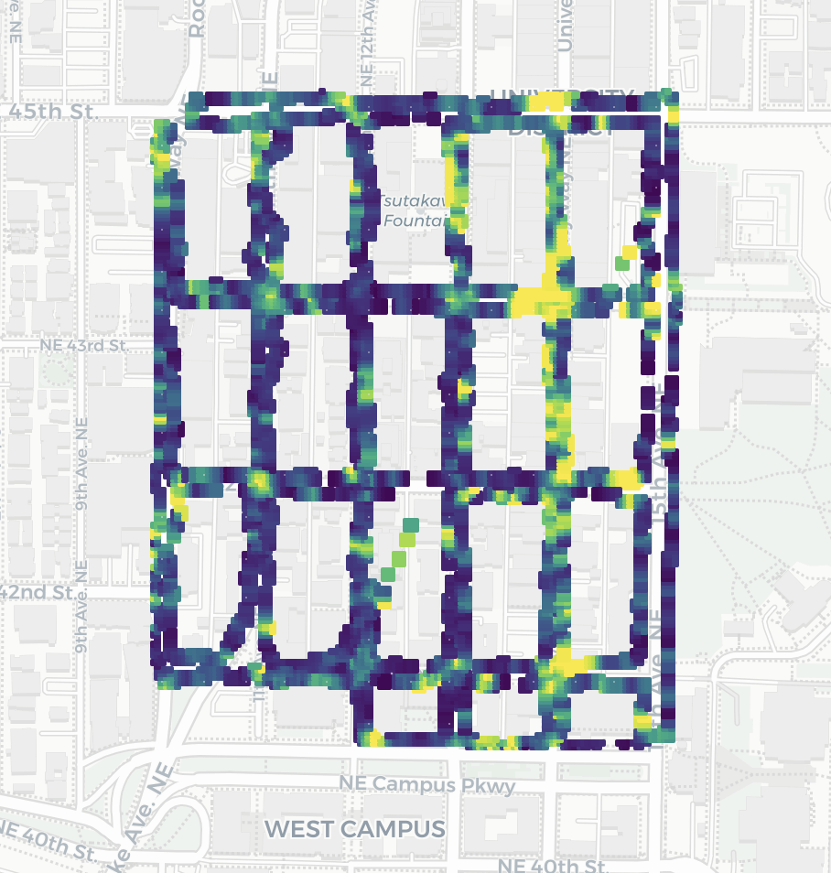
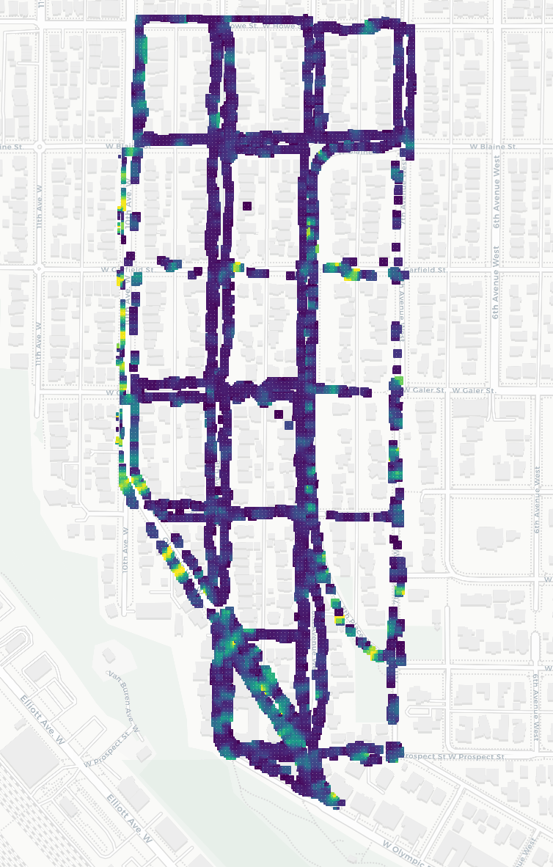
Utility: Neighborhood Data Collection
Waterfront
Gridded
Residential
Low Light
High Light
Notes:
Having validated the feasibility of this sensing approach, we then demonstrate the utility of this signal for route planning.
The research team walked about 17 kilometer to collect light data across 3 different neighborhoods of Seattle with varying characteristics: including varying street alignments, lighting distributions, and zoning (i.e., commericial space vs residential).
for context, This data was collected in the summer of 2024 which means the sun sets at 9pm so we were walking around at like 10pm to 2am.

Slide 20
User Study
Gauging effects of light data on route planning
1. Semi-structured interview, followed by;
2. Think-aloud route planning task first without light data and then repeated with access to light data
Notes:
We then incorporate this data into a two part user study consisting of:
1) semi-structured interviews about their experience walking at night, and 2) a think-aloud route planning task where we provided printed maps of origin-destination pairs and asked participants to draw their preferred routes and repeated this once without light data and once again with light data we collected for each neighborhood.

Slide 21
“If I had to walk at night, my primary concern is whether
there is enough light”
User Study
Light is already a concern
-P11
Notes:
prior to route planning, lighting was already a concern.

Slide 22
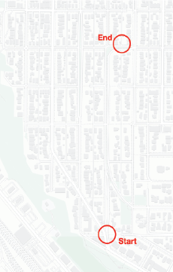
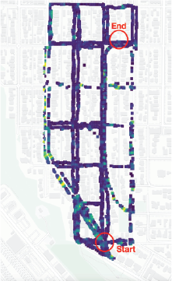
Residential Neighborhood

Slide 23
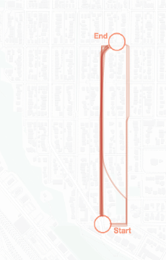
Residential Neighborhood

Slide 24
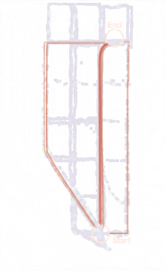
Residential Neighborhood
Choosing a longer route
Notes:
For example, in this residential neighborhoods we see that after seeing the lighting conditions, some participants chose a walking route that was over 1.5x longer than their original because it was better light.

Slide 25
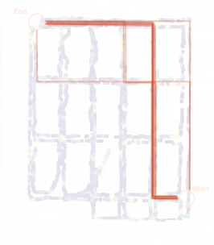
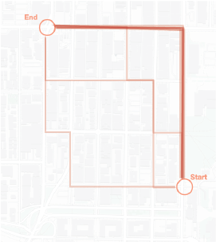
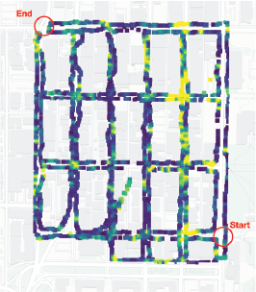
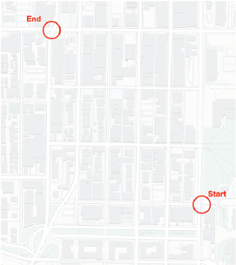
Gridded Neighborhood
All routes equidistant
Notes:
Daniel SPEAKS HERE
We found this shift to be more pronounced in the in the gridded neighborhood where the routes all have the same distance.

Slide 26
Gridded Neighborhood
Notes:
In the gridded neighborhood, where there is no shortest route. Most people chose the simplest route with only one turn.

Slide 27
Gridded Neighborhood
Notes:
However, once they are presented with the NightLight data, we see a convergence to the well-light street on the right.

Slide 28
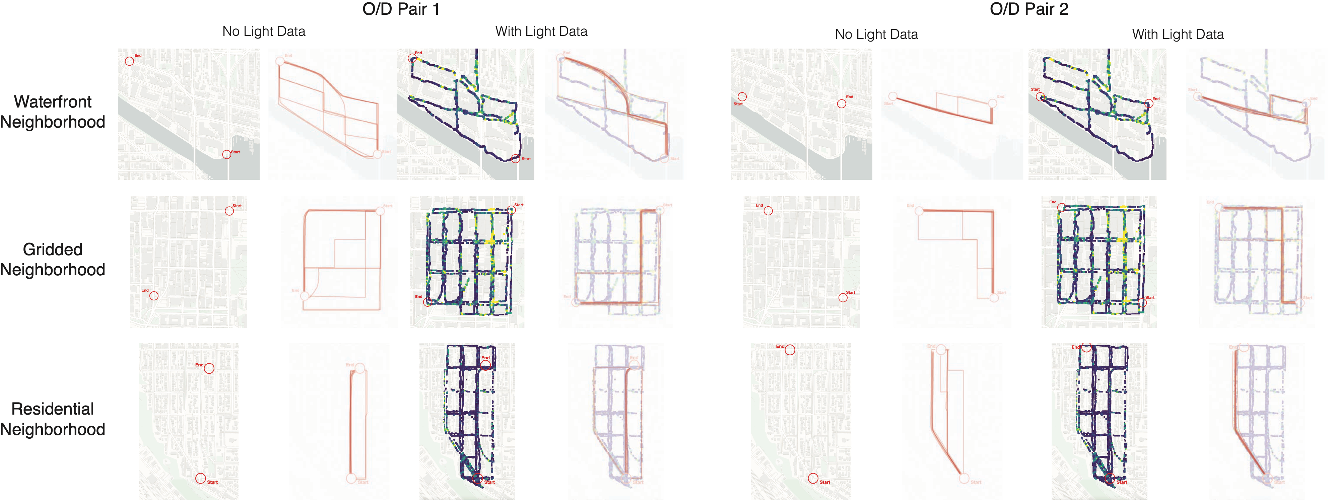
Impact of light maps on route choice
50/72 (70%) Routes Changed
Notes:
50/72 routes changed in response to seeing light data. Some of the unchanged routes were because they were already along the most well light path.

Slide 29
Impact of light maps on route choice
All women changed at least one of their routes to a more well-lit route
Notes:
While not all men changed their routes when presented the light dat

Slide 30
Limitations
Future Work
Limited test pool (geographic and users)
Large scale deployment study over time
Actual routes may differ than planned routes
Build routing app that integrates light level for suggestions
Phone operating system only allows us to get lux value
Integrate more sensor data (i.e., cameras, rear-facing ALS, etc) to improve data quality
Notes:
DANIEL TALKS HERE
Okay, reflecting on our process and thinking on future directions for this work:
obviously, the participant pool was limited to Seattle which has unique geographic consideration. Future work could explore a large scale deployment study over longer period of times to asses how NightLight could be used to track how lighting conditions change over time.
While we had participants draw their preferred walking routes, this may differ from the paths they take if they were actually walking the streets. (partially because we not sure sending Future work could build a navigation app that suggests well-light walking routes.
And We also explore just one signal but future work can integrate more sensors like cameras, some phones have rear-facing ALS which can provide richer context.

Slide 31
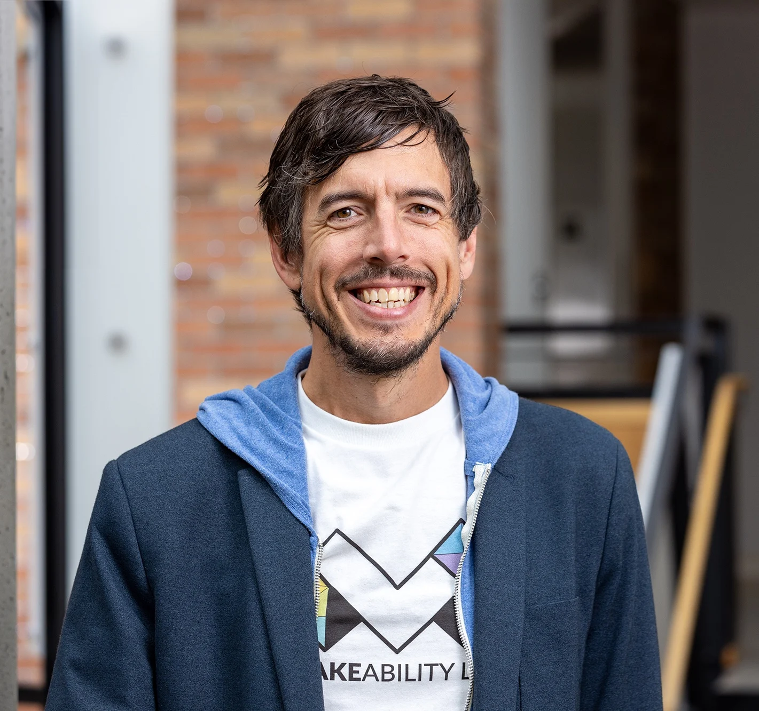
NightLight
Conclusion
We can leverage smartphones to passively aggregate and analyze lighting conditions
This might have differential benefits for various populations (tourists, women, vulnerable populations)
We can and should provide this data to help inform pedestrians on possible route choices
Paper
Joseph Breda*
joebreda.github.io
Daniel Campos Zamora*
danielcz.xyz
On the job market soon!
Thank you!
Shwetak Patel
Jon Froelich
Notes:
As our initial work in this direction, Nightlight indicates that we can leverage the smartphones to passively aggregate and analyze lighting ocnditions
This benefits are particularly useful for differnet populations like women or tourists

Slide 32
Gridded Neighborhood

Slide 33
NightLight
Design Considerations
Pedestrian-Oriented Data
Passive Data Collection
Leverage Existing Hardware
Data Coverage
Notes:
DANIEL TALKS THIS SLIDE
To summarize our considerations, we designed nightlight to focus on:
Pedestrian Oriented Light Data: Captures not just street light data but also other lighting sources businesses.
Allow for passive data collection since, the ALS sensor is already running in the background usually to automatically adjust screen brightness.
As we mentioned, this hardware is already included in virtually every modern smartphone.
And Lastly, this would allow us to cover wide areas using pedestrian.

Slide 34
Motivation
Active mobility is good for physical and mental health and is a sustainable form of transportation.
But walking at night brings different consideration such as safety or comfort
These considerations vary across populations (i.e., women consider safety more often)
Notes:
First, we want to emphasize the benefits of walking as a mode of transportation. As a form of active mobility, it provides physical and mental health benefits and is a sustainable form of transportation. The American Heart Associatuon recommends 20 minutes of walking per day to precent cardiovascular disease which is a leading cause of death globally. But 80% percent of Americans fail to meet the recommendation. So It’s important to ask, what factors prevent people from choosing to walk as a mode of transportation? MAKE IT MORE ABOUT THE PERCEIVED SAFETY.

Slide 35
But how do we measure light?
Notes:
Add a visual here. Maybe busy intersection of sidewalk and introduce these benefits more slowly. One by one.

Slide 36
NightLight
Opportunity for passively Crowdsourcing light levels
[Animation]

Slide 37
NightLight
Opportunity for passively crowdsourcing light levels
With additional sensor data (IMU, GPS) we can map light level.
How can we then leverage the ubiquity of these sensors across the built environment to aggregate and analyze light at scale?

Slide 38
Validation
Feasibility
Utility
In-Lab: Sensor validation and variation across phones
On-Street: Robustness to real-world conditions

Slide 39
In-lab Validation
Setup
4 Phones
Controlled sweep using gimbal
Smartphone
Light Panel
Gimbal
Light Meter
3.8m
Notes:
First, we had to evaluate the ambient light sensor in various smartphones to see if they can perform comparable to the commercial light meters for this task. We set up a lab experiment in a dark room with a dimmable light source, a motorized gimbal to control the phone position, and a commercial light meter to compare against.

Slide 40
On-street Validation
Real World Setting
Normalized Average Lux at Distances
East
Direction of Travel
-10
-5
0
5
10
Distance Relative to Streetlamp (meters)
West
-10
-5
0
5
10
Distance Relative to Streetlamp (meters)

Slide 41
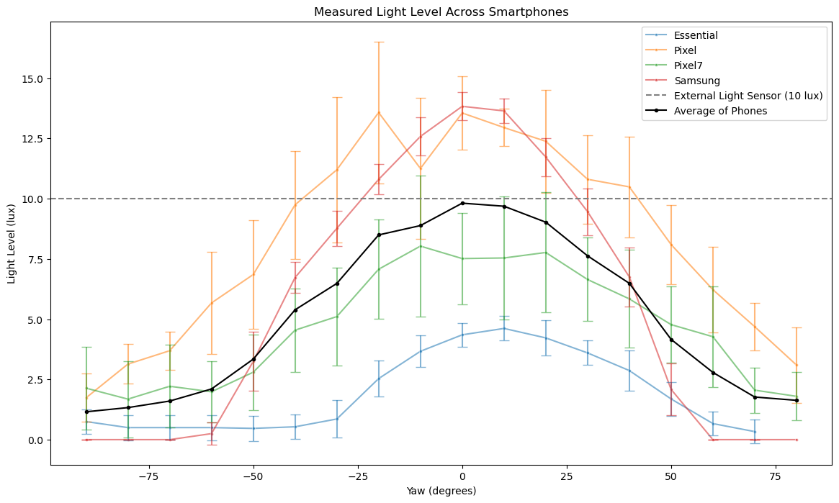
Technical in-lab validation
Generalizability across smartphones
While there are differences across phones, on aggregate they do perform comparably to the commercial grade light meter
Notes:
While there are differences across phones, on aggregate they do perform comparably to the commercial grade light meter

Slide 42
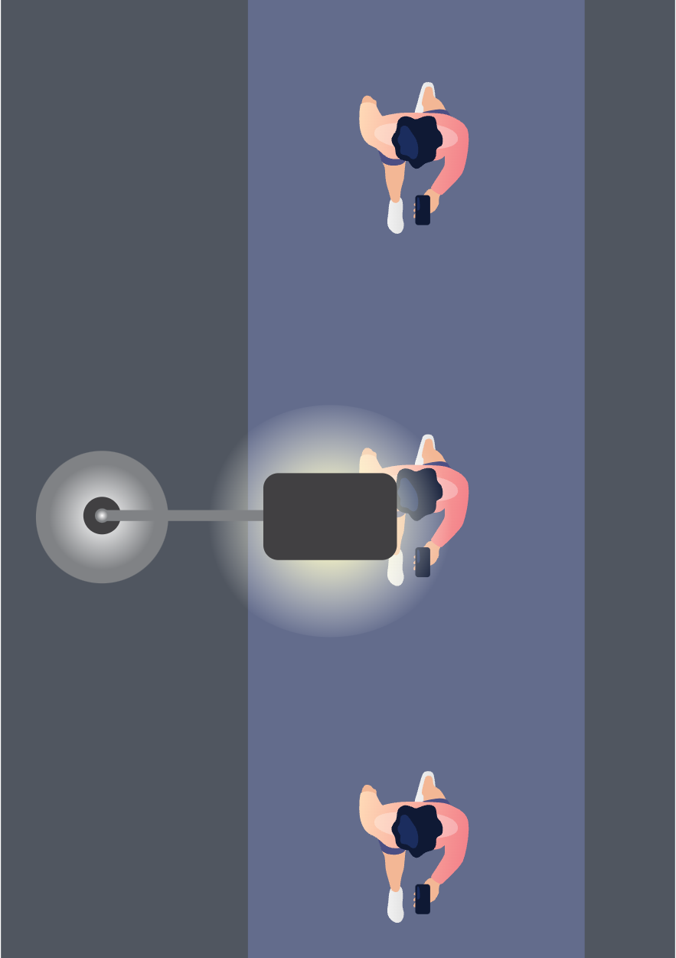
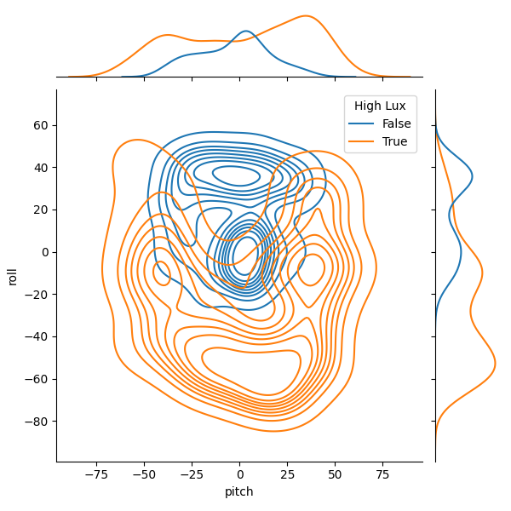
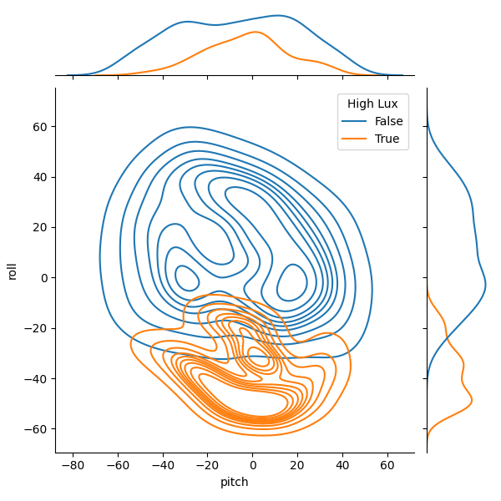
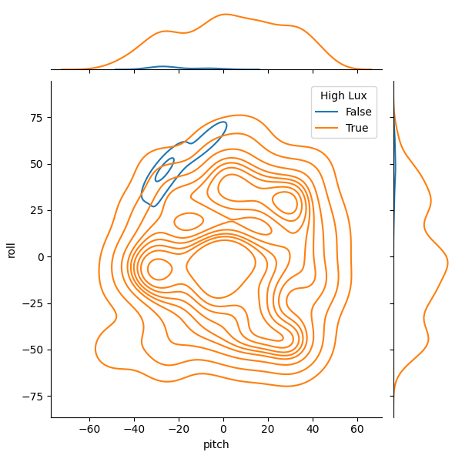
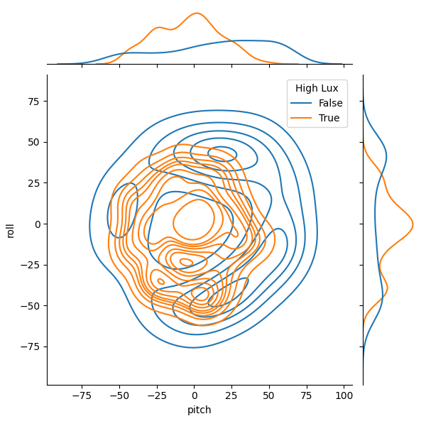
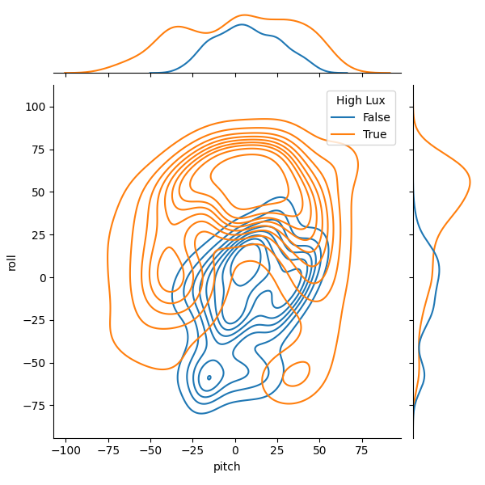
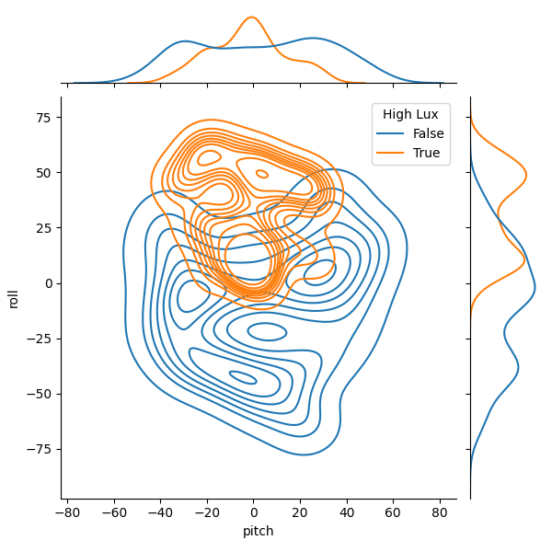
On-Street Validation
Validating intuition
Pitch
Bright Light Source
Dim Light Source
Low Lux
High Lux
Yaw
Notes:
Based on the positive results from the in-lab study, we did an on-street evaluation by walking along a street and measuring the light level as we walked on. These density plots show that we read the higher light values more frequently directly under and right after we pass a light.

