Slide 1
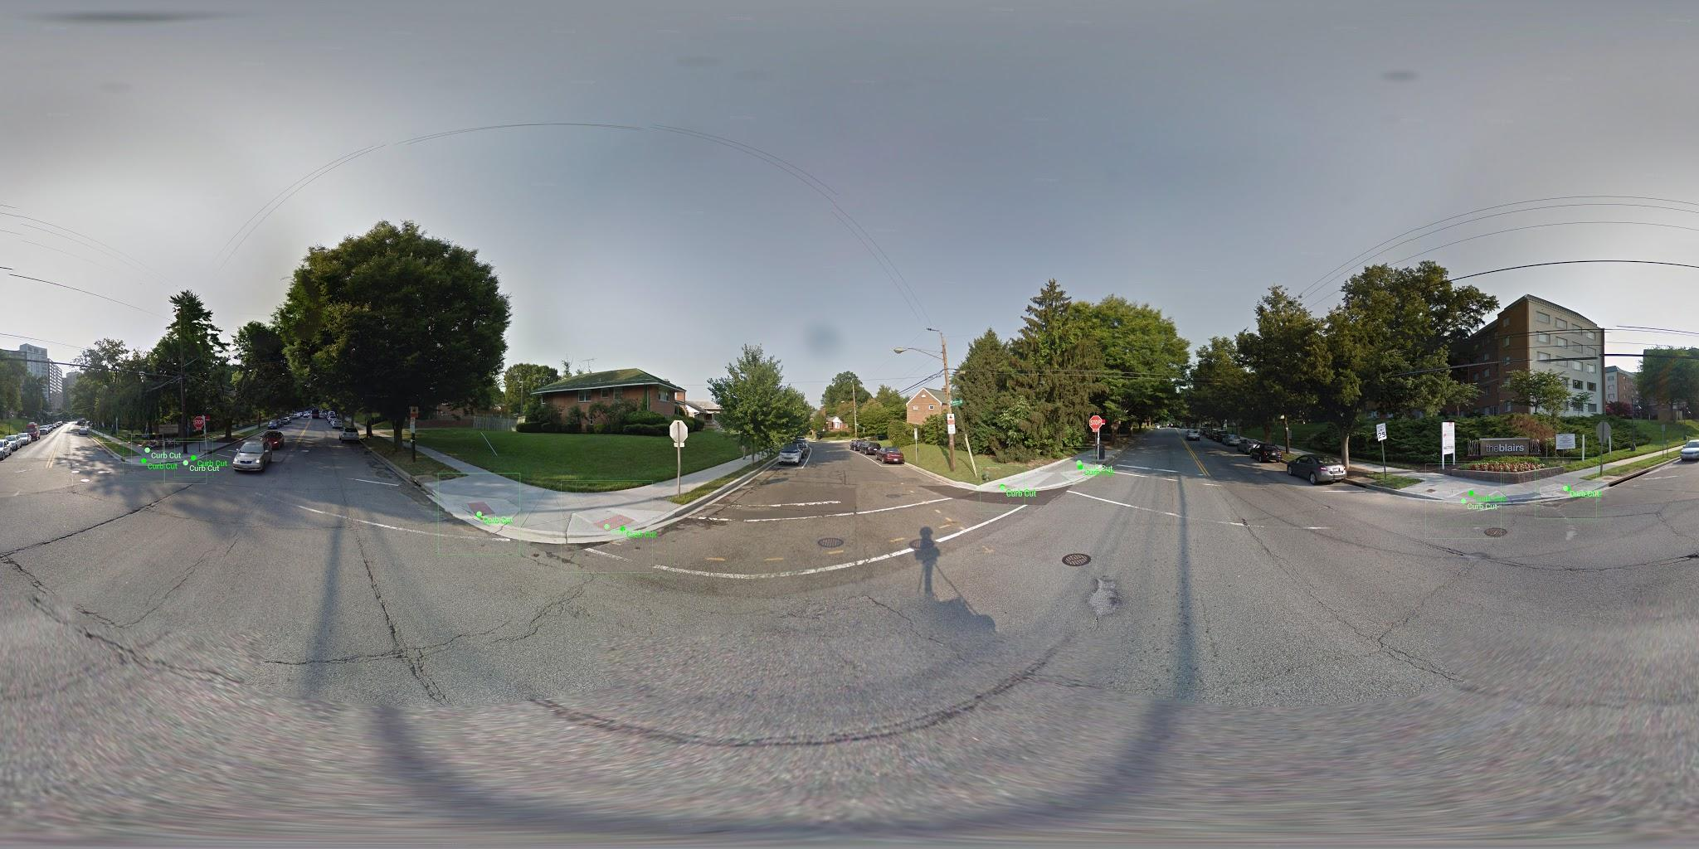
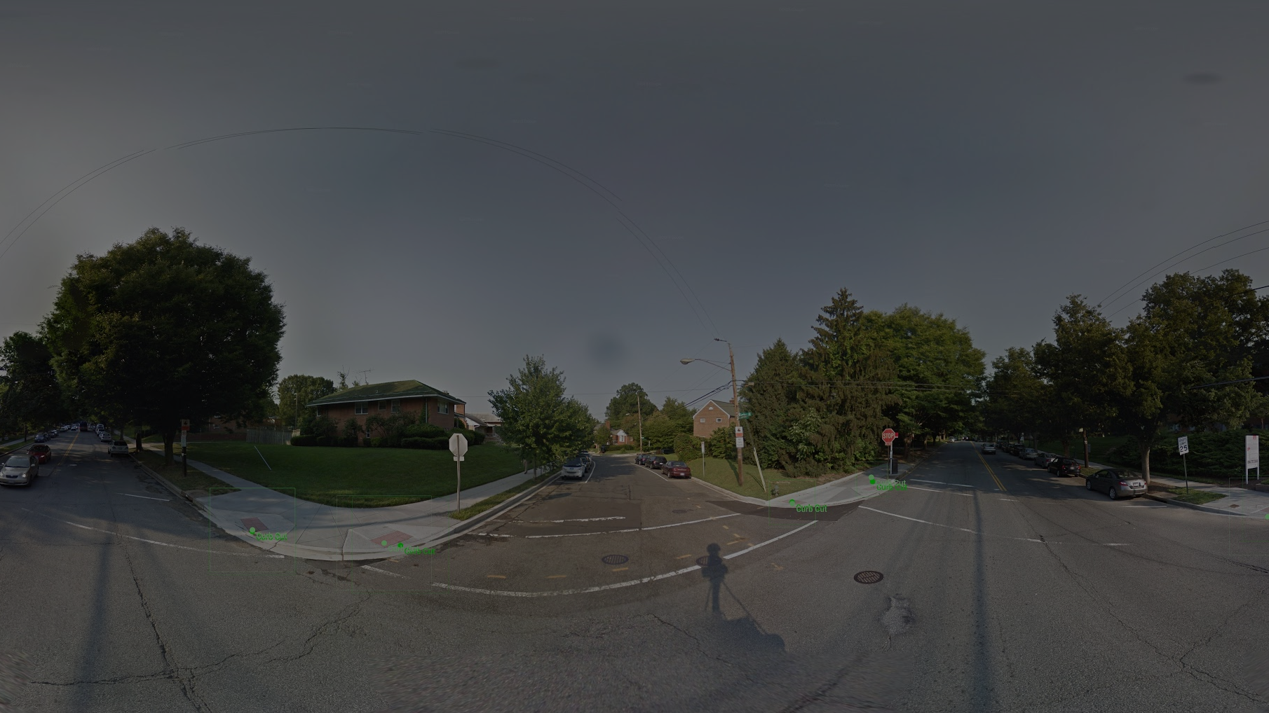


Deep Learning for Automatically Detecting Sidewalk Accessibility Problems Using Streetscape Imagery
Galen Weld, Esther Jang, Anthony Li, Aileen Zeng, Kurtis Heimerl, Jon Froehlich

Slide 2
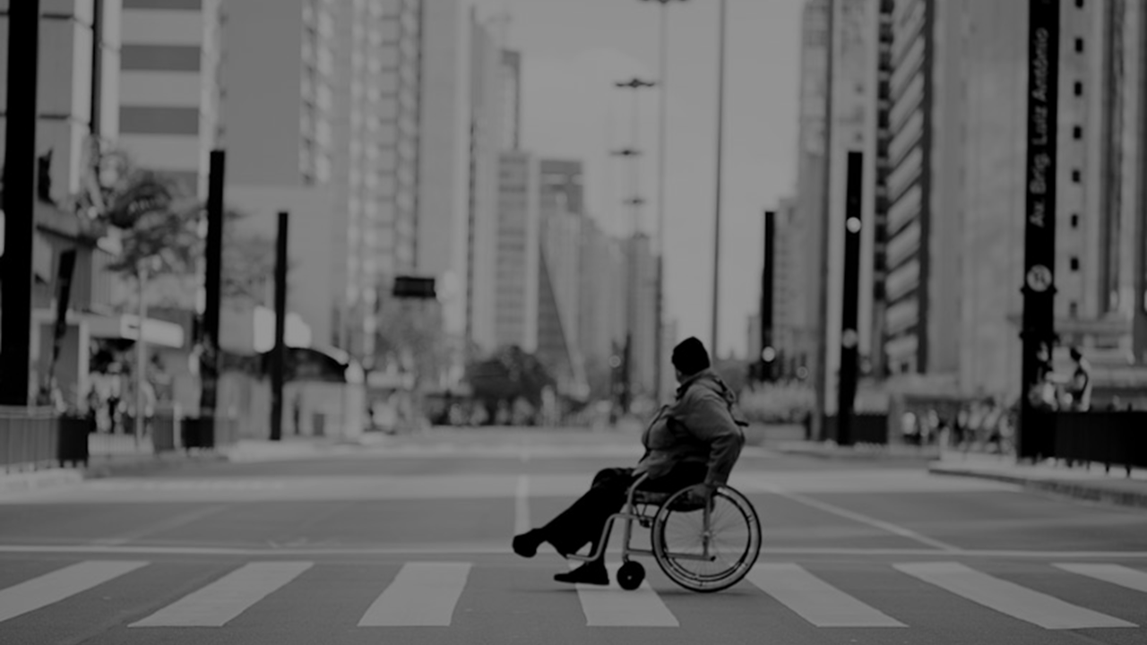
30.6
million U.S. adults
have a mobility impairment
Source: 2010 U.S. Census
Notes:
According to the most recent Census (2010), roughly 30 million adults have physical disabilities that impact their mobility.
-----
Flickr: 3627562740_c74f7bfb82_o.jpg

Slide 3
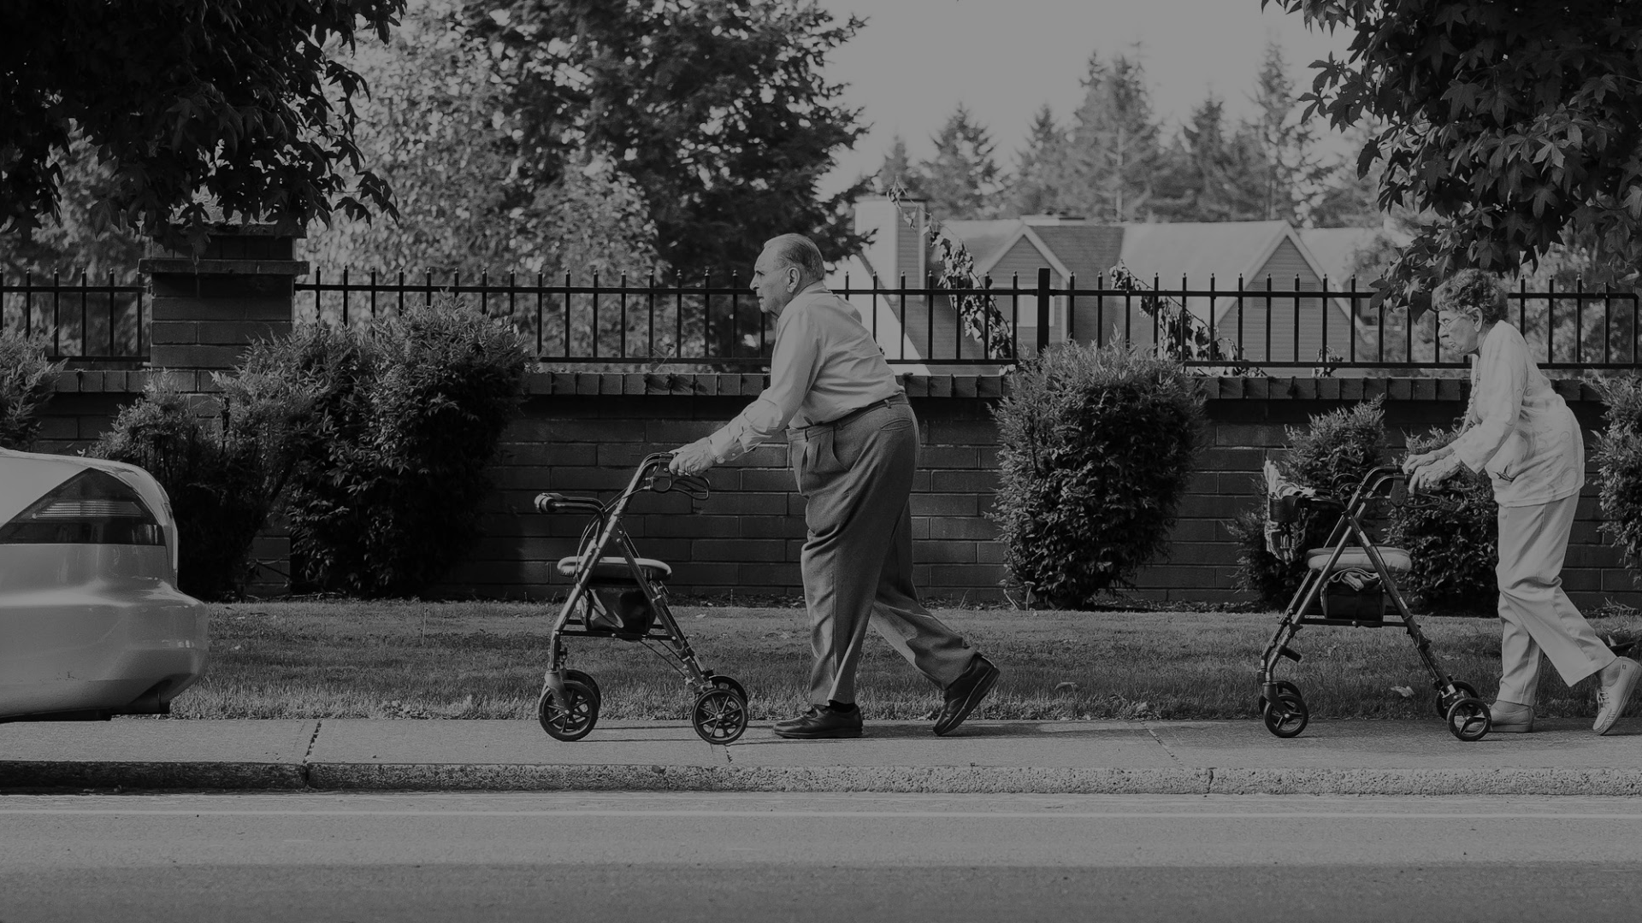
15.2
million use an assistive aid
Source: 2010 U.S. Census
Notes:
Of these, nearly half report using an assistive aid such as a wheelchair (3.6 million), cane, or walker (11.6 million)
These numbers are only expected to rise with our growing and aging population
----
Flickr: 14816521847_5c3c7af348_o.jpg

Slide 4
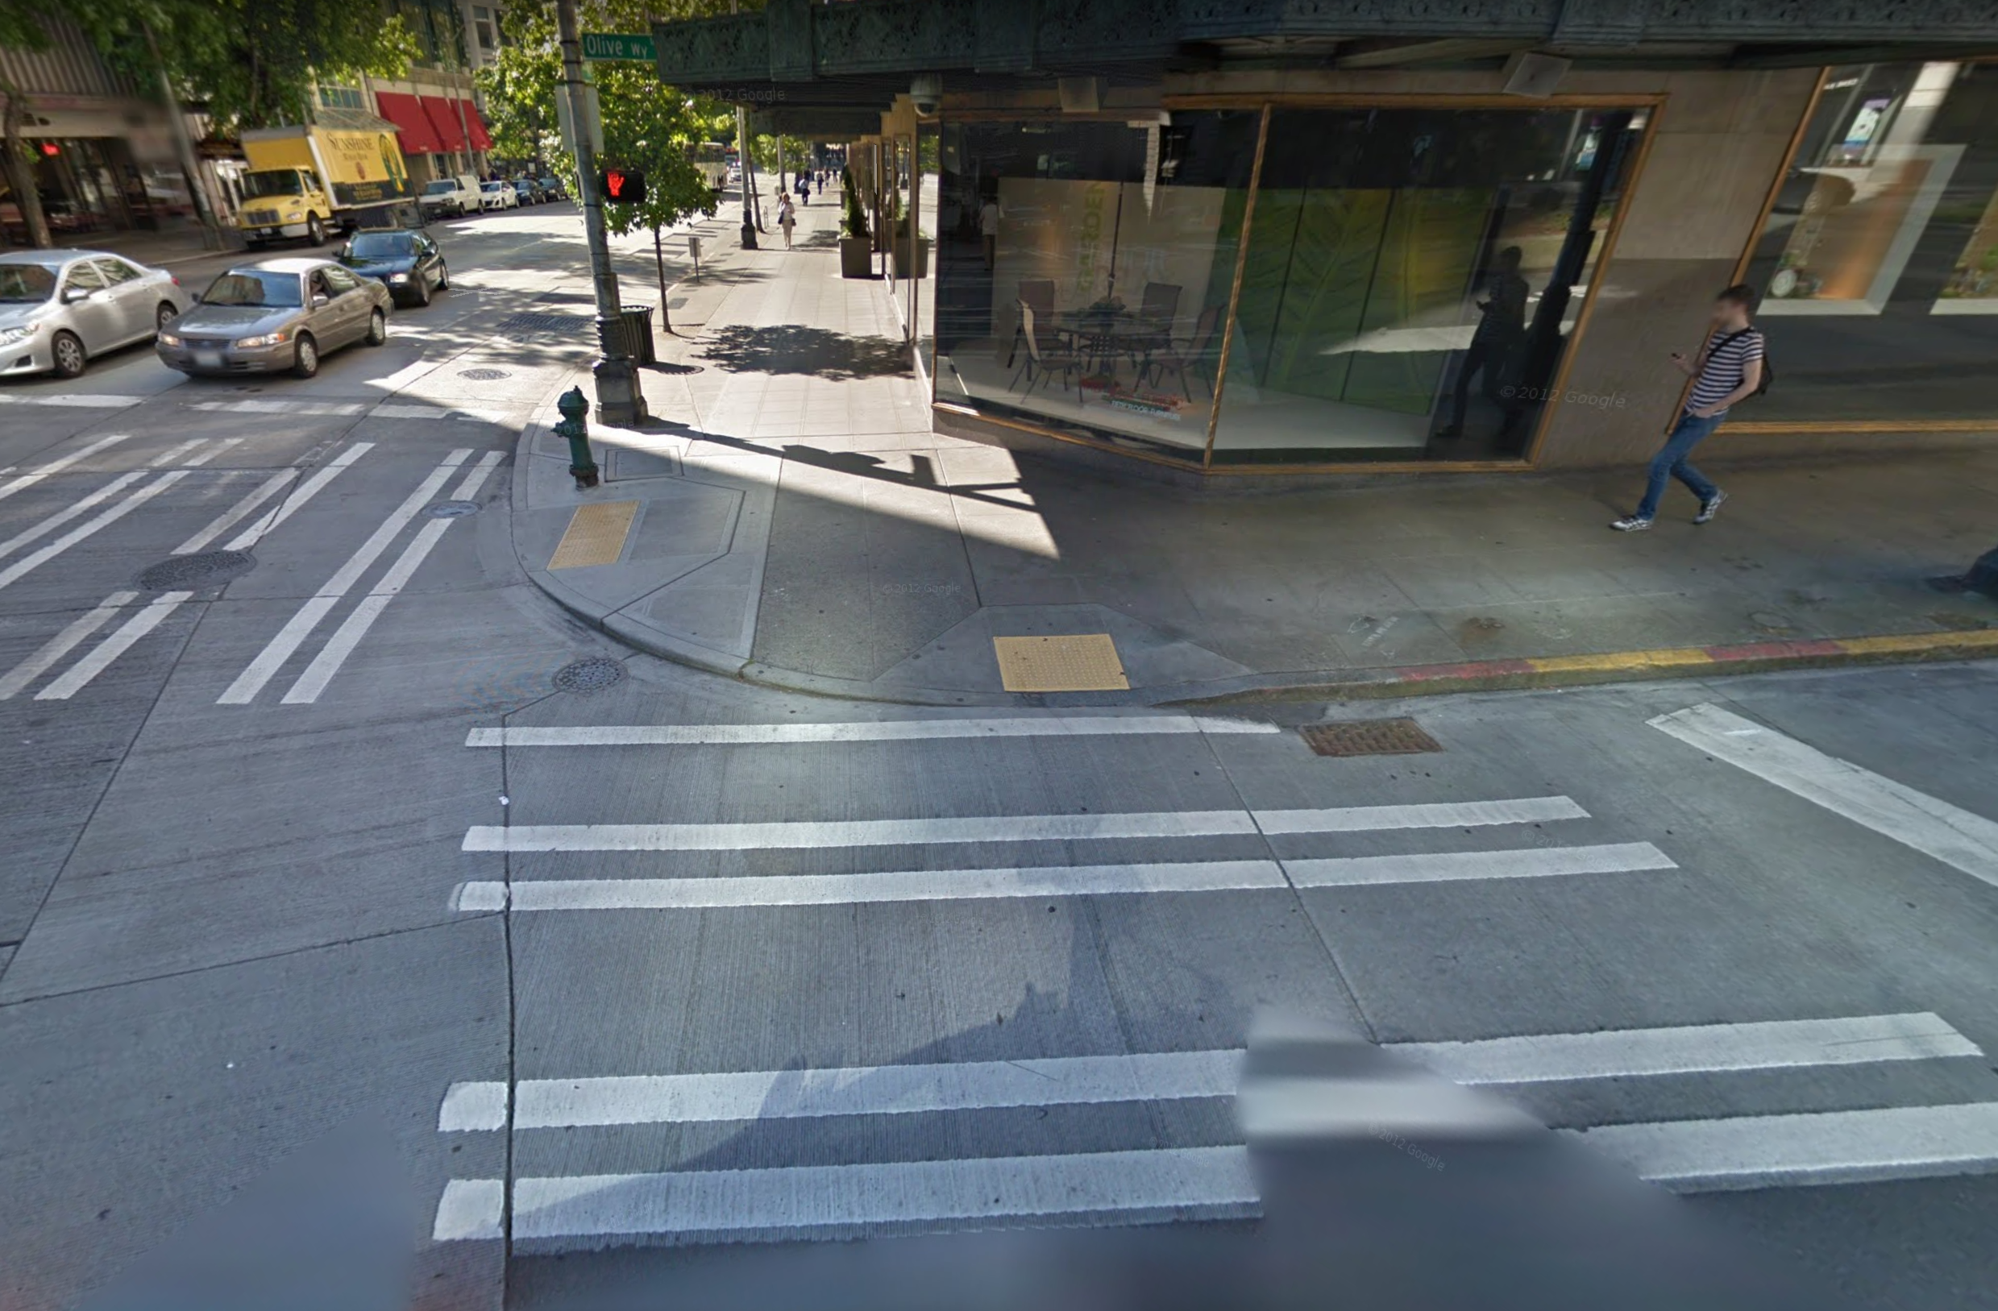
Notes:
Pedestrian infrastructure (click)
----
https://www.google.com/maps/@47.6121401,-122.3386379,3a,75y,151.28h,58.63t/data=!3m6!1e1!3m4!1ssxCRHuCWzKbitv0-Dhk9xw!2e0!7i13312!8i6656?hl=en

Slide 5
CURB RAMPS
Notes:
Pedestrian infrastructure, such as these curb ramps, is critical to mobility to everyone.
----
https://www.google.com/maps/@47.6121401,-122.3386379,3a,75y,151.28h,58.63t/data=!3m6!1e1!3m4!1ssxCRHuCWzKbitv0-Dhk9xw!2e0!7i13312!8i6656?hl=en

Slide 6
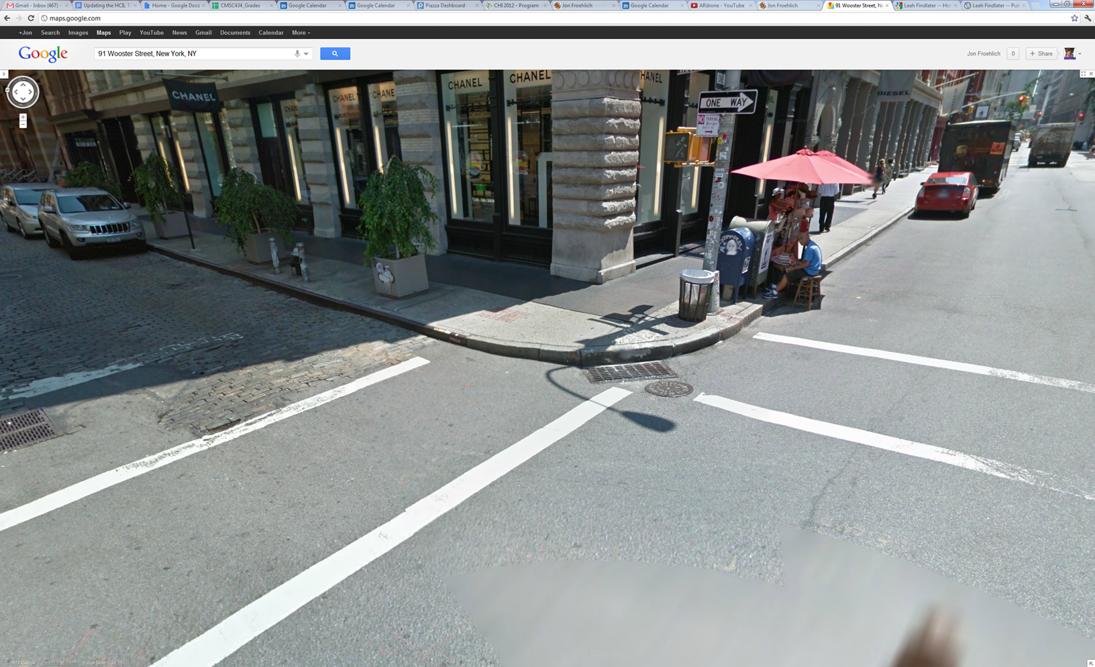
MISSING CURB RAMPS
Notes:
But despite the significant need for it, infrastructure can lack basic accessibility features.
----
http://maps.google.com/maps?q=91+Wooster+Street,+New+York,+NY&hl=en&ll=40.724226,-74.00131&spn=0.011375,0.023378&sll=40.724129,-74.001218&layer=c&cbp=13,82.1,,0,21.72&cbll=40.724156,-74.001173&hnear=91+Wooster+St,+New+York,+10012&t=h&z=17&panoid=2Mb1_pWtkIFPRAeW-tPA5A

Slide 7
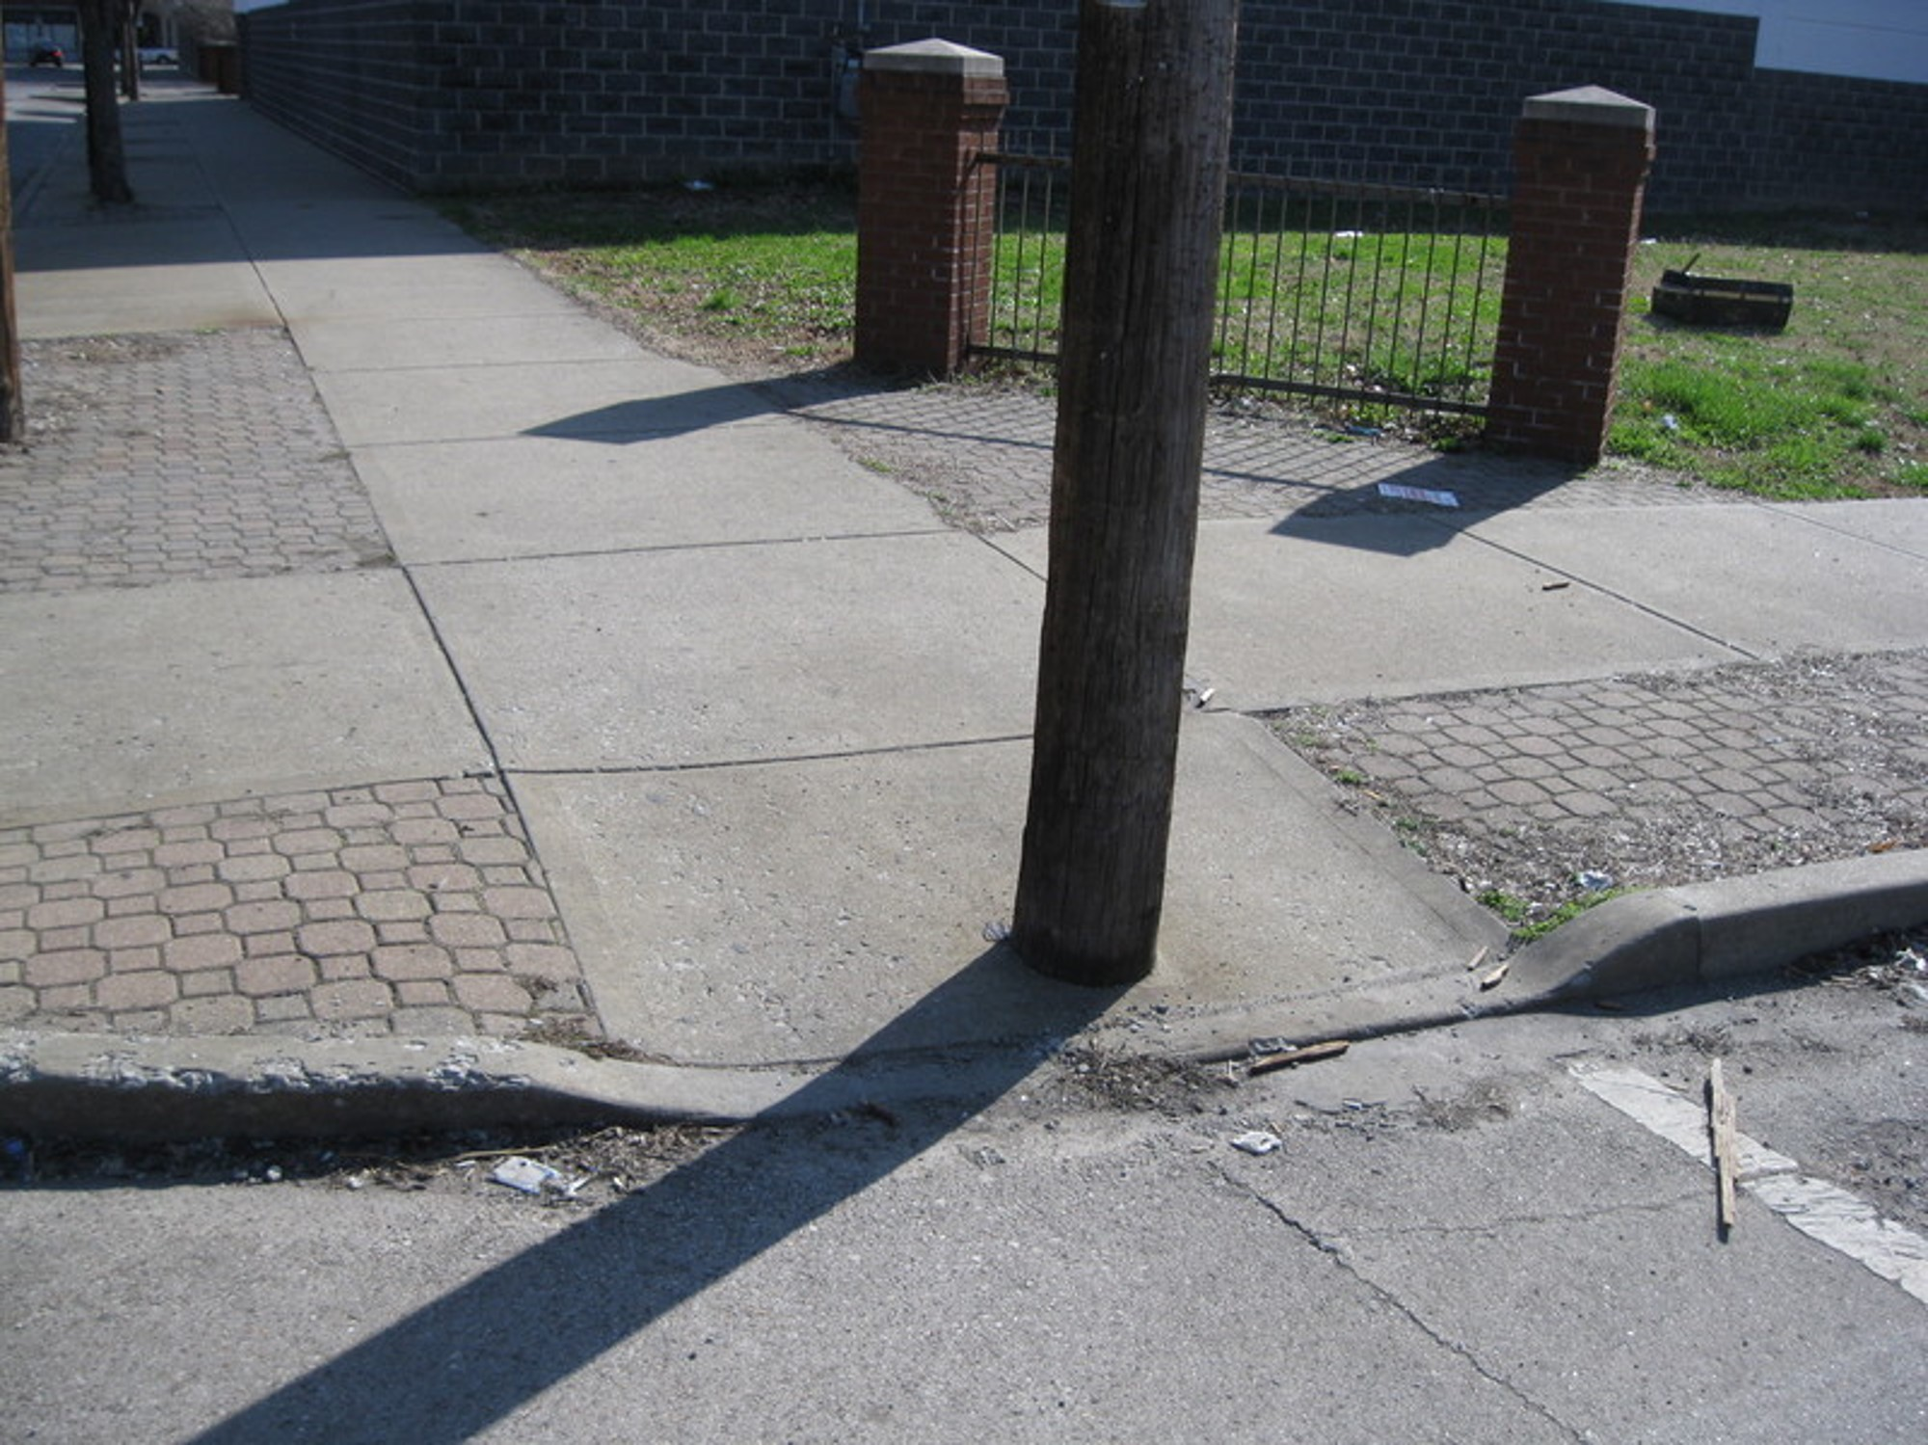
OBSTACLES
Notes:
Or include barriers such as physical obstacles,
---
Image source:
http://seeclickfix.com/files/issue_images/0000/6975/img_0048.jpg

Slide 8
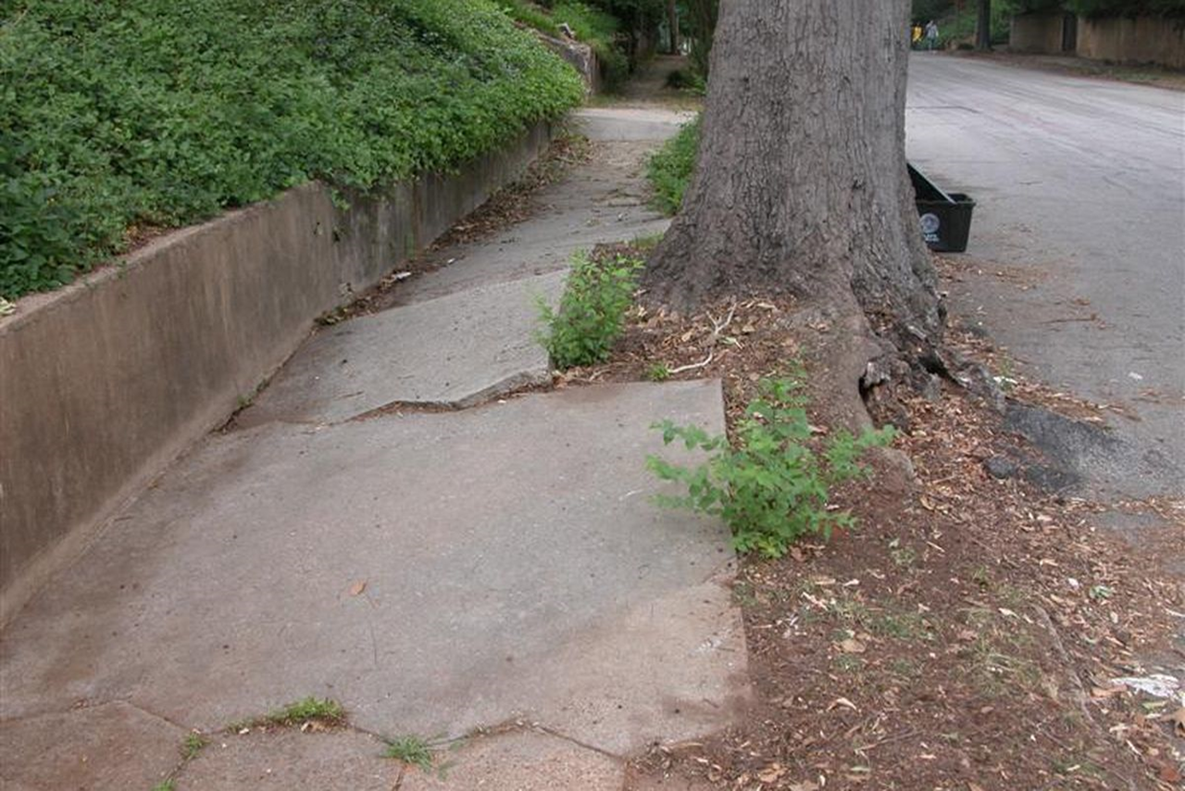
SURFACE PROBLEMS
Notes:
Or surface problems due to weathering or natural growth
---
Source:
https://cdn0.vox-cdn.com/thumbor/M83612e3TfRBFb-KHtzOETs1Jv0=/0x0:800x600/1200x800/filters:focal(0x0:800x600)/cdn0.vox-cdn.com/uploads/chorus_image/image/48004761/3751846301_8969f60248_o.0.jpg

Slide 9
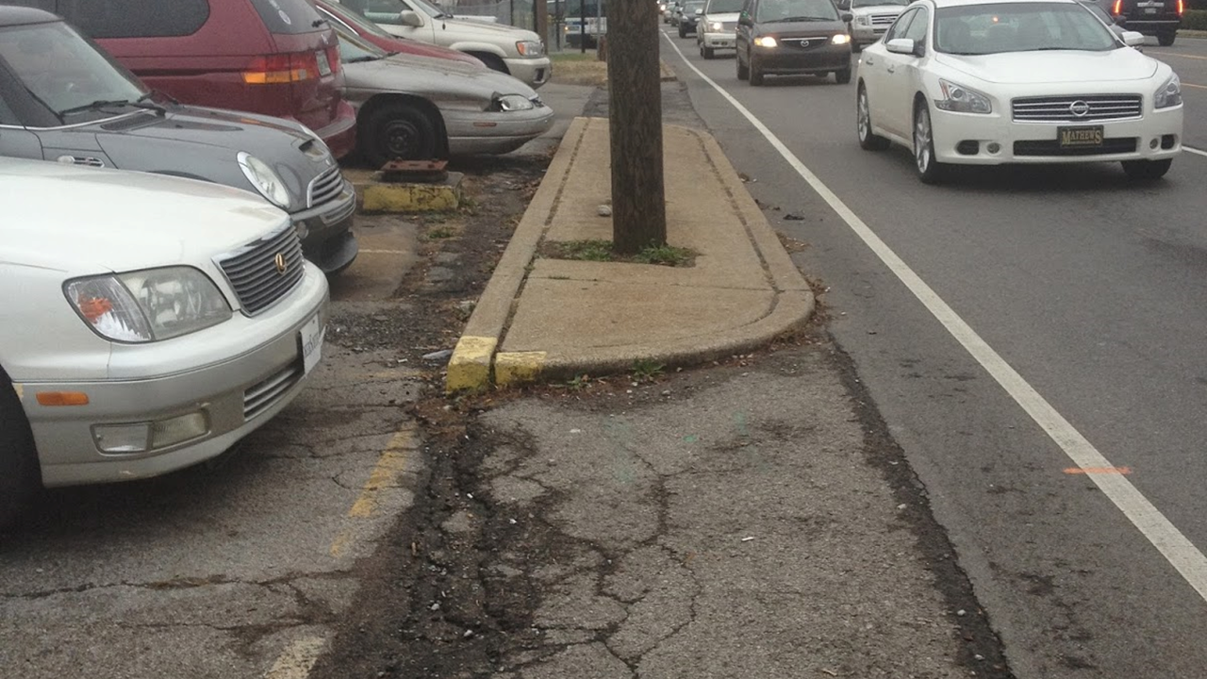
OBSTACLE
MISSING CURB RAMP
SURFACE PROBLEM
Notes:
And, in the worst case, sidewalks can look like this, with many problems appearing together.

Slide 10
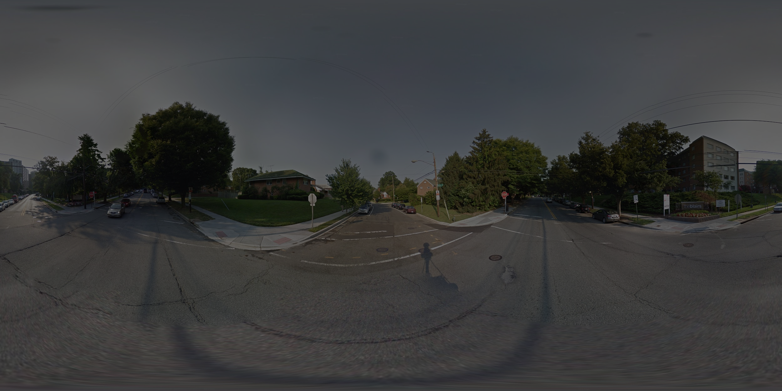
Problem: there is no comprehensive information on “the degree to which sidewalks are accessible” in cities.
- National Council on Disability, 2007
Notes:
The problem is a lack of comprehensive information on the sidewalk accessibility, despite the need for this information to plan trips, construct infrastructure, and ensure accountability and equity.
National Council on Disability. (2007). The impact of the Americans with Disabilities Act: Assessing the progress toward achieving the goals of the ADA.

Slide 11
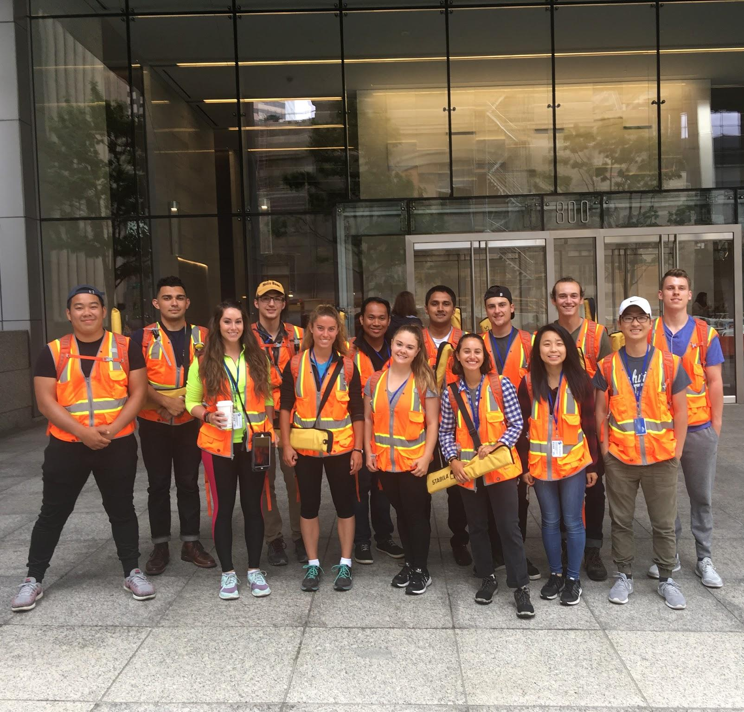
Traditional methods for gathering this information are time-consuming, laborious, and expensive.
https://sdotblog.seattle.gov/2017/08/28/seattle-sidewalk-survey-update/
Notes:
Traditional methods for gathering sidewalk accessibility information are time-consuming, laborious, and expensive.
As one example, the Seattle Department of Transportation recently completed their first ever
sidewalk assessment in 2016, which took 14 interns nearly a year to complete.

Slide 12
Some automated methods have been attempted…
Notes:
Earlier work has attempted to automate the process using Google Street View and/or satellite imagery....

Slide 13
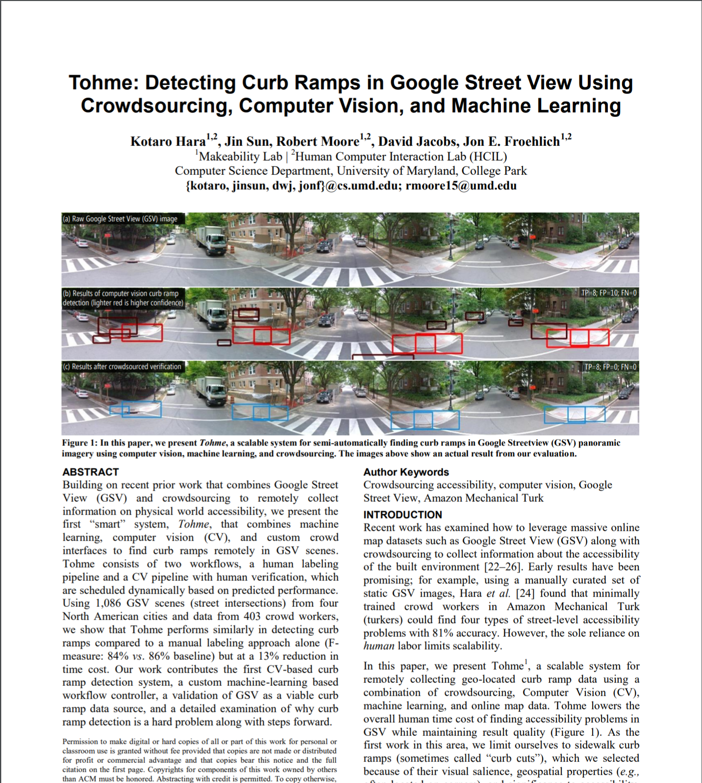
Some automated methods have been attempted…
26% precision
67% recall
for curb ramps
Kotaro Hara, Jin Sun, Robert Moore, David Jacobs, and Jon Froehlich. 2014. Tohme. In Proceedings of the 27th annual ACM Symposium on User interface software and technology - UIST ’14.
Notes:
Like Tohme, published in 2014, which included fully-automatic system to detect curb ramps. This model, however, achieved only 26% precision with 67% recall.

Slide 14
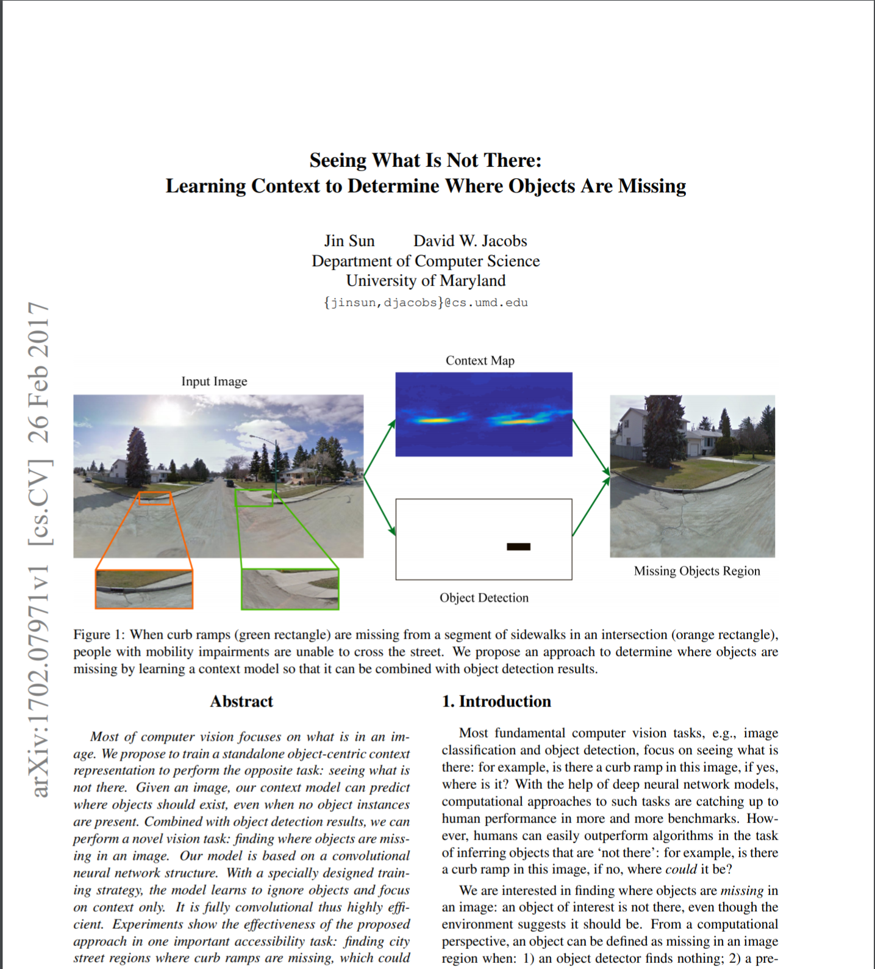
Some automated methods have been attempted…
27% recall
for missing curb ramps
Jin Sun and David W. Jacobs. 2017. Seeing What is Not There: Learning Context to Determine Where Objects are Missing. In 2017 IEEE Conference on Computer Vision and Pattern Recognition (CVPR). IEEE, 1234–1242.
Notes:
In this paper, published in 2017, used the same dataset as Tohme to automatically detect missing curb ramps specifically, with 27% recall.

Slide 15
Some automated methods have been attempted… however these have had moderate performance, and narrow focus.
Notes:
In general, existing automated systems have had underwhelming accuracy and focus specific to just one type of problem.

Slide 16
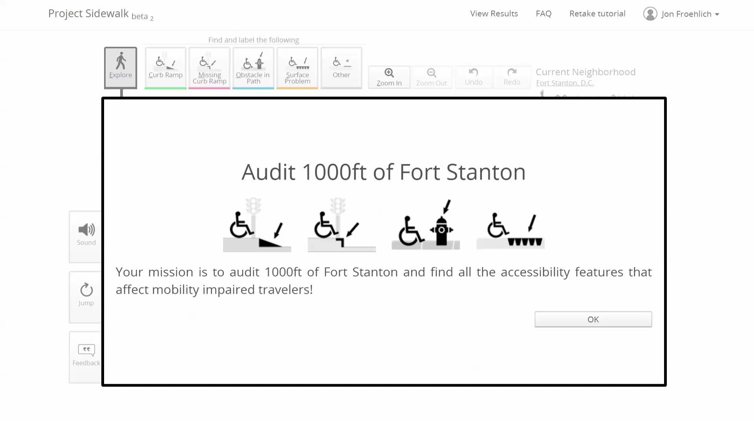
Crowdsourcing tools offer better performance, but are still slow and expensive.
Notes:
Tools for crowdsourcing accessibility information from Street View imagery offer good performance and are much less time consuming than in-person surveys, but are still slow and expensive.
Here, we see a demo of Project Sidewalk, in which users virtually walk along a street and label problems.
In this work, we used Project Sidewalk to collect labels to train our automated system.

Slide 17
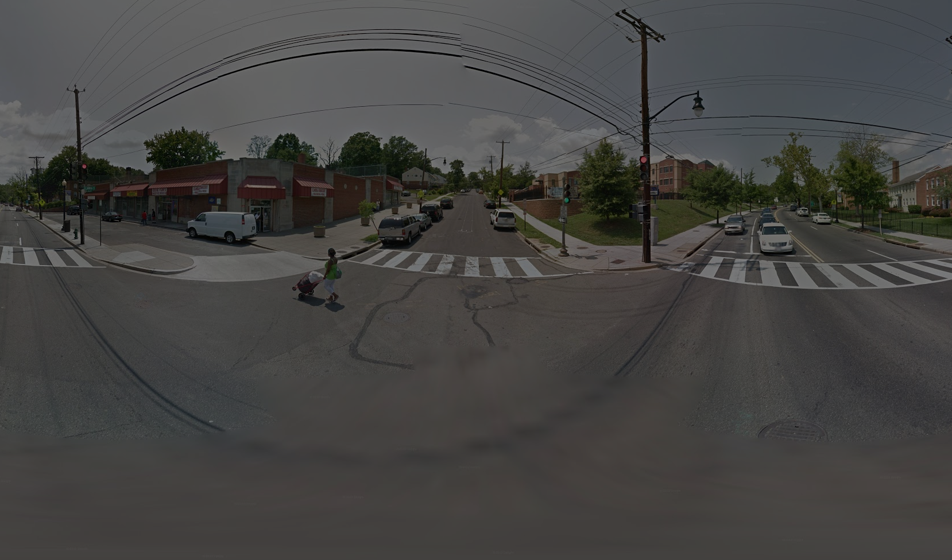
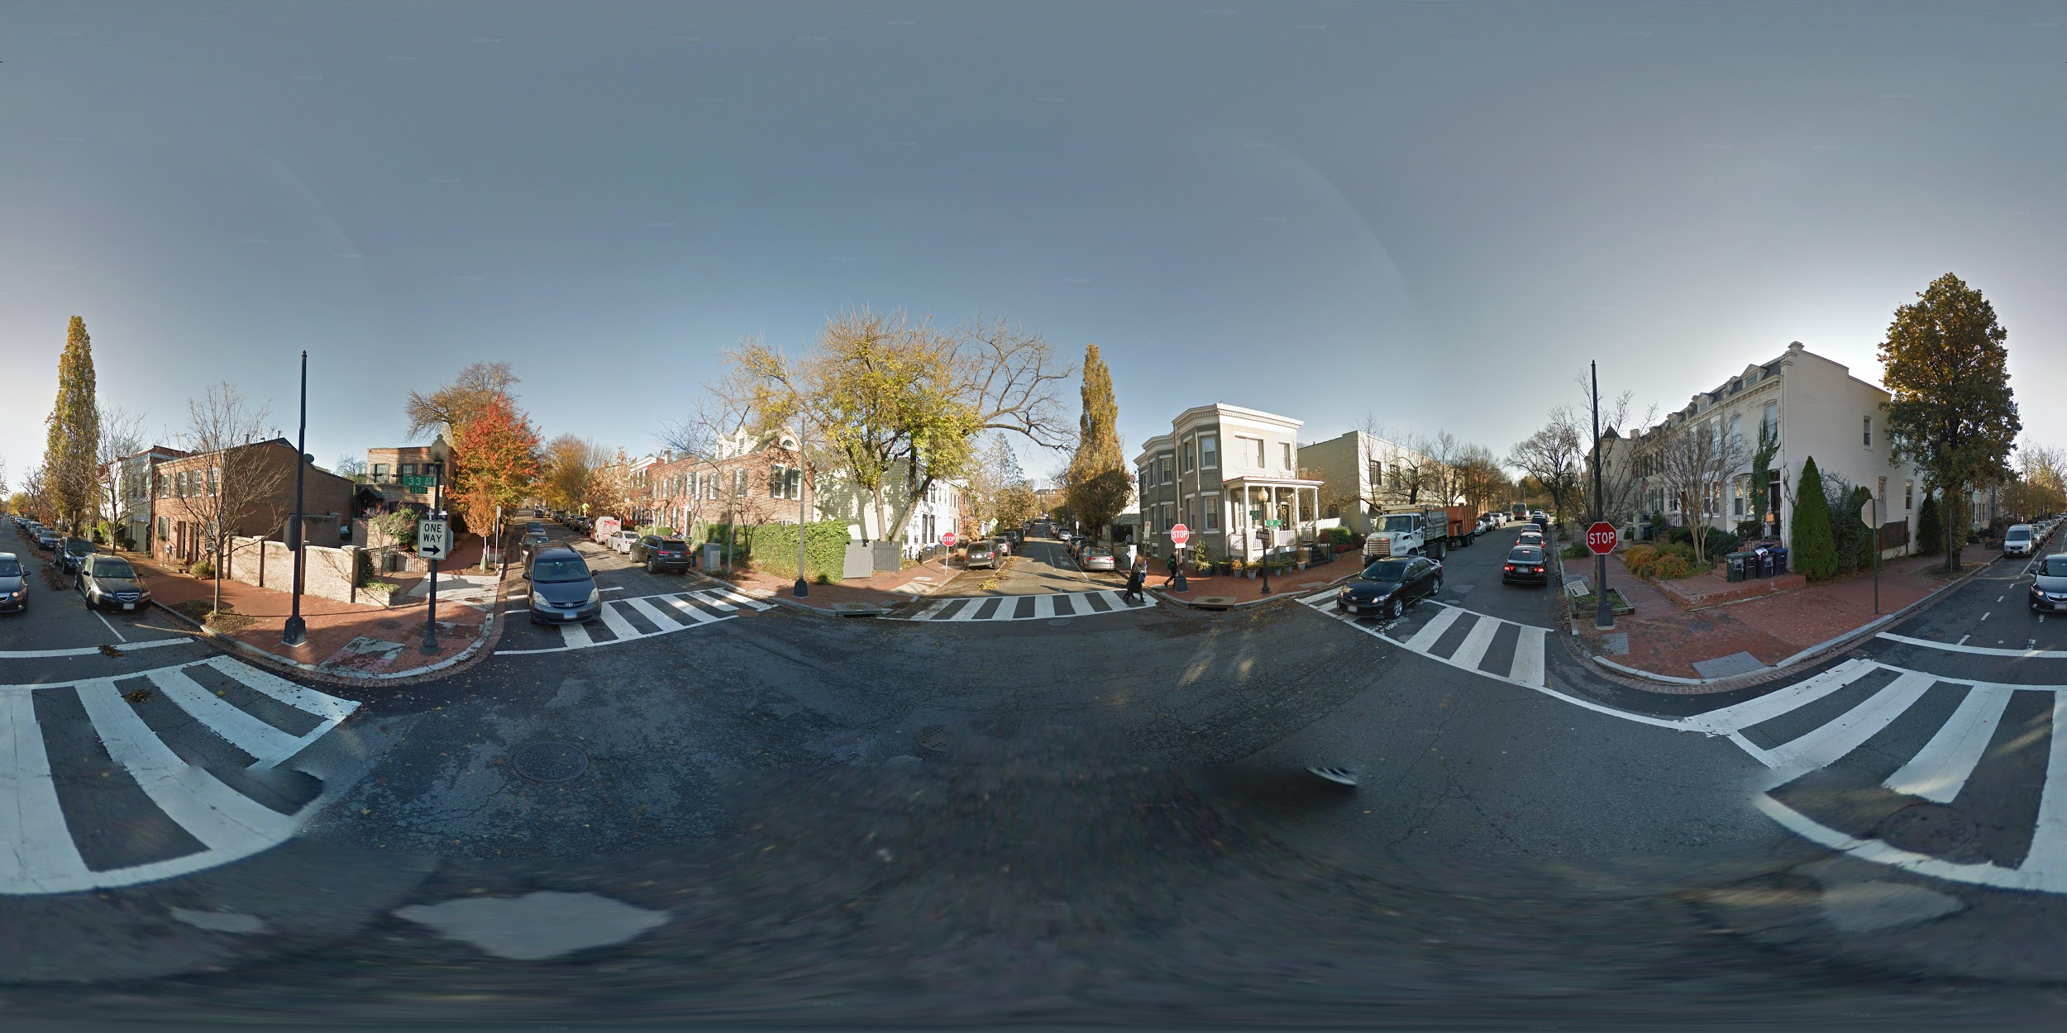
52.4k
labeled panoramas
Notes:
Using the Project Sidewalk dataset, we gathered 52.4k labeled panoramas from the Washington DC area. These panoramas contained...

Slide 18
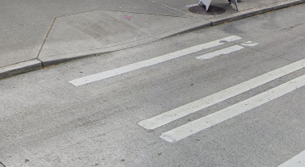
52.4k
labeled panoramas
135k
curb ramps

Slide 19
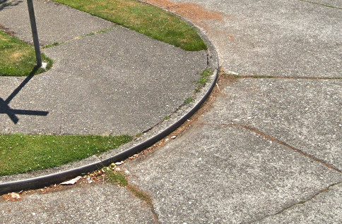
52.4k
labeled panoramas
135k
curb ramps
17.7k
missing curb ramps

Slide 20
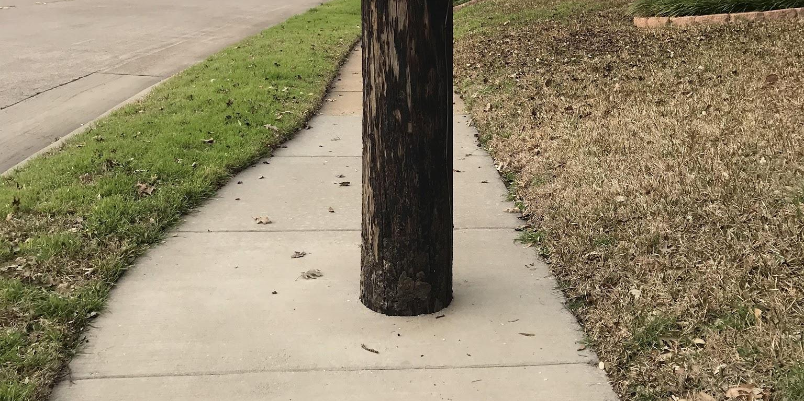
52.4k
labeled panoramas
135k
curb ramps
17.7k
missing curb ramps
20.0k
obstructions

Slide 21
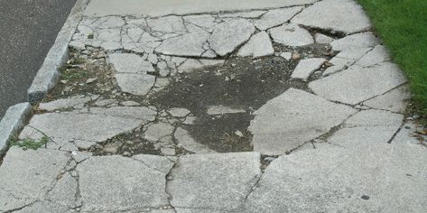
52.4k
labeled panoramas
135k
curb ramps
17.7k
missing curb ramps
20.0k
obstructions
8.1k
surface problems
Notes:
These are the five classes we focused on: curb ramps, missing curb ramps, obstructions, and surface problems.

Slide 22
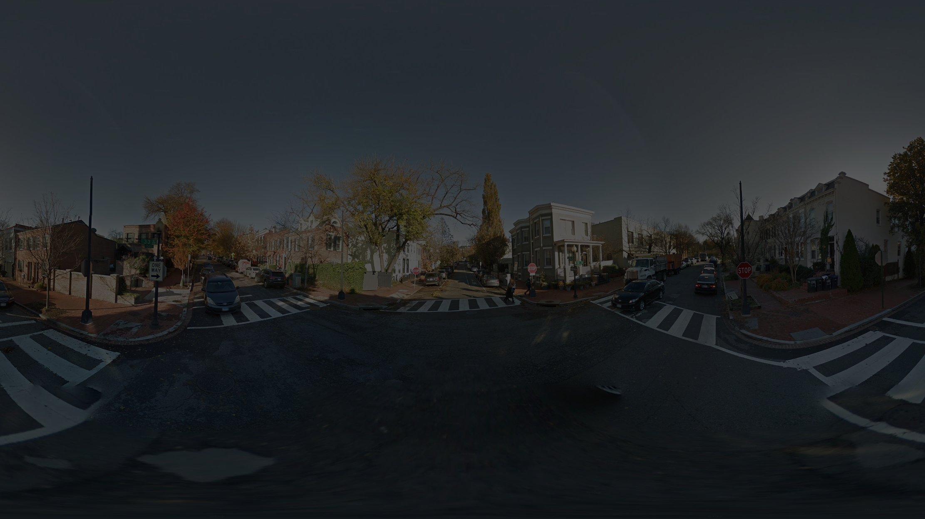
Our Goal
Develop a system to automatically detect different types of sidewalk problems using streetscape imagery.
This system should be accurate, and generalizable to any city.

Slide 23
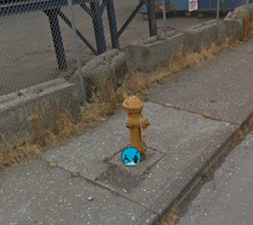
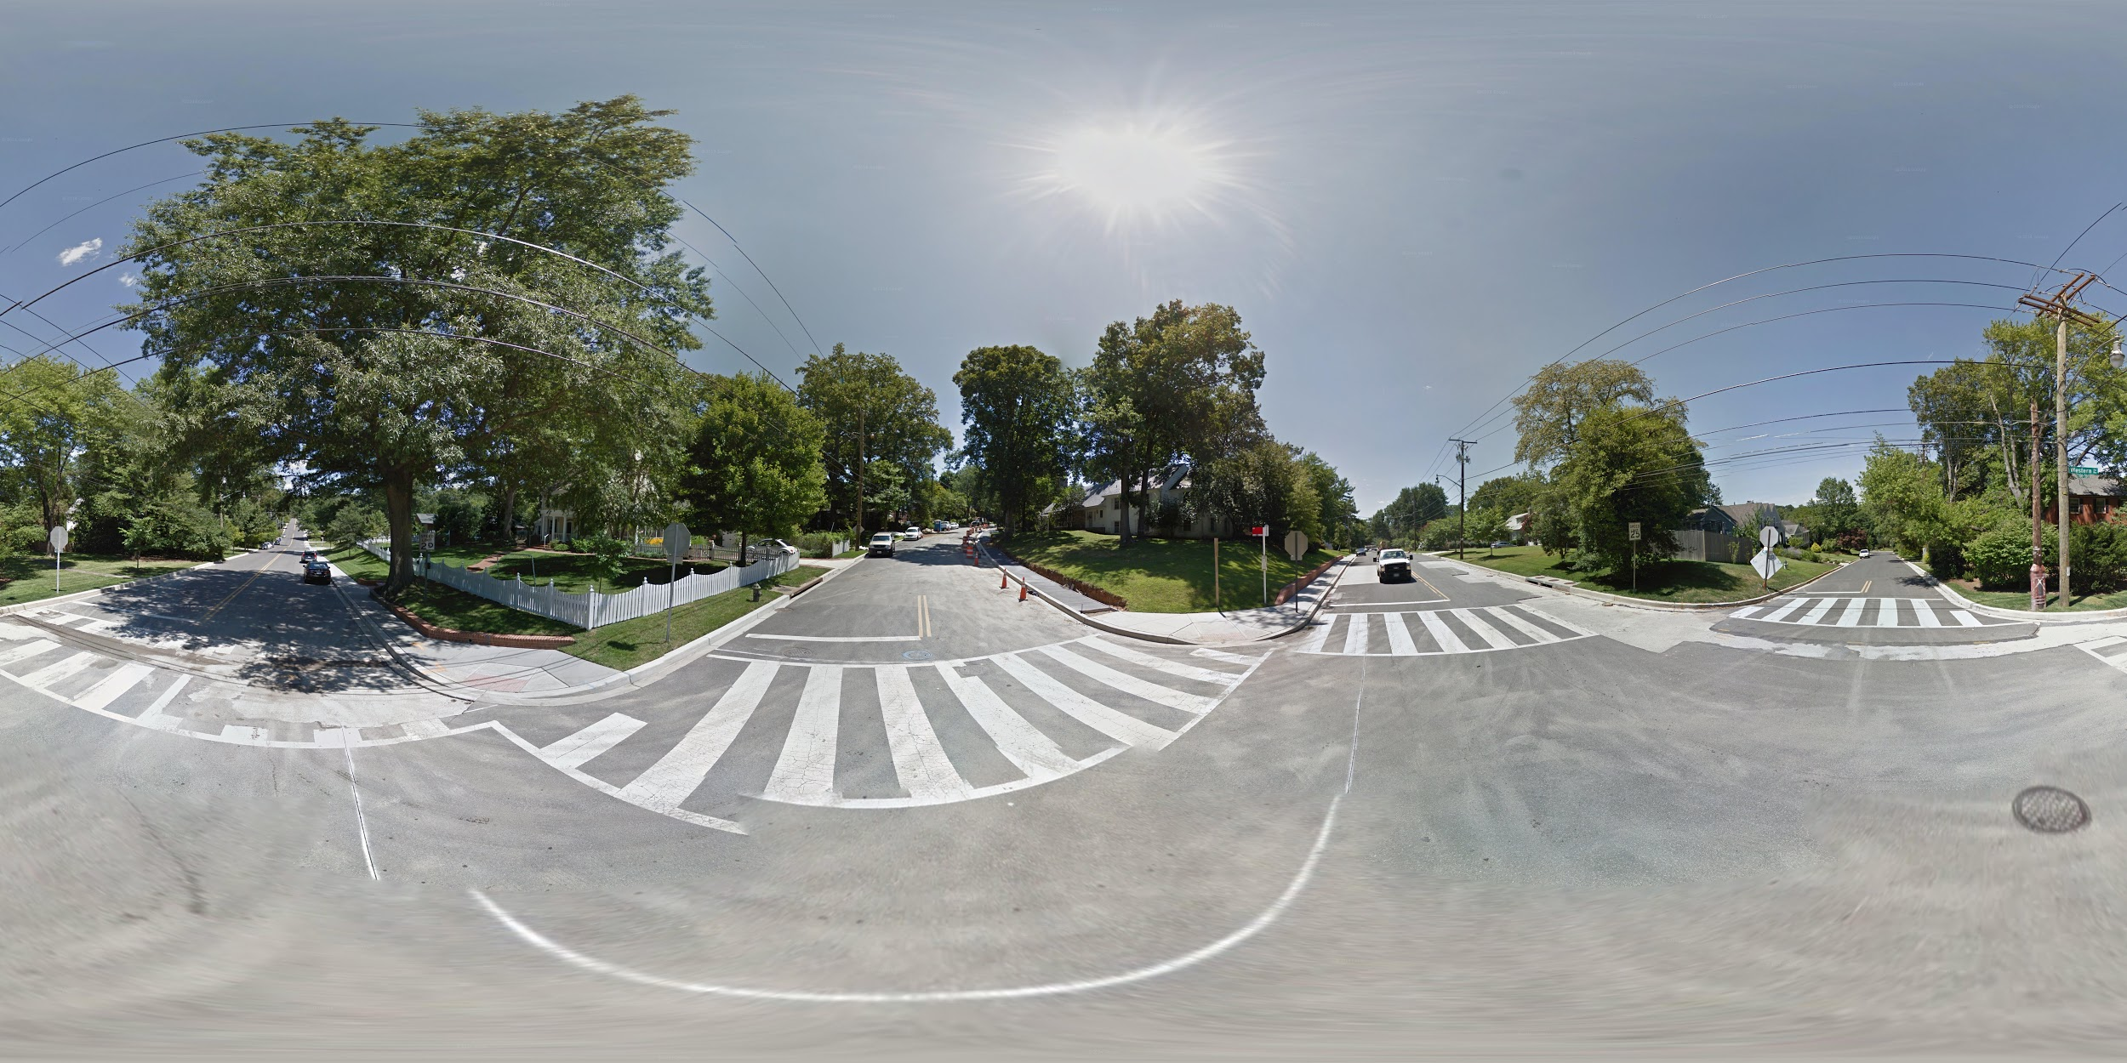
Two Automated Tasks
Validation
Labeling
Is this an obstruction?
What problems are in this pano?
Notes:
We wanted to evaluate our system on two related yet distinct tasks: validation, and labeling.

Slide 24
Two Automated Tasks
Validation
Is this an
obstruction?
Notes:
For validation, the idea is that we use the automatic system to check human-placed labels. Is this an obstruction? Yes!

Slide 25
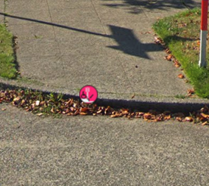
Two Automated Tasks
Validation
Is this an
obstruction?
Is this a
missing curb ramp?
Notes:
Many times, human labels are correct, like this missing curb ramp.

Slide 26
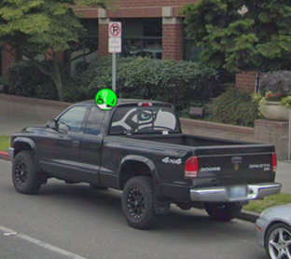
Two Automated Tasks
Validation
Is this an
obstruction?
Is this a
missing curb ramp?
Is this a
curb ramp?
Notes:
Some times, they’re obviously wrong, like this incorrect curb ramp label. If they are wrong, can we tell if they should have a different label? Or are they just labels placed on nothing useful?

Slide 27
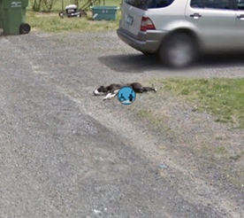
Two Automated Tasks
Validation
Is this an
obstruction?
Is this a
missing curb ramp?
Is this a
curb ramp?
Is this an
obstruction?
Notes:
The answer isn’t always obvious, even to people - like this dog lying on the side of the road!

Slide 28
Two Automated Tasks
Validation
Labeling
Is this an obstacle?
What problems are in this pano?
Notes:
For labeling, we try to do everything automatically. We take an entire panorama of a street, and try and label all the problems on that street. Let’s blow this panorama up a bit, so we can see it better.

Slide 29
Two Automated Tasks
Notes:
Here we have an entire Google Streetview panorama, covering 360 degrees horizontally by 180 degrees vertically.
What problems can we see?

Slide 30
Two Automated Tasks
Missing Curb Ramp
Notes:
Well, for starters, I see a missing curb ramp at the end of the crosswalk over here, so let’s mark that.

Slide 31
Two Automated Tasks
Missing Curb Ramp
Notes:
And, there are actually three other missing curb ramps over here, let’s mark those too.

Slide 32
Two Automated Tasks
Surface Problem
Missing Curb Ramp
Notes:
If you look carefully, there’s actually a chunk of missing pavement in the sidewalk in the middle, so let’s mark that as a surface problem.

Slide 33
Two Automated Tasks
Surface Problem
Missing Curb Ramp
Curb Ramp
Curb Ramp
Notes:
Now, they’re not sidewalk “problems” persay, but it’s important to keep track of them, too, so we’re gonna mark these two nice new curb ramps in the middle here.
That’s labeling - identify all the problems (and curb ramps) in a panorama.

Slide 34
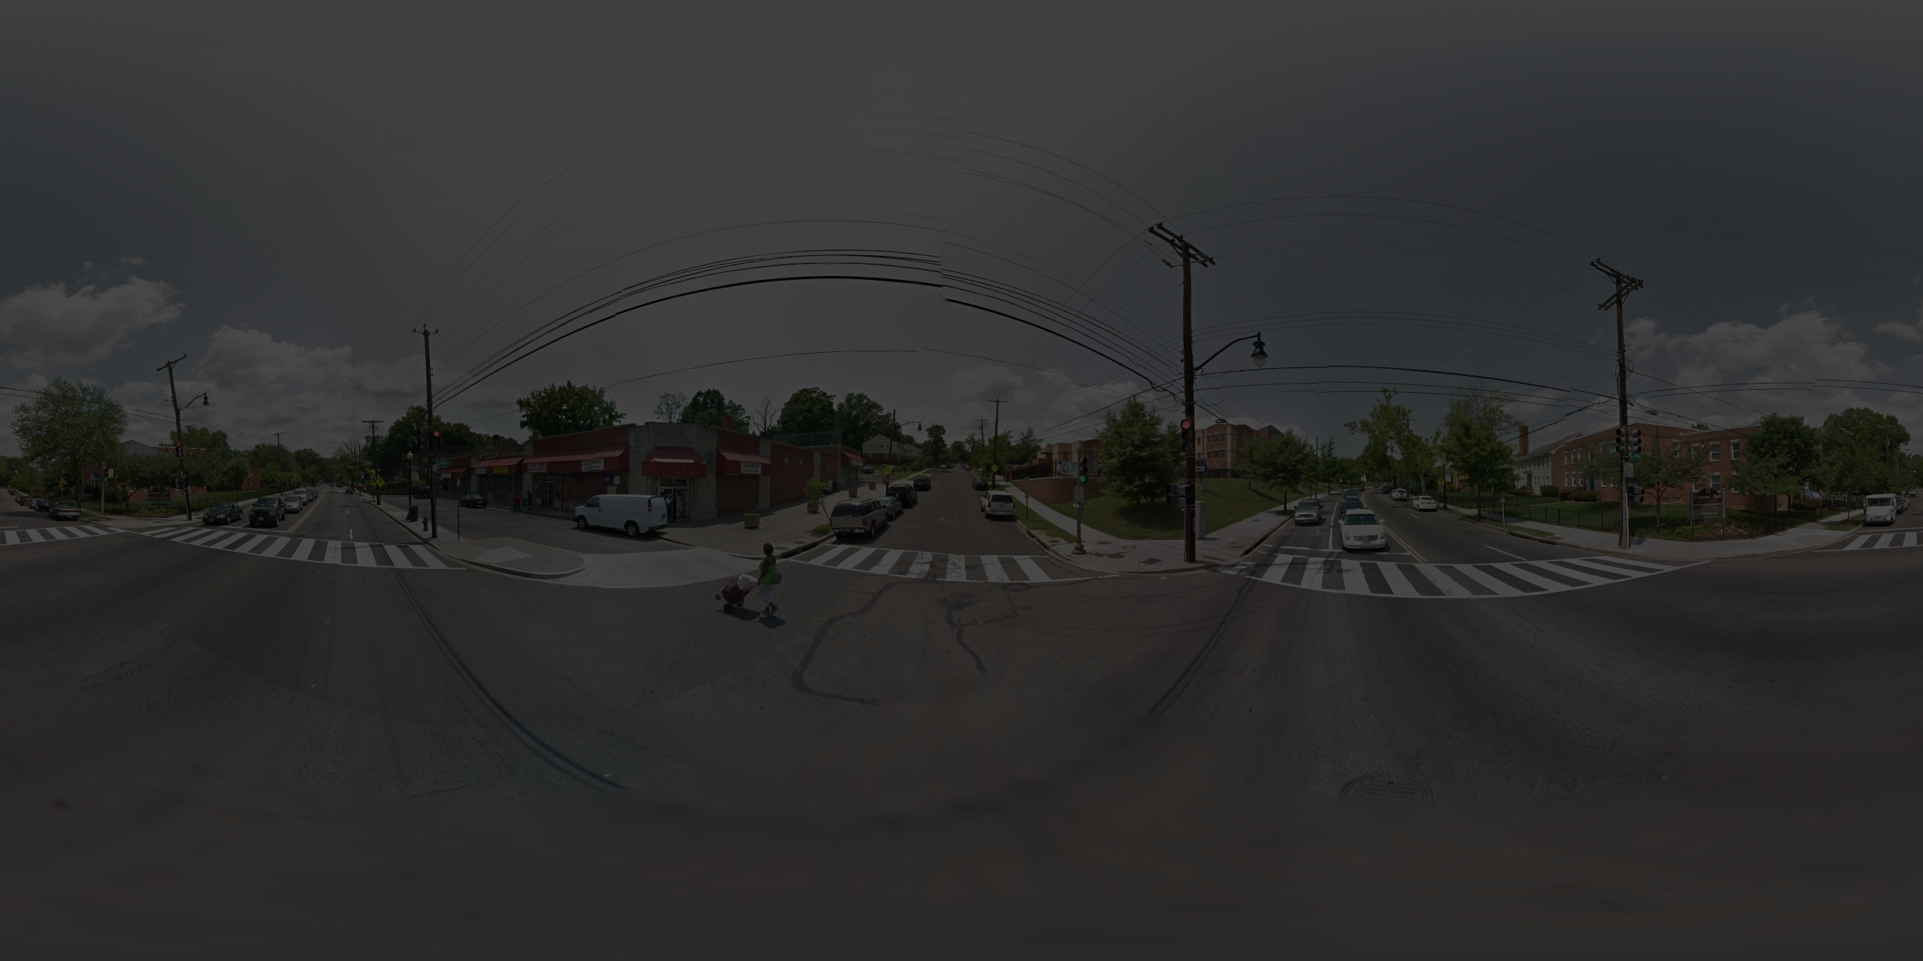
How do we automate these tasks?
Start with 181k labeled problems from Project Sidewalk dataset.
Compute 3 types of features for each human-placed label.
Train two different neural networks, one for validation, one for labeling.
Use a sliding window to label panoramas.
Evaluate on a researcher-created ground-truth test dataset.
Notes:
So, how do we automate these tasks? Here’s an overview of our methods:
We start with our dataset of 180 thousand plus human-placed labels from Project Sidewalk. We randomly partition these into train and val sets using an 80:20 split.
We then compute three different types of features for each label in the dataset.

Slide 35
3 types of features
image features
positional features
geographic features
Notes:
What are these 3 types of features? They help us describe the position and appearance of a label within a city, incorporating additional context around the label.
We categorize them as image features, positional features, and geographic features.

Slide 36
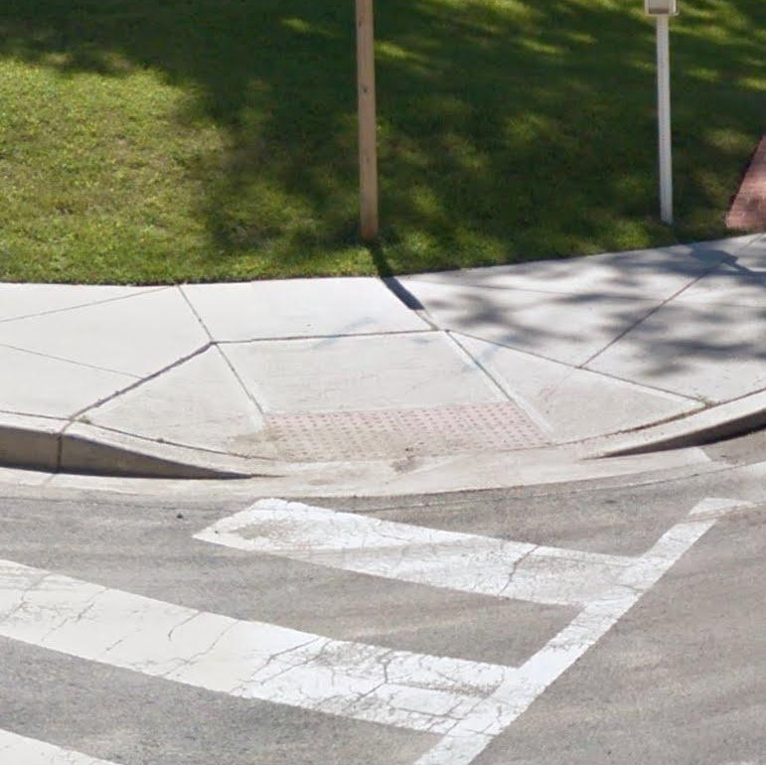
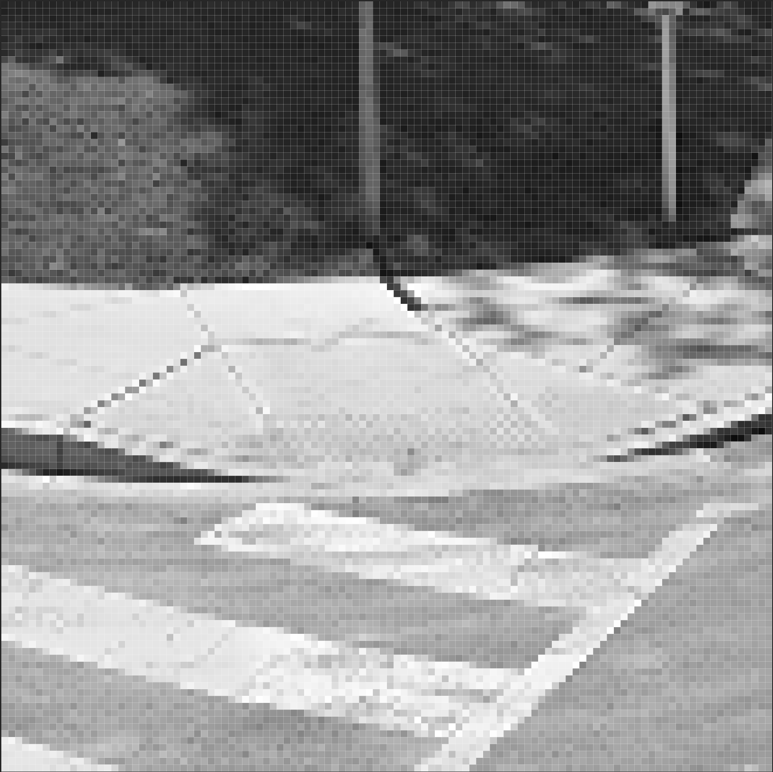
3 types of features
image features
positional features
geographic features
224 px
4.2 meters
3 channels
224 px
Notes:
Let’s start with image features.
Image features are the simplest, and they describe the appearance of the object
from the streetview panorama, we make a square crop around the label, using depth data to size the crop.
The further away the label is, the smaller the crop should be.
We then resize it to 224x224 pixels, each with R, G, and B values.

Slide 37
3 types of features
image features
positional features
geographic features
Notes:
Positional features describe where within a single panorama a label is located.
You can see the black circle marks our curb ramp from the previous slide.

Slide 38
3 types of features
image features
positional features
geographic features
street-axis
horizon
-22.8°
34.5°
4.2 meters
Notes:
In our positional features, we include the distance from the streetview vehicle to the label, based on depth data, and the angle from the street-axis to the label, as well as the angle above or below the horizon. These make a 7 by 1 vector.

Slide 39
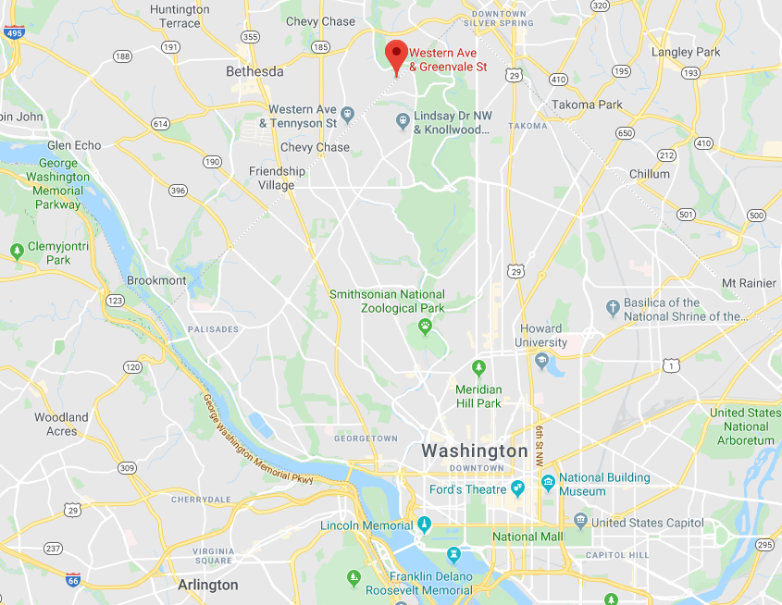
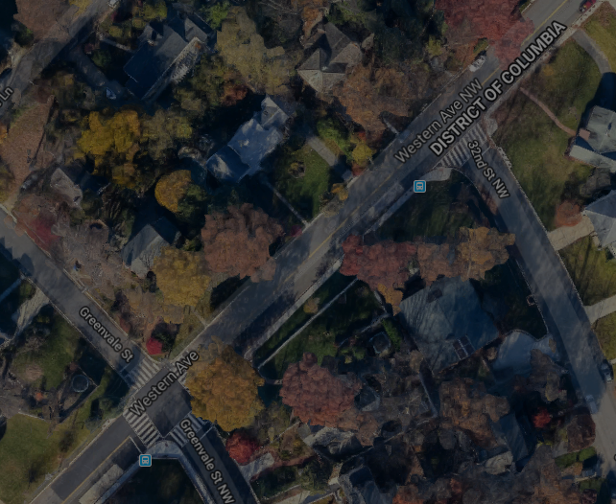
3 types of features
image features
positional features
geographic features
44.2°
9.7 km
block length 98m
357°
distance to intersection 3.8m / 3.9% of block
Notes:
Geographic features, on the other hand, describe where the panorama is located within the city.
They include the bearing and distance from the panorama to the city center,
The heading of the street-axis, and the absolute and relative position of the pano along the block.

Slide 40
How do we automate these tasks?
Start with 181k labeled problems from Project Sidewalk dataset.
Compute 3 types of features for each human-placed label.
Train two different neural networks, one for validation, one for labeling.
Use a sliding window to label panoramas.
Evaluate on a researcher-created ground-truth test dataset.
Notes:
Alright, that was our three types of features. Let’s return to our overview of the process.
Once we’ve processed our training data, we train two different neural networks, one for the validation task, and one for labeling.

Slide 41
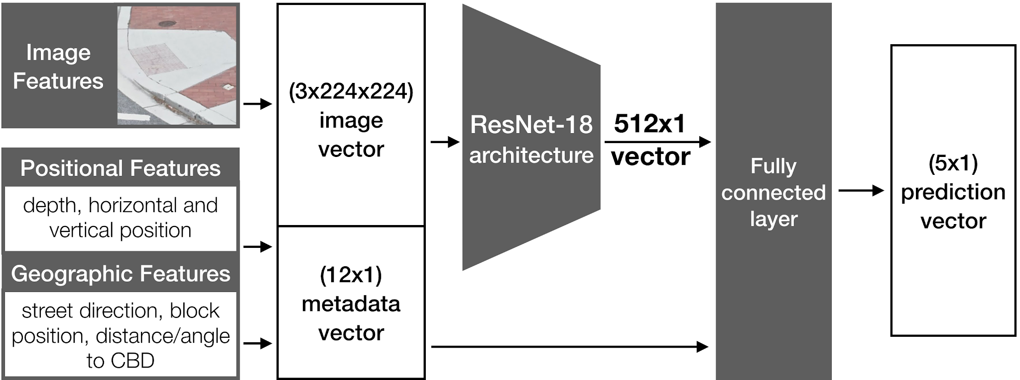
Neural Network Architecture
Notes:
The architecture of our network is the same for the two models, the only difference is the data we train the network on - I’ll get to that in a second.
Our network is derived from ResNet-18, a common neural network architecture for computer vision that achieves state of the art results on image classification tasks.
We modified the architecture to incorporate our positional and geographic features by adding a final fully-connected layer, after the ResNet blocks, into which we input the extra features.
The final output of the model is a 5x1 vector with values corresponding to the confidence of the prediction for each of our 5 feature types: curb ramp, missing curb ramp, obstruction, surface problem, and “null”.

Slide 42
Neural Network Architecture
Notes:
The architecture of our network is the same for the two models, the only difference is the data we train the network on - I’ll get to that in a second.
Our network is derived from ResNet-18, a common neural network architecture for computer vision that achieves state of the art results on image classification tasks.
We modified the architecture to incorporate our positional and geographic features by adding a final fully-connected layer, after the ResNet blocks, into which we input the extra features.
The final output of the model is a 5x1 vector with values corresponding to the confidence of the prediction for each of our 5 feature types: curb ramp, missing curb ramp, obstruction, surface problem, and “null”.

Slide 43
How do we automate these tasks?
Start with 181k labeled problems from Project Sidewalk dataset.
Compute 3 types of features for each human-placed label.
Train two different neural networks, one for validation, one for labeling.
Use a sliding window to label panoramas.
Evaluate on a researcher-created ground-truth test dataset.
Notes:
Now we’ve seen how to get a prediction for a single point in a panorama.
For labeling, how do we attempt to locate all the problems in a panorama?

Slide 44
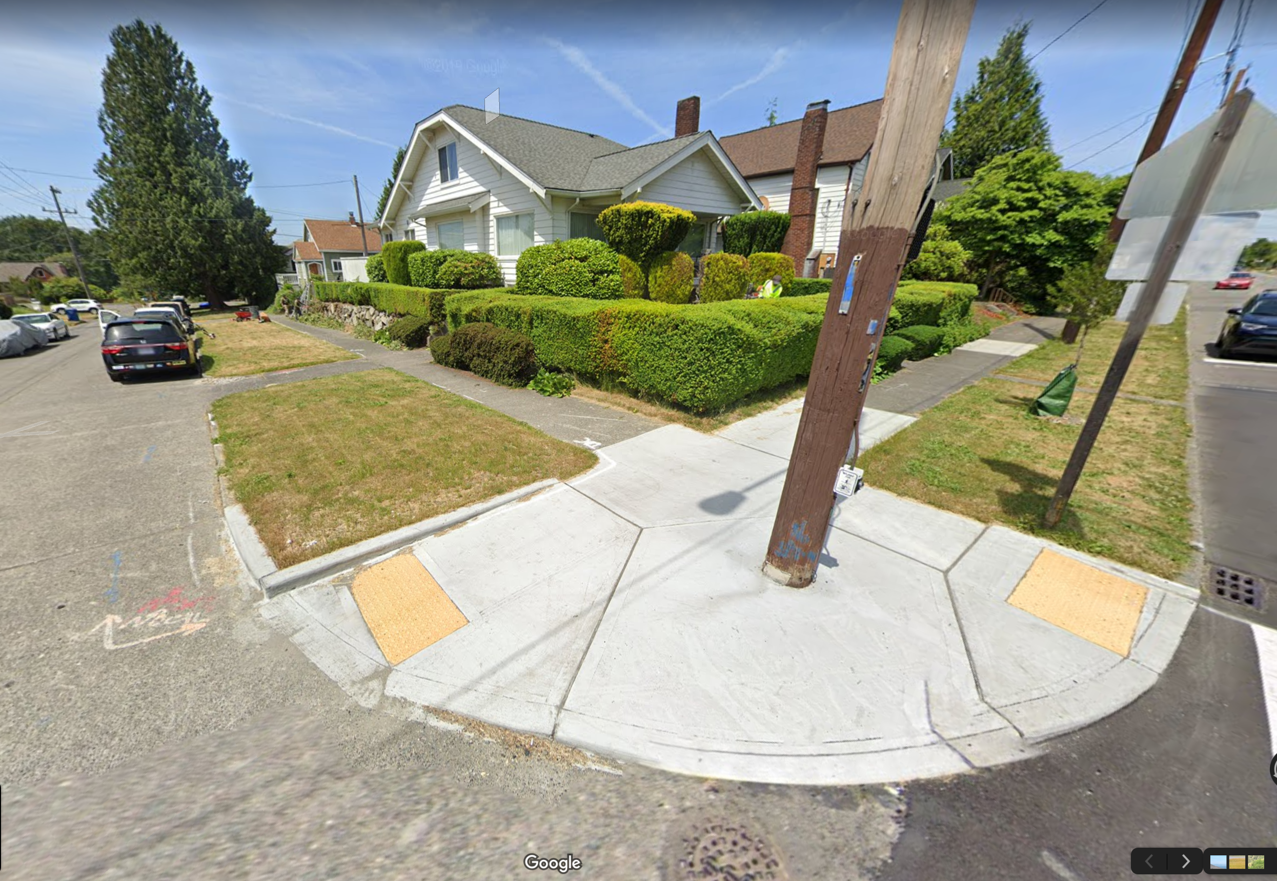
Sliding Window
Notes:
The answer is to use a sliding window, a standard computer vision technique.

Slide 45
Sliding Window
Notes:
We divide the image up into overlapping crops, and get predictions for each one.

Slide 46
Sliding Window
4
curb ramp
Notes:
We divide the image up into overlapping crops, and get predictions for each one.

Slide 47
Sliding Window
4
curb ramp
Notes:
We divide the image up into overlapping crops, and get predictions for each one.

Slide 48
Sliding Window
4
curb ramp
Notes:
We divide the image up into overlapping crops, and get predictions for each one.

Slide 49
Sliding Window
4
3
curb ramp
curb ramp
Notes:
We divide the image up into overlapping crops, and get predictions for each one.

Slide 50
Sliding Window
4
3
curb ramp
curb ramp
Notes:
Then, we re-assemble all the predictions onto the original image.

Slide 51
How do we automate these tasks?
Start with 181k labeled problems from Project Sidewalk dataset.
Compute 3 types of features for each human-placed label.
Train two different neural networks, one for validation, one for labeling.
Use a sliding window to label panoramas.
Evaluate on a researcher-created ground-truth test dataset.
Notes:
We’ve covered most of the pipeline, now we just need to evaluate our results on the test dataset.
This dataset was created by two authors of the paper, who labeled 224 randomly sampled panoramas from the Washington, D.C. area.

Slide 52
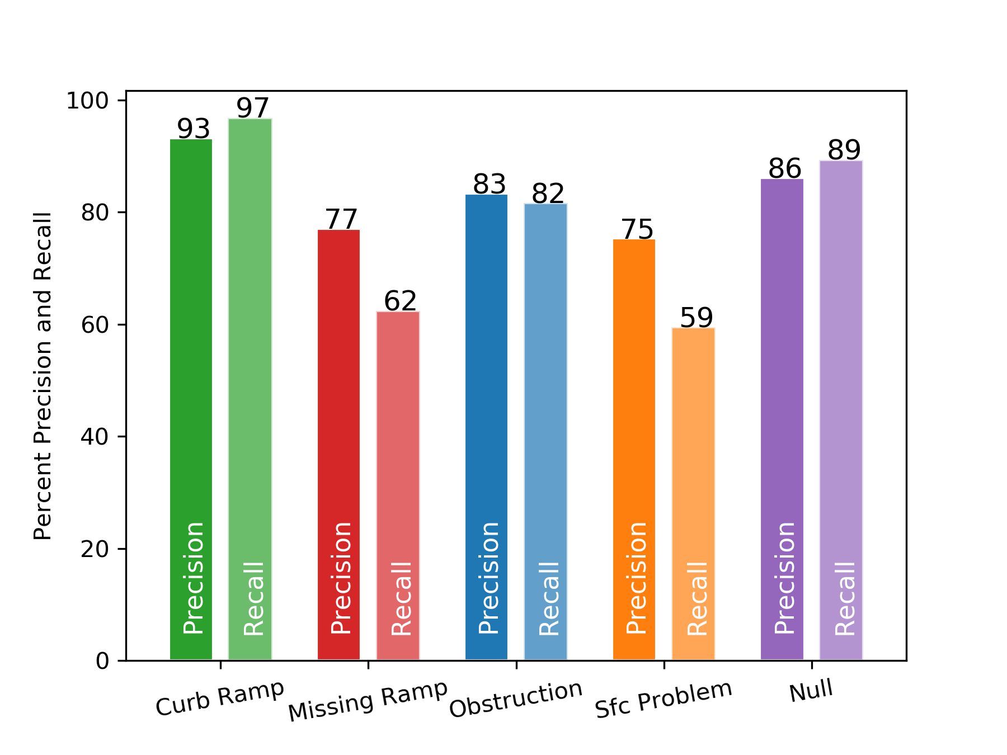
Validation Performance
Notes:
First, let’s look at how our system performs on the validation task.
The x-axis is percent, so higher is better. For each class, we’ll look at precision and recall. Precision is the percentage of our predictions that were correct, and recall is the percentage of actual items that we were able to detect. Ideally, both would be high.
Here, you can see both our precision and recall for curb ramps is good.
What about the other classes?

Slide 53
Validation Performance
Notes:
Missing curb ramps and surface problems were the most challenging to identify correctly.

Slide 54
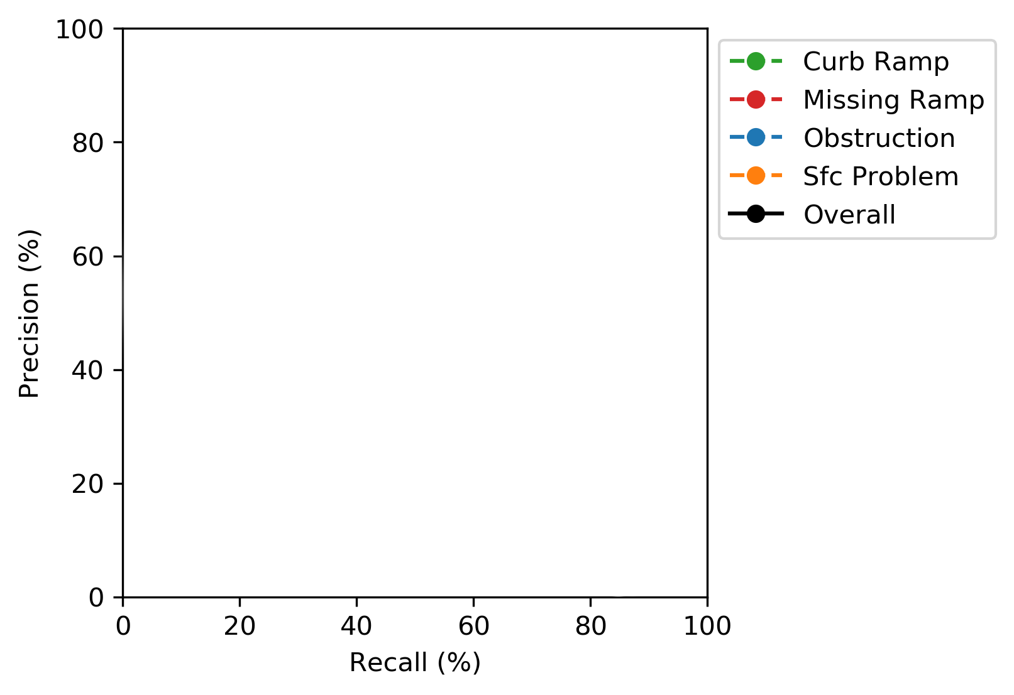
Labeling Performance
Notes:
Let’s look at a precision-recall curve for our labeling performance. Again, precision is the percentage of predictions that are correct, and recall is the percentage of actual labels that are detected, but here we look at both of them on the same graph. Precision is on the vertical axis, and recall is on the horizontal access.

Slide 55
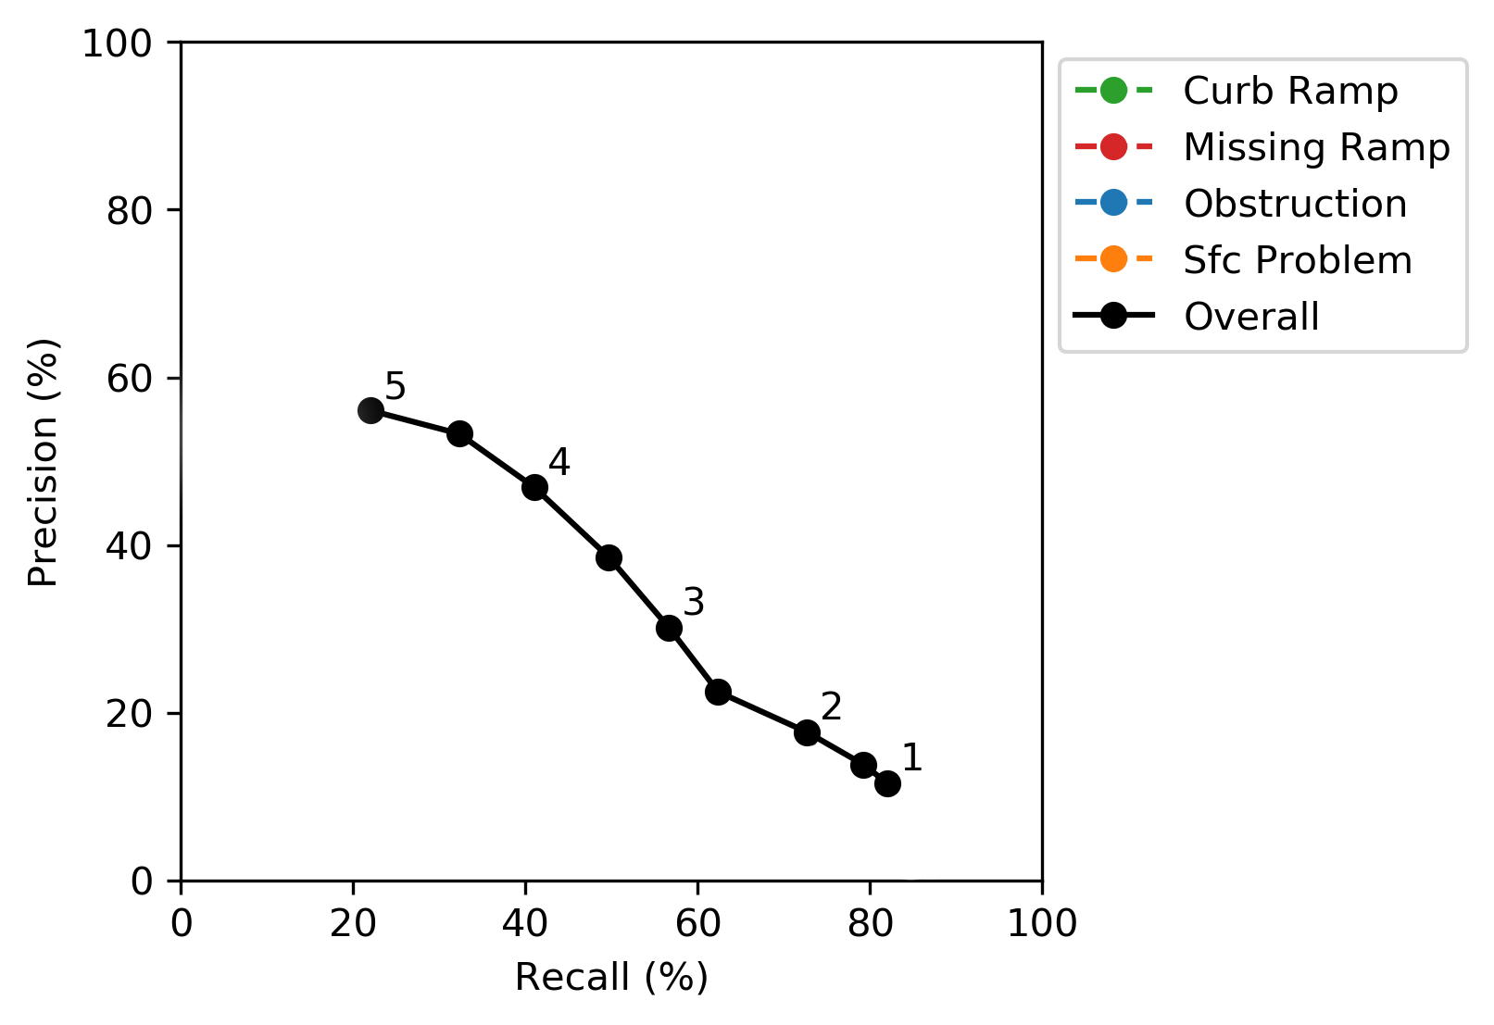
Labeling Performance
Notes:
To make this plot, we needed to be able to tune our system to trade-off precision versus recall. We did this by setting a confidence threshold for our predictions, where we only used predictions with a confidence higher than that threshold. The higher the threshold, the more likely our predictions were to be correct, but we are also more likely to miss something.
Our overall performance is decent, but we do much better on some classes than others.

Slide 56
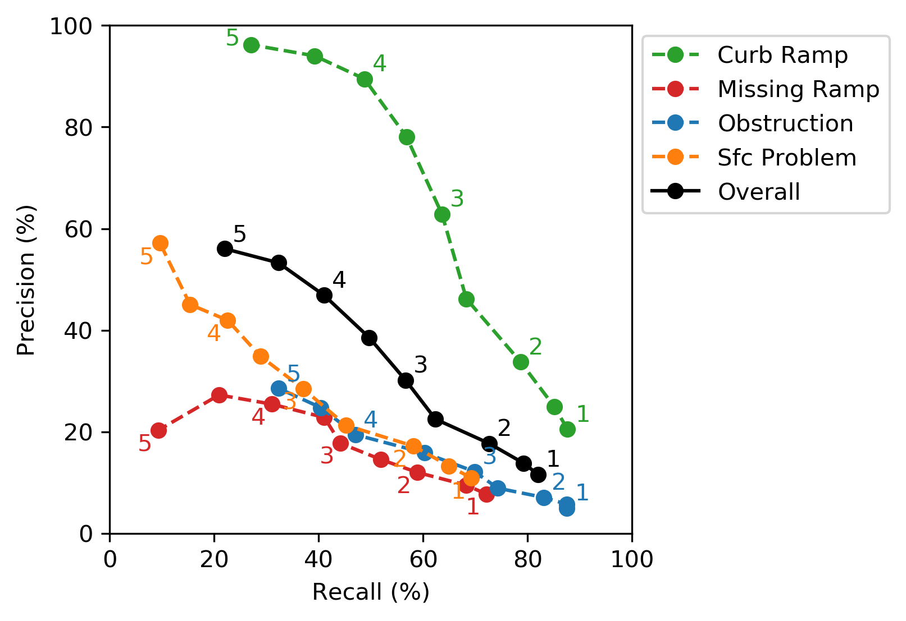
Labeling Performance
Notes:
Again, our curb ramp performance was best: 89% precision and 49% recall. Note that depending on the desired application, one can achieve much higher recall with moderate precision by tuning the system differently.
We wanted to better understand what made these classes difficult. What types of errors was the system making?

Slide 57

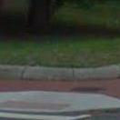


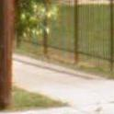

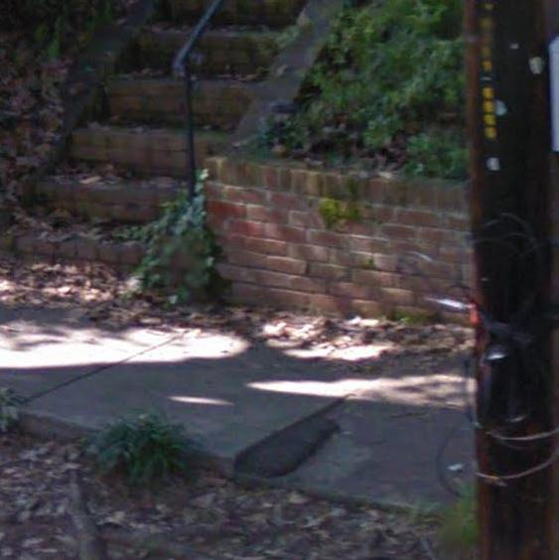
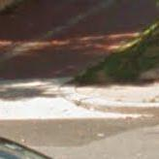
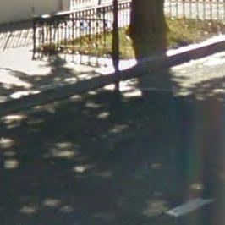
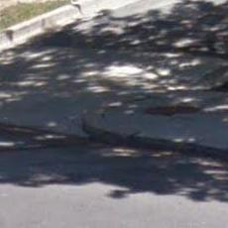
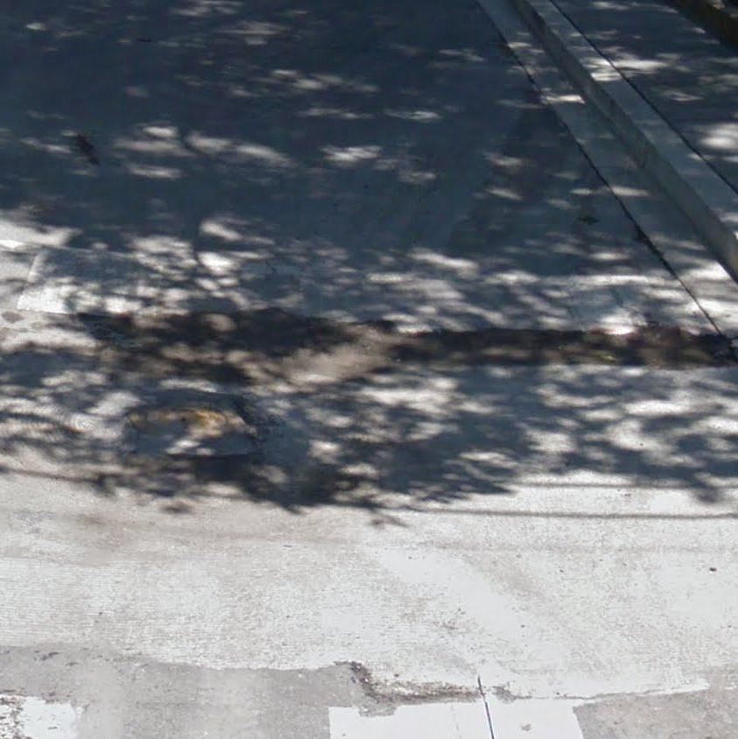
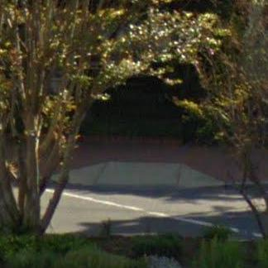
Validation Errors - Common Factors
low resolution imagery
difficult lighting
Notes:
To do so, we randomly sampled 100 false positives and 100 false negatives for each class from the validation set, and categorized them.
Two factors were present in almost all categories of error, both which are imagery limitations: low-resolution crops, which occur when the problem is far away from the camera, and poor lighting, mostly caused by deep or uneven shadows.
Brightening shadows in the imagery before processing them is one possible solution, and Google is already starting to photograph scenes in higher resolution.

Slide 58
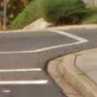
Validation Errors - False Positives
curb ramp
27%
crosswalk
Notes:
What about the specific errors present in false positives? What causes our system to think that a problem is present when there is none?
27% of false-positive curb ramps had visible crosswalk markings nearby, again suggesting that the system is using the presence of sidewalks to learn where curb ramps are and aren’t.

Slide 59
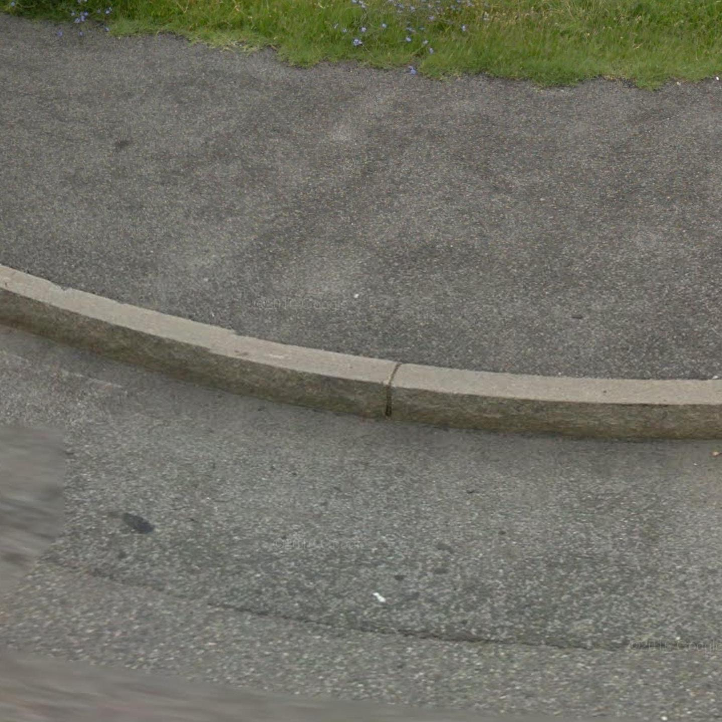
Validation Errors - False Positives
curb ramp
27%
crosswalk
missing curb ramp
86%
curb
Notes:
86% of false-positive missing curb ramps contained a stretch of curb. This is another area where contextual features might help a lot - if the system could know where there’s likely not to be any pedestrian crossing, it might be less prone to thinking curbs are missing curb ramps.

Slide 60
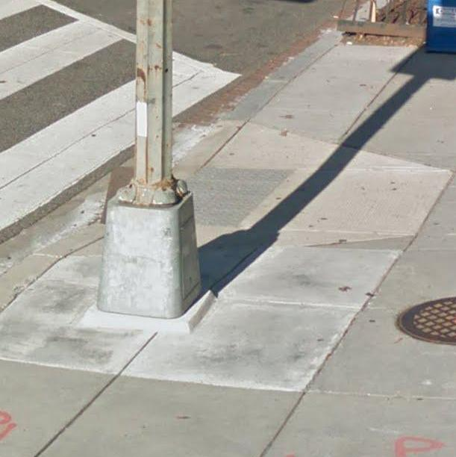
Validation Errors - False Positives
curb ramp
27%
crosswalk
missing curb ramp
86%
curb
obstruction
58%
not on path
Notes:
58% of false-positive obstructions were objects that could obstruct a sidewalk, but were located off the pedestrian path. Again, same story with contextual features.

Slide 61
Comparison with Automated Systems
 |  | Tohme [1] | Our Model | Change
Curb Ramp | precision | 26% | 33.7% | +30%
 | recall | 67% | 78.7% | +17%
 |  | Sun et al. [2] | Our Model | Change
Missing Ramp | precision | not reported | 12.0% | N/A
 | recall | 27% | 58.6% | +117%
Fully Automated Systems
[1]
Kotaro Hara, Jin Sun, Robert Moore, David Jacobs, and Jon Froehlich. 2014. Tohme. In Proceedings of the 27th annual ACM Symposium on User interface software and technology - UIST ’14.
[2]
Jin Sun and David W. Jacobs. 2017. Seeing What is Not There: Learning Context to Determine Where Objects are Missing. In 2017 IEEE Conference on Computer Vision and Pattern Recognition (CVPR). IEEE, 1234–1242.
Notes:
Comparisons with other systems are always difficulty due to the number of confounding factors, especially the different test datasets used for evaluation.
In order to approximate a fair comparison, we tuned our system (using gamma) to emulate as similar of a precision-recall balance as possible.
With gamma=2, we improved upon Tohme’s curb-ramp detection with a 30% increase in precision and a 17% increase in recall, while also improving upon Sun et al.’s missing curb ramp detection system with a 117% improvement in recall.

Slide 62
Comparison with Human Systems
 |  | Hara et al. [3] | Our Model | Change
Overall | precision | 37% | 39% | +5%
 | recall | 46% | 50% | +9%
Majority Vote of 5 Crowdworkers
[3]
Kotaro Hara, Vicki Le, and Jon Froehlich. 2013. Combining crowdsourcing and google street view to identify street-level accessibility problems. In Proceedings of the SIGCHI Conference on Human Factors in Computing Systems - CHI ’13.
Notes:
Similarly, comparisons with human labeling performance are especially difficulty.
However, based on Hara et al.’s 2013 CHI paper, in which a majority vote was taken from 5 crowd workers’ independent labels, we find that our system performs comparably overall, with 39% precision and 50% recall compared to 37% precision and 46% recall of the majority vote system.

Slide 63
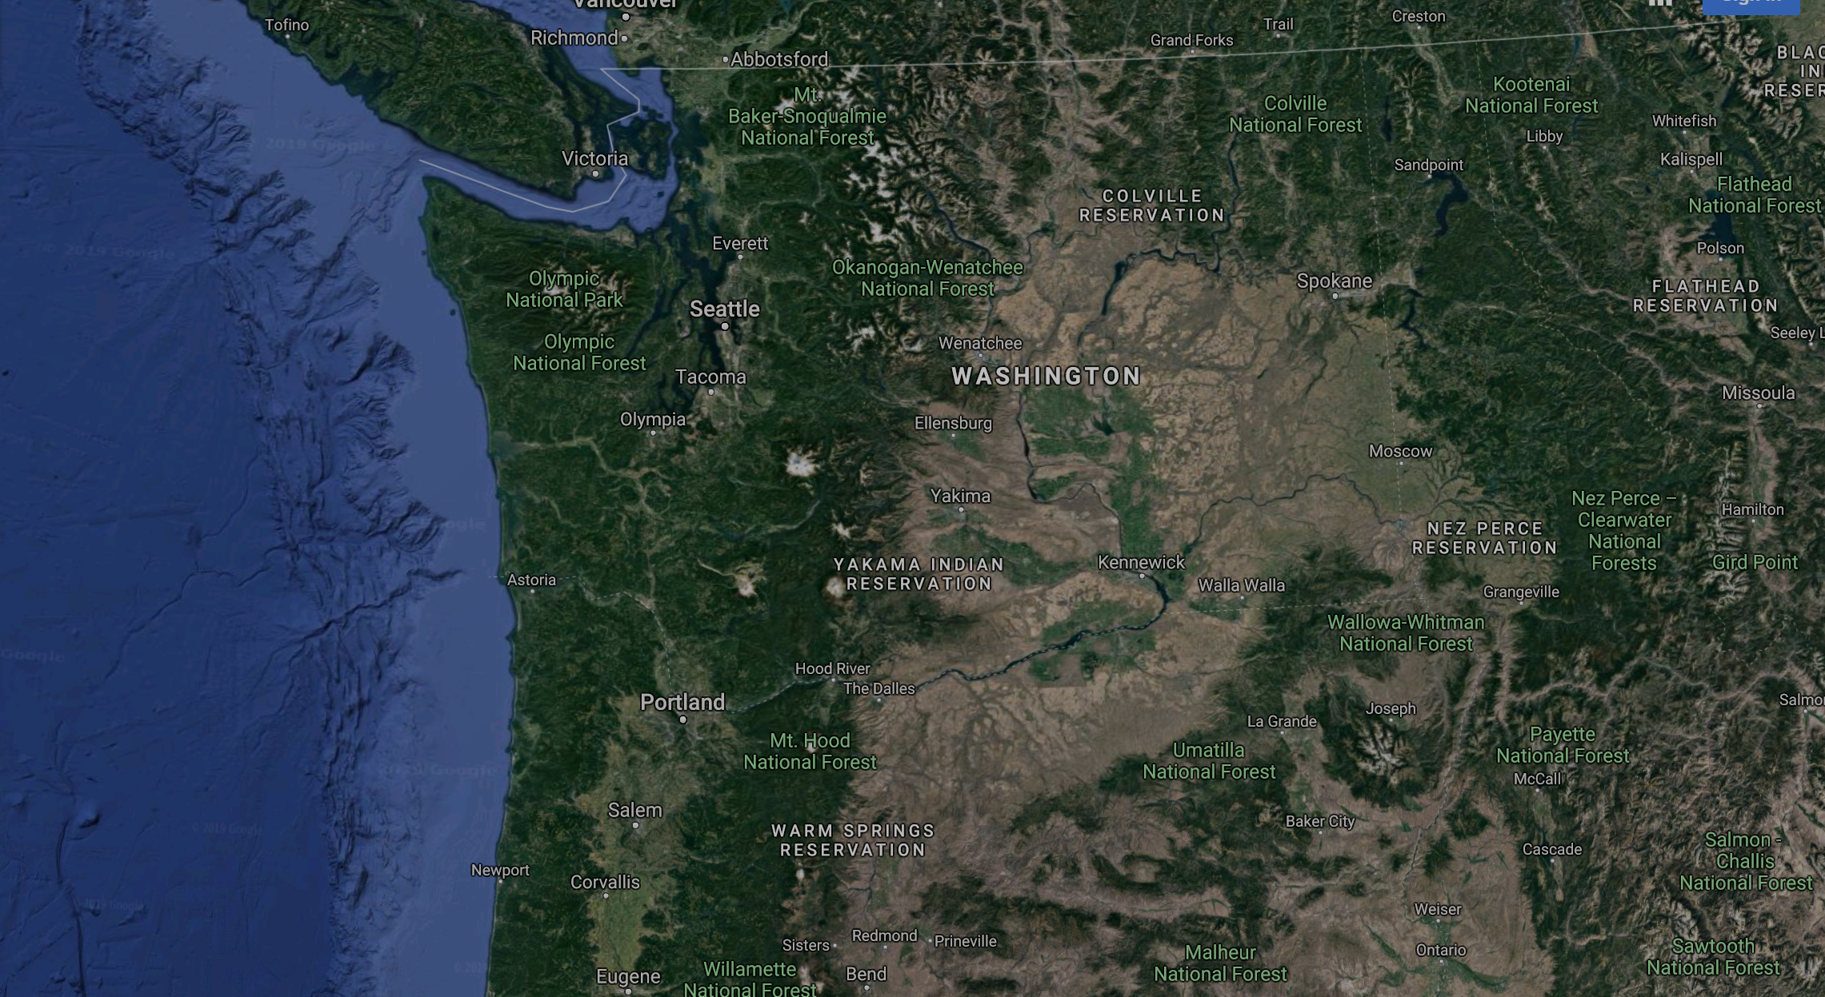
Cross-City Generalizability
Seattle, WA
Newberg, OR
Notes:
One critical question for us was how well our system performs in other cities.
To study this, we took advantage of recent Project Sidewalk deployments to two new cities: Seattle, Washington, and Newberg, Oregon, a small city about half an hour outside of Portland.

Slide 64
Cross-City Generalizability
4.4k
labels
7.1k
labels
181k
labels
Newberg, OR
Seattle, WA
D.C.
Notes:
At the time of our study, we had about 4 and a half thousand labels for Newberg, and 7 thousand in Seattle - significantly fewer than we had for Washington, D.C.

Slide 65
Cross-City Generalizability
baseline | D.C. model
three experiments | D.C. + new city
 | new city only
 | new city, pretrained with D.C.
Notes:
For a baseline, we simply applied our D.C. model to the new cities’ test sets.
To improve upon this, we tried three experiments - training on a larger dataset by taking the union of the new cities’ labels plus D.C.’s labels, training on only the data from the new city, and training with the new cities’s data but initializing the model with the D.C. weights - effectively using the larger D.C. dataset for “pretraining.”

Slide 66
Cross-City Generalizability
baseline | D.C. model
three experiments | D.C. + new city
 | new city only
 | new city, pretrained with D.C.
Notes:
We found that this last approach offered the best performance for both Newberg and Seattle… [click]

Slide 67
Cross-City Generalizability
90.2%
overall recall
82.8%
overall recall
89.9%
overall recall
Newberg, OR
Seattle, WA
D.C.
Notes:
...allowing us to get performance almost as good as we achieved in D.C. with just a couple thousand labels for each new city.
These results suggest that our approach generalizes well, and that our D.C. model is an excellent starting point for city-specific models.

Slide 68
what’s next?
Notes:
It’s exciting to see this neural network approach perform so well compared to past systems, but there’s still room for improvement.

Slide 69
richer contextual features
street-axis
horizon
-22.8°
34.5°
4.2 meters
Notes:
In particular, improving our use of contextual features, for position and geography, should help reduce some of the common types of errors we saw.
We would like to experiment with richer encodings of depth data, geography, and the cityscape more broadly.

Slide 70
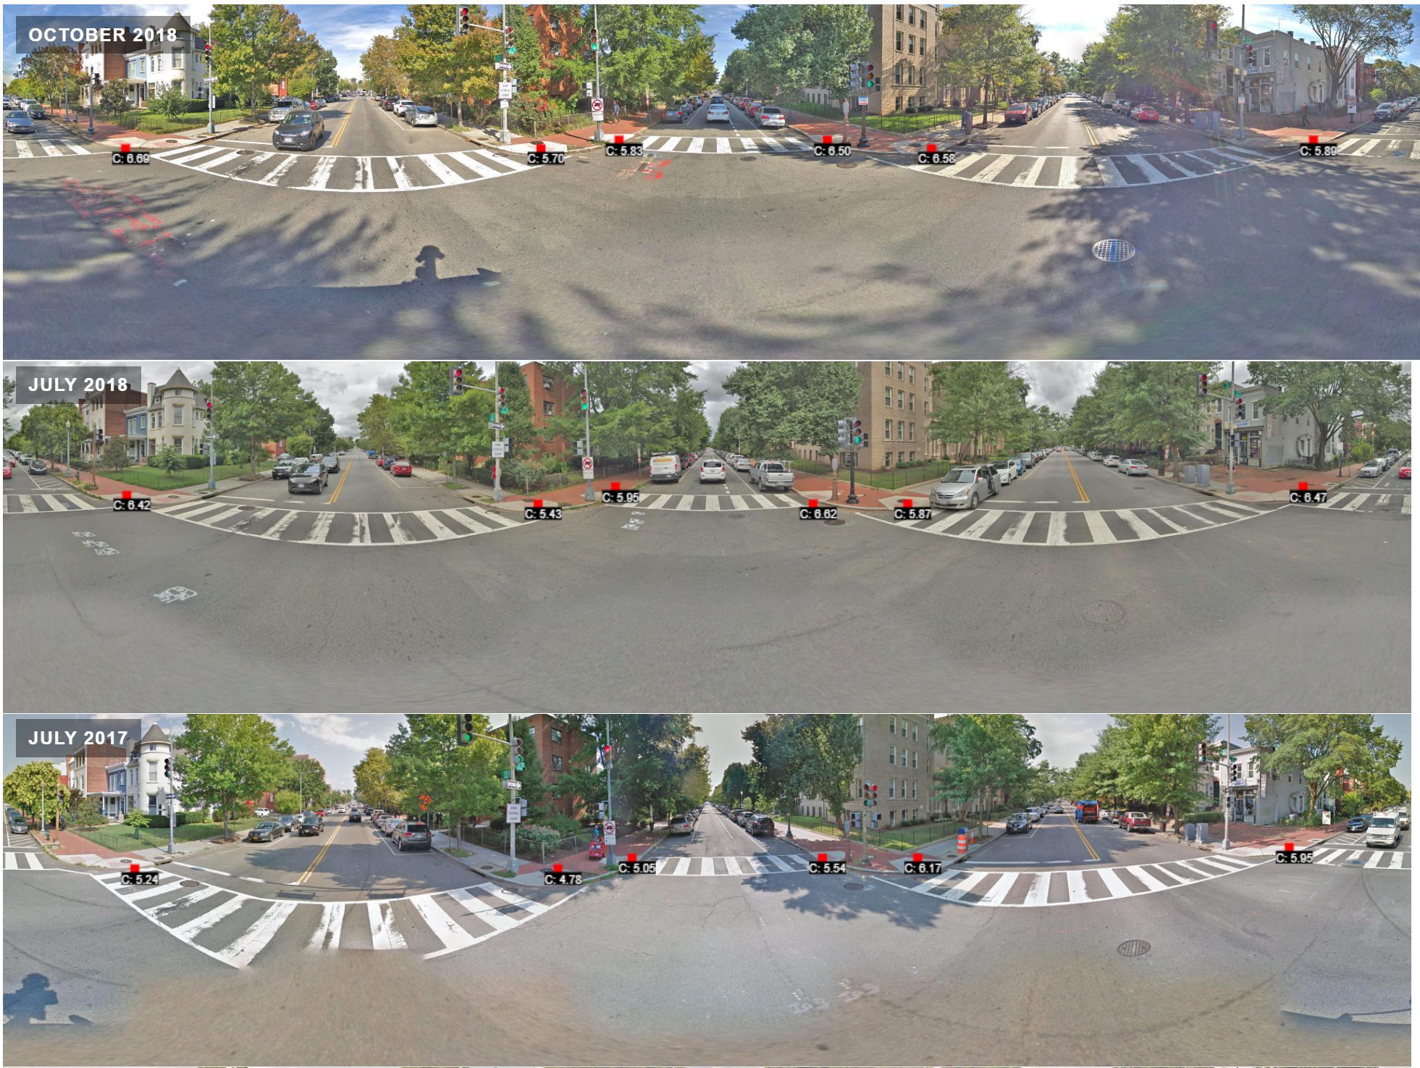
What new work can we enable?
Notes:
Lastly, I’m excited to see the impact that this work can have in other projects, as well. We’re already working on a system to track how sidewalks evolve over time, and we’re incorporating some computer vision into that system, but this just barely scratches the surface of possibilities.

Slide 71
map the accessibility of all sidewalks in the world
our vision is to
Notes:
Our vision is to map the accessibility of all sidewalks in the world. This is an ambitious goal, but we believe that this work is a small step in that direction.

Slide 72




acknowledgements
Notes:
I would like to thank the NSF and the Sloan Foundation for their support of this work, and Project Sidewalk for their dataset.

Slide 73
acknowledgements
and thanks...
Esther Jang, Anthony Li, Aileen Zeng, Kurtis Heimerl, and Jon Froehlich
Notes:
And most importantly, my many wonderful co-authors.

Slide 74
Thank You. Questions?
Notes:
And lastly, thank you! I would love to answer any questions you have.

Slide 75
Possibilities to include (that I haven’t already)
How do we generate null-crops?
Differences between the sliding-window training set and the centered-crop training set.

Slide 76

Validation Errors - False Negatives
curb ramp
41%
bad delineation
Notes:
What about some more specific factors? Let’s start with false negatives - the problems that we missed.
41% of missed curb ramps had poor delineation between the ramp and the street or sidewalk. This is a tricky issue, as it primarily results from certain angles. Using a closer panorama that’s facing the ramp might help.

Slide 77

Validation Errors - False Negatives
curb ramp
41%
bad delineation
missing curb ramp
30%
no crosswalk
Notes:
30% of missed missing curb ramps didn’t have an adjacent marked crosswalk, suggesting that the system was using crosswalk markings to help with detection.

Slide 78

Validation Errors - False Negatives
curb ramp
41%
bad delineation
missing curb ramp
30%
no crosswalk
surface problem
48%
grass
Notes:
Surface problems were tricky to detect when they were mostly grass on the sidewalk, perhaps because they appear similar to lawns. 48% of missed surface problems contained grass.
This seems like an area where contextual features might help a lot - if the system can know where sidewalks ought to be, it may be able to better differentiate between sidewalks covered in grass, and lawns.

Slide 79
1
3
3
2
4
2
curb ramp
1
3
2
Notes:
This example is simplified somewhat, but in the real system, the grid is spaced more closely together, and the crops overlap more.
What do we do if we get multiple overlapping predictions?

Slide 80
4
curb ramp
Notes:
We keep only the one with the highest confidence.
This process is called non-maximum suppression.

Slide 81
1
curb ramp
4
3
curb ramp
curb ramp
Notes:
At the end, we output all our labels and their associated confidences.
See that curb ramp prediction at the left there?
We can tune the system to be less prone to false-positives (at the cost of additional false-negatives) using a clipping-value which we call gamma.

Slide 82
4
3
curb ramp
curb ramp
Notes:
We simply ignore all the predictions with a confidence less than gamma. In this case, a gamma of 2 removes that erroneous prediction.

Slide 83

Effect of Extra Input Features
Notes:
We were interested in evaluating how much of an impact our extra positional and geographic features had when compared to an image-only baseline.
We found their impact was overall quite small, with little overall decrease or increase in either precision or recall.
They had the most beneficial impact on the recall of curb ramps, improving it almost 3 percentage points.
However, we only scratched the surface of these contextual features, and strongly believe that with further improvements of how they’re encoded and incorporated into the model, they have the potential to significantly improve performance.

Slide 84

Labeling Performance
Notes:
How did our system fair on the labeling task? Here are 3 example panoramas from our ground truth dataset.
The top one demonstrates perfect performance, detecting all 6 curb ramps.
The middle one demonstrates mixed performance, with the system correctly detecting 2 curb ramps, but missing 2 other problems, and adding 3 false positives.
The bottom panorama shows poor performance, with the system completely missing a stretch of bad pavement on the left, and adding a false-positive surface problem on the right, in addition to a correctly detected surface problem.

Slide 85


Cross-City Generalizability
Notes:
For a baseline, we simply applied our D.C. model to the new cities’ test sets.
To improve upon this, we tried three experiments - training on a larger dataset by taking the union of the new cities’ labels plus D.C.’s labels, training on only the data from the new city, and training with the new cities’s data but initializing the model with the D.C. weights - effectively using the larger D.C. dataset for “pretraining.”
We found that this last approach offered the best performance for both Newberg and Seattle, allowing us to get performance almost as good as we achieved in D.C. with just a relatively small amount of data from each new city.
These results suggest that our approach generalizes well, and is able to achieve good performance with only a small amount of additional data.

Slide 86
3 types of features
image features - describe appearance of object
geographic features
positional features
Notes:
What are these 3 types of features? They help us describe the position and appearance of a label within a city, incorporating additional context around the label.
Image features describe the appearance of the object, as a 224x224 pixel image.

Slide 87
3 types of features
image features - describe appearance of object
geographic features - where is the object within a panorama?
positional features
Notes:
Geographic features describe where an object is located within a panorama, using depth distance from the street-view vehicle to the object, the distance above or below the horizon, and position relative to the axis of the street.

Slide 88
3 types of features
image features - describe appearance of object
geographic features - where is the object within a panorama?
positional features - where is the panorama within the city?
Notes:
Positional features, on the other hand, encode where the panorama is located within the broader context of the city, using the position relative to the city center, and the position in the street block.

Slide 89

Cross-City Generalizability
N ➤
Newberg, OR
Seattle, WA
Notes:
One critical question for us was how well our system performs in other cities.
To study this, we took advantage of recent Project Sidewalk deployments to two new cities: Seattle, Washington, and Newberg, Oregon, a small city about half an hour outside of Portland.

