Slide 1
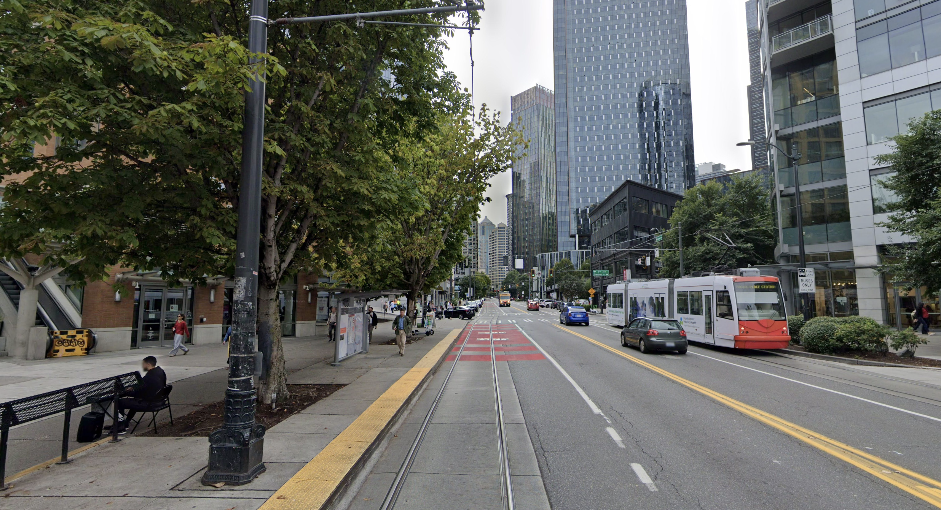
Notes:
Good afternoon, my name’s Zeyu, I’m a PhD student at the University of Washington. This work was done under Makeability lab, where we do a lot of work with accessibility, urban computing and so on.
Today I am really excited to talk to you about our work – Street View for Whom? Which is an initial Examination of Google Street View’s Urban Coverage and Socioeconomic Indicators in the US.
I’ll start by motivating our work, then I’ll discuss the technical pipelines together with some initial findings and finally I’ll conclude by stating contributions and limitations.

Slide 2
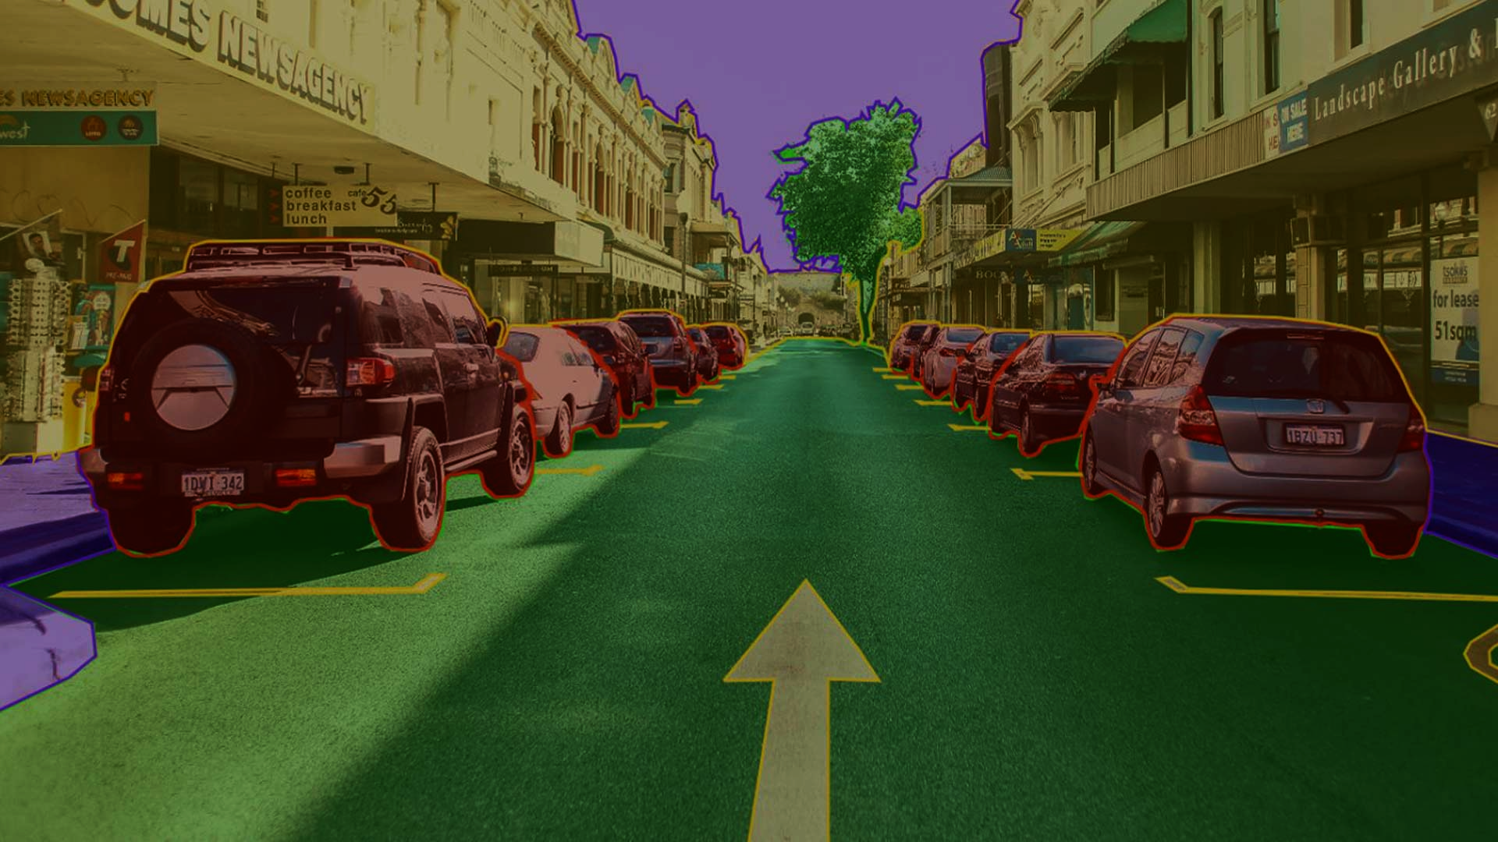
Notes:
So, to motivate our work, street-level imagery has become fundamental to urban informatics, supporting a wild range of research in urban planning, infrastructure monitoring, neighborhood audits, and real estate analytics.

Slide 3
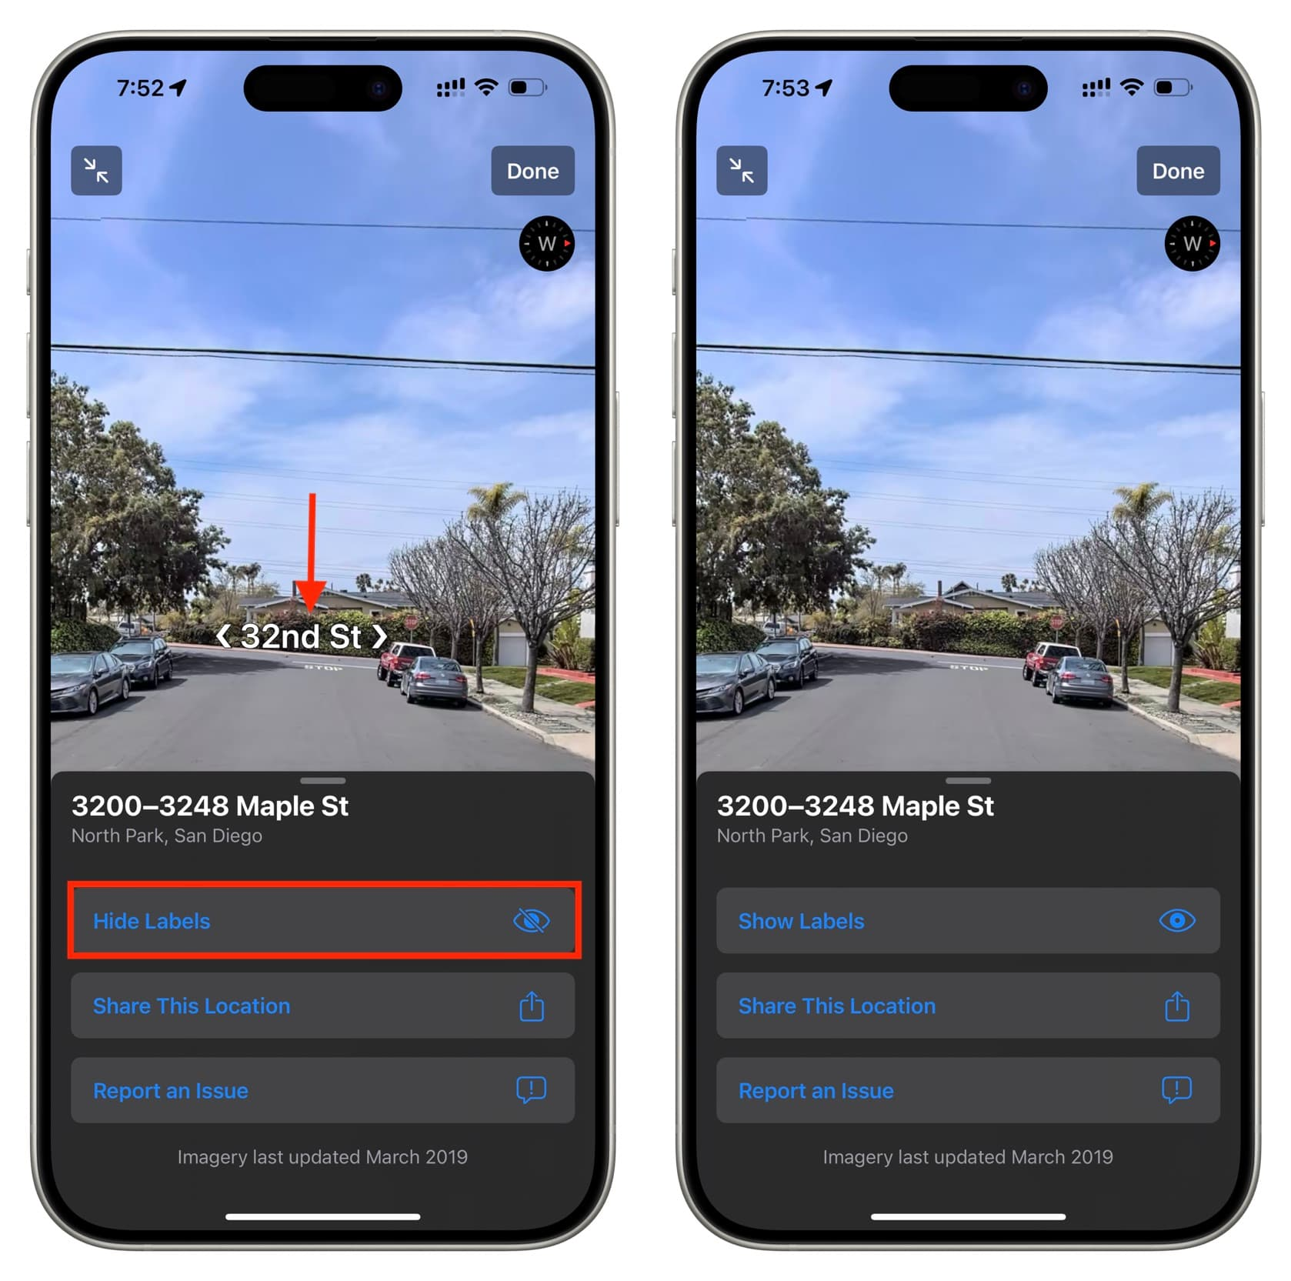
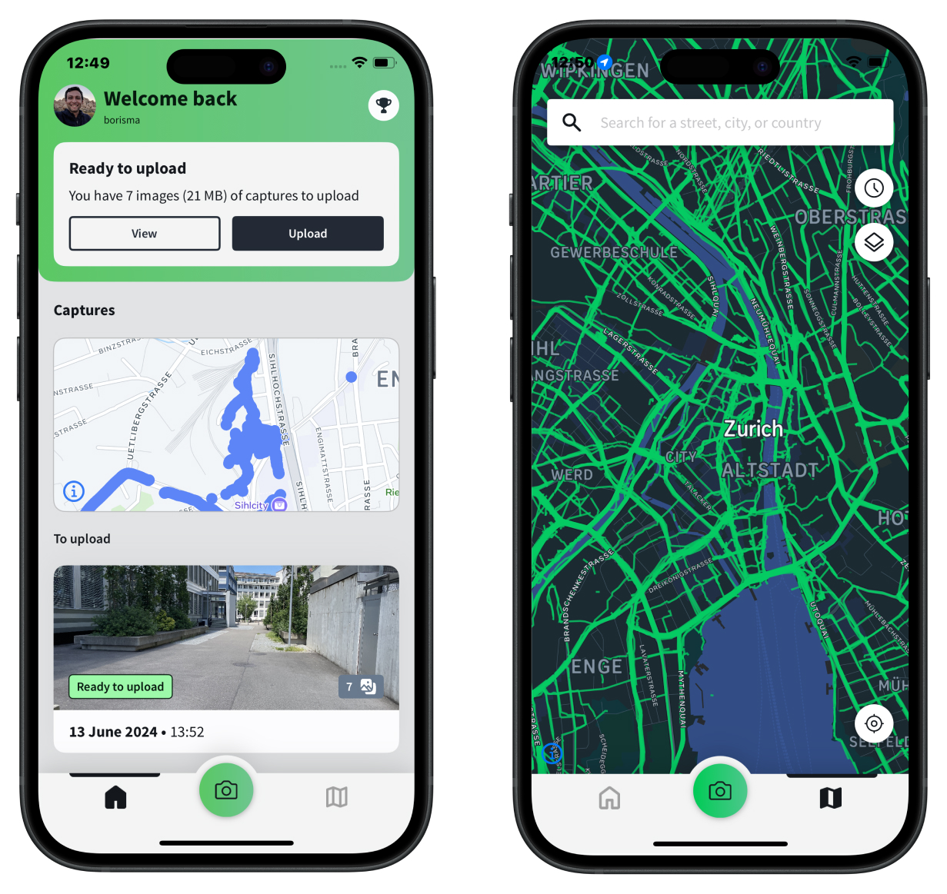
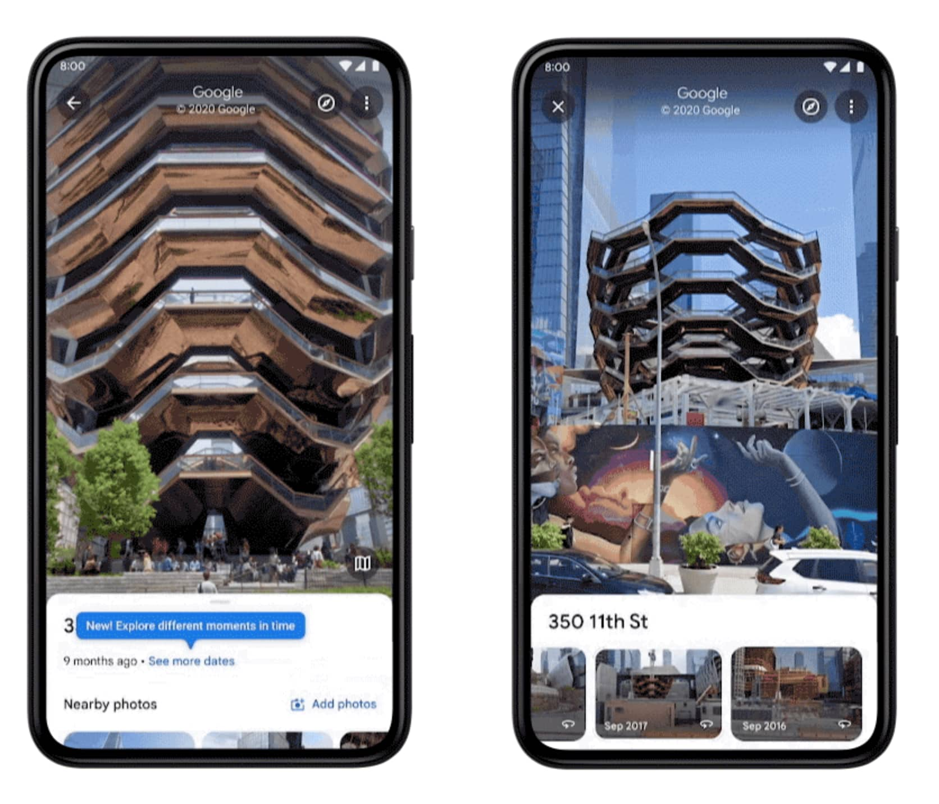



Notes:
These are the major street-level imagery providers across the globe, we have apple lookaround, Meta Mapillary and Google Street View, we also have the provider like Baidu Maps, Kartaview and Grabmaps that provide quality regional services.

Slide 4
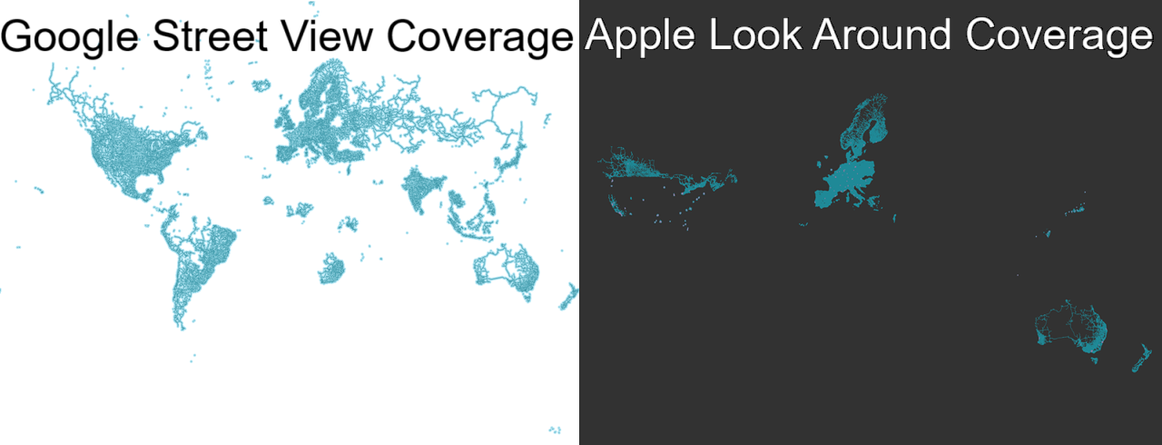
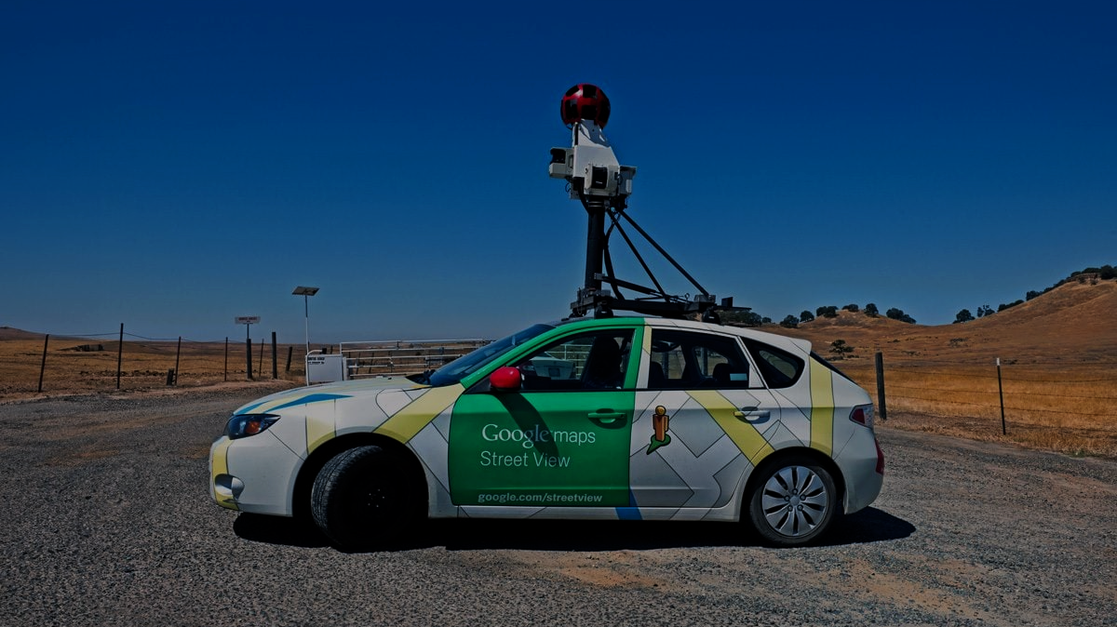
https://brilliantmaps.com/apple-look-around/
Notes:
Among all the major street-level imagery providers we just saw, Google Street View stands out as particularly influential.
With over 220 billion images collected across more than 100 countries, Google Street View offers an incredibly rich and consistent visual record of the world’s built environments.

Slide 5
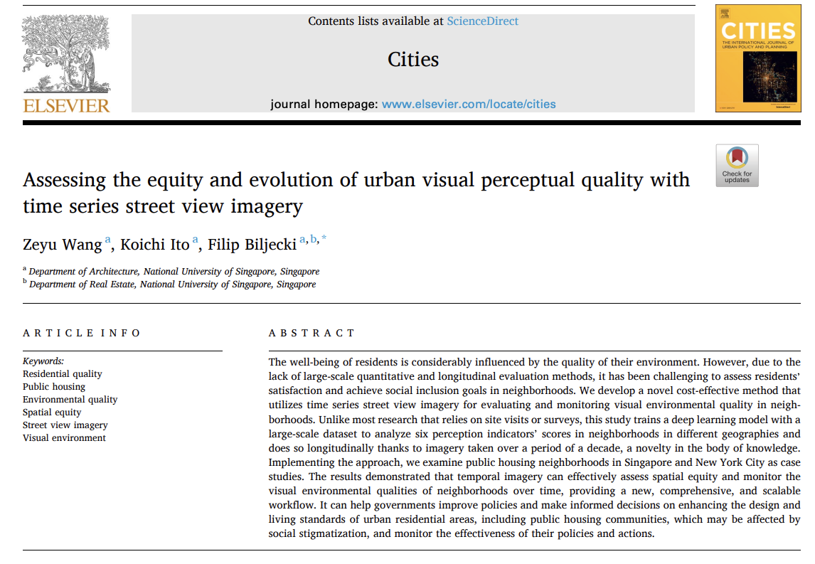
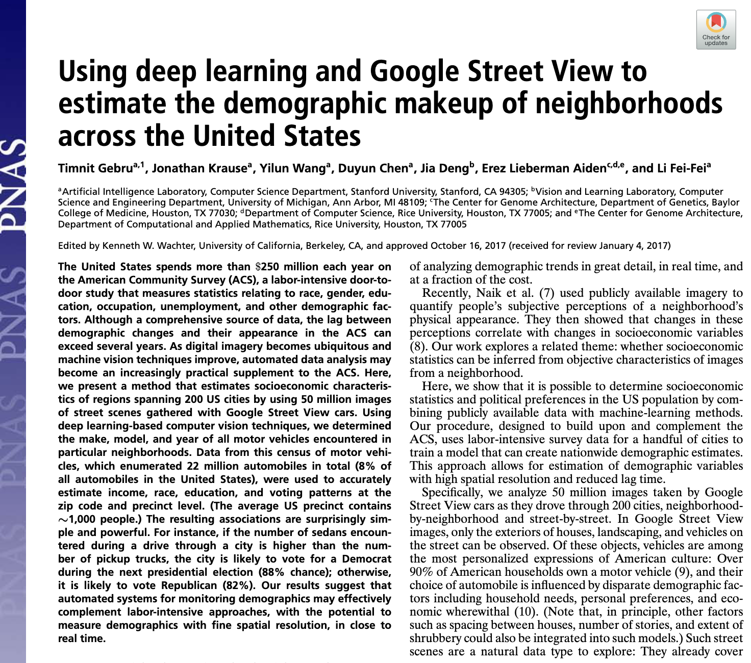
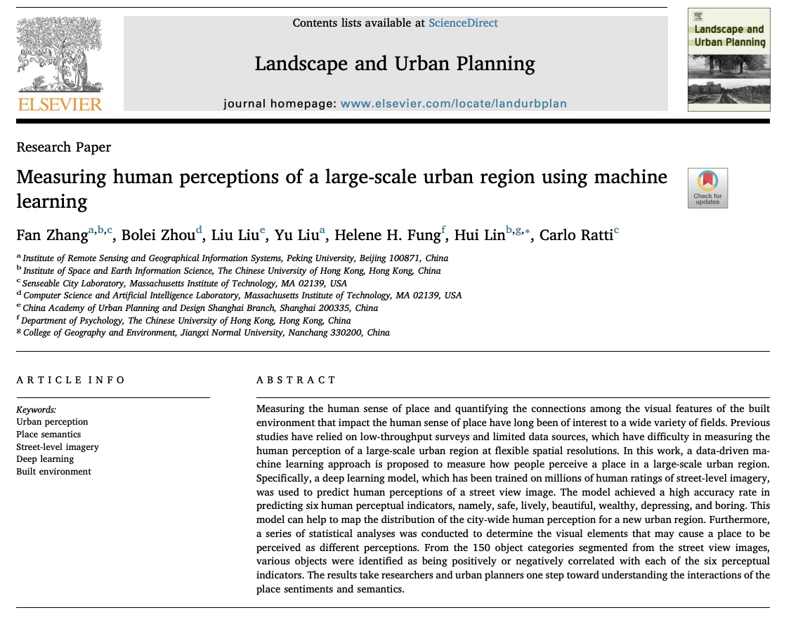
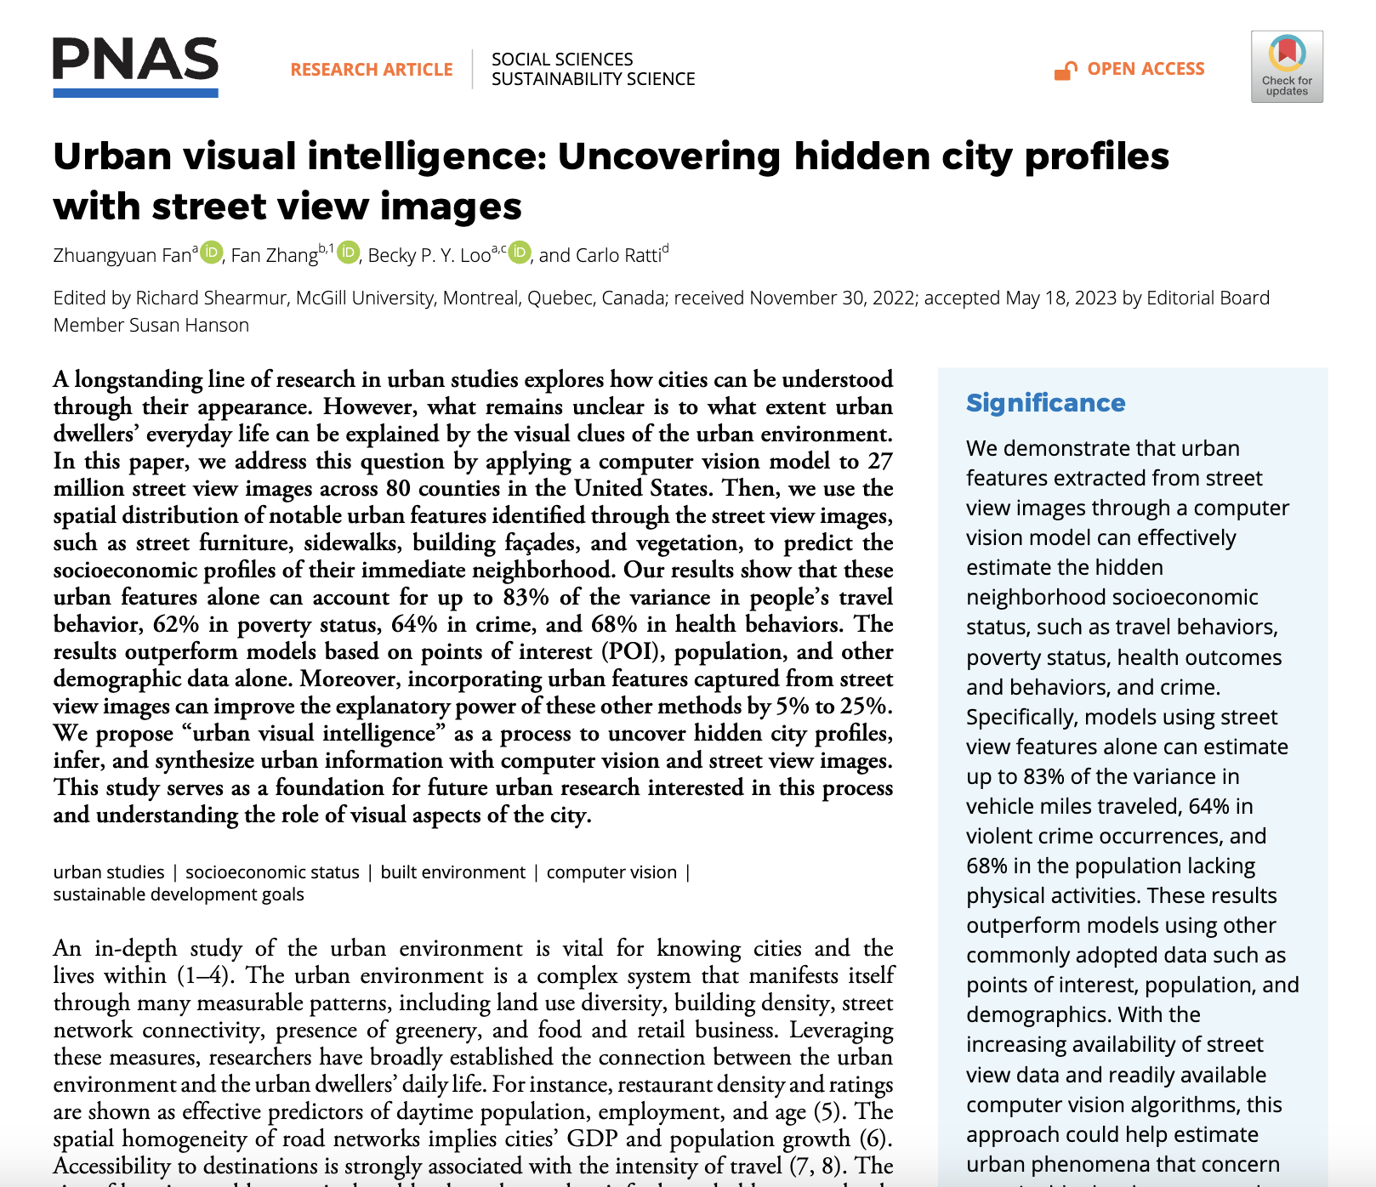
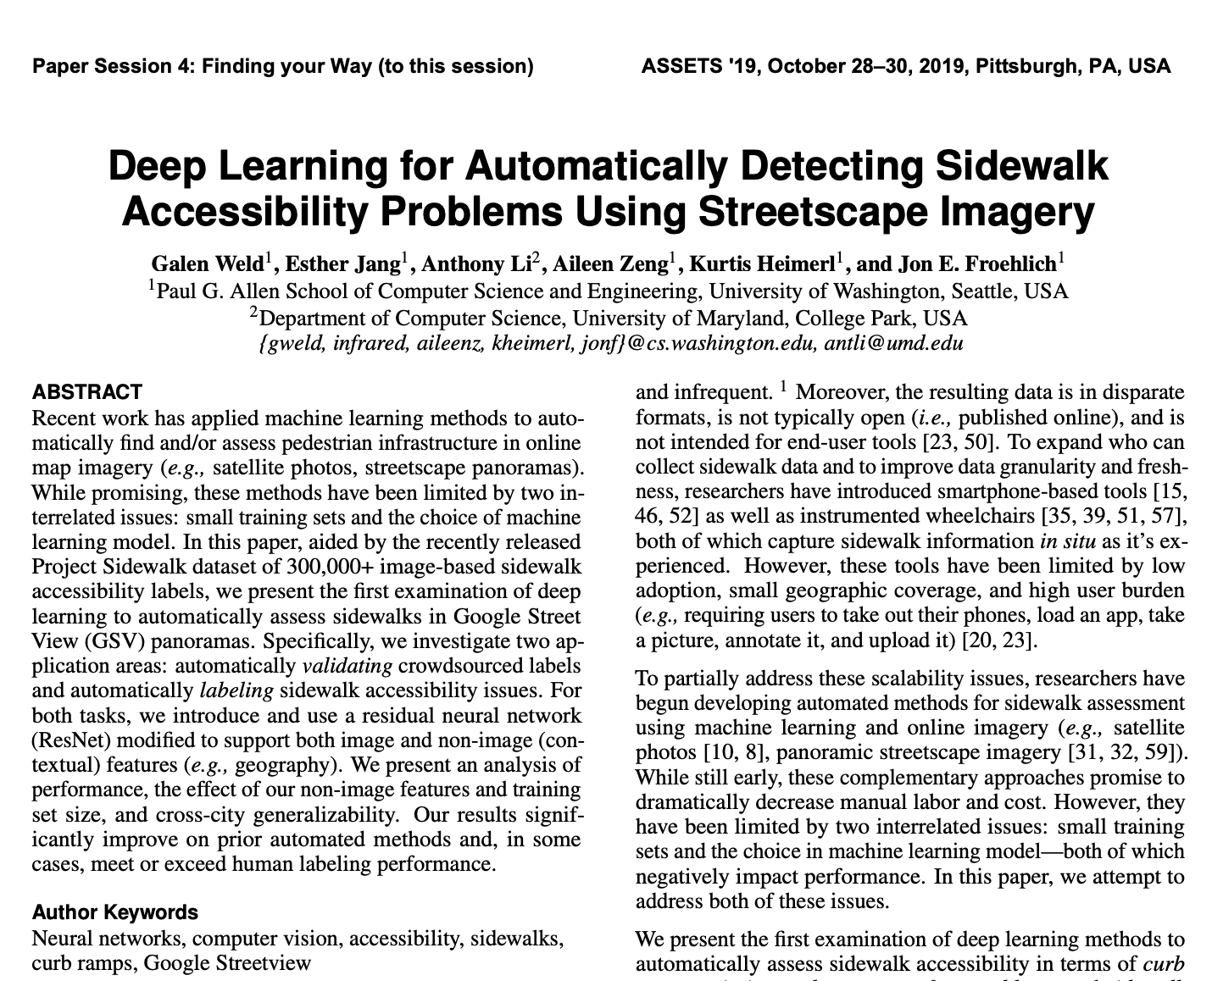
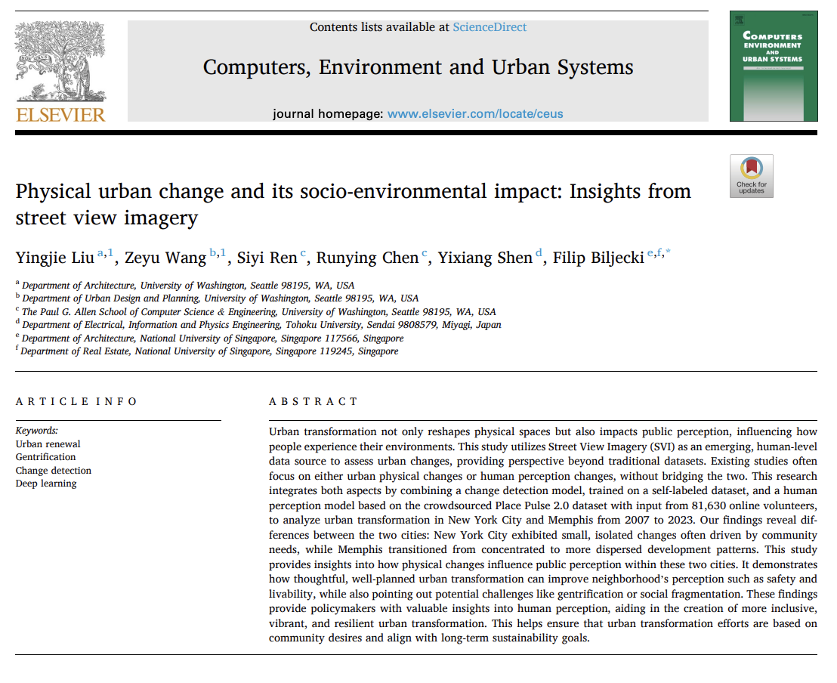
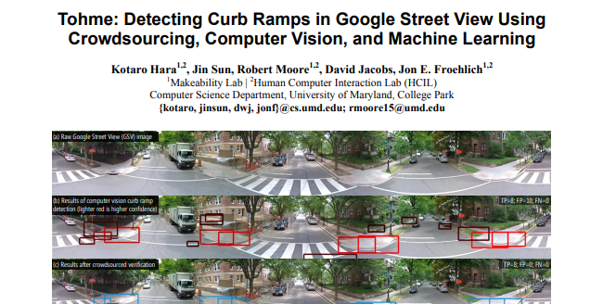
Notes:
Because of its vast geographic coverage and visual richness, GSV has become a key data source for urban research.
Today, researchers across geography, computer science, and urban planning use GSV to sense cities in new ways
— measuring how people see and experience urban spaces,
; auditing streets and infrastructure,
and even uncovering social and demographic patterns
— all from imagery at a massive scale.

Slide 6
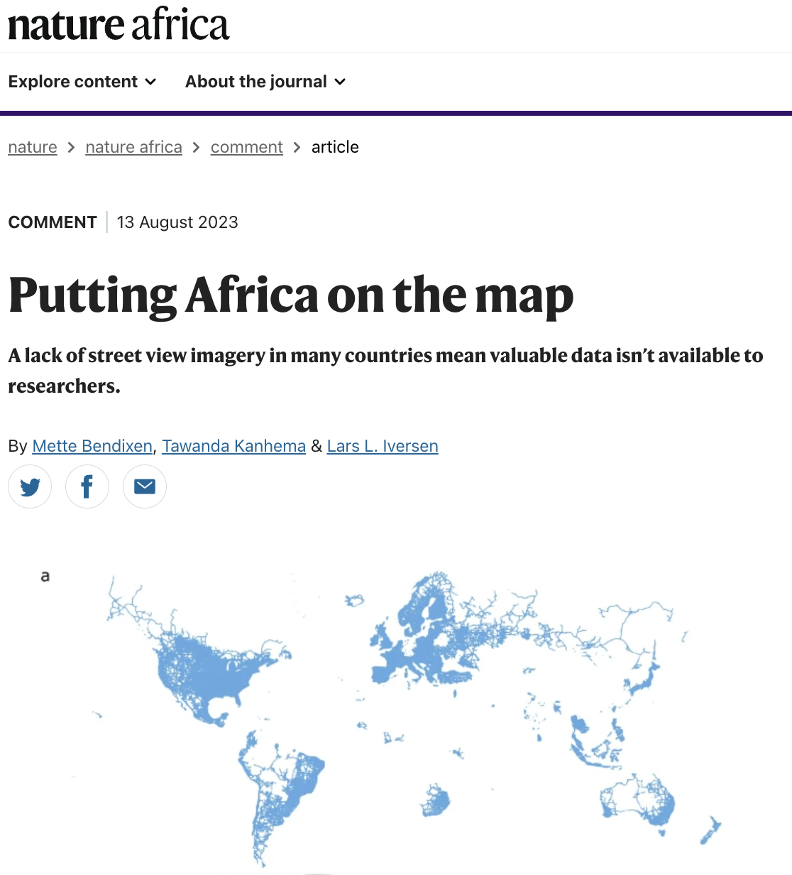
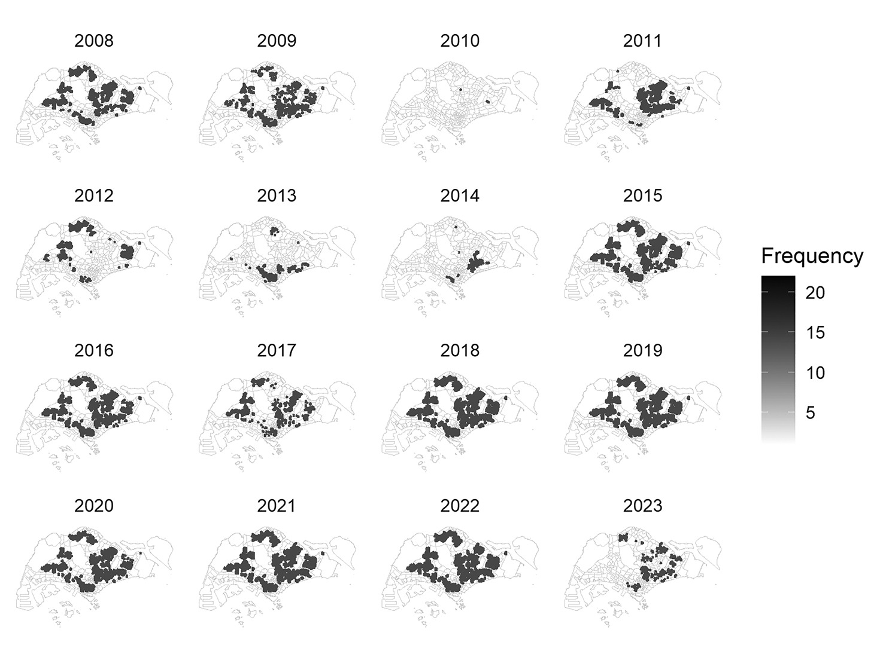
The spatio-temporal distribution of images retrieved from Google Street View in Singapore
Source: Wang, Z., Ito, K., & Biljecki, F. (2024). Assessing the equity and evolution of urban visual perceptual quality with time series street view imagery. Cities, 145, 104704.
Notes:
While Google Street View has been widely adopted and proven incredibly useful for research, it’s not without its limitations.
Coverage remains uneven across the globe — as highlighted many regions in the Global South have little to no imagery available.
So, despite its global reach, the temporal and spatial consistency of Street View data still varies a lot — and that’s an important issue for research that relies on it.

Slide 7
The spatio-temporal distribution of images retrieved from Google Street View in Singapore
Source: Wang, Z., Ito, K., & Biljecki, F. (2024). Assessing the equity and evolution of urban visual perceptual quality with time series street view imagery. Cities, 145, 104704.
Notes:
This uneven pattern becomes even clearer when we look at examples like Singapore, where the imagery update frequency is highly concentrated in specific areas at certain years between 2008 to 2023.
Such disparities may reflect deeper inequalities in the digital representation of urban spaces.
In other words, certain neighborhoods end up being overrepresented, while others fade from the digital map.
This imbalance can bias research outcomes that depend on Street View data and, in turn, influence how we interpret cities or even shape policy decisions.

Slide 8
Notes:
So the gaps are as follows:
First, we lack scalable and reproducible frameworks for integrating standardized demographic data with Street View metadata. [click]
Second, most analyses are limited to specific cities or regions, which prevents broader geographic comparisons. [click]
And finally, we’re missing accessible, interactive tools that allow researchers to explore these spatial representation patterns more transparently.

Slide 9
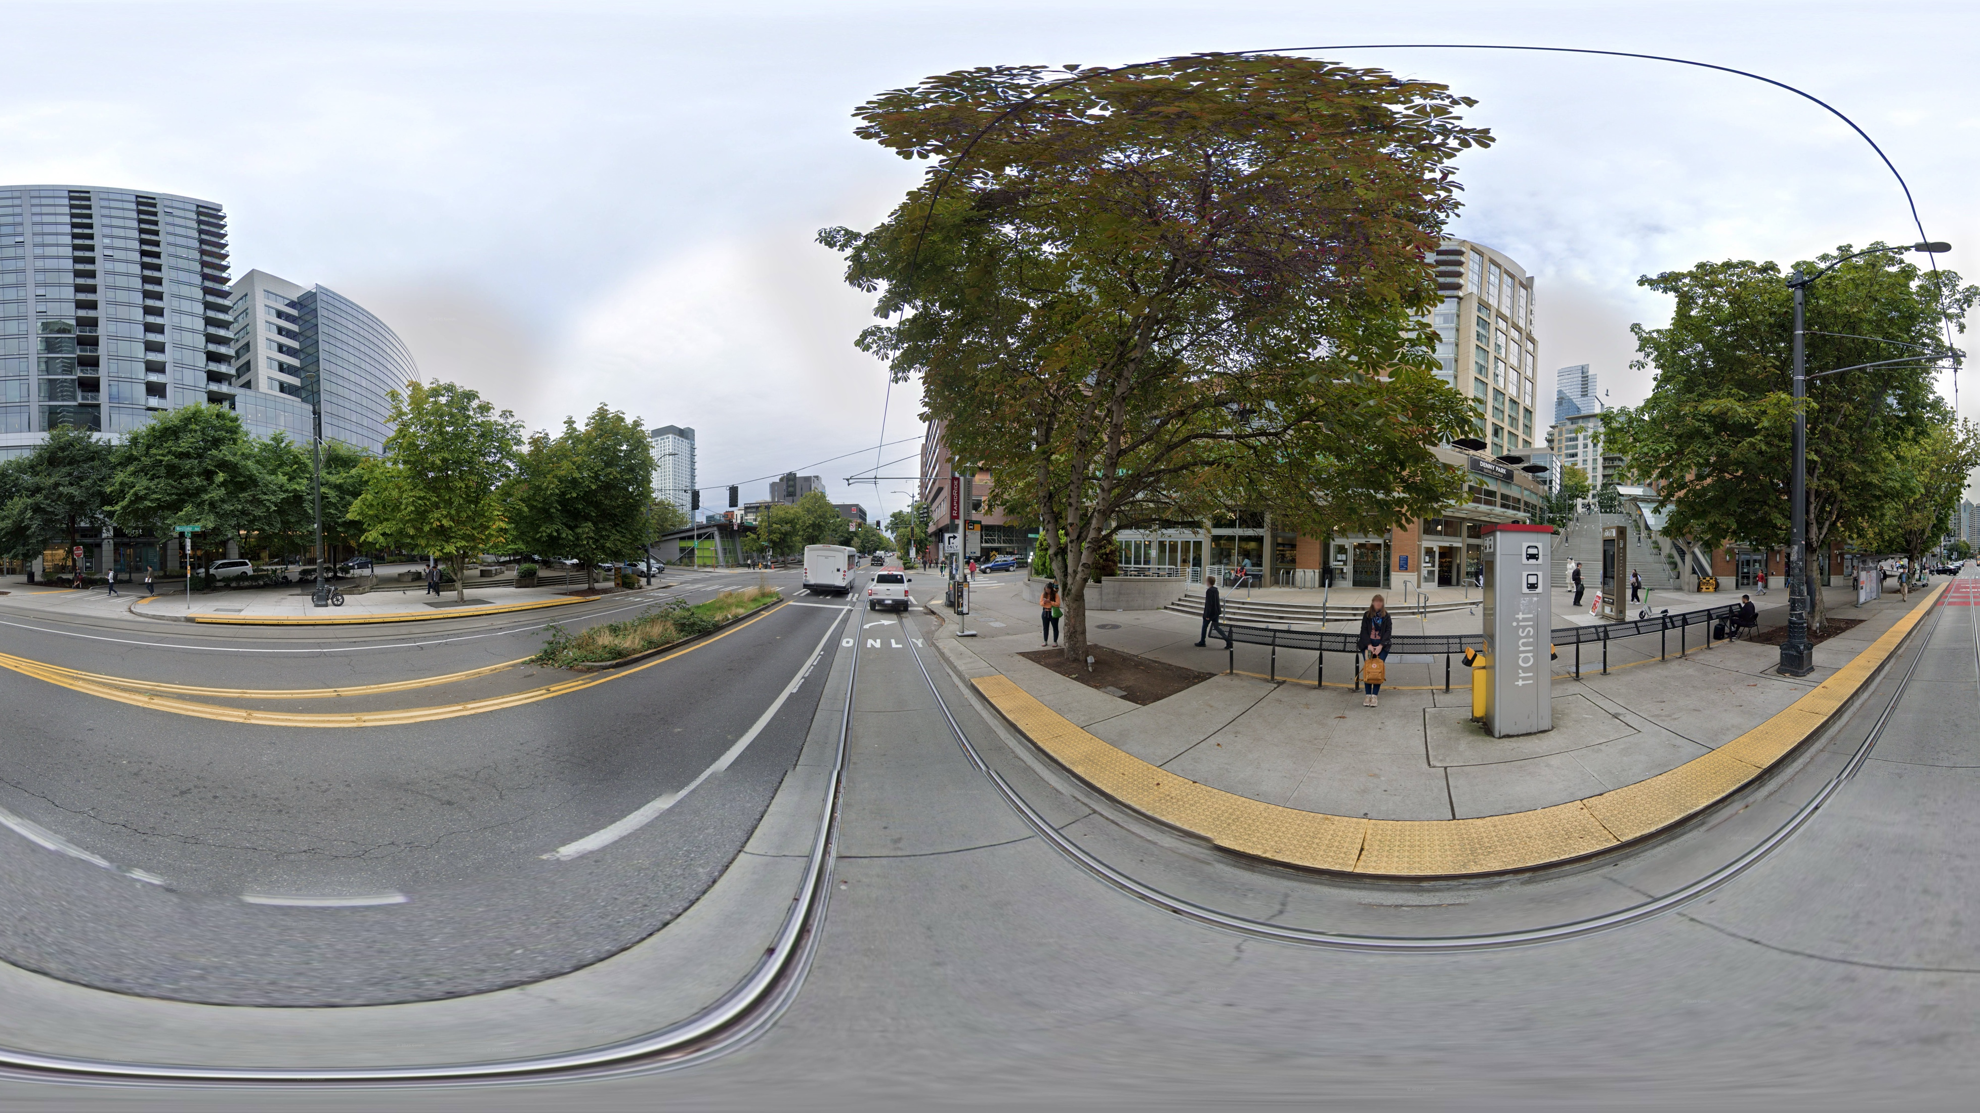
We developed a scalable framework that integrates GSV metadata with standardized ACS data at the census block group level, enabling comparisons across urban contexts while providing an interactive platform for exploration of spatial disparities.
Notes:
To address these gaps, we developed a scalable framework that integrates Google Street View metadata with standardized ACS data at the census block group level. It allows us to compare urban contexts across different cities in a consistent way, helping reveal where and how spatial disparities occur. And to make this process more transparent and accessible, we also built an interactive platform that enables users to explore these spatial patterns and differences directly.

Slide 10
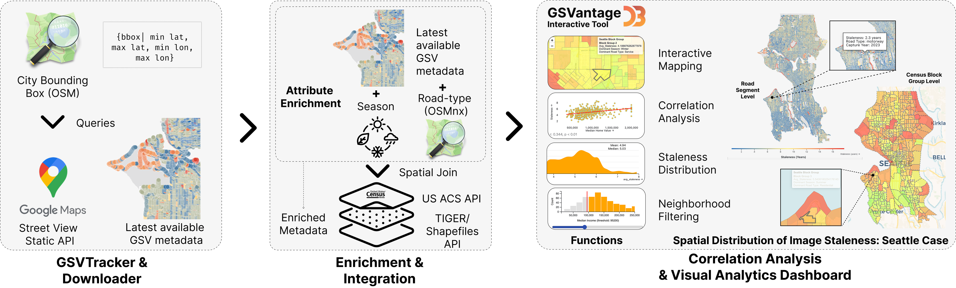
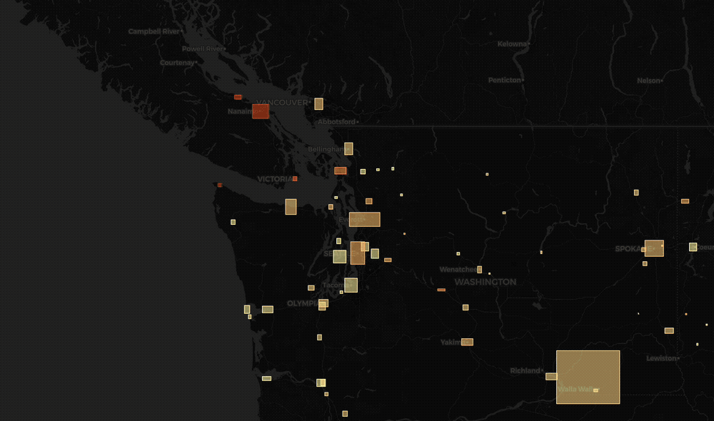
Notes:
Our pipeline begins with Stage 1, the GSVTracker & Downloader.
We define each city’s bounding box using OpenStreetMap and we generate sample points on the road network. At each point, we query the Google Street View Static API to retrieve the latest available panorama metadata—its location and capture date.
Since the API returns only the most recent image, we have adopted the concept of ‘staleness’, the time elapsed since that capture.

Slide 11
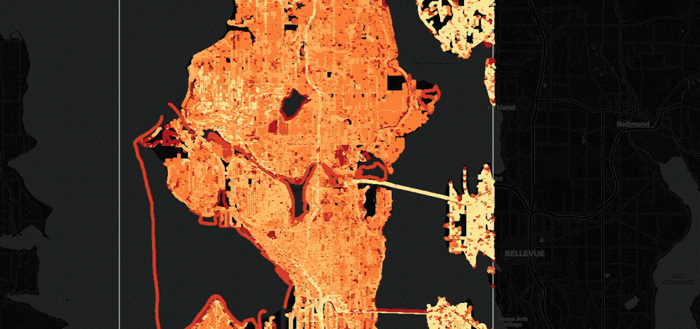
Notes:
In Stage 2, we enrich each panorama with contextual attributes.
Using OSMnx, we add road-type data and infer the season from the timestamp.
We then join each image to its Census block group using TIGER shapefiles and link 2023 ACS variables: income, race, commuting, vehicle ownership, and housing—through the Census API.
These attributes are then merged by GEOID to produce an enriched dataset of mean staleness, season, and road type at the neighborhood level.

Slide 12
Notes:
Finally, Stage 3 performs the analysis and visualization.
We compute Pearson correlations between socioeconomic variables (X) and image staleness (Y), exclude invalid records, and calculate a consistency score showing how stable each correlation is across the cities.
Results feed into our interactive dashboard – GSVantage, built with Observable, supporting mapping, filtering, and correlation exploration.
Altogether, this open-source pipeline provides a scalable, reproducible framework for assessing digital-visibility disparities across urban neighborhoods.

Slide 13
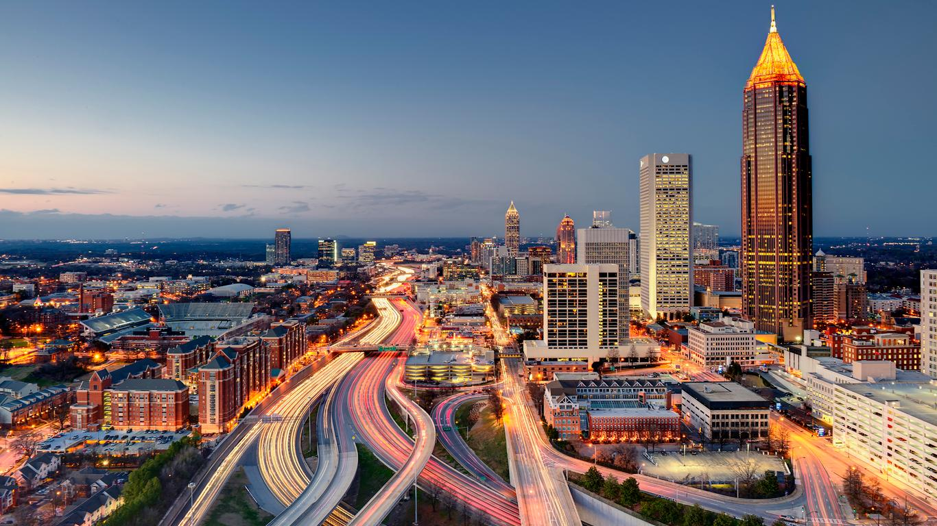

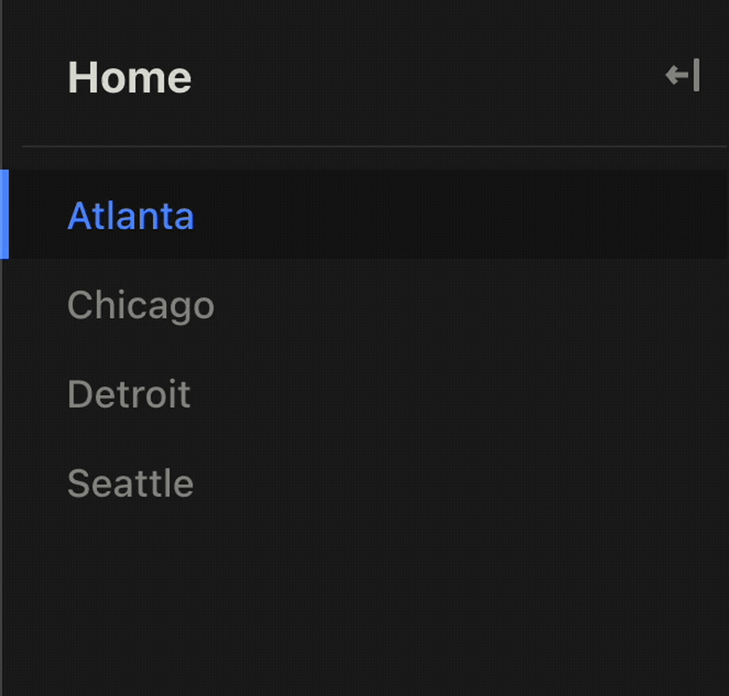


Notes:
Now that the pipeline is established, we move to a demonstration.
Our initial analysis covers four U.S. cities — Atlanta, Chicago, Detroit, and Seattle — chosen to represent diverse urban forms and demographics.
The dashboard allows us to switch easily between these cities.

Slide 14
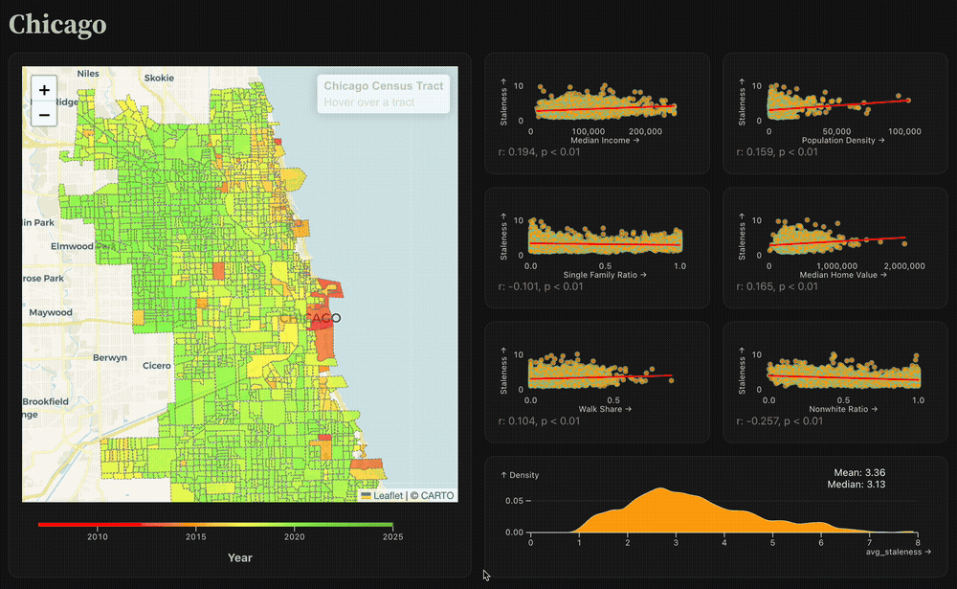
Notes:
Here you see the interactive interface for Chicago.
The map on the left shows the average capture year of Google Street View imagery for each census block group.
On the right, we display distribution plots that relate image staleness to socioeconomic variables such as income, race, and housing value.
This lets us observe how the recency of imagery varies spatially within a city.

Slide 15
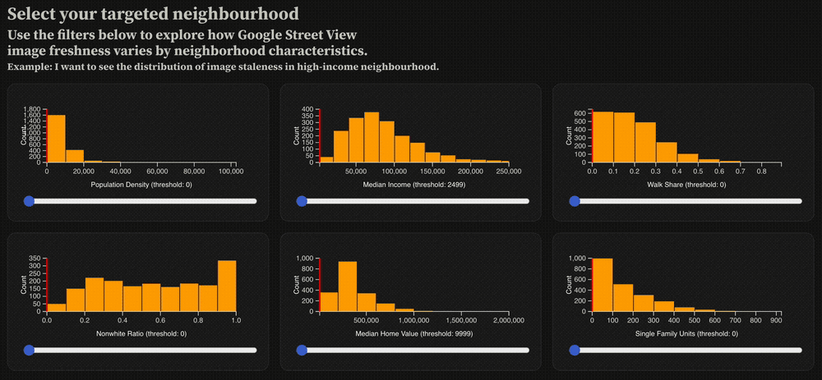
Notes:
The dashboard also includes sliders for filtering neighborhoods by key attributes — for example, focusing on higher-income or denser urban areas.
Users can explore how imagery freshness shifts when isolating these subsets.

Slide 16
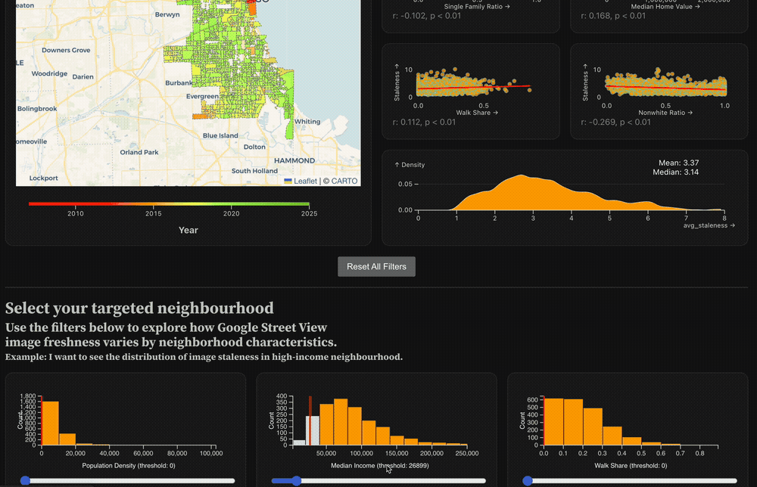
Notes:
As you adjust the sliders, the map and all plots update instantly, showing only the filtered block groups.
It enables intuitive exploration of how digital visibility changes across different neighborhood profiles.

Slide 17
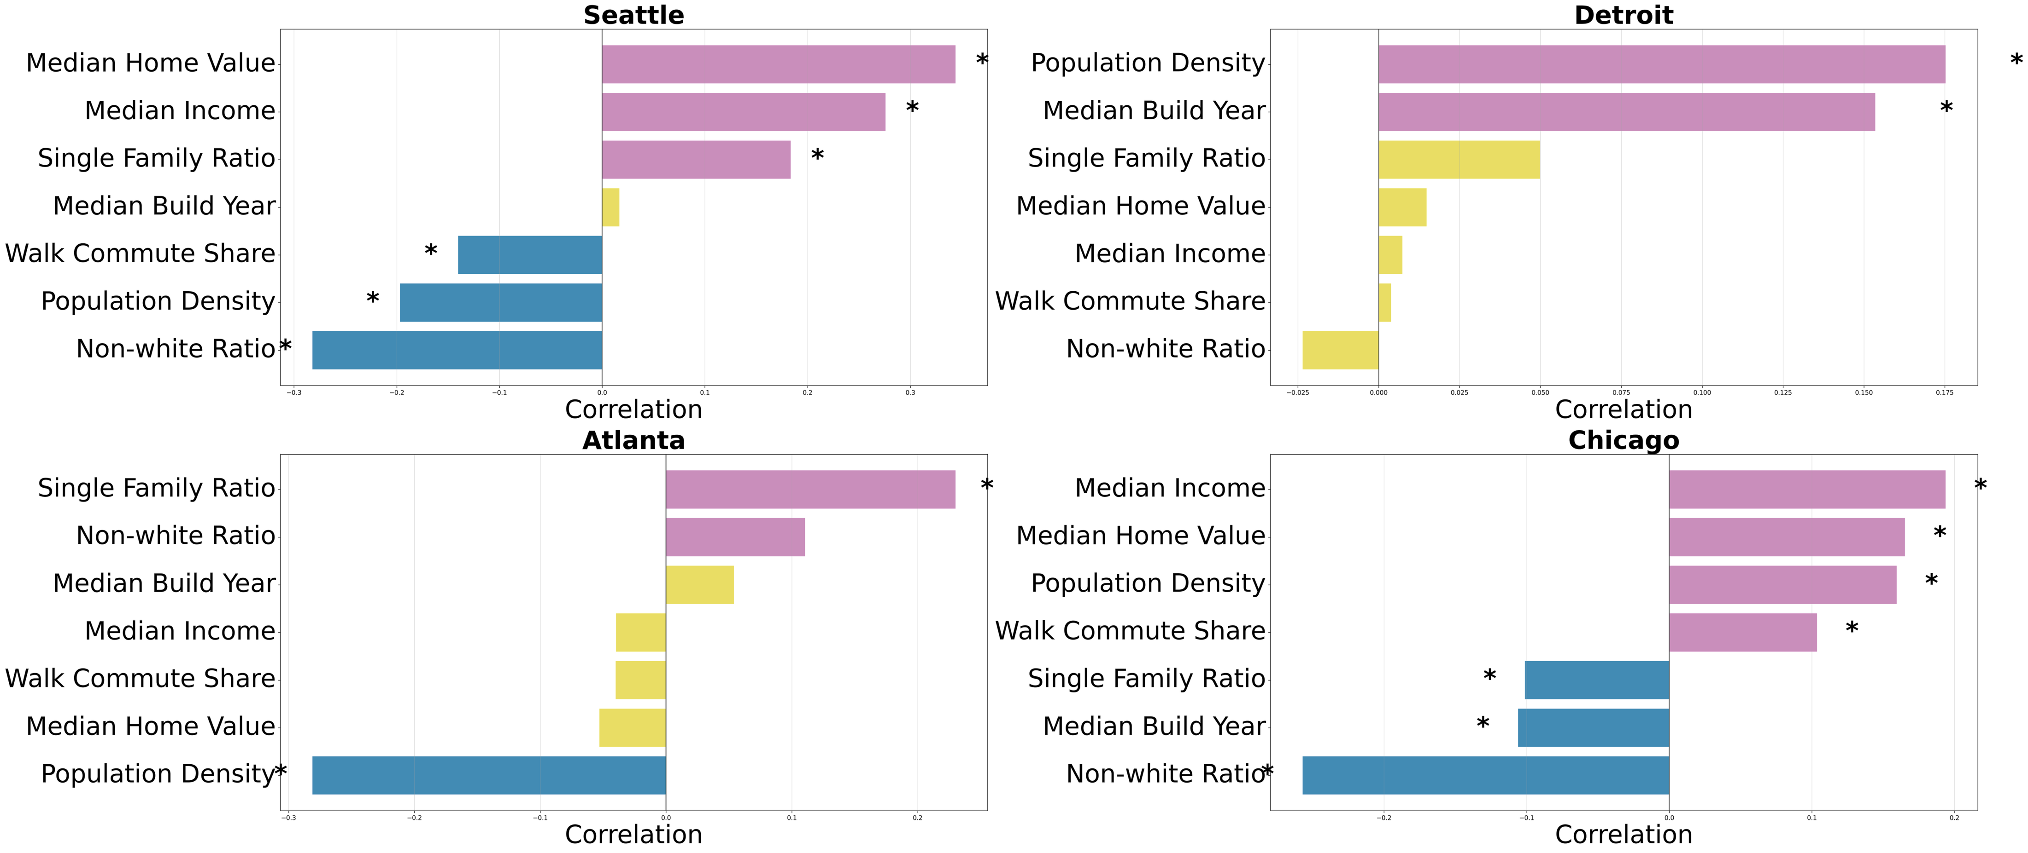
Notes:
Here are the initial result when we looking at all the data from the 4 selected cities. We have gotten enough observations for each city.
Across all four cities, we find similar correlations:
– Median income and home value are positively correlated with image staleness — older imagery.
– Population density and walk commute share are negatively correlated, indicating fresher imagery.
Detroit exhibits slightly weaker or mixed results, but the overall trend is remarkably consistent.

Slide 18
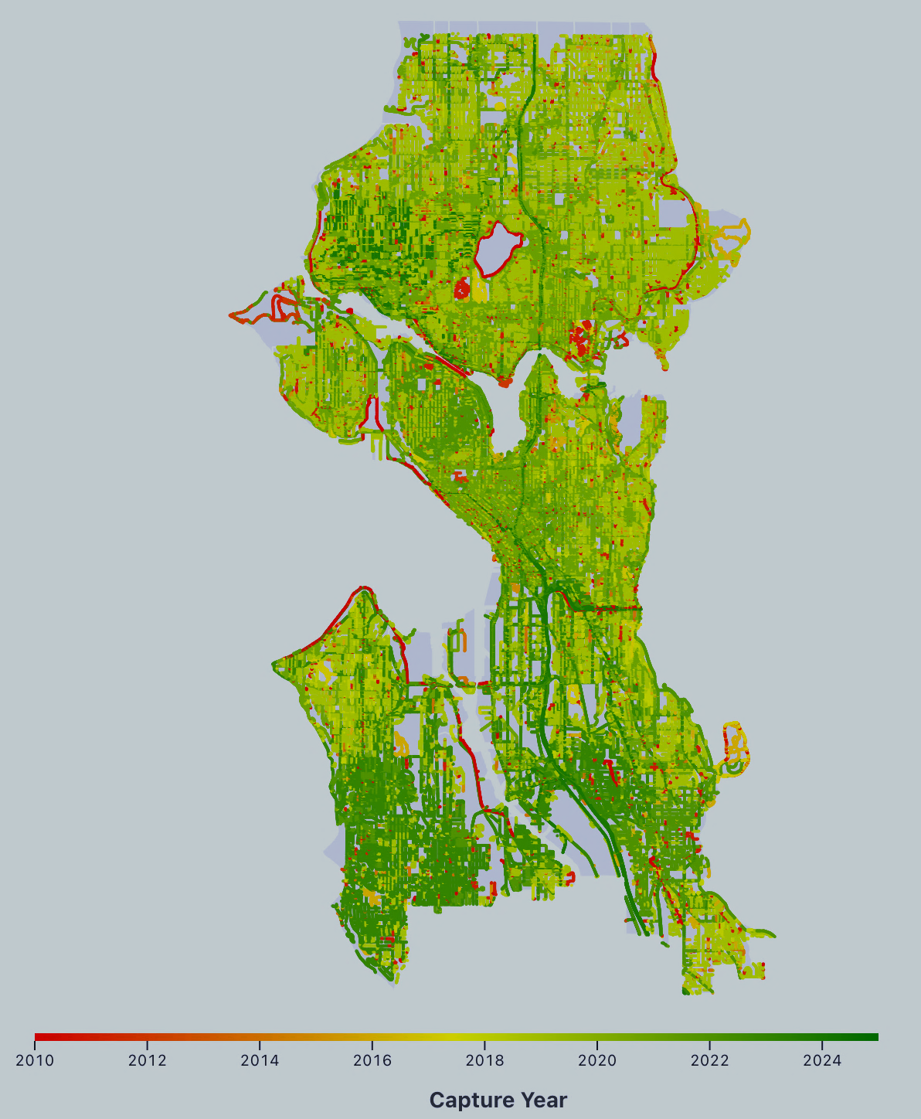
Notes:
From this exploration, we observe a consistent pattern resembling digital redlining.
Here we have included a visualization of the Seattle case, where you can clearly see the latest images, you can get from GSV varies greatly across neighborhood.
Based on the initial examination,
Higher-income, higher-value, suburban, single-family neighborhoods tend to have older imagery,
while denser, pedestrian-oriented, and higher-minority areas receive more frequent updates.
Interestingly, this result is controversial to similar studies that conducted in South America.

Slide 19
Notes:
To conclude, our work makes three key contributions.
First, we provide empirical evidence of spatial inequalities in one of the most widely used sources of street-level imagery—Google Street View. [CLICK]
Second, we introduce an open-source, extensible pipeline that integrates Street View metadata with socioeconomic indicators, allowing replication across diverse cities. [CLICK]
And third, we present an interactive visualization tool that promotes transparency and supports audits of digital equity in visual data coverage.

Slide 20
Notes:
Of course, there are limitations to note.
Spatial dependencies in imagery updates still need more explicit modeling.
Our sample of four cities may introduce selection bias—an expanded set would strengthen generalizability.
And finally, these are correlational findings, not causal proof; our goal is to surface inequities, not to assign intent.
Going forward, we aim to extend this framework to additional cities and integrate temporal modeling to better understand how visual data refresh cycles evolve over time.

Slide 22
Notes:
Hi there! My name’s Zeyu, I’m a PhD student at the University of Washington. This work was done under Makeability lab, where we do a lot of work with accessibility, urban computing and so on.
Today I am really excited to talk to you about our work – Street View for Whom? Which is an initial Examination of Google Street View’s Urban Coverage and Socioeconomic Indicators in the US.
I’ll start by motivating our work, then I’ll discuss the technical pipelines together with some initial findings and finally I’ll conclude by stating contributions and limitations.

