Slide 1
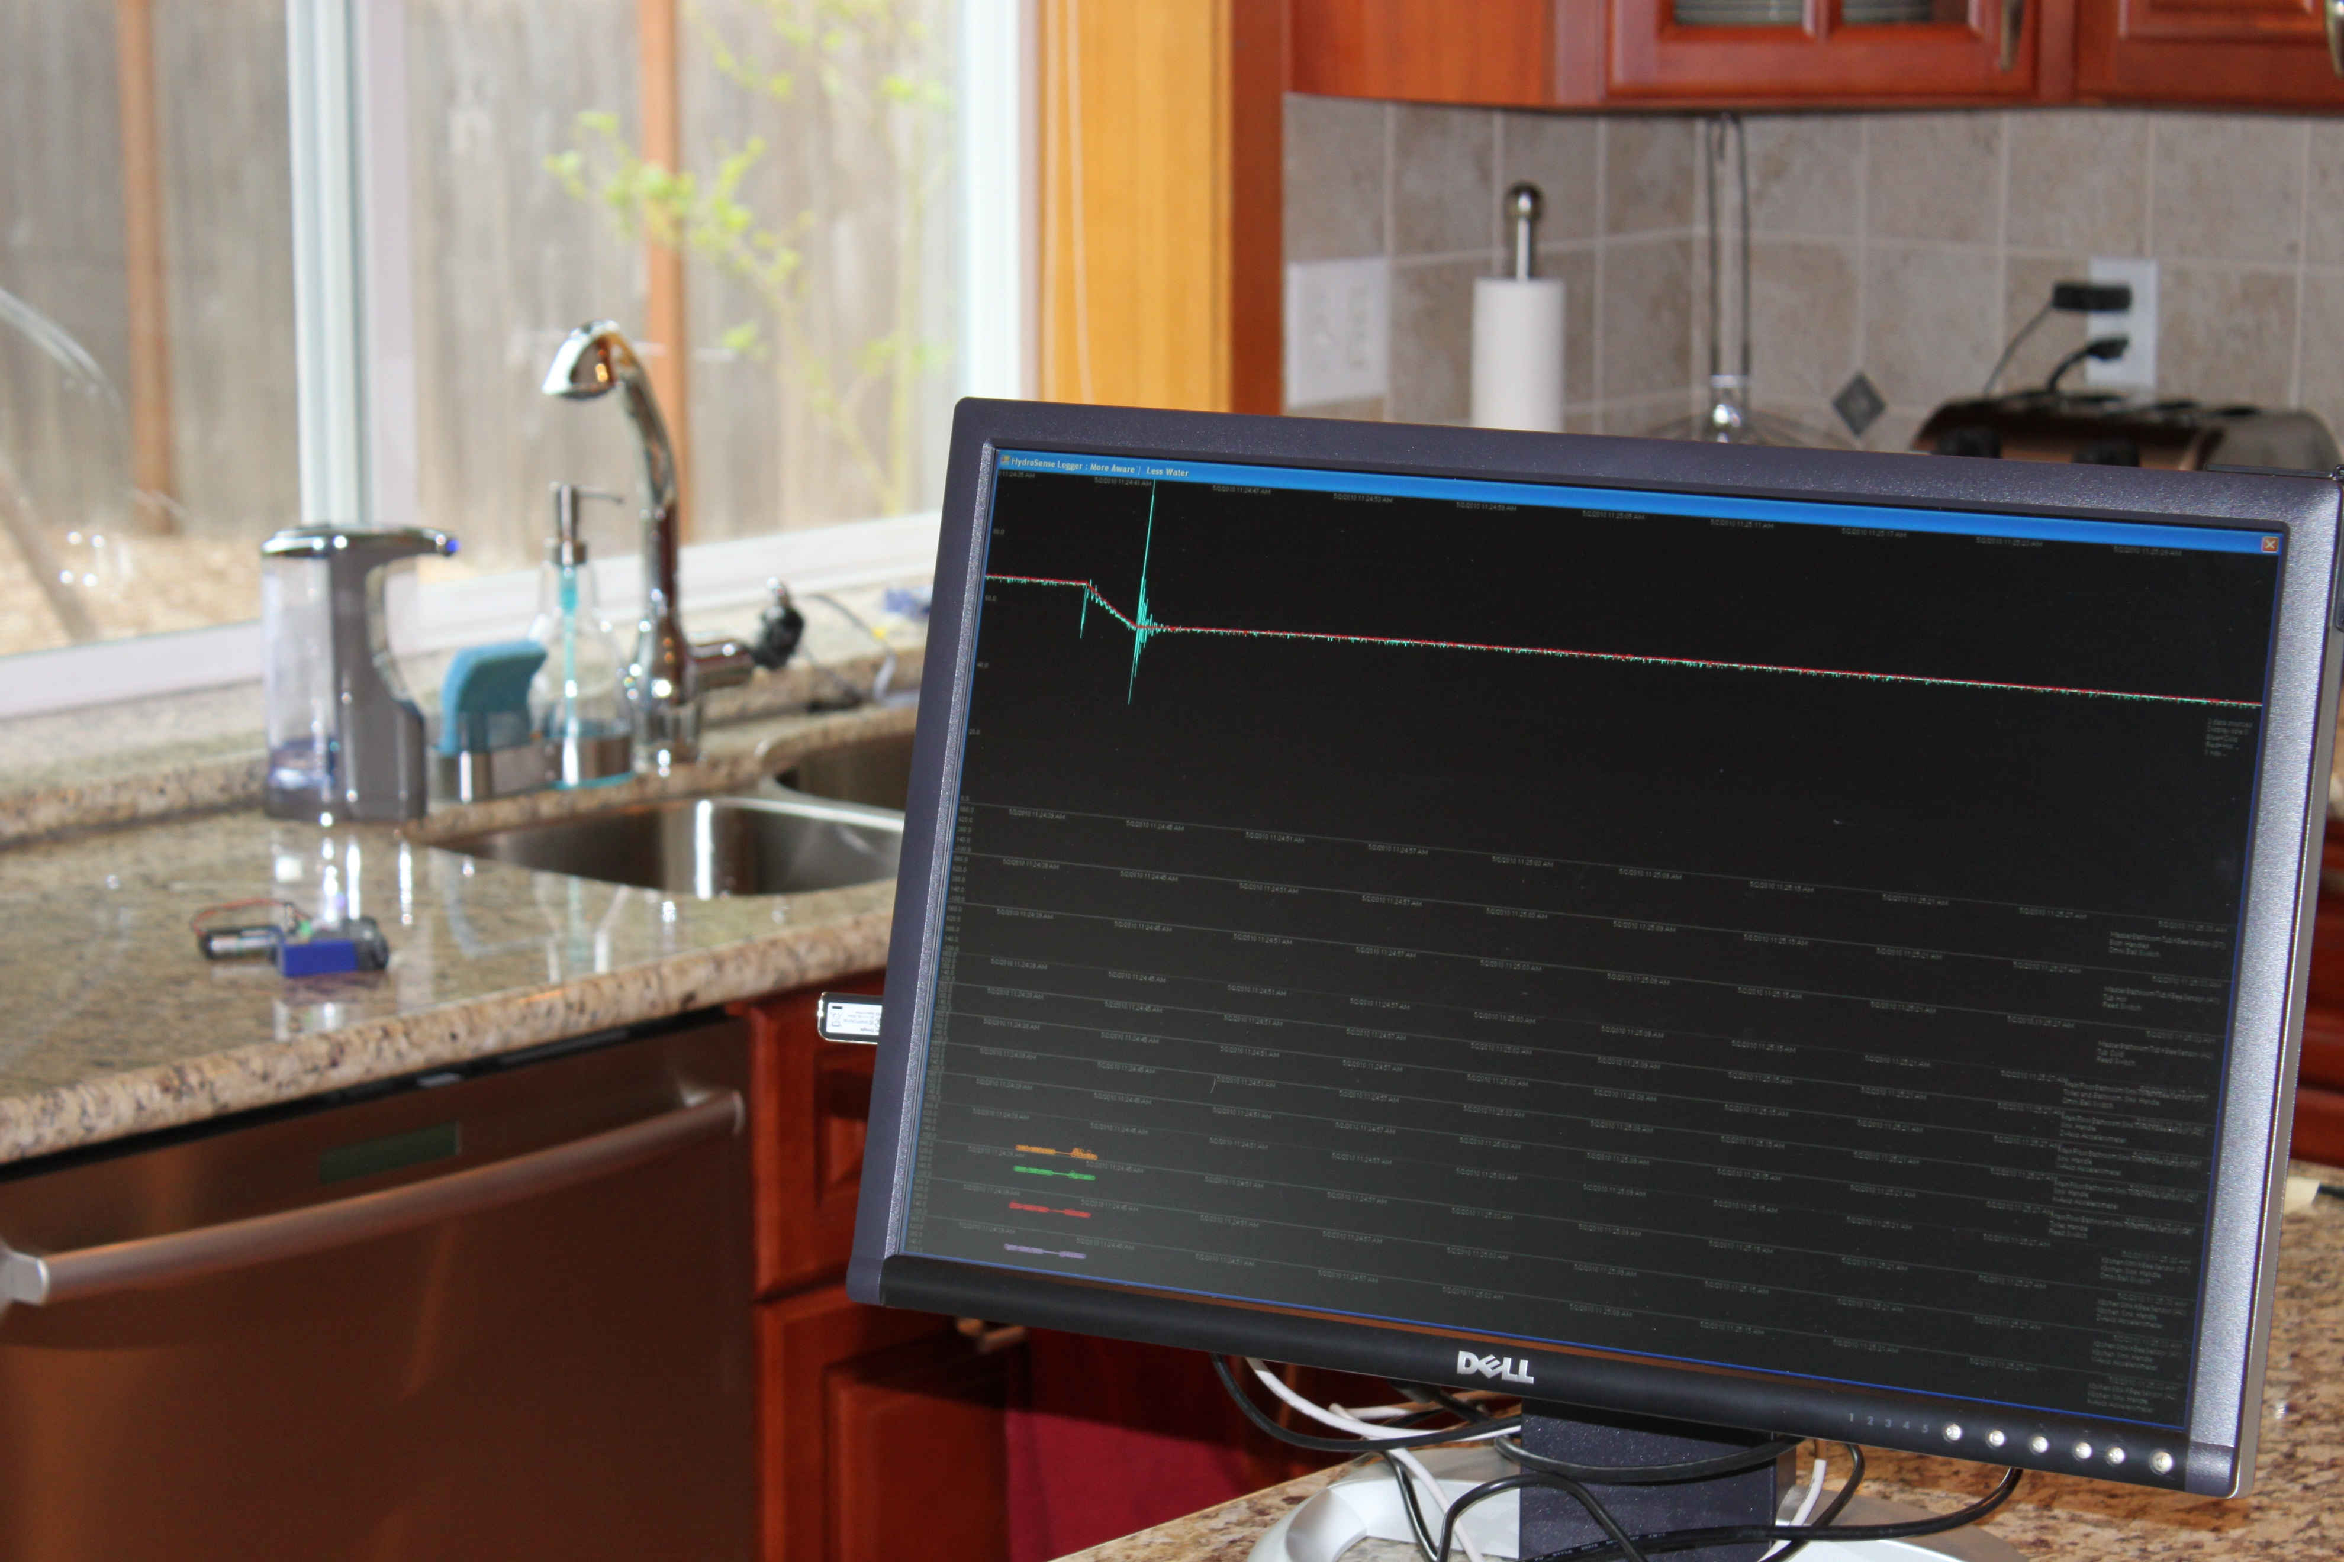
under pressure
transforming the way we think about water in the home
jon froehlich, eric larson, shwetak patel
twitter: @jonfroehlich
dorkbot seattle, oct 27, 2010
design:
ubicomp lab
use:
build:
university of washington
sustainability research
university of washington
Notes:
Under Pressure: Transforming the Way We Think About Water in the Home
Under Pressure is not just one of the greatest musical collaborations of all time, it also the basis for our water sensing research at the University of Washington. In this talk, I will show how with just a single screw-on pressure sensor we can track water usage at each fixture in a home. I will talk about our longitudinal deployments where we directly instrumented water fixtures with accelerometers, reed switches, and hall effect sensors (among others) to collect ground truth data in order to validate our approach. I'll discuss failures as well as successes. I'll close the talk with a discussion about the future of sensing and feedback for environmental behaviors.
Jon is a Microsoft Research Graduate Fellow in Human Computer Interaction (HCI) and Ubiquitous Computing (UbiComp) at the University of Washington advised by Professors James Landay and Shwetak Patel. He was recently selected as the 2010 Student Innovator of the Year at the UW College of Engineering. He takes great inspiration from this.
We hope to see you ther

Slide 2
Movie Removed for Public Posting of Slides
sky soleil performing under pressure by queen & bowie

Slide 6
water pressure

Slide 7
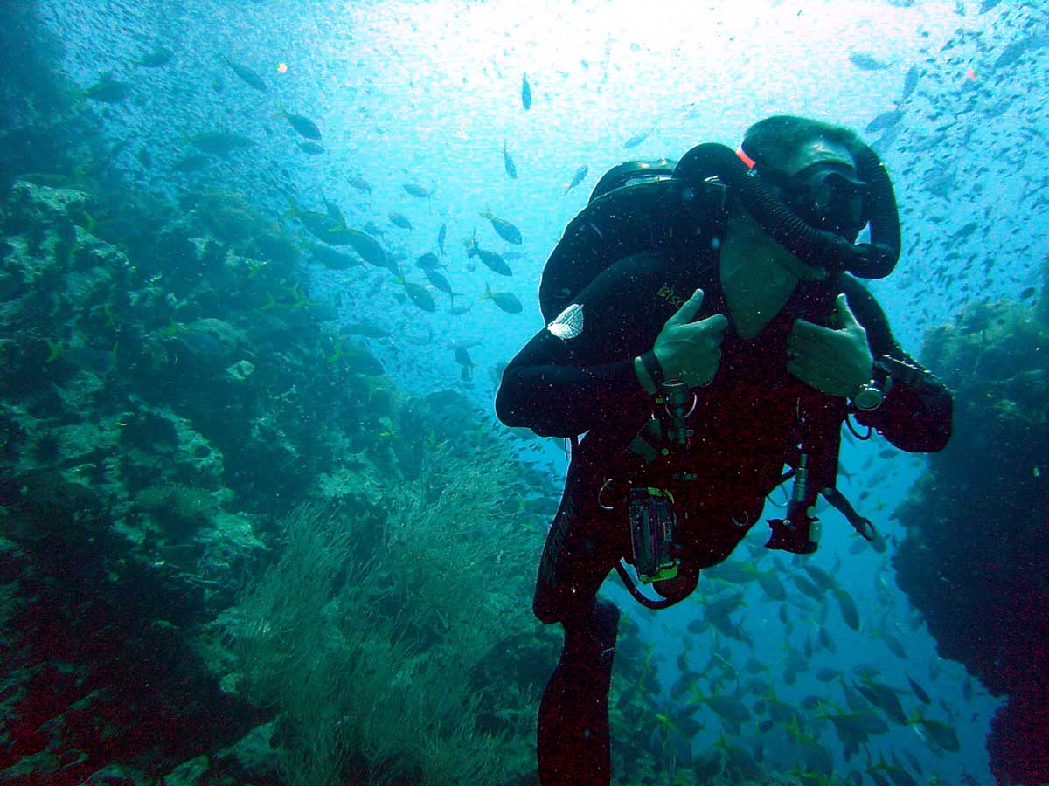
Notes:
I’m not talking about the kind of water pressure that gives you the bends

Slide 8
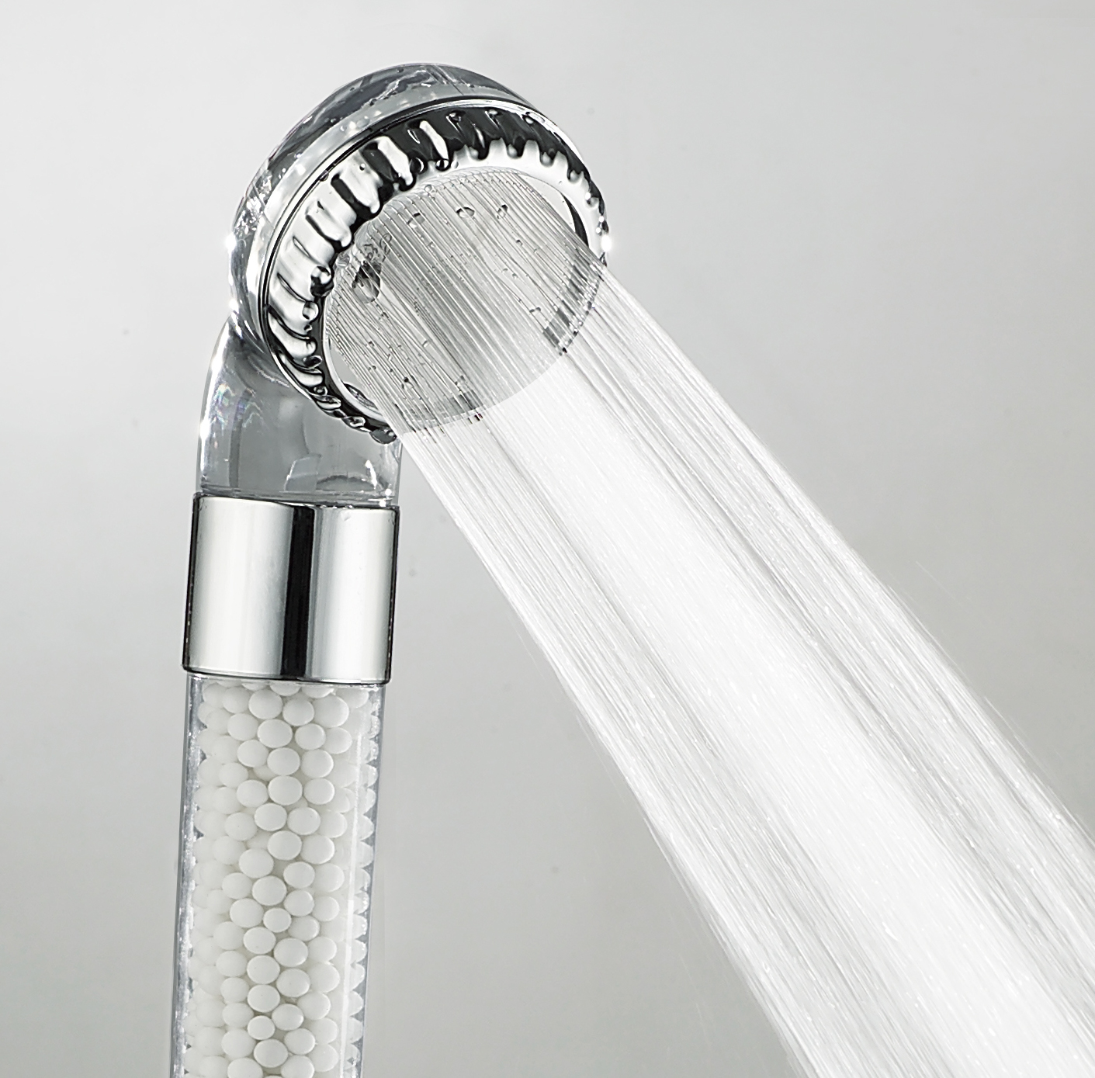
Notes:
But rather the kind that allows you to use water fixtures in your home

Slide 9
what are the most water consuming activities in your home?
Notes:
Most residents have no idea how much water they use nor what the most water consuming activities are in the home.
So, ask yourself, what do you think the most water consuming activities are in your home?
Most people cannot accurately answer this question. We have been working with our local water utility, SPU…
Most customers believe they use 20 gallons a day (Al Dietemann) rather than roughly 70 and have no idea what the top water usage activities in the home.
This is a striking disconnect considering that most of us have used modern plumbing all of our lives.
To close this gap, we have been working on new sensing techniques for water usage
---
According to a recent survey at our local water utility in Seattle, most customers believe they use 20 gallons a day (Al Dietemann) rather than roughly 70.

Slide 10
top indoor water usage activities
Vickers, 2001
Notes:
Most residents have no idea how much water they use nor what the most water consuming activities are in the home.
So, ask yourself, what do you think the most water consuming activities are in your home?
Most people cannot accurately answer this question. We have been working with our local water utility, SPU…
Most customers believe they use 20 gallons a day (Al Dietemann) rather than roughly 70 and have no idea that toilets, clothes washers, and showers are the top water usage activities in the home. This is a striking disconnect considering that most of us have used modern plumbing all of our lives.
To close this gap, we have been working on new sensing techniques for water usage
---
According to a recent survey at our local water utility in Seattle, most customers believe they use 20 gallons a day (Al Dietemann) rather than roughly 70.

Slide 11
one sensor tracks water usage at every fixture
Notes:
Most residents have no idea how much water they use nor what the most water consuming activities are in the home.
So, ask yourself, what do you think the most water consuming activities are in your home?
Most people cannot accurately answer this question. We have been working with our local water utility, SPU…
Most customers believe they use 20 gallons a day (Al Dietemann) rather than roughly 70 and have no idea what the top water usage activities in the home.
This is a striking disconnect considering that most of us have used modern plumbing all of our lives.
To close this gap, we have been working on new sensing techniques for water usage
---
According to a recent survey at our local water utility in Seattle, most customers believe they use 20 gallons a day (Al Dietemann) rather than roughly 70.

Slide 12
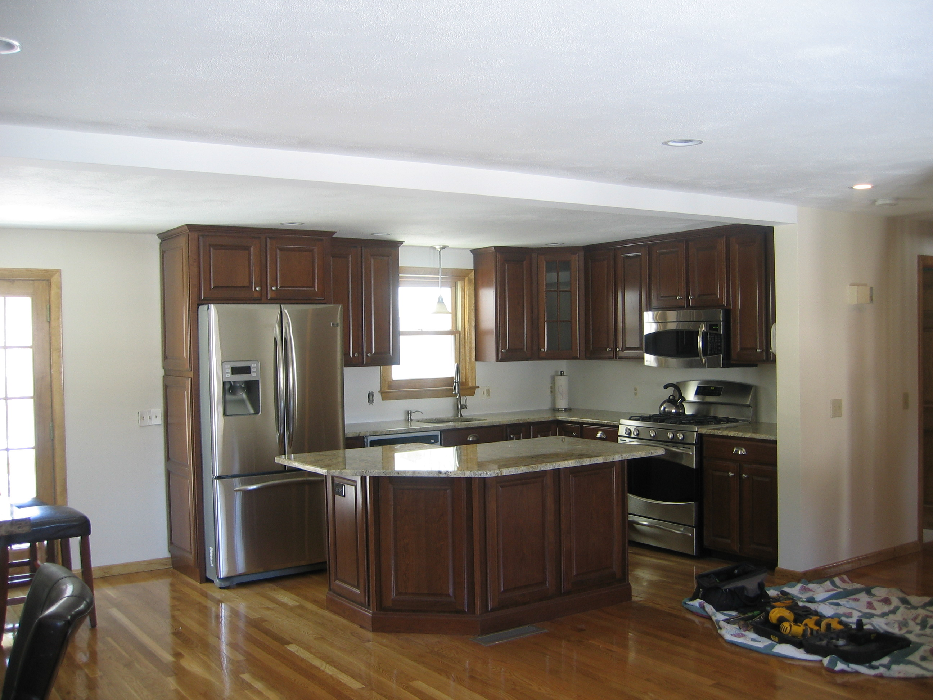
today‘s usage
refrigerator 0.3 gallons
kitchen sink
28 gallons
dishwasher
6.5 gallons

Slide 13
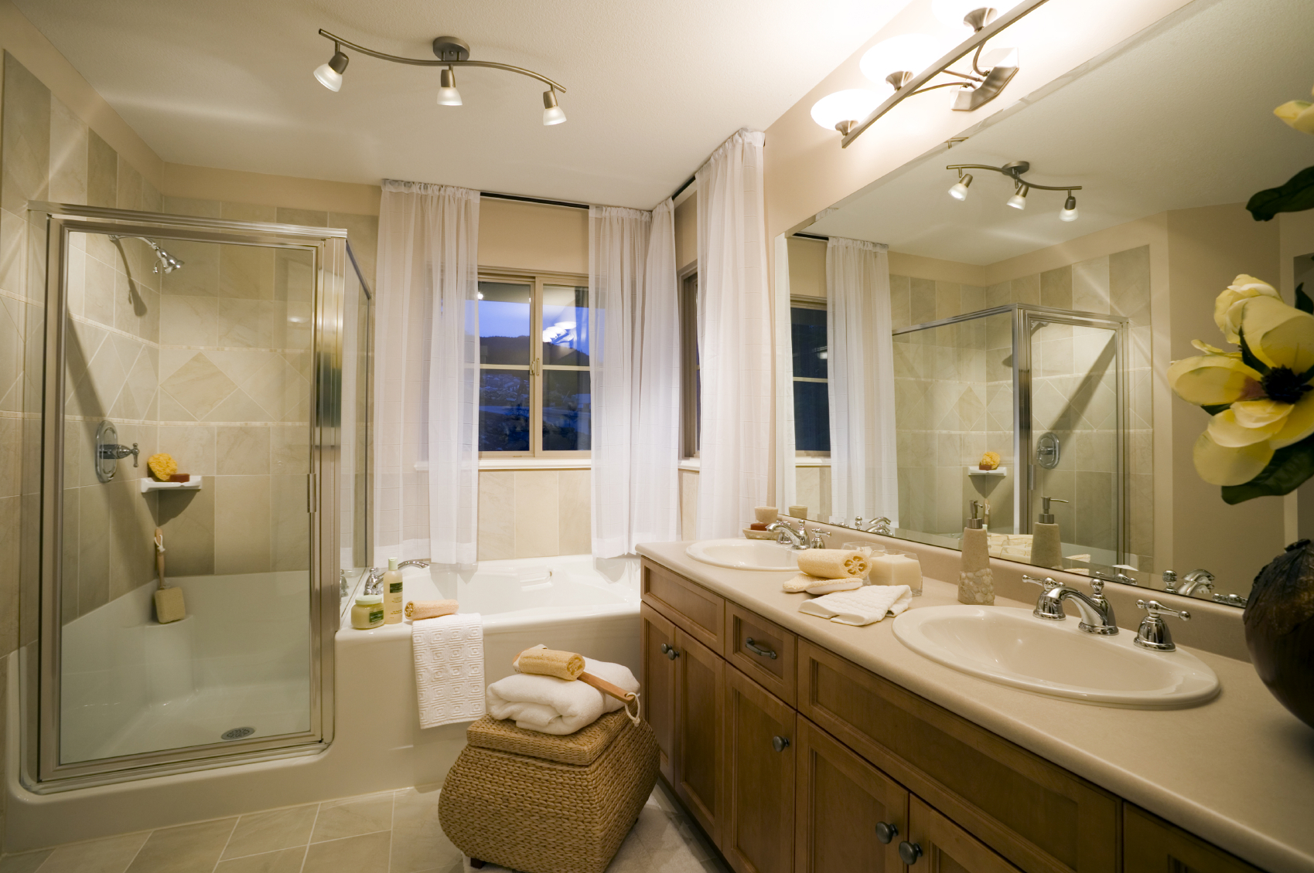
today‘s usage
shower 62.4 gallons
bathroom sink 1 4.2 gallons
bathroom sink 2 0.8 gallons
bath
6.5 gallons
toilet
78.4 gallons

Slide 14
today‘s usage: hot vs cold
shower 52.4 gallons
shower 10.4 gallons
bathroom sink 1 3.2 gallons
bathroom sink 1 1.2 gallons
bathroom sink 2 0.8 gallons
bath
6.5 gallons
bath
0.0 gallons
bathroom sink 2 2.4 gallons
toilet
78.4 gallons

Slide 15
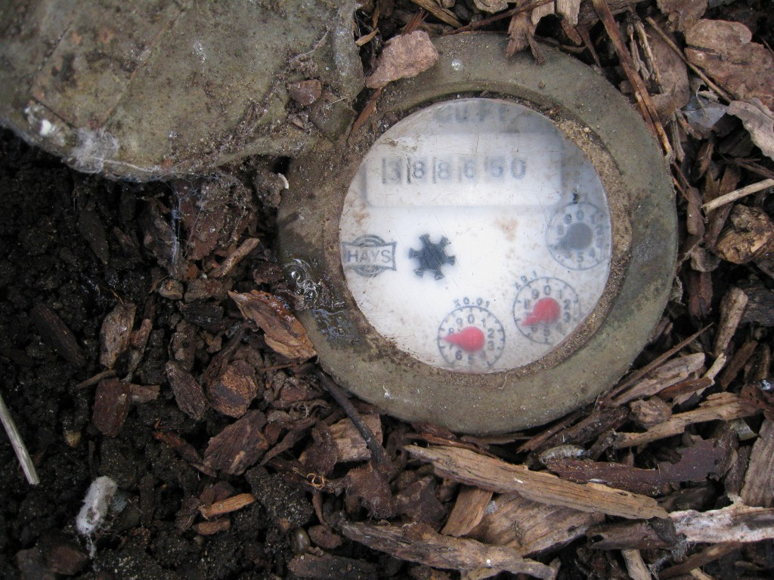
water meter

Slide 16
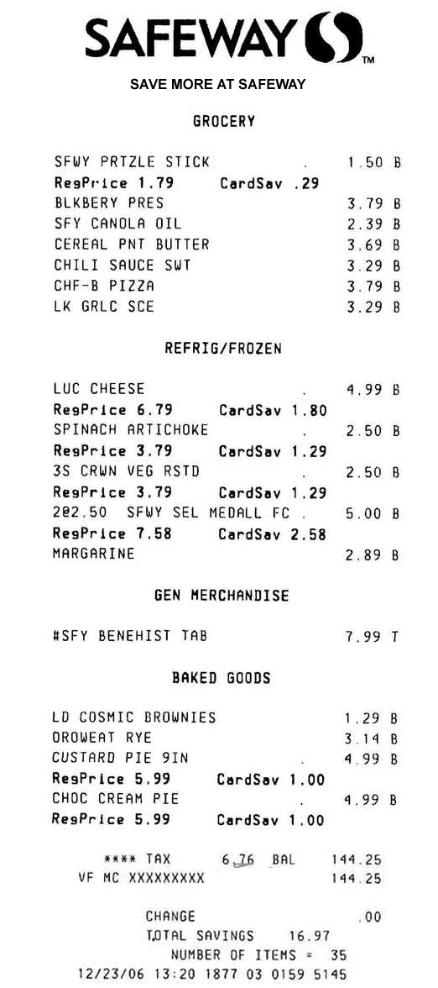
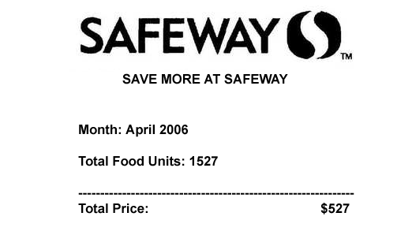

Slide 17
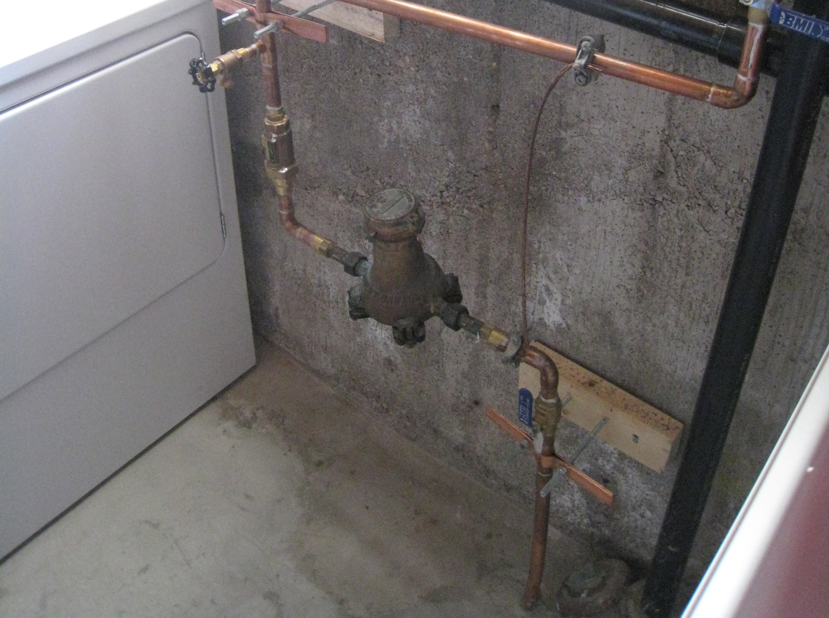
traditional inline
water meter
Notes:
Typical water meters only provide aggregate information on water usage and require costly pipe modifications to install. (click)
In constrast, the HydroSensor can simply screws on to a hose water bib.

Slide 18
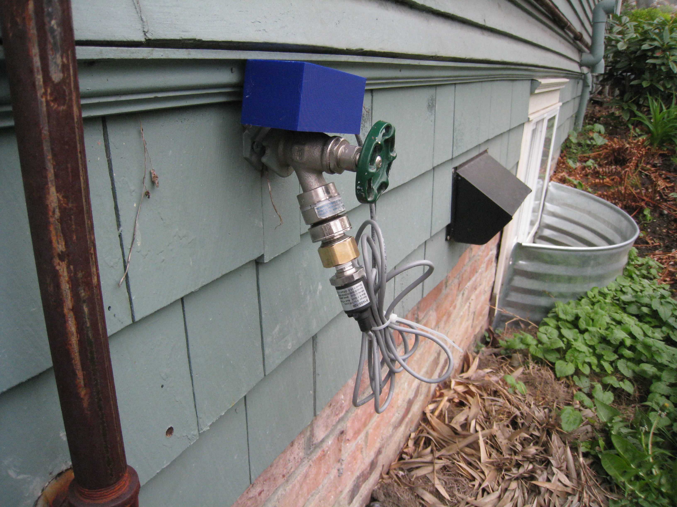
hydrosense
3d printed enclosure adc, microcontroller & bluetooth module
water turned on
pressure sensor
pace scientific p1600

Slide 19
brief plumbing tutorial

Slide 20
brief plumbing tutorial

Slide 21
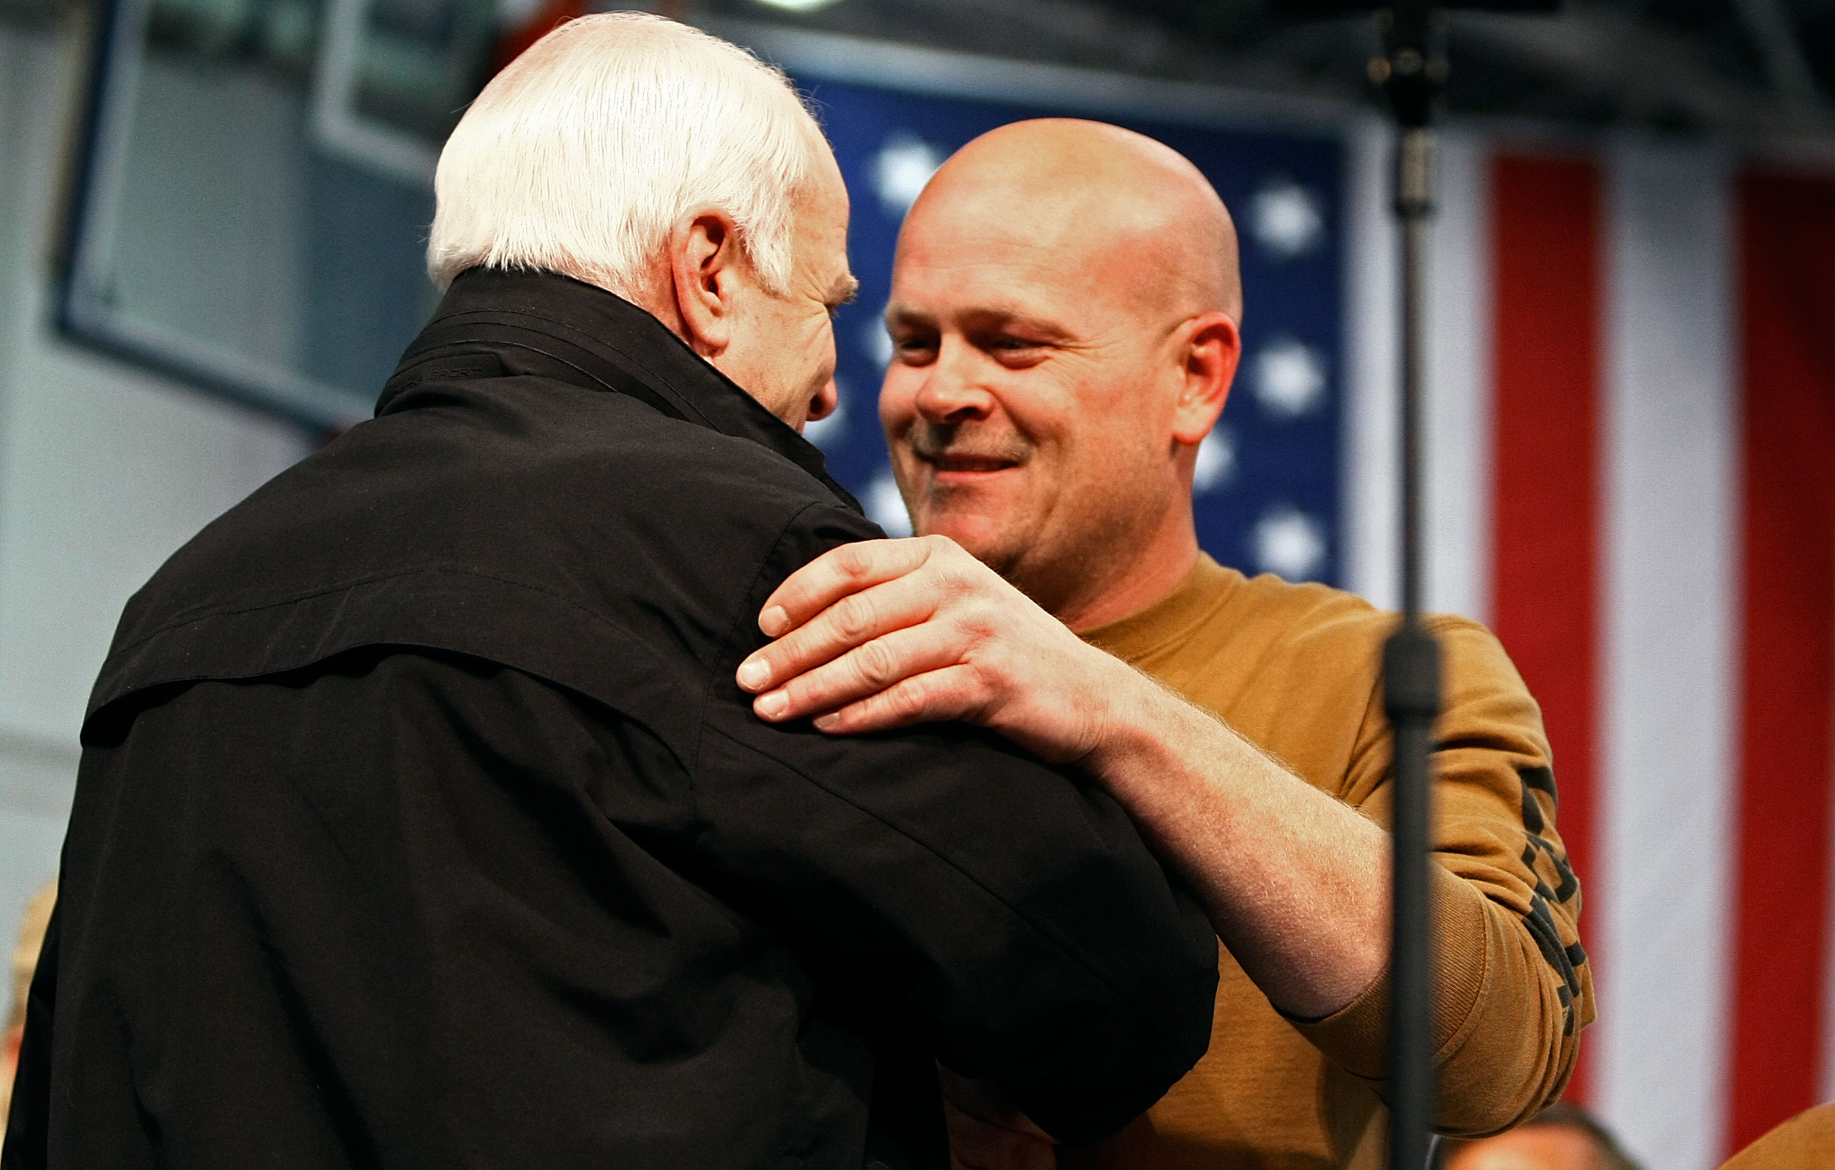
brief plumbing tutorial

Slide 22
plumbing primer
water tower
water tower
Notes:
To understand how HydroSense works, its useful to go over a brief primer of home water/pipe infrastructure.
Most households obtain water from a public water supply.
Public water is distributed by local utilities, relying on gravity and pumping stations to push water through major distribution pipes

Slide 23
plumbing primer
water tower
water tower
incoming cold water from supply line
Notes:
Cold water enters the home through a service line, typically at 40-100 pounds per square inch (psi) depending on such factors as the elevation and proximity to a water tower or pumping station.
Pressure is important to the proper functioning of HydroSense because it’s a pressure-based sensing solution.
------
The pound per square inch or, more accurately, pound-force per square inch (symbol: psi or lbf/in² or lb_{f}/in²) is a unit of pressure or of stress based on avoirdupois units. It is the pressure resulting from a force of one pound-force applied to an area of one square inch:
1 psi (6.894757 kPa) : pascal (Pa) is the SI unit of pressure.
40 psi is 275.79 kilopascals
100 psi is 689.47 kilopascals

Slide 24
pressure regulator
water tower
water tower
incoming cold water from supply line
utility water meter
pressure regulator
Notes:
Cold water enters the home through a service line, typically at 40-100 pounds per square inch (psi) depending on such factors as the elevation and proximity to a water tower or pumping station.
Pressure is important to the proper functioning of HydroSense because it’s a pressure-based sensing solution.
------
The pound per square inch or, more accurately, pound-force per square inch (symbol: psi or lbf/in² or lb_{f}/in²) is a unit of pressure or of stress based on avoirdupois units. It is the pressure resulting from a force of one pound-force applied to an area of one square inch:
1 psi (6.894757 kPa) : pascal (Pa) is the SI unit of pressure.
40 psi is 275.79 kilopascals
100 psi is 689.47 kilopascals

Slide 25
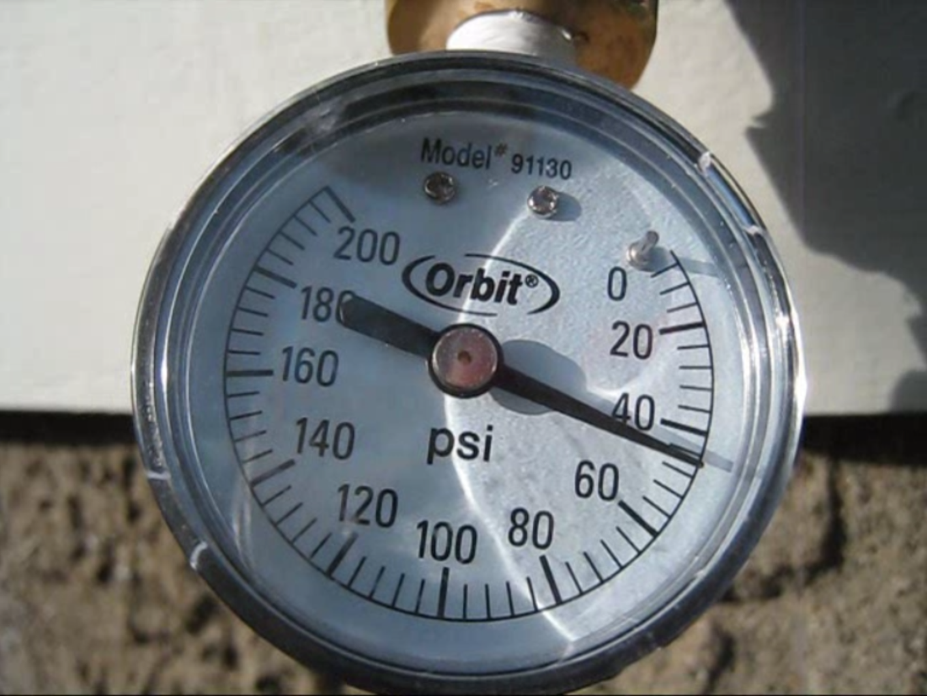
pressure regulator
water tower
water tower
incoming cold water from supply line
utility water meter
pressure regulator
Notes:
Many homes have a pressure regulator that stabilizes the water pressure and also reduces the incoming water pressure to a safe level for household fixtures.
From the regulator, most homes contain a combination of series plumbed and branched piping.

Slide 26
plumbing layout
water tower
water tower
incoming cold water from supply line
utility water meter
pressure regulator
Notes:
The cold water supply branches to the individual water fixtures (e.g., toilets/sinks/showers) and into the water heater.

Slide 27
closed pressure system
water tower
water tower
bathroom 1
hose
spigot
kitchen
incoming cold water from supply line
dishwasher
thermal
expansion
tank
utility water meter
pressure regulator
hot
water heater
bathroom 2
laundry
Notes:
The plumbing system forms a closed loop pressure system with water held at a relatively stable pressure throughout the piping.
This is why, when you open a faucet, water immediately flows out.

Slide 28
closed pressure system
water tower
water tower
bathroom 1
hose
spigot
kitchen
incoming cold water from supply line
dishwasher
thermal
expansion
tank
utility water meter
pressure regulator
hot
water heater
hot
water heater
bathroom 2
laundry
Notes:
The hot water tank connects the cold water pipes to the hot water pipes.
So when you open a hot or cold water valve, the pressure signal is transmitted through the hot water heater thus allowing for a single-point pressure sensing solution.
Every hot water tank has a drain valve, which is of interest to us because it provides an easy potential installation point for our hydrosensor, particularly for locations like apartments which don’t have outdoor hose bibs.

Slide 29
water tower
water tower
toilet flushed
bathroom 1
hose
spigot
toilet
kitchen
incoming cold water from supply line
dishwasher
thermal
expansion
tank
utility water meter
pressure regulator
hot
water heater
bathroom 2
laundry
Notes:
The cold water supply branches to the individual water fixtures (e.g., toilets/sinks/showers) and into the water heater.
The plumbing system forms a closed loop pressure system with water held at a relatively stable pressure throughout the piping.
This is why, when you open a faucet, water immediately flows out.

Slide 30
water tower
water tower
toilet
bathroom 1
hose
spigot
kitchen sink cold
kitchen sink cold open
kitchen
incoming cold water from supply line
dishwasher
thermal
expansion
tank
utility water meter
pressure regulator
hot
water heater
bathroom 2
laundry
Notes:
The cold water supply branches to the individual water fixtures (e.g., toilets/sinks/showers) and into the water heater.
The plumbing system forms a closed loop pressure system with water held at a relatively stable pressure throughout the piping.
This is why, when you open a faucet, water immediately flows out.

Slide 31
water tower
water tower
toilet
kitchen sink cold
bathroom 1
hose
spigot
kitchen sink hot
kitchen sink hot open
kitchen
incoming cold water from supply line
dishwasher
thermal
expansion
tank
utility water meter
pressure regulator
hot
water heater
bathroom 2
laundry
Notes:
The cold water supply branches to the individual water fixtures (e.g., toilets/sinks/showers) and into the water heater.
The plumbing system forms a closed loop pressure system with water held at a relatively stable pressure throughout the piping.
This is why, when you open a faucet, water immediately flows out.

Slide 32
water tower
water tower
bathroom 1
hose
spigot
kitchen sink hot
kitchen sink hot open
kitchen
incoming cold water from supply line
dishwasher
thermal
expansion
tank
utility water meter
pressure regulator
hot
water heater
bathroom 2
laundry
Notes:
The cold water supply branches to the individual water fixtures (e.g., toilets/sinks/showers) and into the water heater.
The plumbing system forms a closed loop pressure system with water held at a relatively stable pressure throughout the piping.
This is why, when you open a faucet, water immediately flows out.

Slide 33
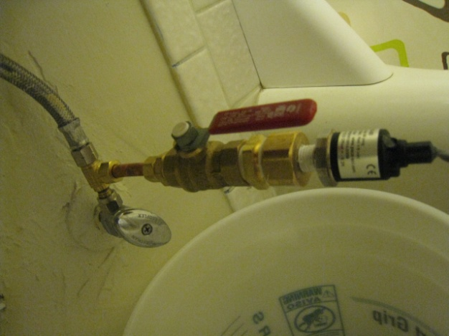
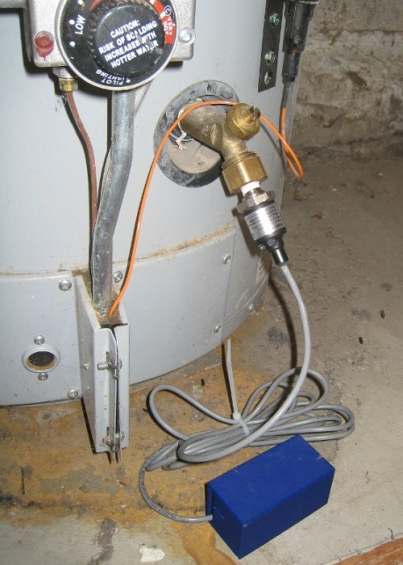
water tower
water tower
bathroom 1
hose
spigot
kitchen
incoming cold water from supply line
dishwasher
utility water meter
pressure regulator
hot
water heater
bathroom 2
laundry
Notes:
The cold water supply branches to the individual water fixtures (e.g., toilets/sinks/showers) and into the water heater.
The plumbing system forms a closed loop pressure system with water held at a relatively stable pressure throughout the piping.
This is why, when you open a faucet, water immediately flows out.

Slide 34
bathroom sink pressure signal
psi
open
close
0
4.5
9
time (s)

Slide 35
bathroom sink pressure signal
psi
flow volume
open
close
0
4.5
9
time (s)

Slide 36
bathroom sink pressure signal
psi
flow volume
open
close
0
4.5
9
time (s)
Notes:
Remember to go over this slowly and introduce axes and so on

Slide 37
Movie Removed for Public Posting of Slides

Slide 38
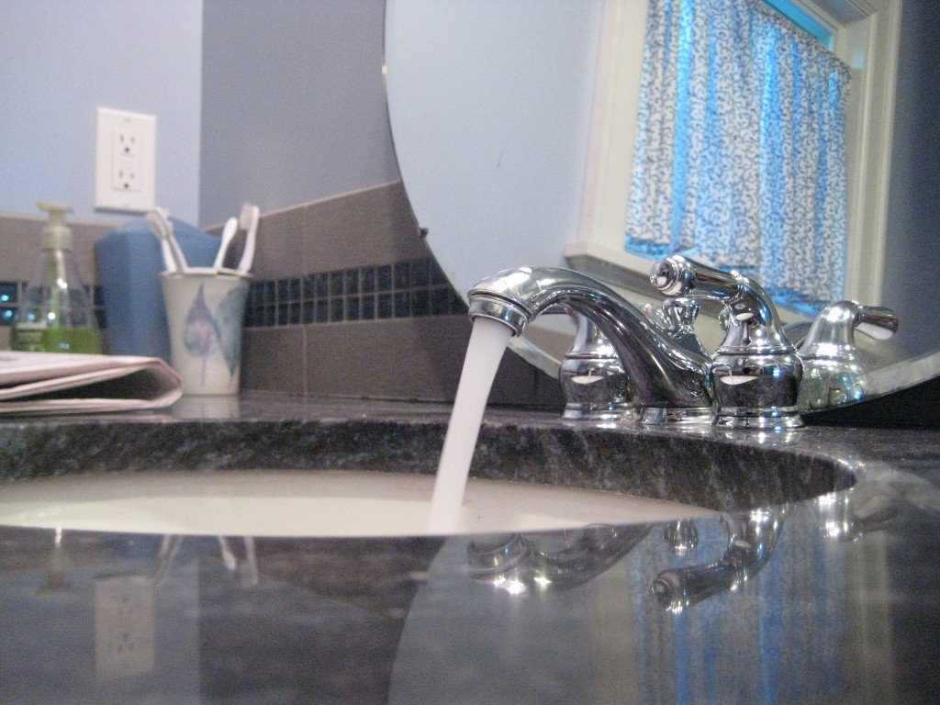
how it works
detect that a water event has occurred
classify event as “open” or “close”
determine source of event (e.g., toilet, shower).
provide flow estimate
Notes:
So, how does this work exactly?

Slide 39
event detection
raw pressure (psi)
time (s)
smoothed pressure
(psi)
derivative
(psi/s)
Notes:
The raw pressure signal is smoothed using a low-pass filter. We then take the derivative of this smoothed signal to check for rapid changes in pressure (i.e., pressure transients).
These rapid changes in pressure (or pressure transients) are what indicate water usage.
----
The low pass filter is a low-pass linear phase finite impulse response filter.
The smoothed signal is the 1 Hz envelope of the signal, calculated using a discrete prolate spheroidal window filter of length 1 second.
The bandpass derivative has a cutoff of 1Hz and a linearly increasing frequency response, it is also 1 second long.
These parameters were chosen based on the bandwidth with the highest energy concentration for all the data we collected in all homes.

Slide 40
event detection
raw pressure (psi)
time (s)
smoothed pressure
(psi)
derivative
(psi/s)
critical change in pressure
Notes:
So, let’s see how this works in practice.
As we run a 1 sec sliding window over the data, we flag the signal when the derivative exceeds a specified threshold relative to the home’s static pressure

Slide 41
event detection
raw pressure (psi)
time (s)
smoothed pressure
(psi)
critical stabilization point
derivative
(psi/s)
Notes:
Then, we look for when the “amplitude” of the derivative goes below 5% of the original magnitude

Slide 42
event detection
automatically detected event
valve open event
raw pressure (psi)
time (s)
smoothed pressure
(psi)
pressure decrease
and
negative initial
derivative
derivative
(psi/s)
= valve open event
Notes:
The direction of stabilized pressure change and the sign of derivative determines whether the event is an open or close event.
In this case, it’s a valve open event.

Slide 43
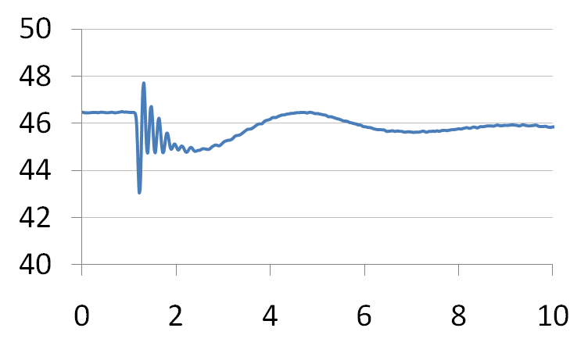
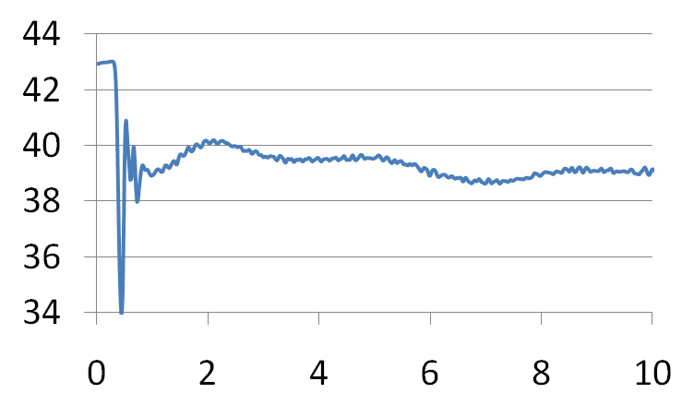
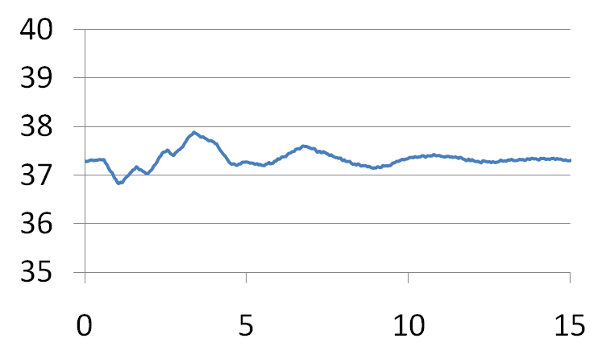
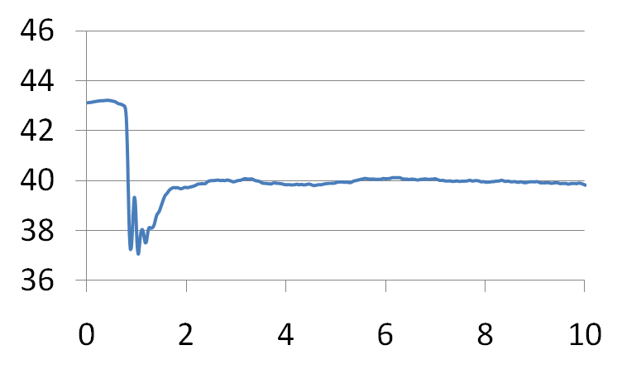
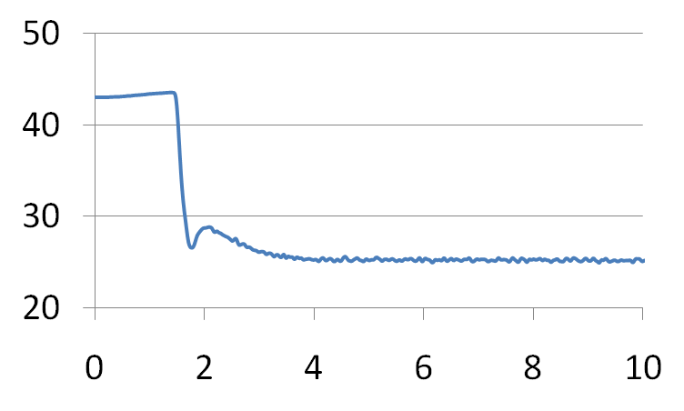
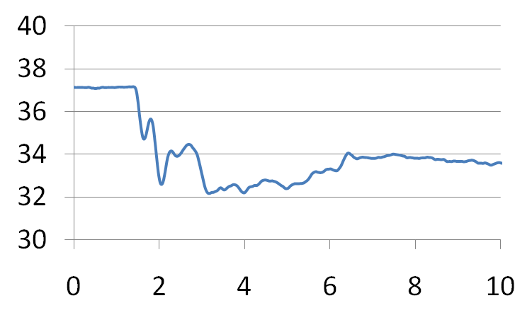
example open events
home 1
home 2
home 3
toilet
signature dependent on:
fixture type
valve type
valve location in home
faucet
shower
Notes:
As you might imagine, the pressure signatures differ across fixture and valve types. However, the valve’s location in the home is also a strong determinant in shaping the signal. (click)
As a result we haven’t seen a lot of cross-home similarity between fixture event signals.
From this point forward, the vertical-axis will always refer to psi and the horizontal-axis will refer to time in seconds
----
First, note that the transients are unique across fixtures. (click)
---
Now, I’m showing data from three different homes. Note how the signals differ for like fixtures across homes; this is because the signal is influenced both by the valve type as well as the pipe pathway to the valve.
Therefore, while detection and distinguishing between open and close can be done with a drop-in system in any home, actual fixture classification and flow must be calibrated on a per home basis.

Slide 44
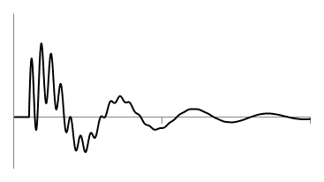
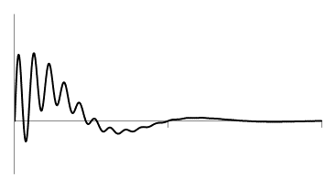
matched filtering
kitchen sink close
bathroom sink close template
save maximum
similarity
similarity
Notes:
Match filtering allows us to compare two signals’ similarity using a pointwise correlation coefficient
(click) we save the maximum correlation as the degree to which the two signals are similar

Slide 45
matched filtering
kitchen sink close
kitchen sink close template
new maximum
similarity
similarity
Notes:
And two very similar signals will have a higher similarity value,
We can perform matched filtering in a variety of signal subspaces. The more orthogonal the different fixture signals are in the subspace, the better.
The reason behind this is that orthogonal signals have a correlation of zero (and, thus, a matched filter comparison close to zero).

Slide 46
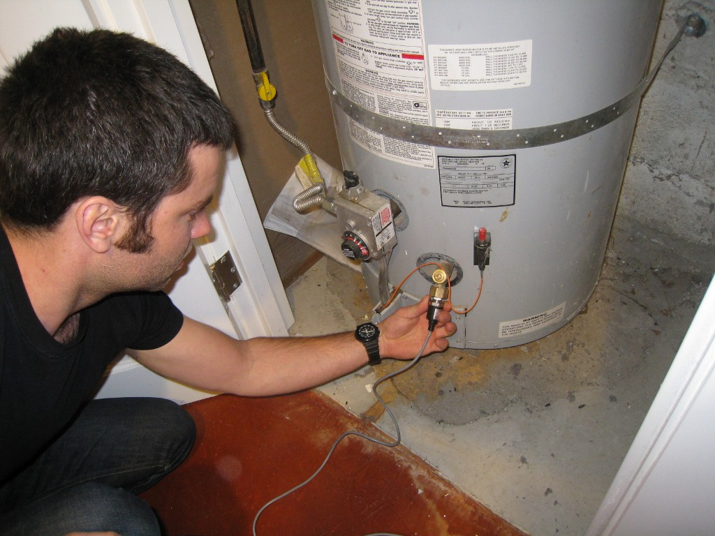
evaluation
Notes:
Now, I will go over our in-home data collection and experimental validation.

Slide 47
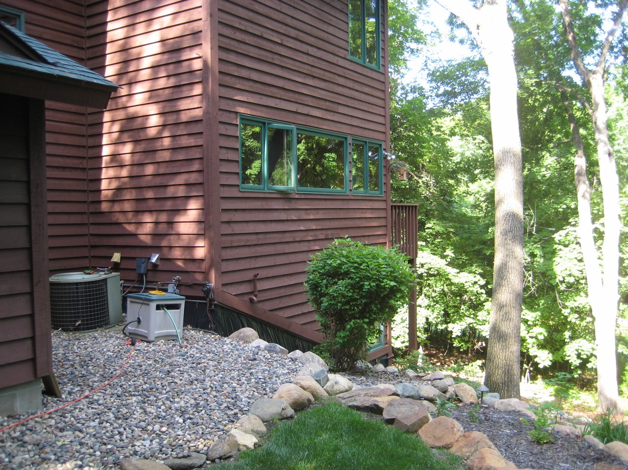
home profiles
ten test locations
8 houses / 1 apt / 1 cabin
avg size: 2,300 sq ft
1920s – 2000s
installation points
8 outdoor hose bibs
1 water heater
1 utility faucet
Notes:
We installed HydroSense in a variety of locations: 8 houses, 1 apartment, and 1 cabin with a range in size from 750 sq feet to 4,000 sq ft.
We also used three different installation points: 8 hose bib, 1 water heater, and 1 utility faucet connection.

Slide 48
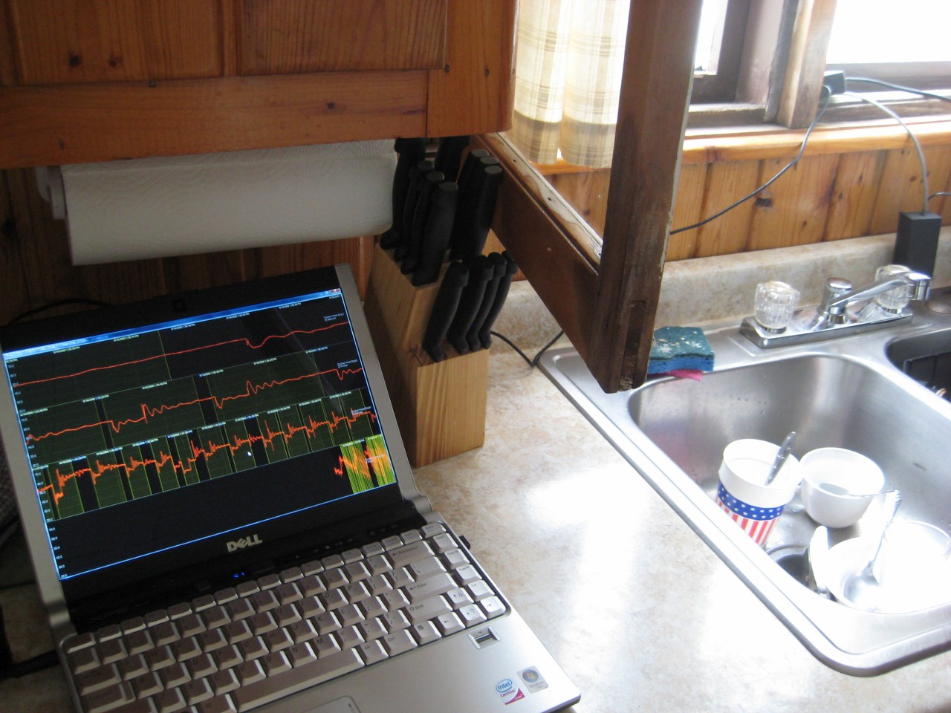
experimental protocol
controlled experiments
2 researchers per site
5 trials per valve
experimental script for each trial:
valve opened full stop
pause for ~5 seconds
valve closed
Notes:
Each collection session was conducted by a pair of researchers: one would record the sensed pressure signatures to a laptop while the other activated the home’s water fixtures.
We recorded five trials per valve. A sink, for example, has two valves (one hot, and one cold) and thus would receive 10 trials—5 for hot and 5 for cold.
For each trial, the valve was open for ~5 seconds and then closed.

Slide 49
example trial
Movie Removed for Public Posting of Slides

Slide 50
5 manually annotated bath trials

Slide 51
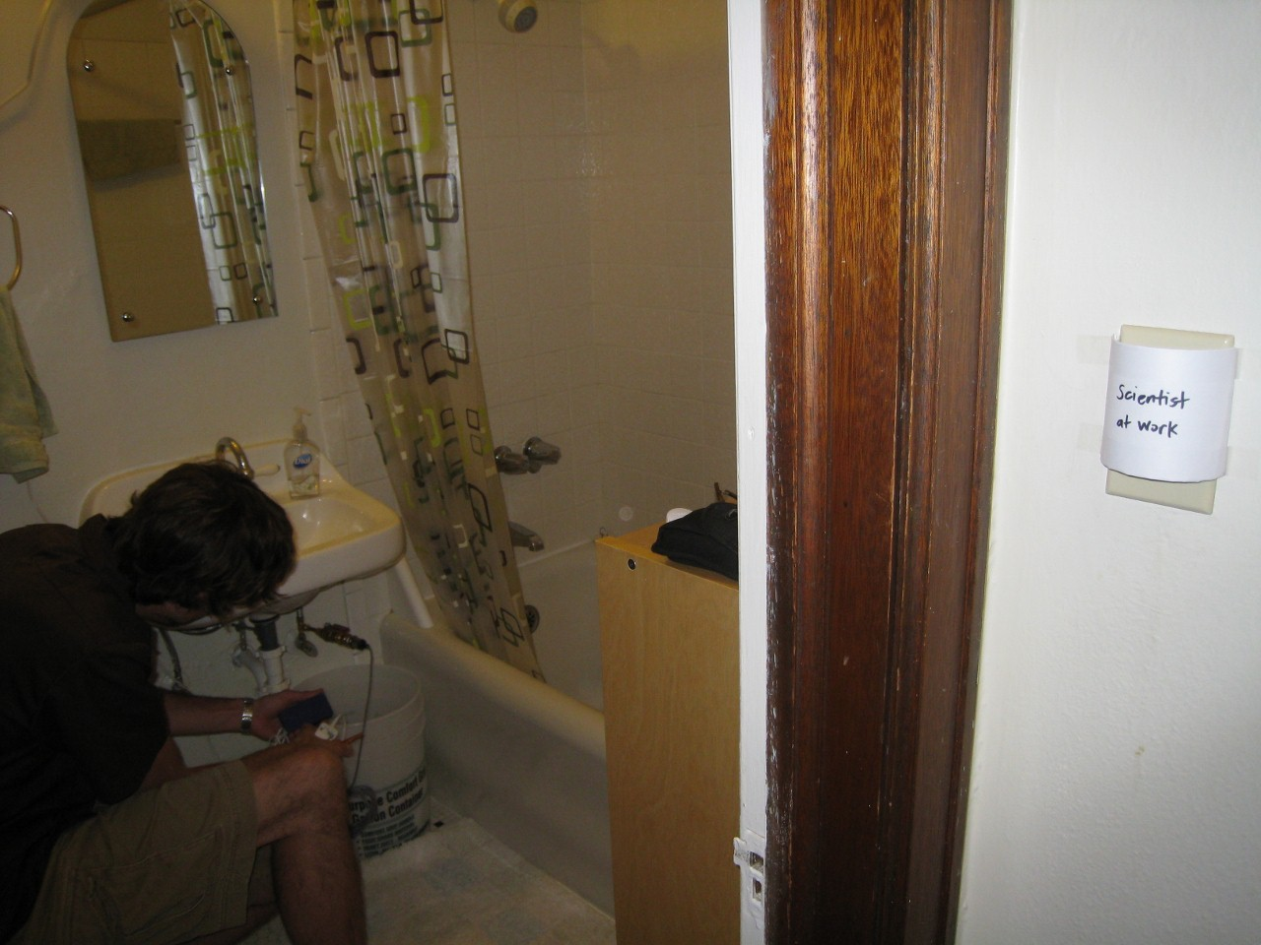
data collection stats
ten test sites
706 trials
155 flow trials
84 total fixtures tested
Notes:
In all, we conducted experiments in 10 locations resulting in 706 trials with 155 flow rate trials and 84 total fixtures tested.

Slide 52
fixture classification results
by home
Notes:
This figure shows the accuracy of fixture-level identification of valve open and valve close events within each home as well as the aggregate 97.9% accuracy of fixture-level classification.
Many homes resulted in 100% open and close fixture classification.
The worst performing house, H10, was due to noise from the eleven cabins that share the same supply line at the resort.

Slide 53
fixture classification results
by home
98.9%
96.8%
Notes:
This figure shows the accuracy of fixture-level identification of valve open and valve close events within each home as well as the aggregate 97.9% accuracy of fixture-level classification.
Many homes resulted in 100% open and close fixture classification.
The worst performing house, H10, was due to noise from the eleven cabins that share the same supply line at the resort.

Slide 54
fixture classification results
by home
98.9%
96.8%
97.9%
Notes:
This figure shows the accuracy of fixture-level identification of valve open and valve close events within each home as well as the aggregate 97.9% accuracy of fixture-level classification.
Many homes resulted in 100% open and close fixture classification.
The worst performing house, H10, was due to noise from the eleven cabins that share the same supply line at the resort.

Slide 55
fixture classification results
by fixture
Notes:
This graph shows the same data as before but categorized by fixture. Again, nearly all fixtures are above 95% or better.
Here, the worst performer is the hot water valve in showers at 89%--although this is still pretty good, we’re not sure why this is and it warrants further investigation.

Slide 56
first to show: pressure can be used to dissaggregate water usage
but….

Slide 57
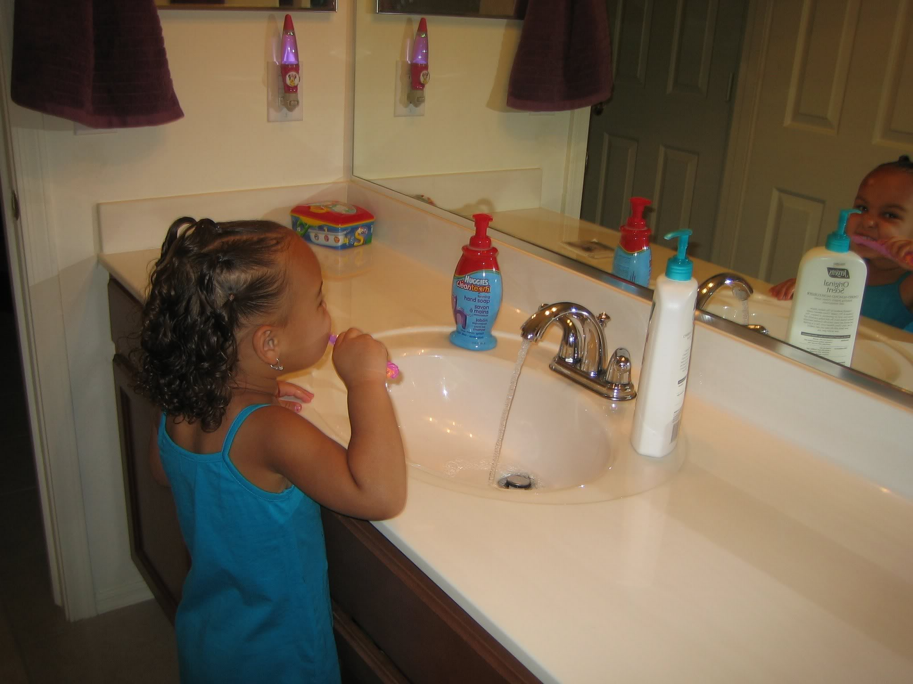
brushing teeth

Slide 58
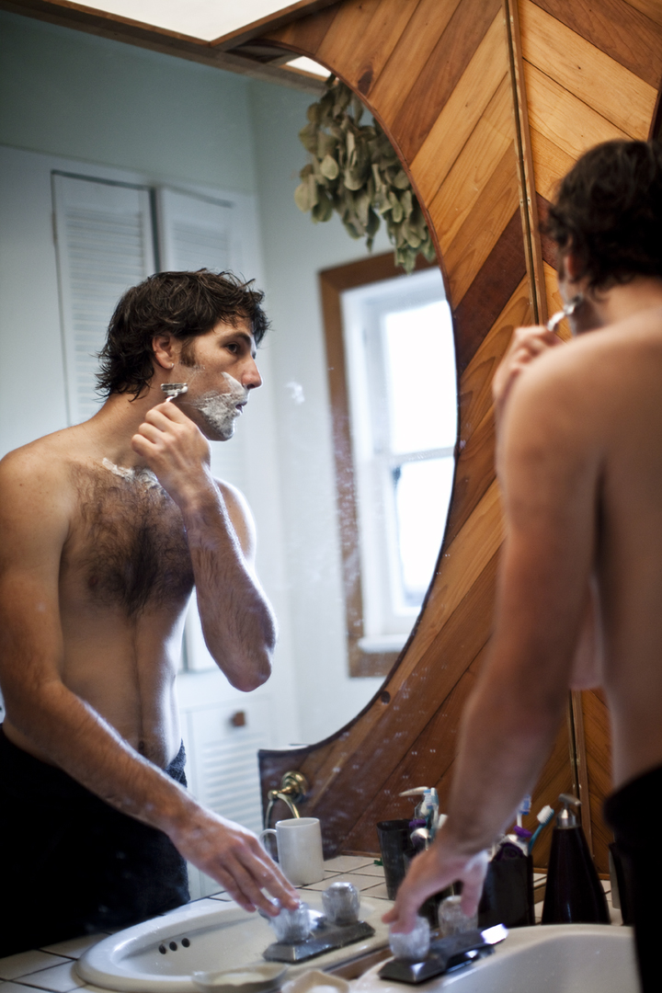
shaving

Slide 59
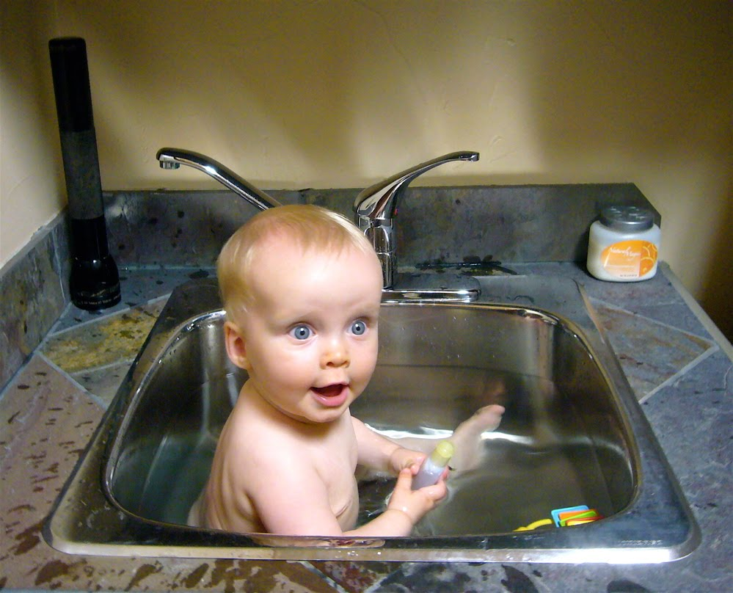
bathing

Slide 60
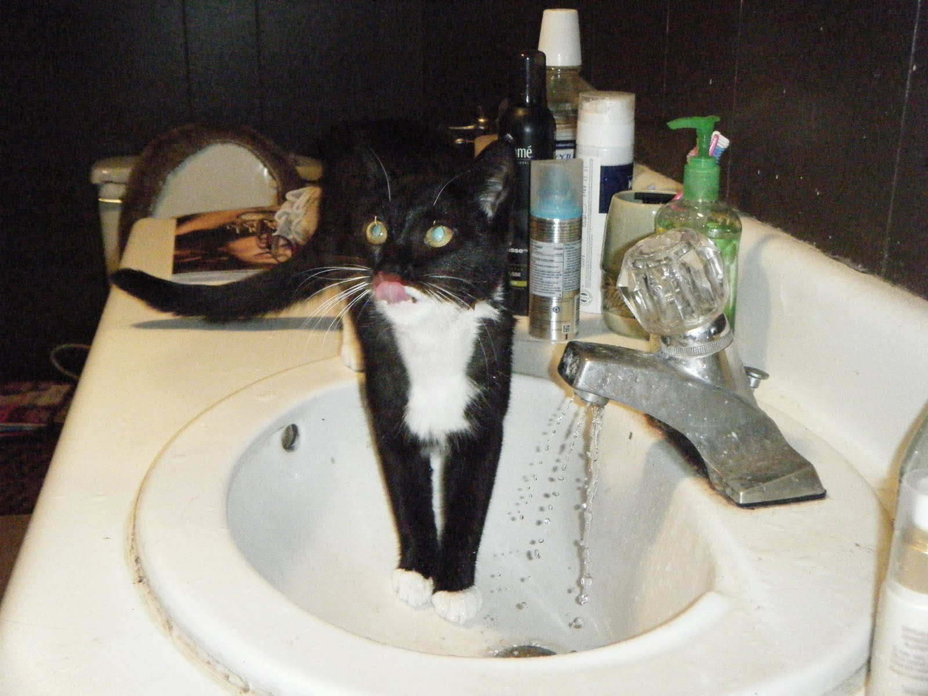
paw washing

Slide 61
water tower
water tower
bathroom 1
hose
spigot
compound events
kitchen
incoming cold water from supply line
dishwasher
thermal
expansion
tank
utility water meter
pressure regulator
hot
water heater
bathroom 2
laundry
Notes:
The cold water supply branches to the individual water fixtures (e.g., toilets/sinks/showers) and into the water heater.
The plumbing system forms a closed loop pressure system with water held at a relatively stable pressure throughout the piping.
This is why, when you open a faucet, water immediately flows out.

Slide 62
how can we study naturalistic uses of water?

Slide 63
FAIL
Movie Removed for Public Posting of Slides

Slide 64
how can we collect “ground truth labels”?

Slide 65
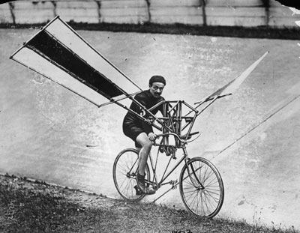
our failed attempts

Slide 66
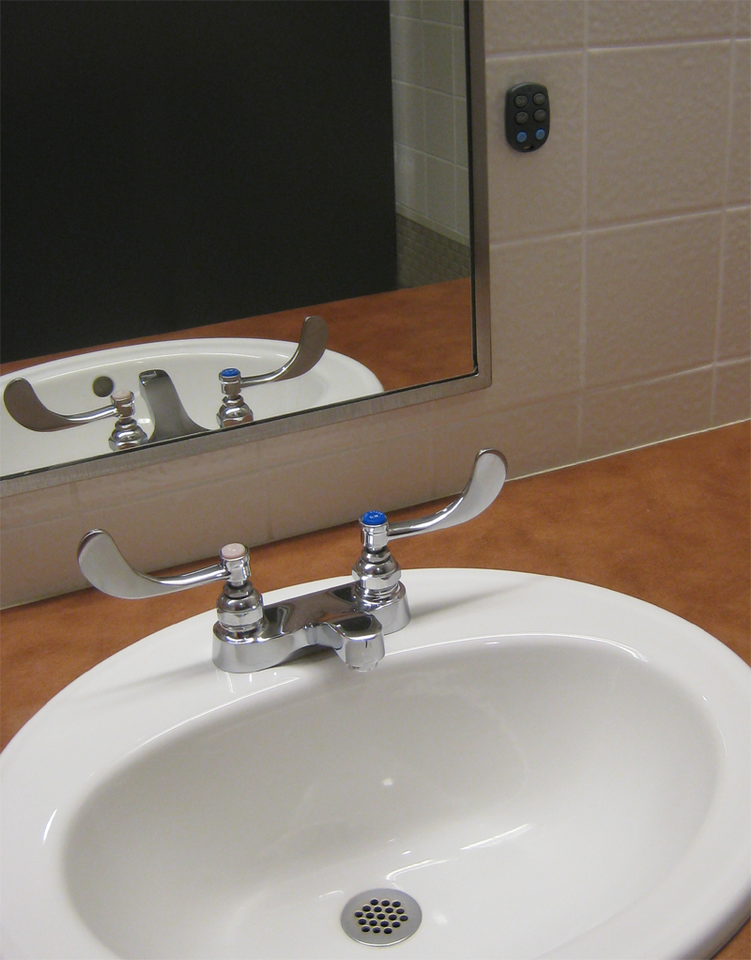
wireless buttons

Slide 67
how many times will the hot and cold water valves be opened and closed while washing these dishes?
Movie Removed for Public Posting of Slides
tracks the number of times hot and cold are turned on/off

Slide 68
Movie Removed for Public Posting of Slides

Slide 69
wireless buttons
FAIL #1

Slide 70
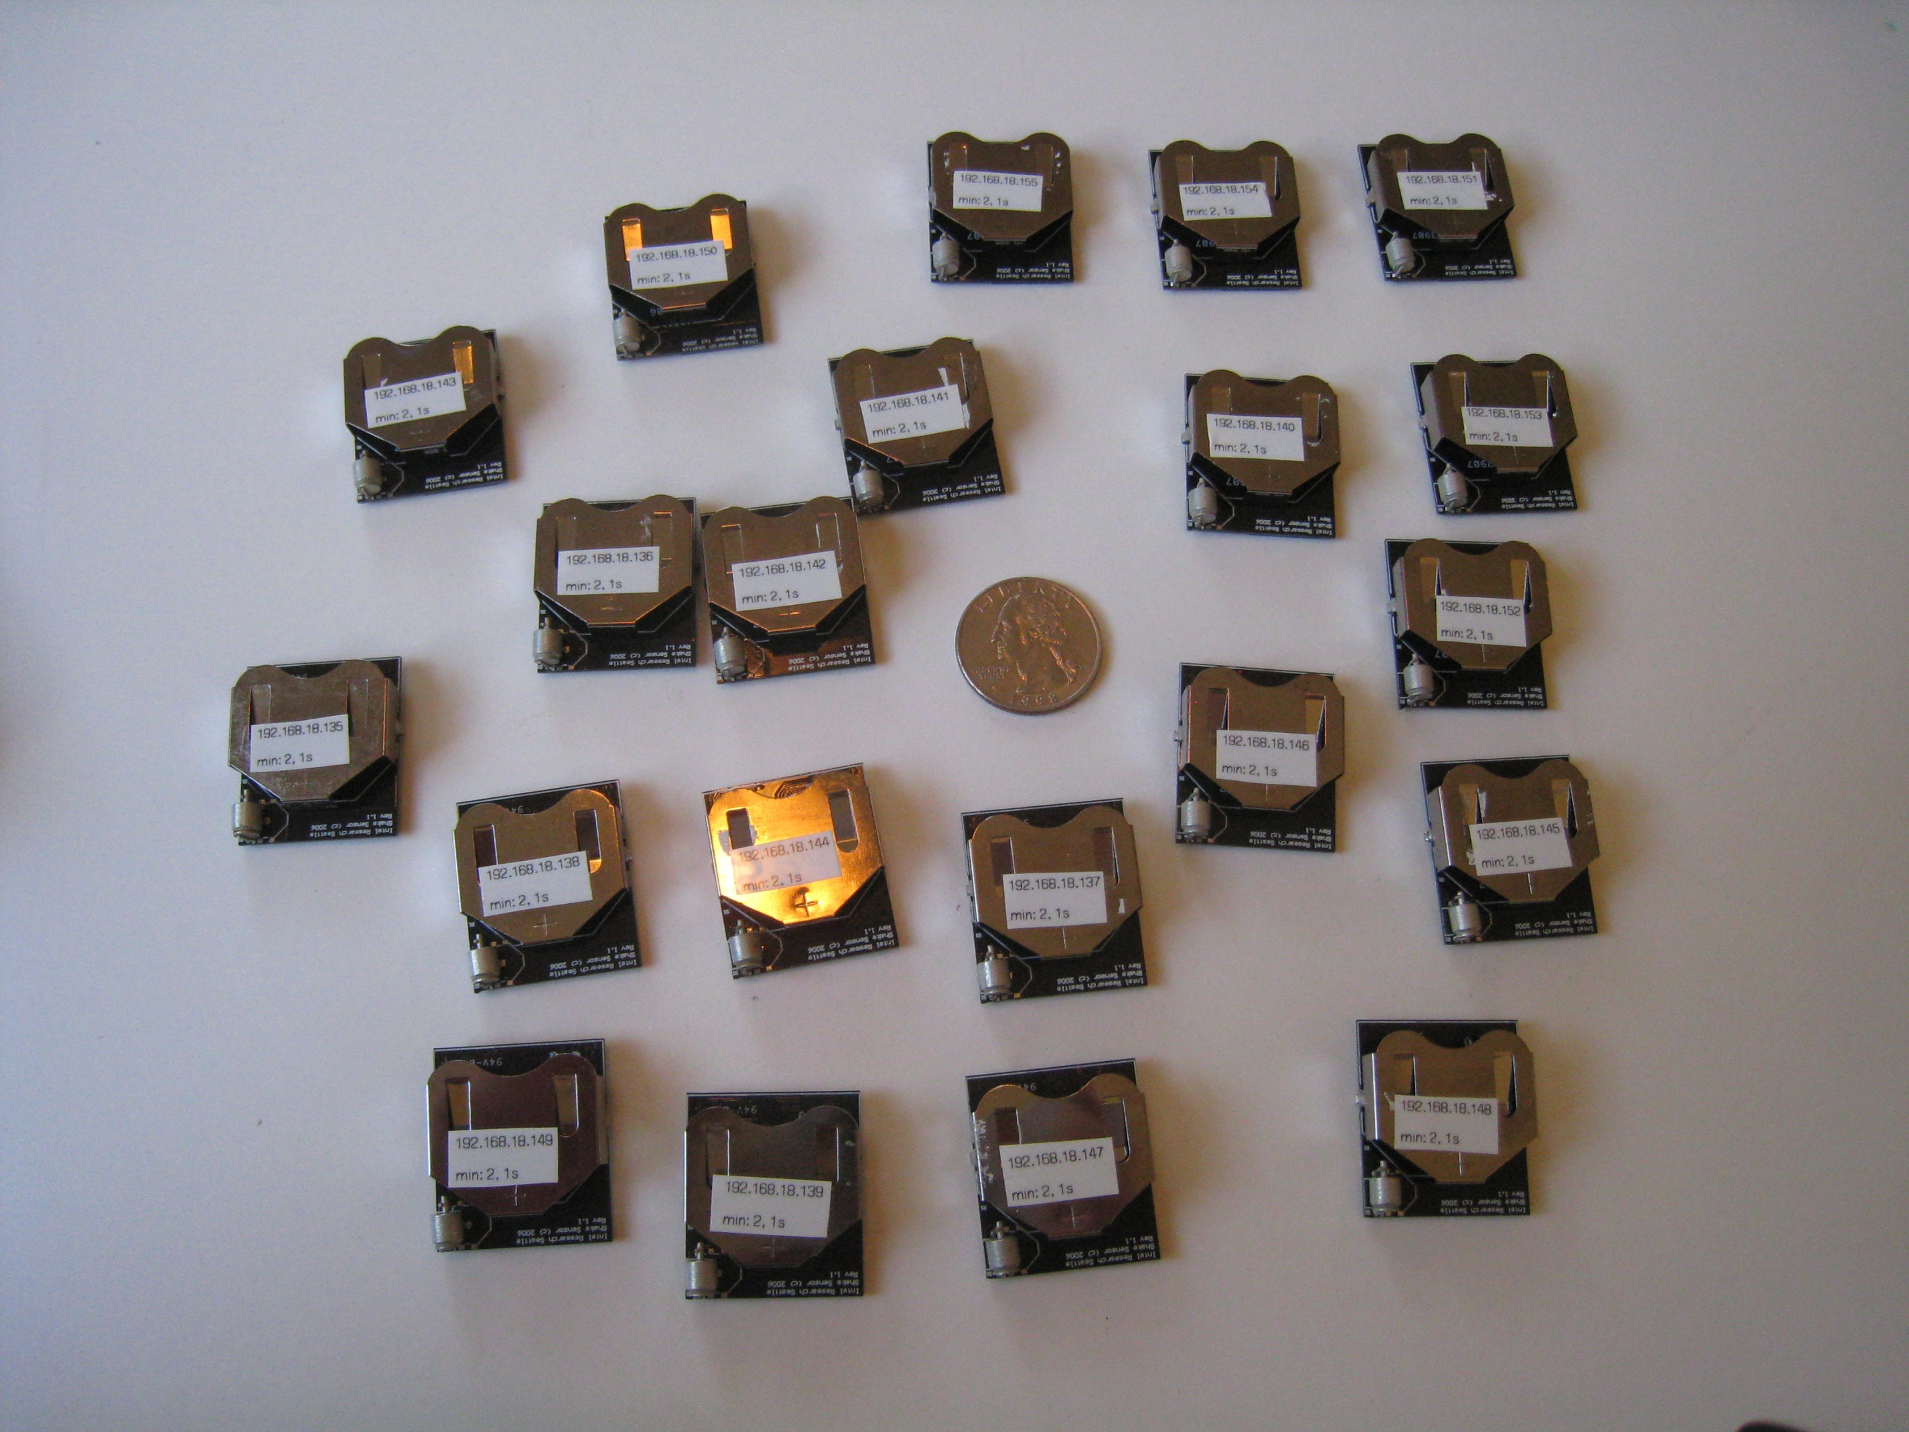
intel labs shake sensors
FAIL #2

Slide 71
nike+ ipod piezo
FAIL #3
Movie Removed for Public Posting of Slides
Notes:
The word piezoelectricity means electricity resulting from pressure
Piezoelectricity is the charge which accumulates in certain solid materials in response to applied mechanical strain

Slide 72
thermistor
FAIL #88
Movie Removed for Public Posting of Slides
Notes:
But what about short cold opens?

Slide 73
our solution

Slide 74
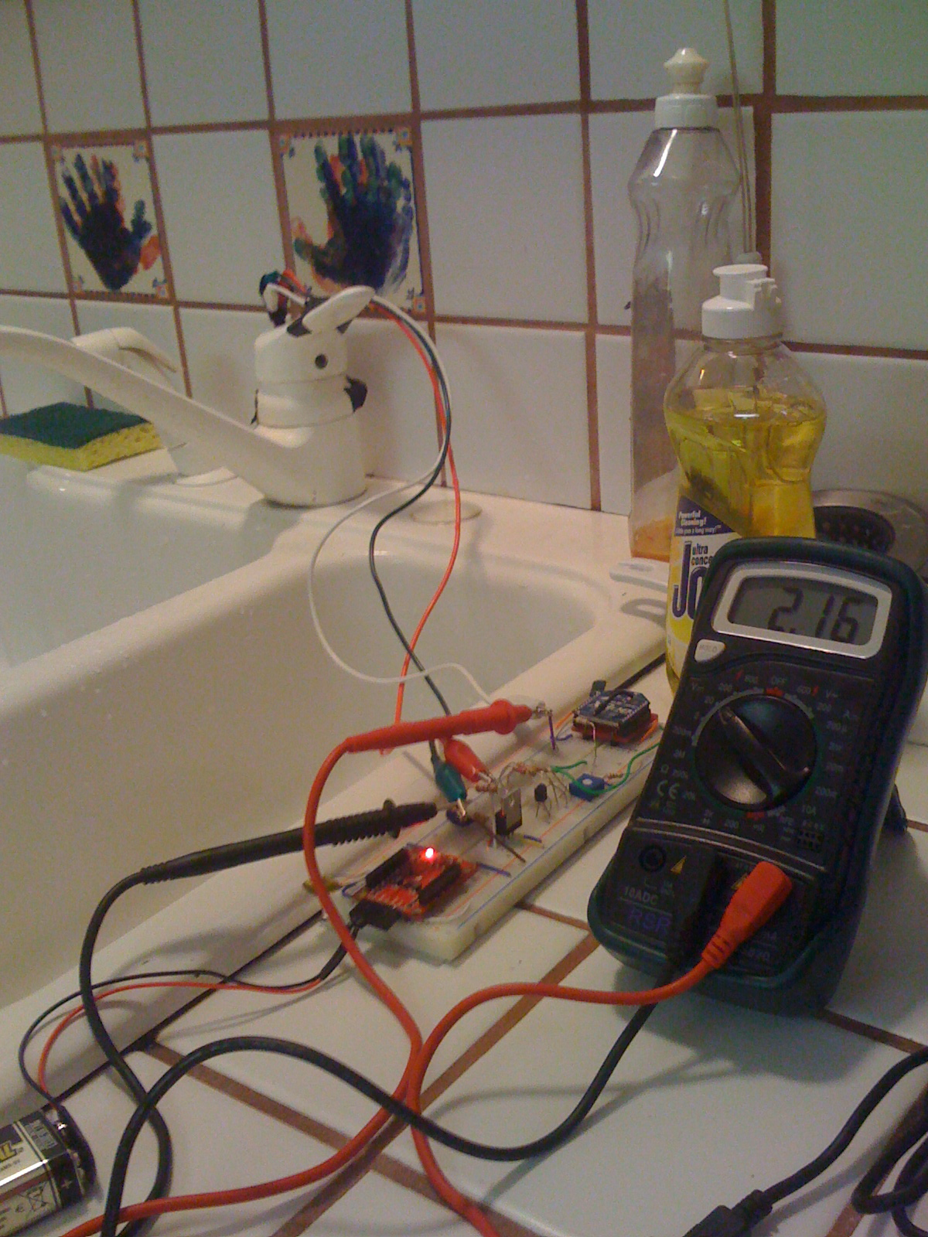
custom direct sensors
design goals
wireless
low-power
water resistant
detect fixture opens/closes
track hot only, cold only, mixed

Slide 75
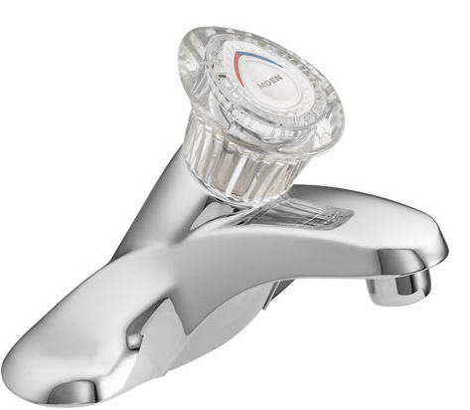
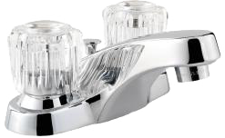
challenge: fixture diversity
temperature control
cold flow control
hot flow control
flow
control
single handle faucet
dual handle faucet

Slide 76
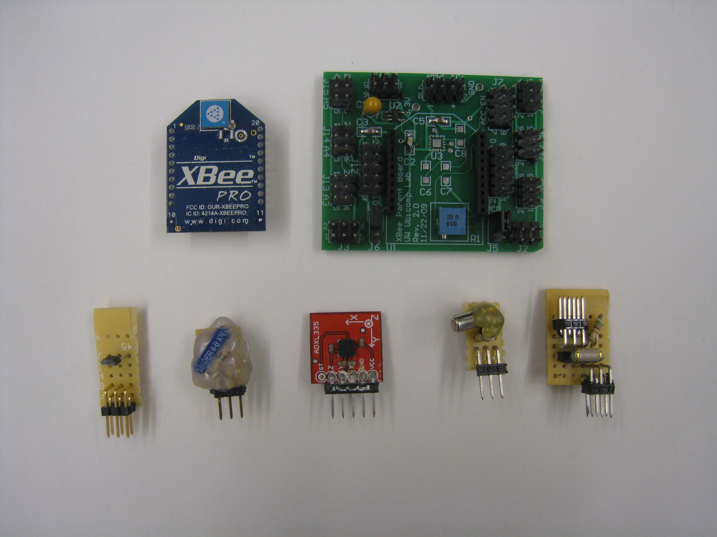
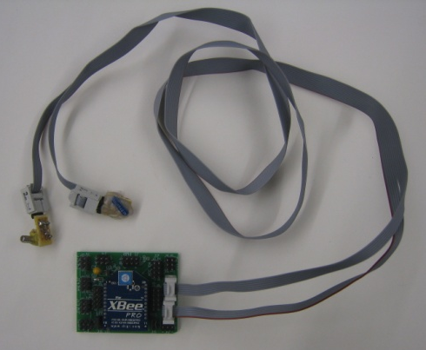
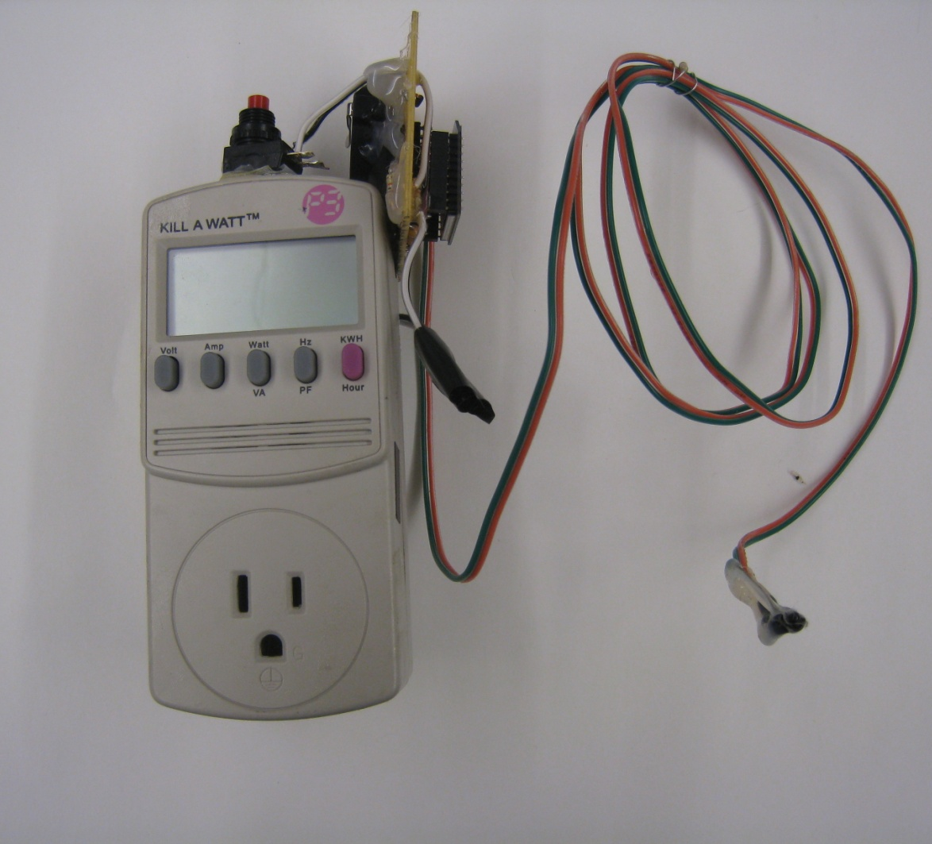
custom ground truth data collection system
push button
xbee wireless transmitter
placeholder (I want a pic showing power supply)
fixture usage sensor board
xbee wireless modem
fixture usage sensor board
modified kill-a-watt
thermistor
hall
effect
reed switch
3-axis accelerometer
unidirectional ball switch
omnidirectional ball switch

Slide 77
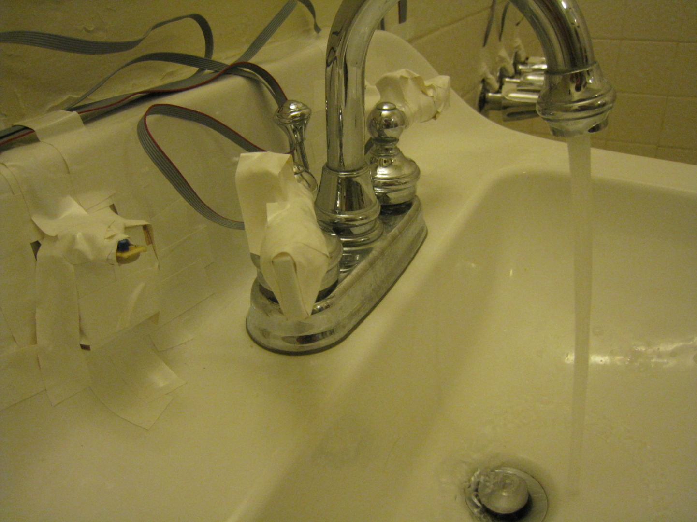
reed switch
(hidden)
ball switch
magnet
reed switch
ball switch
hot handle movement
magnet

Slide 78
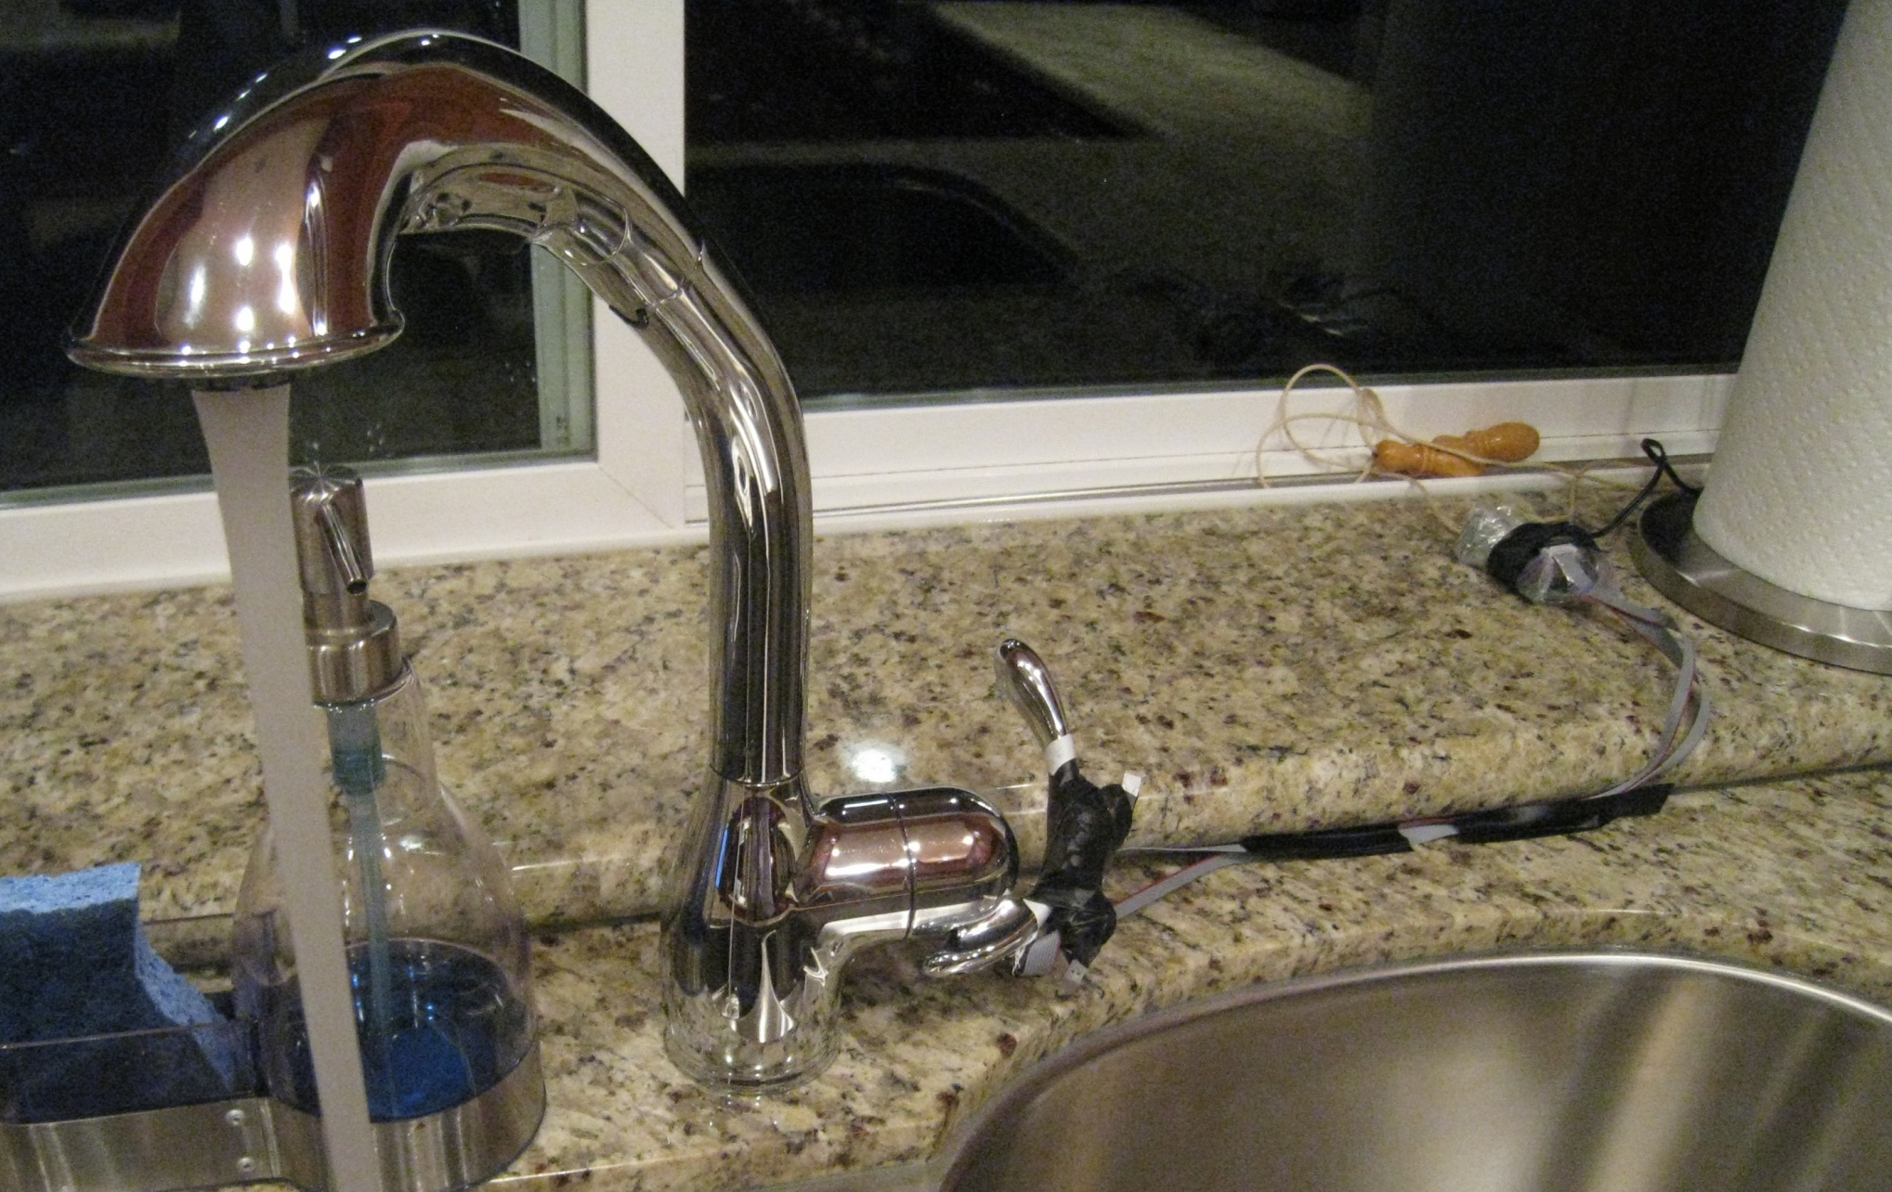
parent sensor board
accelerometer & ball switch

Slide 79
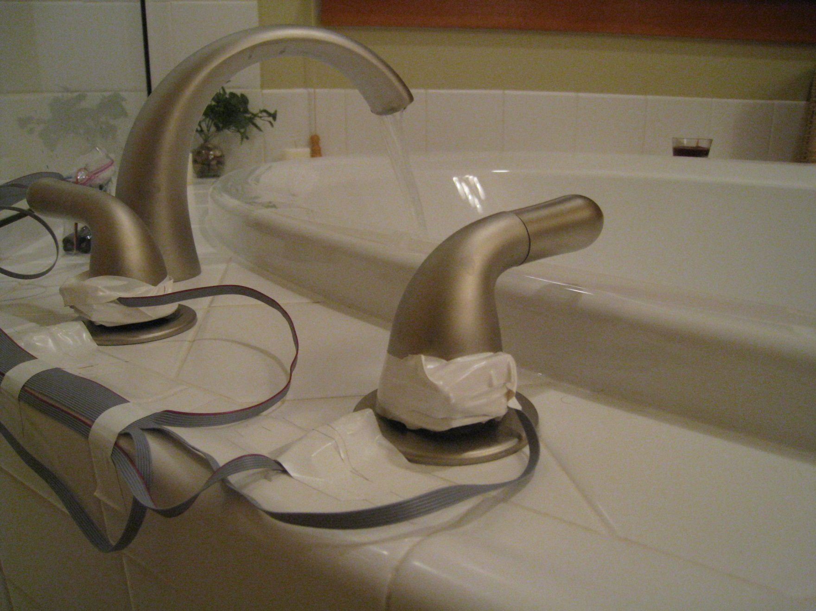
magnet & ball switch
magnet & ball switch
reed switch (cold handle)
reed switch (hot handle)

Slide 80
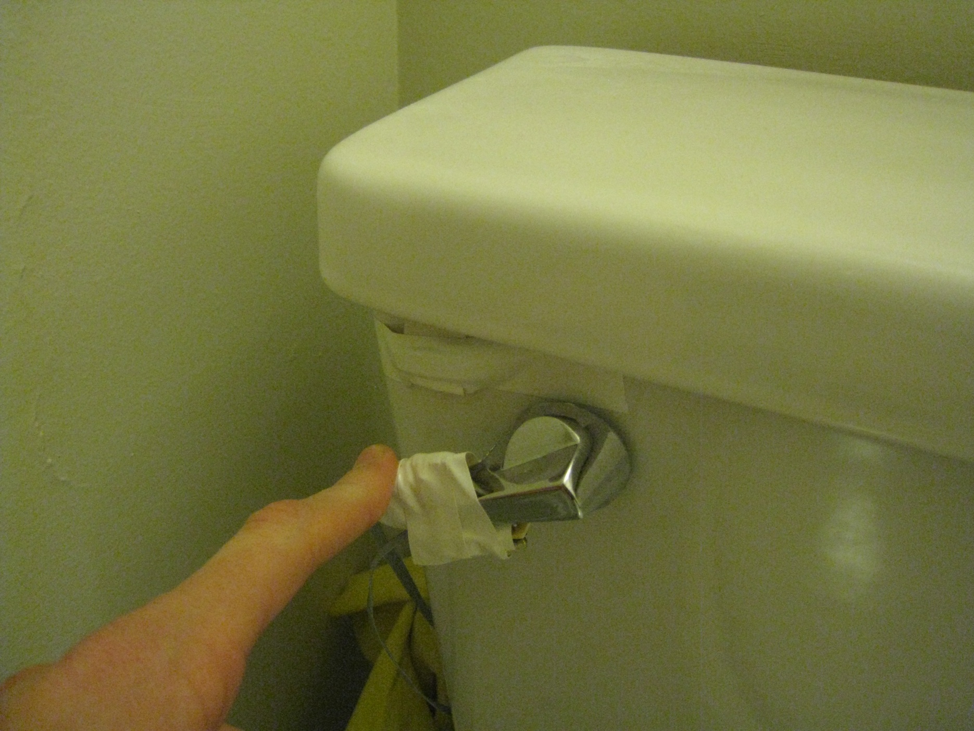
magnet
reed
switch
omni-directional ball switch

Slide 81
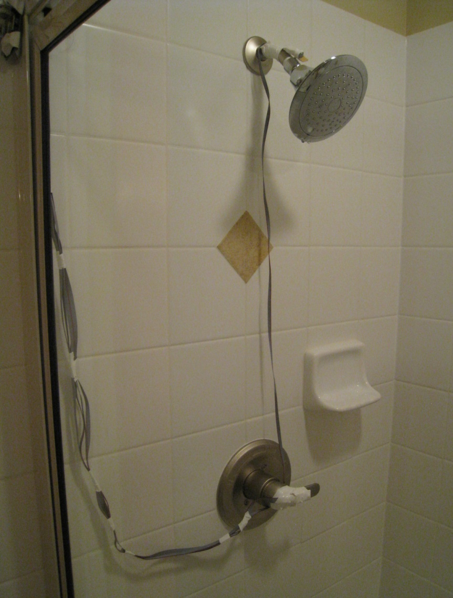
omni-directional ball switch
accelerometer

Slide 82
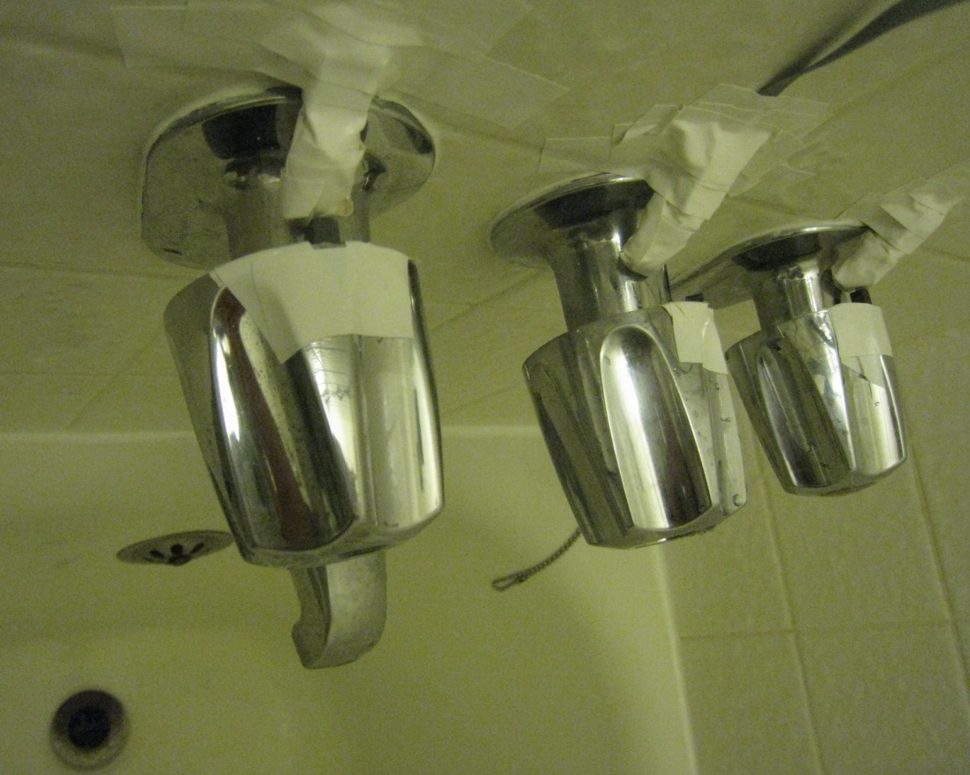
reed switch (hot handle)
reed switch (tub/shower diverter)
reed switch (cold handle)
magnet
magnet
magnet

Slide 83
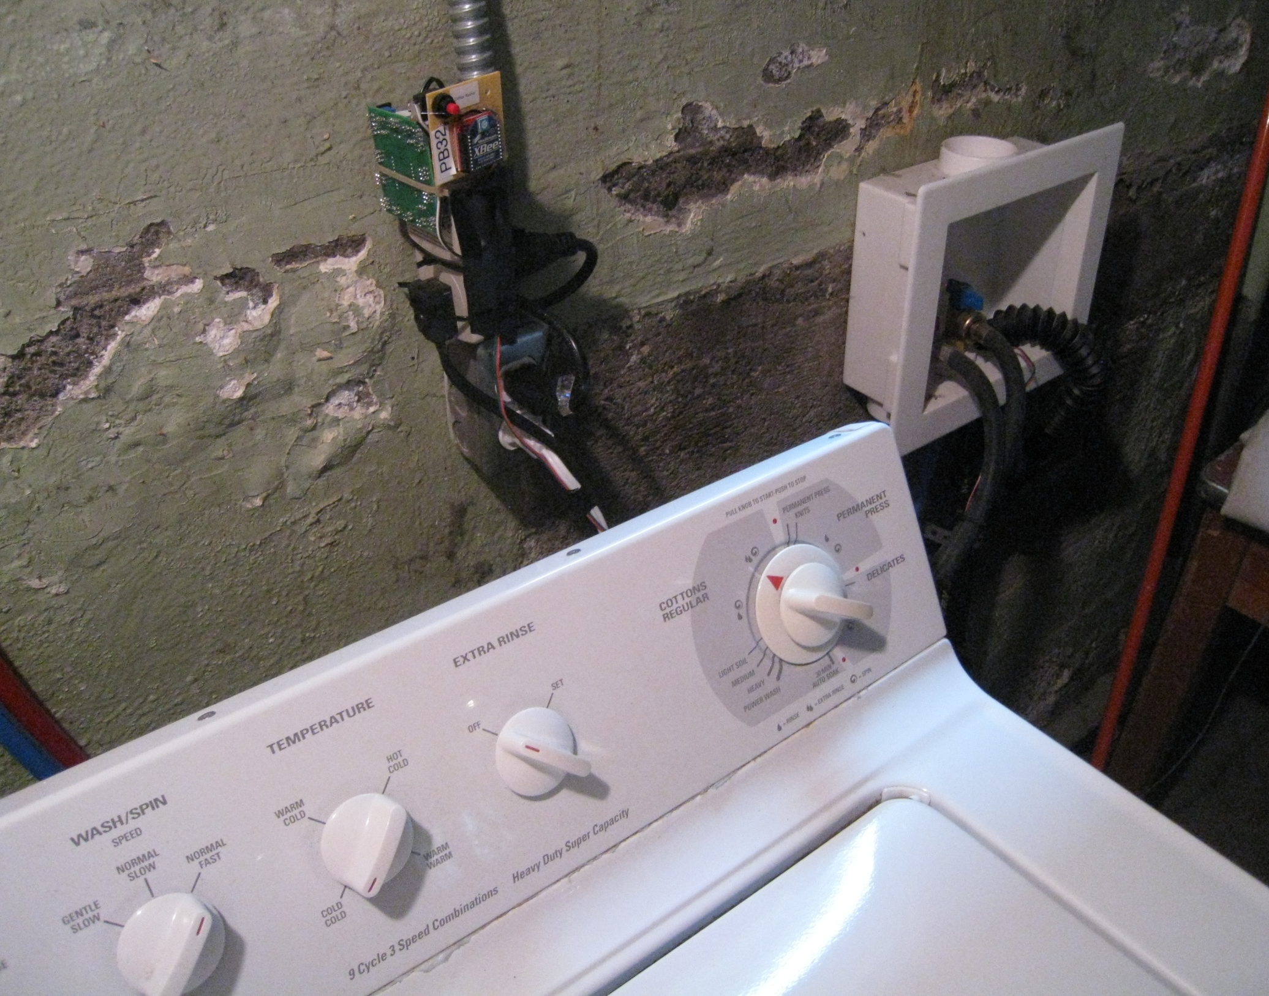
xbee wireless transmitter
parent sensor board
modified kill-a-watt
thermistor cable for drain pipe (in red)
washing machine plug
(connects to kill-a-watt outlet)

Slide 84
how did we do the installations?

Slide 85
Movie Removed for Public Posting of Slides

Slide 86
ground truth sensors example
Movie Removed for Public Posting of Slides

Slide 87
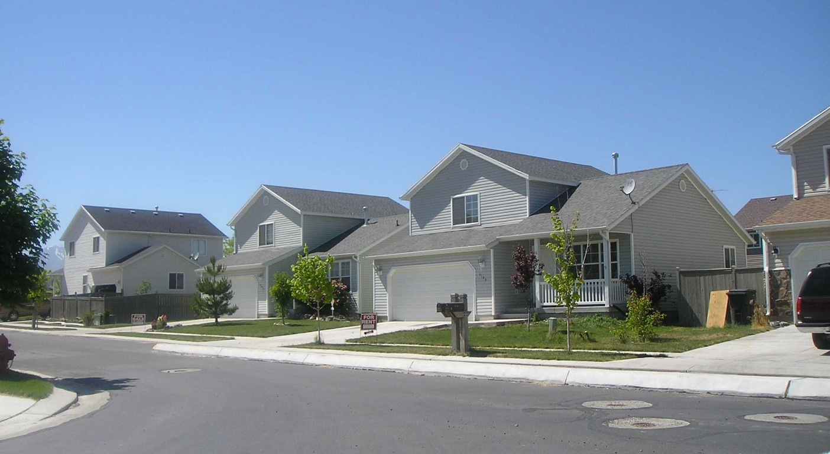
five week deployment 2 apartments & 3 houses
103 water valves
a total of 14,960 water events

Slide 88
water tower
water tower
bathroom 1
hose
spigot
compound events
kitchen
incoming cold water from supply line
dishwasher
thermal
expansion
tank
utility water meter
pressure regulator
hot
water heater
bathroom 2
laundry
Notes:
The cold water supply branches to the individual water fixtures (e.g., toilets/sinks/showers) and into the water heater.
The plumbing system forms a closed loop pressure system with water held at a relatively stable pressure throughout the piping.
This is why, when you open a faucet, water immediately flows out.

Slide 89
compound event effect
Home 1: Bathroom Sink – Isolated
Home 1: Bathroom Sink – In Compound
psi
open
close
open
close
0
4.5
9
0
4
8
time (s)
time (s)

Slide 90
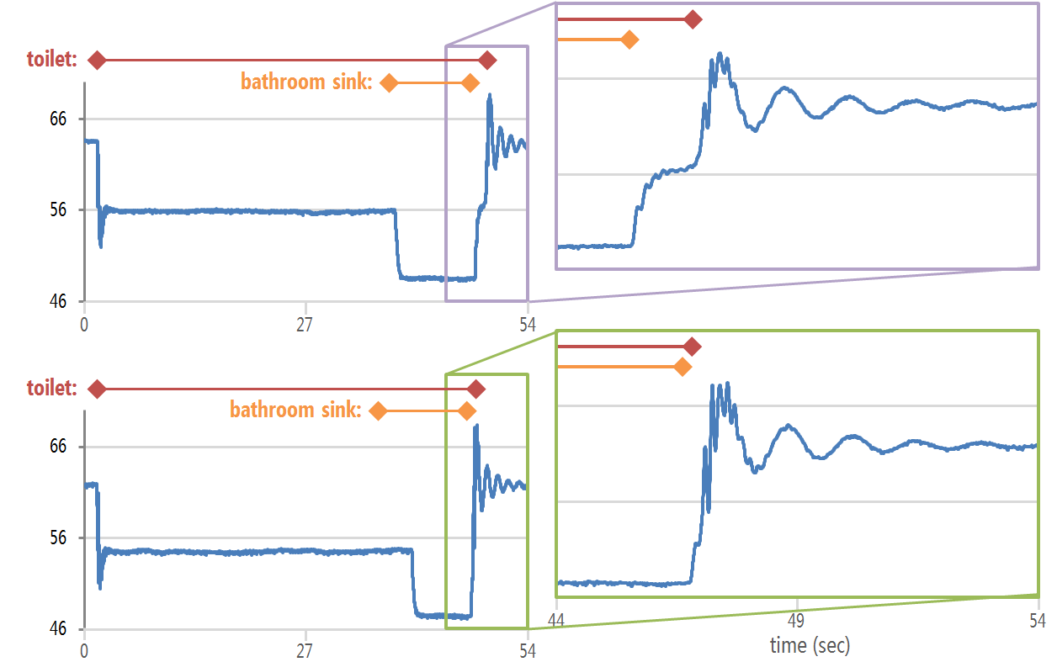
collisions

Slide 91
of all water events were either compound or collisions
22%

Slide 92
five week deployment 2 apartments & 3 houses
103 water valves
a total of 14,960 water events
75.5% valve
89.5% fixture
95.9% fixture category

Slide 93
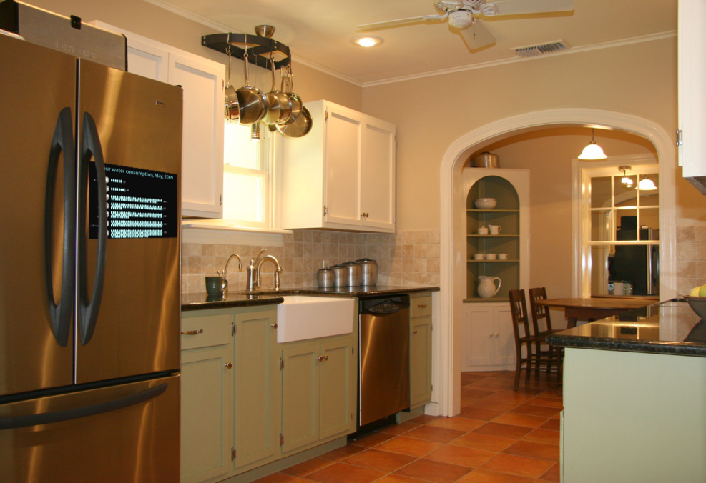
real-time water feedback

Slide 94
thank you!
jonfroehlich@gmail.com
twitter @jonfroehlich
http://ubicomplab.cs.washington.edu
http://dub.washington.edu/
students
faculty
Jon Froehlich
Eric Larson
Tim Campbell
Elliot Saba
Shwetak Patel James Fogarty James Landay Les Atlas
design:
ubicomp lab
use:
build:
university of washington
sustainability research
university of washington

Slide 95
two pressure sensors per home

Slide 96
water scarcity
Notes:
Although energy usage and measurement has lately received a great deal of attention in the HCI and UbiComp communities, water has not.
And yet, the United Nations predicts that water will be the dominating issue over the next 20 years.
And, as you can tell from this map, this is a problem that affects every continent on earth including the US.
----
By 2025, more than 2.8 billion people living in 48 countries will face water shortages.
Environmental water stress is assessed as the percentage of available water resources
currently abstracted compared to environmental water requirements. Environmental water
requirements are defined as the volume of water needed by a river to maintain key ecosystem
functions and biodiversity. This is expressed as a % of the naturalised flow of a river, and can vary
under different conditions, notably between arid and non-arid river systems. In Figure 2 the red
depicts the systems under the highest environmental water stress.

Slide 97
barcelona, spain
Notes:
Already, cities are going to unprecedented lengths to provide their residents with water.
For example, in April of last year, Barcelona, Spain took the unprecedented step of importing water by ship from neighboring nations at a cost of $35 million a month (Crawford, 2008).
Nearly 23m litres of drinking water - enough for 180,000 people for a day

Slide 98
lake mead, nevada
Notes:
The US is not immune from such problems either. According to US government estimates, 36 states will face serious water shortages in the next five years (EPA, 2008).
Lake Mead, which supplies 90% of Las Vegas’ water, is estimated to drop below existing intake pipes by 2012 (Lippert and Efstathiou, 2009).
The city of Las Vegas is paying people to remove their lawns at $1.50 per square foot of lawn replaced with desert-friendly plants for a maximum of $300,000 per year in rebates. (http://www.greenbiz.com/print/35667).
Many utilities invest millions of dollars into conservation programs meant to educate their customers about water and cost savings.
---

Slide 99
feedback improves performance
low-level
high-level
Becker, J. of Applied Psychology 1978
Notes:
One of the best-established findings in psychology is the positive effect that information feedback can have on performance (Becker, 1978).
low-level feedback can provide explicit detail about how to change or improve specific behavior, e.g., which answers I got wrong on a test
high-level feedback can help improve performance by motivating a person to try harder or persist longer at a task, e.g., my current grade in the class
Becker, L. J. Joint Effect of Feedback and Goal Setting on Performance: A Field Study of Residential Energy Conservation. J. of Applied Psychology 63. 4(1978), 428-433.

Slide 100
toyota prius

Slide 101
speedometer
gas gauge
Notes:
One of the best established findings in psychology is the role of feedback on performance. Think about how ingrained feedback is in our environment.
For example, driving:
this type of feedback is always available, passively given allowing us to sort of pre-attentively recognize it

Slide 102
Notes:
We want to create these sorts of passive awareness systems.

Slide 103
vehicle
activated
speed
signs
Notes:
Vehicle Activated Speed

Slide 104
speed cameras
Notes:
Vehicle Activated Speed
In Britain, the VAS signs cost upwards of 90% less to operate annually than speed cameras while preventing more accidents
Sutherland, 2008

Slide 105
vehicle
activated
speed
signs
Notes:
Vehicle Activated Speed
In Britain, the VAS signs cost upwards of 90% less to operate annually than speed cameras while preventing more accidents
Sutherland, 2008

Slide 106
vas signs

Slide 107
fixture classification
unclassified open event
open event library
shower
toilet
dishwasher
kitchen faucet
bath faucet
bath tub
Notes:
Now that we’ve automatically detected events and classified them as open or close, we need to determine where the events came from.
To do this we use a template matching approach and, in particular, we rely on matched filtering to compare our signals, which provides a measure of correlation between signals.

Slide 108
unclassified open event
open event library
shower
toilet
dishwasher
kitchen faucet
bath faucet
bath tub
detrended_{unclassified}
detrended_{shower}
derivative_{unclassified}
derivative_{shower}
cepstrum_{unclassified}
cepstrum_{shower}
Notes:
We chose three transformations in which to use the matched filter. (click)
1. The first transformation is the waveform with trending removed
2. The second transformation is the derivative waveform that we used in the open/close event detection step.
3. The final transformation is the cepstrum transformation, which is popular in the signal processing community and often used to separate a filter from its source.
---
The last space we chose was the Cepstral space. The real cepstrum is a transformation related to the Fourier transform and has been used in the speech recognition community for decades. It’s popular in the signal processing community to separate source from filter.
One property of the real cepstrum is that the space is highly orthogonal and thus is good fit for our application.

Slide 109
unclassified open event
open event library
shower
toilet
dishwasher
kitchen faucet
bath faucet
bath tub
test similarity
detrended_{unclassified}
detrended_{shower}
matched filter
derivative_{unclassified}
derivative_{shower}
possible events
matched filter
cepstrum_{unclassified}
cepstrum_{shower}
matched filter
Notes:
To test for similarity, we look at the transformations for each saved event in the library.
If the similarity is above a certain threshold in each subspace, we add the event to a list of possible events. The thresholds are learned using a leave one out cross validation of all other homes in our database.
--
We also use the mean squared error of the de-trended signal. If the MSE is above a cross validation threshold, it passes the similarity test.

Slide 110
unclassified open event
open event library
toilet
dishwasher
kitchen faucet
bath faucet
bath tub
detrended_{unclassified}
detrended_{toilet}
derivative_{unclassified}
derivative_{toilet}
possible events
cepstrum_{unclassified}
cepstrum_{toilet}
Notes:
We repeat this process for every event in our library…

Slide 111
unclassified open event
open event library
toilet
dishwasher
kitchen faucet
bath faucet
bath tub
detrended_{unclassified}
detrended_{toilet}
matched filter
derivative_{unclassified}
derivative_{toilet}
possible events
matched filter
cepstrum_{unclassified}
cepstrum_{toilet}
matched filter
Notes:
Here a toilet signal transform fails a similarity test and thus it is discarded from the pool of possible events.

Slide 112
unclassified open event
open event library
dishwasher
kitchen faucet
bath faucet
bath tub
detrended_{unclassified}
derivative_{unclassified}
possible events
cepstrum_{unclassified}
Notes:
this occurs for each event in the library.

Slide 113
unclassified open event
open event library
shower
detrended_{unclassified}
dishwasher
derivative_{unclassified}
possible events
kitchen faucet
cepstrum_{unclassified}
Notes:
If more than one possible event is in our possible event pool, we perform one additional comparison.

Slide 114
unclassified open event
open event library
derivative_{shower}
shower
shower
dishwasher
detrended_{unclassified}
derivative_{toilet}
dishwasher
derivative_{unclassified}
possible events
kitchen faucet
kitchen faucet
derivative_{kitchen} _{faucet}
cepstrum_{unclassified}
Notes:
on the derivative waveform, which is the most orthogonal subspace.

Slide 115
unclassified open event
open event library
derivative_{shower}
shower
derivative_{toilet}
dishwasher
nearest neighbor match
derivative_{unclassified}
possible events
kitchen faucet
derivative_{kitchen} _{faucet}
Notes:
We perform a nearest neighbor search on all remaining possible events using the matched filter similarity score in the derivative space.
Once the event is identified, we can assign flow, in gpm, using a calibrated fluid resistance value for the specific valve.

