Slide 1





A Large-Scale Mixed-Methods Analysis of Blind and Low-vision Research in ACM and IEEE
Yong-Joon Thoo¹, Maximiliano Jeanneret Medina^{1, 2},
Jon E. Froehlich³, Nicolas Ruffieux¹ and Denis Lalanne¹
¹Human-IST Institute, University of Fribourg
²HEG Arc, HES-SO // University of Applied Sciences Western Switzerland
³University of Washington
ASSETS ’23, October 22-25, 2023, New York, NY, USA
Notes:
Good morning everyone. My name is Yong-Joon and with the help of co-author Max, we will co-present our paper entitled "A large-scale mixed methods analysis of blind and low-vision research in ACM and IEEE". We are both from the Human-IST institute of the University of Fribourg and we are presenting on behalf of co-authors Jon Froehlich from the University of Washington, as well as Nicolas Ruffieux and Denis Lalanne from the University of Fribourg.

Slide 2





Context
Field-, technology-, method-agnostic review
 | All abilities (e.g., visual, hearing, motor, cognitive) | Blind and/or Low-vision (BLV) People
General
Focused | Not identified
Concept¹
(e.g., accessibility)
Goal/Task
Methods²
Technology or Device³
¹Mack et al. CHI’21; Sarsenbayeva et al. International Journal of Human-Computer Studies 2023
²Brulé et al. CHI’20
³Bhowmick and Hazarika Journal on Multimodal User Interfaces 2017
Notes:
Whilst many review papers on blind and low-vision research have been conducted within our community, we note that past reviews have either included multiple abilities (e.g., providing an overview of what we mean by accessibility research) or, for those that we specific to blind and low-vision research, focused primarily on a specific goal/task (e.g. navigation), reporting of evaluation methods, and or the use of a specific technology or device. As such, to extend upon previous work, we wanted to conduct a field-, technology- and method-agnostic review of blind and low-vision research.

Slide 3
Context
Field-, technology-, method-agnostic review
RQ1 Research areas | RQ2 Communities of focus
RQ3 Technological trends* | RQ4 Interaction modalities
*Not part of the presentation
Notes:
To do this, we leveraged techniques from the field of bibliometrics which Max will present in a moment and focused on 4 main research questions. Namely:
RQ1 What are the main research areas targeting BLV users?
RQ2 What are the main communities of focus considered in these studies (e.g., low-vision, blind, N/S)?
RQ3 What are the main technological trends and devices used?
RQ4 What are the common interaction modalities employed with regards to the targeted end-users' visual abilities?
Now, for the sake of this presentation, we will focus mainly on the main research areas, the main communities of focus and the common interaction modalities. So I'll first let Max present the methodology before I present our main results.

Slide 4





Methodology
Bibliometric Workflow
1. Research design
2. Compilation of bibliographic data
3. Analysis
4. Visualization
Science map:
5. Interpretation
Zupic and Čater Organizational Research Methods 2015
Notes:
Our review methodology follows a five-step process commonly used in the bibliometric field. This process consists of designing the research, collecting the bibliographic data, analyzing the data with bibliometric techniques, visualizing the data in a science map, and finally interpreting the results.

Slide 5
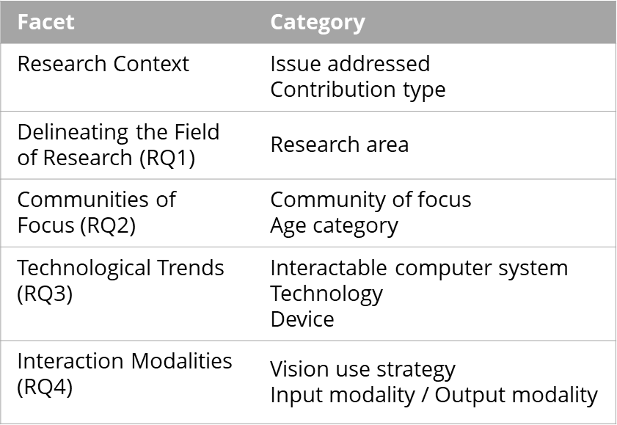

Methodology
Research design (1)
Quantitative
Qualitative
Bibliometric
Documents Bibliographic Coupling Analysis (DBCA)
Programmatic
Frequency counting of terms
Deductive and inductive
Conceptual framework
A
B
Doc.
BLV:
Ref.
R₁
R₂
R₃
Notes:
In the first step, we favored a mixed methods research design. We first applied bibliometric and programmatic analyses.
The main bibliometric technique we used is called documents bibliographic coupling analysis, or DBCA for short.
Let me explain DBCA: I write a paper “A” about web accessibility for low vision people, and Yong Joon write a paper “B” about augmented reality for low vision people. If we cite a same third document, our works will be coupled with a strength of 1.
In a second step, we developed a conceptual framework to perform a qualitative data analysis to a subset of papers.

Slide 6
Methodology
Compilation of bibliographic data (2)
Search Terms* | Venue / Document Type | Period
blind | low-vision | deaf-blind | with visual impairments | blindness | partially sighted | partial vision | visually impaired | …
&
people | person | user
ACM OR IEEE
Conference proceedings OR journal articles
2010-2022 (inclusive)
3,378 papers with bibliographic references and # citations (incoming)
→ N=3,193 (after screening)
*Adapted primarily from Brulé et al. CHI’20; Mack et al. CHI’21; and inspired by Sharif et al. ASSETS’22.
Simplified for clarity. Retrieved the 7th of April 2023.
Notes:
To create our dataset, we extended the search queries from prior works to include common denominations of visual abilities with person- and identity-first language. We selected conference or journal papers published in ACM or IEEE venues and focused on the last thirteen years. The resulting dataset was then screened to remove false positive.

Slide 7
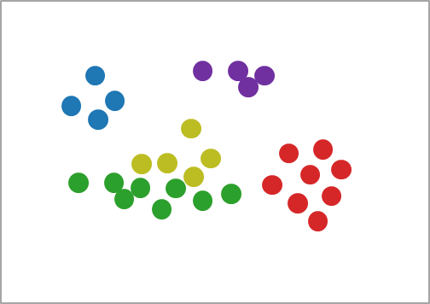
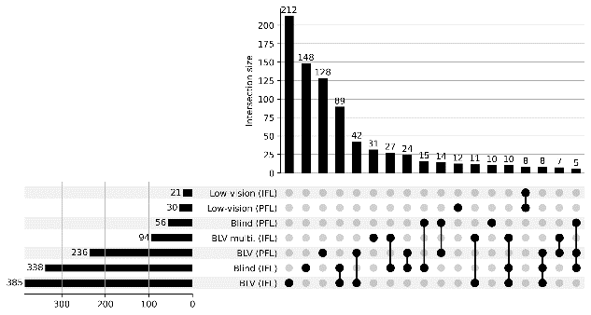
Methodology
Analysis (3) & Visualization (4)
Input | Processing* | Visualization
Science map (VOS)
N=880
Bibliometric processing:
Filtering (norm. citation)
DBCA
Clustering
N=3,193
with bibliographic references and # citations (incoming)
Rank | Cluster | Paper
1 | 1 | Antol et al. ICCV 2015
1 | 2 | Bigham et al. UIST 2010
 |  | …
Programmatic processing:
Counting terms in TAK
Consolidation (manual)
Counting terms in TAK
UpSet plot
N=880
N=880
with Title, Abstract and Author Keywords (TAK)
*Data cleaning details and tools are described in the paper
Notes:
We then cleaned and filtered the screened dataset to retain the 880 (eight hundred and eighty) papers that received the most interest in terms of incoming citations. Then, we performed a DBCA to obtain a science map with papers grouped into clusters. The proximity between papers is determined by their common references.
NEXT
Additionally, we implemented custom-made scripts to count the frequency of terms in Title, Abstract, and Author Keywords. We then used several data visualizations to explore the data under various dimensions.

Slide 8



Methodology
Interpretation (5) – a two-level iterative analysis
1) First-level Analysis (N=880)
2) Second-level Analysis (N=100)
a) Five clusters obtained after DBCA
b) Four research areas obtained after tagging paper’s TAK
In-depth qualitative analysis based on our conceptual framework
Science map (VOS)
Science map (VOS)
Facet | Category
Research Context | Issue addressed Contribution type
Delineating the Field of Research (RQ1) | Research area
Communities of Focus (RQ2) | Community of focus Age category
Technological Trends (RQ3) | Interactable computer system Technology Device
Interaction Modalities (RQ4) | Vision use strategy Input modality / Output modality
RA₂
RA₁
RA₃
RA₄
 | Cluster | N=880 (%)
 | C_{A} | 95 (10.8)
 | C_{B} | 166 (22.4)
 | C_{C} | 176 (20)
 | C_{D} | 403 (45.6)
 | C_{E} | 40 (4.5)
Research Area | N=880 (%)
RA₁ | 280 (31.8)
RA₂ | 195 (22.2)
RA₃ | 54 (6.1)
RA₄ | 331 (37.6)
RA_{Other} | 20 (2.3)
N=100
32
22
6
38
2
Notes:
Regarding the interpretation, we used DCBA as an intermediate phase to first acquire insights into the diversity of BLV research before assigning research areas manually. After having obtained 5 clusters (automatically through bibliometrics), we favored 4 research areas.
Furthermore, for our in-depth qualitative analysis, we extracted the top 100 most-cited papers per research area which were coded using our conceptual framework.

Slide 9
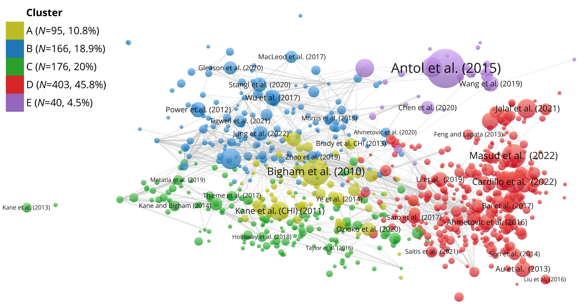
Results and Discussion
Delineating the Field of Research
Quantitative: Bibliometric & Programmatic
E: model; app; deep learning
A & B: app; accessibility
C: access; interact; tactile
D: system; navigation; environment
Notes:
In this slide, we have a visualization of science map that was obtained after performing the DBCA on our set of 880 papers where the nodes or bubbles present a specific paper, and the edges present the common references. Moreover, the larger the node, the higher the citation count. Furthermore, the map is organized into 5 clusters suggested with the first two clusters surrounding keywords such as app and accessibility, the third cluster containing keywords such as access, interact and tactile, the fourth cluster with keywords such as system; navigation and environment and the last cluster with keywords such as deep learning and model. Now, whilst the DBCA provided us with a preliminary structure of the field and an overview of the research field, Max and I manually verified and revised the clusters by reviewing each of the publications' title, abstract and keywords and assigning or re-assigning a single research area.

Slide 10
Results and Discussion
Delineating the Field of Research
Accessibility at Home & on the Go (N=280, 31.8%)
Visual Question Answering¹
Assistive wearable and mobile technologies³
Speech
Orientation & Mobility
(N=331, 37.6%)
Visual media description²
Non-Visual Interaction (N=195, 22.2%)
Touch
Education
(N=54, 6.1%)
Tangibles for STEM
Localization, detection, pathfinding
BLV Research (N=880)
Inclusive & collaborative learning
Outdoor/indoor environments
Navigation behaviors and preferences
Qualitative
Research Area
Major Topics
¹Antol et al. ICCV’15; Bigham et al. UIST’10; Brady et al. CSCW’13; Gurari et al. CPVR’18
²Gleason et al. CHI’20; Morris et al. CHI’16; Wu et al. CSCW’17; Stangl et al. CHI’20
³Ahmetovic et al. CHI’20; Neto et al. IEEE THMS 2017
Notes:
After this iterative process, we finally settled upon 4 main research areas.
The first is entitled "accessibility at home and on the go" which contains 32% of our dataset and includes studies focused on assisting blind and low-vision users to perform daily activities involving visual content. More specifically, we identified papers focused on digital content and papers focused on providing assistance to users in multiple settings.

Slide 11
Results and Discussion
Delineating the Field of Research
Accessibility at Home & on the Go (N=280, 31.8%)
Visual Question Answering
Assistive wearable and mobile technologies
Speech¹
Orientation & Mobility
(N=331, 37.6%)
Visual media description
Non-Visual Interaction (N=195, 22.2%)
Touch²
Education
(N=54, 6.1%)
Tangibles for STEM
Localization, detection, pathfinding
BLV Research (N=880)
Inclusive & collaborative learning
Outdoor/indoor environments
Navigation behaviors and preferences
Qualitative
Research Area
Major Topics
¹Azenkot and Lee ASSETS’13; Branham and Roy ASSETS’19; Leporini et al. OzCHI’12; Pradhan et al. CHI’18
²Holloway et al. CHI’18; Kane et al. CHI’11; Oliveira et al. ASSETS’11; Ozioko et al. IEEE TNSRE 2020
Notes:
The second research area is labelled as "Non-visual interaction" with about 22% of our dataset and included studies focused on investigating non-visual modalities to enable blind and low-vision users to interact with computer systems. For instance, we identified studies that investigated the speech modality via the use of voice personal assistants or the touch modality via the use of touchscreens.

Slide 12
Results and Discussion
Delineating the Field of Research
Accessibility at Home & on the Go (N=280, 31.8%)
Visual Question Answering
Assistive wearable and mobile technologies
Speech
Orientation & Mobility
(N=331, 37.6%)
Visual media description
Non-Visual Interaction (N=195, 22.2%)
Touch
Education
(N=54, 6.1%)
Tangibles for STEM²
Localization, detection, pathfinding
BLV Research (N=880)
Inclusive & collaborative learning¹
Outdoor/indoor environments
Navigation behaviors and preferences
Qualitative
Research Area
Major Topics
¹Brulé et al. CHI’16; Metatla et al. CHI’19 & 20; Thieme et al. DIS’17
²Kane and Bigham SIGCSE’14; Koushik et al. CHI’19
Notes:
The third research area is labelled as "Education" and consists of 6% of our dataset with studies investigating means by which to promote inclusive and/or collaborative learning as well as papers that aim to help blind and low-vision students learn or study STEM subjects which rely heavily on the visual modality.

Slide 13
Results and Discussion
Delineating the Field of Research
Accessibility at Home & on the Go (N=280, 31.8%)
Visual Question Answering
Assistive wearable and mobile technologies
Speech
Orientation & Mobility
(N=331, 37.6%)
Visual media description
Non-Visual Interaction (N=195, 22.2%)
Touch
Education
(N=54, 6.1%)
Tangibles for STEM
Localization, detection, pathfinding^{1, 2}
BLV Research (N=880)
Inclusive & collaborative learning
Outdoor/indoor environments^{1, 2}
Navigation behaviors and preferences³
Qualitative
Research Area
Major Topics
^{1, 2}Ahmetovic et al. MobileHCI’16; Au et al. IEEE TMC 2013; Bai et al. IEEE TMC 2017; Sato et al. ASSETS’17
³Azenkot et al. CHI‘11; Colley et al. CHI’20; Williams et al., ASSETS’13 & 14
Notes:
Finally, our 4th research area, labelled as "Orientation and Mobility", contains 38% of the papers from our study and focuses on improving the independence and safety of users in the context of O&M tasks. In particular, we identify papers focused on one or multiple aspects of O&M, such as locating the user, detecting obstacles in their way of users and providing feedback /instructions to guide them.

Slide 14
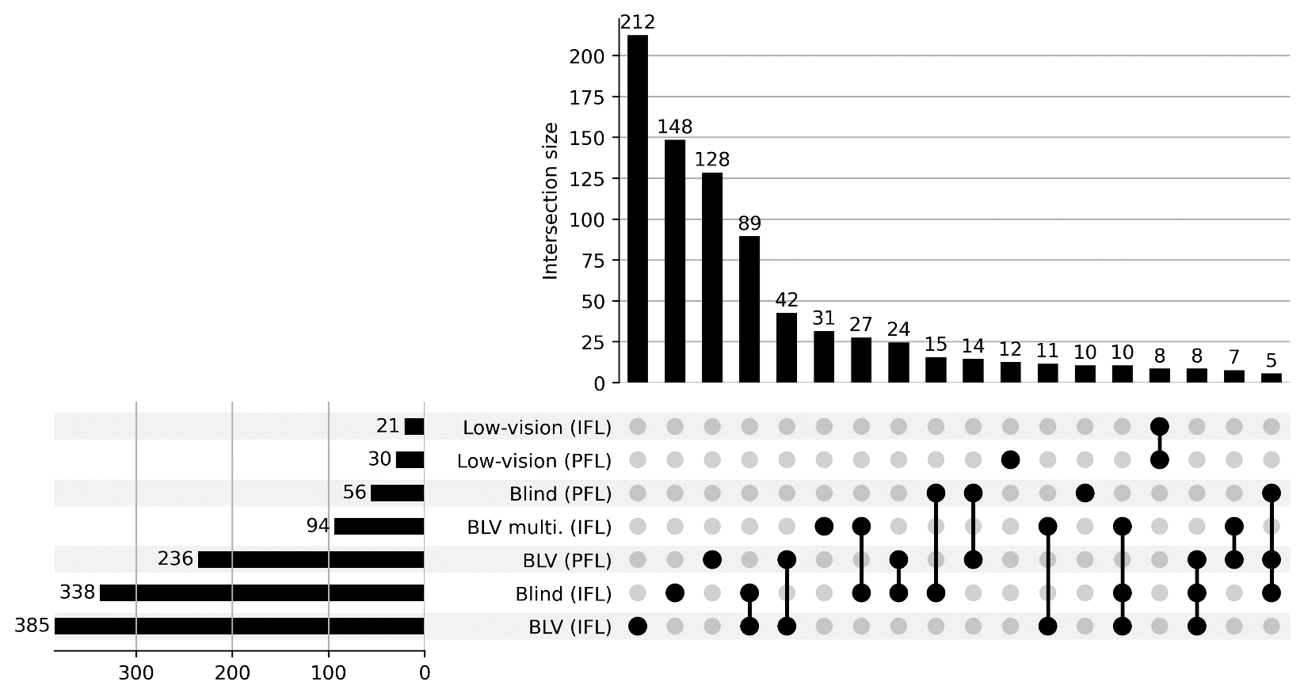
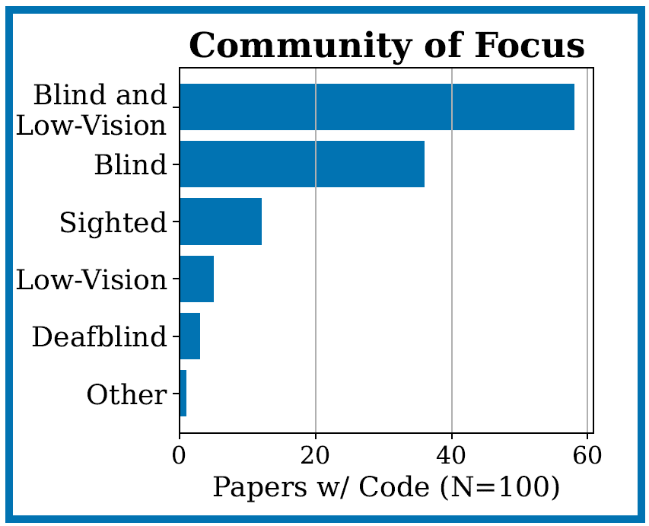
Results and Discussion
Communities of Focus
Quantitative: Programmatic
Qualitative
UpSet plot
N=880
IFL: identity-first language
PFL: person-first language
→ Reporting participants’ visual abilities
Notes:
Regarding the communities of focus, which is reflected via our second research question, in this slide we present 2 plots that highlight the main blind and low-vision denominations that we identified. The figure on the left hand side presents the denominations identified from the title, abstract and keywords from the set of 880 papers and the figure on the right presents the communities of focus indentified from the coding of the top 100 papers.
More specifically, the figure on the left highlights not only the number of times a given dénomination was identified via the horizontal bars but also the number of times multiple dénominations occured within a same paper. For instance, we found multiple papers the mentioned blind and low-vision or "visually impaired" at the beginning of their abstract but then mentioned solely low-vision or blind when it came to the evaluation of the system.
Now initially, my colleague and I wanted to code the specific visual ability with whom artefacts were evaluated. However, as highlighted in previous reviews, we identified a large variety in terms of reporting visual status. Whilst previous work has encouraged the use of the WHO classification, other papers have hinted that this may not be sufficient due to individual preferences and visual strategies. As such, in our paper we encourage the HCI to reflect and discuss potential guidelines regarding what information about BLV participants should be collected and how.

Slide 15
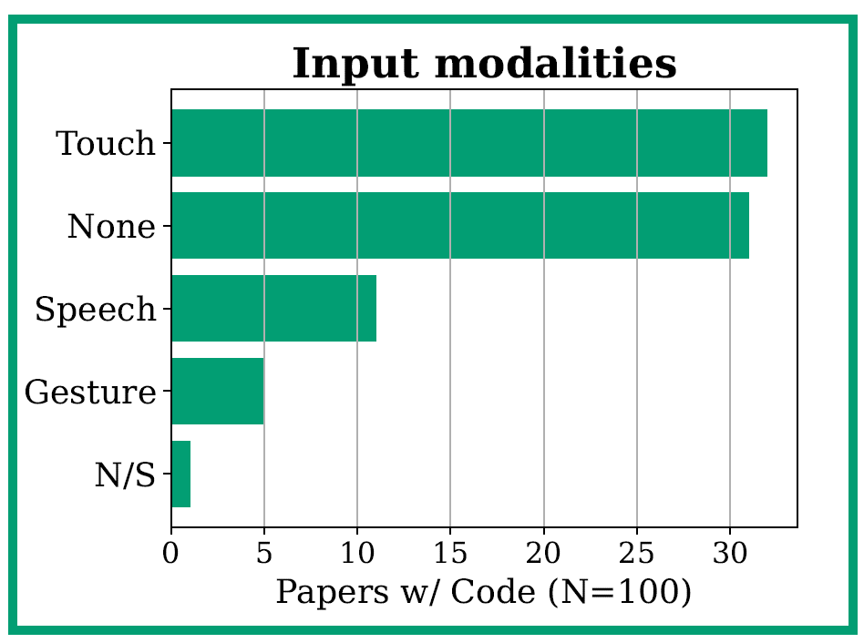
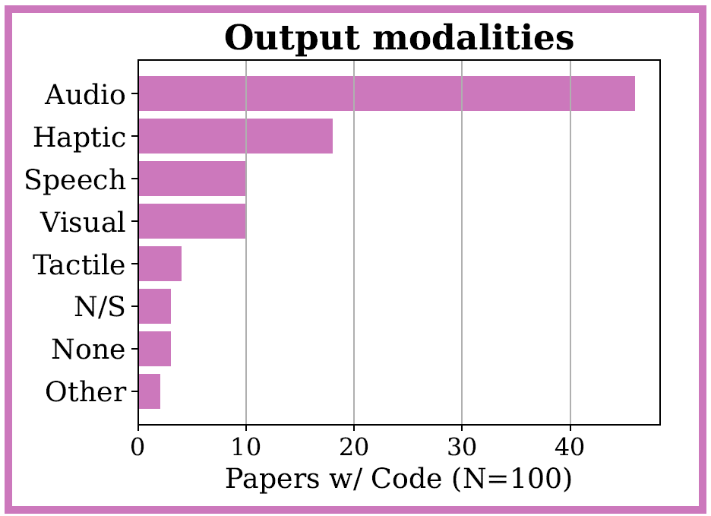
Results and Discussion
Interaction Modalities
Qualitative
→ Use of residual vision
→ Provide more control to users
Notes:
Finally, regarding the interaction modalities, this slide contains two figures that present the main input and output modalities identified via the coding of the top 100 papers. In particular, in line with previous studies, we highlight the use of non-visual feedback to blind and low-vision users and highlight a study that emphasizes the desire of low-vision participants to be able to control/adapt the technology in use to their needs. As such, in our paper, we encourage work to enable users to gain more control of the assistance provided and provide some ideas for future work.

Slide 16
Conclusion
Delineation of the most prominent research areas related to BLV across ACM and IEEE
An evidence-based discussion of current gaps and opportunities for future work
Open-source programmatic analysis to support our two-level analysis
Notes:
To conclude, in this work, we conducted a field-, technology- and method- agnostic review of BLV research over the last 12 years and provide discussions regarding current gaps and opportunities for future work. For instance, whilst in our study we aimed at providing a descriptive analysis of studies from ACM and IEEE, future work could involve a comparative analysis of studies from these venues. Finally, in our work, we also provide our open-source programmatic analysis (e.g., notebook) that was used to support our two-level analysis and plots presented in our paper.

Slide 17





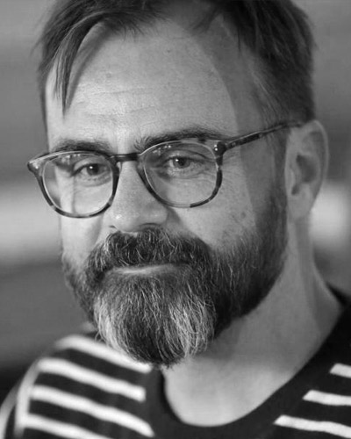

Thank you
https://github.com/human-ist/BLV-research-analysis
Yong-Joon Thoo
Maximiliano
Jeanneret Medina
Jon E. Froehlich
Nicolas Ruffieux
Denis Lalanne
Notes:
Github link? Only oraly?

Slide 18
Results and Discussion
Delineating the Field of Research
Accessibility at Home & on the Go (N=280, 31.8%)
Visual Question Answering
Assistive wearable and mobile technologies
Speech
Orientation & Mobility
(N=331, 37.6%)
Visual media description
Non-Visual Interaction (N=195, 22.2%)
Touch
Education
(N=54, 6.1%)
Tangibles for STEM
Localization, detection, pathfinding
BLV Research (N=880)
Inclusive & collaborative learning
Outdoor/indoor environments
Navigation behaviors and preferences
Qualitative
Research Area
Major Topics
Notes:
After this iterative process, we finally settled upon 4 main research areas.
The first is entitled "accessibility at home and on the go" which contains 32% of our dataset and includes studies focused on assisting blind and low-vision users to perform daily activities involving visual content. More specifically, we identified papers focused on digital content and papers focused on providing assistance to users in multiple settings.
The second research area is labelled as "Non-visual interaction" with about 22% of our dataset and included studies focused on investigating non-visual modalities to enable blind and low-vision users to interact with computer systems. For instance, we identified studies that investigated the speech modality via the use of voice personal assistants or the touch modality via the use of touchscreens.
The third research area is labelled as "Education" and consists of 6% of our dataset with studies investigating means by which to promote inclusive and/or collaborative learning as well as papers that aim to help blind and low-vision students learn or study STEM subjects which rely heavily on the visual modality.
Finally, our 4th research area, labelled as "Orientation and Mobility", contains 38% of the papers from our study and focuses on improving the independence and safety of users in the context of O&M tasks. In particular, we identify papers focused on one or multiple aspects of O&M, such as locating the user, detecting obstacles in their way of users and providing feedback /instructions to guide them.

Slide 19
Methodology
Bibliometric Workflow
Step | Sub-step | Detail
1. Research design | 1.1 Methods | Mixed methods : Bibliometric methods: documents bibliographic coupling analysis (DBCA) Programmatic analyses: qualitative analyses:
2. Compilation of bibliographic data | 2.1 Search scope | Brulé et al. [28] ACM or IEEE (indexed by Scopus) 2010-2022 (inclusive) N=3,378 → 3,193 (in scope)
3. Analysis | 3.1 Cleaning | Reference Data Cleaning Cleaning and Processing Title, Abstract, and Author Keywords (TAK) Dataset Filtering (Z-score) : N=880 and N =100 (most cited per research area)
 | 3.2 Processing | Documents bibliographic coupling analysis (DBCA) Semi-automatic : consolidated list of the most frequent groups of terms.
4. Visualization | 4.1 Science Mapping | VOS map / Leiden clustering / association strength normalization UpSet Plot
5. Interpretation | 5.1 First-Level Analysis | Open coding (clusters) Tagging Research Areas (N=880)
 | 5.2 Second-Level Analysis | In-Depth Qualitative Analysis (N=100)

Slide 20
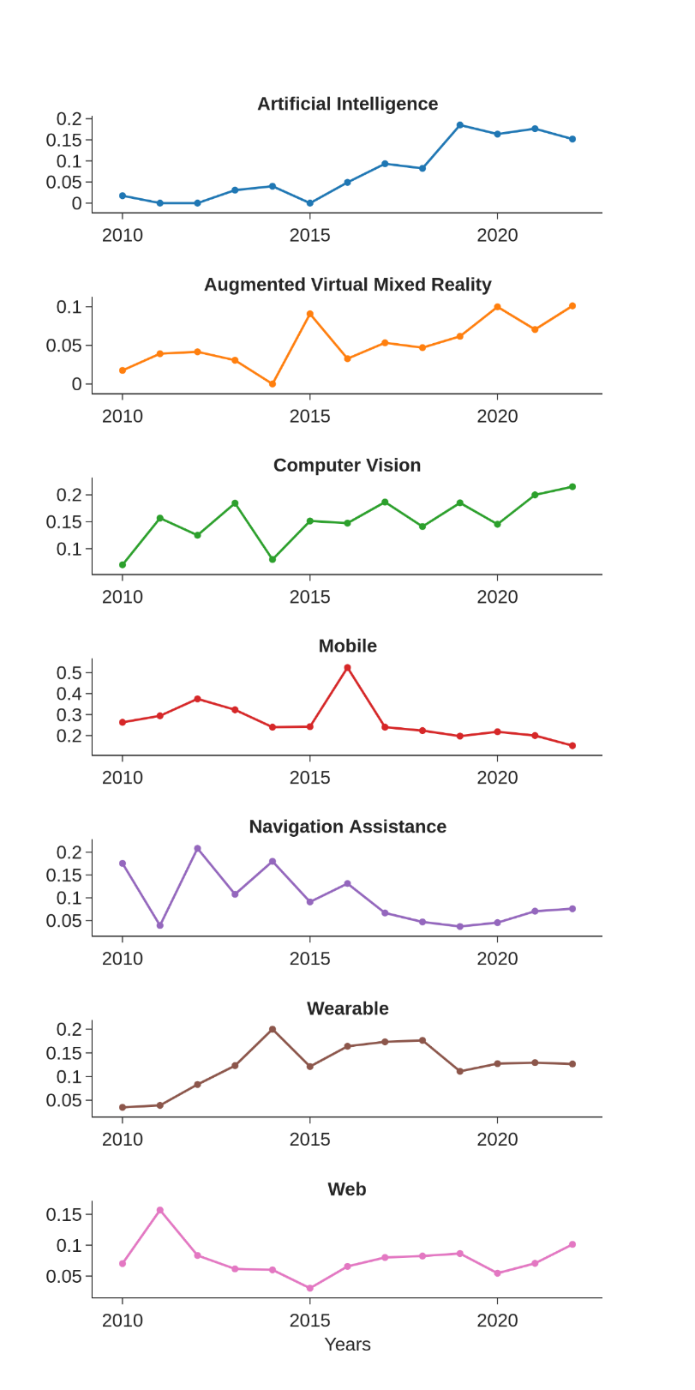
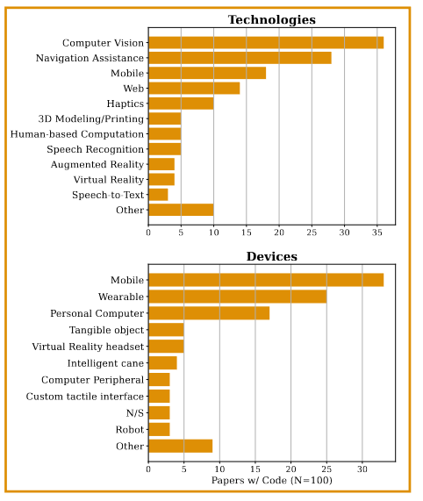
Results
Technologies and Devices

Slide 21
Results and Discussion
Delineating the Field of Research
Accessibility at Home & on the Go (N=280, 31.8%)
Visual Question Answering
Assistive wearable and mobile technologies
Speech
Orientation & Mobility
(N=331, 37.6%)
Visual media description
Non-Visual Interaction (N=195, 22.2%)
Touch
Education
(N=54, 6.1%)
Tangibles for STEM
Localization, detection, pathfinding
BLV Research (N=880)
Inclusive & collaborative learning
Outdoor/indoor environments
Navigation behaviors and preferences
Qualitative
Research Area
Major Topics

Slide 22
Q/R: clustering
Step | Purpose | Domain
Accessibility at Home & on the Go | Transversal Autonomy | General
Non-Visual Interaction | Communicate | General
Education | Learn | School
Orientation & Mobility | Move | Navigation

Slide 23
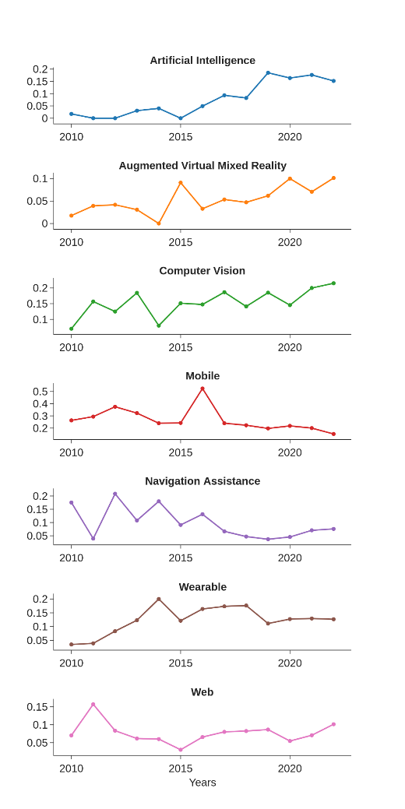
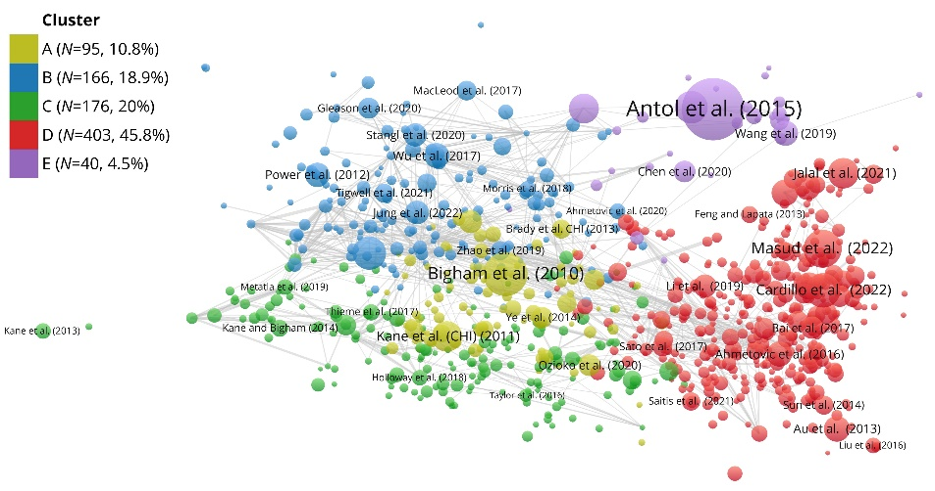
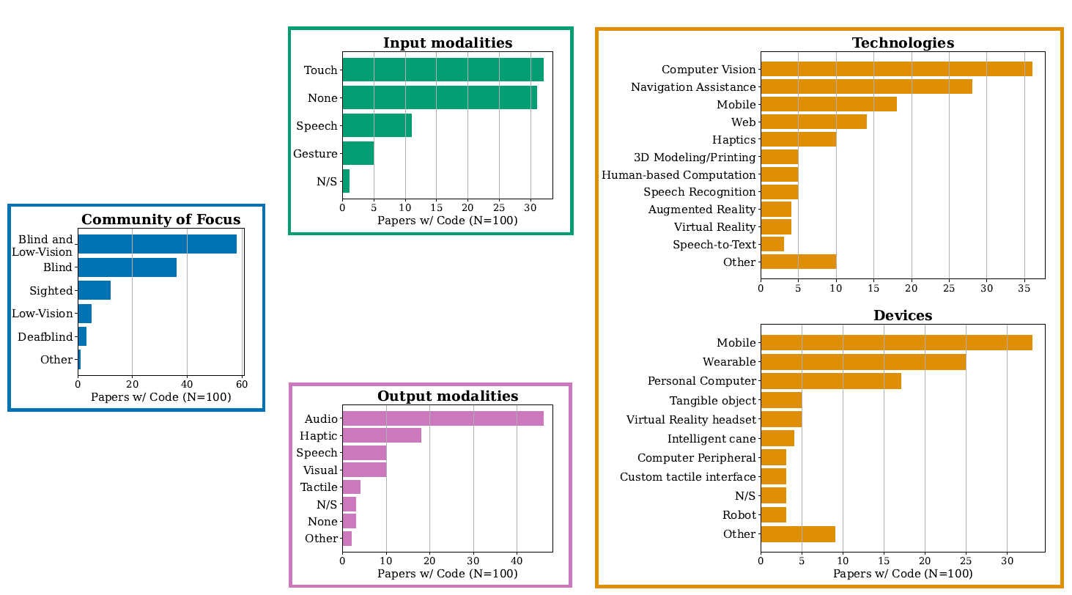

Results and Discussion
Quantitative: Bibliometric & Programmatic
Qualitative: Conceptual Framework
Notes:
Only for video : Bibliometric and Programmatic Analyzes va Qualitative Data Analysis

Slide 24
Context
Field-, technology-, method-agnostic review
RQ1 What are the main research areas targeting BLV users?
RQ2 What are the main communities of focus considered in these studies (e.g., low-vision, blind, N/S)?
RQ3 What are the main technological trends and devices used?
RQ4 What are the common interaction modalities employed with regards to the targeted end-users' visual abilities?

