Slide 1
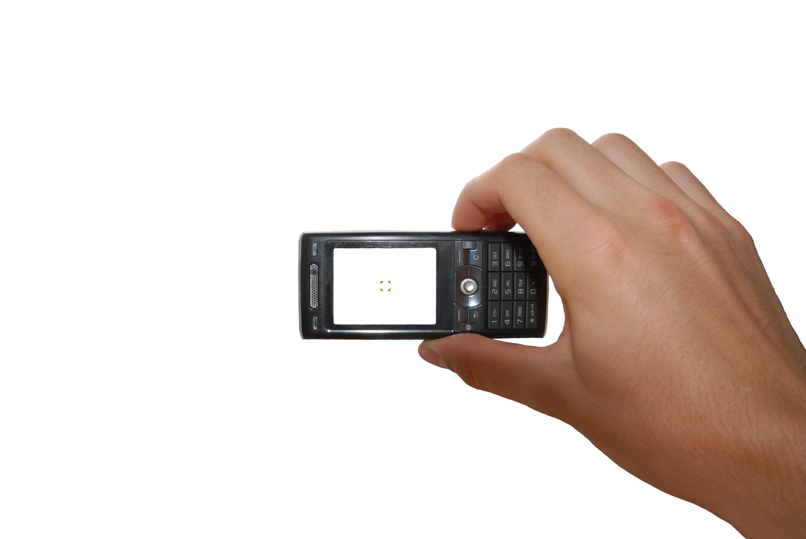
The Mobile Phone as a Window into Human Behavior
Jon Froehlich
@jonfroehlich
PhD Candidate
Computer Science and Engineering
University of Washington

Slide 2
data is fundamental to any science
Notes:
Allows one to make measurements and validate claims

Slide 3
collecting data on human behavior is often hard and expensive
data is fundamental to any science

Slide 4
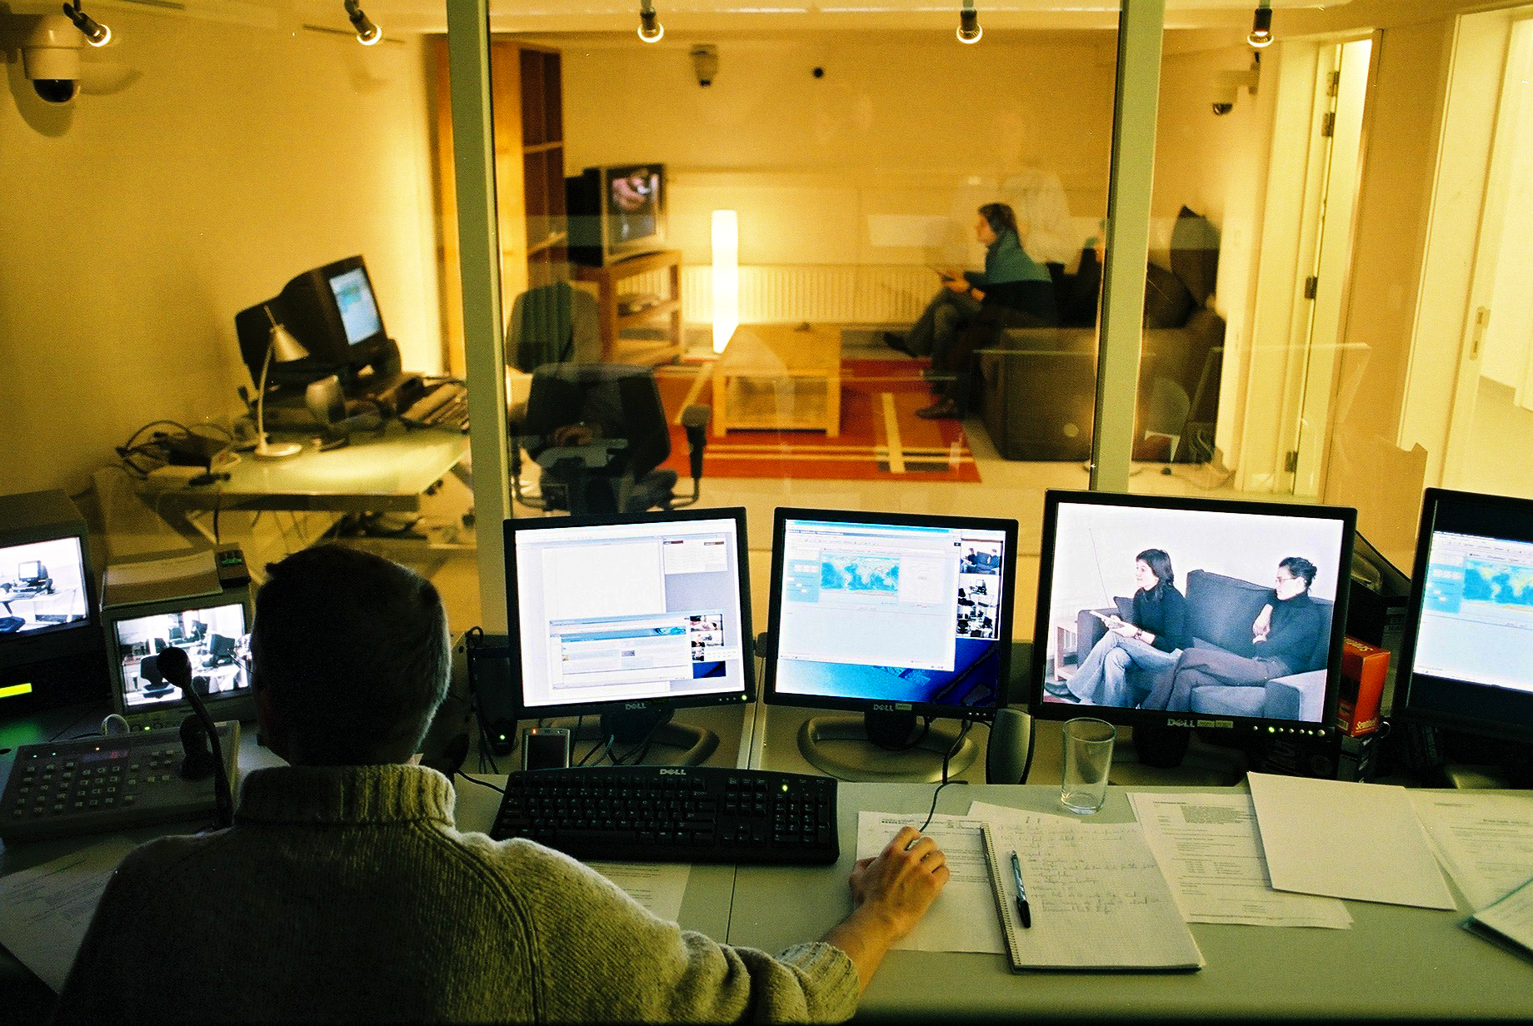
in the lab
Notes:
The lab is nice because it is a constrained environment; allows you to setup highly controlled experiments but how many people’s living rooms have two way mirrors

Slide 5
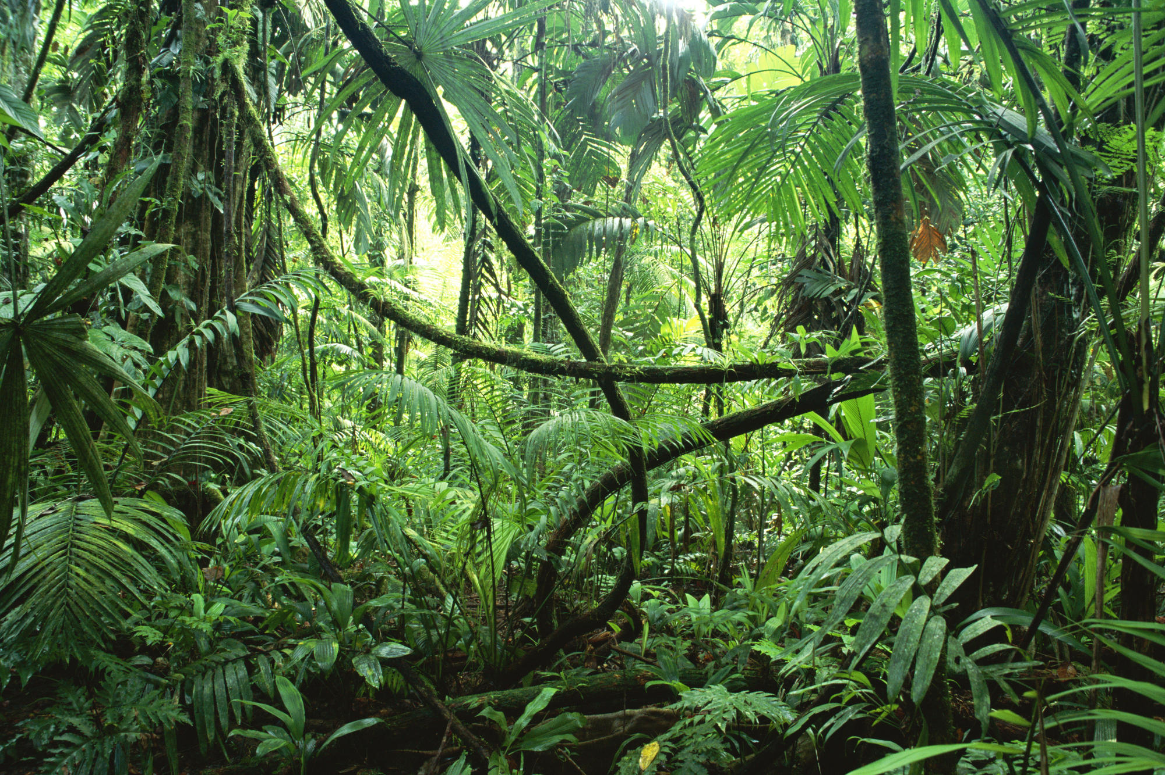
out in the wild

Slide 6
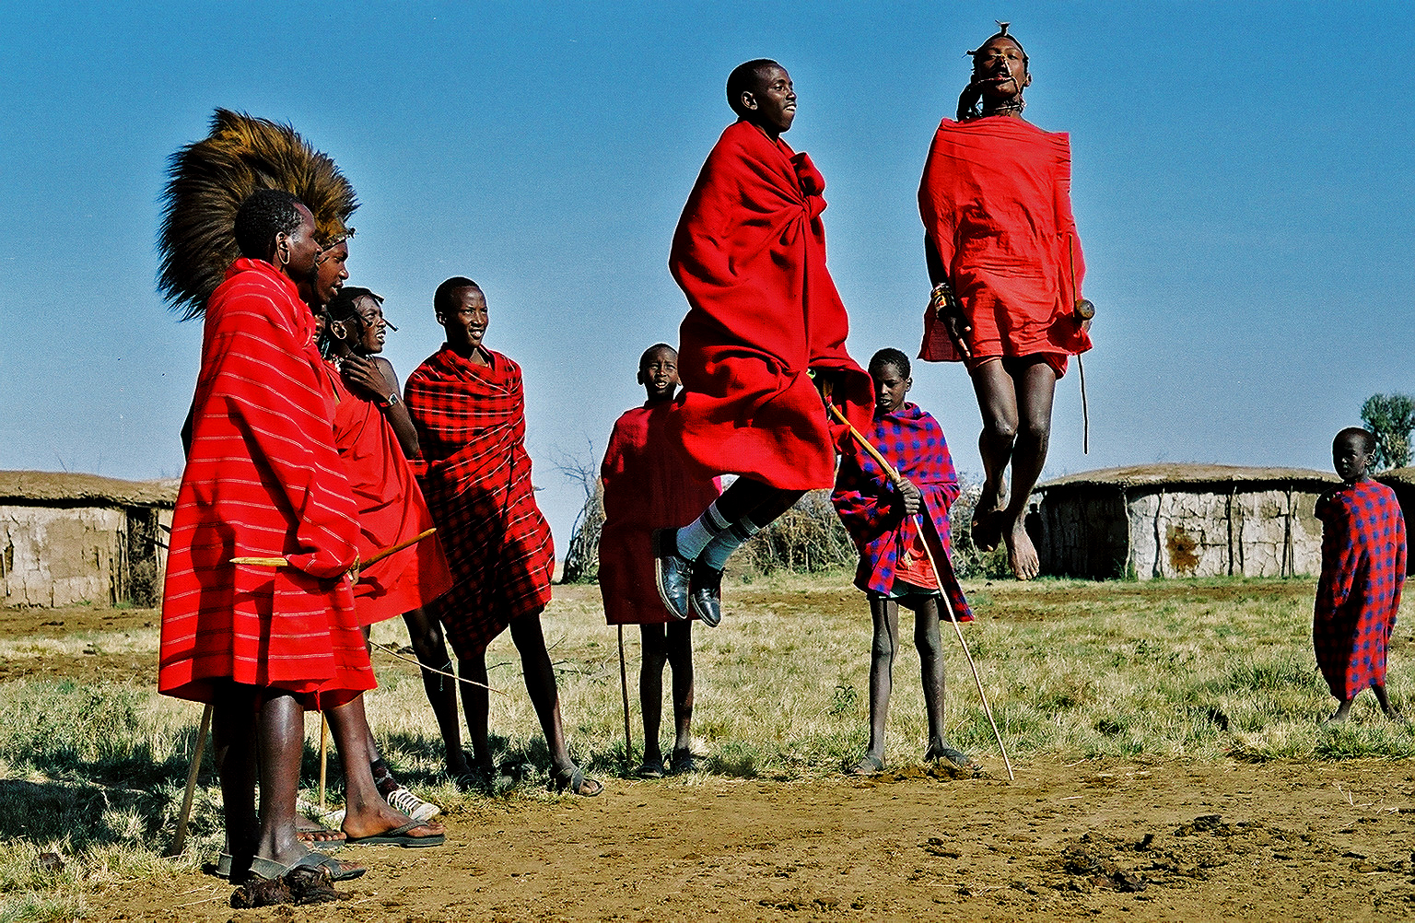
ethnography

Slide 7
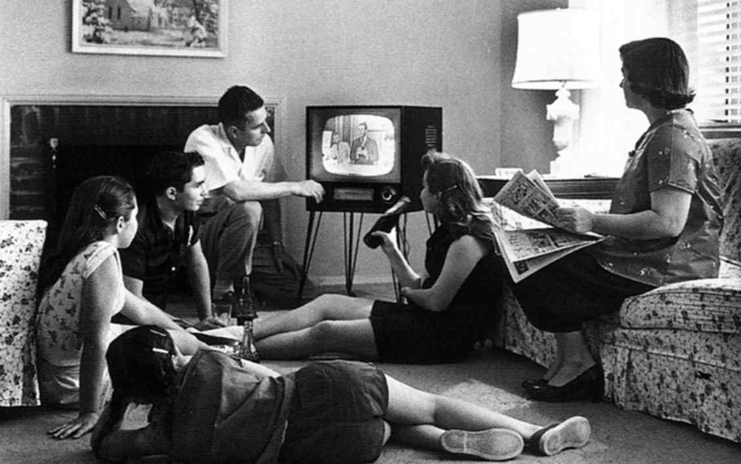
ethnography

Slide 8
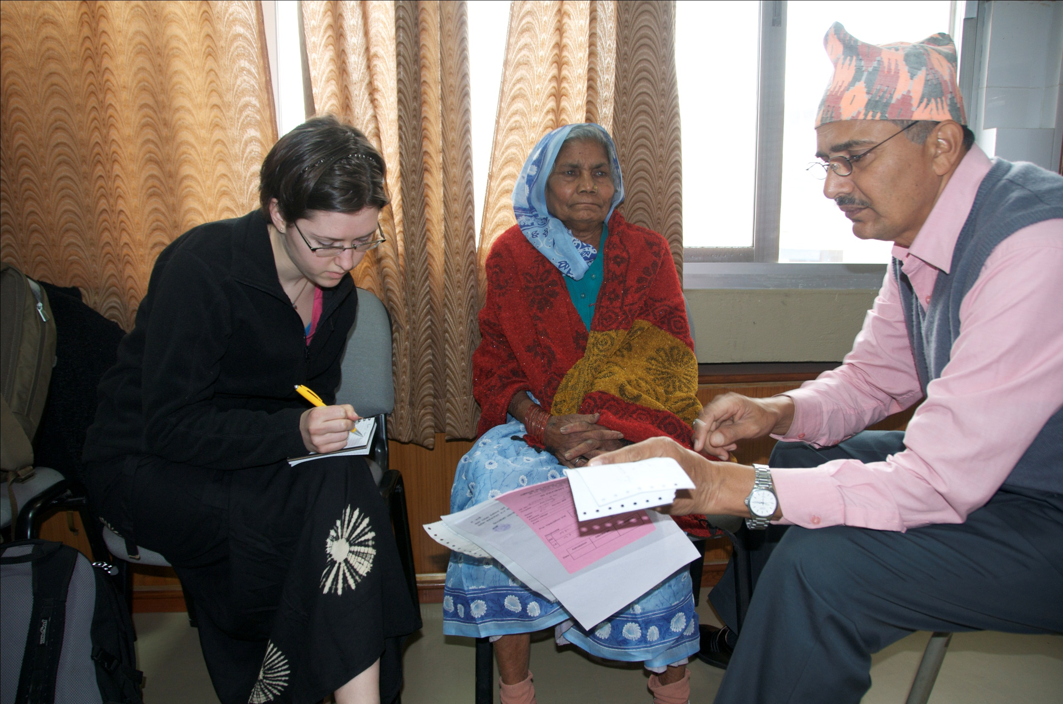
interviews

Slide 9


Slide 10
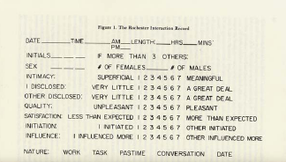
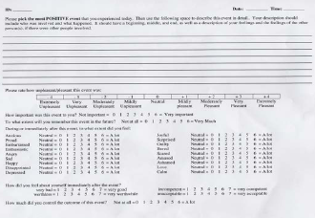
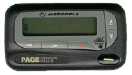
experience-sampling method
(Random Beeps)
+

Slide 11
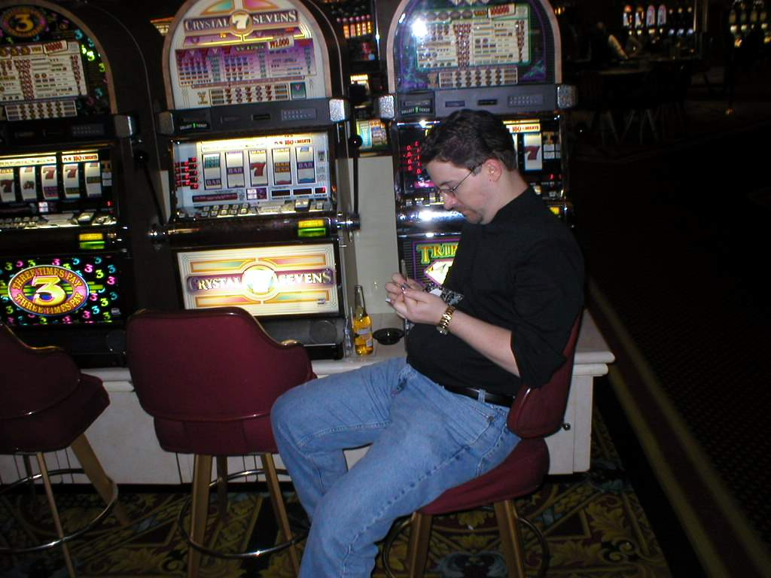
experience-sampling method

Slide 12
other ESM sampling techniques
Interval-contingent sampling
  Sample on experiences at fixed times
  Good for time series data
  Typically less burdensome to subjects
    They begin to expect prompts
Event-Contingent sampling
  Report on experiences based on event of interest
  Subject must be “cognitively-engaged” into own actions

Slide 13
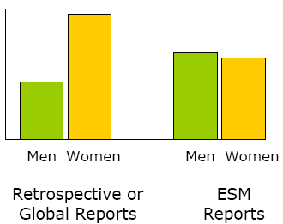

immediacy
Reduce recall memory bias
  Important for qualitative data [Barrett 1998]
    Difficult to remember mood, feeling, thoughts of particular events retrospectively
Notes:
Comparison of retrospective emotion reports with ESM reports for men and women

Slide 14
immediacy
Reduce recall memory bias
  Important for qualitative data [Barrett 1998]
    Difficult to remember mood, feeling, thoughts of particular events retrospectively
Notes:
Comparison of retrospective emotion reports with ESM reports for men and women

Slide 15
multiple assessments
Multiple assessments over time allows for studying within-person processes [Conner 2004]
  Time-series data
  Observe patterns
  Look for correlations between elements
    Medication taken
    Perceived pain
  Calibrate responses per subject

Slide 16
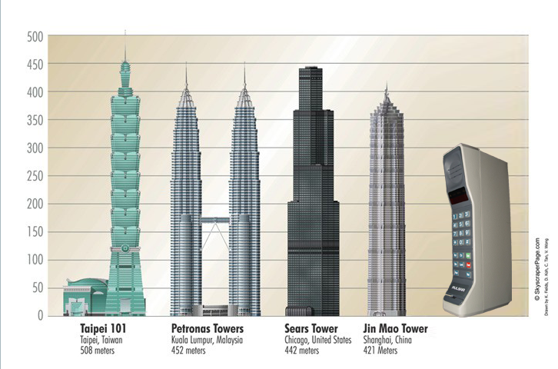
DynaTAC
Motorola, 1983
2 lbs, $3995
Notes:
1 hr talk time on dynatac, 30 phone numbers
Phone had one application: voice communication.

Slide 17
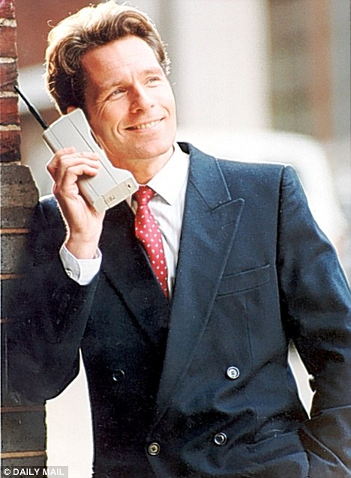

Slide 18
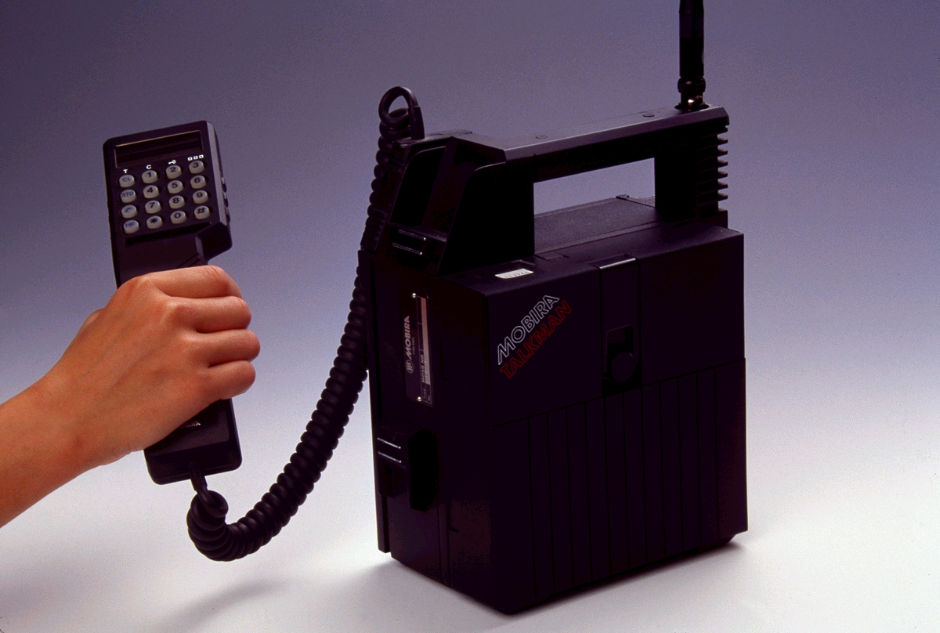
Notes:
Nokia launched the Mobira Talkman in 1984 and was one of the world's first transportable phones

Slide 19
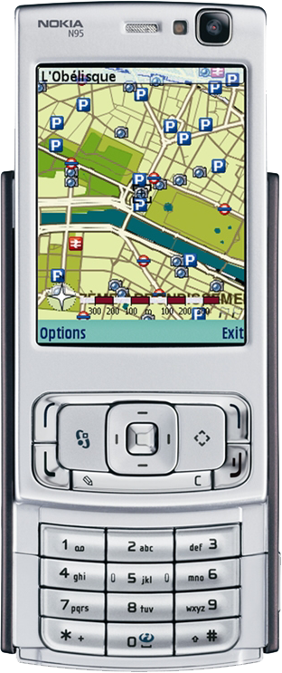
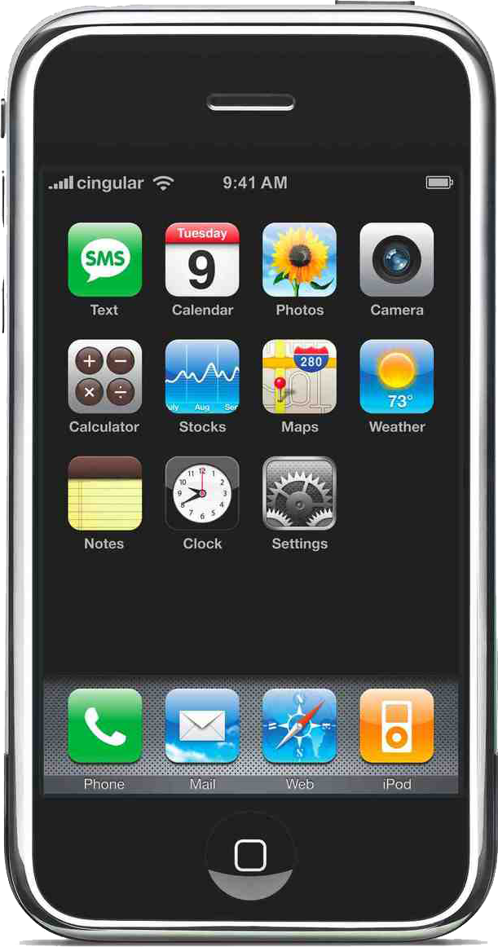
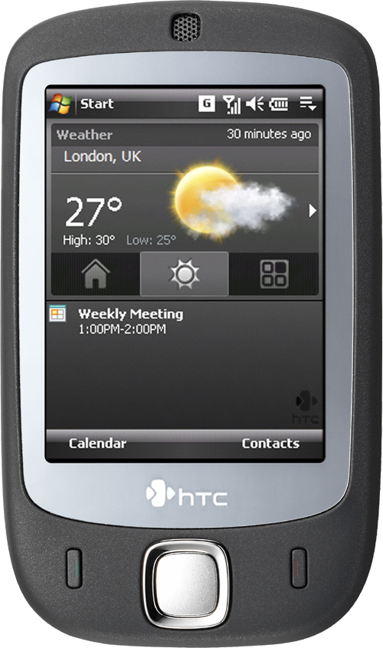
Notes:
Nokia N95
Flagship smartphone includes GPS, Accelerometer, light sensor, WiFi, media player, two cameras. Back camera is five megapixels
Apple iPhone
Needs no introduction. Multitouch screen, WiFi, ipod functionality, proximity sensor, ambient light sensor, 3-axis accelerometer

Slide 20
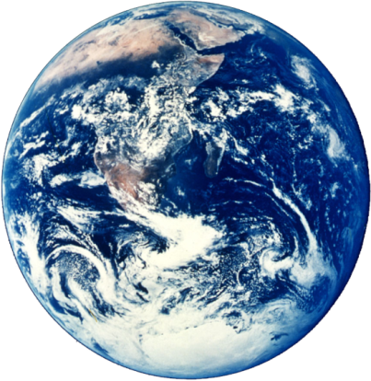
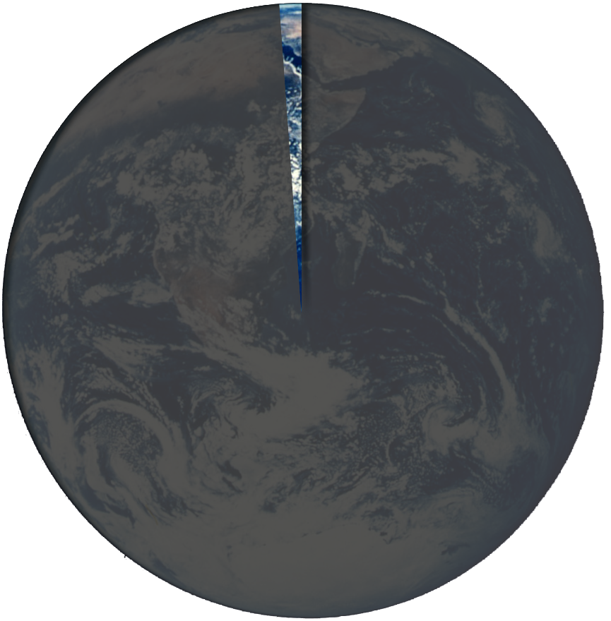
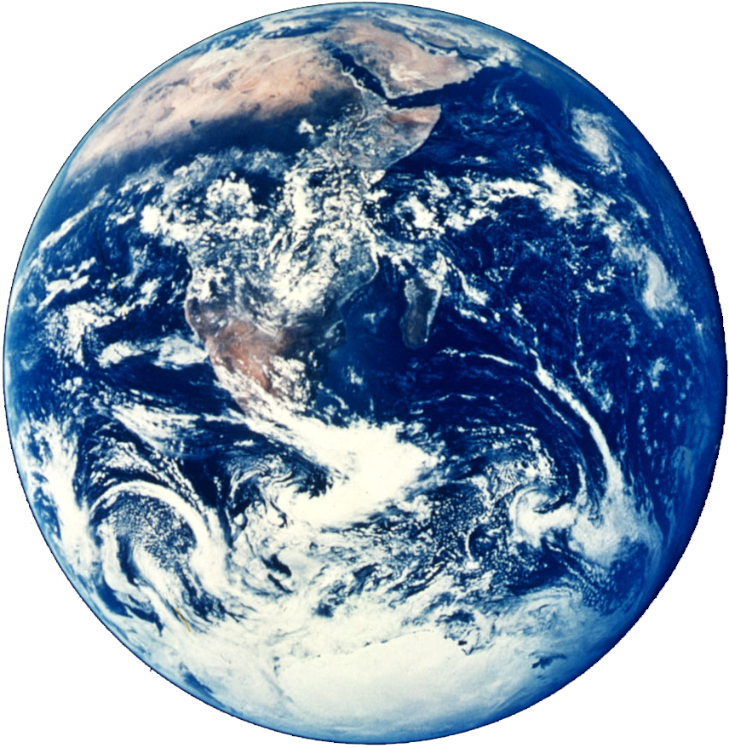
Mobile Phone Subscribers Worldwide 1995
1.7%
Notes:
Why mobile phone as a data collection platform:
Inexpensive and pervasive

Slide 21
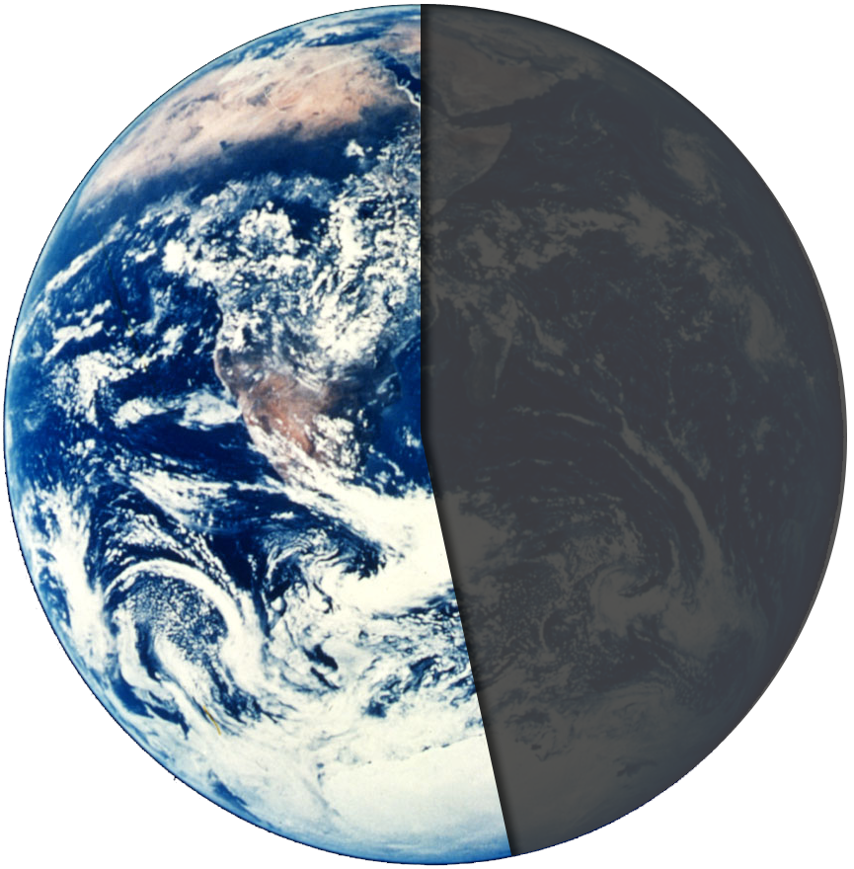
Mobile Phone Subscribers Worldwide 2010
51.5%
Notes:
Why mobile phone as a data collection platform:
Inexpensive and pervasive

Slide 22
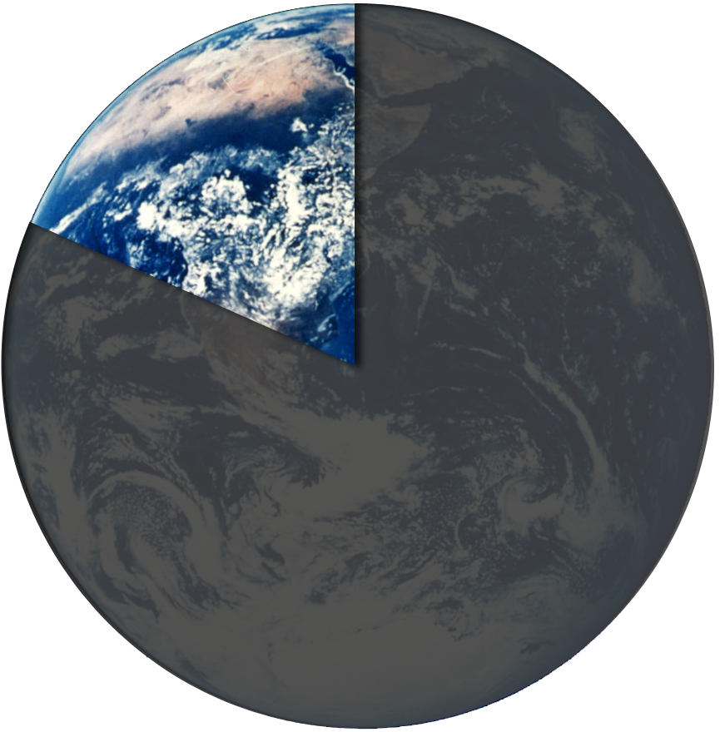
2010 Worldwide Projections
51.5% Mobile Phone Subscribers
19.12% PC Users
Notes:
Year World Population Mobile Phone Subscribers Worldwide PC Users Worldwide
1995 5.7 0.095 0.1
2006 6.4 2.6 0.67
2010 6.8 3.5 1.3

Slide 23
The mobile phone is positioned to revolutionize the way we can collect data about people, their behavior and the environment.

Slide 24
challenges
How do we collect the data?
How do we incentivize people to contribute data?
How can we sustain participation over time?
How do we handle privacy issues?
How do we analyze/filter the data?
Notes:
Applications to healthcare, elderly care, rural computing
Vision: massive data collection
--things needed for vision:
* alternative transports for data beyond GPRS
* servers to aggregate data
* battery usage optimization
* active learning techniques
* incentives?
Current: tool for field studies

Slide 25
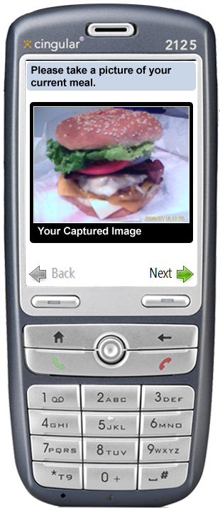
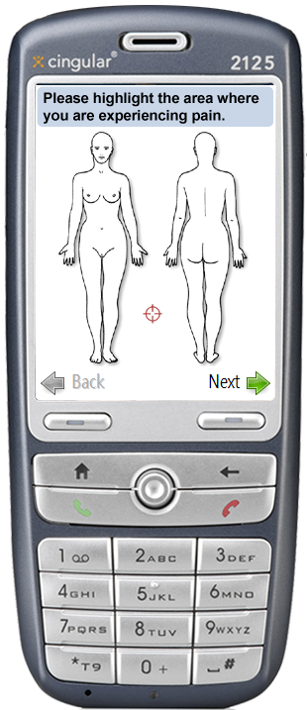
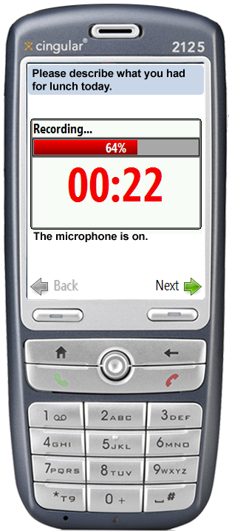
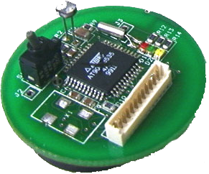
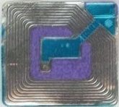
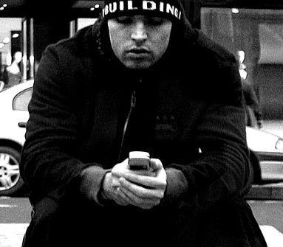
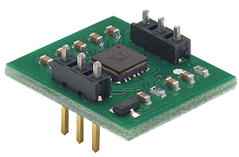
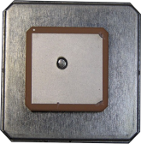
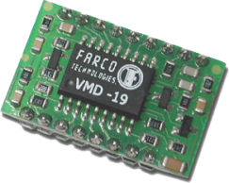
the myexperience tool
http://myexperience.sourceforge.net
Device usage and environment states (e.g., GPS) can be automatically sensed and logged.
+ Technique scales well
– Cannot capture user intention,
perception, reasoning, or feelings
Users respond to short context-triggered surveys on their mobile device.
+ Can gather otherwise imperceptible
data (both qual. and quant.)
– Lower sampling rate than sensors
(increased user burden)
sensors
user
+
=
context
self-report
myexperience
MyExperience is open source software under the BSD license

Slide 26
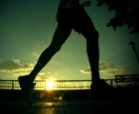
sensors, triggers, actions
Sensors
Triggers
Actions
trigger
We noticed that you just finished your morning walk, how is your breathing rate?
15
0
1.
2.
3.
I feel out of breath
d
I’m breathing heavier than normal
3
I had to stop walking to catch my breath
Example Sensor:
DeviceIdleSensor
PhoneCallSensor
RawGpsSensor
SmsSentSensor
HumanScaleActivitySensor
Example Triggers:
DeviceIdle > 15 mins
PhoneCall.Outgoing == true
Gps.Longitude ==“N141.23”
SmsSent == true
Activity.StateExited == Walking
Example Actions:
ScreenshotAction
VibrationAction
SmsSendAction
DatabaseSyncAction
SurveyAction
Notes:
Sensor states are logged

Slide 27

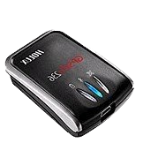
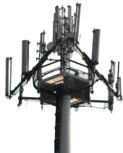
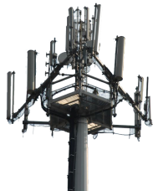
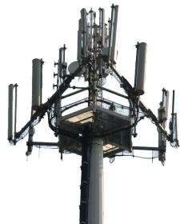
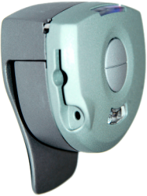
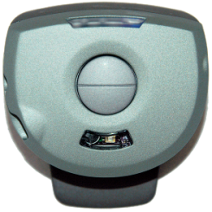
hardware sensors
GPS Sensors
GpsLatLongSensor
GpsRecordSensor
GpsSpeedSensor
GpsSpeedWindowSensor
GpsSustainedSpeedSensor
GSM Sensors
GsmCommonCellRatioSensor
GsmCellSensor
GsmMotionSensor
PhoneSignalStrengthSensor
MSP Sensors
ActivityProbabilitySensor
MspConnectionSensor
Notes:
sensors

Slide 28
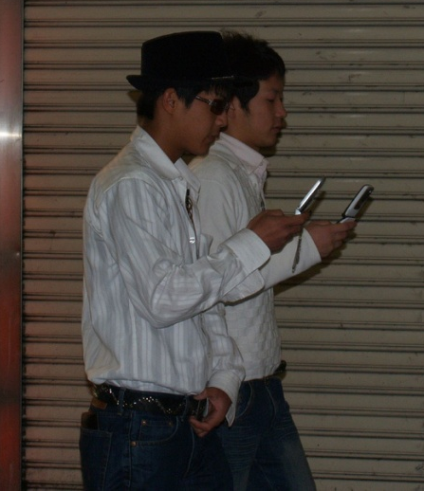
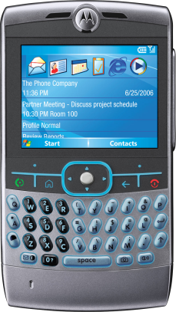
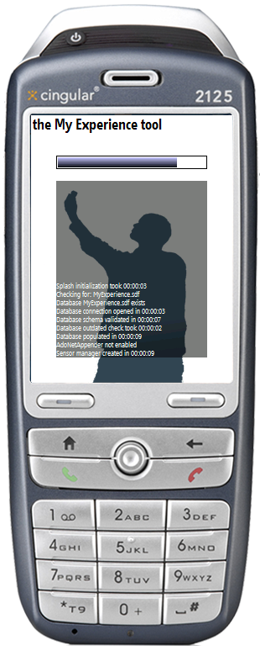
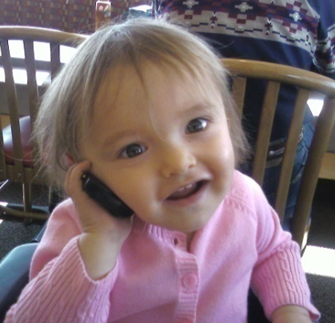
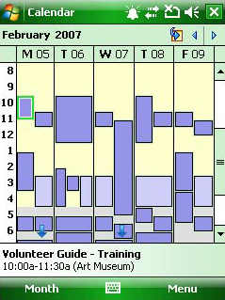
software sensors
Device Usage Sensors
ButtonSensor
ActiveApplicationSensor
ForegroundWindowSensor
DeviceIdleSensor
MediaPlayerSensor
Device State Sensors
StorageCardFullSensor
PhoneProfileSensor
PowerLineSensor
PhoneRoamingSensor
Communication Sensors
IncomingCallSensor
OutgoingCallSensor
SmsSentSensor
SmsReceivedSensor
Meta-Sensors
ActionCompletedSensor
ActionStartingSensor
GlobalsSensor
MyExpStartingUpSensor
MyExpShuttingDownSensor
Calendar Sensors
CalAppointmentSensor
CalAppointmentLocationSensor
CalAppointmentSubjectSensor
Notes:
Sensors

Slide 29
Action Type | Summary Description
CreateProcessAction | Launches an additional process (this can be any executable that is local to the device).
KillProcessAction | Kills an existing process.
MessageAction | Displays a message in a dialog box to the user.
NotificationAction | Displays a notification in a dialog box to the user with a sound and/or vibration alert. User may respond “OK” or “Dismiss.”
PlayerAction | Plays a sound, vibrates the device, and/or flashes the device’s LEDs.
RecordAudioAction | Records audio in the background using the device’s microphone.
RestartDeviceAction | Restarts the device.
ScreenShotAction | Takes a screen shot of the current screen on the device.
SendSmsAction | Sends an SMS to a specified address.
SqlReplicationAction | If SQL Replication is setup, this action invokes a data replication with the master web server.
SurveyAction | Displays a survey to the user.

Slide 30
Action Type | Summary Description
CreateProcessAction | Launches an additional process (this can be any executable that is local to the device).
KillProcessAction | Kills an existing process.
MessageAction | Displays a message in a dialog box to the user.
NotificationAction | Displays a notification in a dialog box to the user with a sound and/or vibration alert. User may respond “OK” or “Dismiss.”
PlayerAction | Plays a sound, vibrates the device, and/or flashes the device’s LEDs.
RecordAudioAction | Records audio in the background using the device’s microphone.
RestartDeviceAction | Restarts the device.
ScreenShotAction | Takes a screen shot of the current screen on the device.
SendSmsAction | Sends an SMS to a specified address.
SqlReplicationAction | If SQL Replication is setup, this action invokes a data replication with the master web server.
SurveyAction | Displays a survey to the user.

Slide 31
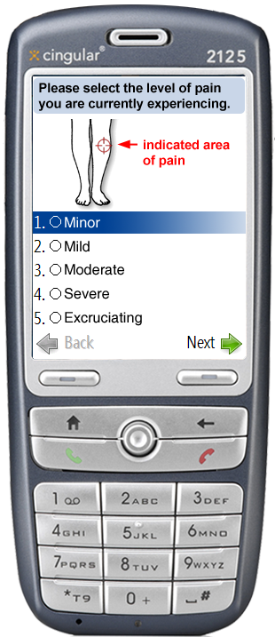
Surveys do not necessarily have to ask simple closed form questions (e.g., Likert scale questions)
Notes:
Studying eating habits: trigger survey based on location or time
Studying pain therapy: could be a random time trigger or based on some physiological sensor

Slide 32
xml / scripting interface
XML : Declarative
  Define sensors, triggers,
  actions, and user interface
  Set properties
  Hook up events
Script : Procedural
  Create fully dynamic behaviors between elements specified in XML
  Interpreted in real time
  New scripts can be loaded on the fly
<sensor name=“Motion“ type=“GsmMotionSensor">
<prop name=“PollInterval">00:00:01</prop>
</sensor>
<trigger name=“Motion“ type=“Trigger">
<script>
motionSensor = GetSensor(“Motion”);
if(motionSensor.StateEntered = “Stationary”){
... do some action ...
}
</script>
</trigger>

Slide 33
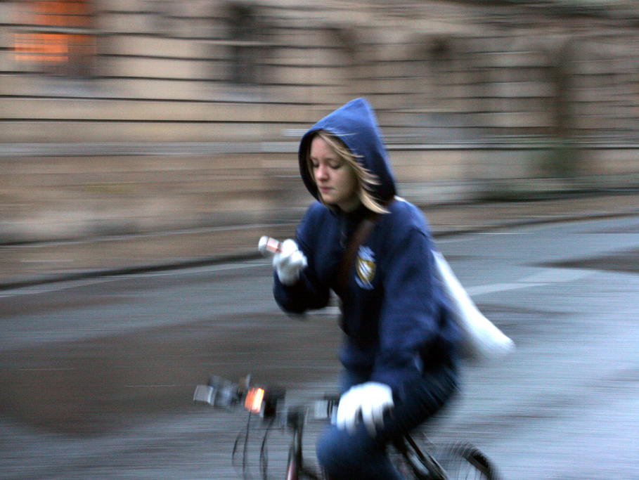


MobiSys2007, ongoing
mobilephoneusage
Jon Froehlich^{1,2}, Mike Y. Chen², Sunny Consolvo^{1,2}, James Landay^{1,2}
design:
use:
build:
¹ university of washington
² Intel Research, Seattle

Slide 34
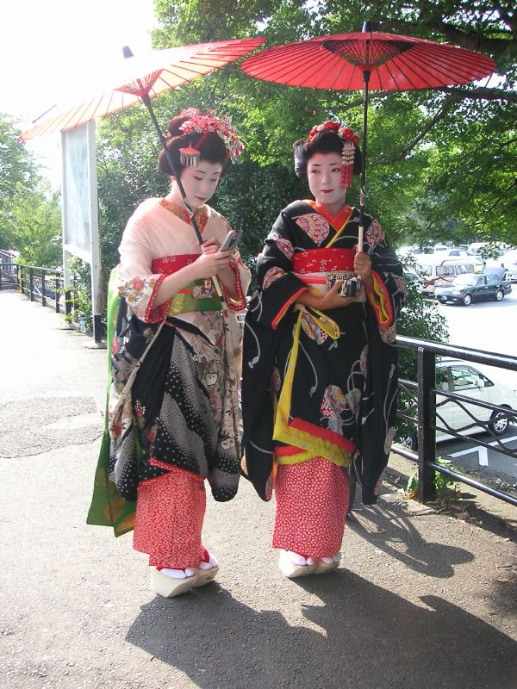

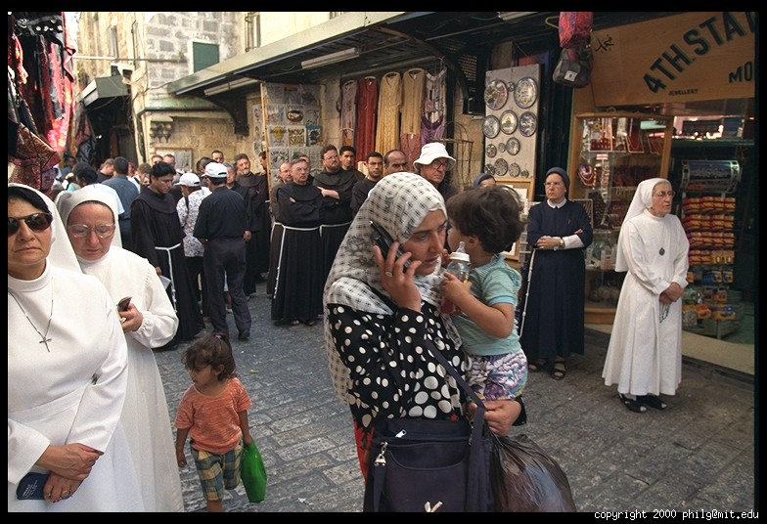
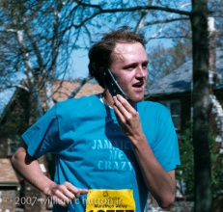
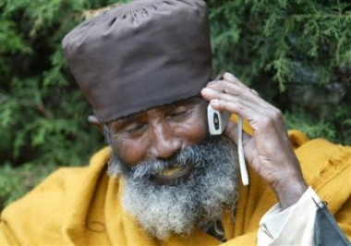
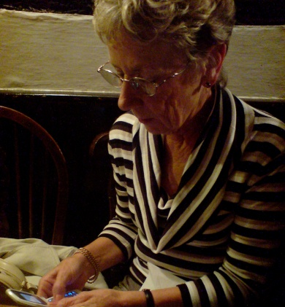








Slide 35


Slide 36



our goal
Collect data about real device usage & context in the field in a scalable fashion
Data can be used to
  Better understand actual device/system usage
    E.g., how mobility patterns affect access to WiFi
  Inform the design of future systems
    E.g., optimize battery utilization algorithms based on learned charging behaviors

Slide 37






Kjeldskov, J. and Stage, J. New Techniques for Usability Evaluation of Mobile Systems. IJHCS2003
Schusteritsch et al. Towards the Perfect Infrastructure for Usability Testing on Mobile Devices. CHI2007.

Slide 38





Roto et al. Examining Mobile Phone Use in the Wild with Quasi-Experimentation. HIIT Tech Report 2004
Notes:
Helsinki Institute for I

Slide 39



Reichl et al. The LiLiPUT Prototype: A Wearable Lab Environment for User Tests of Mobile Telecommunication Applications. CHI2007

Slide 40


research challenges
Coverage: collect rich information about features of interest
Scale: collect large amounts of data over long periods of time
Extensible: easily add new data collecting capabilities
Situated: collect real usage data in its natural setting
Robustness: protect or backup data collected in the field

Slide 41


case study 1: charging behavior
Motivation
  Battery life has long been a challenge in mobile computing
  Dependent on usage:
    WiFi, video, length of calls
Study
  2 week pilot study with 4 people
  Log device usage (e.g., phone calls, WiFi, active applications)
  Actively track battery life
  Survey at moments of charging

Slide 42
battery life & user response
At home
Battery was getting low
Recharged using AC adapter
At Work
Needed to sync data
Recharged using USB

Slide 43


case study 2: sms usage
Motivation
  1 trillion SMS messages sent worldwide in 2005
  Explosive growth begs research questions:
    Why SMS vs. voice?
    Where do people use SMS?
Study
  Similar setup as before
  Asked questions after SMS sent
    User’s location
    Reason for using SMS

Slide 44
sms usage, mobility & self-report
Location: work
Reason: couldn’t use voice
Location: home
Reason: did not need immediate response
Estimated
mobile periods

Slide 45



analysis tools
How can we analyze gigabytes of sensor data per participant plus contextualized self-report data?
Hotmap showing where subject indicated experiencing pain over the course of the study

Slide 46
myexperience studies
Studying Activity Recall
Stress, Behavior Change and Heart Monitoring
UbiFit
Activities and Mobile Phone Usage
Mobile Heart Health Study
Vote with Your Feet
UbiGreen
Pain/Fatigue Management in Multiple Sclerosis Patients
Obesity, Activities and Geography

Slide 47

UbiComp 2006
votewithyourfeet
Jon Froehlich^{1,2}, Mike Chen²,
Ian Smith², and Fred Potter^{1,2}
design:
use:
build:
¹ university of washington
² Intel Research, Seattle

Slide 48

Explicit
Implicit
Notes:
Introduce concepts of implicit and explicit indicators.
Might even put those words up on the screen.
Collaborative filtering (CF) is the method of making automatic predictions (filtering) about the interests of a user by collecting taste information from many users (collaborating). The underlying assumption of CF approach is that: Those who agreed in the past tend to agree again in the future. For example, a collaborative filtering or recommendation system for music tastes could make predictions about which music a user should like given a partial list of that user's tastes (likes or dislikes).

Slide 49



Slide 50






translation to physical world
Can we view place visit behaviors as an implicit form of expressing interest?
+
Mamma Mias
Visits to Pagliaccis Pizza
→ I like Pagliaccis Pizza?
→ I like Pizza?
→ I like Italian food?
Visits to more Italian restaurants
→ Make stronger claims?
Notes:
Does a visit to Pagliacci’s pizza indicate that I like Pagliaccis?
Can this be generalized to pizza?
Multiple visits to Italian restaurants…

Slide 51


explicit vs. implicit indicators
vs.
Explicit Indicators
Move about the world →
Supply rating “tags”
Requires device interaction
Implicit Indicators
Location aware device →
Observe travel patterns
No device Interaction

Slide 52



Notes:
Both online web and phone experience converge

Slide 53




study overview
Four week study
Participant profile
  16 Participants
  Gender balanced (8 male / 8 female)
  Ages: 22-56 (median 29)
  Various professions
    Furniture designer, political consultant, bookseller, translator, …
Tasked with
  Carrying mobile phone for four weeks
  Answering 11 in situ surveys a day about current place
  Completing a minimum of 3-4 web diary entries a week
Compensation
  $1 per survey
  Also compensated for interviews & paper questionnaires

Slide 54


survey triggers
stationary
in motion
if stationary for 10 minutes
then trigger a survey
Pseudo-Random Time Trigger
  No movement detected for 1 hr → trigger survey randomly within next hour
  Ensures consistent sampling in case of sensor failure
Sohn et al. Mobility Detection Using Everyday GSM Traces. UbiComp2006.
Notes:
Mobility Sensor
Similar to Sohn et. al UbiComp 2006
GSM signal variation to detect movement
No external sensors required
Stationary for 10 minutes → trigger survey

Slide 55





Slide 56

Fox Sports Grill

Slide 57

data collection stats
ESM
  3,458 completed out of 4,295 (80.5%)
  216 surveys completed per person
  28 days average
  1.5 minute average completion time
Web Diary
  368 web diary sessions completed
Places
  1,981 individual place visits logged
  862 of which were public
    ~2 a day per participant

Slide 59

skewed distribution of ratings
…by and large I go to places I’ve been to before and I already like.
-Participant #1
Most of them get pretty good ratings, 4’s or 5’s because I scrupulously avoid places that I’ve known I don’t like and I always go back to the ones I do like.
- Participant #12
Distribution of ratings indicates that people tend to go where they like

Slide 61
Notes:
4.64% drop in completion between the first two weeks and the latter two weeks of study.
Talk about active learning.

Slide 62

ongoing
ubifit
Sunny Consolvo^{1,2}, Jon Froehlich^{1,2}, Beverly Harrison², Pedja Klasnja^{1,2}, Anthony LaMarca, ² James Landay^{1,2}, Louis Legrand², Ryan Libby^{1,2}, David McDonald¹, Ian Smith², Tammy Toscos²
design:
use:
build:
¹ university of washington
² Intel Research, Seattle
Notes:
overweight & obesity are a global epidemic
over 1 billion affected worldwide ($100+ billion cost in US alone)

Slide 63






msp &
myexperience
Bluetooth
15
50%
0
0%
standing
jogging
sitting
walking
biking
raw data
inference data
Notes:
- Raw data collected from sensors on the MSB
- msb-server feeds data from the MSB to other apps on the imote2
- margin, the classifier, does a little magic, and sends the scores over a window to bt-listener
bt-listener maintains a bluetooth connection with the phone and send the scores that does it for the imote.
On the phone side:
- A MyExperience sensor maintains the bluetooth connection to the imote using our IMoteLib, which in turn uses InTheHand.Bluetooth.Net.
- A descendant of that sensor attempts to glob the readings into "human scale activities"
- A further descendant take the output activities and makes a choice:
either write the activity to the database, or trigger a survey asking the user for clarification
- An activity appears in the main and ambient displays.
nothing really runs on the msb.. the msb collects sensor data, but the software world kind of starts with msb-server, which runs on the imote. msb-server, margin, and bt-listener all communicate on the imote over IPC

Slide 64















activity
journaling
any physical activity including those not inferred by the fitness device
journal on phone
Notes:
Six activities are automatically detected
Bicycling
Elliptical trainer
Running
Sedentary
Stairmaster
Walking

Slide 65




manual journaling

Slide 66


subset of ubifit triggers
Journal reminder
  If journal has not been used in ~2 days and it’s past 8PM, launch journal reminder
Uncertain activity occurred
  If the system knows an activity occurred but couldn’t determine the exact activity, a survey is launched
MSP troubleshooter
  If the MSP hasn’t been seen in ~2 hrs and it’s after 10AM, launch a troubleshooter

Slide 67














glanceable display
runs on the background screen of mobile phones, so it’s frequently seen by the individual
strength
cardio
flexibility
at-a-glance determination of:
active or inactive week,
variety in routine,
this week’s goal met
recent goal met
walk
this week’s goal met
recent goal met
day view

Slide 68




the glanceable display in action
walk
cardio
strength
flexibility
this week’s goal met
recent goal met

Slide 69

ongoing
ubigreen
Jon Froehlich^{1,2}, Beverly Harrison², Pedja Klasnja^{1,2}, James Landay^{1,2}, Jen Mankoff³
design:
use:
build:
¹ university of washington
² Intel Research, Seattle

Slide 70






ubigreen

Slide 71

thankyou!
download myexperience @ http://myexperience.sourceforge.net
email: jonfroehlich@gmail.com
Notes:
It's orgins are traced to Malinowski's fieldwork among Trobriand Islanders in 1914 (P15). "He was the first to use participant observation to generate specific anthropological knowledge."

Slide 72
backup slides

