Slide 1
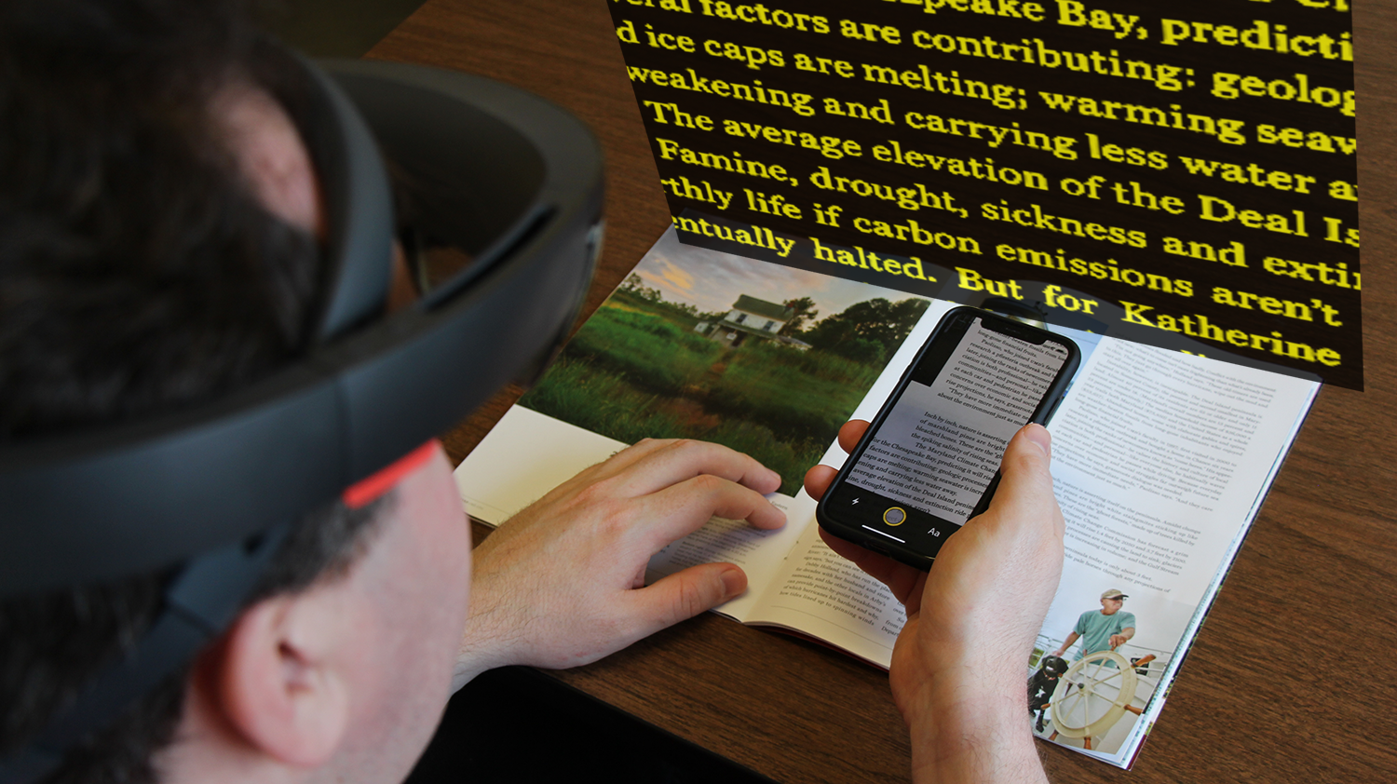



Design of an Augmented Reality
Magnification Aid for Low Vision Users
Lee Stearns
University of Maryland
Email: lstearns@umd.edu
Jon Froehlich
Leah Findlater
University of Washington
Notes:
Hi everyone! My name is Lee Stearns, and today I’ll be presenting work that was completed while I was at the University of Maryland. I collaborated with Professors Jon Froehlich and Leah Findlater from the University of Washington.
Our work is on the design of an augmented reality magnification aid for low vision users.

Slide 2
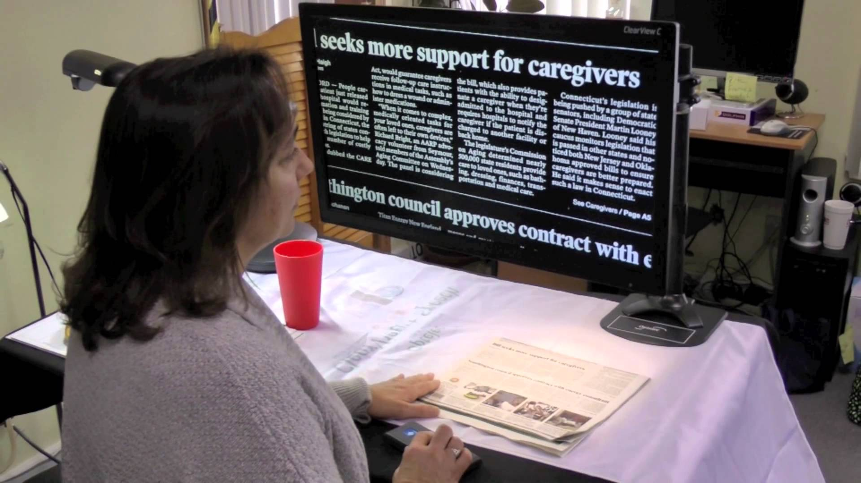
Common reading aids for low vision users include closed circuit television (CCTV), handheld magnifiers, and smartphone apps
Photo from Vision Dynamics (Opaltec Clearview C Flex)
Notes:
There are a lot of different magnification aids designed for low vision users. For example, this picture shows someone reading a newspaper using a CCTV, and there are also handheld magnifiers and smartphone apps to help with reading printed materials.

Slide 3
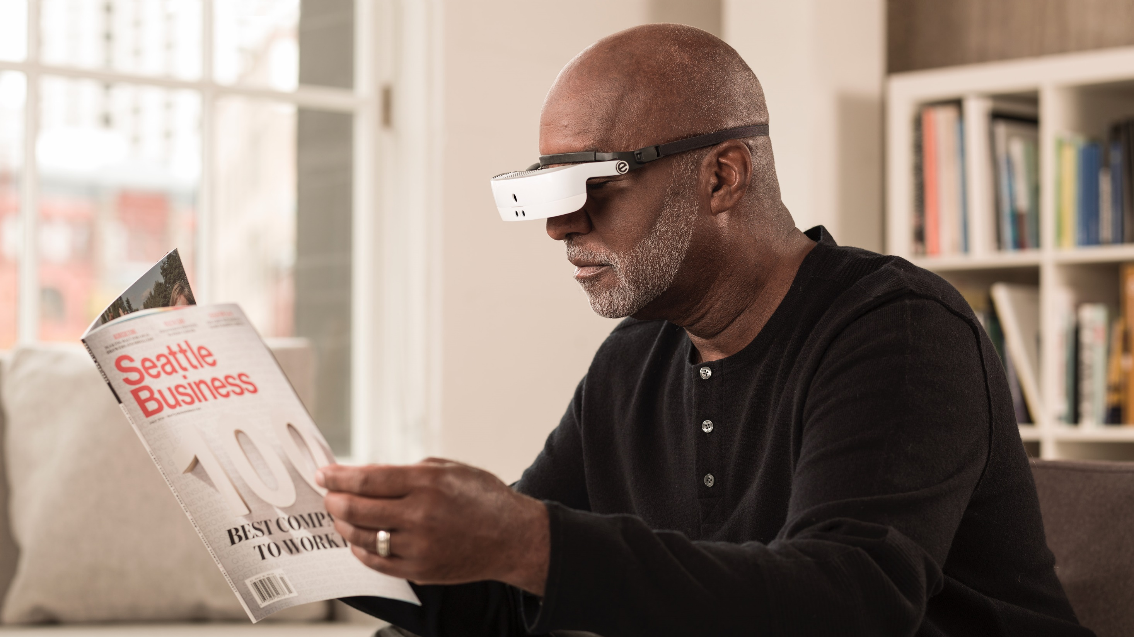
AR has the potential to be more portable, provide easier multi-tasking, and be better integrated into a person’s everyday life.
For low vision users, head-mounted displays that enhance visual capabilities are particularly promising
Photo from Artefact Group (eSight 3)
Notes:
But recent advancements in augmented reality technology open up a whole new set of possibilities, with the potential to be more portable, allow for easier multitasking, and be better integrated into a person’s everyday life.
[next] And for low vision users, head-worn displays that can enhance existing visual capabilities are particularly promising.

Slide 4
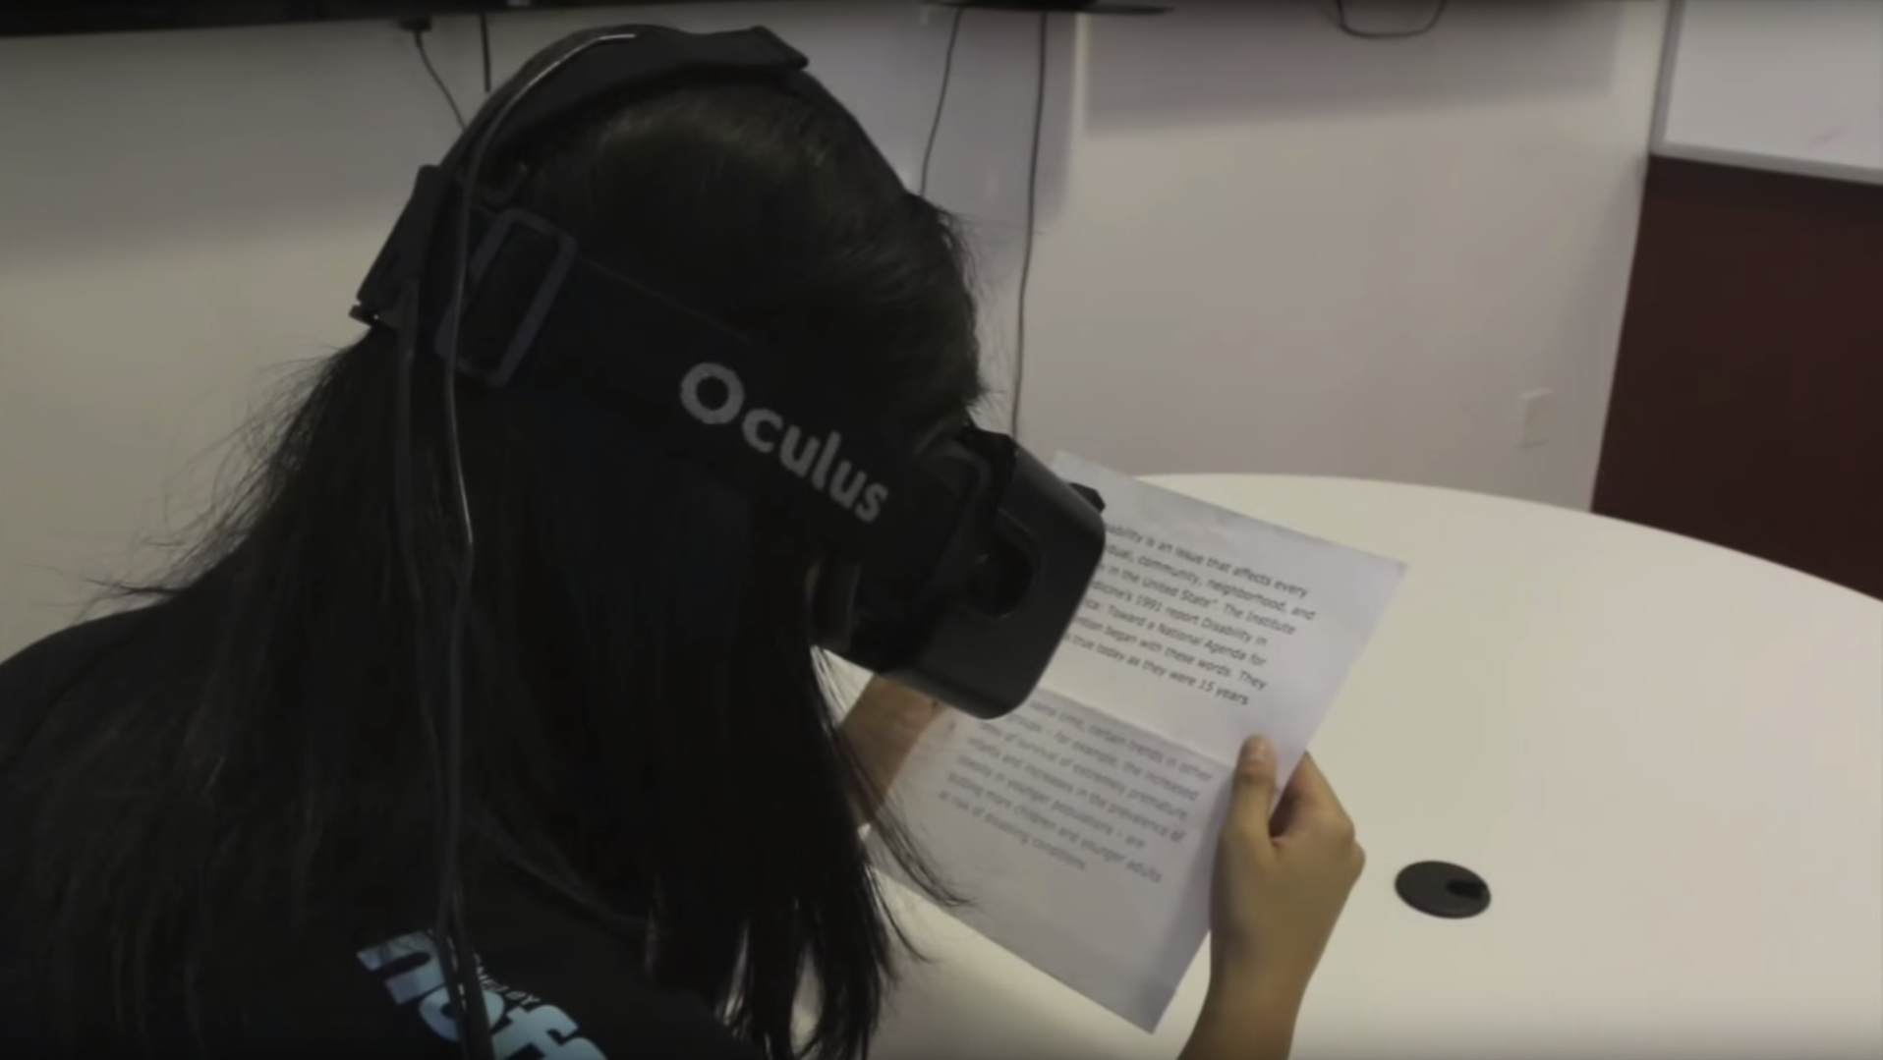

ForeSee
Zhao et al., ASSETS 2015
Notes:
For example, a few years ago a project called ForeSee added a camera to an Oculus Rift headset and used it to magnify and enhance text content.

Slide 5
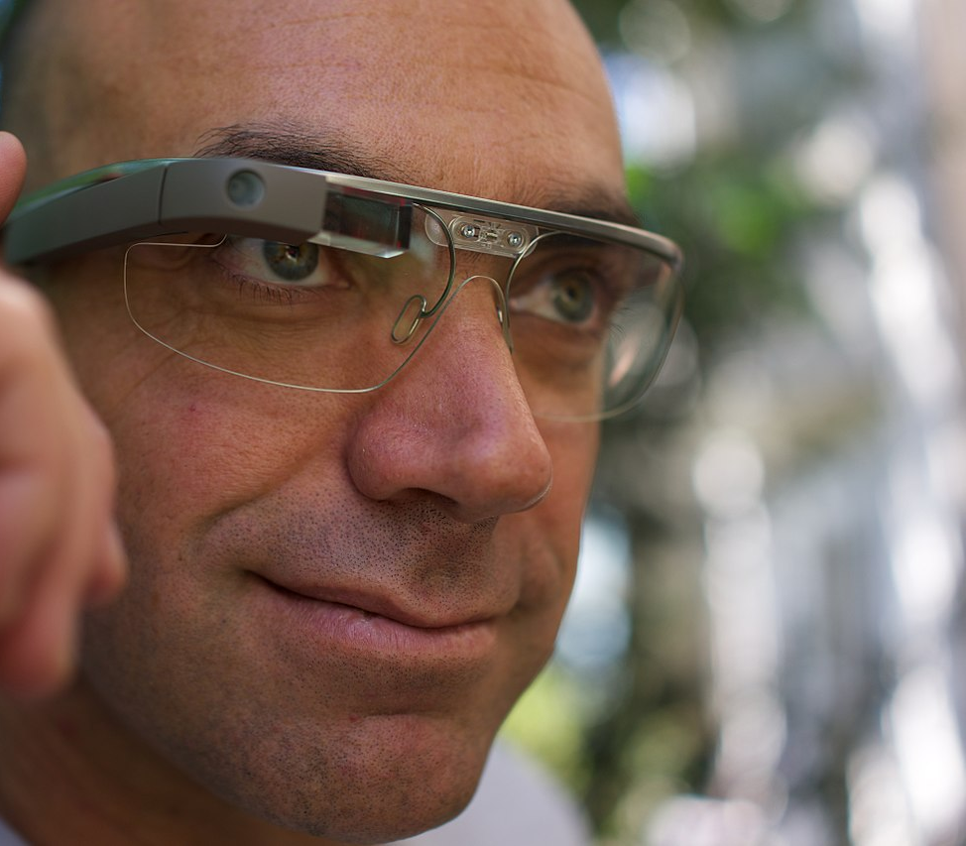
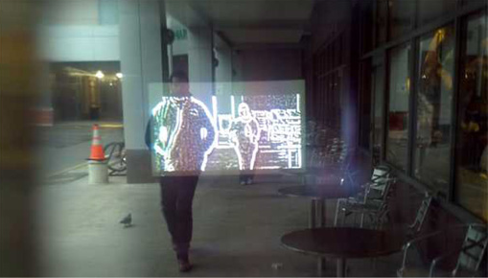
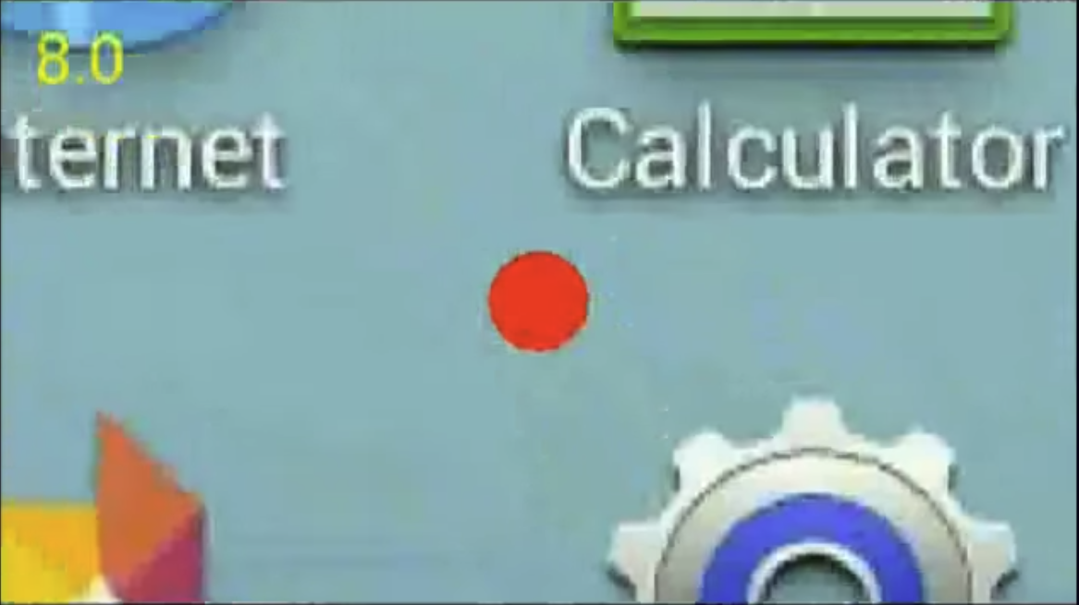
Google Glass
Edge Enhancement
Hwang and Peli, Optometry and Vision Science, Aug 2014
Smartphone Magnification
Photo from Wikimedia Commons
Pundlik et al., IEEE Trans. Neural Systems and Rehab. Engineering, Jan 2017
Notes:
Other researchers have used Google Glass to enhance edges, or to display magnified content from a smartphone screen.

Slide 6
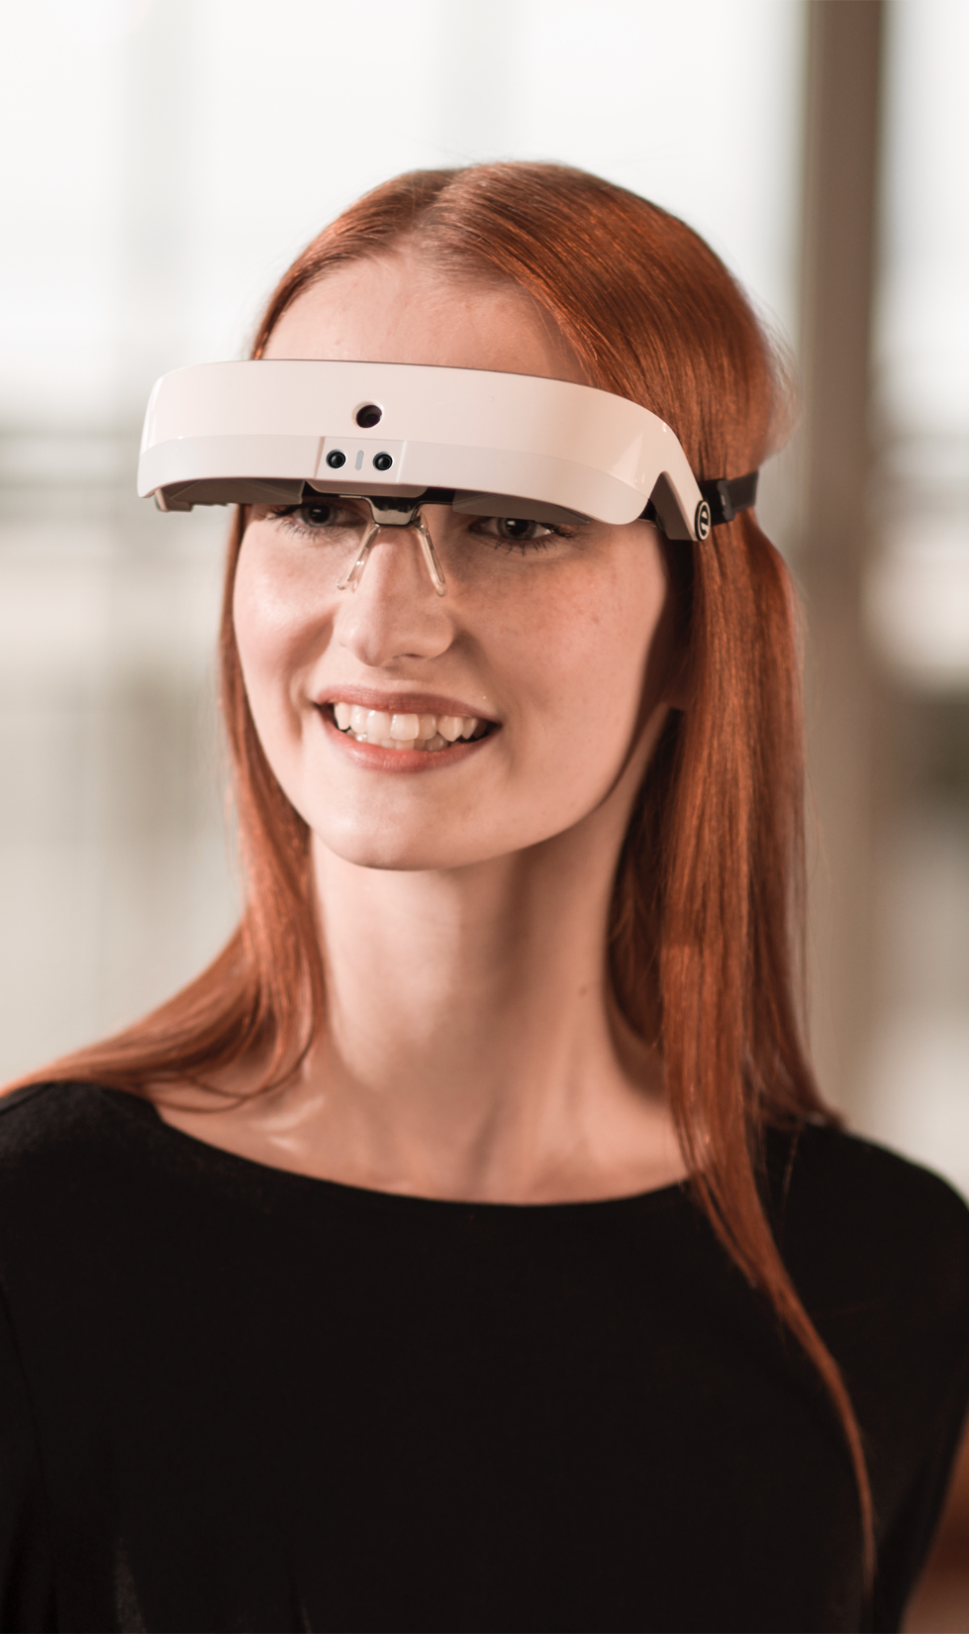
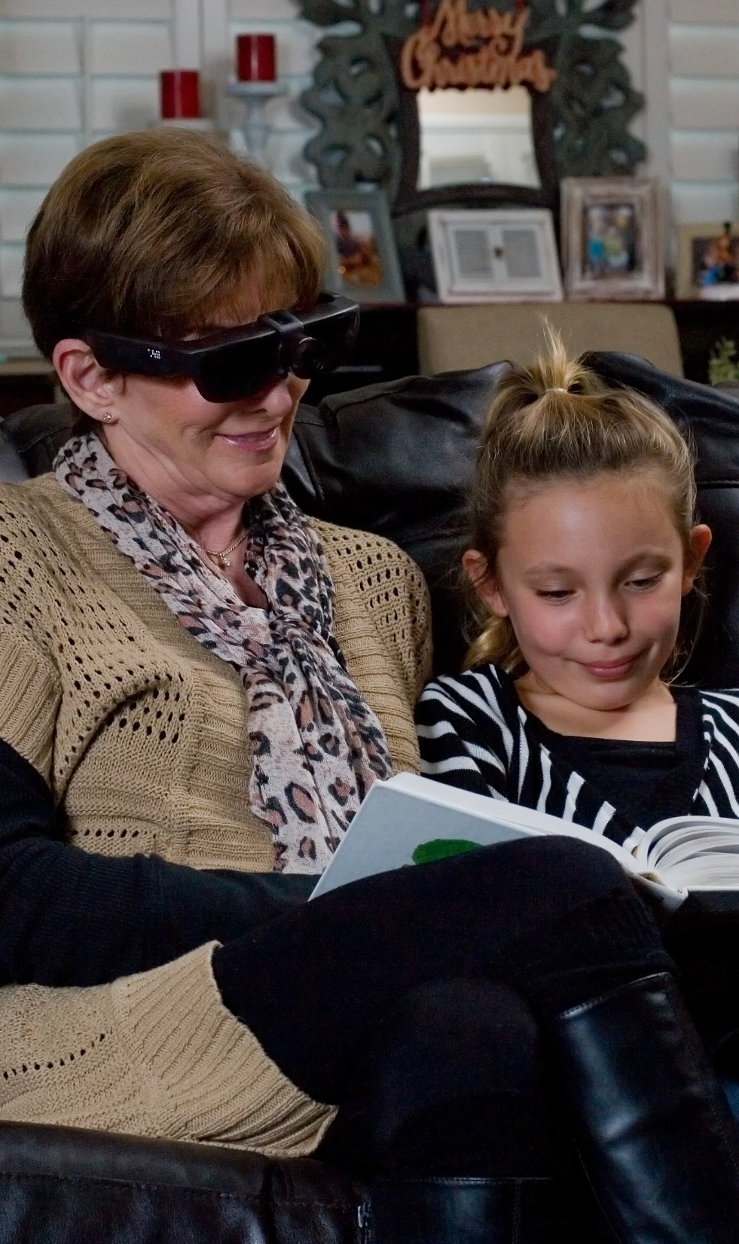
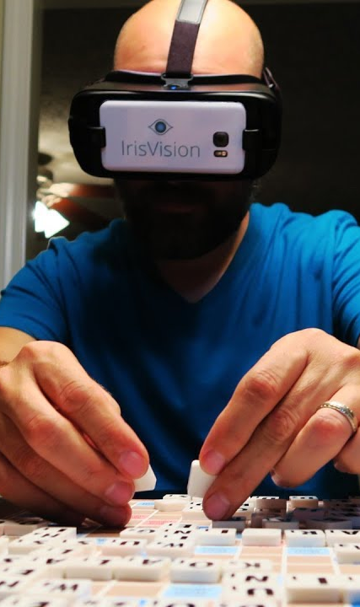
Commercial Head-Worn Vision Enhancement Systems
Zolyomi et al., ASSETS 2017—a recent study with eSight that showed the impact a head-worn vision enhancement system can make in users’ lives.
eSight
NuEyes
IrisVision
Notes:
And there are several commercial systems that display magnified video from a camera worn on the head. [next]
A recent study with eSight, one of the more popular commercial systems, showed the impact that a vision enhancement system can make in users’ lives.

Slide 7
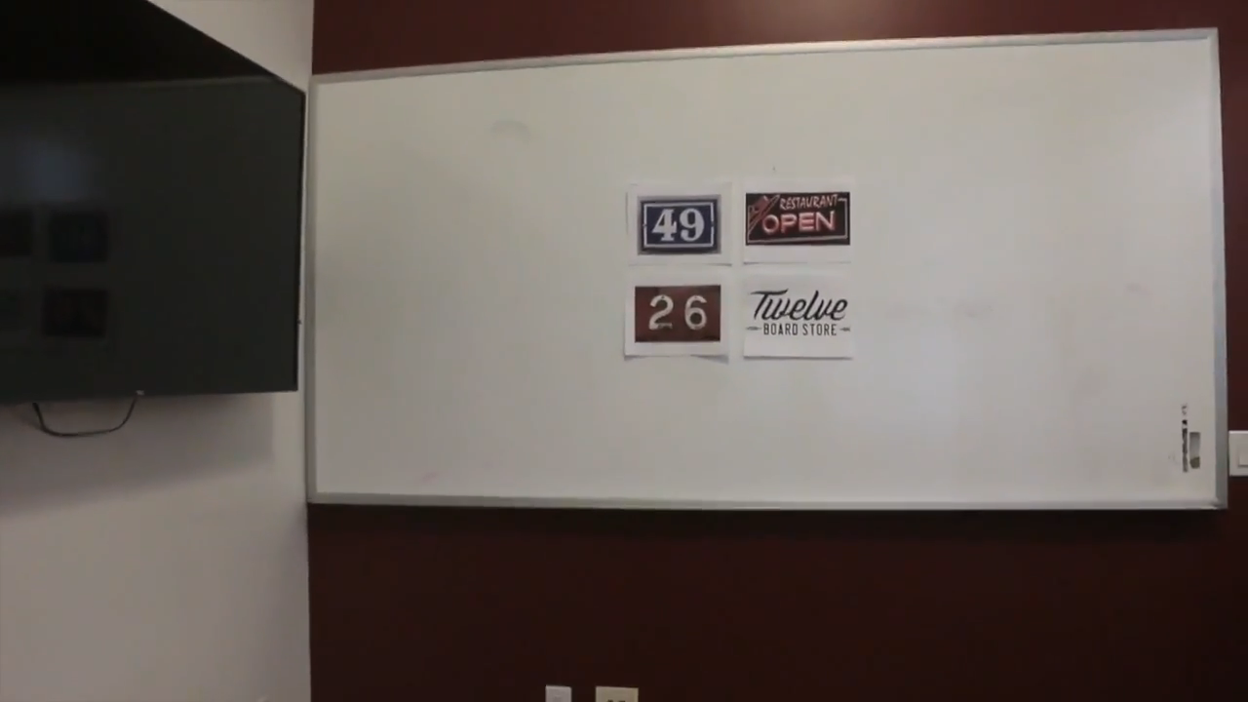
AR systems combine real and virtual objects, are interactive in real-time, and are registered in 3D
Ronald T. Azuma (paraphrased)
A Survey of Augmented Reality, 1997
Video by Yang et al., 2015
Notes:
This prior work has begun to explore ways to augment the user’s vision, but so far they’re limited to enhancing and magnifying the 2D image from a video camera.
[next] But a popular definition for augmented reality combines real and virtual objects that are interactive in real-time and registered in 3D. That type of system is now becoming possible to implement with off-the-shelf technology.

Slide 8
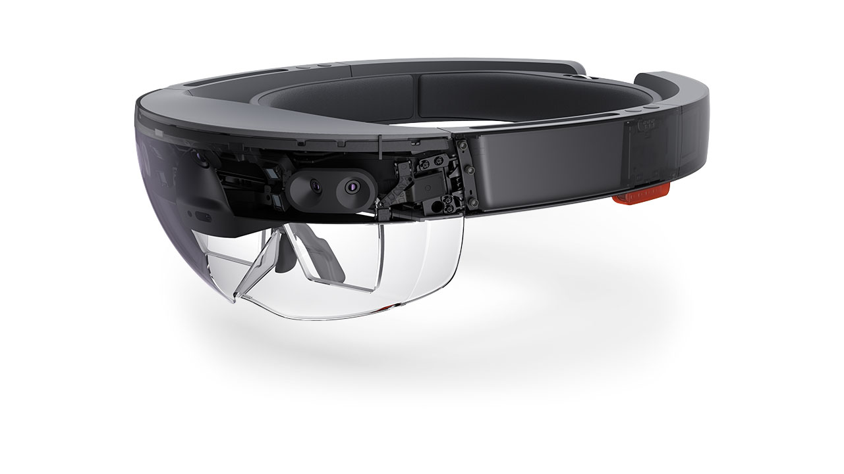
Transparent AR Display
Persistent 3D Content
Microsoft HoloLens
Photo from Wikimedia Commons
Notes:
One example is the Microsoft HoloLens, which has an transparent display that allows persistent digital content to be shown in 3D space on top of real-world objects.

Slide 9
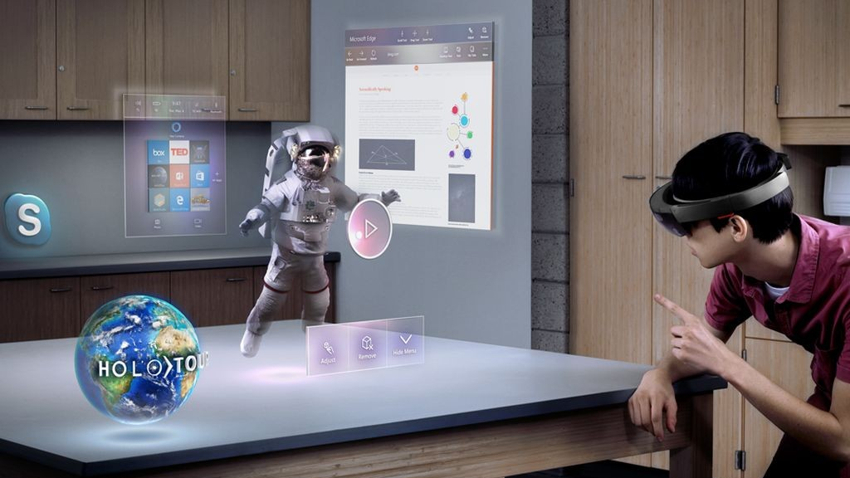
3D Augmented Reality
Photo from Windows Central
Notes:
The ability to sense the physical environment in 3D and anchor virtual content on top of it allows for new types of visual enhancements that are better integrated with the user’s real-world tasks.
For example, a magnified view of an object can be displayed directly on top of the real object, or the magnified view can be fixed to a desk near the user’s workspace or projected on a nearby wall.

Slide 10
Our Approach
Notes:
We wanted to investigate the new design possibilities for augmented reality magnification that this capability would enable.
To do that, we conducted a series of iterative design sessions with low-vision participants, developing and refining several prototype designs.

Slide 11
Design Space
Goals
Augment rather than replace existing vision capabilities
Notes:
When designing the system and interfaces, we tried to follow three basic goals.
The first was to augment rather than replace the user’s existing vision capabilities by using a transparent display.

Slide 12
Design Space
Goals
Augment rather than replace existing vision capabilities
Leverage augmented reality and persistent 3D content
Notes:
Second we wanted to go beyond the static 2D displays provided by existing systems and leverage the capabilities of augmented reality to overlay persistent digital content into the physical world.

Slide 13
Design Space
Goals
Augment rather than replace existing vision capabilities
Leverage augmented reality and persistent 3D content
Prioritize customization and flexibility
Notes:
And third, we wanted to prioritize customization and flexibility to support a wide range of vision levels and different situations.

Slide 14
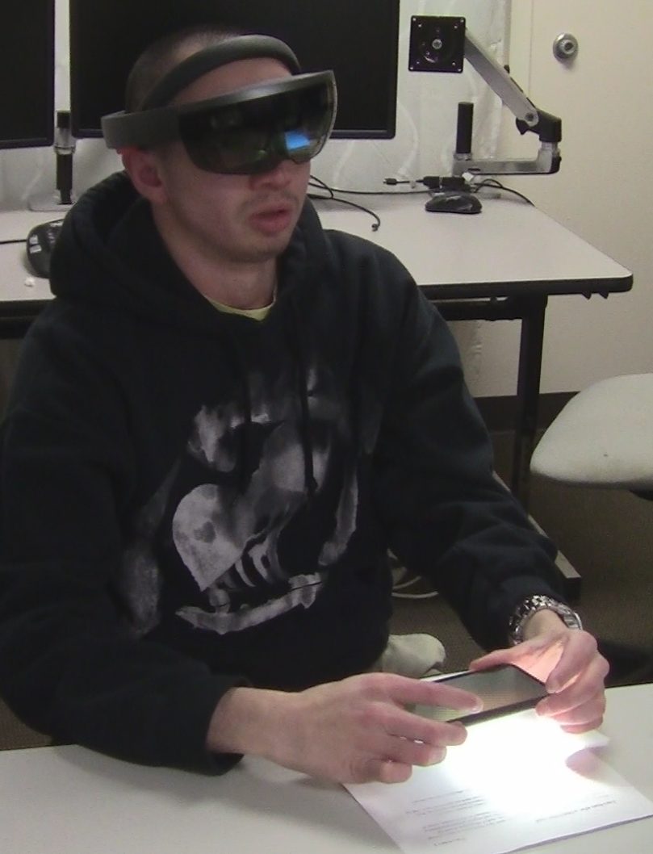
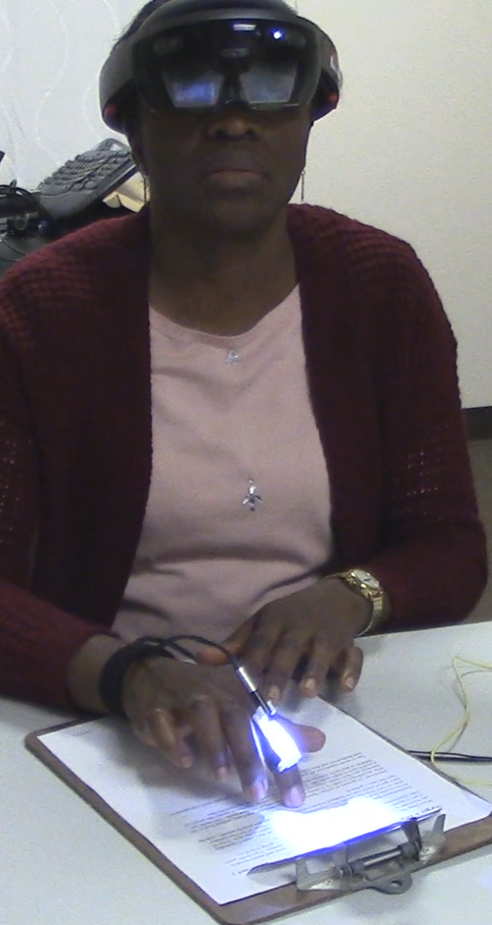
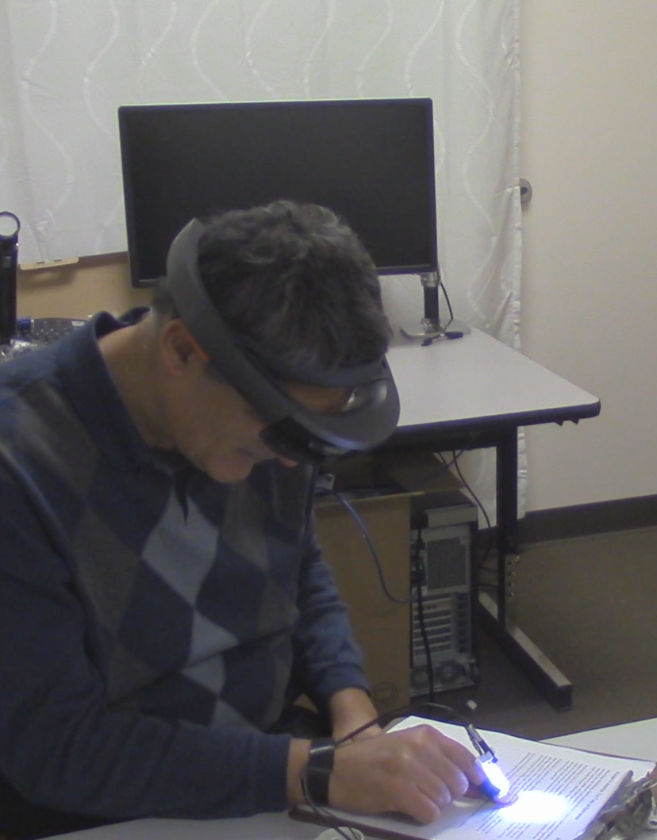
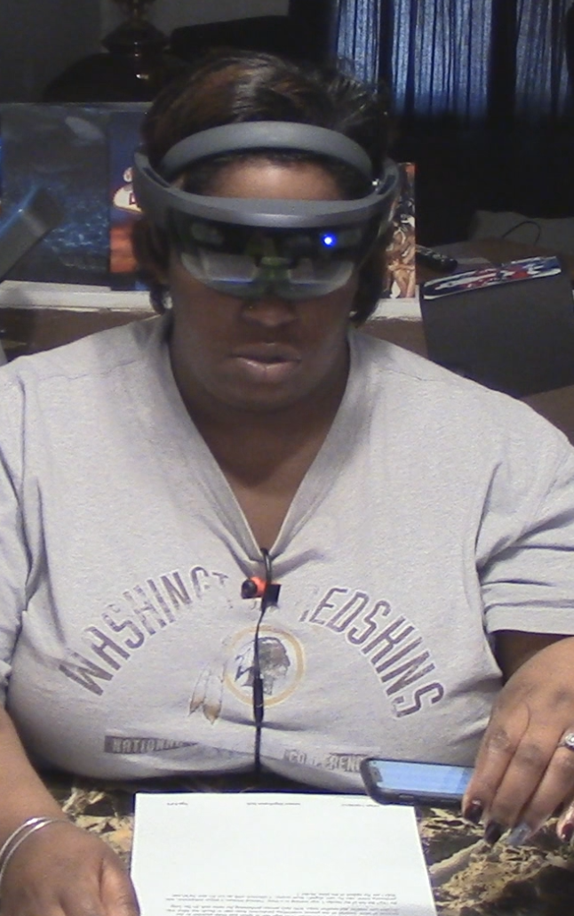
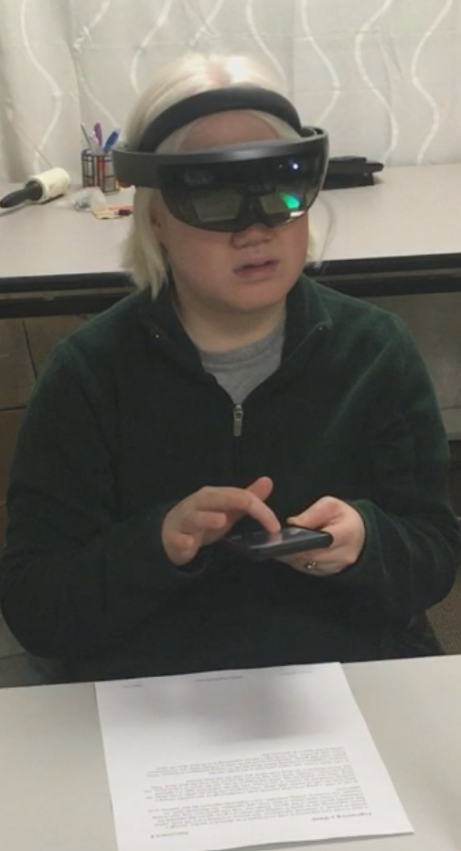
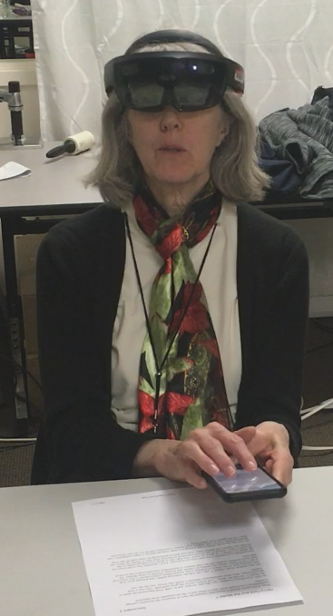
Iterative Design
Method
Nine design sessions
Seven VI participants
Notes:
We conducted a series of design sessions to explore the design space.
There were a total of nine sessions with seven unique participants, who had a range of vision levels but who all used some form of digital magnification aid in their daily lives.

Slide 15
Iterative Design
Method
Nine design sessions
Seven VI participants
Three basic prototype designs
HoloLens Only
HoloLens and Finger-Camera
HoloLens and Smartphone
Notes:
We grouped our prototypes into three basic designs based on the components and interactions they used.

Slide 16
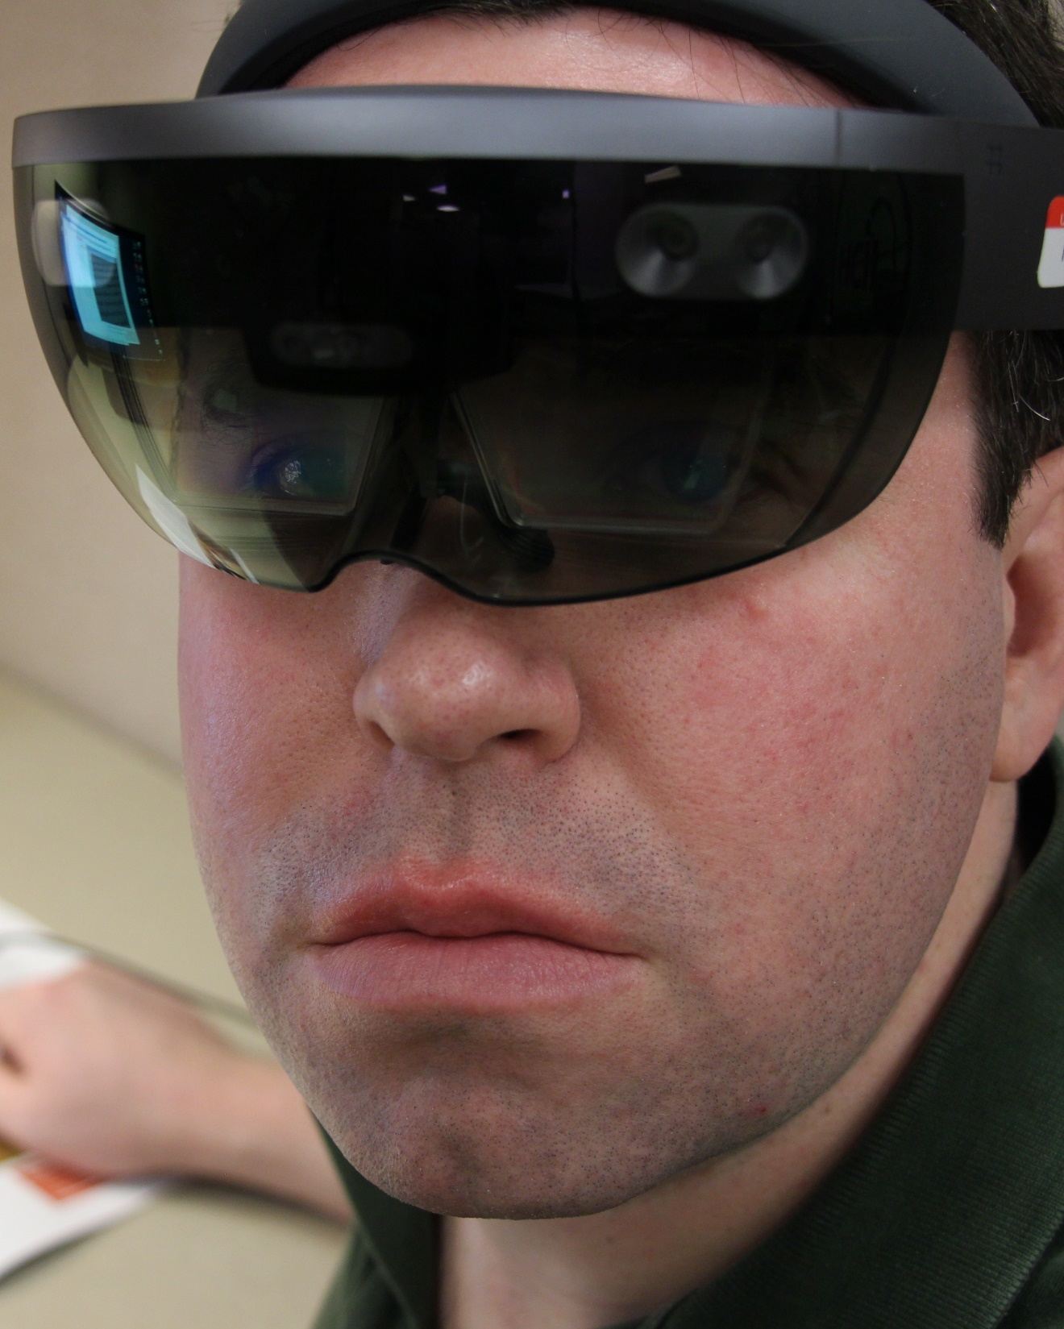

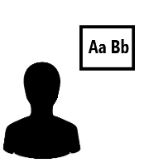


Initial Investigation: HoloLens
Design
Built-in camera to capture images
Two display modes:
Fixed 2D & Fixed 3D
Voice Commands to select mode
Image Enhancements:
Binary threshold & Invert colors
Notes:
Our initial design used only the HoloLens.
[next] It used the built-in camera to capture images of what the user looked at [next] and provided two modes for displaying an enhanced version of those images. I’ll explain those modes a bit later.
[next] Voice commands let users toggle between the display modes [next] or select two basic image enhancements.

Slide 17
Initial Investigation: HoloLens
Observations
Camera resolution too low
Turning head to look at desired content was uncomfortable
Voice commands cumbersome, imprecise, limited customization
Notes:
This design was functional, but our internal tests showed that it had some problems.
[next] The camera’s resolution was too low to be useful when magnified. [next] Also, requiring the user to turn their head to look at the content they wanted to magnify was uncomfortable, [next] and the voice commands were cumbersome, imprecise, and only provided limited options for customization.
We used these observations to design the next iteration of our prototype, which was the first to be tested with low vision participants.

Slide 18
Prototype 1
HoloLens and Finger-Camera
Notes:
[pause] To address those issues and expand on our design, [next] we added an external camera, implemented two additional display modes and more customization options, and replaced the voice commands with a virtual menu controlled using midair gestures.

Slide 19
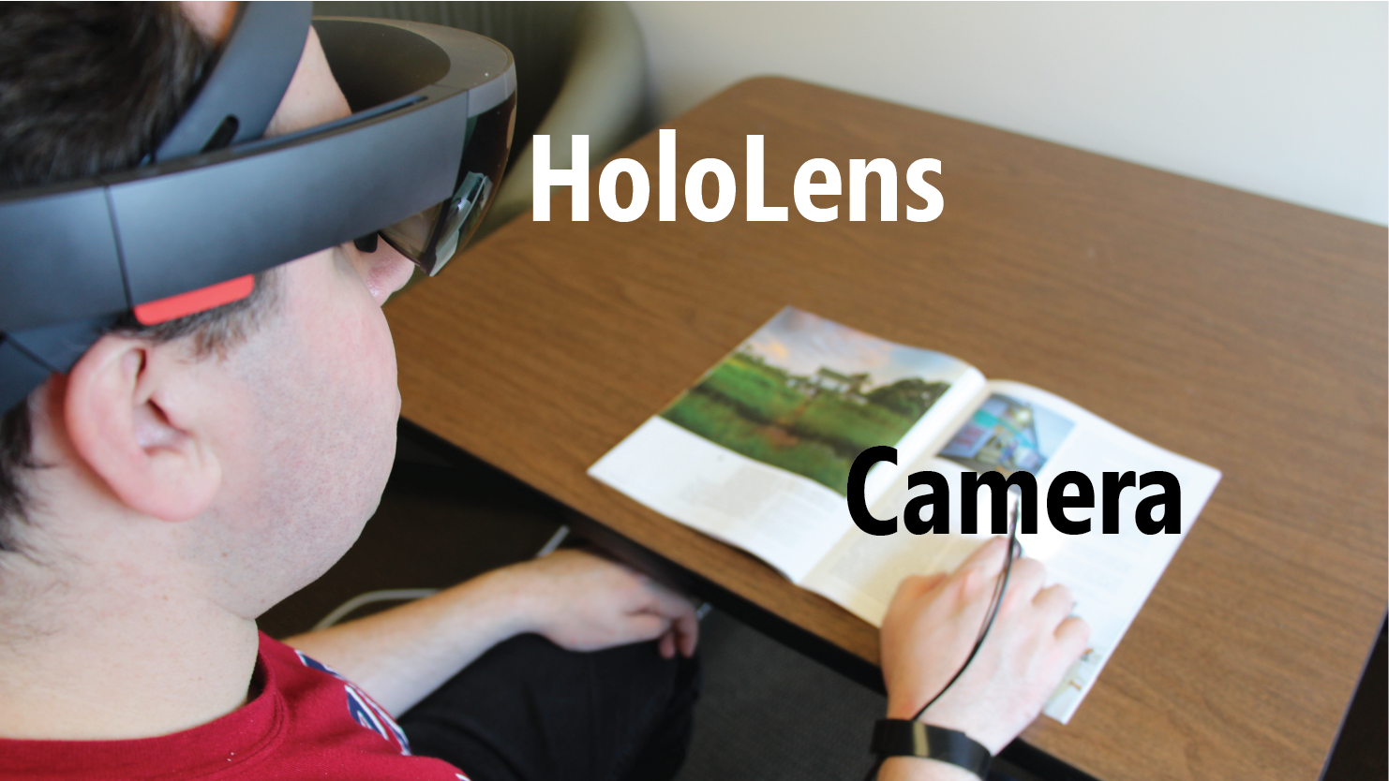
Physical Design
Prototype 1: HoloLens and Finger-Camera
Notes:
[pause] To address those issues and expand on our design, [next] we added an external camera, implemented two additional display modes and more customization options, and replaced the voice commands with a virtual menu controlled using midair gestures.

Slide 20
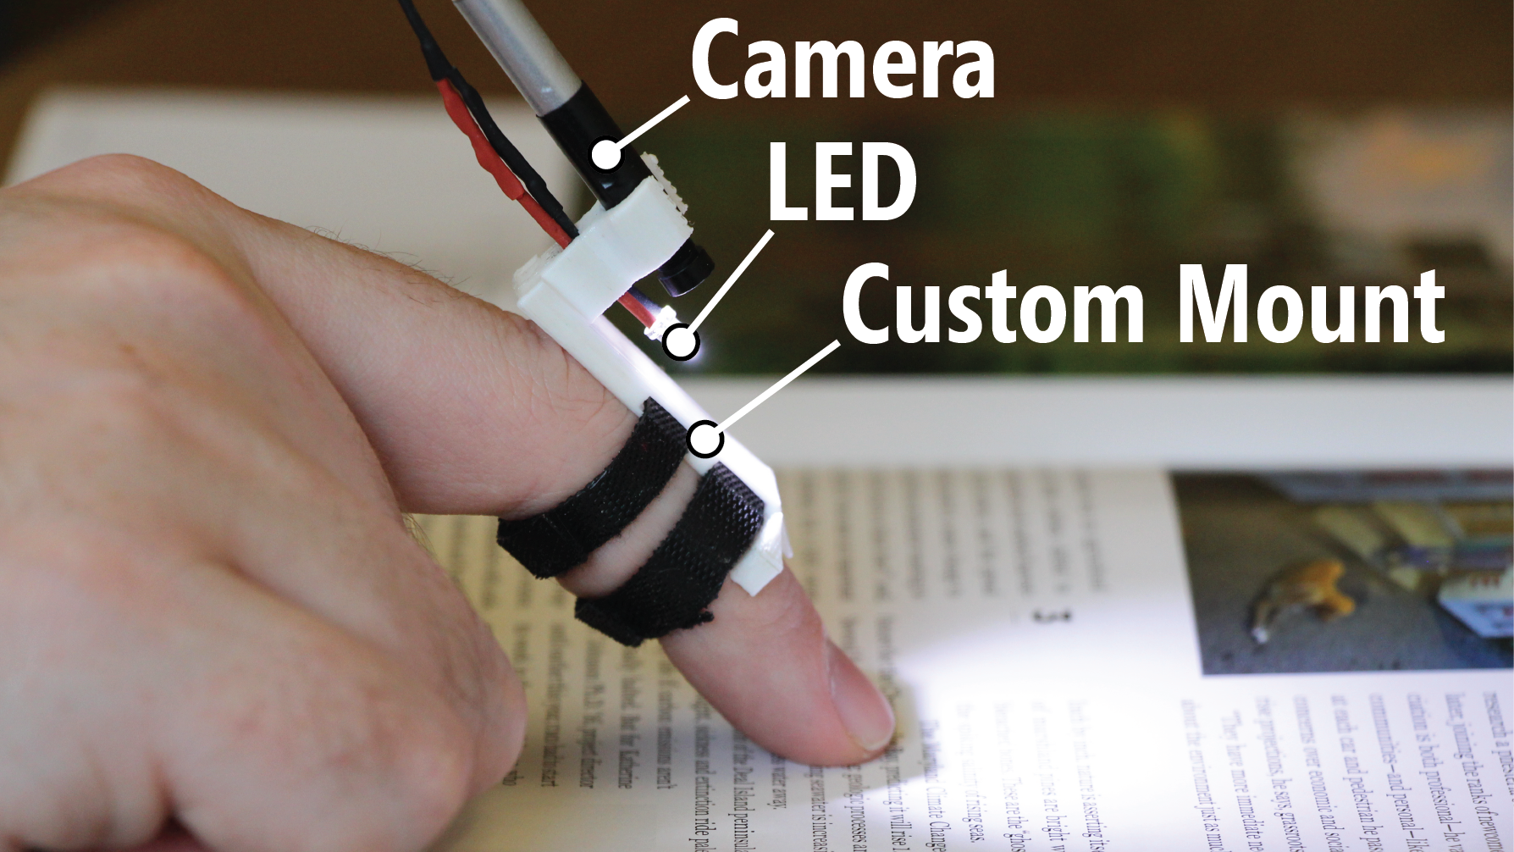

Physical Design
Prototype 1: HoloLens and Finger-Camera
Notes:
This prototype used a small camera worn on the finger to provide a close-up view of the target content and allow the user to read without needing to frame the text within the head-worn camera’s field of view.

Slide 21
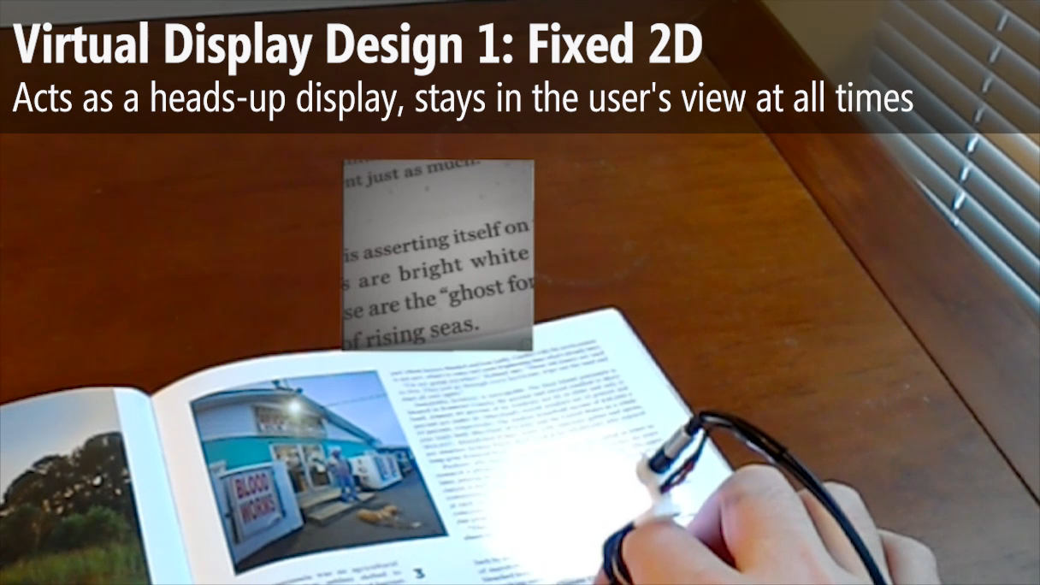
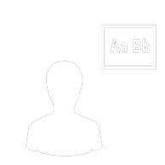
Virtual Displays
Prototype 1: HoloLens and Finger-Camera
Notes:
We implemented four virtual display options, shown in the video that’s now playing. First was the fixed 2D design, which acted as a heads-up display and stayed in the user's view at all times. [pause]
Next was the fixed 3D design, which acted as a virtual monitor that stayed in place in the physical world. [pause] This design had two variations: vertical and horizontal. [pause]
And last was the finger-tracking design, which acted like a magnifying glass and followed the user's finger as they read.

Slide 22
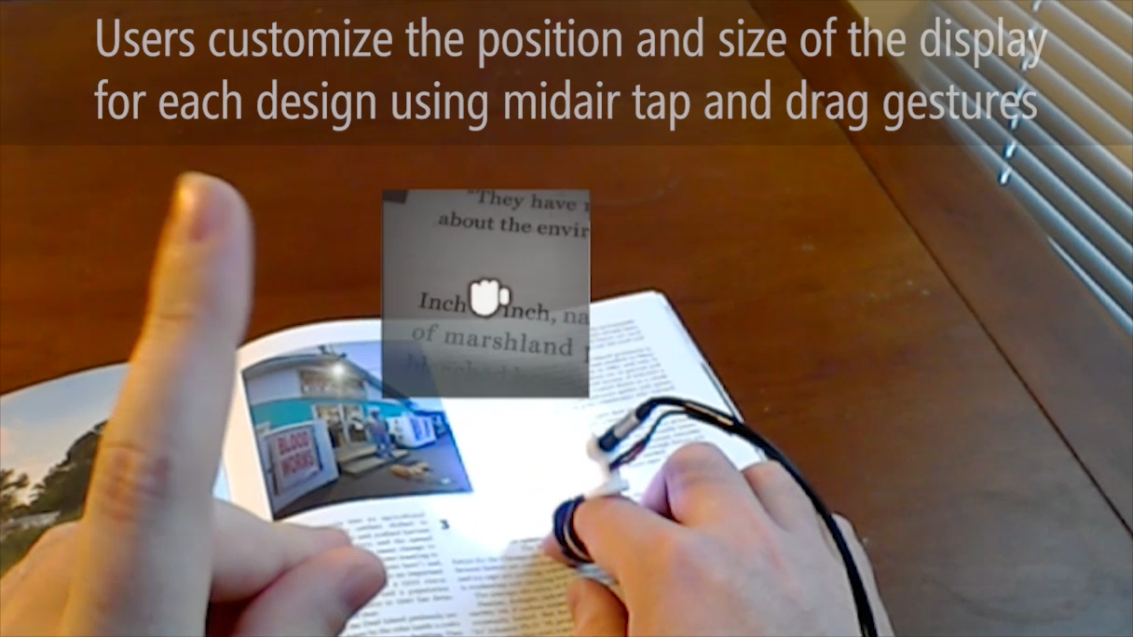

User Interactions
Prototype 1: HoloLens and Finger-Camera
Notes:
Each design allowed users to customize the position and size of the display, using midair tap and drag gestures to adjust each setting.

Slide 23
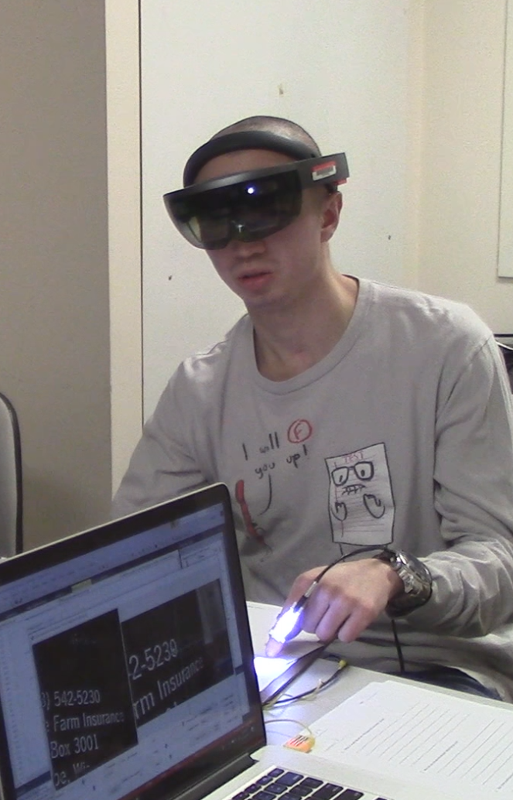
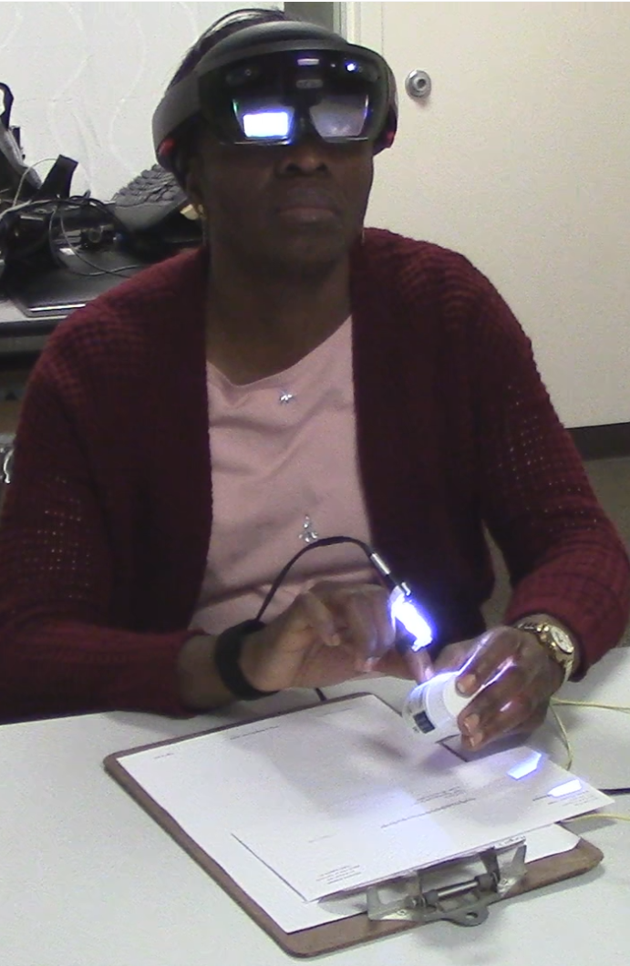
Prototype 1: HoloLens and Finger-Camera
Method
3 Low Vision Participants (1 Female, 2 Male, Ages 28-54)
Each participant used four virtual display designs to read documents and other text (e.g., mail, pill bottle, cereal box)
Notes:
Three participants used this prototype, comparing the virtual display designs and discussing the overall idea of augmented reality vision enhancement. They used each of the four display options to read the text on a few different types of document and other objects.

Slide 24
Prototype 1: HoloLens and Finger-Camera
Method
They provided feedback and suggestions on their likes, dislikes, design preferences, ideas for improvements or new features
Notes:
After using each design, they gave feedback on what they liked and disliked for that particular design. And at the end of the study we asked open-ended questions about their experience with using the system, which design they preferred, and what ideas they had for improvements or new features.

Slide 25
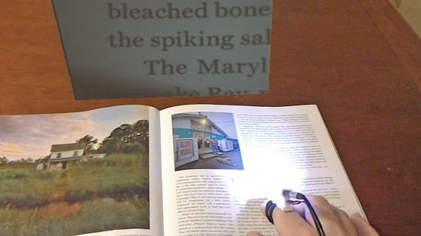
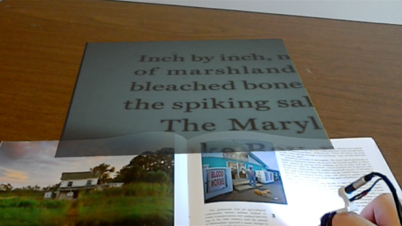
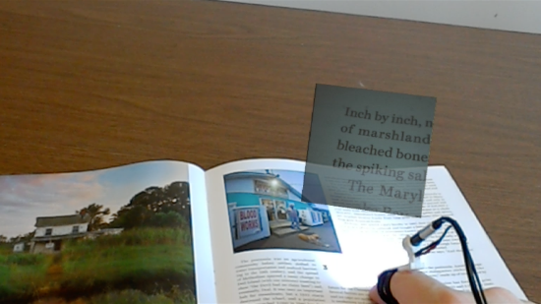
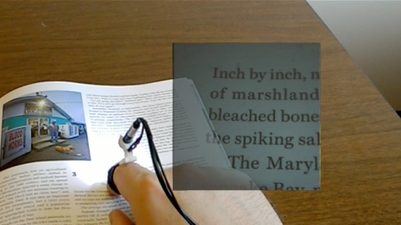
Prototype 1: HoloLens and Finger-Camera
Findings
Virtual Display Designs
Fixed 3D (Vertical or Horizontal)
Reading experience similar to using
a CCTV or handheld magnifier.
Finger Tracking
Can help to quickly search a document.
Fixed 2D
Always visible, required least concentration.
Notes:
Two of the participants reacted positively to our approach, and commented specifically on advantages of the 3D virtual display designs.
[next] They considered the two fixed 3D designs to be more like the reading experience with a CCTV or handheld magnifier, [next] and the finger tracking design could potentially help to quickly locate a particular location in a document when reading. [next] One participant preferred the fixed 2D design because it was always visible and required the least concentration to use.

Slide 26
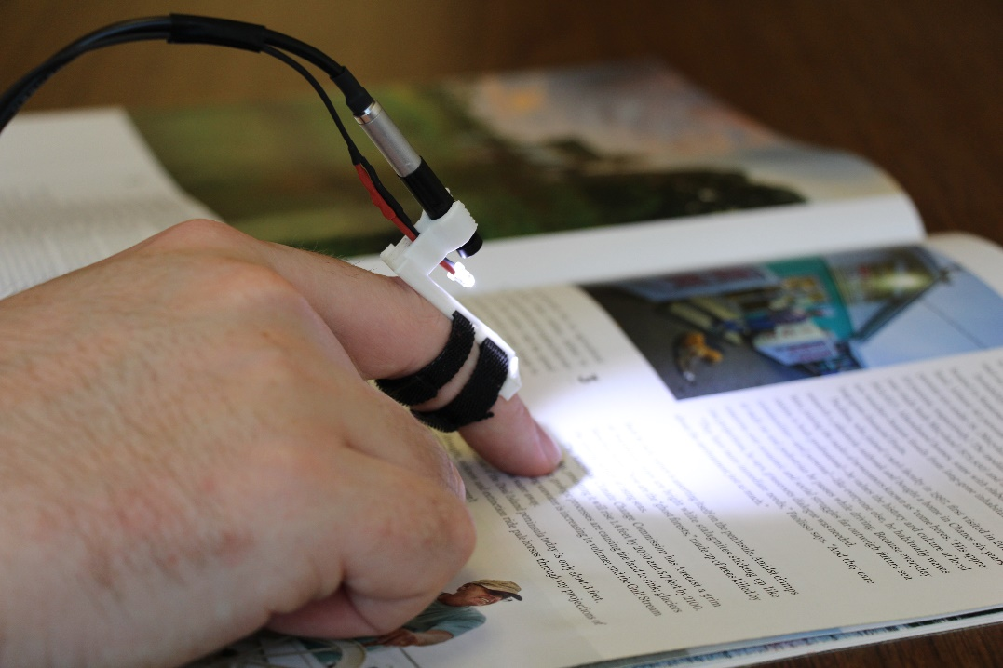
Prototype 1: HoloLens and Finger-Camera
Findings
Finger-Worn Camera
[+] Flexible, allows hands-free use
[–] Requires moving finger to read
[–] Small field of view (~3-4 lines)
Notes:
Other comments were about the components of the system.
[next] The camera could be used hands-free and because it was separate from the display it allowed participants to find a comfortable reading position.
[next] But participants disliked the need to move their finger to read and found it difficult to move from one line of text to the next.
[next] And the camera’s position close to the page meant that it had a small field of view that could only see a few lines of text at a time.

Slide 27


Prototype 1: HoloLens and Finger-Camera
Findings
HoloLens Display
[–] Low contrast due to transparency
[–] Narrow view, center of vision
(problem for one participant)
Notes:
The HoloLens worked reasonably well for two of the participants, [next] but all three mentioned that the contrast of the transparent display was a bit low.
[next] The display is also relatively narrow and located in the middle of the user’s vision, which is a problem for users with central vision loss (like one of our participants).

Slide 28

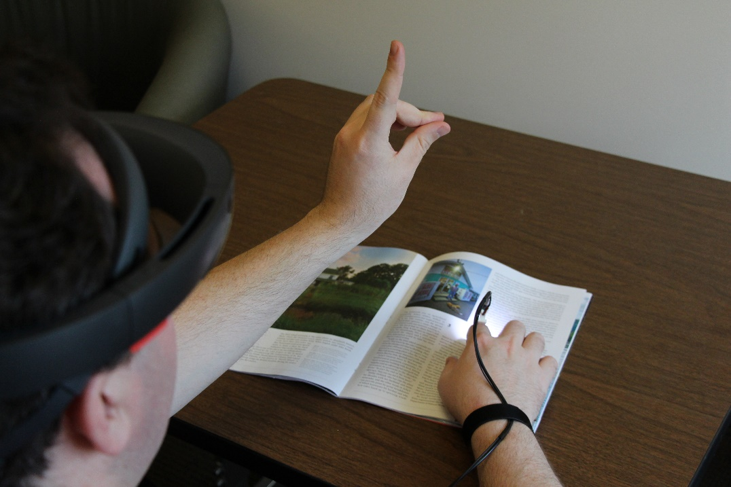
Prototype 1: HoloLens and Finger-Camera
Findings
User Input
[–] Midair gestures difficult to use
[–] Unable to make quick adjustments
Notes:
And while the participants were able to use the midair gestures to adjust the display, they all found the gestures to be slow and difficult to use for quick adjustments.

Slide 29
Prototype 2
HoloLens and Smartphone
Notes:
We redesigned several aspects of our system to address the issues with the first prototype and to implement participants’ suggestions.

Slide 30
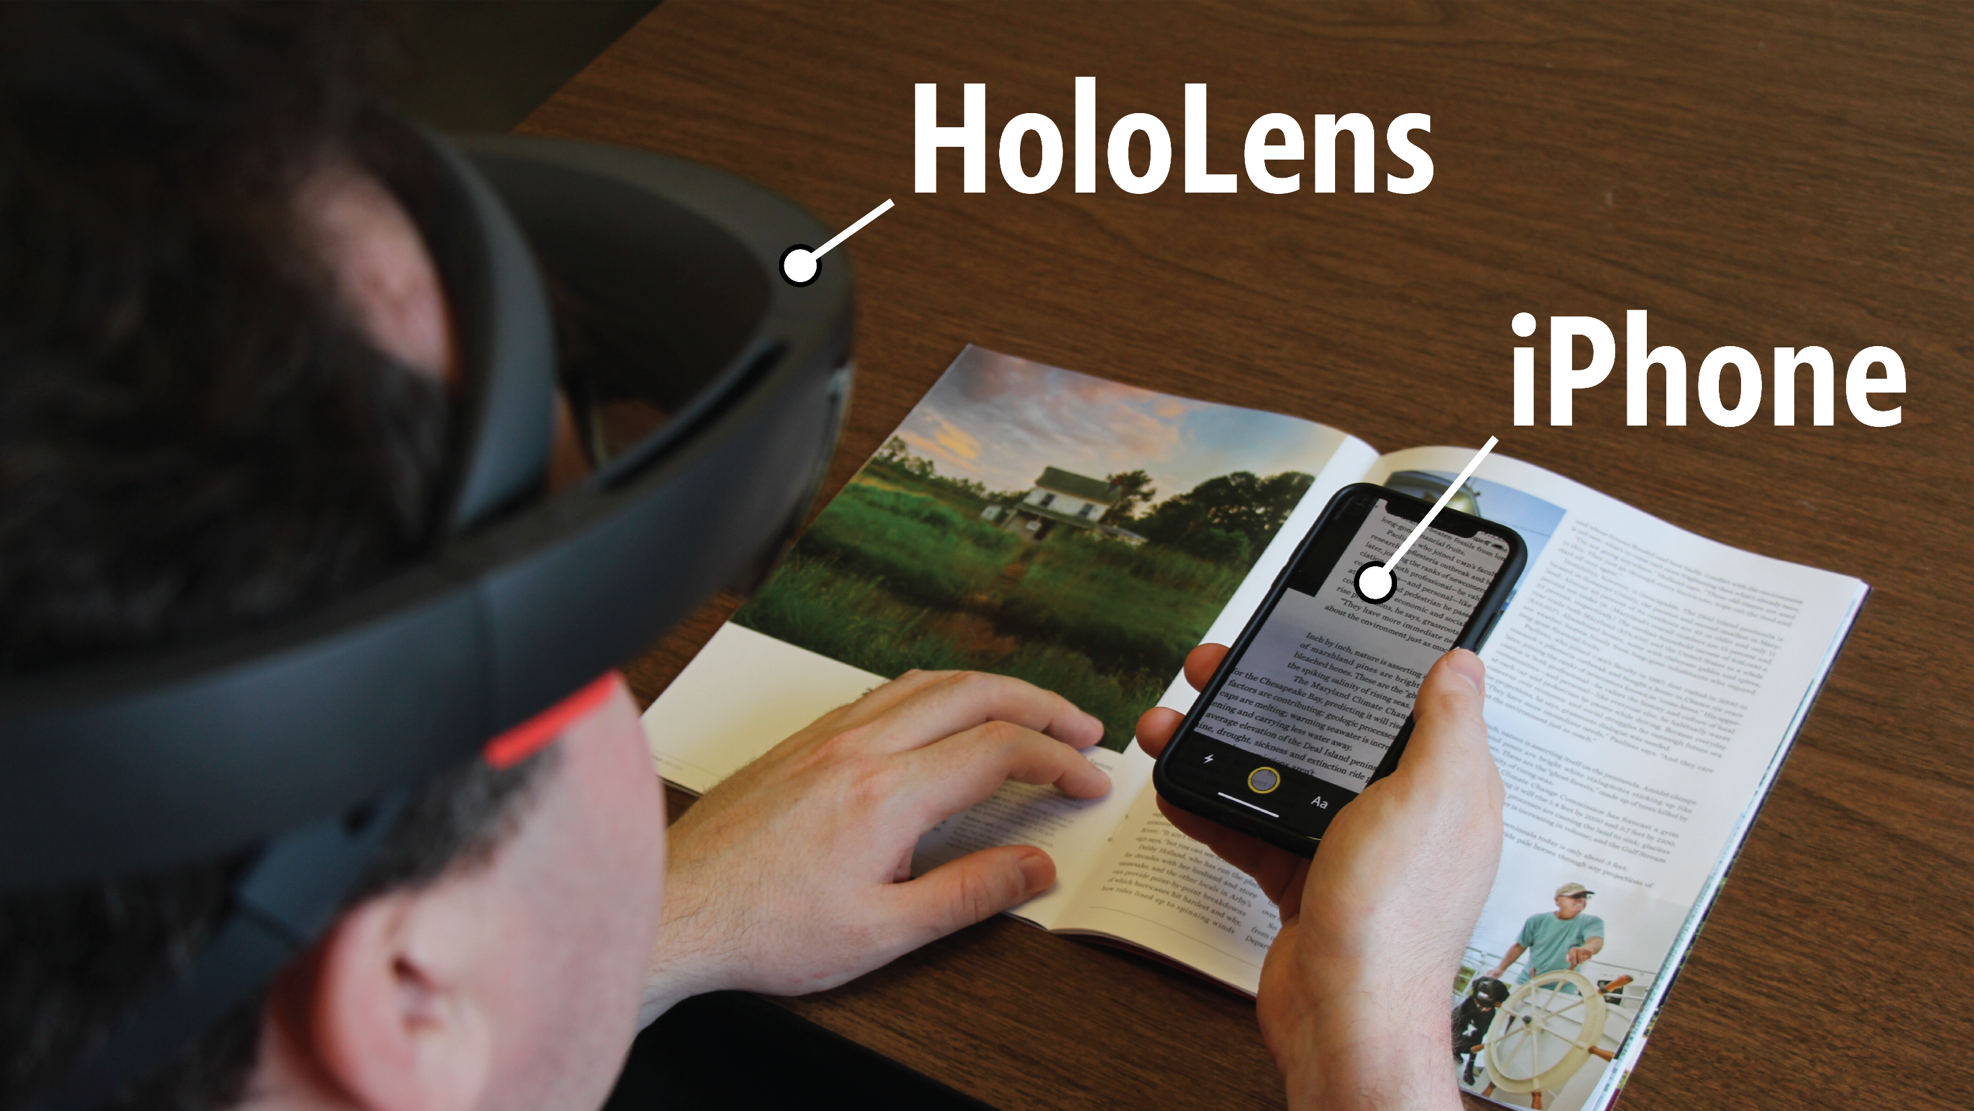
Physical Design
Prototype 2: HoloLens and Smartphone
Notes:
We decided to experiment with using a handheld smartphone camera instead of the finger-worn camera.

Slide 31
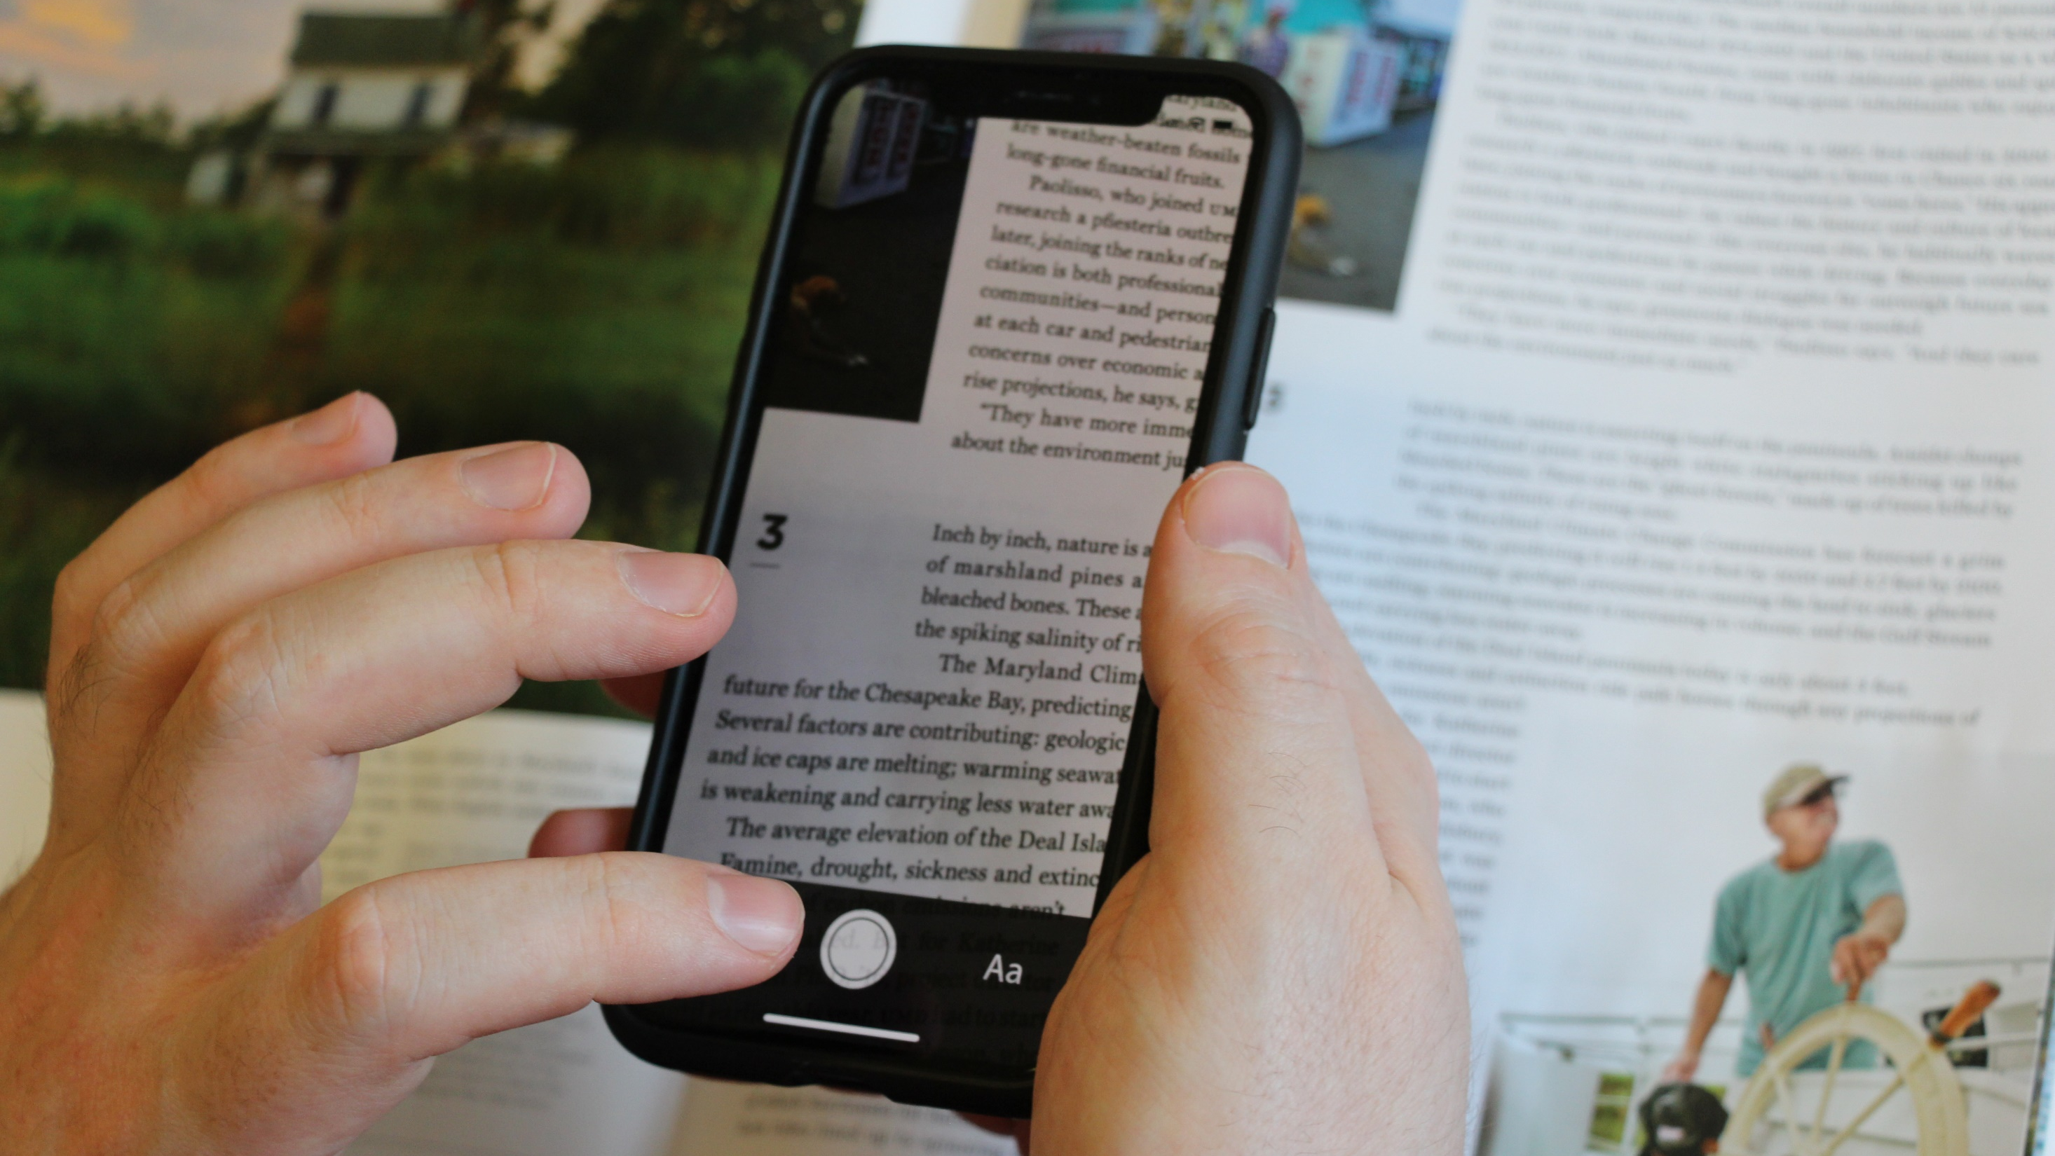
Prototype 2: HoloLens and Smartphone
Physical Design
Smartphone app features:
Wireless streaming to HoloLens
Standard touchscreen gestures
Motion to position virtual display
Notes:
Our smartphone app captured images using the camera and sent them wirelessly to the HoloLens to display. It used standard touchscreen gestures to zoom in and out, and provided buttons to adjust how the image appeared. And along with the touchscreen controls we also used the motion sensors in the phone to allow users to more easily position the display.

Slide 32
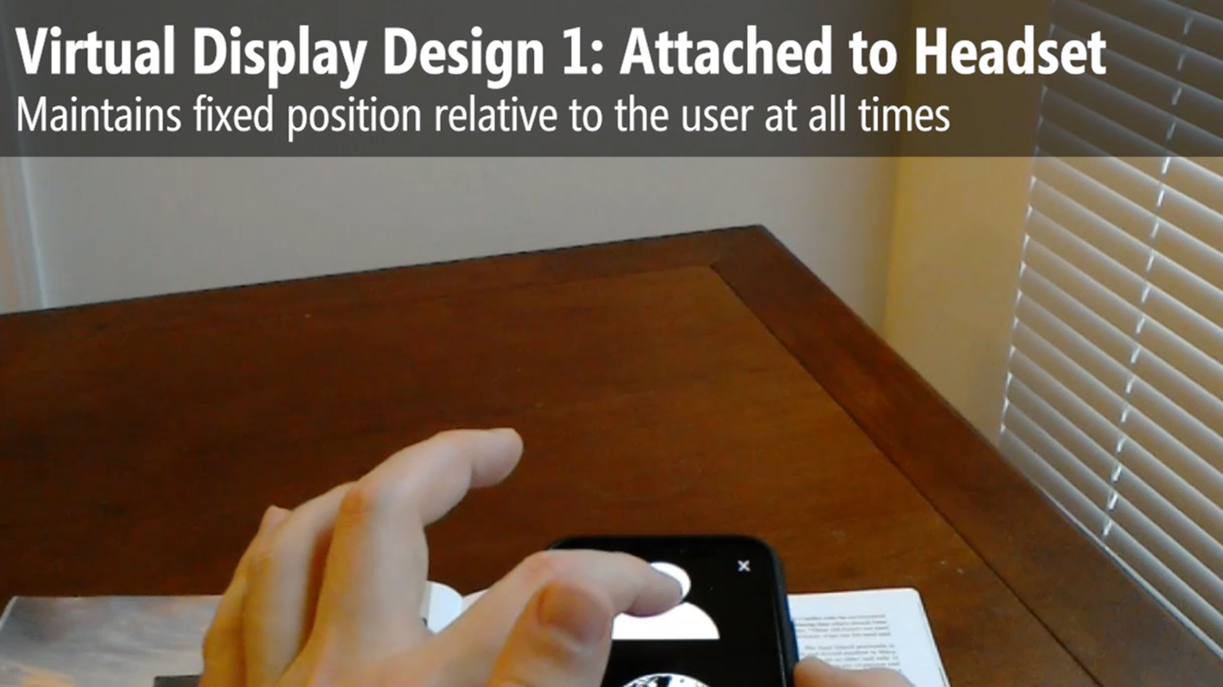
Virtual Displays
Prototype 2: HoloLens and Smartphone
Notes:
Our updated prototype provided three virtual display designs, which differed depending on where the display was attached. This video will demonstrate how the user positioned the virtual display for each design.

Slide 33

Virtual Displays
Prototype 2: HoloLens and Smartphone
Notes:
The first design attached the display to the headset, so that it maintained a fixed position relative to the user at all times.
The second design attached the display to a location in the physical world, remaining stationary as the user moved.
And the third design attached the display to the smartphone, moving along with it like a magnifying glass.

Slide 34
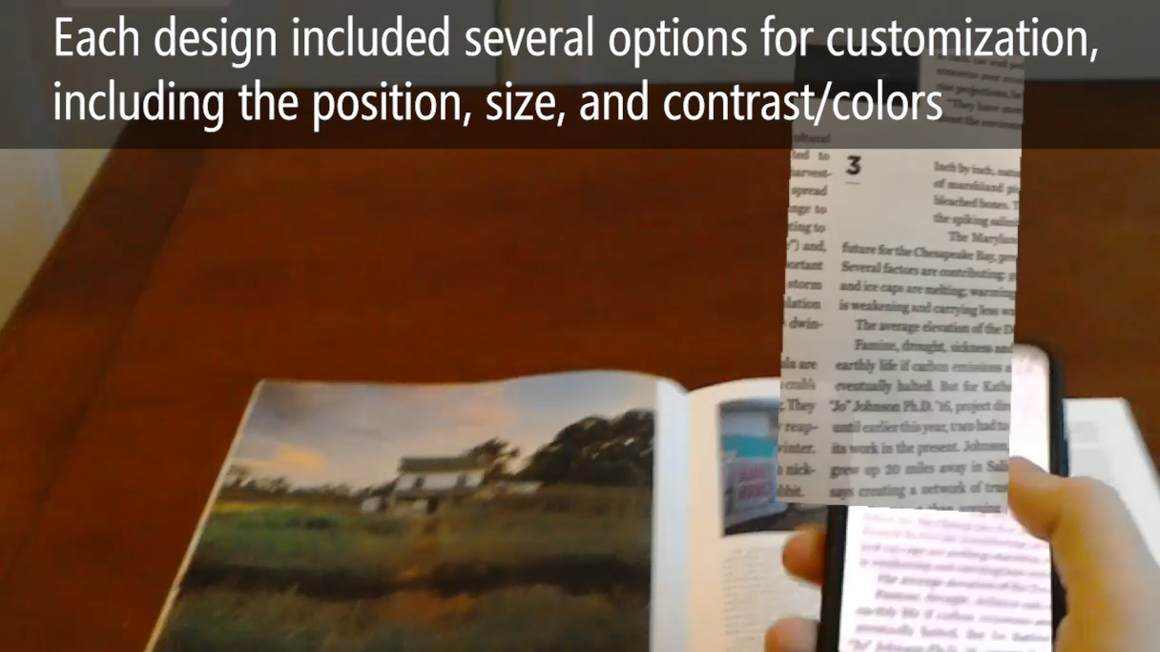
User Interactions
Prototype 2: HoloLens and Smartphone
Notes:
Each design also included several options for customizing how the display appeared. Users could adjust the position by physically moving the phone, or adjust the size of the display and the contrast or colors using on-screen controls.

Slide 35
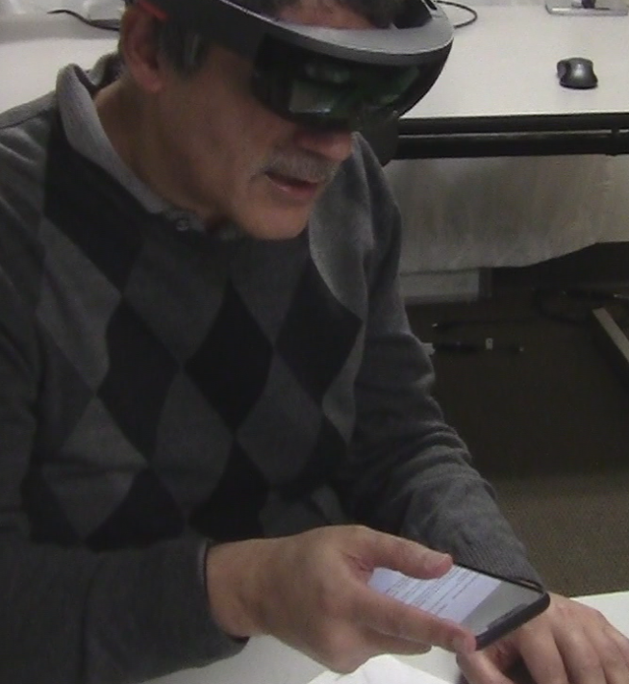
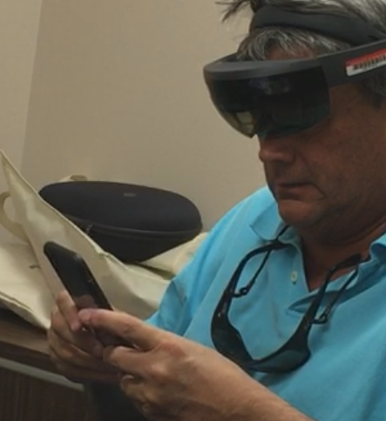
Prototype 2: HoloLens and Smartphone
Method
6 Low Vision Participants (3 Female, 3 Male, Ages 28-68)
Each participant used three virtual display designs to read documents and other text (e.g., mail, pill bottle, cereal box)
Notes:
Six participants used this prototype, including two who returned from the first sessions.
[next] The sessions were similar to those with the first prototype, with participants reading text on documents and other objects with each of the display modes and providing feedback and suggestions.

Slide 36
Prototype 2: HoloLens and Smartphone
Findings
Participants were more successful and positive about their experience using this version of our system.
They were better able to experience the AR aspects of our approach, which most participants found promising.
Notes:
In general participants were more successful and positive about their experience using this prototype than we observed with the previous version.
[next] They were better able to experience the augmented reality aspects of our approach, which most participants found promising.

Slide 37
Prototype 2: HoloLens and Smartphone
Findings
“ ”
That is so much better [than my CCTV], you can go down the whole page and read it. Like if I want to read a book or something to my kids, Mommy doesn't have to go line by line. I can read it and keep the flow going.”
P4
Notes:
One participant was particularly enthusiastic, saying “That is so much better than my CCTV, you can go down the whole page and read it. Like if I want to read a book or something to my kids, Mommy doesn’t have to go line by line. I can read it and keep the flow going.”

Slide 38
Prototype 2: HoloLens and Smartphone
Findings
Virtual Display Designs
Notes:
Participants saw advantages to all three virtual display designs, and some said they liked the flexibility of having multiple options available and that they would use different versions depending on the situation.

Slide 39
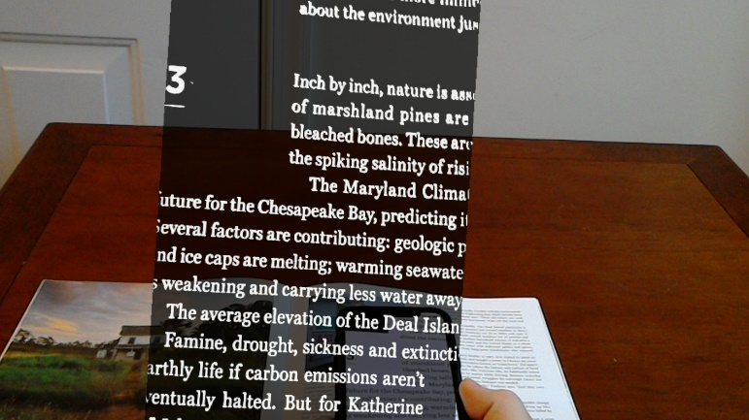
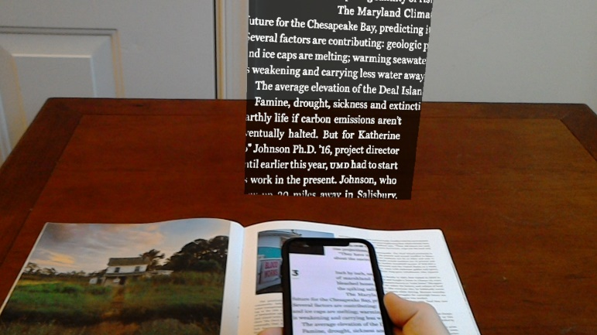
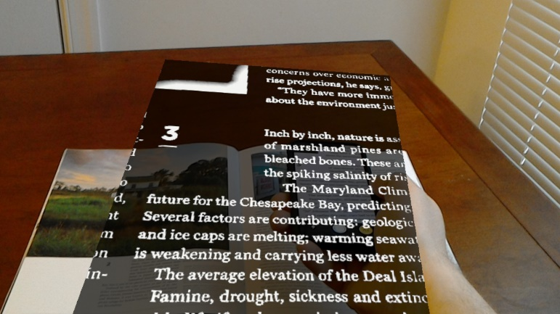
Prototype 2: HoloLens and Smartphone
Findings
Virtual Display Designs
Attached to Headset
Easier to focus on the text
Attached to World
Natural reading experience
Easier to multitask
Attached to Phone
Versatile
Intuitive interactions
Potentially distracting
Notes:
Two participants liked the Attached to Headset design because they found it easier to focus on the text with fewer variables to consider.
[next] In contrast, one participant found that mode to be too distracting, especially when speaking with someone or multitasking. [next] She preferred the Attached to World design since it provided a more natural reading experience. It was like a private, portable CCTV that stayed where you want it to stay.
[next] Some participants also liked how versatile and intuitive the Attached to Phone design was, and said that it would especially be useful when away from home.

Slide 40
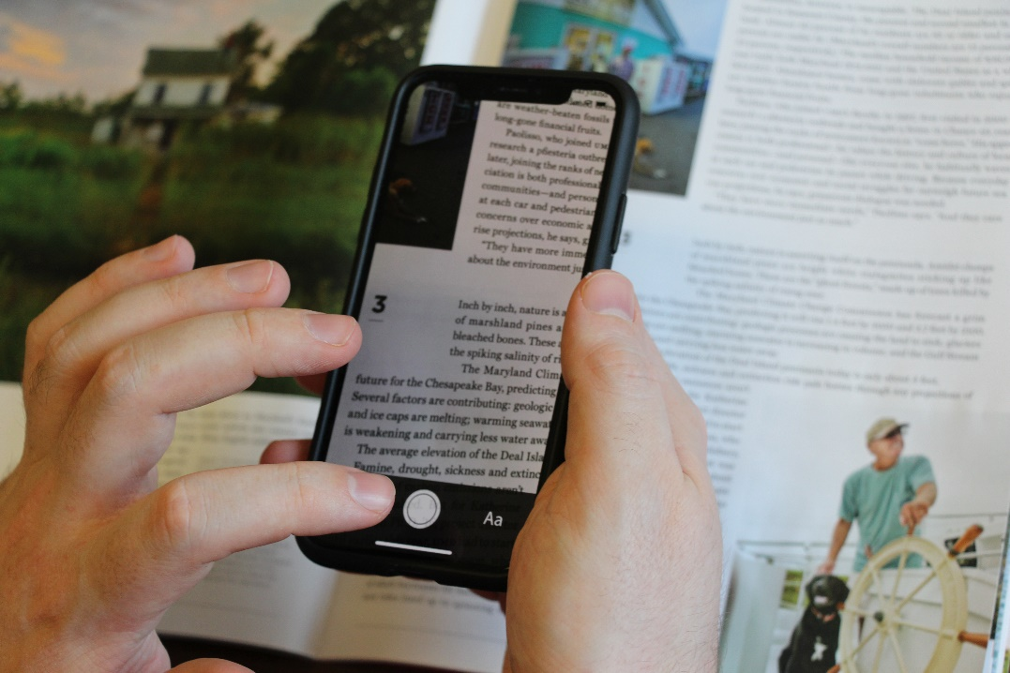
Prototype 2: HoloLens and Smartphone
Findings
Smartphone
[+] Better camera
[+] More usable interactions
[–] No longer hands-free
[–] Too heavy for extended use
Notes:
Participants felt that the new version was an improvement, [next] with a better camera and more useable interactions. But while the previous version was lightweight and could be used hands-free, [next] the updated design required holding the phone steady in midair while reading.

Slide 41
Prototype 2: HoloLens and Smartphone
Findings
HoloLens
Issues with contrast, field of view, and physical size and weight still present.
Emphasizes need for customizability.
Notes:
We weren’t able to address the limitations of the HoloLens display. The narrow field of view was more of an issue for some participants than others, especially for the two participants with central vision loss. But in contrast, one participant with tunnel vision found the display perfectly sized.
[next] The variations between participants emphasize the need for customizability, and maybe for a different display technology to support some users.

Slide 42
Conclusions
Strengths and Weaknesses of 3D AR for Magnification
[+] Enables new interactions not possible with other approaches
[+] Good for multitasking
Notes:
To summarize our high-level findings, 3D augmented reality which anchors virtual content to the physical world has both advantages and disadvantages.
[next] It enables new interactions that are not possible using any other approach. For example, participants could use the fixed 3D designs as an arbitrarily large virtual display and then read a full document by turning their head, rather than scanning line by line like with other portable reading aids.
[next] Participants also liked how the designs allowed them to easily multitask, for example turning away from the virtual display to speak with someone, and then turning back to continue reading.

Slide 43
Conclusions
Strengths and Weaknesses of 3D AR for Magnification
[+] Enables new interactions not possible with other approaches
[+] Good for multitasking
[–] May require more effort to use than fixed 2D display
Future work
Alternative camera positions and virtual display designs
Notes:
But our approach may also require more effort to use than other reading aids, and some participants preferred the simplicity of a fixed 2D display—especially when they are trying to concentrate on what they’re reading.
[next] There is still a lot of room for future work in this area, and we would especially like to investigate alternative camera positions and virtual display designs in more depth.

Slide 44
Design of an Augmented Reality
Magnification Aid for Low Vision Users
Jon Froehlich
Leah Findlater
University of Washington
Lee Stearns
University of Maryland
Email: lstearns@umd.edu
This work was supported by the Office of the Assistant Secretary of Defense for Health Affairs under Award W81XWH-14-1-0617
Notes:
That’s the end of my presentation, thank you for listening.

