Slide 1
Sensing and Predicting the Pulse of the City through Shared Bicycling
Jon Froehlich (U. of Washington)
Joachim Neumann (Telefonica) Nuria Oliver (Telefonica)
design:
use:
Telefonica
build:
Research
university of washington
Notes:
Our focus is on utilizing existing urban infrastructure to sense data about human behavior that is *freely* available which is, in this case, shared bicycling
This has wide-ranging implications…

Slide 2
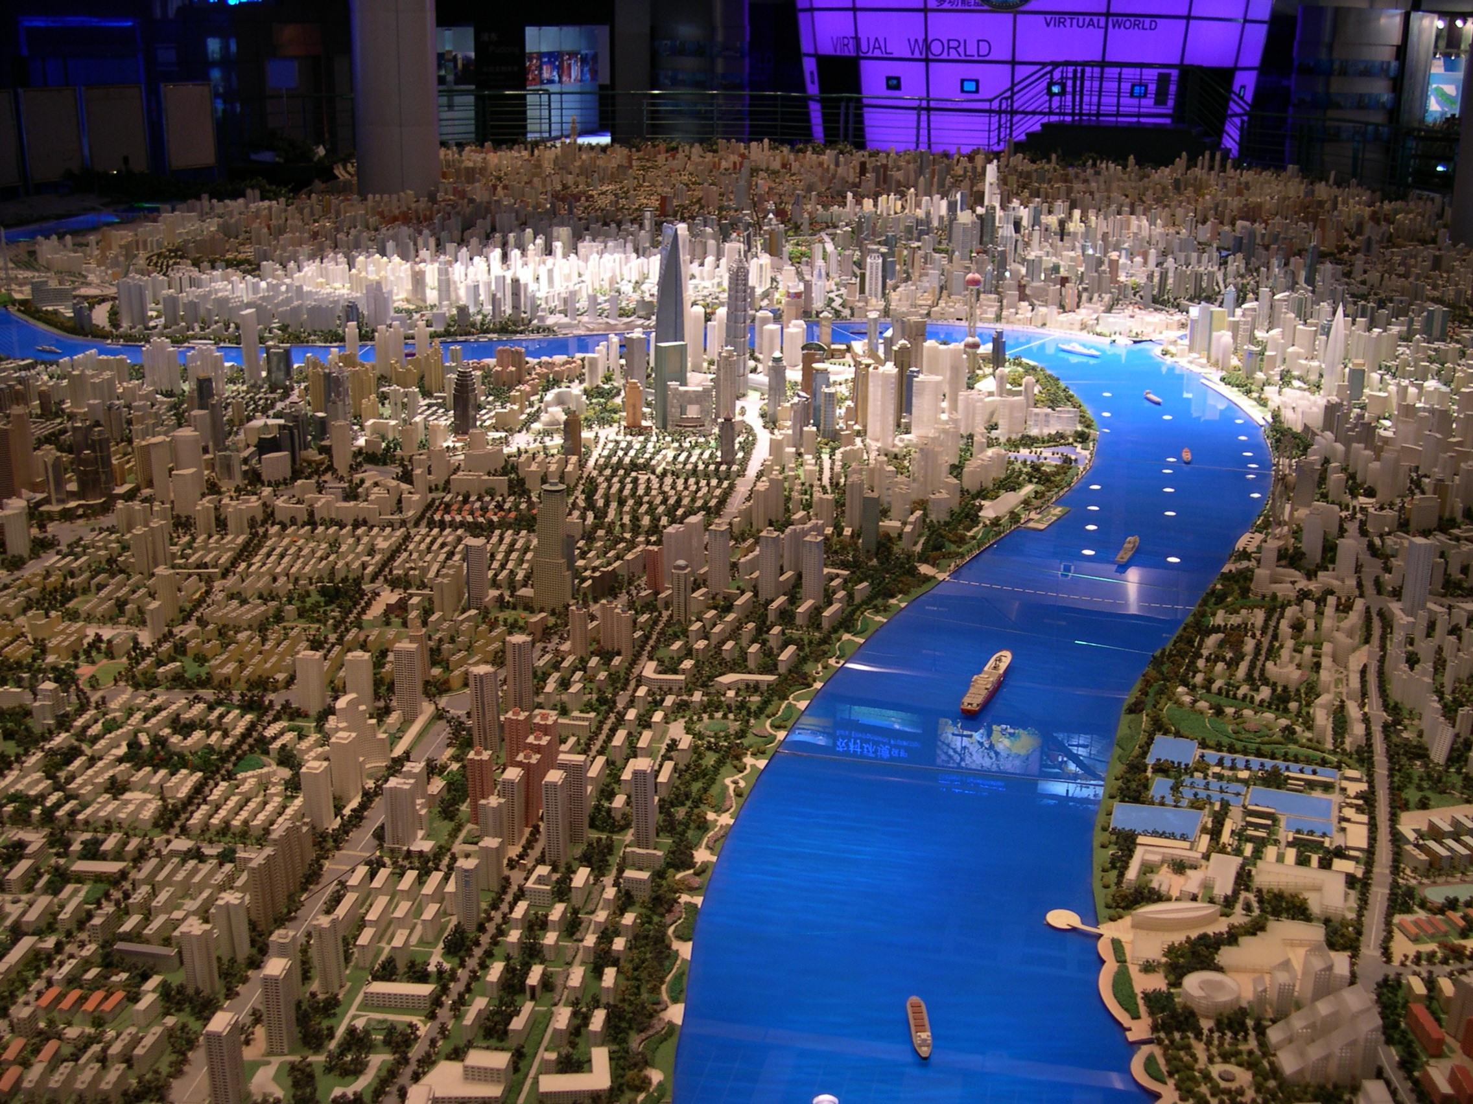
Notes:
for city-planners, governments, urban transit studies, traffic forecasting

Slide 3
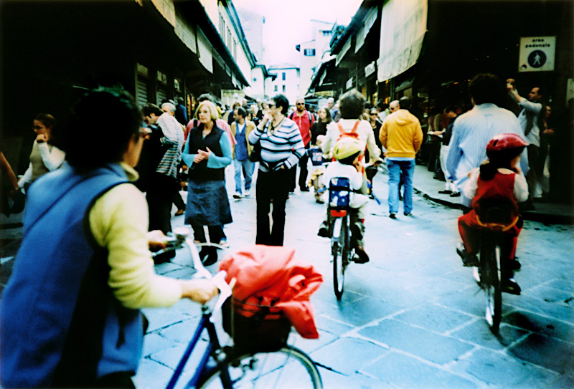
Notes:
* for social scientists to understand the periodicity and routines in behavior
* potential to access the masses of data that are of the same order of magnitude as that of the natural sciences (latour)

Slide 4
Notes:
understand and predict the spread of biological viruses

Slide 5
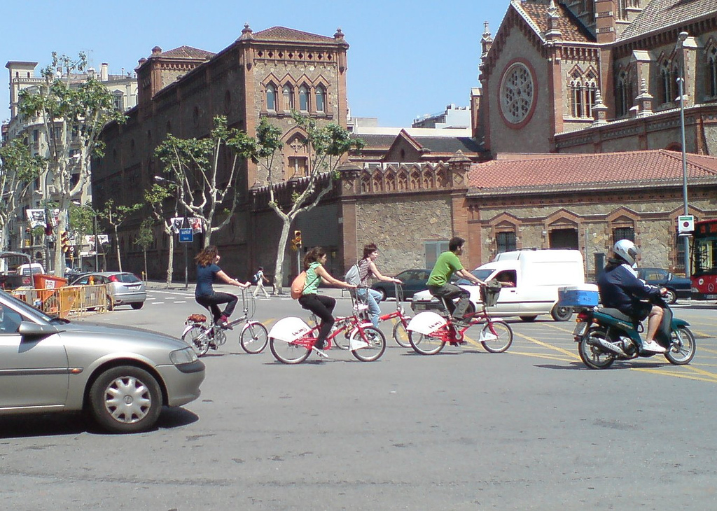
Notes:
In our paper, we introduce a new source of real-world human behavioral data from an emerging type of urban infra­structure: shared bicycling systems.

Slide 6
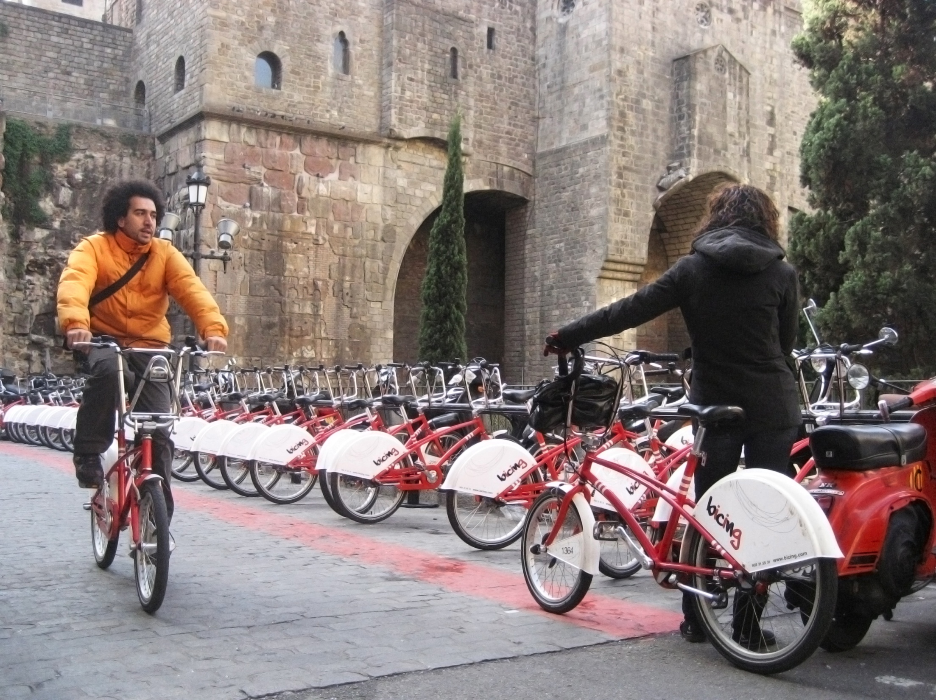
contributions
introduce potential of shared bicycling as a data source
highlight spatiotemporal patterns and their relation to the city
prediction of usage patterns and an analysis of influential factors

Slide 8
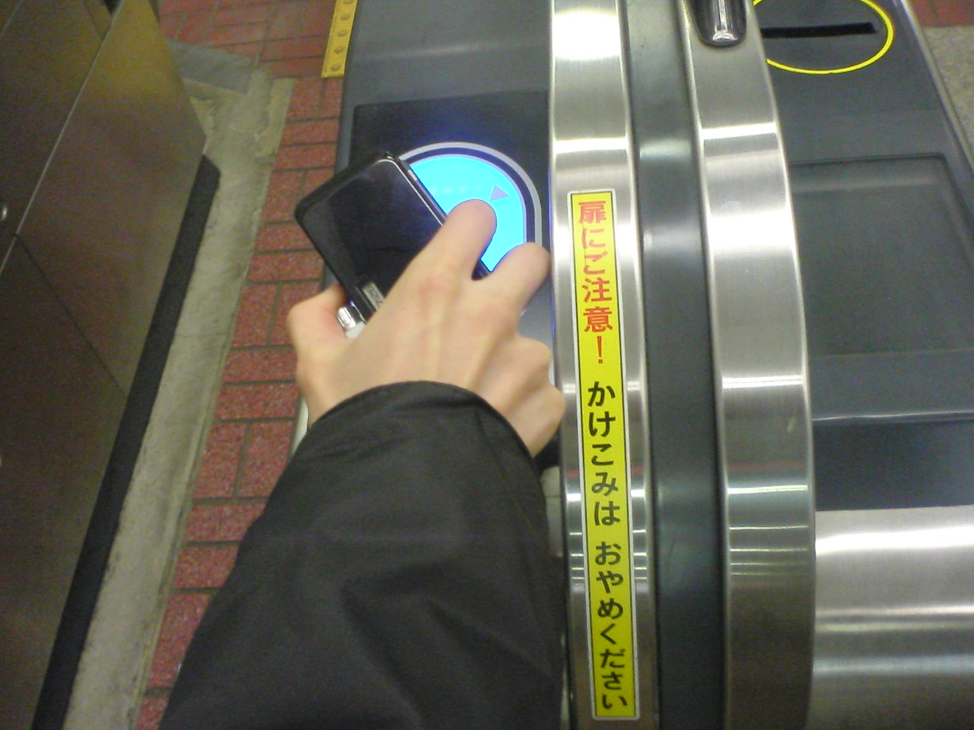

Slide 9
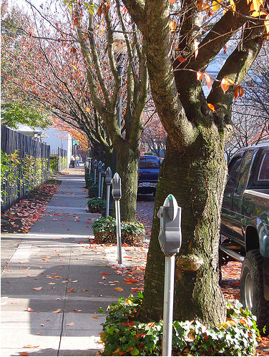
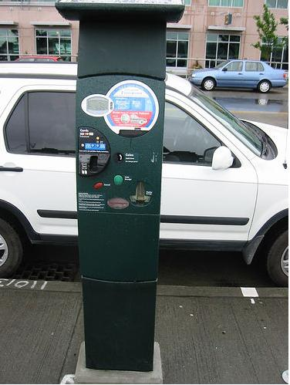

Slide 11
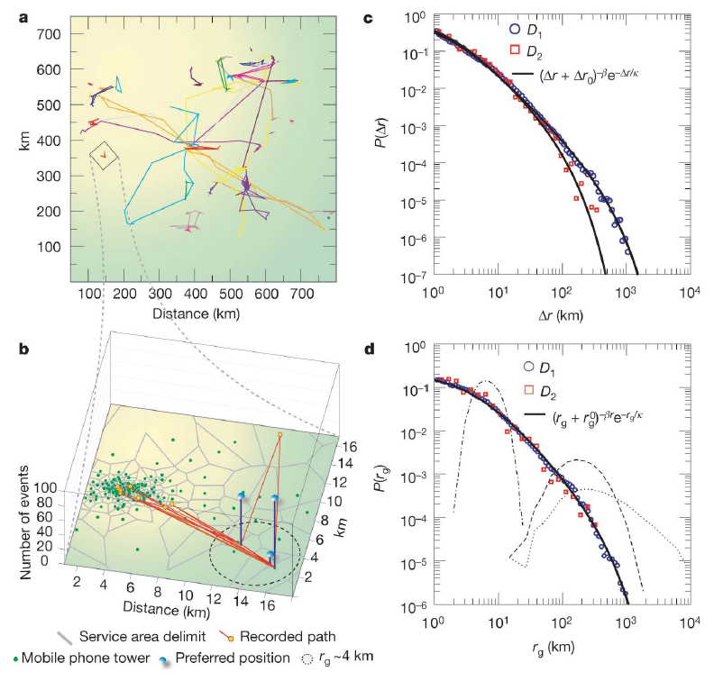
understanding human mobility patterns
Marta C. González, César A. Hidalgo & Albert-László Barabási, Nature, 5 June 2008
Notes:
Gonzalez et al. studied the trajectory of 100,000 anonymized mobile phone users whose position is tracked for a
six-month period. Found that in contrast with the random trajectories predicted by the prevailing Levy flight and random walk models, human trajectories show a high degree of temporal and spatial regularity

Slide 12
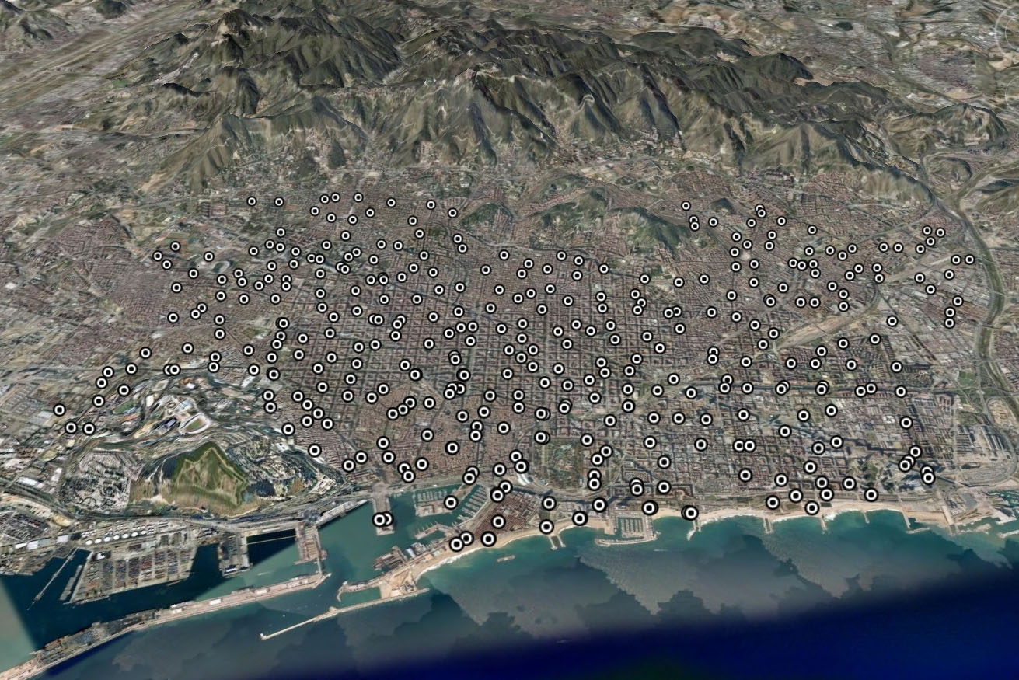
bicing in barcelona, spain
Notes:
Bicing station

Slide 13
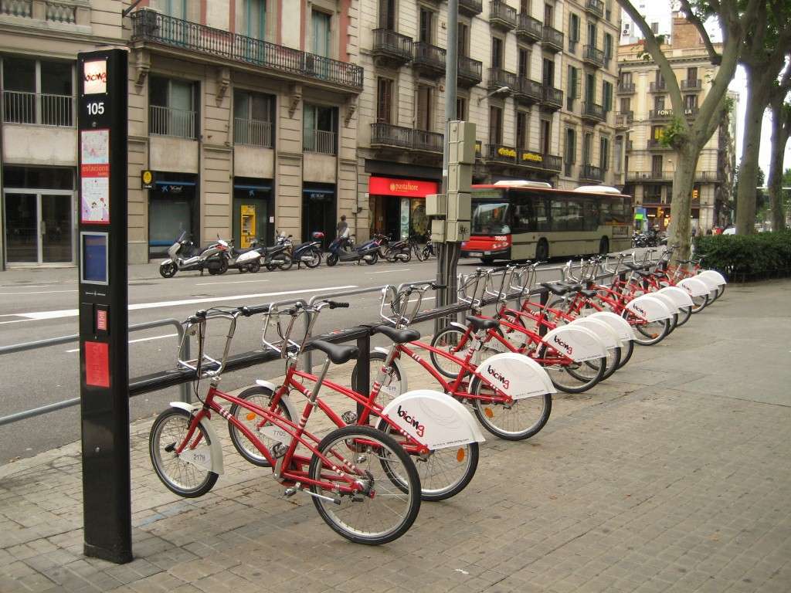
bicing in barcelona, spain
launched march 2007
by summer 2008:
- 373 stations
- 6,000 bicycles
- 150,000 subscribers
Notes:
Community shared bicycling programs offer an environmentally friendly, healthy, and inexpensive alternative to automobile transportation.
Recent technological advances have led to a third generation shared bicycling system whose real-time usage data can be collected, archived, and analyzed.
Currently, there are over forty such programs in the world including Vélib’ in Paris, which has 20,000 bicycles and 1,450 stations (approximately 1 station every 300 meters) and a new program in Washington DC called SmartBikeDC.
One thing that makes Bicing in Barcelona unique is that it’s a subscription based system, not meant for tourists.

Slide 14
Notes:
Bicycles are checked out by swiping an RFID membership card at a Bicing station kiosk which then unlocks a bicycle and displays its rack location on an LCD screen.
Check-out information is uploaded to a web server that provides real-time information about the number of available bicycles and vacant slots at each station

Slide 15
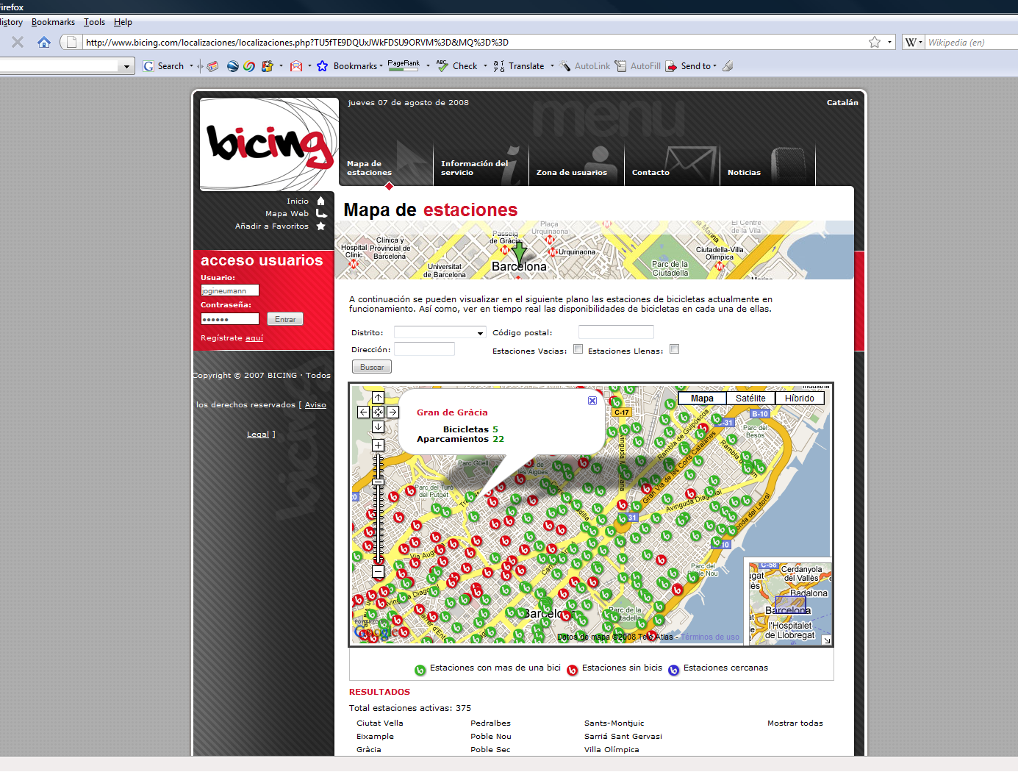
data collection
scrape bicing webpage every 2 minutes
extract
station’s geo-location
# of available bicycles
# of vacant parking slots

Slide 16
example data
station 15: num available bicycles
erroneous oscillations
20
random zero value
10
# of avail bicycles
0
fri sat sun mon tues wed thurs fri
time
after cleansing
station 15: num available bicycles
20
# of avail bicycles
10
0
fri sat sun mon tues wed thurs fri

Slide 17
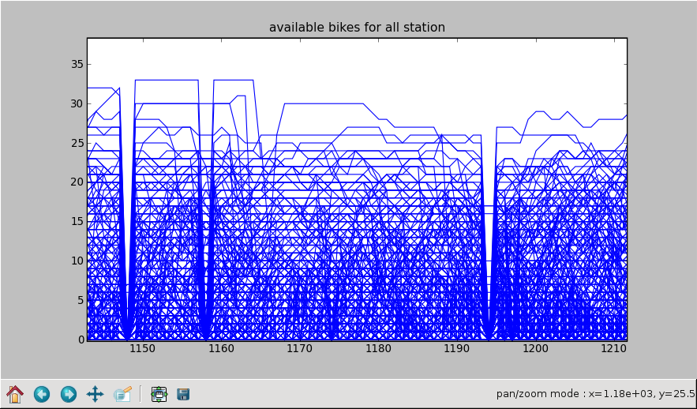
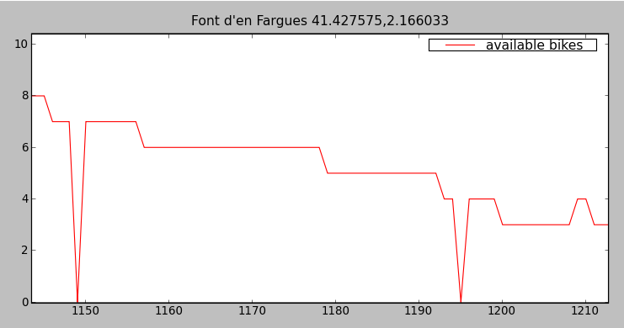
data cleansing example
# of avail bicycles
random zero value
and here as well
6 hours
Notes:
The data scraped from the Bicing website is noisy as a result of temporary station closures, technical issues at the stations caused by maintenance work, internet connectivity failures, server-side SQL time-outs, and broken bicycles and parking slots. We employed a three step process to detect and eliminate these faulty observations. Data cleansing was criti­cal to ensure that the data used to train our prediction models was valid.

Slide 18
dataset
 | raw dataset | cleaned dataset
stations | 390 | 370
days | 25K | 22.7K
observations | 26.1M | 20.2M
parking slots | 9831 | 9315
13 weeks of observations
(Aug 27 – Dec 1, 2008)

Slide 19
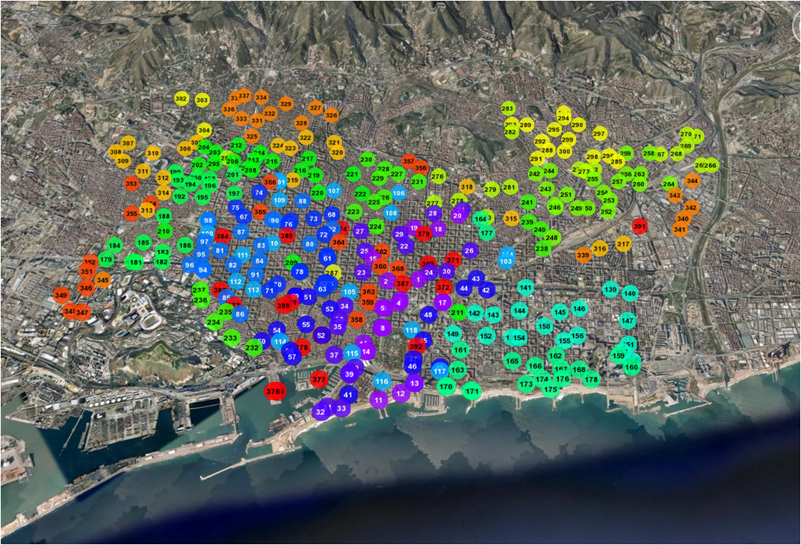
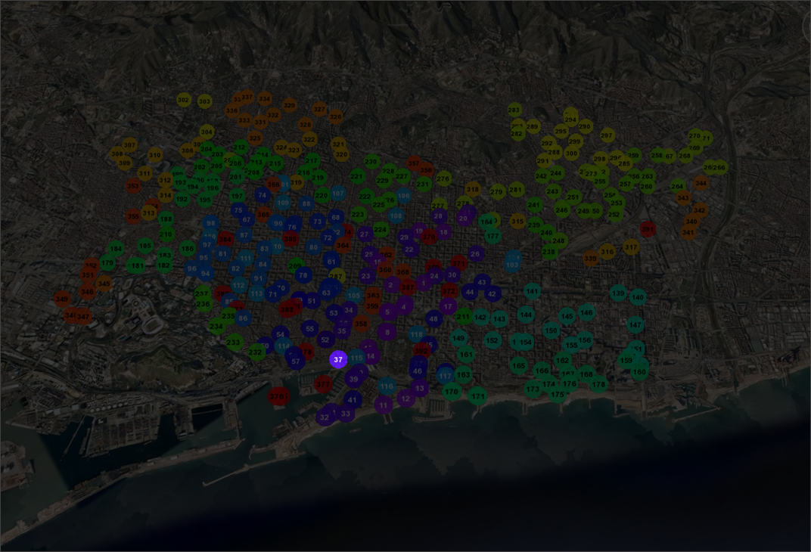
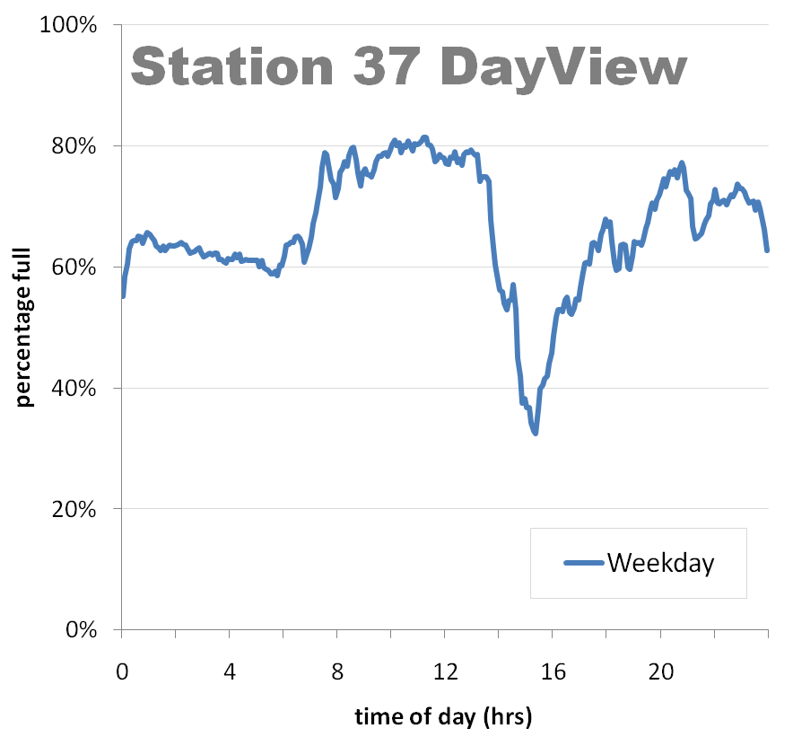
introducing DayViews
Mon Tues Wed Thur Fri
Notes:
A DayView is calculated by averaging station data that matches certain criteria into a 24 hour window, discretized into five-minute bins (288 bins/day).
For example, a station’s “Percentage Full DayView” is created by computing the station’s average percentage full values in each of the 288 bins for each weekday over a given observation period.

Slide 20
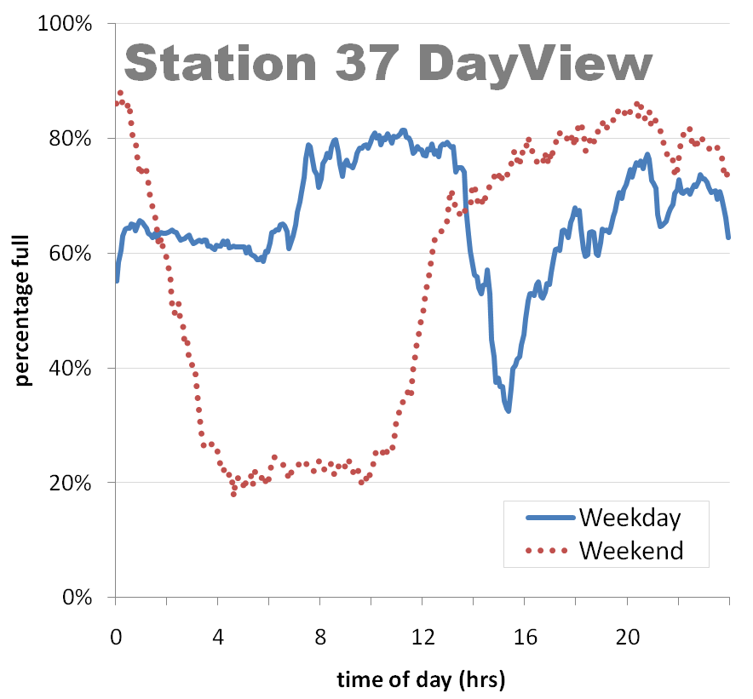
10am beach goers begin arriving
morning commute starts @ 7am
lunch rush begins @ 1pm
return from lunch/work at 3:30pm

Slide 21
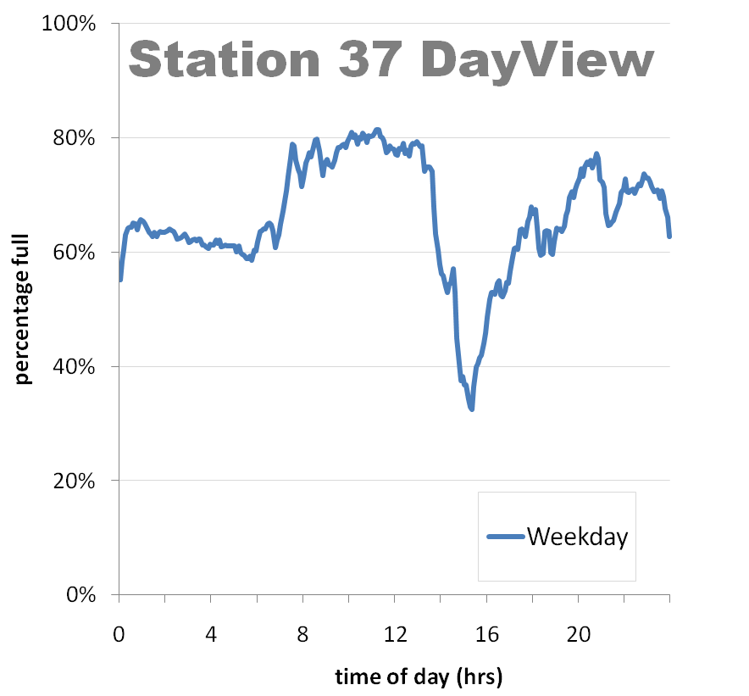
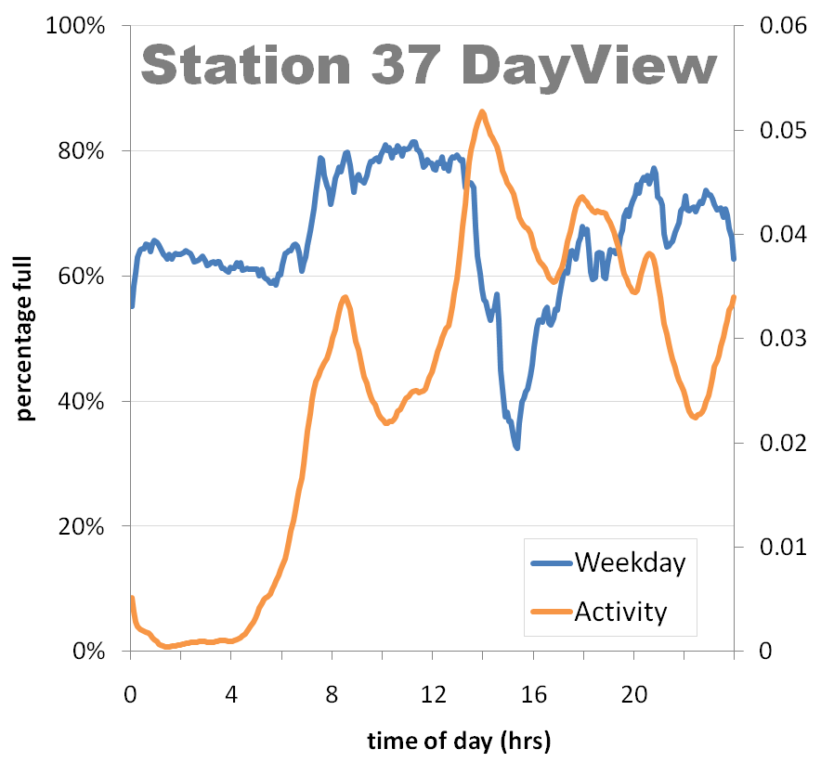
lunch rush begins @ 1pm
return from lunch/work at 3:30pm
morning commute starts @ 7am
Activity Score:
AS(t)=|B_{t} -B_{t-1}|

Slide 22
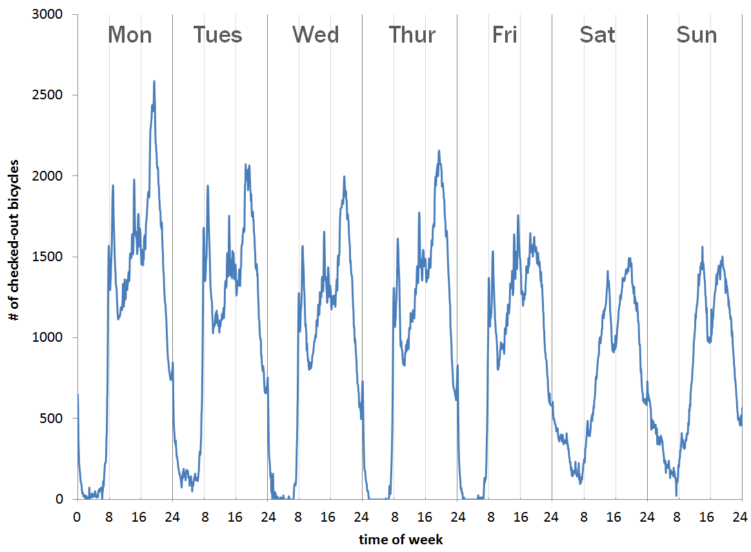
num checked-out bicycles across all stations
evening commute
evening commute
late spanish lunch
sleeping in on weekends
morning commute

Slide 23
how are bicing patterns shared across stations and distributed in the city?

Slide 24
temporal clustering
activity clusters
available bicycle clusters
applied dendrogram clustering with dynamic time warping as distance metric
Notes:
We used a Dynamic Time Warping (DTW) based metric with a one-hour Sakoe-Chiba band (Sakoe, 1978). DTW was used in preference to a Euclidean-distance measure because we were interested in comparing overall temporal patterns and wanted to allow for up to one hour of temporal shifts in the data.

Slide 25
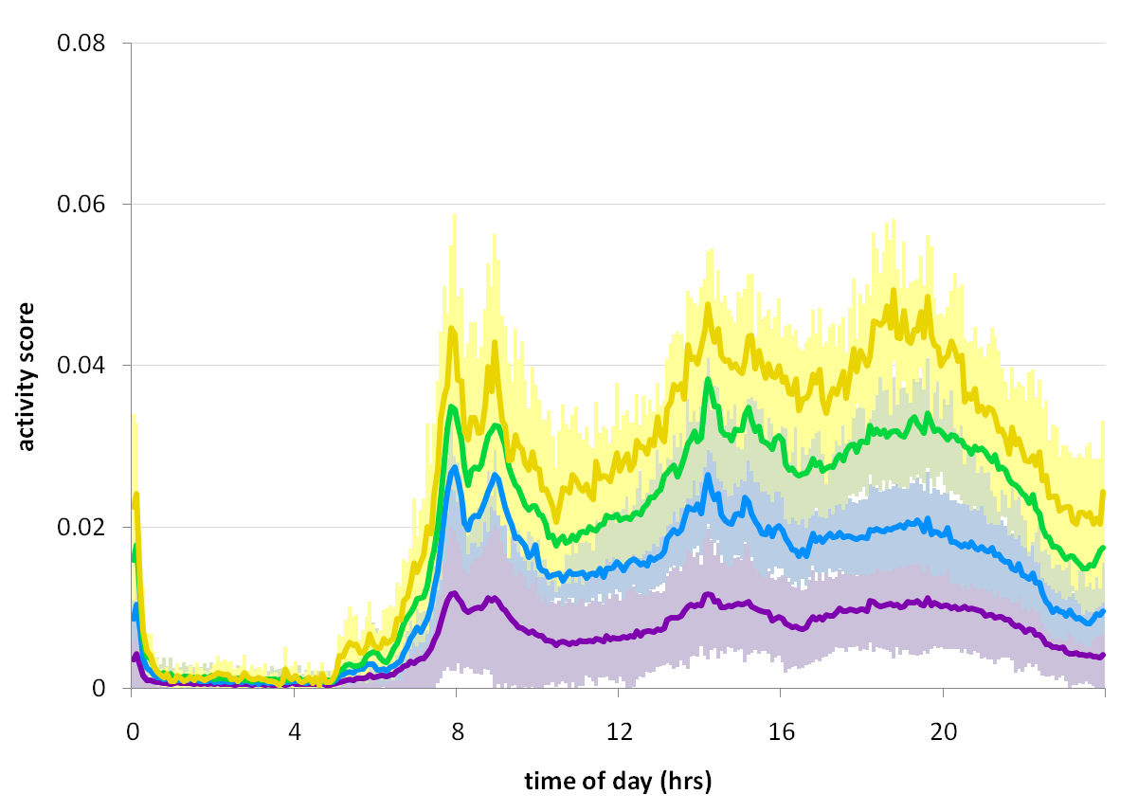
activity clusters
Cluster A1 (N=207)
Cluster A2 (N=76)
Cluster A3 (N=74)
Cluster A4 (N=12)

Slide 26
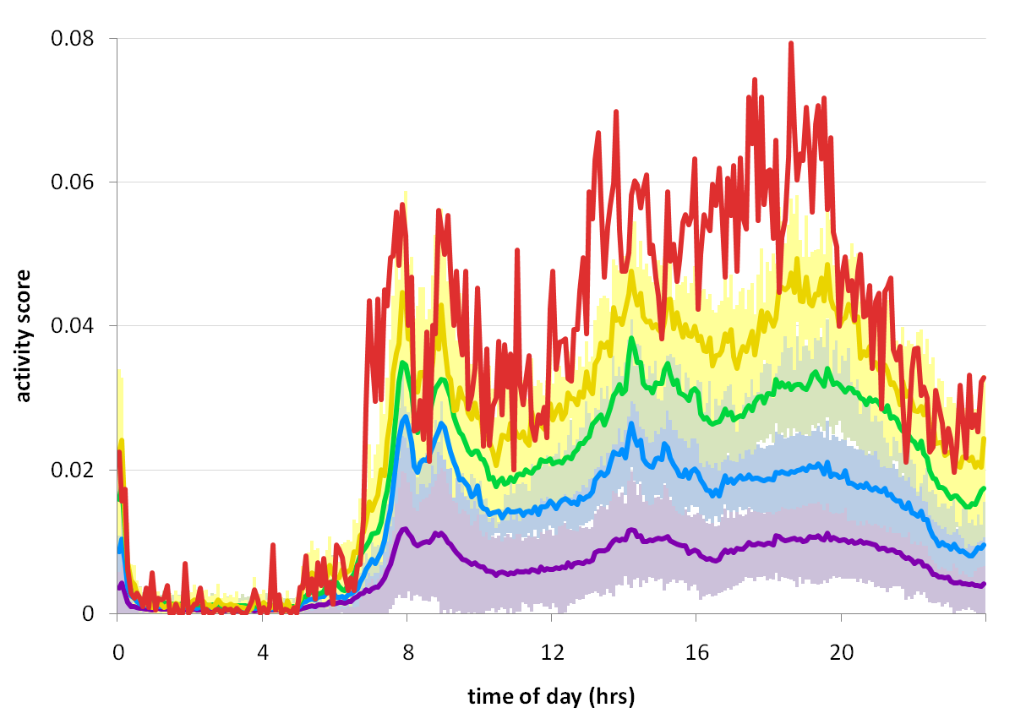
activity clusters
Cluster A1 (N=207)
Cluster A2 (N=76)
Cluster A3 (N=74)
Cluster A4 (N=12)
Cluster A5 (N=1)
Notes:
The more active clusters (A3, A4, and A5) become noticeably more active as the day advances.

Slide 27
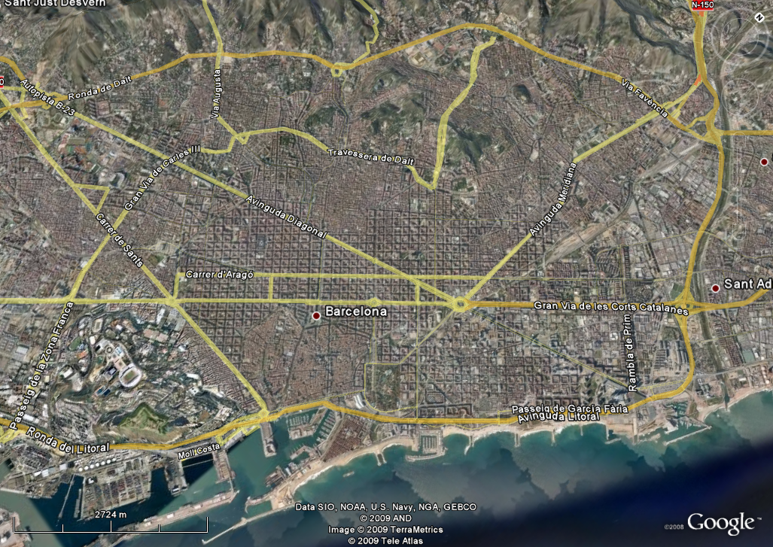
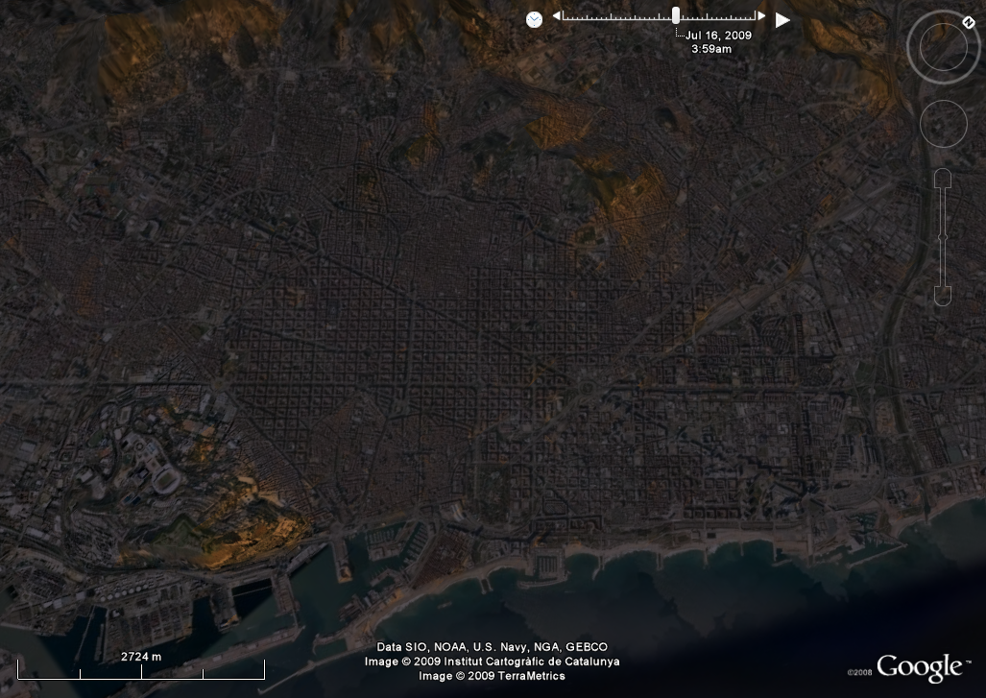
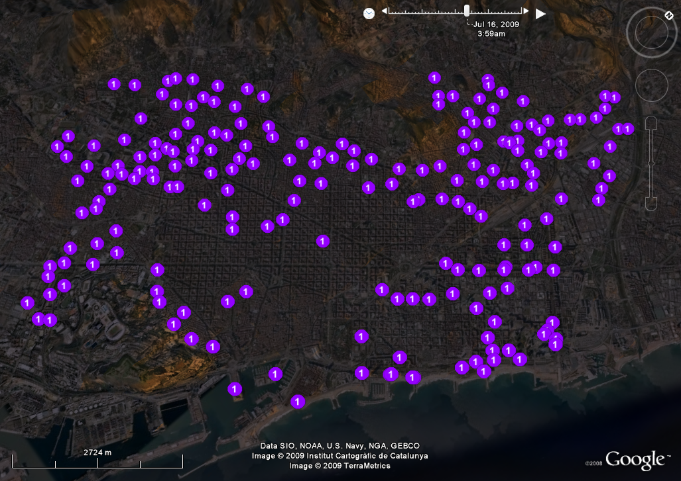
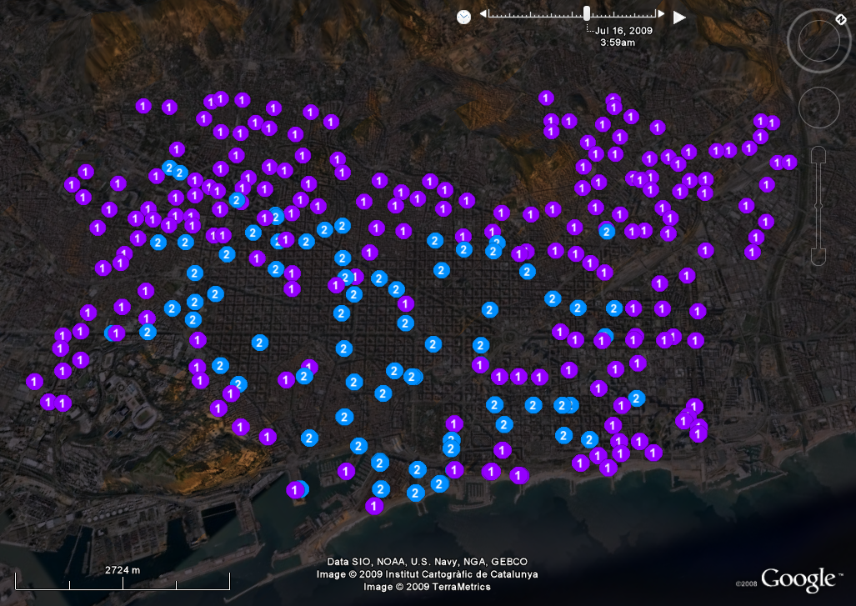
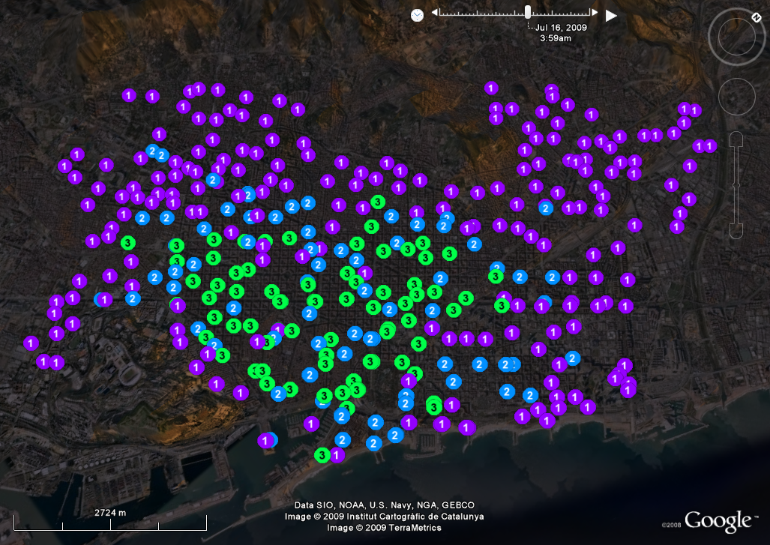
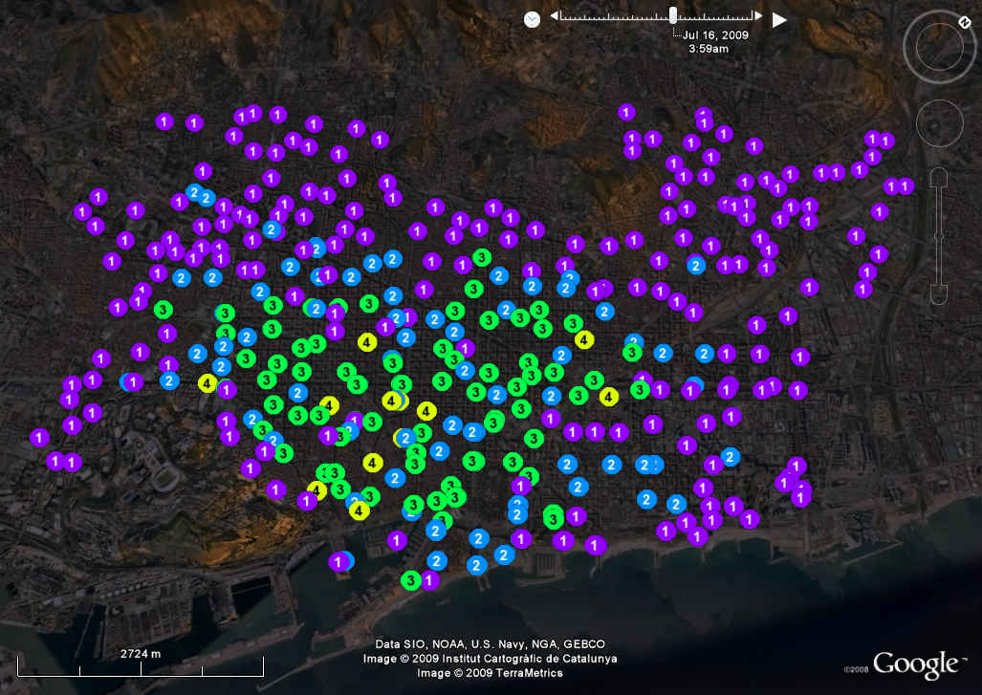
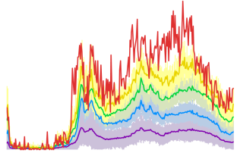
Notes:
The least active cluster, Cluster A1 (N=207), surrounds nearly the entire perimeter of Barcelona.
The clusters generally become more active (from A1 to A5) as one moves from the outward edges of the city into downtown.

Slide 28
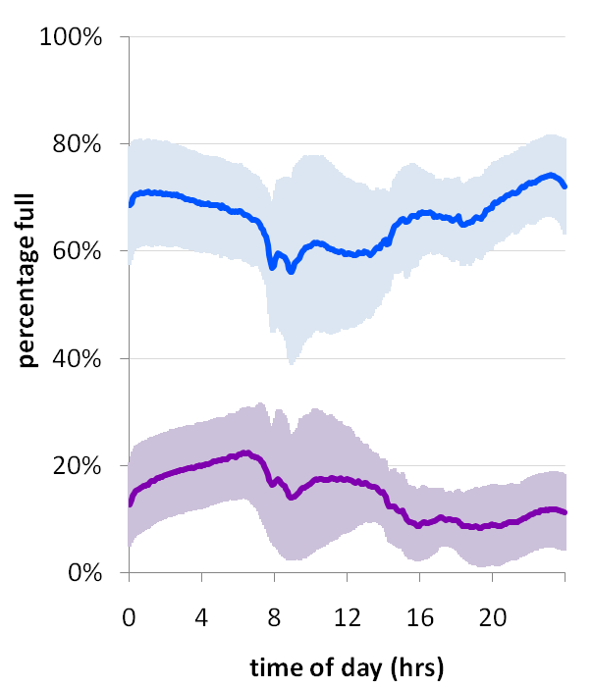
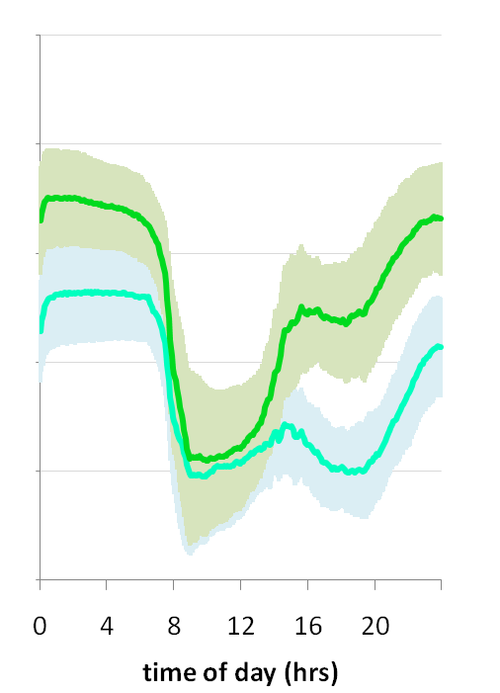
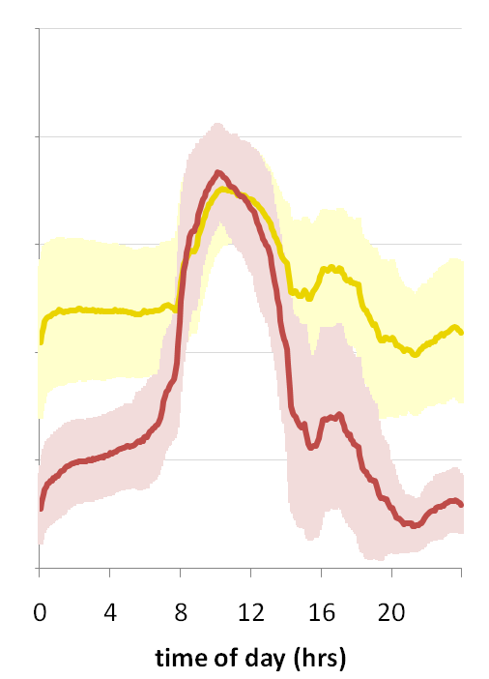
avail. bicycle clusters
flat
outgoing
incoming
Cluster B1 (N=106)
Cluster B3 (N=42)
Cluster B5 (N=50)
Cluster B2 (N=72)
Cluster B4 (N=62)
Cluster B6 (N=38)
Notes:
Our algorithm identified six bicycle clusters (depicted in Figure 6) with three classes of behavior:
flat (Clusters B1 and B2), outgoing (Clusters B3 and B4), incoming (Clusters B5 and B6)
Cluster B2 tends to have a high degree of available bicycles (on average, it is 66% full) whereas cluster B1 is just the opposite (15% availability).
The outgoing clusters show a precipitous drop in available bicycles around 7-8AM as people leave for work, a slight rise at 2-3PM during lunch and a return to early morning levels by 10-11PM.
The incoming station shape is nearly inverse of the outgoing stations: people be­gin arriving around 7-8AM and begin leaving around 1‑2PM. Many financial businesses in Barcelona open at 9AM and close around 2:30PM, which aligns well with the tem­poral patterns of these two clusters.

Slide 29
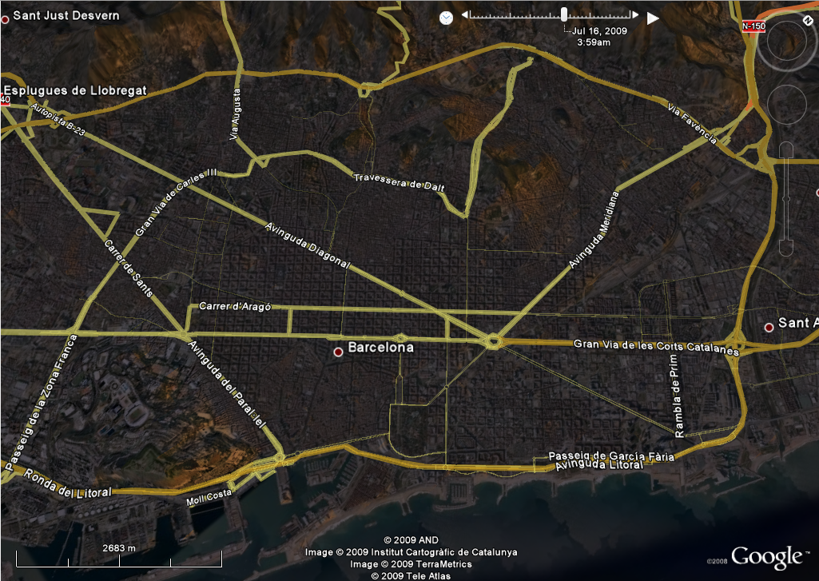
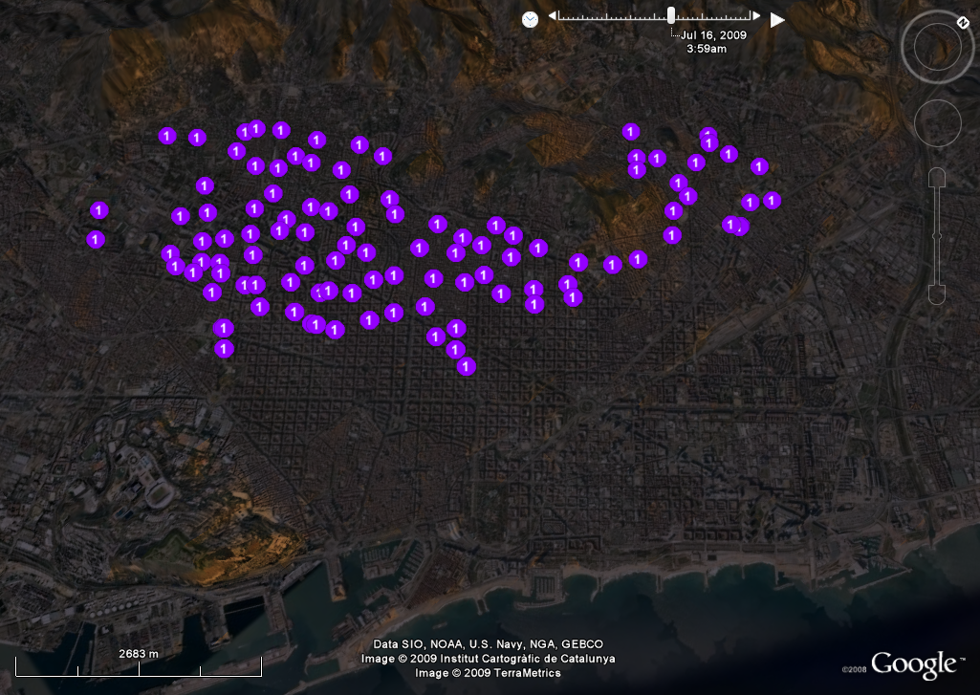
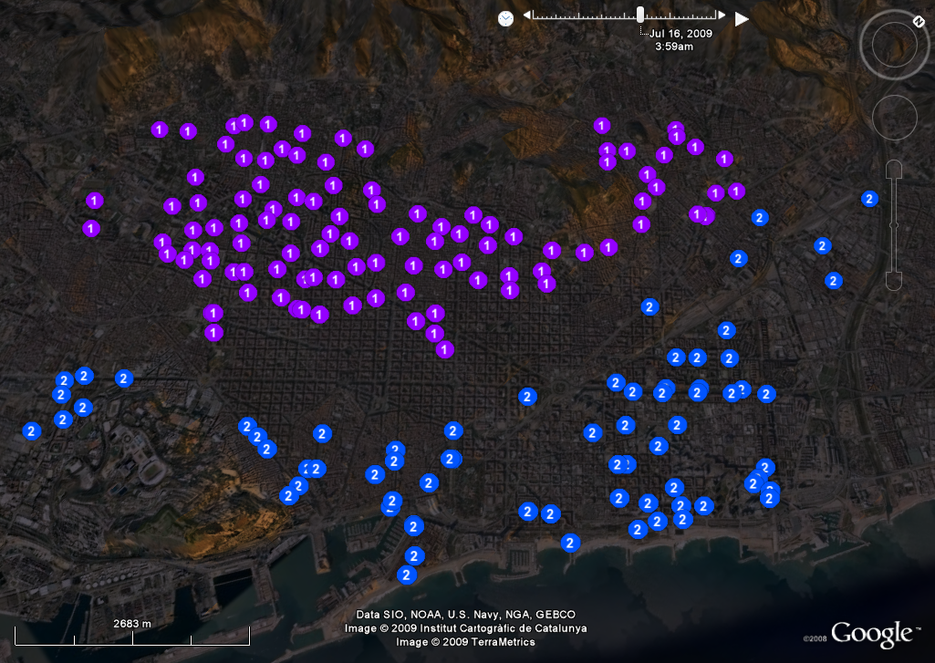
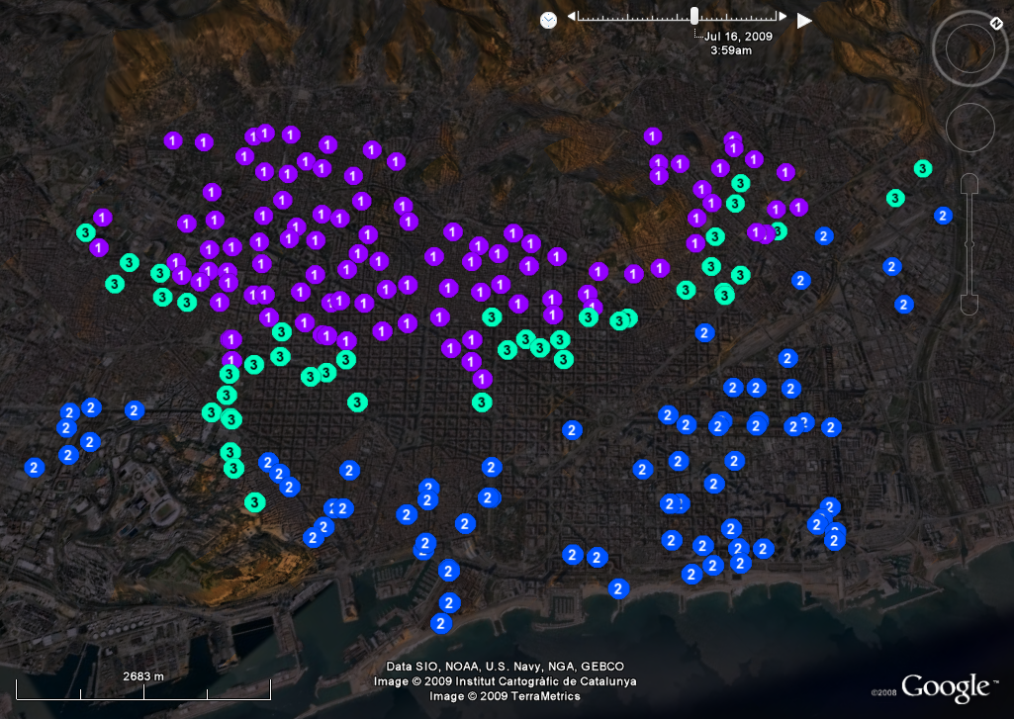
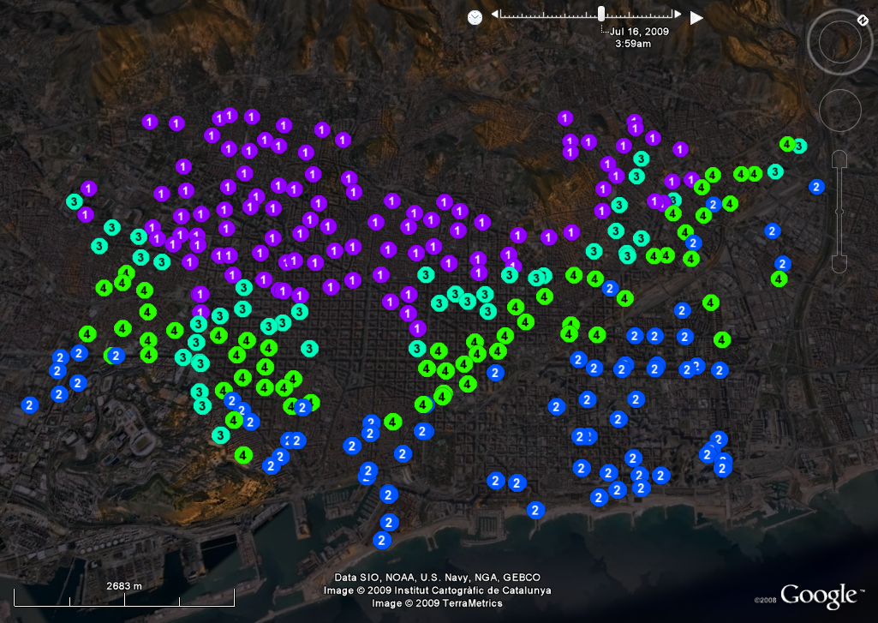
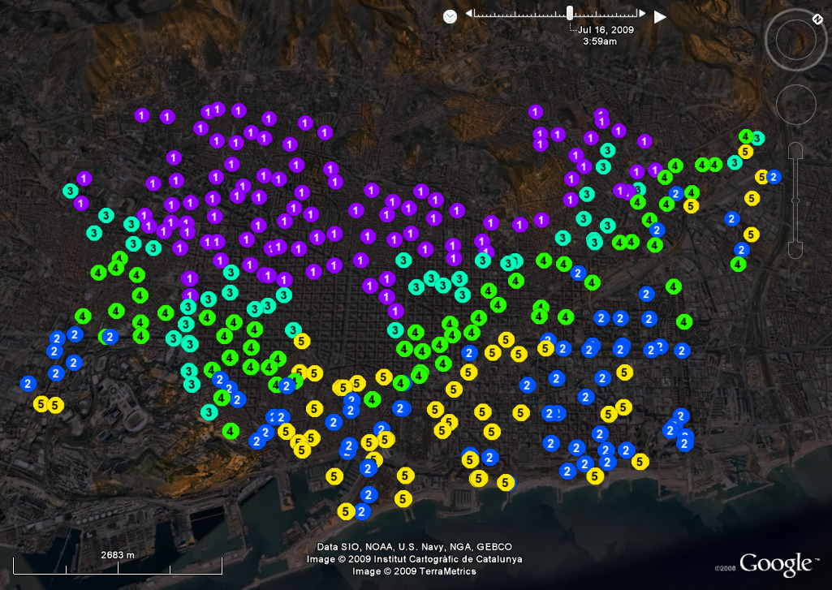
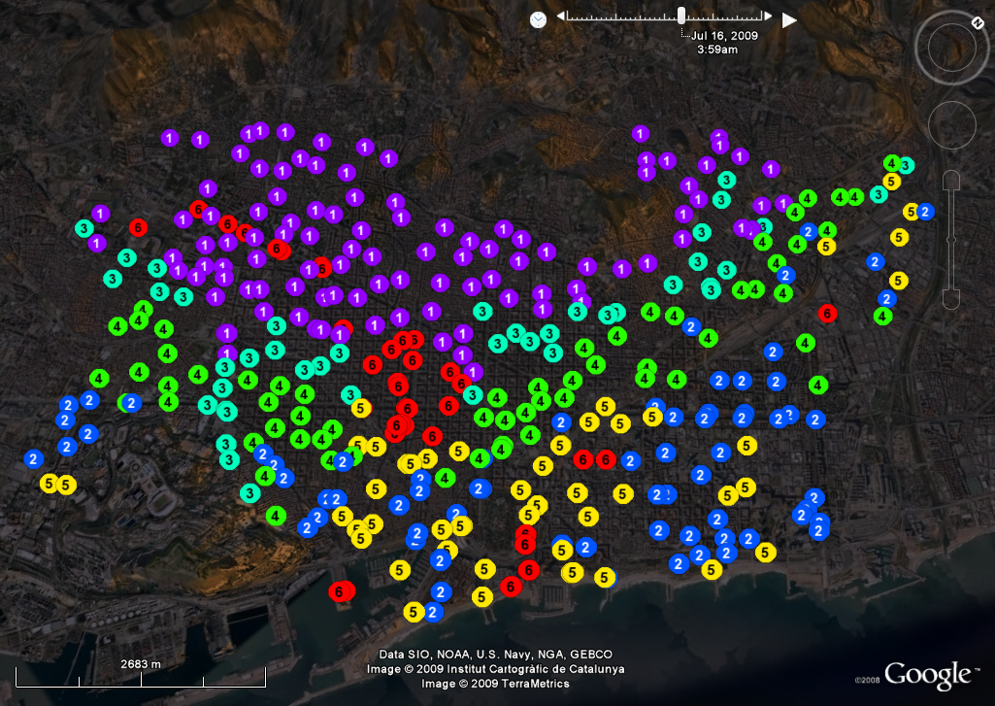
flat
outgoing
incoming
Notes:
The outgoing stations: edges of the downtown and midtown sections of the city.
The incoming stations: high density commercial areas & along two major arterial routes: Rambla de Catalunya and Avinguda Diagonal
I mentioned before cluster B2 tends to have a high degree of bicycles and B1 is just the opposite:
one reason for this discrepancy is likely due to Barcelona’s topography: the city itself is built on a long incline. Stations located at the top of the map are between 80-110 meters above sea level versus those at the bottom, which are at 0-10 meters above sea level.
People tend not to bicycle up to the higher altitudes, thus leaving those stations in Cluster B1 starving for bicycles.

Slide 30
can bicing usage be predicted?

Slide 31
why care?
load balancing
assist urban planners / city officials about expected activity
provide new web/mobile services to bicing users
Notes:
Predictive station usage models would
allow for more accurate load balancing of the stations;
assist urban planners and city officials by providing them with information about expected activity in the city; and
open the way to new mobile services for Bicing users.

Slide 32
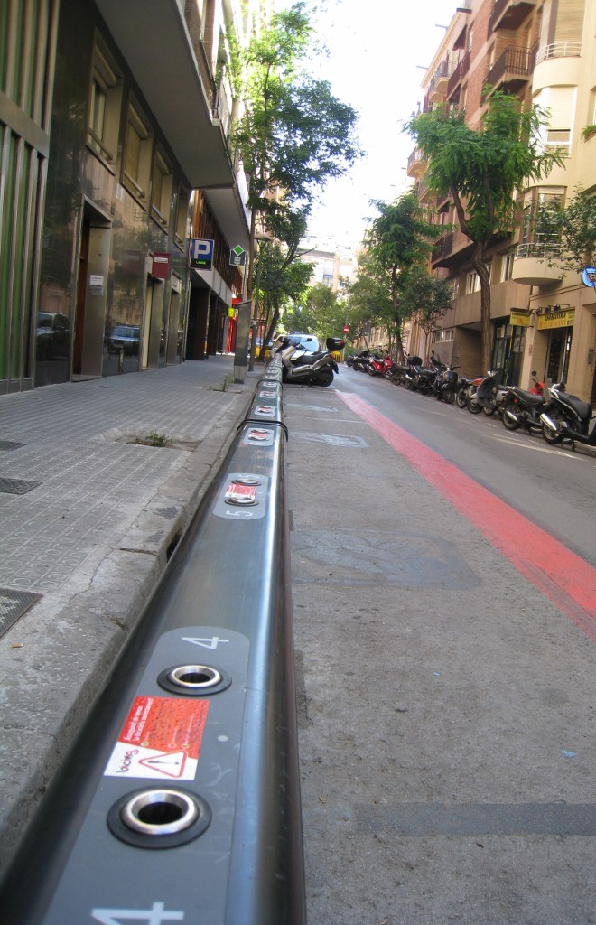
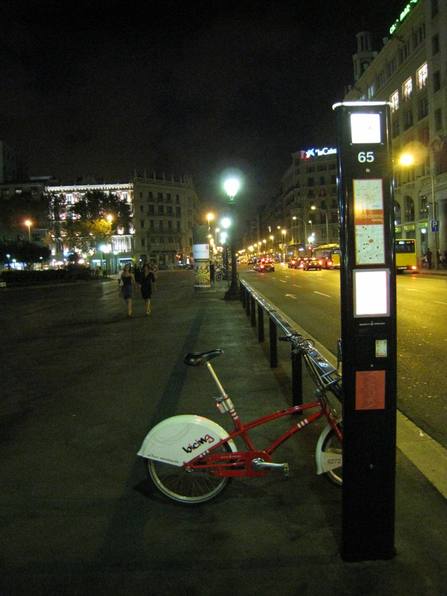
uphill station
(midday)
downtown station
(night)
76% of respondents had difficulty finding a bicycle
Notes:
In the previously mentioned online survey, Bicing users identified finding an available bicycle and parking slot as the two most important problems in their Bicing experience (76% and 66% of respondents, respectively).

Slide 33
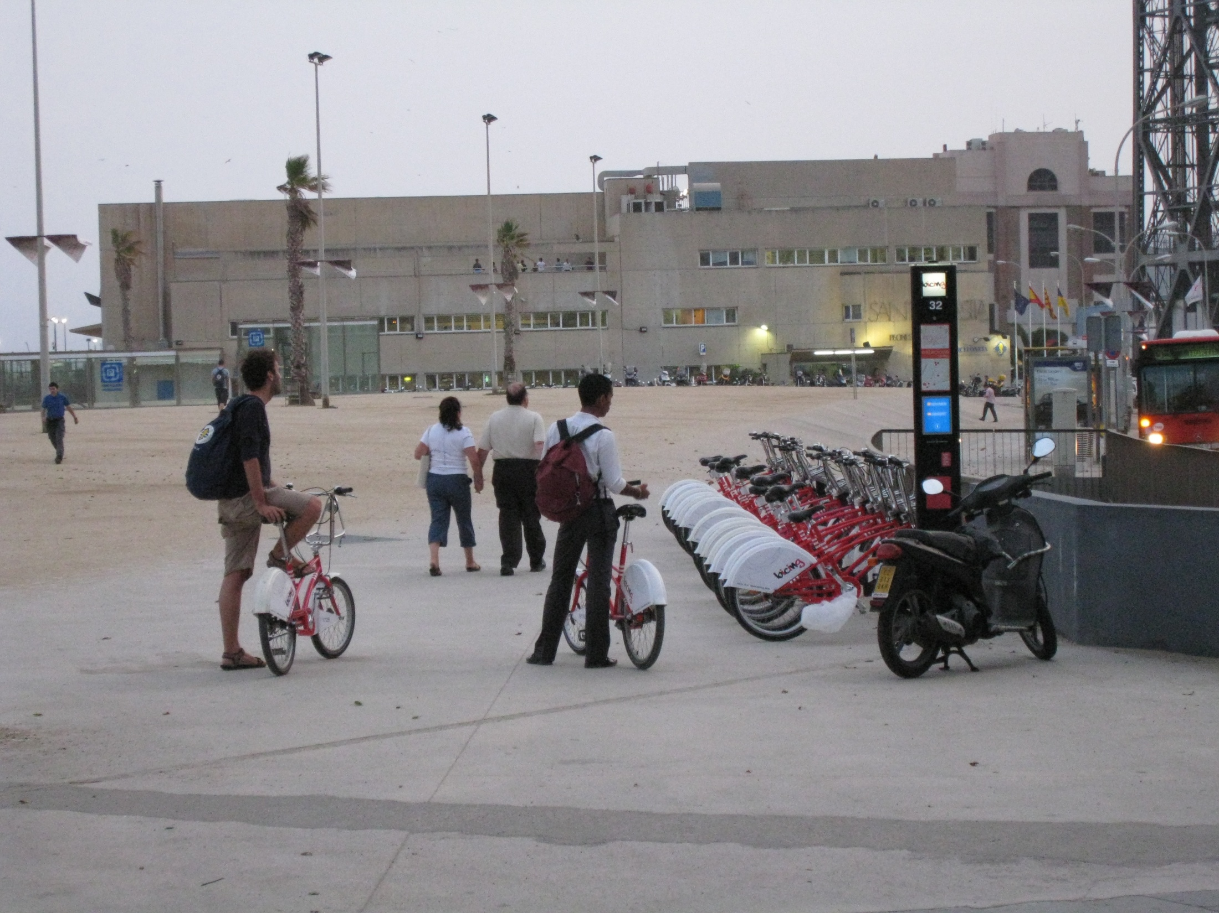
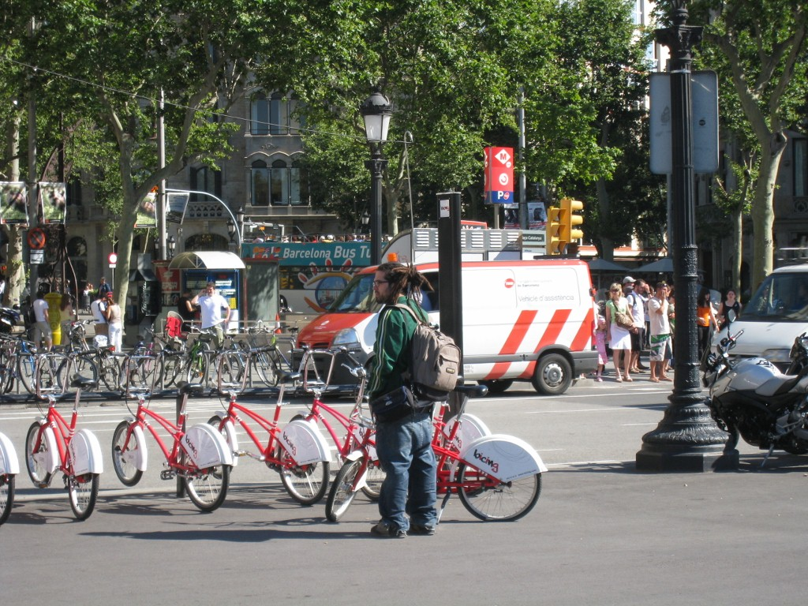
downtown station
(morning)
66% of respondents had difficulty finding a parking slot

Slide 34
beach station
(evening)
50% of respondents avoid Bicing when they are traveling to a place where they must be on time

Slide 35
station models
B_{t0} =27
t₀
30
# of available bicycles
PW=10min
0
time
Notes:
All models have three input parameters:
the current time;
the last known number of bicycles at time (B_{t0});
and a prediction window (PW) that specifies how far into the future to predict. In this paper, we focus on PW values ranging from 10 min to 120 min, as they correspond to the most common Bicing usage scenario.

Slide 36
last value
Pred_{LV}=(t₀,B_{t0},PW)=B_{t0}
B_{t0} =27
t₀
Pred_{LV}=27
Pred_{LV}=27
30
Actual Value=27
# of available bicycles
PW=10min
Actual Value=10
PW=2hr
0
time

Slide 37
historic mean
Pred_{HM}=(t₀,B_{t0},PW)=B_{TBt0 + PW}
Station’s DayView

Slide 38
historic mean
Pred_{HM}=(t₀,B_{t0},PW)=B_{TBt0 + PW}
Actual Value=27
B_{t0} =27
t₀
Pred_{HM}=23
30
# of available bicycles
Pred_{HM}=14
Station’s DayView
PW=10min
Actual Value=10
PW=2hr
0
time

Slide 39
historic trend
Pred_{HT}=(t₀,B_{t0},PW)=B_{t0}+B_{TBt0 + PW}-B_{TBt0}
B_{t0} =27
t₀
Pred_{HT}=27+(25-24)=28
30
Actual Value=27
Pred_{HT}=27+(15-24)=18
# of available bicycles
Station’s DayView
PW=10min
Actual Value=10
PW=2hr
0
time

Slide 40
bayesian network
Pred_{BN}=(t₀,B_{t0},PW)=B_{t0}+ delta
time: discrete observed node corresponding to hours in the day
bikes: the # of avail bikes at time t
PW: the prediction window
delta: continuous Gaussian var that represents change in number of bikes at time t + PW
bikes
time
PW
delta
prediction made by adding the value of the delta node to the most recent observation
Notes:
time, a discrete observed node with 24 possible values corresponding to each of the hours of the day;
bikes, the value of NAB at time t, discretized into five bins, where a value of one corresponds to 0-20% of bicycles, two corresponds to 20-40%, etc;
PW, the size of the prediction window, with six possible values corresponding to 10, 20, 30, 60, 90 and 120 minutes into the future; and
delta, a continuous Gaussian variable that contains the change in the number of bikes at time t + PW with respect to its value at time t. Predictions in the number of bicycles are made by adding the value of the delta node to the most recent observation

Slide 41
prediction evaluation
november
3 weeks of data to build models
1 week of test data
models were fed:
the current time
current # of avail bicycles
each of the six pw values (10,20,30,60,90,120 mins)
Notes:
The three history-based predictors used three weeks of historic data, from Nov. 2, 2008 to Nov. 23, 2008 (see Figure 10) to build their models. The HM and HT predictors used the corresponding DayViews built from the same three-week period.
Each BN was trained by computing a posterior over the parameters given the fully observed data from time, bikes, PW and delta, with covering the three-week period of training data, in five minute increments.
Starting at midnight on Nov 24th, the prediction models were fed the current time (in five minute increments), the current number of available bicycles, and each of the six previously mentioned PW values. For each PW, our models returned the predicted number of available bicycles.

Slide 42
prediction error metric
absolute difference between the predicted number of bicycles & the ground truth observation at time t₀ + PW
error is in number of bicycles
normalized by the station’s size

Slide 43
high level results
error is in normalized available bicycles (nab)
Model | Avg Error | Stdev of Error
Random | 0.37 | 0.27
HistoricMean | 0.17 | 0.16
LastValue | 0.09 | 0.14
HistoricTrend | 0.09 | 0.13
Bayesian Network | 0.08 | 0.12
0.37 corresponds to roughly 9 bicycles
Notes:
Random predictor (Rand) returned a random value drawn from a uniform distribution between zero and the station’s size.
The HM predictor performed worst of all, implying that a station’s daily activity is quite varied when compared to its historic mean. If station usage was perfectly consistent across weekdays, this predictor would perform flawlessly.
The BN predictor had the smallest average error of 0.08 NAB. At a station with 25 slots, this corresponds to an average error of two bicycles (8%).

Slide 44
prediction error vs. pw
0.1 corresponds to~2.5 bicycles at a station with 25 slots
Historic Mean
PW > 60, HT and BN significantly better
10 20 30 60 90 120
Notes:
The BN predictor had the smallest average error of 0.08 NAB. At a station with 25 slots, this corresponds to an average error of two bicycles (8%).
The LV predictor did nearly as well as the best performing predictors for PW <= 60 min.
For PWs > 60 min, however, the HT and BN predictors begin to perform significantly better than the rest: an unpaired t-test showed that the difference in prediction error at PW=120min is significant between all four predictors

Slide 45
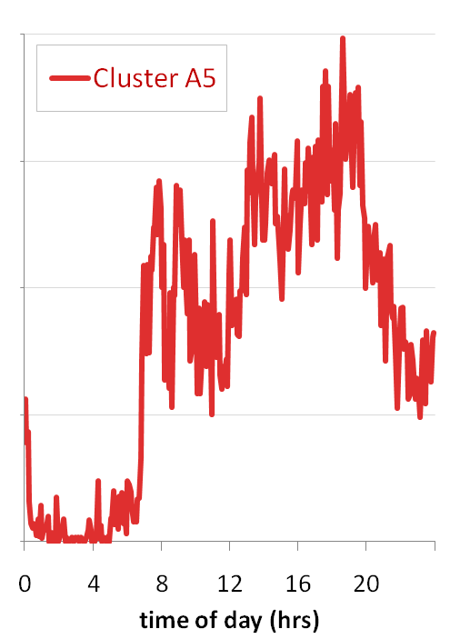
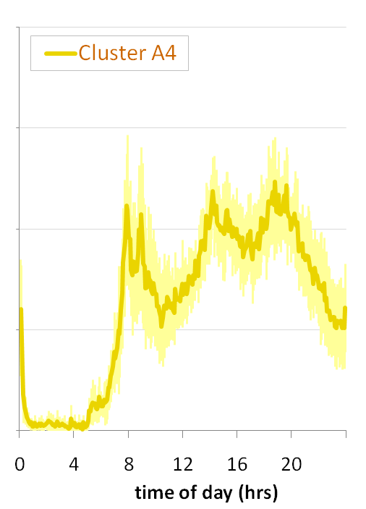
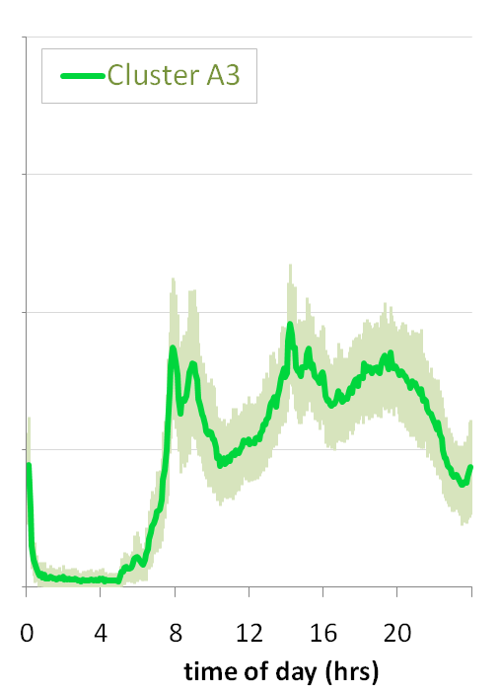
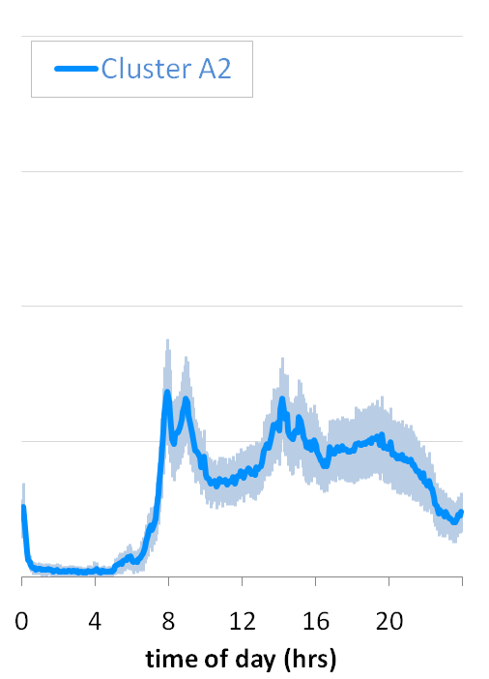
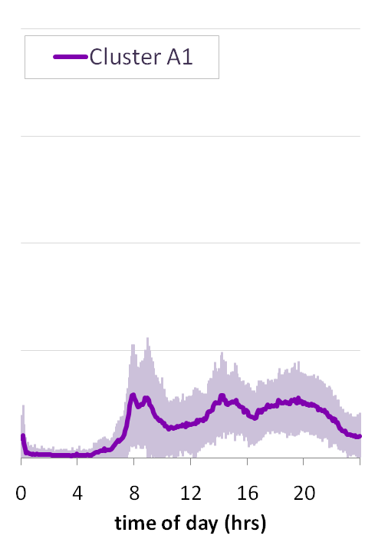
prediction vs. activity cluster
0.1 corresponds to ~2.5 bicycles at a station with 25 slots
A5 (N=1) A4 (N=12) A3 (N=74) A2 (N=76) A1 (N=207)
activity scores
Notes:
In general, the more active stations are more difficult to predict
The BN is significantly better in the more active clusters than other predictors.

Slide 46
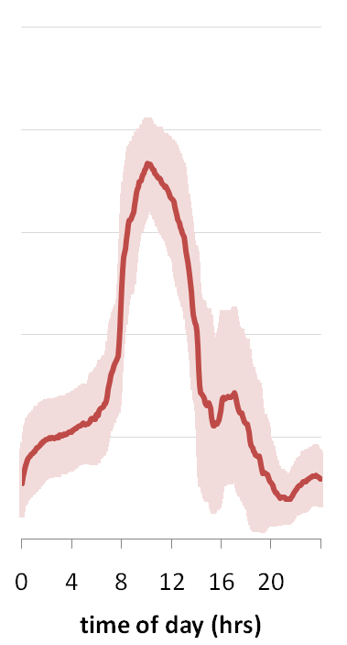
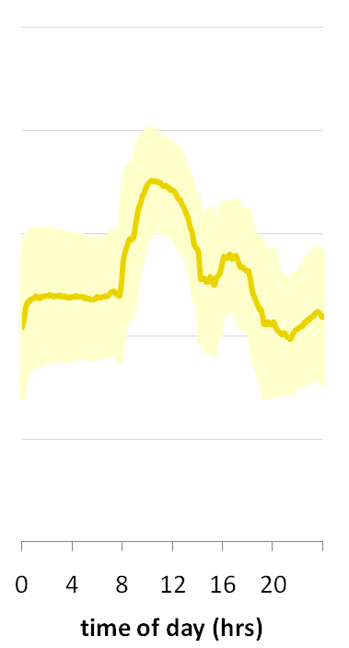
prediction vs. bicycle cluster
0.1 corresponds to ~2.5 bicycles at a station with 25 slots
B6 (N=38) B5 (N=50) B4 (N=62) B3 (N=42) B2 (N=72) B1 (N=106)
# of avail bicycles
Notes:
The flat clusters (B1 and B2) result in the lowest overall prediction error as there is minimal variation in bicycle availability over time (Figure 12).
There are no significant differences between incoming and outgoing stations, probably due to having similar, yet reversed, dynamics in their behavior.

Slide 47
biases of human behavior
Notes:
bicing provides only one type of view into the city—some human behaviorial aspects might be skewed as a result
for example, a popular place in the city may not have a correspondingly popular station simply because its uphill
you can see with the left graph, a correlation between lack of available bicycles and station elevation
there is a correlation between activity and elevation as well, though not as strong

Slide 48
weather

Slide 49
other mass transit
other transit sources

Slide 50
self-sustainable system
Notes:
Can we make bicing more self-sustainable?
Increasing efficiency of trucks.
Decreasing dependency on trucks.

Slide 51
promote usage
at current pace:
expected arrival: 11 mins
current: 4 empty slots
predicted: 6 (11 mins)

Slide 52
thank you!
Jon Froehlich
jfroehli@cs.washington.edu
Joachim Neumann
joachim@tid.es
Nuria Oliver
nuriao@tid.es
design:
use:
build:
university of washington
Research
Notes:
the digitalization of urban infrastructure can be leveraged to:
further our understanding of human behavior
create new services
other things…
how can data sources be tied together?
what tools/viz need to be built?
what other sources of data await us?
how can we protect our own traces?

Slide 53
Notes:
Checking out a bicycle

Slide 54
understanding human mobility patterns
Marta C. González, César A. Hidalgo & Albert-László Barabási, Nature, 5 June 2008
Notes:
Despite their importance for urban planning1, traffic forecasting2
and the spread of biological3–5 and mobile viruses6, our understanding
of the basic laws governing human motion remains
limited owing to the lack of tools to monitor the time-resolved
location of individuals. Here we study the trajectory of 100,000
anonymized mobile phone users whose position is tracked for a
six-month period. We find that, in contrast with the random trajectories
predicted by the prevailing Le´vy flight and random walk
models7, human trajectories show a high degree of temporal and
spatial regularity, each individual being characterized by a timeindependent
characteristic travel distance and a significant probability
to return to a few highly frequented locations. After
correcting for differences in travel distances and the inherent
anisotropy of each trajectory, the individual travel patterns collapse
into a single spatial probability distribution, indicating that,
despite the diversity of their travel history, humans follow simple
reproducible patterns. This inherent similarity in travel patterns
could impact all phenomena driven by human mobility, from
epidemic prevention to emergency response, urban planning
and agent-based modelling.

Slide 55
barcelona cellular network
12AM
7AM
4PM
12AM

Slide 56
streetline: sfpark
Notes:
http://www.nytimes.com/2008/07/12/business/12newpark.html

Slide 57
from Fabien Giradin’s ICING 2008 talk entitled Sentient to Responsive Cities
Notes:
what does it mean when potentially every action we take can be observed and stored?
Picture originally from Flickr but seen in Fabien Giradin’s talk at ICING2008

Slide 58
Notes:
velib

Slide 59
cellular network data
Notes:
Real Time Rome is the MIT SENSEable City (directed by Carlo Ratti)
The project aggregated data from cell phones (obtained using Telecom Italia's innovative Lochness platform), buses and taxis in Rome to better understand urban dynamics in real time. By revealing the pulse of the city, the project aims to show how technology can help individuals make more informed decisions about their environment. In the long run, will it be possible to reduce the inefficiencies of present day urban systems and open the way to a more sustainable urban future?
http://senseable.mit.edu/realtimerome/

Slide 60
digital footprinting: uncovering tourists with user-generated content
Girardin, F., Calabrese, F., Dal Fiore, F. , Ratti, C., and Blat, J. (2008). IEEE Pervasive Computing

