Slide 1
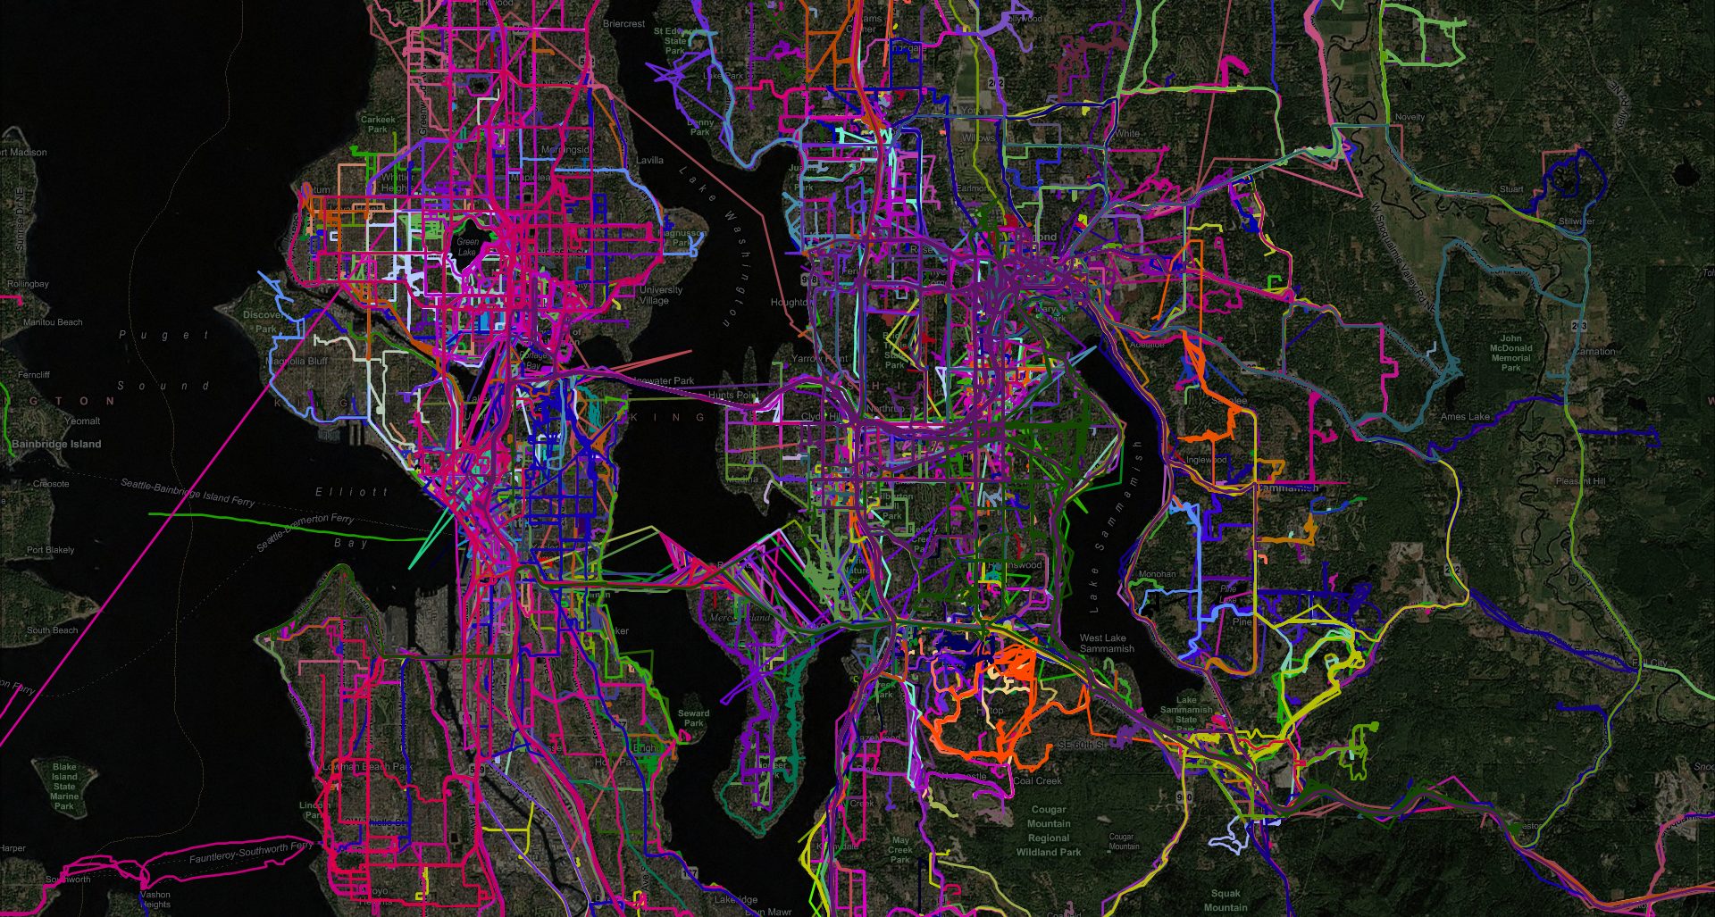


Route Prediction from Trip Observations
Jon Froehlich (UW) and John Krumm (MSR)
Notes:
Hello, I’m John Krumm from Microsoft Research. This is joint work I did with Jon Froehlich from the University of Washington. My talk today is about route prediction given prior trip observations. Such predictions are useful for giving the driver warnings about upcoming traffic hazards or information about upcoming points of interest, including advertising.

Slide 2
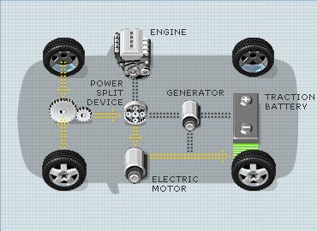
Regenerative Braking
http://www.toyota.com/vehicles/2007/prius
Notes:
One of the most innovative applications of end-to-end route prediction is for improving the efficiency of hybrid vehicles. In a hybrid vehicle, when the brakes are applied the electrical motor becomes a generator converting otherwise wasted kinetic energy, which is usually dissipated in the form of heat with conventional brakes, into electricity for the battery.
(For sudden stops, the conventional brakes are also applied. According to John Miller, can capture 30% of energy normally lost to heat).

Slide 3
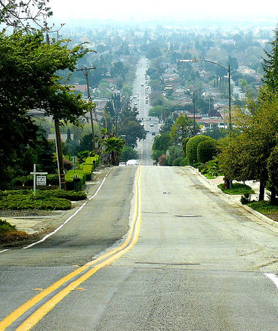
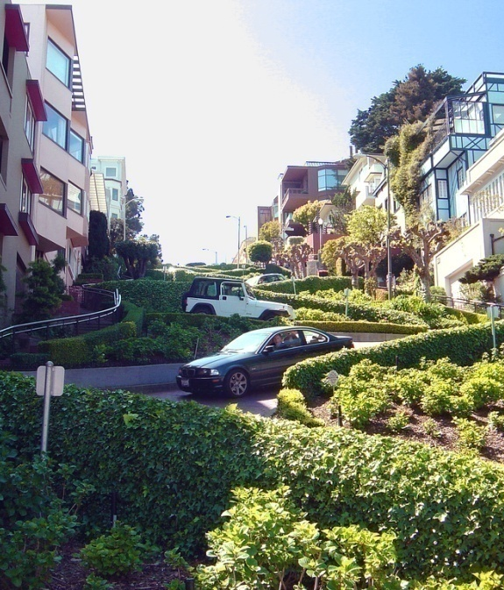
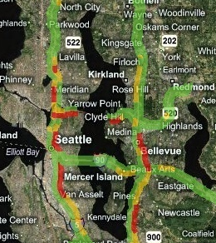
What if we could
predict a driver’s route?
road grade
road curvature
traffic conditions
Notes:
If a hybrid vehicle knows about an upcoming opportunity to recharge its batteries from regenerative braking (e.g., down a steep hill, sharp curves, or stop-and-go traffic), it can use up part of its battery power prior to the opportunity to make room for the expected incoming charge.

Slide 4
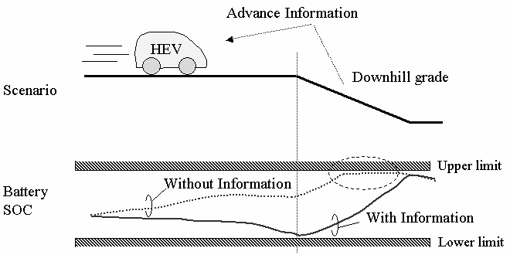
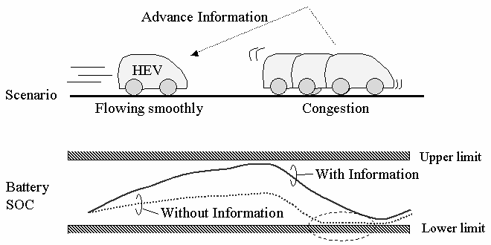
HEV Charge/Discharge Control System Based on Navigation Information
Convergence Transportation Electronics Association 2004
Nissan Motor Company
road grade
traffic conditions
Notes:
Researchers from Nissan showed that it is possible to improve hybrid fuel economy by up to 7.8% if the route is known in advance [1]. Tate and Boyd also explore the optimal control scheme for a hybrid assuming the route is already known [2]. However, we’re confident most people don’t want to enter their route (or even destination) every time they take a drive.

Slide 5
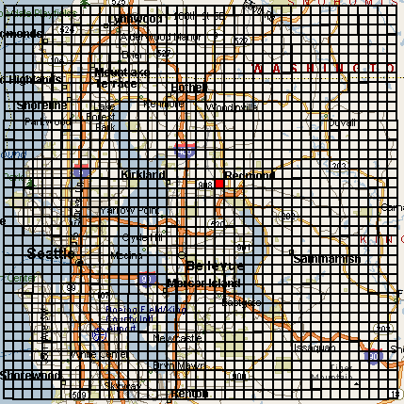
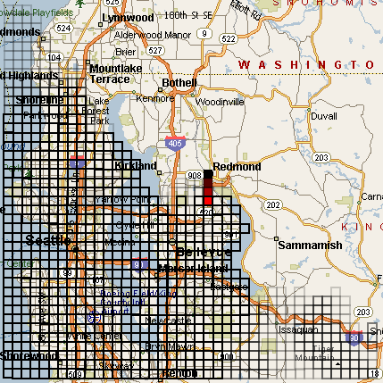
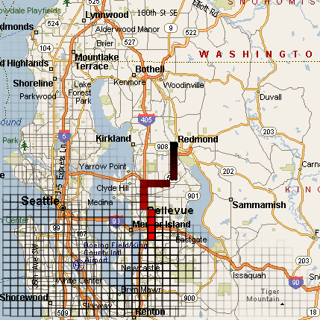
Predestination:
Inferring Destinations from Partial Trajectories
Ubiquitous Computing 2006
John Krumm and Eric Horvitz
Trip starts, uniform destination probability
4 squares south, half of region eliminated
More squares in trip, ¾ of region eliminated

Slide 6
Our Goal:
predict a vehicle’s entire route as it is driven

Slide 7
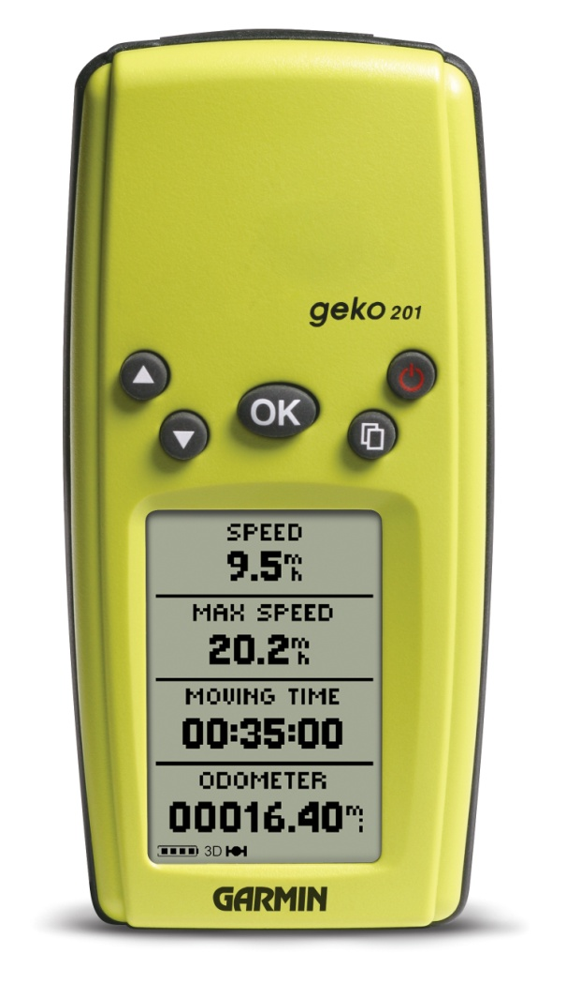
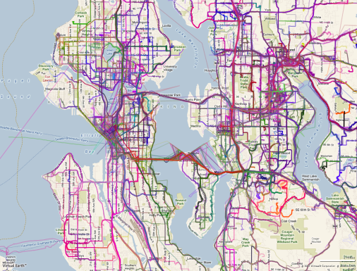
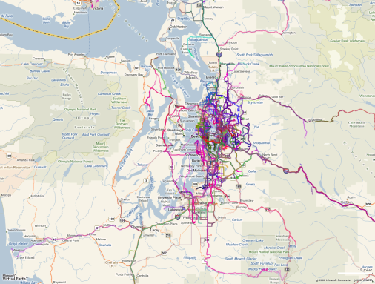
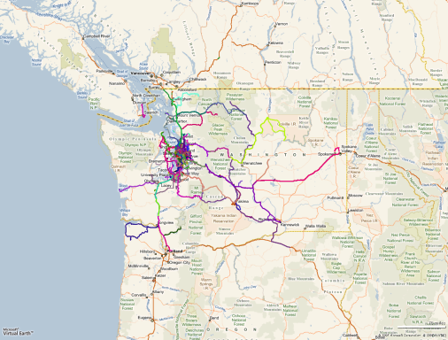
Data Collection
Seattle
Greater Seattle
Washington
Microsoft Multiperson Location Survey
GPS data collection initiative
Started in 2005
252 subjects
  Volunteer to drive with GPS recorder
  Avg. 15.1 days of data per person
2.2 million GPS location points
Garmin Geko 201

Slide 8
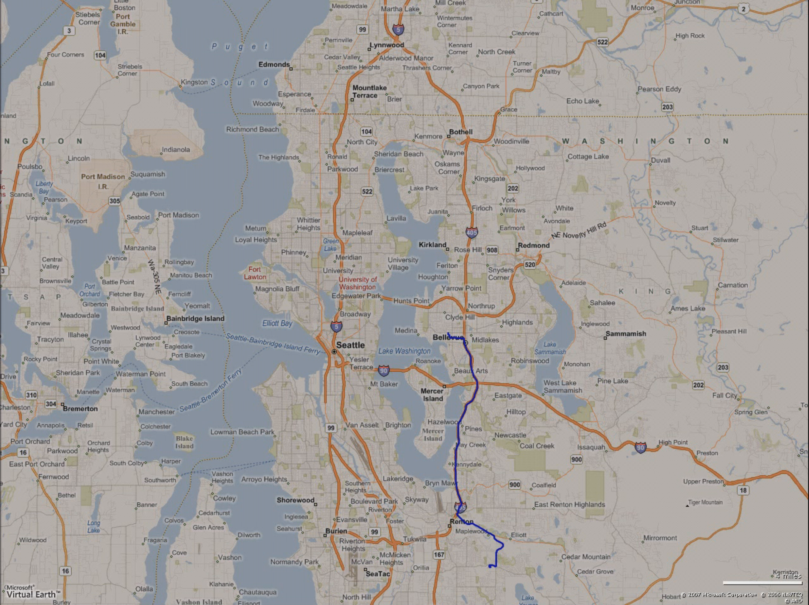
A subset of raw GPS data

Slide 9
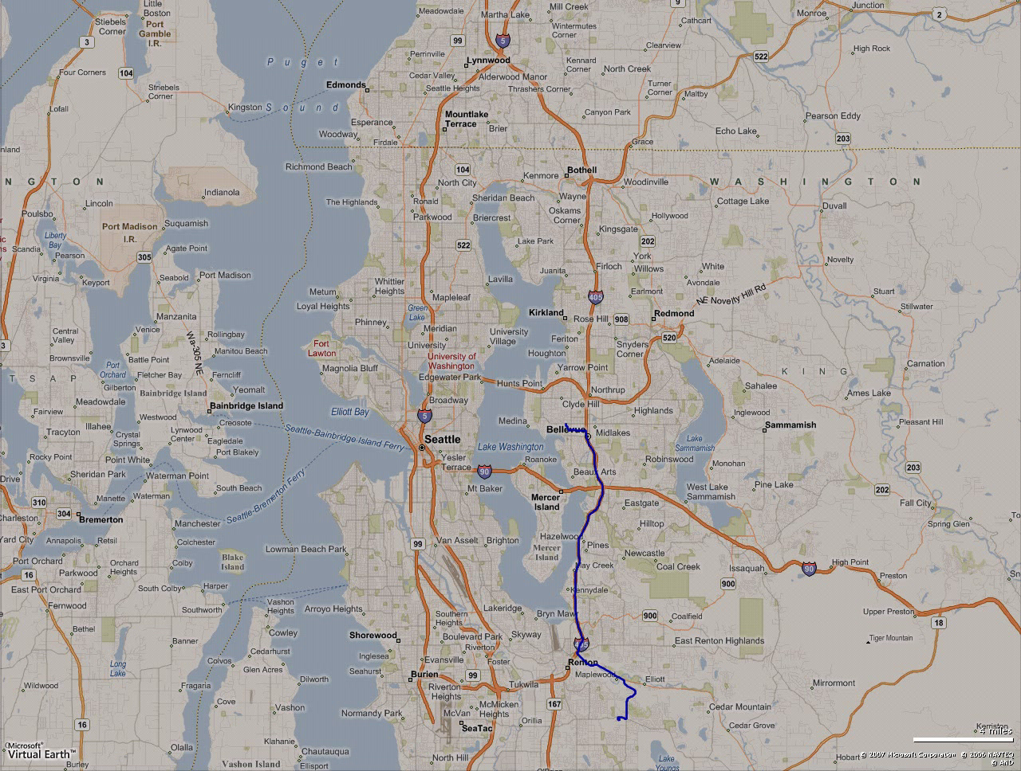
Notes:
Movie (auto-play)

Slide 10
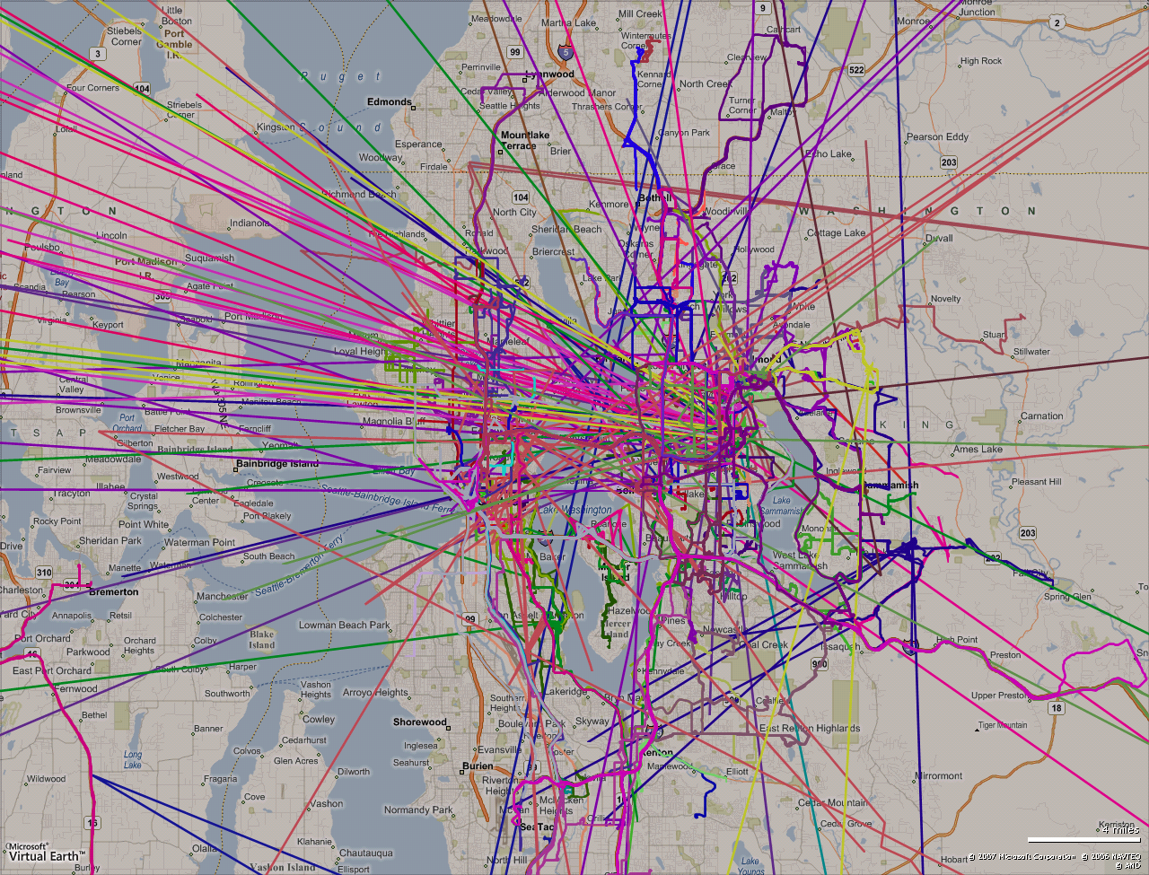
We need to transform this raw GPS data into trips…

Slide 11
From GPS Data to Trips
A trip describes a driver’s path through time and space using time stamped GPS data
Three stage transformation process:
  Trip Segmentation: segment the trips into multipoint trip objects
  Trip cleansing: clean the trips by removing invalid data points
  Trip filtering: filter the trips to eliminate false trip objects
Notes:
To learn more about this transformation process, consult the paper.

Slide 12
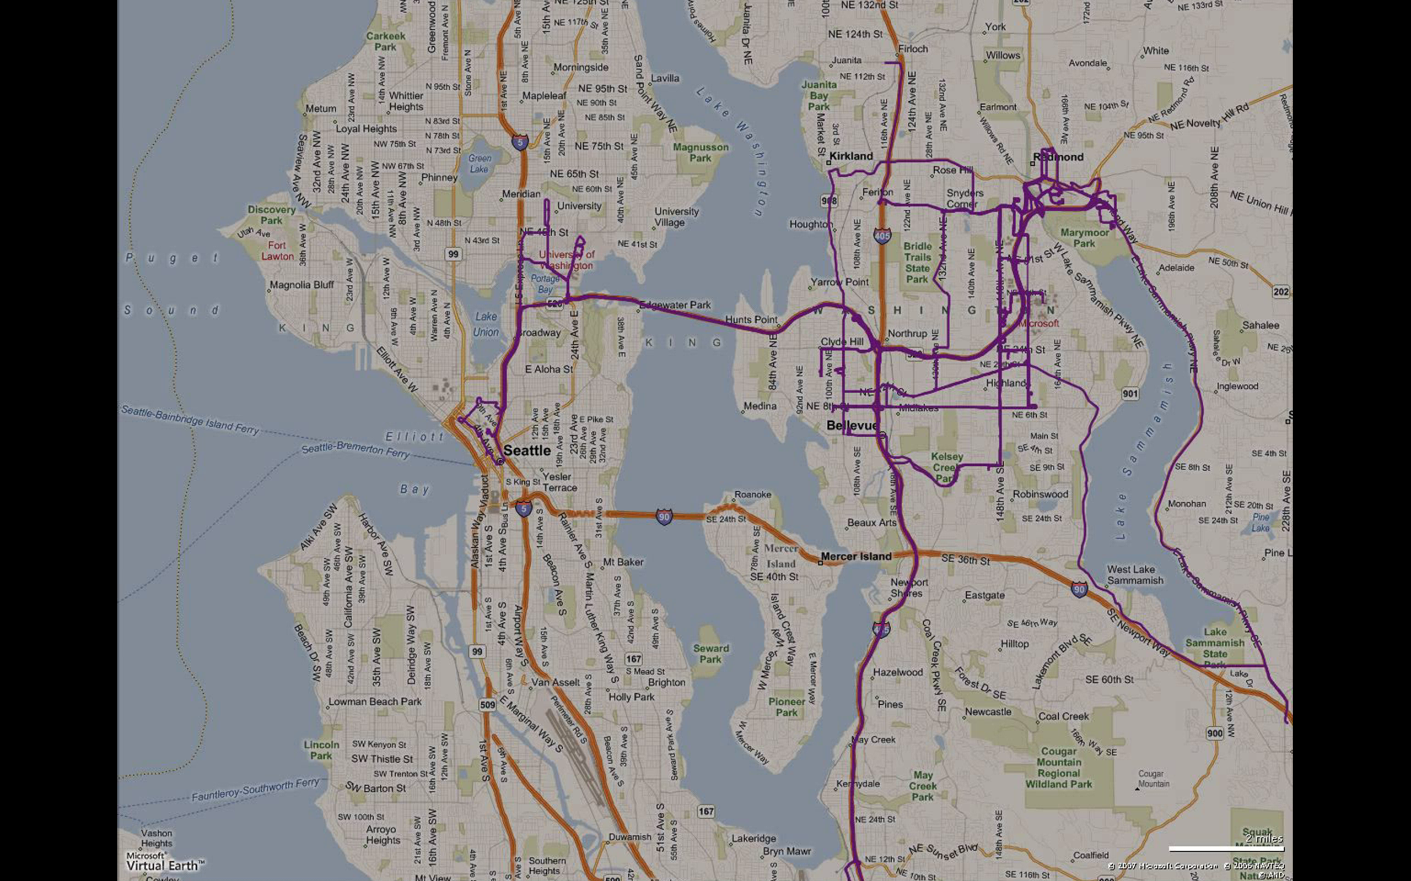
A subset of
segmented,
cleaned, and filtered
trip data

Slide 13
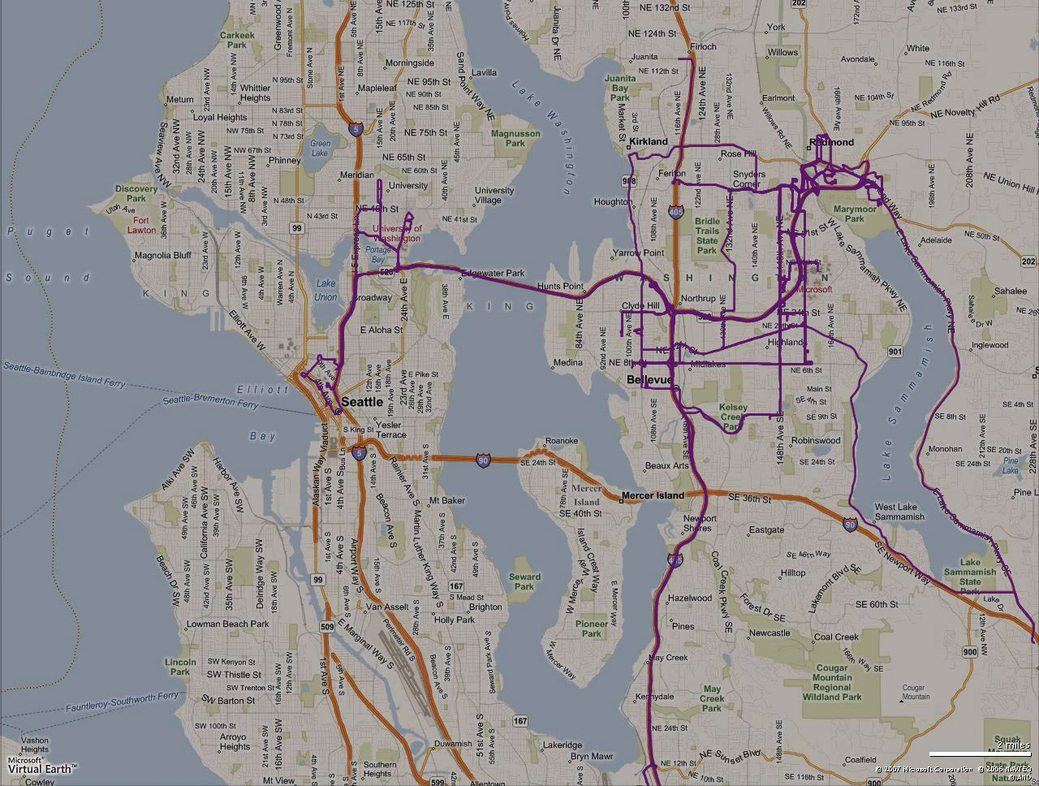
Notes:
Movie (auto-play)

Slide 14
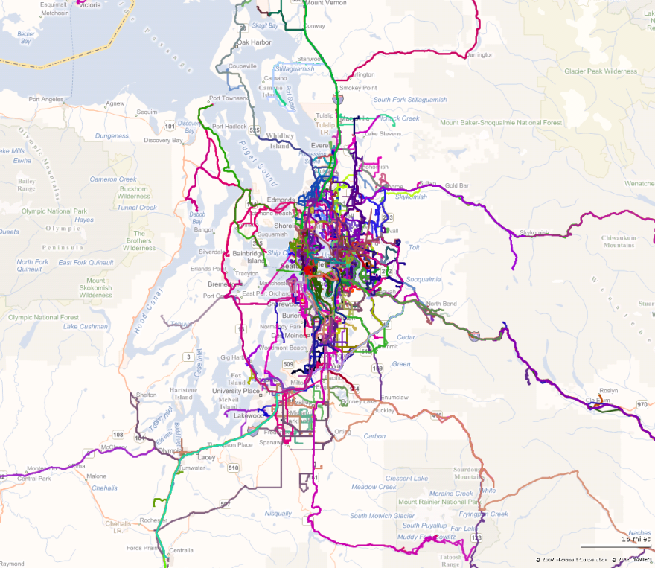
Overview of Trip Data
14,468 trips / 240 subjects
description | avg. | med.
trip distance (miles) | 7.7 | 4.2
trip time (min) | 16.3 | 11.5
num trips / day | 4 | 3.9
num trips / subject | 60.3 | 50
num days of data / subject | 15.1 | 13
High Level Trip Stats
Greater Seattle Area

Slide 15
Trips to Routes
A trip describes a driver’s path through time and space using time stamped GPS data.
A route is simply an abstraction of a trip (or trips) without the temporal component.
  That is, a route is a collection of latitude, longitude pairs that define a directed path
A regular route is a path that a driver drives often
Notes:
Maybe talk about how this isn’t dependent on road information (i.e., we do not take into consideration map information, it is purely agnostic from map road data)

Slide 16
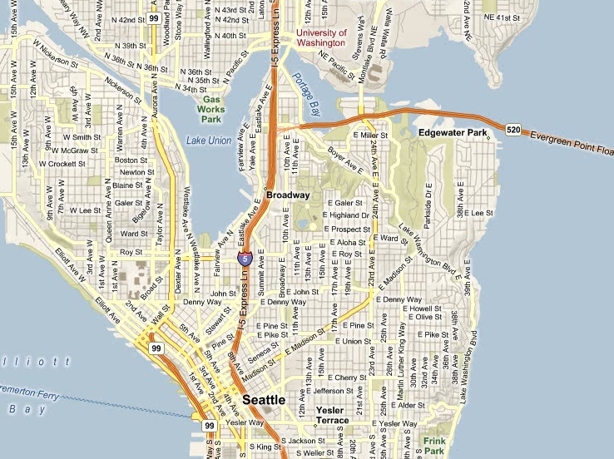
University of
Washington
Downtown
Seattle
Trip A
Trip B

Slide 17
Trip A
Trip B
Notes:
Pull the trips apart to make the explanation easier

Slide 18
P_{A5}
d_{AB5}
For all points in Trip A, we find the closest trip segment in Trip B
TS_{B4}
P_{A4}
d_{AB4}
TS_{B3}
P_{A3}
d_{AB3}
The average d_{AB} represents the trip similarity score Score_{AB} from Trip A to Trip B
TS_{B2}
d_{AB2}
P_{A2}
TS_{B1}
90°
P_{A1}
d_{AB1}
Trip A
Trip B

Slide 19
d_{BA5}
P_{B5}
We repeat the algorithm to calculate the similarity score Score_{BA} from Trip B to Trip A
TS_{A4}
P_{B4}
d_{BA4}
TS_{A3}
d_{BA3}
P_{B3}
TS_{A2}
d_{BA2}
P_{B2}
TS_{A1}
P_{B1}
d_{BA1}
Trip A
Trip B

Slide 20
P_{A5}
d_{AB5}
d_{BA5}
P_{B5}
The final trip similarity score between Trip A and Trip B is:
ScoreAB + ScoreBA
2
d_{BA4}
P_{B4}
P_{A4}
d_{AB4}
d_{AB3}
P_{A3}
d_{BA3}
P_{B3}
We use this trip similarity score to automatically detect routes. Trips that are very similar are along the same route.
d_{BA2}
d_{AB2}
P_{B2}
P_{A2}
d_{AB1}
P_{A1}
d_{BA1}
P_{B1}
Trip A
Trip B

Slide 21
Route Detection
We create routes from trip data by comparing every trip in a subject’s dataset
The result of each trip by trip comparison is the previously described trip similarity score
These scores are stored in a trip similarity matrix
We repeatedly combine trips with the lowest scores (most similar) into routes

Slide 22
Our Clustering Technique
Dendrogram Clustering: a hierarchical clustering technique
  Recursively clusters data points until a pre-specified threshold is reached
In our case:
  We repeatedly combine trips into clusters until the lowest score in the similarity matrix is > 0.05 miles
  The size of the trip cluster represents how frequently that route was traveled

Slide 23
Trip A
Trip B
Trip C
Trip D
home
Example:
detect the three routes
Trip E
Trip F
Notes:
For example, assume a driver takes six trips over three separate routes. Here’s how we would transform this trip data into routes

Slide 24
Dendrogram Cluster
Route 3
Trip A
Trip B
Trip C
Route 1
Route 1
Trip D
Route 3
cut off threshold
Route 1
home
Route 2
Route 1
Trip E
Route 2
A
B
C
D
E
F
Trip F
No scores below our cutoff threshold of 5
 | A | B | C | D | E | F
A | 0 | 5 | 8 | 9 | 14 | 16
B | 5 | 0 | 3 | 4 | 9 | 11
C | 8 | 3 | 0 | 1 | 6 | 8
D | 9 | 4 | 1 | 0 | 5 | 7
E | 14 | 9 | 6 | 5 | 0 | 2
F | 16 | 11 | 8 | 7 | 2 | 0
 | A | B | R1 | E | F
A | 0 | 5 | 8.5 | 14 | 16
B | 5 | 0 | 3.5 | 9 | 11
R1 | 8.5 | 3.5 | 0 | 5.5 | 7.5
E | 14 | 9 | 5.5 | 0 | 2
F | 16 | 11 | 7.5 | 2 | 0
Final Route Matrix
 | A | B | R1 | R2
A | 0 | 5 | 8.5 | 15
B | 5 | 0 | 3.5 | 10
R1 | 8.5 | 3.5 | 0 | 6.5
R2 | 15 | 10 | 6.5 | 0
 | A | R1 | R2
A | 0 | 7.3 | 15
R1 | 7.3 | 0 | 7.7
R2 | 15 | 7.7 | 0
 | R3 | R1 | R2
R3 | 0 | 7.3 | 15
R1 | 7.3 | 0 | 7.7
R2 | 15 | 7.7 | 0
Notes:
After our trip similarity matrix is constructed by comparing all trips, we combine trips that are most similar into routes. Here, Trip C and Trip D are most similar (they share a trip similarity score of 1). Note how they are also represented as closest to each other in our dendrogram cluster. Thus, Trip C and Trip D form our first route: Route 1. The trip similarity matrix dimensionality is reduced by 1 and we repeat this process until the cluster threshold of 5 is reached.

Slide 25
Route Prediction
We attempt to predict a driver’s entire route based on previous trip history
Our algorithms are based on the observation that drivers are highly regular
  A repeat trip is a trip that occurs more than once along a route
  39.3% of the trips in our dataset are repeat trips
  For 67 / 240 subjects, the repeat trip rate was greater than 50%
    That is, one out of every two trips for these drivers is along an established route

Slide 26
After approximately 1 month of observation, the number of repeat trips reaches 50%
Notes:
In general, we find more repeat trips with more days of observation. In fact, the number of repeat trips approaches 50% for subjects observed for approximately one month. That is, after one month there is roughly a 50% chance that a driver is taking a trip along a route that we have seen before. This repeat trip growth rate is relevant because our proposed system predicts a driver’s route based on the driver’s trip history. A slow growth rate for repeat trips would mean that the system would have to monitor the driver for a longer period of time before making accurate predictions.
Note that there is more noise at the right of the graph because it is represented by fewer subjects (after day 40 we only had 4 subjects)

Slide 27
The top ten most frequently traveled routes account for 50% of a driver’s trips
This line represents the hypothetical case where no repeat trips occurred in our dataset
The most frequently traveled route accounts for 12% of a driver’s trips
Notes:
Finally, one additional way to look at route regularity is by the distribution of a driver’s trips across routes. A highly regular driver will have a large portion of his/her trips distributed over only a few routes. That is, a small amount of routes will account for a large percentage of this driver’s trips. In our data, the route traveled most frequently accounts for an average of 12% of a driver’s total trips. This is typically the morning commute route. The top ten most frequently traveled routes account for nearly 50% of a driver’s trips.
This graph reveals that a small amount of routes comprise a majority of trips driven. It takes roughly 10 routes to account for 50% of a driver’s trips. For comparison, the thin green diagonal line depicts a trip to route ratio of 1:1. In other words, it graphs the hypothetical case of our dataset having no repeat trips.
Note that there is noise in the graph towards the right because not all subjects drove a large number of routes.

Slide 28
Basic Premise
As a trip progresses, we find which previously driven route, if any, the driver is on
Trip A
Route 1
Route 2
Closest Match: Route 2
Closest Match: Route 1
Notes:
We propose two route prediction algorithms, both work off the basic premise of continuously calculating a distance (the trip similarity score) from the currently driven trip to existing routes.

Slide 29
Testing Setup
Tested two route prediction algorithms on:
  14,468 trips
  240 subjects
Leave one out approach
  One test trip is left out of a subject’s dataset
  Remaining trips clustered into routes
  Test trip is then virtually driven in 5% increments
  Route prediction algorithms applied
  Repeat steps 1 – 4 on every trip from each subject

Slide 30
1. Closest Match Algorithm
Input:
  The current trip
  The route database
Output: an ordered list of the routes most similar to the current trip
  The closest matching route (index zero of ordered list) is taken as the predicted route

Slide 31
After 1 mile, correct route within top 8 matches
After 50% of trip has been driven, the correct route is, on average, within the top 2 matches
After 5 miles, correct route within top 5
matches
Notes:
These figures show where the correct route match location is in our ordered list of route match results as the trip progresses. The figure on the left shows that after 50% of a trip has been driven, the correct route is, on average, within the top 2 matches. The figure on the right more accurately portrays the performance of the closest match prediction algorithm in a real usage scenario. It shows, on average, how highly the correct route is ranked as a function of the trip’s current travel distance. For example, by the end of a trip’s first mile, the correct route is, on average, within the top 8 matches and within the top 5 after 5 miles of driving.
Note that because this graph is an aggregate view of performance, each point includes trips that are in a range of completion. For instance, at the mile 3 slice, the graph includes data on short trips that are just completing (e.g., trips of 3-4 miles in length) as well as long trips that are really just beginning (e.g., > 20 miles).

Slide 32
At halfway, the correct prediction is within the top 10 matches over 90% of the time
At halfway, we can correctly predict 40% of the routes for repeat trips
Halfway into a trip, we can correctly predict 17% of the routes
All trips
Only repeat trips
Correct prediction
in top 10 matches
Notes:
50% into a trip, we can correctly predict 17% of the routes. If we focus only on repeat trips (that is trips that go along an established route), this prediction jumps to 40%. Finally, depending on the application, even an n-best list of matching routes could be useful, at the halfway point, over 90% of routes are correctly predicted within the top 10 matches.
If there is an important warning, for example an upcoming accident site, then alerting the driver even with some uncertainty about his/her route may be worthwhile. In the case of a hybrid vehicle, the control system could plan for the worst case route (or the average case) until a clear winner emerges. Our 2nd algorithm, which we describe next, returns confidence estimates along with its predictions—these could be used to better reason about instituting dynamic behaviors based on the predictions.

Slide 33
2. Threshold Match Algorithm
Input:
  The current trip (and travel distance)
  Distances to 1st and 2nd closest routes (d₁ & d₂)
  The route database
Output: the predicted route and a confidence measure
  Confidence measure represents how often the route prediction has been correct in the past with the same parameters
Notes:
The parameters d₁ and d₂ are not point-to-point distances but rather the Hausdorff-like, trip similarity measure described earlier. Our intuition was that the percentage of correctly predicted routes would rise proportionally as d₁ grew small and d₂ grew large. In other words, our predictions would become more accurate as the current trip comes closer to the closest route and father away from the 2nd closest route.

Slide 34
When d₁ <= 0.05 miles and grows large d₂ > 1 mile, our accuracy is greater than 85%
d₁ Threshold (miles)
… and as d₁ grows small, our accuracy increases as expected
d₂ Threshold (miles)
As d₂ grows large
Notes:
This graph was constructed by iterating over d₁ and d₂ threshold values at a trip distance interval of 0 – 2 miles and calculating the correct route prediction accuracies when d₁ <= the d₁ threshold and d₂ > the d₂ threshold
Within the first 0 – 2 miles of a trip, the prediction accuracy largely follows our intuition. When d₁ is small and d₂ is comparatively large, the accuracy is high. For example, when d₁ <= 0.05 miles and d₂ > 1 mile, our accuracy is greater than 85%.

Slide 35
When d₁ is small and d₂ is large the accuracy trend becomes more pronounced as the trip progresses
d₁ Threshold (miles)
d₂ Threshold (miles)
d₁ grows small
d₂ grows large
Notes:
At the 4 – 6 mile point in a trip, more is known about the trip’s path structure and thus the overall predictions are slightly better than the previous intervals.

Slide 36
A high density of trips where both d₁ and d₂ are small
d₁ Threshold (miles)
d₂ Threshold (miles)
Notes:
One thing worth pointing out is that there is a very high density of trips where both d₁ and d₂ are small. This makes the problem of correct end-to-end route prediction even more challenging—it means that a trip often has at least two close routes as it progresses. Distinguishing the two may not be possible by focusing completely on their geographic similarity. In future work we propose additional attributes that could be used to aid prediction in these cases.

Slide 37
Future Work
We only incorporated one feature into our route prediction: geographic distance
Other features to explore:
  Partial route matching
  General route popularity
  Common destinations amongst area population
  Optimal path behavior
  Driver familiarity with area
  Identifying the driver
  Identifying passengers in the car
  Temporal aspects such as start time and route recencies
Notes:
We only incorporate one feature into our route prediction, that of geographic distance, however many additional features should be explored to see how they may aid route prediction—particularly in the case when the driver is taken a trip along a new route.

Slide 38
Summary
We provided a methodology for automatically extracting routes from raw GPS data without knowledge of the underlying road structure
We presented a detailed discussion and analysis of repeat trip behavior from a real world dataset of 14,468 trips from 252 drivers
We developed and evaluated two algorithms that used a driver’s trip history to make route predictions of their current trip
Notes:
We only incorporate one feature into our route prediction, that of geographic distance, however many additional features should be explored to see how they may aid route prediction—particularly in the case when the driver is taken a trip along a new route.

Slide 39
Thank You!
Contact Information:
  Jon Froehlich : jfroehli@cs.washington.edu
  John Krumm : john.krumm@microsoft.com
Acknowledgements:
  Eric Horvitz, Kayur Patel, Scott Saponas, and Mike Toomim
Seattle
Greater Seattle
Washington

Slide 40
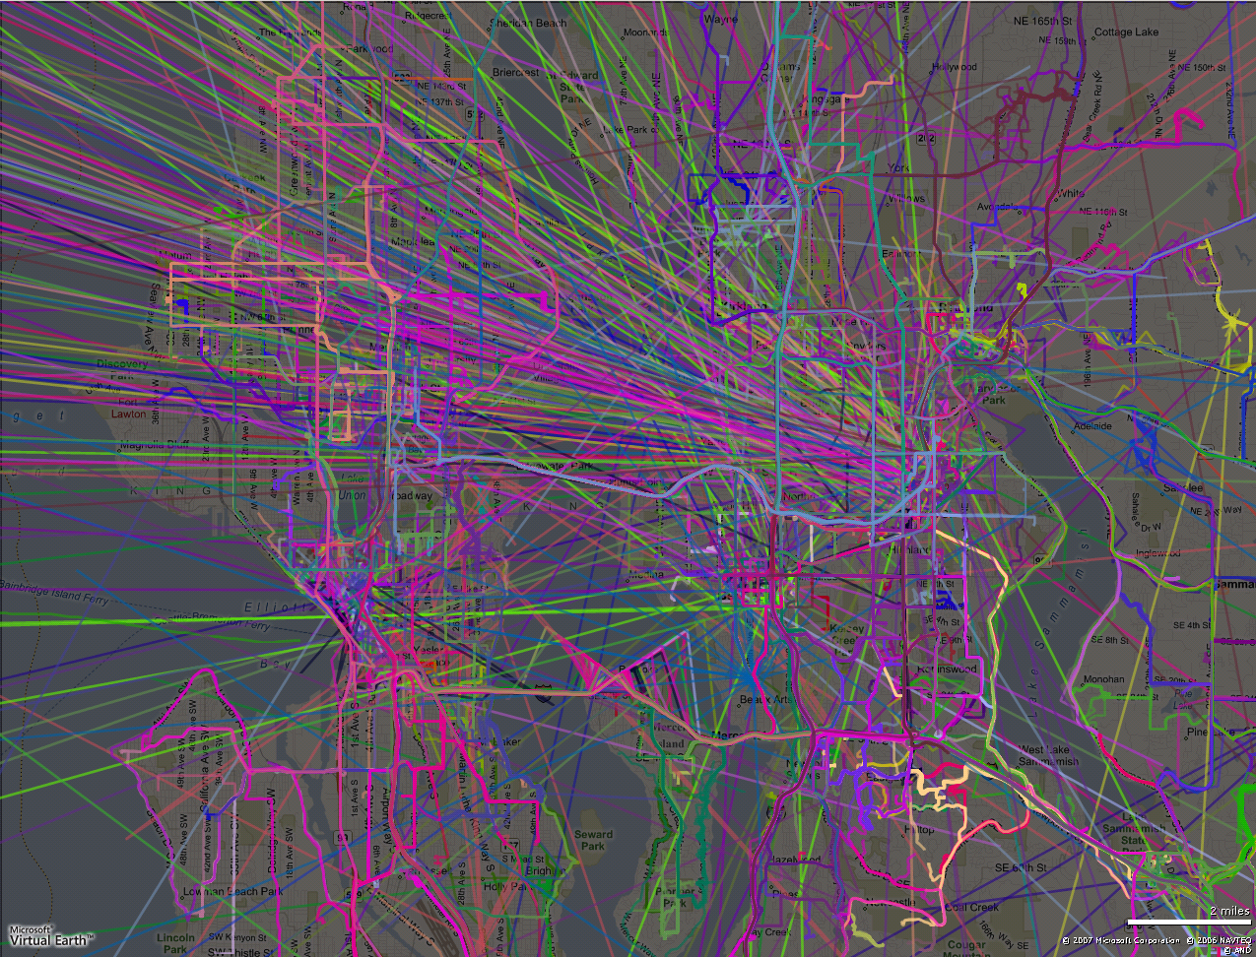
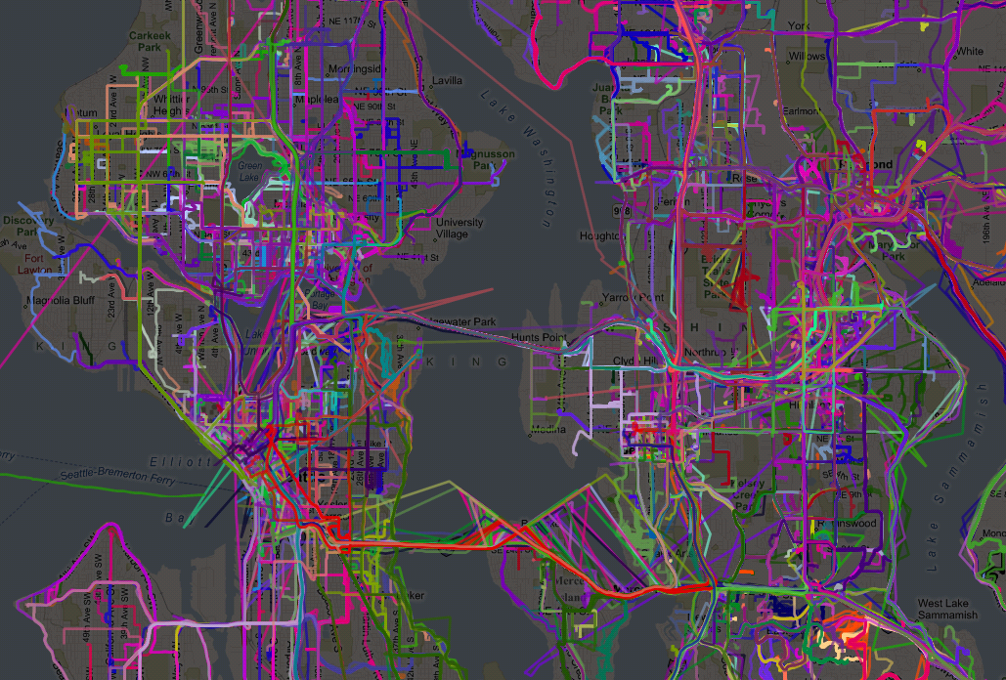

Slide 41
Trip Segmentation
Sort each subject’s raw GPS data chronologically
Find gaps between two consecutive recorded points (P₁, P₂) of three minutes or more
If a gap is found, P₁ becomes end point of last trip and P₂ the beginning point of the current trip

Slide 42
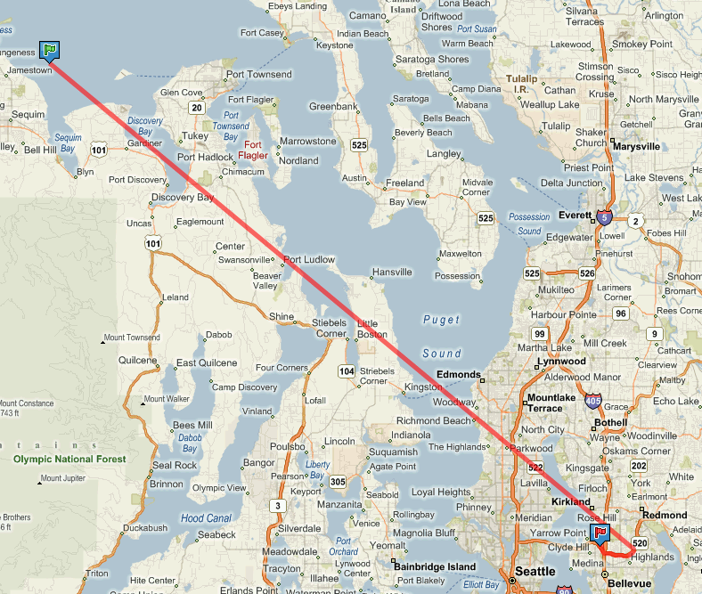
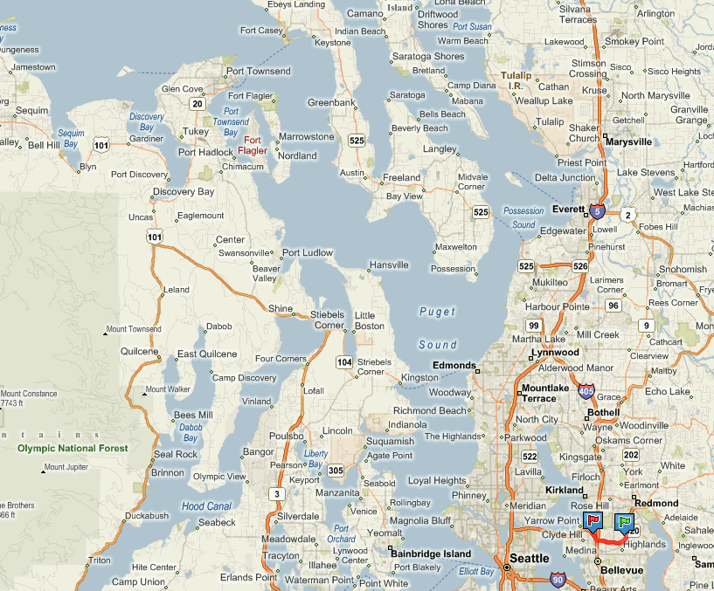
Trip Cleansing
Invalid Starting Point
Invalid Starting Point Removed
Remaining Valid Trip

Slide 43
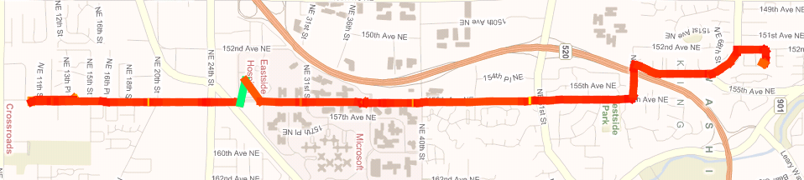
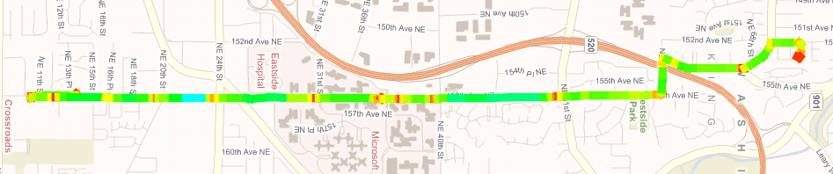
Trip Cleansing
Invalid GPS Point
(Green Trip Segment=397.8 mph)
Invalid GPS Point Removed

Slide 44
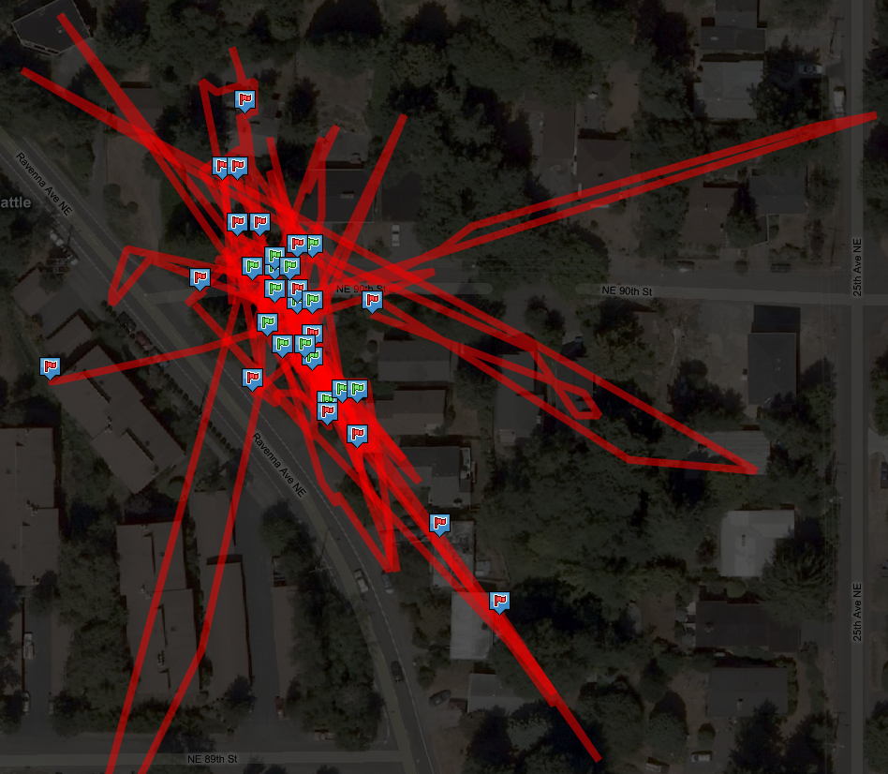
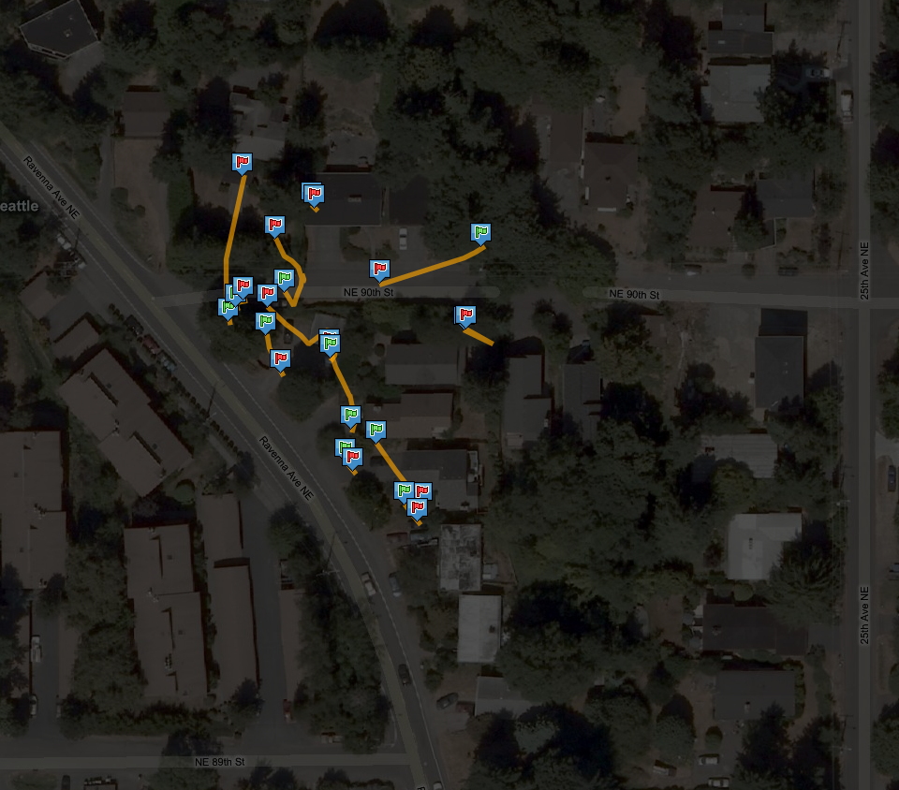
Trip Filtering

Slide 45
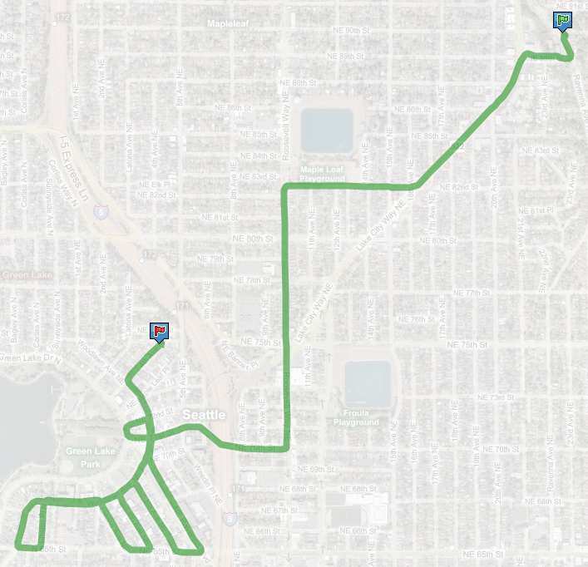
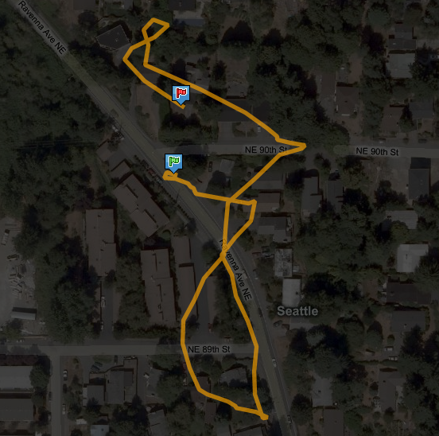
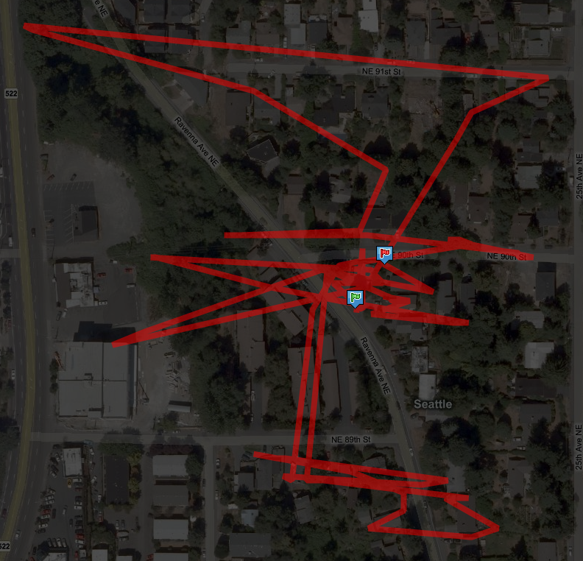
Trip Filtering

