Slide 1

TouchCam: Realtime Recognition of Location-Specific On-Body Gestures to Support Users with Visual Impairments
Uran Oh
Lee Stearns¹, Uran Oh^{1,2,*}, Leah Findlater^{1,3} and Jon E. Froehlich^{1,3}
¹University of Maryland, College Park, ² Carnegie Mellon University,
³University of Washington, *Currently at Ewha Womans University
@Ubicomp2018
Notes:
Hi everyone. My name is Uran Oh.
I will present a finger-worn system called TouchCam which was designed support on-body interaction for people with visual impairments
This work had been done together with Lee Stearns, Leah Findlater and Jon Froehlich awhile ago at University of Maryland, College Park

Slide 2
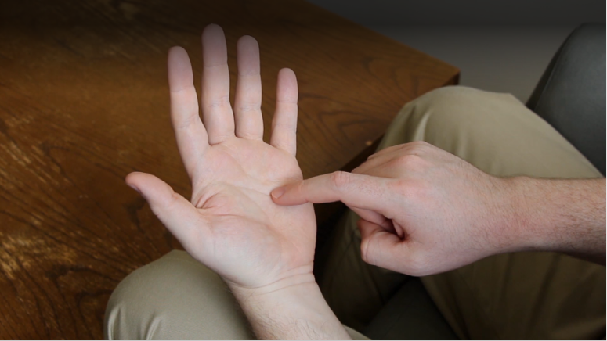
On-Body Interaction – Definition
A type of interaction technique which employs the user’s own body as an interactive surface

Slide 3
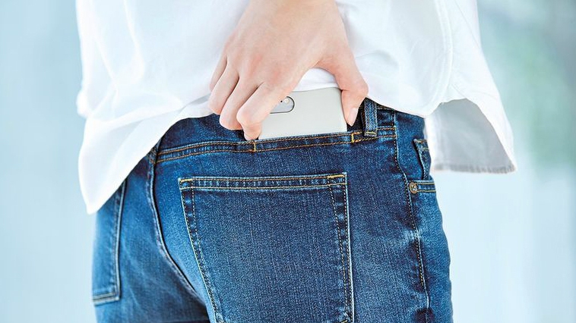
On-Body Interaction – Benefits
(+) Always-available control

Slide 4
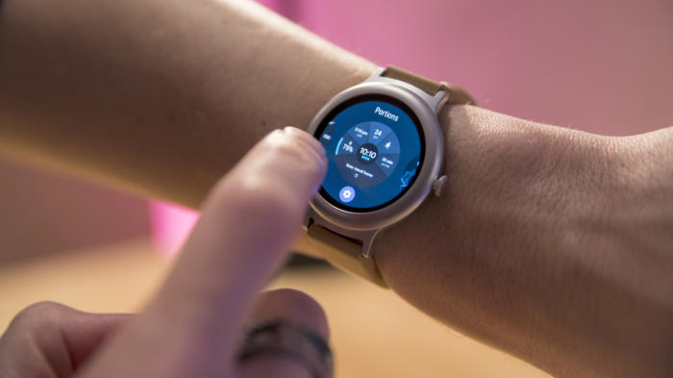
On-Body Interaction – Benefits
(+) Always-available control
(+) Expanded input/output space

Slide 5
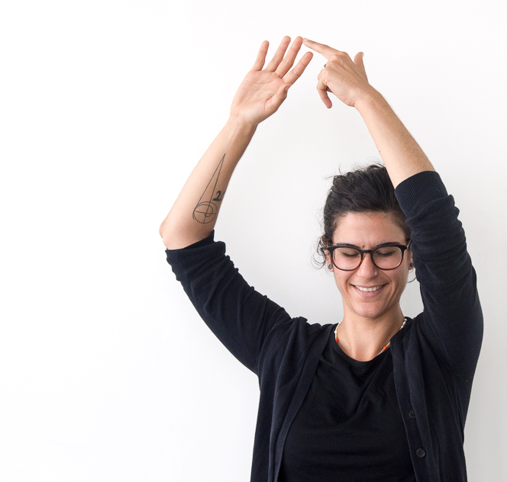
On-Body Interaction – Benefits
(+) Always-available control
(+) Expanded input/output space
(+) Eyes-free Interaction

Slide 6
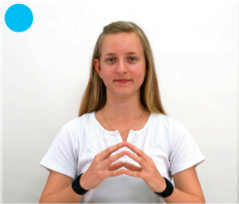
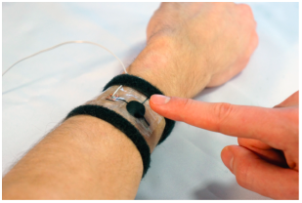
On-Body Input Sensing – Approaches
Capacitive
Touché [Sato et al. (2012)] (left), iSkin [Weigel et al. (2015)] (right)

Slide 7
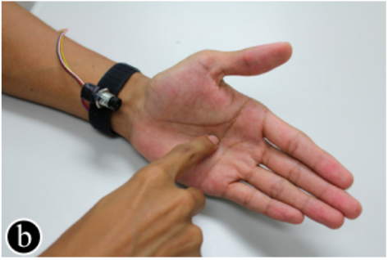
On-Body Input Sensing – Approaches
Capacitive
Infrared Reflective
SenSkin [Ogata et al. (2013)] (left), PalmGesture [Wang et al. (2015)] (right)

Slide 8
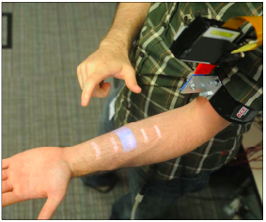
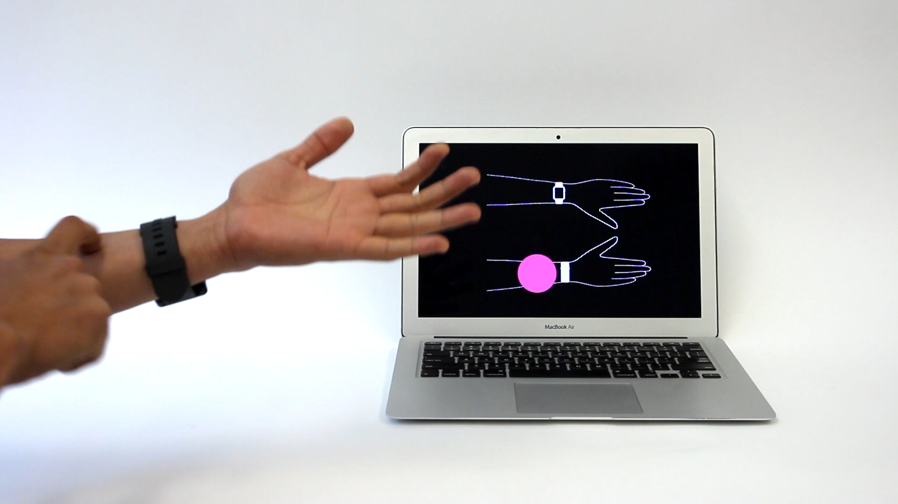
On-Body Input Sensing – Approaches
Capacitive
Infrared Reflective
Bio-acoustic
Skinput [Harrison et al. (2010)] (left), ViBand [Gierad et al. (2016)] (right)

Slide 9
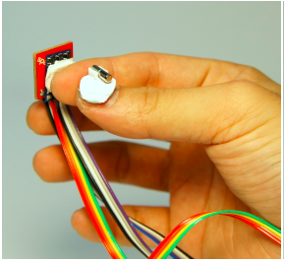
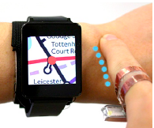
On-Body Input Sensing – Approaches
Capacitive
Infrared Reflective
Bio-acoustic
(Electro) Magnetic
Fingerpad [Chan et al. (2013)] (left), SkinTrack [Zhang et al. (2016)] (right)

Slide 10
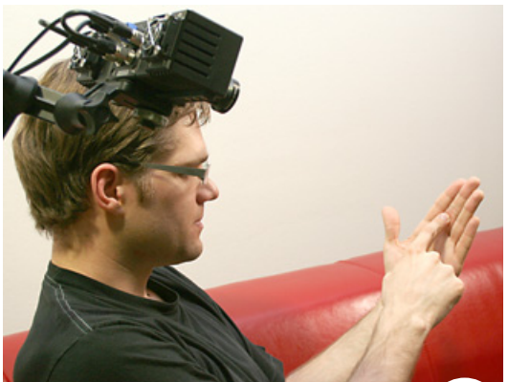
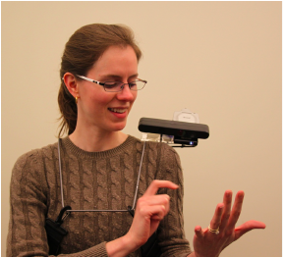
On-Body Input Sensing – Approaches
Capacitive
Infrared Reflective
Bio-acoustic
(Electro) Magnetic
Optic
Imaginary Phone [Gustafson et al. (2011)] (left), OmniTouch [Harrison et al. (2011)] (right)

Slide 11
On-Body Input Sensing – Limitations
Interaction space
  Small and fixed area
  Single location

Slide 12
On-Body Input Sensing – Limitations
Interaction space
Input vocabulary
  Input localization only
  Gesture recognition only

Slide 13
On-Body Input Sensing – Limitations
Interaction space
Input vocabulary
Sensing & touching locations

Slide 14
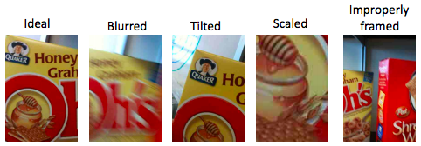
On-Body Input Sensing – Limitations
Interaction space
Input vocabulary
Sensing & touching locations
  E.g., Camera for people with visual impairments
Example pictures taken by people with visual impairments [Bigham et al. (2010)]

Slide 15
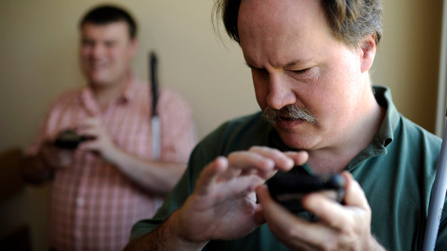
On-Body Input Sensing – Limitations
Interaction space
Input vocabulary
Sensing & touching locations
Target user
  Designed and evaluated for typical users only

Slide 16
Our Approach: On-Body Input Recognition
Using Finger-Worn Sensors

Slide 17
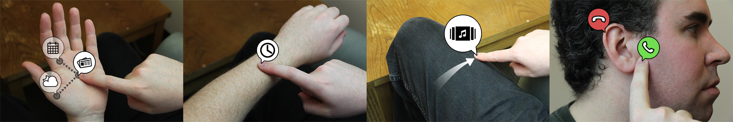
Our Approach: On-Body Input Recognition
Using Finger-Worn Sensors
Advantages
Flexible input locations
Larger input vocabulary
Simplified sensing and processing
Notes:
script

Slide 18
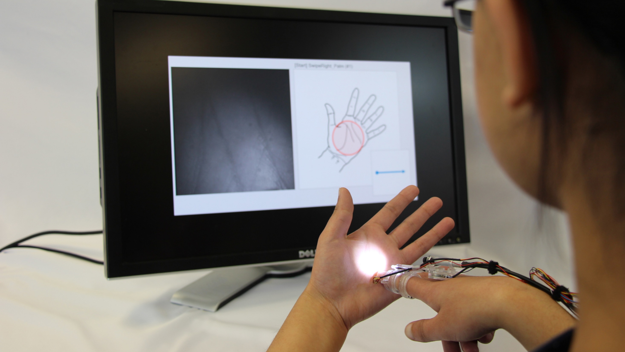
TouchCam – Methods
Study I
Goal: to assess the feasibility

Slide 19
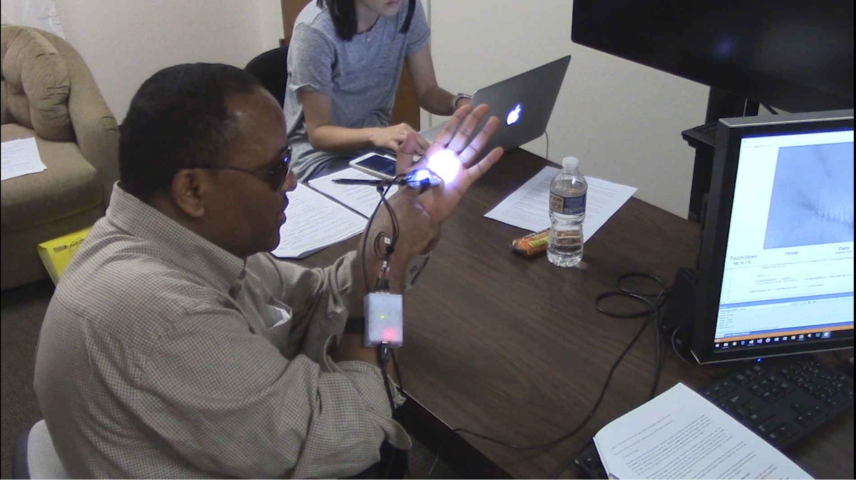
TouchCam – Methods
Study I
Study II
Goal: to assess the feasibility
Goal: to evaluate the usability

Slide 20
Study I
A Feasibility Study with Offline Evaluations

Slide 21
Study I
Participants
The number of subjects:
  24 (16 female, 8 male)
Avg. age:
  28.9 (SD = 7.95, range: 19 - 51)
Level of vision:
  Normal or corrected-to-normal

Slide 22
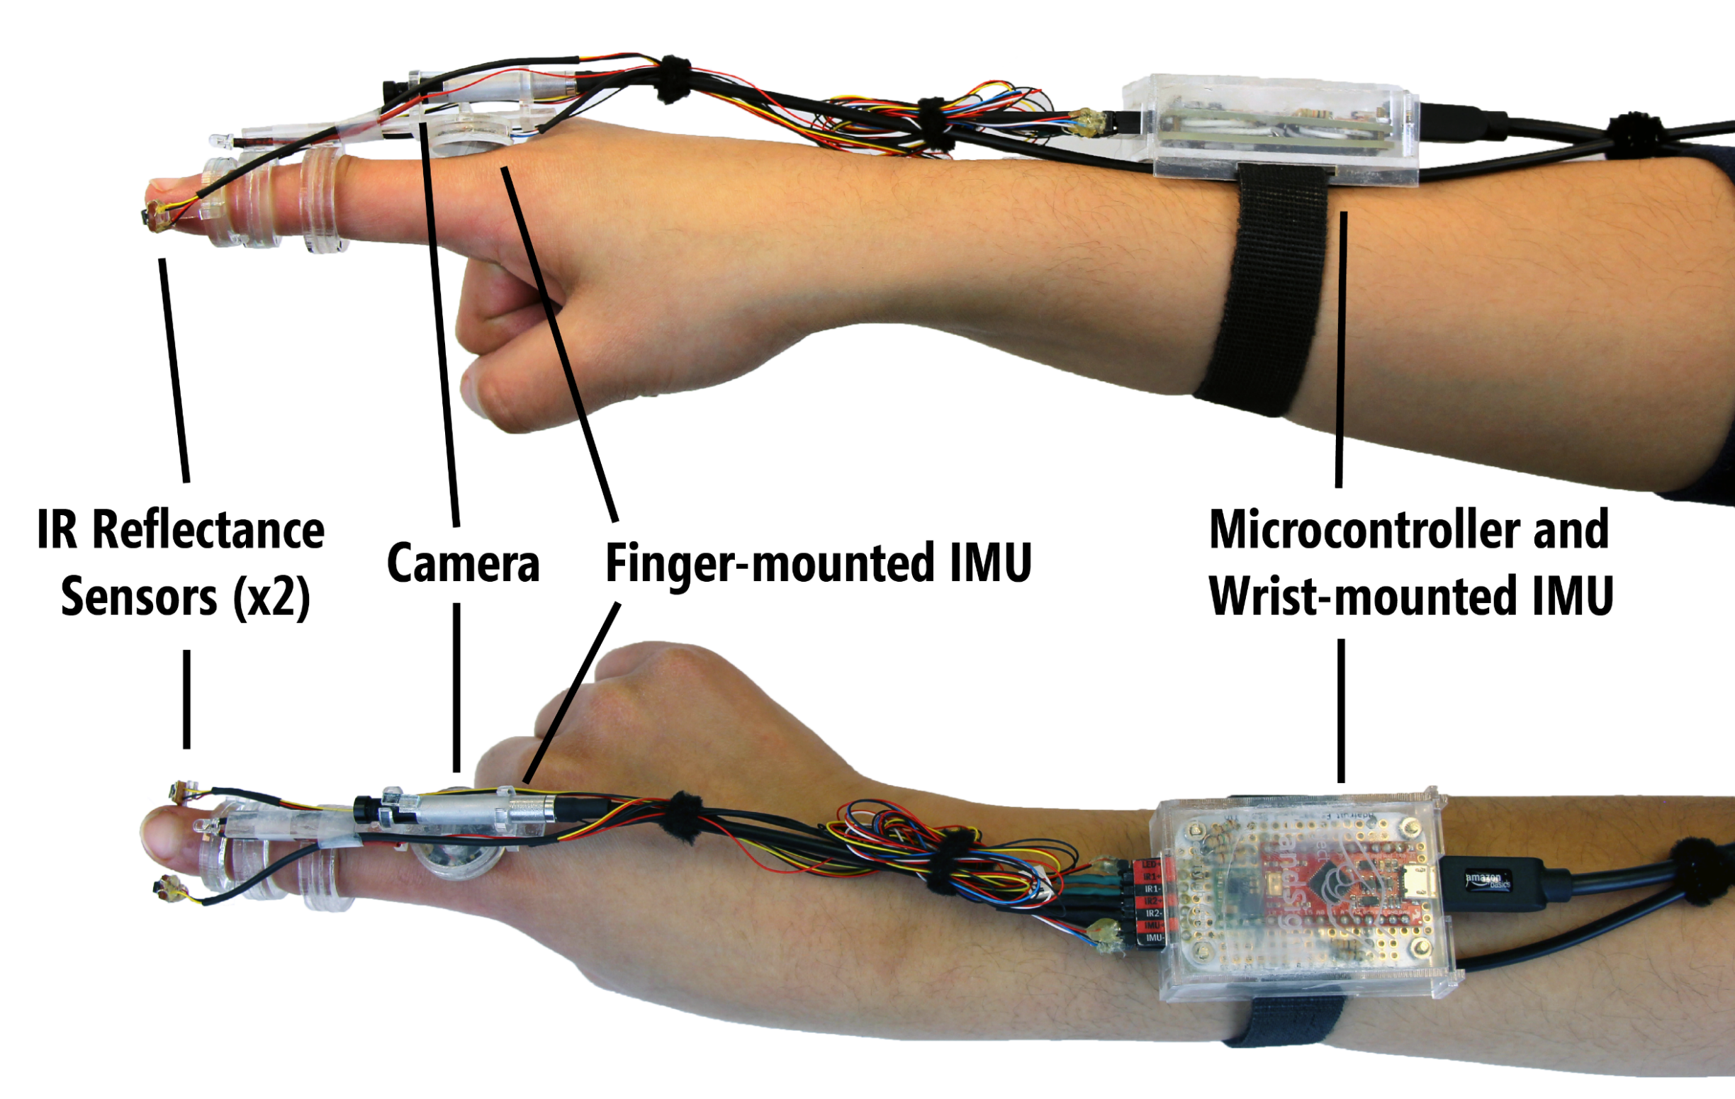
Study I
Apparatus – HW Prototype V1

Slide 23
Study I
Apparatus – Data Collection Tool

Slide 24
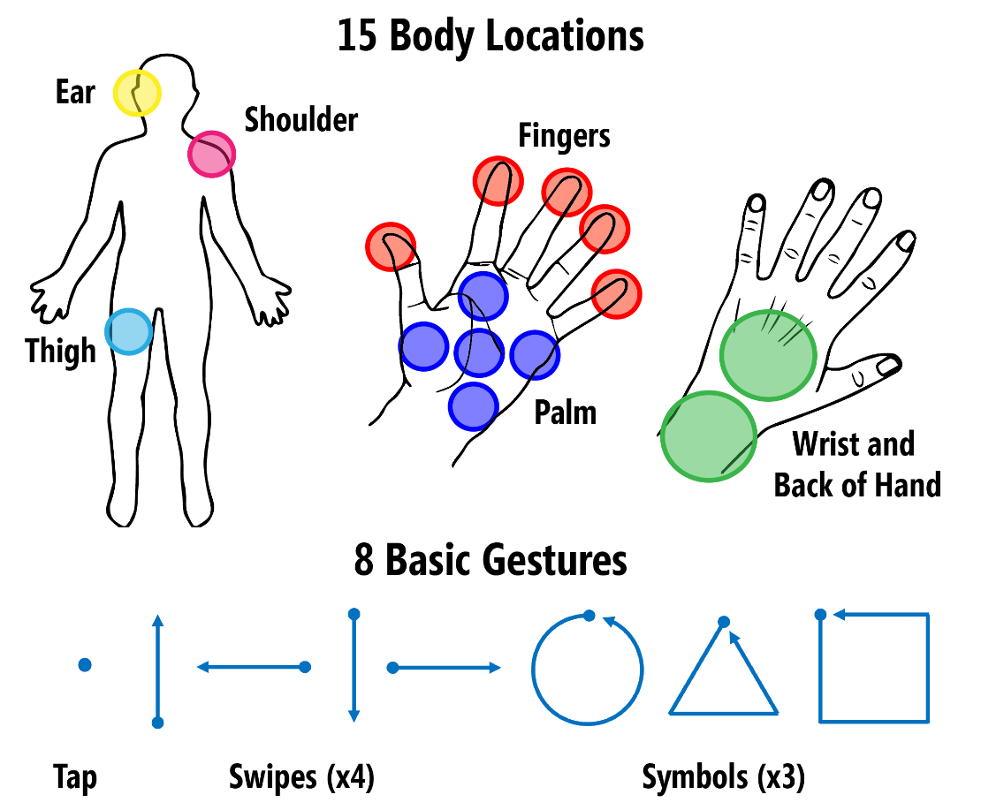
Study I
Procedure (~90 min.)
Demographic Questionnaire
System Calibration
Data Collection
  Location-specific touches
    15 locations x 10 blocks

Slide 25
Study I
Procedure (~90 min.)
Demographic Questionnaire
System Calibration
Data Collection
  Location-specific touches
  Location-specific gestures
    3 locations (palm, wrist, thigh)
    x 8 gestures x 10 blocks

Slide 26
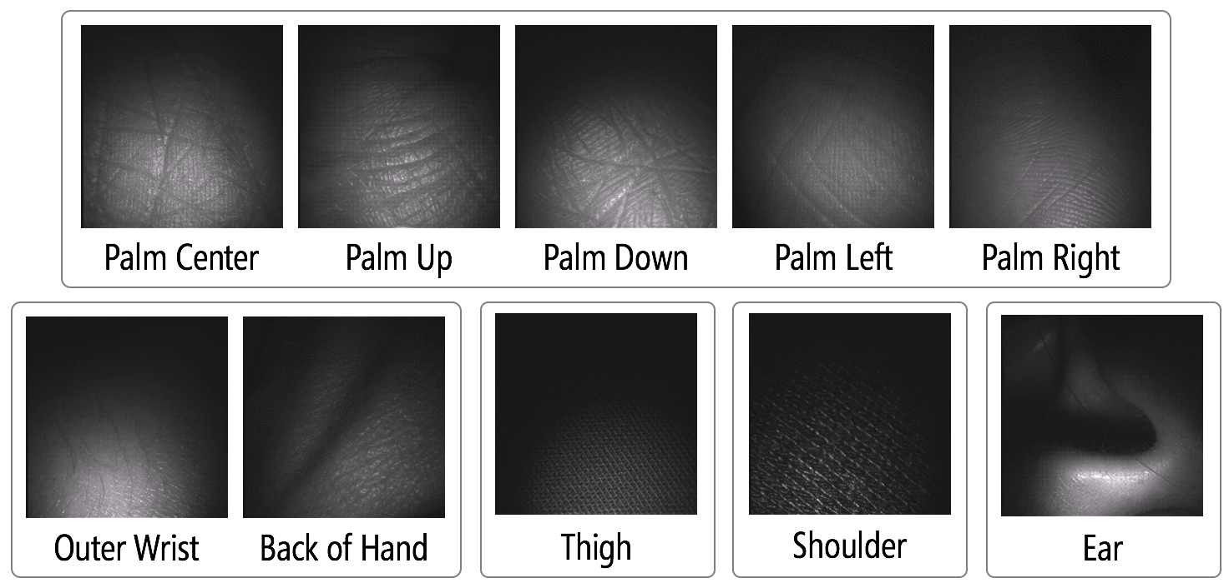
Study I
Data and Analysis
Data Ex:

Slide 27
Study I
Results – Localization
  Fine-Grained Localization Avg. Accuracy: 88.7% (SD=7.0%) (15 classes: PalmCenter, PalmLeft, …)
  Coarse-Grained Localization Avg. Accuracy: 98.0% (SD=2.3%) (6 classes: palm, fingers, wrist and back of hand, shoulder, thigh, ear)
Notes:
Leave-One-Out Within-Person Classification Experiment (N=24)

Slide 28
Study I
Results – Sensor Combinations
  Fine-Grained Accuracy:
  88.7% with all sensors
  84.0% with camera only
  52.9% with all sensors except camera
  Coarse-Grained Accuracy:
  98.0% with all sensors
  97.5% with camera only
  87.5% with all sensors except camera
*Coarse-Grained: p<.001, t(23) = 7.12, d=1.92; Fine-Grained: p<.001 t(23) = 16.74, d=2.99
Notes:
No sig. difference between all sensors vs. camera only
Sig. difference between camera only and all other sensors for both coarse-grained and fine-grained accuracy.

Slide 29
Study I
Results – Gesture Recognition
  Location-Specific Gestures Avg. Accuracy: 95.7% (SD=3.2%)
  (24 classes: palm-swipeUp, wrist-swipeUp, …, palm-swipeDown, …)
  Accuracy for different sensor combinations:
  84.6% with camera only
  91% and 91.4% with one IMU (finger vs. wrist)
  95.1% with two IMU’s
  95.4% with camera and two IMU’s
Notes:
Camera alone may not be sufficient, but using a camera in addition to IMU sensor helps

Slide 30
Study I
Summary
The feasibility evaluation:
  Accuracy
    88%–98%
  Efficiency
    Too slow (approx. 2 sec. per image)
Advantages with sensor fusion:
  Sensor combination can be optimized

Slide 31
Study II
A Usability Study with a Realtime Interactive System

Slide 32
Study II
Participants
The number of subjects:
  12 (7 female, 5 male)
Avg. age:
  46.2 (SD = 12.0, range: 29 - 65)
Level of vision:
  9 blind, 3 low vision
Notes:
Recruited via e-mail list and local organization
$60 compensation

Slide 33
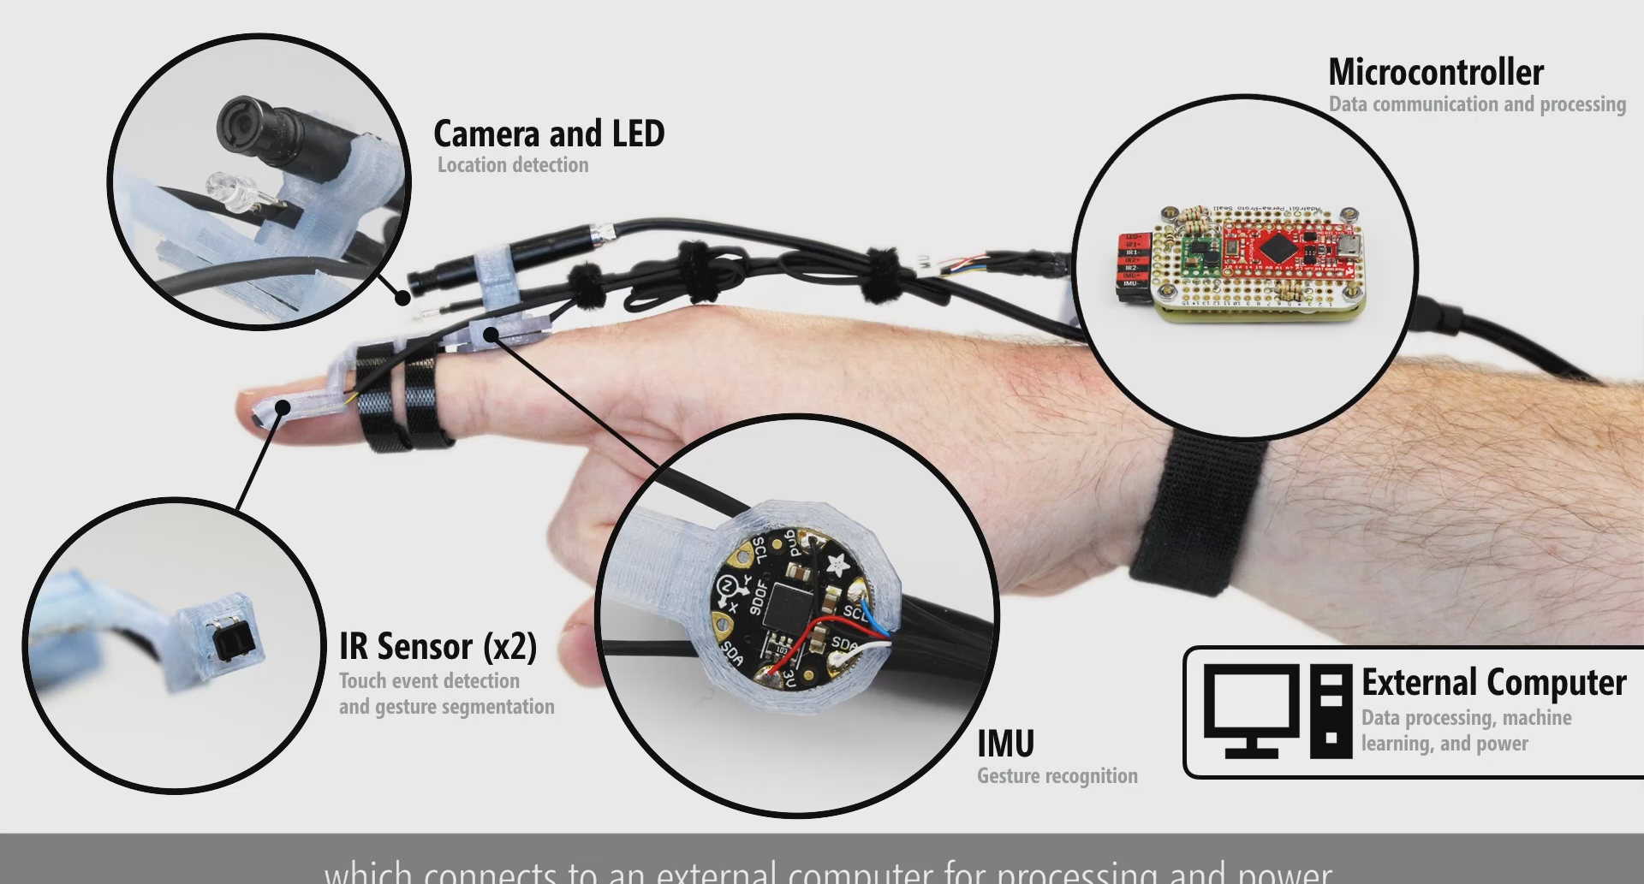
Study II
Apparatus – HW Prototype V2

Slide 34
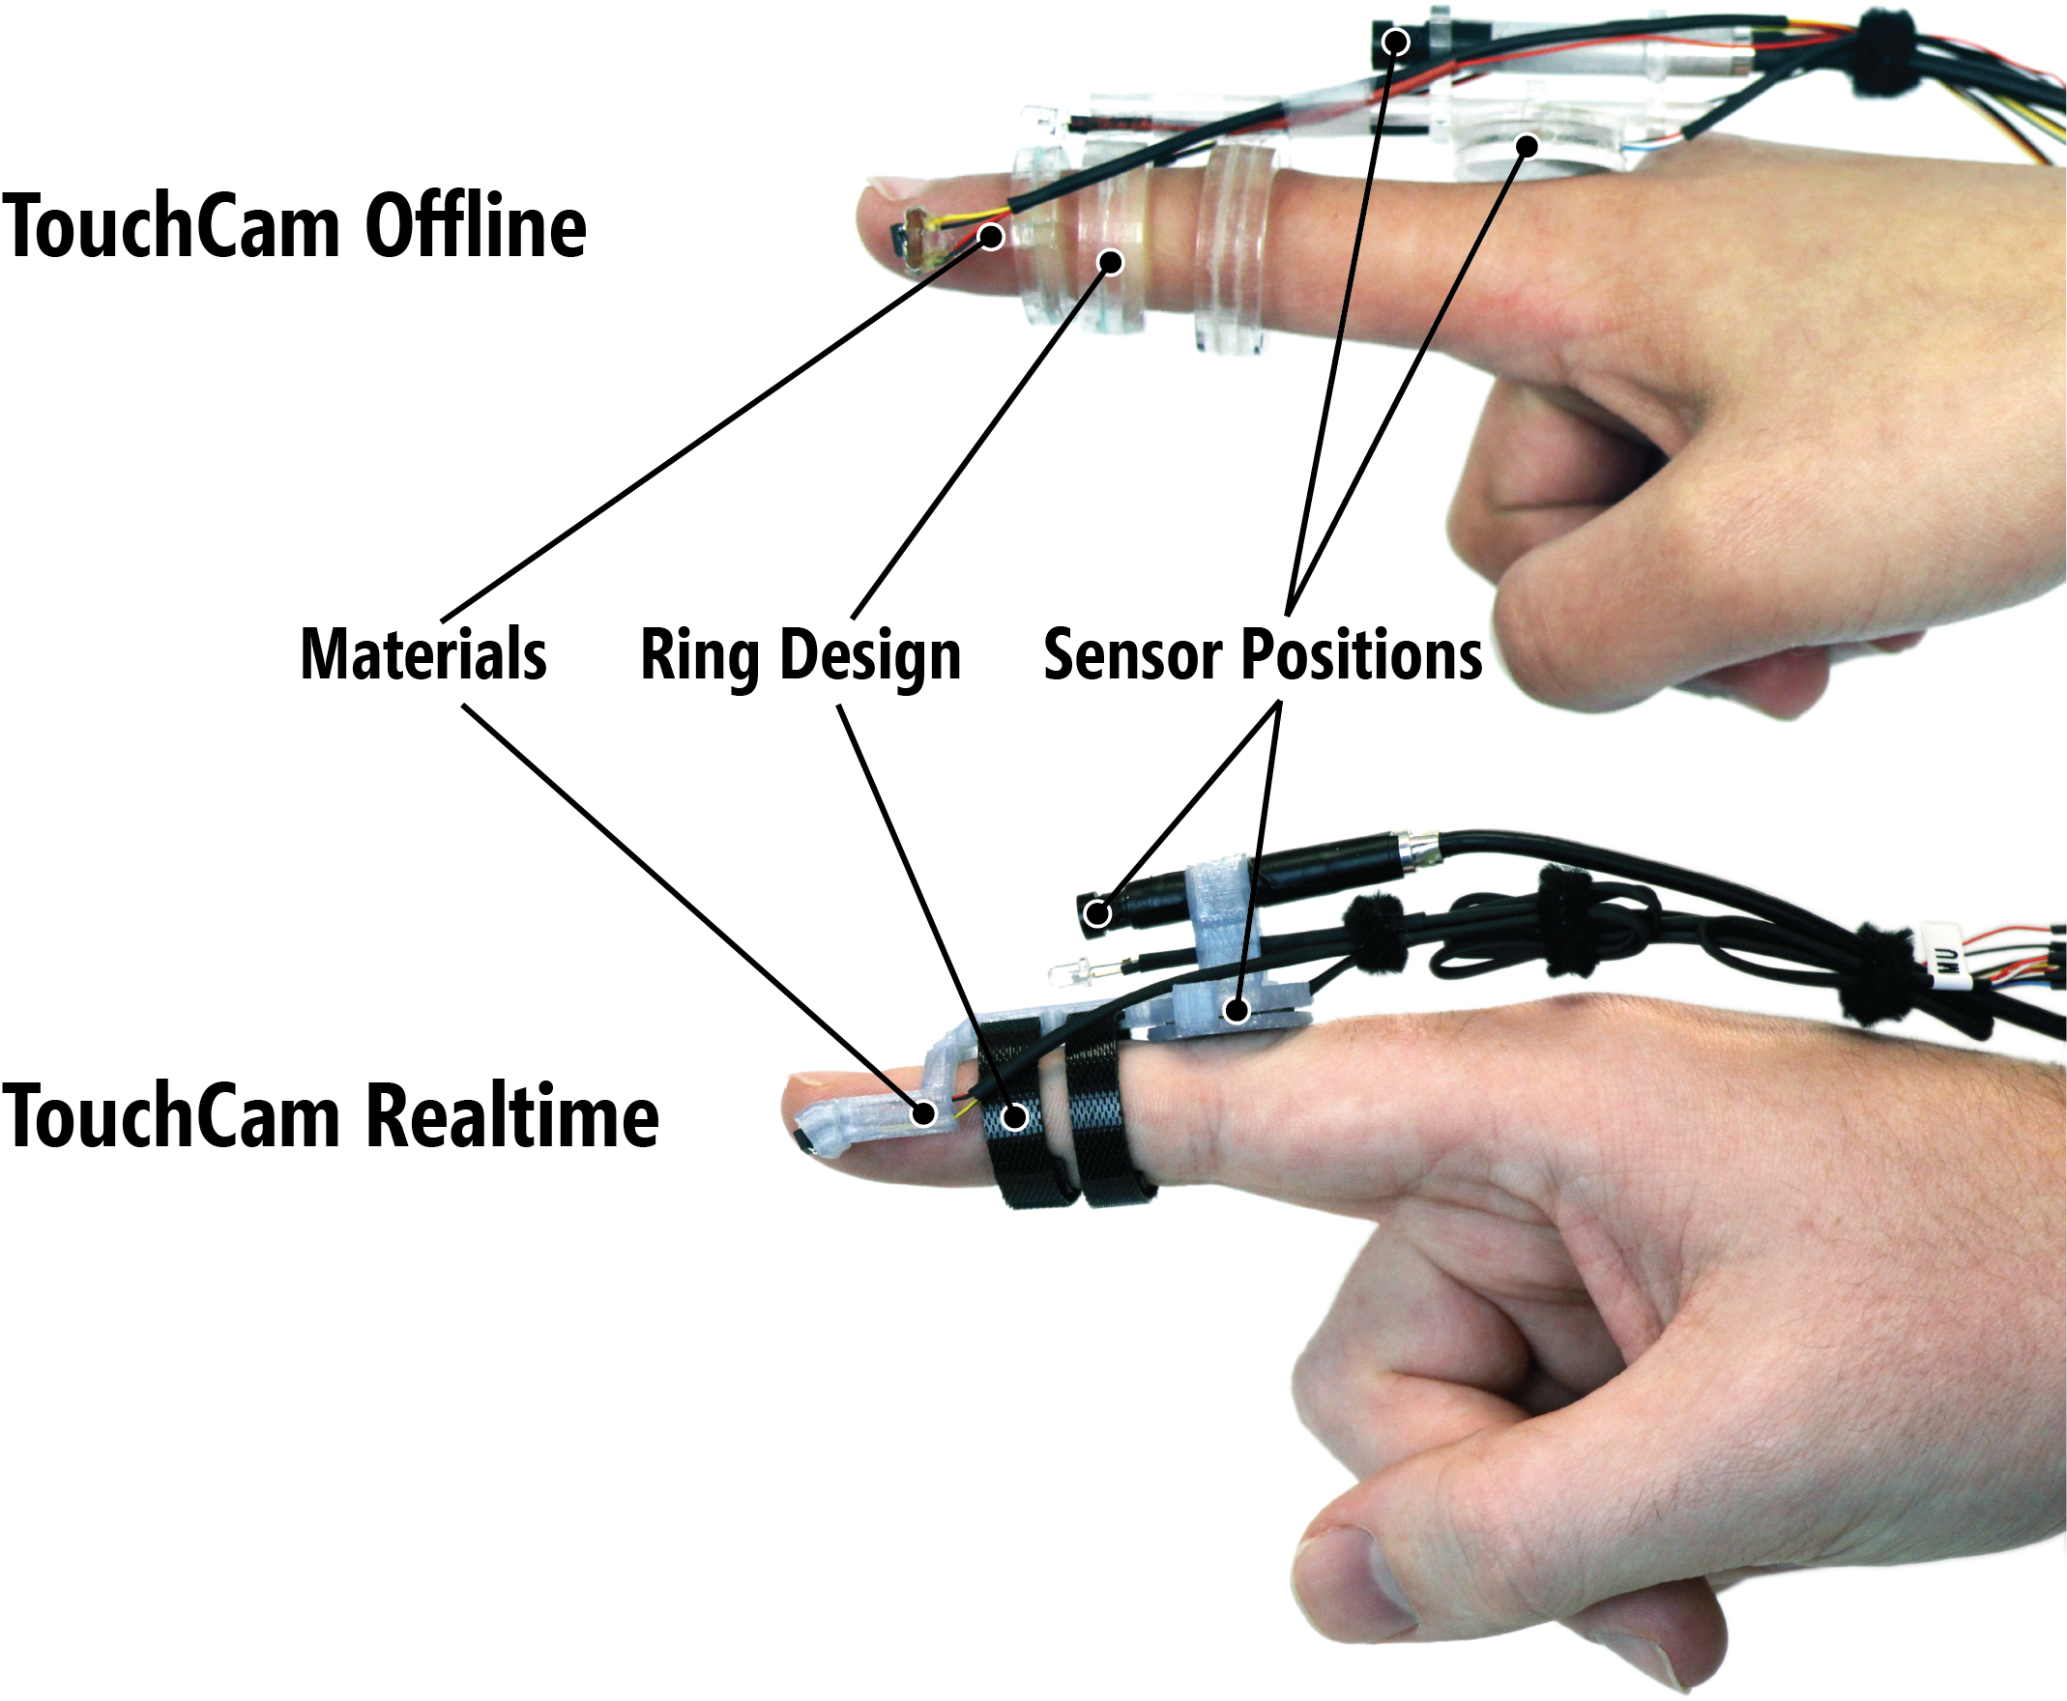
Study II
Apparatus – HW Prototypes
(V1)
(V2)

Slide 35
Study II
Apparatus – HW Prototypes
(V1)
(V2)

Slide 36
Study II
Data and Analysis – Recognition
Stage I: Touch Segmentation
Stage II: Feature Extraction
Stage III: Localization
Stage IV: Gesture Classification
Notes:
The third and fourth stages run in parallel, using the features from the previous stage to classify either location or gesture using support vector machines.

Slide 37
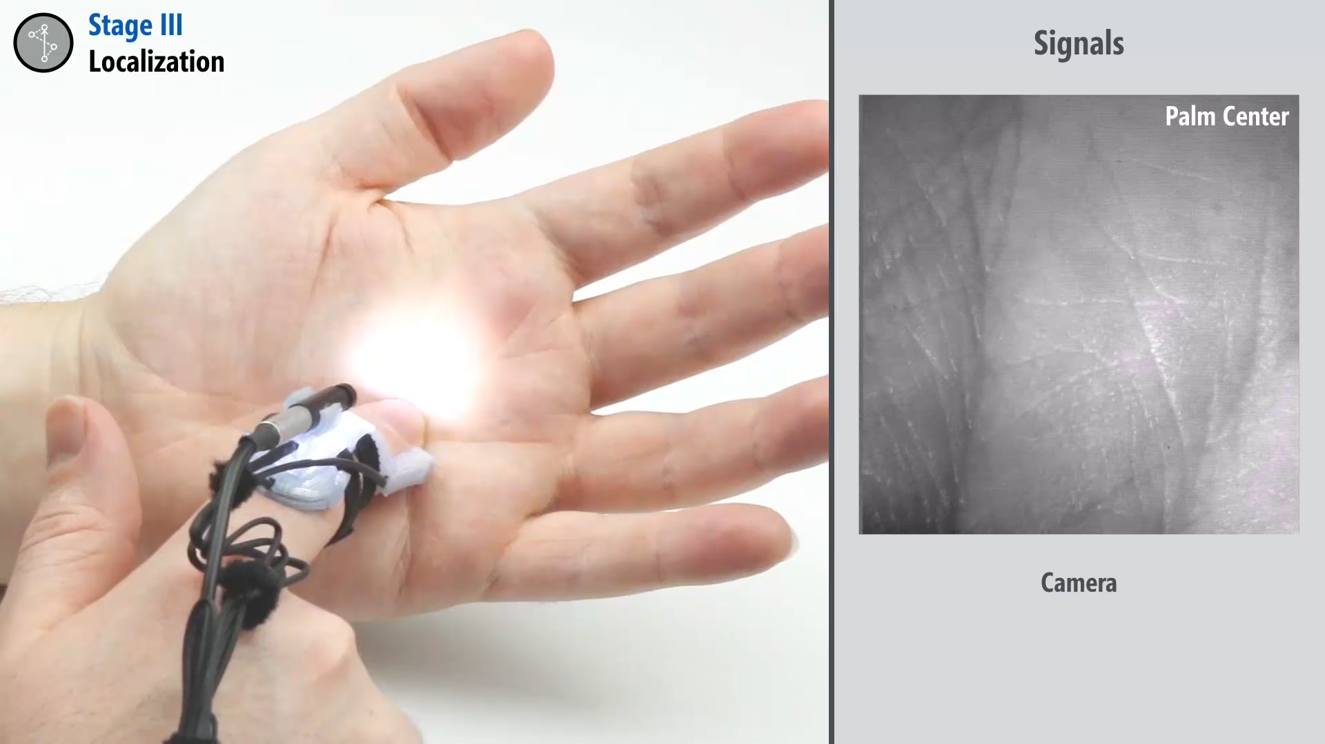
Notes:
Stage 3 uses classifiers that are trained individually for each user, first classifying coarse-grained locations like the palm or wrist, and then classifying fine-grained locations like the upper or lower palm.
[wait]
Stage 4 uses a single gesture classifier that is identical for all users, which we trained using a large set of pre-recorded gesture data.

Slide 38
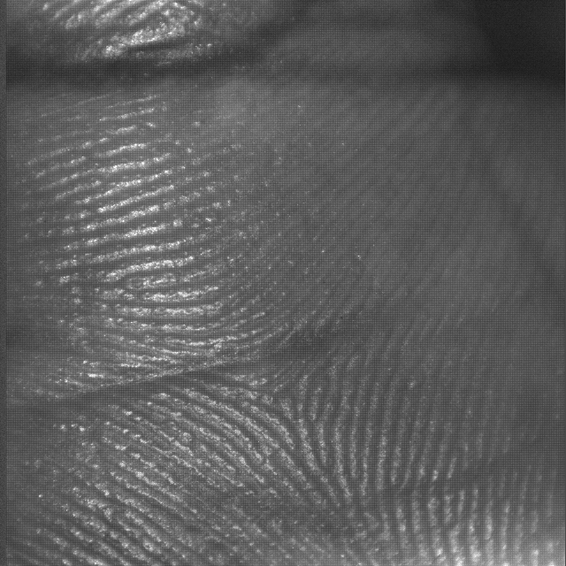
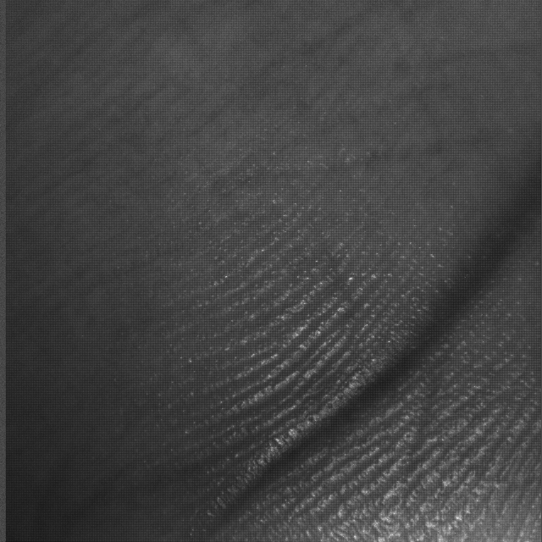
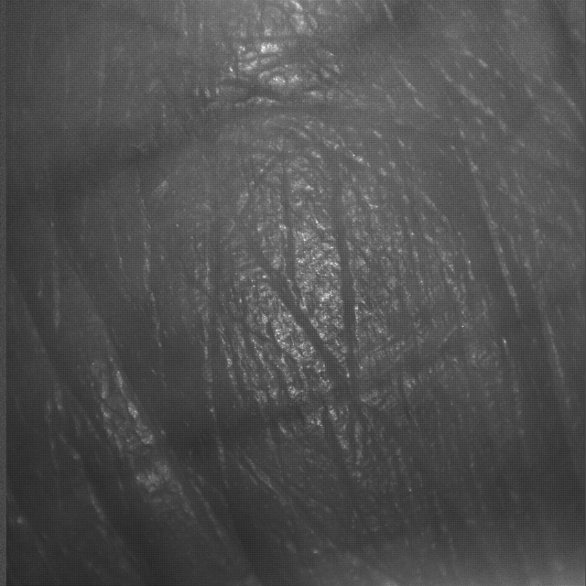
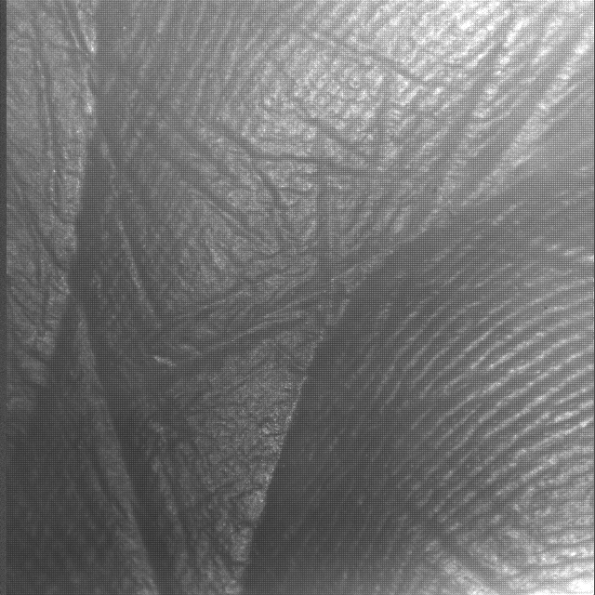
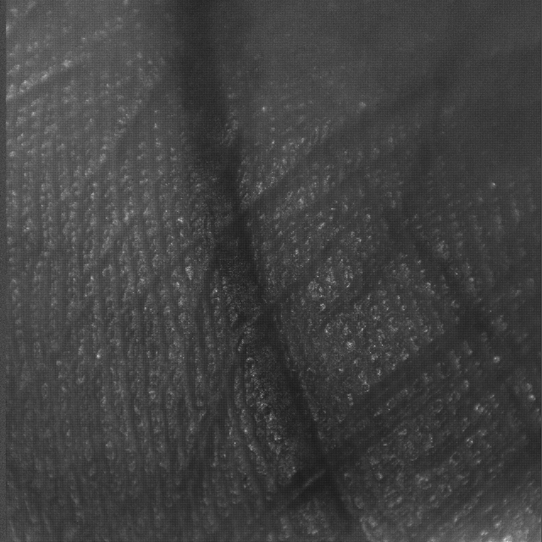
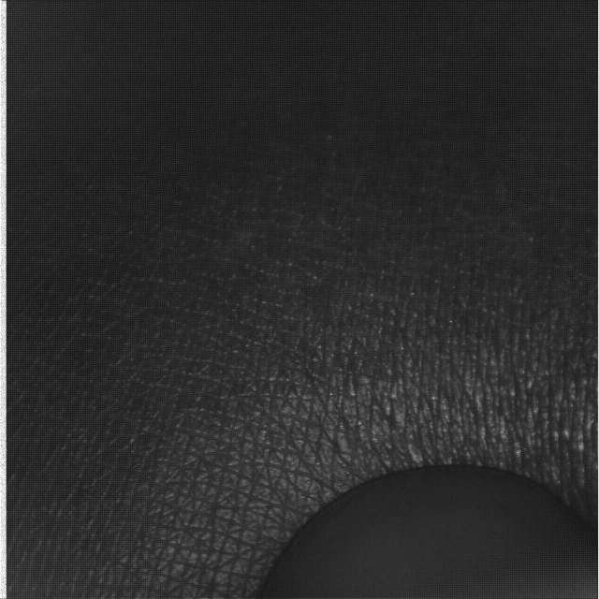
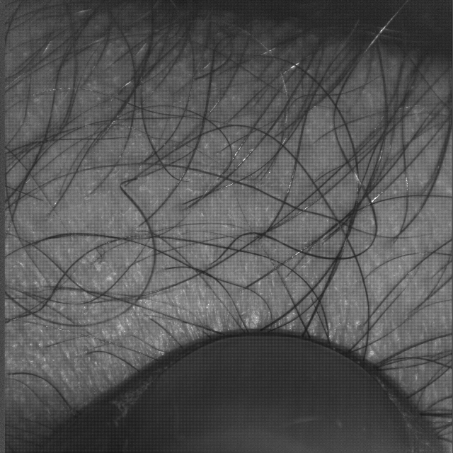
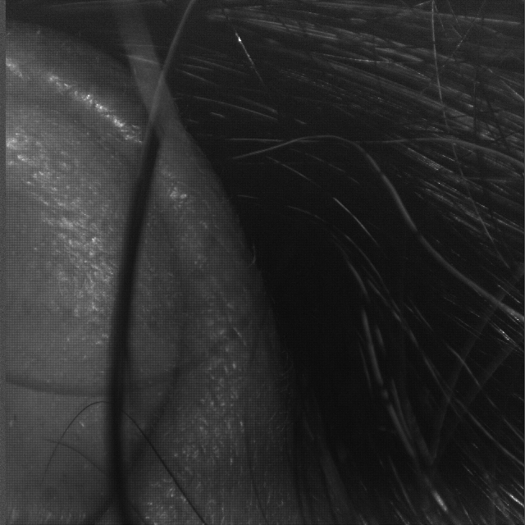
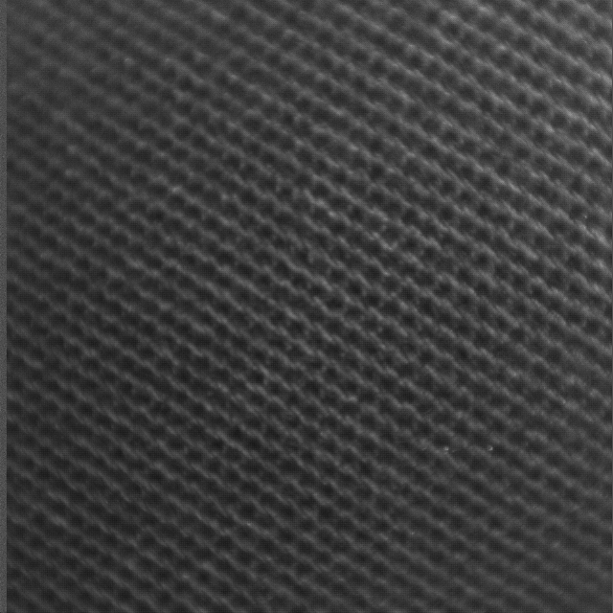
Study II
Procedure (~120 min.)
Interview
System calibration and training
Tasks
  Location-specific touches
    9 locations
Palm: up, down, left, right, center
Wrist: inner, outer
Ear
Thigh

Slide 39
Study II
Procedure (~120 min.)
Interview
System calibration and training
Tasks
  Location-specific touches
  Basic mobile tasks with 3 interaction designs

Slide 40
Study II
Procedure (~120 min.)
Interview
System calibration and training
Tasks
Post-study questionnaires

Slide 41
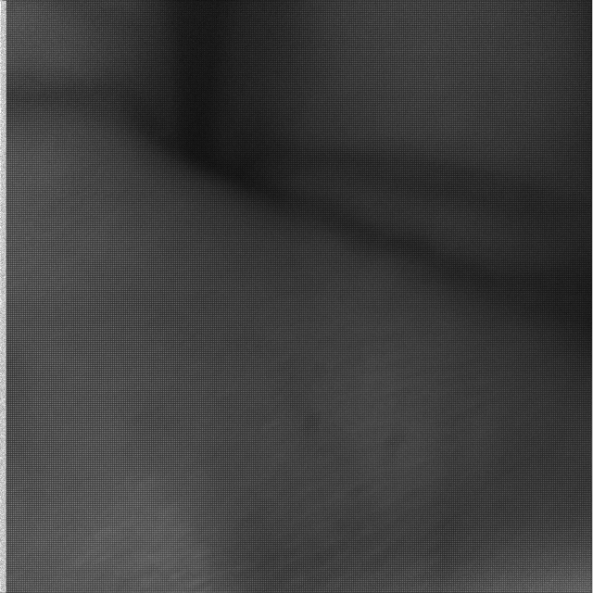

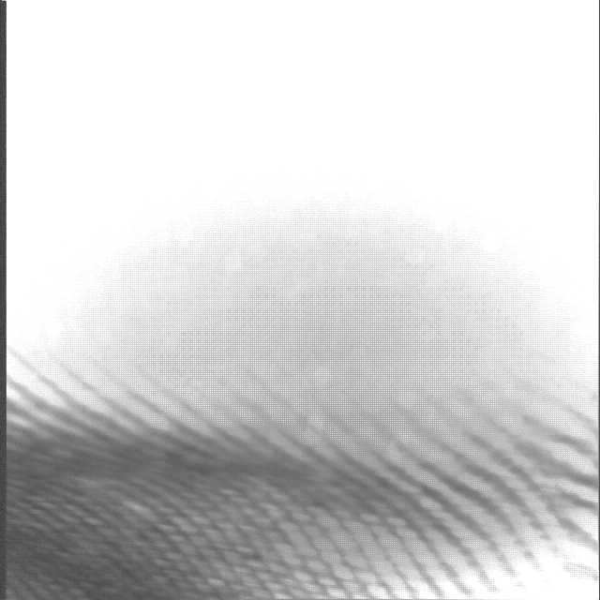
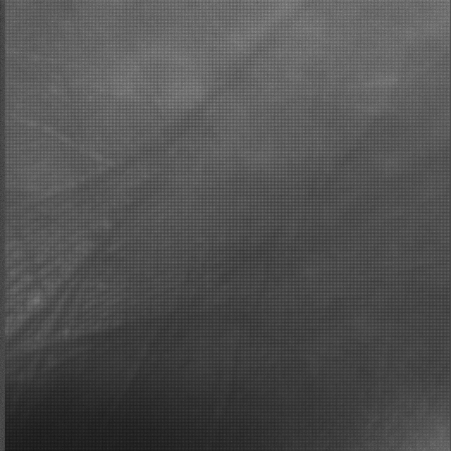
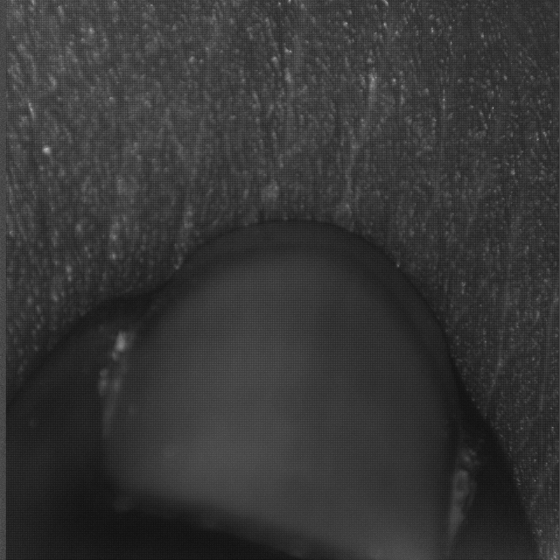
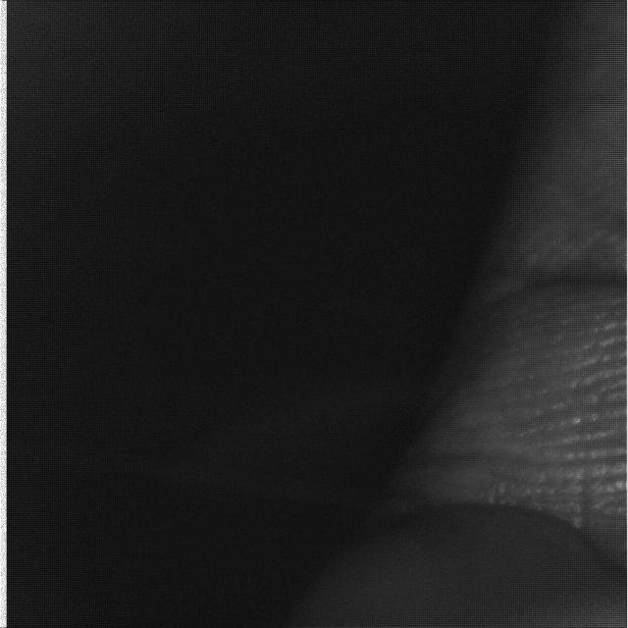
Study II
Results – Localization Accuracy
Leave-one-out cross-validation (N=12)
  81.3% with 9 classes
  94.2% with 4 classes (i.e., palm, wrist, ear, thigh)
Issues with images (22%)
  13.6% with poor focus
  5.4% with insufficient illumination
  4.3% with poor contrast
  3.2% with target uncaptured

Slide 42
Study II
Summary
  Developed a realtime interactive system
    Iterative design process
  Assessed realtime performance and evaluation with our target population
  Identified obstacles to robust camera-based on-body input recognition

Slide 43
TouchCam – Discussion and Future work
The benefits
  Expanded on-body input vocabulary
    Location-specific input for context-specific input
    high degree of flexibility and customization
    Can be further expanded by supporting multitouch

Slide 44
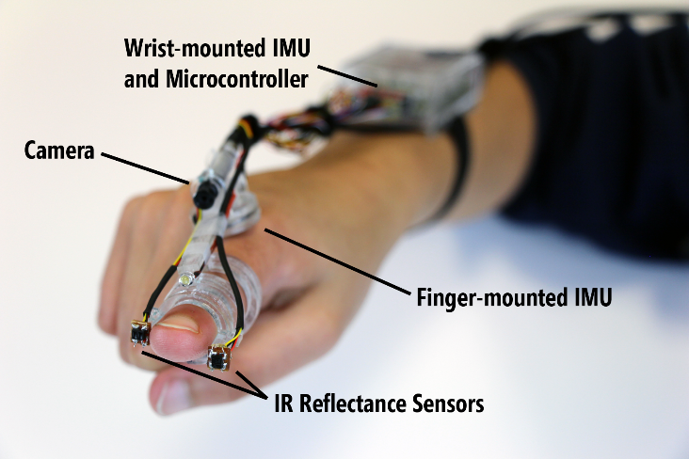
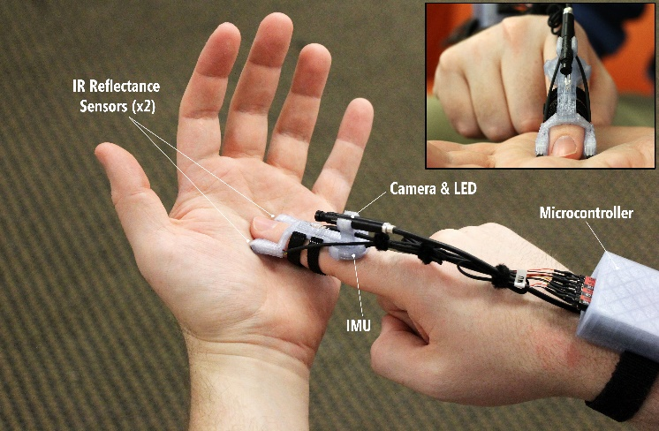
TouchCam – Discussion and Future work
The benefits
The feasibility
    Physical design
      Still large, weak computing power
      Future design should be a small stand-alone device
Notes:
Demonstrated with a computer-vision driven finger camera approach

Slide 45
TouchCam – Discussion and Future work
The benefits
The feasibility
    Physical design
    Performance
      High accuracy with realtime performance
      Can be improved with
        Auto-focus
        Wide-angle camera with higher resolution
        Efficient finger-,palmprint recognition
Notes:
Demonstrated with a computer-vision driven finger camera approach

Slide 46
TouchCam – Discussion and Future work
The benefits
The feasibility
The usability
  Training and calibration take time
  Can be improved with
    Bootstrapping the system
    Training as needed

Slide 47
TouchCam – Conclusion
  Introduced an on-body input sensing system
    using sensors worn on the user’s gesturing finger
    for people with visual impairments
  Demonstrate feasibility with
    Accuracy
    Recognition time
  Identified design implications and goals for future on-body interfaces

Slide 48
Thank you ☺
Questions?
You can also reach
Lee Stearns (our first author) at lstearns@umd.edu
or Uran Oh (me) at uran.oh@ewha.ac.kr
Notes:
13-min presentation, 2 min. QnA

Slide 49
TouchCam – References
Localization:
Stearns, L., Oh, U., Cheng, B. J., Findlater, L., Ross, D., Chellappa, R., & Froehlich, J. E. (2016, December). Localization of skin features on the hand and wrist from small image patches. In Pattern Recognition (ICPR), 2016 23rd International Conference on (pp. 1003-1010). IEEE.
Qualitative Analysis:
Oh, U., Stearns, L., Pradhan, A., Froehlich, J. E., & Findlater, L. (2017, October). Investigating Microinteractions for People with Visual Impairments and the Potential Role of On-Body Interaction. In Proceedings of the 19th International ACM SIGACCESS Conference on Computers and Accessibility (pp. 22-31). ACM.
Notes:
13-min presentation, 2 min. QnA

