Slide 1
Moving Beyond Line Graphs
@jonfroehlich

Slide 2
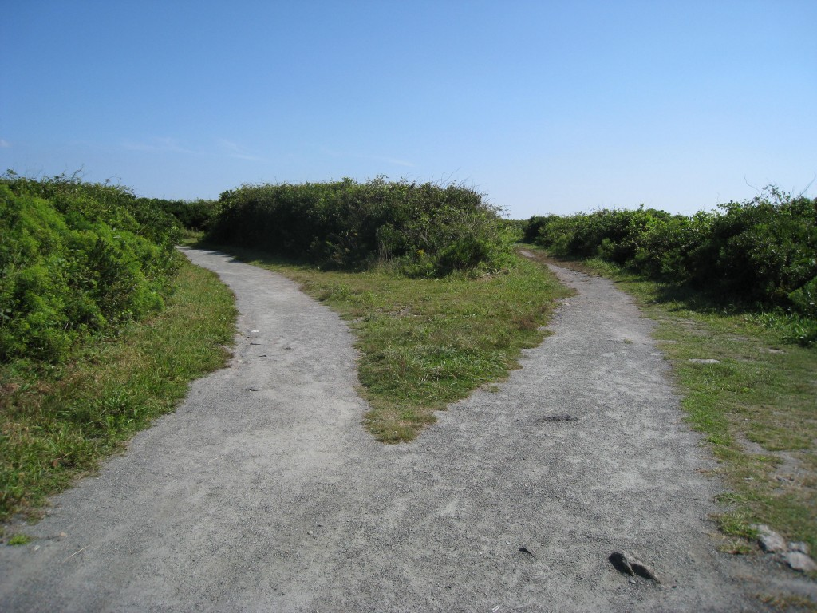
Feedback is about empowering people with information to positively inform and change behavior

Slide 3
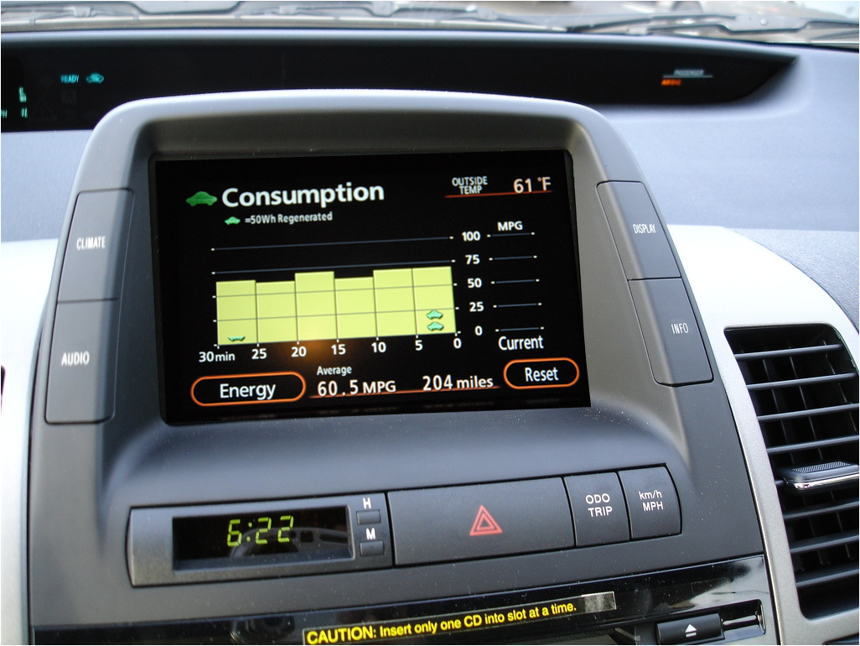
the prius effect?

Slide 4
why is the prius effective?
Immediate
Simple
Educates
Constrained environment
Reason to care
Informs only one action

Slide 5
the prius effect?

Slide 6
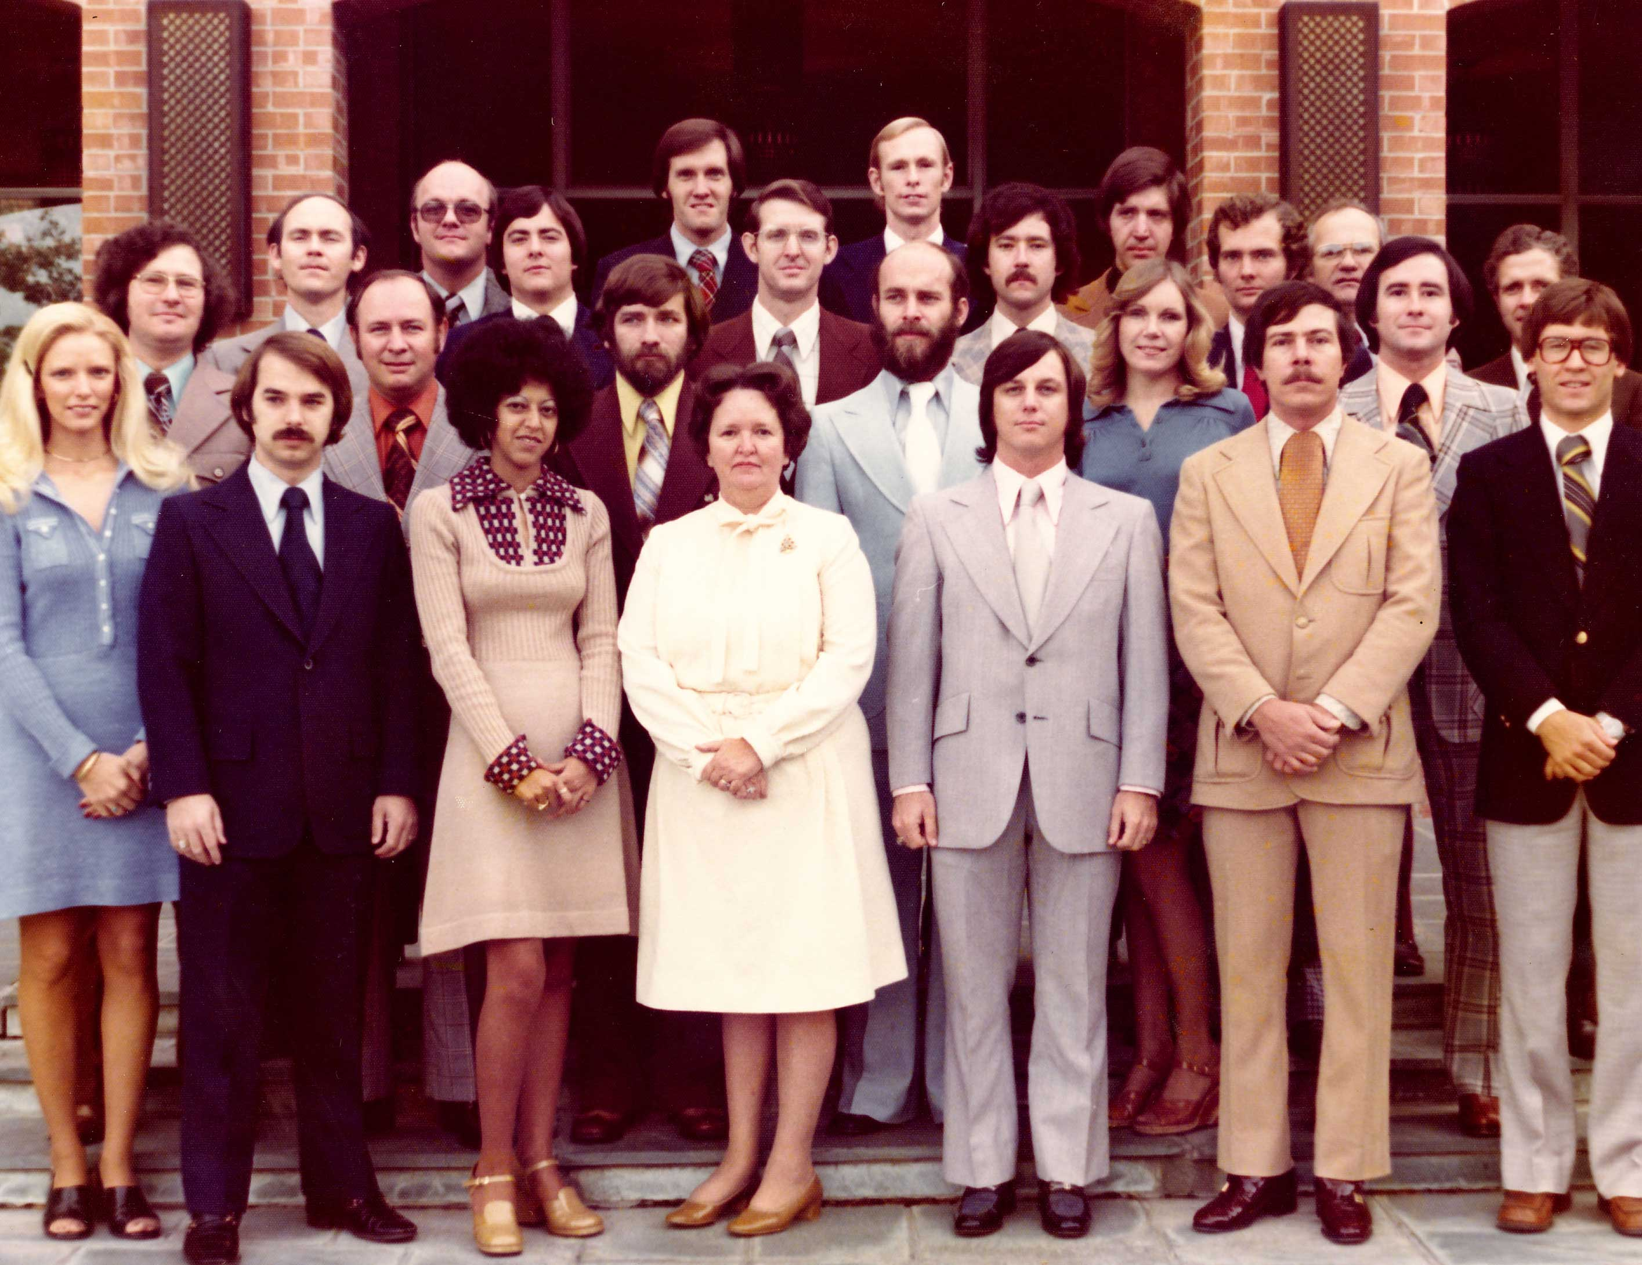
1976
Notes:
1976
Apple is formed
Viking 1 lander successfully lands on mars
Elvis is still alive
First study of energy feedback

Slide 7
Kohlenberg et al., J. of Applied Behavior Analysis, 1976
Notes:
But we these simple devices have been found to reduce consumption:
Kohlenberg
Powercost blue monitor – cananda study
Positive Energy Bills
Which leads me to ask: why do we need all this data?

Slide 8
kitchen
Kohlenberg et al., J. of Applied Behavior Analysis, 1976

Slide 9
the lightbulb effect?
Immediate
Simple
Educates
Constrained environment
Reason to care
Informs only one action
kitchen
Kohlenberg et al., J. of Applied Behavior Analysis, 1976

Slide 10
the lightbulb effect?
Immediate
Simple
Educates
Constrained environment
Reason to care
Informs only one action
kitchen
Kohlenberg et al., J. of Applied Behavior Analysis, 1976

Slide 11
2010
Notes:
Still have robots on Mars
Economic recession ends supposedly
BECC 4th year

Slide 12
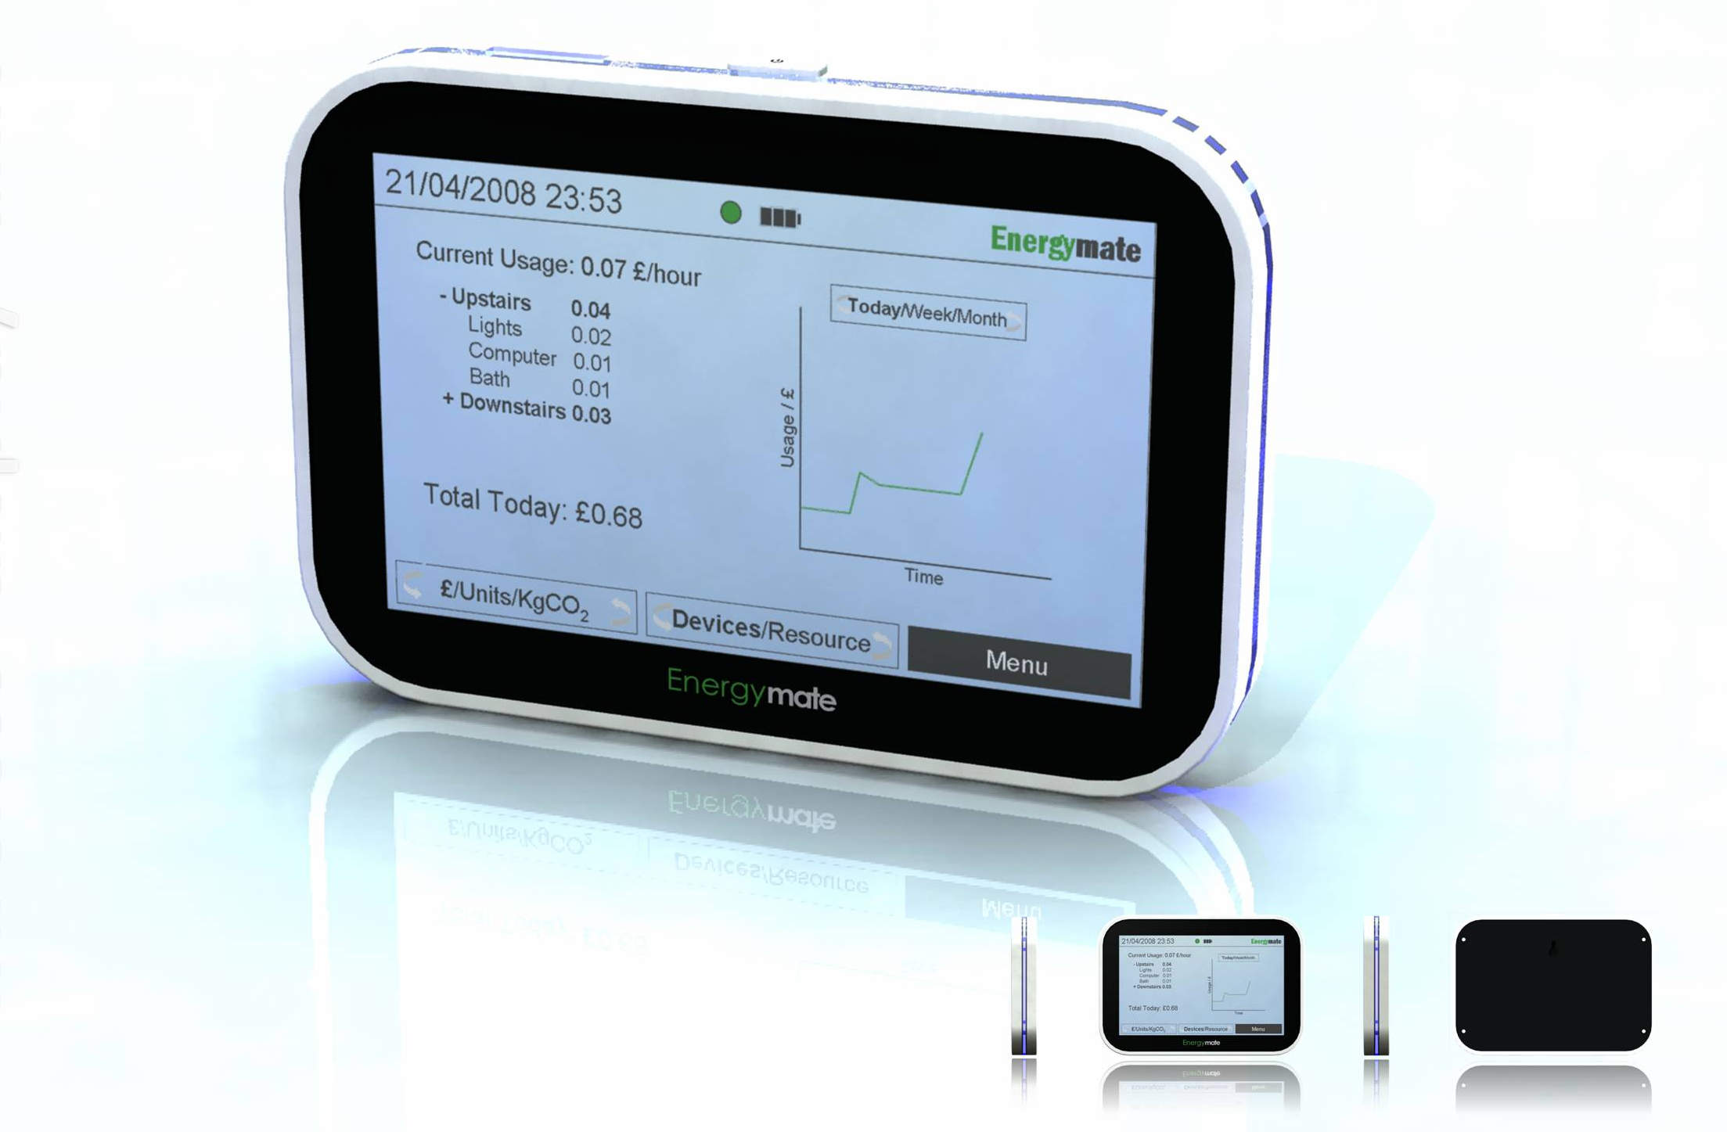
Talk about feedback intervention
Talk about energy savings from feedback studies
Feedback results in energy savings of between 5-12%
Darby, 2000; Abrahamse, 2005; Fischer, 2008; EPRI 2009
Notes:
Feedback technologies have been shown to be one of the most effective strategies in reducing energy consumption in the home, although they have not been comprehensively explored in the transportation domain.
Corinna Fischer reviewed approximately twenty studies exploring the effects of feedback on electricity consumption and found that typical energy savings were between 5 and 12%.

Slide 13
Talk about feedback intervention
Talk about energy savings from feedback studies
But we’re still unsure what aspects of feedback are most effective
Darby, 2000; Abrahamse, 2005; Fischer, 2008; EPRI 2009
Notes:
Feedback technologies have been shown to be one of the most effective strategies in reducing energy consumption in the home, although they have not been comprehensively explored in the transportation domain.
Corinna Fischer reviewed approximately twenty studies exploring the effects of feedback on electricity consumption and found that typical energy savings were between 5 and 12%.

Slide 14
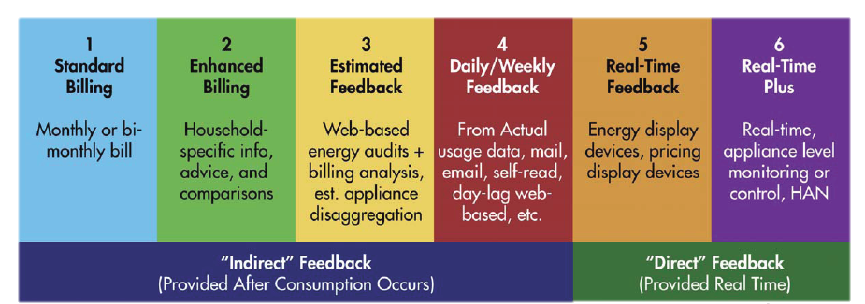
low
data update frequency
cost to implement
high
Residential Electricity Use Feedback: A Research Synthesis and Economic Framework, EPRI 2009
Notes:
Residential Electricity Use Feedback: A Research Synthesis and Economic Framework

Slide 15
low
data update frequency
cost to implement
high
OPower
Energy Savvy.com
PG&E Website
The Energy Detective
Residential Electricity Use Feedback: A Research Synthesis and Economic Framework, EPRI 2009
Notes:
Residential Electricity Use Feedback: A Research Synthesis and Economic Framework

Slide 16
low
data update frequency
cost to implement
high
Type2
Type3
Type4
Type5
Type6
Notes:
Why aren’t real-time (type 5) and real-time plus (type 6) dwarfing the other feedback types in effectiveness?

Slide 17
Talk about feedback intervention
Talk about energy savings from feedback studies
More information != More Behavior Change
Data Presentation > Data Update Frequency
Darby, 2000; Abrahamse, 2005; Fischer, 2008; EPRI 2009
Notes:
More information does not guarantee more behavior change
Data presentation outweighs data update frequency, which is why a redesigned bill ala Positive Energy can promote greater energy efficiency than a real-time feedback system

Slide 18
Feedback du jour line graphs

Slide 19
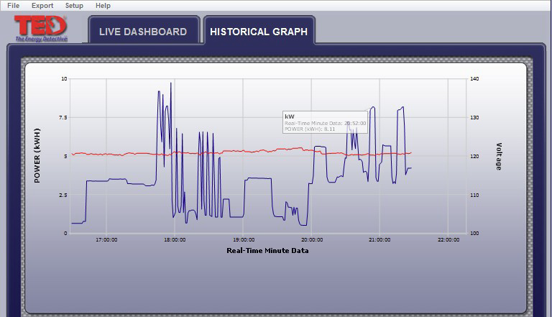
TED The Energy Detective

Slide 20
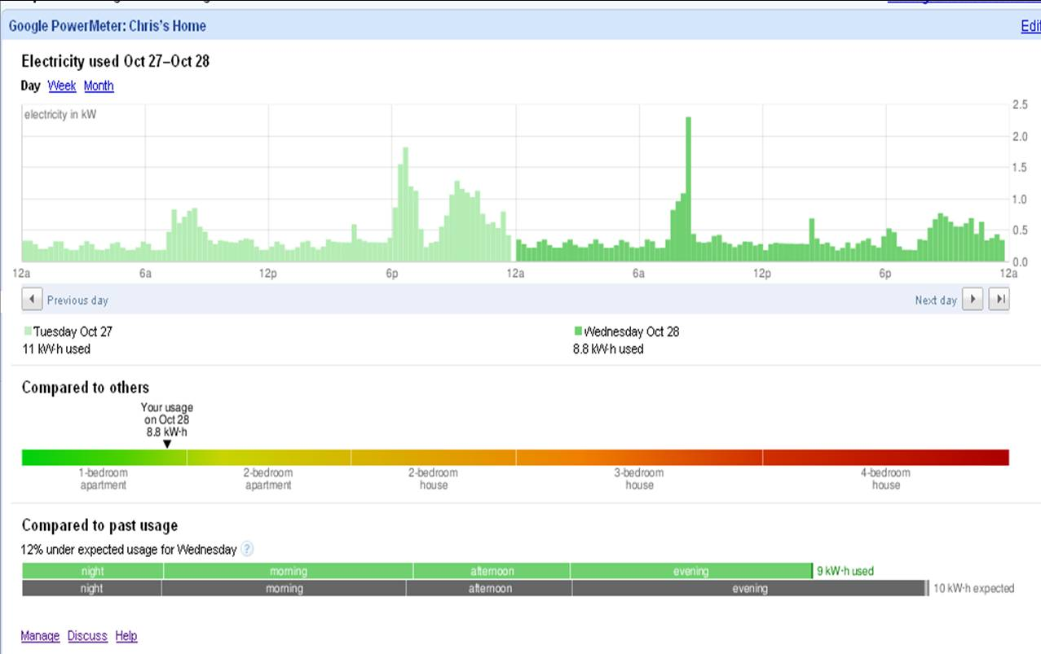
Google PowerMeter

Slide 21
Yello Strom

Slide 22
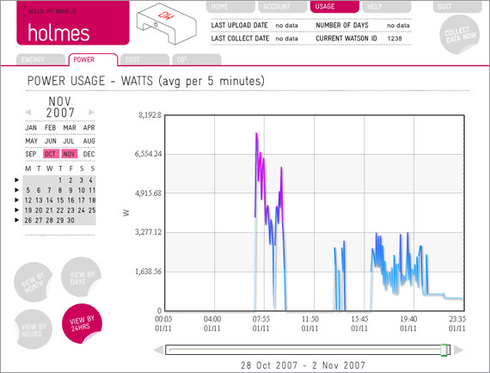
Wattson Holmes

Slide 23
Lucid Design Group

Slide 24
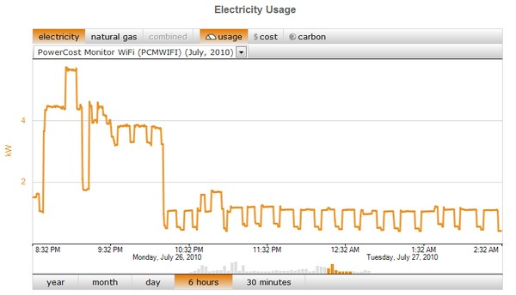
Microsoft Hohm

Slide 25
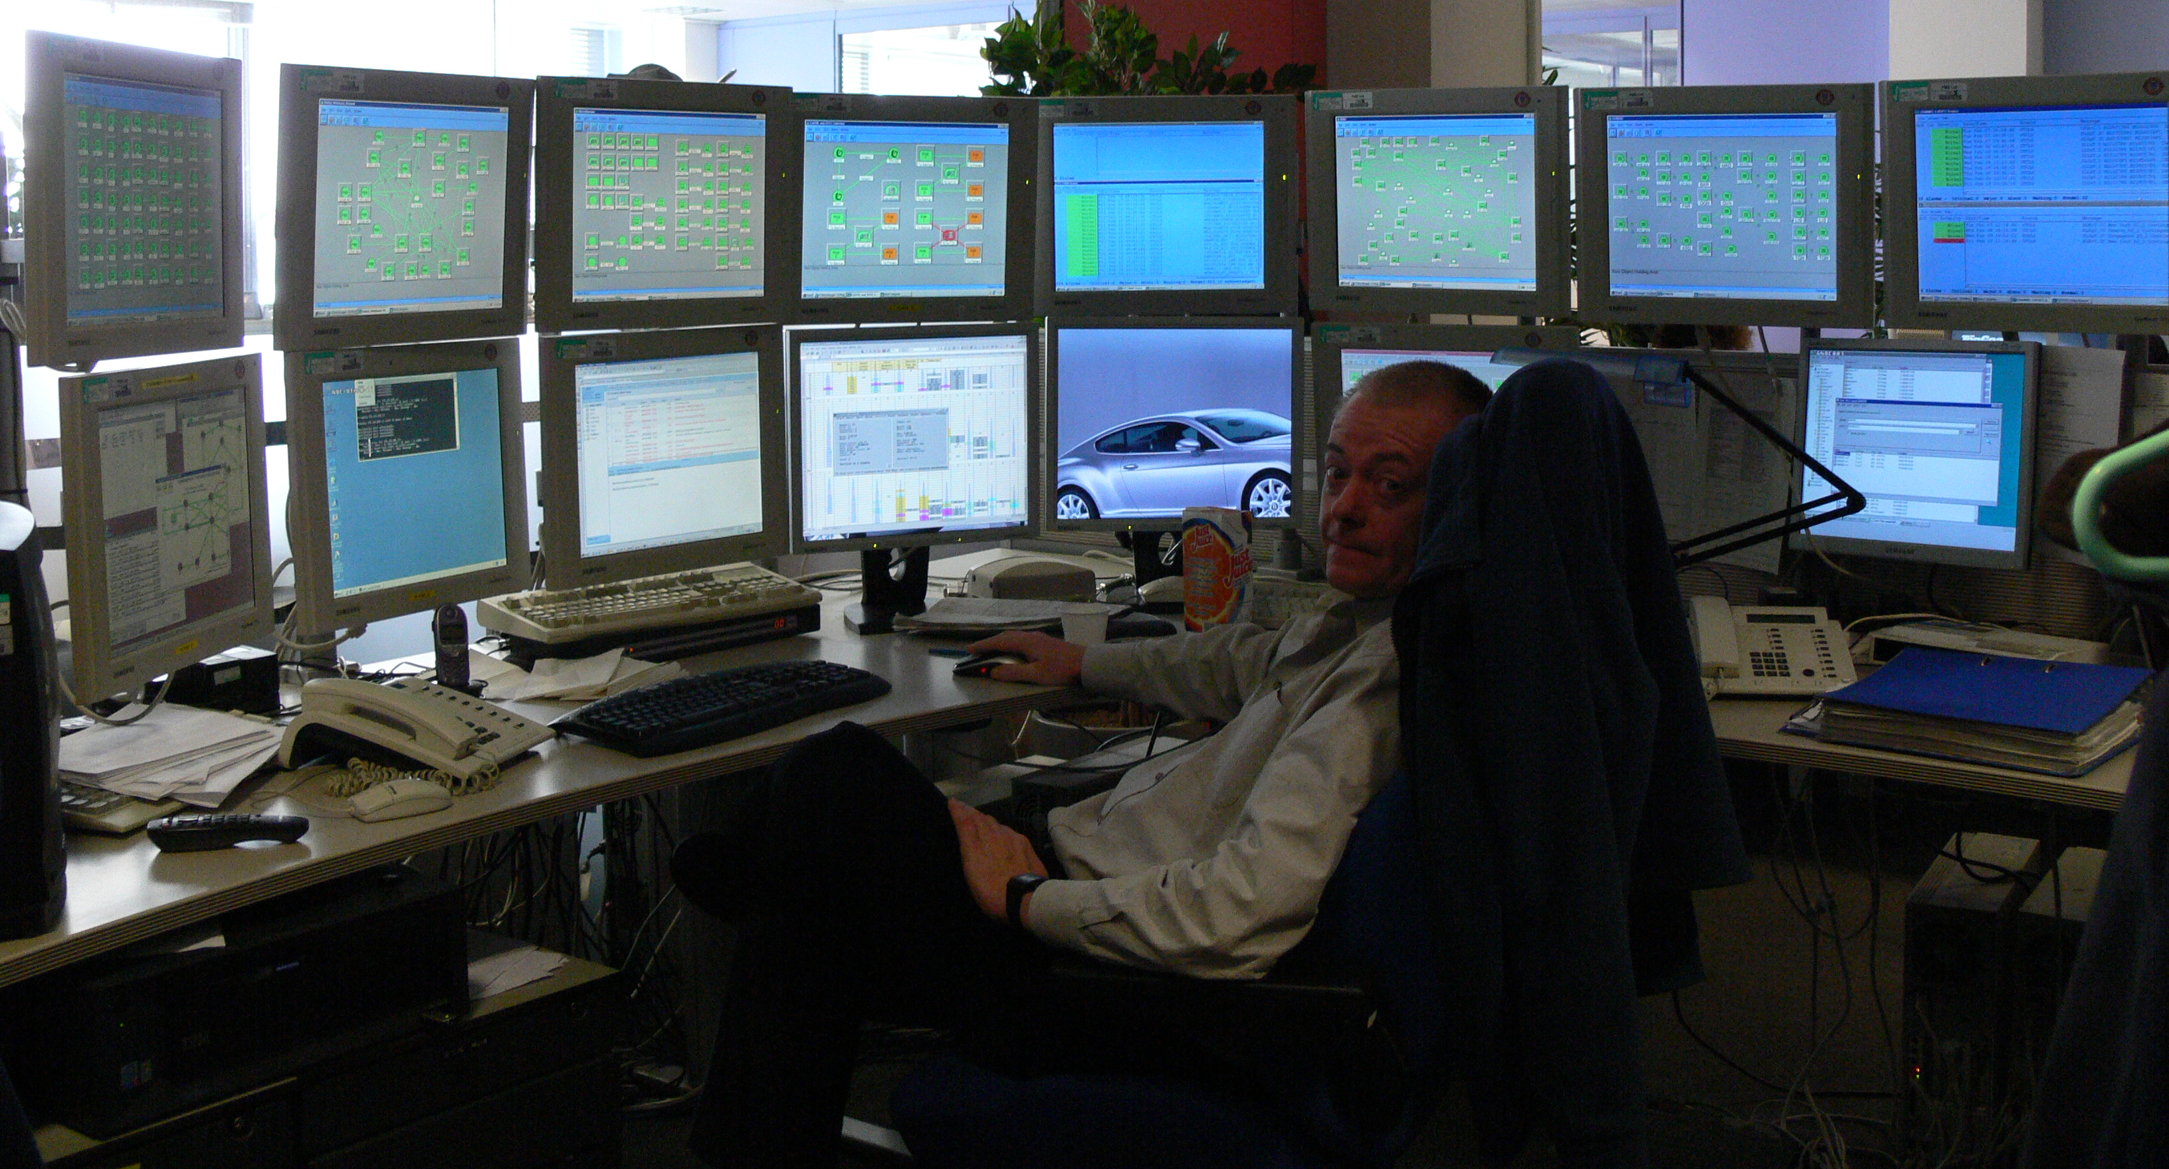
Notes:
Financial analyst

Slide 26
High cognitive burden on person. Why?
Notes:
Financial analyst

Slide 27
How much time per day do we expect people will spend exploring their consumption behaviors?

Slide 28
How much time per day do people spend exploring their finances?

Slide 29
financially prudent
8.4 hrs/mo → 16.8 min/day
less financially successful
4.6 hrs/mo → 9.2 min/day
me (grad student)
0.5 hrs/mo → 1 min/day

Slide 30
< 1 min

Slide 31
Line Graphs
How actionable is this information?

Slide 32
Notes:
The Doors were a successful rock band fronted by Jim Morrison

Slide 33
which door do i push, which door do i pull?

Slide 34
which door do i push, which door do i pull?

Slide 35
which door do i push, which door do i pull?
pull
push

Slide 36
which door do i push, which door do i pull?
Notes:
http://chriselyea.com/design-lessons-learned/badly-designed-doors/

Slide 37
Notes:
http://chriselyea.com/design-lessons-learned/badly-designed-doors/

Slide 38
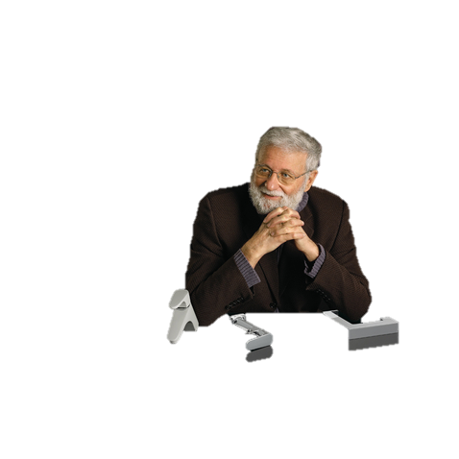
Norman door!
Notes:
http://chriselyea.com/design-lessons-learned/badly-designed-doors/

Slide 39
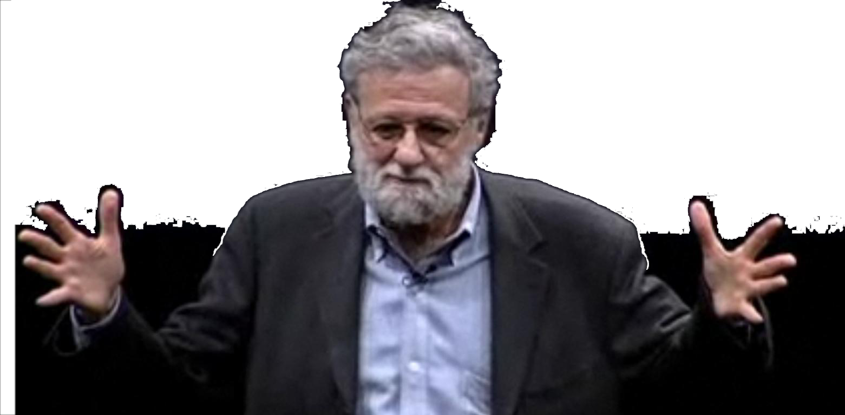
affordance refers to the perceived properties of a thing that determine just how that thing could possibly be used
vertical handle cues pull behavior
don norman
Notes:
Design of Everyday Things (also Psychology of Everyday Things)

Slide 40
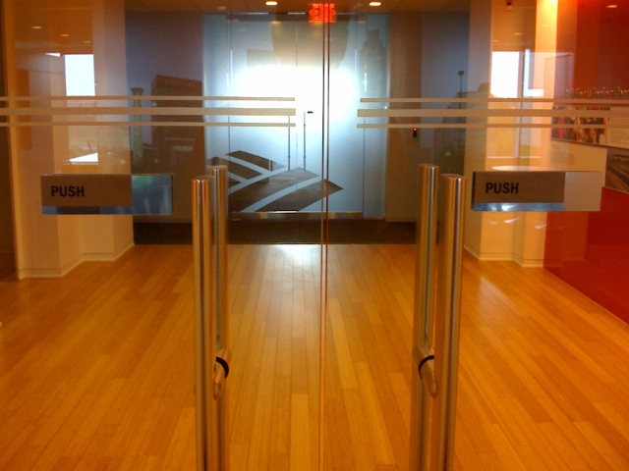
FAIL #1

Slide 41
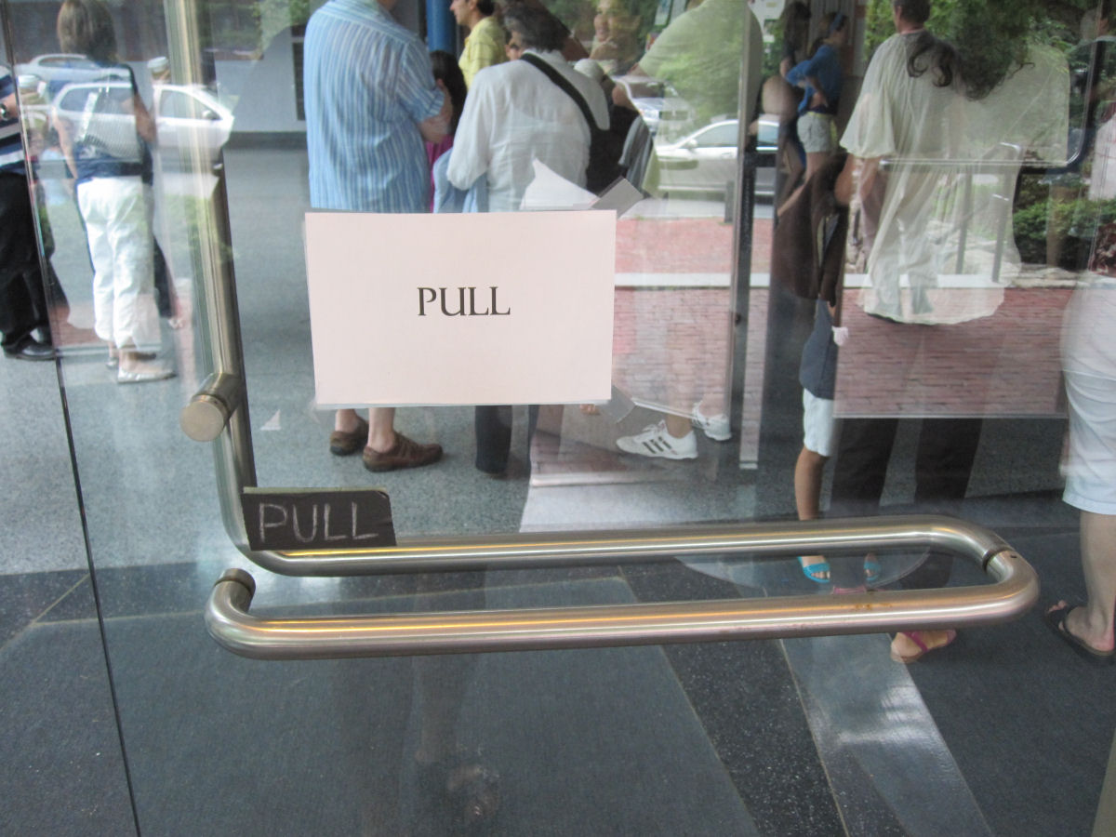
FAIL #2
Notes:
If you have to write an instruction manual on the door, it’s a design failure

Slide 42
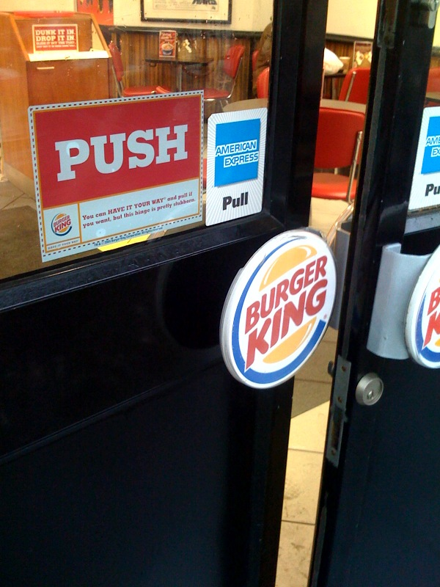
FAIL #3
FAIL #4

Slide 43
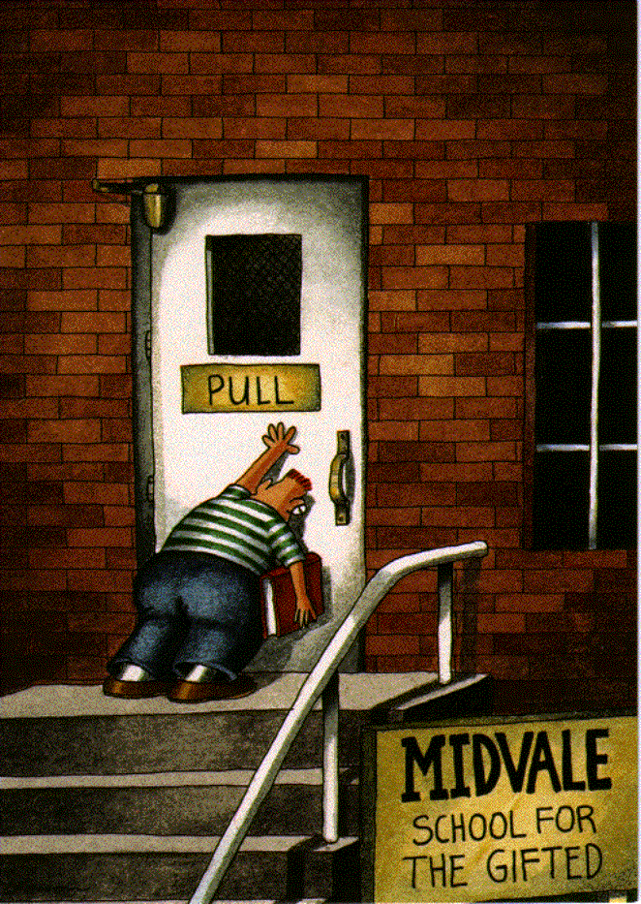

Slide 44
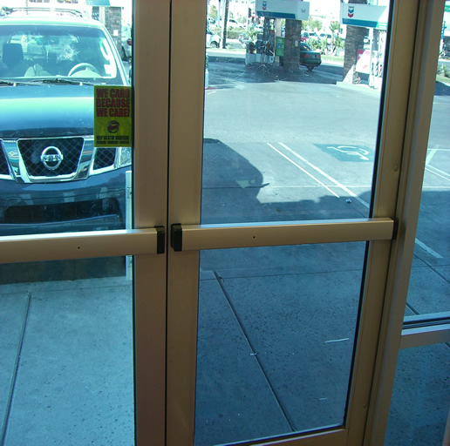
Notes:
These afford the pushing action so much they are called panic doors

Slide 45
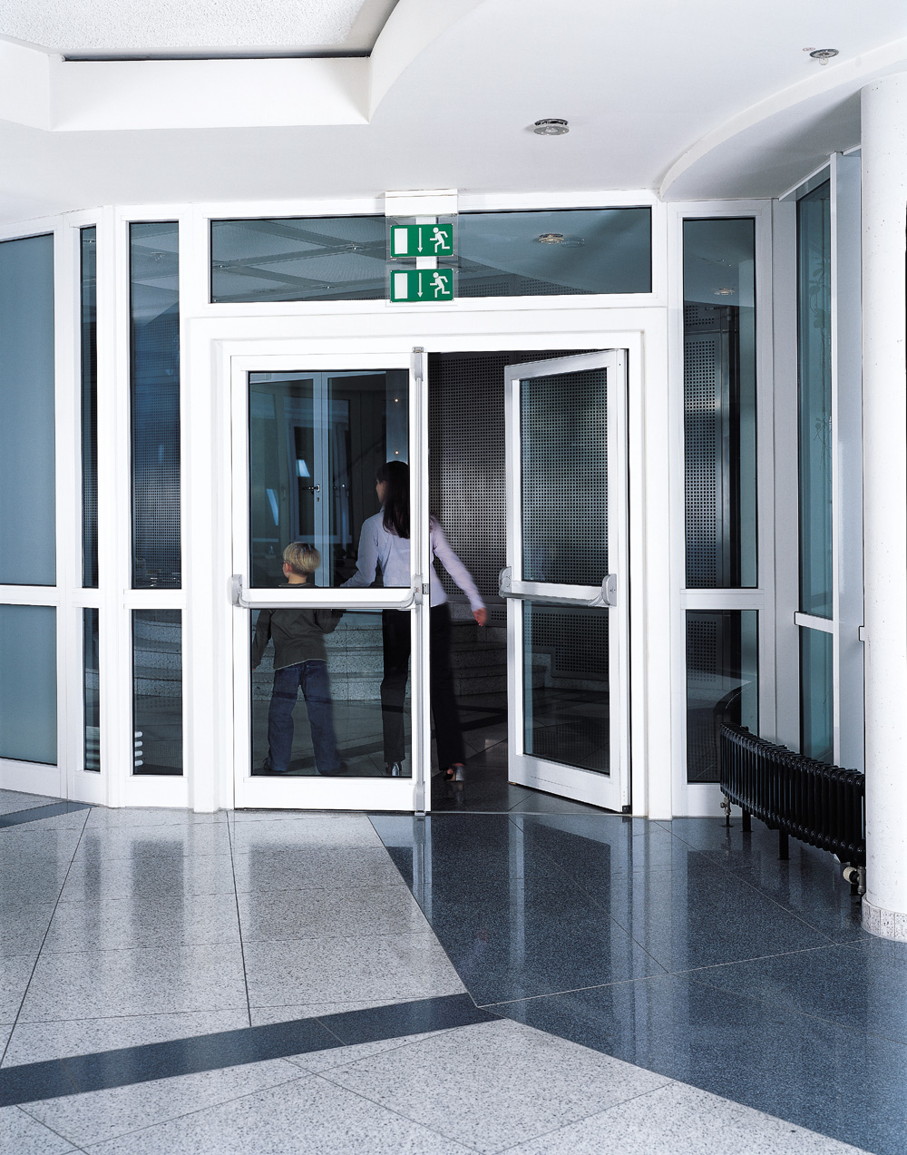

Slide 46
affordances affect our perception of use
can affordances change our behavior?

Slide 47
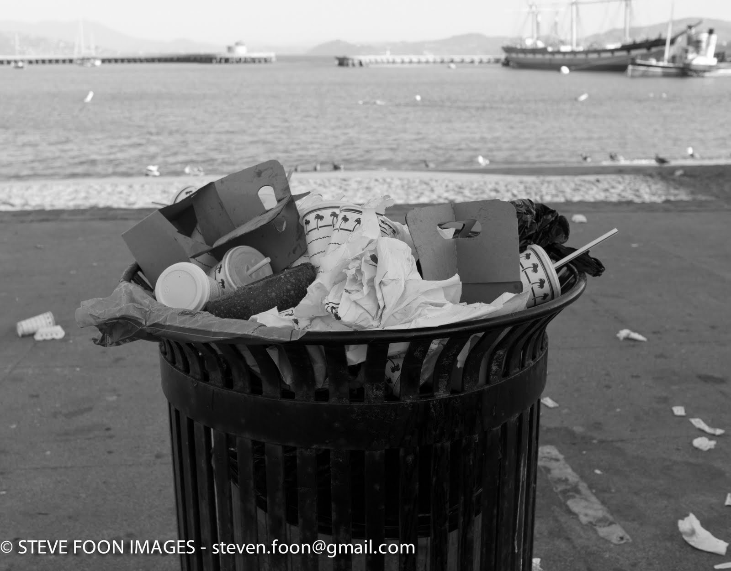
In-N-Out
Burger!

Slide 48
Battle of the Cans

Slide 49
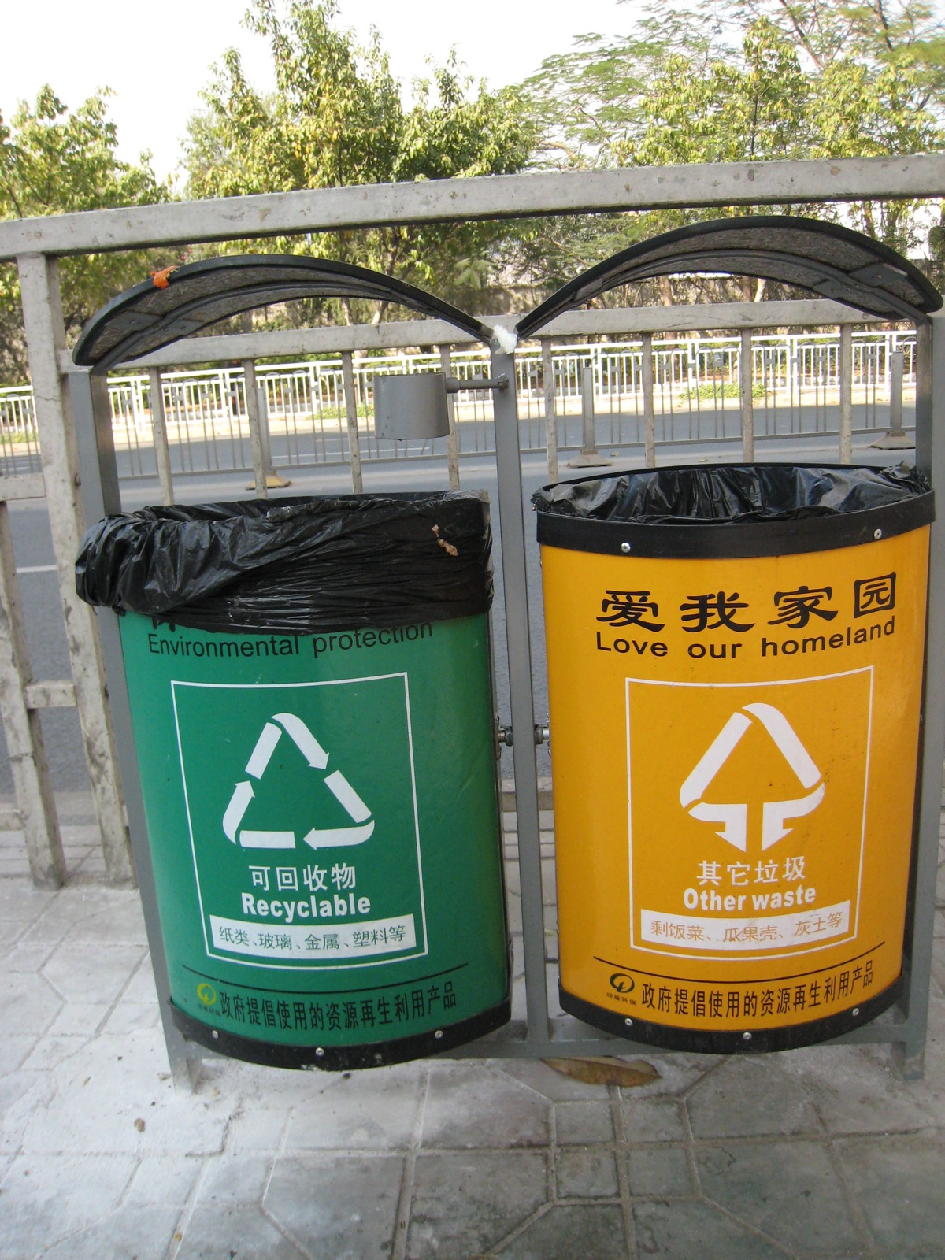

Slide 50
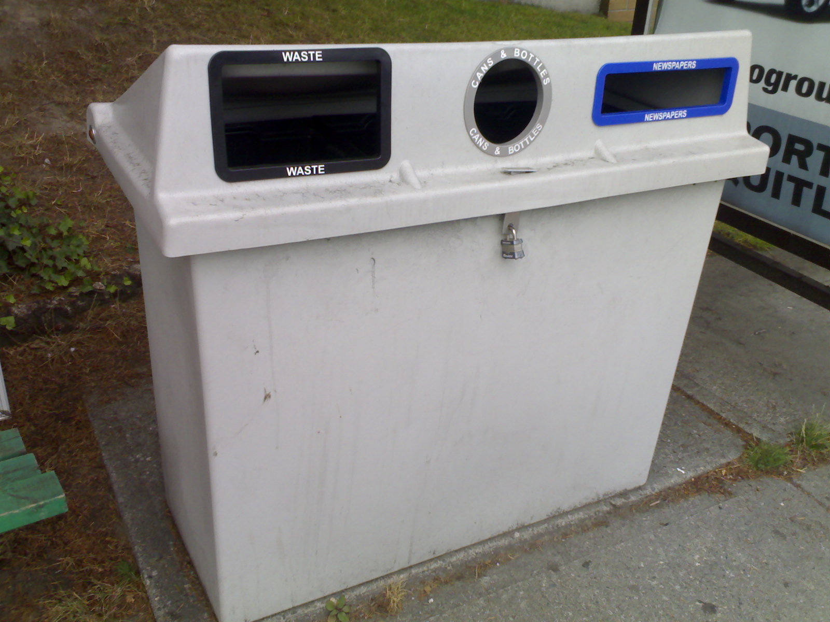

Slide 51
Battle of the Cans

Slide 52
Winner!
34% increase in recycling
Duffy, Environment and Behavior, 2010

Slide 53
Holes constrain behavior and also remind what is recyclable
Duffy, Environment and Behavior, 2010

Slide 54
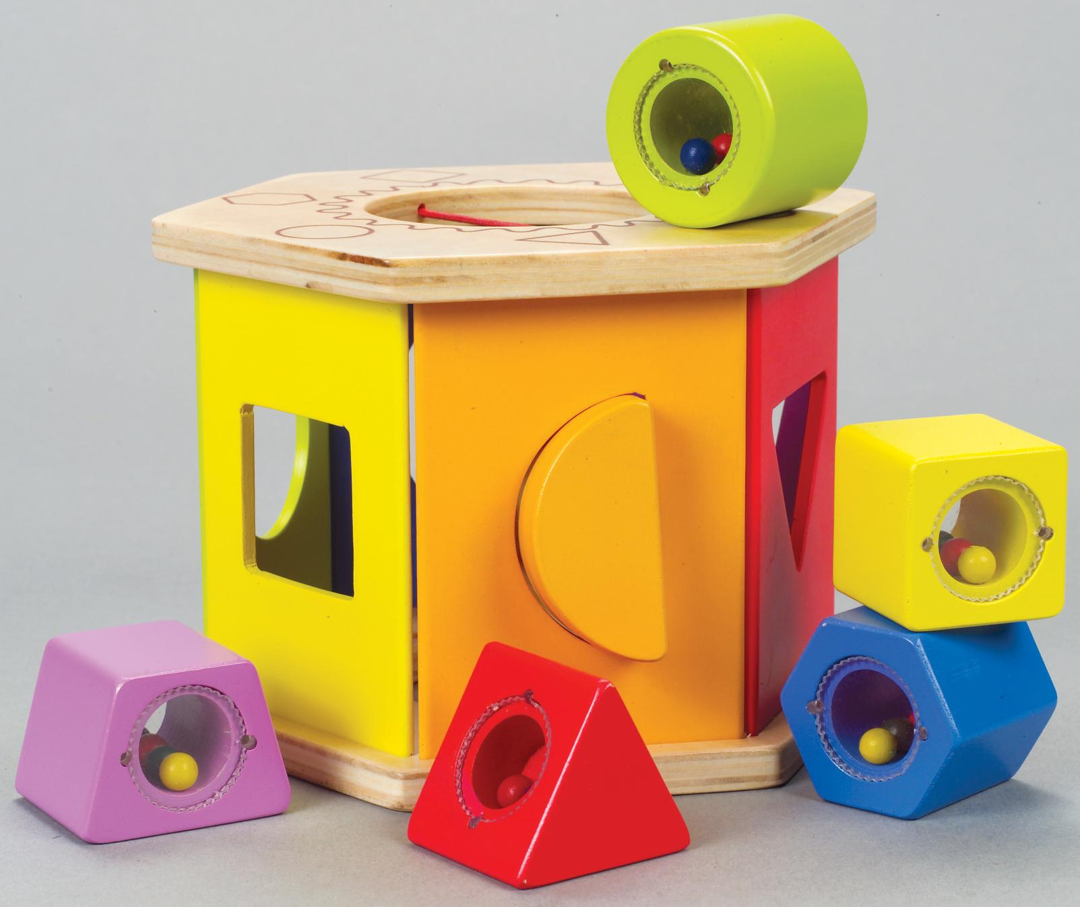

Slide 55
What
does this have to do with feedback?
Notes:
The problem is we are talking about the design of interfaces here to inform and motivate behavior.

Slide 56
Perceptual affordance refers to the perceived properties of a thing that determine how that thing is used
Flat textured surface affords
pushing!
Vertical handle affords pulling

Slide 57
Motivational affordance refers to the perceived properties of information that determine how that information is acted upon
Highly effective at stopping drivers
Notes:
Or information affordance
Or data affordance
Or effect affordance
Just made up motivational affordance but the idea is…

Slide 58
Motivational affordance refers to the perceived properties of information that determine how that information is acted upon
Information that affords an action
Highly effective at stopping drivers

Slide 59
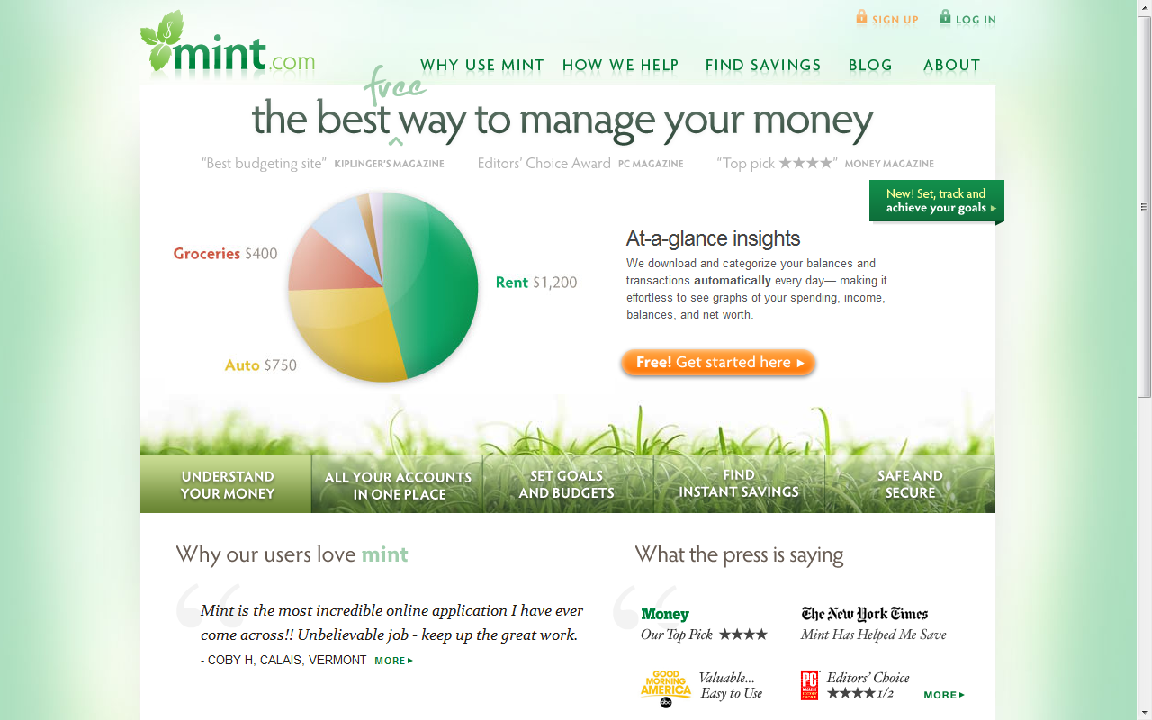
analytics engine for personal spending

Slide 60
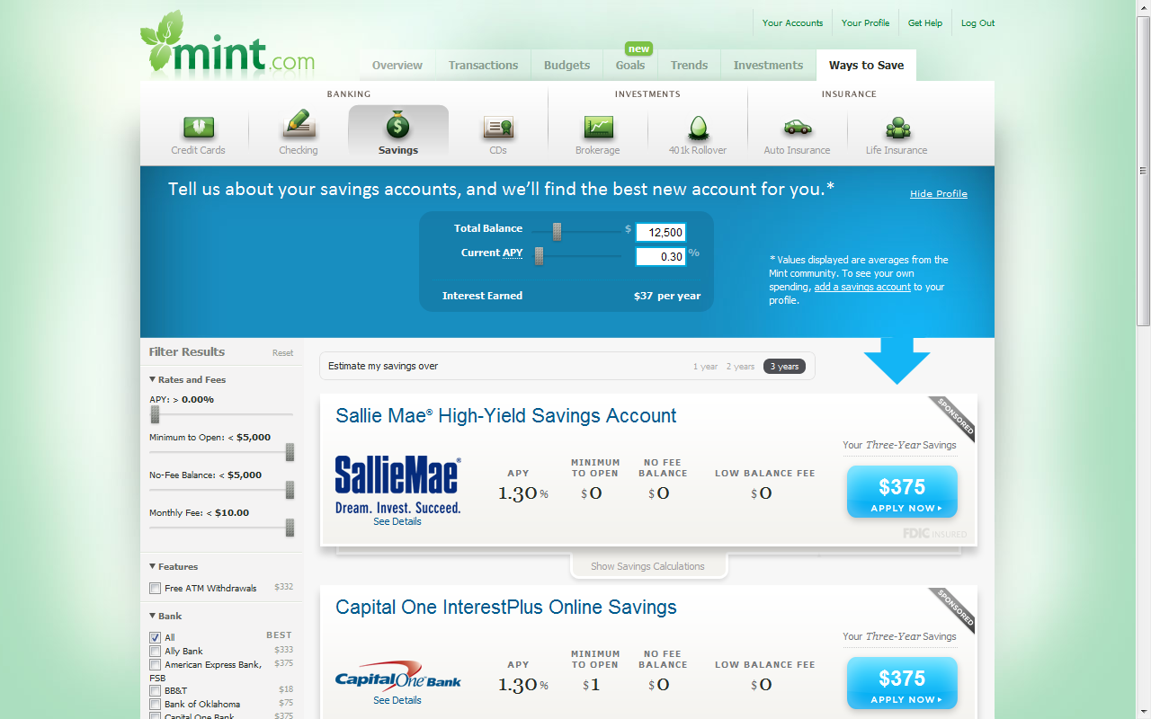

Slide 61
How much money do I spend per month on Starbucks?

Slide 62
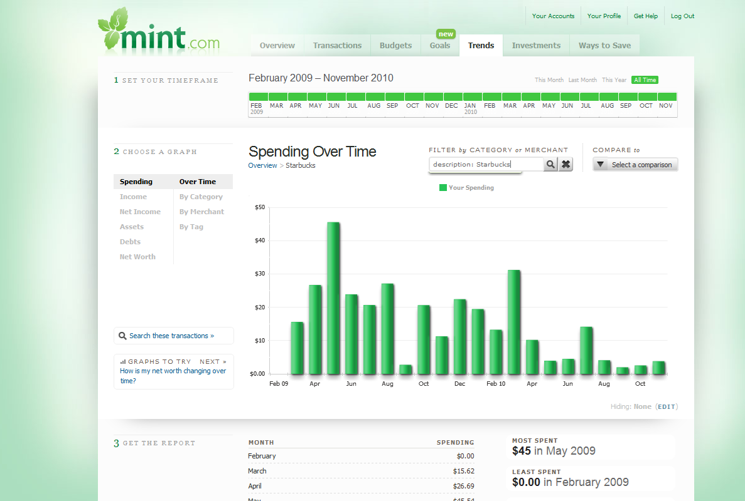
starbucks spending

Slide 63
This type of inquiry is not possible with current energy feedback systems; it needs to be.

Slide 64
Future
Notes:
Targets specific behaviors
Highly personalized
Disaggregated

Slide 65
Feedback system provides dissaggregated feedback

Slide 66
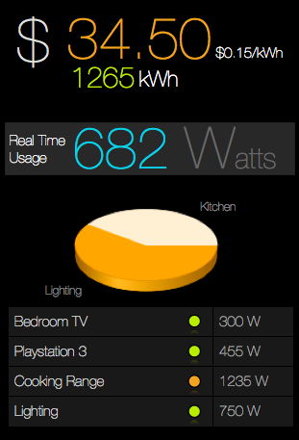
itemized energy feedback
image credit: sidhant gupta

Slide 67
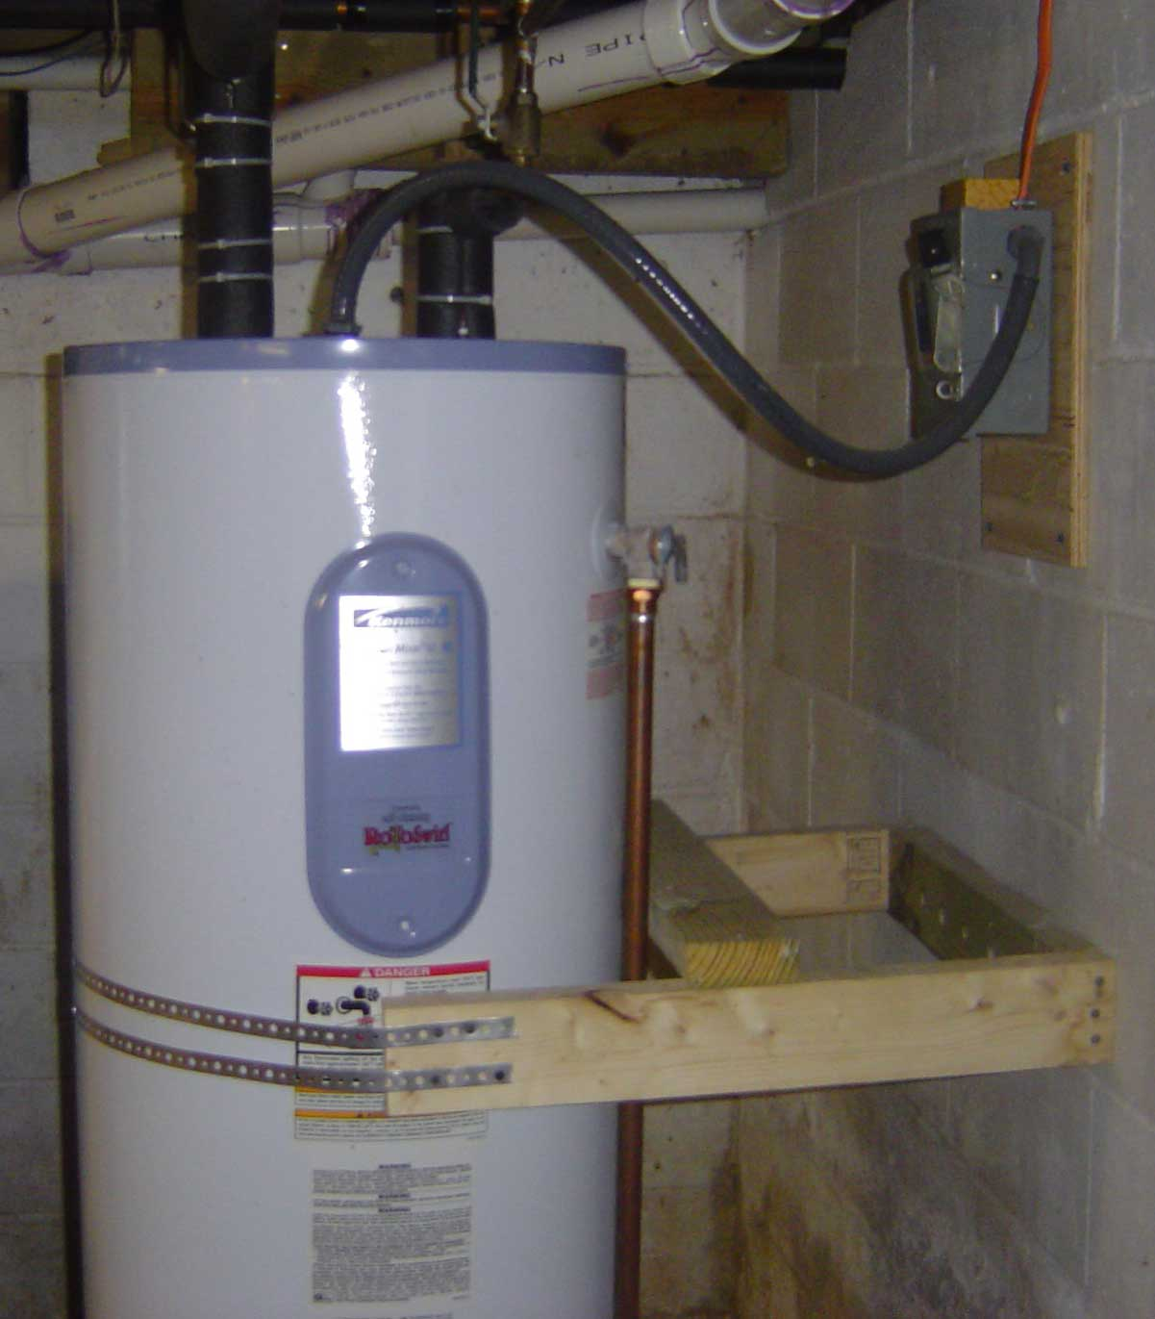
Hot Water Heater Consumes 19% of Your House’s Energy

Slide 68
Feedback system suggests lowest effort actions for greatest efficiency gain

Slide 69
Replace Your Hot Water Heater with a Tankless System and Save $250/yr

Slide 70
You are losing $250/yr by using this water heater
Notes:
Framing bias

Slide 71
< 1 min

Slide 72
http://bit.ly/jonuw
See also: CHI 2010 talk

Slide 73
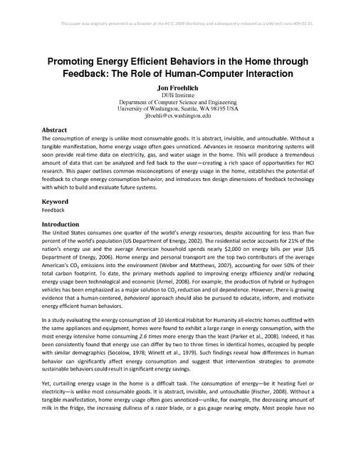
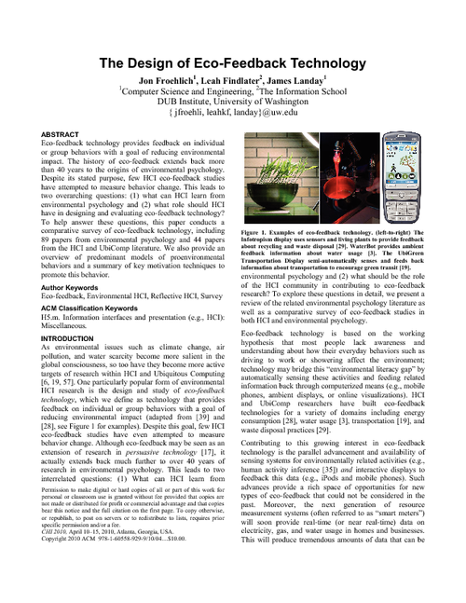
http://bit.ly/jonuw
See also: these two papers
Best
Paper!

Slide 74
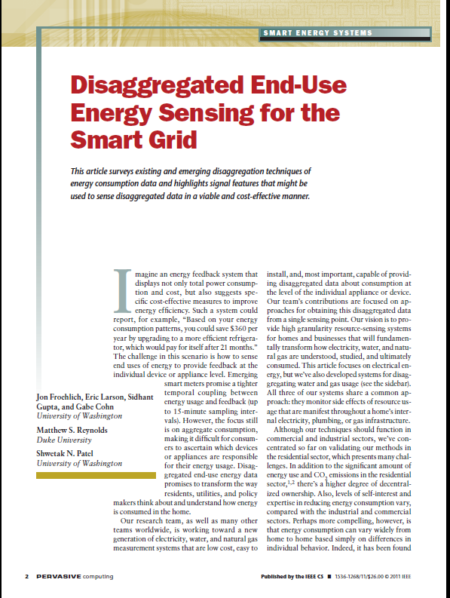
http://bit.ly/jonuw
fresh off the presses:

Slide 75
photo credits
first/last slide: flickr code poet
slide 6: trinity university, class of 1976
slide 11: monctonblogger
slide 18: remarkably domestic
slide 25: flickr grant mitchell
slide 27,28,30,71: flickr tonyvc
slide 47: steve foon images
slide 48, 51: loston wallace
slide 49,51: flickr conbon33
slide 50,51, 52, 53: flickr sillgywailo
Notes:
I take visuals very seriously (as one can probably tell from my slides). And, with that, I try my best to credit my sources. Thanks particularly to those flickr users who share their photos under creative commons.

Slide 76
Moving Beyond Line Graphs
twitter: @jonfroehlich
design:
ubicomp lab
use:
build:
university of washington
sustainability research
university of washington

