Slide 1
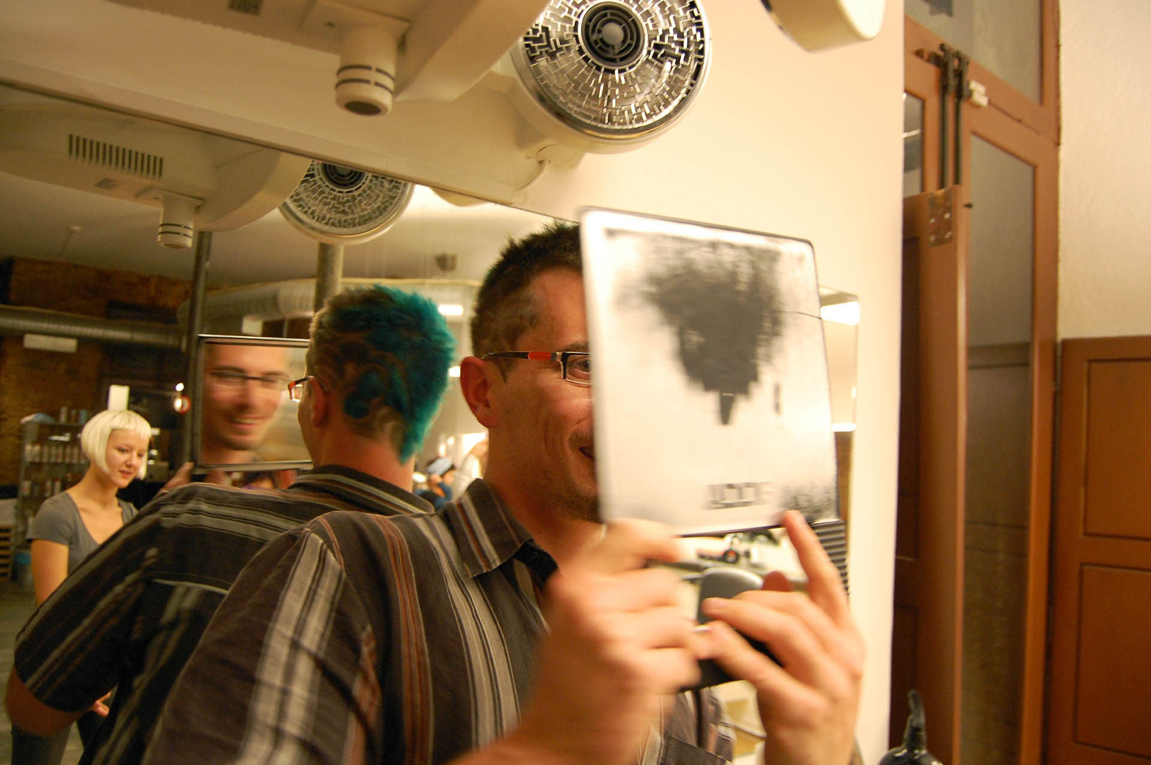
mirrors tell you one thing
data can tell you another
for mobile persuasion
jonfroehlich@uw.edu
phd candidate in computer science
university of washington
aug 2, 2010
design:
ubicomp lab
use:
build:
university of washington
sustainability research
university of washington
Notes:
Picture modified from: http://hairport.files.wordpress.com/2008/11/z_finish_mirror.jpg

Slide 2
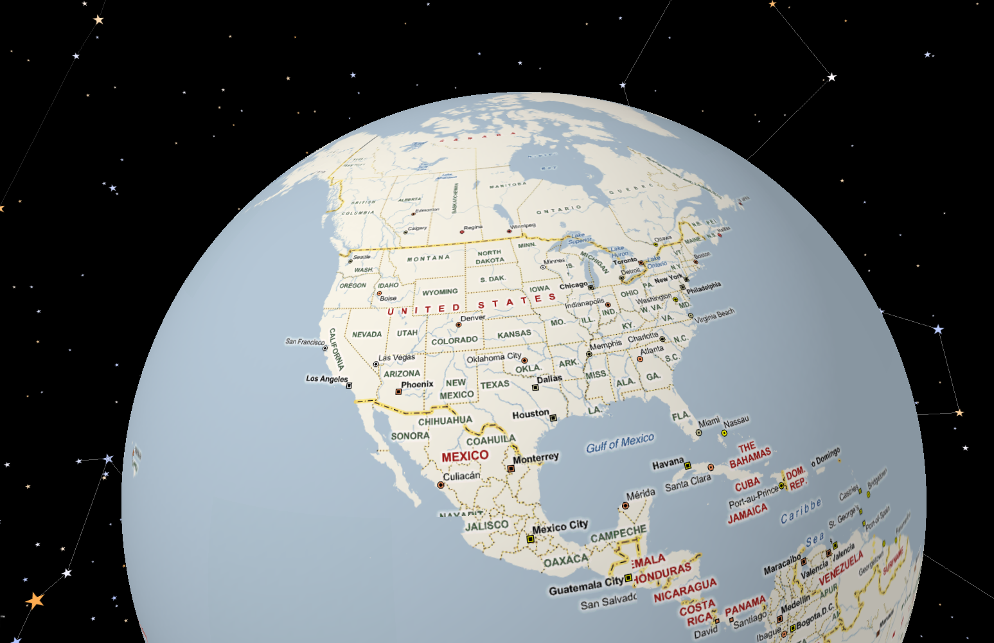
seattle, wa
minneapolis, mn
portland, or
ames, ia
orange county, ca

Slide 3
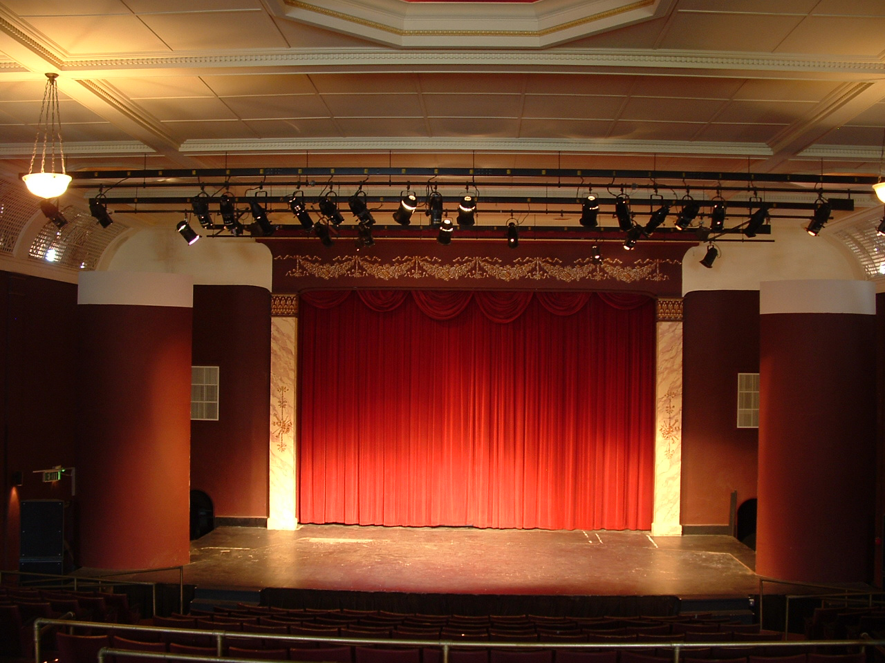

Slide 4
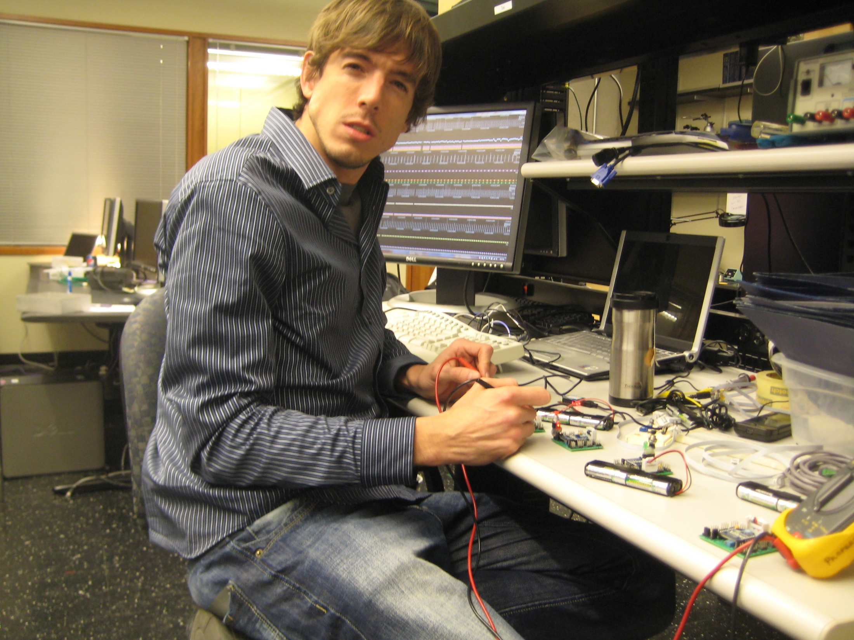

Slide 6
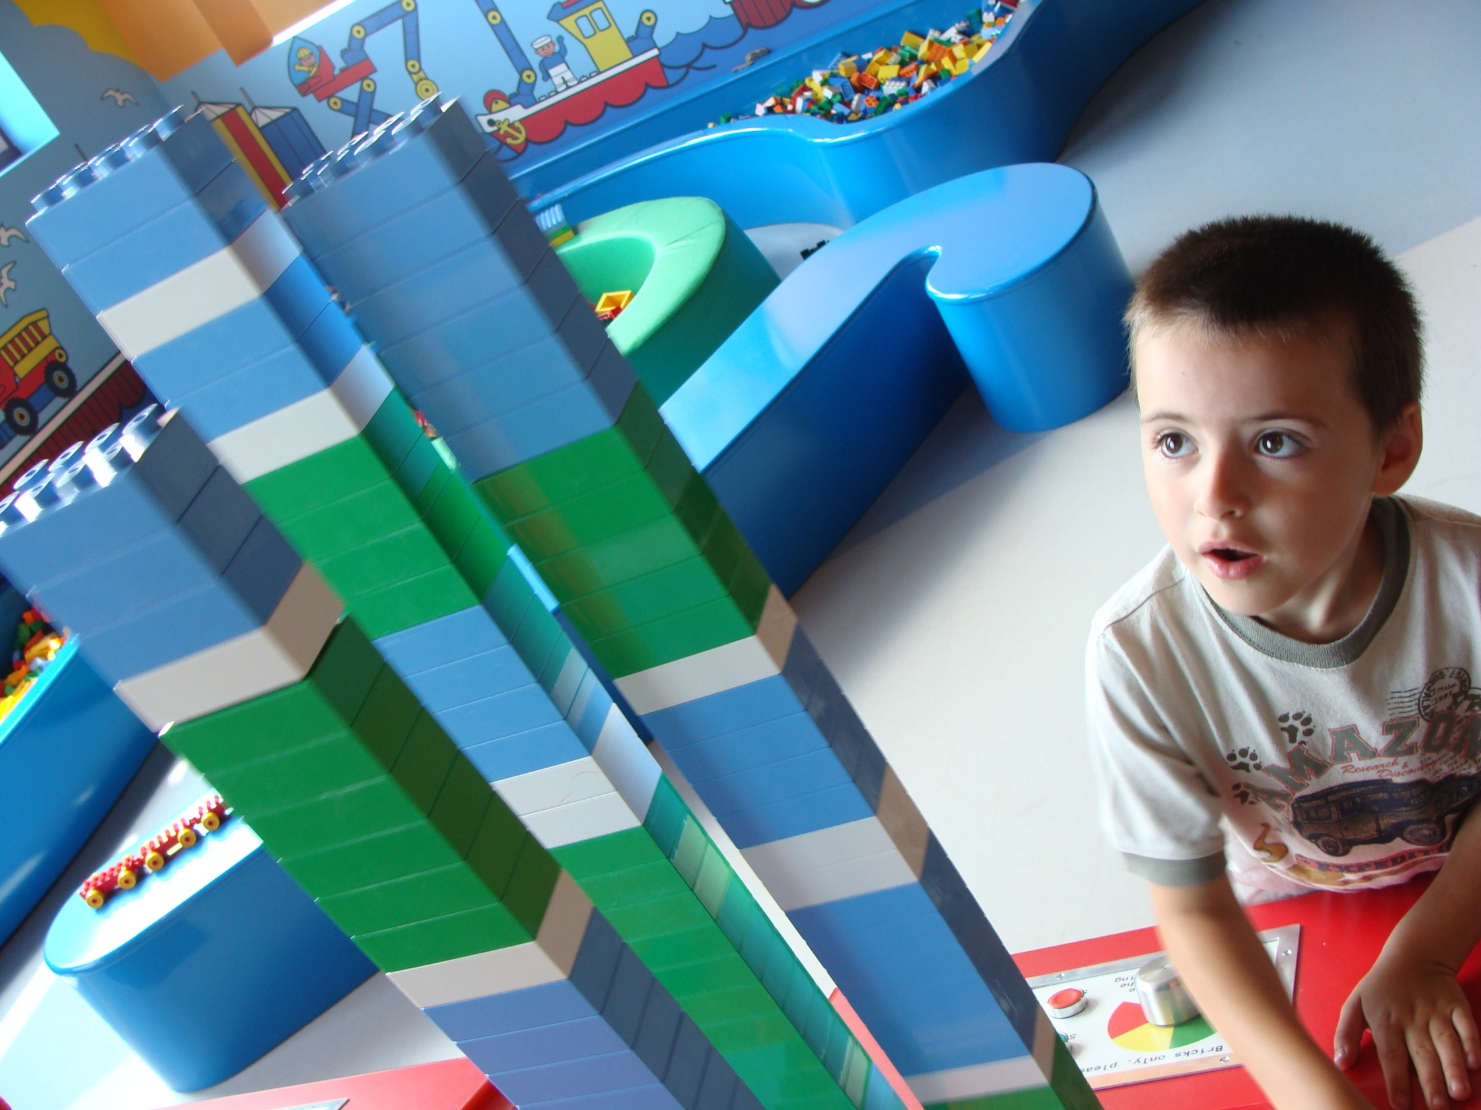

Slide 7
mirrors tell you one thing
data can tell you another
for mobile persuasion
design:
ubicomp lab
use:
build:
university of washington
sustainability research
university of washington
Notes:
Picture modified from: http://hairport.files.wordpress.com/2008/11/z_finish_mirror.jpg

Slide 8
reflections
Notes:
What is strange about this picture?

Slide 9
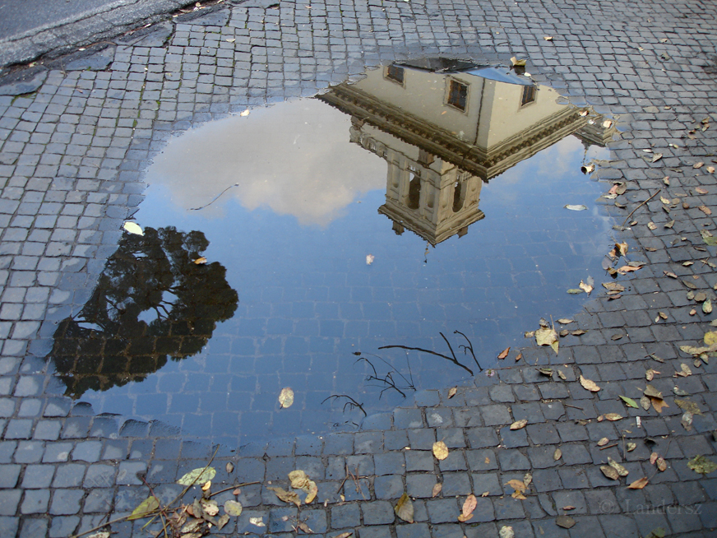
see the world differently
Notes:
Reflections help us look differently at the world

Slide 10
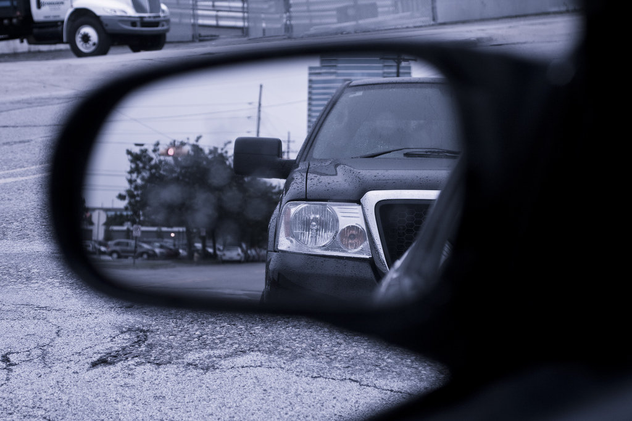
see things we cannot otherwise see
Notes:
Reflections help us see things that we can’t easily see

Slide 11
help us practice
Notes:
Reflections help us practice

Slide 12
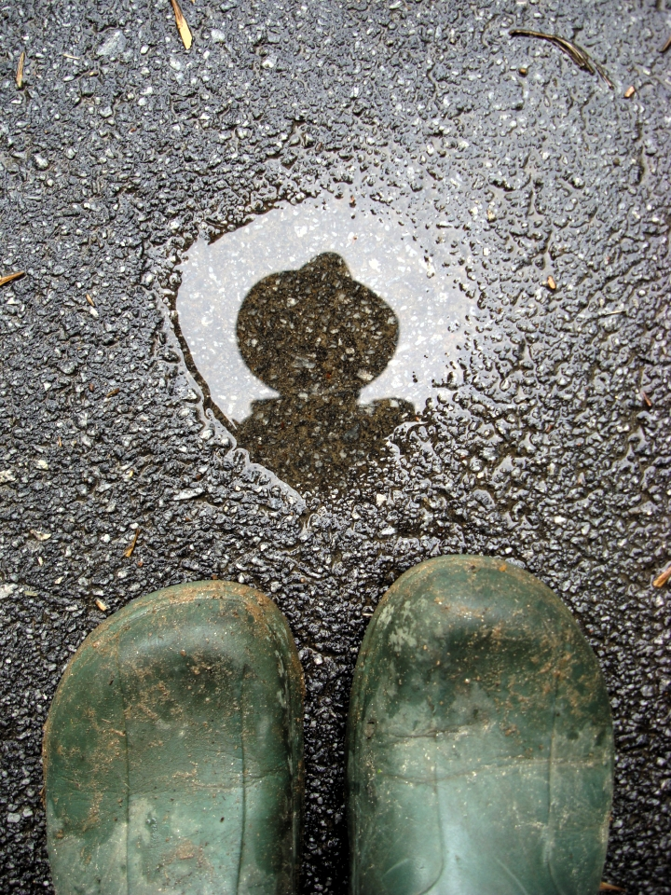
see ourselves differently
Notes:
Reflections help us see ourselves in a different light

Slide 13
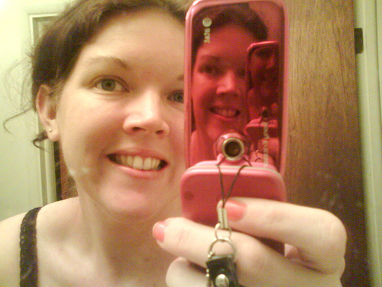
new reflections of self with
technology
our behaviors
our routines
our past actions
our social connections
new insights

Slide 14
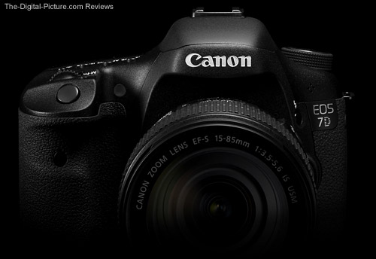
example
a simple
objective vs. subjective self

Slide 16
thanks, great clips!

Slide 17
how do you react to this feedback? can we sense changes?
you
sensing
feedback
how can we create sensors to sense and infer your behaviors?
how do we present this data back to you? what medium and interface is most effective?

Slide 18
human-computer interaction
you
sensing
feedback
computer science

Slide 19
why?
1. i want to make the world better
2. now is the time…
Notes:
A few reasons:
Computing technology has progressed to the point where really interesting sensing and feedback technologies are possible
Sensing + Feedback is a powerful combination that, I believe, has the potential to positively change people’s lives

Slide 20
running
lester et al., ijcai 2005
choudury et al., ieee pervasive 2008

Slide 21
walking
lester et al., ijcai 2005
choudury et al., ieee pervasive 2008

Slide 22
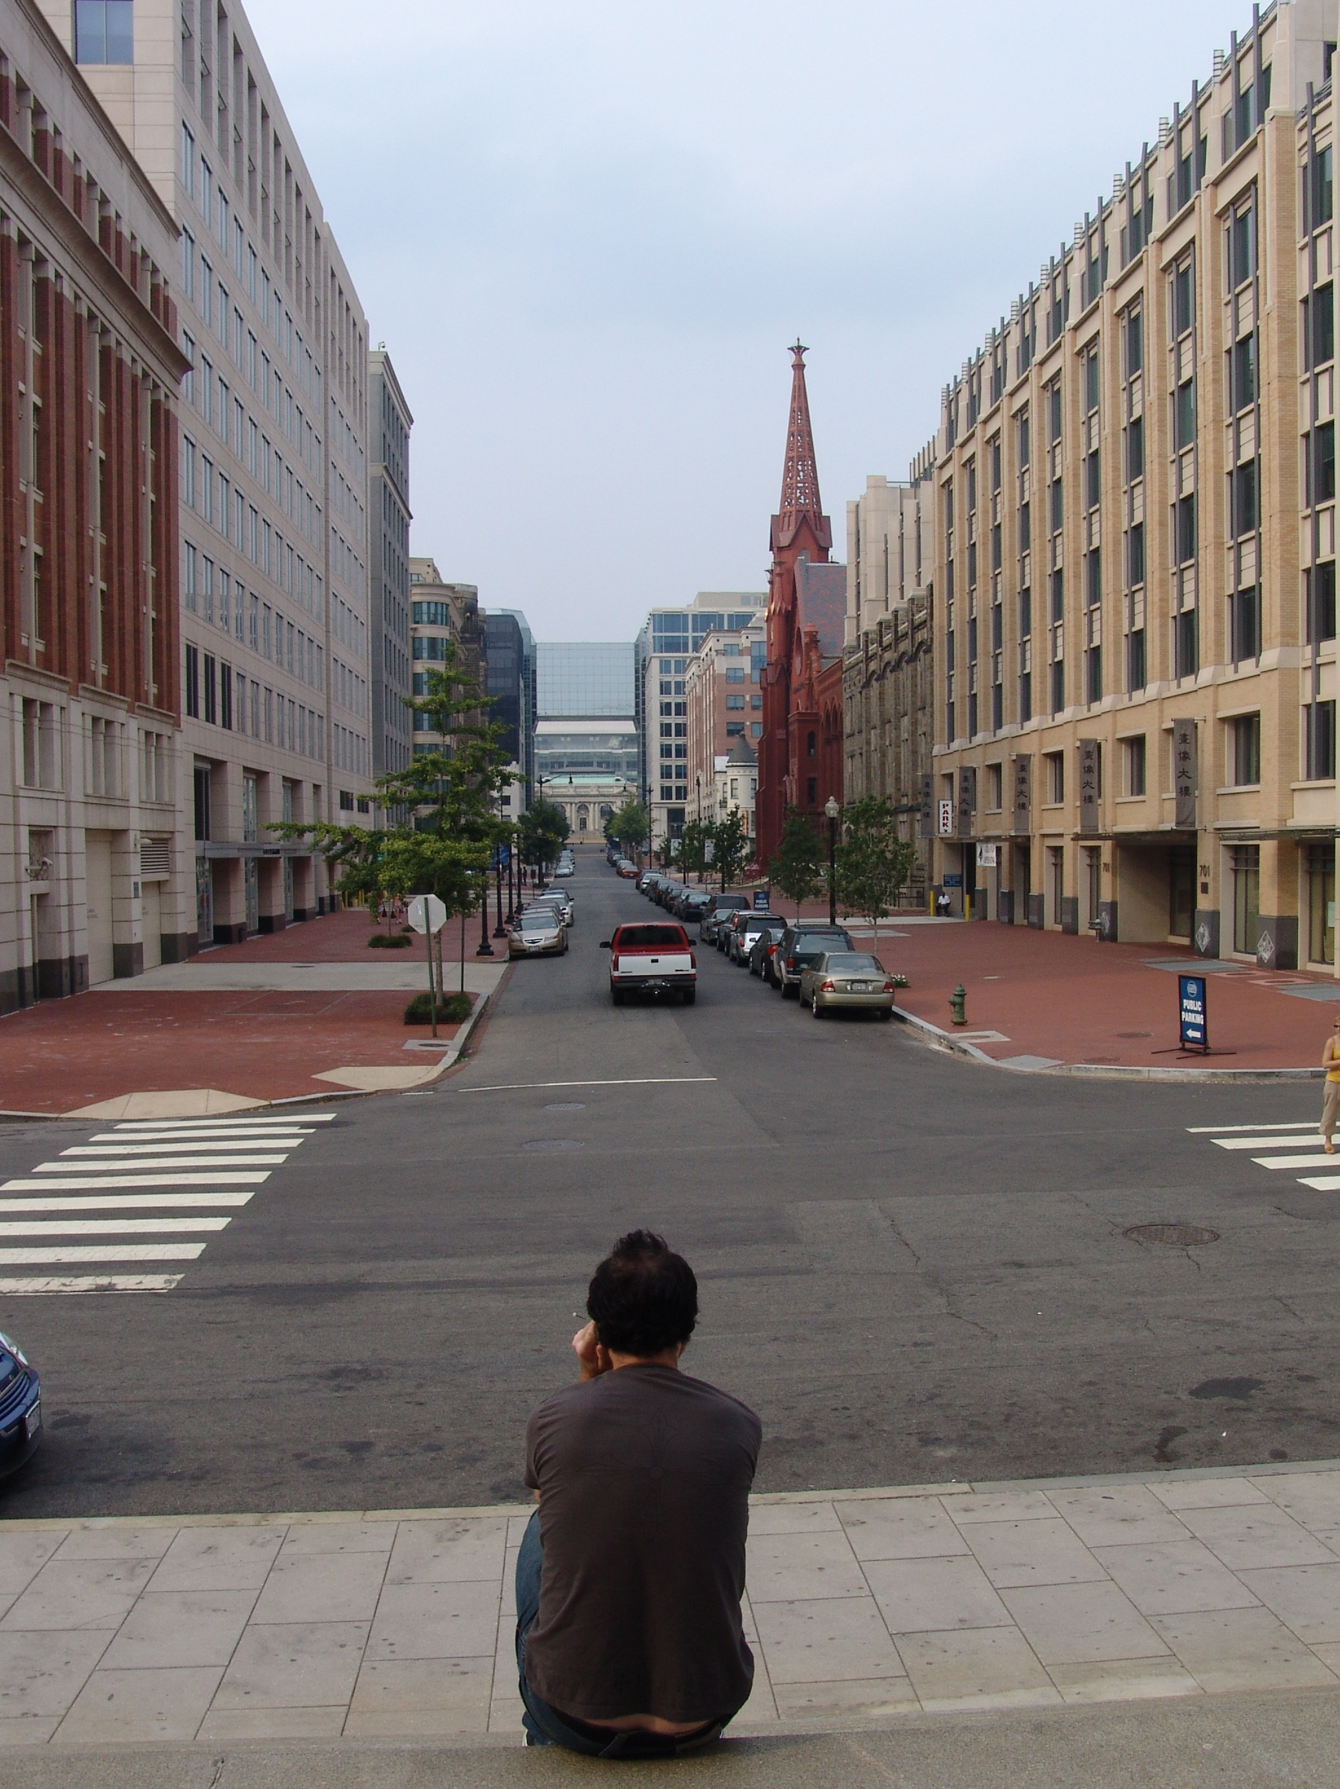
sitting
lester et al., ijcai 2005
choudury et al., ieee pervasive 2008

Slide 23
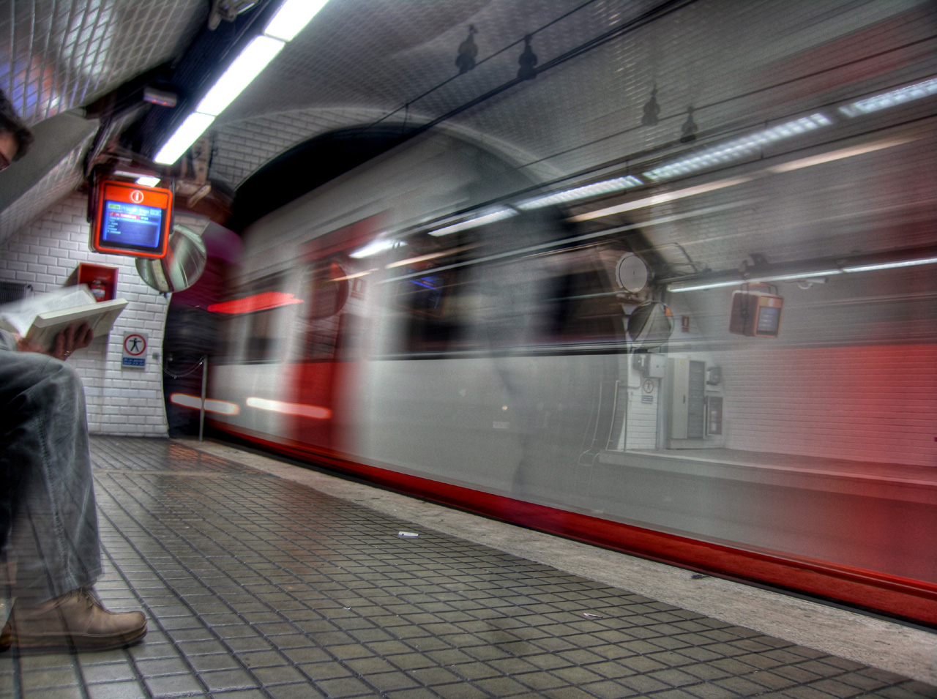
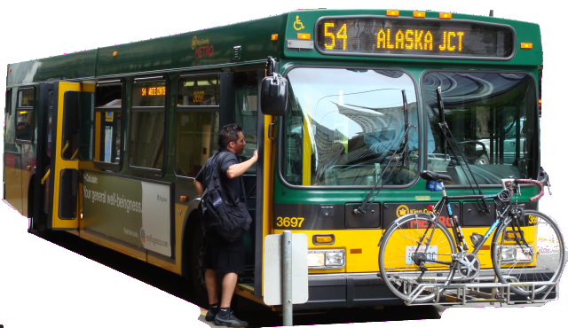
transit modes
patterson et al., ubicomp 2003
zheng et al., ubicomp 2008
reddy et al., sensor networks2009

Slide 24
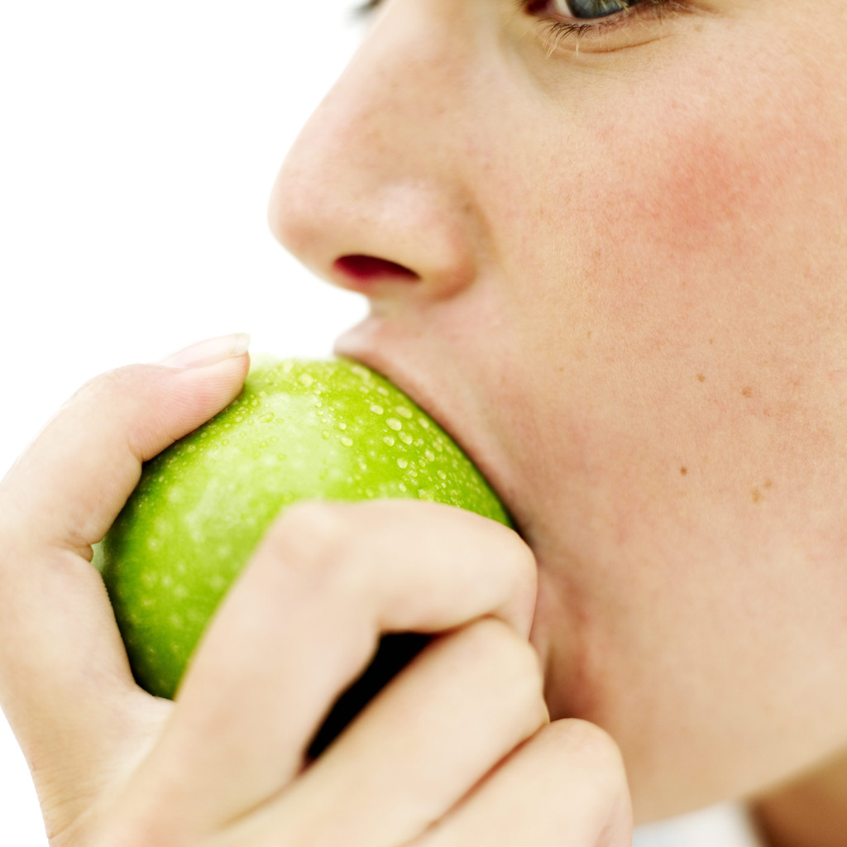
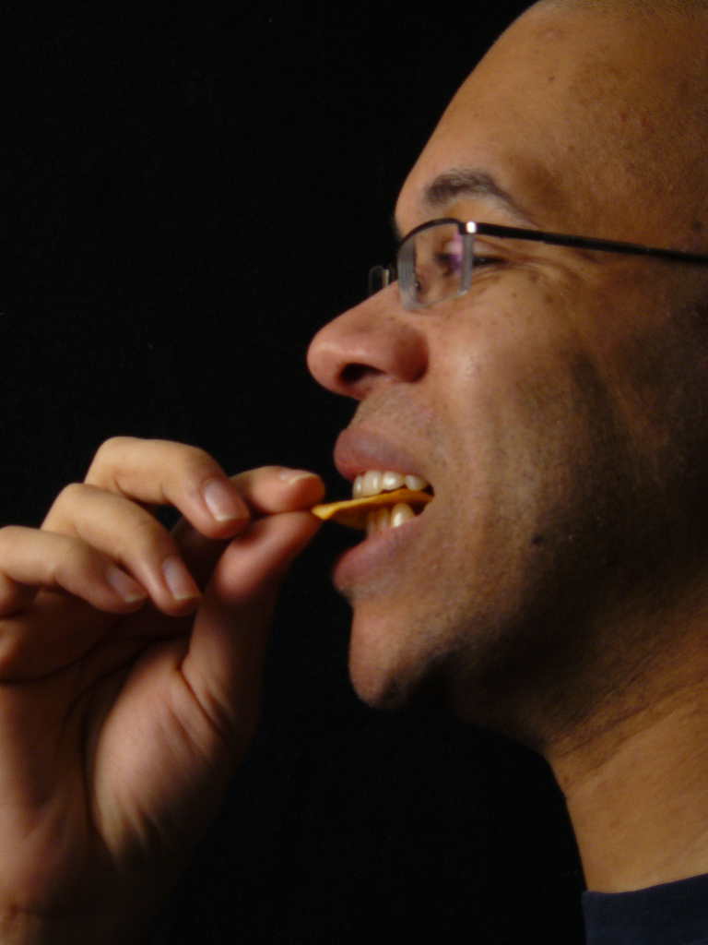
eating
eating
jawbone microphone
microphone in ear detects when a person is eating with 99% accuracy
amft et al., ubicomp 2007
cheng et al., pervasive 2010
Notes:
The sounds are acquired with a microphone located inside
the ear canal. This is an unobtrusive location widely accepted in
other applications (hearing aids, headsets).
To validate our method we present experimental results containing 3500 seconds of chewing data
from four subjects on four different food types typically found in a meal.
Up to 99% accuracy is achieved on eating recognition and between 80%
to 100% on food type classification.

Slide 25
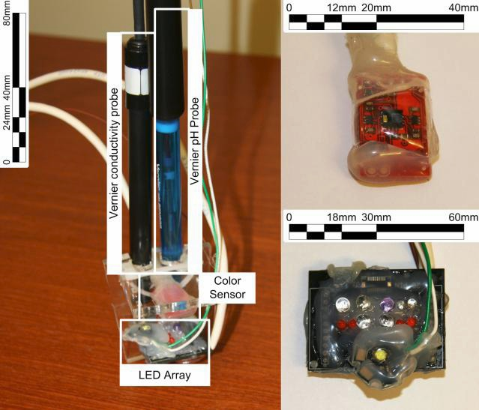
identifying fluids
instrumented cup
79% classification accuracy
68 different fluids including sodas, juices, beers, wines
lester et al., pervasive health 2010
Notes:
Sensing system need not be on phone; can also be communicated via the cloud.
System used optical, ion selective electrical pH, and conductivity sensors in order to sense and classify liquid in a cup in a practical way.
Feedback system can still be phone.
Drinks make up a surprisingly large portion of daily caloric intake with some research suggesting that 21% of a person’s daily caloric intake comes from beverages (458 calories) [5]. These tend to be ‘optional’ calories, not consumed exclusively to satiate hunger, and thus potentially easier to eliminate or replace with healthier alternatives
Automatic Classification of Daily Fluid Intake by Jonathan Lester, Desney Tan, Shwetak Patel, and A.J. Brush 22 March 2010; IEEE Pervasive Health 2010 Proceedings

Slide 26
coughing
liu et al., in submission
Notes:
Coughing is the most frequently cited symptom when people seek medical advice in the united states…

Slide 27
ok, we have all this data… now what?

Slide 28
coughing
liu et al., in submission
Notes:
Coughing is the most frequently cited symptom when people seek medical advice in the united states…

Slide 29
automatically detecting coughs with a commodity mobile phone
microphone
liu et al., in submission
Notes:
In our lab, we’ve been exploring the use of commodity mobile phones to automatically detect and classify when a person coughs.
Sensing system doesn’t have to be complicated; it’s the software algorithms that are smart.

Slide 30
collecting and analyzing the cough dataset
17 participants
72 hours of naturalistic audio recording
6 graduate students annotated recordings
2542 coughs labeled by annotators
84.4% of coughs were correctly classified
0.7% false positive rate (3.3/hr)
liu et al., in submission
Notes:
Ratio of about 4 to 1 annotation hours to recording hours

Slide 31
number of coughs
measured vs. self-report
Notes:
The participants were informed to monitor….

Slide 32
inaccuracy of self-report
diff: mean (22.8/hr), std (33/hr)
number of coughs
measured vs. self-report
diff: mean (22.8/hr), std (33/hr)
Notes:
similar findings for people estimating their caloric intake and the amount of exercise they get per week.
If you can’t measure it, you can’t change it.
http://www.adajournal.org/article/S0002-8223(02)90316-0/abstract
http://content.nejm.org/cgi/content/abstract/327/27/1893
http://www.ncbi.nlm.nih.gov/pubmed/10490791?ordinalpos=6&itool=EntrezSystem2.PEntrez.Pubmed.Pubmed_ResultsPanel.Pubmed_DefaultReportPanel.Pubmed_RVDocSum

Slide 33
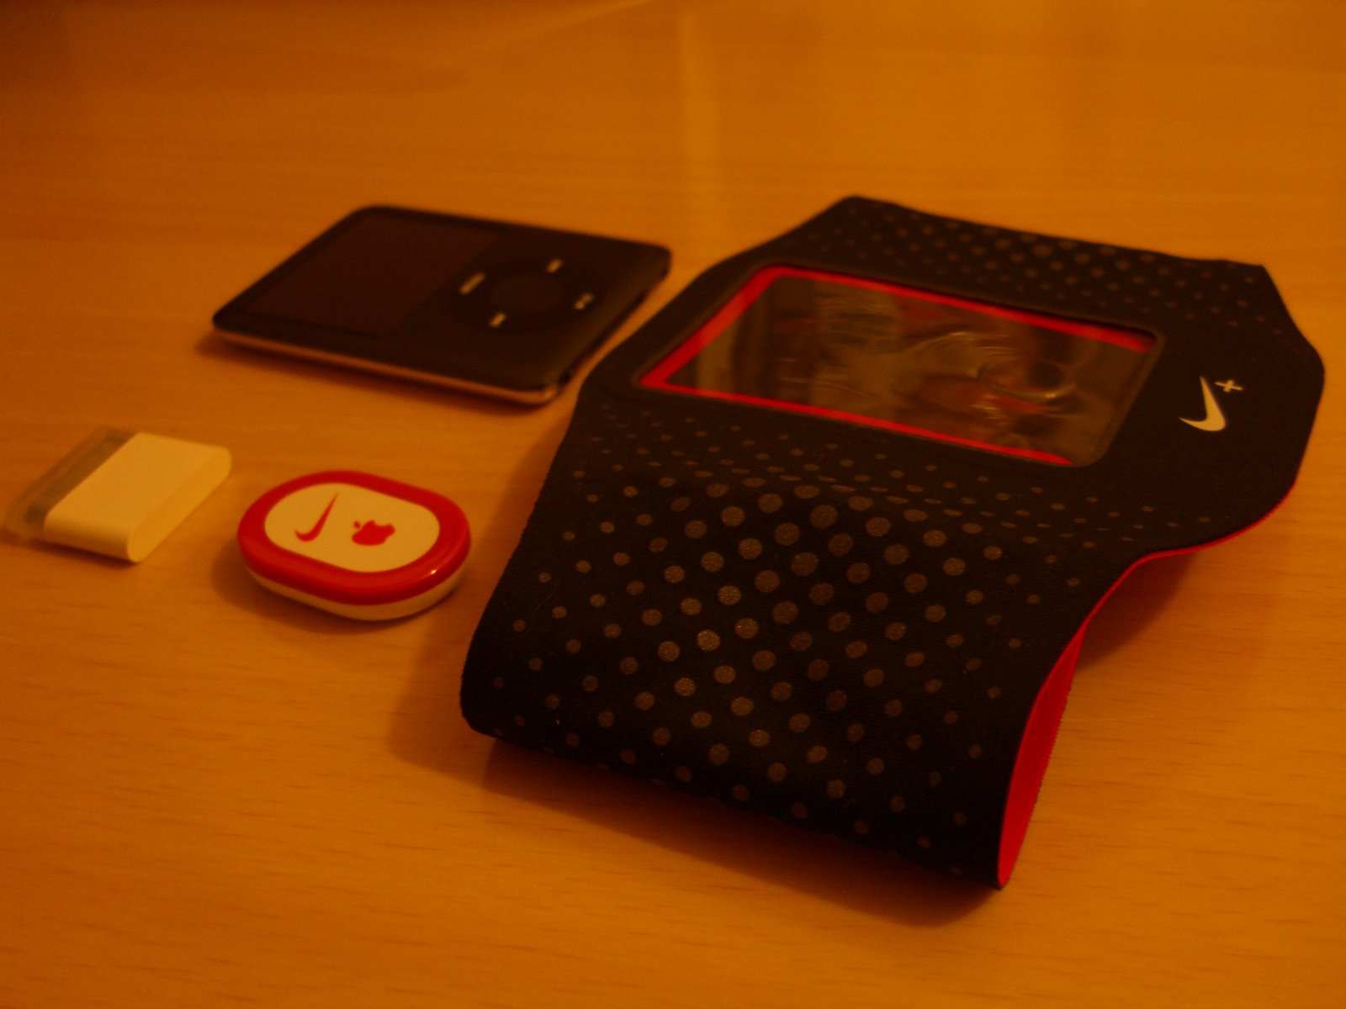
nike+ipod

Slide 34
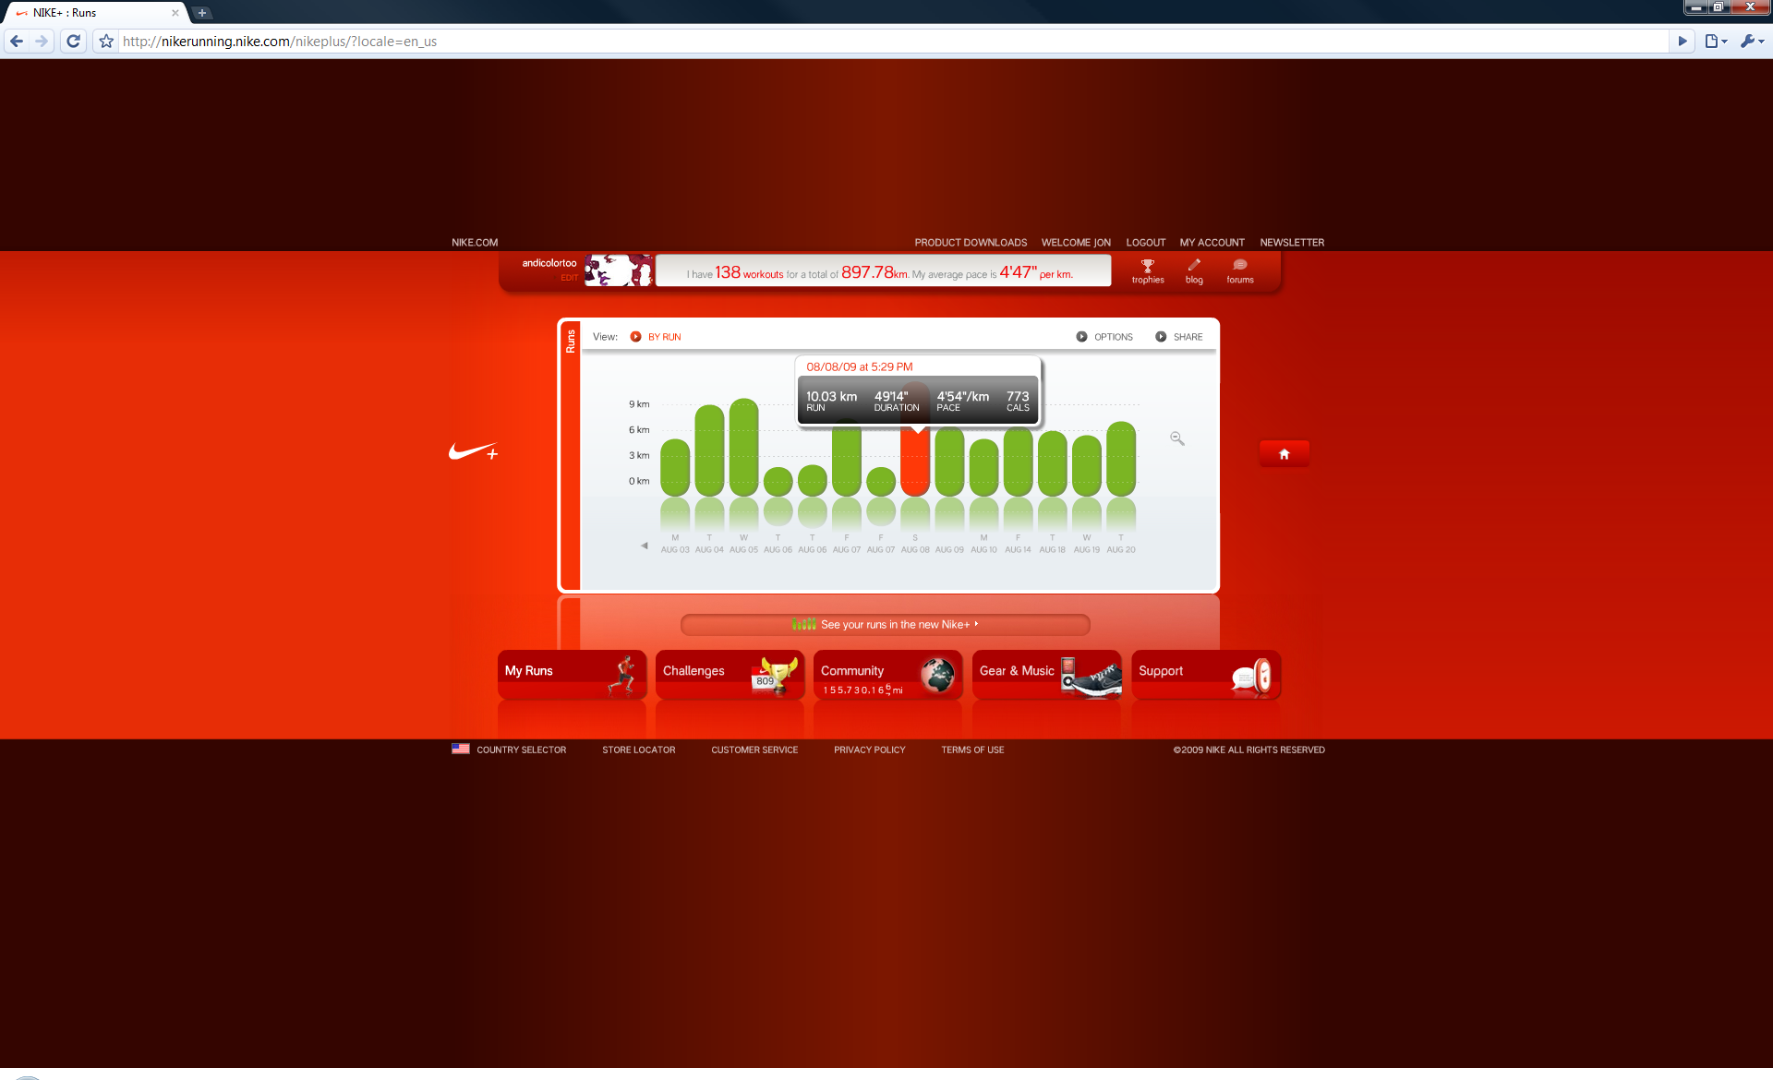
nike+ interface

Slide 35
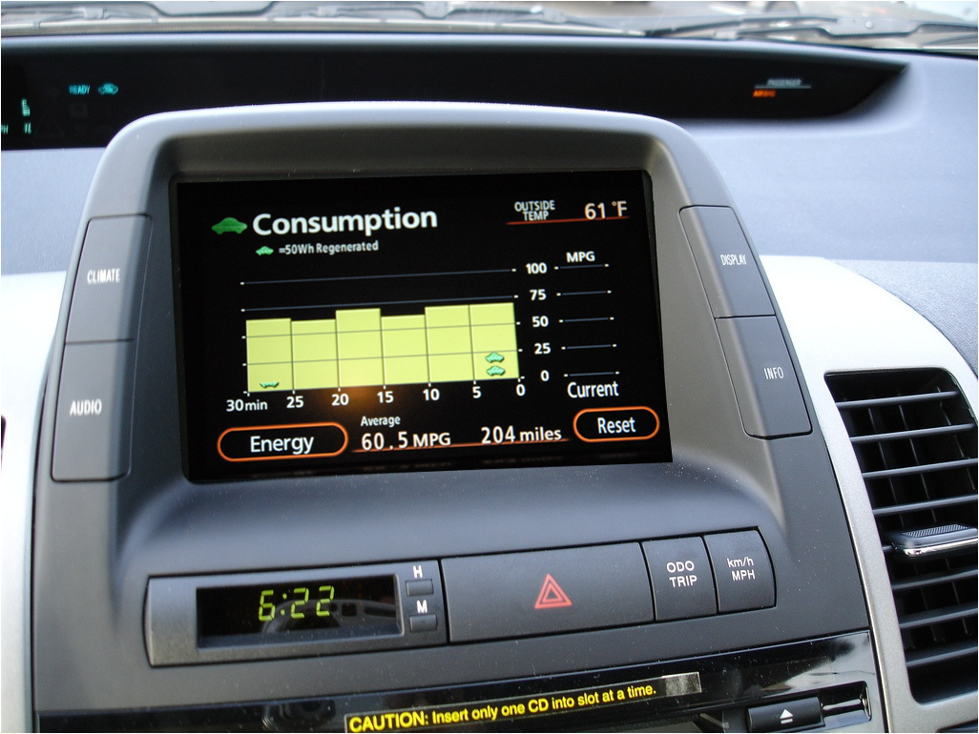
toyota prius

Slide 36
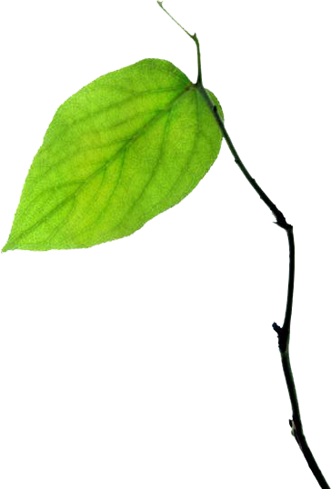
eco-feedback
sensing behavior paired with feedback to reduce environmental impact
Notes:
The goal of eco-feedback is to provide feedback about individual or group behavior in order reduce environmental impact.

Slide 37
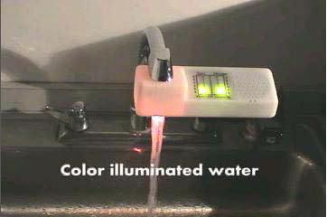
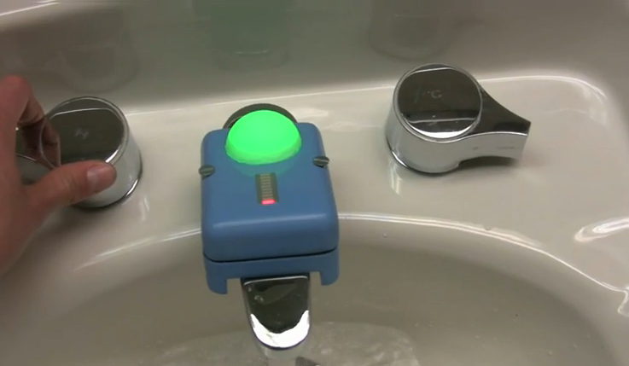
eco-feedback
Arroyo et al., CHI2005
a brief history
Kuznetsov et al., CHI2010
hci/ubicomp
2003
2010
Fogg, B.J., Persuasive Technology, 2003
Notes:
So let’s look at eco-feedback in a historical context.
Hci/ubicomp community has really been looking at this for last 7 years. Many attribute their work to BJ Fogg’s persuasive tech 2003.

Slide 38
eco-feedback
Arroyo et al., CHI2005
a brief history
Kuznetsov et al., CHI2010
Kohlenberg et al.,
J. Applied Behavior Analysis, 1976
environmental
psychology
hci/ubicomp
1970
1976
2003
2010
Fogg, B.J., Persuasive Technology, 2003
Notes:
In 1976 Kohlenberg et al. found that a light bulb, which illuminated when households were within 90% of their peak energy levels, changed energy usage behaviors [33].
Around that time, in the late 1960s and early 70s, environmental psychology was an emerging discipline that had grown out of the realization that environmental conservation was a twofold problem: partly technical and partly human.
Since this first study 40 years ago, environmental psychology has actively explored models of proenvironmental behavior, techniques to motivate behavior change, and studies of eco-feedback technology.
In comparison, HCI has only recently begun looking at eco-feedback; although some of the design elements are similar, even to the early work, the hci eco-feedback technologies are often evaluated not on their ability to change environmentally impactful behavior but rather on their aesthetic and overall understandability.

Slide 39
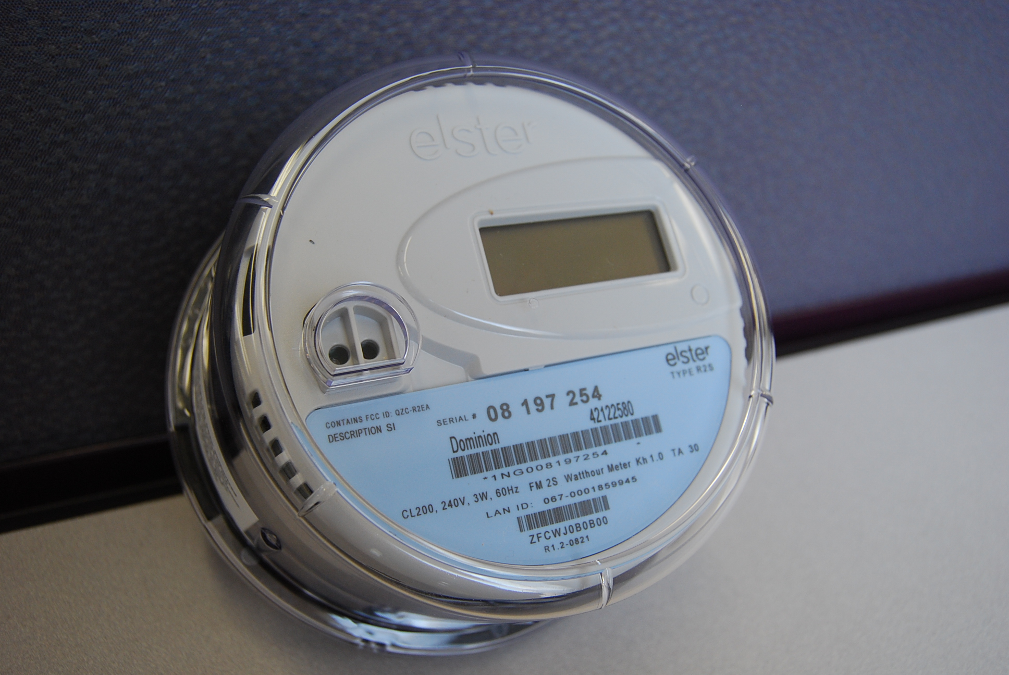
smart meters
Notes:
Moreover, the next generation of resource measurement systems (often referred to as “smart meters”) will soon provide real-time (or near real-time) data on electricity, gas, and water usage in homes and businesses.
This will produce tremendous amounts of data that can be analyzed and fed back to the user, creating even more
opportunities for eco-feedback technology research
<exit transition> so there’s a lot of technological momentum and interest in eco-feedback research within hci and ubicomp but let’s step back for a moment and see eco-feedback in its historical context

Slide 40
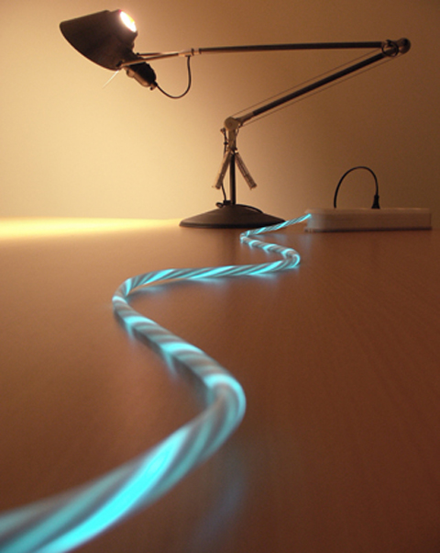
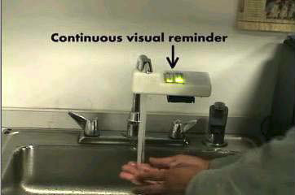
power-aware cord
cord light pulsates & varies in intensity based on power draw
Gustafsson and Gyllenswärd, CHI2005
Notes:
To begin let’s look at…
Gustafsson_ThePowerAwareCord_EnergyAwarenessThroughAmbientInformationDisplay_CHI2005.pdf

Slide 41
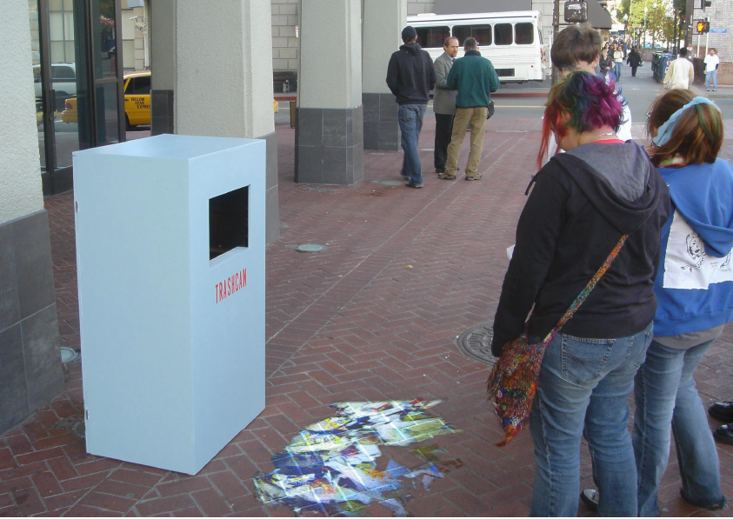
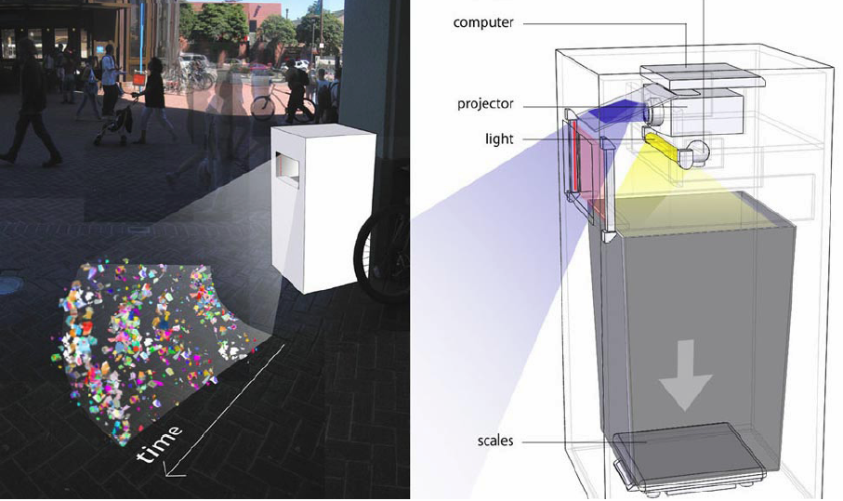
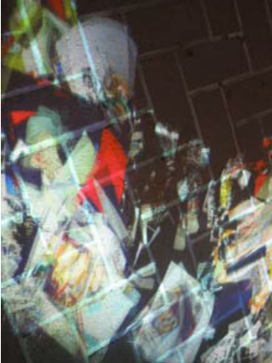
jetsam
visualization allows pedestrians to view amount and type of garbage at-a-glance
Paulos and Jenkins, CHI2005
Notes:
<exit transition> designs such as this one would not have been possible w/out new types of sensing which are only getting cheaper

Slide 42
toyota prius

Slide 43
toyota prius
what makes this design effective?
immediacy – relevant information accessible
constrained environment – few distractions
reason to care – gas mileage is important
simple – interface is easy to understand
educates – immediacy combined with history can teach efficient driving practices
is the prius effect simply a learning effect?

Slide 44
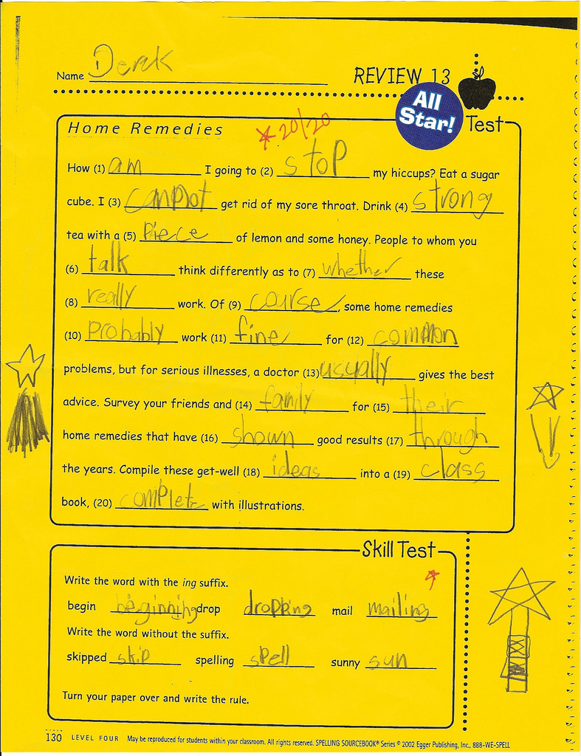
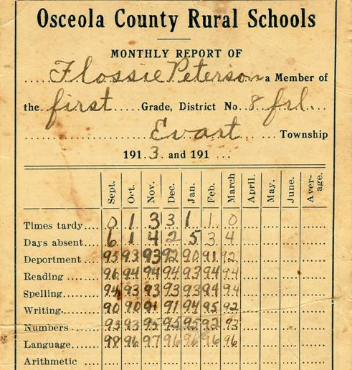
feedback improves performance
low-level
high-level
Becker, J. of Applied Psychology 1978
Notes:
One of the best-established findings in psychology is the positive effect that information feedback can have on performance (Becker, 1978).
low-level feedback can provide explicit detail about how to change or improve specific behavior, e.g., which answers I got wrong on a test
high-level feedback can help improve performance by motivating a person to try harder or persist longer at a task, e.g., my current grade in the class
Becker, L. J. Joint Effect of Feedback and Goal Setting on Performance: A Field Study of Residential Energy Conservation. J. of Applied Psychology 63. 4(1978), 428-433.

Slide 45
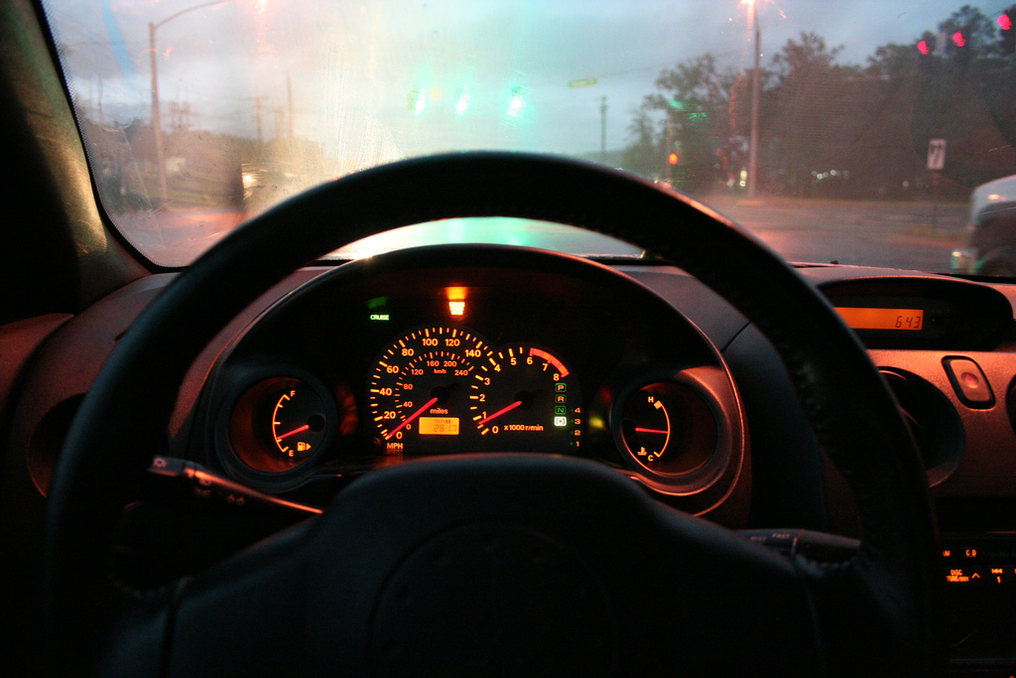
speedometer
gas gauge
Notes:
One of the best established findings in psychology is the role of feedback on performance. Think about how ingrained feedback is in our environment.
For example, driving:
this type of feedback is always available, passively given allowing us to sort of pre-attentively recognize it

Slide 46
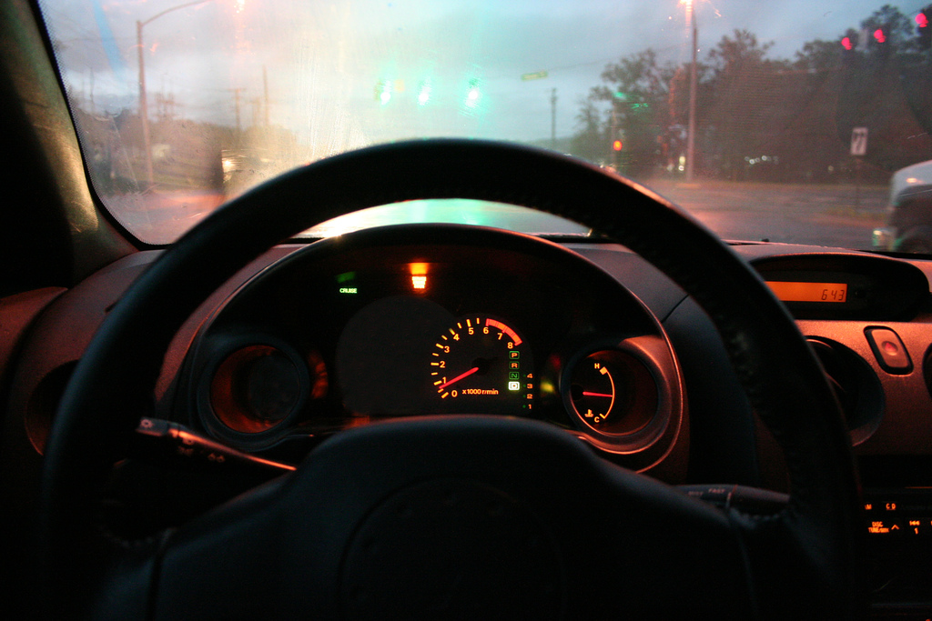
Notes:
We want to create these sorts of passive awareness systems.

Slide 47
but if we have speedometers, why do we have…

Slide 48
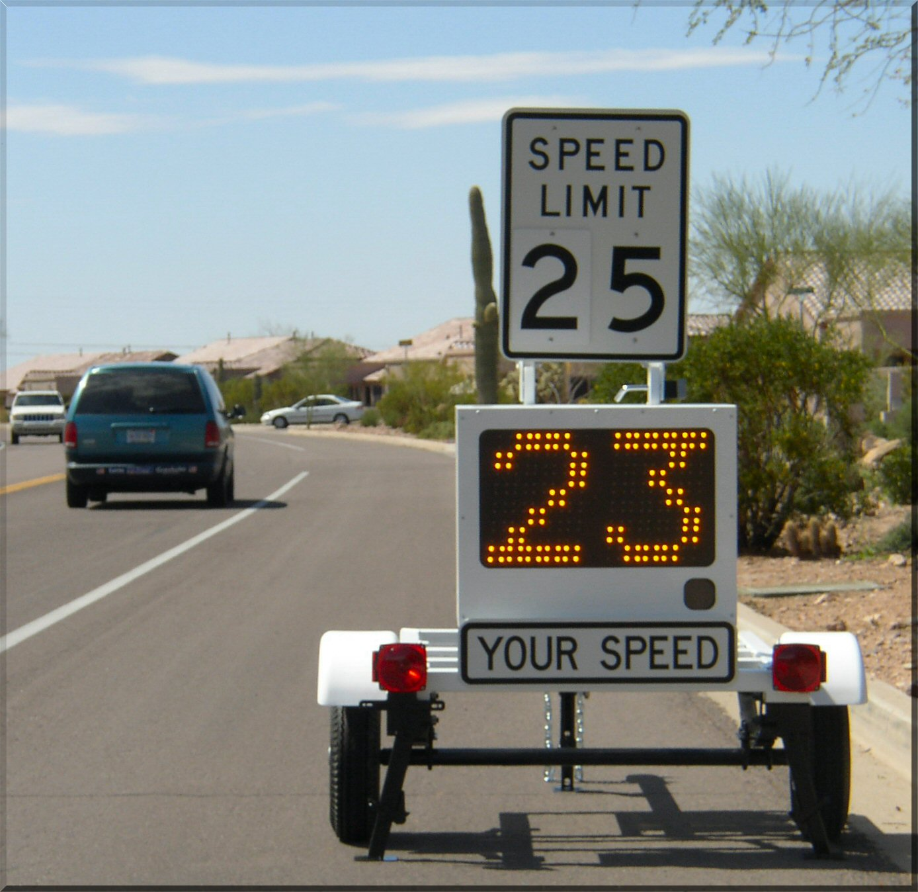
vehicle
activated
speed
signs
Notes:
Vehicle Activated Speed

Slide 49
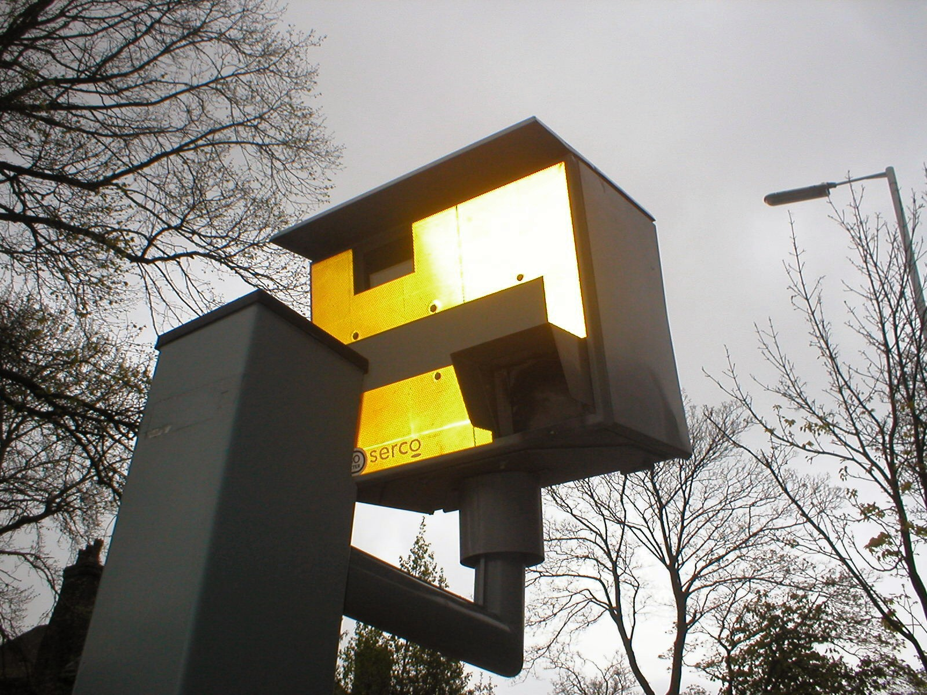
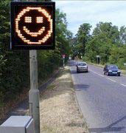
speed cameras
Notes:
Vehicle Activated Speed
In Britain, the VAS signs cost upwards of 90% less to operate annually than speed cameras while preventing more accidents
Sutherland, 2008

Slide 50
vehicle
activated
speed
signs

Slide 51
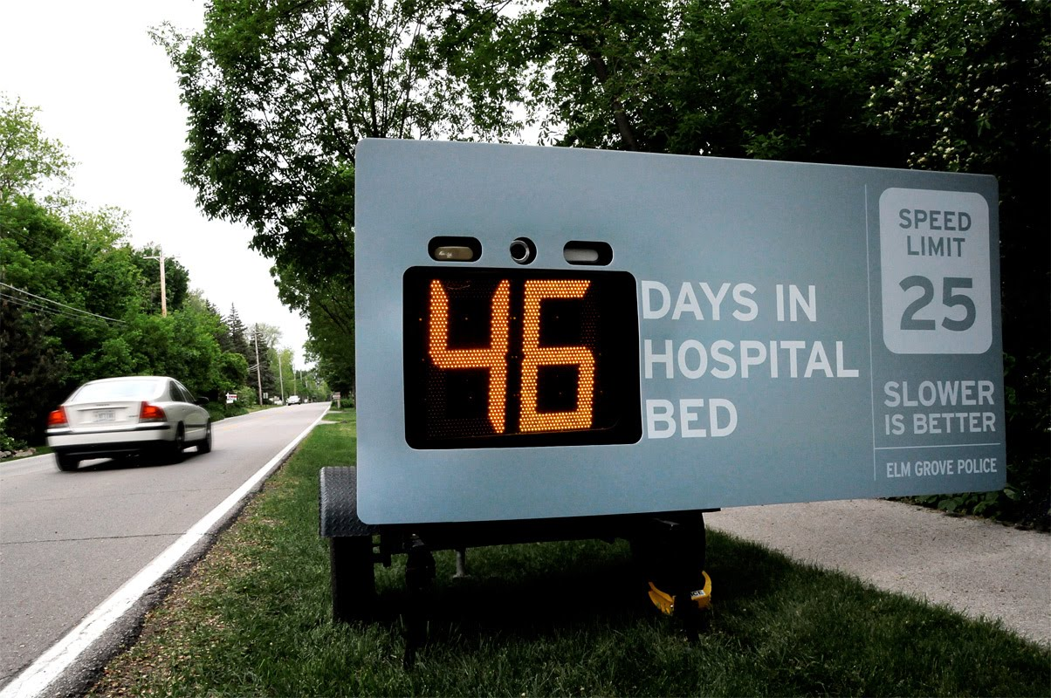
the design of vehicle
activated speed signs

Slide 52
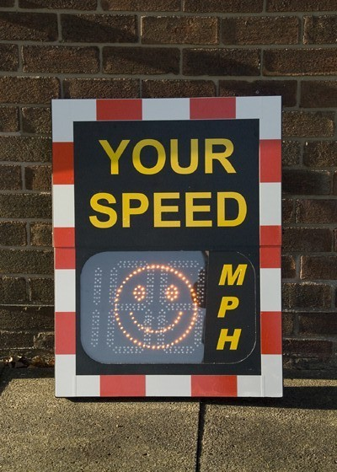
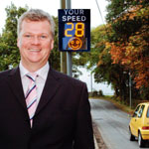
vas signs

Slide 53
so an interesting research question then is: how can we design technology to influence behaviors?

Slide 54
behavior change
techniques
information
prompts
goal-setting
comparison
Geller et al., 1990
Health Education Research
commitment
incentives
feedback
Notes:
These techniques largely extend from behavioral psychology, not environmental psychology specifically. In the paper we provide examples of how each one of these has been applied in environmental behavior studies, but here we’ll highlight only a few of them to underscore how they can be used in general.
These are techniques from environmental psychology that you, as hci-designers, can use in your designs of eco-feedback technology.

Slide 55
behavior change
techniques
information
prompts
goal-setting
comparison
commitment
incentives
feedback
Notes:
Many conservation programs use high-level written or verbal messages, called prompts, to promote conservation.
Investigations into general prompting strategies have shown that prompting has limited influence on behavior but can be made more effective by improving specificity, timing, and placement
Geller, E.S., Winett, R.A., & Everett, P.B. Preserving the environment: New strategies for behavior change. New York: Pergamon Press, 1982

Slide 56
prompts
much more effective!
Winett et al., Journal of Applied Psychology, 1978
Notes:
Prompts that are disconnected from where the consumption action takes place are less effective than prompts that are closer in time and place.
So a poster reminding people to use energy wisely is much less effective at motivating people to turn off the lights than a label right on the light switch.

Slide 57
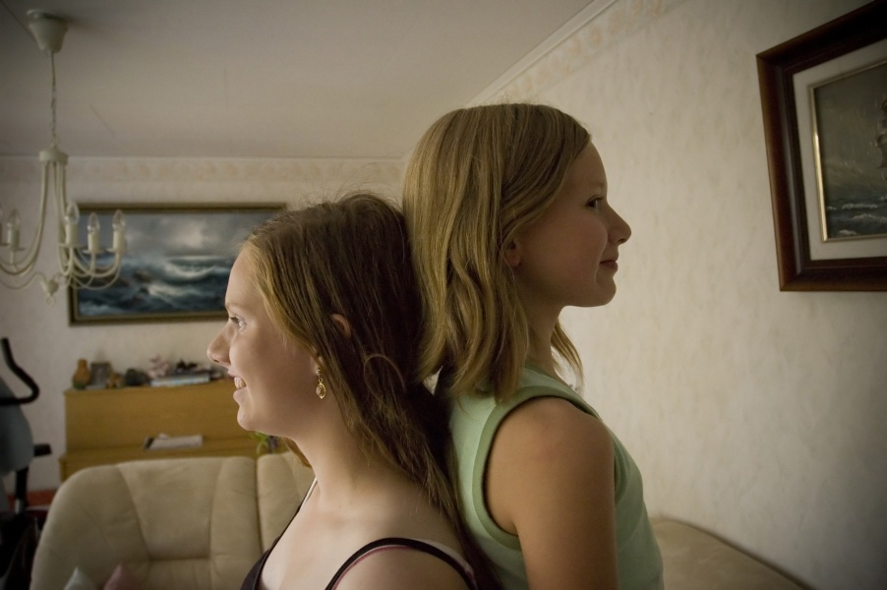
comparison
Notes:
A comparison between individuals or groups can be useful in motivating action, particularly when combined with feedback about performance.
Look at McColskey – Differential Effects of Norms

Slide 58
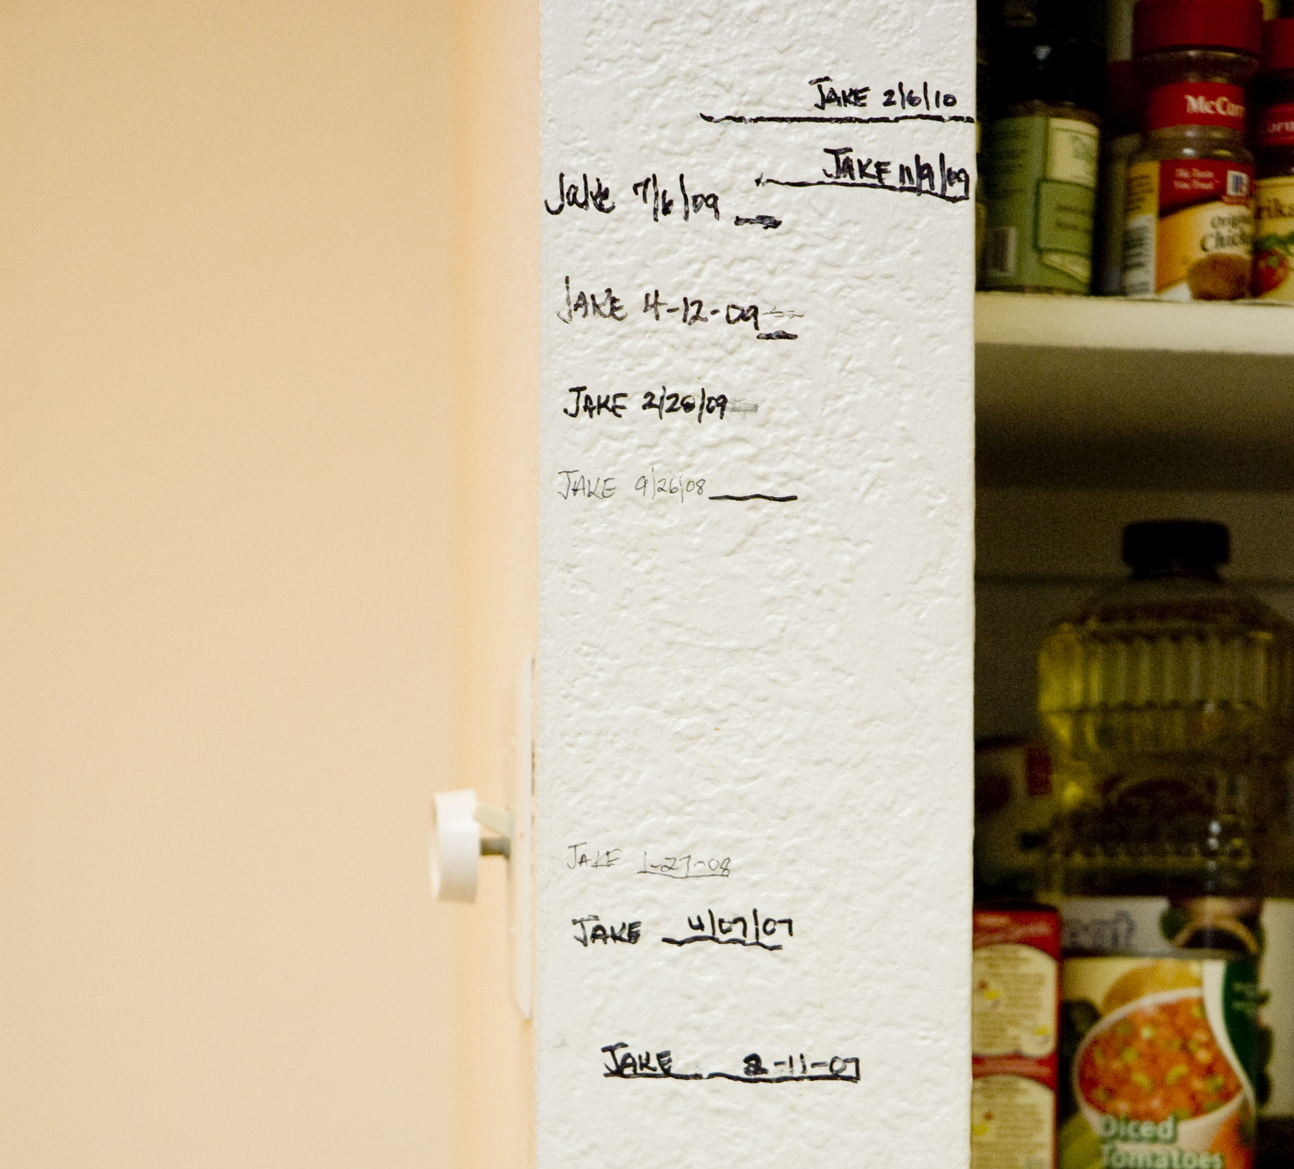
self comparison
Notes:
Even feedback that provides information comparing one’s current behavior to past behavior has been shown to be effective (i.e., self comparison).
Look at McColskey – Differential Effects of Norms

Slide 59
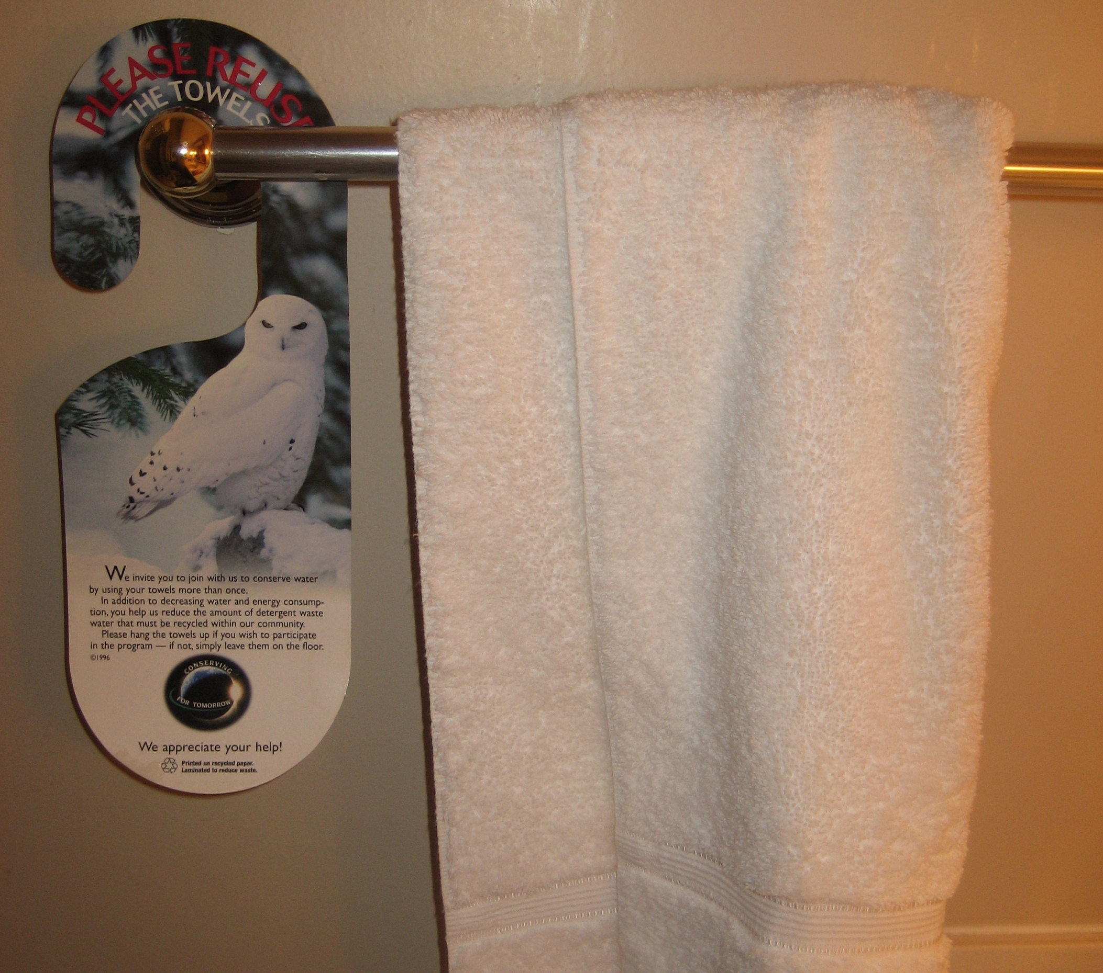
comparison
JOIN YOUR FELLOW GUESTS IN HELPING TO SAVE THE ENVIRONMENT. Almost 75% of guests who are asked to participate in our new resource savings program do help by using their towels more than once. You can join your fellow guests in this program to help save the environment by reusing your towels during your stay.
Notes:
Look at McColskey – Differential Effects of Norms

Slide 60
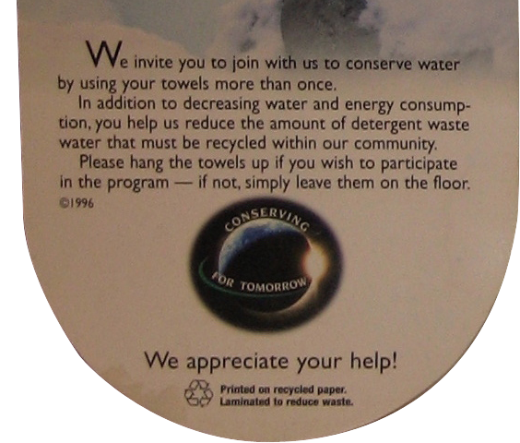
comparison
JOIN YOUR FELLOW GUESTS IN HELPING TO SAVE THE ENVIRONMENT. Almost 75% of guests who are asked to participate in our new resource savings program do help by using their towels more than once. You can join your fellow guests in this program to help save the environment by reusing your towels during your stay.
standard environmental message
descriptive norm message
35.1%
44.1%
Notes:
Look at McColskey – Differential Effects of Norms
25.6% increase
Marriott, a hospitality company that's demonstrated a real commitment to environmentalism, says it "saves an average of 11 per cent to 17 per cent on hot water and sewer costs at each hotel," through the linen-reuse program.

Slide 61
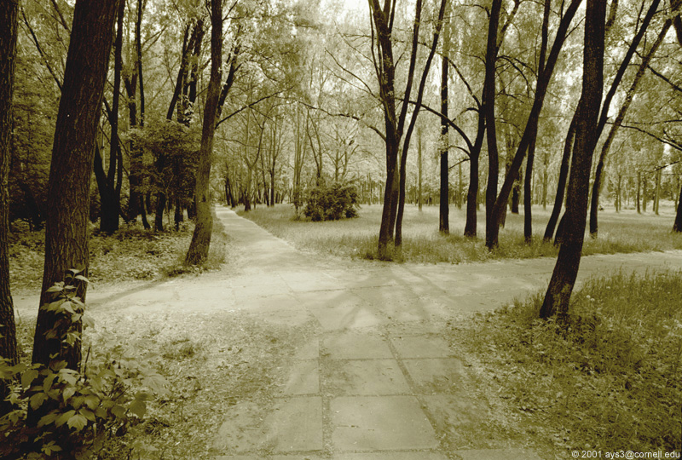
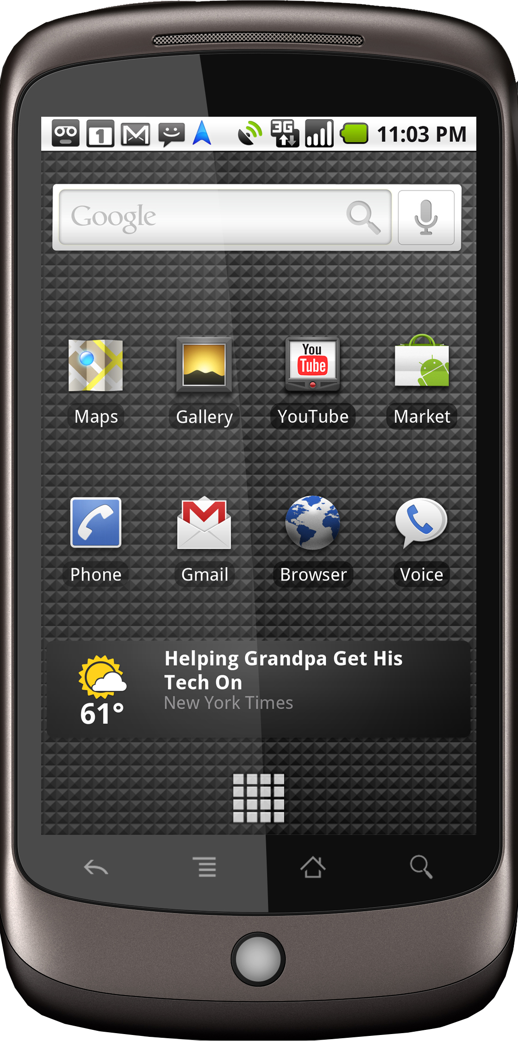
sensing opportunities
for mobile health persuasion

Slide 62
sensing opportunities
for mobile health persuasion
Twin Falls is only 1.4 mi away and you’ll burn an estimated 170 calories round trip.
Twin Falls is only 1.4 mi away.
Twin Falls!
Burn 170
cal & reach your walking goal for the week!
Notes:
Maybe add in social persuasion here?
Maybe write on arrow instead?

Slide 63
sensing opportunities
for mobile health persuasion
Kairos technology that suggests a behavior at the most opportune moment
-fogg, 2003
Twin Falls is only 1.4 mi away and you’ll burn an estimated 170 calories round trip.
Twin Falls is only 1.4 mi away.
Twin Falls!
Burn 170
cal & reach your walking goal for the week!
Notes:
So, from a technology perspective,
there’s two things going on here: (1) we have a sensing system that can track location and infer particular decision moments and (2) we have a navigation application that uses persuasion tactics to motivate behavior.
Kairos (καιρός) is an ancient Greek word meaning the right or opportune moment (the supreme moment).

Slide 64
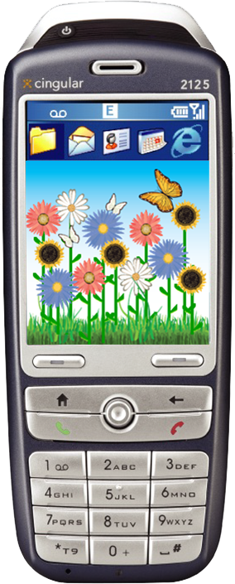
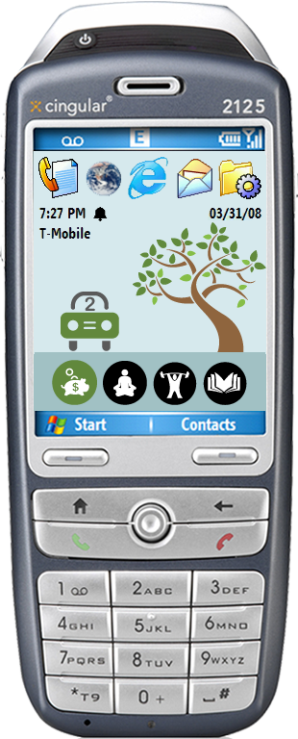
two mobile phone examples:
ubifit
ubigreen
encouraging fitness behaviors through passive sensing and feedback
consolvo et al., chi 2008
consolvo et al., ubicomp2008
encouraging proenvironmental behaviors through passive sensing and feedback
froehlich et al., chi 2009

Slide 65
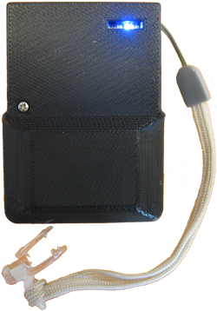
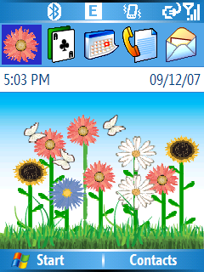
ubisystem components
collects data about physical activities
activity recognition device
glanceable display
phone wallpaper!
+
communicates data about physical activities

Slide 66
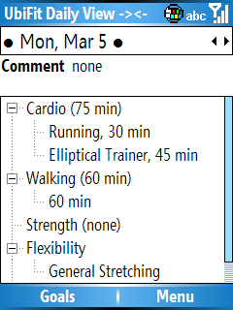
ubisystem components
towards zero effort applications
collects data about physical activities
activity recognition device
interactive application
glanceable display
+
+
communicates data about physical activities
Notes:
The goal is for the primary interactions to be completely passive; for both ubifit and ubigreen

Slide 67
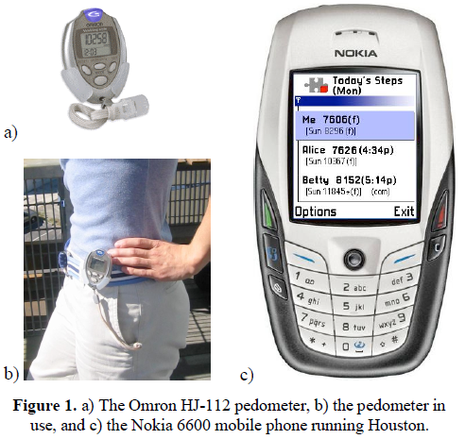
pedometer cell phone fitness study
Consolvo, S., et al. Design Requirements for Technologies that Encourage Physical Activity. CHI 2006
Notes:
For example, in a study conducted by one of my colleagues at the University of Washington, a pedometer (step-counter) was linked to a mobile phone. We found that the use of asterisks to reward step goals being met was enough to motivate more walking.

Slide 68
ubifit
personal ambient display
walk
cardio
strength
flexibility
primary goal met
alternate goal met
recent goal met
Notes:
68

Slide 69
ubigreen tracked 6 transit activities
drive alone
walk
bike
train
carpool
bus
“not-green”
“green”
minimum activity duration: 7 minutes

Slide 70
ubigreen
personal ambient display
phone
background
(wallpaper)
current activity
evolving image
value icon bar

Slide 71
sense of anticipation for how story would unfold

Slide 72
ubigreen
personal ambient display
tree
design:
03/30/08
03/31/08
03/31/08
03/31/08
03/31/08
04/01/08
04/01/08
04/01/08
04/01/08
04/02/08
04/02/08
04/03/08
04/03/08
04/03/08
04/03/08
04/03/08
04/03/08
04/03/08
04/04/08
04/04/08
04/04/08
04/04/08
04/05/08
04/05/08
7:27 PM
04/06/08
7:45 AM T-Mobile
8:05 AM T-Mobile
5:15 PM T-Mobile
5:30 PM T-Mobile
7:23 AM T-Mobile
8:05 AM T-Mobile
5:38 PM T-Mobile
6:11 PM T-Mobile
7:41 AM T-Mobile
5:22 PM T-Mobile
6:55 AM T-Mobile
7:15 AM T-Mobile
4:48 PM T-Mobile
5:56 PM T-Mobile
6:09 PM T-Mobile
9:45 PM T-Mobile
10:07 PM T-Mobile
07:28 AM T-Mobile
05:41 PM T-Mobile
07:35 PM T-Mobile
11:01 PM T-Mobile
08:31 AM T-Mobile
10:19 AM T-Mobile
12:00 AM T-Mobile
everything resets on sunday

Slide 73
ubigreen
personal ambient display
polar bear
design:
03/30/08
03/31/08
03/31/08
03/31/08
03/31/08
04/01/08
04/01/08
04/01/08
04/01/08
04/02/08
04/02/08
04/03/08
04/03/08
04/03/08
04/03/08
04/03/08
04/03/08
04/03/08
04/04/08
04/04/08
04/04/08
7:27 PM
04/04/08
7:45 AM
8:05 AM
5:15 PM
5:30 PM
7:23 AM
8:05 AM
5:38 PM
6:11 PM
7:41 AM
5:22 PM
6:55 AM
7:15 AM
4:48 PM
5:56 PM
6:09 PM
9:45 PM
10:07 PM
07:28 AM
05:41 PM
07:35 PM
11:01 PM

Slide 74
Monday
Saturday
Notes:
As Jon mentioned, we had real time access to participant’s phone data so we could monitor the state of their phones in real time
This screen shot was taken on a Monday, towards the beginning of the week, and shows the initial stages of their transit behavior.
[next slide] Here, the shot was taken towards the end of the week; you can see how participants’ icons progressed throughout the week. At the bottom left you can see that one participant reached the final state of the progression and saw the Northern Lights.

Slide 75
personal ambient display
impressions of ubifit
If you didn’t have a screen [display], I wouldn’t think about it [physical activity] as much… I think about it maybe subconsciously every time I look at my phone.
- P5_{UF}
With a website, it’s so easy to ignore… it’s just out of sight, out of mind. But on the phone, you can’t really ignore it…
- P9_{UF}
Notes:
[The glanceable display] was a constant reminder…whereas if you didn’t have a screen [glanceable display], you probably—I wouldn’t think about it [physical activity] as much, you know, I think about it maybe subconsciously every time I look at my phone. {S5}

Slide 77
game mechanics
playful
measured progress
virtual achievements
collections
Notes:
Abstractions allowed for playfulness
Progress was visible
Achievements were rewarded
Could build collection of achievements

Slide 78
loss aversion
Notes:
I don’t have time to go through all of the persuasive/influence tactics that we thought about… but it’s worth mentioning that we specifically didn’t use loss aversion as a motivation technique here…
We wanted people to enjoy using and feel good about using the applications.

Slide 79
need for quantitative data
I would like to see some graph or raw data.
- P13_{UG}
quantitative data
builds trust system is working
allows for self-comparison
some people like it better
Notes:
I would like to see some graph or raw data.
- Participant 13

Slide 80
effectiveness of the ubifit glanceable display
Linear Trend
Best Fit
Linear Trend
Best Fit
no glanceable display
glanceable display
study occurred over thanksgiving, christmas, and new years.
Notes:
Consolvo conducted a 3-month study with a control and experimental group and found that those with the ambient display outperformed those without.

Slide 81
mpg?
gpm?
kwh?

Slide 82
how much water do you use when you shower?
Notes:
20-42 gallons of water depending on length (5-10 minutes)

Slide 83
how much energy does your dryer use?
Notes:
65.9 billion kWh
5.8% of electricity in average home
7th most consuming activity behind: air conditioning, refrigeration, space heating, water heating, and lighting.

Slide 84
why the dis- connect?
Notes:
We have been using energy and water our entire lives yet most of us are completely unaware of the answers to these questions. This represents a profound disconnect between action and effect.
it’s a fundamental problem of knowledge and information.
most of us simply have no means of understanding how our behaviors affect the environment.

Slide 86
Notes:
Or use esoteric units that are difficult to understand.

Slide 87
smart meters
Notes:
Smart meters at least give us access to power consumption data in digital but still it’s in aggregate form and typically only at 15 minute intervals…

Slide 88
Notes:
Not visually interesting, not easy to read.
Only provide high level, aggregate information

Slide 89
Kempton and Layne, 1994
Notes:
Kempton and Layne (1994) draw the analogy that this likens to shopping at a grocery store where the goods are not marked with individual prices and the only feedback received about purchasing is through a monthly bill which provides one, aggregate total cost (e.g., “You spent $527 for 2362 food units in April”).
This level of information makes it difficult to economize and judge the relative merits of individual conservation practices (Dennis, 1990).

Slide 90
design activity
split into groups of 3 or 4
identify an activity that you want to change via sensing and feedback (energy usage, fitness, sleep, diet, etc.)
design an interface to influence that activity.

Slide 91
think about
what does the interface look like?
why would someone want to use it?
how does the user see the interface?
does the interface use social competition? gaming?

Slide 92
high resolution resource consumption sensing for electricity, water and gas
electrisense
hydrosense
gassense
ubicomp lab
http://ubicomplab.cs.washington.edu
sustainability research

Slide 93
three design goals
low-cost
easy-to-install
device-level information

Slide 94
how much energy does your dryer use?
+
=
appliance
sensor
appliance- level data!

Slide 95
distributed direct sensing
overhead lighting
refrigerator
coffee maker
microwave
stove
convection oven

Slide 96
distributed direct sensing
infrastructure mediated sensing
overhead lighting
refrigerator
coffee maker
microwave
stove
convection oven
Patel et al., UbiComp 2007

Slide 97
electrisense: appliance level sensing with two sensors
powerline event
detection sensor
contactless power consumption sensor
automatically detects and classifies electrical events on the home powerline
whole-home power consumption sensing from outside breaker panel
Patel et al., UbiComp 2007
Patel et al., CHI2010

Slide 98
demo
my colleague, sidhant, will walk around using various electrical switches/appliances
list of recently activated events
currently detected event
graph of power consumption over time
total power being consumed in real-time
not for end users

Slide 99
Movie Removed for Public Posting of Slides

Slide 100
how does this work?
Notes:
In the case of transient noise, the impulses typically last only a few microseconds and consist of a rich spectrum of frequency components, which can range from 10 Hz to 100 kHz. the The noise signature of a particular device depends both on the device and the transmission line behavior of the interconnecting power line.

Slide 101
PowerMeter
power consumption spikes and temporal patterns correlate to usage
this is only one input feature into our machine learning algorithm!

Slide 102
your noise is our signal
electrisense
hydrosense
gassense

Slide 103
how ped works
mechanical switches
Off
electrical noise transient
R
R
Notes:
In the case of transient noise, the impulses typically last only a few microseconds and consist of a rich spectrum of frequency components, which can range from 10 Hz to 100 kHz. the The noise signature of a particular device depends both on the device and the transmission line behavior of the interconnecting power line.

Slide 104
how ped works
mechanical switches
Off
electrical noise transient
R
R
Notes:
In the case of transient noise, the impulses typically last only a few microseconds and consist of a rich spectrum of frequency components, which can range from 10 Hz to 100 kHz. the The noise signature of a particular device depends both on the device and the transmission line behavior of the interconnecting power line.

Slide 105
each switch has a unique transient signature
on
on
based on:
switching mechanisms
load characteristics
position on transmission line
off
off
switch 1
switch 2
Notes:
Depending on the switching mechanism, the load characteristics, and length of transmission line, these impulses can be very different.

Slide 106
transmission line shapes signal
allows us to identify identical devices, which are in different locations in the home
Notes:
The influence of the transmission line’s transfer function is an important contributor to the different electrical noise signatures we observed, which explains why similar device types
(e.g., light switches) can be distinguished and why the location of the data collection module in the house impacts the observed noise.

Slide 107
Movie Removed for Public Posting of Slides

Slide 108
how ped works
three classes of noise
generates continuous noise
resistive
inductive loads (e.g., from motors)
loads with solid state switching (e.g., tvs, cfls, computers)
Notes:
* three general classes of electrical noise sources may be found in a home (see Figure 3): resistive loads, inductive loads such as motors, and loads with solid state switching.
* purely resistive loads, such as a lamp or an electric stove, do not create detectable amounts of electrical noise while in operation

Slide 109
transients
Notes:
The continuous breaking and connecting by the motor brushes creates a voltage noise synchronous to the AC power of 60 Hz (and at
120 Hz). Solid state switching devices, such as MOSFETs found in computer power
supplies or TRIACs in dimmer switches or microwave ovens, emit noise that is
different between devices and is synchronous to an internal oscillator. Thus, the latter
two classes contribute noise from both the external power switching mechanism
(transient) and the noise generated by the internal switching mechanism (continuous).

Slide 110
transients
continuous
noise
fan resonant noise frequency
tv resonant noise frequency
Notes:
The continuous breaking and connecting by the motor brushes creates a voltage noise synchronous to the AC power of 60 Hz (and at
120 Hz). Solid state switching devices, such as MOSFETs found in computer power
supplies or TRIACs in dimmer switches or microwave ovens, emit noise that is
different between devices and is synchronous to an internal oscillator. Thus, the latter
two classes contribute noise from both the external power switching mechanism
(transient) and the noise generated by the internal switching mechanism (continuous).

Slide 111
fan resonant noise frequency
tv resonant noise frequency

Slide 112
Movie Removed for Public Posting of Slides

Slide 113
Infrastructure-Mediated Single-Point Sensing of Whole-Home Water Activity
Jon Froehlich¹, Eric Larson², Tim Campbell³, Conor Haggerty⁴, James Fogarty¹, Shwetak N. Patel^{1,2}
¹Computer Science & Engineering, ²Electrical Engineering,
³Mechanical Engineering, ⁴Community, Environment, and Planning
UbiComp 2009
Notes:
Infrastructure-Mediated Single-Point Sensing of Whole-Home Water Activity

Slide 114
what are the most consuming water activities in your home?
average indoor household water usage per person/day (70 gpd)
Vickers, 2001
Notes:
Most residents have no idea how much water they use nor what the most water consuming activities are in the home.
So, ask yourself, what do you think the most water consuming activities are in your home?
Most people cannot accurately answer this question. We have been working with our local water utility, SPU…
Most customers believe they use 20 gallons a day (Al Dietemann) rather than roughly 70 and have no idea that toilets, clothes washers, and showers are the top water usage activities in the home. This is a striking disconnect considering that most of us have used modern plumbing all of our lives.
To close this gap, we have been working on new sensing techniques for water usage
---
According to a recent survey at our local water utility in Seattle, most customers believe they use 20 gallons a day (Al Dietemann) rather than roughly 70.

Slide 115
water scarcity
Notes:
Although energy usage and measurement has lately received a great deal of attention in the popular media, water has not.
And yet, the United Nations predicts that water will be the dominating issue over the next 20 years. As you can tell from this map, this is a problem that affects every continent on earth including the US.
Mention energy/water nexus

Slide 116
barcelona, spain
Notes:
Already, cities are going to unprecedented lengths to provide their residents with water.
For example, in April of last year, Barcelona, Spain took the unprecedented step of importing water by ship from neighboring nations at a cost of $35 million a month (Crawford, 2008).
Nearly 23m litres of drinking water - enough for 180,000 people for a day

Slide 117
lake mead, nevada
Notes:
The US is not immune from such problems either. According to US government estimates, 36 states will face serious water shortages in the next five years (EPA, 2008).
Lake Mead, which supplies 90% of Las Vegas’ water, is estimated to drop below existing intake pipes by 2012 (Lippert and Efstathiou, 2009).
The city of Las Vegas is paying people to remove their lawns at $1.50 per square foot of lawn replaced with desert-friendly plants for a maximum of $300,000 per year in rebates. (http://www.greenbiz.com/print/35667).
Many utilities invest millions of dollars into conservation programs meant to educate their customers about water and cost savings.
---

Slide 118
hydrosense
single-point pressure-based sensor of water usage
identifies water usage activity down to fixture level (e.g., toilet)
provides estimates of flow at each fixture

Slide 119
typical water meters
only provide aggregate information on water usage
require pipe modification for installation
traditional inline
water meter
Notes:
Typical water meters only provide aggregate information on water usage and require costly pipe modifications to install. (click)
In constrast, the HydroSensor can simply screws on to a hose water bib.

Slide 120
Movie Removed for Public Posting of Slides

Slide 121
the hydrosensor prototype
Pressure Sensor
16-bit ADC
20 MHz Microcontroller
Class 1 Bluetooth Radio
3D-Printed Enclosure
Notes:
Our prototype HydroSense sensor implementation consists of two primary parts:
a customized stainless steel pressure sensor
a 3d-printed encasement holding an analog to digital converter (ADC), a microcontroller, and a
Bluetooth wireless radio (see Figure 4), which communicates the raw pressure data to a computer.

Slide 122
Movie Removed for Public Posting of Slides

Slide 123
raw bathroom sink signal
open
valve
close
valve
stabilized
pressure drop
time (t)
Notes:
The instant a valve is opened or closed (be it a bathroom faucet or a mechanical valve in a dishwasher), a pressure change occurs and a pressure wave is generated in the home plumbing system.
The transient can have a positive or negative rate of change depending on whether a valve is being opened or closed.
The pressure drop is indicative of how much water is being used.

Slide 124
brief plumbing primer
water tower
Notes:
To understand how HydroSense works, its useful to go over a brief primer of home water/pipe infrastructure.
Most households obtain water from a public water supply.
Public water is distributed by local utilities, relying on gravity and pumping stations to push water through major distribution pipes

Slide 125
brief plumbing primer
water tower
1 psi = 6.89 kpa
incoming cold water from supply line
40 psi
100 psi
Notes:
Cold water enters the home through a service line, typically at 40-100 pounds per square inch (psi) depending on such factors as the elevation and proximity to a water tower or pumping station.
Pressure is important to the proper functioning of HydroSense because it’s a pressure-based sensing solution.
------
The pound per square inch or, more accurately, pound-force per square inch (symbol: psi or lbf/in² or lb_{f}/in²) is a unit of pressure or of stress based on avoirdupois units. It is the pressure resulting from a force of one pound-force applied to an area of one square inch:
1 psi (6.894757 kPa) : pascal (Pa) is the SI unit of pressure.
40 psi is 275.79 kilopascals
100 psi is 689.47 kilopascals

Slide 126
pipe layout
water tower
incoming cold water from supply line
pressure regulator
Notes:
Many homes have a pressure regulator that stabilizes the water pressure and also reduces the incoming water pressure to a safe level for household fixtures.
From the regulator, most homes contain a combination of series plumbed and branched piping.

Slide 127
closed pressure system
water tower
bathroom 1
hose
spigot
kitchen
thermal
expansion
tank
incoming cold water from supply line
dishwasher
pressure regulator
hot
water heater
bathroom 2
laundry
Notes:
The cold water supply branches to the individual water fixtures (e.g., toilets/sinks/showers) and into the water heater.
The plumbing system forms a closed loop pressure system with water held at a relatively stable pressure throughout the piping.
This is why, when you open a faucet, water immediately flows out.

Slide 128
water tower
bathroom 1
hose
spigot
kitchen
thermal
expansion
tank
incoming cold water from supply line
dishwasher
pressure regulator
hot
water heater
hot water heater drain valve
hot
water heater
bathroom 2
laundry
Notes:
The hot water tank connects the cold water pipes to the hot water pipes.
So when you open a hot or cold water valve, the pressure signal is transmitted through the hot water heater thus allowing for a single-point pressure sensing solution.
Every hot water tank has a drain valve, which is of interest to us because it provides an easy potential installation point for our hydrosensor, particularly for locations like apartments which don’t have outdoor hose bibs.

Slide 129
some possible installation points
water tower
bathroom 1
hose
spigot
kitchen
thermal
expansion
tank
incoming cold water from supply line
dishwasher
pressure regulator
hot
water heater
bathroom 2
laundry
Notes:
We have investigated placing HydroSense at a variety of installation points including the drain valve on the hot water heater, the outdoor hose spigot and the 3/8” hot and cold water inlet lines to bathroom and kitchen sinks.
Note: remember this is a single point sensing solution; I’m just showing single installation points that we’ve investigated.

Slide 130
bathroom sink cold open
hydrosense
hose
spigot
(cold)
thermal
expansion
tank
kitchen sink
hot open
dishwasher
hot
water heater
laundry
Notes:
So a single pressure sensor in a home take advantage of the existing infrastructure to do all the work. When you turn on or off the cold water in …

Slide 131
Movie Removed for Public Posting of Slides

Slide 132
in-home data collection
Notes:
Now, I will go over our in-home data collection and experimental validation.

Slide 133
home profiles
ten locations
- 8 houses
- 1 apt / 1 cabin
size
- avg: 2,300 sq ft
- min: 750 sq ft
- max: 4,000 sq ft
install point:
- 8 hose bib
- 1 water heater
- 1 utility faucet
Notes:
We installed HydroSense in a variety of locations: 8 houses, 1 apartment, and 1 cabin with a range in size from 750 sq feet to 4,000 sq ft.
We also used three different installation points: 8 hose bib, 1 water heater, and 1 utility faucet connection.

Slide 134
experimental protocol
controlled experiments
2 researchers per site
5 trials per valve
e.g., 5 cold / 5 hot for bathroom sink
for each trial, valve open for 5 seconds, then closed
Notes:
Each collection session was conducted by a pair of researchers: one would record the sensed pressure signatures to a laptop while the other activated the home’s water fixtures.
We recorded five trials per valve. A sink, for example, has two valves (one hot, and one cold) and thus would receive 10 trials—5 for hot and 5 for cold.
For each trial, the valve was open for ~5 seconds and then closed.

Slide 135
collecting flow data
4 / 10 homes gathered flow data
measure time to fill 1 gallon in a calibrated bucket
this provides Q, allowing us to solve for R_{f}
R_{f} = ∆P / Q
Notes:
For 4 of the 10 homes we also gathered flow data. For the faucet and shower trials, we measured the time it took to fill 1 gallon of water into a calibrated bucket.
This provides Q (the flow rate) and allows us to solve for the fluid resistance at that valve and pipe pathway.

Slide 136
data collection stats
ten locations
706 trials
155 flow rate trials
84 total fixtures tested
Notes:
In all, we conducted experiments in 10 locations resulting in 706 trials with 155 flow rate trials and 84 total fixtures tested.

Slide 137
fixture classification results across homes
Notes:
This figure shows the accuracy of fixture-level identification of valve open and valve close events within each home as well as the aggregate 97.9% accuracy of fixture-level classification.
Many homes resulted in 100% open and close fixture classification.
The worst performing house, H10, was due to noise from the eleven cabins that share the same supply line at the resort.

Slide 138
fixture classification results across homes
97.9%
Notes:
This figure shows the accuracy of fixture-level identification of valve open and valve close events within each home as well as the aggregate 97.9% accuracy of fixture-level classification.
Many homes resulted in 100% open and close fixture classification.
The worst performing house, H10, was due to noise from the eleven cabins that share the same supply line at the resort.

Slide 139
fixture classification results across fixtures
Notes:
This graph shows the same data as before but categorized by fixture. Again, nearly all fixtures are above 95% or better.
Here, the worst performer is the hot water valve in showers at 89%--although this is still pretty good, we’re not sure why this is and it warrants further investigation.

Slide 140
what i’m currently working on:
studying hydrosense performance in field deployments
building water feedback interfaces

Slide 141
Movie Removed for Public Posting of Slides

Slide 142
Movie Removed for Public Posting of Slides

Slide 143
Movie Removed for Public Posting of Slides

Slide 145
Notes:
The new water bill could provide disaggregated breakdown of water usage to the consumer and we can start to bride the disconnect.
We can suggest water practices tailored to individual use
Or offer web services like this that offer the consumer a way to easily track their water usage in real time and make water saving suggestions like based on your daily usage, installing this low flow fixture would save you X amount on your water bill and Y in heating bill, paying for itself in Z months.

Slide 147
Thank You!
jonfroehlich@gmail.com
twitter @jonfroehlich
http://ubicomplab.cs.washington.edu
http://dub.washington.edu/
faculty
students
Jon Froehlich Gabe Cohn Sidhant Gupta Eric Larson Tim Campbell Kate Everitt Marilyn Ostergren
Shwetak Patel James Fogarty James Landay
design:
ubicomp lab
use:
build:
university of washington
sustainability research
university of washington

Slide 148
GasSense: Appliance-Level, Single-Point Sensing of Gas Activity in the Home
Gabe Cohn¹, Sidhant Gupta², Jon Froehlich², Eric Larson¹, Shwetak Patel^{1,2} ¹Electrical Engineering, ²Computer Science and Engineering
Notes:
GasSense is a low-cost, single-point sensing solution that uses changes in acoustic intensities of gas events to automatically identify gas use down to its source (e.g., water heater, furnace, fireplace) and provide estimates of gas flow

Slide 149
gassense installs on outside of gas regulator

Slide 150
the gassense signal
the intensity of this audio signal and its rate of change indicate fixture
and directly
correlates to flow
Notes:
GasSense automatically classifies gas use down to its source based on flow volume and rate-of-change. Each gas device in the home draws a unique amount of gas when activated and the flow rate-of-change is based on the type of appliance and, to some extent, its location in the home (i.e., the pipe pathway to the gas appliance).

Slide 151
example data

Slide 152
mirrors tell you one thing
data can tell you another
for mobile persuasion
design:
ubicomp lab
use:
build:
university of washington
sustainability research
university of washington
Notes:
Picture modified from: http://hairport.files.wordpress.com/2008/11/z_finish_mirror.jpg

Slide 154
you
sensing
feedback
sensing
feedback
you

Slide 155
thanks!

Slide 158
sensors
nike+ipod
fitbit
mobile phone

