Slide 1
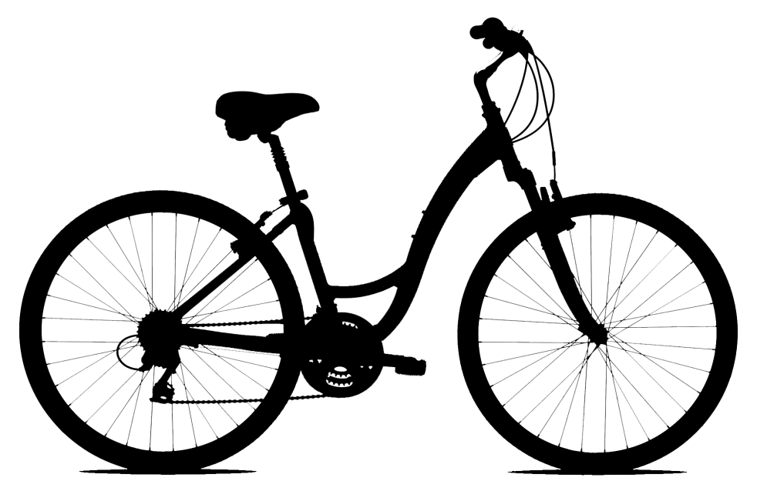
Measuring the Pulse of the City through Shared Bicycle Programs
Jon Froehlich (UW)
Joachim Neumann (TiD) and Nuria Oliver (TiD)
design:
use:
build:
university of washington
Research
Notes:
Our focus is on utilizing existing urban infrastructure to sense data that is *freely* available

Slide 2
collecting large volumes of real data about human mobility patterns is a challenging yet high value problem

Slide 3
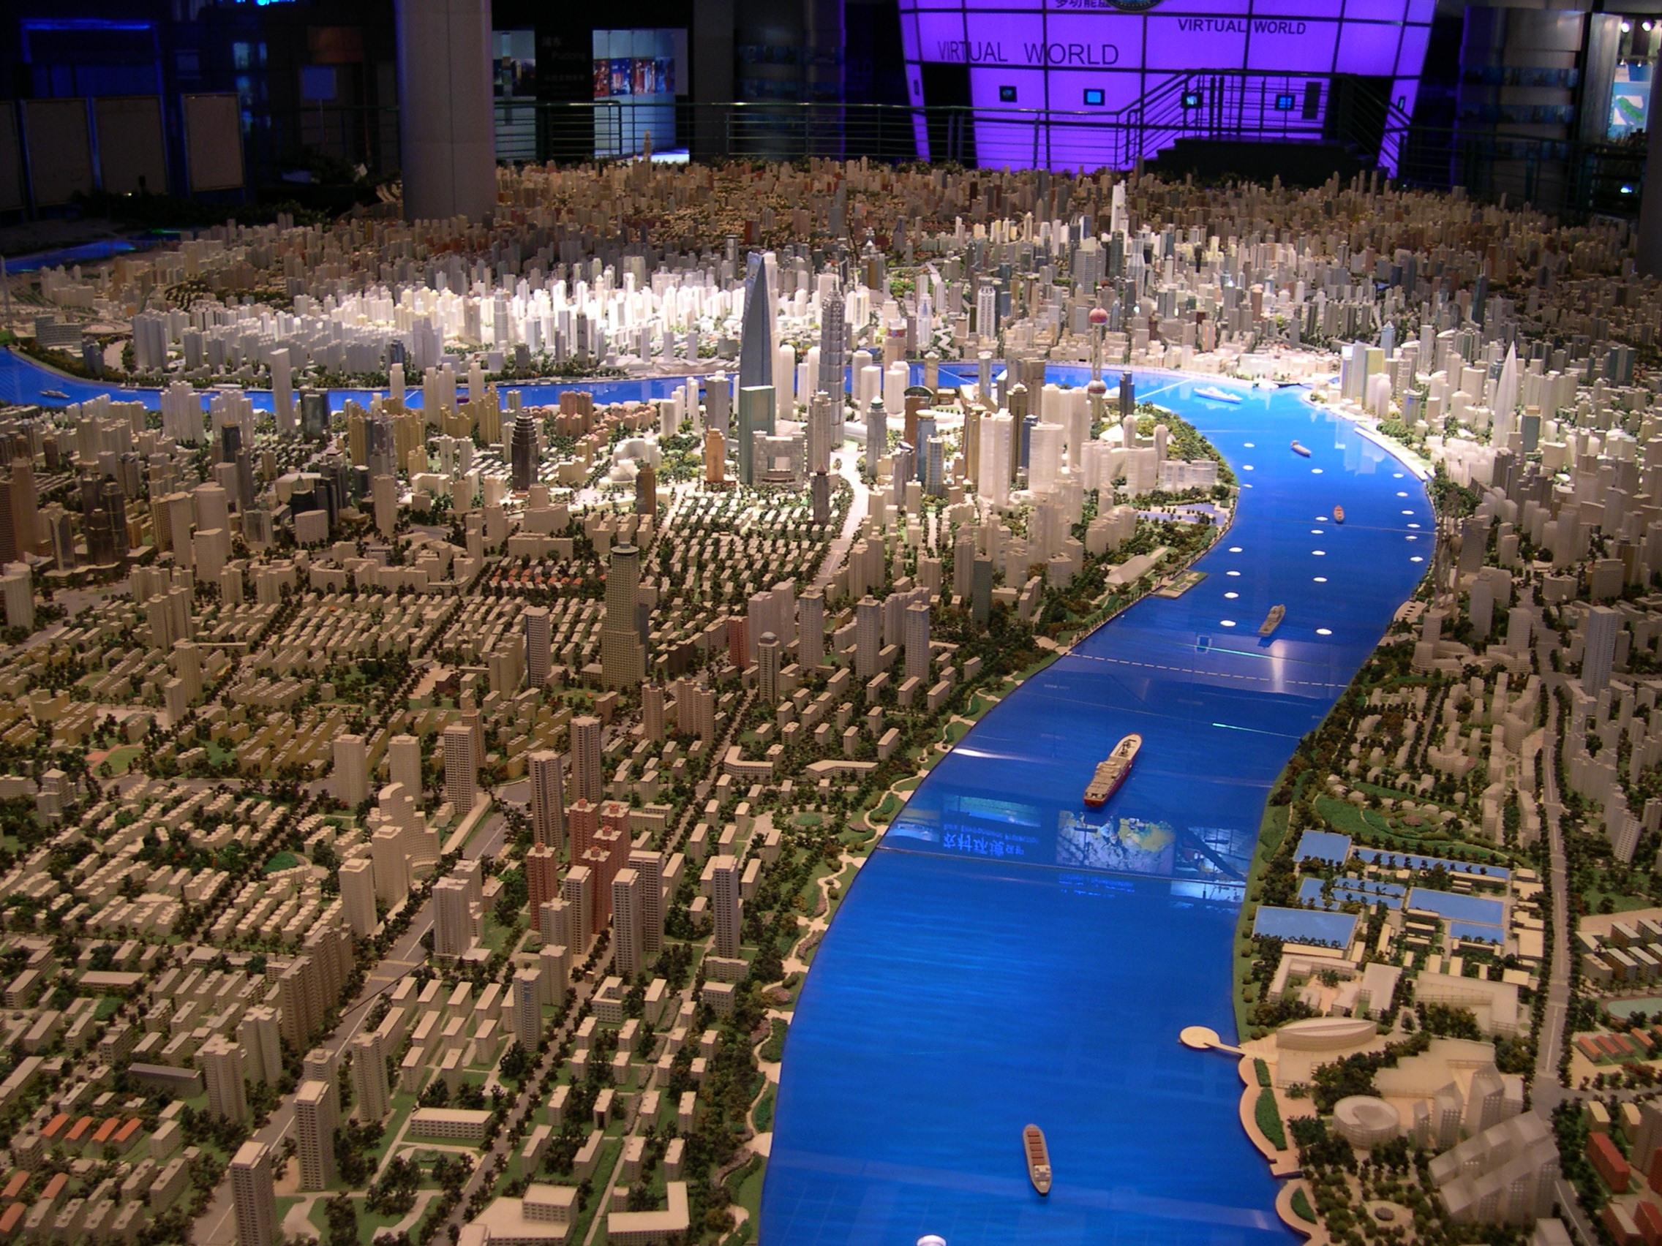
Notes:
for city-planners, governments, urban transit studies, traffic forecasting

Slide 4
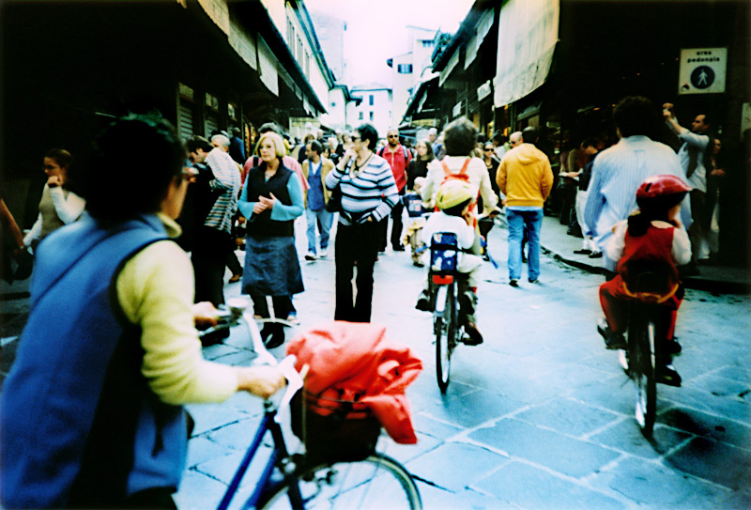
Notes:
for social scientists to understand the periodicity and routines in behavior
access to masses of data that are of the same order of magnitude as that of the natural sciences (latour)

Slide 5
Notes:
understand and predict the spread of biological viruses

Slide 6
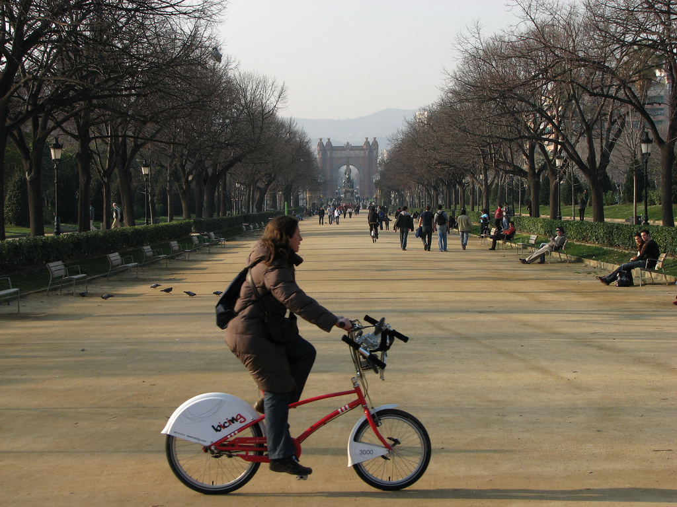
Bicing users themselves
Notes:
bicing users and the bicing administrators

Slide 7
large volume human mobility datasets

Slide 8
real-time rome
MIT’s SENSEable City Lab, directed by Carlo Ratti
Notes:
Real Time Rome is the MIT SENSEable City Lab’s contribution to the 2006 Venice Biennale, directed by professor Richard Burdett. The project aggregated data from cell phones (obtained using Telecom Italia's innovative Lochness platform), buses and taxis in Rome to better understand urban dynamics in real time. By revealing the pulse of the city, the project aims to show how technology can help individuals make more informed decisions about their environment. In the long run, will it be possible to reduce the inefficiencies of present day urban systems and open the way to a more sustainable urban future?
http://senseable.mit.edu/realtimerome/

Slide 9
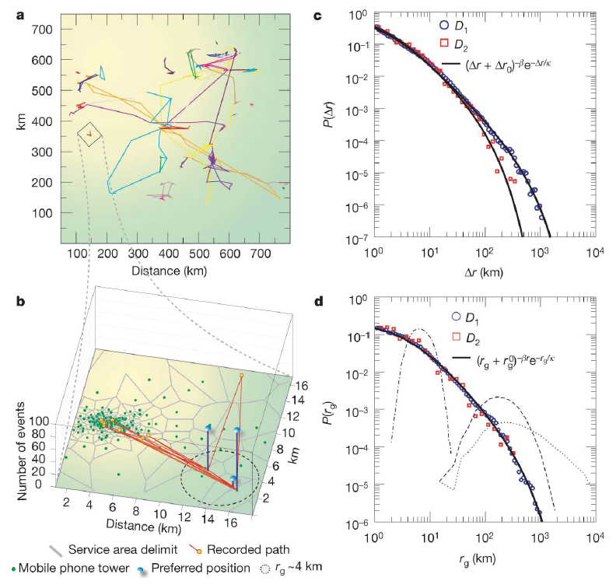
understanding human mobility patterns
Marta C. González, César A. Hidalgo & Albert-László Barabási, Nature, 5 June 2008
Notes:
Despite their importance for urban planning1, traffic forecasting2
and the spread of biological3–5 and mobile viruses6, our understanding
of the basic laws governing human motion remains
limited owing to the lack of tools to monitor the time-resolved
location of individuals. Here we study the trajectory of 100,000
anonymized mobile phone users whose position is tracked for a
six-month period. We find that, in contrast with the random trajectories
predicted by the prevailing Le´vy flight and random walk
models7, human trajectories show a high degree of temporal and
spatial regularity, each individual being characterized by a timeindependent
characteristic travel distance and a significant probability
to return to a few highly frequented locations. After
correcting for differences in travel distances and the inherent
anisotropy of each trajectory, the individual travel patterns collapse
into a single spatial probability distribution, indicating that,
despite the diversity of their travel history, humans follow simple
reproducible patterns. This inherent similarity in travel patterns
could impact all phenomena driven by human mobility, from
epidemic prevention to emergency response, urban planning
and agent-based modelling.

Slide 10
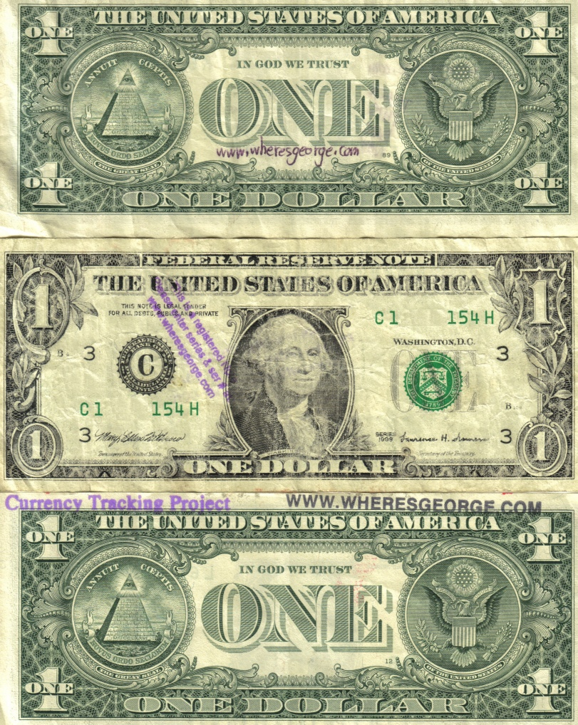
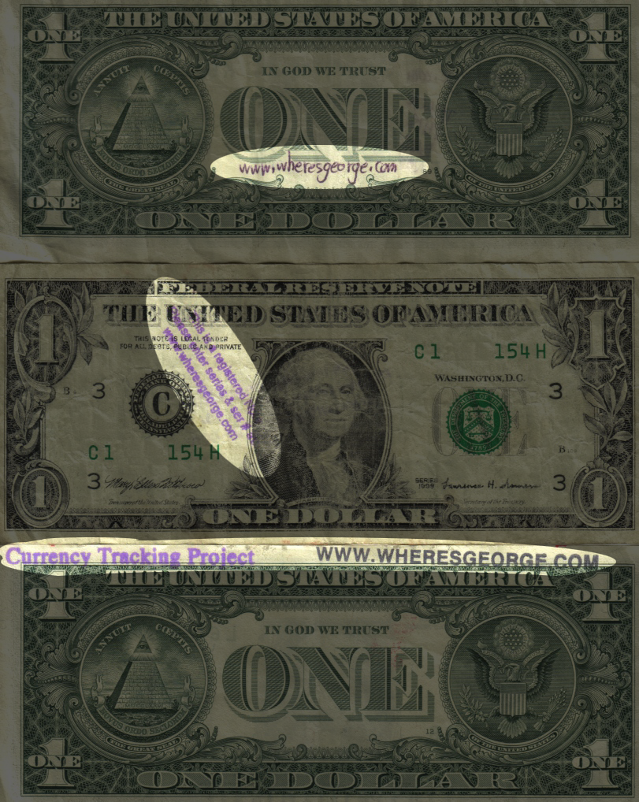
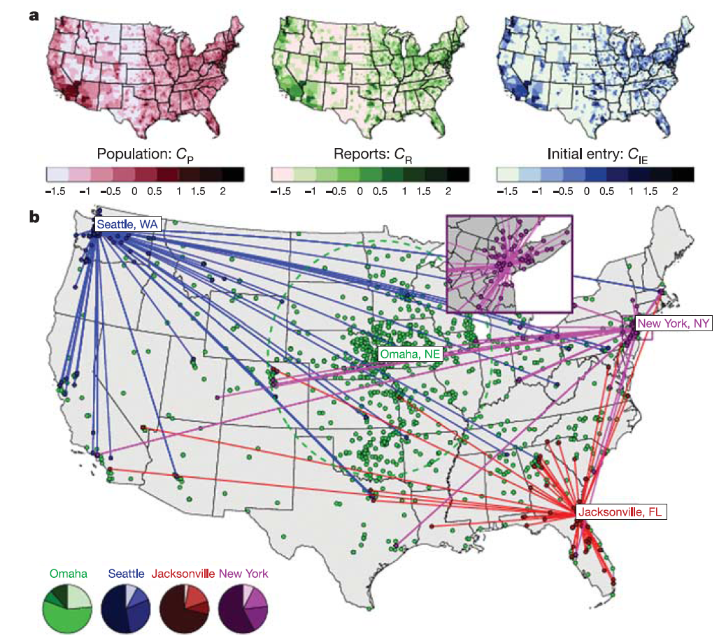

Slide 11
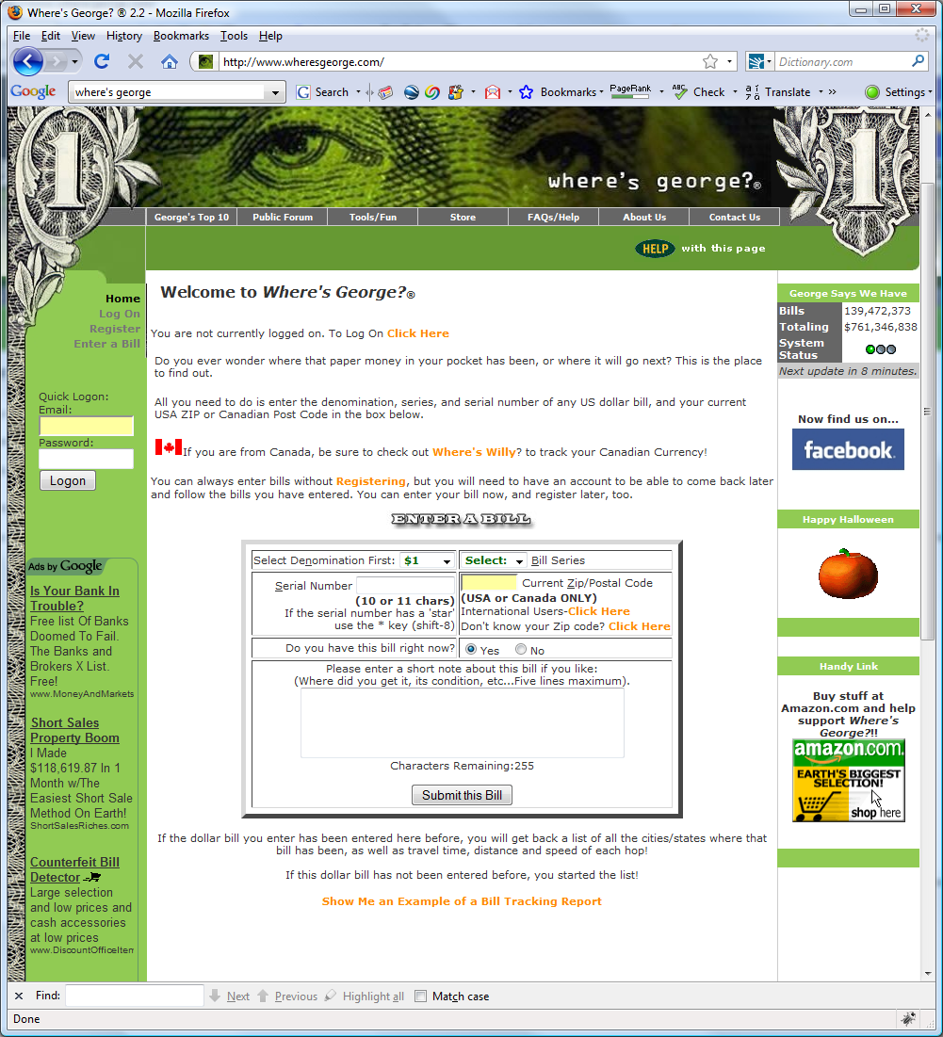

Slide 12
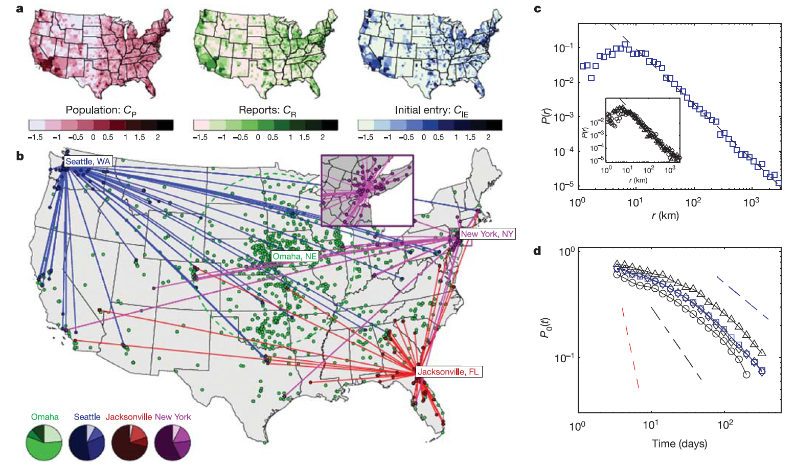
scaling laws of human travel
D. Brockmann, L. Hufnagel & T. Geisel, Nature, 26 Jan 2006
Notes:
The dynamic spatial redistribution of individuals is a key driving
force of various spatiotemporal phenomena on geographical
scales. It can synchronize populations of interacting species,
stabilize them, and diversify gene pools. Human travel, for
example, is responsible for the geographical spread of human
infectious disease. In the light of increasing international trade,
intensified human mobility and the imminent threat of an influenza
A epidemic10, the knowledge of dynamical and statistical
properties of human travel is of fundamental importance. Despite
its crucial role, a quantitative assessment of these properties on
geographical scales remains elusive, and the assumption that
humans disperse diffusively still prevails in models. Here we
report on a solid and quantitative assessment of human travelling
statistics by analysing the circulation of bank notes in the United
States. Using a comprehensive data set of over a million individual
displacements, we find that dispersal is anomalous in two ways.
First, the distribution of travelling distances decays as a power law,
indicating that trajectories of bank notes are reminiscent of scalefree
random walks known as Le´vy flights. Second, the probability
of remaining in a small, spatially confined region for a time T is
dominated by algebraically long tails that attenuate the superdiffusive
spread.We show that human travelling behaviour can be
described mathematically on many spatiotemporal scales by a
two-parameter continuous-time random walk model to a surprising
accuracy, and conclude that human travel on geographical
scales is an ambivalent and effectively superdiffusive process.

Slide 13
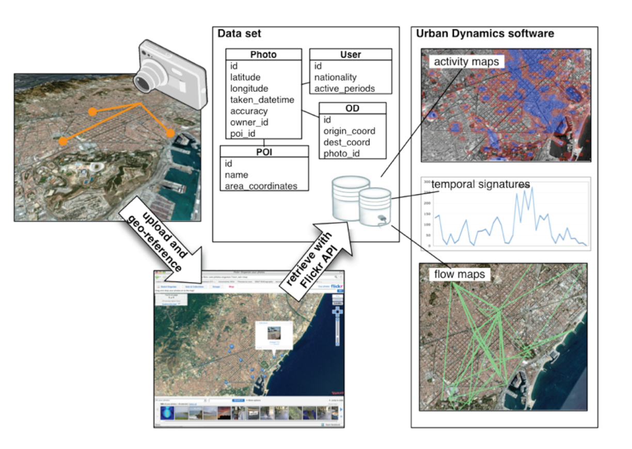
digital footprinting: uncovering tourists with user-generated content
Girardin, F., Calabrese, F., Dal Fiore, F. , Ratti, C., and Blat, J. (2008). IEEE Pervasive Computing

Slide 14
so why now?
Notes:
short of it: the data is becoming pervasive and its cheap to store

Slide 16
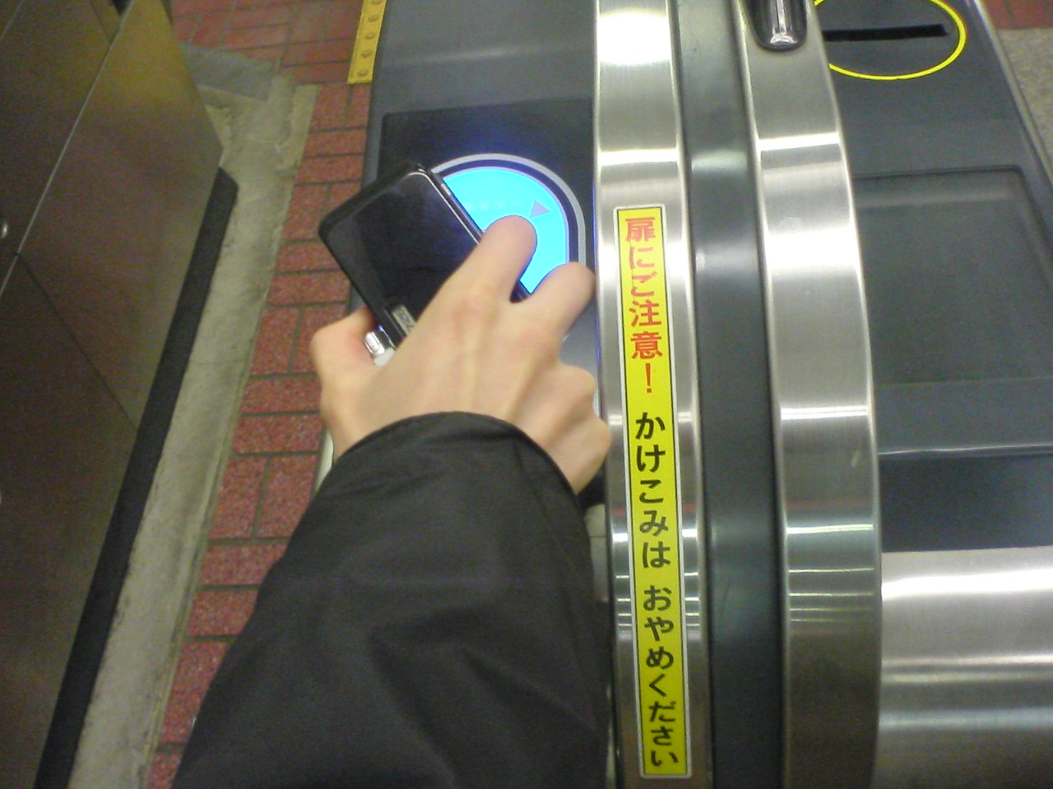

Slide 17
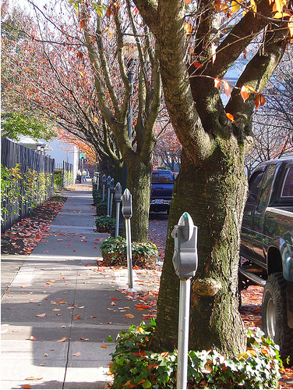
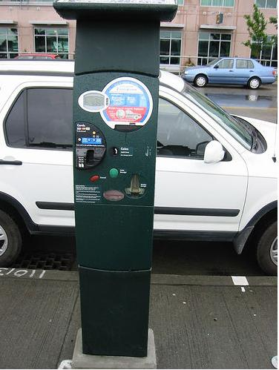

Slide 18
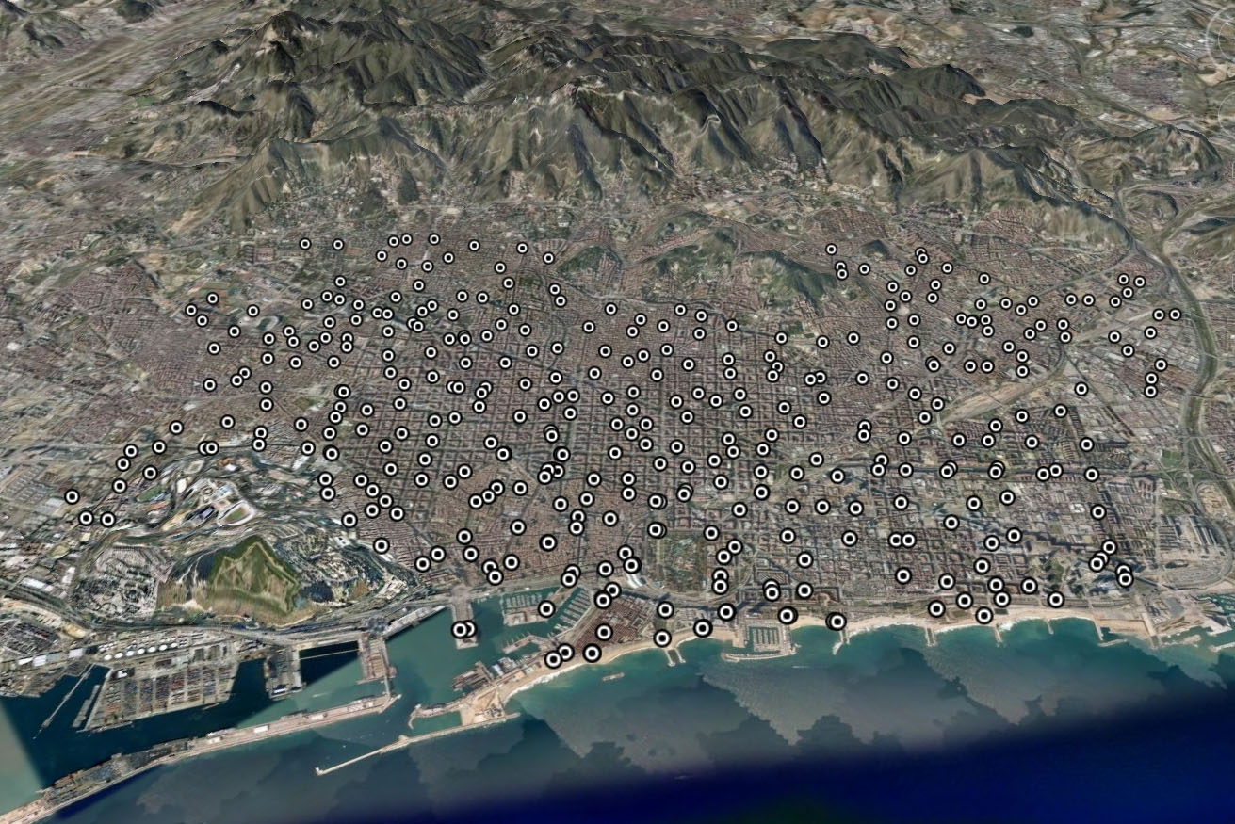
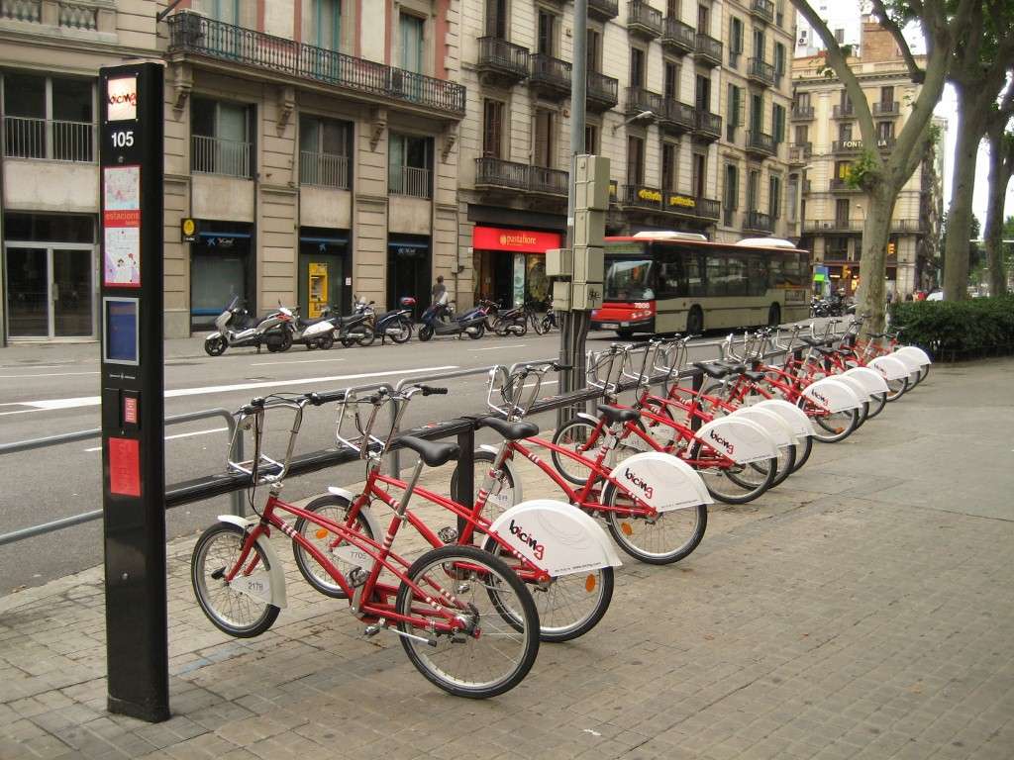
Launched March 2007
By Summer 2008:
- 373 stations
- 6,000 bicycles
- 150,000 subscribers
Notes:
Bicing station

Slide 19
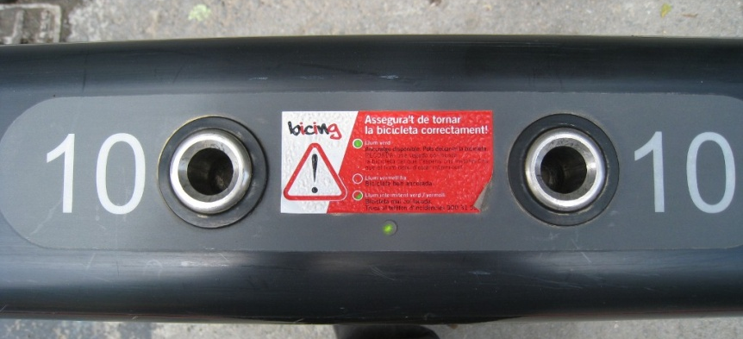
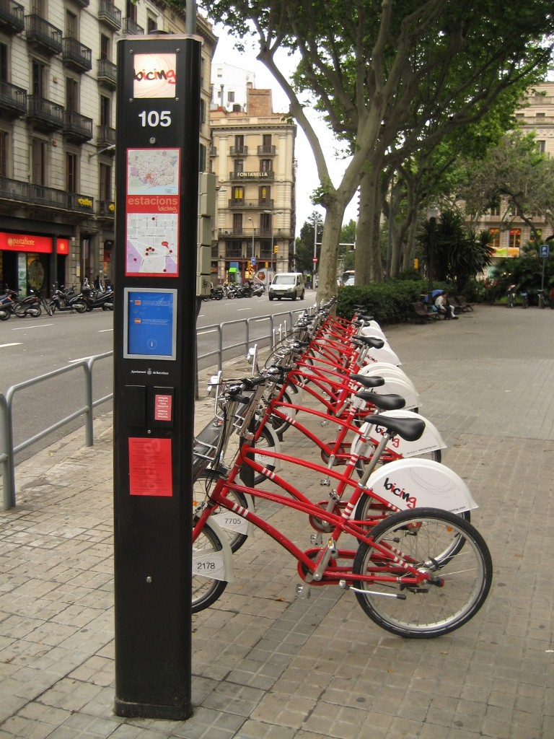
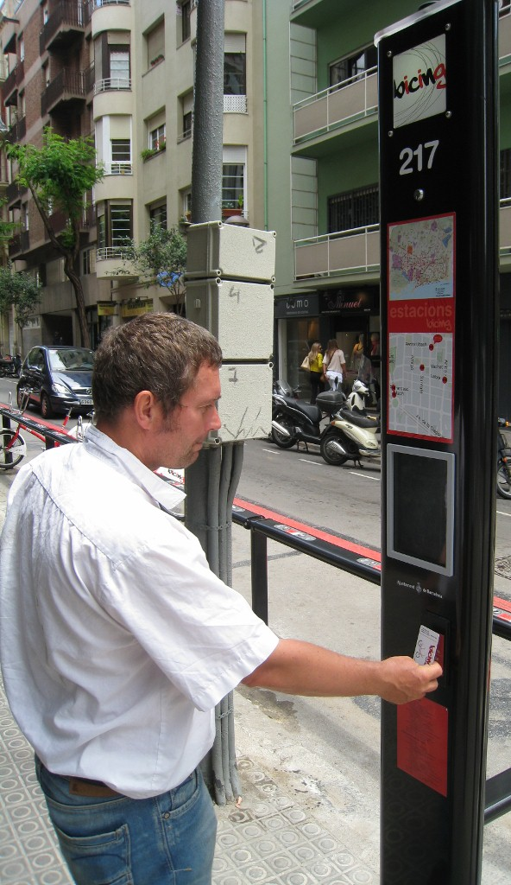
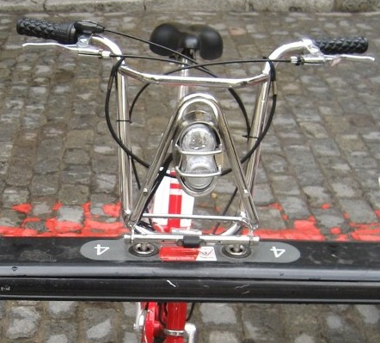
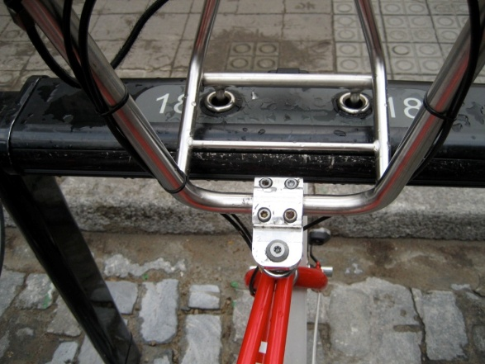

Slide 20
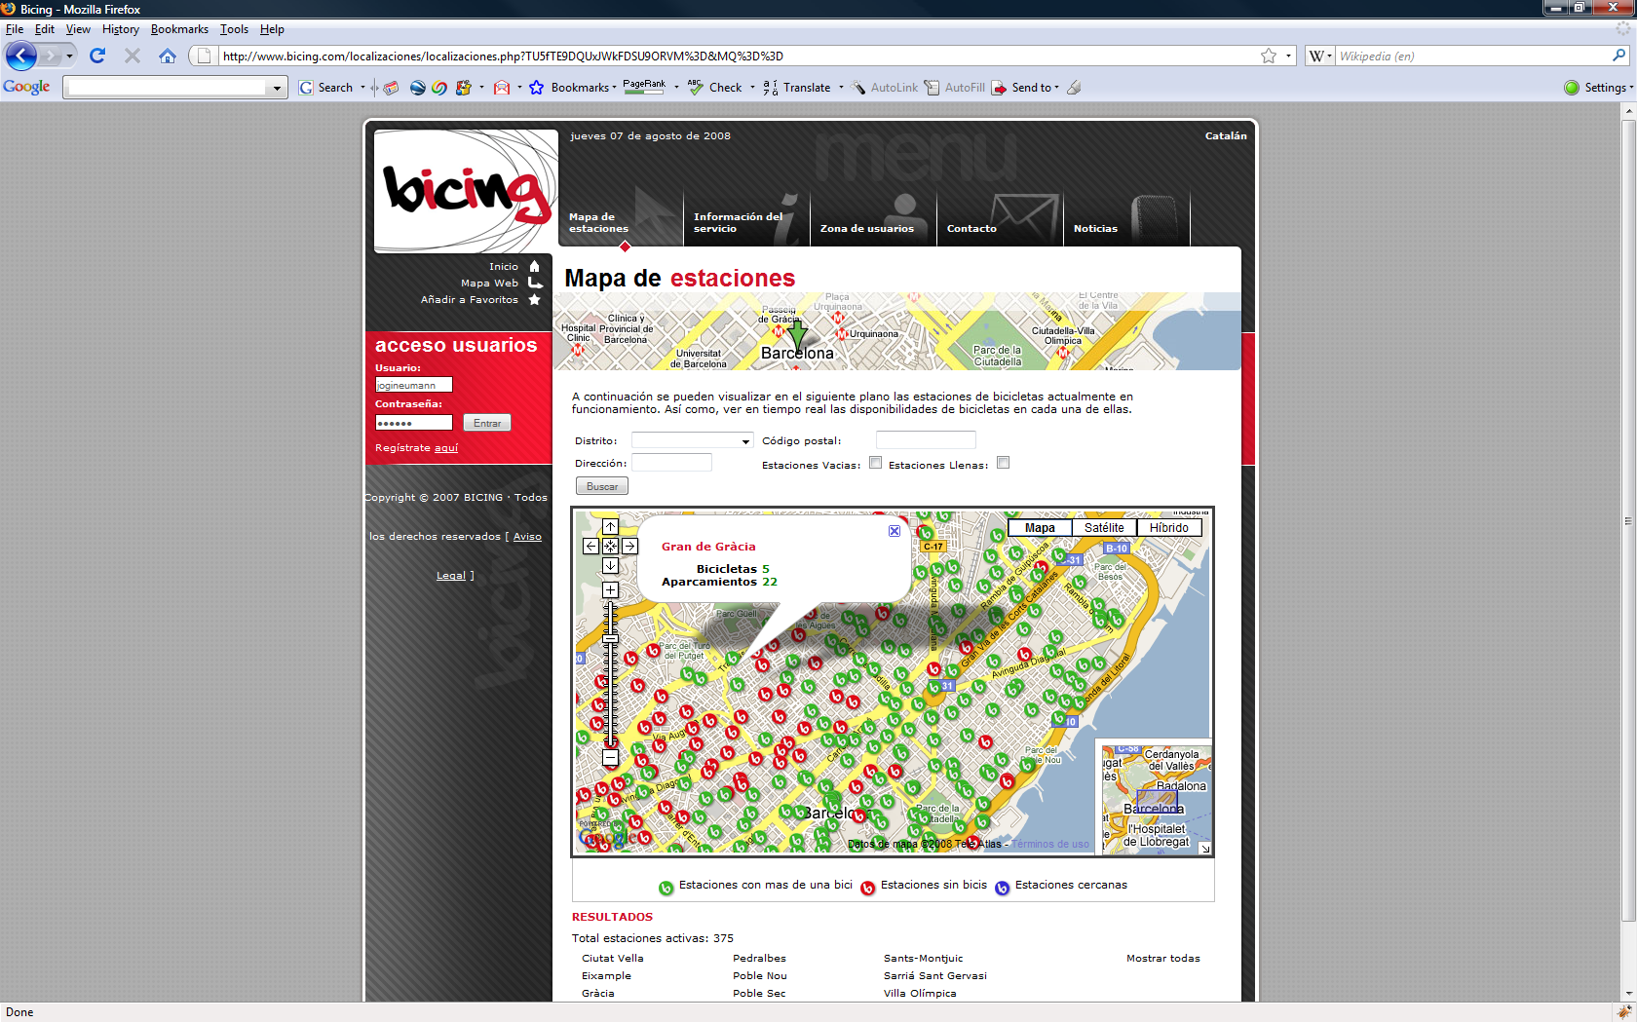
data collection
Scrape Bicing webpage every 5 minutes
Extract
Station’s geo-location
# of available bicycles
# of vacant parking slots
No personally identifiable information
4.3 million observations / 371 stations
Notes:
We scrape this webpage every five minutes and extract three data elements per station: the station’s geo-location, the number of available bicycles and the number of vacant parking slots. We do not obtain personally identifiable information. Our data logger automatically accounts for new Bicing stations as they appear online.
About 1% of the raw data extracted from the Bicing website suffers from noise. Our cleaned dataset includes six weeks of station observations starting on May 23rd and ending on July 3rd, 2008 for a total of over 4.3 million data points. Note that 2 of the 373 stations consistently reported invalid data and were thus disregarded from our analysis. Although our web scraper has been logging continuously since May 23rd, the Bicing website was down from July 3rd - 30th.

Slide 21
pause for video

Slide 22
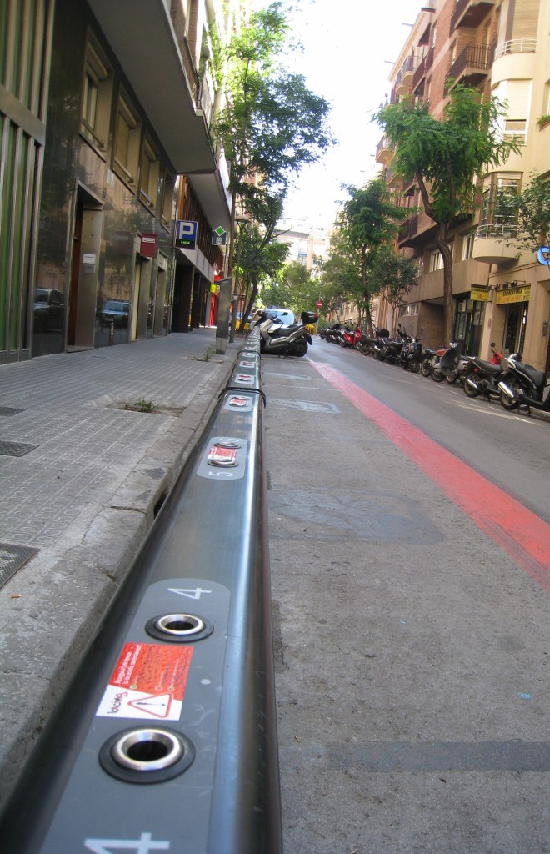
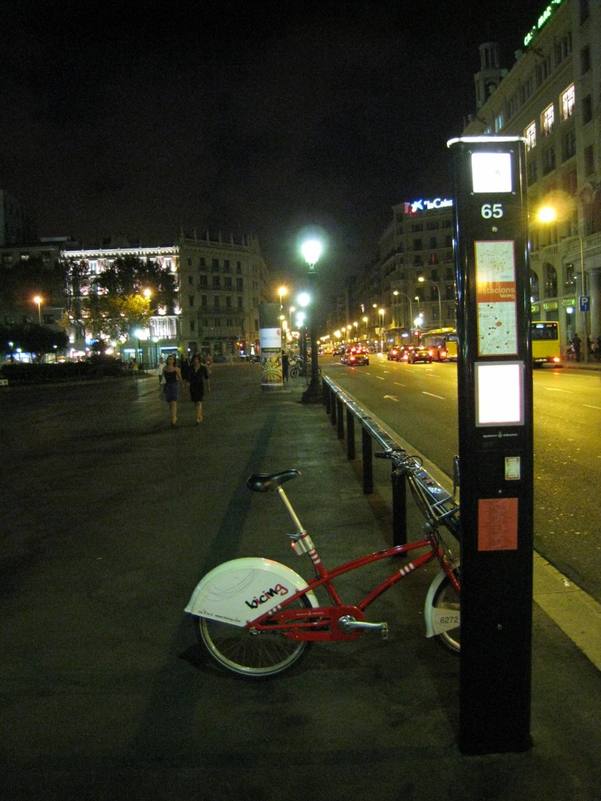
uphill station
(midday)
downtown station
(night)

Slide 23
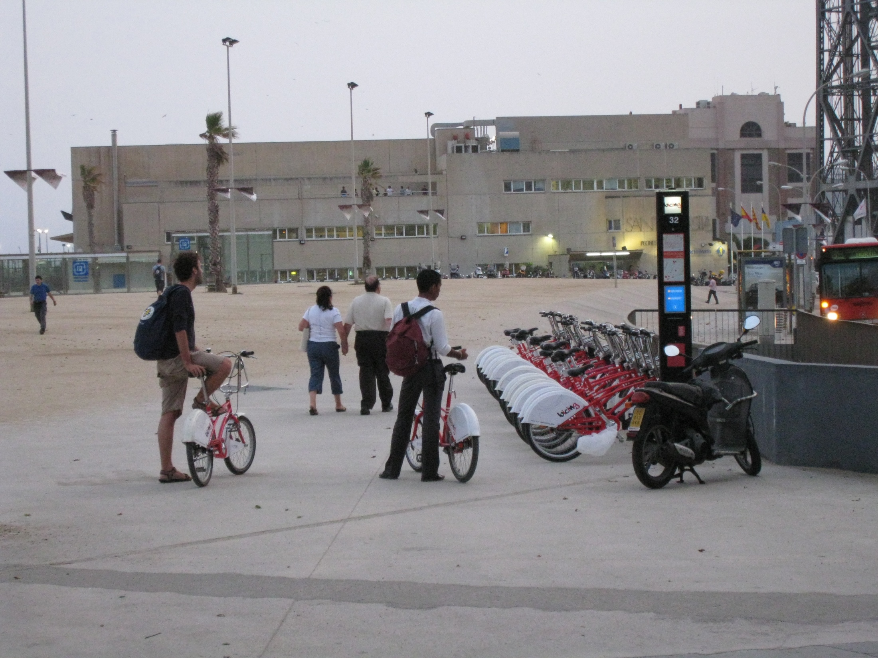
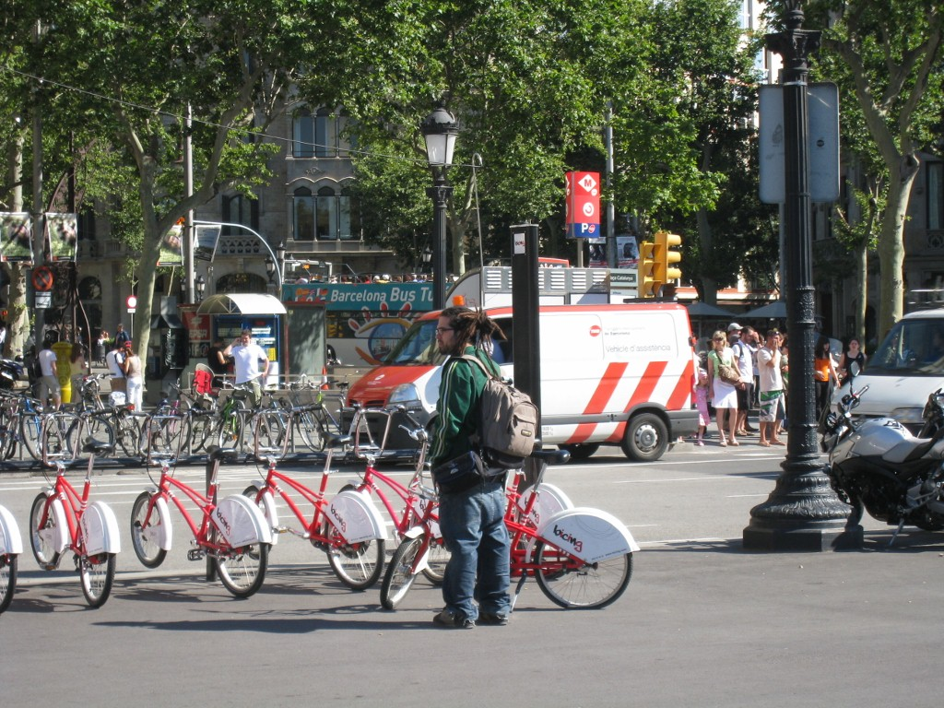
downtown station
(morning)

Slide 24
beach station
(evening)

Slide 25
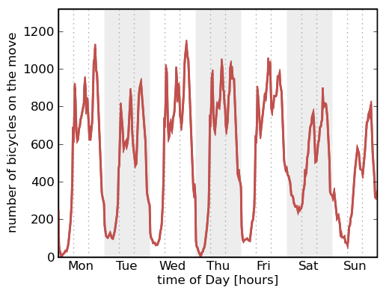
bicycles on the move
morning commute
late spanish lunch
evening commute
sleeping in on weekends

Slide 26
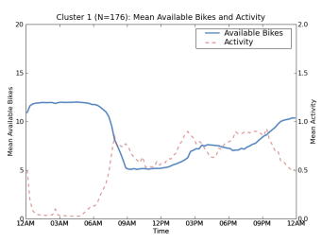
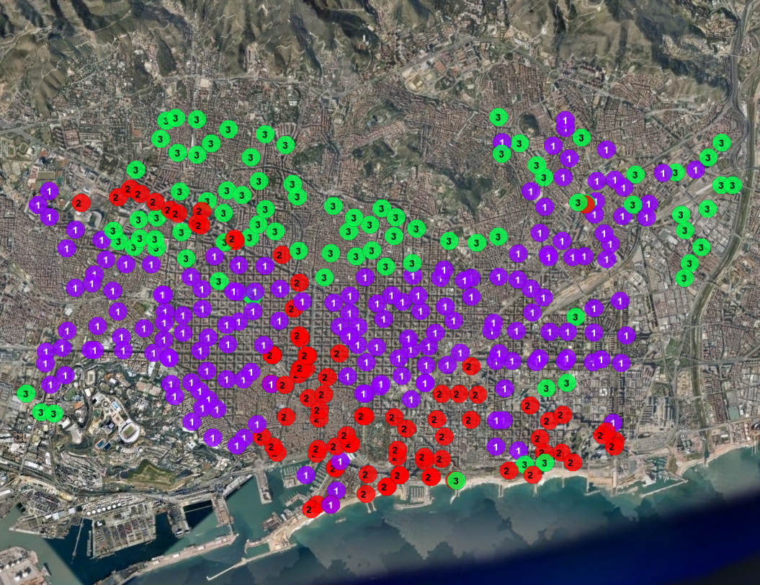
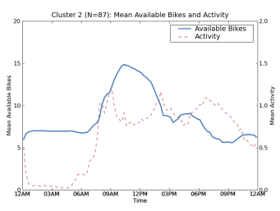
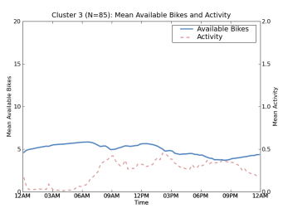
neighborhoods
1
outgoing
2
incoming
3
low activity

Slide 27
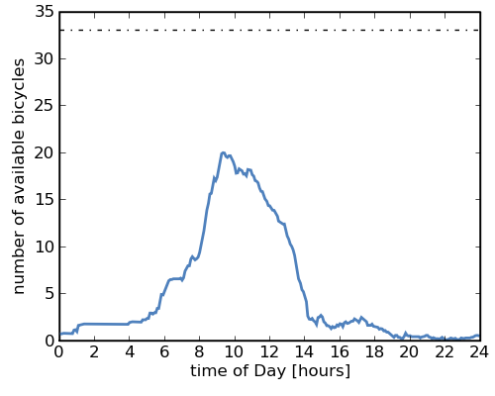
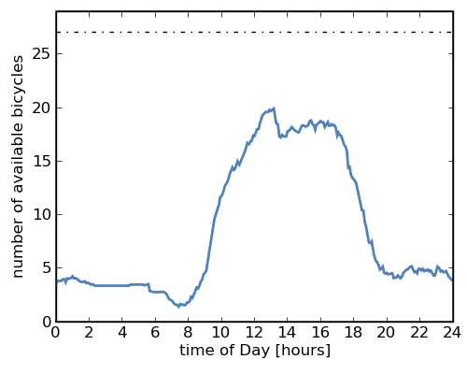
subtle differences
Commercial District (Station 203)
Beach (Station 170)
6AM
2PM
8AM
8PM

Slide 28
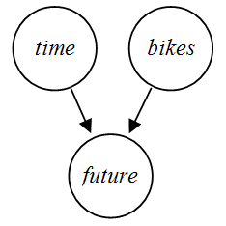
predicting human behavior
???
Notes:
Can we begin predicting human behavior and station usage patterns?

Slide 29
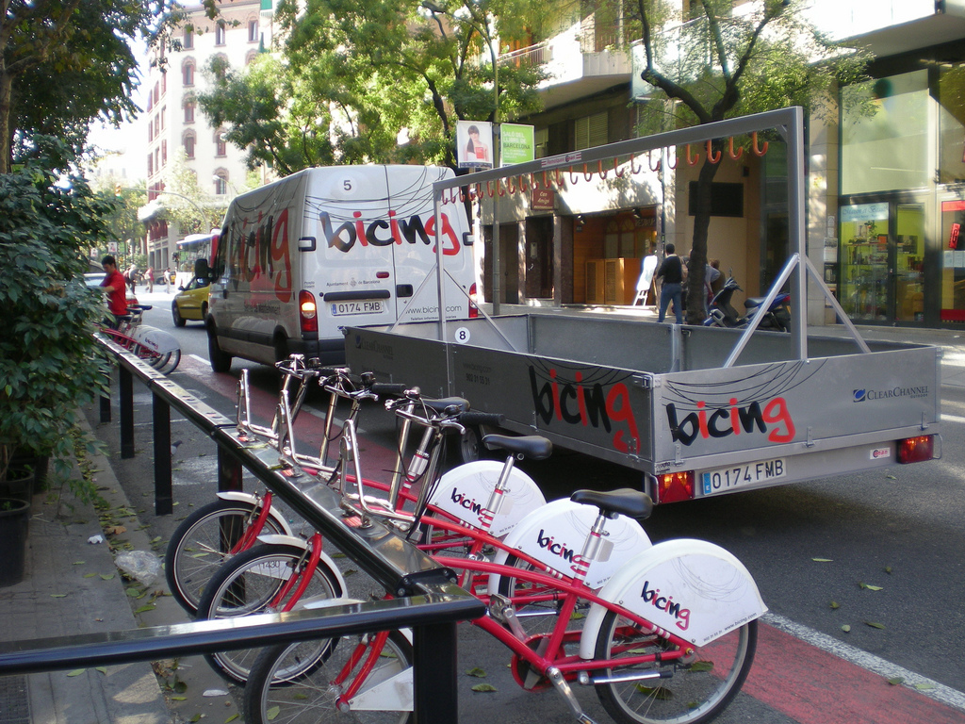
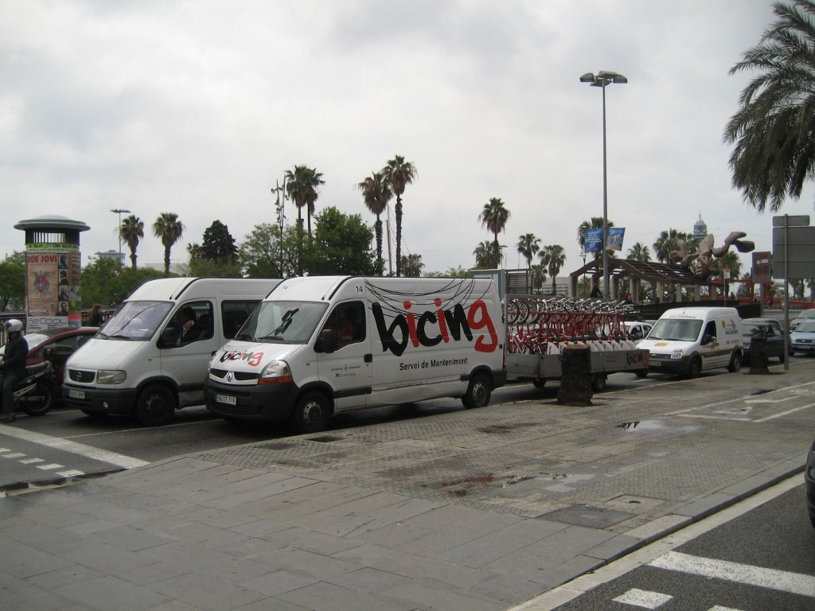
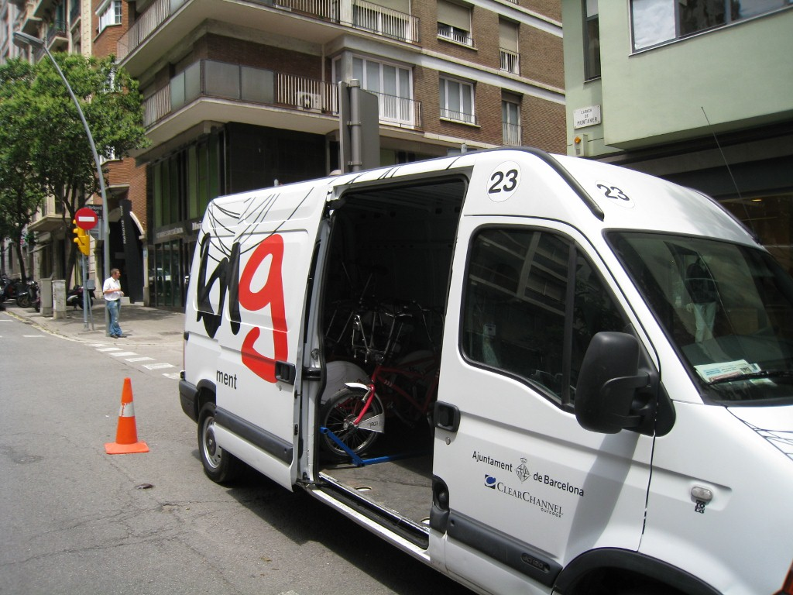
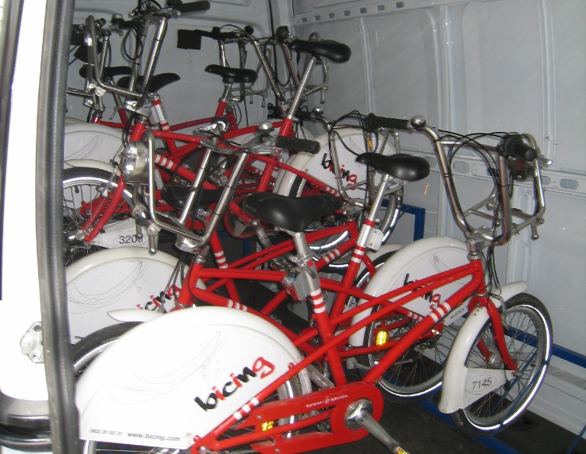
self-sustainable system
Notes:
Can we make bicing more self-sustainable?
Increasing efficiency of trucks.
Decreasing dependency on trucks.

Slide 30
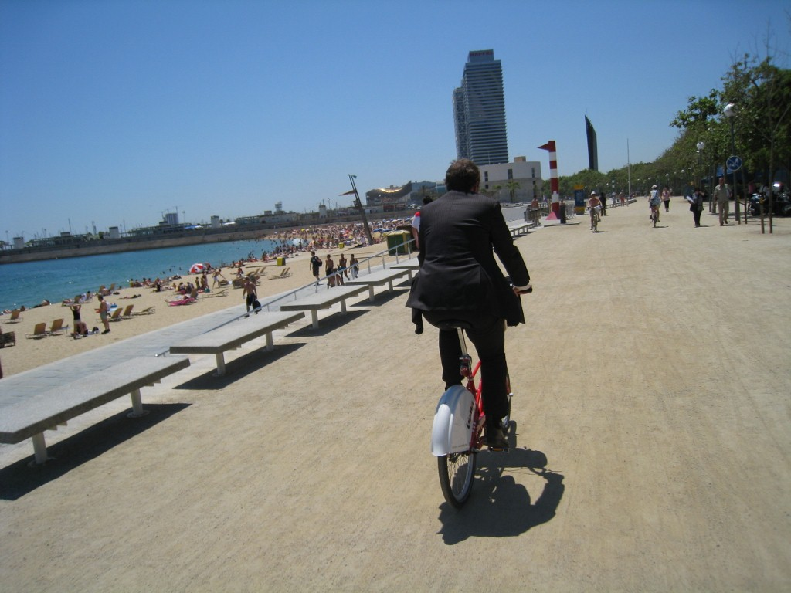
promote usage

Slide 31
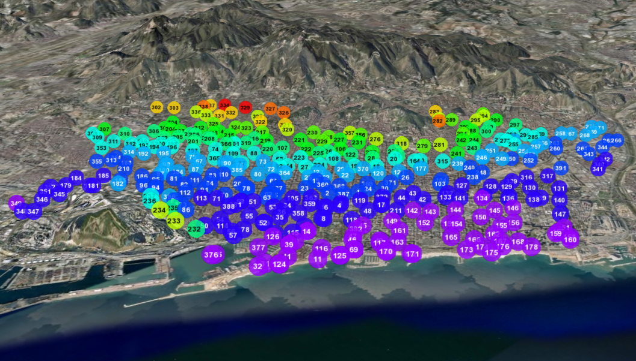
limitations...
Notes:
bicing provides only one type of view into the city—some human behaviorial aspects might be skewed as a result (for example, a popular place in the city does not have a correspondingly popular station simply because its uphill).

Slide 32
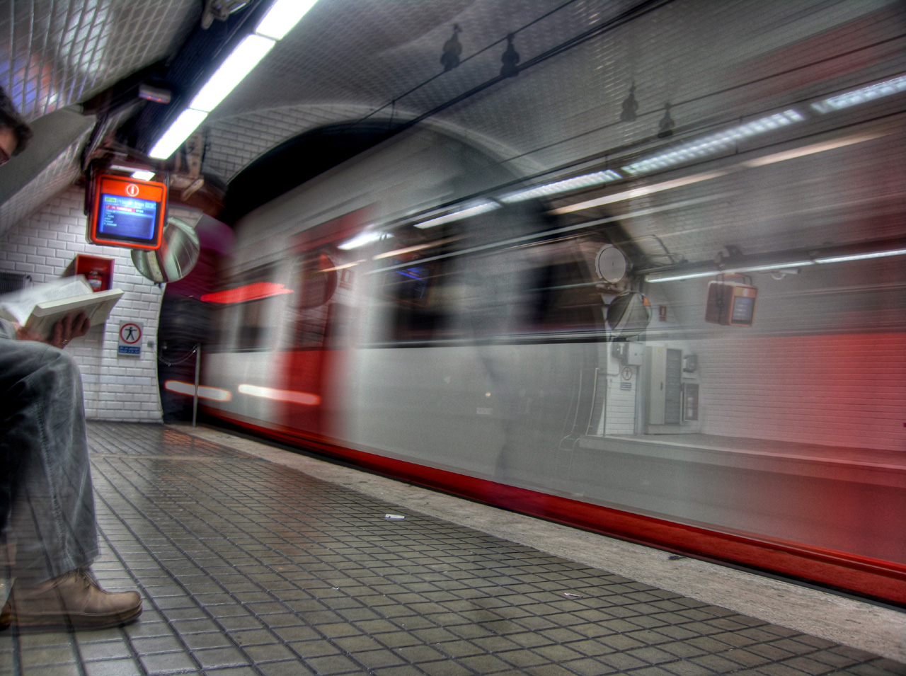
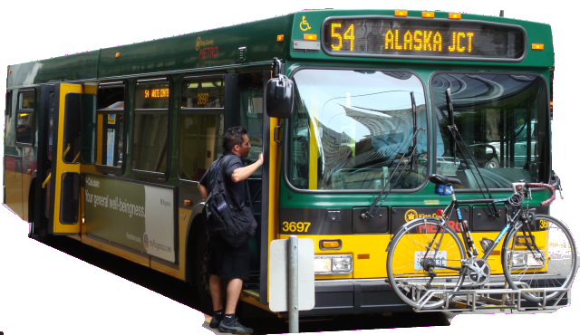
other mass transit
Notes:
Oyster card in England; cell phones in japan
Bus real-time locations available in seattle (and many other cities)
Access to data introduces many privacy concerns

Slide 33
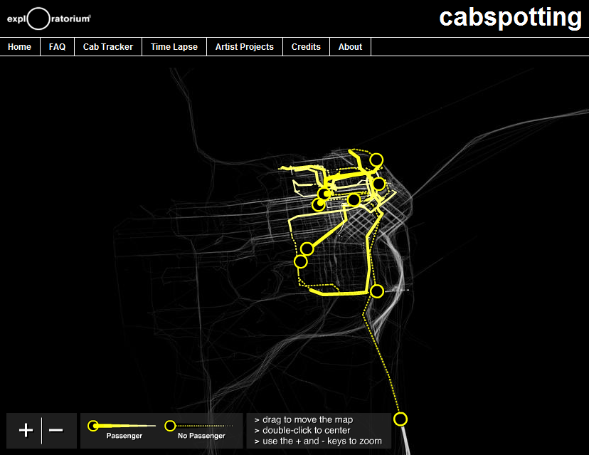

Slide 34
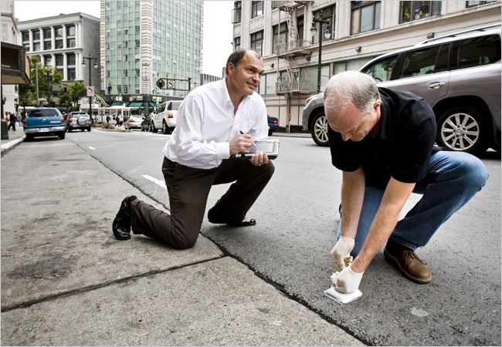
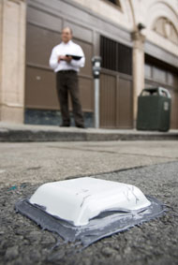
streetline: sfpark
Notes:
http://www.nytimes.com/2008/07/12/business/12newpark.html

Slide 35
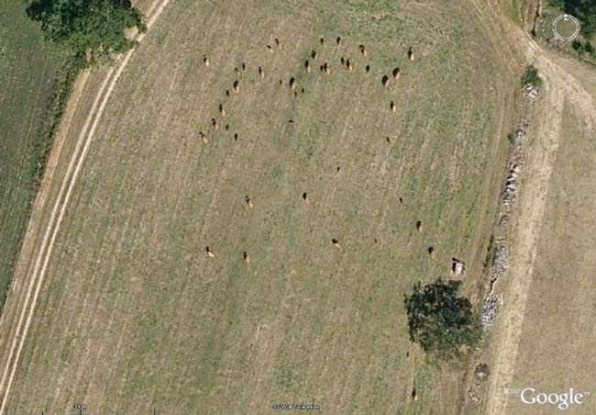
satellite imagery
Notes:
http://blog.wired.com/wiredscience/2008/08/google-earth-re.html
http://articles.latimes.com/2008/aug/26/science/sci-cows26

Slide 36
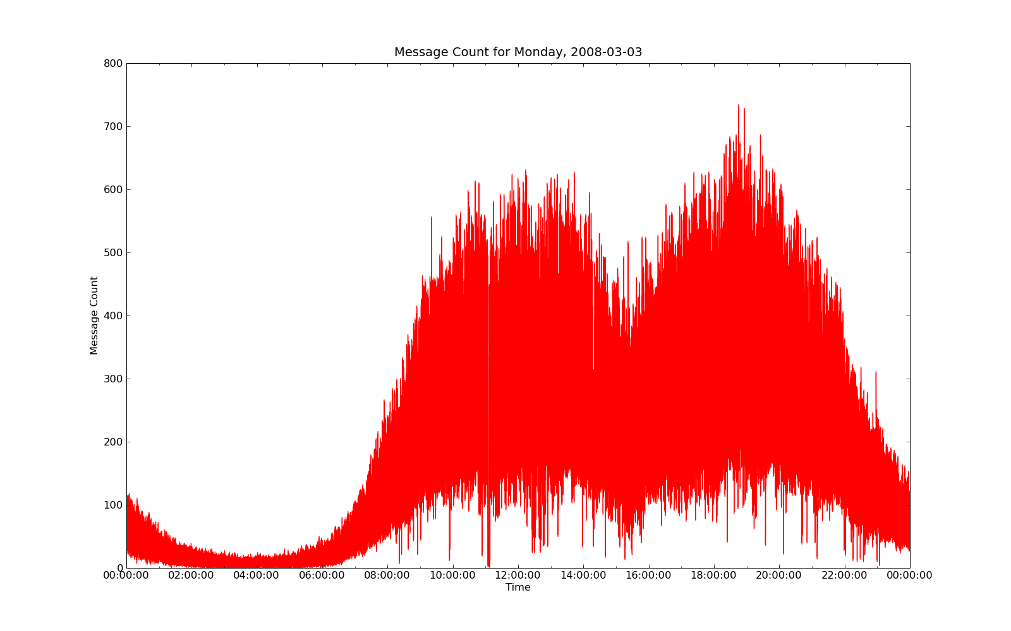
barcelona cellular network
12AM
7AM
4PM
12AM

Slide 37
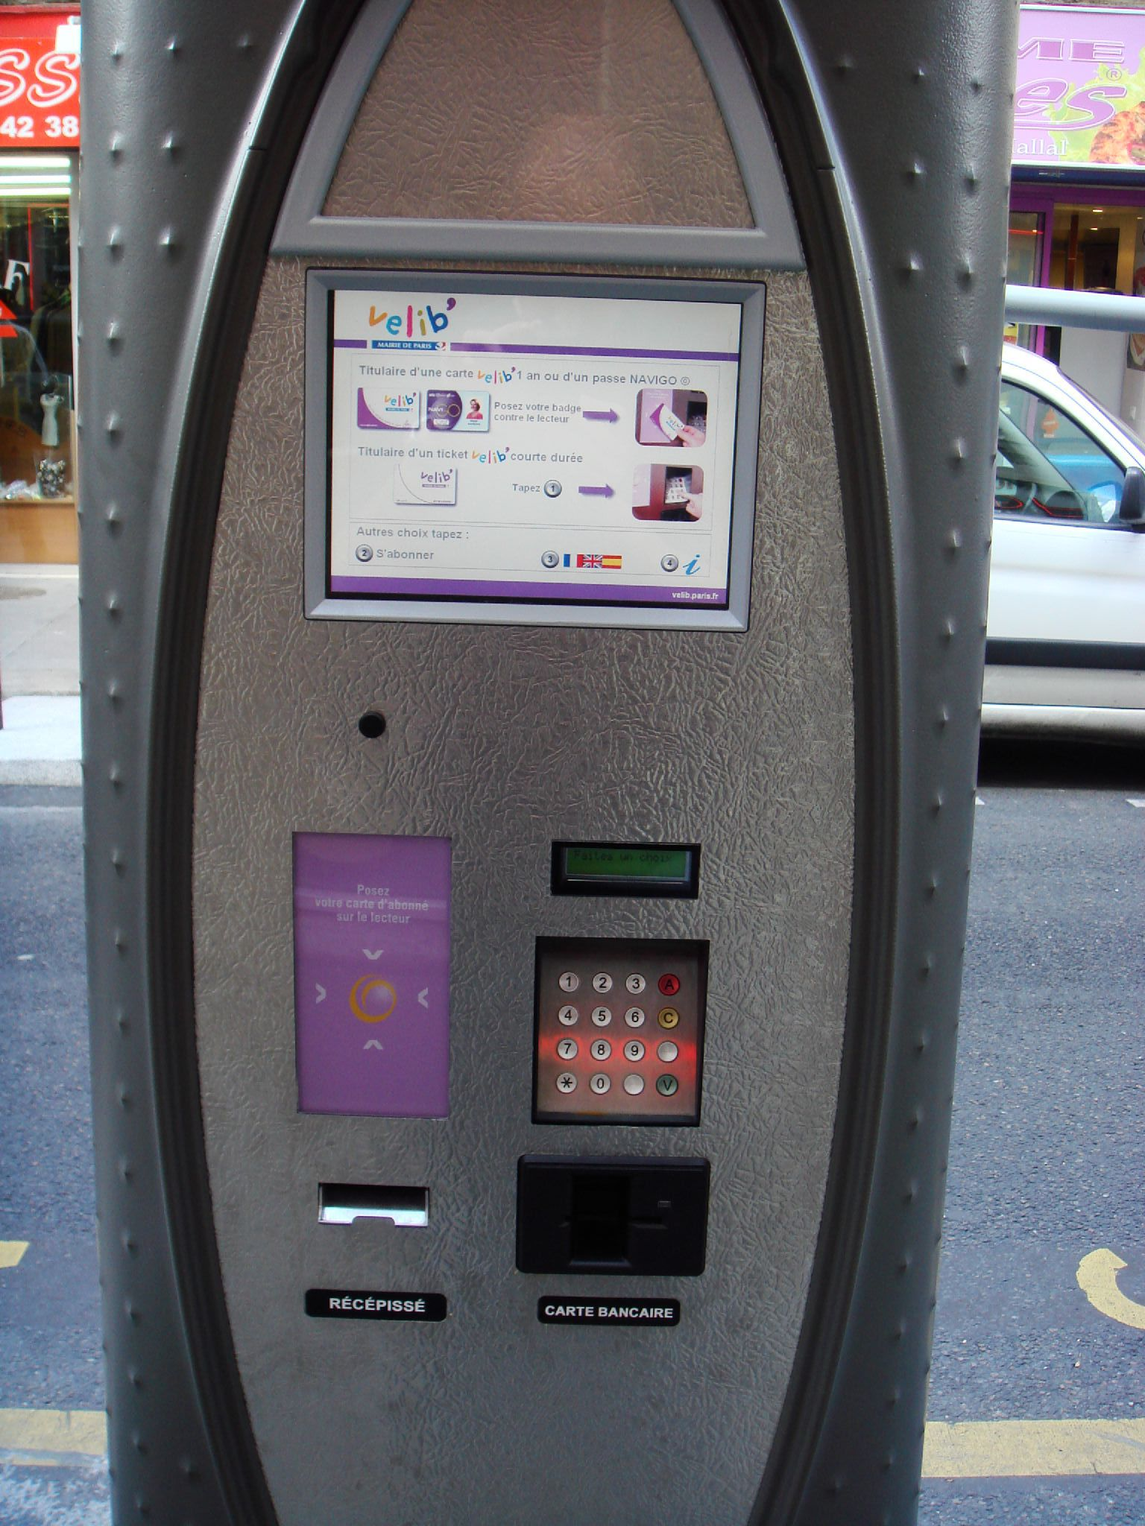
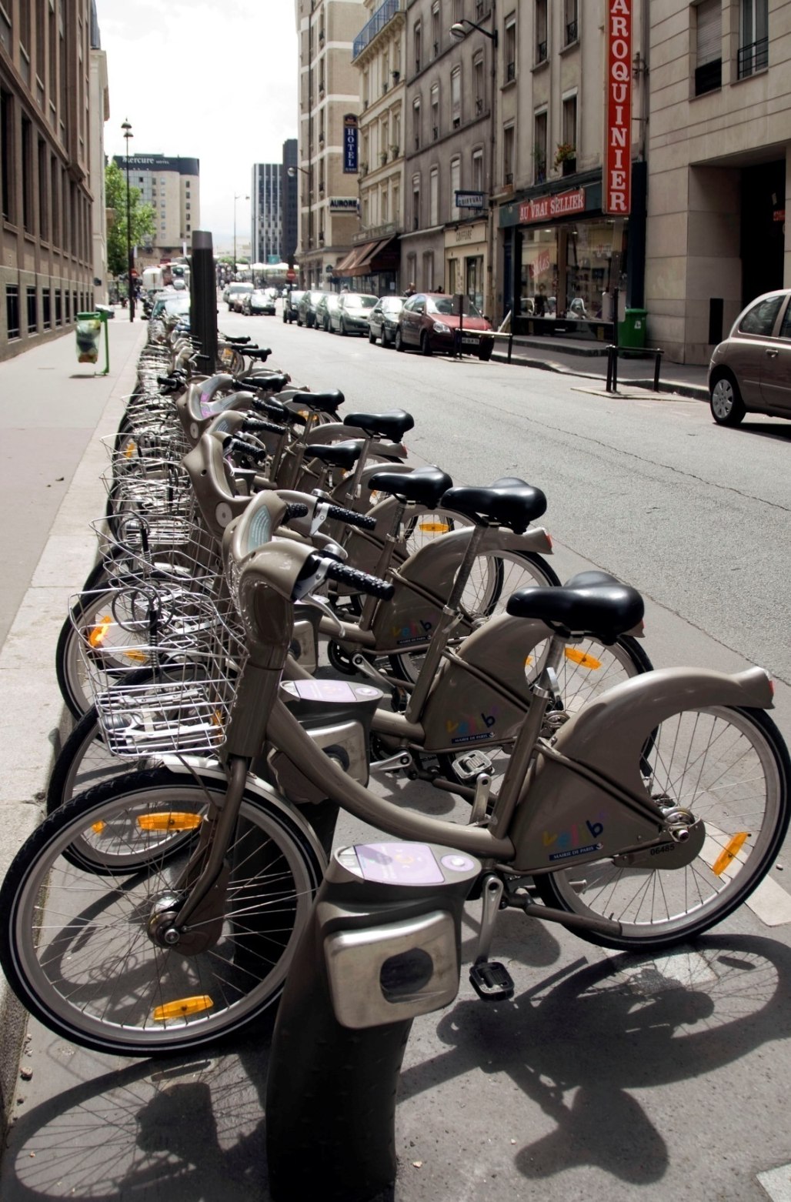
Notes:
velib

Slide 38
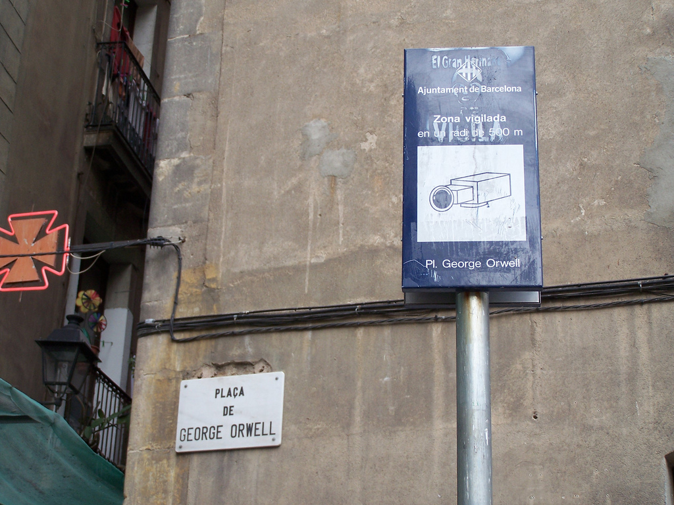
from Fabien Giradin’s ICING 2008
talk on Sentient to Responsive Cities
Notes:
what does it mean when potentially every action we take can be observed and stored?
Picture originally from Flickr but seen in Fabien Giradin’s talk at ICING2008

Slide 39
final slide
the digitalization of urban infrastructure can be leveraged to:
further our understanding of human behavior
create new services
how can data sources be tied together?
what tools/viz need to be built?
what other sources of data await us?
how can we protect our own traces?

Slide 40
Thank you!
jonfroehlich@gmail.com
design:
use:
build:
university of washington
Research

Slide 41
weekday vs. weekend
Station 47, Ramon Trias Fargas

Slide 43
cellular network data
Notes:
Real Time Rome is the MIT SENSEable City Lab’s contribution to the 2006 Venice Biennale, directed by professor Richard Burdett. The project aggregated data from cell phones (obtained using Telecom Italia's innovative Lochness platform), buses and taxis in Rome to better understand urban dynamics in real time. By revealing the pulse of the city, the project aims to show how technology can help individuals make more informed decisions about their environment. In the long run, will it be possible to reduce the inefficiencies of present day urban systems and open the way to a more sustainable urban future?
http://senseable.mit.edu/realtimerome/

