Slide 1
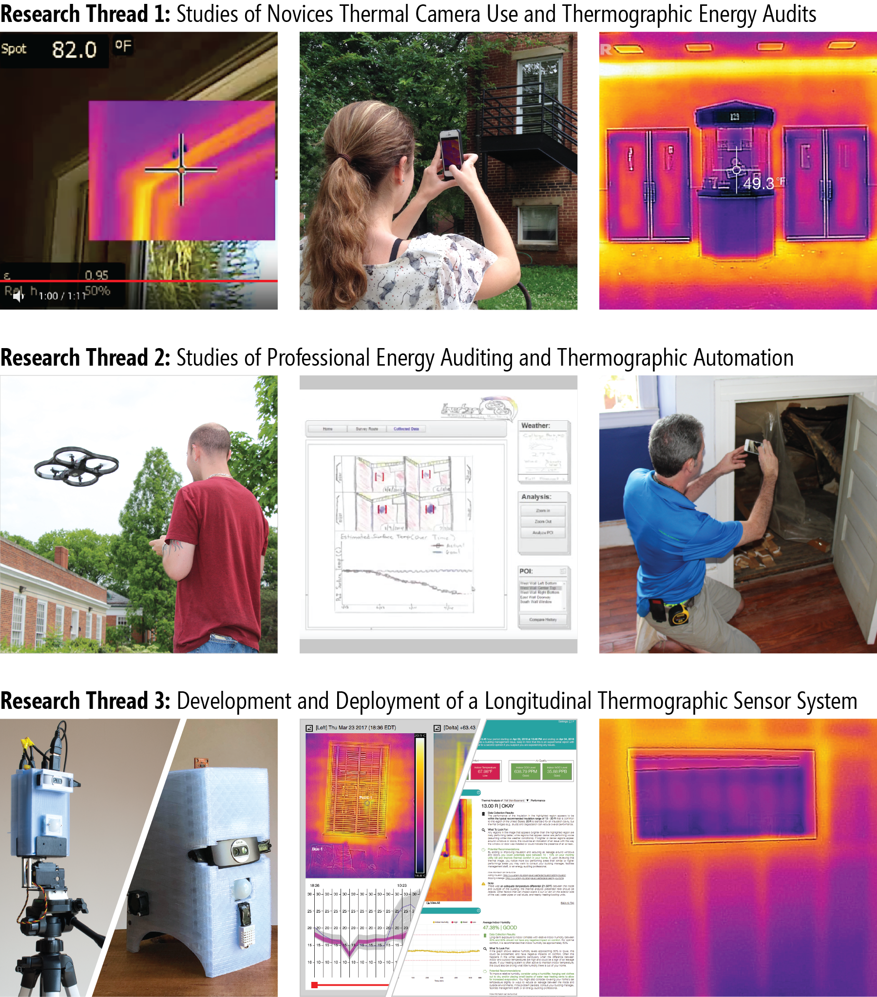

Thermporal: An Easy-to-Deploy Temporal Thermographic Sensor System to Support Residential Energy Audits
CHI 2019 | May 9th
Session on Sustainable HCI
Matthew Louis Mauriello
@mattm401
Brenna McNally
Jon E. Froehlich
Notes:
Hello, My name is Matthew Mauriello, I am a postdoc at Stanford University, and today I’ll discuss two qualitative evaluations of a novel, thermographic sensor system that were part of my dissertation work at the University of Maryland.

Slide 2
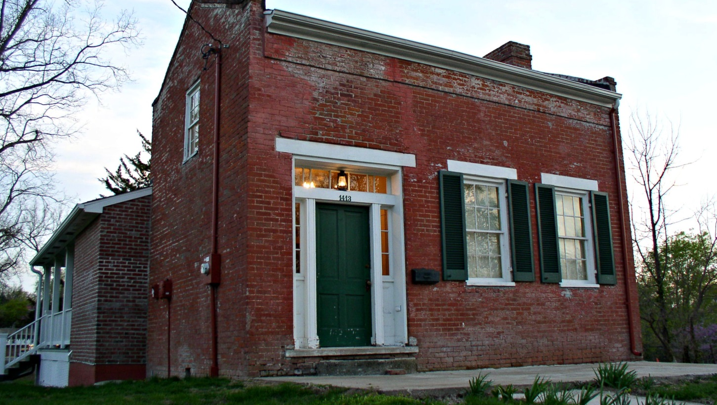
Notes:
So let’s start by looking at a typical residential home, if you or I were living here and paying the utility bill we would probably want this home to be as energy efficient as possible….

Slide 3
Common reasons for building inefficiencies include their design, materials, and age.
To address these issues, renovations and retrofits of existing building stock has become a pressing need.
The US Department of Energy (DOE), for example, has set a goal of reducing housing energy use by up to 70%.
Norberg-Bohm, V. and White, C. Building America Program Evaluation. 2004
Notes:
However, some common reasons for inefficiencies include the design of the building itself, the materials used in its construction which degrade over time, and then (of course) the building’s age. [CLICK]
Most buildings in the US are over 50 years old and replacing them would be quite expensive, so renovations and retrofits of existing building stock are viewed as a critical pathway for improving energy efficiency. [CLICK]
And, for example, The US Department of Energy encourages these actions as way of achieving their strategic goals of reducing housing energy use nationally…

Slide 4
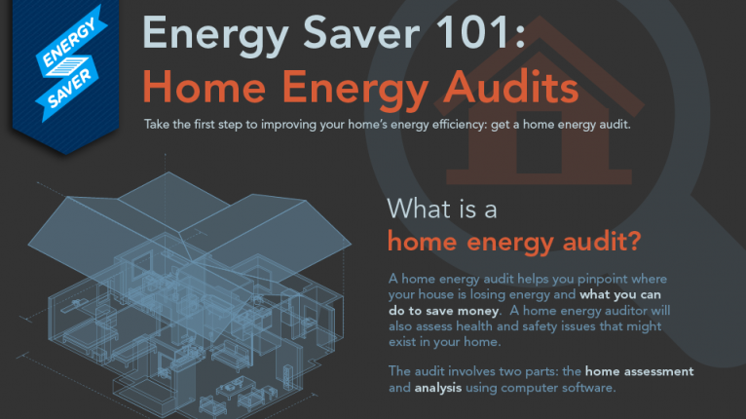
Notes:
One practice that has been shown to be effective at raising awareness and motivating retrofits is energy auditing,
which helps to identify problems, generate recommendations, and includes auxiliary benefits like ensuring the proper ventilation of onsite equipment.

Slide 5

Notes:
Increasingly, energy audits involve a thermographic component where auditors employ thermal cameras as both a diagnostic and communication aid…

Slide 6
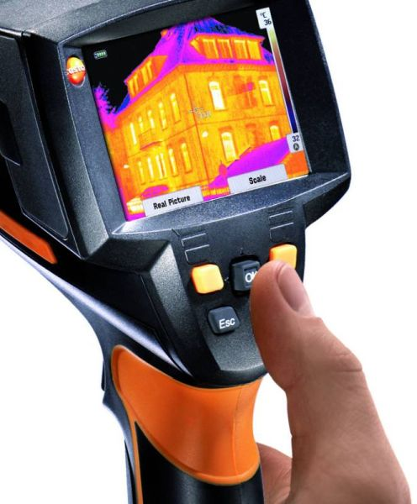
Thermal Cameras
Thermal cameras (or infrared cameras) detect electromagnetic radiation with lower frequencies than visible light (i.e., infrared frequencies).
All objects above absolute zero emit infrared radiation, so thermal cameras can ‘see’ in the dark without external illumination.
The amount of radiation emitted by an object increases with temperature, so thermal cameras can also measure heat.
Notes:
and these cameras work by detecting electromagnetic radiation *Click*
any object above absolute zero emits this type of radiation *Click*
and the amount of radiation emitted by an object allows a thermal camera to infer surface temperatures;
Thermal signatures are typically assessed qualitatively by auditors and then saved as an image called a thermogram.

Slide 7
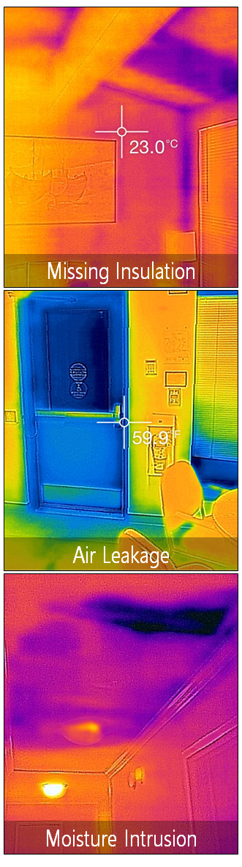
Common Thermographic Issues
Notes:
Common issues found by thermal cameras include missing insulation in exterior walls, air leakage around windows and doors,
And moisture intrusions caused by say a leaky pipe in the ceiling of your grad school apartment;
all these issues tend to be quite common but are often not visible to building occupants until they become a more obvious and costly problem.

Slide 8
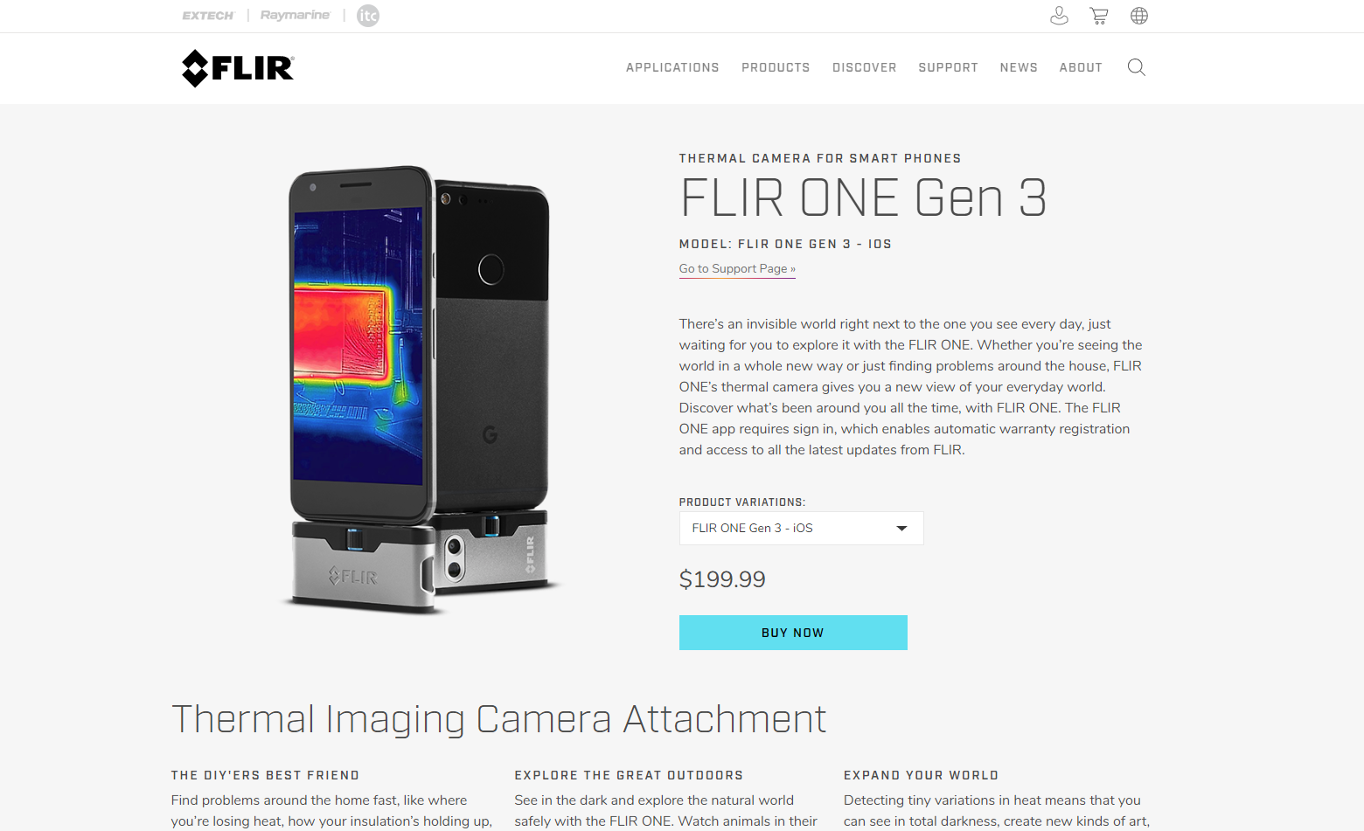
$249.99
Notes:
Now, The recent availability of low-cost smartphone-based thermal camera attachments has begun to increase the adoption of this technology as it is not only being marketed to professional energy auditors, but novice users as well for the purposes of Do-It-Yourself energy audits…

Slide 9
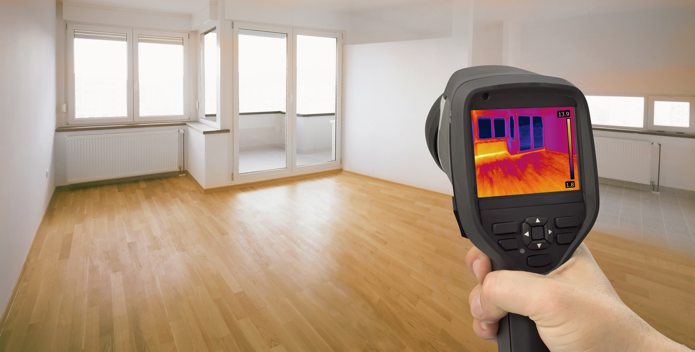
Energy audits and thermographic surveying
are time and labor intensive
Notes:
However, the practice of building thermography remains laborious and requires training and experience.

Slide 10
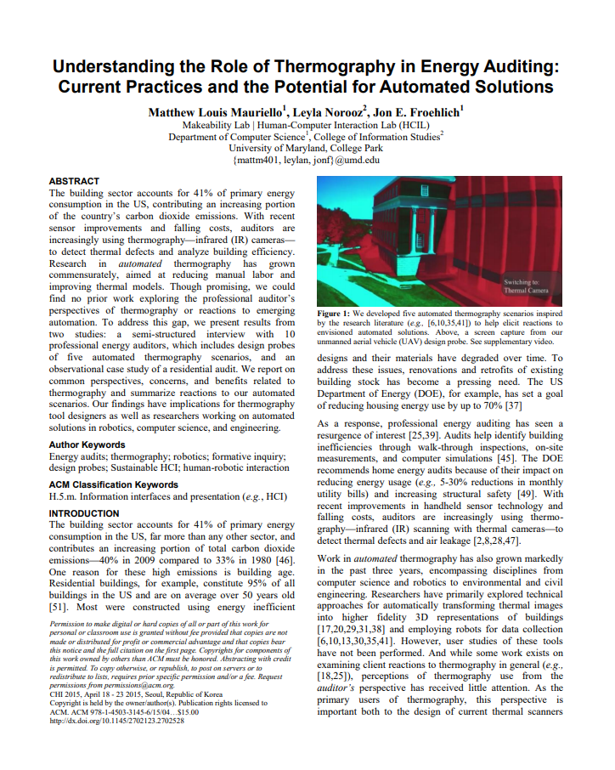
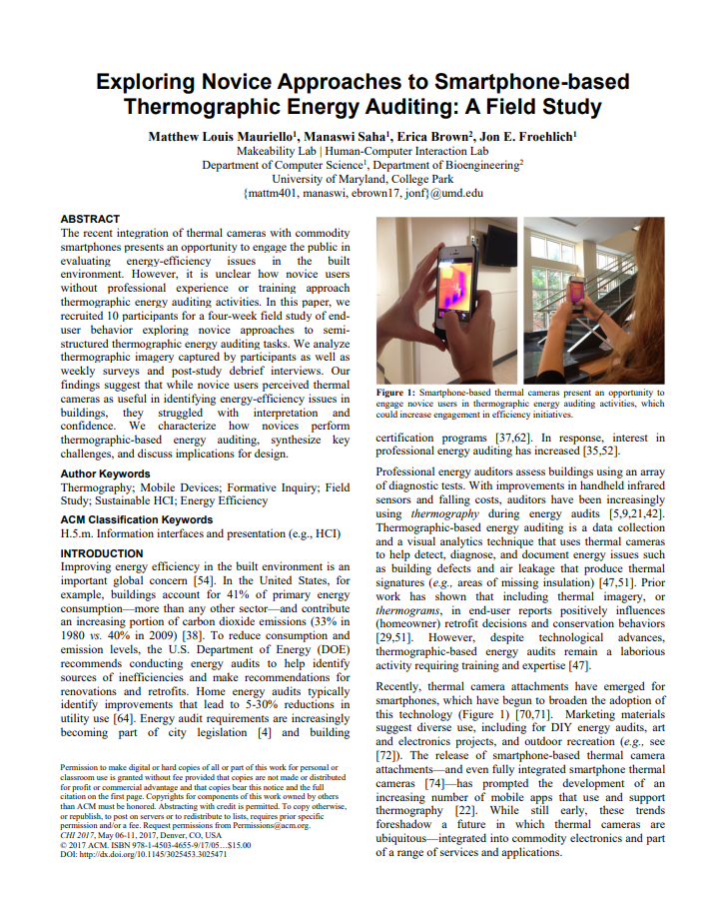
Recent Work at CHI
Energy auditors who use building thermography techniques experience varying degrees of certainty when interpreting thermograms.
Energy auditors generally have limited time to conduct scans, collect data, and review their results.
Mauriello et al. , 2015, 2017
Notes:
Recent work at CHI has highlighted several challenges faced by both novice and professional auditors including that… [CLICK]
Both experience varying degrees of confidence when interpreting a thermographic images [CLICK]
And both populations have limited time to conduct scans and review results… professional auditors may only have a few hours on a job site and a few more for analysis and reporting. [CLICK]

Slide 11
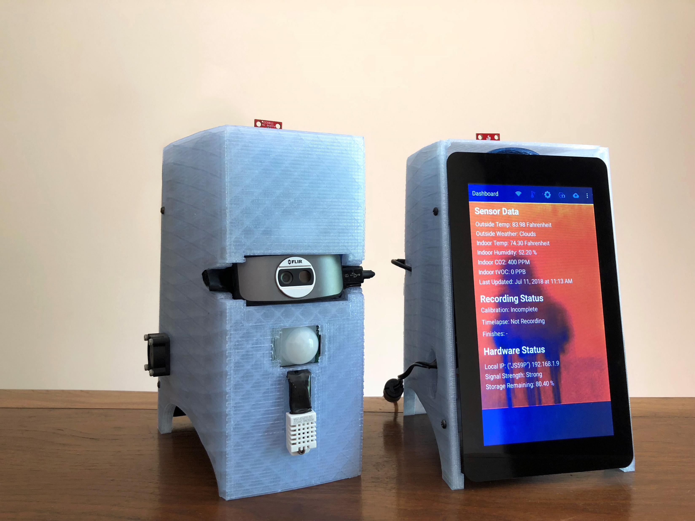
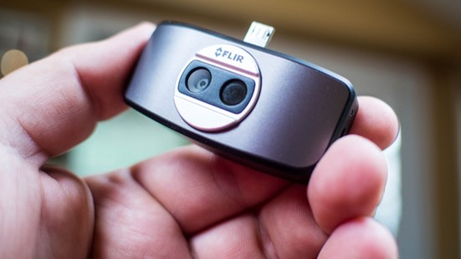
Notes:
So we thought to address these challenges through the design of an easy-to-deploy temporal thermography system that could support residential energy auditing activities using commodity thermal cameras…

Slide 12
Research Questions
How does using our temporal thermography system influence homeowner’s behaviors or perspectives?
What do professional auditors think of temporal thermography systems and how do their views differ from homeowners?
1
2
Notes:
And, as part of this research, we asked how does using our temporal thermography system influence homeowner’s behaviors or perspectives around building maintenance and how do the views of professional auditors regarding the system differ from that of homeowners?

Slide 13






Talk Overview
Introduction
Background
System Overview
Field Deployment
Expert Review
Conclusion
Notes:
With that introduction,

Slide 14
Talk Overview
Introduction
Background
System Overview
Field Deployment
Expert Review
Conclusion
Notes:
I’d now like to provide you with some building science background before describing our system and the evaluations.

Slide 15
Related Work: Temporal Data Collection
Fox et al., Energy and Buildings ‘14
Notes:
To assess insulation issues, our system replicates a technique that’s similar to time-lapse photography…

Slide 16
Related Work: Temporal Data Collection
Fox et al., Energy and Buildings ‘14
Notes:
this diagrams shows a large thermal camera placed on a tripod, calibrated, and then left out overnight to record thermograms at a set interval… say every 30 minutes…

Slide 17
Related Work: Temporal Data Collection
Fox et al., Energy and Buildings ‘14
Notes:
You’ll also notice additional sensors setup to measure internal and external environmental conditions of the building being scanned
this is done to ensure that a strong temperature differential exists which allows the thermal camera to accurately observe changes in surface temperature that may indicate a problem

Slide 18
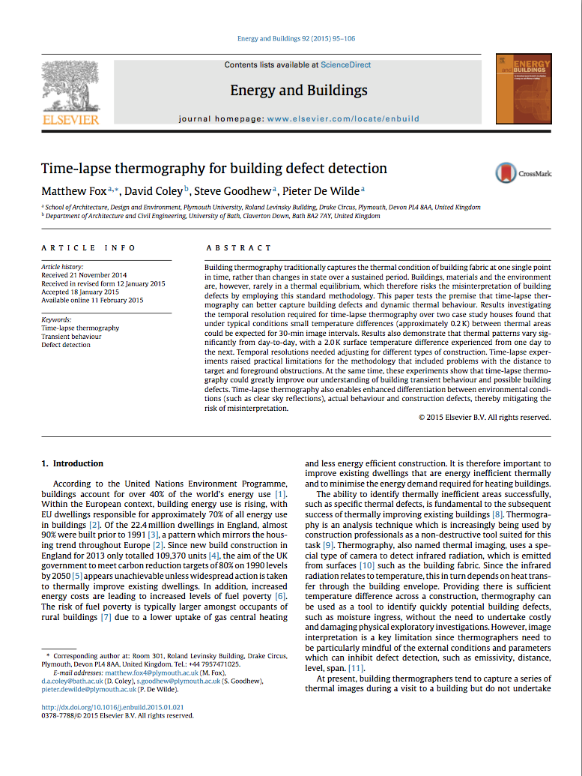
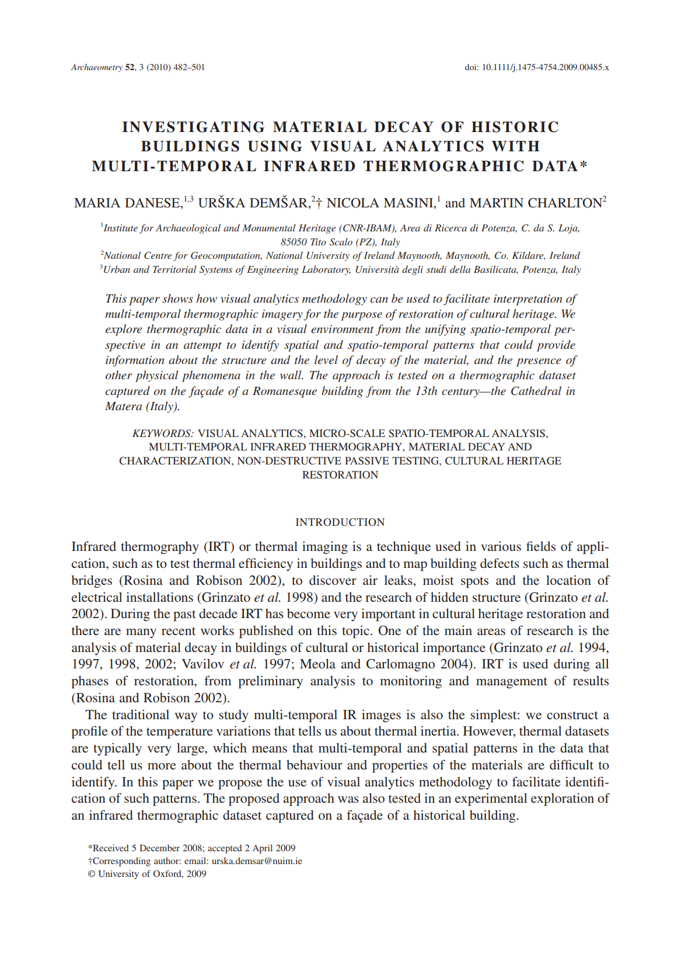
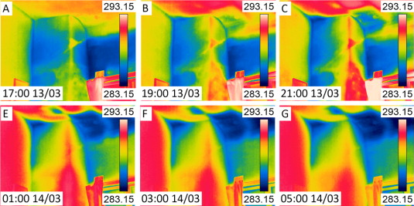
Related Work: Temporal Visualizations
Fox et al., Energy and Buildings ‘14
Danese et al., Archaeometry ‘08
Notes:
Insights from this data are often gathered through a visual analysis of the images over time and by plotting the average temperature change for a region of interest in the image…

Slide 19
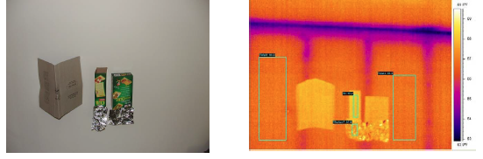
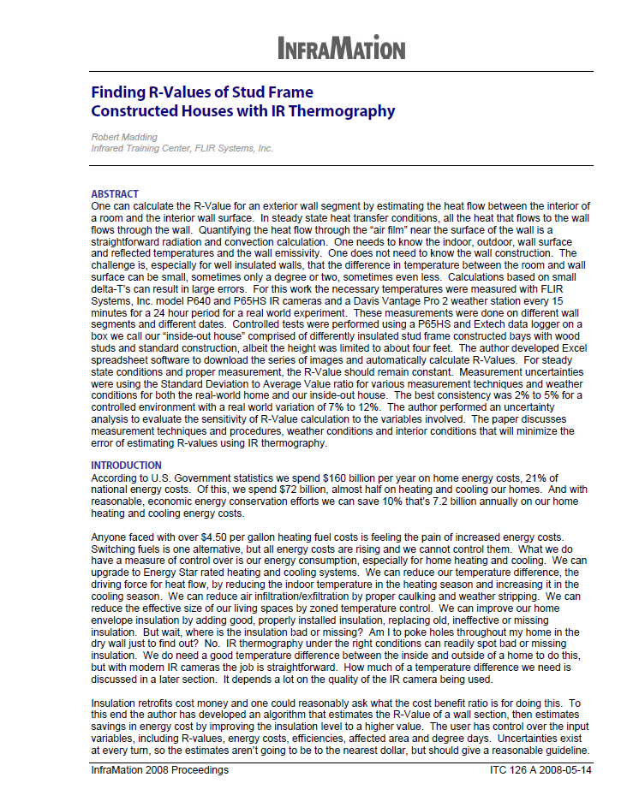

Related Work: Quantitative Thermography
Madding, 2008
Notes:
However, Madding, in 2008, introduced a quantitative assessment method that reasonably estimated the resistance or R-value of cavity wall insulation…

Slide 20
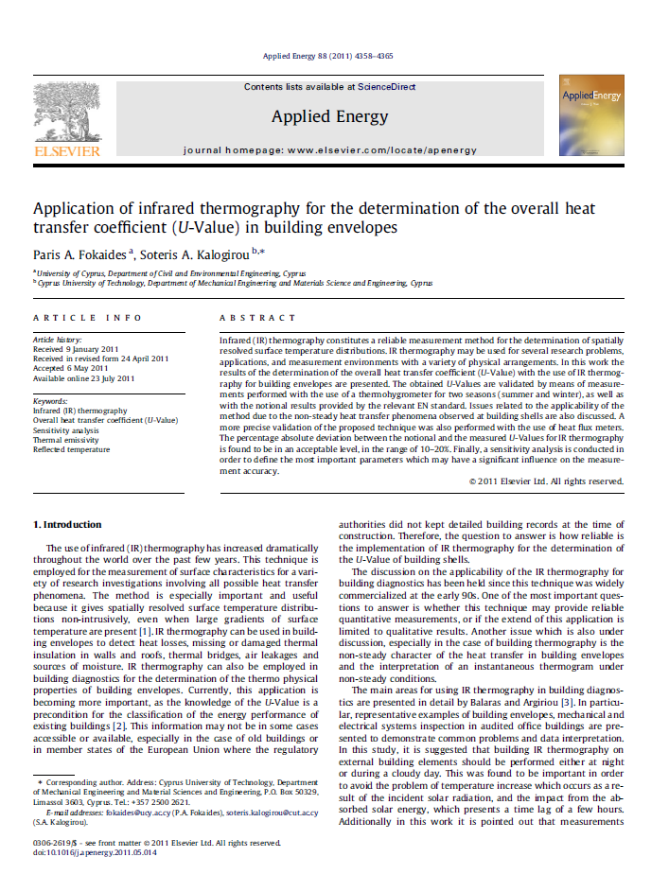
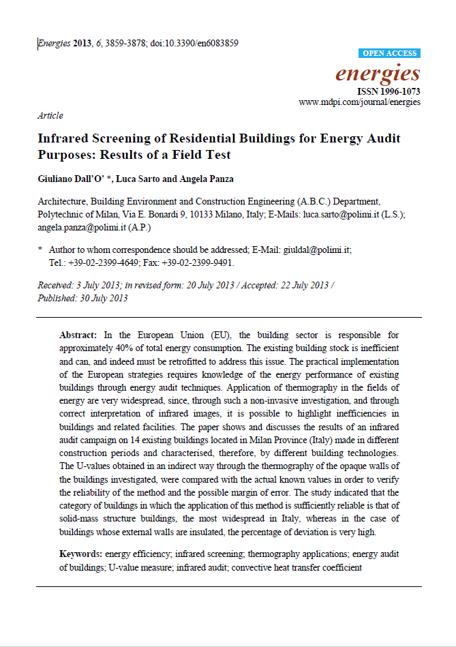
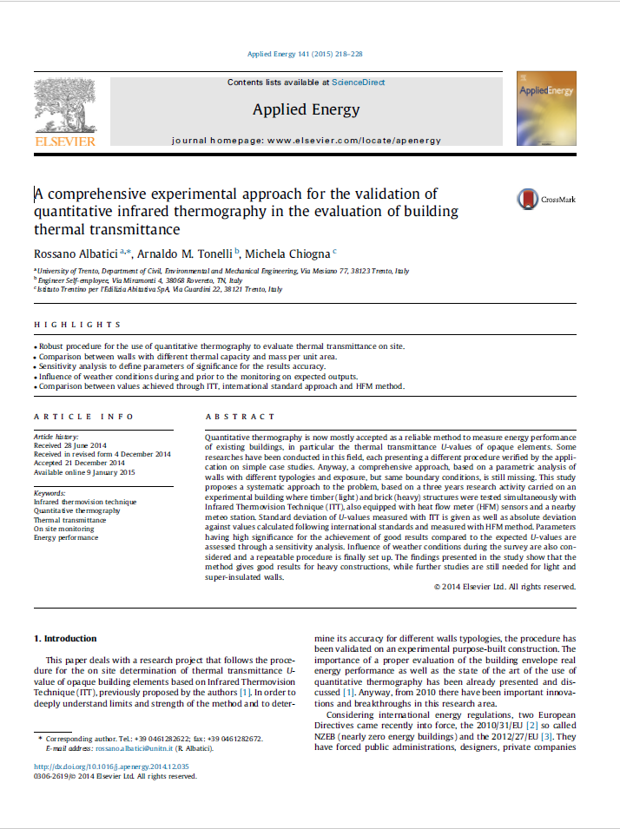
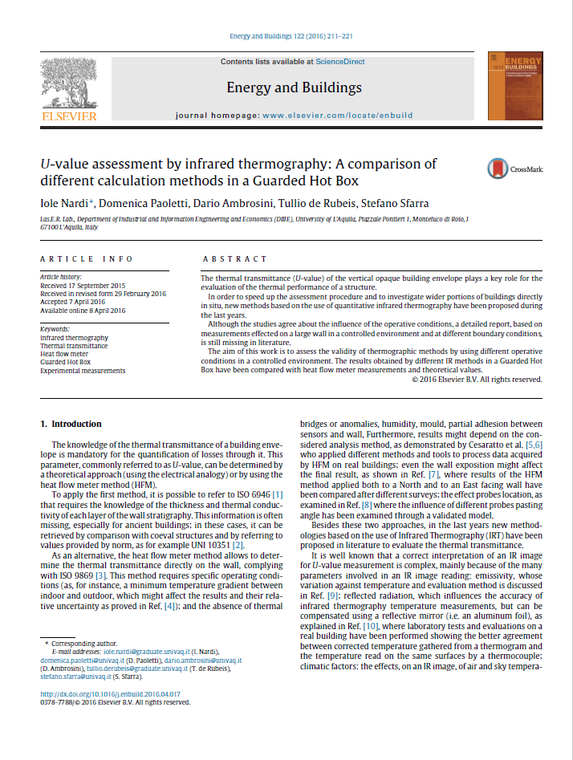
Related Work: Quantitative Temporal Thermography
Fokaides & Kalogirou, 2011
Dall’O et al., 2013
Albatici et al., 2015
Nardi et al., 2016
Notes:
And, since then researchers have been exploring different ways to estimate insulation performance usually by repeatedly averaging calculations derived from Madding’s original work…

Slide 21
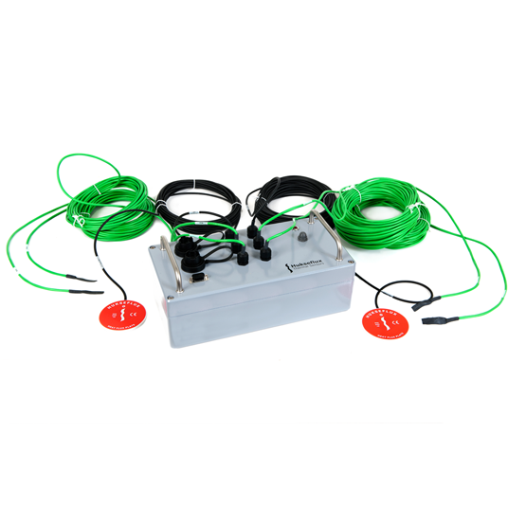
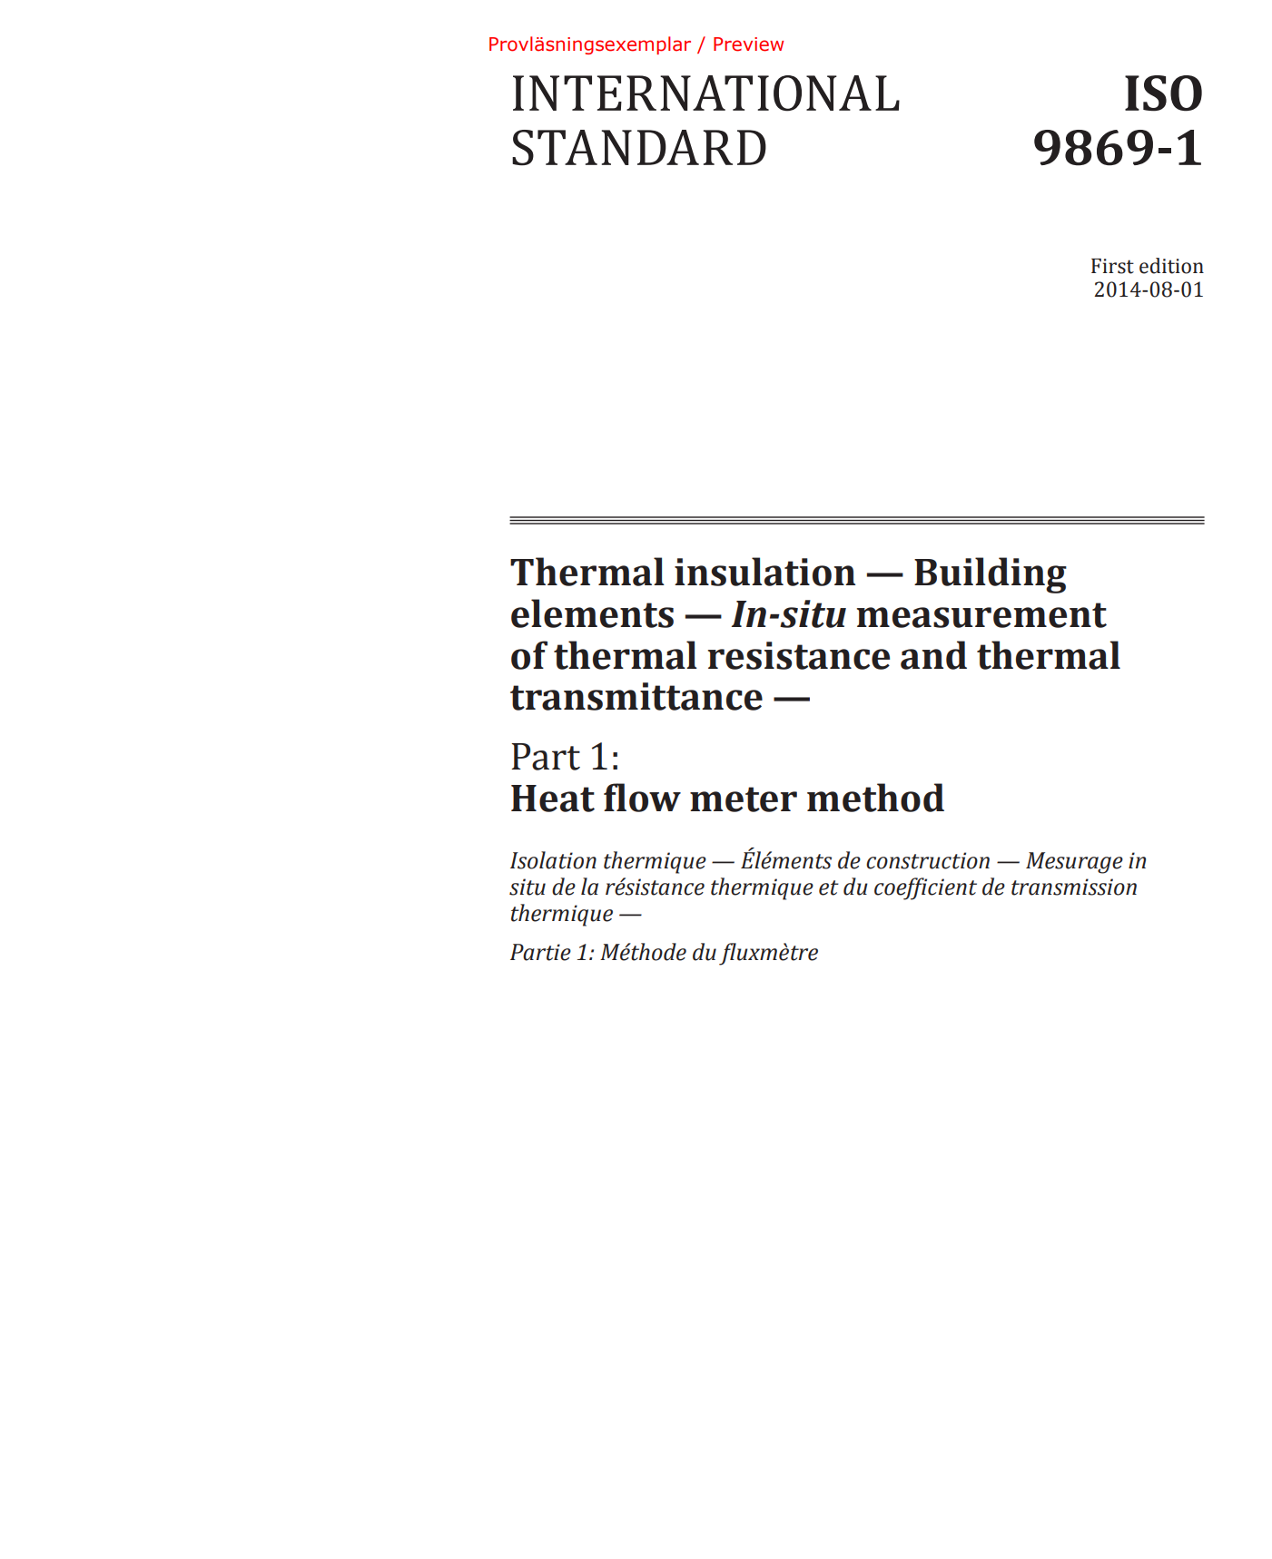
Related Work: Quantitative Measurement
Direct Contact Methods:
Heat Flux Sensors and Thermocouples
Notes:
And, in these studies, accuracy is determined by comparing thermal camera estimates to those made by direct contact sensors; however, the length of these assessments are typically long which is why some are advocating that these shorter thermographic protocols be adopted by assessment communities…

Slide 22
Research Contributions
Future work called for within these assessments includes real-world deployments with professional users
This work contributes the design of such a system, and evaluations with both professional and non-professionals
Notes:
However, there are few examples of new techniques like these being used by auditors in the field, so not only does our work contribute a novel sensor system that simplifies these temporal deployments, but also solicits early feedback about such systems from the growing community of professional and non-professional energy auditors.

Slide 23
Talk Overview
Introduction
Background
System Overview
Field Deployment
Expert Review
Conclusion
Notes:
So given this temporal thermographic measurement technique…[click]

Slide 24
Talk Overview
Introduction
Background
System Overview
Field Deployment
Expert Review
Conclusion
Notes:
Our system attempts to assist auditors with judging the severity of insulation problems in the field.

Slide 25
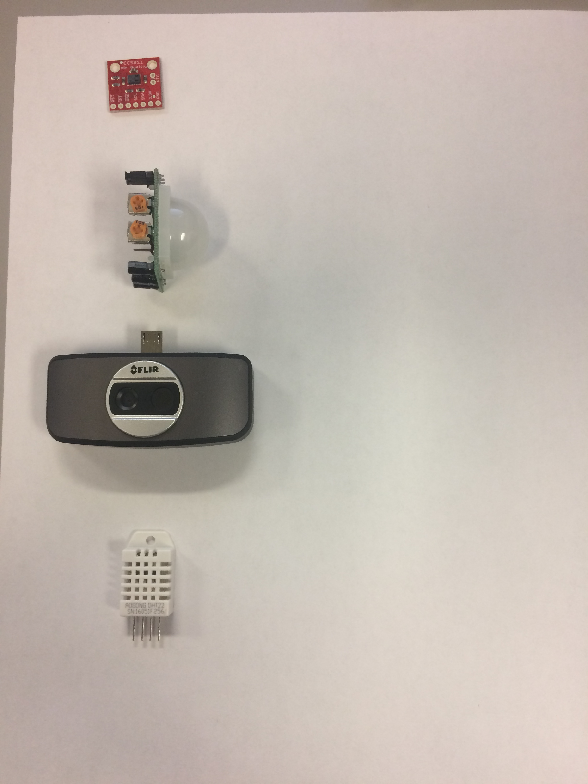

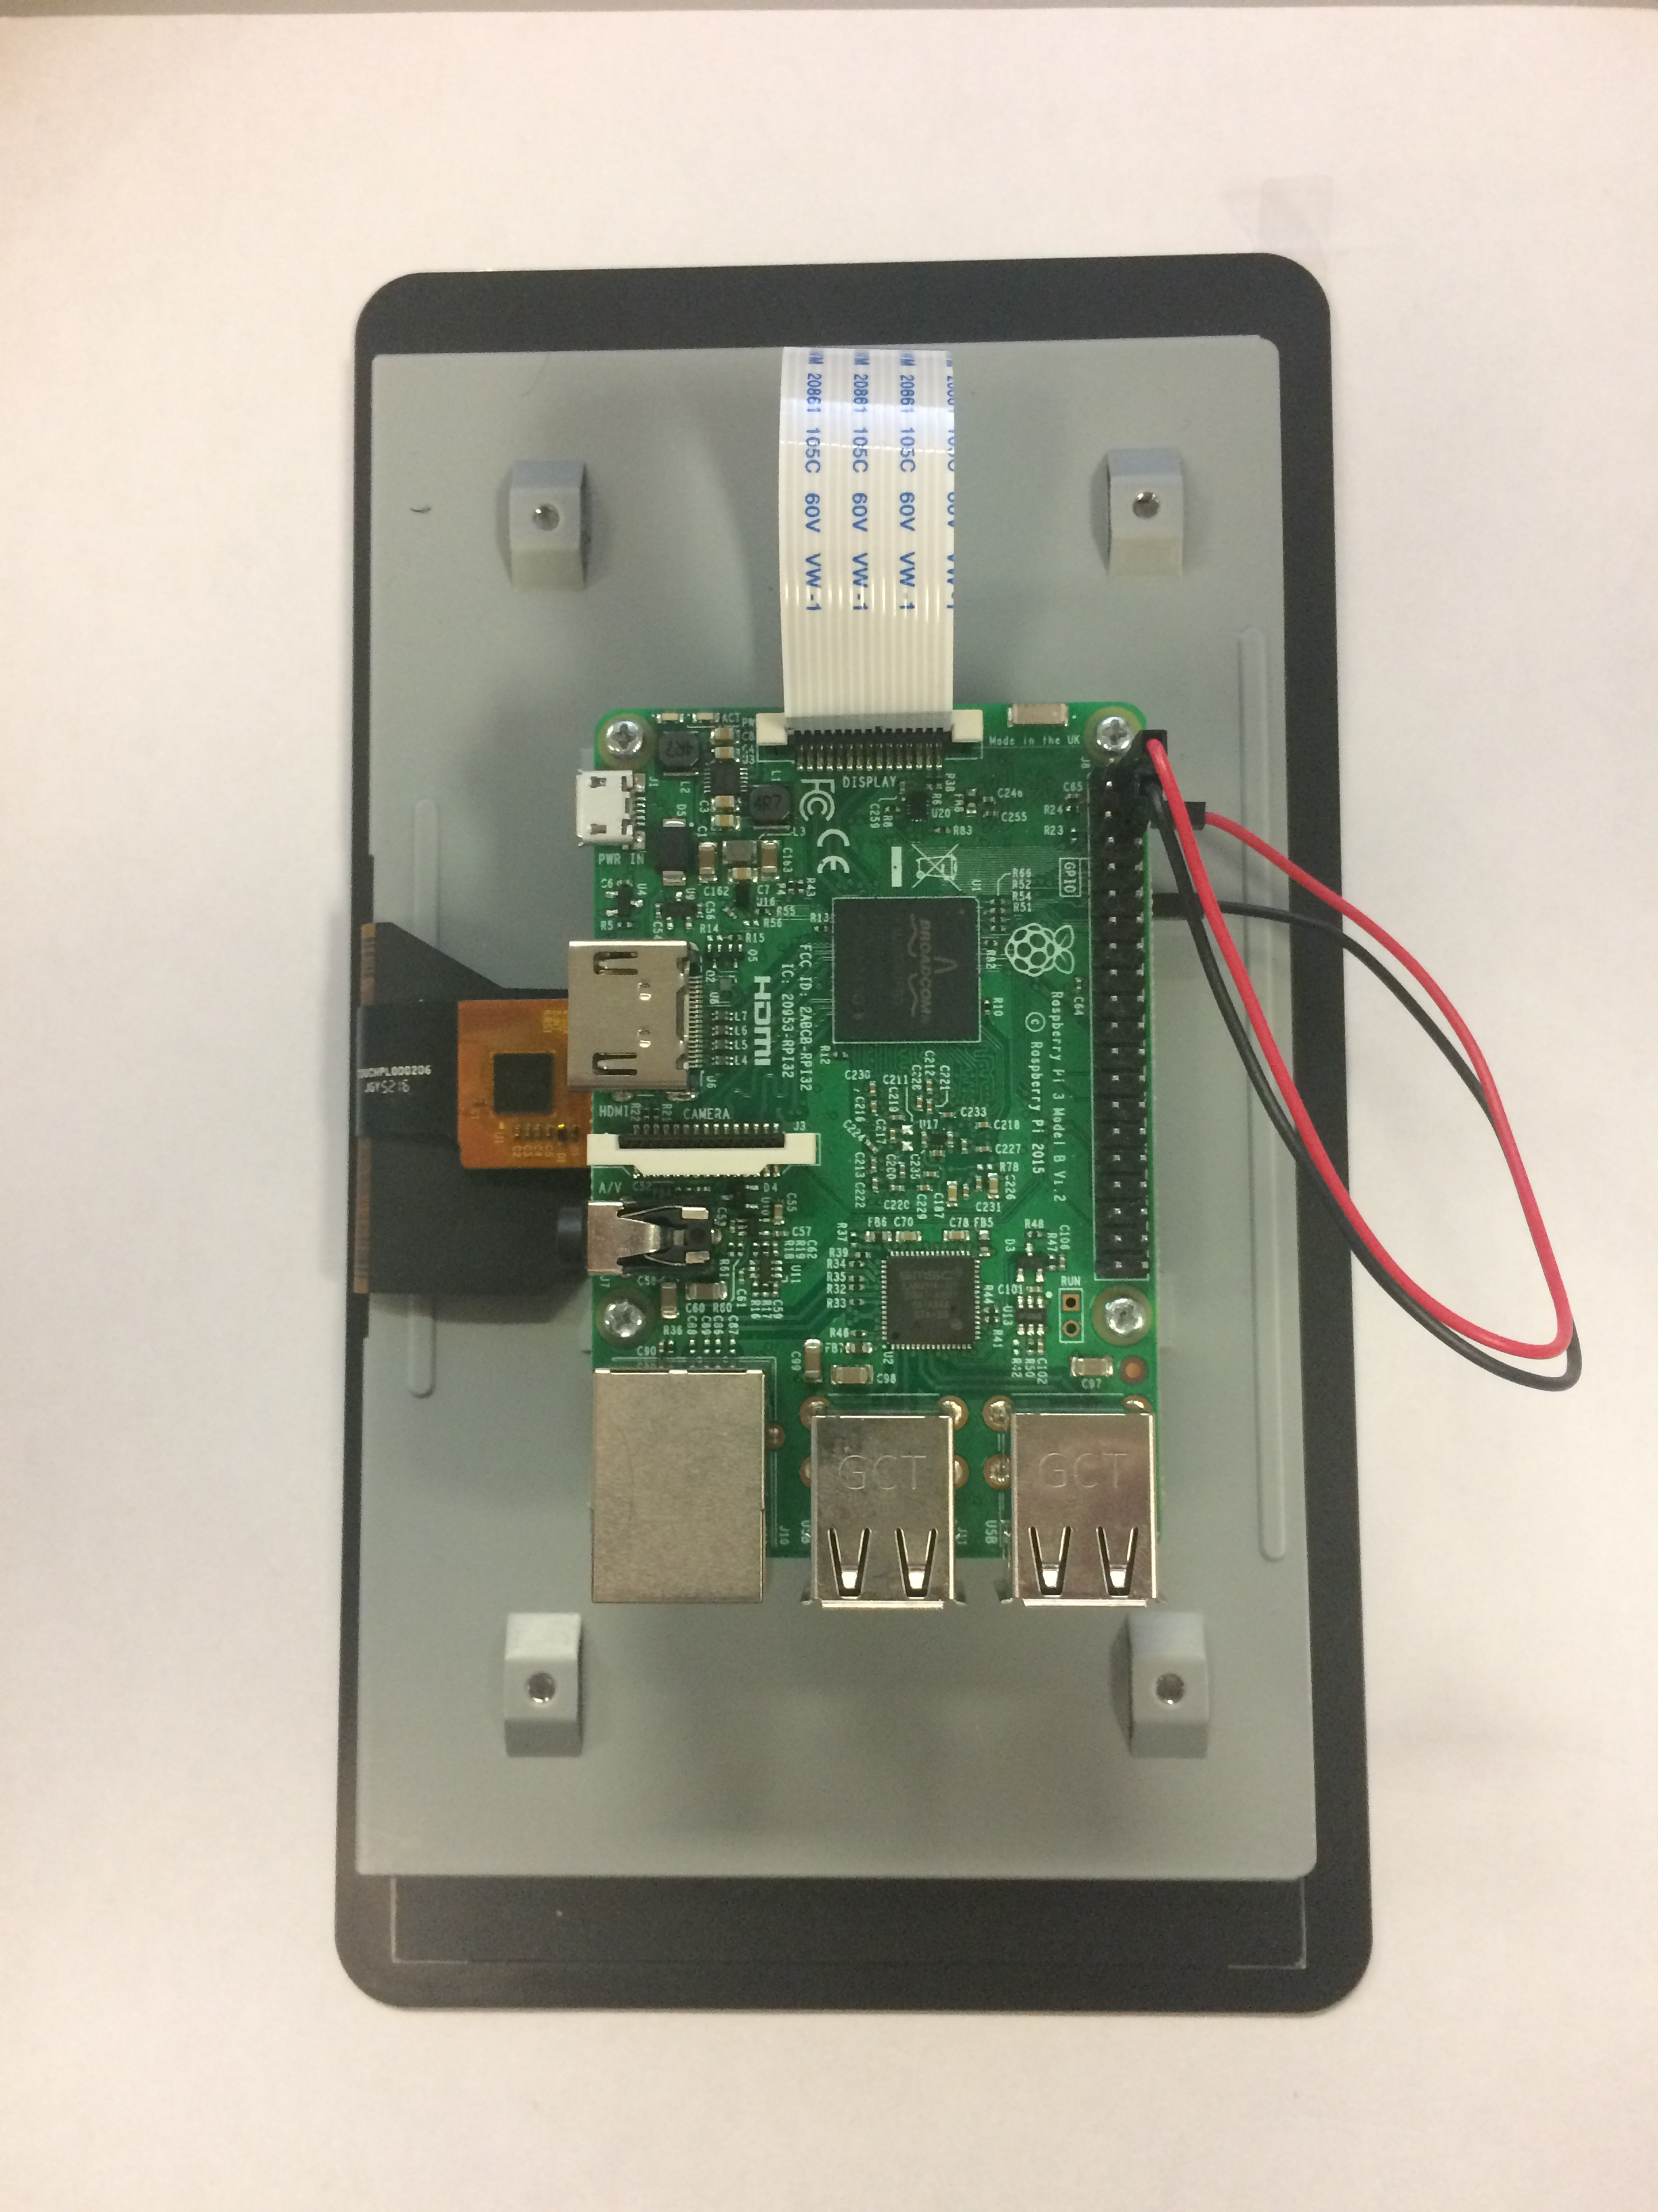
Development: Design Goals
  Easy-to-Deploy
  Non-intrusive
  Provide Rapid Analysis
  Help with Severity Estimation
  Holistic Report
Notes:
Now, when designing our system we had several design goals including that the system must be: “Easy to deploy”, [CLICK]
non-intrusive in the lives of users, [CLICK]
must provide rapid analysis once data collection completes, [CLICK]
and needs to help users gauge the severity of insulation problems [CLICK]
while providing a holistic report.

Slide 26
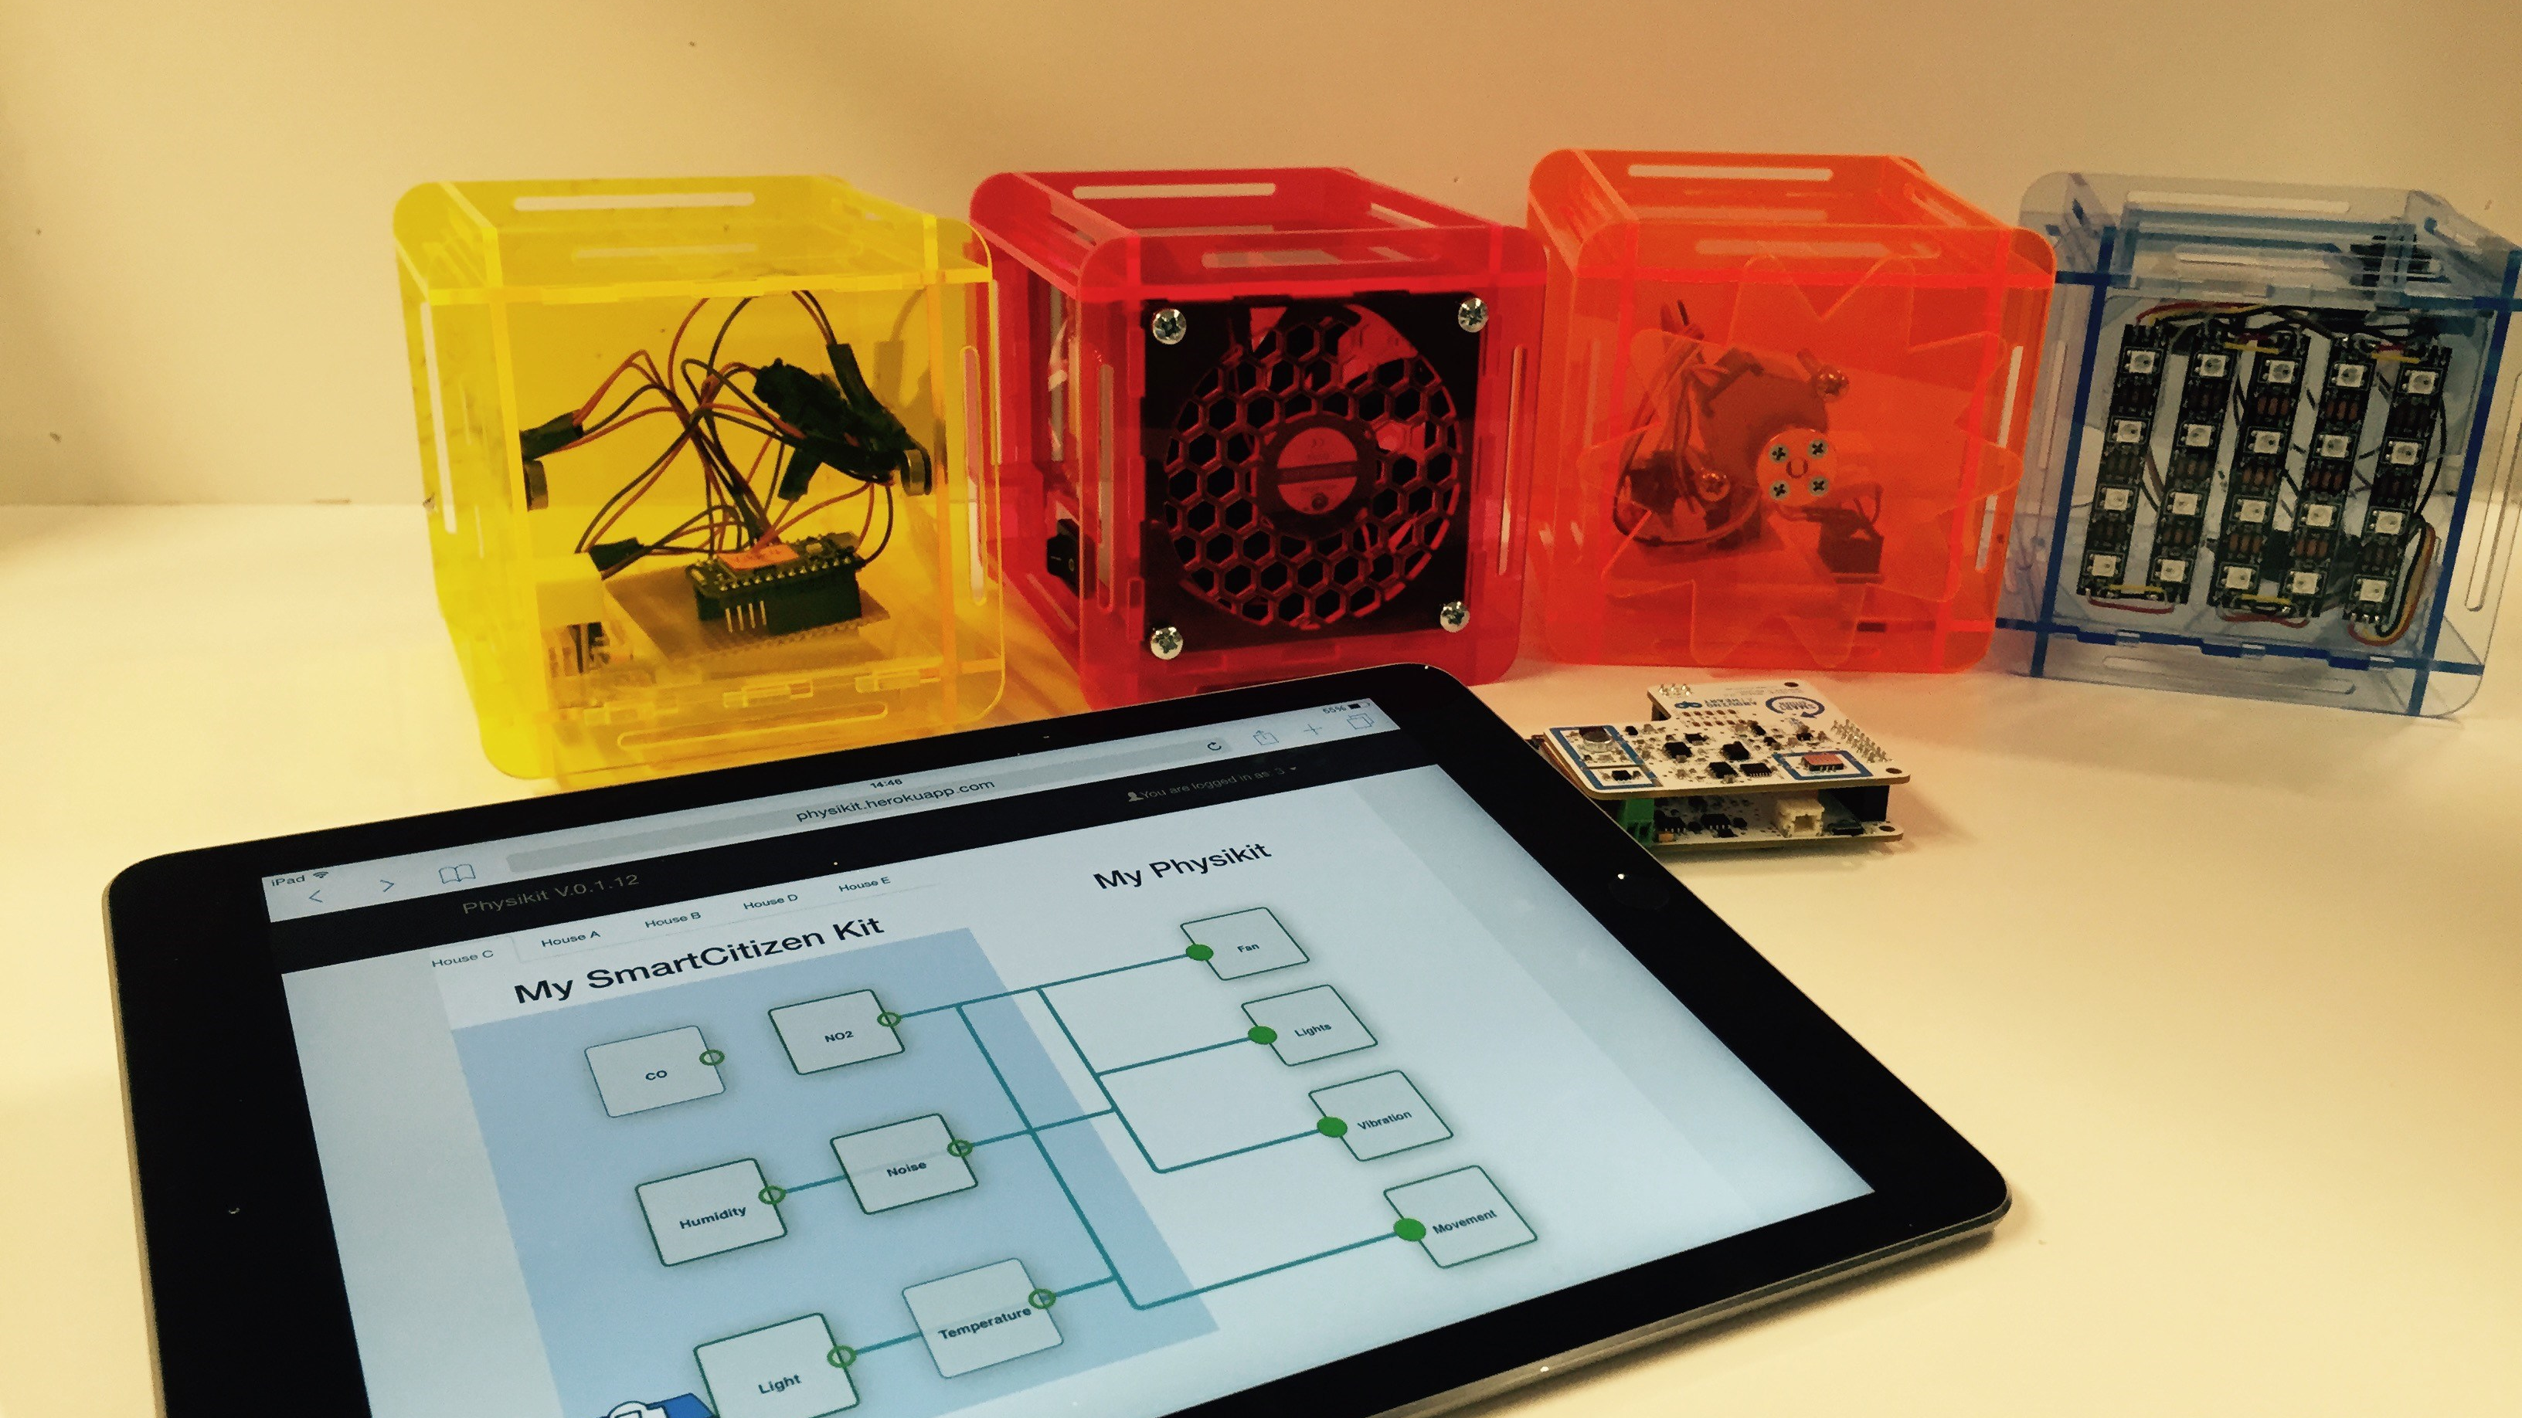
Physikit
Houben et al., 2016
Notes:
We took inspiration from recent sensor kits that allow users to collect and interact with data about the built environment including Physikit which makes air quality and environmental data easy for novices to collect and visualize in the home….

Slide 27
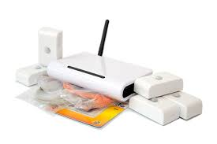
Physikit
Houben et al., 2016
BuildAX Environmental Sensor Toolkit
Finnigan et al. 2017
Notes:
And BuildAX which focused more on facilities managers in non-residential settings.
Systems like these reflect the increasing number of IoT devices that allow us to augment our environment, monitor what is going on, and make decisions that impact our comfort at home, our utility bills, and our carbon footprints...

Slide 28
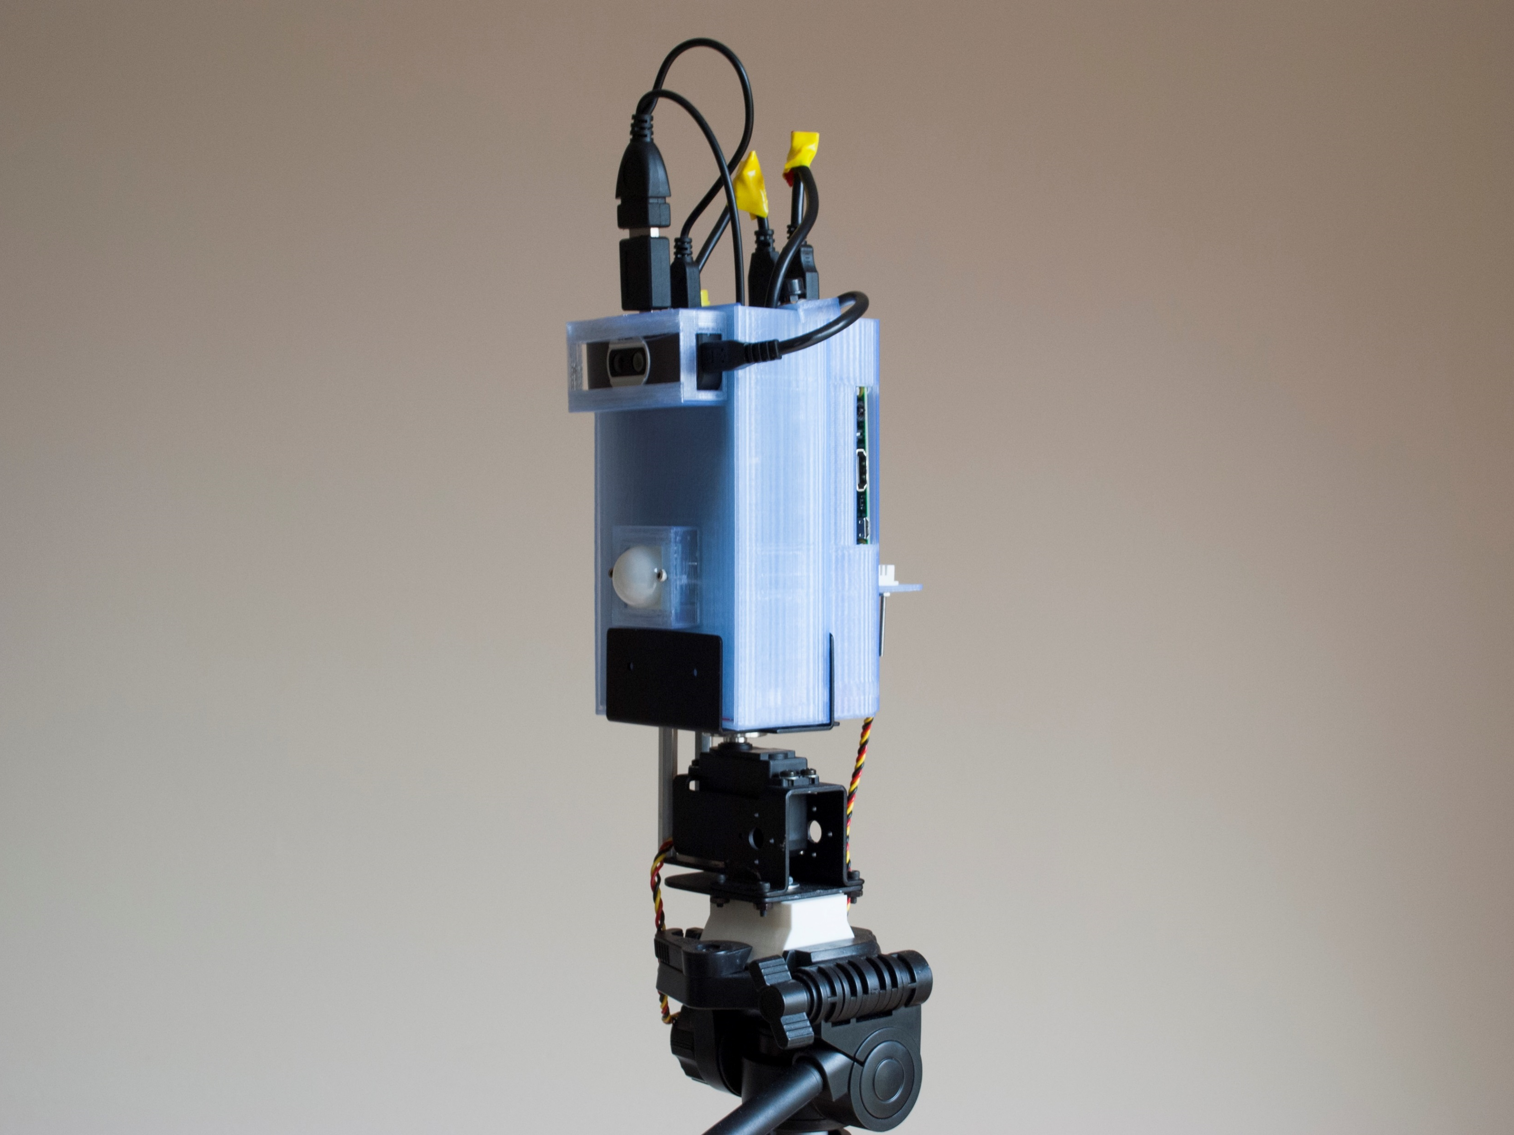
Easy-to-Deploy Thermographic Sensor system
(v3.0)
GPS Unit & High Capacity Battery
Thermal Camera
Raspberry Pi
Motion Sensor
Humidity/Temperature Sensor
Pan
Unit
Interchangeable Mounting Plate
Notes:
Our early prototypes focused on function, assembling the sensors necessary for collecting data, and streaming the data to the cloud to be reviewed later…

Slide 29
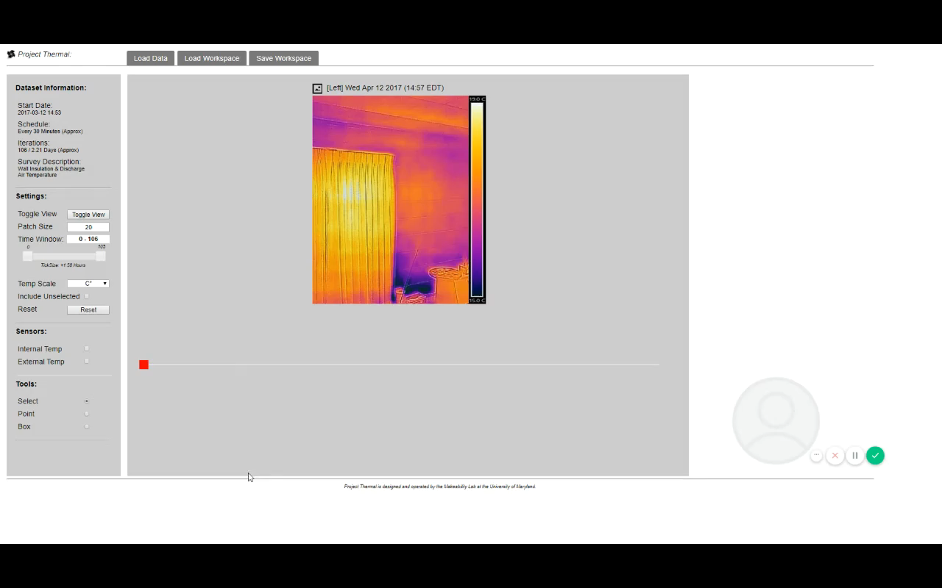
Notes:
We then designed user interfaces based on the building science literature and common auditing software that allowed users to review the data they collected.
Testing with auditors and persons with thermal camera experience…

Slide 30
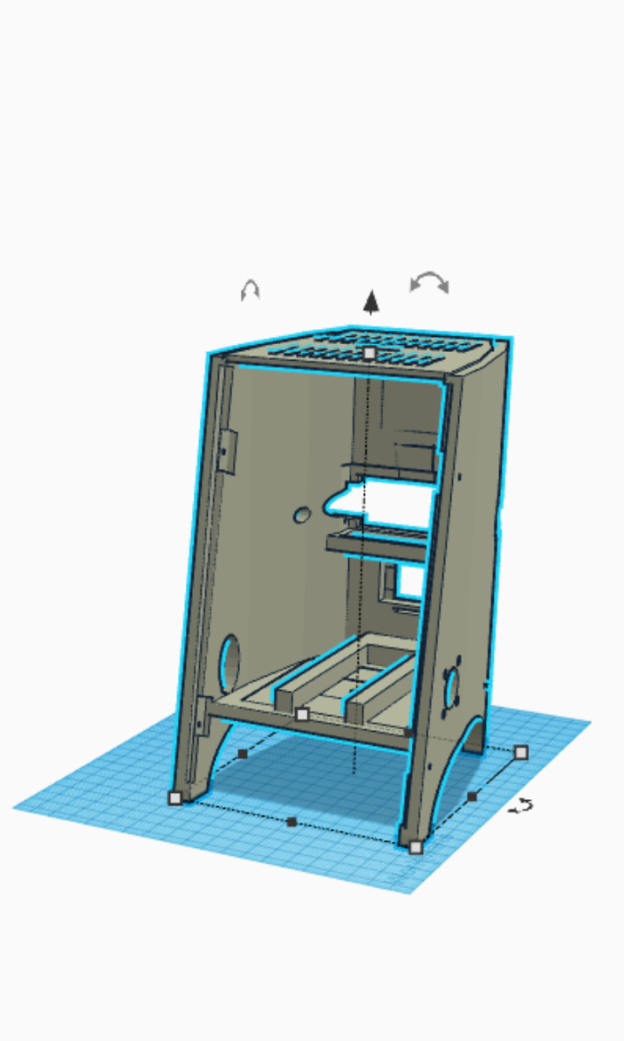
Development: Easy-to-Deploy Thermographic Sensor Kit (v4.0)
Air Quality
FLIR One
Motion
Temp/Humidity
Notes:
…quickly illustrated that the system needed to easier to operate, which is why the most recent version enabled setup and configuration via an onboard touchscreen…

Slide 31
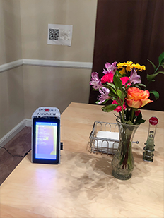
Development: System Overview
Notes:
Without needing to attach a tripod, the system could be placed on a table or chair and calibrated using a target affixed to the surface of the measurement area. Users can then select a region of interest on the touchscreen…

Slide 32




Development: System Overview
Calibration, Processing, Reporting
Sensing
Notes:
And the system offloads these parameters and the data to the cloud…

Slide 33
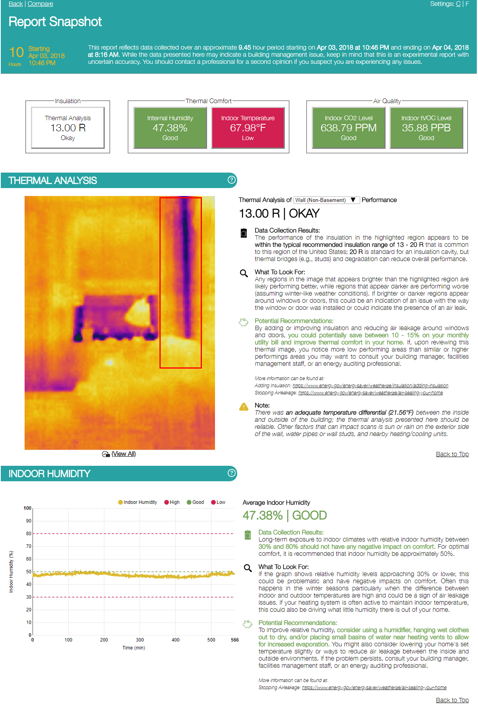
Development: System Overview
Calibration, Processing, Reporting
Sensing
Notes:
Once data collection finishes the results are processed and a report is automatically generated…

Slide 34
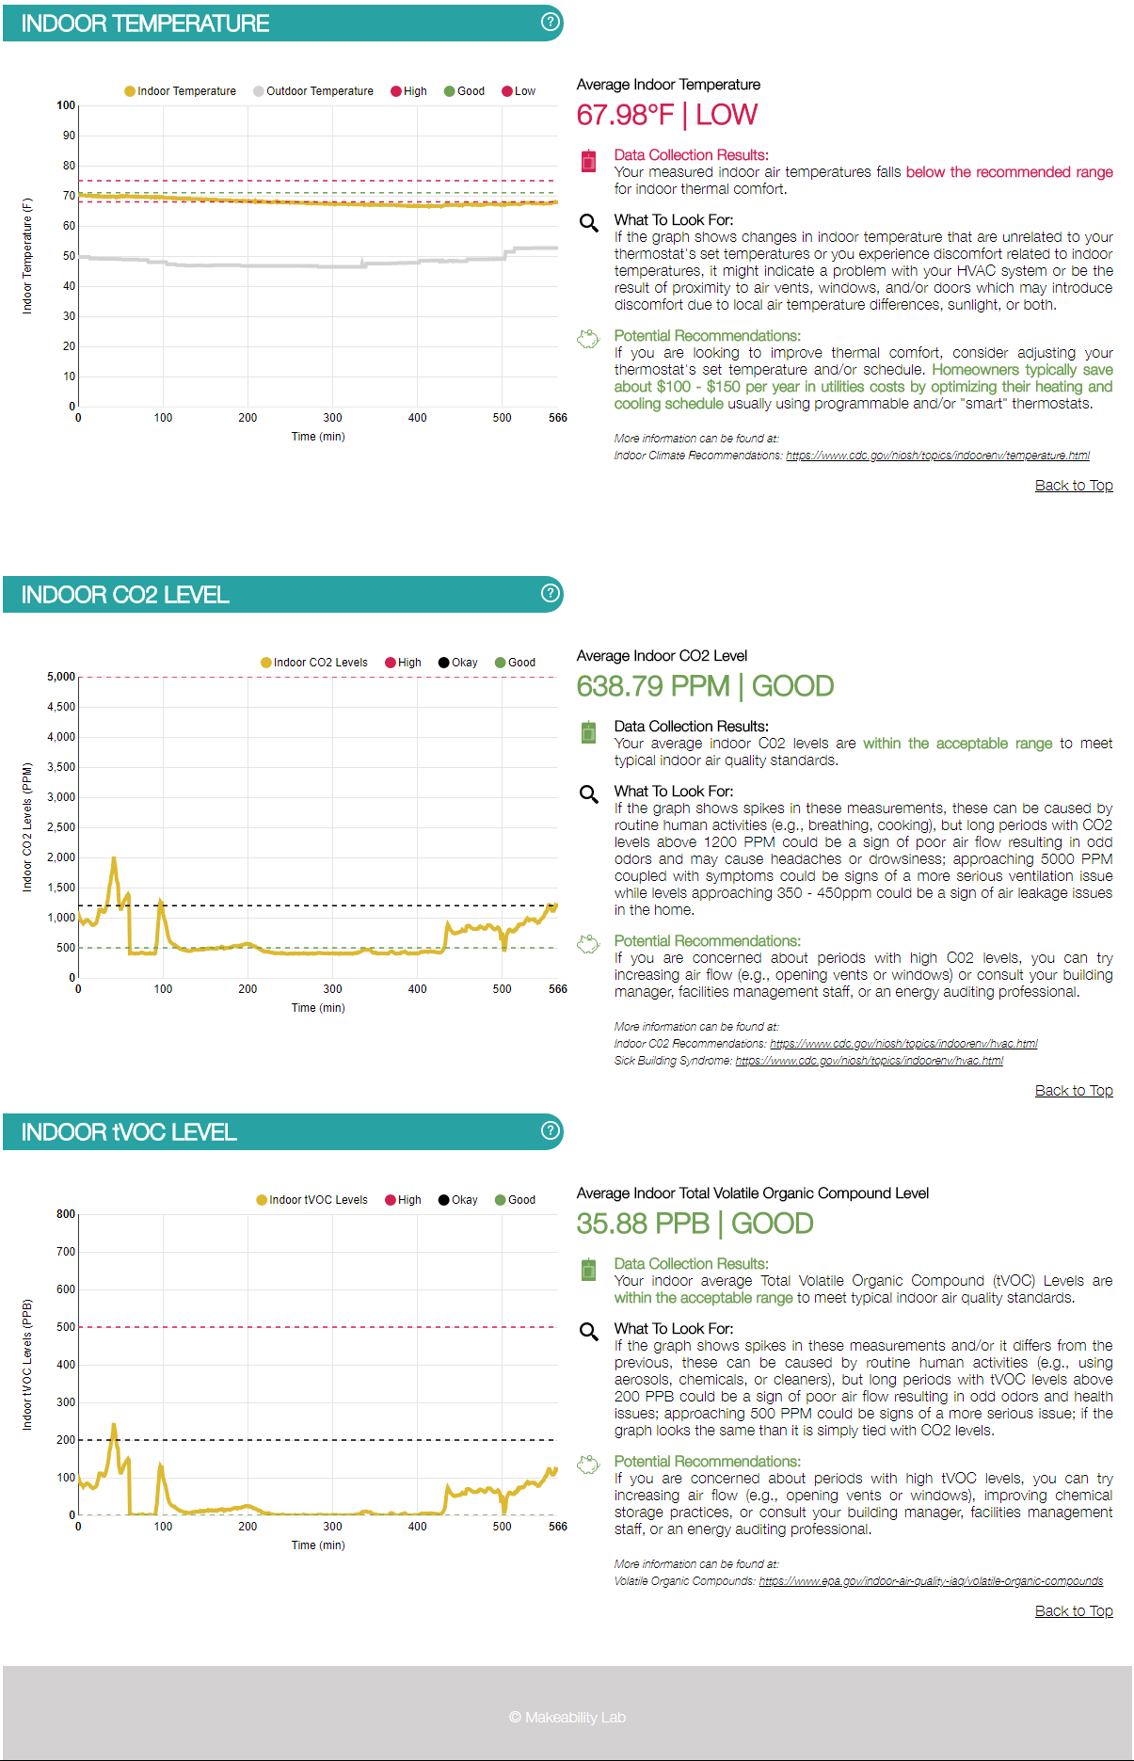
Development: Revised Visualization
Notes:
The report, accessible on any browser, is presented as a stylized, lightly interactive infographic featuring information on insulation performance, thermal comfort, and air quality… all important aspects of an energy audit. Insulation performance is compared to local building codes and recommendations ranging from DIY fixes to contacting a professional are suggested based on results of the scan.

Slide 35
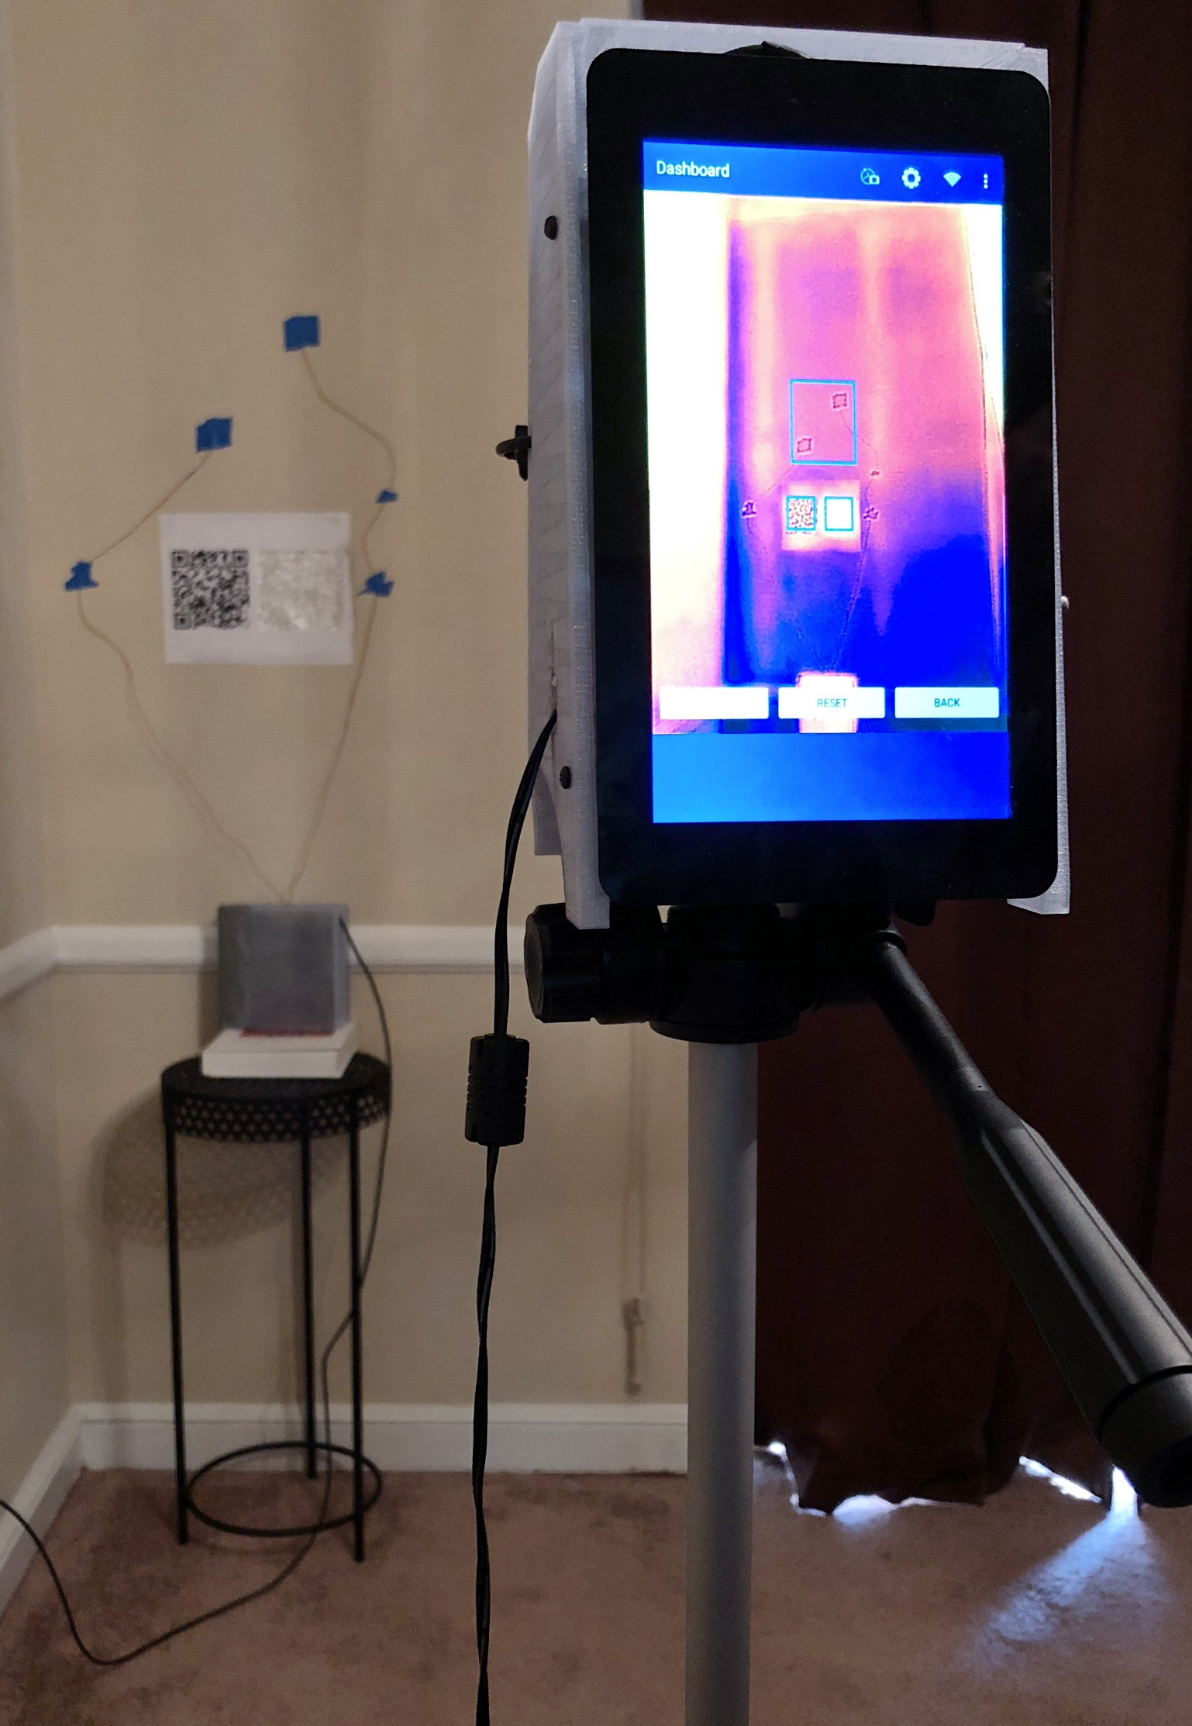
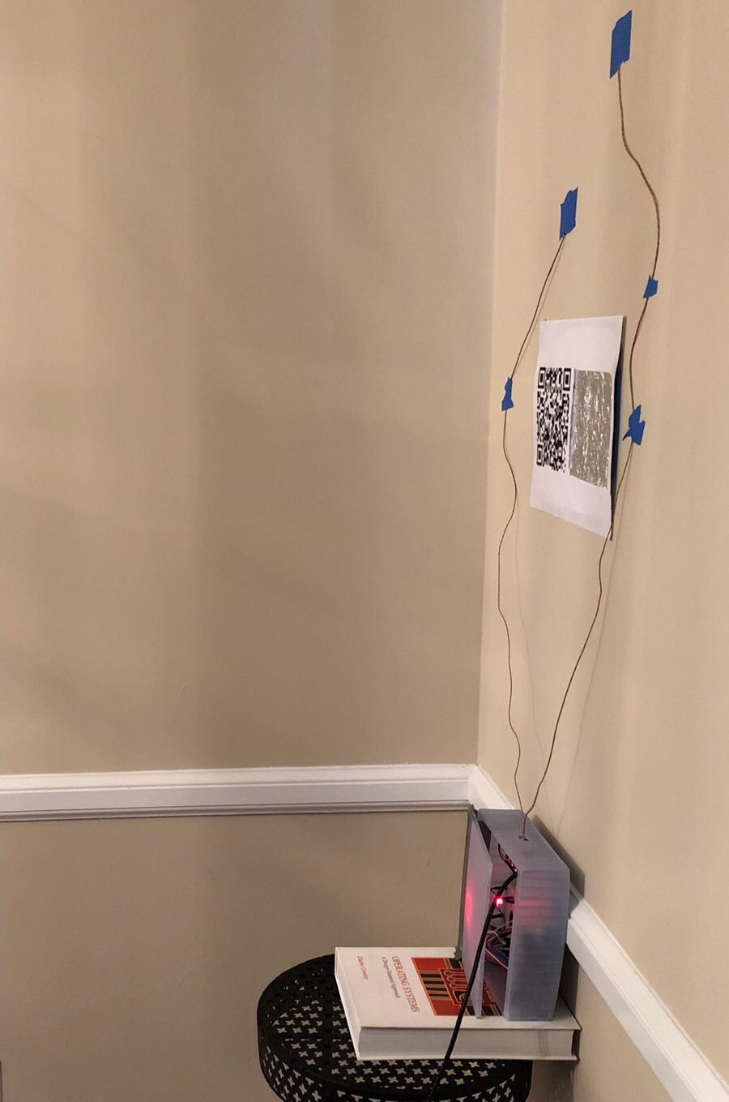
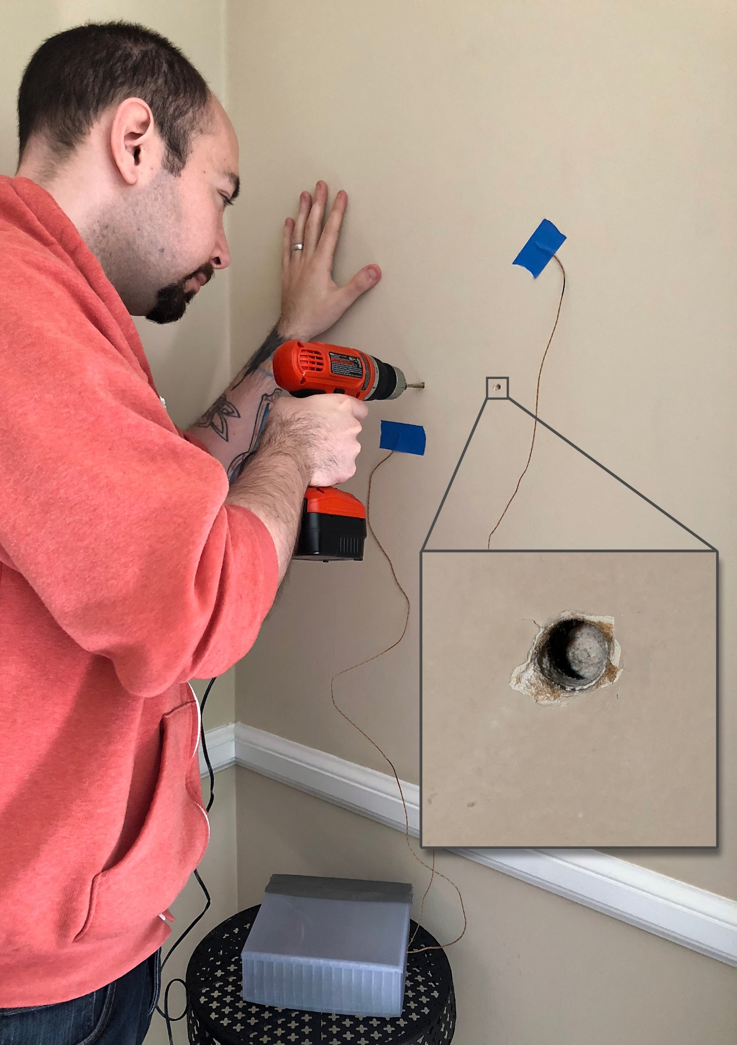
Development: Validation Experiments
Notes:
We validated our system by comparing our results to that of our surface mounted sensors and notional values that we confirmed through destructive testing.

Slide 36
Development: Validation Results
Data Segment | Notional | THM (deviation) | IRT (deviation) | Average Temp. Delta
Day 1 | R-6.50 | R-7.54 (16.00%) | R-7.67 (18.00%) | 27.47°C
Day 2 | R-6.50 | R-6.67 (2.61%) | R-6.29 (3.23%) | 20.96°C
Full Campaign | R-6.50 | R-6.30 (3.07%) | R-6.39 (1.69%) | 22.85°C
Notes:
We collected data over 48 hours to compare to our direct contact sensors and we can see here that repeatedly measuring the surface areas and averaging the data converges to a reasonable estimate of the insulation performance when there’s are strong temperature differentials between the indoor and outdoor weather conditions.

Slide 37
Talk Overview
Introduction
Background
System Overview
Field Deployment
Expert Review
Conclusion
Notes:
Having validated our system, ….

Slide 38
Talk Overview
Introduction
Background
System Overview
Field Deployment
Expert Review
Conclusion
Notes:
…we then moved on to deploying it in the field.

Slide 39
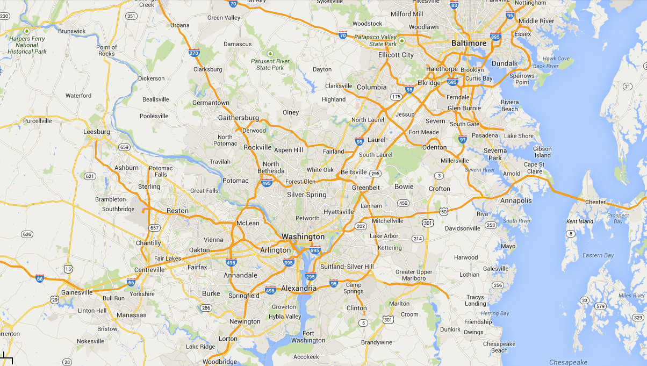
Field Deployment: Recruitment
We recruited local participants using listserv, community message boards, and word-of-mouth in the Washington D.C. metro area.
Notes:
We started out, by recruiting participants from the local DC-metro area during the winter of 2018….

Slide 40


Field Deployment: Participants
5 Participants
(3 Male, 1 Female, 1 Prefer Not to Answer)
Notes:
Which resulted in five novice participants being included in the study

Slide 41

Field Deployment: Procedure
Pre-Study
Questionnaire
Introduction
Meeting
Notes:
These participants completed a short pre-study questionnaire before we met with them in their homes to acquire consent and review the study procedure, including…

Slide 42
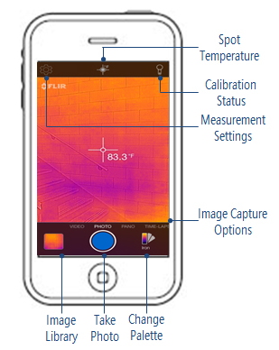
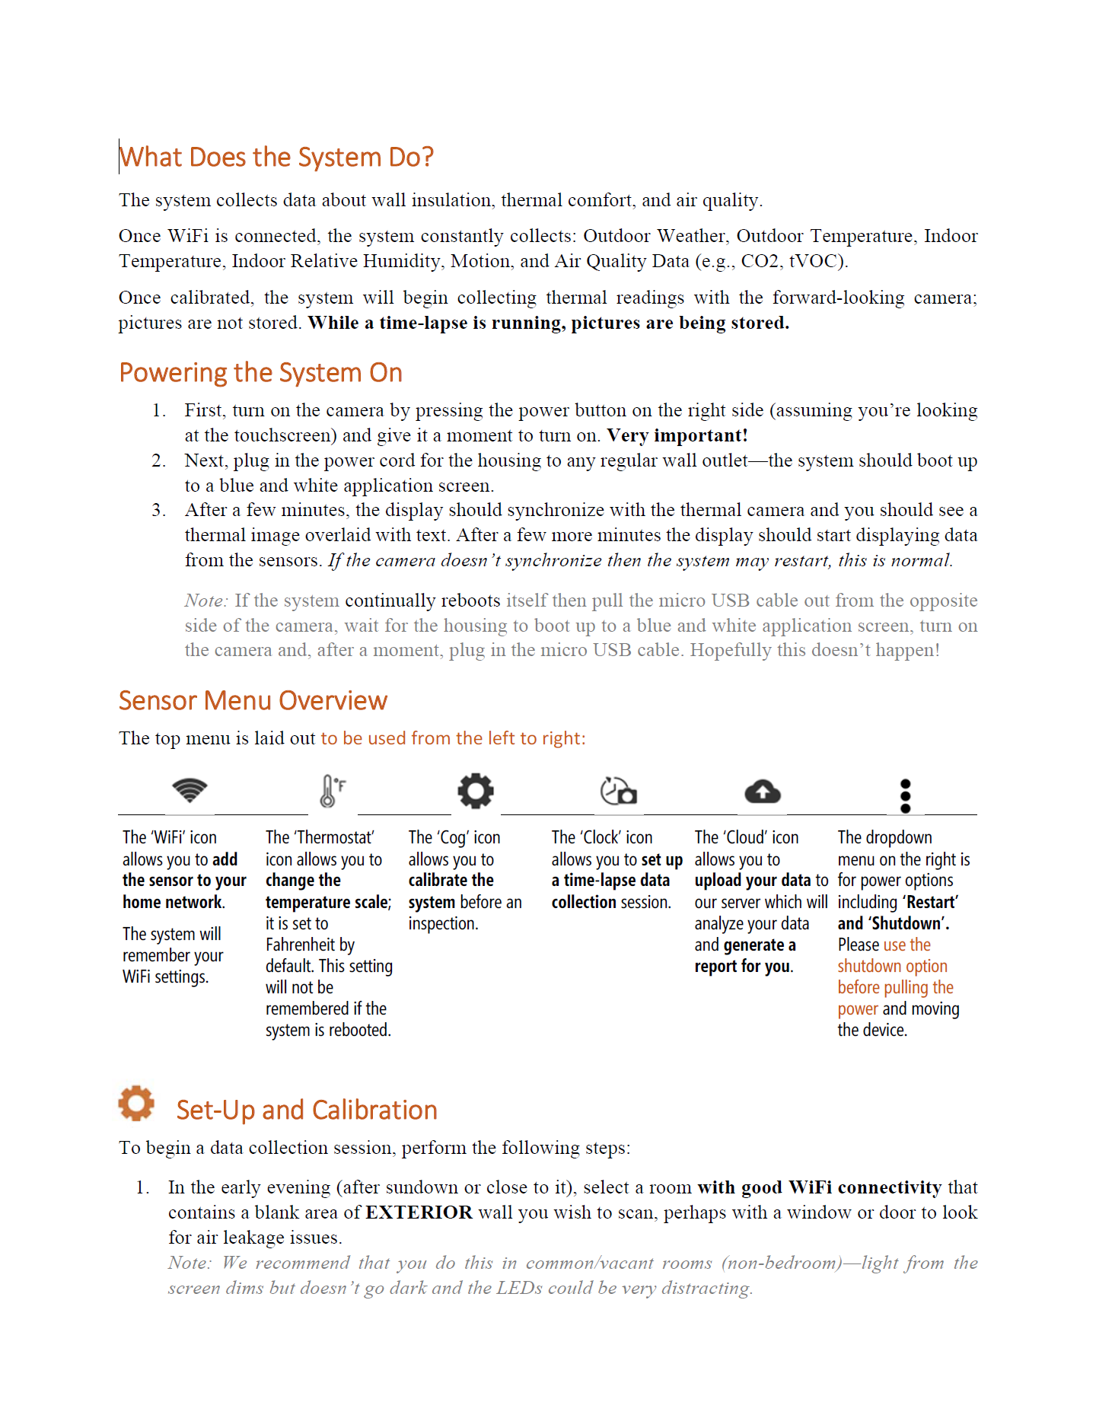
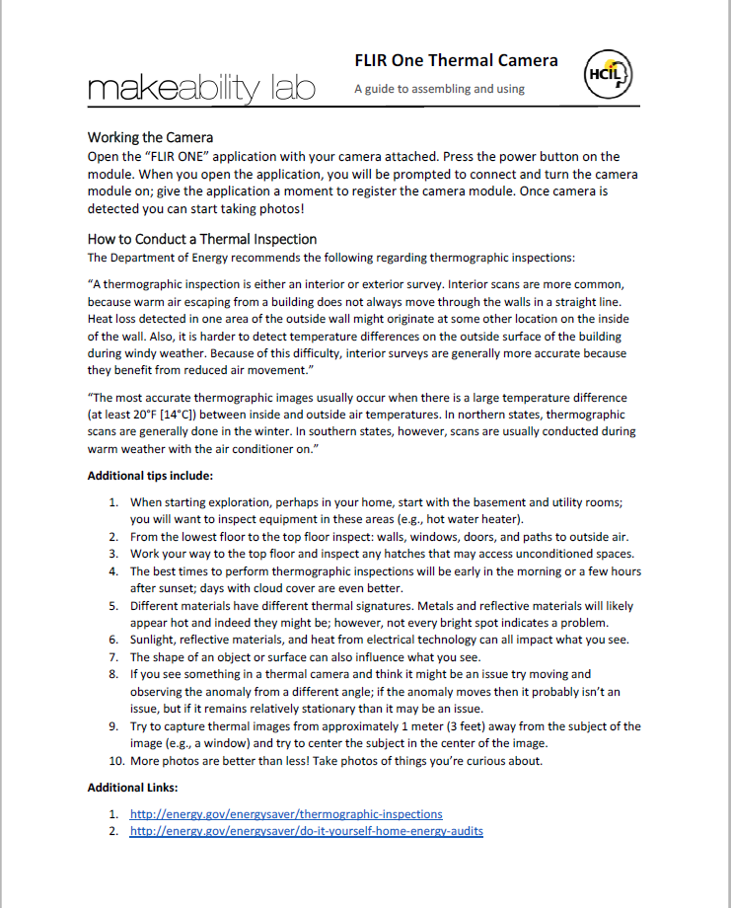
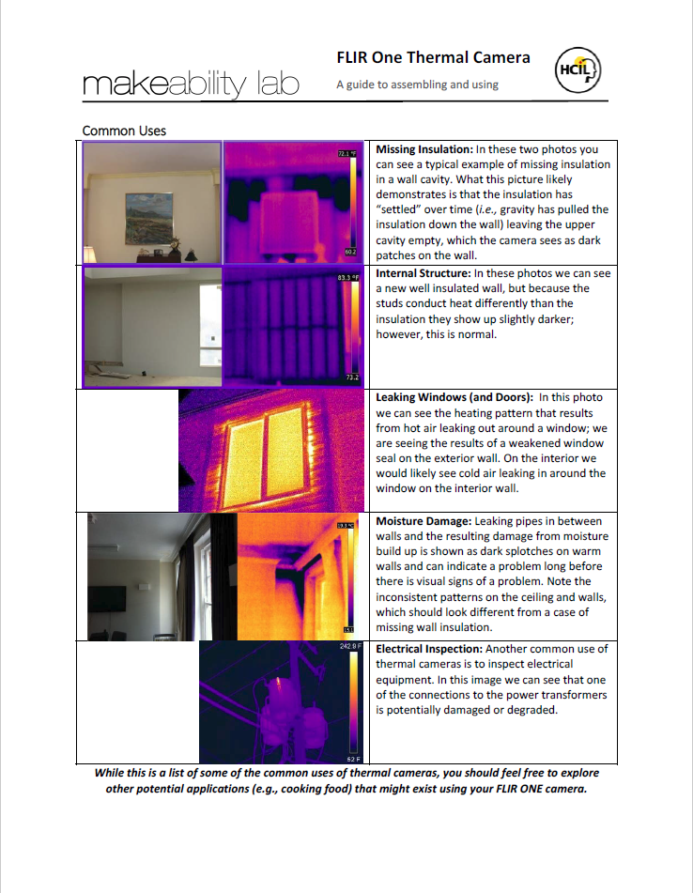
Field Deployment: Training
Hardware/Software Overview
How-to Thermporal
Guide
Thermographic Inspection Guide
Notes:
Reviewing how to use the thermographic tools that we provided them, which included both a smartphone-based thermal camera attachment for their personal smartphone and our temporal thermography system along with short guides about DIY energy auditing

Slide 43
Field Deployment: Procedure
Thermal
Camera
“Mission”
Pre-Study
Questionnaire
Introduction
Meeting
Survey
Notes:
Over the next week, participants first inspected their home with the thermal camera attachment and then completed a survey about their experience…

Slide 44
Field Deployment: Procedure
Thermal
Camera
“Mission”
Sensor
System
“Mission”
Pre-Study
Questionnaire
Introduction
Meeting
Survey
Notes:
Next they identified areas of insulation to test with our sensor system based on their photos or areas they had identified a priori as being problematic…and then they completed another survey.

Slide 45
Field Deployment: Procedure
Thermal
Camera
“Mission”
Sensor
System
“Mission”
Pre-Study
Questionnaire
Post-Study
Follow-up
(~45 days)
Introduction
Meeting
Survey
Semi-Structured
Interview
Notes:
At the end of the week, participants completed a semi-structured interview and then we followed up with them using another short survey 45 days after participation had ended to assess any long-term impact.

Slide 46
Field Deployment: Analysis
We qualitatively coded the survey and interview data to uncover themes.
Notes:
We qualitatively coded the survey and interview data to uncover themes.

Slide 47
Field Deployment: Results
Thermal
Camera
“Mission”
Survey
Notes:
And now, I’d like to provide you with some highlights from the results, starting with the first thermal camera mission…

Slide 48

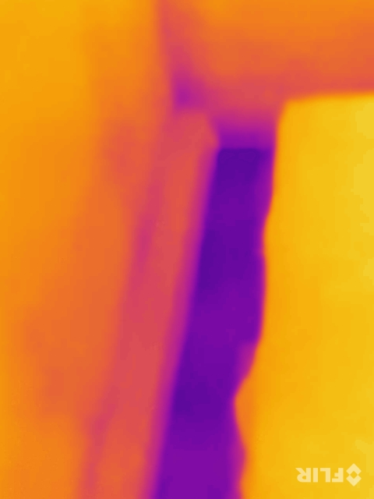
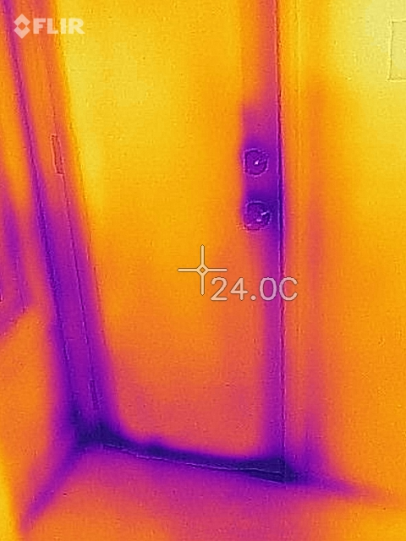
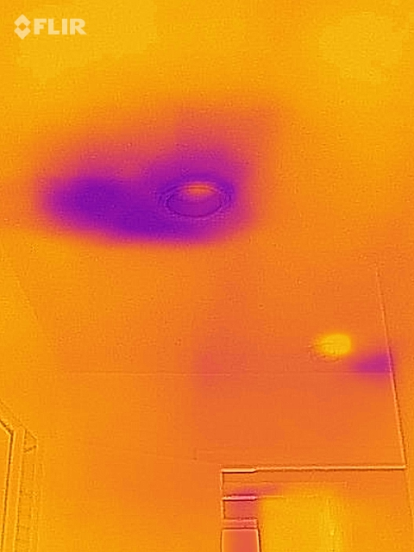
Field Deployment: Thermal Camera Results
Notes:
where we found, similar to the results reported in our CHI 2017 paper, that participants reported investigating pre-existing comfort issues… drafts around windows in doors… and potential insulation irregularities…
In their surveys, participants noted similar issues around gauging the severity of these problems… for example, one participant wrote

Slide 49
Field Deployment: Thermal Camera Results
“There are some very cold spots in the office, but it’s hard to tell if they are just because it's unheated or that there's some big gaps in the insulation.” –NS2
Notes:
…

Slide 50
Field Deployment: Results
Sensor
System
“Mission”
Survey
Notes:
During the sensor mission…

Slide 51
Field Deployment: Sensor System Results
Participant ID | Sensor Kit Aimed at Suspected Issue | Issue was Found
P1 | No | No
P2 | Yes | Yes Less severe than anticipated
P3 | Yes | Yes
P4 | No | Yes
P5 | Yes Based on intuition, not thermal camera mission | No
Notes:
Some participants, like Participant 1 did not find any issues in their home with the thermal camera and so they simply tested segments of their external wall, again, finding no issues.. Thus matching their expectations…

Slide 52
Field Deployment: Sensor System Results
Participant ID | Sensor Kit Aimed at Suspected Issue | Issue was Found
P1 | No | No
P2 | Yes | Yes Less severe than anticipated
P3 | Yes | Yes
P4 | No | Yes
P5 | Yes Based on intuition, not thermal camera mission | No
Notes:
Participant 2, inspected several suspected issues and found them to be less severe than anticipated when reviewing their report against their earlier conclusions based on the thermal images alone…

Slide 53
Field Deployment: Sensor System Results
“It kind of gave me a why. It's real cold here and it is below code. Here's some further information you can look at. That was super helpful. I can decide if I agree that this is a problem, and it’s telling me something I can do.”
–NI2
Participant ID | Sensor Kit Aimed at Suspected Issue | Issue was Found
P1 | No | No
P2 | Yes | Yes Less severe than anticipated
P3 | Yes | Yes
P4 | No | Yes
P5 | Yes Based on intuition, not thermal camera mission | No
Notes:
Noting (later) about their report that…

Slide 54
Field Deployment: Sensor System Results
Participant ID | Sensor Kit Aimed at Suspected Issue | Issue was Found
P1 | No | No
P2 | Yes | Yes Less severe than anticipated
P3 | Yes | Yes
P4 | No | Yes
P5 | Yes Based on intuition, not thermal camera mission | No
Notes:
In contrast, Participant 5 was trying to confirm an issue they suspected with a recent insulation installation but found that neither their thermal images nor the sensor system could confirm their suspicion that it was underperforming…

Slide 55
Field Deployment: Sensor System Results
Participant ID | Sensor Kit Aimed at Suspected Issue | Issue was Found
P1 | No | No
P2 | Yes | Yes Less severe than anticipated
P3 | Yes | Yes
P4 | No | Yes
P5 | Yes Based on intuition, not thermal camera mission | No
“My reports were negative, so I am not sure what else to glean from them.” –NS5
Notes:
Writing about this issue that…

Slide 56
Field Deployment: Results
Semi-Structured
Interview
Notes:
Now, from the semi-structured interviews…

Slide 57
Field Deployment: Semi-structured Interview Results
Interactive Reporting
Data Privacy
Personal Confidence
Post-Mission Attitudes
Notes:
we discuss findings around the interactive report, data privacy, participant’s confidence in their assessments, and their post-mission attitudes…

Slide 58
Field Deployment: Semi-structured Interview Results
Interactive Reporting
Data Privacy
Personal Confidence
Post-Mission Attitudes
Notes:
I’ll briefly describe the first three.

Slide 59
Field Deployment: Semi-structured Interview Results
Interactive Reporting
Data Privacy
Personal Confidence
Post-Mission Attitudes
Notes:
Starting with the interactive report…

Slide 60
Interactive Reporting
Field Deployment: Semi-structured Interview Results
Participants described the interactive report in several ways:
4 of 5 were positive about receiving the easy-to-read, automatically generated report.
Notes:
Most participants were positive about it, indicating it was easy to read and understand…

Slide 61
Interactive Reporting
Field Deployment: Semi-structured Interview Results
Participants described the interactive report in several ways:
4 of 5 were positive about receiving the easy-to-read, automatically generated report.
4 of 5 liked having longitudinal data and the additional depth the report provided by comparison to thermograms alone.
Notes:
Most appreciated having longitudinal data and the additional depth the report provided over thermograms alone….

Slide 62
Interactive Reporting
Field Deployment: Semi-structured Interview Results
Participants described the interactive report in several ways:
4 of 5 were positive about receiving the easy-to-read, automatically generated report.
4 of 5 liked having longitudinal data and the additional depth the report provided by comparison to thermograms alone.
“I like the idea of having a report that I can refer to again afterward. You get that with pictures too, obviously. But the reporting aspect gives you more detail, […] the fact that you had the environmental and air quality readings also gave you something more to look at.” –NI3
Notes:
As one participant noted…

Slide 63
Interactive Reporting
Field Deployment: Semi-structured Interview Results
Participants described the interactive report in several ways:
4 of 5 were positive about receiving the easy-to-read, automatically generated report.
4 of 5 liked having longitudinal data and the additional depth the report provided by comparison to thermograms alone.
3 of 5 envisioned using this data as a tool to communicate with professionals
Notes:
And, 3 participants envisioned using this data as a tool for discussing improvements with professional service providers… viewing this as advantageous… as one described..

Slide 64
Interactive Reporting
Field Deployment: Semi-structured Interview Results
Participants described the interactive report in several ways:
4 of 5 were positive about receiving the easy-to-read, automatically generated report.
4 of 5 liked having longitudinal data and the additional depth the report provided by comparison to thermograms alone.
3 of 5 envisioned using this data as a tool to communicate with professionals
“If there's a big problem, that's the thing I want to fix, but I don't trust that some guy is coming in and not trying to sell me.” –NI2

Slide 65
Field Deployment: Semi-structured Interview Results
Interactive Reporting
Data Privacy
Personal Confidence
Post-Mission Attitudes
Notes:
As far as the privacy of their data was concerned…

Slide 66
Data Privacy
Field Deployment: Semi-structured Interview Results
Participants were largely homogenous when it came to the privacy of their data:
4 of 5 desired explicit control over all data collected about/in their home.
Notes:
Most participants desired explicit control over all data collected about or in their home…

Slide 67
Data Privacy
Field Deployment: Semi-structured Interview Results
Participants were largely homogenous when it came to the privacy of their data:
4 of 5 desired explicit control over all data collected about/in their home.
“If it were not an internet connected device, if it were just a local network thing that I used in my house, that would be fine. If information is going out, then I have a big problem with technology like that.” –NI2
Notes:
As one participant stated…

Slide 68
Data Privacy
Field Deployment: Semi-structured Interview Results
Participants were largely homogenous when it came to the privacy of their data:
4 of 5 desired explicit control over all data collected about/in their home.
1 of 5 desired aggregated data about their neighborhood and advocated that local policy makers should have access.
Notes:
However, in contrast, one participant was very interested in neighborhood data and advocated data from the system should be shared with policy makers to provide information about the local building stock.

Slide 69
Field Deployment: Semi-structured Interview Results
Interactive Reporting
Data Privacy
Personal Confidence
Post-Mission Attitudes
Notes:
Lastly, a brief note about personal confidence…

Slide 70
Field Deployment: Sensor System Results
Participant ID | Sensor Kit Aimed at Suspected Issue | Issue was Found
P1 | No | No
P2 | Yes | Yes Less severe than anticipated
P3 | Yes | Yes
P4 | No | Yes
P5 | Yes Based on intuition, not thermal camera mission | No
Notes:
We noticed that participants self-reported increased confidence in their assessment in cases where the system confirmed a problem (in both the surveys and interviews), however the two participants who did not find or could not confirm any issues became more neutral or were unchanged.

Slide 71
Field Deployment: Results
Post-Study
Follow-up
(~45 days)
Notes:
Finally, results from our follow-up survey which indicated that…

Slide 72
Follow-up Findings
Field Deployment: Follow-up Survey
5 of 5 reported thinking more about energy efficiency issues in their home since participation had ended.
Notes:
All participants reported thinking more about energy efficiency issues in their home since participation had ended in the study… One participant wrote…

Slide 73
Follow-up Findings
Field Deployment: Follow-up Survey
Participants were largely homogenous when it came to the privacy of their data:
5 of 5 reported thinking more about energy efficiency issues in their home since participation had ended.
“It has made me generally more aware of where there might be issues and why.” –NS3

Slide 74
Follow-up Findings
Field Deployment: Follow-up Survey
Participants were largely homogenous when it came to the privacy of their data:
5 of 5 reported thinking more about energy efficiency issues in their home since participation had ended.
2 of 5 reported making some repairs for air leakage issues; however, all reported that insulation issues required more savings and planning.
Notes:
And, while a few participants had made some minor repairs… most noted that large fixes like insulation repairs required more money and planning…as participant 3 concluded…

Slide 75
Follow-up Findings
Field Deployment: Follow-up Survey
Participants were largely homogenous when it came to the privacy of their data:
5 of 5 reported thinking more about energy efficiency issues in their home since participation had ended.
2 of 5 reported making some repairs for air leakage issues; however, all reported that insulation issues required more savings and planning.
“I'd say it's kind of too late for a homeowner, unless you're about to do a renovation.” –NI3
Notes:
(READ QUOTE THEN THIS) Indicating that timing is key… and also that perhaps 45 days is too soon to follow-up on these sorts of larger issues…

Slide 76
Talk Overview
Introduction
Background
System Overview
Field Deployment
Expert Review
Conclusion
Notes:
Now…

Slide 77
Talk Overview
Introduction
Background
System Overview
Field Deployment
Expert Review
Conclusion
Notes:
Turning to our expert review…

Slide 78
Expert Review: Participants
5 Participants
(All male)
Notes:
We recruited 5 professional energy auditors from the same local population

Slide 79

Expert Review: Presentation of Design Probes
Scenario 1
(Text)
Interactive Demo
Scenario 3
(Text)
Notes:
and presented them with several design probes based on our work…

Slide 80
Expert Review: Presentation of Design Probes
Scenario 1
(Text)
Interactive Demo
Scenario 3
(Text)
Residential Audit
Notes:
Including a text scenario about a residential audits where homeowners would provide them with reports and access to their in-home sensor data…

Slide 81
Expert Review: Presentation of Design Probes
Scenario 1
(Text)
Interactive Demo
Scenario 3
(Text)
Hardware & Procedure
Study Data & Reports
Notes:
an interactive demo of our system and review of study 1 data

Slide 82
Expert Review: Presentation of Design Probes
Scenario 1
(Text)
Interactive Demo
Scenario 3
(Text)
Audits-at-Scale
Notes:
And, then we discussed a scenario about how these sensors might be used at scale in an urban environment…

Slide 83
Expert Review: Design Probe Results
Notes:
In the interest of time, I’ll quickly go over the pro’s and con’s…starting with…

Slide 84
Expert Review: Design Probe Results
Raising Awareness
Notes:
Raising awareness…Overall, professional auditors were positive about the potential for the system to raise awareness of energy efficiency issues.

Slide 85
Expert Review: Design Probe Results
Raising Awareness
Providing Reliable Data
Notes:
They were also positive about the system providing them with reliable, longitudinal data about home performance as homeowners were not always the most reliable sources of information.

Slide 86
Expert Review: Design Probe Results
Raising Awareness
Providing Reliable Data
Relationship Building
Notes:
Finally, auditors viewed clients approaching them with data in-hand as a potentially positive way to begin auditor-client relationships.

Slide 87
Expert Review: Design Probe Results
Notes:
However, auditors were primarily concerned about…

Slide 88
Expert Review: Design Probe Results
Installation and Coverage
Notes:
ensuring proper installation in the home and increasing the coverage of the system. For example, deploying the system near a combustion source could render the air quality data invalid.

Slide 89
Expert Review: Design Probe Results
Installation and Coverage
Motivating Action
Notes:
Moreover, they were concerned that the reporting feature may not result in actions as often their own reports proved ineffective.

Slide 90
Talk Overview
Introduction
Background
System Overview
Field Deployment
Expert Review
Conclusion
Notes:
Finally…

Slide 91
Talk Overview
Introduction
Background
System Overview
Field Deployment
Expert Review
Conclusion
Notes:
To wrap up…

Slide 92
Conclusion
Notes:
In this paper, we present a brief overview of a novel, easy-to-deploy temporal thermographic sensor system…

Slide 93
Conclusion: Design Recommendations
Notes:
While our work suggests that temporal thermography could address several challenges within auditing communities, some additional design recommendations include:

Slide 94
Conclusion: Design Recommendations
Framing efficiency recommendations with the right motivations and delivering them with the right timing is critical.
Notes:
Systems likes our must ensure that the framing of efficiency recommendations includes motivations beyond the financial (which wasn’t particularly motivating) and that presenting information at the right times is critical.

Slide 95
Conclusion: Design Recommendations
Framing efficiency recommendations with the right motivations and delivering them with the right timing is critical.
Permanently deployed sensor system that provide increased coverage are preferred to overnight scanning
Notes:
Moreover, we learned that permanently deployed sensor systems that can provide increased coverage are preferred to overnight scans as is being currently proposed. And, there are a few more system improvements suggested in the paper…

Slide 96
Conclusion: Limitations
Small N for both studies
Homogeneous weather conditions and construction types
Professional participants only evaluated the results of deployments
Notes:
Now, of course, There are several limitations of our work, [CLICK] the most notable of which is that both studies had small Ns [CLICK]
the system was also calibrated specifically for the local weather and constructions, [CLICK]
And, Professional participants only evaluated the results of deployments and did not deploy the system themselves

Slide 97
Conclusion: Summary
Temporal/Quantitative analysis provides more specific insights in the case of insulation performance.
Increasing homeowner agency opens new opportunities for professional auditor and homeowner relations.
While we saw DIY solutions enacted, motivating larger-scale structural changes remains challenging.
Notes:
However, we were able to demonstrate that temporal thermography can assist novice users with gauging insulation performance and professional auditors were positive about this as well. [CLICK]
Both populations envisioned the system providing new opportunities for agency and communication with professional auditors, which we describe more in the paper… [CLICK]
However, motivating larger retrofits remains challenging…

Slide 98
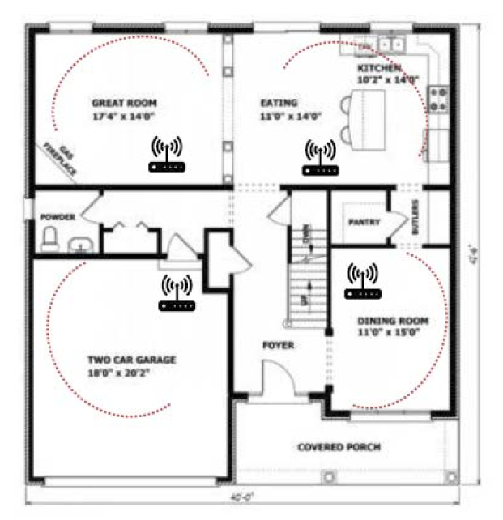
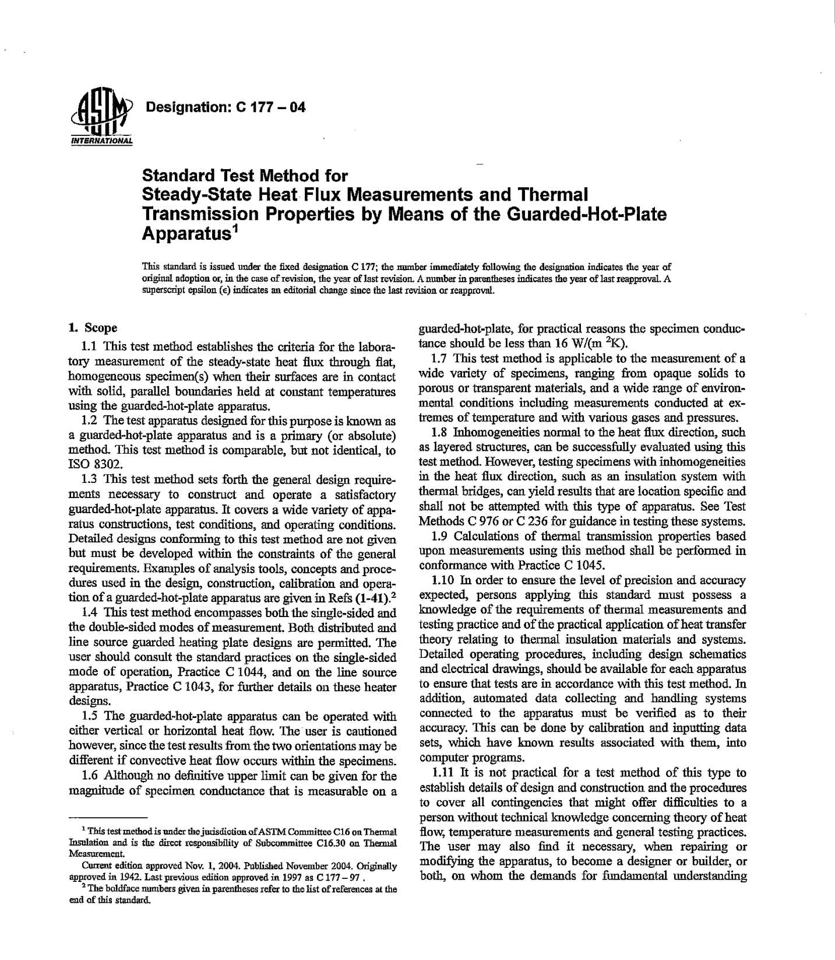
Conclusion: Future Work
Multi-Sensor Deployments
Standard for Temporal Thermography
Notes:
Investigating multi-sensor deployments, longitudinal deployments over a building’s lifetime, and conducting empirical studies toward establishing a common standard for temporal thermography are all open areas for future work.

Slide 99


Conclusion: Future Work
Notes:
However… our immediate goals is opening sourcing the code and instructions to build our sensor system on platforms like GitHub and Instructable.

Slide 100
Conclusion: Acknowledgements
Students
Noa Chazan
Simran Chawla
Jamie Gilkeson
Erica Brown
Funding
University of Maryland’s Office of Sustainability
Notes:
I’d like to thank the students and organizations for funding…

Slide 101
Thermporal: An Easy-to-Deploy Temporal Thermographic Sensor System to Support Residential Energy Audits
CHI 2019 | May 9th
Session on Sustainable HCI
Matthew Louis Mauriello
@mattm401
Brenna McNally
Jon E. Froehlich
Notes:
And, with that I’d like to thank my co-authors who helped make this work possible and thank you for listening.
At this time, I’d be happy to take any questions…

