Slide 1
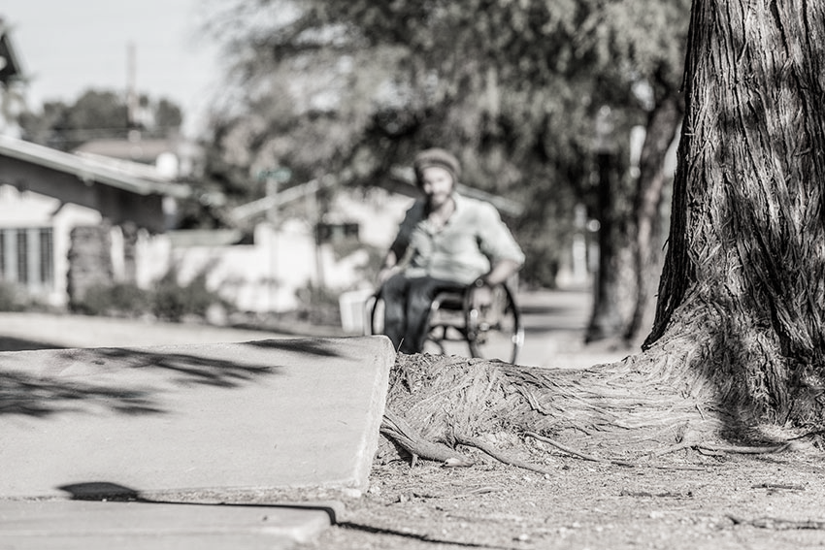





A Pilot Study of Sidewalk Equity in Seattle
Using Crowdsourced Sidewalk Assessment Data
Chu Li
PhD Student | Computer Science | University of Washington
Co-authors
Lisa Orii
Michael Saugstad
Stephen J. Mooney
Yochai Eisenberg
Delphine Labbé
Joy Hammel
Jon E. Froehlich
ASSETS’ 22 WORKSHOP
The Future Of Urban Accessibility
Notes:
Hello my name is Chu, I’m a Phd student at the University of Washington
today I will be talking to you about our study sidewalk equity using crowdsourced assessment data

Slide 2
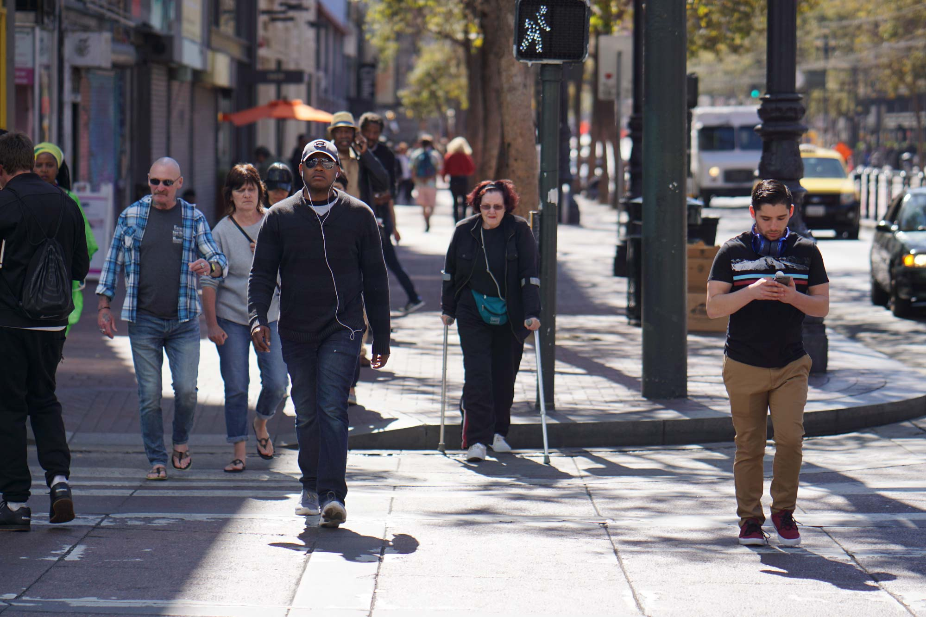
Sidewalks are critical public infrastructure
Notes:
Sidewalks are a critical public infrastructure…. They fundamentally shape how and where we travel in cities,
and For people disabilities, sidewalks play a crucial role in supporting independence, quality of life, and overall physical activity

Slide 3




MOTIVATION
Sidewalk Disparities
WHERE
HOW
WHAT
RELATIONSHIP
sidewalks are
they are connected
their conditions are
to socio-economic factors
Notes:
We also want to look at sidewalks where are the sidewalks,
how are they connected,
what is their condition and
how do they respond to socioeconomic factors like wealth, race, education and density?
Are there parts of the city that have poor infrastructure? And what are the key correlates to that?

Slide 4
How might we use crowdsourced sidewalk assessment data to examine sidewalk condition patterns in a city?
Notes:
So in our research, we aim to address two questions:
How can we use crowdsourced sidewalk assessment data to examine sidewalk condition patterns in a city?

Slide 5
How do sidewalk quality scores relate to neighborhood socioeconomic characteristics?
Notes:
And how do sidewalk quality patterns map to socioeconomic factors like wealth, race, density and education?

Slide 6
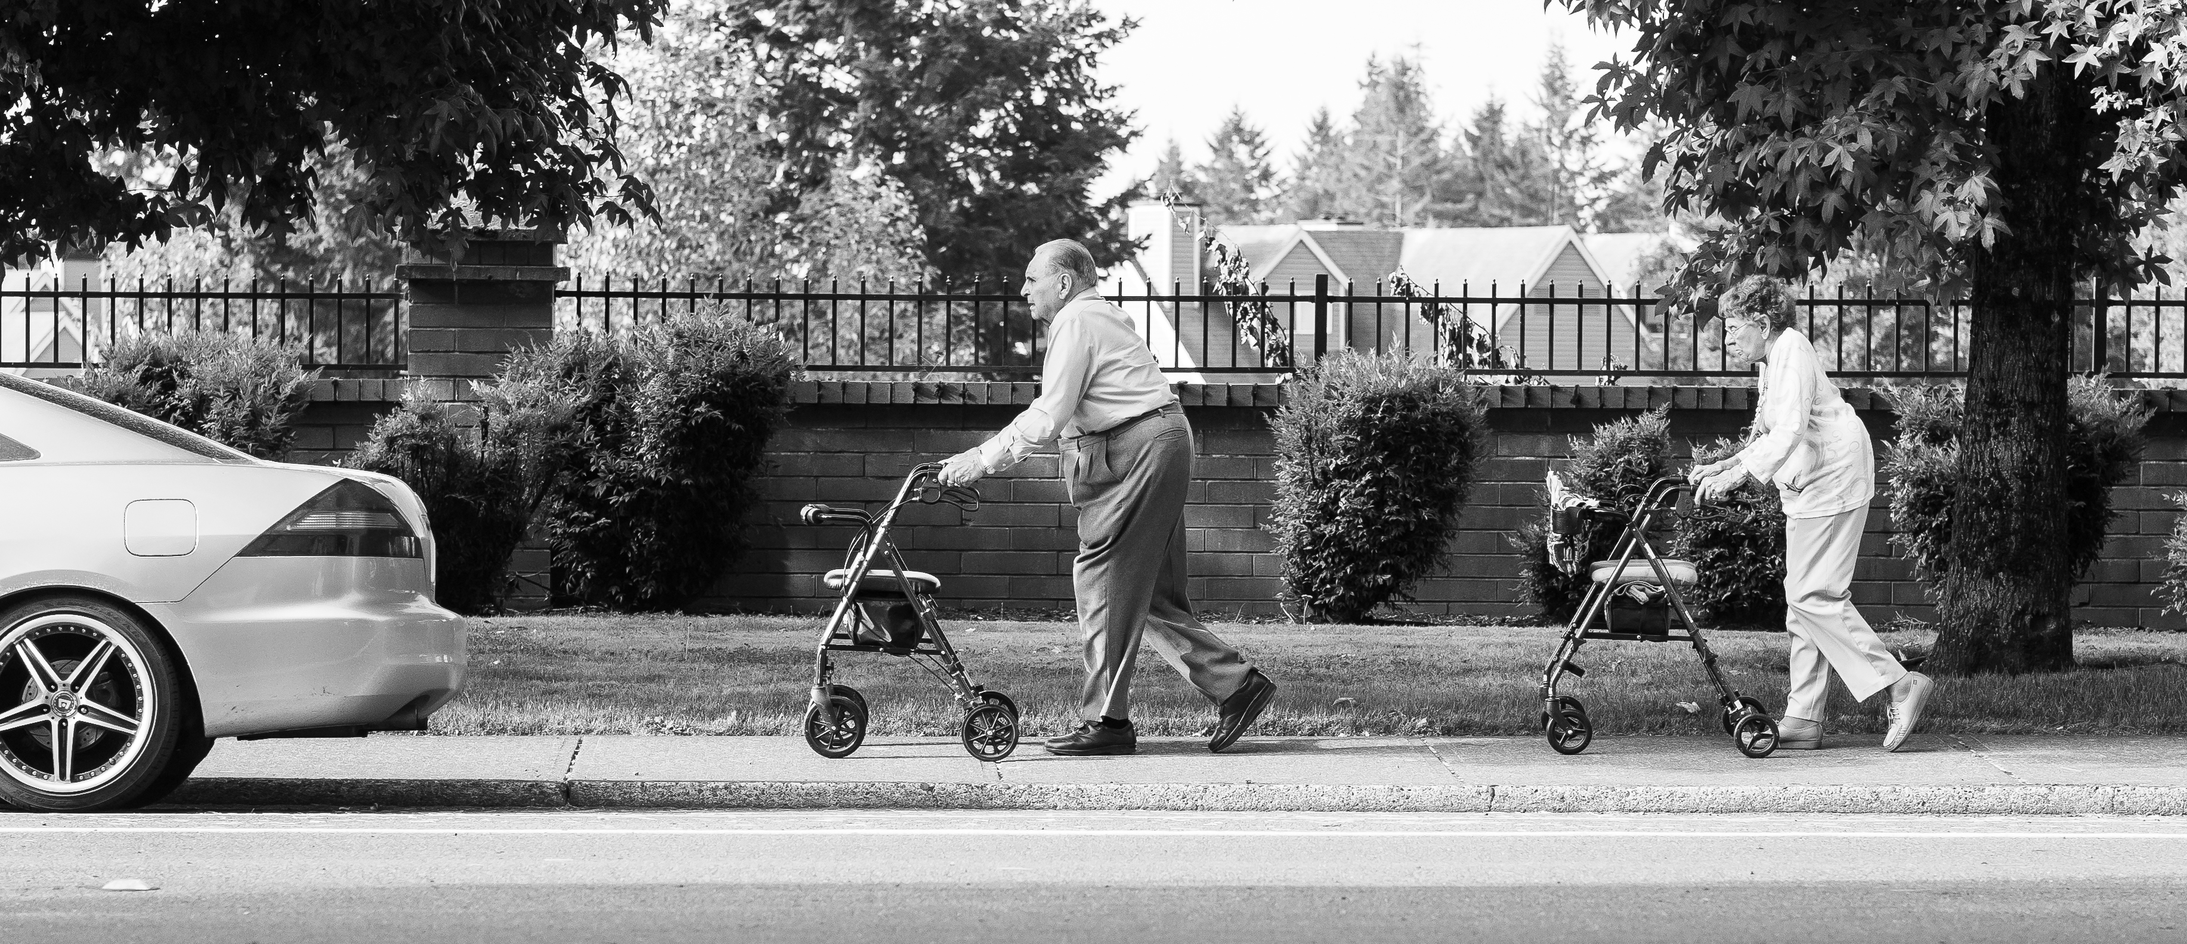
Sidewalks shape how and where we travel
Sidewalks
Shape How &
Where We Travel
Notes:
They fundamentally shape how and where we travel in cities

Slide 7
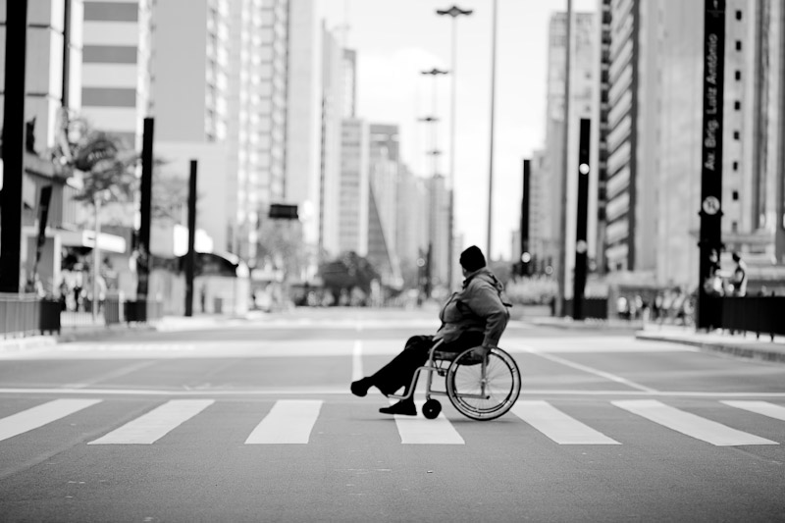
Independence,
Quality Of Life,
Physical Activity
Thapar et al., 2004 ; Nuernberger, 2008
Notes:
For people disabilities, sidewalks play a crucial role in supporting independence, quality of life, and overall physical activity.

Slide 8
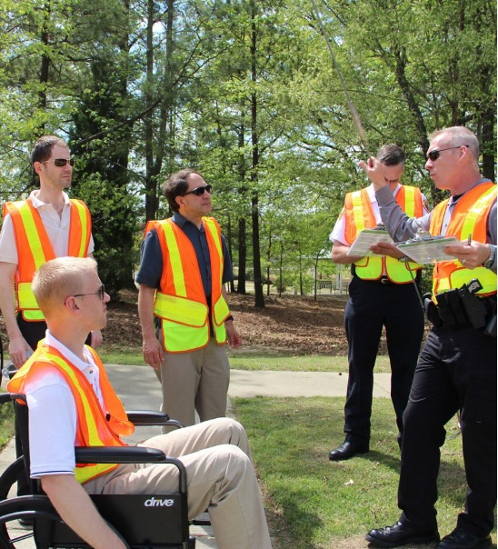
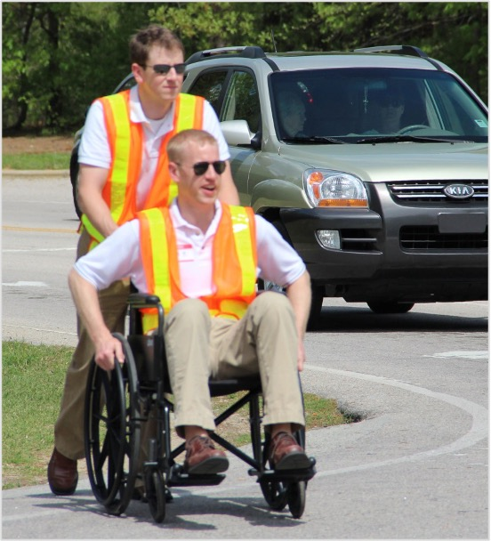
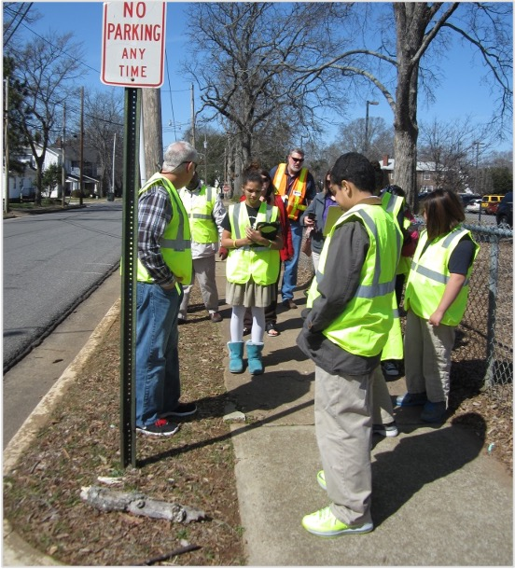
SIDEWALK DATA COLLECTION
Traditional accessibility audits
Walkability Audit
Wake County, North Carolina
Walkability Audit
Wake County, North Carolina
Safe Routes to School Walkability Audit
Rock Hill, South Carolina
Notes:
Most previous studies on sidewalk equity are limited to a certain scale or region
due to the laborious nature of collecting data through sidewalk auditing

Slide 9
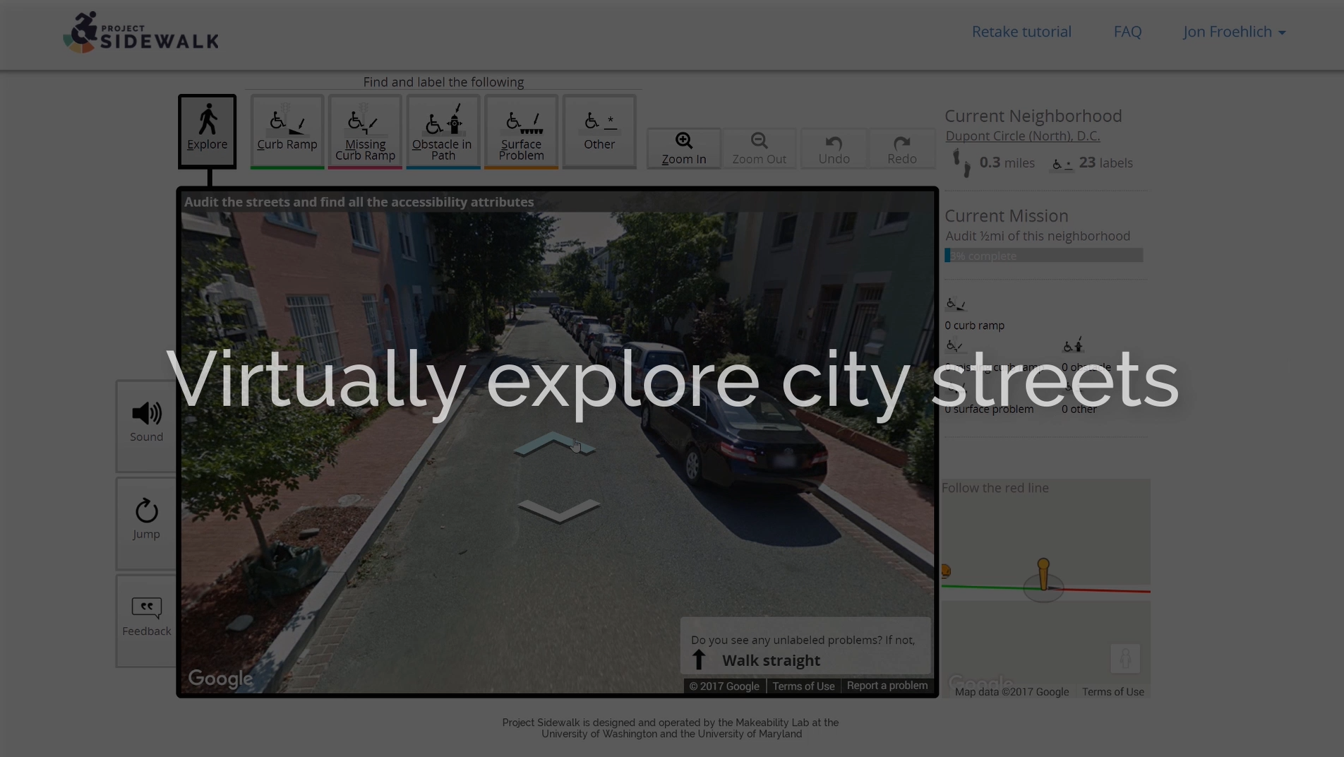
Notes:
Our study has been made possible by Project Sidewalk, an open-source crowdsourcing platform where online users remotely label sidewalk features in Google Street View (GSV)

Slide 10
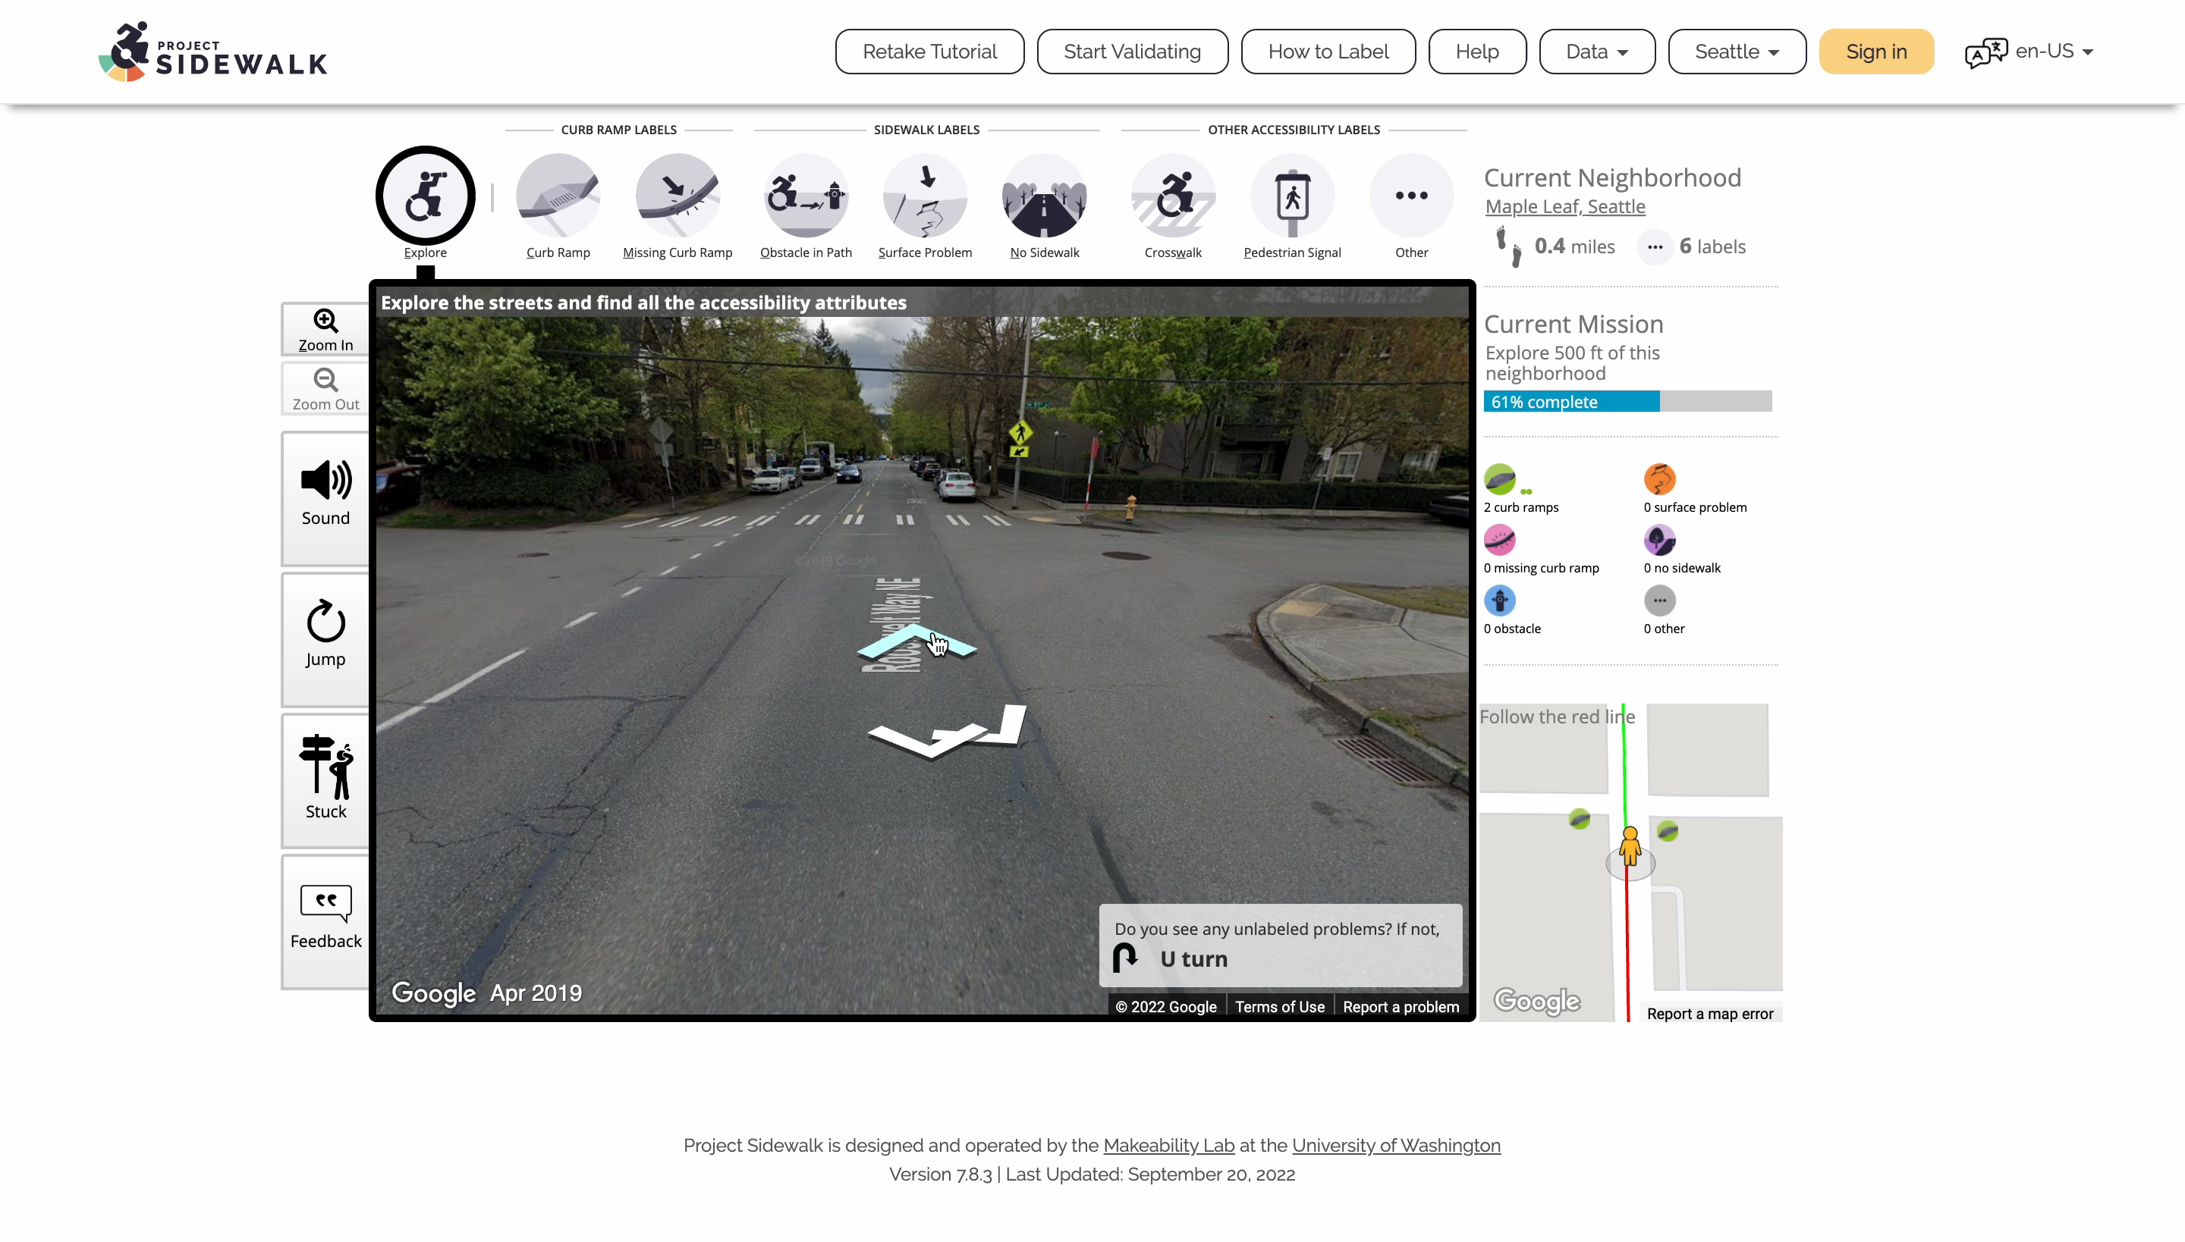
Notes:
Our study has been made possible by Project Sidewalk, an open-source crowdsourcing platform where online users remotely label sidewalk features in Google Street View (GSV)

Slide 11
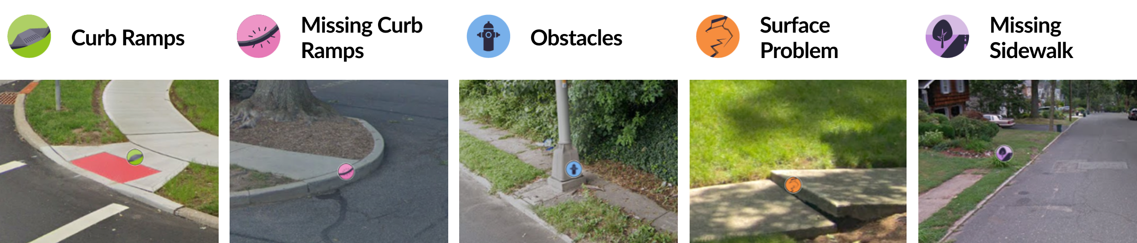
SIDEWALK DATA COLLECTION
Label Types
Notes:
Project sidewalk has 5 primary label types including missing curb ramps obstacles and surface problems

Slide 12
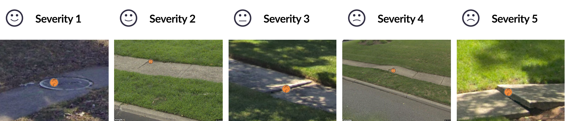
SIDEWALK DATA COLLECTION
Severity Rating
Notes:
For every label, users can rate the severity level

Slide 13
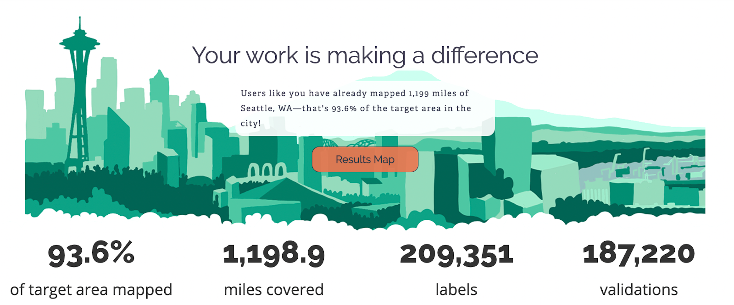
SIDEWALK DATA COLLECTION
Project Sidewalk in Seattle
Notes:
We have an especially robust dataset in the city of Seattle.
Since its launch in April 2019, over 7,000 users contributed to over 200k labels covering more than 1000 miles of Seattle streets.

Slide 14
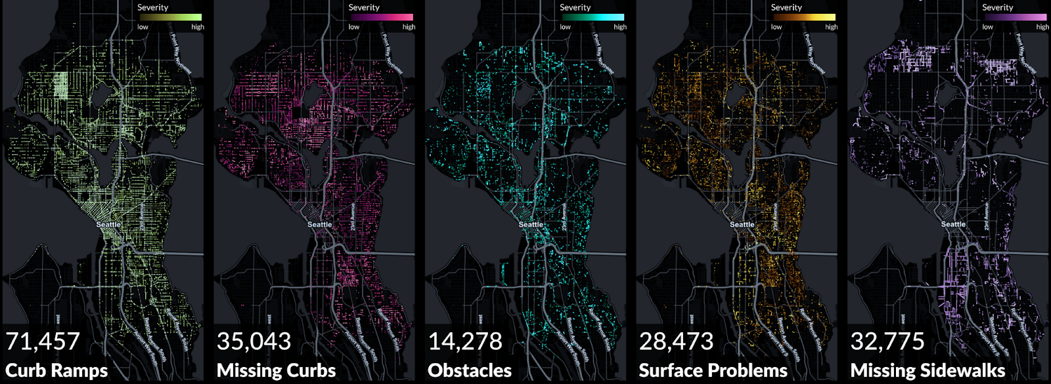
SIDEWALK DATA COLLECTION
Project Sidewalk in Seattle
Notes:
So we can see here a trellis view of sidewalk condition labels contributed by online users, including curb ramps, missing curbs, obstacles, surface problems and missing sidewalks.

Slide 15
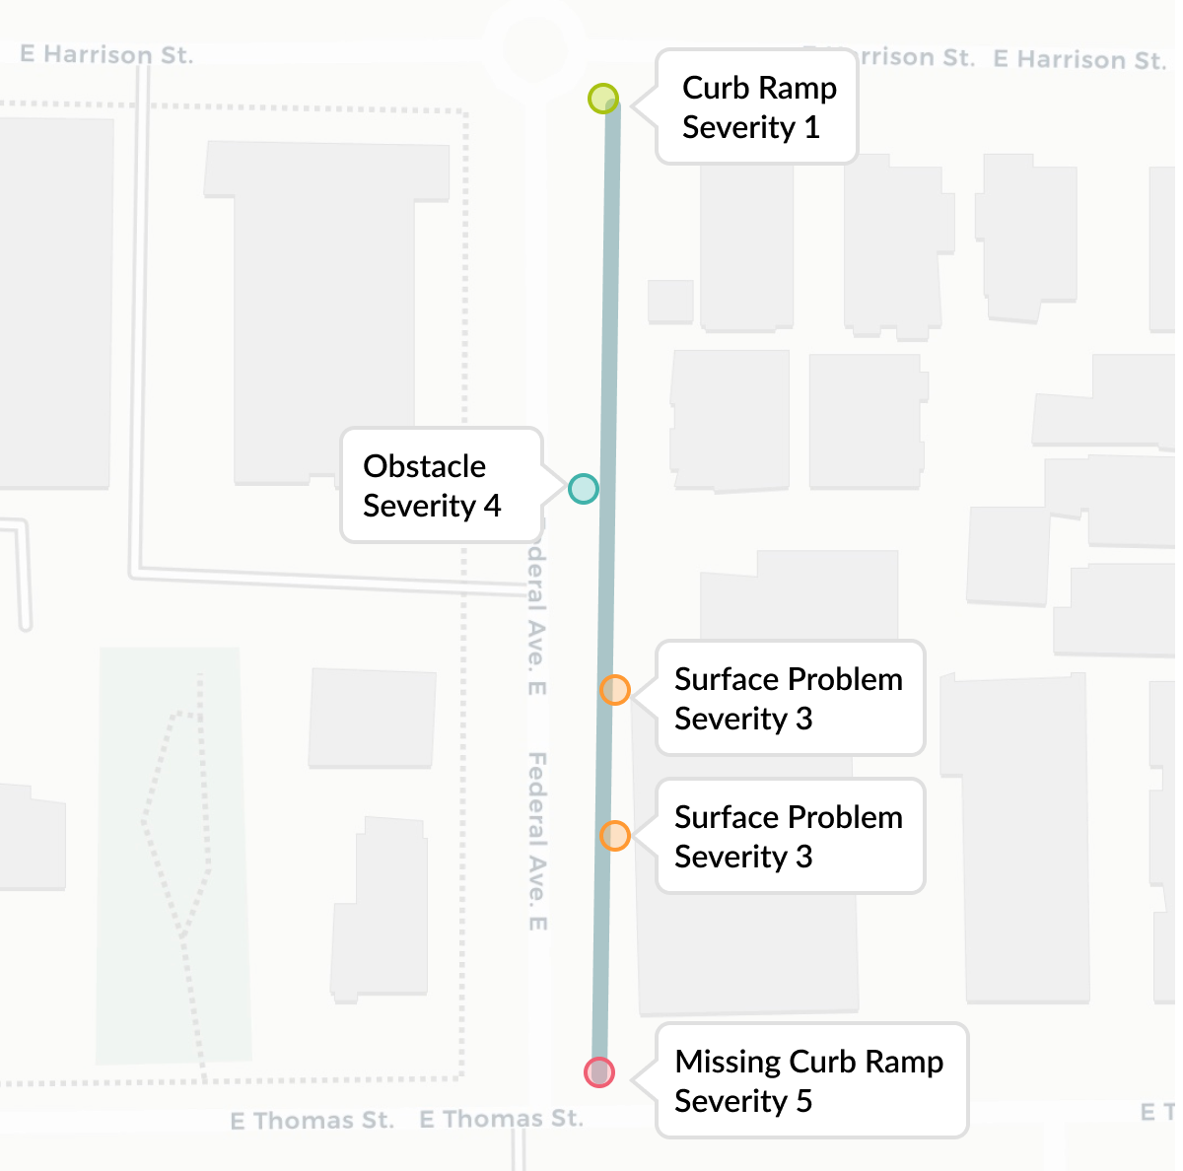
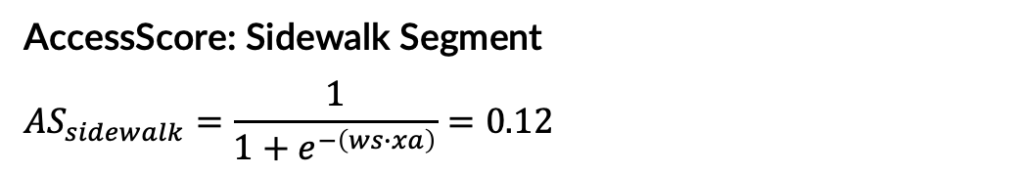
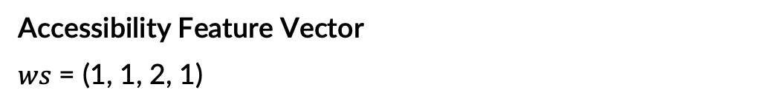
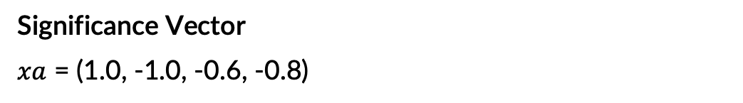
METHOD
Access Score Model
  Label Type (positive/negative)
  Severity Rating (1-5)
  Count
  Significance Vector
  $xa$ = (1.0, -1.0, -0.6, -0.8)
  Accessibility Feature Vector
  $ws$ = (1, 1, 2, 1)
  AccessScore: Sidewalk Segment
  $${AS}_{sidewalk}=\frac{1}{1+e^{−\left(ws∙xa\right)}}=0.12$$
Notes:
To answer our questions on sidewalk equity,
we first developed a simple model to calculate accessibility scores based on our sidewalk labels, the model takes into account the label type, the severity rating and the number of labels
For example this street shown here has a curb ramps with a severity 1, an obstacle with a severity of 4, 2 surfaces problems with a severity of 3 and a missing curb ramp with a severity of 5.
According to our model, the access score for this street is 0.12. Note that the access score ranges between 0 and 1, with 0 being not accessible and 1 being highly accessible.
Please refer to our paper for details.

Slide 16
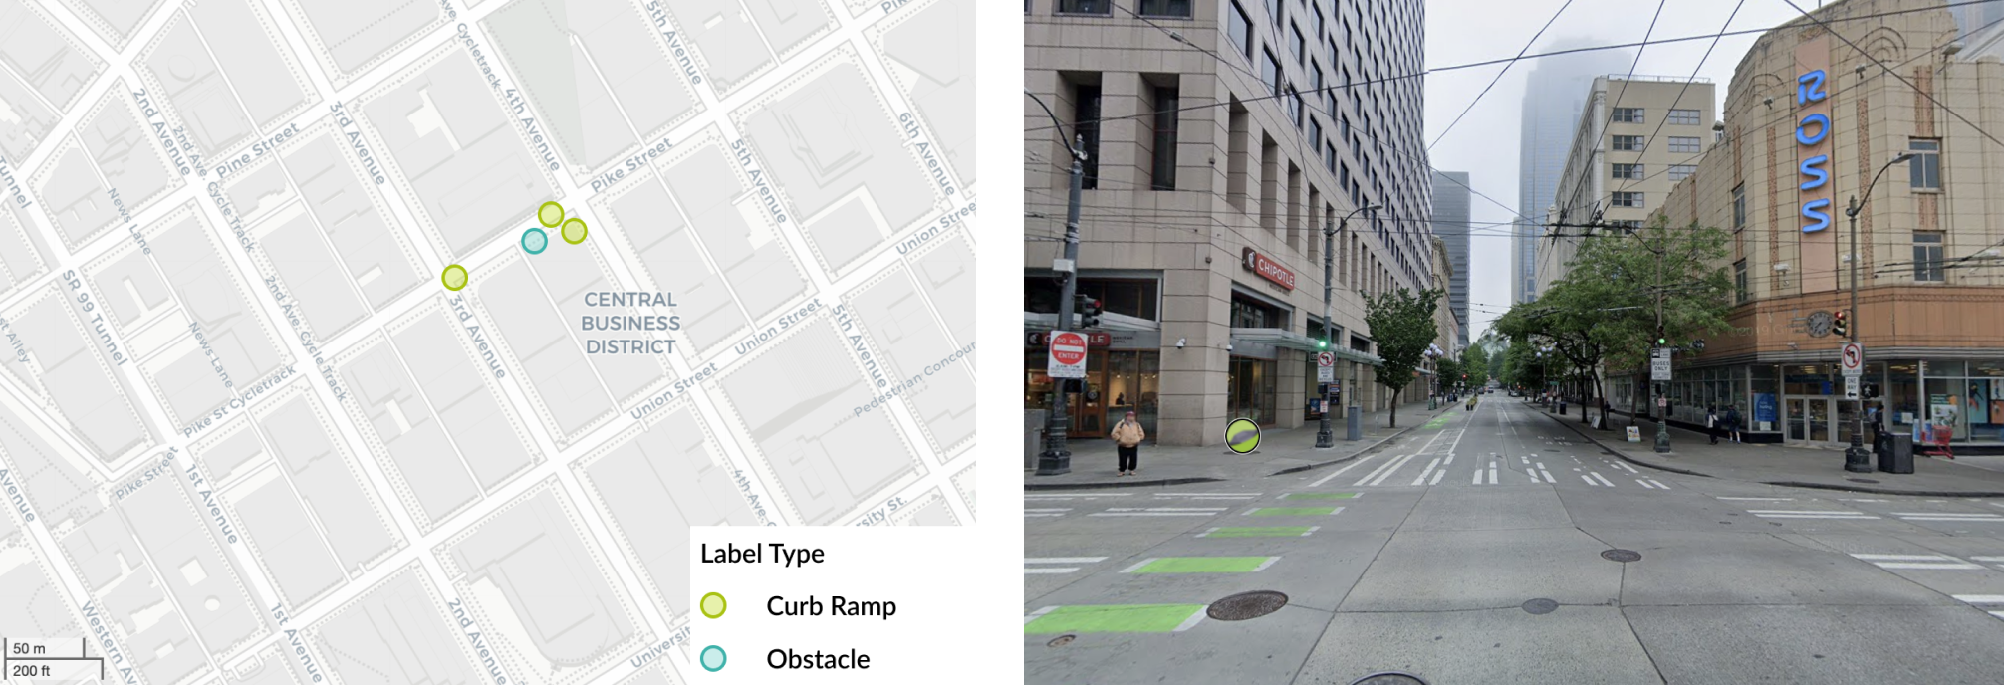
METHOD
High Access Score Street
Notes:
So here’s an example of a high access score street, we can see from the map on the left that this street has frequent curb ramps for wheelchair users

Slide 17
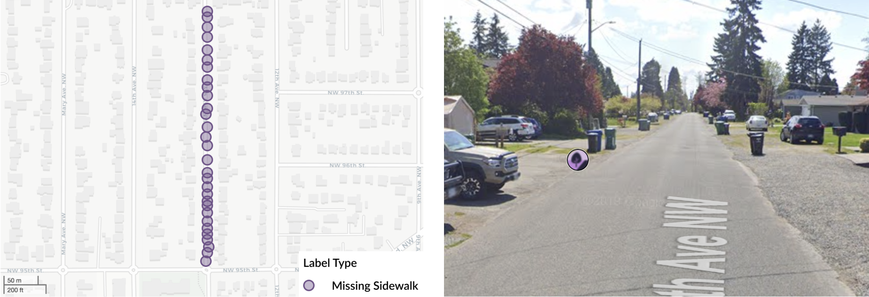
METHOD
Low Access Score Street
Notes:
So here’s an example of a street with a low access score. We can see from the google street view that this street is missing sidewalks completely.

Slide 18
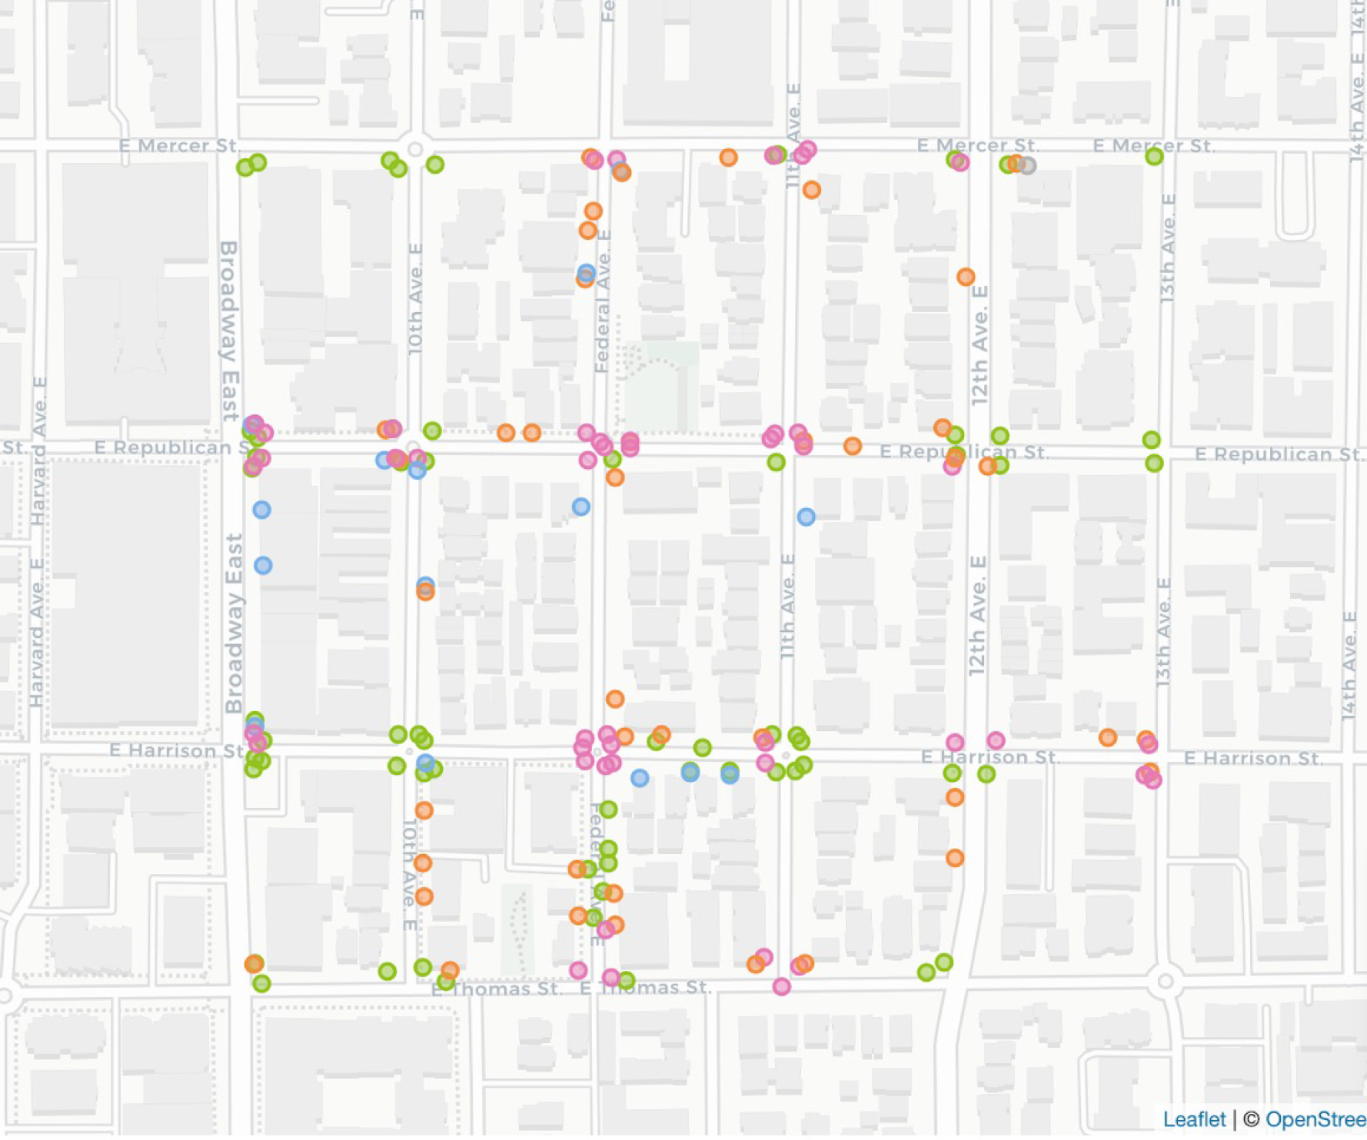
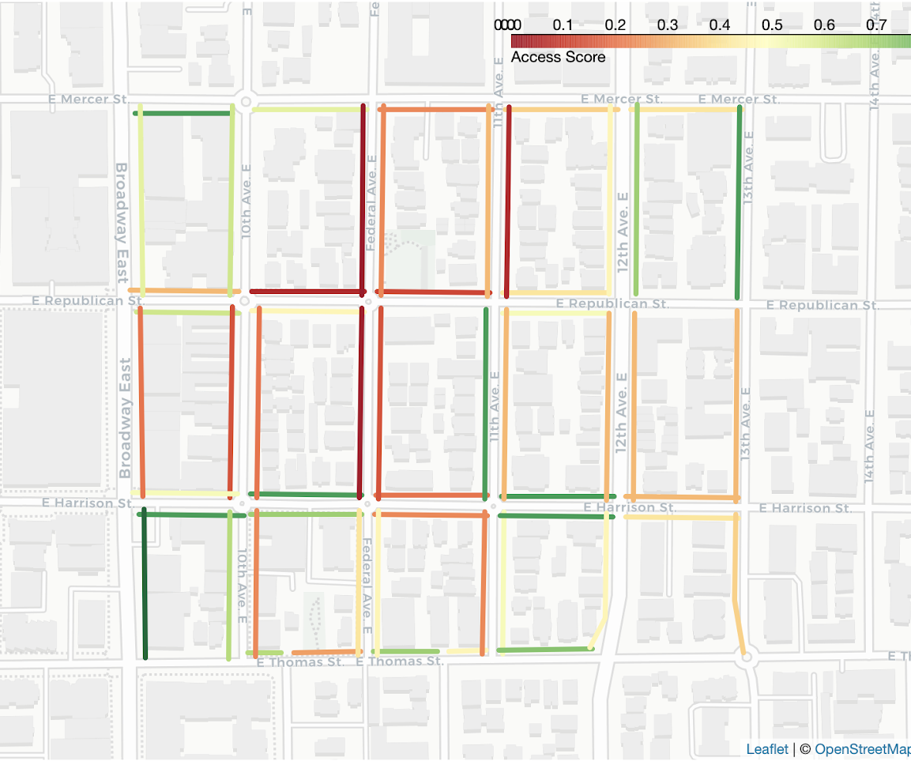
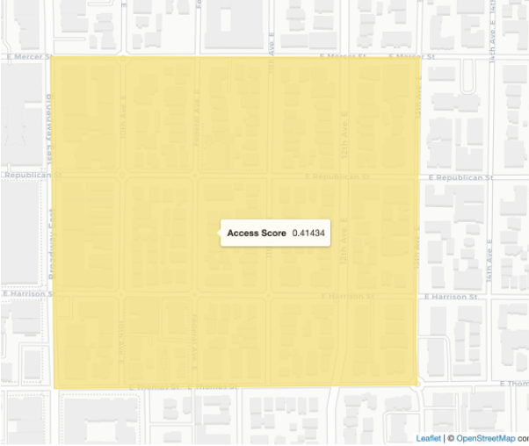
METHOD
Access Score
Labels
Sidewalk Access Score
Neighborhood Access Score
Notes:
When we look at it from a neighborhood level, here are all the different labels within this given neighborhood, we then translate them into access scores per street, and then based on these scores we calculate the access score for the neighborhood.

Slide 19
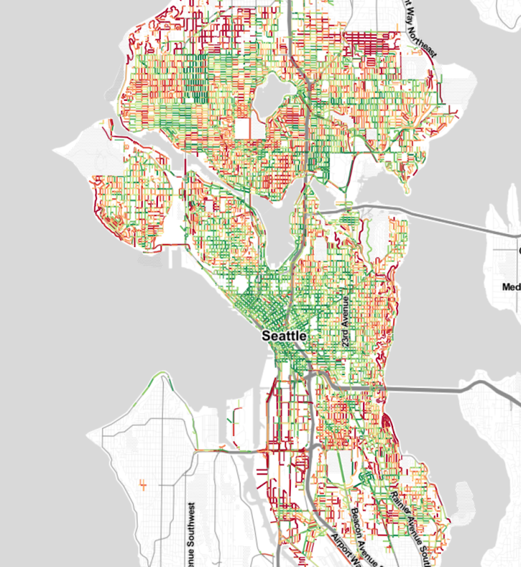
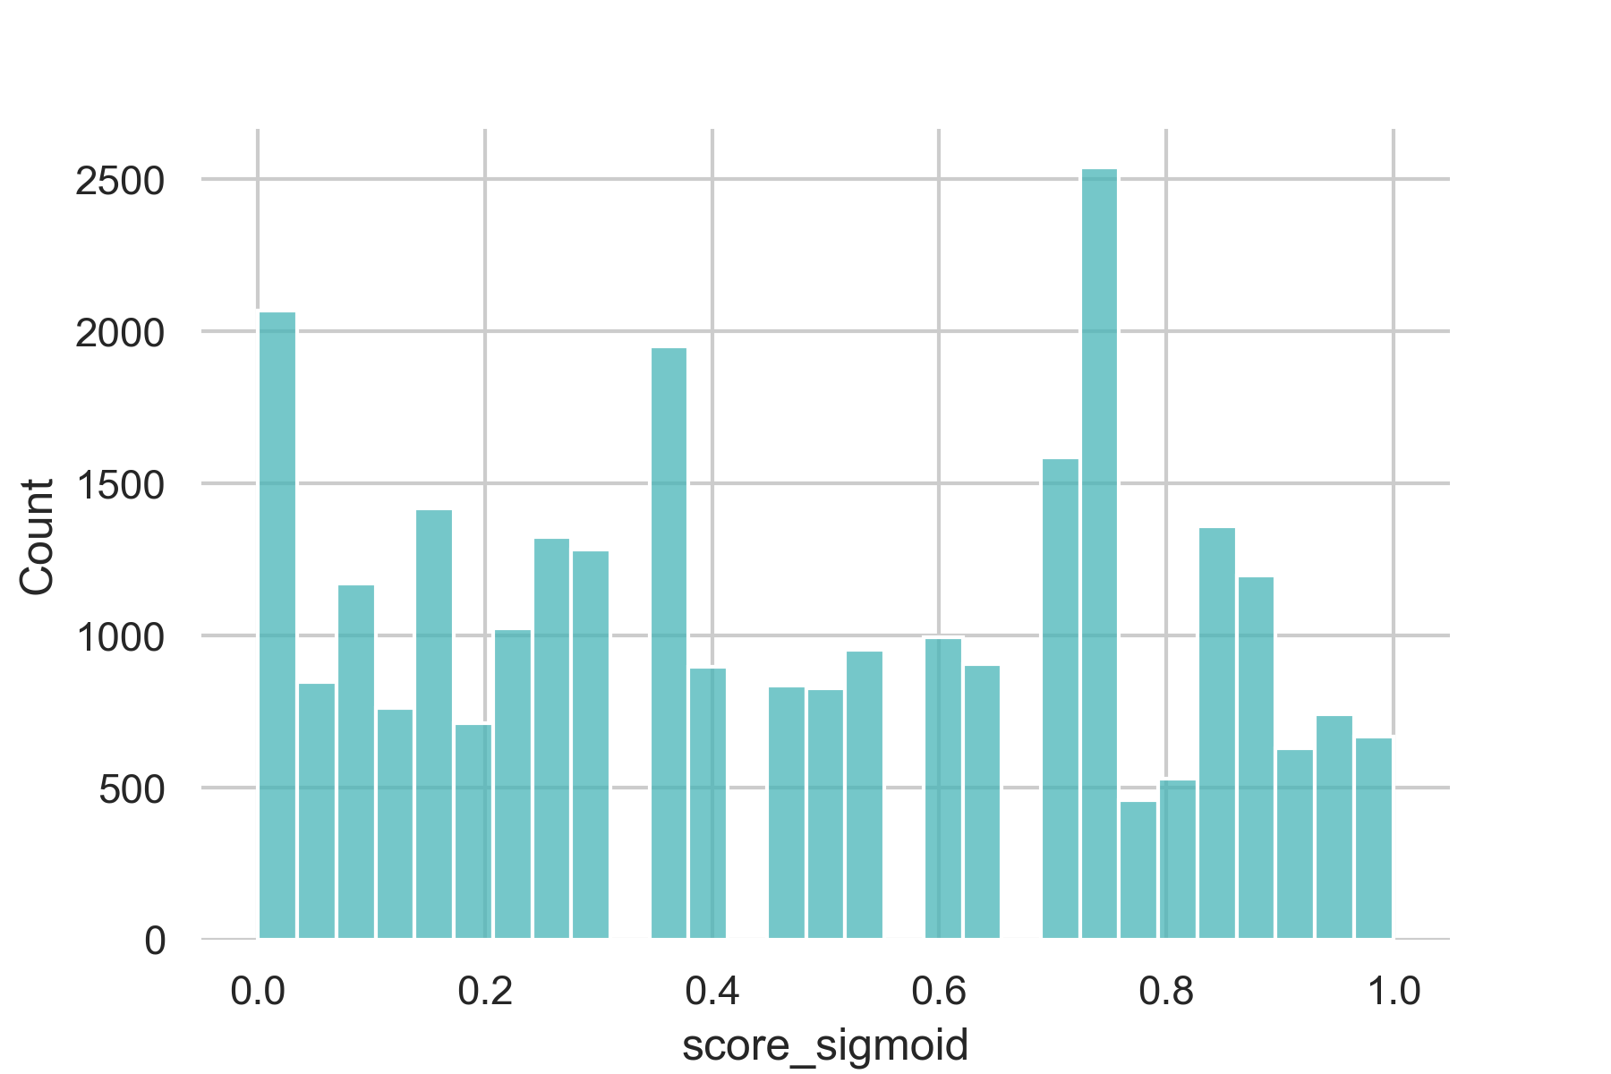
FINDINGS
Spatial Distribution
Per Sidewalk Segment
COUNT
ACCESS SCORE
Notes:
Zooming out city level, here we see how access scores per street are distributed across Seattle. Higher accessible streets or neighborhoods are shown in green and lower accessible areas are shown in red.

Slide 20
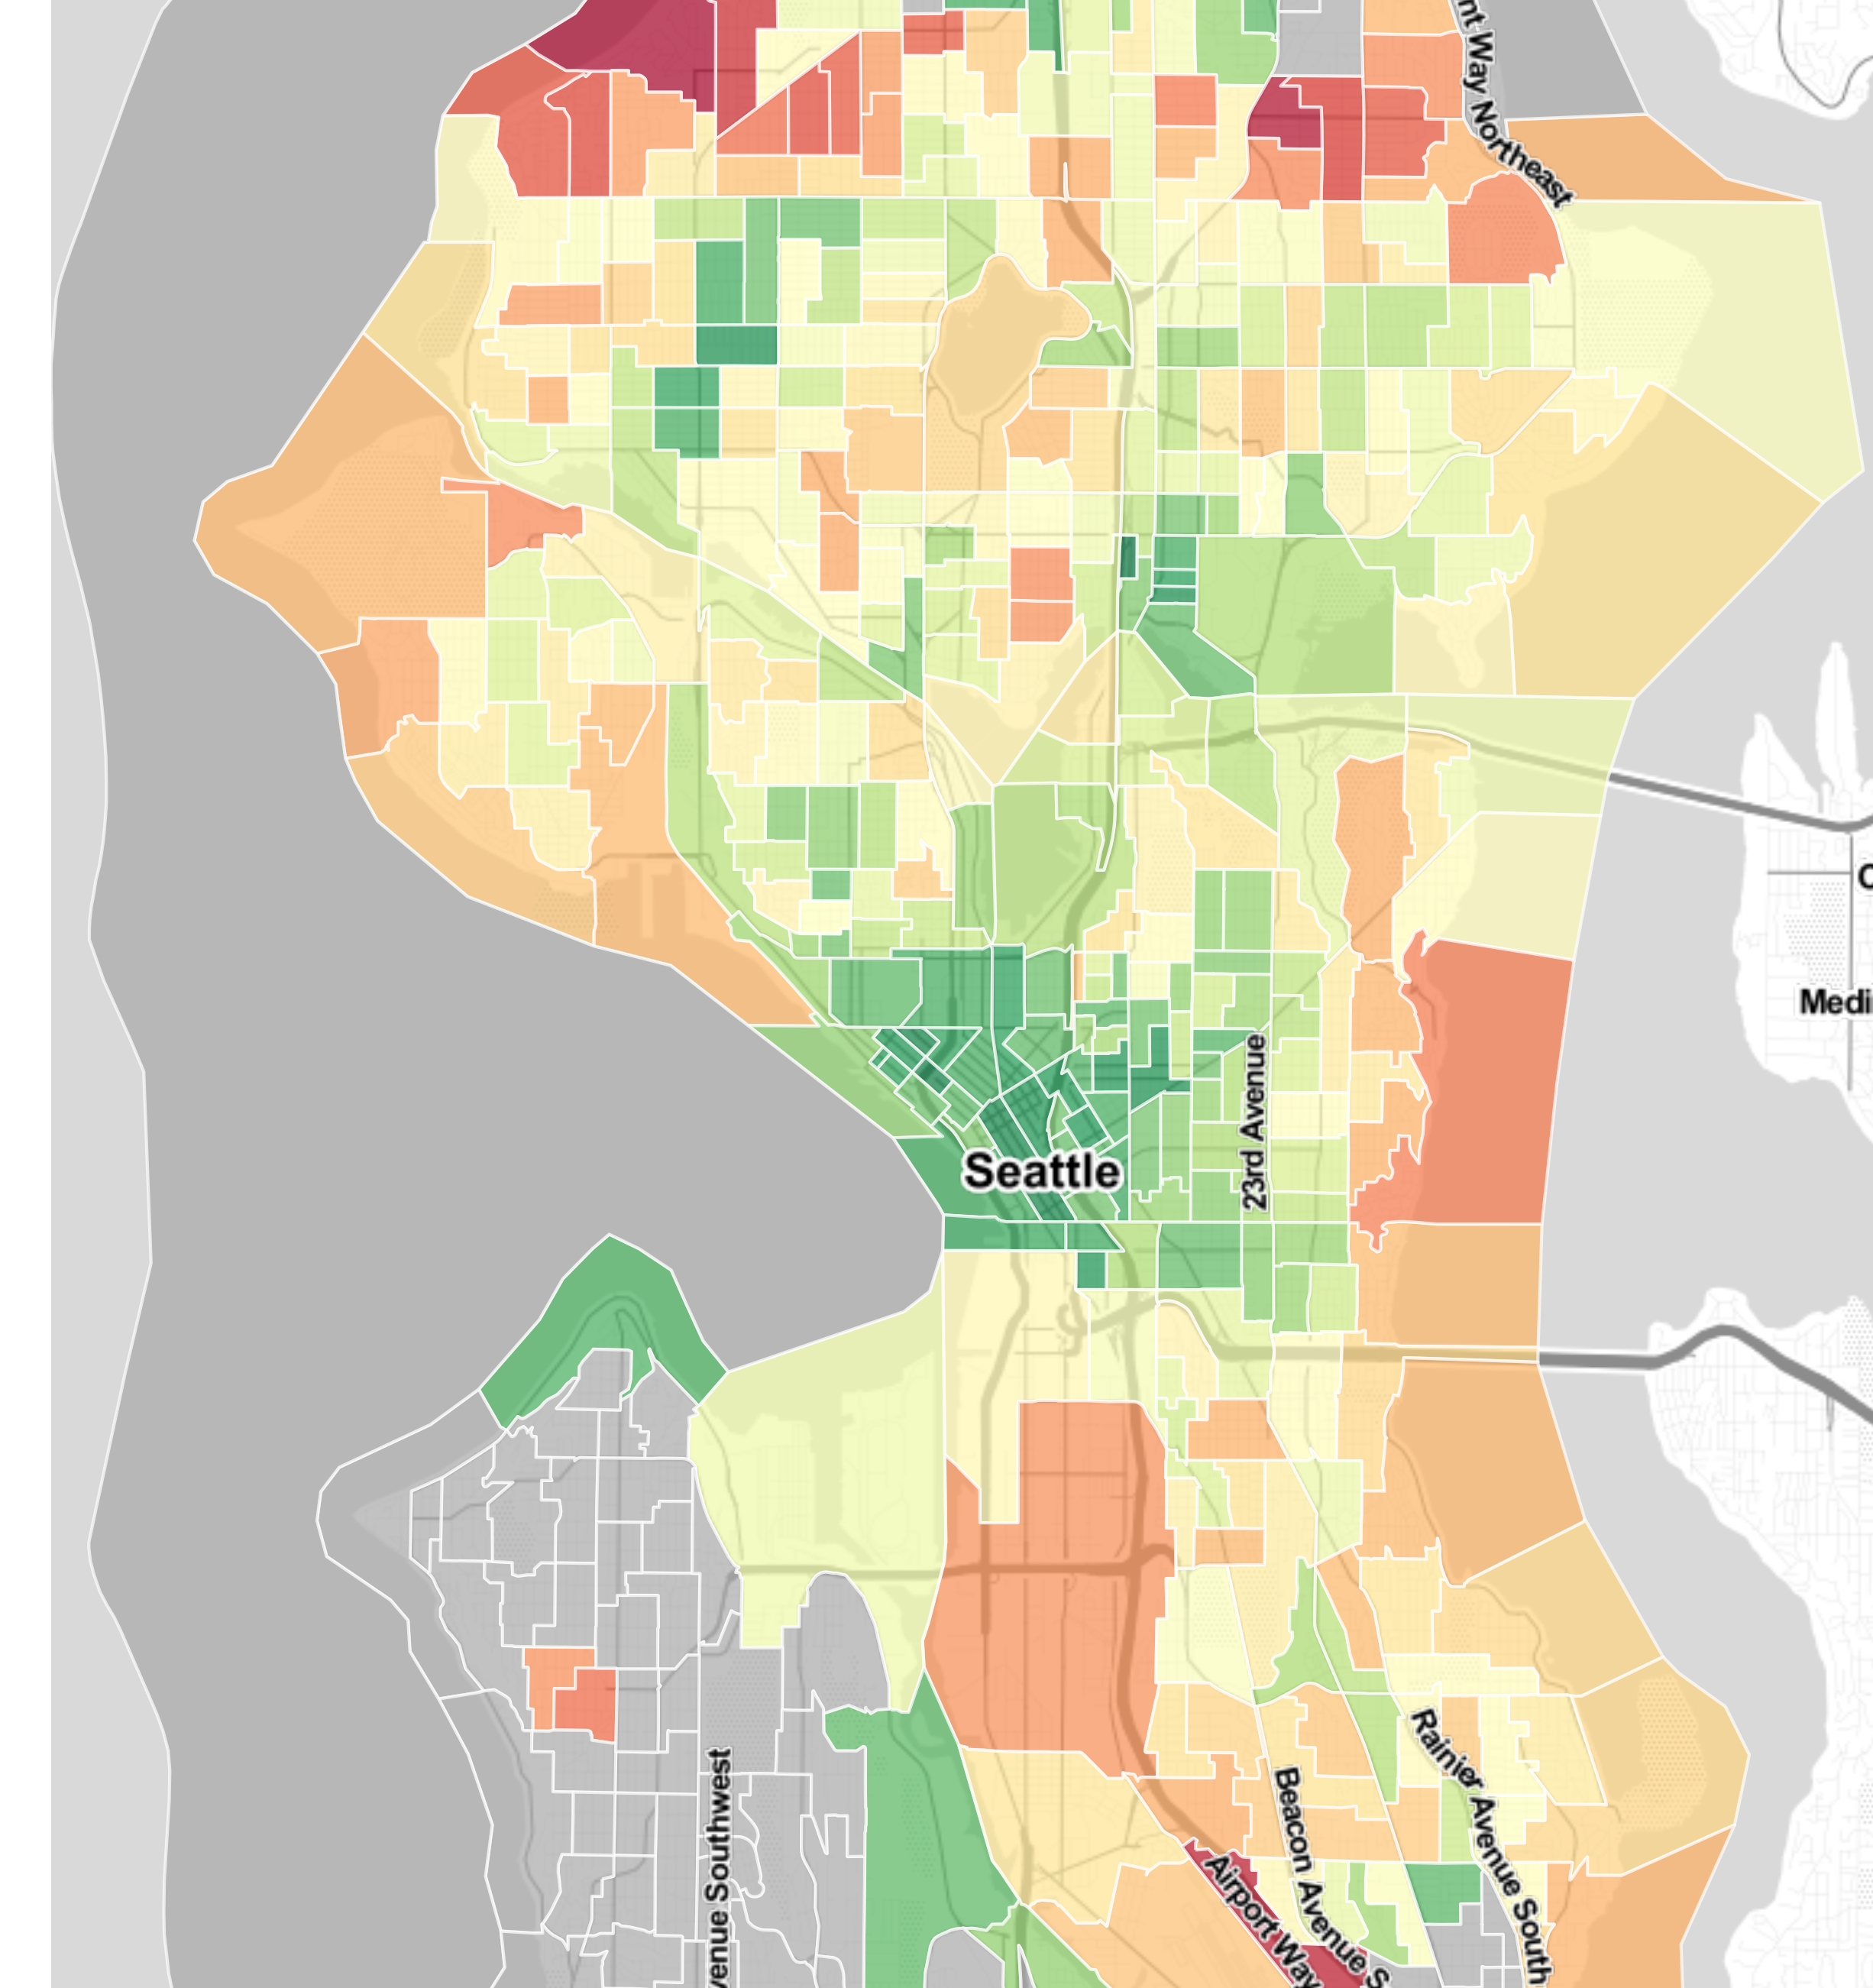
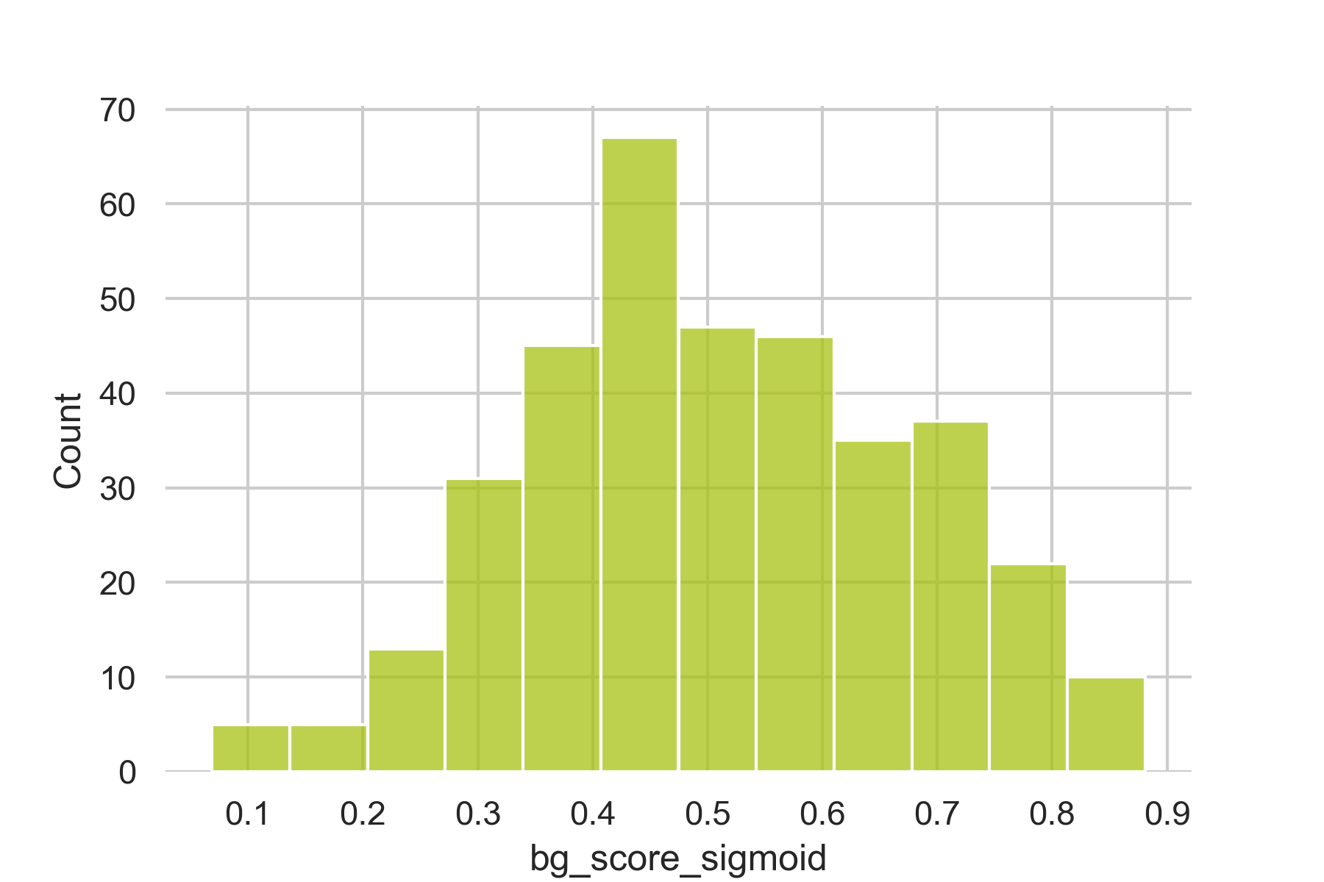
FINDINGS
Spatial Distribution
Per Neighborhood
COUNT
ACCESS SCORE
Notes:
And here's the distribution of access scores per neighborhood. From both of the maps we can see a radial pattern here, with high accessibility areas in the urban core and lower accessibility scores towards the periphery of the study area.

Slide 21
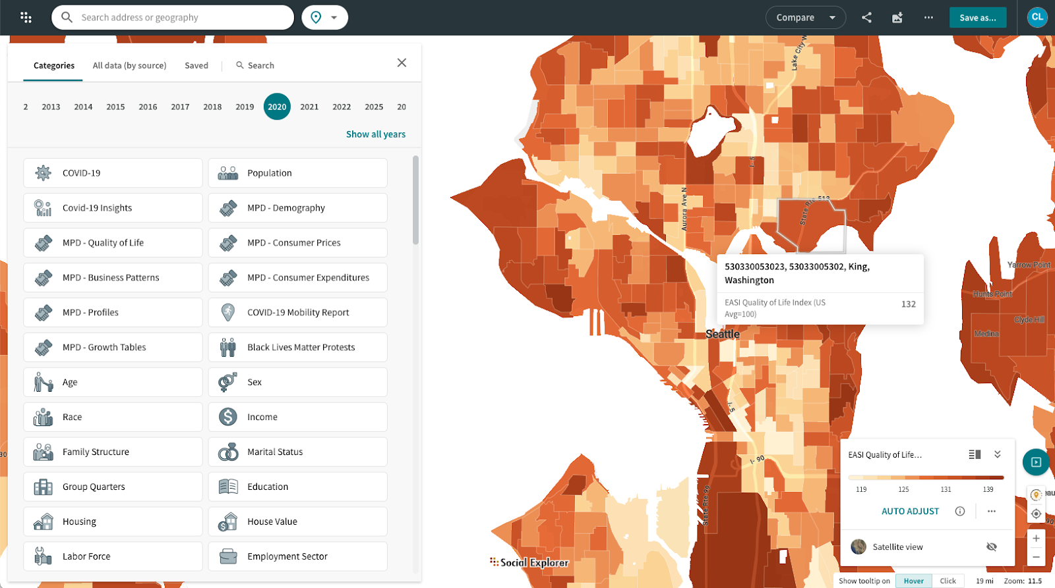

Slide 22
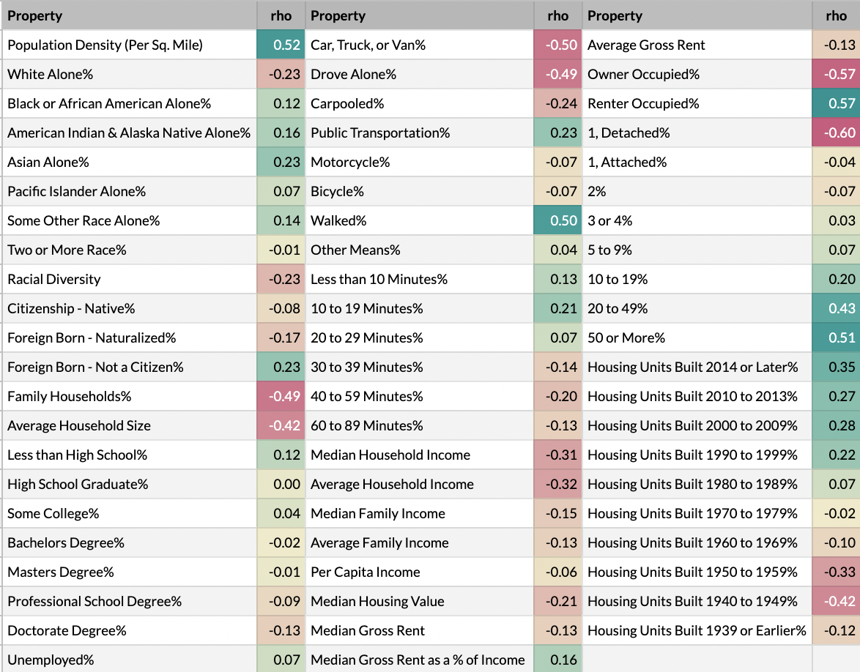
FINDINGS
Socio-economic Correlations
Population
Race & Citizenship
Education
Income
Housing
Modes of travel
Notes:
Now that we’ve observed some spatial patterns for sidewalk quality, how do these patterns relate to socio economic factors?
We obtained data from the American Community Survey covering aspects of population, race, education, income, housing and modes of transportation
then mapped that to our accessibility scores.

Slide 23
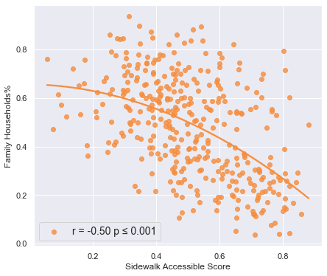
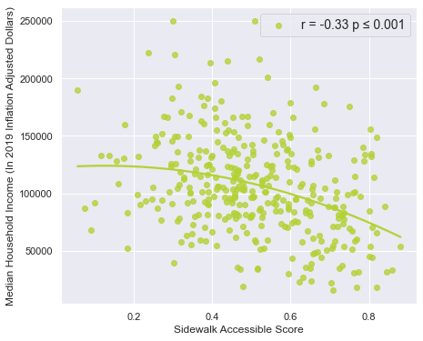
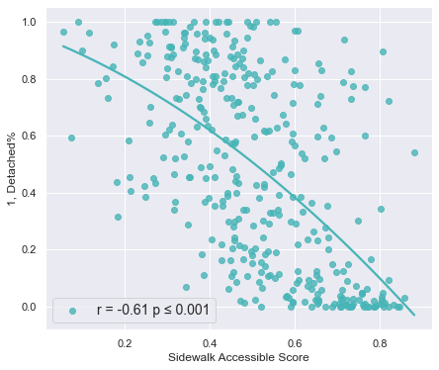
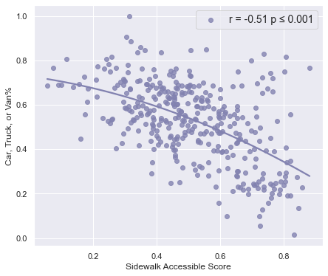
FINDINGS
Socio-economic Correlations
Lower sidewalk quality neighborhoods:
More affluent
Predominantly white
Higher percentage of families
Lower housing and population density
Driving is the primary mode of transportation
Family Households
Income Per Capita
Single Family Housing
Drive To Work
Notes:
Unexpectedly, in Seattle, neighborhoods with lower sidewalk quality are more affluent, predominantly white, have lower housing and population density, and use driving as their primary mode of transportation.

Slide 24
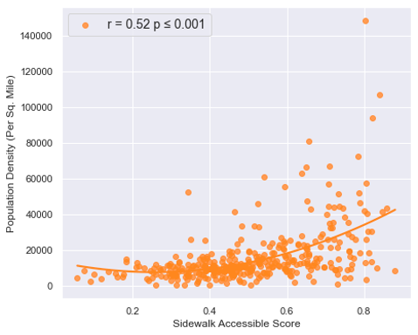
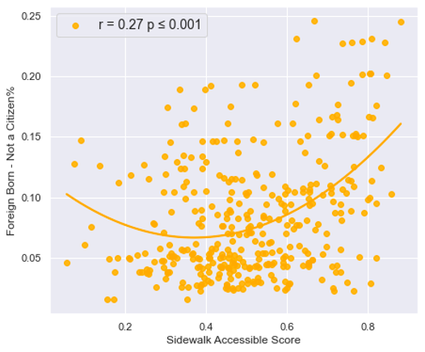
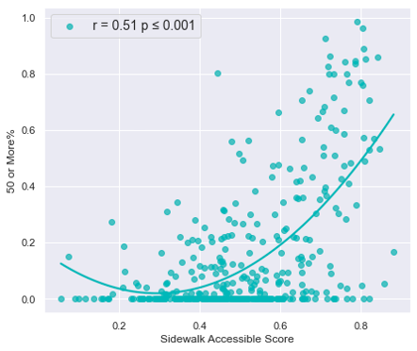
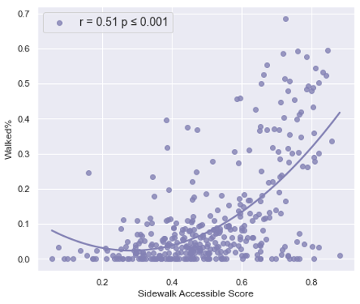
FINDINGS
Socio-economic Correlations
Higher sidewalk quality neighborhoods:
Higher population and housing density
Higher racially diversity
Higher proportion of immigrants
Commute primarily by walking or public transportation
Population Density
Non-citizens
Multi-family Housing
Walk/Public Transit
Notes:
In contrast, neighborhoods with higher sidewalk quality, have higher population and housing density, higher racial diversity, higher percentage of immigrants, and commute primarily by walking or public transportation.

Slide 25
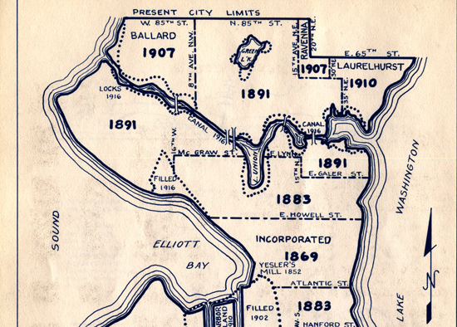
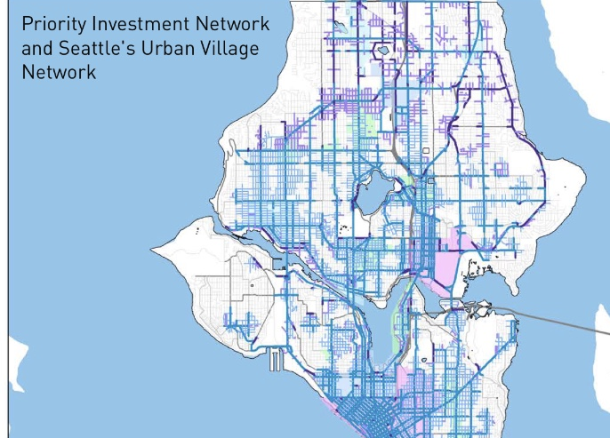
DISCUSSIONS
The ‘Then & Now’ of Seattle
Urban Sprawl in 1950s
Recent Planning Efforts
Notes:
The patterns we identified in our study are closely related to the then and now of Seattle . The predominantly white neighborhoods in north Seattle with severe missing sidewalk problems, were annexed from King County in the 1950s. And at the time King County did not require developers to build sidewalks, and the condition persists today.
On the other hand Recent planning initiatives such as sidewalk repairs programs prioritize investment around urban core areas, which also contributes to better sidewalk conditions in these areas.

Slide 26
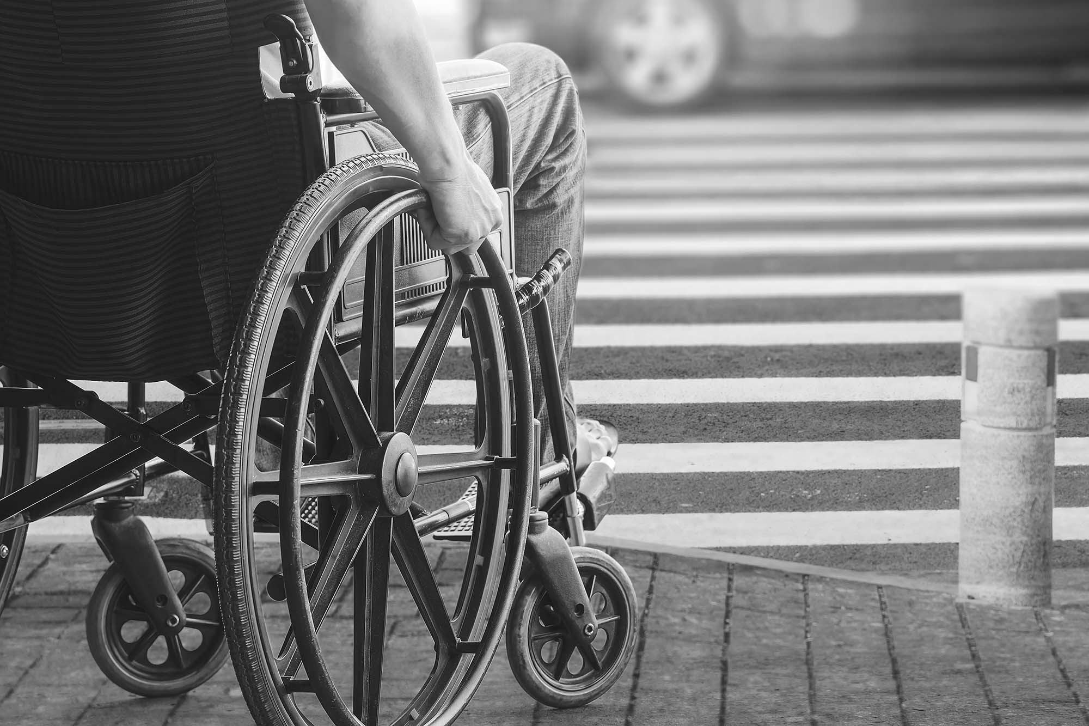
Future Work
Large-scale, cross-regional studies on sidewalk equity
Improve the accessibility of existing infrastructure
Influence urban design guidelines and policies
Notes:
So from this pilot study, we see the potential of using crowdsourced sidewalk assessment data for large-scale, cross-regional studies of sidewalk infrastructure, human mobility, and social equity.
And with these studies, we hope to not only improve the accessibility of existing infrastructure,
But also influence cities and transit departments on urban design guidelines and policies to plan for a more equitable urban future.

