Slide 1
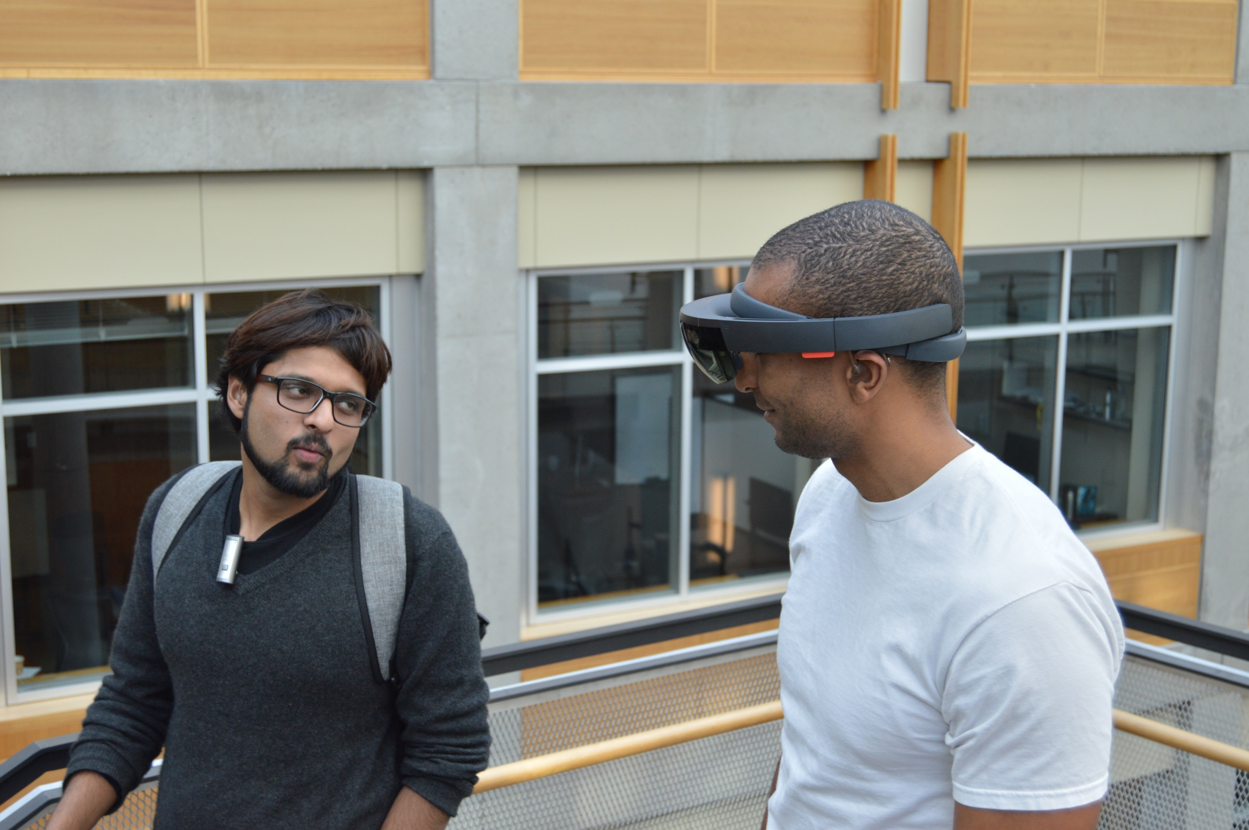
Towards Accessible Conversations in a Mobile Context for People who
are Deaf or Hard of Hearing
We’re going down the
stairs now…
Dhruv Jain, Rachel Franz, Leah Findlater, Jackson Cannon, Raja Kushalnagar, and Jon Froehlich
University of Washington, Seattle
Gallaudet University

Slide 2
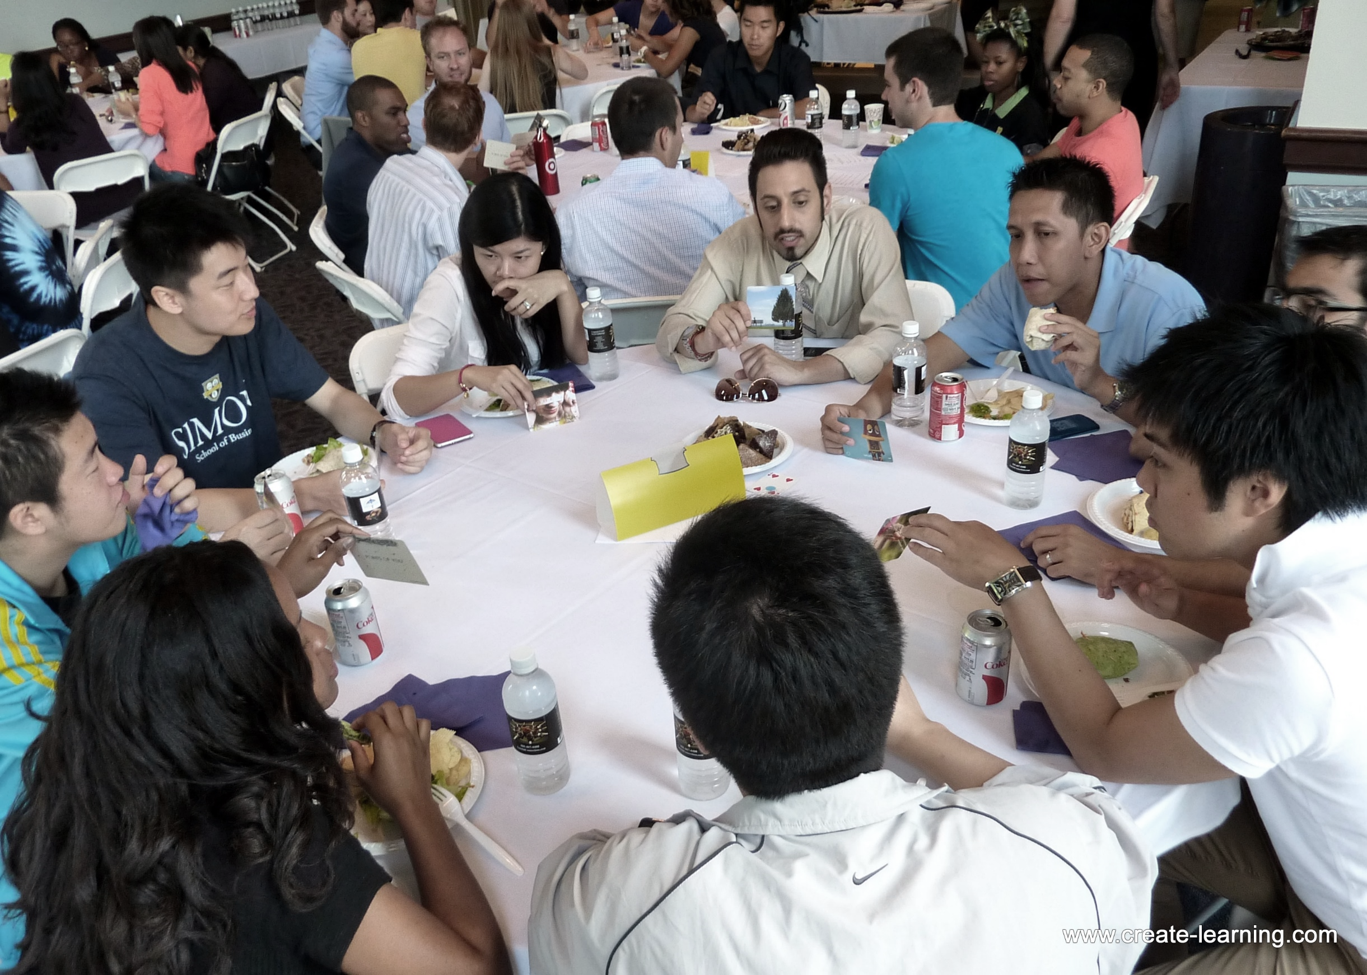
Prior work have investigated communication challenges of DHH people
in stationary contexts such as group meetings and lectures.

Slide 3

Prior work have investigated communication challenges of DHH people
in stationary contexts such as group meetings and lectures.
Moving conversations (e.g., walking) could present new challenges such as
varying background noise and needing to balance visual attention
between looking at the speakers and looking ahead.

Slide 4
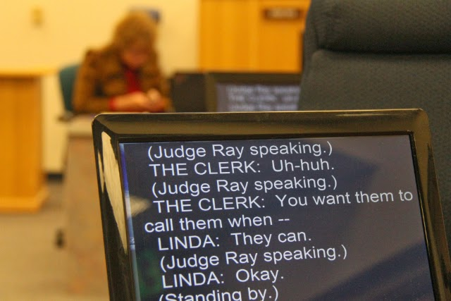
Moreover, assistive technologies like real-time captioning have been traditionally designed for stationary context and are not conducive to mobile scenarios.

Slide 5

Aims
1
To investigate the needs of DHH people in mobile conversations such as walking and transit.

Slide 6
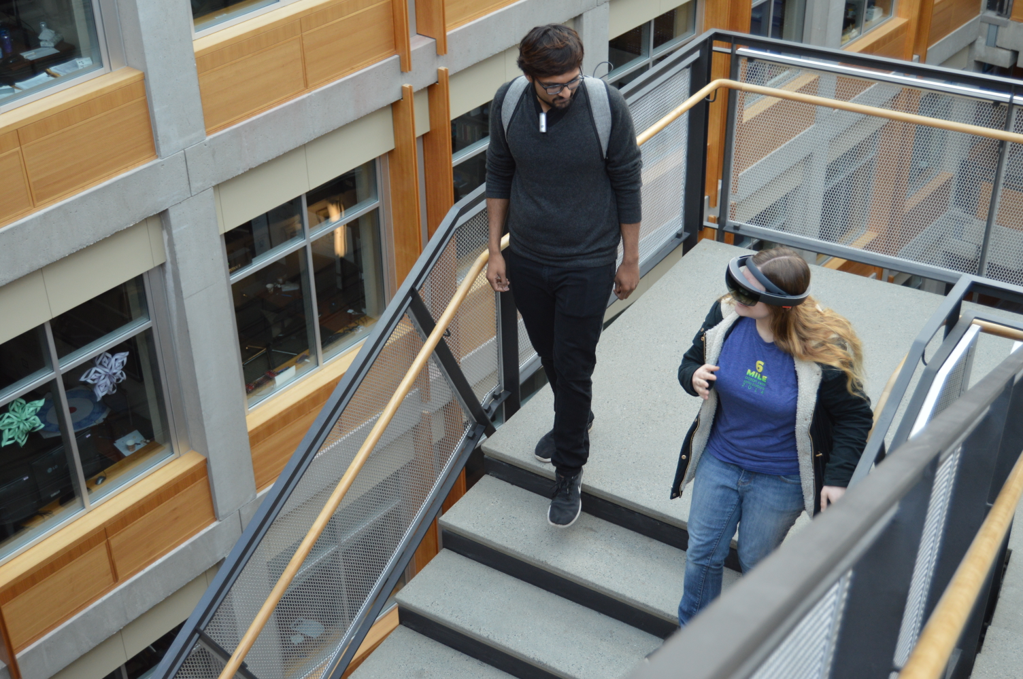
Aims
1
To investigate the needs of DHH people in mobile conversations such as walking and transit.
To study the possibility of captions on head mounted displays (HMDs) to support those needs.
2

Slide 7
This Paper
Study 1: Formative interview with 12 DHH participants on challenges, communication strategies, and future captioning technology.
Study 2: Evaluation of a proof-of-concept HMD-captioning prototype with 10 DHH participants in a walking scenario.

Slide 8
Outline
Background and Past Work
Study 1:
Interview
Proof-of-Concept HMD Prototype
Study 2: Evaluation

Slide 9
Background and Past Work
Study 1:
Interview
Proof-of-Concept HMD Prototype
Study 2: Evaluation

Slide 10
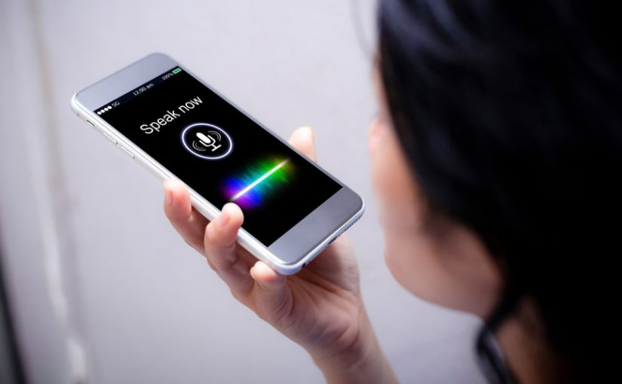
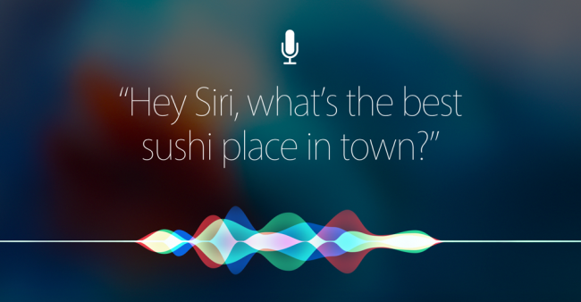
Captions can be generated in two ways:
Automatic Speech Recognition (ASR)

Slide 11
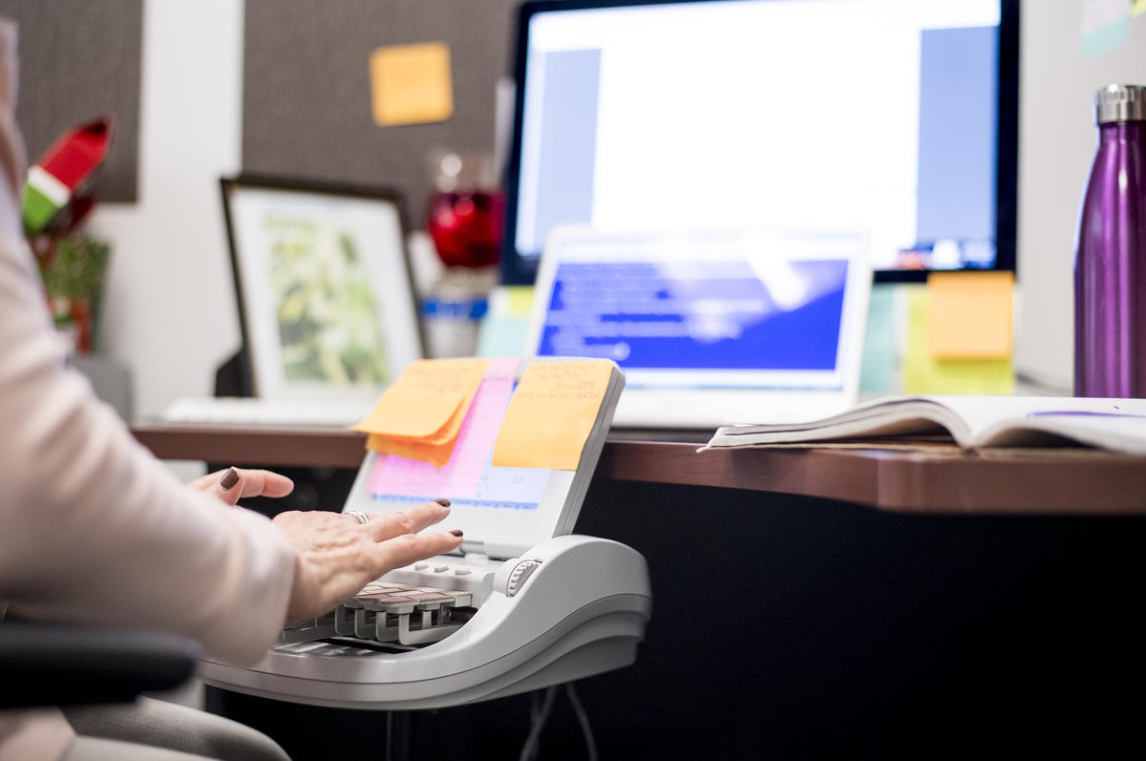
We used a trained transcriber (or real-time captioning).
Captions from a trained transcriber are typically shown on a
laptop or a large shared screen.
Trained Transcriber

Slide 12
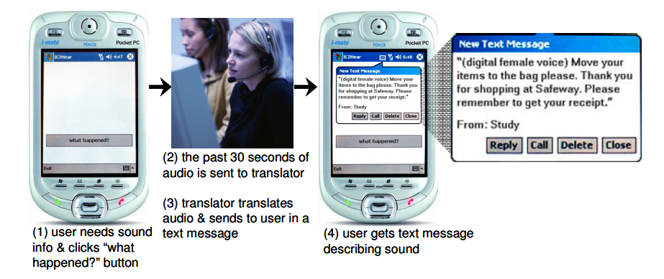
Thus, researchers have explored mobile and wearable solutions.
Matthews et al., UbiComp 2006

Slide 13
Matthews et al., UbiComp 2006

Slide 14
Though portable, smartphone apps require that users turn their
gaze away from the speaker or environment.
Matthews et al., UbiComp 2006

Slide 15
To reduce this visual split, researchers have used HMD to show captions.
Peng et al., CHI 2018

Slide 16
However, no work has evaluated HMD-based captioning in a
mobile context.

Slide 17
Background and Past Work
Study 1:
Interview
Proof-of-Concept HMD Prototype
Study 2: Evaluation

Slide 18
Background and Past Work
Study 1:
Interview
Proof-of-Concept HMD Prototype
Study 2: Evaluation

Slide 19
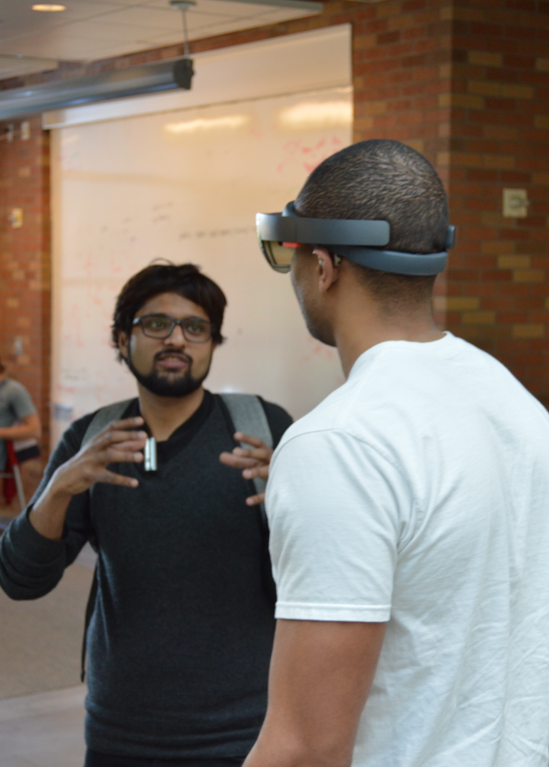
Study 1
Goal
To assess the communication needs and potential technologies for DHH people in mobile contexts.
Participants
12 DHH individuals (5 males, 6 females, 1 did not disclose)
Recruited through email, social media and snowball sampling
Study Method
Two part semi-structured formative interview in lab-setting: (i) challenges in a mobile conversation, (ii) ideas for future captioning technology
Three mobile scenarios were explicitly explored: walking, in transit, and recreational.

Slide 20
Background and Past Work
Study 1:
Interview
Proof-of-Concept HMD Prototype
Study 2: Evaluation
PART 1:
Mobile conversation challenges
PART 2:
Captioning technology design

Slide 21
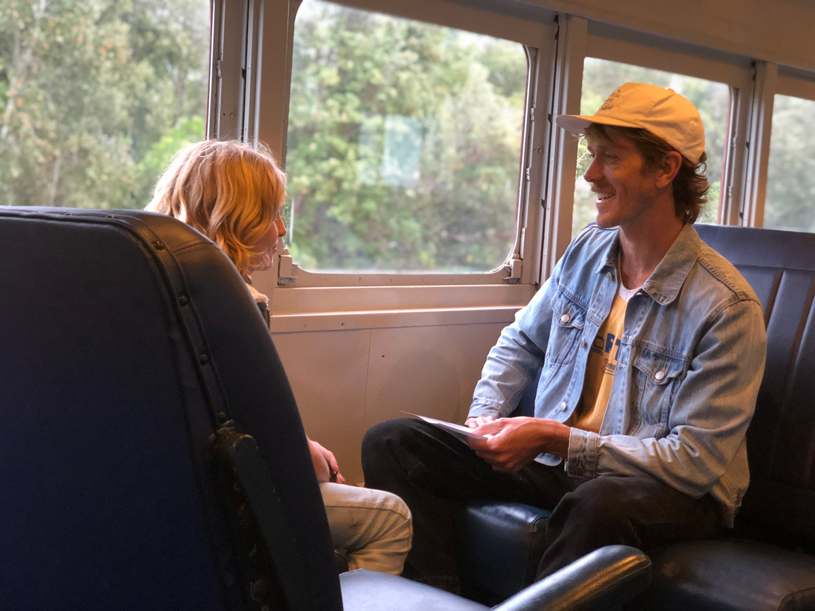
Participants had mobile conversations while walking to or from meetings,
classes, and social activities as well as on public transport and in cars.
Assistive technology use in mobile contexts is rare.
STUDY 1 PART 1: CHARACTERISTICS

Slide 22

“
“I don't usually use technology other than hearing aids in moving conversations. I will occasionally use my phone to type something if it’s impossible to hear. The [phone] isn't perfect because it demands that I split my attention and [also] have one [hand] holding the phone.”
”
- P12

Slide 23
Moving Conversation Challenges
STUDY 1 PART 1: CHALLENGES
Conversations are brief and shallow
Hearing people do not understand and accommodate needs

Slide 24

“
“If I need to look away for some reason, a deaf person will automatically stop talking and resume when I’m ready. A spoken conversation doesn’t have that type of natural stop and start…”
”
- P10

Slide 25
Moving Conversation Challenges
STUDY 1 PART 1: CHALLENGES
Conversations are brief and shallow
Hearing people do not understand and accommodate needs
Recreational activities are particularly challenging

Slide 26

“
“[In] martial arts: you have an instructor showing how to move the arms, hands, body, etc. while talking to describe it. Well if they have to “talk” by signing, then how the hell do they also show you how to hold your arms in the proper position?”
”
- P12

Slide 27
Moving Conversation Challenges
STUDY 1 PART 1: CHALLENGES
Conversations are brief and shallow
Hearing people do not understand and accommodate needs
Recreational activities are particularly challenging
Challenges of varying space, lighting and background noise

Slide 28
Background and Past Work
Study 1:
Interview
Proof-of-Concept HMD Prototype
Study 2: Evaluation
PART 1:
Characteristics
and Challenges
PART 2:
Captioning Technology Design

Slide 29

All participants said they would use real-time captioning in at least
one moving conversation scenario (walking, transit or recreational activity).
However, some were concerned that captions may affect
conversation quality (N=7).
STUDY 1 PART 2: TECHNOLOGY

Slide 30
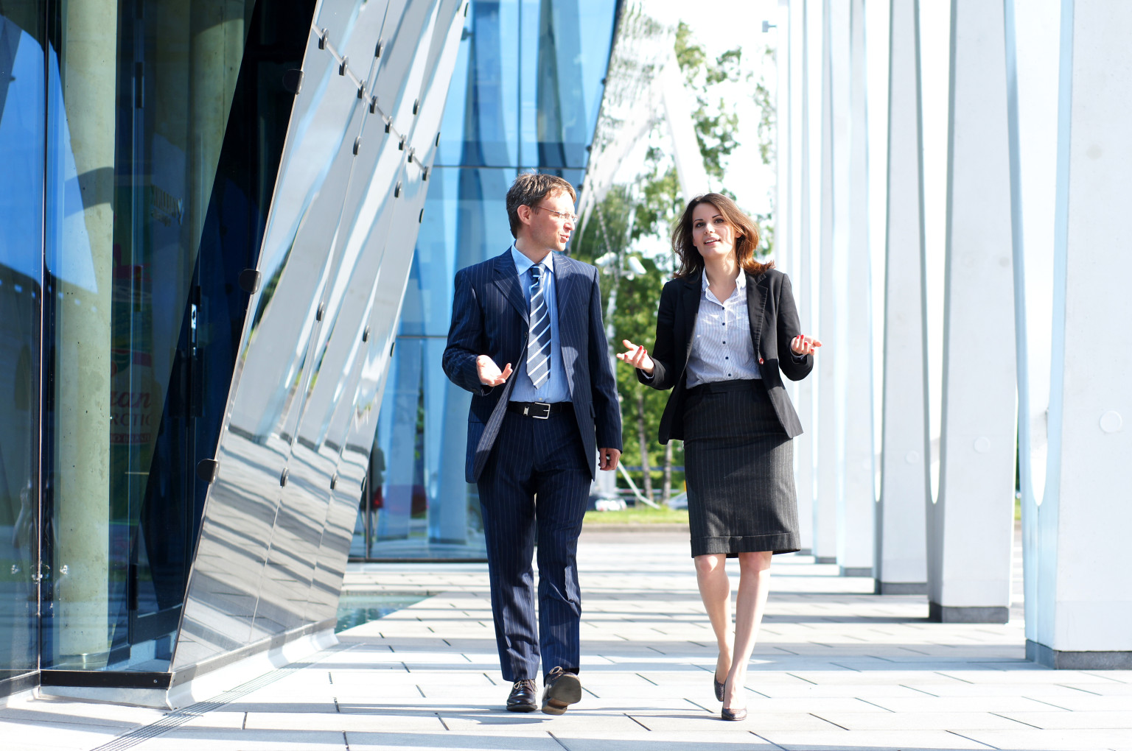
“
“I always prefer direct communication with hearing people. If technology or interpreters are involved, there is always a distance between me and the other person. It diminishes the quality of the human connection.”
”
- P11

Slide 31
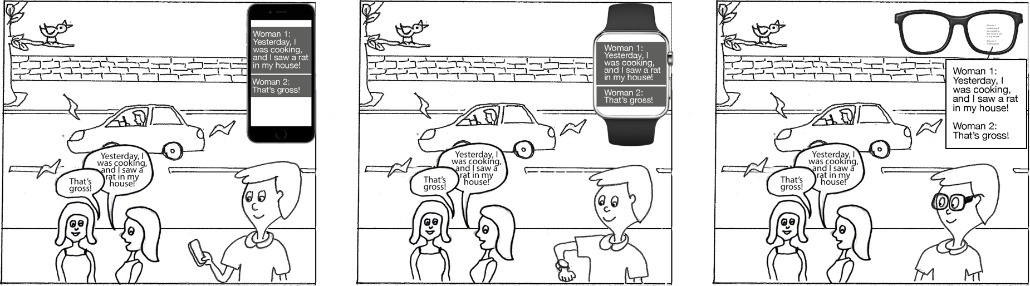
Comparing Devices
STUDY 1 PART 2: TECHNOLOGY
Smartphone Smartwatch HMD

Slide 32
STUDY 1 PART 2: TECHNOLOGY
Smartwatch was the least preferred because of the small display size.
HMD was most preferred because it would reduce the visual attention split.
 | HMD | Smartphone | Smartwatch
Walking | N=11 | N=1
Transit (bus, car) | N=6 | N=4 | N=1
Recreational | N=5 | N=4
For high-contact sports, some people wanted smartphone because HMD could fall off.

Slide 33
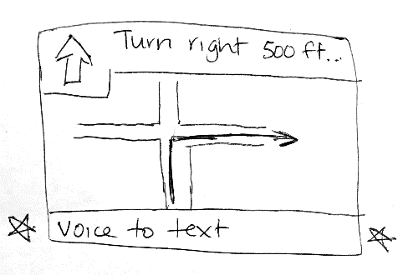
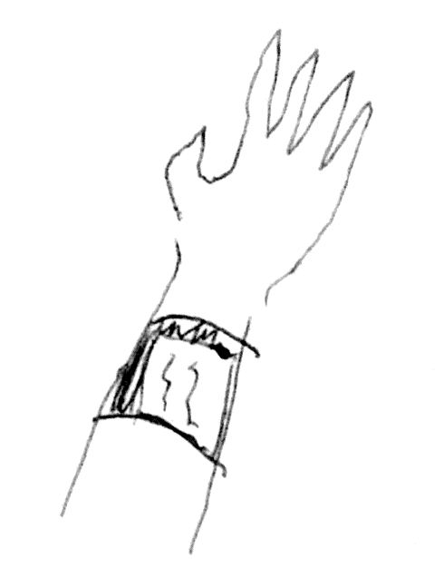
STUDY 1 PART 2: TECHNOLOGY
Designs Sketched By Participants
P5: Integrate captioning with car GPS
To reduce having to look at multiple devices
P2: A wrist worn device
To display captions

Slide 34
Background and Past Work
Study 1:
Interview
Proof-of-Concept HMD Prototype
Study 2: Evaluation

Slide 35
Background and Past Work
Study 1:
Interview
Proof-of-Concept HMD Prototype
Study 2: Evaluation

Slide 36
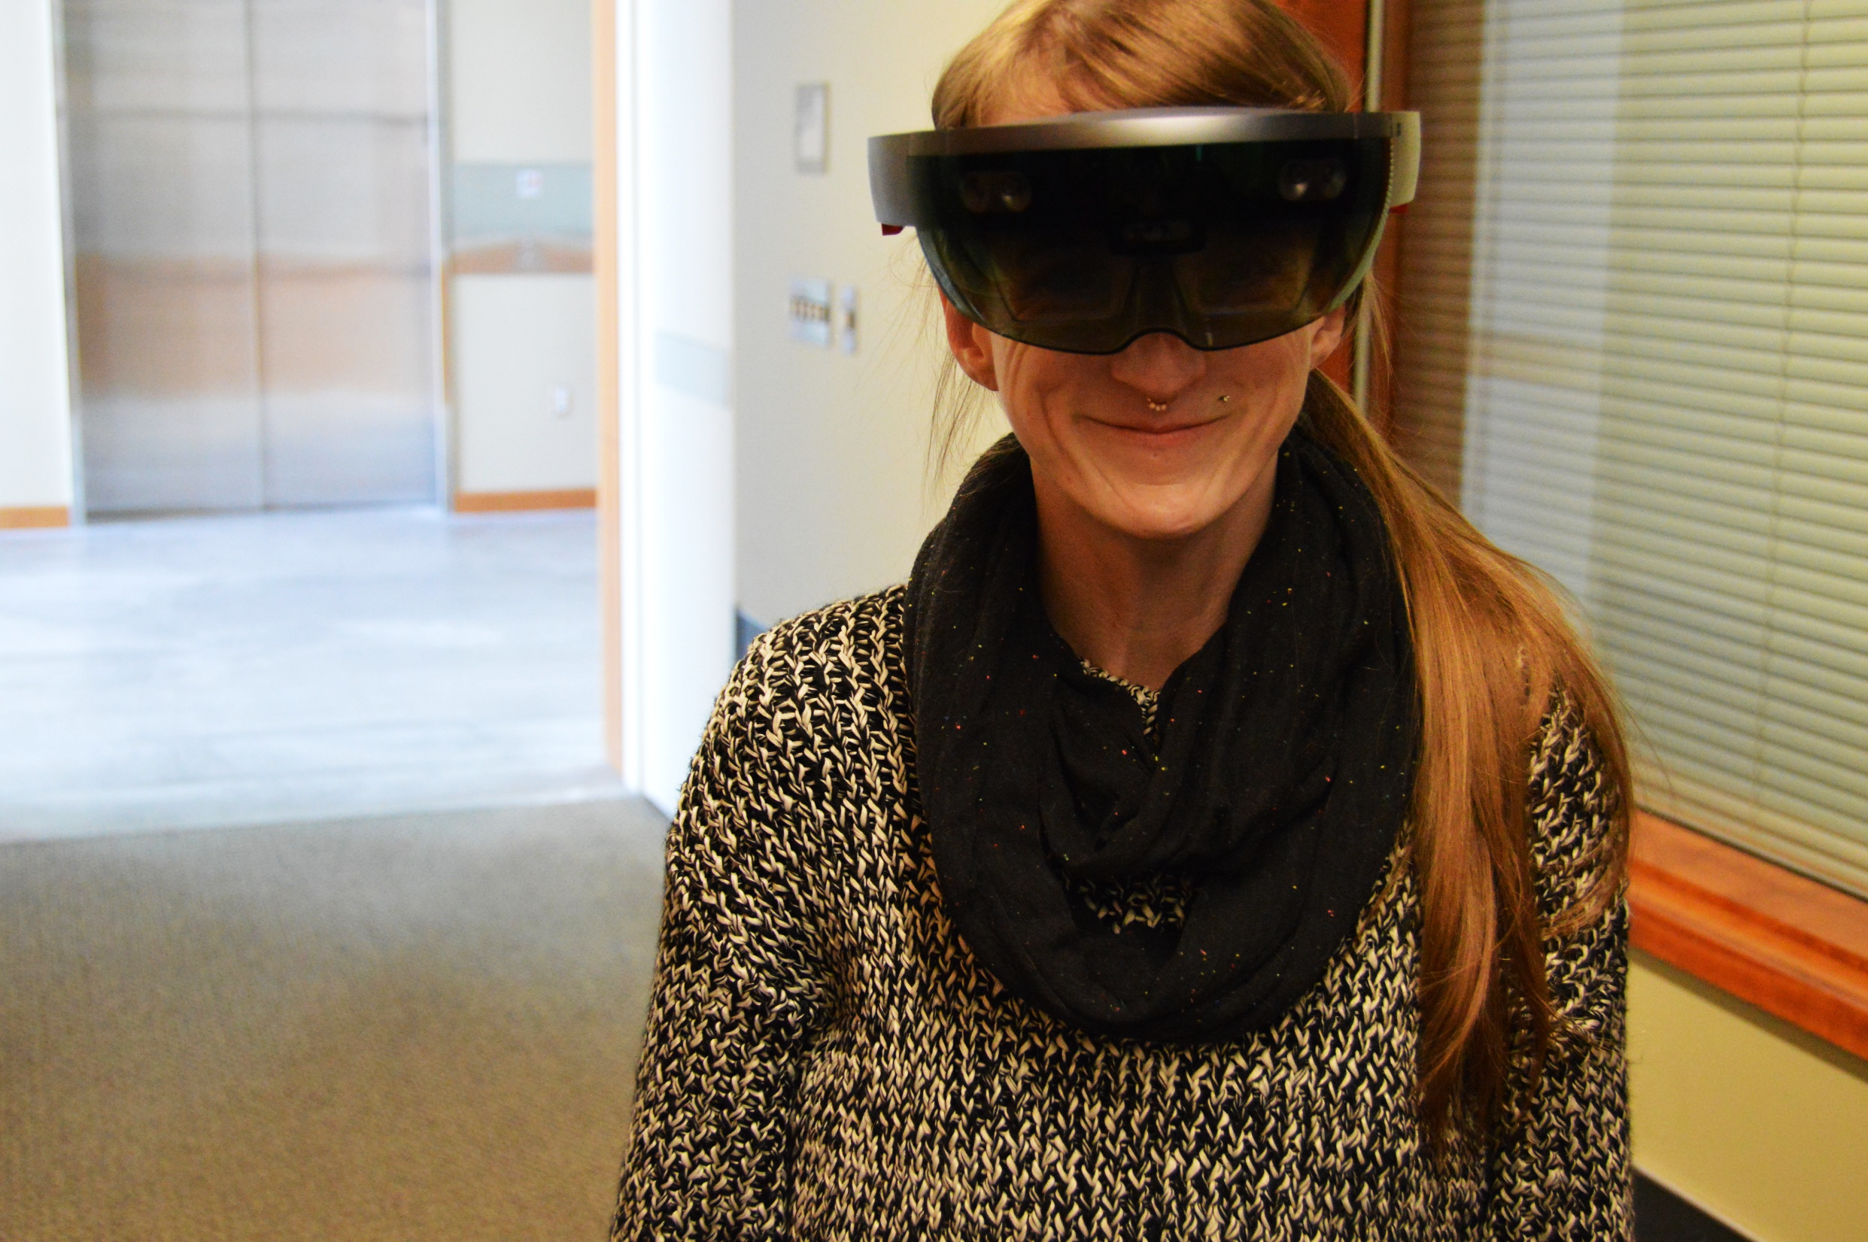
PROOF OF CONCEPT
“This is third floor of
the building. We
have a shop here. ”
“This is third floor of
the building. We
have a shop here. ”
“This is third floor of the building.
We have a shop here…”
“This is third floor of the building.
We have a shop here.
Below, there’s a restroom. ”

Slide 37
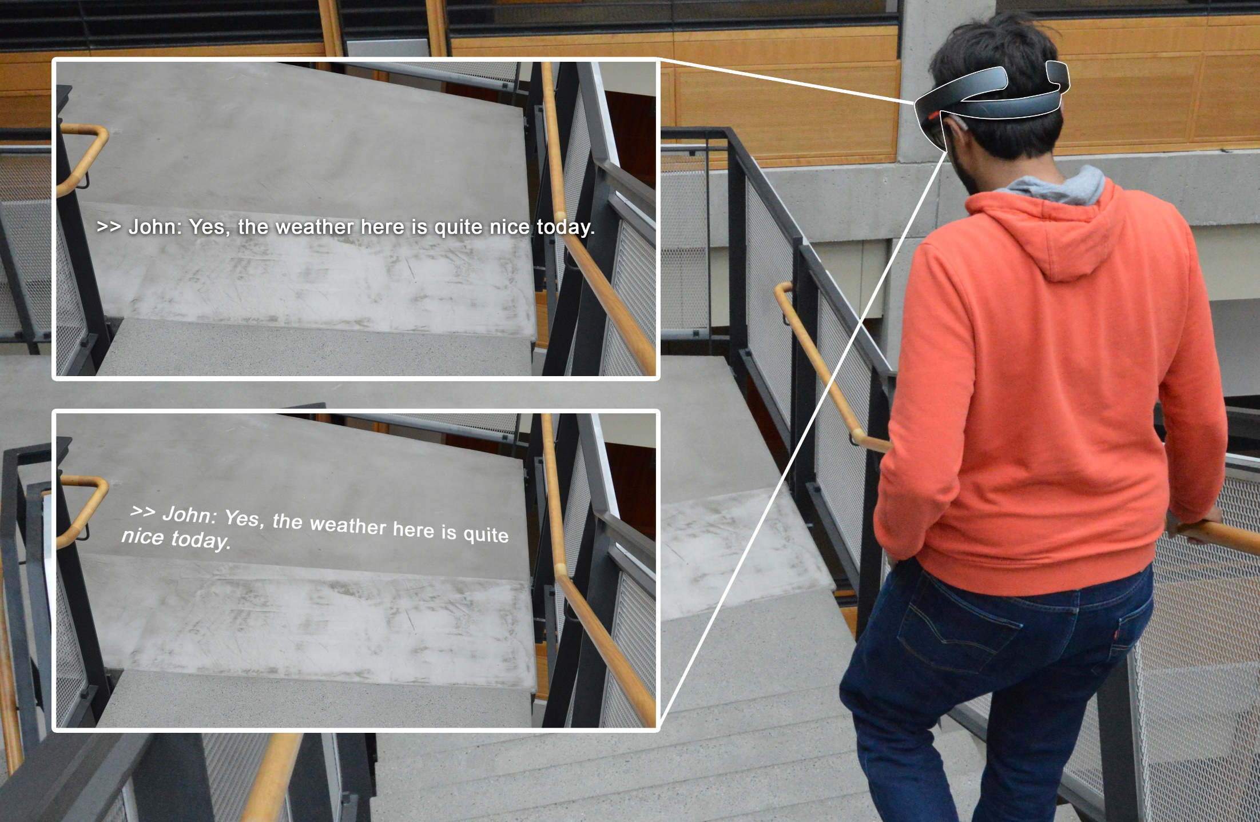
Design 1: Captions at a fixed distance from the eyes
Design 2: Captions projected onto a surface

Slide 38
Background and Past Work
Study 1:
Interview
Proof-of-Concept HMD Prototype
Study 2: Evaluation

Slide 39
Background and Past Work
Study 1:
Interview
Proof-of-Concept HMD Prototype
Study 2: Evaluation

Slide 40
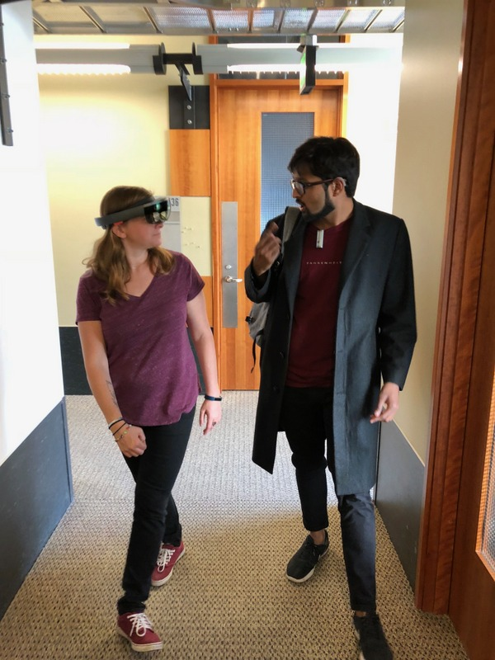
Study 2
Primary Goal
To assess whether the use of HMD captions increased conversation accessibility, and decreased attention split for walking conversations
Participants
10 DHH individuals; 6 from Study 1
Part 1: Walking Scenario with HMD
One researcher conversed with the participant on casual topics
Another researcher took observational notes
The first researcher wore a lapel microphone that relayed speech to the on-site transcriber
Part 2: Open-ended Interview
On the experience any feedback to the prototype

Slide 41
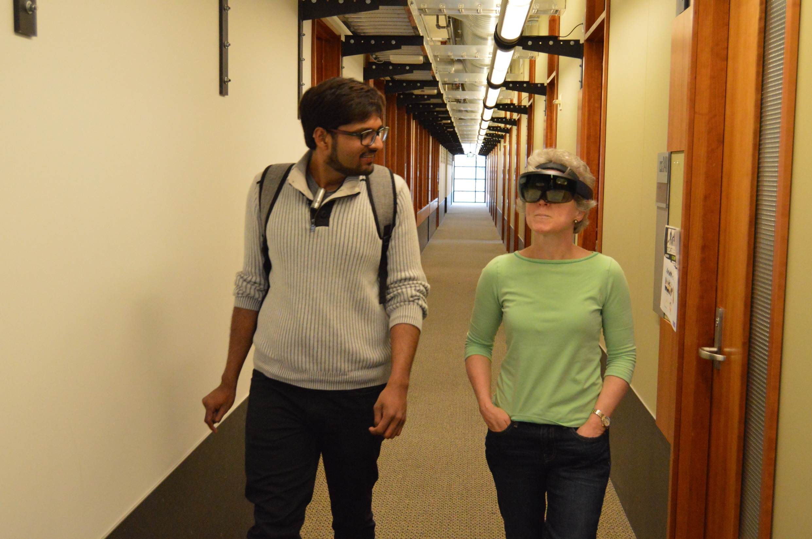
All participants used our prototype to understand at least
some part of the conversation while walking.
STUDY 2: RESULTS

Slide 42
`
“
“With this, you can look where you want and still follow along with the conversation.”
”
- R4

Slide 43
However, four participants found captions to be occasionally distracting.
STUDY 2: RESULTS

Slide 44
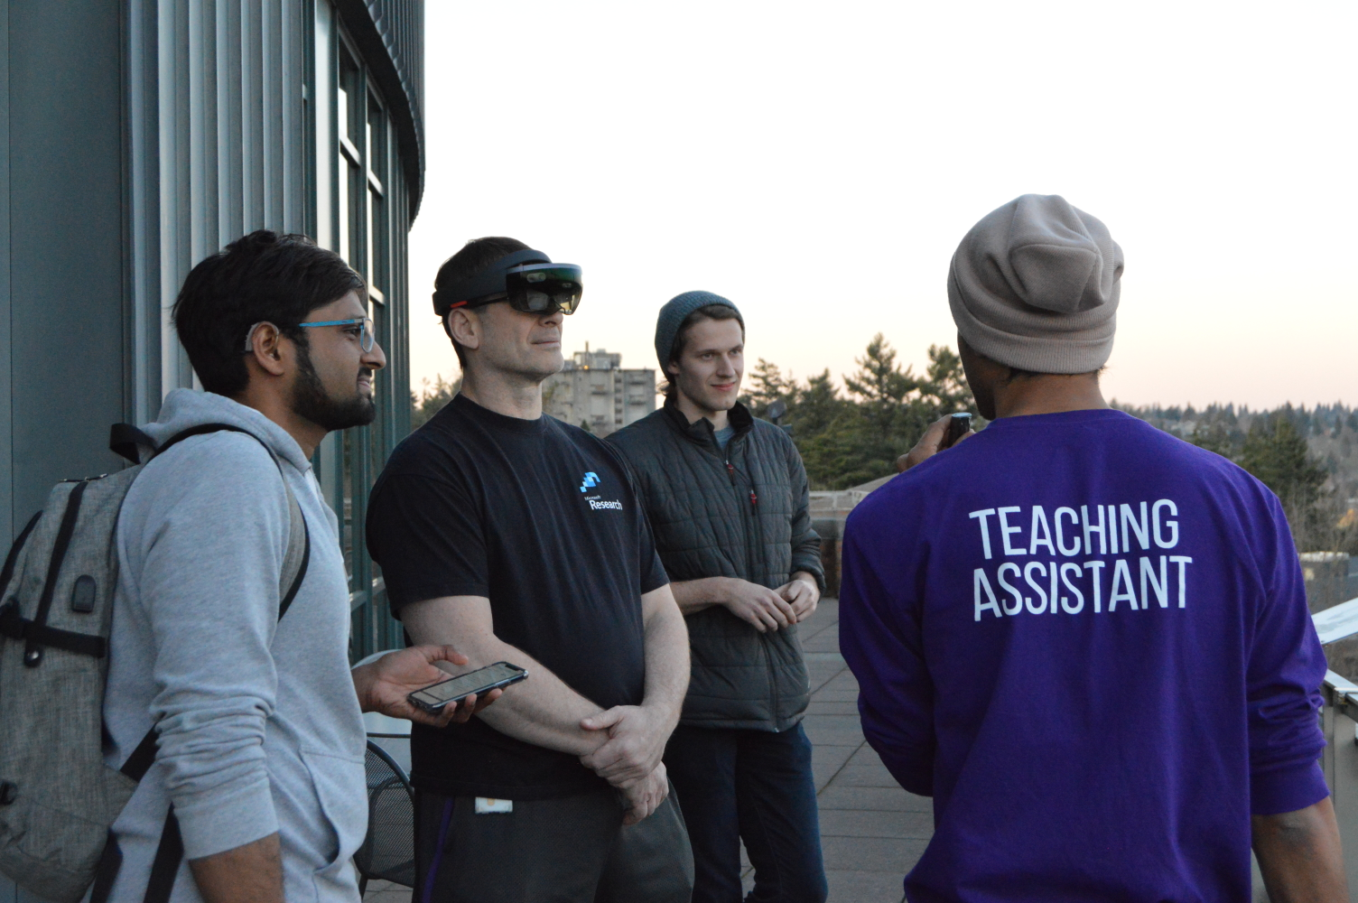
“
When I was trying to formulate my own responses, I would find the captions quite distracting and, in cases like that, I wish […] that I could look away from [the captions], at my discretion.
”
- R5

Slide 45
STUDY 2: RESULTS
High-Level Themes
Visual Split
Participants used both speechreading and captions.
Oral speakers looked at speakers more than captions. Sign language users focused on captions more.
Caption Placement
Split between whether to show captions in the field of view (N=6) or above speakers (N=4).
All wanted the ability to turn off the captions when needed.
Design Suggestions
Display speaker identification cues (e.g., name, location).
Display environmental sounds (e.g., door opening).
Display voice tone and volume.

Slide 46
Emergent Themes
Visual Split
Participants used both speech-reading and captions to understand conversations
Those who prefer to converse orally looked at speakers more than captions. On the other hand, sign language users focused on captions more than speakers
Caption Placement
Split between whether to show captions in the field of view (N=6), or above the speakers (N=4)
All wanted the ability to turn off the captions when needed
Design Suggestions
Display speaker identification cues (e.g., name, location)
Environmental sounds (e.g. door opening)
Voice tone and volume

Slide 47
Emergent Themes
Visual Split
Used both speech-reading and captions to understand conversations.
Split Those who prefer to converse orally looked at speakers more than captions. On the other hand, sign language users focused on captions more than speakers.
Caption Placement
Participants were split between whether to show captions in the field of view (N=6), or above the speakers (N=4)
All wanted the ability to turn off the captions when needed.
Design Suggestions
Display speaker identification cues (e.g., name, location)
Environmental sounds (e.g. door opening)
Voice tone and volume

Slide 48
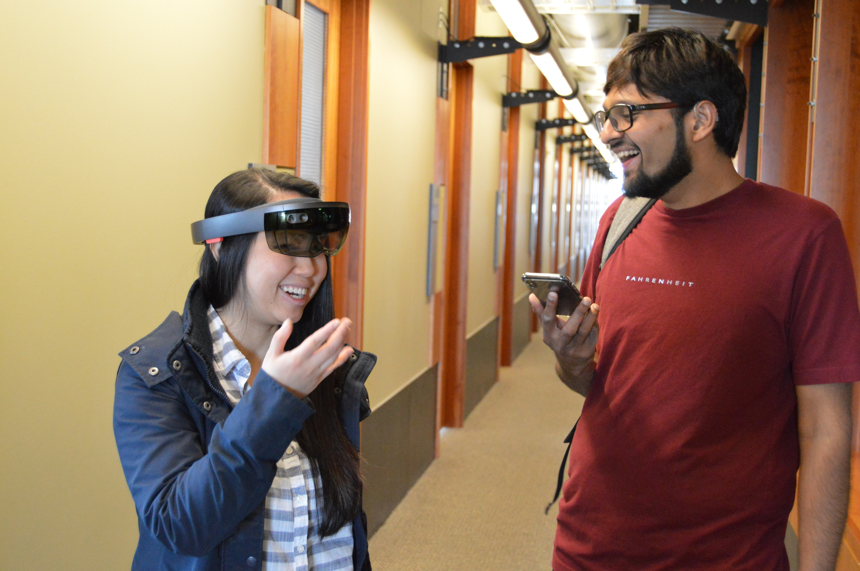
Reflection

Slide 49
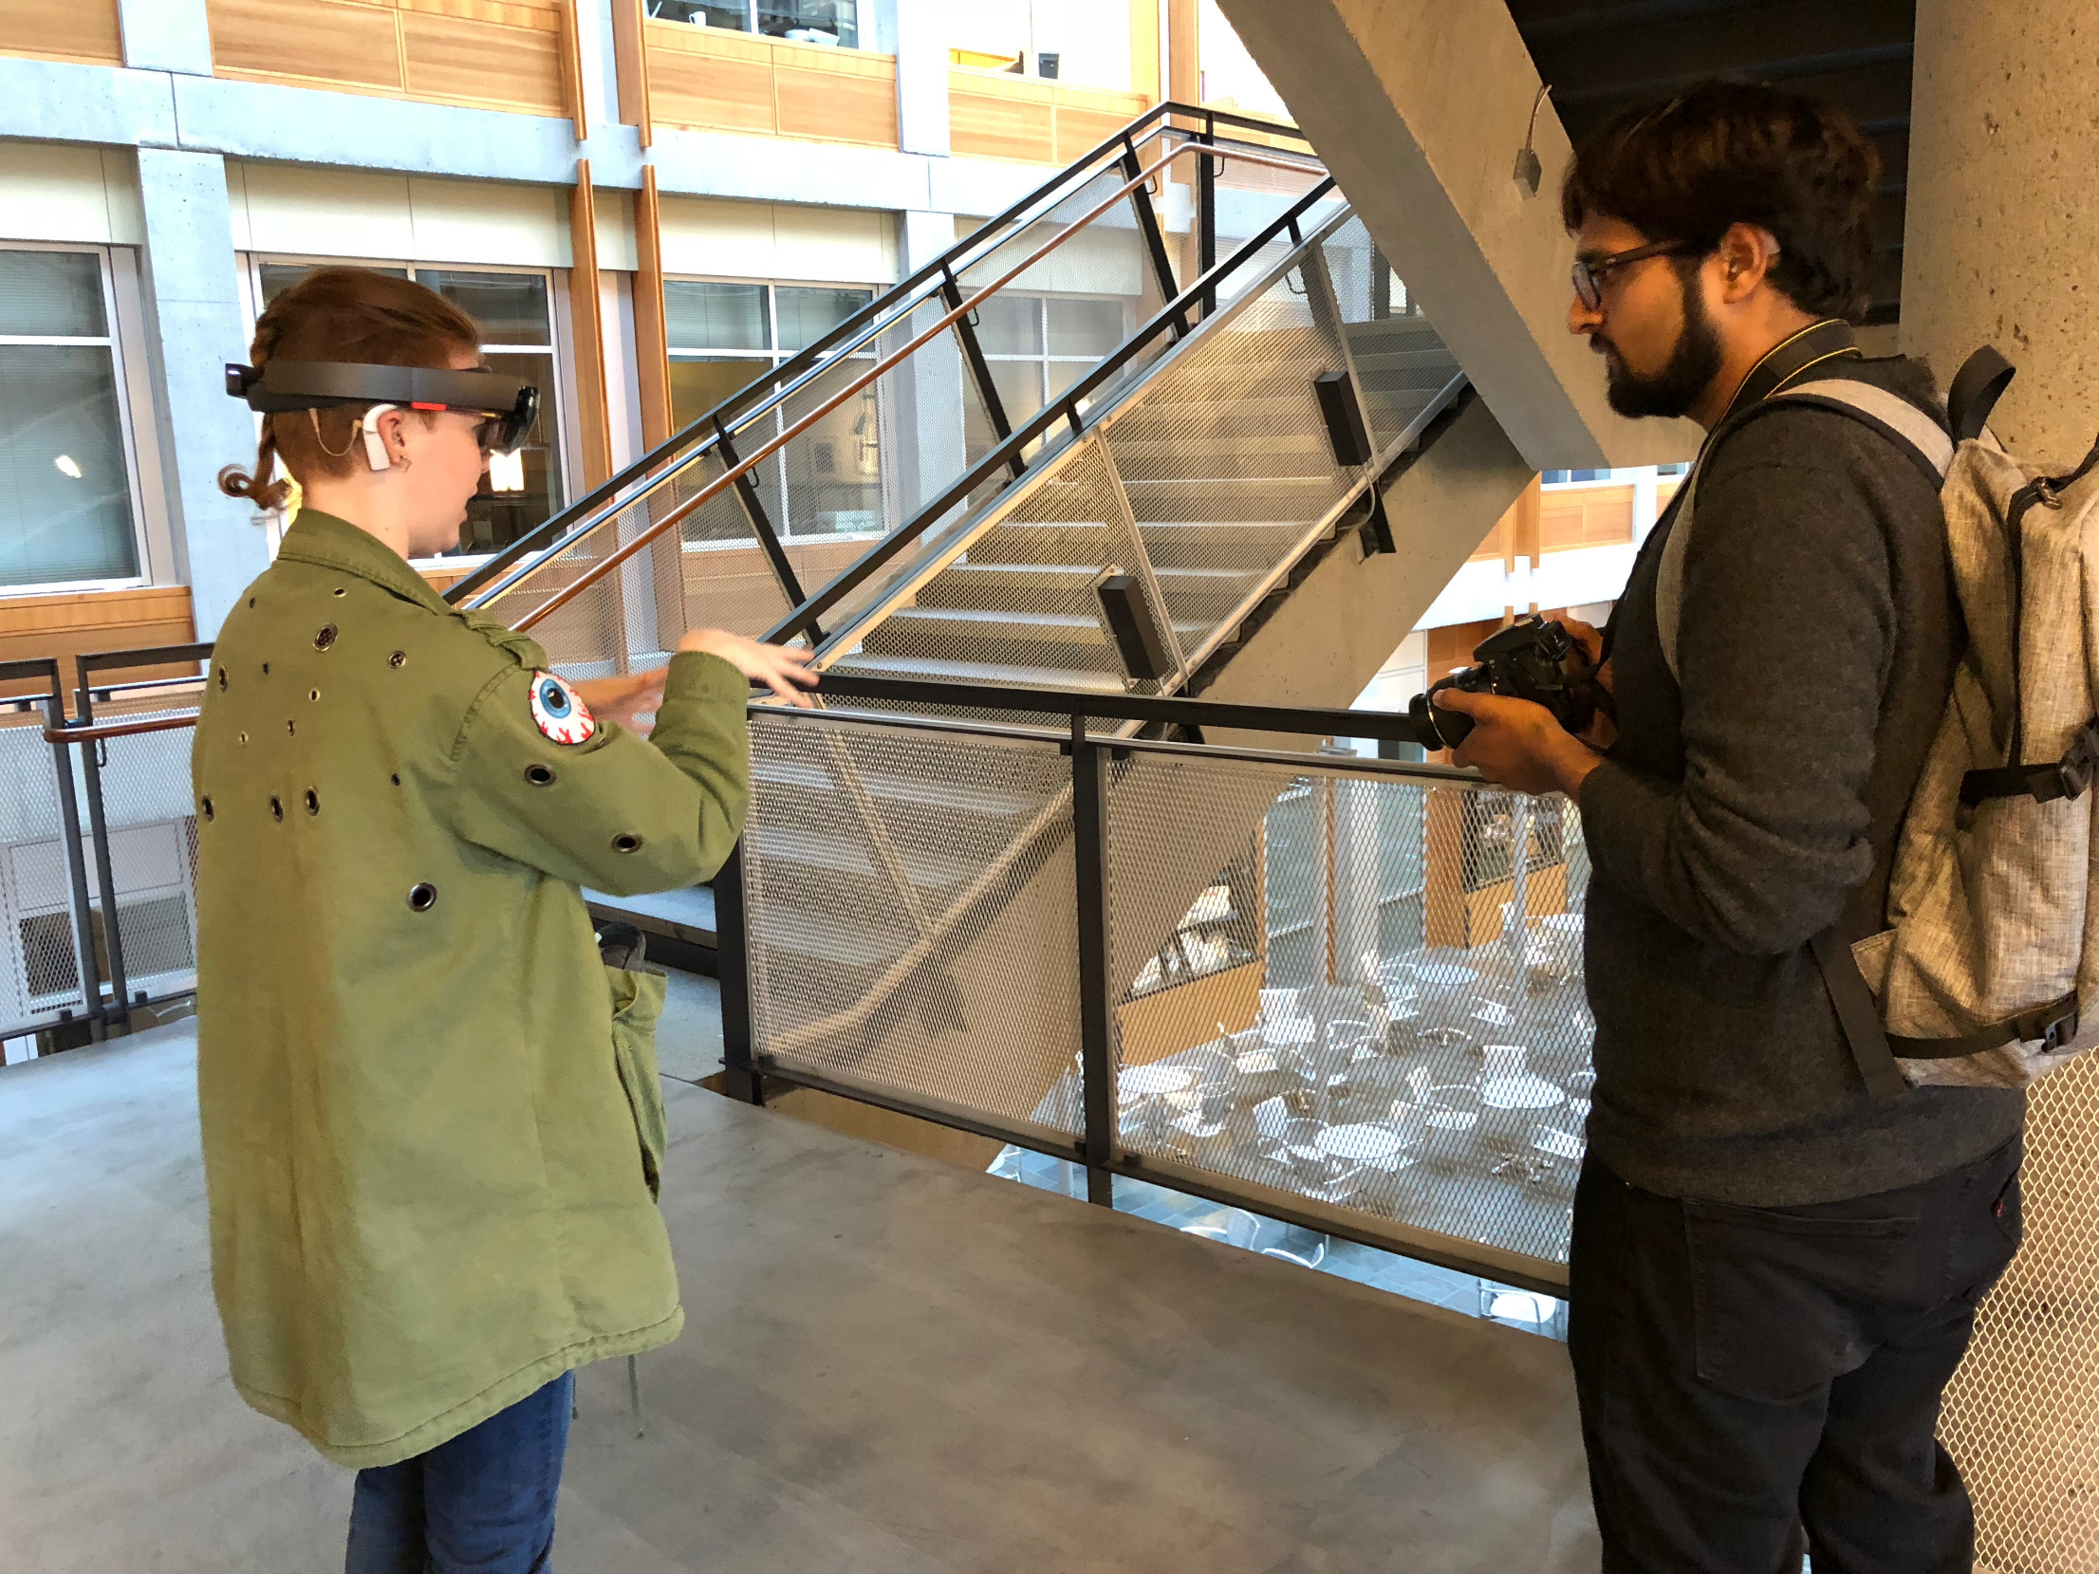
As the first work to explore communication challenges and technology
design for DHH people in mobile context, we have shown that:

Slide 50
  Mobile context offer new challenges and a new unexplored space for innovation.
  Assistive technology in mobile contexts need to be carefully designed.
1
2

Slide 51
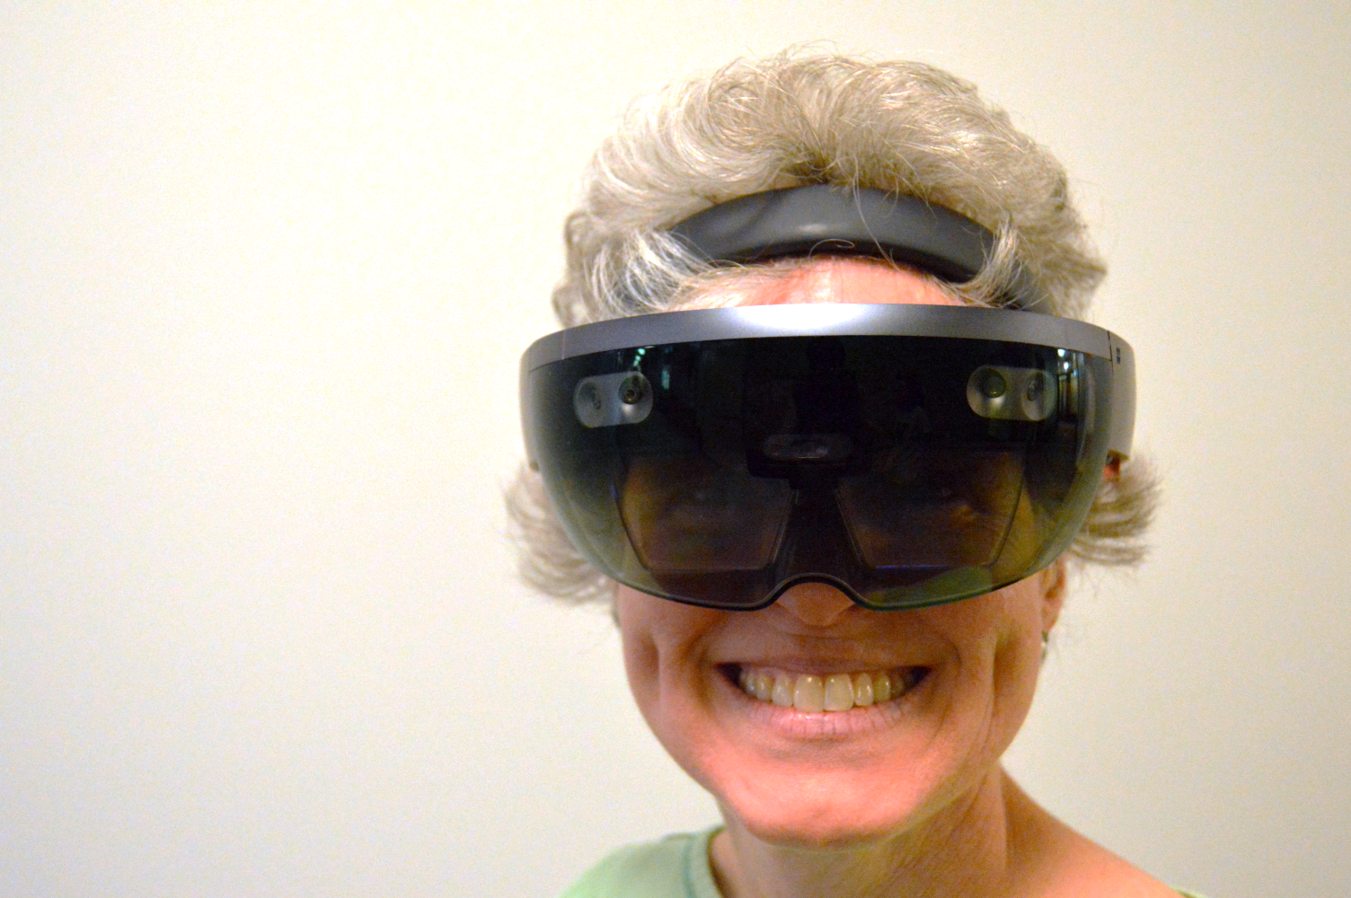
Design Guidelines for HMD-Captioning
Automatic depth alignment
Adapt to changing context
Convey contextual information
Customizable
Notes:
Change Background images one by one to reflect the guidelines.

Slide 52
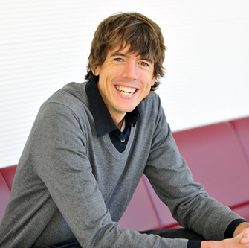
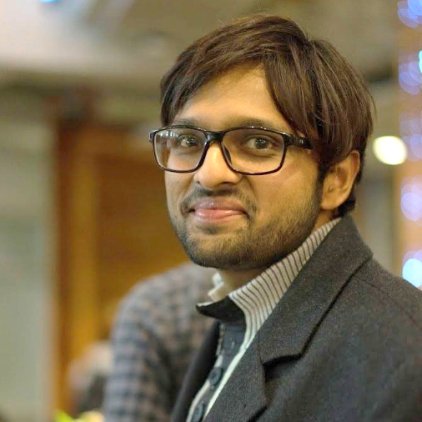

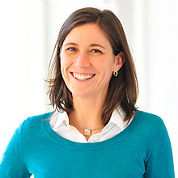
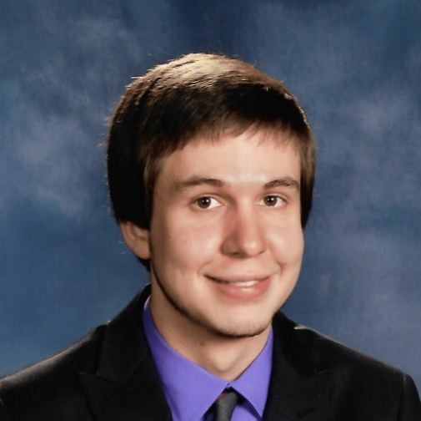
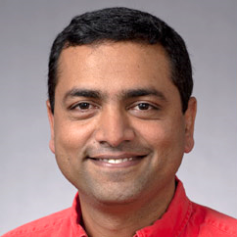
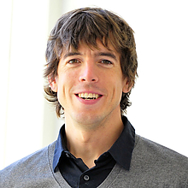
Dhruv Jain
PhD Student, CSE, UW
Rachel Franz
PhD Student, HCDE, UW
Leah Findlater
Assist. Prof., HCDE, UW
Jackson Cannon
UG Student, CSE, UW
Raja Kushalnagar
Prof., Gallaudet University
Jon Froehlich
Assoc. Prof., CSE, UW

Slide 53
Dhruv Jain
PhD Student, CSE, UW
Leah Findlater
Assist. Prof., HCDE, UW
Raja Kushalnagar
Prof., Gallaudet University
Jon Froehlich
Assoc. Prof., CSE, UW

Slide 54
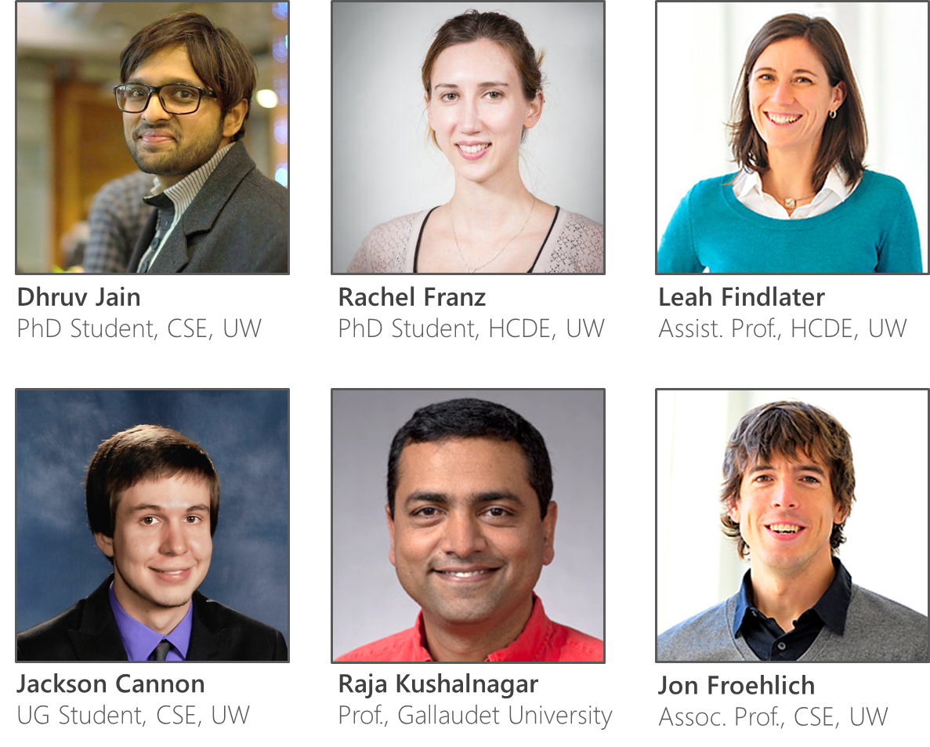




Towards Accessible Conversations in a Mobile Context for People who are Deaf or Hard of Hearing
The Team
djain@uw.edu
franzrac@uw.edu
leahkf@uw.edu
jackscan@uw.edu
raja.kushalnagar@gallaudet.edu
jonf@uw.edu
Sponsors
UW
Reality Lab

