Slide 1
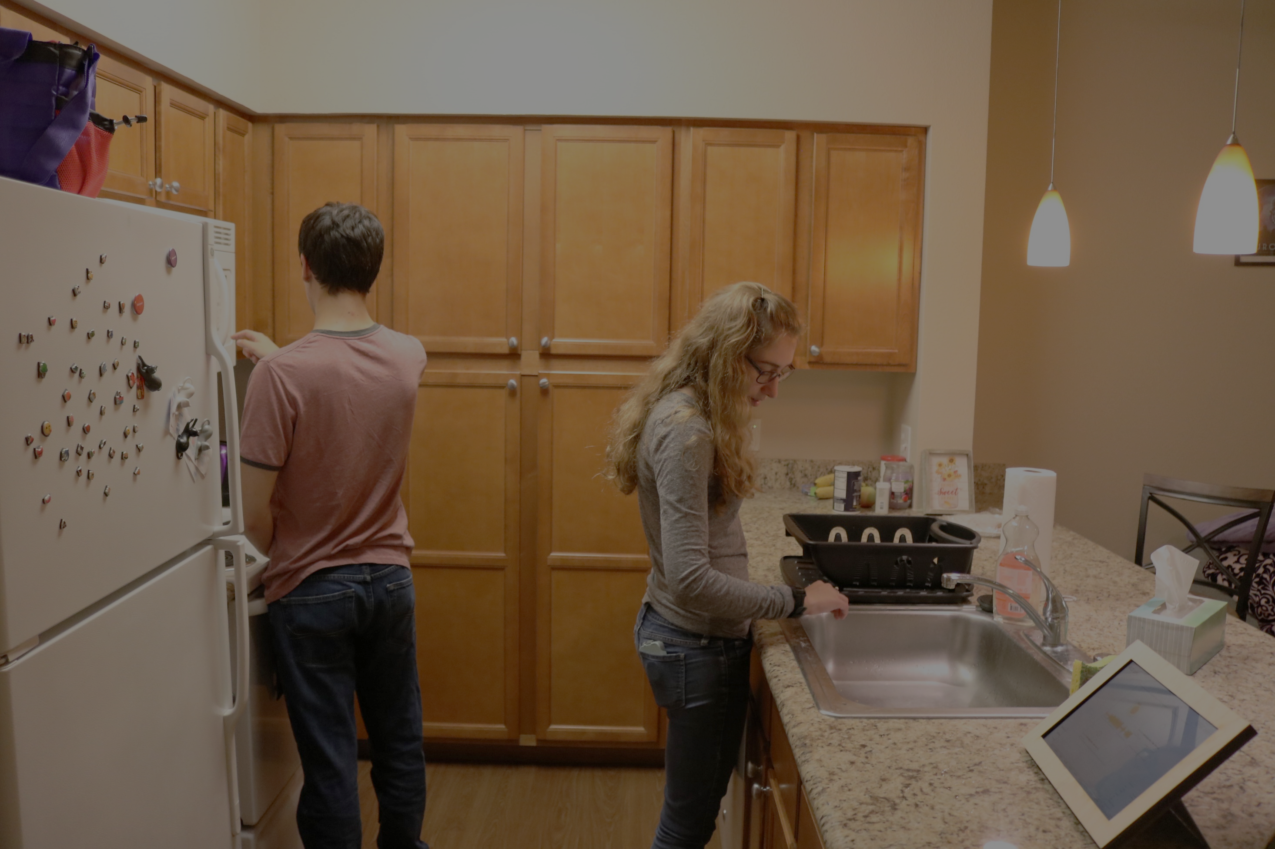
Field Deployment of a Smarthome Sound Awareness System for Deaf or Hard of Hearing Users
Dhruv Jain (DJ)
University of Washington, Seattle

Slide 2
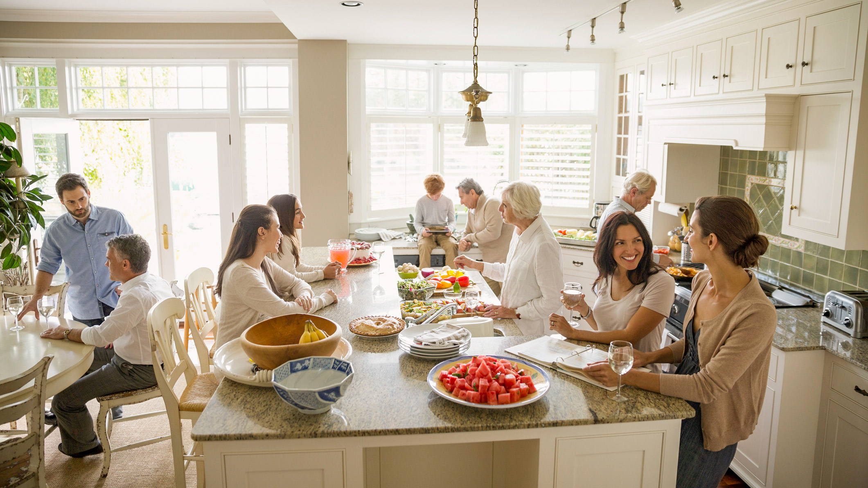
The home environment
is filled with a
rich diversity of sounds

Slide 3

Door opening
People talking
Knife chopping
Dog barking
These sounds inform us about the home, home activities and the household members.
Dryer whirring

Slide 4
However, in many situations, sound is inaccessible to
people who are deaf or hard of hearing (DHH).
Keyboard typing
Knife chopping
People talking
Glass clinking

Slide 5
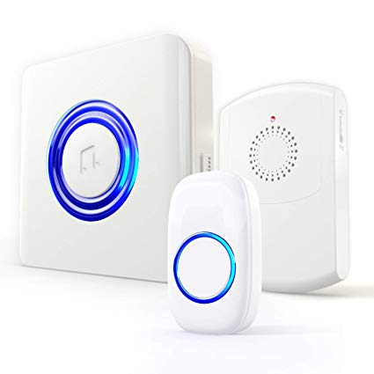
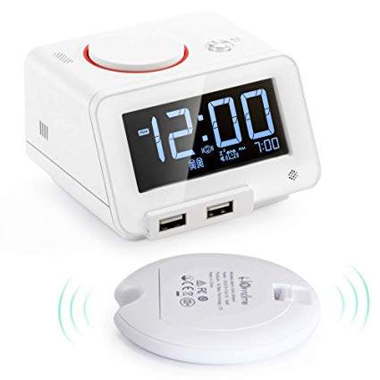
Fortunately, DHH people use visual or vibratory alternatives...
Flashing Doorbell
Vibratory Bed Alarm

Slide 6
While useful for their applications, these products do not
offer a general awareness about sounds in the home.
Fortunately, DHH people use visual or vibratory alternatives...
Flashing Doorbell
Vibratory Bed Alarm

Slide 7
Fortunately, DHH people use visual or vibratory alternatives...
As a result, DHH people miss out on important information needed to:
perform daily tasks (e.g., knowing when the microwave beeped),
keep informed about the state of their home (e.g., knowing when shower is running),
or perform safety-related tasks (e.g., by knowing that an alarm is sounding).
Flashing Doorbell
Vibratory Bed Alarm

Slide 8
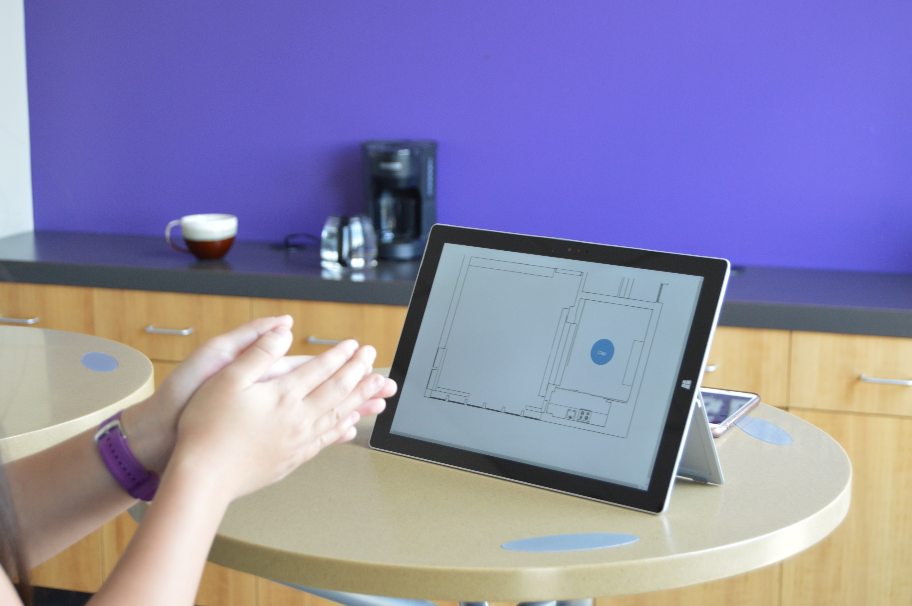
Thus, we’re exploring how to support sound awareness
in the home for people who are deaf or hard of hearing.
Notes:
Thus, in our research, we’re exploring how.. [end] Specifically, we’re examining…. [slide]

Slide 9
  What information about sound do DHH people want in the homes?
  How do they want this information to be conveyed?
  How will a sound awareness system integrate into the homes of DHH people?
  What effect will such as system have on DHH people’s lives, their understanding of their homes and home activities?
Research Questions

Slide 10
Two Phase Project
Investigating the sound awareness needs of DHH people and designs of sound awareness visualizations
Design and field evaluation of two iterative prototypes of in-home sound awareness system
Year 1
Published at CHI 2019
Year 2
Today’s talk
Notes:
We explored these questions in two phases.
[slide] First, following the best HCI practices, we began with investigating the sound awareness needs of DHH people and their preferred designs for sound awareness visualizations. This work was published at CHI 2019.
[slide] Based on these insights, we then designed two iterative prototype of a sound awareness system and conducted field deployments in the homes of DHH people. This second part is what I will talk to you about today.

Slide 11
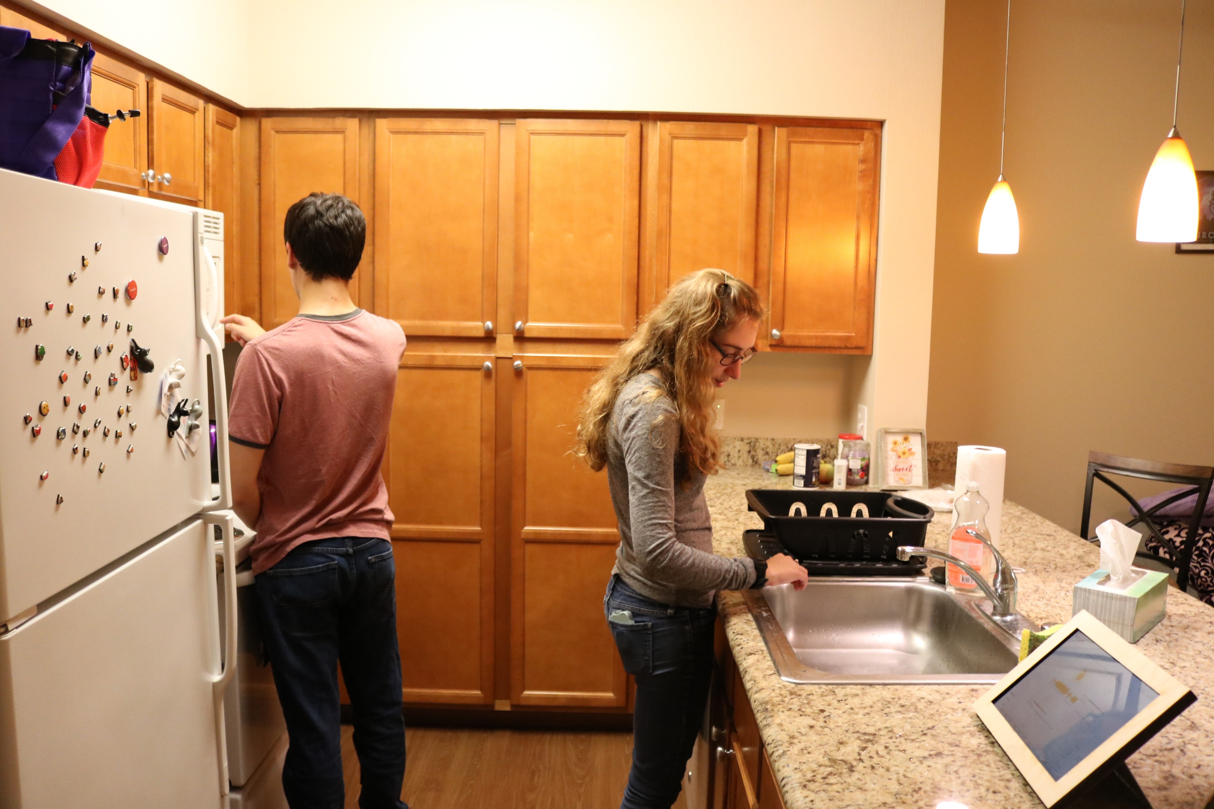
An Iterative Field Deployment of an In-Home Sound Awareness System for
Deaf or Hard of Hearing Users
Dhruv Jain (DJ)
Advisers: Jon Froehlich, Leah Findlater
University of Washington, Seattle
Picture credit: Kelly Mack
Notes:
So, the title of today’s talk is…

Slide 12
  What information about sound do DHH people want in the homes?
  How do they want this information to be conveyed?
  How will a sound awareness system integrate into the homes of DHH people?
  What effect will such as system have on DHH people’s lives, their understanding of their homes and home activities?
Research Questions For Year 2

Slide 13
Several formative studies have explored the needs and preferences of
DHH people for home-based sound awareness systems.
Related Work
Notes:
Before I describe the project, I am going to briefly mention past work. While no work has built a home-based sound awareness system, [slide] several studies have explored the needs and preferences of DHH people for those systems. For example, [slide]

Slide 14
Matthews et al. and Bragg et al. conducted formative interviews and online survey respectively, finding the DHH people’s desired sounds of interest for the home.
They also preformed lab-evaluations of sound awareness feedback designs
using a desktop (Matthews) and a mobile phone (Bragg) display.
Related Work
(Matthews et al., ASSETS 2007)
(Bragg et al., ASSETS 2016)
Notes:
[read]

Slide 15
(Matthews et al., ASSETS 2007)
(Bragg et al., ASSETS 2016)
Notes:
[Pause and slide]

Slide 16
In our CHI 2019 work, we built and evaluated a Wizard-of-Oz smarthome-based
sound awareness display with 22 DHH participants.
Our findings provide several design suggestions, including how to mitigate concerns
that may arise while using a sound awareness technology at home
(e.g., issues of privacy, activitiy tracking).
Related Work
(Jain et al., CHI 2019)
Notes:
In our CHI 2019 work, that I mentioned to you before, we.. [read]

Slide 17
(Jain et al., CHI 2019)
Notes:
This picture shows one of the preliminary designs we evaluated for our CHI 2019 work last year.

Slide 18
Informed from these studies, we built two iterative prototypes
of IoT-based sound awareness system
and performed a three-week field deployment
in the homes of DHH people.
Notes:
[read]

Slide 19
Outline
Prototype 1
Conveyed simple but accurate sound feedback (e.g., loudness, pitch)
Study 1
Prototype 1 deployment
Prototype 2
Conveyed more complex sound features (e.g., sound identity)
Study 2
Prototype 2
deployment
Notes:
So my talk includes 4 parts:
Prototype 1 which conveyed simple but accurate "easy to sense" sound feedback such as loudness and pitch.
Field deployment of Prototype 1, that is Study 1.
Based on Study 1 findings, we built Prototype 2, which conveyed more complex features (e.g. sound identity) using deep learning.
Then, I’ll detail field deployment of Prototype 2, that is Study 2.
Let's start with Prototype 1.

Slide 20
Outline
Our goal was to examine how DHH users would react to a system which conveyed “easy to sense” sound properties, such as loudness and pitch,
Prototype 1
Conveyed simple but accurate sound feedback (e.g., loudness, pitch)
before exploring complex probabilistic characteristics (e.g., sound type).
Notes:
With this prototype, our goal was to examine how DHH users would react to a system which conveyed easy to sense sound properties such as loudness and pitch, [before] before going into more complex sound properties such as the sound type etc.

Slide 21
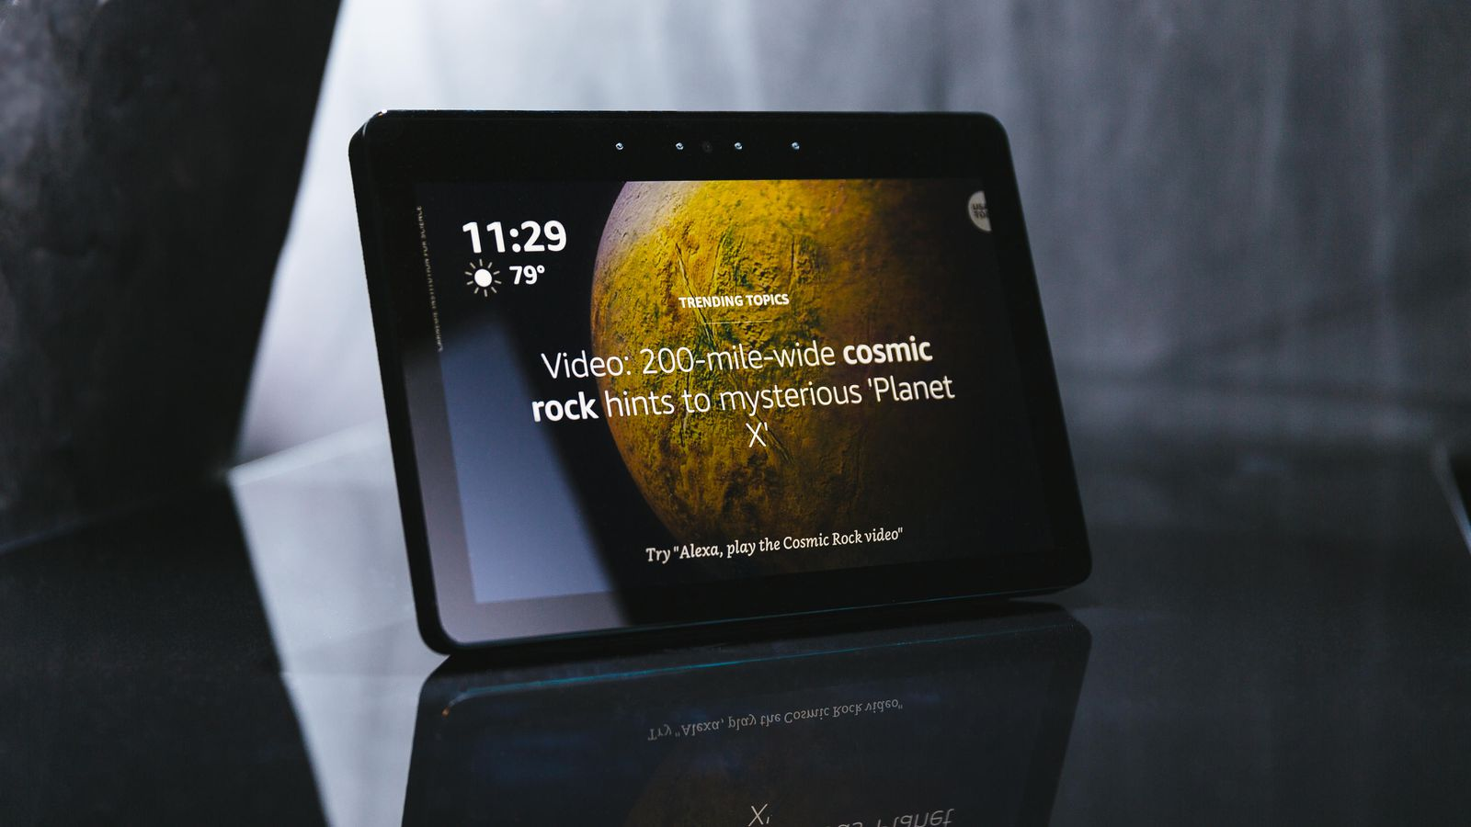
Prototype 1
This prototype was inspired by the new commercially available display-based IoT devices like the Amazon Echo Show…
Notes:
[end] but designed to provide sound feedback to DHH users.

Slide 22
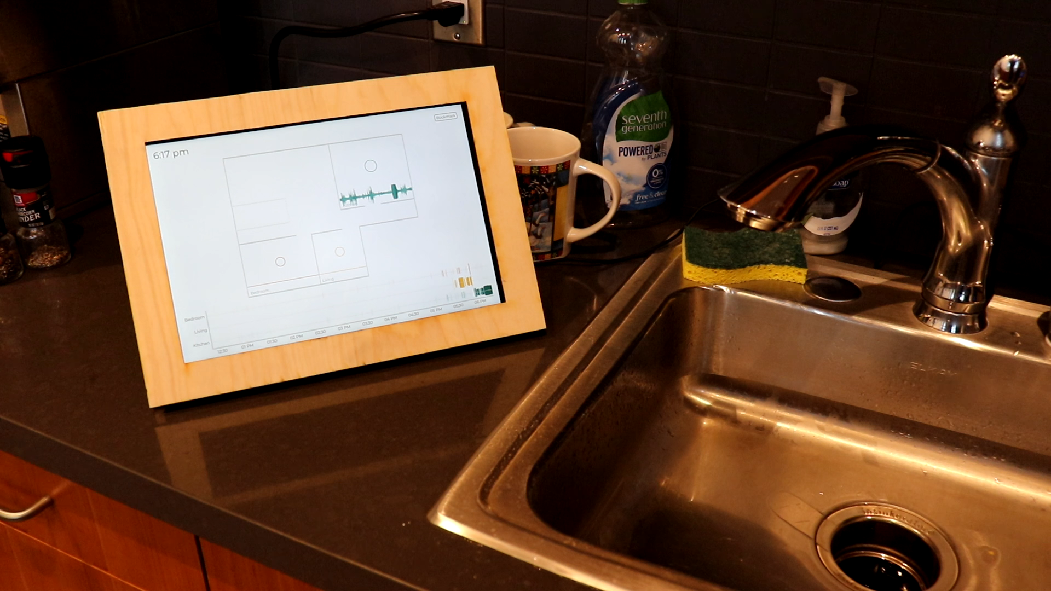
It contained 3-5 "picture frame displays“ each deployed in different room of the house.
Microsoft Surface Pro Tablet
Laser cut wood frame
Notes:
[read and then] These displays were basically [slide] Microsoft Surface Pro Tablets [slide] encased in a [slide] laser cut wooden frame.

Slide 23
Prototype 1
Picture frame display
These displays sensed and visualized basic sound characteristics (e.g., pitch)
Functioned as IoT devices, i.e., for passive viewing
Notes:
This is how a display looked like in the home. We deployed 3-5 of them.
[slide] These displays sensed and visualized basic sound characteristics (e.g., pitch, loudness)
[slide] Since we did not want to burden the user, these displays functioned as IoT devices, that is, they were meant for passive viewing and not active notification.

Slide 24
Let me walk you through what the visualization look liked on each display.
Prototype 1
Picture frame display
These displays sensed and visualized basic sound characteristics (e.g., pitch)
Functioned as IoT devices, i.e., for passive viewing

Slide 25
Prototype 1
Imagine a two-floor home….

Slide 26
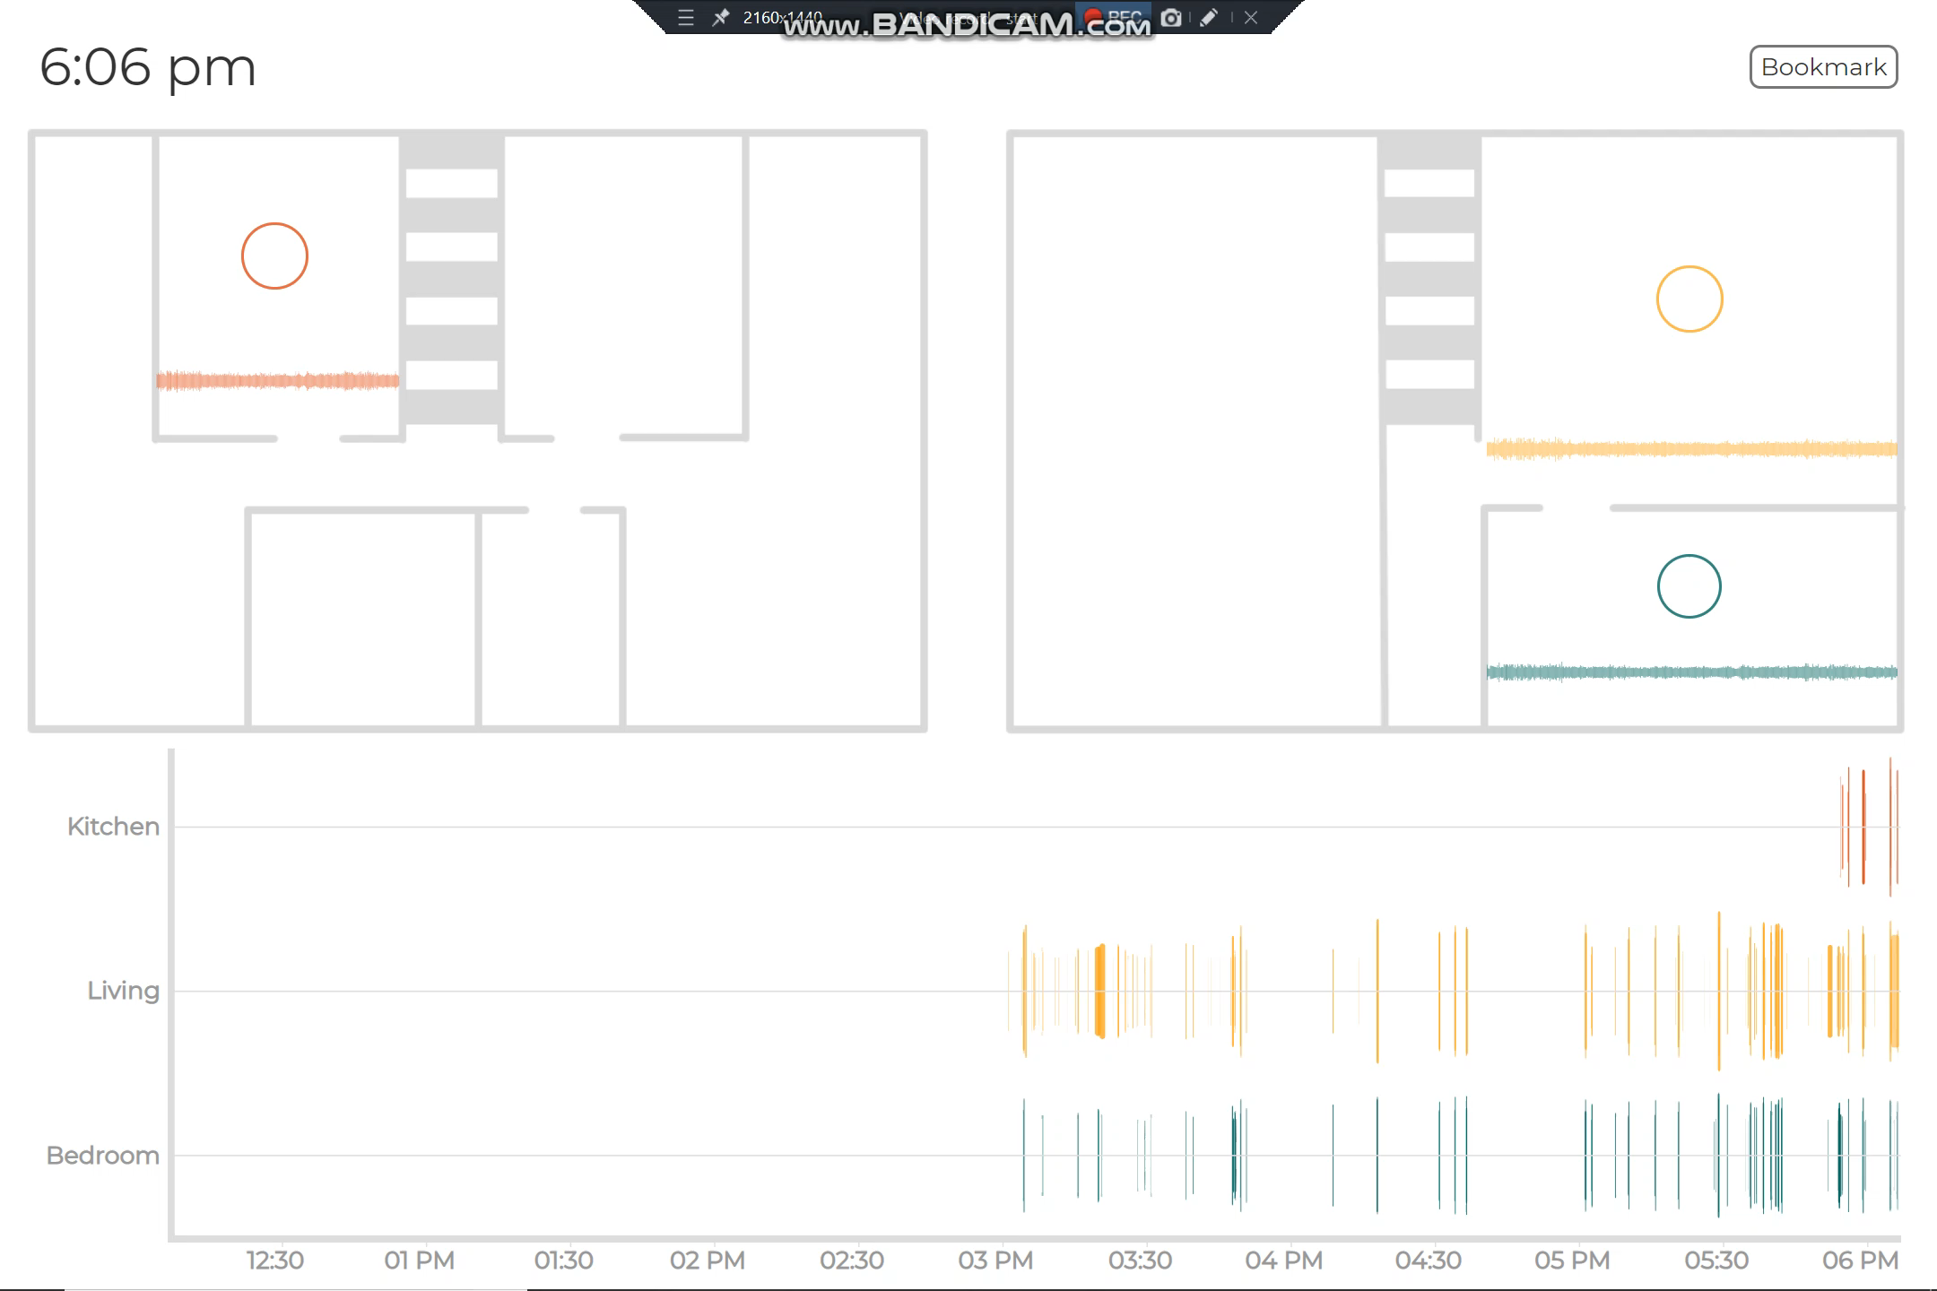
Prototype 1
First floor
Second floor
And this is an approximate floorplan of the home…

Slide 27

Prototype 1
First floor
Second floor
Kitchen
Living Room
Bedroom
Say we install our tablets in three rooms of the house.

Slide 28
Then the display visualization looked something like this….
Prototype 1

Slide 29
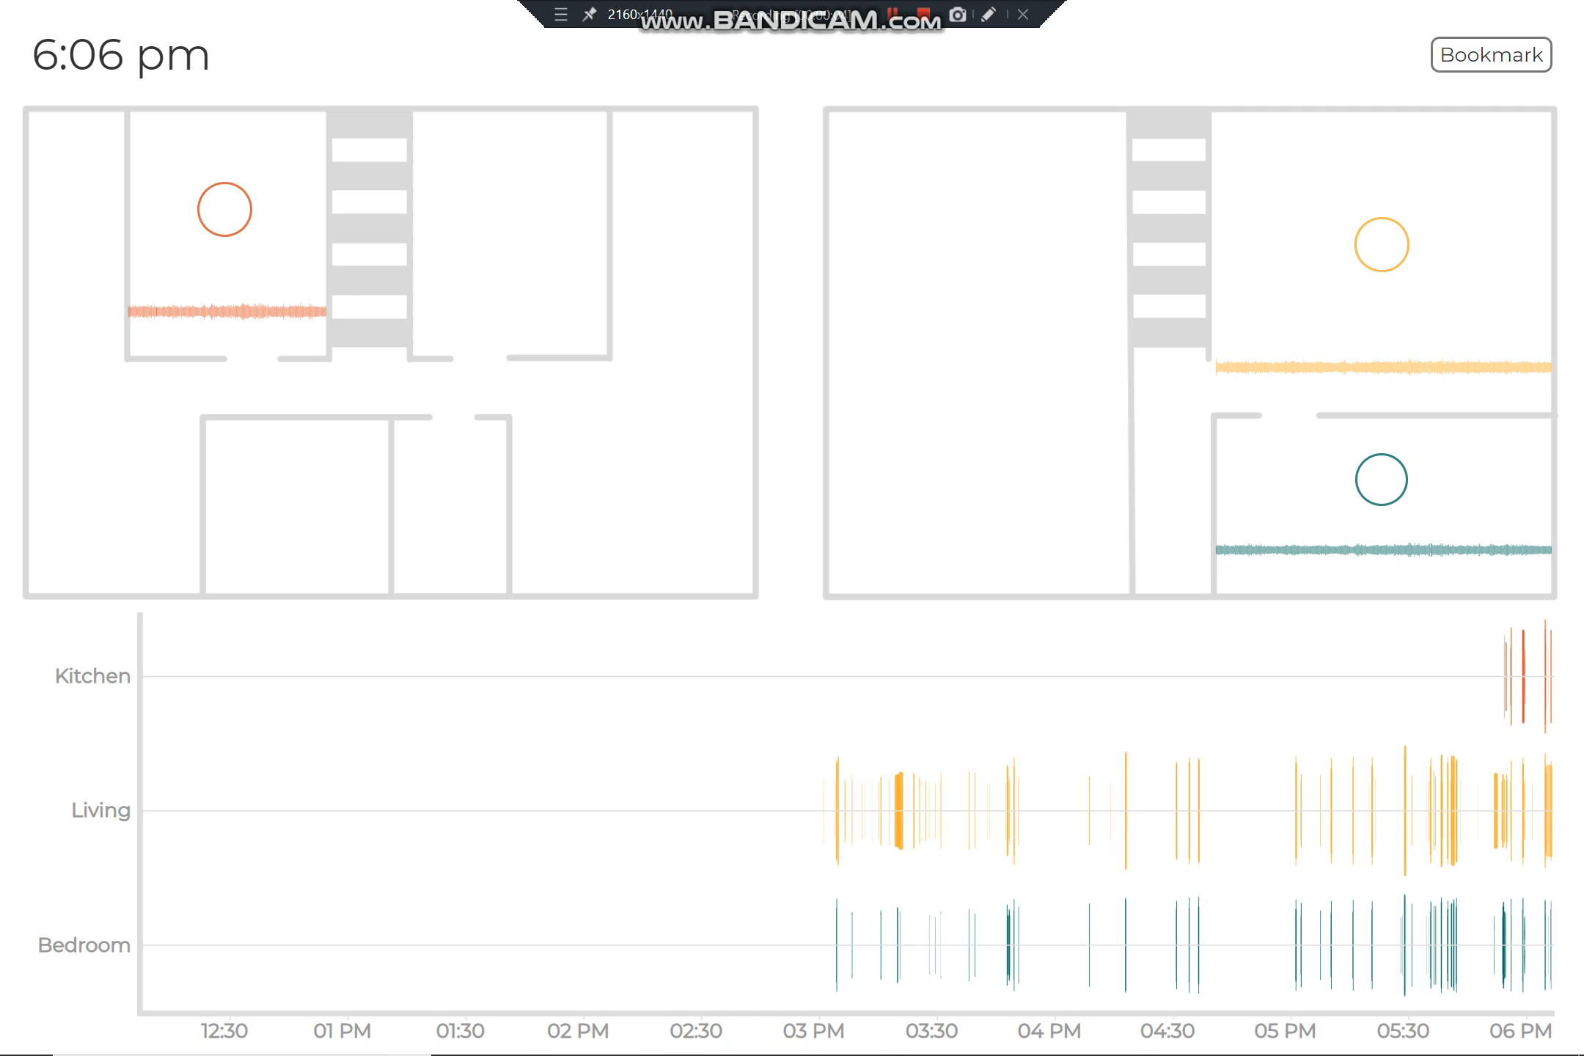
Kitchen
Living Room
Bedroom
Notes:
I don’t expect you to process all this, but just let me briefly go through some visual elements to give you a feel.

Slide 30
The visualization contained two views.
Prototype 1
Kitchen
Living Room
Bedroom
Notes:
The visualization contained two broad views…

Slide 31
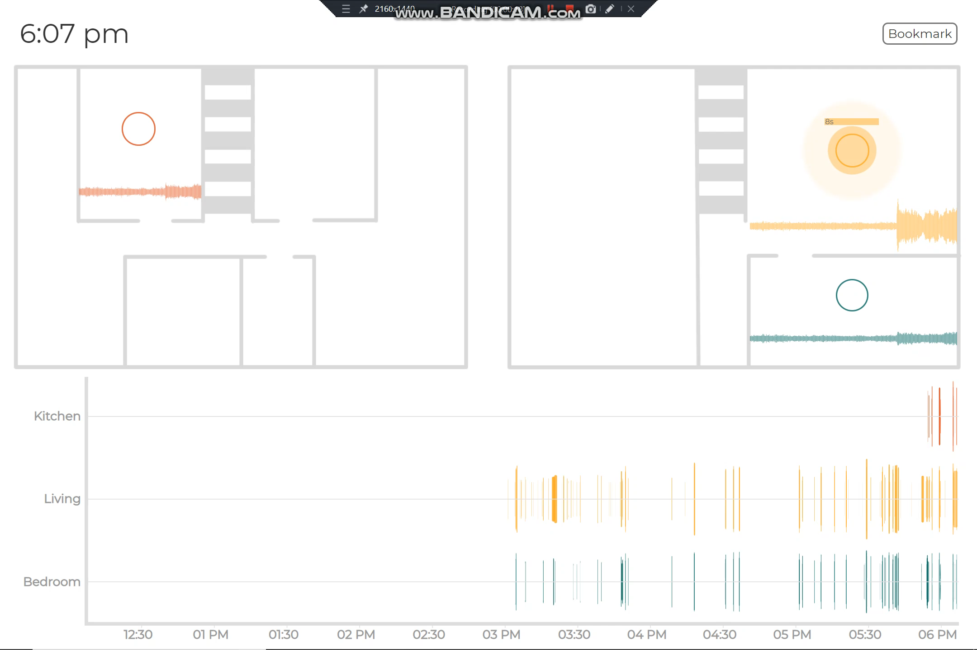
Kitchen
Living Room
Bar showed duration
The pulse shows a loudness of sound in a room.
30 sec waveform to identity patterns in sound activity.
Bedroom
“Floorplan view” – shows the top down blueprint of the home
Notes:
First, the floorplan view showed the top down blueprint of the home. In his view, [slide] pulses showed the loudness of sounds in each room. Then, we showed [slide] a scrolling 30 sec waveform intended for the user to identity patterns in sound activity, and finally the [slide] bar on the top showed duration of a live sound.

Slide 32
Kitchen
Living Room
Bedroom
“History view” – shows sound activity in each room for past 6 hours
Notes:
Then, the second view was the history view that visualized the past sound activity in each room. [pause]
And that’s it, very simple recognizable features about sound.

Slide 33
Prototype 1
Notes:
To demonstrate the prototype, let me show a quick video.. [Slide]
Somebody turns on the water…
And the display visualizes it.
So, that’s how the system worked. Now, I am not going to go into details of the backend, but it’s important to note that, [slide]

Slide 34
We designed our sensing pipeline to protect user privacy
by storing only the non-reconstructable sound features (e.g., avg loudness).
Prototype 1

Slide 35
How did it all work?
Circles showing past 30 min and 6 hour average sound level in the room
Bar shows duration
The pulse shows a live sound occurring.
Waveform shows sound level for past 30 seconds
Sound history – height shows loudness, length shows duration, color darkness shows pitch.
Notes:
Before I show you that, I think it’s important to mention that..

Slide 36
From the onset, we designed our sensing pipeline to protect user privacy. Each device processes sound locally and only uploads non-reconstrucable features.
Circles showing past 30 min and 6 hour average sound level in the room
Bar shows duration
The pulse shows a live sound occurring.
Waveform shows sound level for past 30 seconds
Sound history – height shows loudness, length shows duration, color darkness shows pitch.
Notes:
Let’s see how it worked..

Slide 37
Notes:
Each display deployed in the home first sensed the sound near it and uploaded the non-reconstructable data to the…

Slide 38
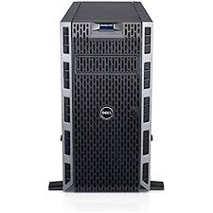
Privacy-preserving Sound data
Privacy-preserving Sound data
Server located at my office
Notes:
Server located at my office in this building..

Slide 39
Server located at my office
Notes:
Then the server processed the sound data, that is calculated pitch, loudness, duration etc. and sent it

Slide 40
Loudness, Pitch, etc.
Loudness, Pitch, etc.
Server located at my office
Notes:
back to the displays for visualization.

Slide 41
Deployed the prototype in 4 homes…
Notes:
After building, we deployed the prototype in 4 homes..

Slide 42
Outline
Prototype 1
Conveyed simple but accurate sound feedback (e.g., loudness, pitch)
Notes:
This ends the description of the prototype 1.

Slide 43
Outline
Prototype 1
Conveyed simple but accurate sound feedback (e.g., loudness, pitch)
Study 1
Prototype 1 deployment
Notes:
Let me talk about how we deployed the prototypes in the homes of DHH people, that is Study 1.

Slide 44
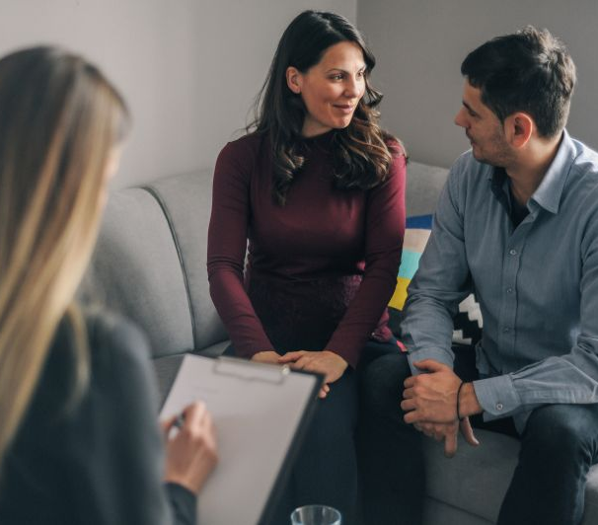
Study 1
Goal
To examine how DHH users reacted to an in-home sound awareness system that showed simple features
Participants
4 Homes; 6 DHH and 1 hearing individual
Study Method
Initial Interview about experience with sound
3 week deployment: 3 weekly surveys + system logs
Post trial interview about experience with Prototype 1
Data Analysis
Thematic analysis of interview transcripts + surveys
Two coders; IRR was 0.66, raw agreement was 86.3%
Disagreements were resolved through consensus
Notes:
The goal of the study was to examine how DHH users reacted to an in-home sound awareness system that showed very simple features, that is our Prototype 1. [slide] Four Homes participated in our study, containing 6DHH and 1 hearing house member. [slide] The study method involved initial interview about experience with the sound. [slide] a three week system deployment, containing 3 weekly surveys and system logs and [slide], a post trial interview about experience with our Prototype. [slide] We analyzed the transcripts and surveys using thematic analysis. [slide] There were two coders, both of which coded all transcripts. The inter rater reliability was 0.66 and raw agreement 86.3%. [Slide] Though the IRR was low, we resolved all disagreements through mutual discussion. Let’s see what we found.

Slide 45
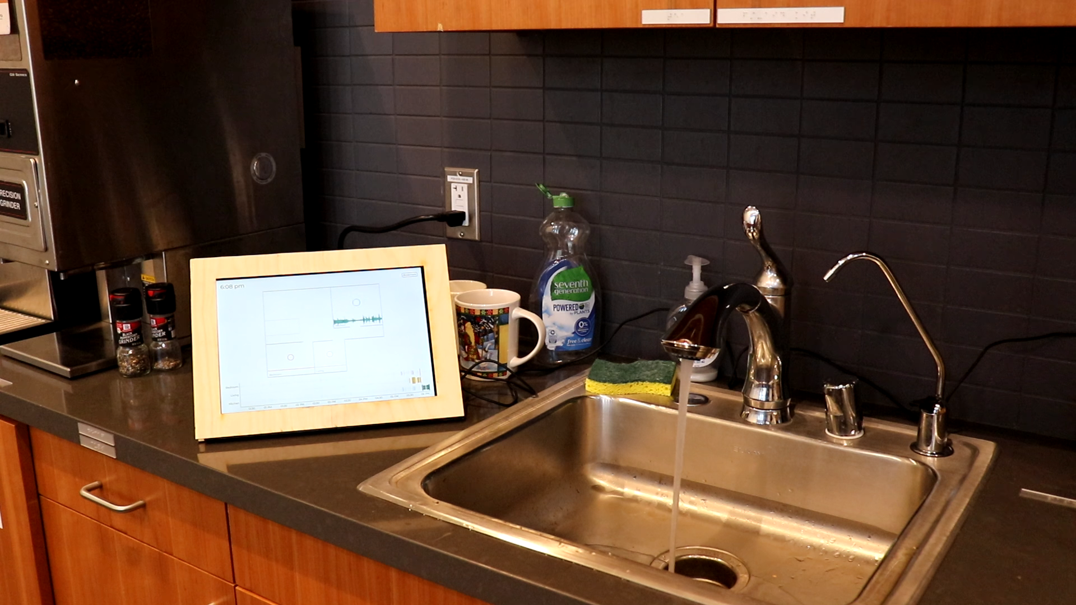
Study 1 Findings
Usage patterns
Affect on home awareness
Concerns about privacy
Improvement suggestions
Notes:
Let’s see what we found. To give an overview, I will discuss 4 things. [read]

Slide 46
Study 1 Findings
Usage patterns
Notes:
Let’s start with usage patterns.

Slide 47
All DHH participants looked at the displays at least a few times a day.
Study 1: Findings
Study 1 Findings
Notes:
Let’s see what we found. [slide]

Slide 48
Study 1: Findings – Usage Patterns
“
”
“I looked at it a lot in the first week, but then not so much in the end. I got used to its presence and forgot it was there…”
- H4P1, post trial interview
Notes:
[read]

Slide 49
Three participants mentioned feeling nostalgic after the deployment ended.
Study 1: Findings – Usage Patterns
Notes:
However, interestingly,

Slide 50
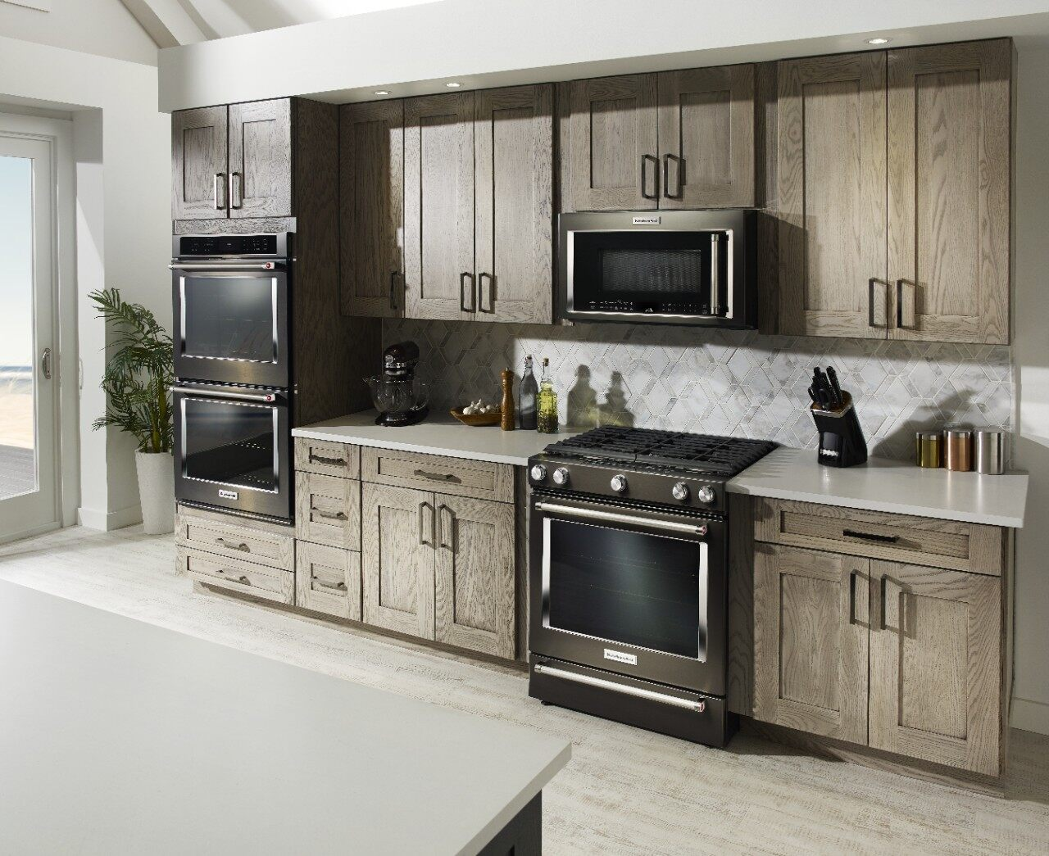
`
Study 1: Findings – Usage Patterns
“I was waiting for the microwave to beep, but was in the bedroom. So, I asked [my husband] if he could hear [it] […] And he said: “where’s the system!?”
- H1P1, text message sent post-study
Notes:
[read..].

Slide 51
Study 1 Findings
Usage patterns
Affect on home awareness

Slide 52
Because the users had to look at the display and because the system showed basic
sound information, it was not found sufficient for home awareness…
However, in some cases, participants relied on context to make use of the system,
suggesting that a future improved system may be useful.
Study 1: Findings
Notes:
Because the users had to look at the display from time to time, and because the system showed very basic sound information such as loudness and pitch, it was not found sufficient for home awareness.
However, in some cases, participants relied on context, their understanding of their home, to make use of the system, suggesting… Let me give you some examples.

Slide 53
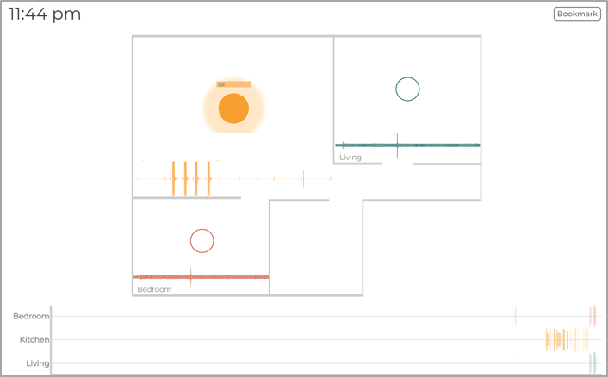
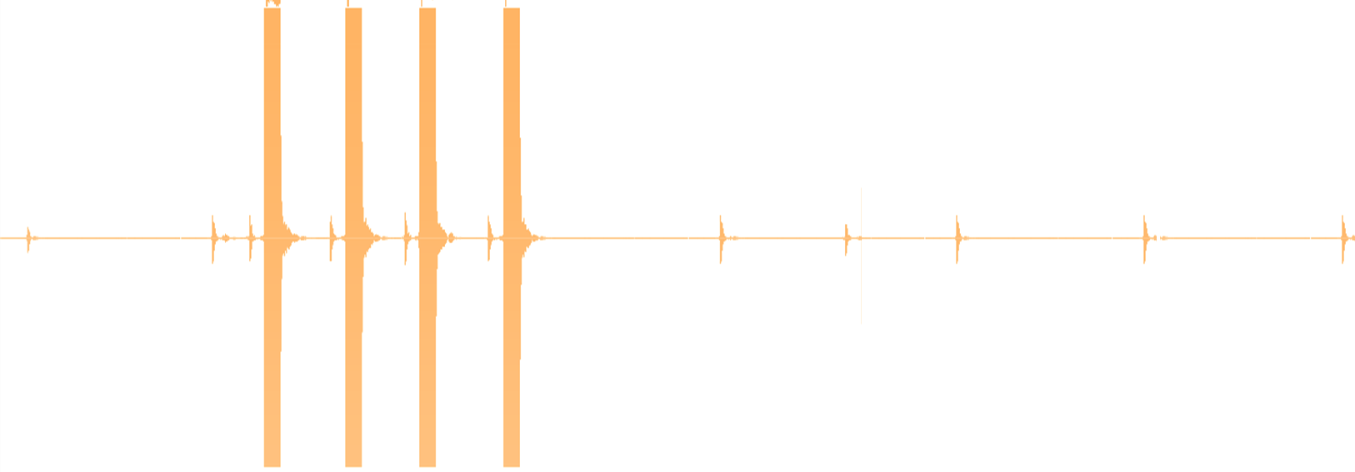
Study 1: Findings
Kitchen
Kitchen
“The peaks in the waveform from Kitchen meant that the microwave must have beeped, and my food was ready. [Because] no one else [was] in the home.”
H4P1 – snapshot taken in week 2
Notes:
This was a snapshot taken by H4P1 in week 2. They noticed the... [slide] 4 pulses in the waveform visualization and said…[read]. Similarly, [slide]

Slide 54
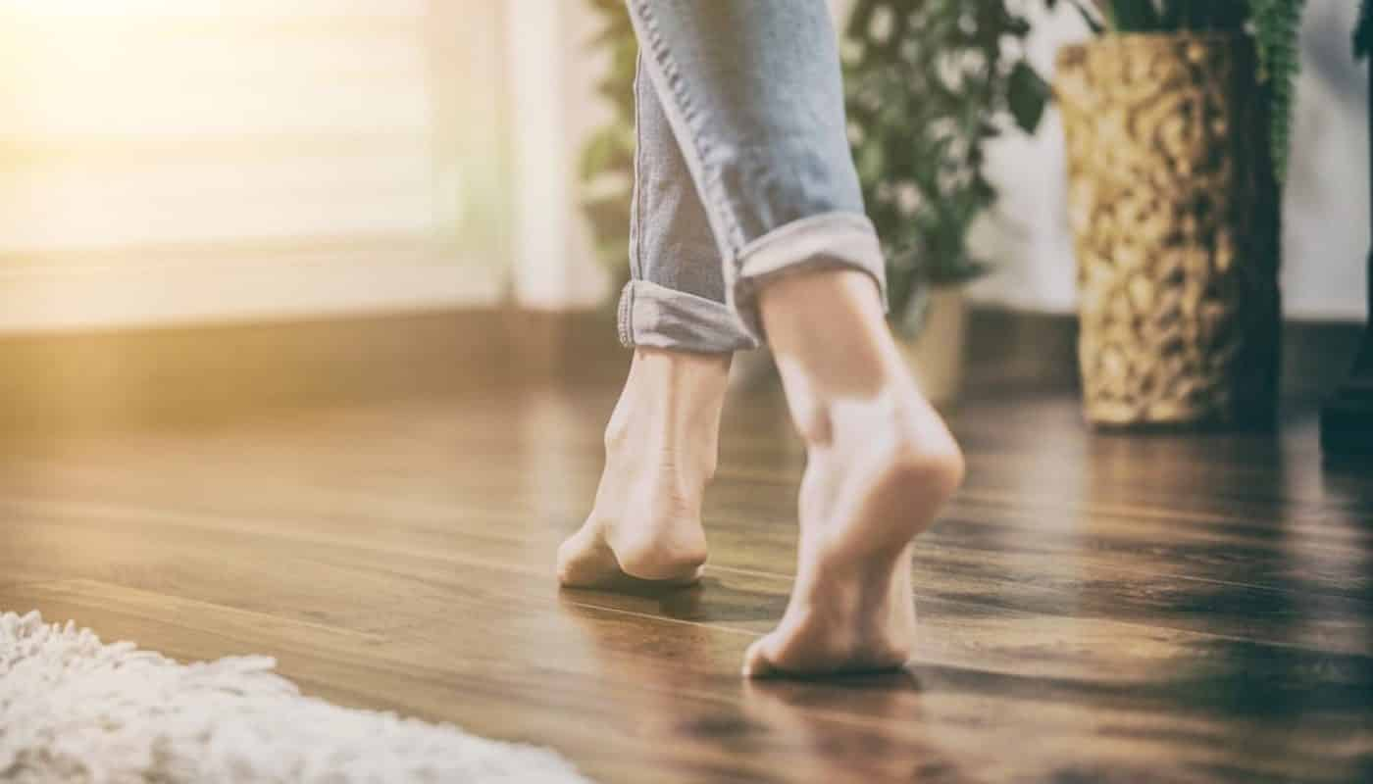
“Every time I walked around the house, I saw disks [pulses] on displays [emanating from] multiple rooms. I realized that my whole wooden home makes a lot of noise when I walking”
- H3P1, week 1 survey
Notes:
In the week 1 survey, H3P1 said,…
This show how people were able to use context along with the displays to increase awareness of their homes.

Slide 55
Study 1 Findings
Usage patterns
Affect on home awareness
Concerns about privacy
Improvement suggestions
Notes:
Let’s see what we found. To provide overview, I will discuss…
[No need of bread crumb if removed privacy..]

Slide 56
In terms of privacy, surprisingly, the DHH participants and their
house members did not voice any privacy concerns.
This may have been because of the ”assistive nature” of the system.
Study 1: Findings
Notes:
[end] as mentioned by H3P1,

Slide 57
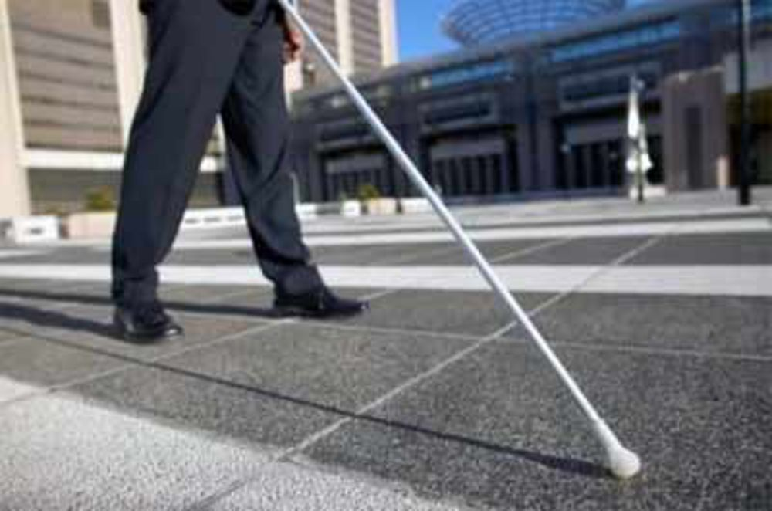
“[My hearing spouse] accepted the system because it was an assistive technology and he knew this was necessary to help me...”
- H1P1, post-trial interview
Notes:
[read..].

Slide 58
However, guests that visited the homes felt differently...
Study 1: Findings

Slide 59
“My friend asked his wife to not hold a conversation near a tablet […] Then I explained that this [system] cannot display words and he seemed to be ok with it then. Although I must say he was a little put off initially.”
- H3P1, post-trial interview
Notes:
[end] Thus, though our system was designed to protect user privacy, the guests felt differently.

Slide 60
Study 1 Findings
Usage patterns
Affect on home awareness
Concerns about privacy
Improvement suggestions
Notes:
Let’s see what we found. To provide overview, I will discuss…
[No need of bread crumb if removed privacy..]

Slide 61
Improvement Suggestions
Study 1: Findings
Notes:
Finally, I’d like to talk about desired system improvements. There were two major ones. [slide].

Slide 62
Improvement Suggestions
Study 1: Findings
Participants wanted more specific information about sounds.

Slide 63
Improvement Suggestions
Study 1: Findings
Need to automatically classify sounds.

Slide 64
Improvement Suggestions
Study 1: Findings
Need to automatically classify sounds.
Participants got tired of having to look at the displays from time to time.

Slide 65
Improvement Suggestions
Study 1: Findings
Need to automatically classify sounds.
A way to provide alert about sounds (e.g., using smartwatch or flashing display screen).
These suggestions inform our prototype 2.

Slide 66
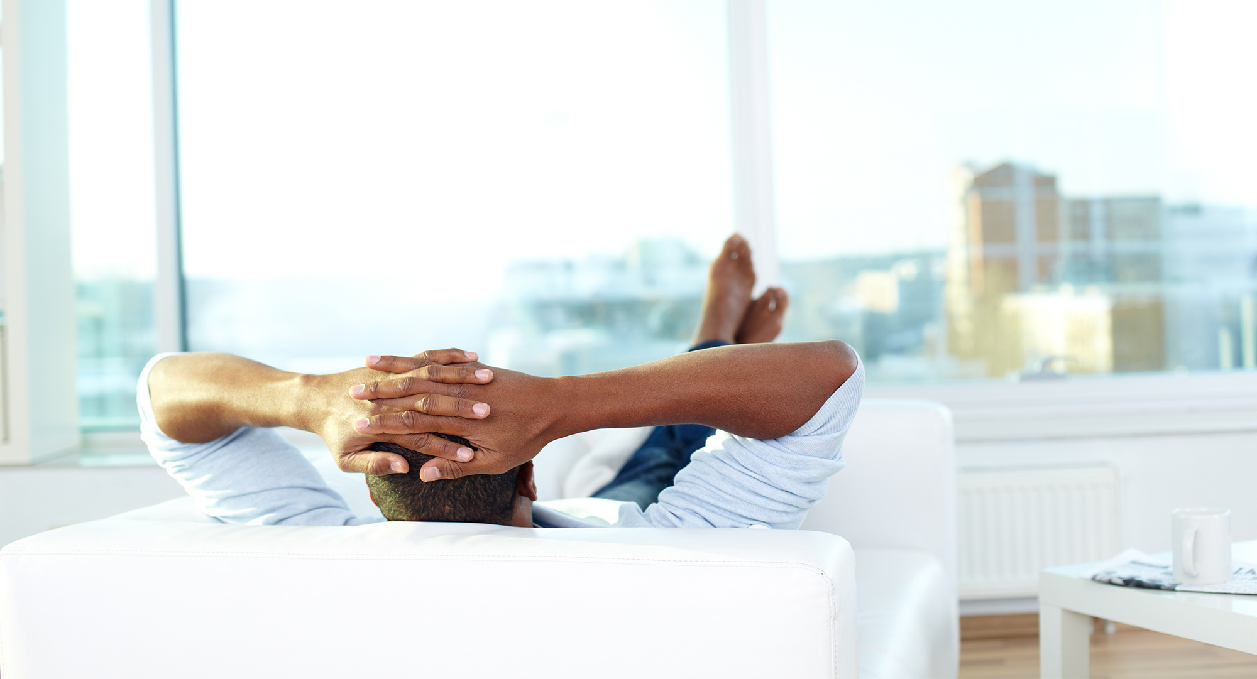
Break Time
Any questions?
https://tinyurl.com/DJ-quals
Notes:
I’d like to take a short break here and answer any questions that you may have.

Slide 67
Recap…
Prototype 1 visualized basic sound information (e.g., loudness, pitch, duration) on IoT-like displays
We deployed the prototype in four homes and conducted field evaluation (Study 1).
Helped increased home awareness in some cases, but needed improvements included: automatic sound classification, and providing alerts about sounds
Notes:
Th

Slide 68
Outline
Prototype 1
Conveyed simple but accurate sound feedback (e.g., loudness, pitch)
Study 1
Prototype 1 deployment
Notes:
This is the outline so far.

Slide 69
Outline
Prototype 1
Conveyed simple but accurate sound feedback (e.g., loudness, pitch)
Study 1
Prototype 1 deployment
Prototype 2
Conveyed more complex sound features (e.g., sound identity)
Notes:
Now we move on to prototype 2.

Slide 70
Two Extensions To Prototype 1
Prototype 2
Sound classification engine for 19 common home sounds
Smartwatch to provide sound alerts using visual + vibration notifications.
Notes:
To make prototype 2, we extended prototype 1 in two ways. [slide] First, we added a sound classification engine to automatically classify 19 sounds in the home. [slide] Second, we added a smartwatch app to provide sound alerts using visual and vibration notifications. Let’s look at each in turn.

Slide 71
Two Extensions To Prototype 1
Prototype 2
Sound classification engine for 19 common home sounds
Notes:
To make prototype 2, we extended prototype 1 in two ways. [slide] First, we added a sound classification engine to automatically classify 19 sounds in the home. [slide] Second, we added a smartwatch app to provide sound alerts using visual and vibration notifications. Let’s look at each in turn [slide].

Slide 72
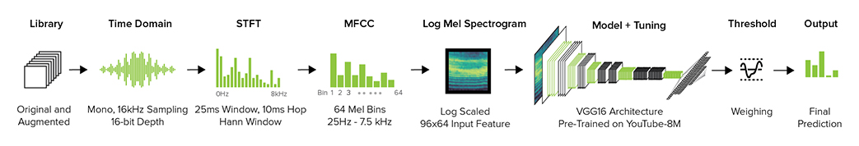
Prototype 2
Sound Classification
Sound clips from online libraries
Features
Notes:
To build our model [slide] we used a deep convolutional neural network based model which was pre-trained on 8 million YouTube videos.
Because this original model was meant for classifying videos, we used [slide] transfer learning to adapted the model for our task (that is, sound classification).

Slide 73
Prototype 2
Sound Classification
Using transfer learning, we adapted this model for our task (sound classification)
Sound clips from online libraries
Features
VGG16 Architecture
Pre-trained on 8M YouTube videos
Notes:
To build our model [slide] we used a deep convolutional neural network based model which was pre-trained on 8 million YouTube videos.
Because this original model was meant for classifying videos, we used [slide] transfer learning to adapted the model for our task (that is, sound classification). To do this, [slide]

Slide 74
Prototype 2
Sound Classification
Clips from online libraries for 19 sound classes
Features
VGG16 Architecture
Pre-trained on 8M YouTube videos
Average test accuracy on sounds recorded in homes of 5 research team members =
85.9% (SD=4.1%)
Notes:
We downloaded sound clips from large online sound libraries for 19 common sounds desired by DHH people. [slide] Then, we fine tuned the model with those sounds.
I am not going to go into much detail here, but we [slide] field tested the model with the sounds recorded in five of our research team members home. [slide] This yielded a relatively high accuracy: 85.9% on average.

Slide 75
Prototype 2
The model was uploaded to each IoT display.
Notes:
[Slide] we uploaded the model to each display from prototype 1.

Slide 76
Prototype 2
The model was uploaded to each IoT display.
To protect user privacy, the classification was performed locally on each display.
Notes:
[Slide] we uploaded the model to each display from prototype 1.

Slide 77
Recognized sound
Recognized sound
Server located at my office

Slide 78
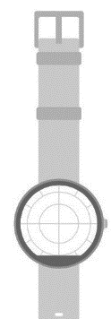
Sound + other info (loudness, pitch..)
Sound + other info (loudness, pitch..)
Server located at my office
Smartwatch
Notes:
The server then sent all this information (along with the previous loudness and pitch information from Prototype 1) back to the displays and the smartwatch.

Slide 79

Water pour, 100%
On the display…
Notes:
I’d like you to recall the display visualization from prototype 1. [slide] This is how the sound classification was shown on the displays with the type of sound, and the classification confidence.

Slide 80
Two Extensions To Prototype 1
Prototype 2
Sound classification engine for 19 common home sounds
Smartwatch to provide sound alerts using visual + vibration notifications.
Notes:
Now, let’s look at the smartwatch app [slide] Recall that we built a smartwatch app because participants in Study 1 wanted a way to alert about sounds, so that they don't have to keep looking at the display.

Slide 81
Prototype 2
Smartwatch App
We built a smartwatch app to alert the users to sounds using vibration + visual feedback.

Slide 82
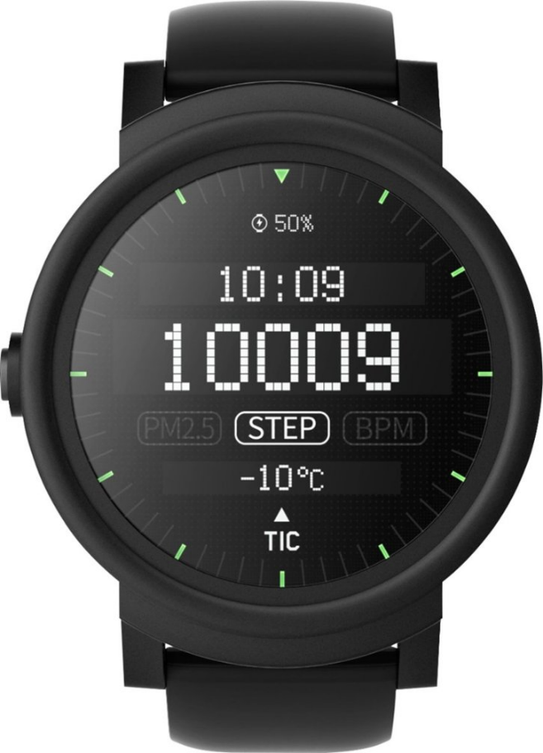
Prototype 2
Smartwatch App
11:44
Kitchen
Water pour, 100%
Notes:
So, we used an android app. Whenever the sound was recognized by the classifier, the smartwatch vibrated [slide] and showed [slide] the room level location, the type of sound and the classification confidence. [slide] Thus, the final system.

Slide 83
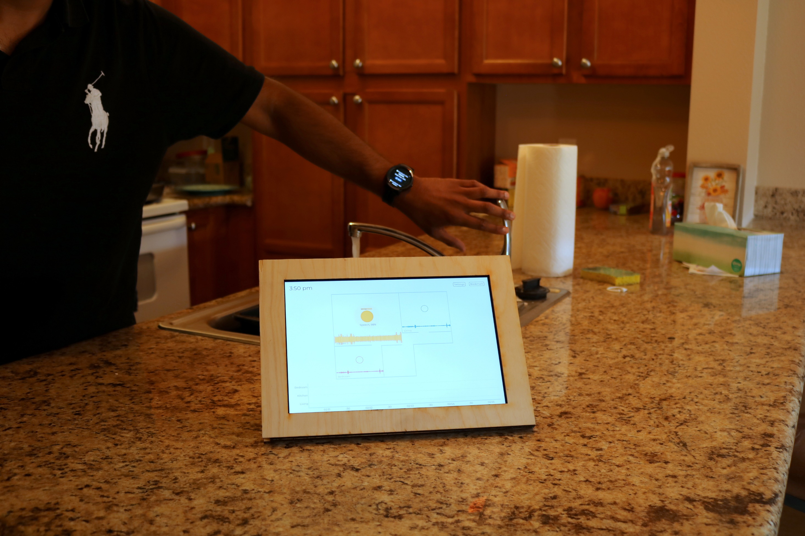
The final system contained 3-5 displays deployed in the home and the smartwatch worn by the DHH user.
Notes:
Thus, the final system contained 3-5 displays deployed in the home and the smartwatch worn by the DHH user.

Slide 84
Outline
Prototype 1
Conveyed simple but accurate sound feedback (e.g., loudness, pitch)
Study 1
Prototype 1 deployment
Prototype 2
Conveyed more complex sound features (e.g., sound identity)

Slide 85
Outline
Prototype 1
Conveyed simple but accurate sound feedback (e.g., loudness, pitch)
Study 1
Prototype 1 deployment
Prototype 2
Conveyed more complex sound features (e.g., sound identity)
Study 2
Prototype 2
deployment
Notes:
Alright, now Study 2, evaluation of this system.

Slide 86
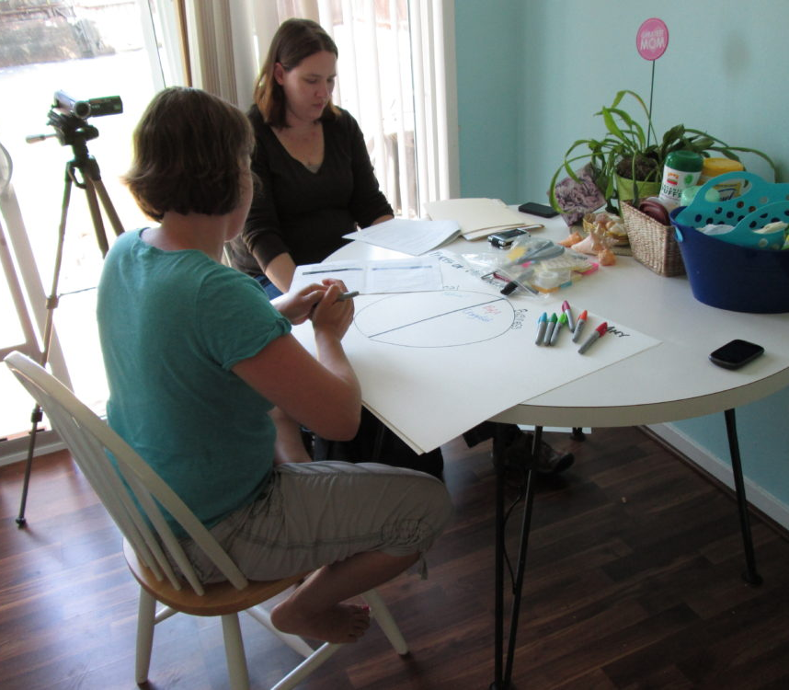
Study 2
Goal
To evaluate Prototype 2
Participants
4 Homes; 2 repeats from Study 1
6 DHH and 2 hearing individual
Method And Data Analysis
Similar procedure as Study 1
Two coders; IRR=0.78, raw agreement=91.7%
Disagreements were resolved through consensus
Notes:
The goal was to evaluate Prototype 2. [slide] We again recruited four homes. As this an iterative deployment, we did not exclude repeat participants; hence two homes were the same as study 1. [slide] These homes resided 6DHH and 2 hearing individuals. [slide] We followed a similar study procedure as Study 1. [slide] The transcripts were again analyzed by two coders, yielding IRR of 0.78 and raw agreement 91.7%. Again, disagreements were resolved through consensus. Let’s see what we found.

Slide 87
Overall, the system was more used than Study 1 due to the addition of smartwatch,
which decreased the visual reliance on the displays.
Further, as the system alerted about specific sounds in the home (e.g., someone knocking,
dog barking), participants were able to effectively perform some household tasks.
Study 2: Findings
Notes:
[read]

Slide 88
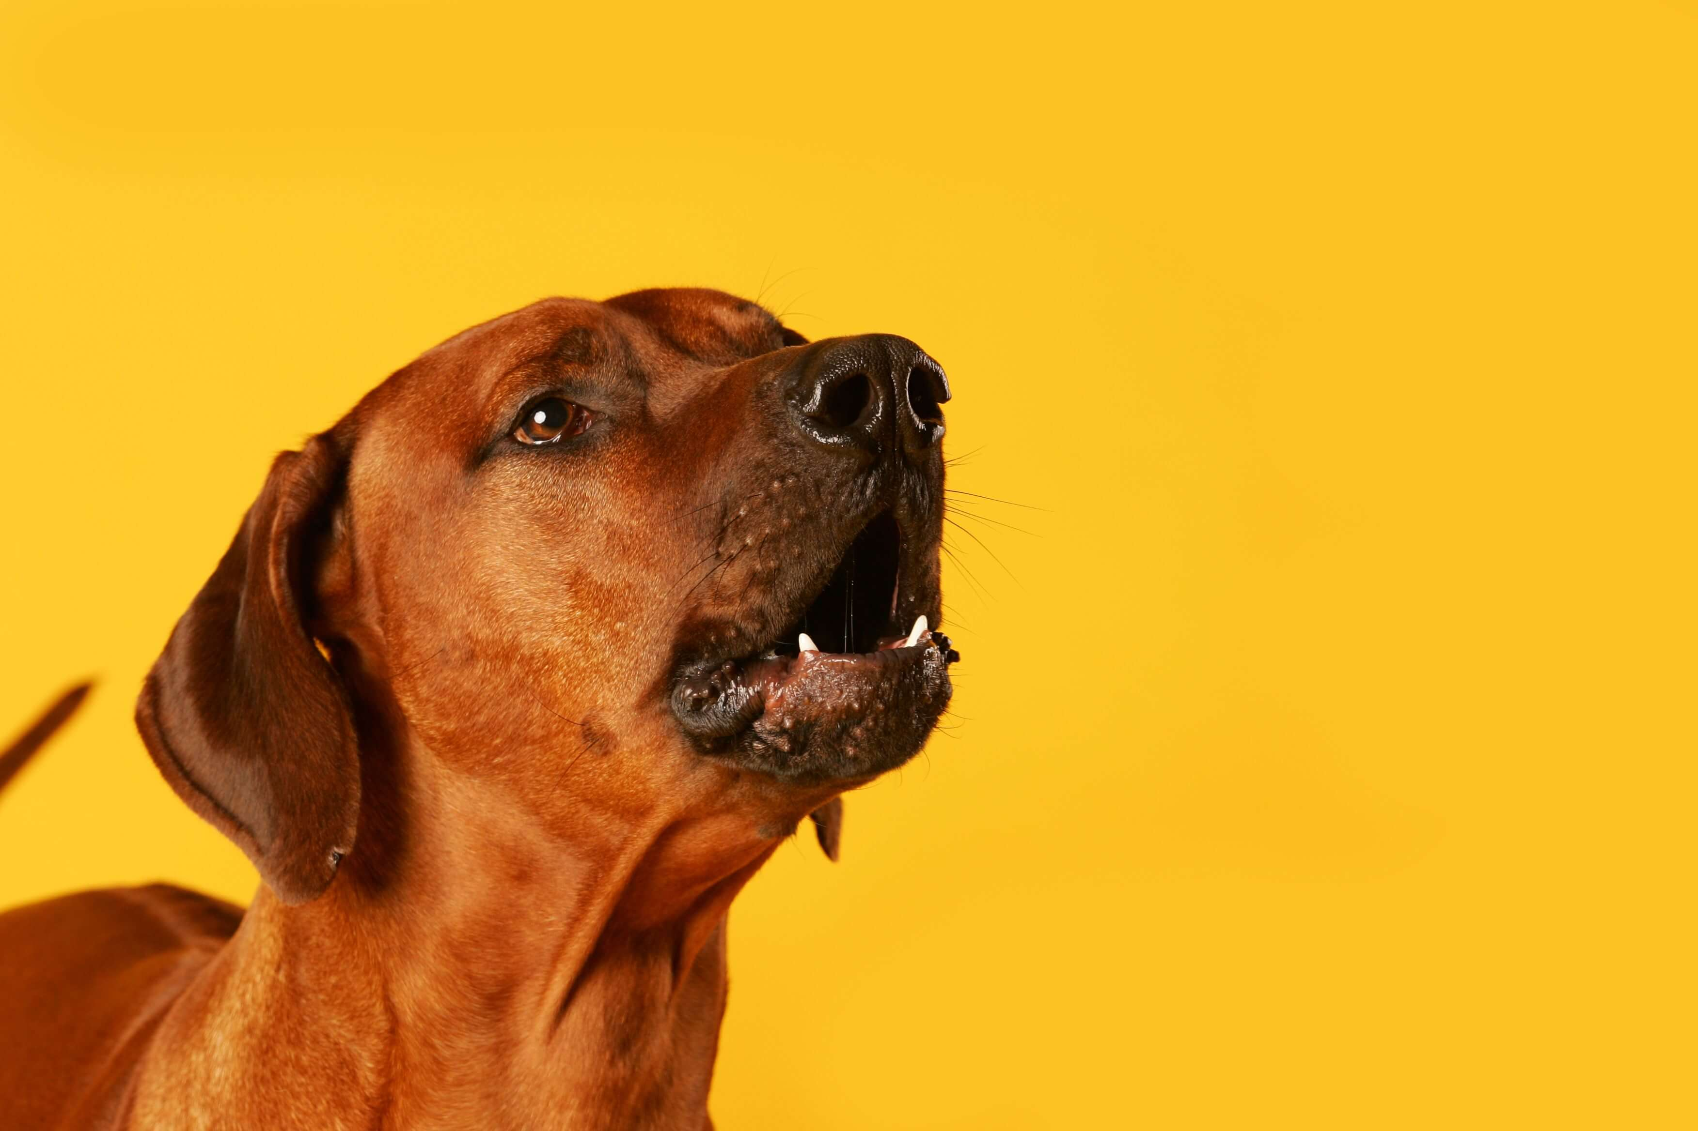
“
"I was […] working on my laptop, the watch showed my dog was barking [in another room]. I went and corrected my dog right away. This helps me train the dog over time [...] Also, the watch lets me know when the washer is done.”
”
- H2P2, week 2 survey
Notes:
[read]

Slide 89
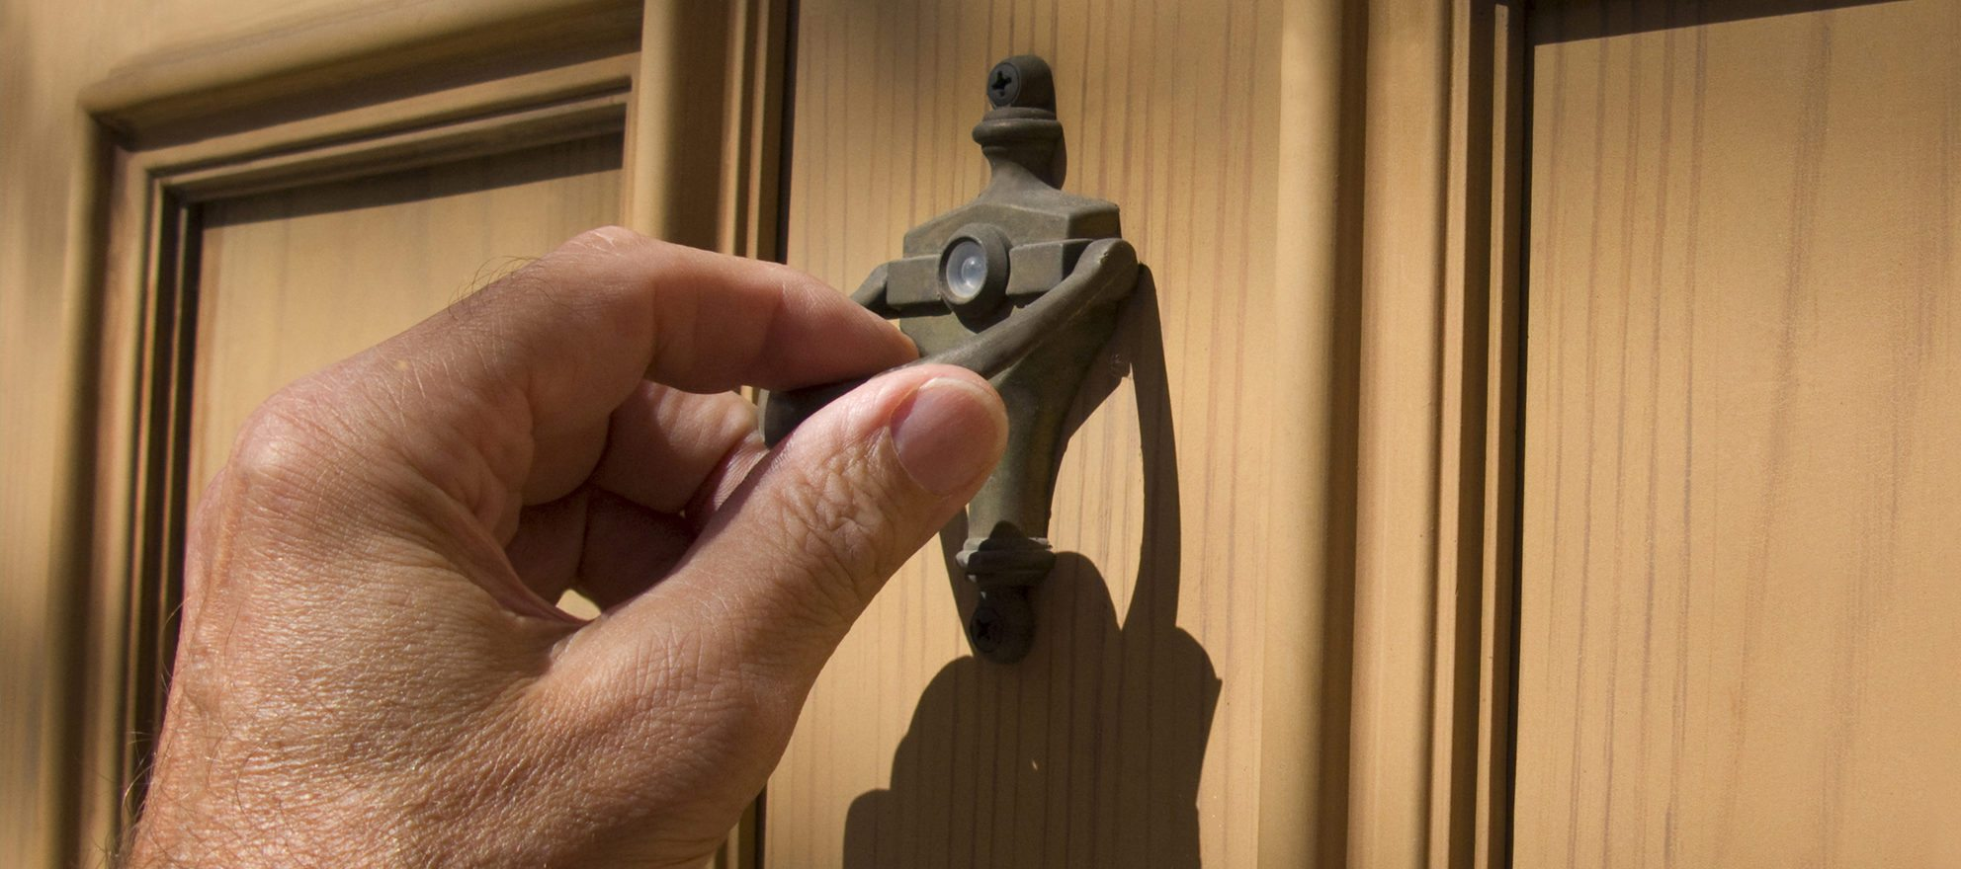
“
“The first day [when] the contractor would come over for the kitchen remodel,. I was sitting close to the door. But the watch vibrated and [displayed] “door knock” and I thought, oh [from] now [on,] I don’t have to sit and wait.”
”
- H6P1, post-trial interview
Notes:
[read]

Slide 90
Study 2: Findings
However, there were two system failures:
The watch vibrated constantly in presence of many sounds
Notes:
However, there were two system failures which affected the user experience. [Slide] The watch vibrated constantly in the presence of many sounds, which was highly distracting. For example, [slide]

Slide 91
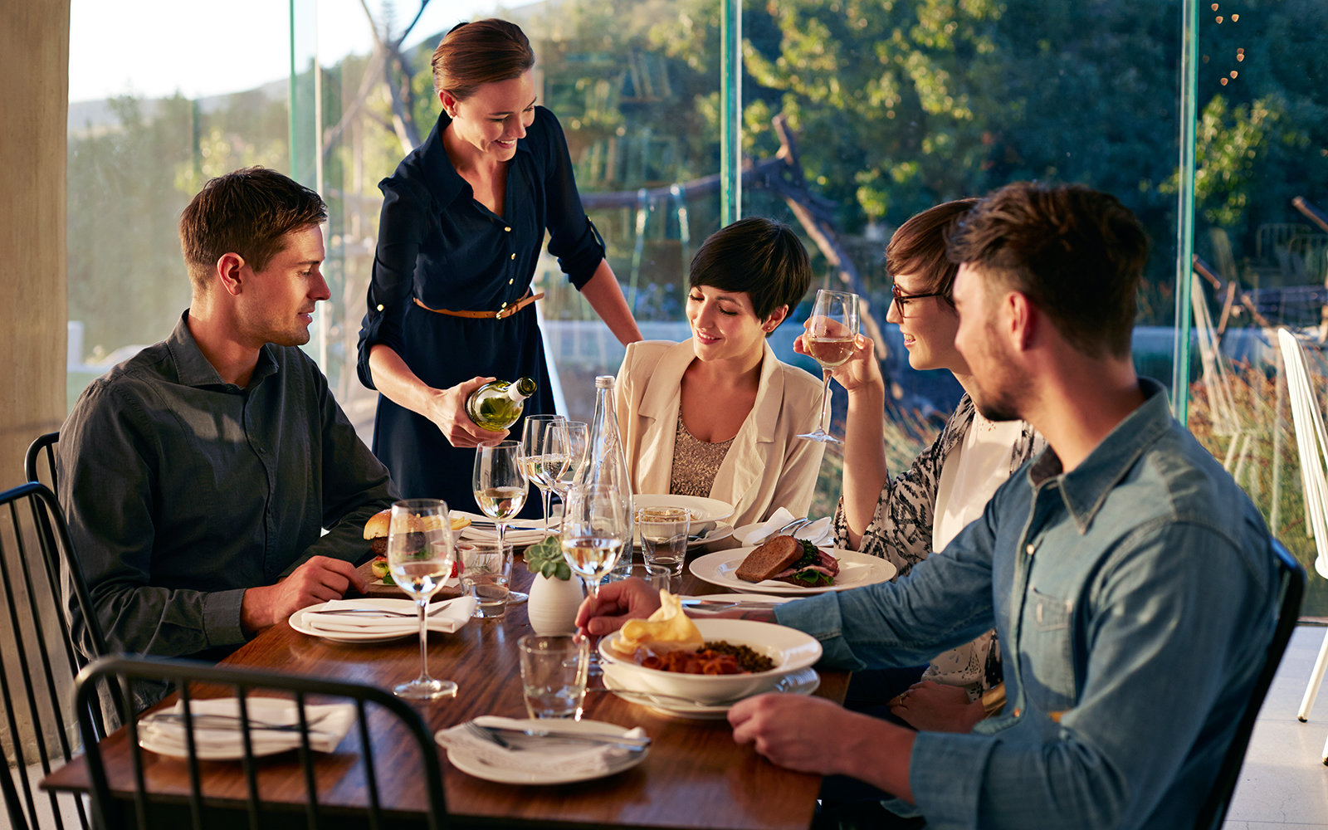
“
“I had company last Sunday. All of a sudden it began [vibrating] constantly. I couldn't take away my attention off because I didn't want to be rude to my company.”
”
- H1P1, post-trial interview

Slide 92
Study 2: Findings
However, there were two system failures:
The watch vibrated constantly in presence of many sounds
The sound misclassifications affected the routine
Notes:
And [when] when the sound was not classified correctly, it affected the daily routine of the participants. For example, [slide]

Slide 93
“A fan running in the kitchen kept identifying as microwave [....] and I had to go and check again and again.”
- H2P1, post-trial interview

Slide 94
Study 2: Findings
To mitigate these issues, participants gave suggestions such as:
Alerting about repeat sounds only after an interval on the watch
Increasing the system accuracy by allow them to record and train the system to custom sounds in their home.
These are future work.
Notes:
[read]

Slide 95
Other findings related to self-awareness, privacy, culture, display placement
and play provide guidance for future home sound awareness technology.
Study 2: Findings
Notes:
[end] I will not talk about these today but we can discuss if you'd like to.

Slide 96
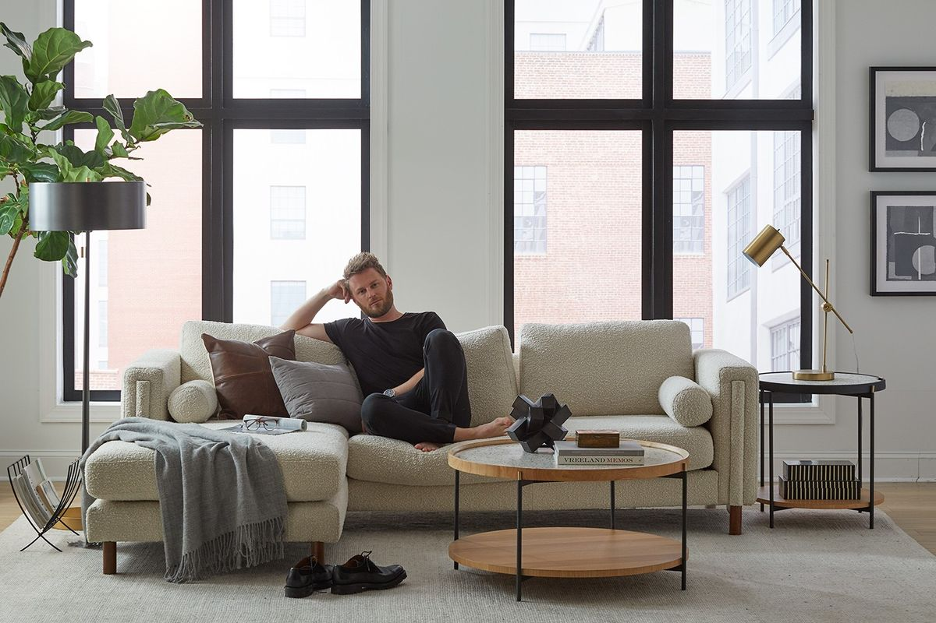
Reflection
Notes:
In reflection, I would say that [slide]

Slide 97
Though past work has identified DHH people's needs and preferences
for in-home sound feedback through formative studies,
we designed and conducted the field evaluation of the
first functional, real-time system.
Notes:
[read]

Slide 98
Our system, particularly prototype 2, was able to interweave into the domestic lives of DHH people, leading them to perform some household tasks effectively.
However, we also uncovered some issues…
Notes:
[end] which gives guidelines for the future..

Slide 99
Future Considerations
Handling misclassifications
Sound misclassifications were reported as an issue.
To mitigate, participants suggested using a customization approach, by allowing them to train the system for the sounds in their home.
However, this training may be tedious and difficult if the sound is inaccessible to DHH users. Future work should consider this.
Another possibility is to adapt the information based on classification confidence, e.g., when the confidence is low, show “a motor sound”, instead of a microwave, as in our design.
Notes:
I’d like to discuss three. First is, [slide] handling misclassifications. [slide] Recall that sound misclassification.s. [read]

Slide 100
Future Considerations
Handling information overload
Constant vibrations on the watch were annoying.
To control for overload, instead of showing every recognized sound on the watch, use context cues such as daily rhythm (e.g., night vs. day), user’s location and activity (e.g., not doing high-focused tasks) to select what to display.
Notes:
[read] constant vibrations..

Slide 101
Future Considerations
Handling activity tracking
While the home occupants accepted the system, guests showed concerns with the sound recording.
Future work should continue to be mindful of what sound information is being listened to, and where the displays are installed in the home
For example, consider carefully: should the displays be installed in a public area like a living room or not?
Notes:
Finally, while the home occupants.. [read]
[end] So, hopefully, some of these points will also help you perform your research. We’re almost at the end.
Before I conclude, I’d like to mention my team members…

Slide 102
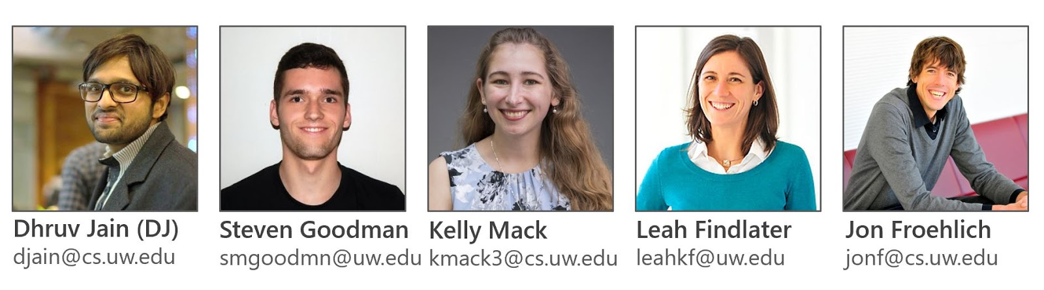
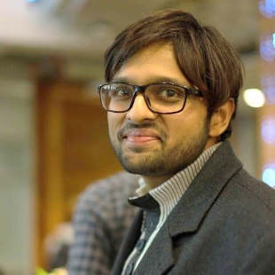
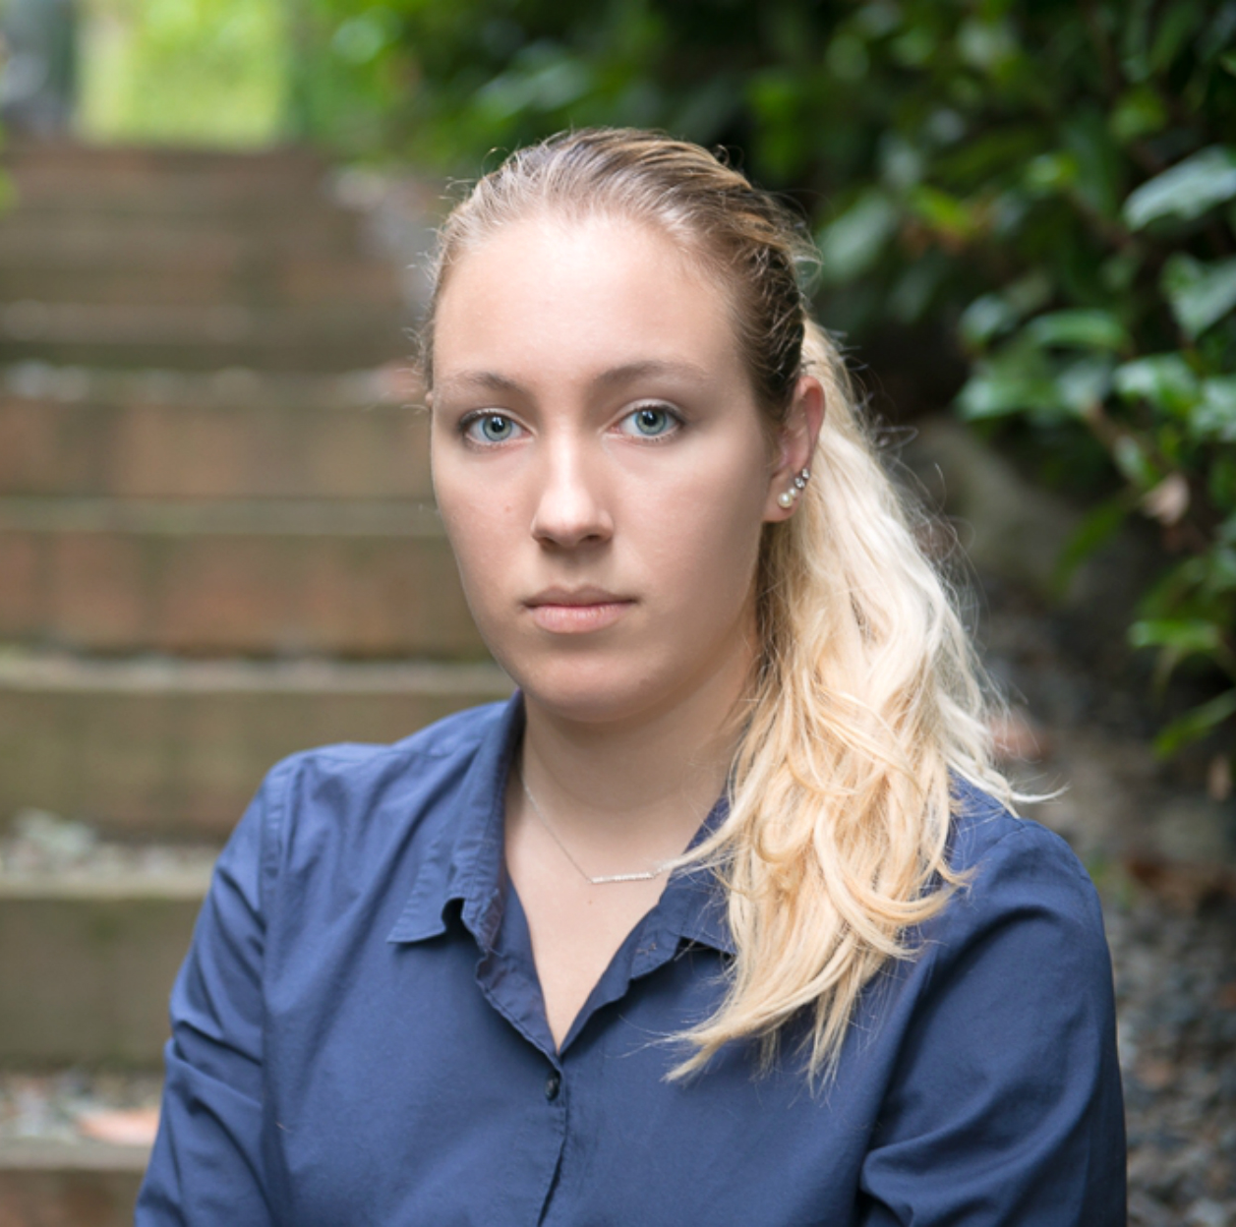
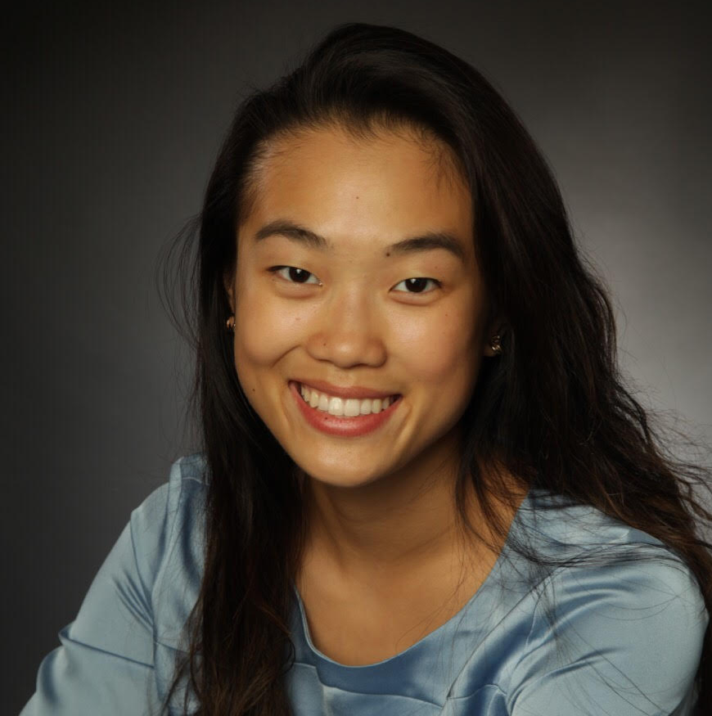
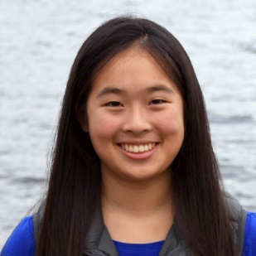
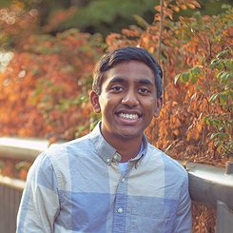
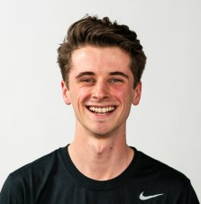
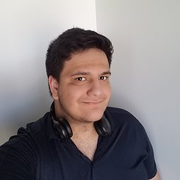
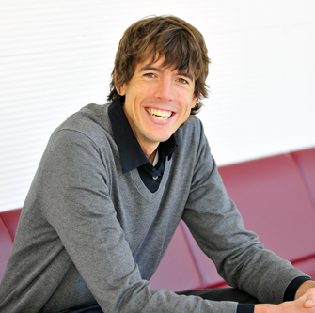
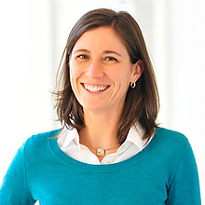
Exploring Sound Awareness in the Home for People who are Deaf or Hard of Hearing
The Team
Dhruv Jain (DJ)
djain@uw.edu
Kelly Mack
kmack3@uw.edu
Steven Goodman
smgoodmn@uw.edu
Rose Guttman
rguttman@uw.edu
Angela C. Lin
angelacareylin@gmail.com
Aileen Zeng
aileenz@uw.edu
Marcus A.
markamal@uw.edu
Matt Wright
matth3w@uw.edu
Akli Amrous
akliamrous2001@gmail.com
Jon Froehlich
jonf@uw.edu
Leah Findlater
leahkf@uw.edu
Notes:
Here they are. [read]

Slide 103




Exploring Sound Awareness in the Home for People who are Deaf or Hard of Hearing
Sponsors
UW
Reality Lab
Notes:
Thanks also to our sponsors, [read]
[end] To conclude, I’d like to say that…

Slide 104
Exploring Sound Awareness in the Home for People who are Deaf or Hard of Hearing
Acknowledgments
Sophie Tian, Liang He and Lisa Hutchinson
Richard Ladner, Jen Mankoff, and others
Venkatesh Potluri, Manaswi Saha, and others
My friends and family
Sponsors
UW
Reality Lab
Notes:
Beyond any successful work, There Are Always Additional Forces Involved.
Thanks also to people who have given me helpful advice over the years that helped me indirectly or directly perform this work.

Slide 105
Recent proliferation of screen-based smarthome devices offer a rich opportunity to design for DHH people, who have trouble interacting with voice-based devices.
Notes:
[read]

Slide 106
By identifying key benefits, challenges and concerns of an in-home sound awareness system, our work has implications for the design of such future “smarthome” displays.
Notes:
[read]

