Slide 1
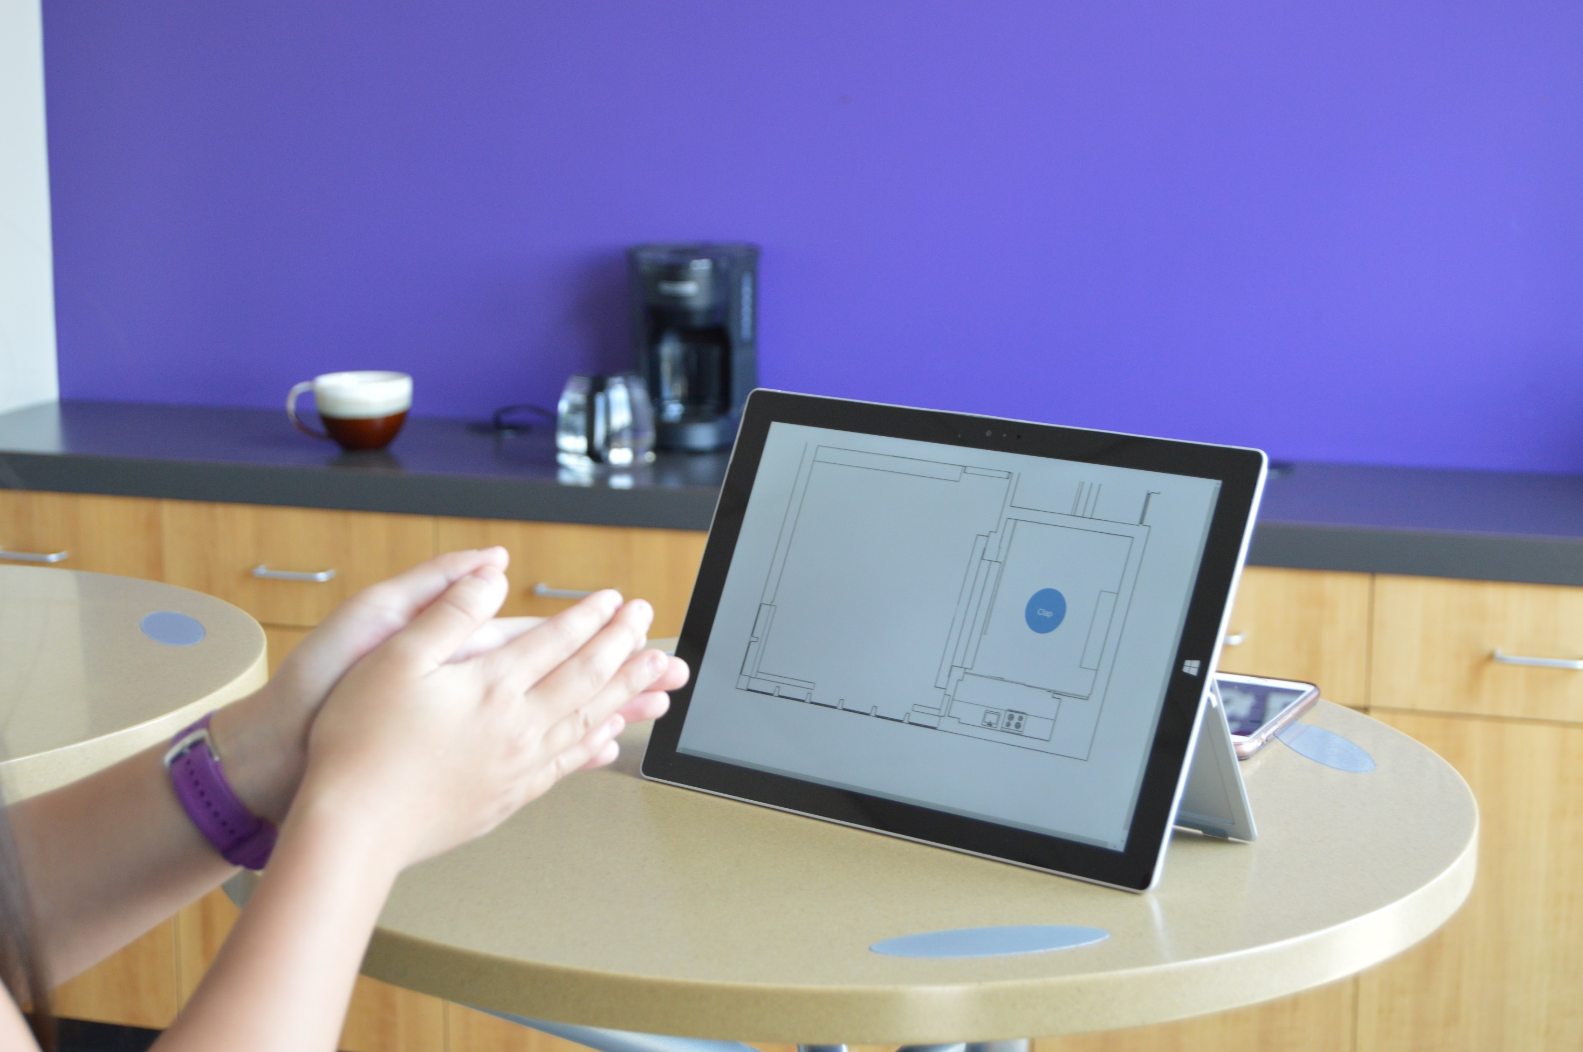


Exploring Sound Awareness in the Home
for People who are Deaf or Hard of Hearing
Dhruv Jain (DJ), Angela Lin, Rose Guttman, Marcus A., Aileen Zeng, Leah Findlater, Jon Froehlich
University of Washington, Seattle

Slide 2
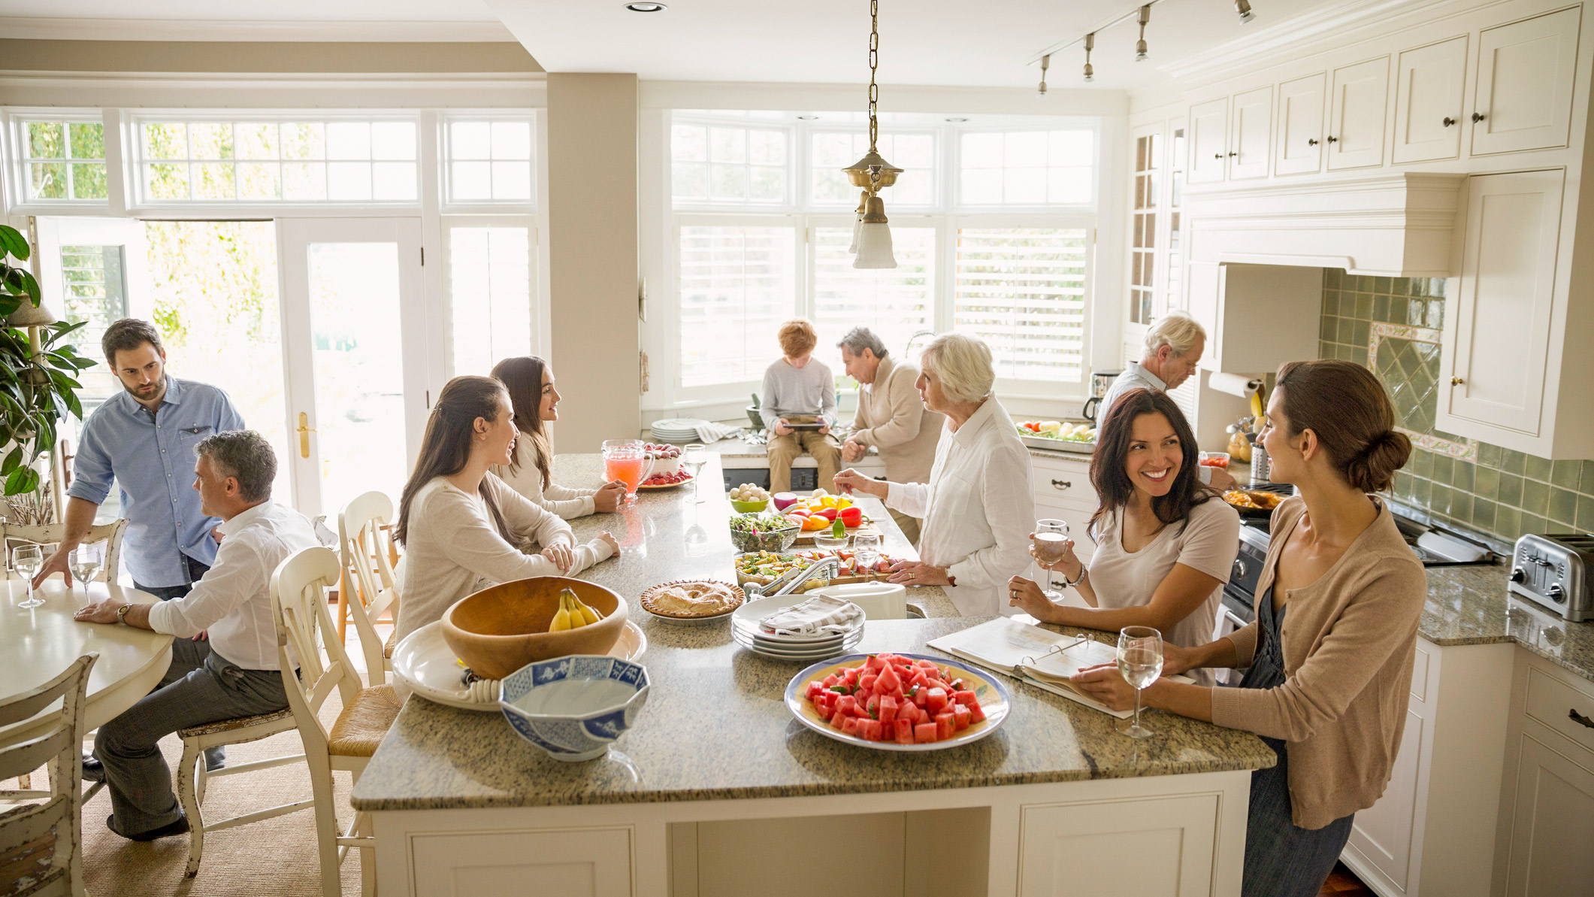
The home environment
is filled with a
rich diversity of sounds

Slide 3

Door opening
People talking
Knife chopping
Dog barking
These sounds inform us about the home and the occupants within it.
Dryer whirring

Slide 4
However, in many situations, sound is inaccessible to
people who are deaf or hard of hearing (DHH).
Keyboard typing
Knife chopping
People talking
Glass clinking

Slide 5
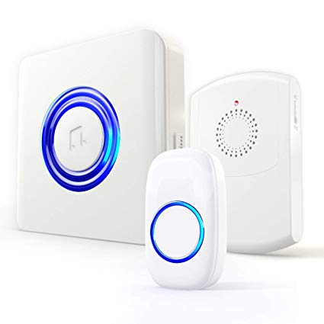
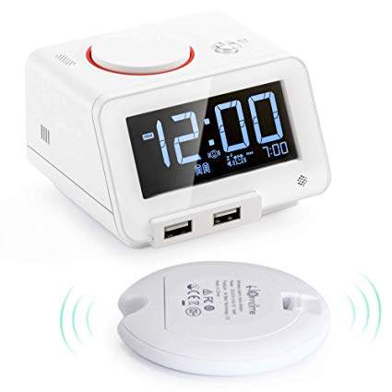
Fortunately, DHH people use visual or vibratory alternatives...
Flashing Doorbell
Vibratory Bed Alarm

Slide 6
While useful for their applications, these products do not
offer a general awareness about sounds in the home.
Fortunately, DHH people use visual or vibratory alternatives...
Flashing Doorbell
Vibratory Bed Alarm

Slide 7
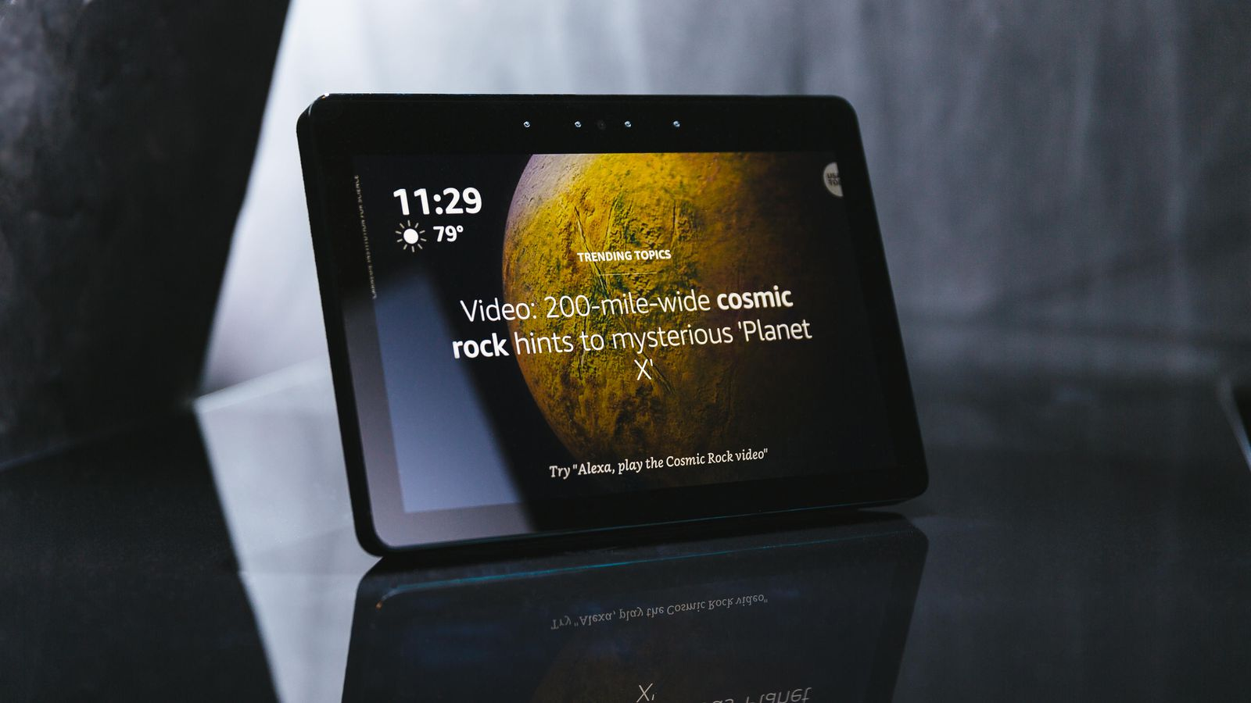
Recent proliferation of screen-based smarthome devices and advances in machine learning for sound offer a new opportunity to design for DHH people…
Notes:
[read].. But, because home is a constant evolving space, these opportunities also open up a range of questions, such as [slide]

Slide 8
Questions
  What information about sound do DHH people want in the homes?
  How do they want this information to be conveyed?
  How would a sound awareness system integrate into the homes of DHH people?
  What concerns may arise when using such a system in the home? (e.g., privacy)
Notes:
[read]

Slide 9
Aims
1
To investigate the sound awareness needs and preferences of DHH people in the home
To explore the design of in-home sound awareness system for the DHH people.
2
Notes:
To examine these questions, we [slide] investigate sound awareness needs and preferences in the home, and the [slide] design of in-home sound awareness system for the DHH people.

Slide 10
Prior work have examined sounds of interest for DHH people,
however only a few have specifically included questions about the home.
Notes:
Prior work have started to examine some of these questions, such as sounds of interests for DHH people, however only a few…

Slide 11
Matthews et al. and Bragg et al. investigated sound awareness needs
in three contexts: at home, at work and while mobile.
They also evaluated providing sound awareness feedback using a
desktop (Matthews) and a mobile phone (Bragg) display.
(Matthews et al., ASSETS 2007)
(Bragg et al., ASSETS 2016)
Notes:
[read x2, after finished… as shown here [slide]]

Slide 12
(Matthews et al., ASSETS 2007)
(Bragg et al., ASSETS 2016)
Notes:
[Pause and slide]

Slide 13
We conducted a more comprehensive and targeted
investigation of needs, concerns and solutions in the home.
We also introduced and evaluated initial sound
awareness prototypes specifically design for the home.
(Matthews et al., ASSETS 2007)
(Bragg et al., ASSETS 2016)
Notes:
We extend past wok by conducting a more comprehensive….
[slide] We also introduced… [read] as opposed to past work which has examined the office environment (cite) or mobile use (cite).

Slide 14
Our Paper
Study 1: A semi-structured interview with 12DHH participants to explore experiences with sounds in the home.
Study 2: A Wizard of Oz study with 10 DHH participants to explore our three sound awareness prototypes.
Notes:
Specifically, we performed two studies… [slide and read x2]
While I will provide a brief overview of Study 1, due to time constraints, [Slide] the focus of the talk is on the more novel Study 2.

Slide 15
Our Paper
Study 1: A semi-structured interview with 12DHH participants to explore experiences with sounds in the home.
Study 2: A Wizard of Oz study with 10 DHH participants to explore our three sound awareness prototypes.
Focus of
this talk
Notes:
Specifically, we performed two studies… [slide and read x2]
While I will provide a brief overview of Study 1, due to time constraints, [Slide] the focus of the talk is on the more novel Study 2.

Slide 16
Outline
A brief overview of Study 1
Study 2
Design of sound awareness prototypes
Wizard-of-Oz
evaluation
Findings
Notes:
So, to outline this talk, I will first provide a brief overview of Study 1 and then discuss Study 2.
Within Study 2, I will describe the design of three sound awareness prototype, the evaluation of these prototypes using a Wizard of Oz method and our findings from the evaluation.

Slide 17
Outline
A brief overview of Study 1
(Formative interview)
Study 2
Design of sound awareness prototypes
Wizard-of-Oz
evaluation
Findings
Notes:
So, let me just briefly talk what we found from out Study 1 formative interview to help motivate Study 2.

Slide 18
Questions
  What information about sound do DHH people want in the homes?
  How do they want this information to be conveyed?
  How would a sound awareness system integrate into the homes of DHH people?
  What concerns may arise when using such a system in the home? (e.g., privacy)
Notes:
There were four questions. Study 1 focuses on the first two [slide], that is, [read]

Slide 19
Questions
  What information about sound do DHH people want in the homes?
  How do they want this information to be conveyed?
Notes:
There were four questions. Study 1 focuses on the first two [slide], that is, [read]

Slide 20
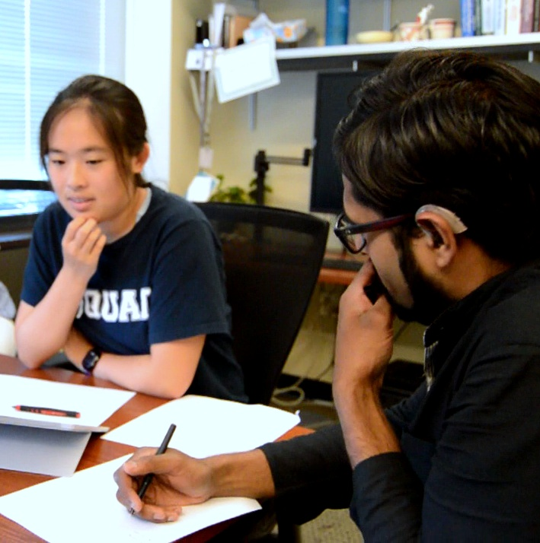
Study 1
Goal
To assess the needs and preferences of DHH individuals with respect to a sound awareness system in the home
Participants
12 DHH individuals
Study Method
Semi-structured formative interview
Design probe
Notes:
[Slide] Which means, the goal of study 1 was to assess…
[Slide] We recruited 12 DHH participants.
[Slide] The study contained two parts: a semi-structured formative interview to collect needs and preferences, and a design probe to assess our sound awareness designs.
Let me explain key findings. [slide]
[Can skip]

Slide 21
Study 1
Goal
To assess the needs of DHH individuals with respect to a sound awareness system in the home
Participants
12 DHH individuals
Study Method
Semi-structured formative interview
Design probe
Notes:
First, during semi-structured interview [slide] all participants…[read]
People were not happy with their current adaptations in the home which usually involved multiple devices. For example, P11 said [slide].
[Can skip].

Slide 22
All participants emphasized the need for a
sound awareness system in the home.
Study 1
Notes:
First, [slide] all 12 participants…[read]

Slide 23
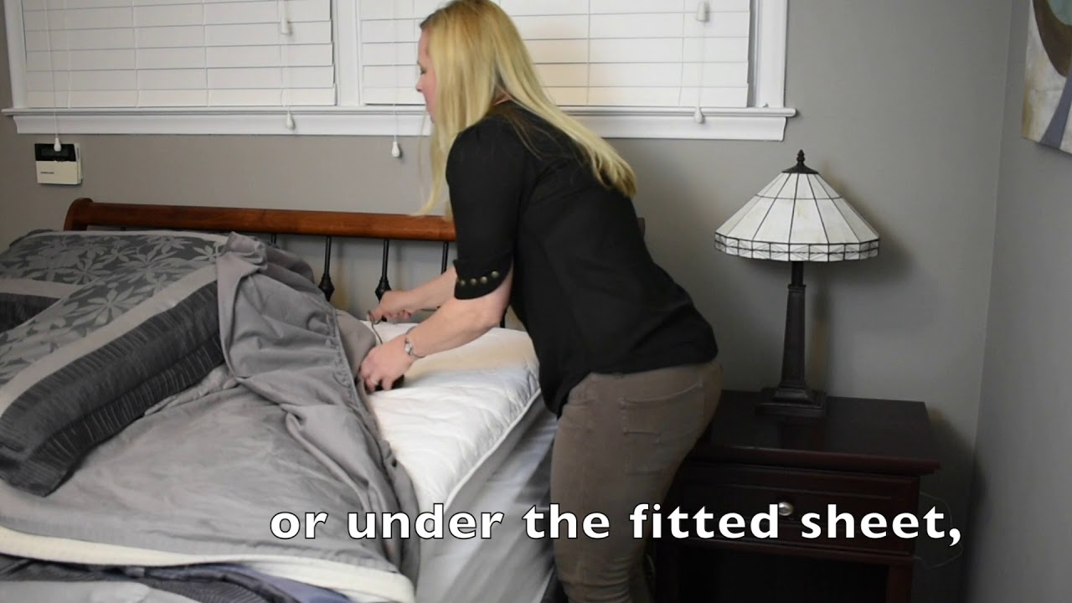
“
Study 1
“I have [a] flashing doorbell... But, one day I was sleeping and somebody came at night [and] rang the doorbell, and I couldn’t see the light. So, I had to get a bed shaker [for the doorbell…] How many devices should [I] keep?”
”
- P11
Notes:
[read] [omit]
[People were not happy with their current adaptations in the home which usually involved multiple devices. For example, P11 said [slide].]

Slide 24
Study 1
Goal
To assess the needs of DHH individuals with respect to a sound awareness system in the home
Participants
12 DHH individuals
Study Method
Semi-structured formative interview
Design probe
Notes:
Now, for design probe [slide] we examined a bunch of different mockups for different dimension with DHH participants. There is a lot of information here, so let me mention three key results [slide].

Slide 25
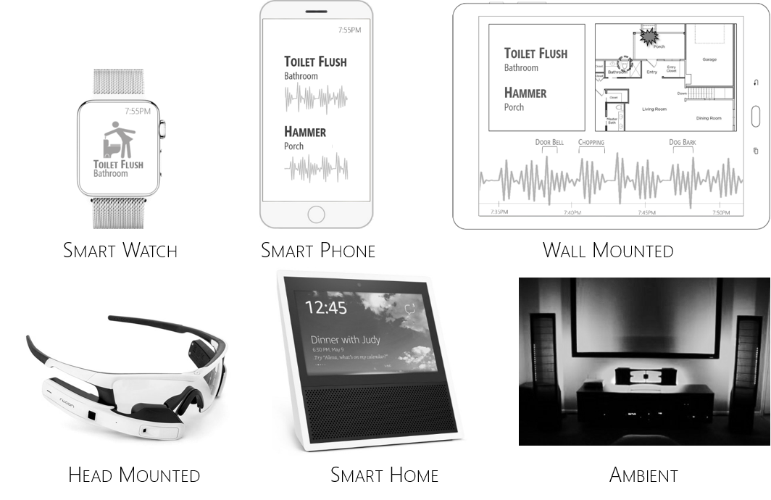
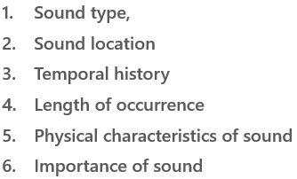
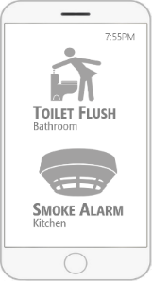
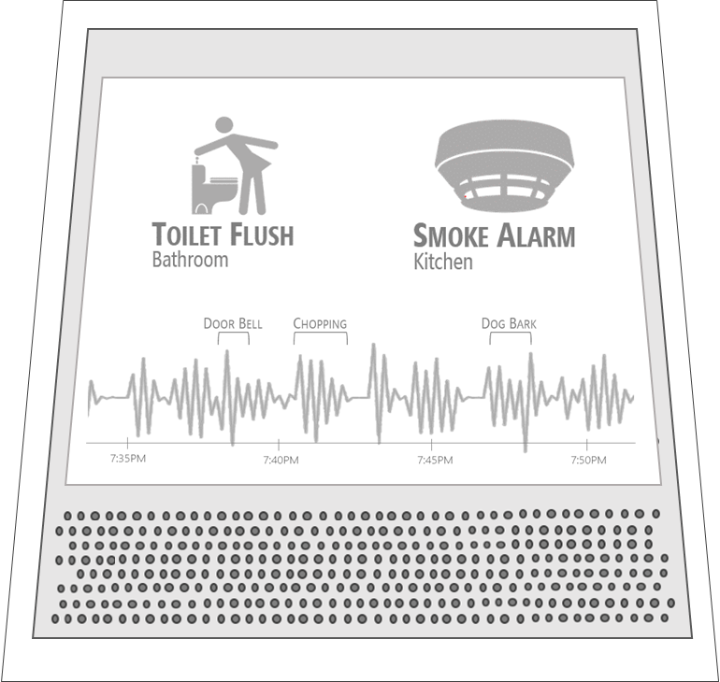
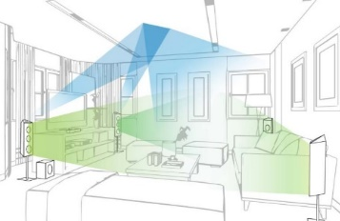
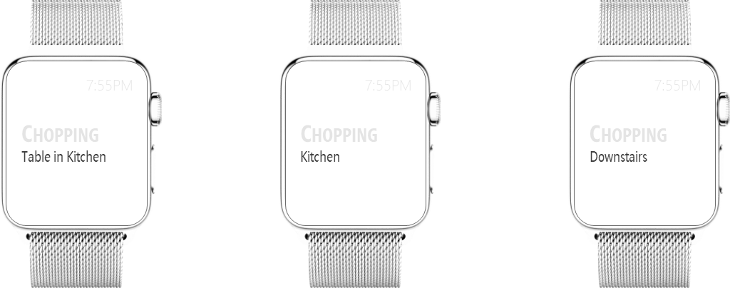
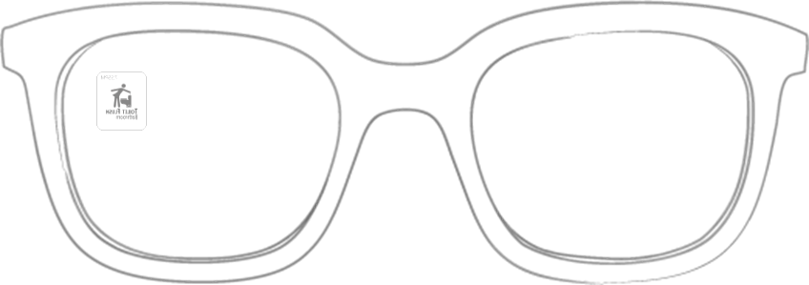
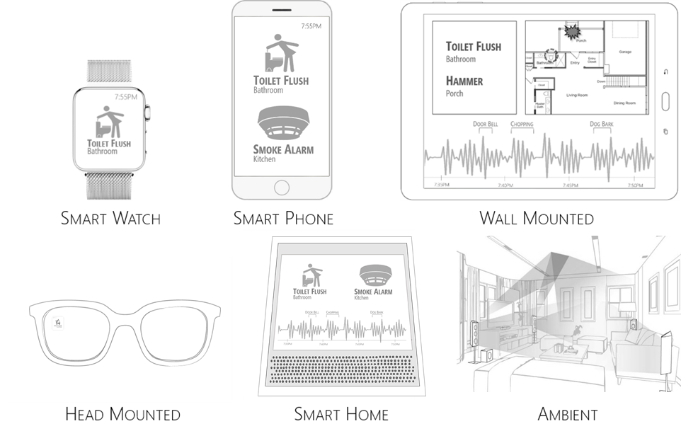
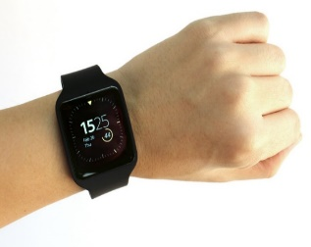
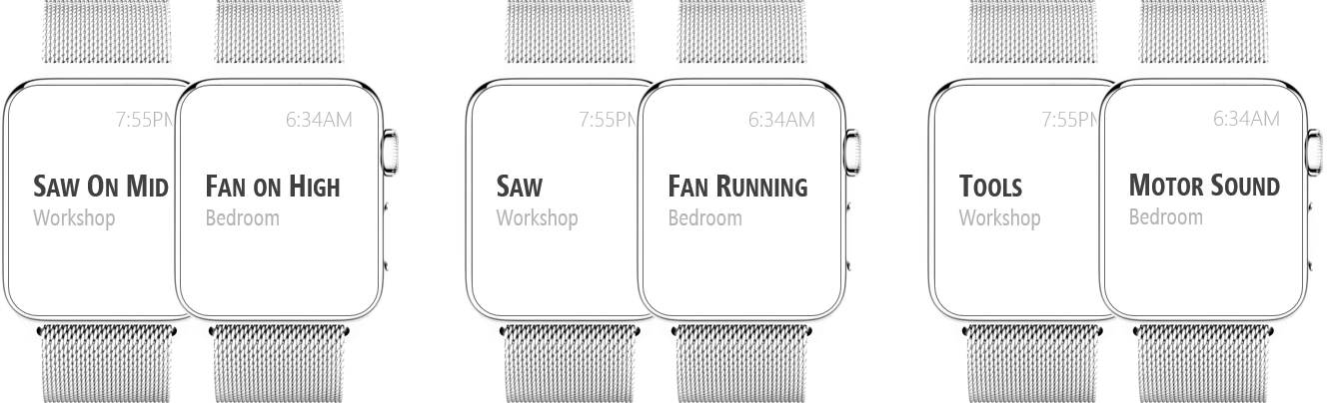

Design Space for In-Home Sound Awareness
Study 1
Form Factor
Display elements
Tablet
Sound location specificity
Output Modality
Very specific
Moderate Specific
General
Sound type specificity
Visual
Vibration
Very specific
Moderate Specific
General
Notes:
To explore preferences for in-home sound awareness, we also examined a design space with multiple dimensions. There is a lot of information here, so let me mention three key results for today’s talk [slide].

Slide 26
Design Space for In-Home Sound Awareness
Study 1
Form Factor
Display elements
Tablet
Sound location specificity
Very specific
Moderate Specific
General
Notes:
For form factor dimension that is what device to show the sound information on, participants wanted ….
For sound location specificity, that is how specific the location should be, participants wanted at least the …
Finally, for what elements about sound to display, participants wanted the system to display at least the specific sound identity such as a door knock, and the location.
Of course, what I discussed here is very brief, so please do refer to paper for more details. I will instead now jump to Study 2 [slide] which is more substantial. [slide]

Slide 27
Outline
A brief overview of Study 1
Study 2
Design of sound awareness prototypes
Wizard-of-Oz
evaluation
Findings
Notes:
For form factor dimension that is what device to show the sound information on, participants wanted ….
For sound location specificity, that is how specific the location should be, participants wanted at least the …
Finally, for what elements about sound to display, participants wanted the system to display at least the specific sound identity such as a door knock, and the location.
Of course, what I discussed here is very brief so, please do refer to paper for more details. I will instead now jump to Study 2 [slide] which is more substantial. [slide]

Slide 28
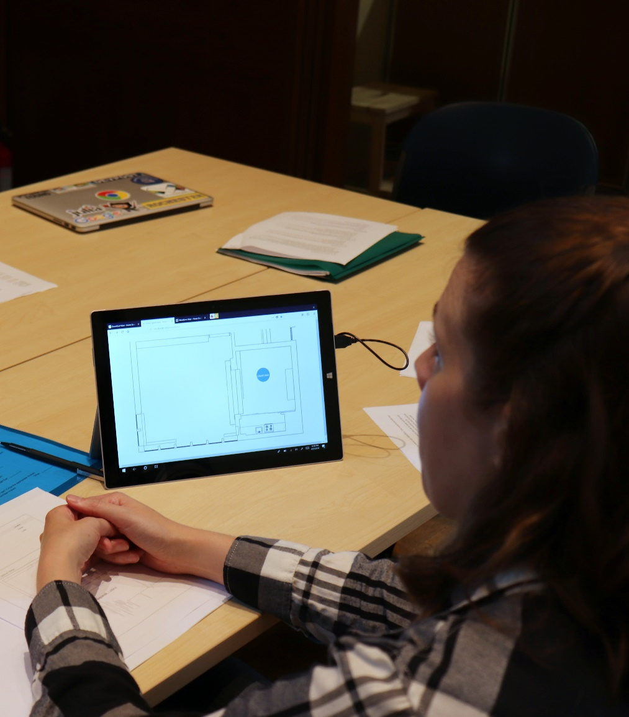
Study 2
Goal
To gain further insight into in-home sound awareness, particularly to investigate themes that are central to the home (e.g., privacy, issues with activity tracking)
Participants
10 DHH individuals
Recruited through email and snowball sampling
Study Method
Built three sound-awareness prototypes
Evaluated the prototypes using a scenario-based Wizard-of-Oz study
Notes:
[Slide] [The goal of study was to gain... that are difficult to explore through static design probes and interviews in Study 1.
[Slide] We recruited 10 participants [slide] and built three sound awareness prototypes to perform a Wizard of Oz study. [pause and slide].

Slide 29
Outline
A brief overview of Study 1
Study 2
Design of sound awareness prototypes
Wizard-of-Oz
evaluation
Findings
Notes:
Let’s discuss our prototypes.

Slide 30
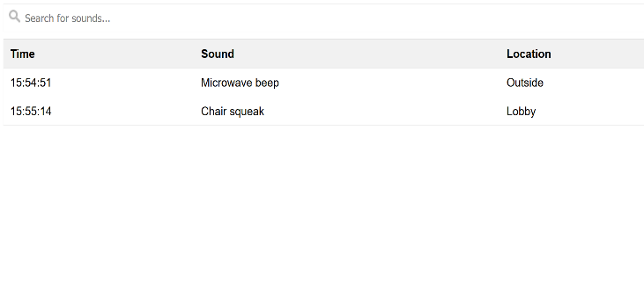
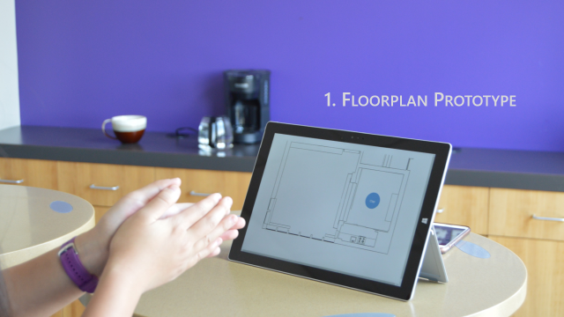
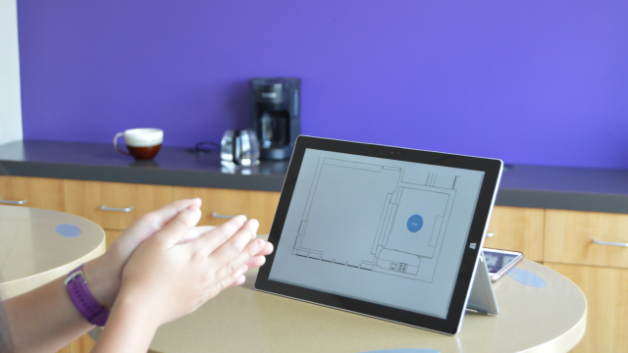
Study 2: Sound Awareness Prototypes
Three Initial Prototypes
Floorplan
List
Waveform
Notes:
We explored three initial prototypes. They were called [click] floorplan, list and waveform. These prototypes were displayed on a tablet such as shown here [Slide] and were controlled from a wizard using this Wizard interface [click]

Slide 31
Notes:
We explored three initial prototypes. They were called [click] floorplan, list and waveform. These prototypes were displayed on a tablet such as shown here [Slide] and were controlled from a wizard using this Wizard interface [click]

Slide 32
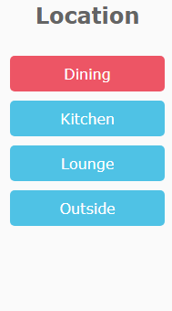
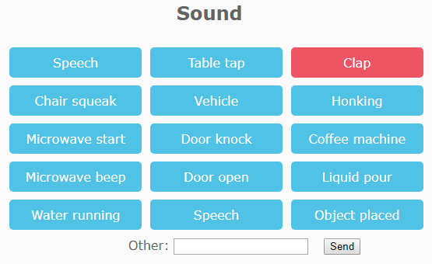
Study 2: Sound Awareness Prototypes
Wizard’s Interface
Notes:
[pause and slide]

Slide 33
Study 2: Sound Awareness Prototypes
Three Initial Prototypes
Floorplan
List
Waveform
Notes:
I will demonstrate these three prototypes using [click] a live demo [show demo]. You might wonder why am I showing you these three prototypes? What is the need? To explain that lets recall our research questions.

Slide 34
Live Demo
Study 2: Sound Awareness Prototypes
Three Initial Prototypes
Floorplan
List
Waveform
Notes:
I will demonstrate these three prototypes using [click] a live demo [show demo]. You might wonder why am I showing you these three prototypes? What is the need? To explain that lets recall our research questions.

Slide 35
  What information about sound do DHH people want in the homes?
  How do they want this information to be conveyed?
  How would a sound awareness system integrate into the homes of DHH people?
  What concerns may arise when using such a system in the home? (e.g., privacy)
Questions
Notes:
Remember that we had 4 questions? Here we are focusing on the last two. That is,
[slide] How would such a system integrate into the homes of DHH people?
[slide] And because home is a constant evolving space shared with many people, what concerns may arise when using such a system in the home?
To explore these two questions, we needed the prototypes to perform an actual live evaluation [emphasis], which I will now discuss.

Slide 36
  How would a sound awareness system integrate into the homes of DHH people?
  What concerns may arise when using such a system in the home? (e.g., privacy)
Questions
Notes:
Remember that we had 4 questions? Here we are focusing on the last two. That is,
[slide] How would such a system integrate into the homes of DHH people?
[slide] And because home is a constant evolving space shared with many people, what concerns may arise when using such a system in the home?
To explore these two questions, we needed the prototypes to perform an actual live evaluation [emphasis], which I will now discuss.

Slide 37
Outline
A brief overview of Study 1
Study 2
Design of sound awareness prototypes
Wizard-of-Oz
evaluation
Findings
Notes:
We used a Wizard of Oz evaluation since the sound recognition technology needed for the prototypes is not here yet. We wanted to explore how the DHH people will feel about a future system.

Slide 38
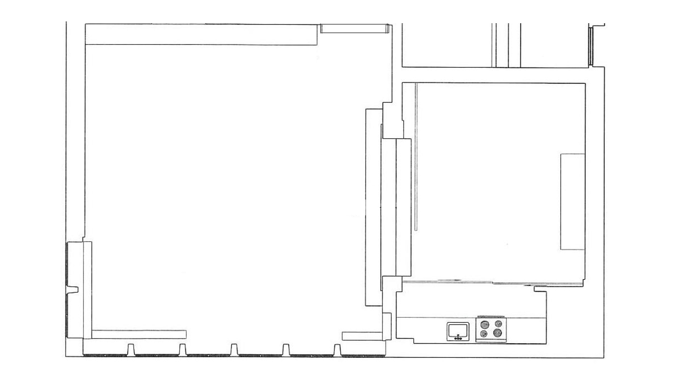
Wizard Of Oz Evaluation
(conducted in a studio on campus that looked like a home)
Lounge
Dining
Kitchen
Notes:
[Slide] The study sessions were held in a studio on campus that looked like a home. [Slide] See here with Kitchen, Dining area and Lounge as I shown you before (this is a rotated view). [Slide]

Slide 39
Wizard Of Oz Evaluation
1. Introduced prototypes
Using short demos of some example sounds (e.g., coffee pouring, door knock)
2. Scenarios-based evaluation
Three scenarios to explore themes central to the home.
Each scenario was in-acted by an actor who made sounds. The wizard then listened to those sounds and clicked on the interface to transmit the sound information to the participant’s screen.
Notes:
Now, let me go through the study procedure [Slide].
We first introduced these three prototypes using short demo of some common sounds in the home as I showed you before. [Slide]
Then we conducted a scenario-based evaluation, where presented three scenarios to explore themes central to usage in the home. [Slide] Each scenario was in-acted by an actor who made sounds. The wizard then listened to those sounds and clicked on the interface to transmit the sound information to the participant’s screen. Let me show you how. [slide]

Slide 40
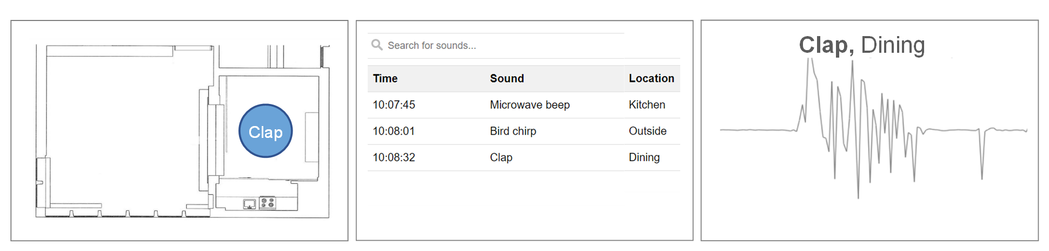
Actor
Wizard
Captioner
Participant
Interpreter
Interviewer
Notes:
[Start from here.] Here we see the participants sitting with the interviewer and the accommodation service providers in the dining area. [Slide]
Assume that the actor is making some sounds in the dining area. [Slide]. The wizard hears those sounds, sees that the actor is in the dining area, and enters this information on the wizard interface. [Slide]
The participant’s tablet then shows the three prototypes with the specific sound and its location entered by the Wizard. [Slide]
Let me show you this view here from the participant’s side. [pause and slide]

Slide 41
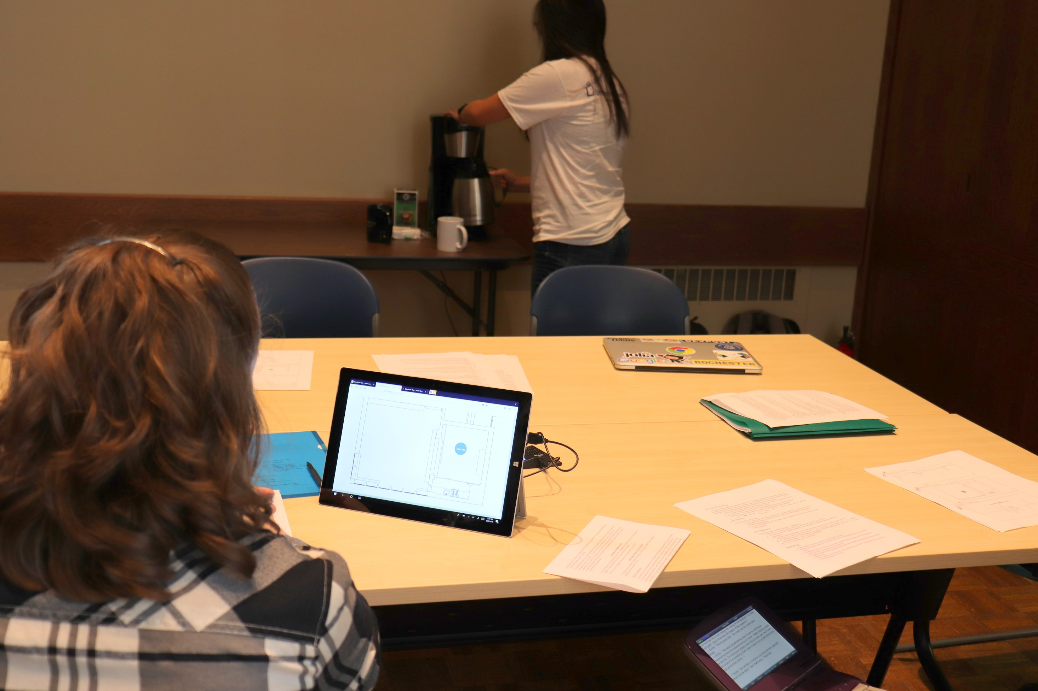
Study 2: Wizard Of Oz Evaluation
Participant
Actor
Coffee Pour
Notes:
[Pause]. Here’s the participant sitting [slide]. The actor [slide] is pouring coffee, which appears on the tablet on the floorplan prototype [slide and pause].

Slide 42
  How would a sound awareness system integrate into the homes of DHH people?
  What concerns may arise when using such a system in the home? (e.g., privacy)
Questions
Notes:
Remember we had a question about [slide] important concerns that may arise when using the system in the home? [slide]

Slide 43
  What concerns may arise when using such a system in the home? (e.g., privacy)
Questions
Notes:
Remember we had a question about [slide] important concerns that may arise when using the system in the home? [slide]

Slide 44

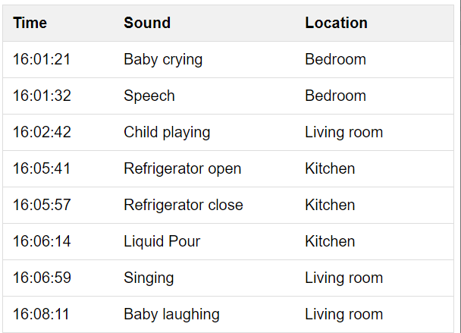
Wizard Of Oz Evaluation
1. Introduced prototypes
Using short demos of some example sounds (e.g., coffee pouring, door knock)
2. Scenarios-based evaluation
Three scenarios to explore themes central to the home.
A. Bathroom
Privacy
B. Babysitter
Activity Tracking
Speech, Dining
C. Movie
Information Overload
Notes:
To explore those concerns, the actor acted three scenarios. These are [slide]
the bathroom scenario to explore the theme of [slide] privacy, which included the actor going to the bathroom and system shows [Slide] toilet flush, water dripping etc. [Slide]
The second is babysitter scenario designed to explore activity tracking – You know leaving baby at home with a babysitter and the system shows [slide] baby crying, toys rattling etc. in a list.
And finally, [slide] the movie scenario which included the actor doing a lot of things -- watching TV, talking on a phone and the system showing lots of sounds.

Slide 45
Wizard Of Oz Evaluation
1. Introduced prototypes
Using short demos of some example sounds (e.g., microwave beep, door knock)
2. Scenarios-based evaluation
Three scenarios to explore themes central to the home.
3. Interview on the experience
A. Bathroom
Privacy
B. Babysitter
Activity Tracking
Speech, Dining
C. Movie
Information Overload
Notes:
We then conducted an interview on the participant's reactions to each scenario. [slide]

Slide 46
Outline
A brief overview of Study 1
Study 2
Design of sound awareness prototypes
Wizard-of-Oz
evaluation
Findings

Slide 47
Study 2: Findings
Prototype Preference
Most preferred
Least preferred
Notes:
In terms of prototype preference, [slide] floorplan was the most preferred because of its intuitive ability to show location, followed by list because it shows history. Waveform was not preferred at all.

Slide 48
Study 2: Findings
Prototype Preference
Notes:
In terms of prototype preference, [slide] floorplan was the most preferred because of its intuitive ability to show location, followed by list because it shows history.
Although waveform was not preferred as a standalone design, participants wanted to incorporate it in the other two prototypes. For example, let’s consider the list view. [slide] Participants wanted to incorporate the waveform as another column, as drawn by one participant here [slide]. [Pause and slide].

Slide 49
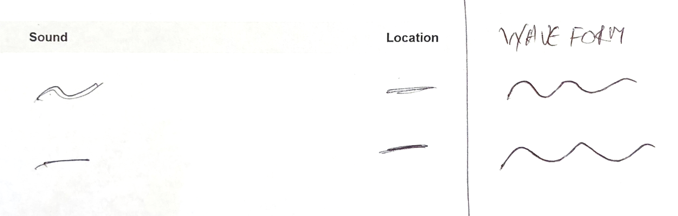
of Oz Evaluation
Study 2: Findings
Prototype Preference
of Oz Evaluation
Integrate waveform in the list prototype as a column
Notes:
In terms of prototype preference, [slide] floorplan was the most preferred because of its intuitive ability to show location, followed by list because it shows history.
Although waveform was not preferred as a standalone design, participants wanted to incorporate it in the other two prototypes. For example, let’s consider the list view. [slide] Participants wanted to incorporate the waveform as another column, as drawn by one participant here [slide]. [Pause and slide].

Slide 50
Themes Related To Home Usage
Study 2: Findings
1
Privacy
Contextualized Feedback
Trust and Confidence
2
3
Notes:
For the themes central to the home, I will discuss 3. [slide and read]

Slide 51
Themes Central To Home Usage
Study 2: Findings
1
Actionability
Privacy
Information Overload
Contextualized Feedback
Trust and Confidence
2
3
4
5
Notes:
For the themes central to the home, I will discuss 5.

Slide 52
Study 2: Findings
1
Actionability
All participants emphasized that a sound awareness system could help them perform the desired task, and gave suggestions for increasing actionability.
For example, the following quote shows a participant emphasizing how showing the tone of important sounds (such as her daughter’s voice) could help her discern the situation:
Notes:
First, actionability. [Slide and read] x2.

Slide 53
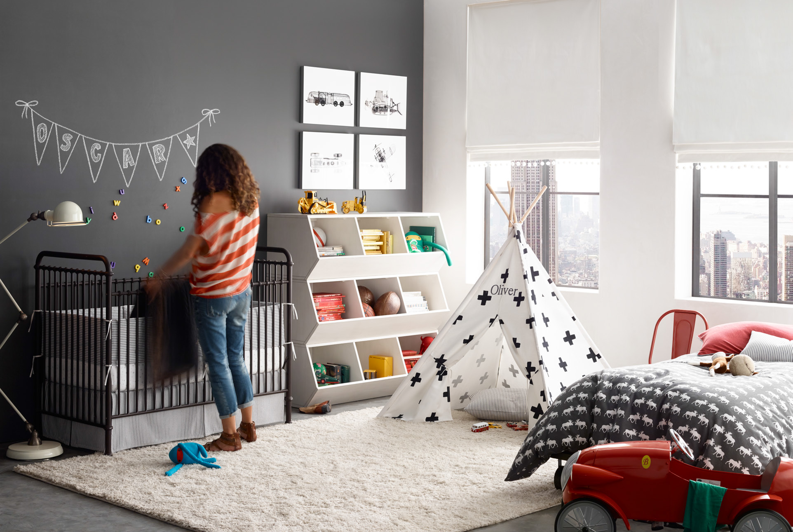
`
Study 2: Findings
“
“If my 9-year old daughter is sitting down in her room and talking normally, I am not concerned. If she's sobbing because she's in pain, then I need to know that.”
”
- R4
Notes:
[read..].

Slide 54
Study 2: Findings
Intimate sounds
1
Privacy
Activity tracking
Notes:
[slide] For privacy, [slide] two issues arose [slide] related to showing of [slide] intimate sounds and [slide] activity tracking.

Slide 55
Study 2: Findings
Intimate sounds
System could show intimate sounds (e.g., toilet flushing)
1
Privacy
Activity tracking
Notes:
[read]

Slide 56
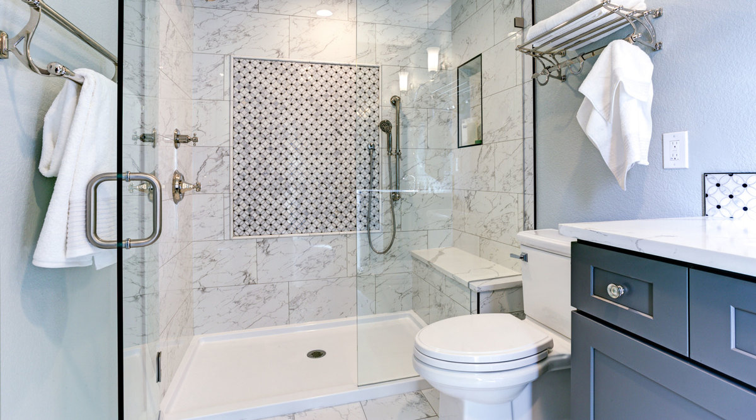
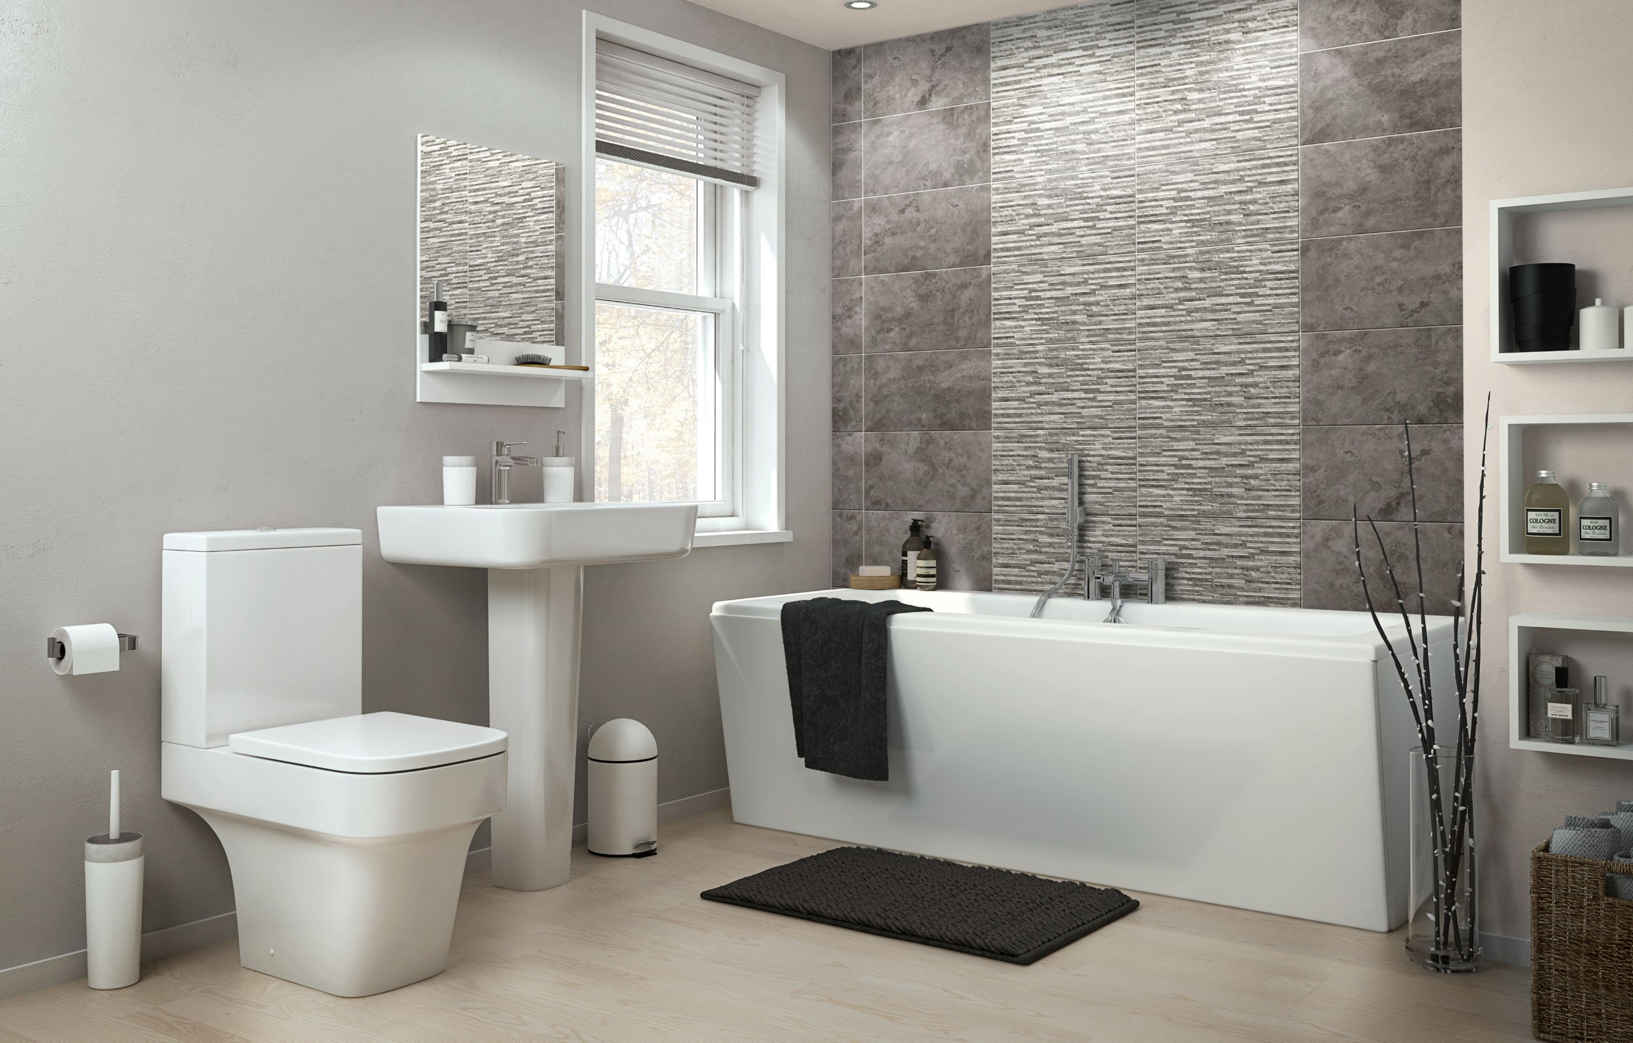
`
Study 2: Findings
“
”
“I don’t want to know if someone is using toilet or whatever they are doing in the bathroom… It's their privacy, you know?”
- R8
Notes:
[read]

Slide 57
Study 2: Findings
Intimate sounds
1
Privacy
Activity tracking
Notes:
For activity tracking, [slide]

Slide 58
Study 2: Findings
Intimate sounds
1
Privacy
Activity tracking
System may provide insight into other household members' activities
Notes:
[read]

Slide 59


Study 2: Findings
“People [would] avoid coming to my house because they’re been monitored each and every moment…”
- R10
Notes:
[read]

Slide 60
Themes Related To Home Usage
Study 2: Findings
1
Privacy
Contextualized Feedback
System should customize what is shown based on participant’s activities or daily rhythm.
2
Notes:
[read]

Slide 61
Study 2: Findings
“Restrict to important sounds only when there’s a large guest party, [because] I don’t want to be distracted at that time”
- R4
“For night time you might want to [show] crying if the kids are in the other room. You wouldn't worry about siren outside or street noise or the air conditioning running. Those are daytime things.”
- R5
Notes:
[readx2]

Slide 62
Themes Related To Home Usage
Study 2: Findings
1
Privacy
Contextualized Feedback
Trust and Confidence
2
3
Notes:
Now, trust and confidence.

Slide 63
Themes Related To Home Usage
Study 2: Findings
1
Privacy
Contextualized Feedback
Trust and Confidence
2
3
Because sound classification algorithms are probabilistic, we also asked participants
about possible ways to handle uncertainty in sound detection.
Notes:
[read]

Slide 64
Themes Related To Home Usage
Study 2: Findings
1
Privacy
Contextualized Feedback
Trust and Confidence
All participants said they would use the system even if it just shows the
sound’s location but not its identity (e.g., bathroom but not toilet flush).
Most participants also felt that other uncertain information can be useful as well such as a general category (e.g., “an alarm-like sound”, R8) or a list of possible sounds (e.g., “this sound could be a clock alarm or a microwave beep”, R4).
2
3
Notes:
We found that [slide]
[read.. because then they can go and check] [Slide]
[read.. if the actual sound is not known] [Slide]

Slide 65
Themes Related To Home Usage
Study 2: Findings
1
Privacy
Contextualized Feedback
Trust and Confidence
2
3
Notes:
We discussed three themes. [slide]
[Slide] There are other considerations in the paper. [slide]

Slide 66
Themes Related To Home Usage
Study 2: Findings
1
Privacy
Contextualized Feedback
Trust and Confidence
Actionability
Trust and Confidence
System Installation
2
3
4
5
6
Notes:
We discussed three themes. [slide]
[Slide] There are other considerations in the paper. [slide]

Slide 67
Themes Central To Home Usage
These considerations give direct guidance for design for
future in-home systems for the DHH people.
Study 2: Findings
1
Privacy
Contextualized Feedback
Trust and Confidence
Actionability
Trust and Confidence
System Installation
2
3
4
5
6
Notes:
[read]

Slide 68
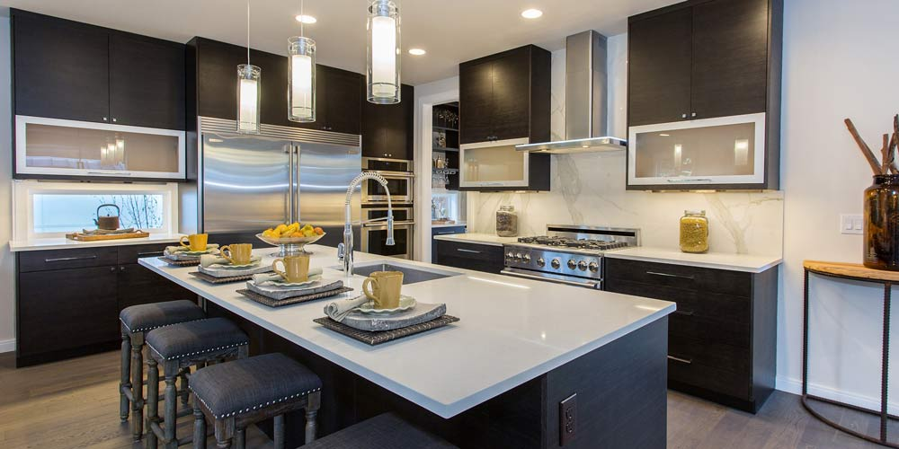
Reflections
Notes:
In reflection, I would say that [slide]

Slide 69
Recent proliferation of screen-based smarthome devices offer a new opportunity to design for DHH people…
Notes:
[read]

Slide 70
We hope that you use this opportunity to increase access for DHH people.
Notes:
[read… and if you are interested, [slide]]

Slide 71
Considerations
  Home is a shared space. Be mindful of what sound information is being listened to, and where the displays are installed.
  System should interweave into the domestic lives of people. Use context cues such as daily rhythm (e.g., night vs. day), user’s location and activity (e.g., not doing high-focused tasks) to select what to record and display.
  Handle uncertainty of sound recognition by displaying additional cues such as location, possible list of sounds, or a general category (e.g. alarm-like sound).
1
2
3
Notes:
Here are some design considerations.
[Slide] Home is a constant evolving space full of life. Home is also a space shared between occupants. Be mindful of..
[Slide and read]

Slide 72

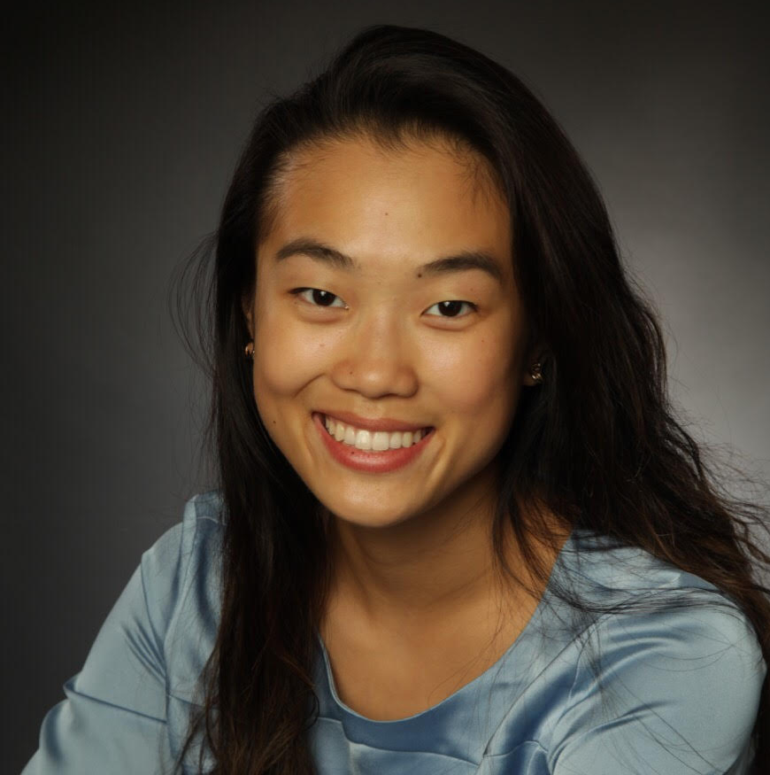
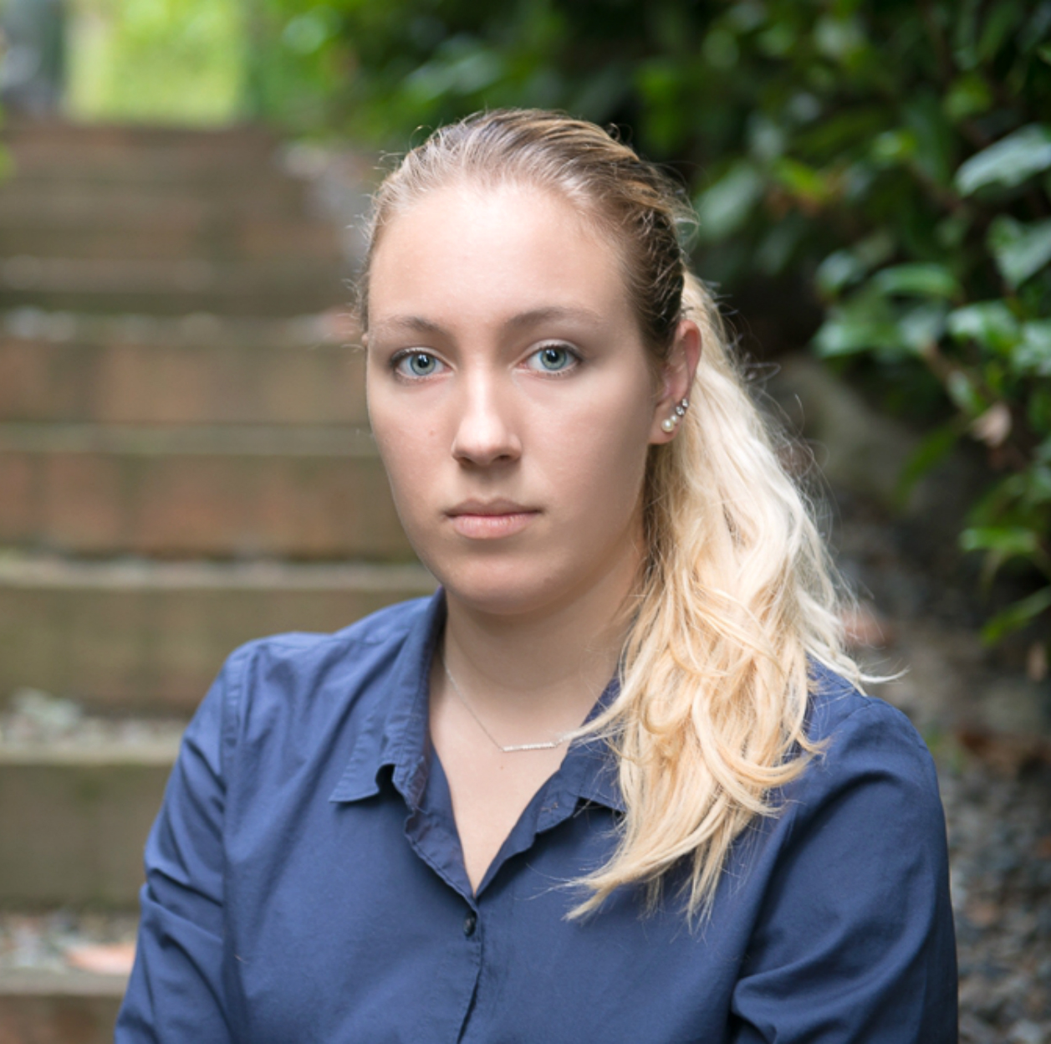


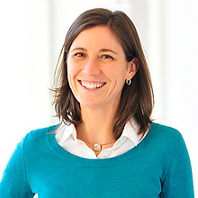
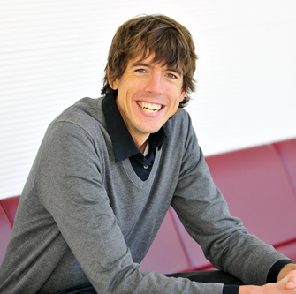




Exploring Sound Awareness in the Home for People who are Deaf or Hard of Hearing
The Team
Dhruv Jain (DJ)
djain@uw.edu
Angela C. Lin
angelacareylin@gmail.com
Rose Guttman
rguttman@uw.edu
Marcus A.
markamal@uw.edu
Aileen Zeng
aileenz@uw.edu
Leah Findlater
leahkf@uw.edu
Jon Froehlich
jonf@uw.edu
Sponsors
UW
Reality Lab
Notes:
Thank you!
[Slide]: Our team.
[Slide]: And sponsors.

