Slide 1
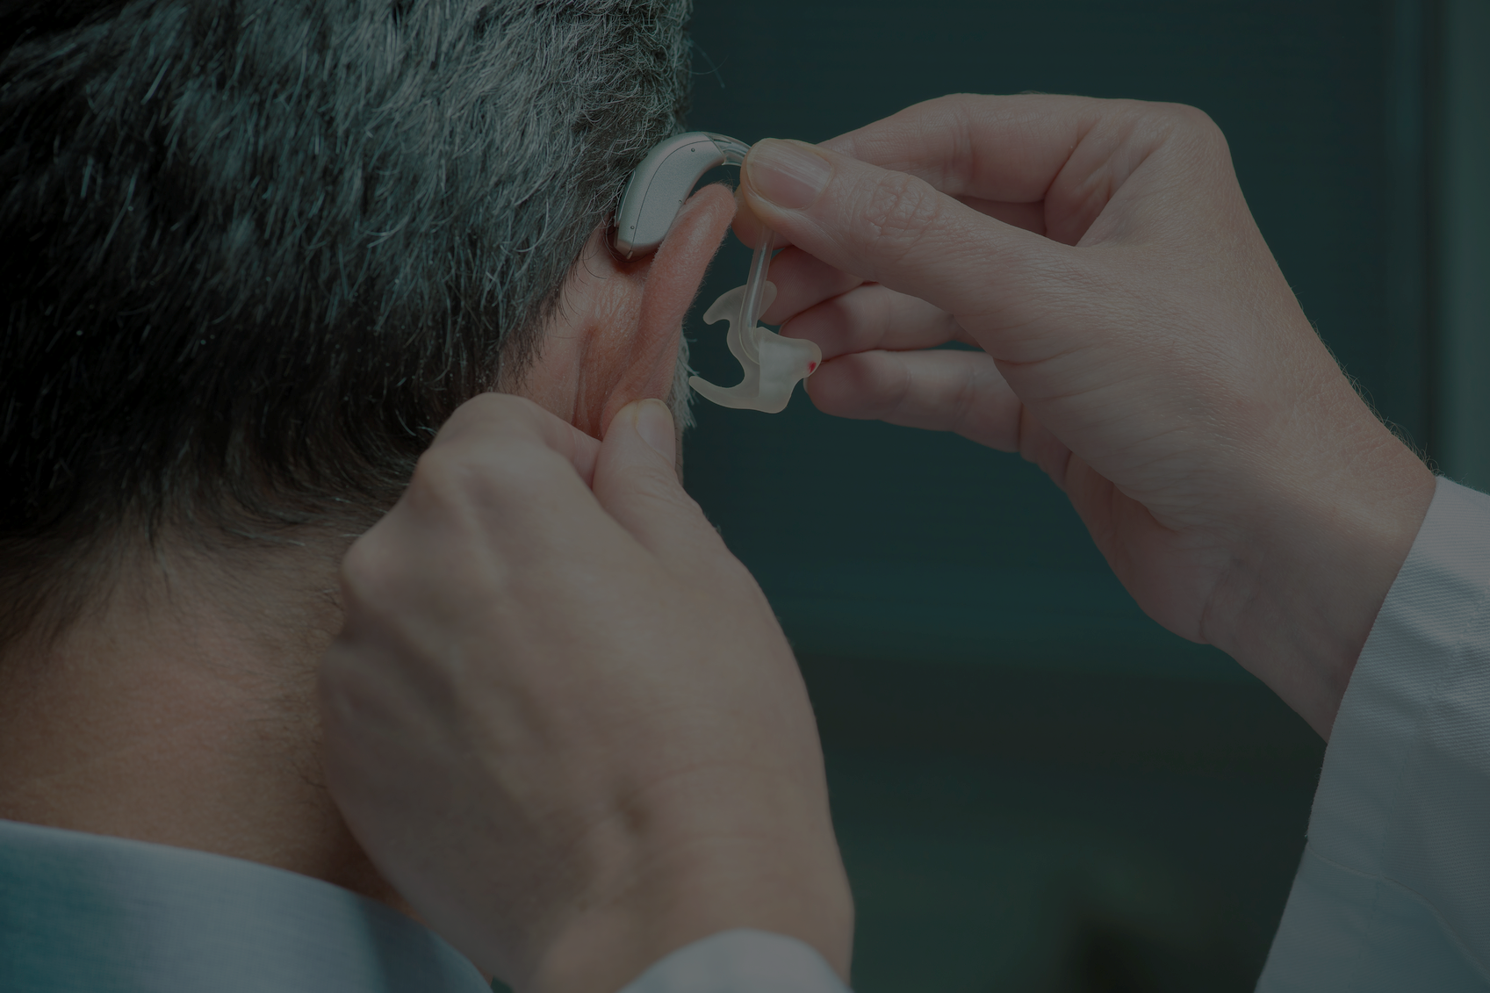



Deaf and Hard-of-hearing Individuals’ Preferences for Wearable and Mobile Sound Awareness Technologies
Leah Findlater, UW
Bonnie Chinh, UW
Dhruv Jain (DJ), UW
Jon Froehlich, UW
Raja Kushalnagar, Gallaudet
Angela Lin, UW
Notes:
DJ from University of Washington, presenting our work tilted “...”
The first author, Prof. Leah Findlater is sorry that she couldn’t be with you today. But, no worries. On behalf of my co-authors, I am very happy to present this work. I will give two talks today related to a larger project about providing sound awareness to people who are deaf or hard of hearing. This is the first talk.

Slide 2
BACKGROUND
Notes:
First a premier on Deafness.

Slide 3
background
BACKGROUND
“Some trouble hearing”
15% of US adults
“Disabling hearing loss”
2% of adults aged 45 to 54
50% of those 75 and older
[National Institute on Deafness and Other Communication Disorders, 2016]
Notes:
Do you know: 15% of the US adults have some trouble hearing? [click] The rates of disabling hearing loss are lower, but they rise substantially with age from 2% at 45-54 years of age to 50% of those 75 and older.

Slide 4
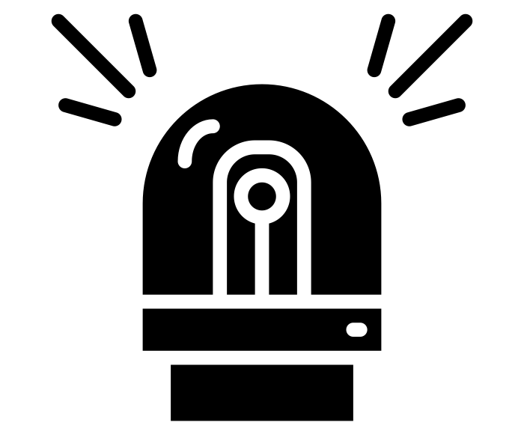

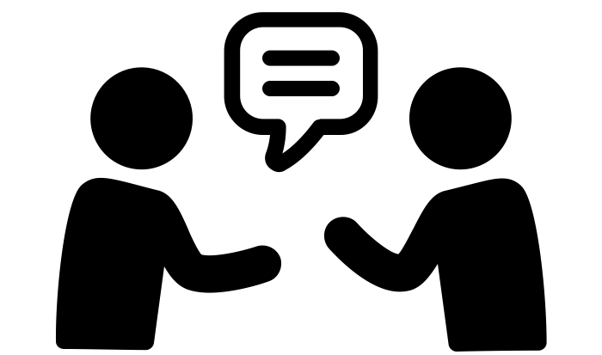
BACKGROUND
Sound awareness has wide-ranging impacts…
Safety-critical sounds
Mundane yet useful sounds
Social interactions with hearing people
[Matthews et al., Behaviour and Information Technology, 2006]
Notes:
For DHH people, sound awareness has wide-ranging impacts from being notified of safety-critical information like a ringing fire alarm to more mundane but still useful sounds like the dryer beep, and also to support social interactions with hearing people.

Slide 5
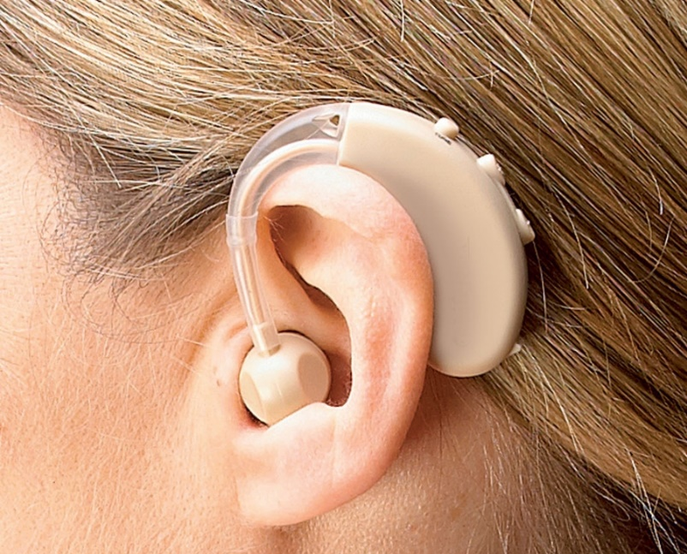
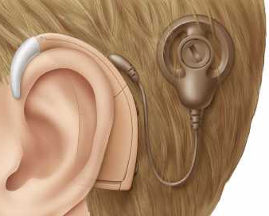
BACKGROUND
Hearing aids
Cochlear implants
+
Can improve sound and speech recognition
Do not eliminate hearing loss
Success varies
(e.g., based on hearing loss level, linguistic abilities, training)
–
–
[Dillon, 2008; NIDCD, 2014]
Notes:
While hearing aids and surgically implanted devices can improve sound and speech recognition, they do not eliminate hearing loss. The success of these devices also depends on a number of factors, such as the wearer’s hearing loss level, linguistic abilities, and training.

Slide 6
BACKGROUND
Our goal
Always-available, private, and unobtrusive sound sensing and feedback that augments the user’s existing sound awareness strategies
Notes:
To address these issues, we are working on a large project with a the goal of creating an always available…

Slide 7
BACKGROUND
But how do we get there?
What interest do deaf and hard of hearing users have in sound awareness?
What information do they want and how would they want it conveyed?
Notes:
But, how do we get there? [click and read]

Slide 8
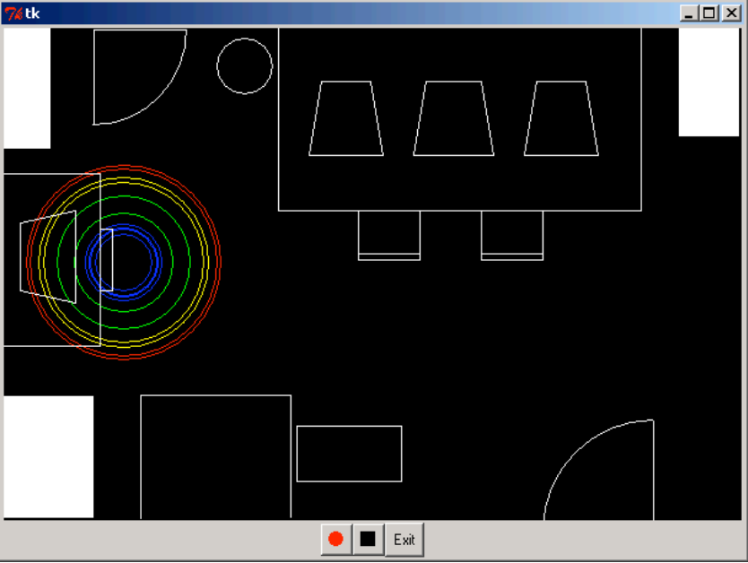
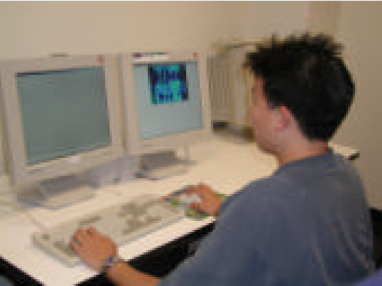
BACKGROUND
Early work on sound awareness needs
Sounds occurred around the room and were visualized on this display.
Also investigated which sounds are desired by DHH individuals.
[Ho-Ching et al., CHI ‘03; Matthews et al., BIT ‘04; Matthews et al., ASSETS ‘05 ]
Notes:
A number of studies have begun to tackle these questions, going back to Matthews et al., who first examined sound feedback almost 15 years ago with a stationary office setup as shown. [click] Sounds occurred around the room and were visualized on this display [Click]. They also investigated what sound are desired by DHH individuals [cite], finding that safety-related sounds like alarms were most preferred.

Slide 9
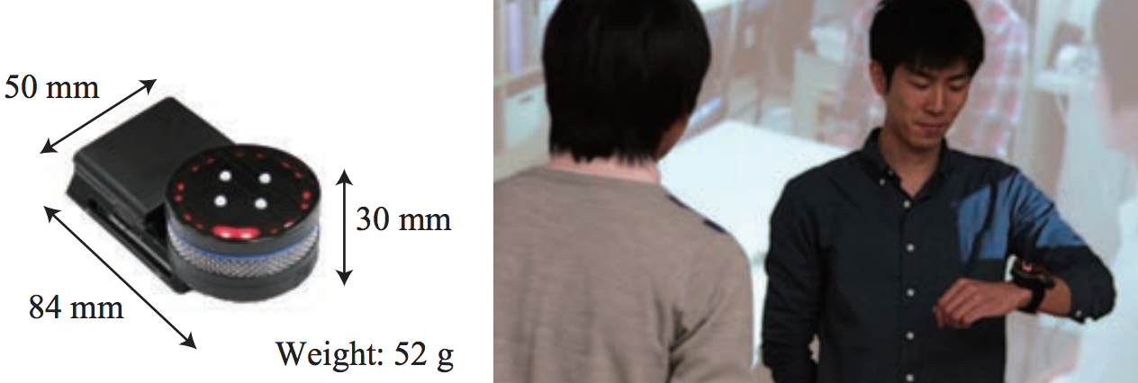
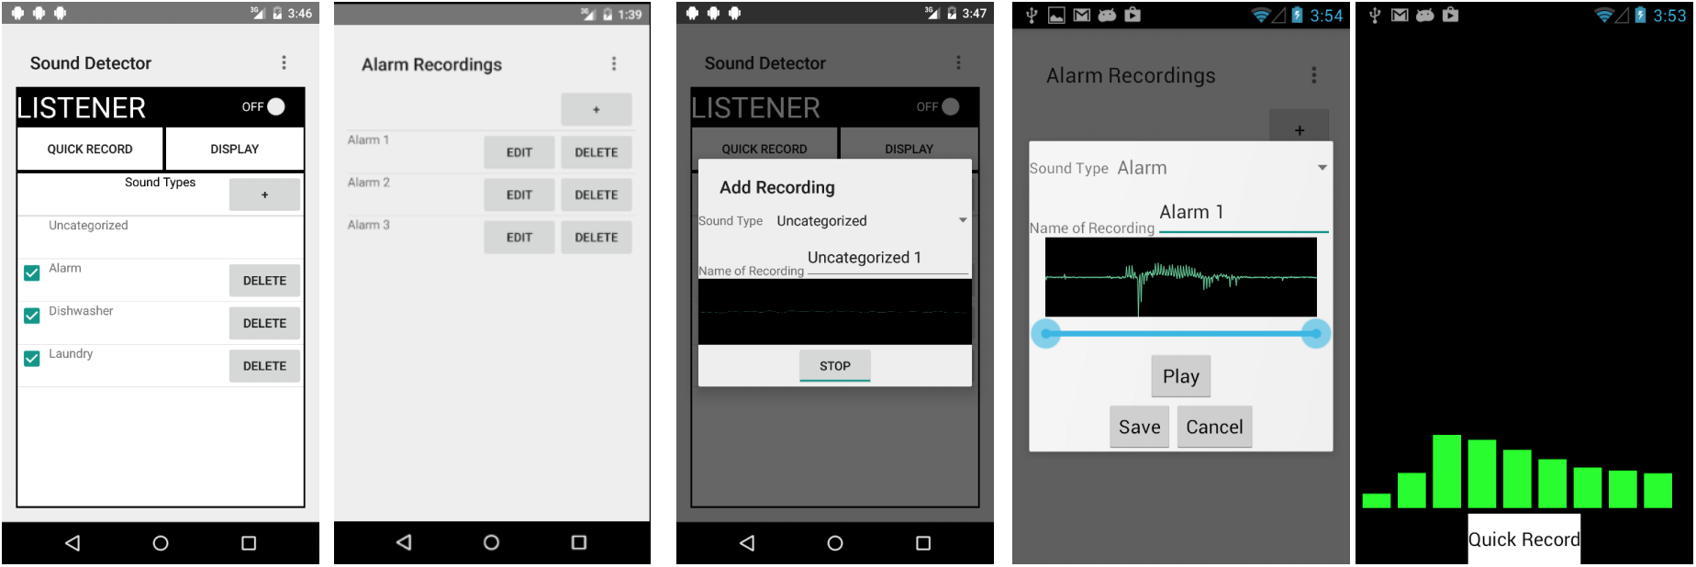
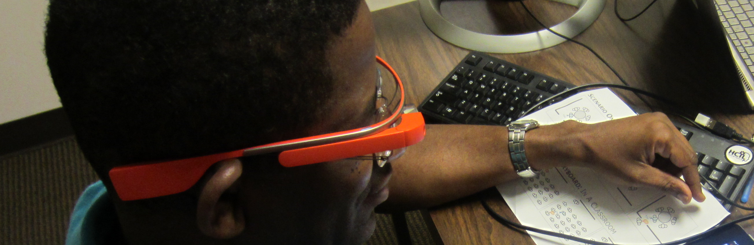
BACKGROUND
More recent trend: mobile and wearable approaches
Wrist-worn “Sound Compass”
e.g., Kaneko et al., IEEE SMC ‘13
Smartphone-based detection
e.g., Bragg et al., ASSETS 2016
Localization on a head-mounted display
e.g., Jain et al., CHI 2015
These studies tend to be qualitative and have not examined social acceptability.
Notes:
More recent work has examined other form factors such as [click] wrist worn displays, [click] smartphones apps, and [click] head mounted displays for general sound detection and speech captioning. [Click] While useful, the studies tend to be qualitative and have not examined issues around social acceptability.
Some surveys also reported in these works have began to uncover what characteristics of sounds are desired, such as identity, location, but did not report on statistically significant differences.

Slide 10
Exploratory Study With 201 DHH People
Notes:
To address these limitations and examine new questions on mobile and wearable sound awareness, we conducted an exploratory study with 201 DHH individuals focusing on the [click] following primary research questions…[click and read]
Therefore, our contributions [click] are then: [click] an examination of the influence of…, [click] a comparison of…, and [click] an assessment of…

Slide 11
Research Questions
Who is interested in sound awareness?
What are form factor and feedback preferences?
What are predicted social implications?
Contributions
Examine the influence of demographic factors
Compare mobile and wearable devices, output modalities, and speech vs. non-speech sounds
Assess utility and comfort across social contexts
Notes:
To address these limitations and examine new questions on mobile and wearable sound awareness, we conducted an exploratory study with 201 DHH individuals focusing on the [click] following primary research questions…[click and read]
Therefore, our contributions [click] are then: [click] an examination of the influence of…, [click] a comparison of…, and [click] an assessment of…

Slide 12
METHOD

Slide 13
method
METHOD
Online survey
    Hosted on surveymonkey.com, and took up to 20mins.
Notes:
We used an online survey which was hosted on [slide] surveymonkey and was designed to take up to 20 minutes.

Slide 14

formative survey: Method
METHOD
Online survey
    Hosted on surveymonkey.com, and took ~20 mins.
Closed- and open-ended questions
    Demographics
    Sound awareness interest
    Imagining device designs: wearable and mobile
    Oral conversation support
    Visual and vibrational feedback
    Filtering and notification
    Social context
Notes:
The survey included closed and open-ended questions within the following categories… [read them – don’t slide until finish]
To help participants envision what we meant by wearable and mobile sound awareness feedback, we showed them this scenario here [slide]

Slide 15
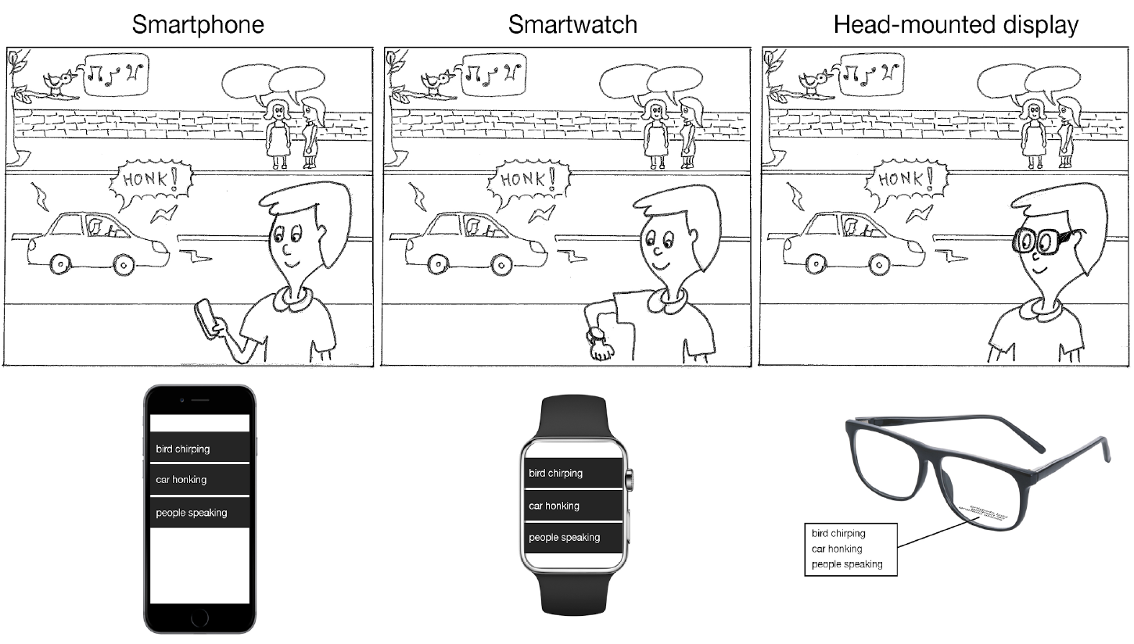
METHOD
Smartphone
Smartwatch
Head-mounted display
Notes:
This scenario shows three form factors: smartphone, watch and HMD, which display speech and non-speech sounds: a bird chirp, a car honk, and people talking.

Slide 16
METHOD
Smartphone
Smartwatch
Head-mounted display
“Imagine that each device has the ability to constantly monitor and identify the sounds around you, and to inform you about those sounds, either through visual or vibrational feedback.”
Notes:
We asked participants to imagine that…..

Slide 17
METHOD
Online survey
Closed- and open-ended questions
Main analysis includes 201 DHH participants
Deaf and hard of hearing
Someone who communicates primarily in sign language with their family might be less interested in sounds than an older adult who has age-related hearing loss and has relied on spoken communication their entire life.
Communication preference
49% oral (spoken)
30% sign language
21% both oral and sign
Discussed more in findings
Notes:
Our primary analysis includes 201 DHH participants [click] Out of these, 49% , 30%... and 21%.... I will get into more demographic detail later, but I want to emphasize the importance of communication preference. [click]
For example, [click] someone who communicates primarily in sign language with their family might be less interested in sounds than an older adult who has age-related hearing loss and has relied on spoken communication their entire life.

Slide 18
METHOD
Online survey
Closed- and open-ended questions
Main analysis includes 201 DHH participants
Qualitative and quantitative analysis
Iterative coding process
Descriptive statistics
Non-parametric tests
Holm-Bonferroni corrections
Notes:
We performed qualitative analysis on the open form questions using [click] Iterative coding process, and quantitative analysis on the quantitative data by using a mix [click] of descriptive statistics, and for our primary ordinal rating scale measures, non-parametric tests with holm-Bonferroni corrections.

Slide 19
FINDINGS
Notes:
Let’s discuss what we found.

Slide 20
FINDINGS
High interest in sound awareness
73% (N=147) “very” or “extremely” interested in sound awareness
Communication Preference
Age
Gender
Hearing Level
Prelingual
(N=201, except for gender N=200)
Notes:
There was high interest in sound awareness across demographic factors. [Click] Overall, 73% of participants were vey or extremely interested in sound awareness.
To understand how this interest varies based on participant’s background, we examined the relationship between five different demographic factors, which include [click and read] and whether the hearing loss was prelingual or not. Let’s look at each in turn.

Slide 21
FINDINGS
High interest in sound awareness
73% (N=147) “very” or “extremely” interested in sound awareness
Communication Preference
(N=201, except for gender N=200)
Notes:
Communication preference [Slide]

Slide 22
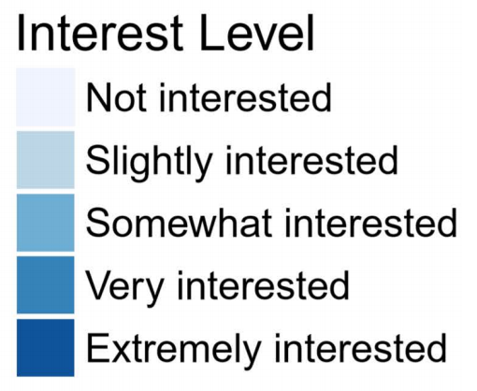
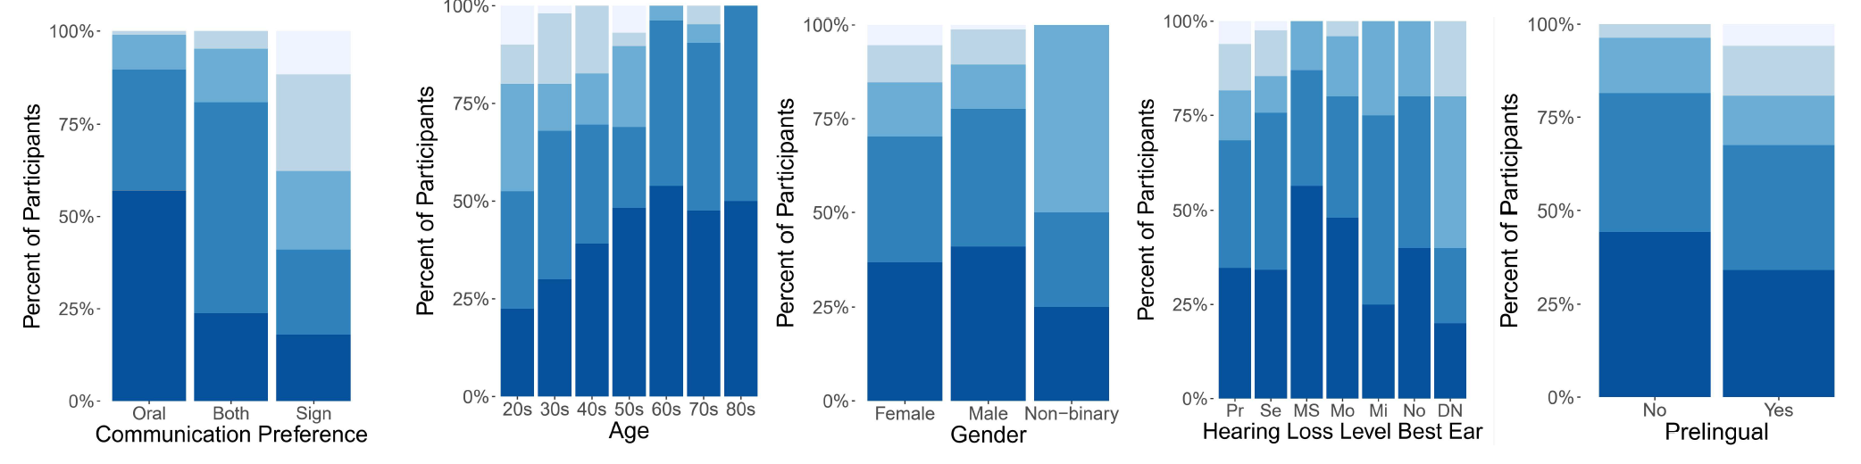
FINDINGS
High interest in sound awareness
73% (N=147) “very” or “extremely” interested in sound awareness
No clear pattern
Communication Preference
Age
Gender
Hearing Level
Prelingual
(N=201, except for gender N=200)
Notes:
Participants who prefer oral communication had the highest interest in sound awareness, while those preferring sign language had the lowest. This could because signing users do not rely on sound for social interactions. But even in the sign language group at least [click] 50% were still interested in the sound.
Here’s age. Interest appears to increase with age, as we go from the 20 up to the 80s. [click] For Gender and hearing loss level the pattern in less clear. Finally, [click] interest appears to be lower if the hearing loss is prelingual than if the loss occurred after age 1. Because if you’re prelingual, you’re more likely to use sign language.

Slide 23
FINDINGS
Most important demographic factor for interest:
communication preference
Logistic regression
Communication preference
Age
Gender
Hearing level
Prelingual hearing loss
Communication preference significantly predicts sound interest level (p < .001)
No other factors significant after controlling for communication preference
Age and communication preference are highly related
We focus on communication preference in our subsequent analysis.
Notes:
We also built a logistic regression model to examine the explanatory power of the factors on overall sound awareness interest. This model showed that [click] communication preference significantly predicted interest level, and that [click] after controlling for that variable, no other factors were significant. [Click] Age, which had seemed important, is also highly related to communication preference which may be because people experiencing age-related hearing loss are less likely to have learned sign language.
As a result, we focus on communication preference in our subsequent analyses.

Slide 24
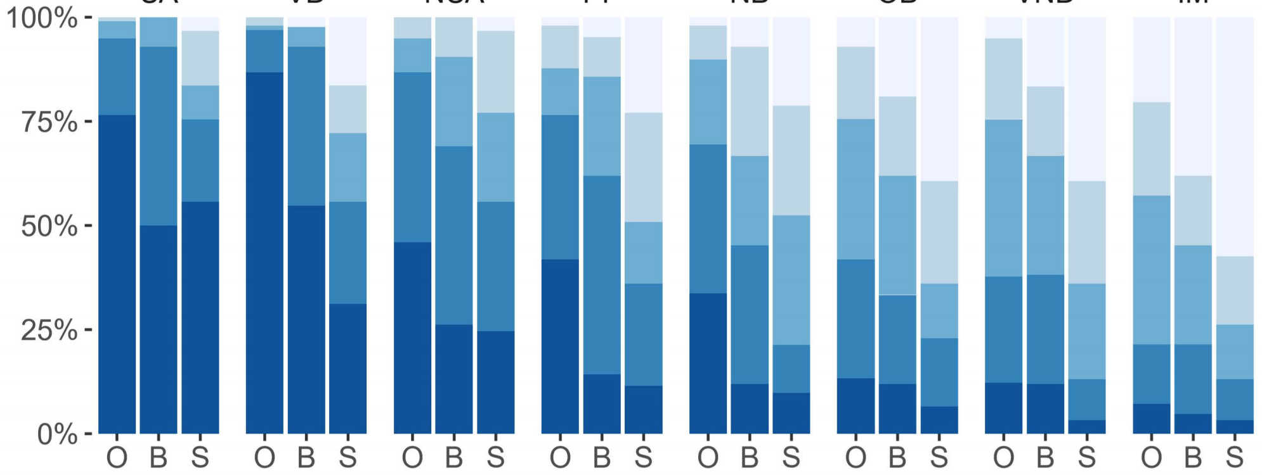
Sound types of interest reflect past work
[Matthews et al., 2006]
[Bragg et al., 2014]
However, we provide statistically significant conclusions…
Urgent alerts
Voices at you
Non-urg. alerts
Pres. of people
Nature backgr.
Outdoor backgr.
Voices not at you
Indoor mech.
Oral
Both
Sign
Oral
Both
Sign
Oral
Both
Sign
Oral
Both
Sign
Oral
Both
Sign
Oral
Both
Sign
Oral
Both
Sign
Oral
Both
Sign
3x8 (communication preference x sound type) ANOVA with ART:
main and interaction effects all significant (p < .05)
(N=201)
Notes:
When digging into specific sounds of interest, the findings largely reflect past work i.e., [click] urgent alerts and voices directed at you were most preferred while [click] voices not directed at you and indoor mechanical noises were least preferred. However, due to a larger sample size and more nuanced measures, [click] we provide statistically significant and detailed conclusions.
For example, [click] an ANOVA with Aligned Rank Transformation showed significant difference in interest based on sound types of interest.

Slide 25
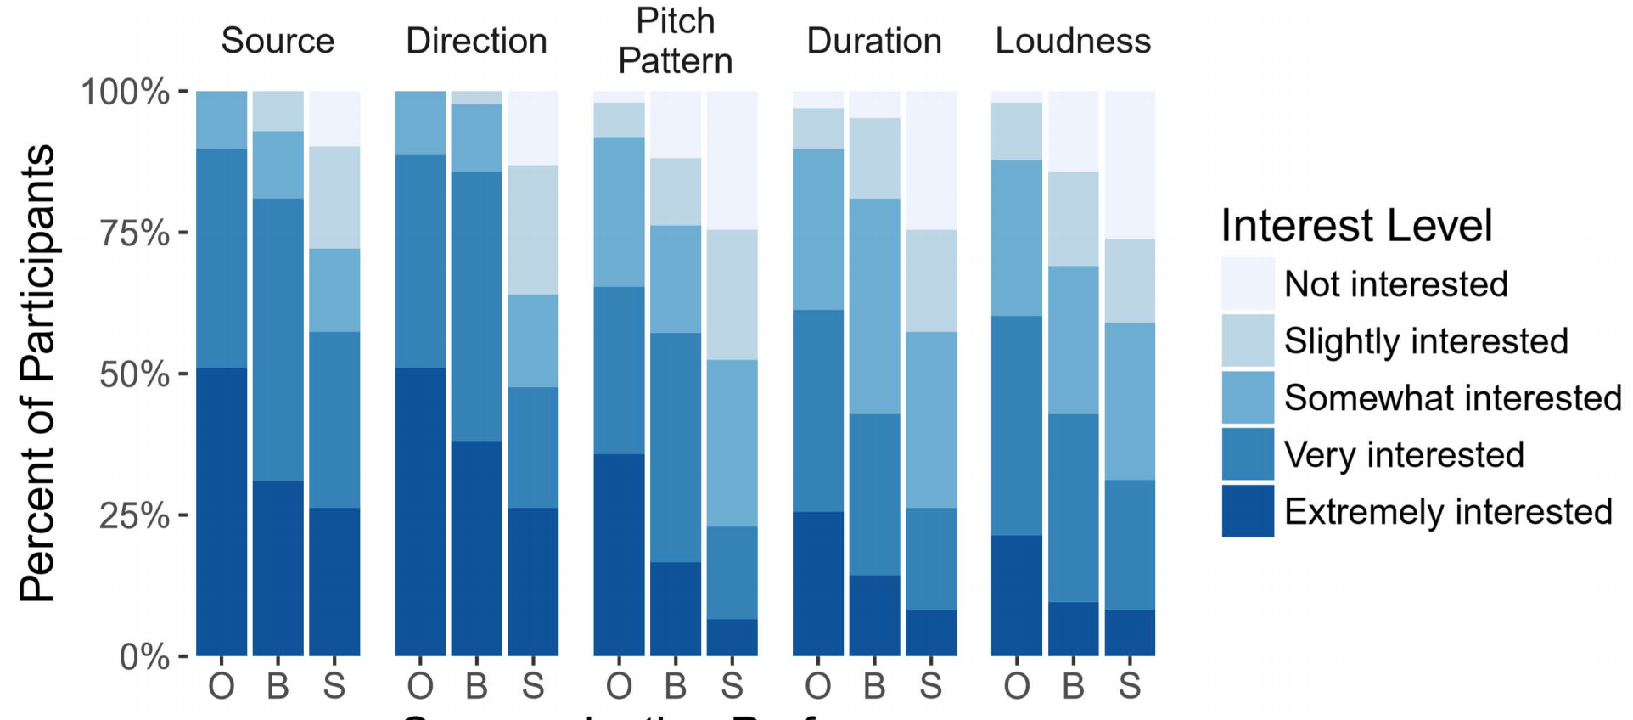
Sound characteristics of interest reflect past work
Oral
Both
Sign
Oral
Both
Sign
Oral
Both
Sign
Oral
Both
Sign
Oral
Both
Sign
3x5 (communication preference x sound characteristics) ANOVA with ART:
main and interaction effects all significant (p < .05)
(N=201)
Notes:
Sound characteristics of interest also largely reflected past work. [click] Here are interest levels in five sound characteristics, with [click] sound source identity and sound direction being of highest interest. [click] Again, an ANOVA with ART showed that interest differed significantly based on sound characteristics.

Slide 26
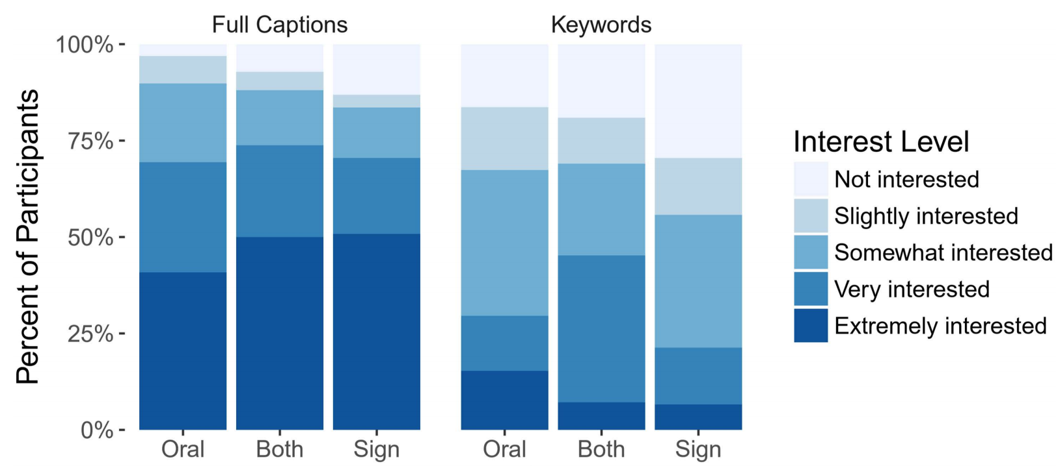
Full captions are of high interest
Oral
Both
Sign
Oral
Both
Sign
“Keywords will not give me full impression of what was spoken. This can cause confusion, misleading thoughts/information”
(P149, profoundly deaf and preferred both sign and oral communication)
Notes:
If we keep this slide we need to add the ANOVA results
Point is high desire for captions and less desire for keywords only

Slide 27
Form factor tradeoffs
Smartphone
Smartwatch
Head-mounted display
Notes:
Before continuing further, recall that we asked participants to compare the head-mounted display, smartphone, and smartwatch.

Slide 28
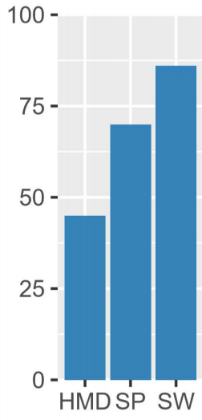
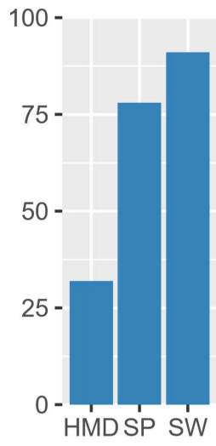
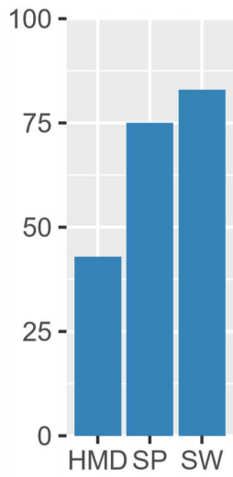
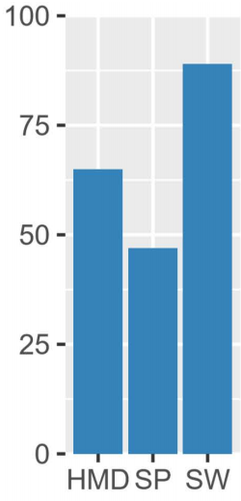
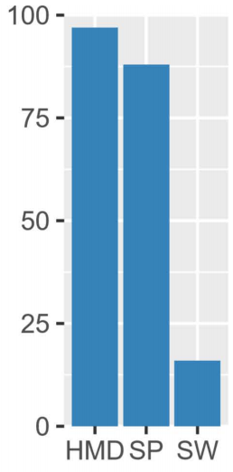
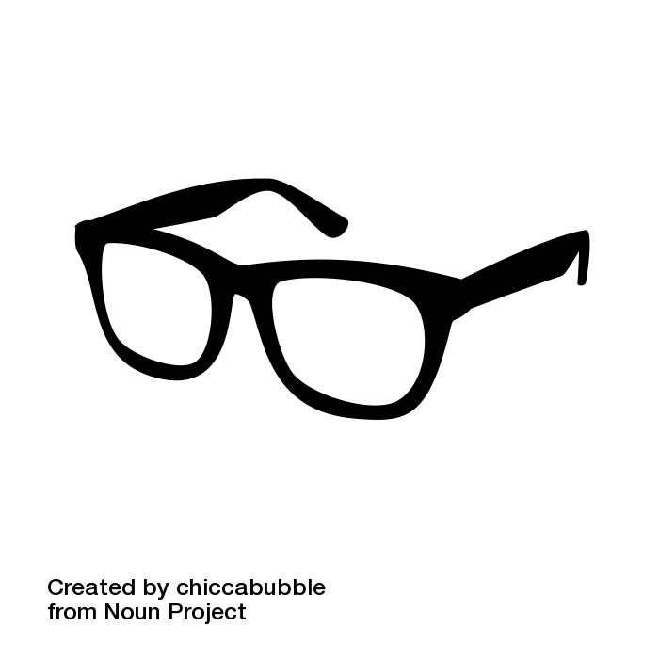
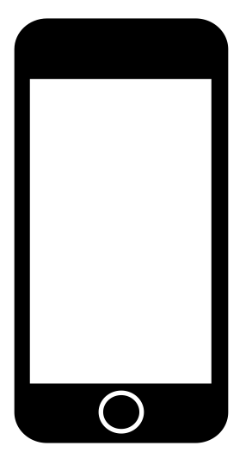
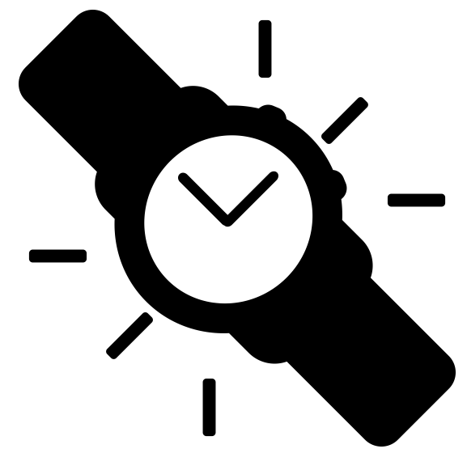
Form factor tradeoffs
Overall preference
Social acceptability
Preferred for captions
Usefulness
Glanceability
(N=201)
Notes:
We found that [click] for overall preferred device, social acceptability, and usefulness, most participants preferred [click] smartwatch or the [click] smartphone over the HMD.
You know these graphs show counts out of 201, not percentages.
[Click] For more visual concerns, however, the HMD fared better, with a [click] third of participants deeming it the most glanceable after the [click] smartwatch, and almost half [click] preferring it for captions. In contrast, the [click] smartwatch was not seen as useful for captions because, maybe, small size.

Slide 29
Form factor tradeoffs
Overall preference
Social acceptability
Preferred for captions
Usefulness
Glanceability
(N=201)
Notes:
We found that [click] for overall preferred device, social acceptability, and usefulness, most participants preferred [click] smartwatch or the [click] smartphone over the HMD.
You know these graphs show counts out of 201, not percentages.
[Click] For more visual concerns, however, the HMD fared better, with a [click] third of participants deeming it the most glanceable after the [click] smartwatch, and almost half [click] preferring it for captions. In contrast, the [click] smartwatch was not seen as useful for captions because, maybe, small size.

Slide 30
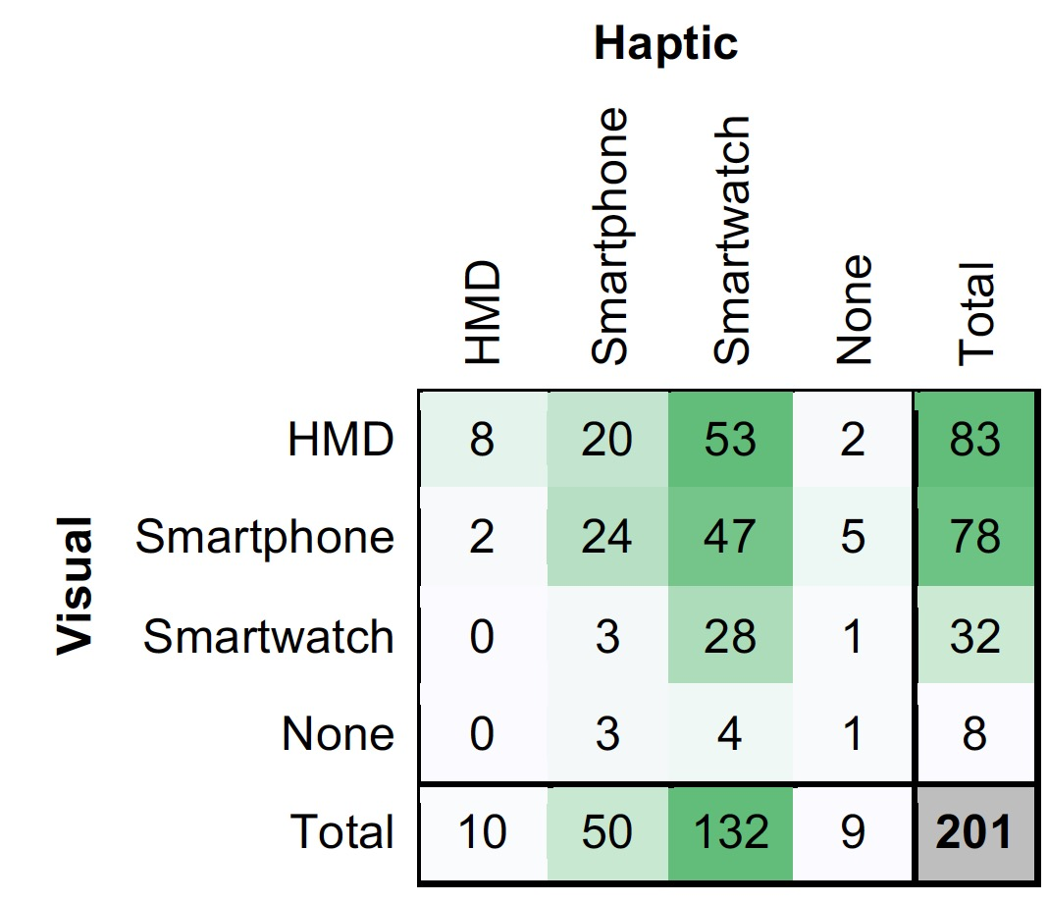
Envisioning an ideal setup
92% of 201 wanted haptic and visual feedback
Most common ideal setup involved two devices
Haptic
Visual
Smartwatch
(66% of 201)
HMD
(41% of 201)
Smartphone
(39% of 201)
Notes:
When asked to envision their ideal setup that could include visual and/or vibrational feedback on a smartphone, smartwatch, or HMD, [click] participants overwhelmingly wanted both visual and haptic feedback, at 92%.
Moreover, [click] the most common ideal setup involved two devices, where [click] the haptic feedback would be provided on a smartwatch and the visual feedback would be provided on a HMD or smartphone.

Slide 31
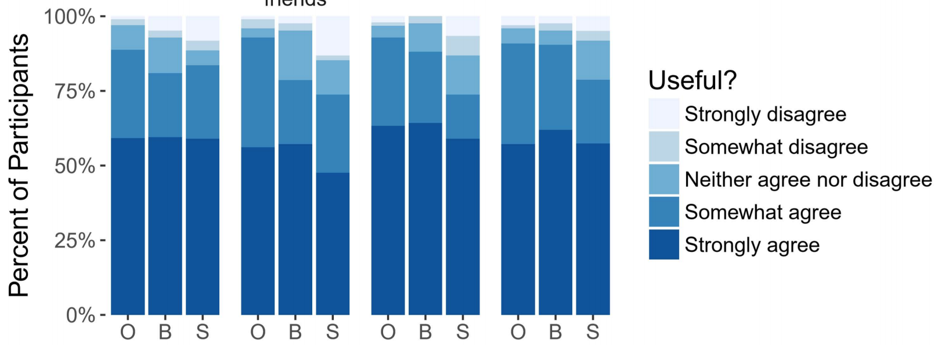
Utility across social contexts
Family/
friends
Alone
Work
Strangers
Oral
Both
Sign
Oral
Both
Sign
Oral
Both
Sign
Oral
Both
Sign
Most participants “strongly” agreed would be useful across all contexts
…except possibly for people who prefer sign language with family/friends
Significant main and interaction effects with 2-way ANOVA with ART
(N=201)
Notes:
On usefulness of a sound awareness device across different social contexts, most participants strongly agreed that sound awareness feedback would be useful across all contexts..
A 2-way ANOVA with ART shows both communication preference and context significantly influenced ratings.

Slide 32
Utility across social contexts
Most participants “strongly” agreed would be useful across all contexts
Notes:
On usefulness of a sound awareness device across different social contexts, most participants “strongly” agreed that the device would be useful across all contexts. [click]
However, the social acceptability, [click] decreased with social distance: i.e., from alone to family/friends, to work to strangers. Even then, “[click]” most somewhat or strongly agreed that the device would be acceptable across all contexts.
[click] Again, context significantly impacted social acceptability, and the social acceptability was lower with strangers.

Slide 33
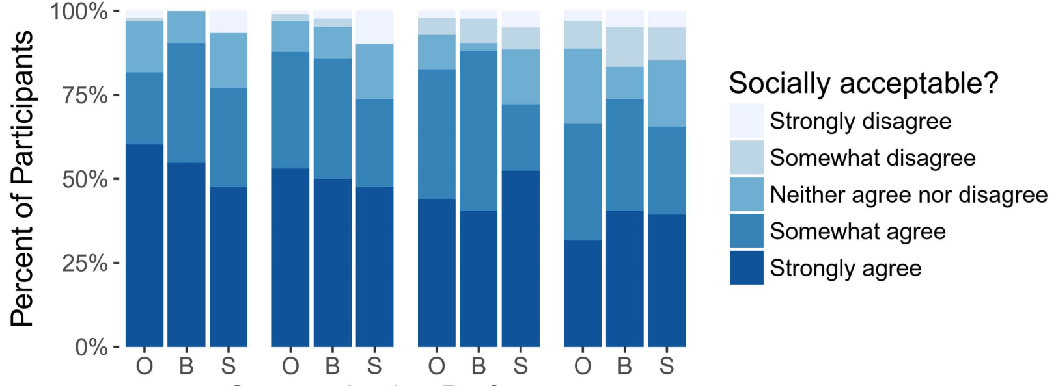
Socially acceptability across different contexts
Family/
friends
Alone
Work
Strangers
Oral
Both
Sign
Oral
Both
Sign
Oral
Both
Sign
Oral
Both
Sign
Most “somewhat” or “strongly” agreed would be acceptable across all contexts
Context significantly impacted social acceptability (main effect ANOVA with ART)
…social acceptability lower with strangers
(N=201)
Notes:
On usefulness of a sound awareness device across different social contexts, most participants “strongly” agreed that the device would be useful across all contexts. [click]
However, the social acceptability, [click] decreased with social distance: i.e., from alone to family/friends, to work to strangers. Even then, “[click]” most somewhat or strongly agreed that the device would be acceptable across all contexts.
[click] Again, context significantly impacted social acceptability, and the social acceptability was lower with strangers.

Slide 34
Would social context impact willingness to use?
50% said YES
31% said NO
Others unsure
“Most definitely. I would feel the need to explain why I have the device when I’m around someone I don’t know”
(P58, male, age 46, sign and oral communication)
“Might not need as much with friends and family. May need more in work meetings, and most in unfamiliar situations, such as running errands, traveling.”
P164 (male, 45, oral communication)
“Being a member of Deaf Culture, I would’ve thought that it’d be considered rude if I am to place sounds above visual cues available to everyone. With Hearing people, I think they’d insist on sounds being available to me.”
(P95, female, age 29, prefers sign language)
Notes:
We also asked whether social context impact the willingness to use the device. [click] 50% said yes, 31% said no, others were unsure.
To complement this quantitative result, we also received some open-ended comments. Participants emphasized potential discomfort in using the device around strangers. [click] Such as this quote by P58. [pause]
However, some said that the device is more useful with unfamiliar conversation partners compared to friends and family. Such as this.. [click and pause]
Finally, some highlighted that this type of device would not be useful in a Deaf cultural context. [click]

Slide 35
CONCLUSION
Notes:
In conclusion,

Slide 36
Takeaways
High interest in sound awareness, modulated by communication preference
Support both visual and haptic feedback, possibly even on two devices: smartwatch + HMD or smartphone
Social context affects perceived usefulness and comfort with using a sound awareness device
Notes:
[Click before talking] We observed high interest in…
[Click] Future sound awareness devices should support both…
[Click] Social context affects perceived usefulness and comfort with using a mobile or wearable sound awareness device, [likely reflecting a variety of factors such as changing social perceptions of wearable technology, and the stigma that can be associated with assistive technologies.]

Slide 37


Deaf and Hard-of-hearing Individuals’ Preferences for Wearable and Mobile Sound Awareness Technologies
Leah Findlater, Bonnie Chinh, Dhruv Jain (DJ), Jon Froehlich, Raja Kushalnagar, Angela Lin.
Sponsors

