Slide 1
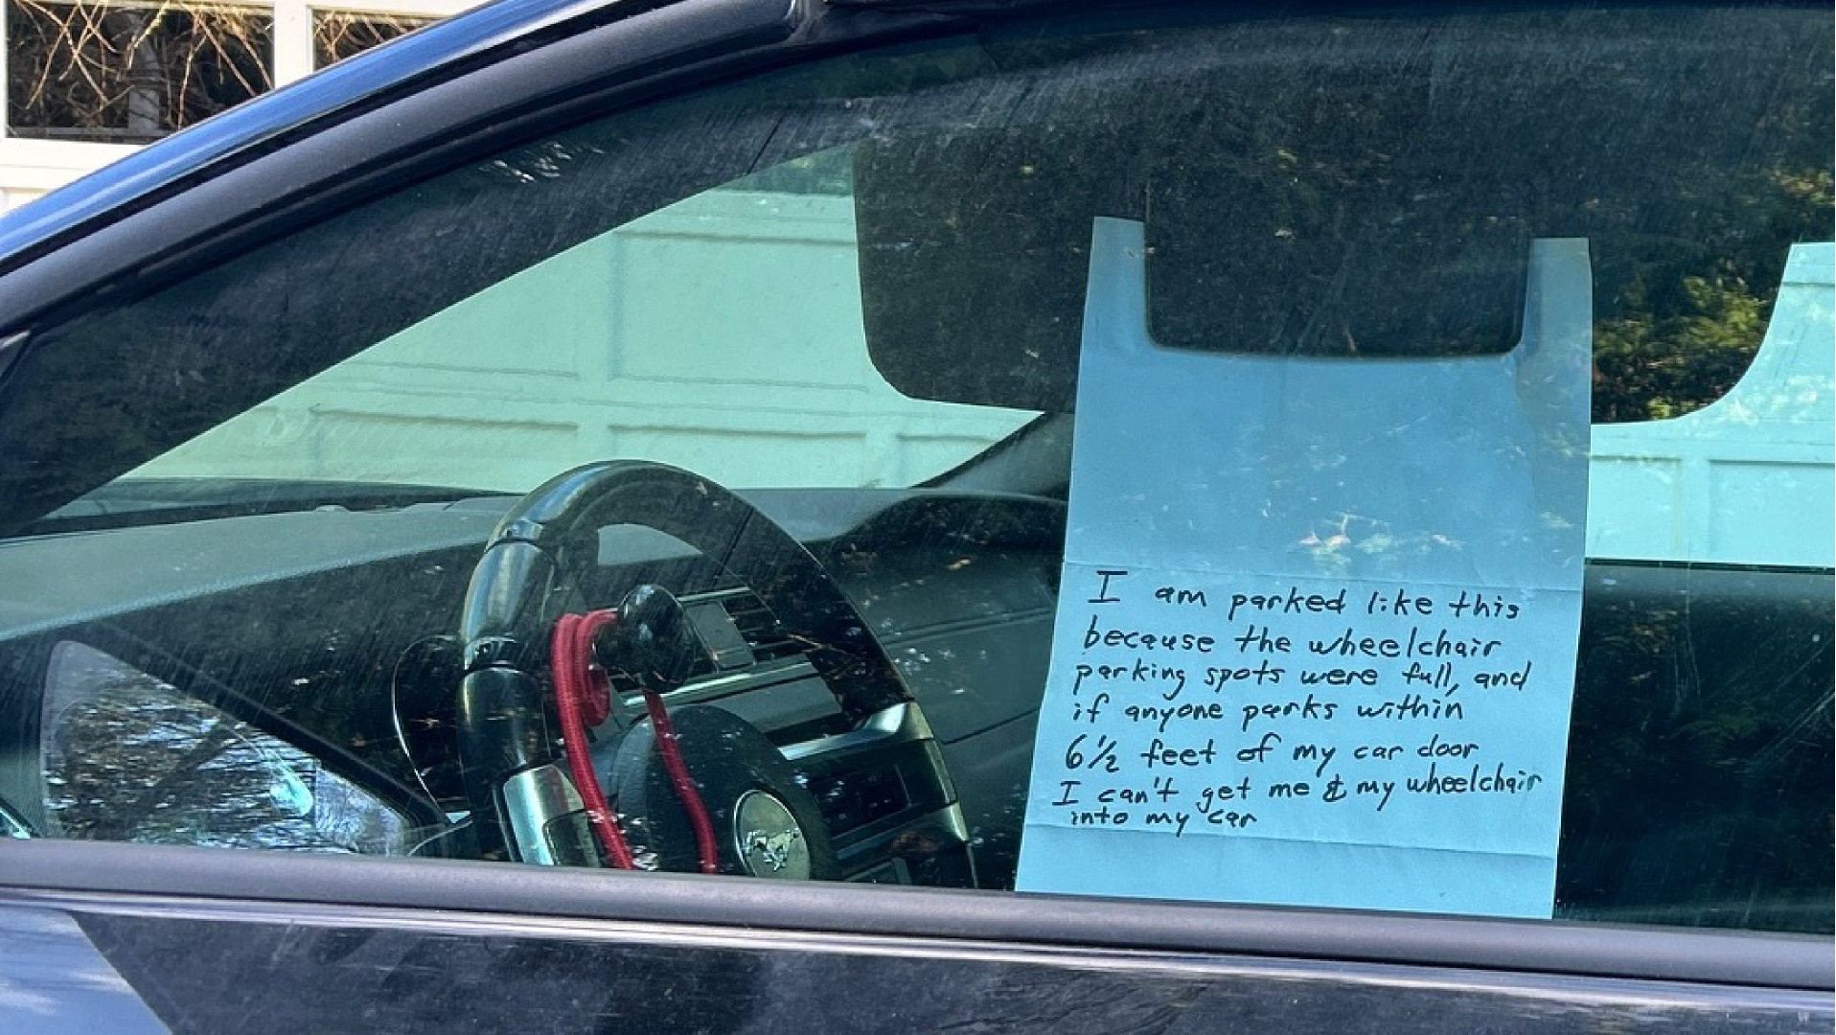



















Where Can I Park?
Understanding Human Perspectives
and Scalably Detecting Disability Parking
Jared
Hwang
UW CSE
Chu
Li
UW CSE
Hanbyul
Kang
UW CSE
Maryam
Hosseini
UC Berkeley
City and Regional
Planning
Jon E.
Froehlich
UW CSE

Slide 2
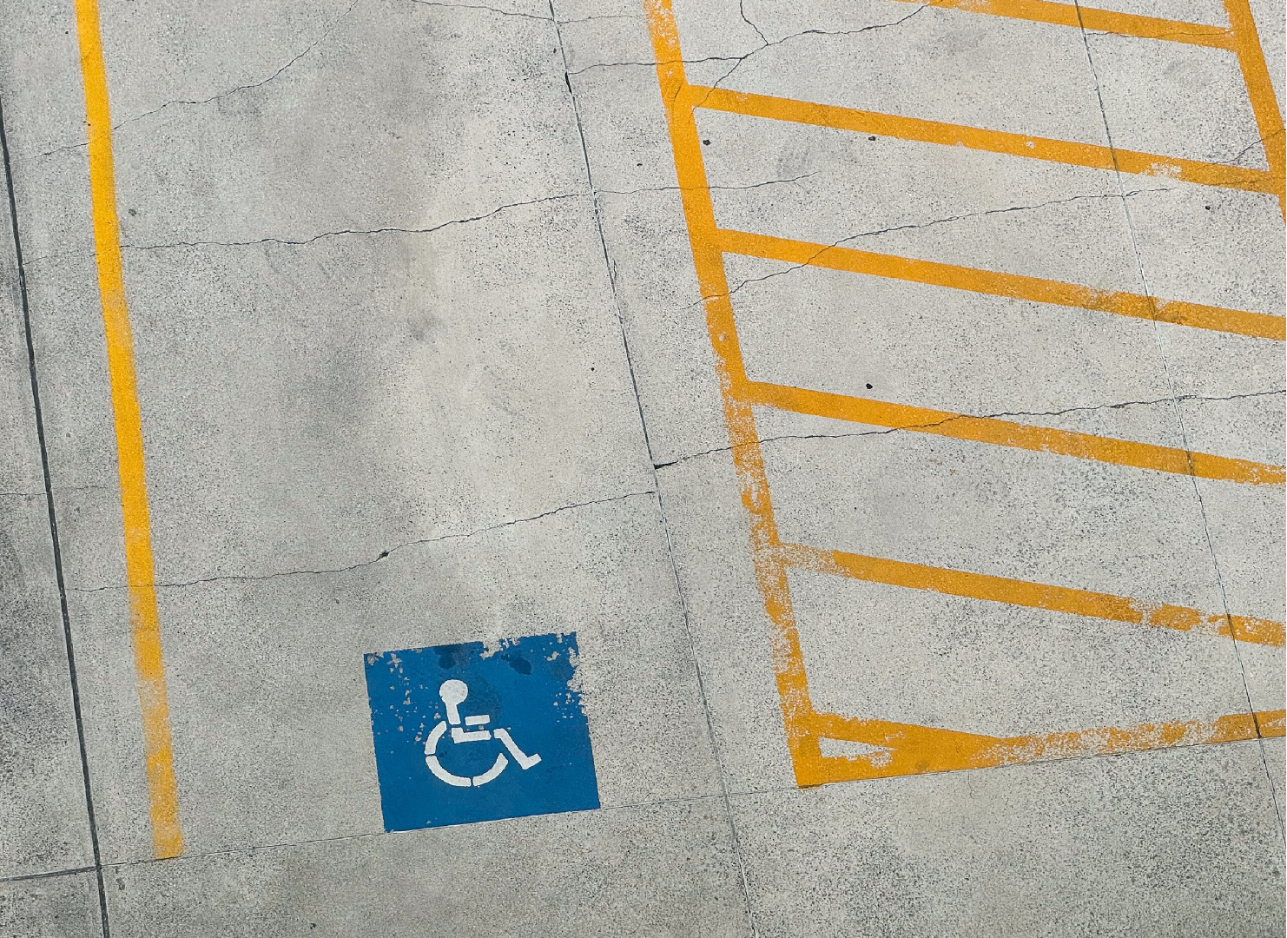
Americans with
Disabilities Act (ADA)
4 - 8%
No compliance verification measures
Notes:
Accessible parking is crucial for people with disabilities.
since the Americans with Disabilities Act of 1990, 4-8%...

Slide 3
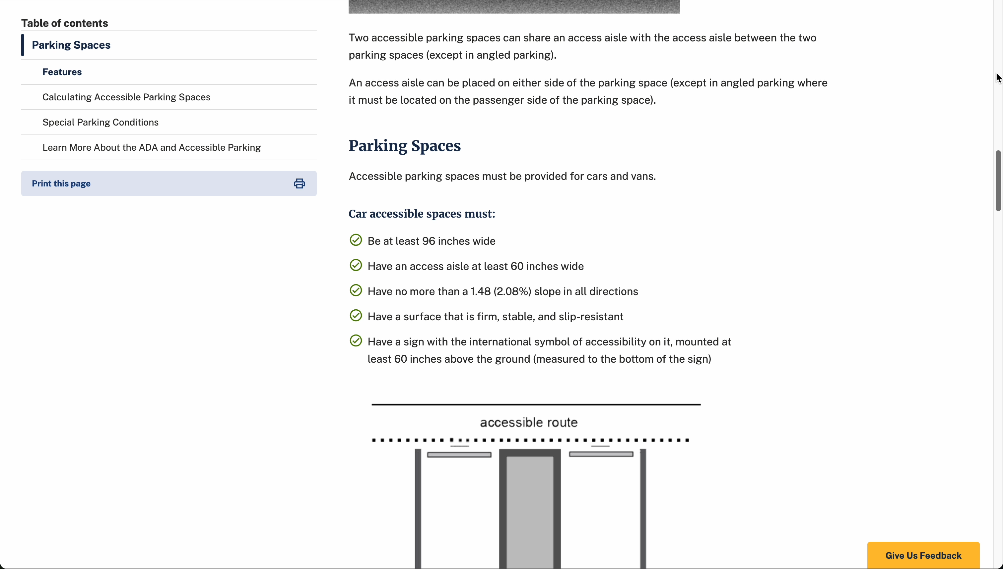
No large-scale study of disability parking in the US
Little work understanding how people use disability parking

Slide 4
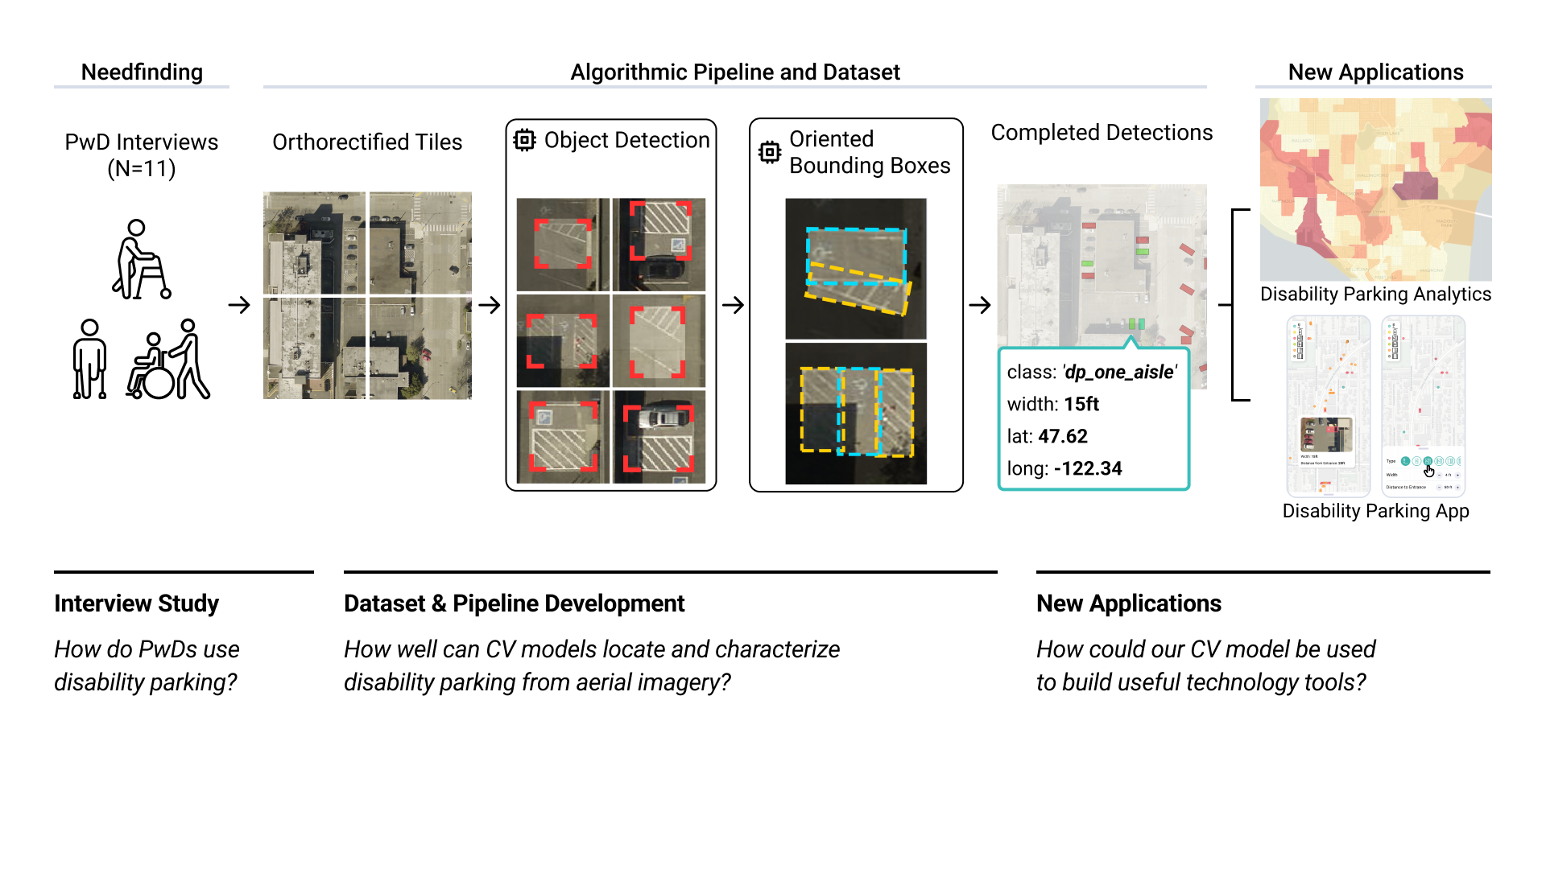

Slide 5
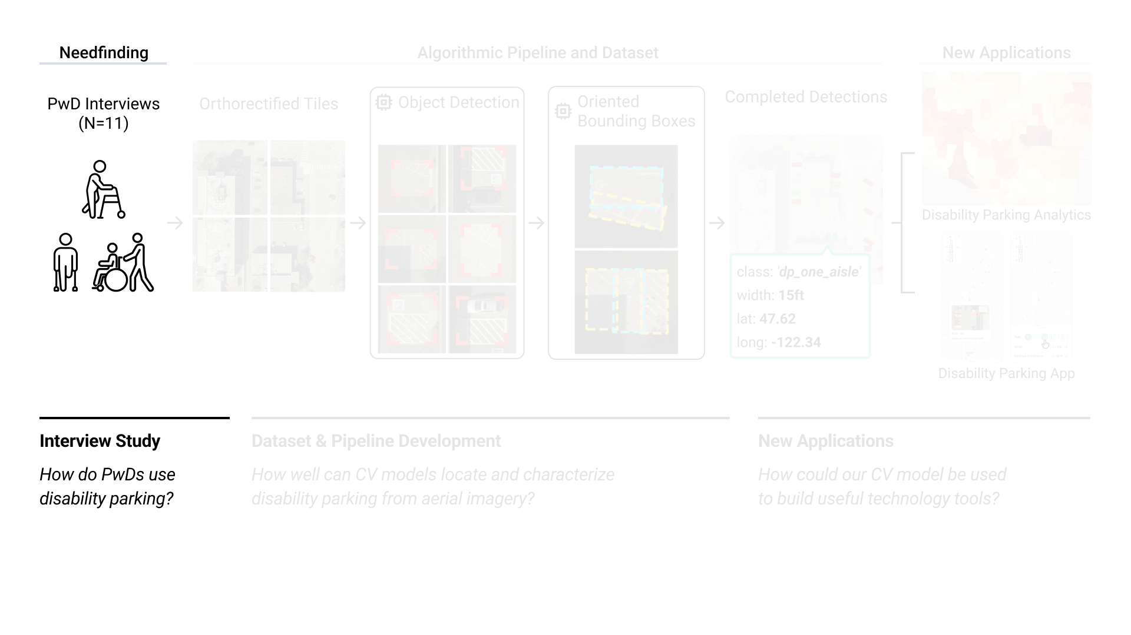

Slide 6




Recruitment:
PwD Interviews (N=11)
11 Participants with disabilities
Eligible for disability parking
Interview:
Part 1: How does disability parking factor into transportation decisions?
Part 2: What do participants like/dislike about disability parking?
Interview Study
How do PwDs use disability parking?
Part 3: Technology tools

Slide 7
Disability parking needs
Individual burden and adaptation
Technology tools
Notes:
Coming to the results, **

Slide 8
Disability parking needs
“ As long as I can use my equipment, I don’t mind going further, but other times without sidewalks and curb cuts, there’s been times where I couldn’t park anywhere. “
“ Most are on the right side, why not the left? Doesn’t make any sense to me, except for if somebody’s in a manual chair. ”
“ If the car can fit in and I can get in and out of the car, that’s all I look for. ”
P7
P9
P4
Individual burden and adaptation
Technology tools
Notes:
We found that disability parking needs varied between individuals. Most commonly, was simply having enough space to get in and out of the car (in the form of access aisles)
**
This need often dominated other aspects, like distance from the entrance
**
Other participants called out the design of spaces themselves

Slide 9
Disability parking needs
Individual burden and adaptation
“ There’s been quite a few times when I’ve had to either create my own space or illegally park in a bank that was closed. ”
“ I’ll park out over the white line... and then you come back and you can see people who got really annoyed, and it’s like, I’m sorry, I can’t help it. ”
“ I do math in my head about...how badly do I need to go to the store today? ”
P2
P3
P11
Technology tools
Notes:
These highly personalized needs meant that users often had to adapt to situations or create their own accessible parking
**
However, having to create your own parking is obviously not ideal.
**
This meant that users often had to evaluate how important a given trip was to them

Slide 10
Disability parking needs
Individual burden and adaptation
Technology tools
“ I don’t necessarily know whether there’s a flight of stairs or the accessible ramp is that way... just having that extra information, it can’t not help ”
“ If you could say ’All these are full; the next closest ADA spot is here,’ that would be pretty cool. ”
“ I don’t want somebody else’s computer program getting me the information that I want when I can just do it myself. ”
P8
P10
P7
Notes:
Coming to technology tools, many users felt that tools that help them understand the state of parking where theyre going would be most helpful
**
However, there are privacy and trust concerns.

Slide 12
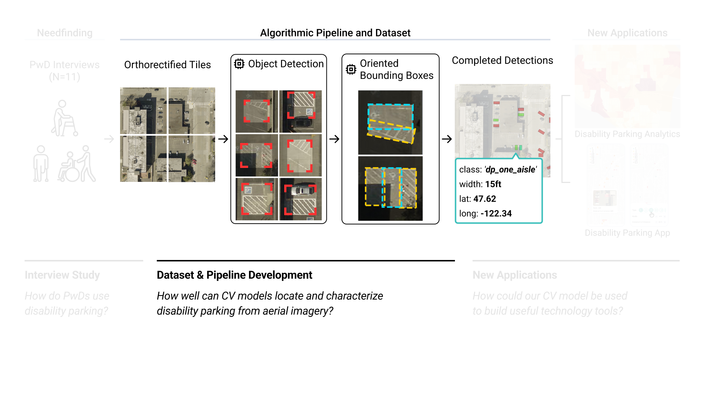

Slide 13
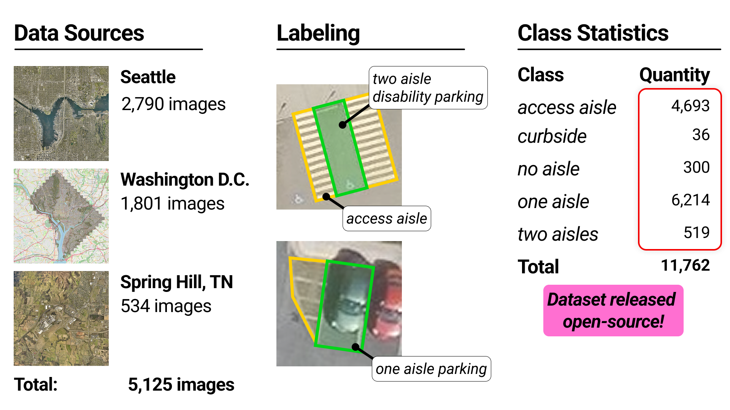

Slide 14
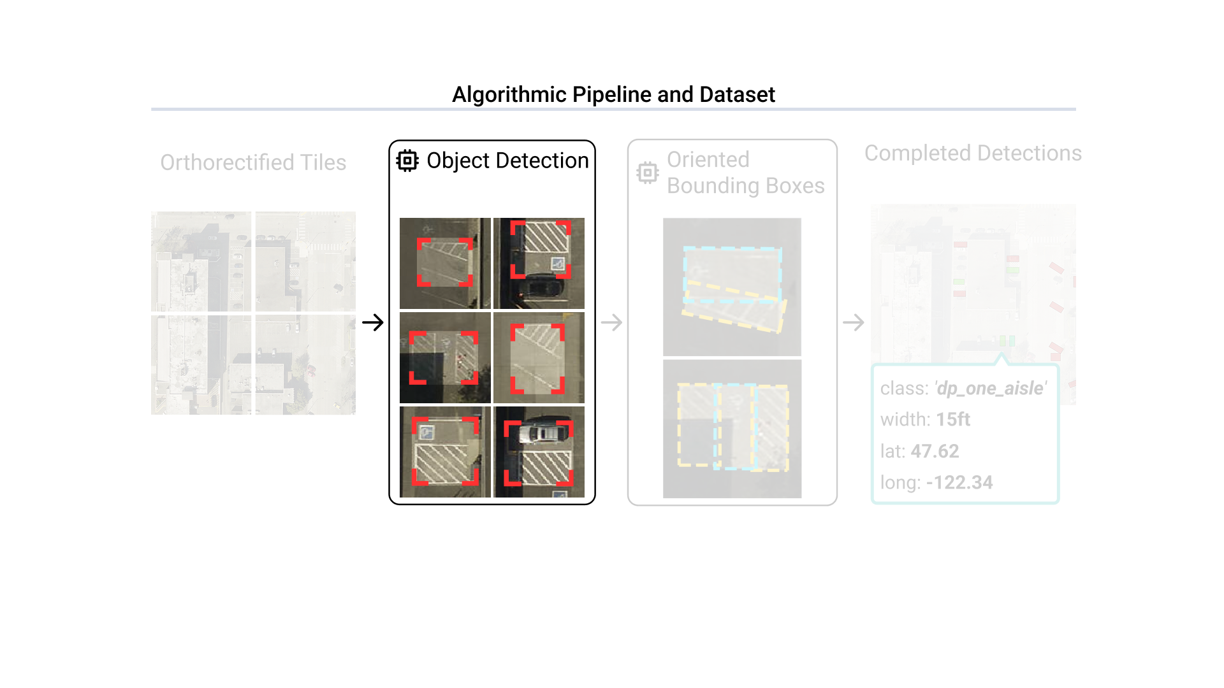

Slide 15
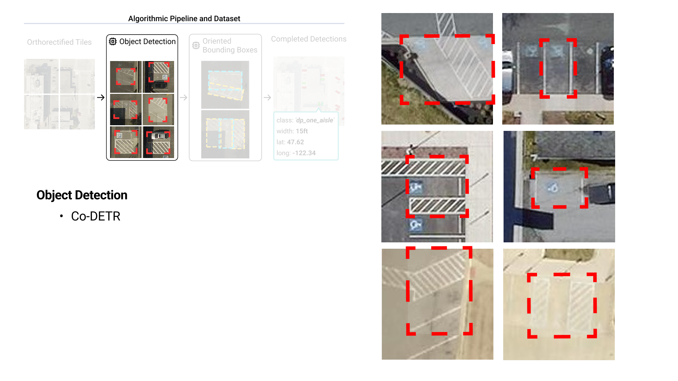

Slide 16
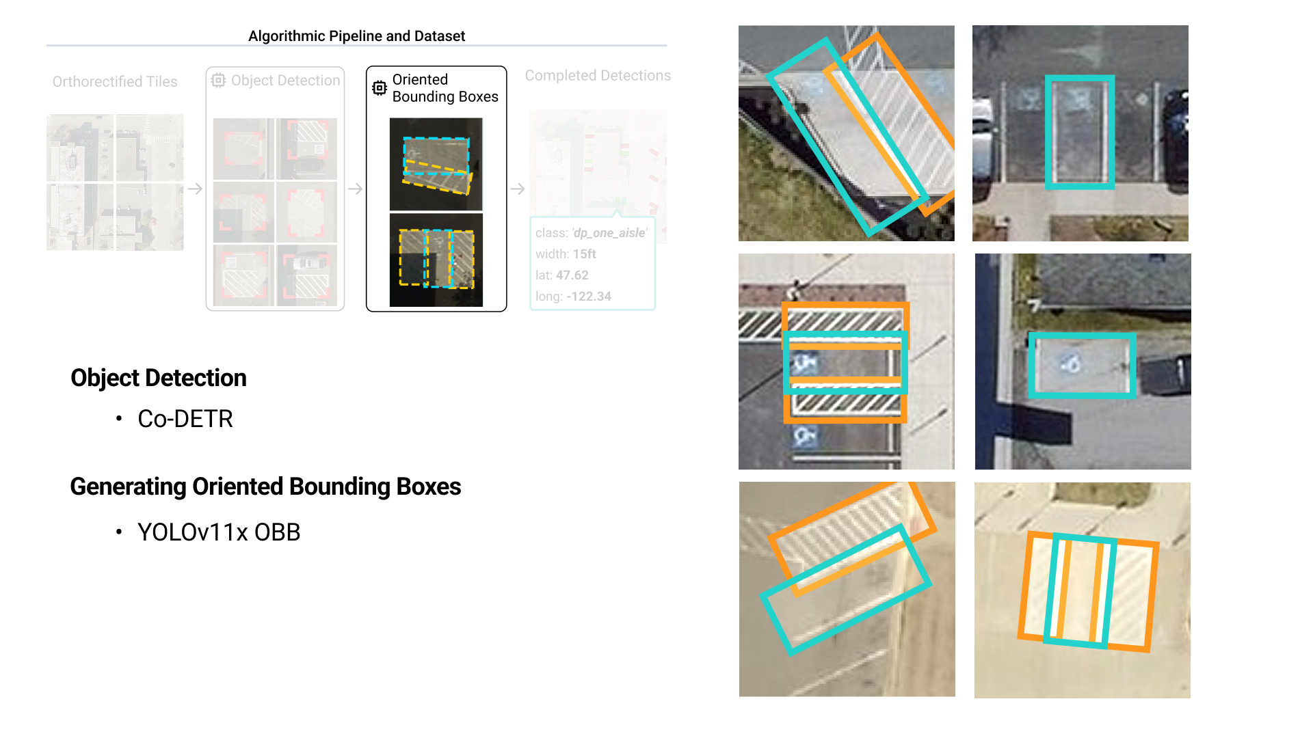

Slide 17
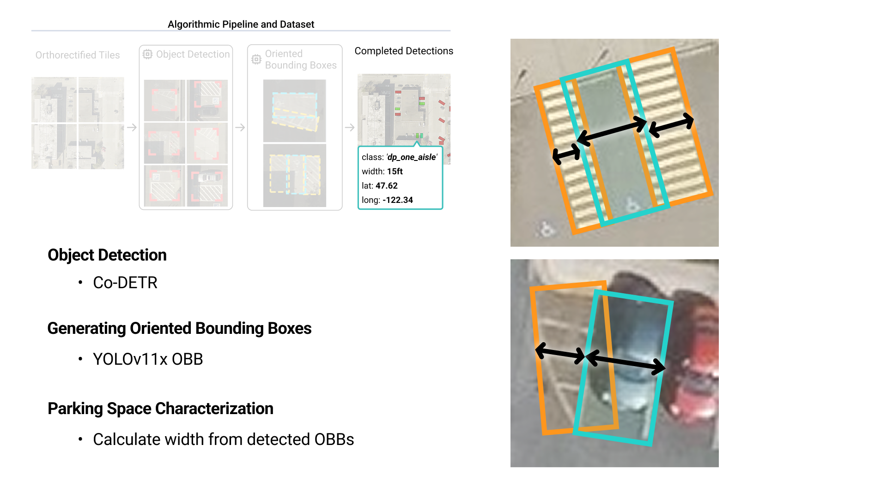

Slide 18
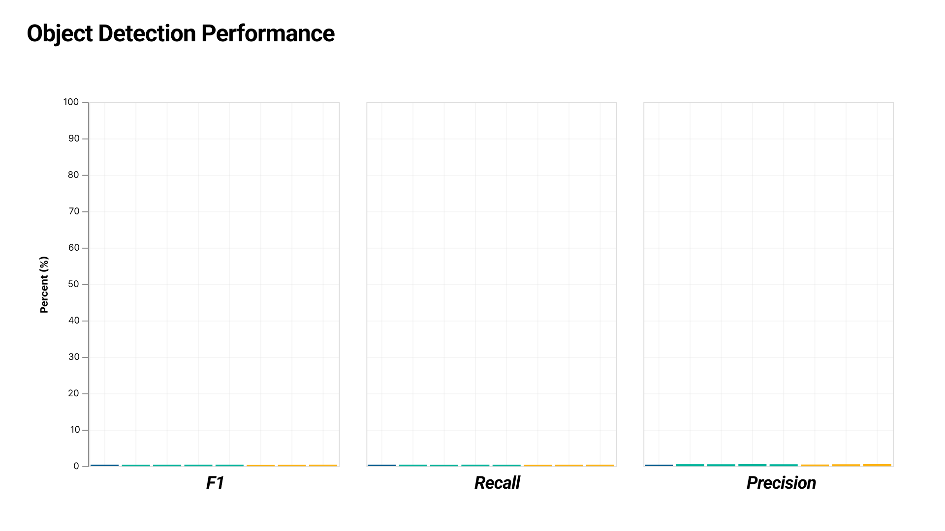
Notes:
Coming to object detection performance, we first evaluated our models on both a test subset of our dataset, and four manually labeled one km regions in our test cities

Slide 19
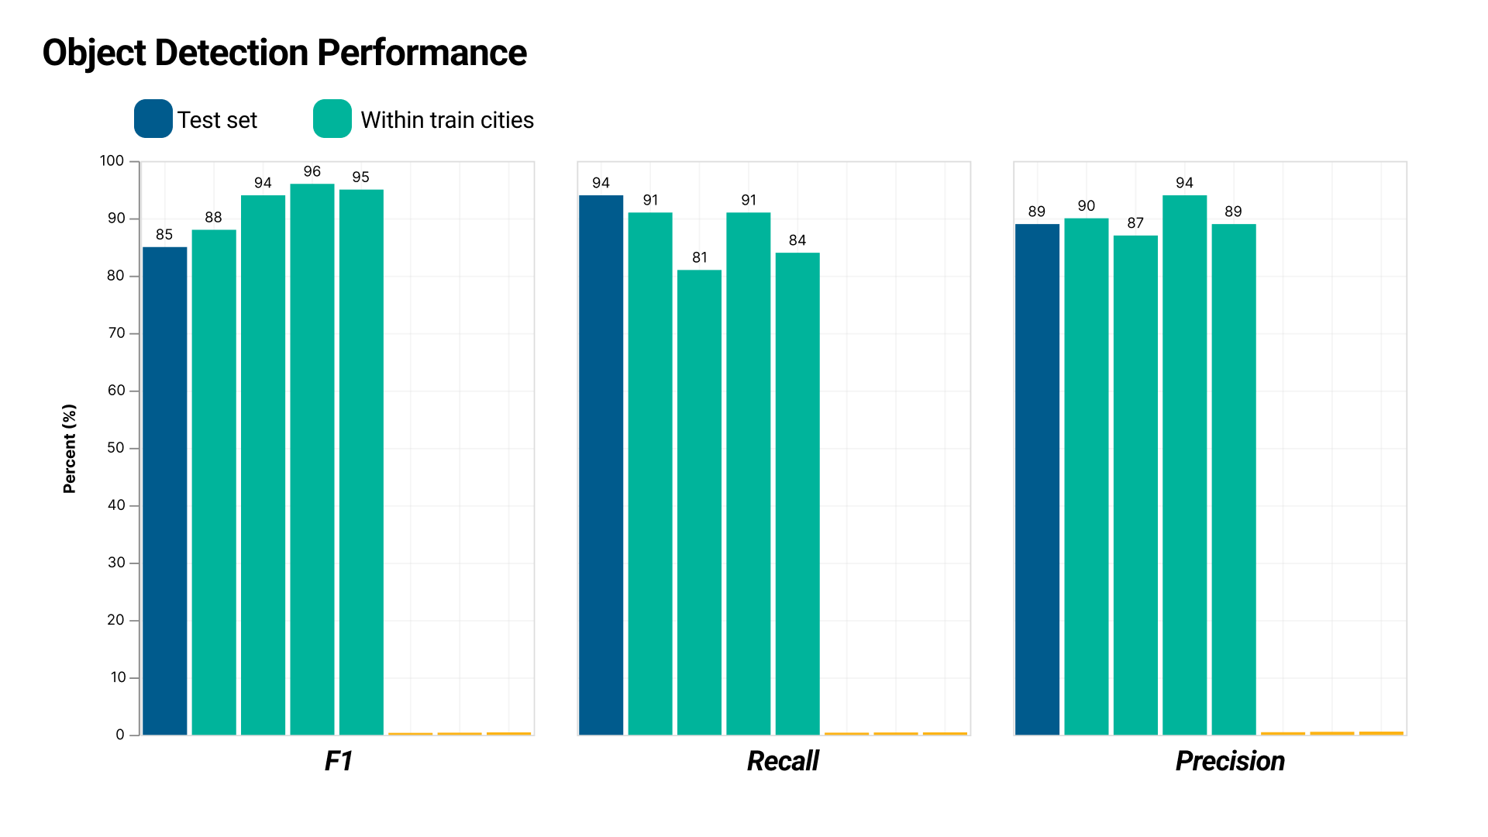
Notes:
We find relatively good performance, around the mid 80s to 90s.

Slide 20
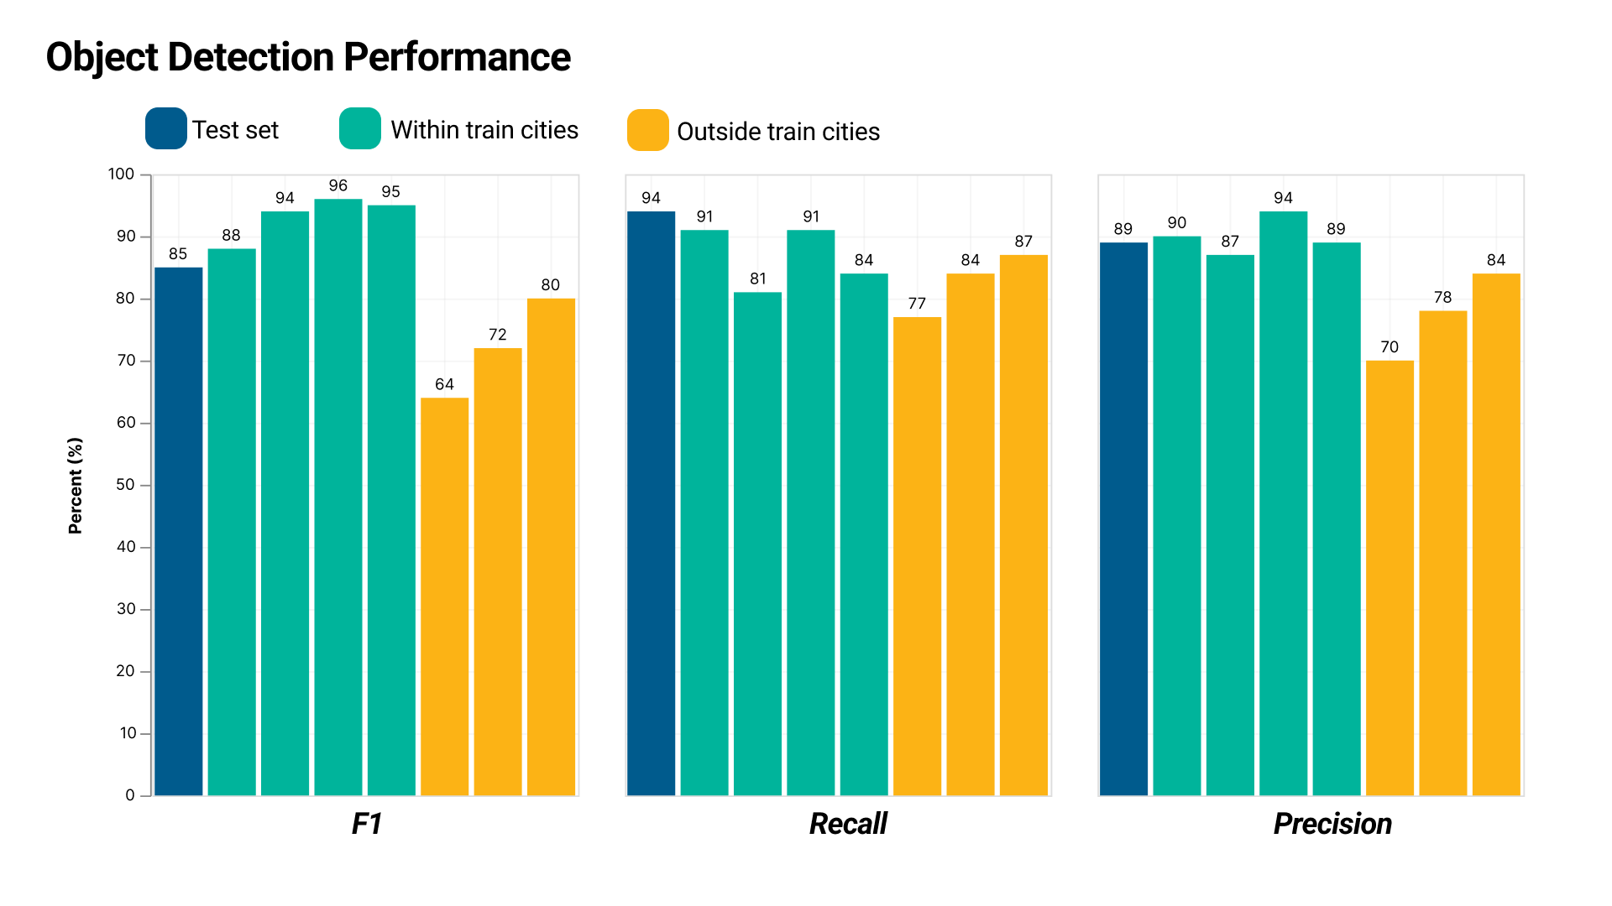
Notes:
To get a more generalized understanding of the performance, we also tested it on three manually labeled 1km regions outside of our train cities.
We find that, while performance is slightly worse...

Slide 21
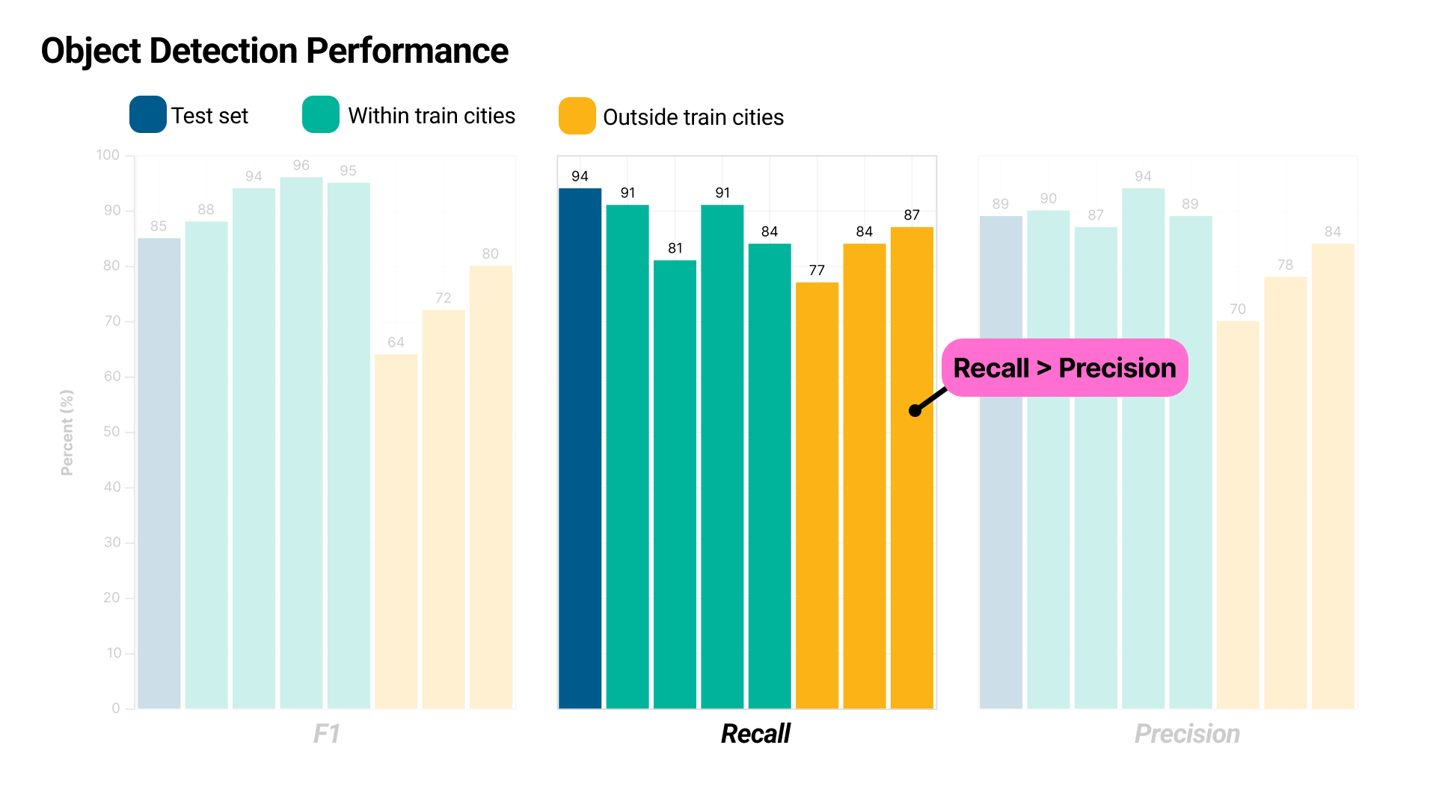
Notes:
For recall it is comparable. We'd like to note that we specifically trained the models to have high recall, as we feel that in this context, correcting a false positive is easier than finding a false negative.

Slide 22
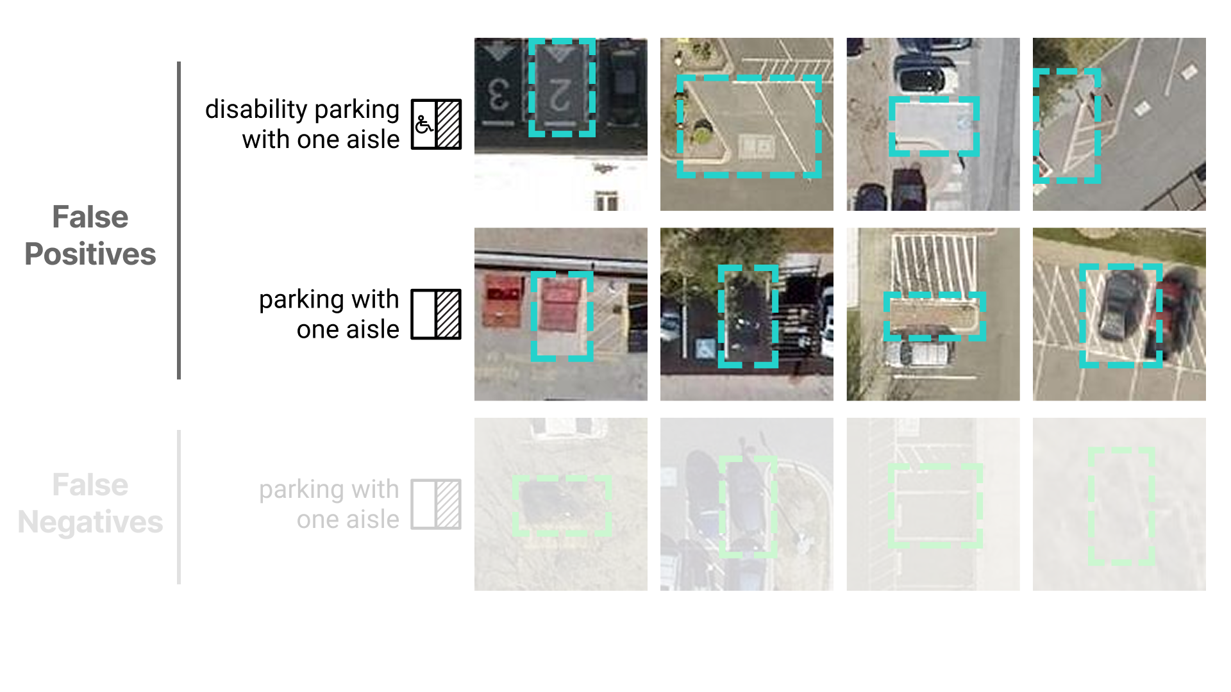
Notes:
Taking a look at where our models performed worse, we often see false positives in cases where there is some marking where a disability parking logo would be, or in cases where there is something that looks like a space or an access aisle

Slide 23
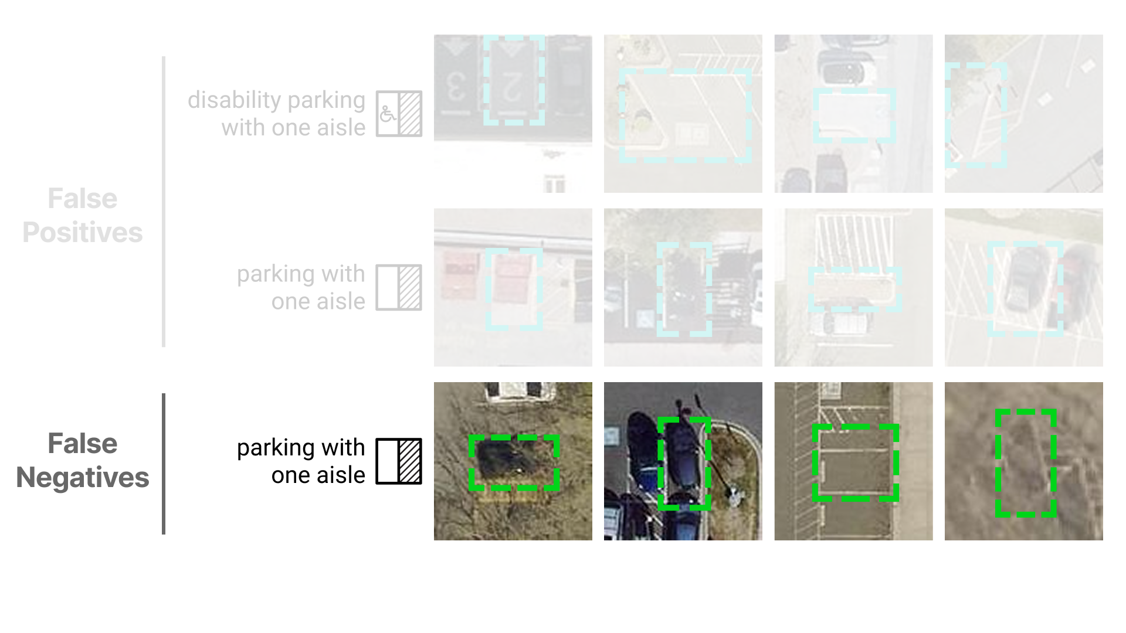
Notes:
As for the spaces it missed, this often came down to occlusion or blurry imagery.

Slide 24
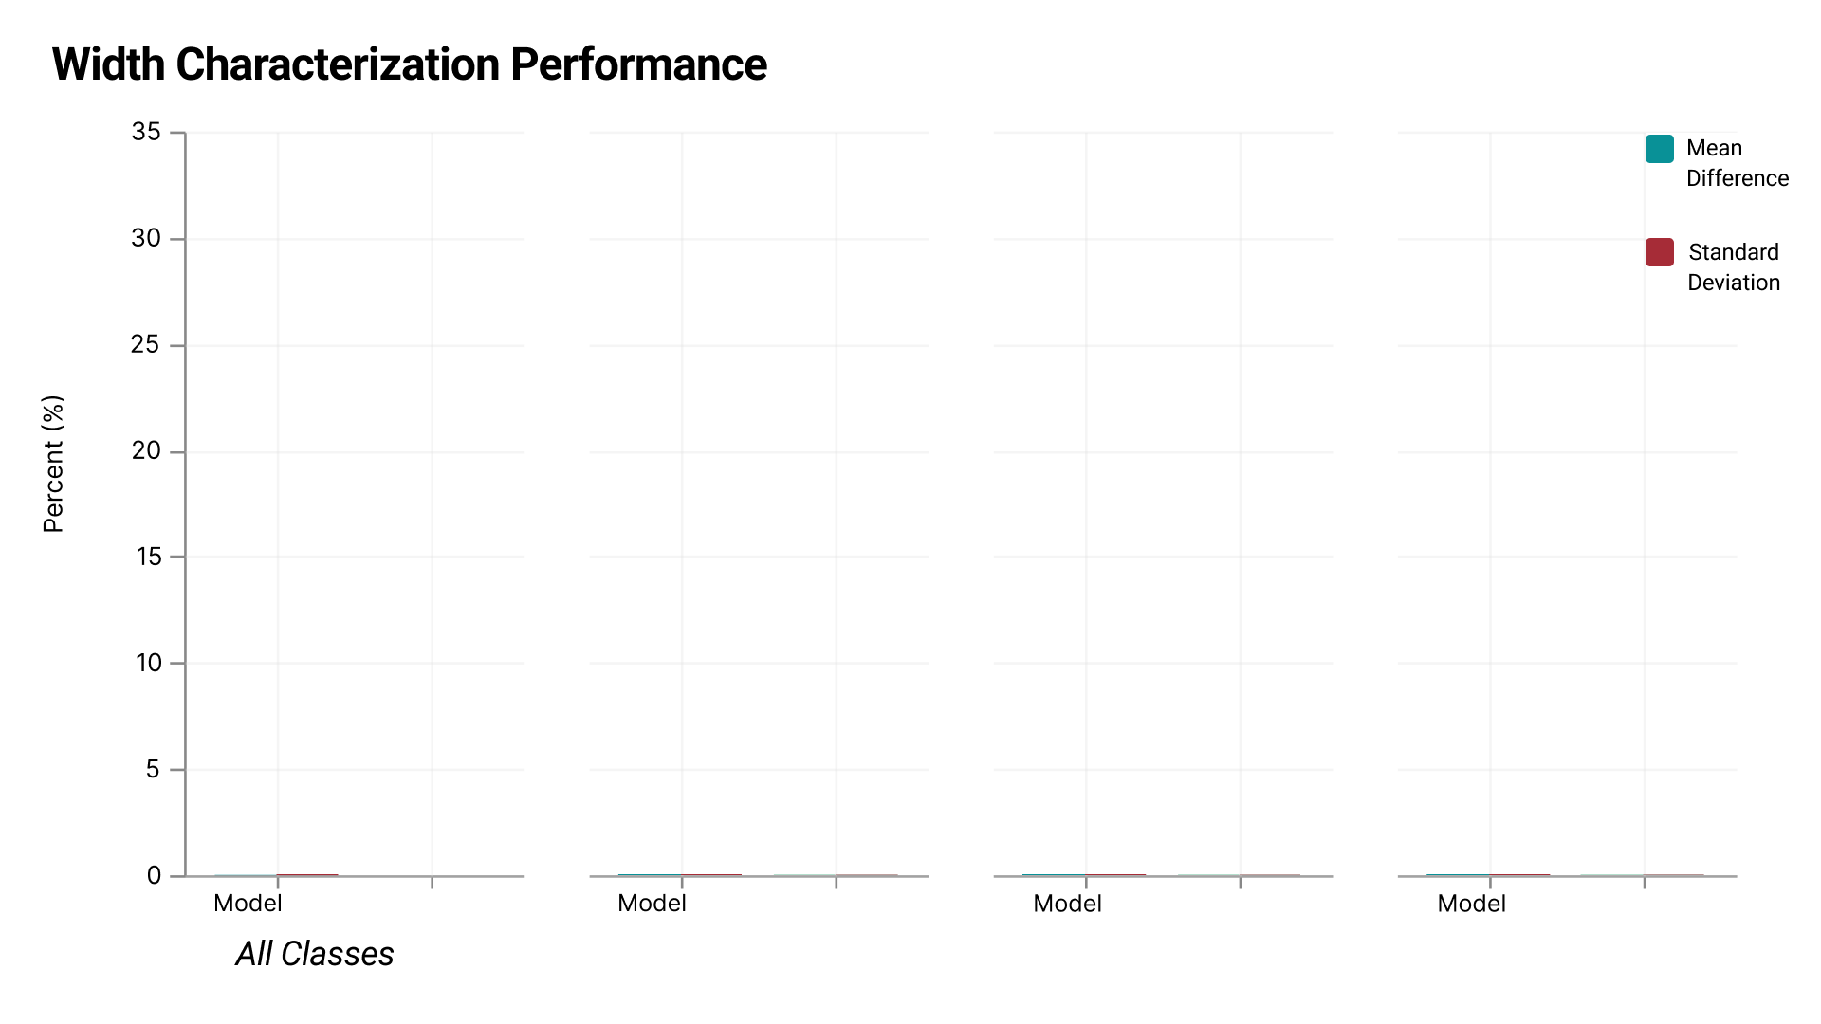
Notes:
For accuracy in determining width of parking spaces, we found that **

Slide 25
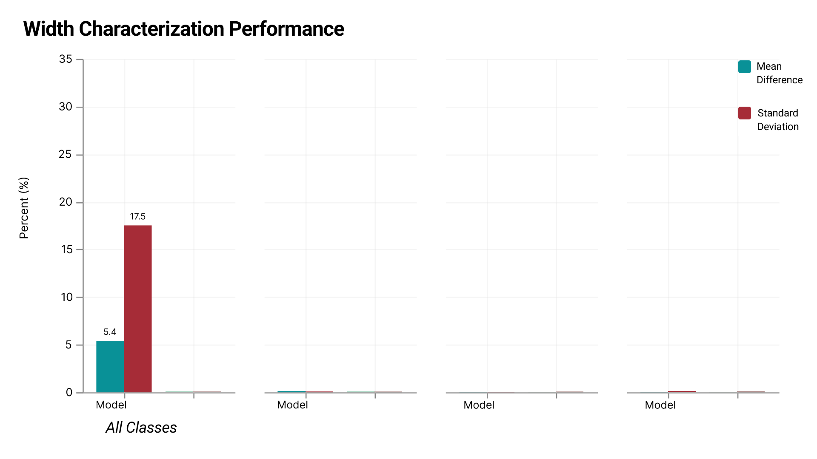
Notes:
on average, the model overestimated the width by 5.4%, with a standard deviation of 17.5%.
To get a frame of reference to understand this performance, we had two human labelers label the same subset of data and compared their difference to each other. **

Slide 26
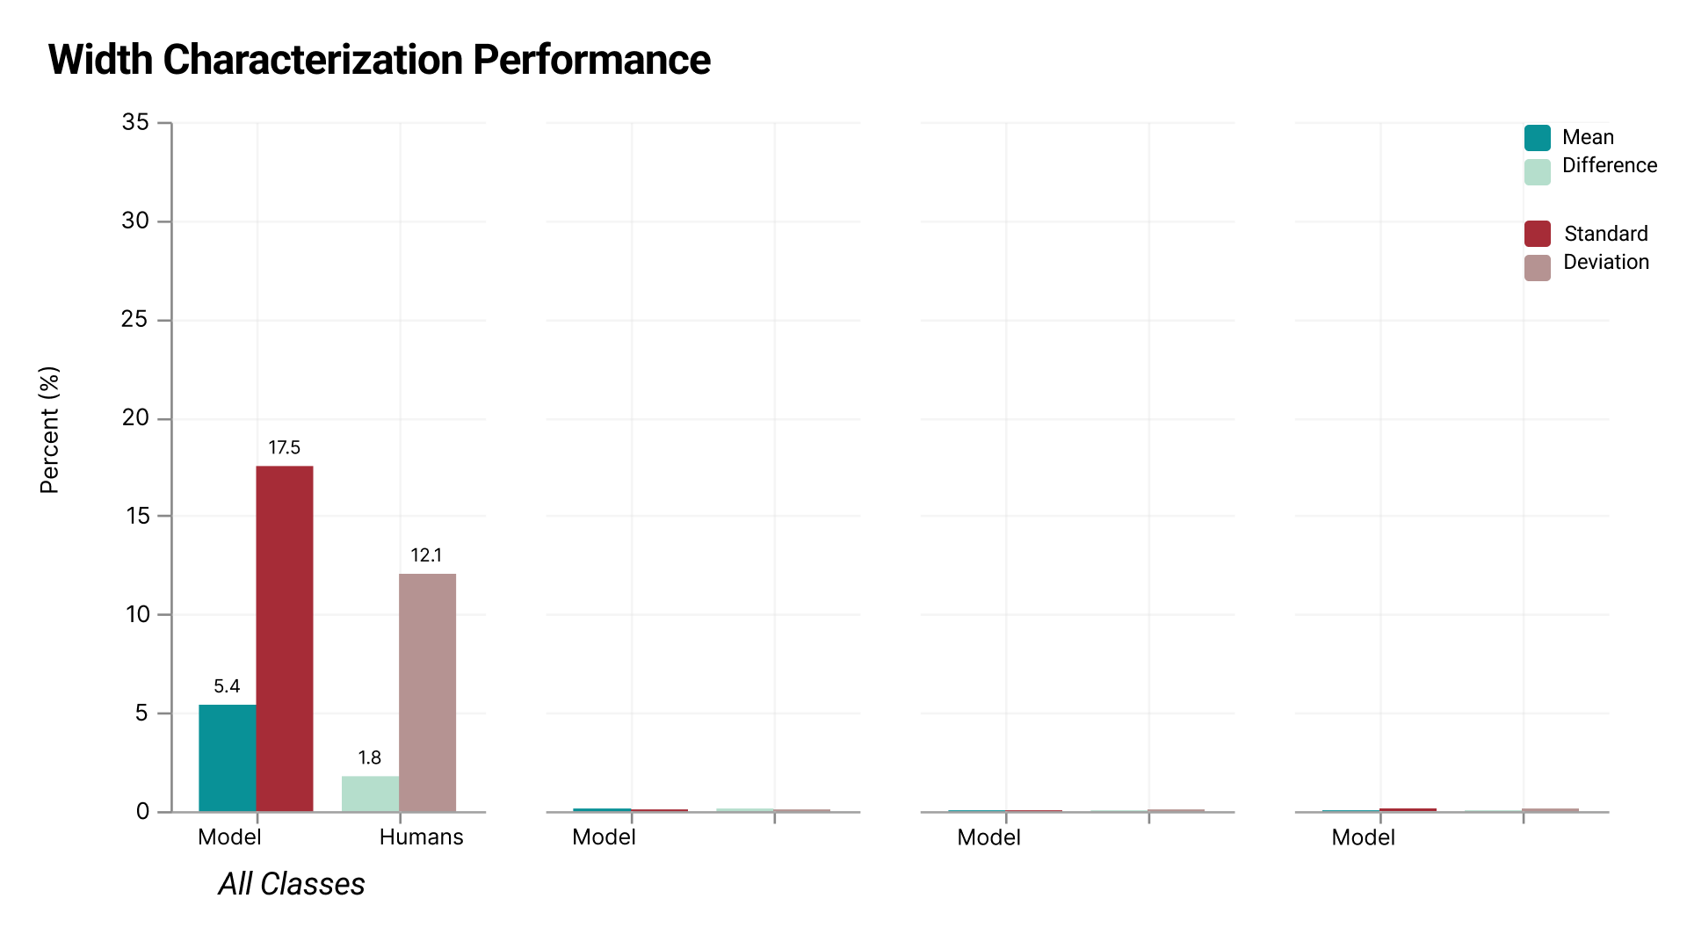
Notes:
and here is the result of that. While the humans were closer than the model and one human, its not by much, and we observe the same pattern of a high standard deviation.
We can also split these results by class. **

Slide 27
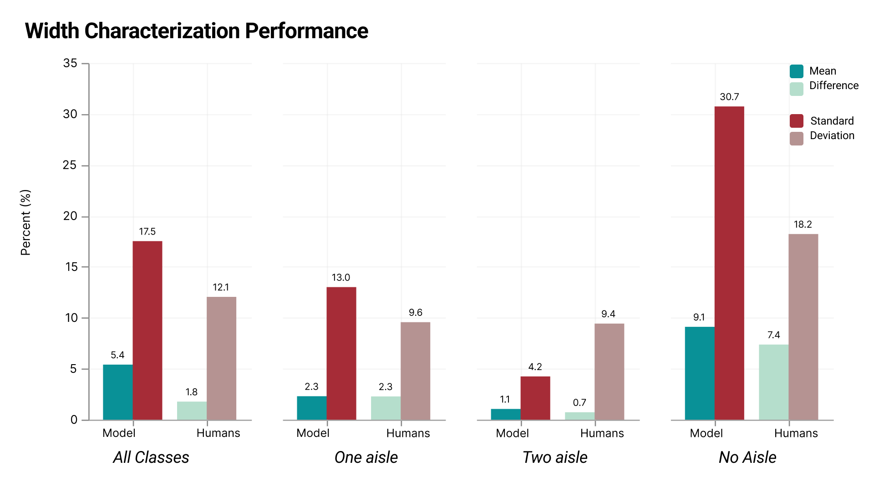
Notes:
Both the model and the humans performed the best on two aisle classes (perhaps, because they are wider), and the worst on no aisle classes, though the model performed much worse here. Which, makes some sense considering that no aisle parking is among the least represented in our dataset.
So where does this all bring us?

Slide 28
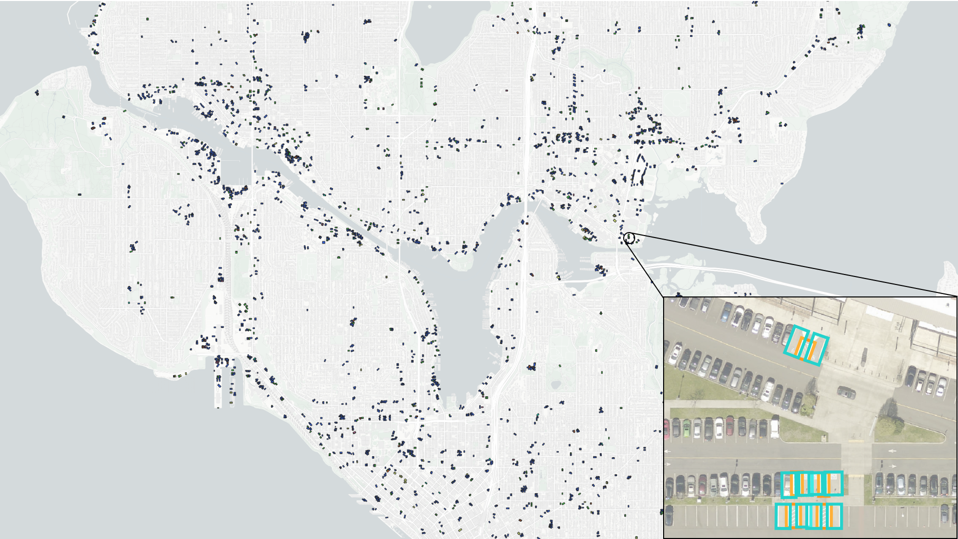
Notes:
We ran our pipeline on the entirety of Seattle, which you can see here. Every dot is a potential disability parking space, characterized both in location and geometry.
Using this, we can start to really dig into the scalable auditing aspect of our work, for example, looking at where there are clusters of disability parking, or, maybe more importantly, lack of clusters. This brings us to
**

Slide 29
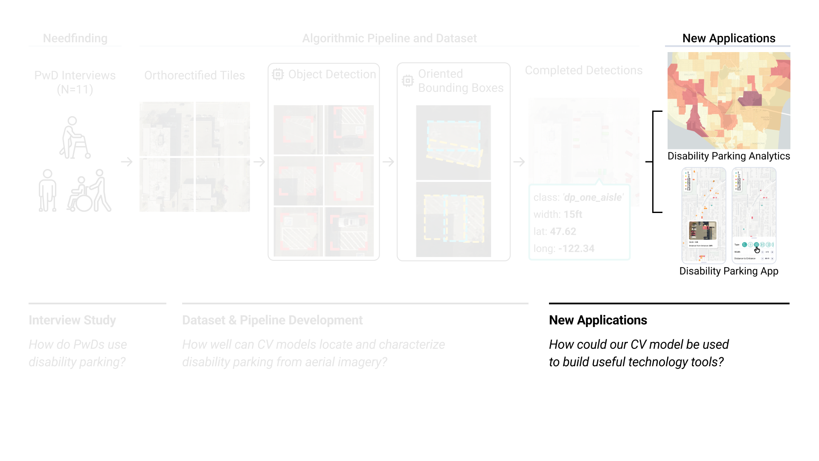
Notes:
Our final section, where I'd like to talk about some potential uses for our findings.

Slide 30
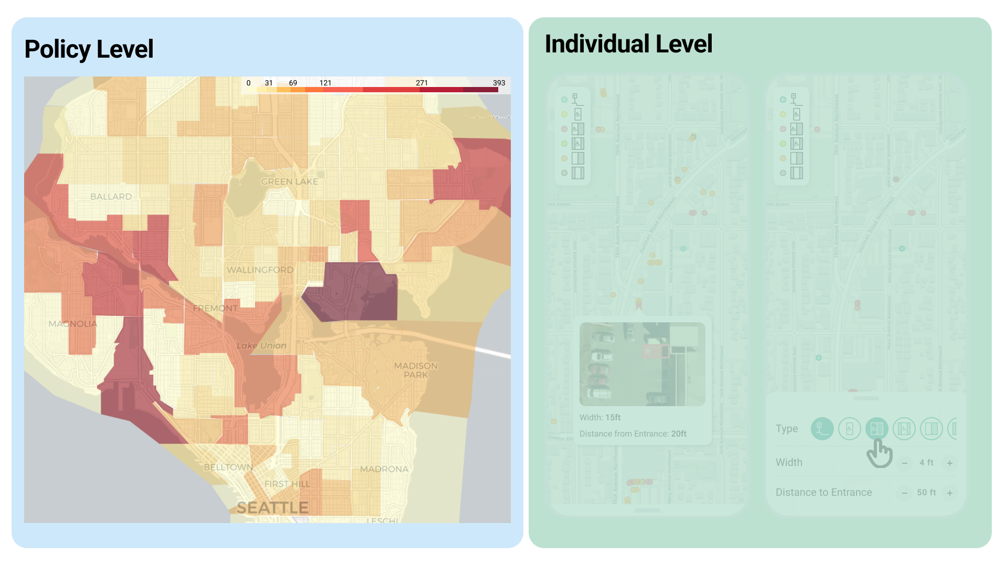
Notes:
We think of uses on two levels.
First, a policy level, where local governments can inspect where there is disability parking and if it aligns with regulation for width on a macro scale

Slide 31
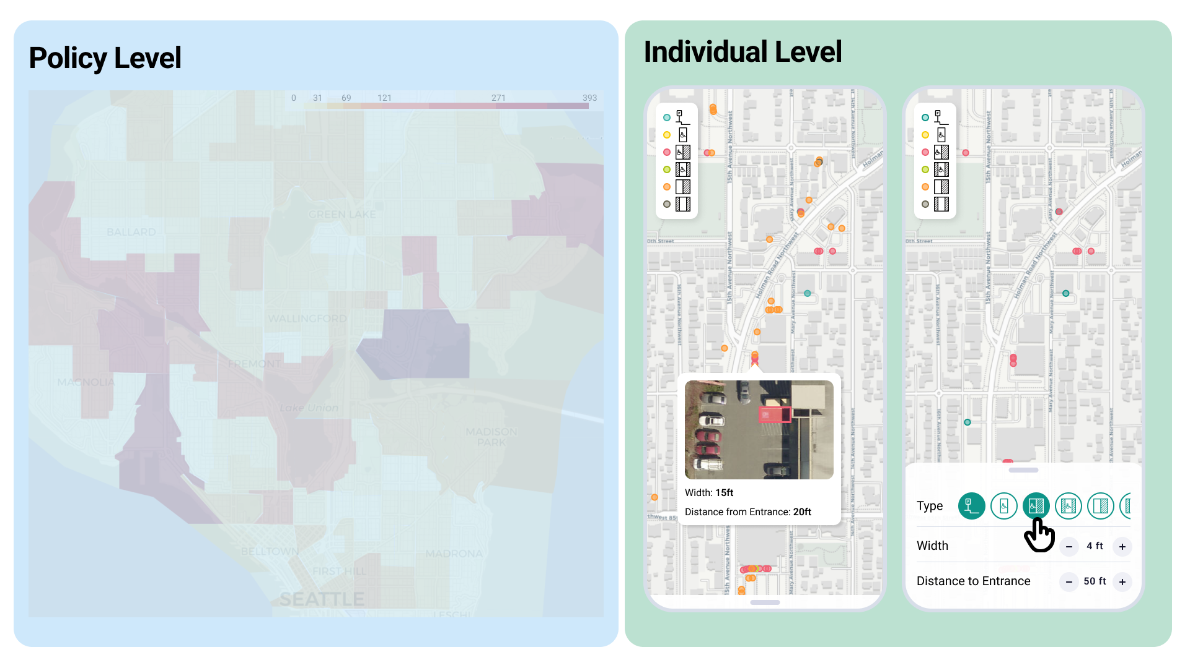
Notes:
Second, on an individual level, where individuals can find and filter for disability parking that suits their particular needs, responding to the need our participants described in the interview study.

Slide 32
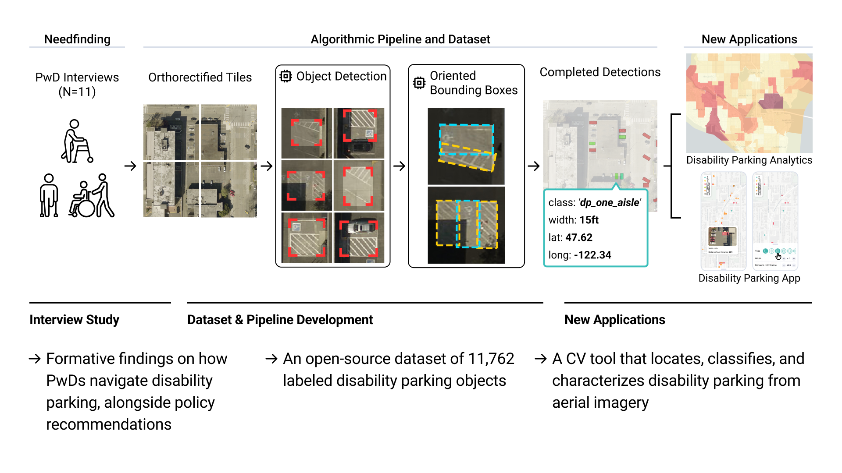
Notes:
Today, i've talked about our work to understanding disability parking and scalably audit it.
We contribute...
** ** **
We hope our work serves as a step towards scalable auditing of disability parking infrastructure, and greater individual agency

Slide 33
Where Can I Park?
Understanding Human Perspectives
and Scalably Detecting Disability Parking
Jared
Hwang
UW CSE
Chu
Li
UW CSE
Hanbyul
Kang
UW CSE
Maryam
Hosseini
UC Berkeley
City and Regional
Planning
Jon E.
Froehlich
UW CSE

Slide 34
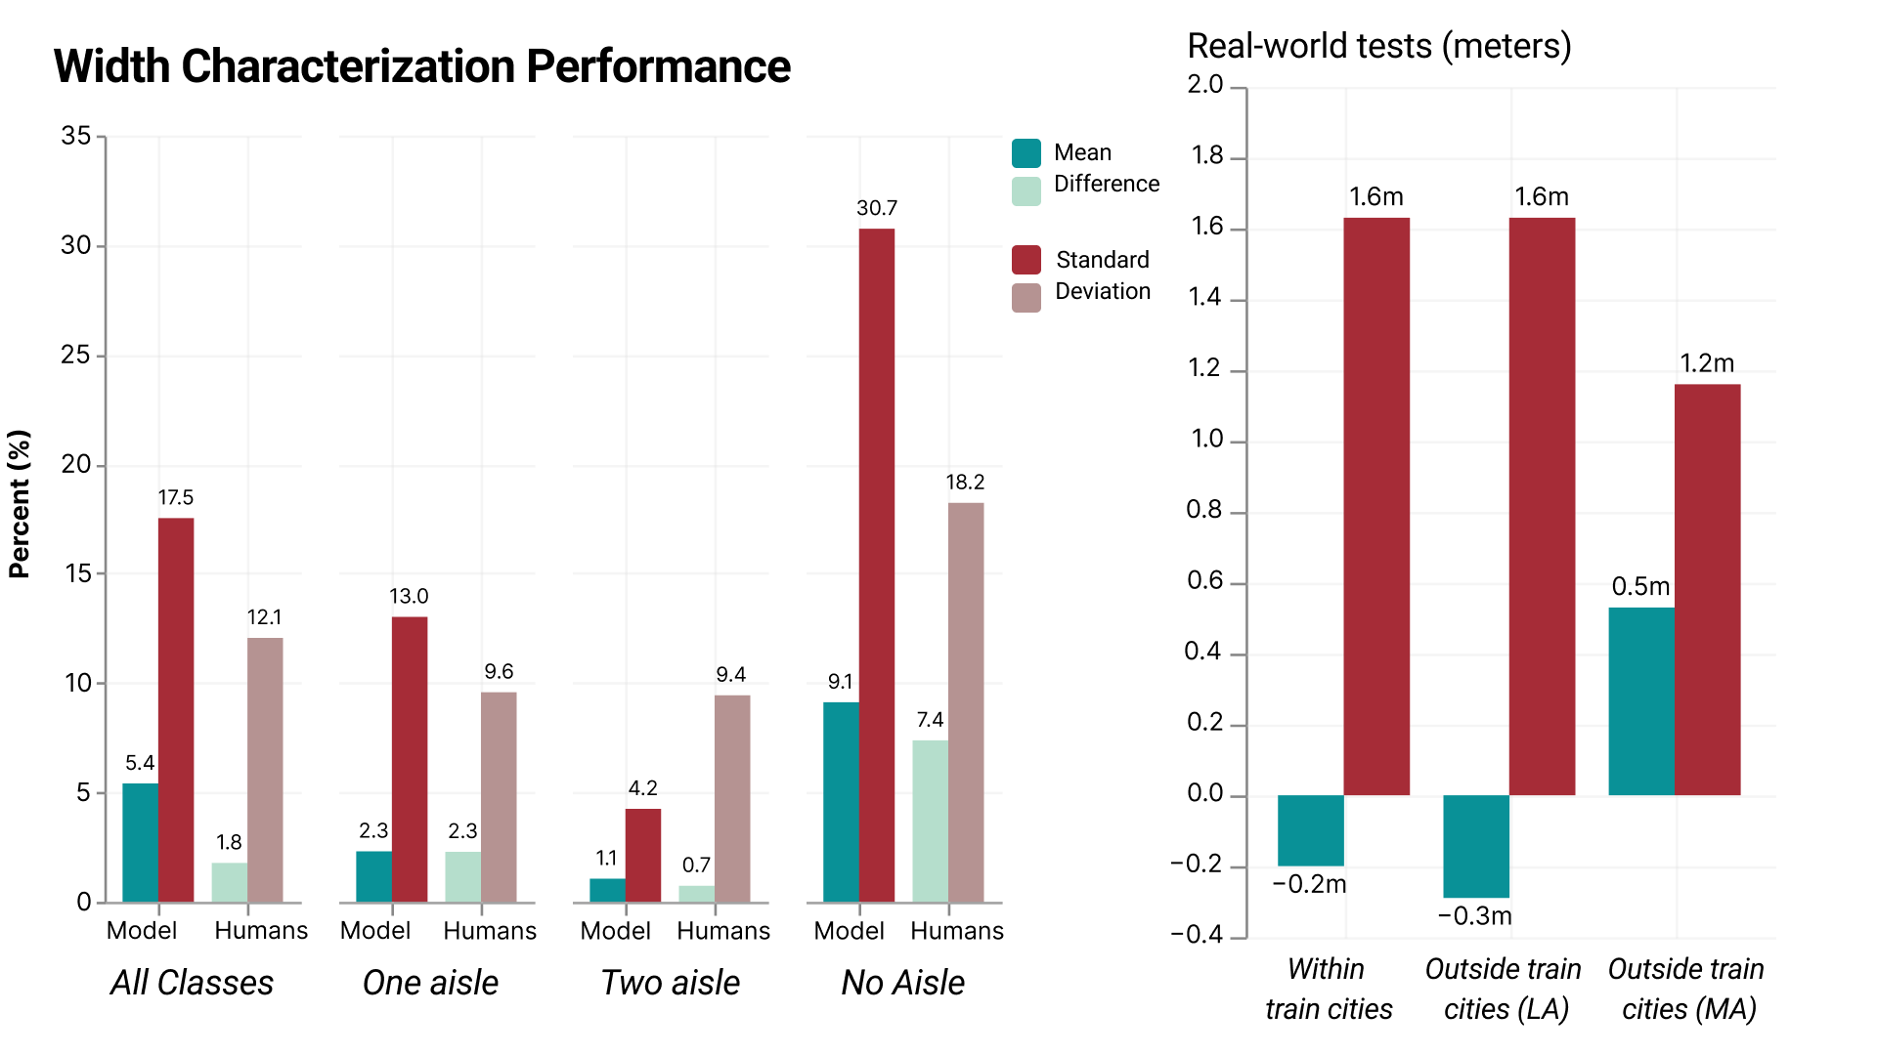

Slide 35
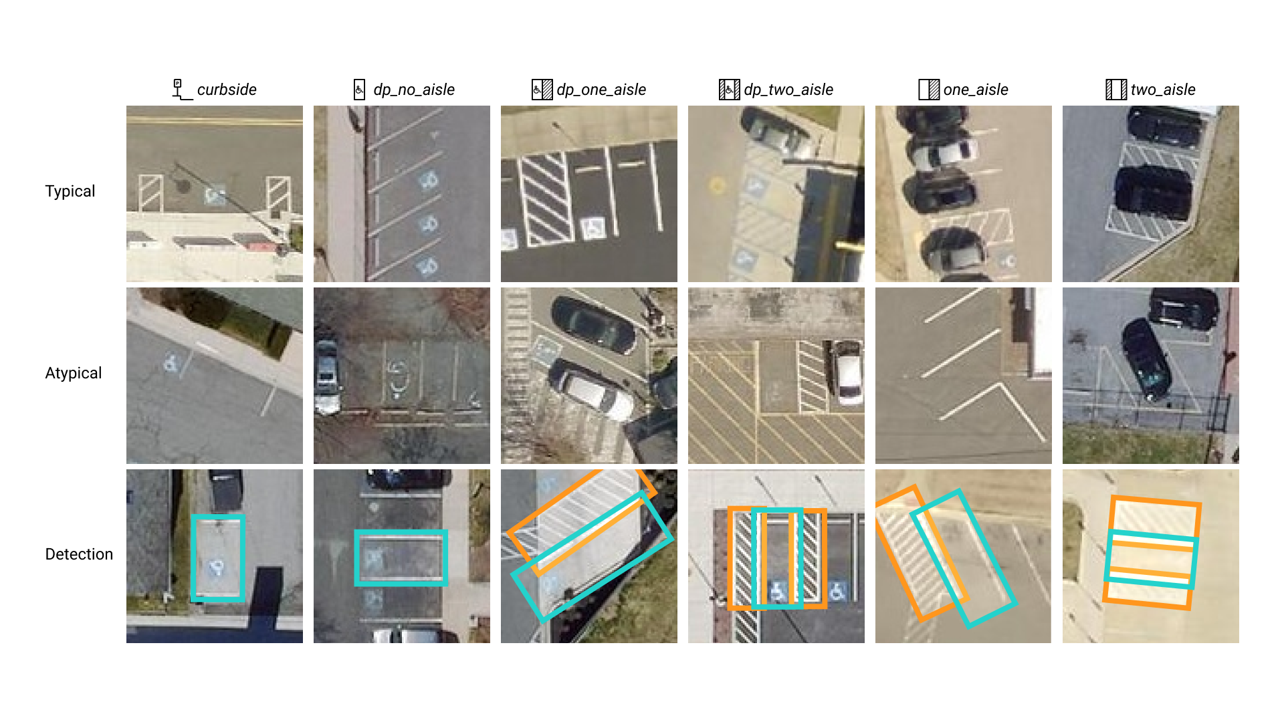

Slide 36
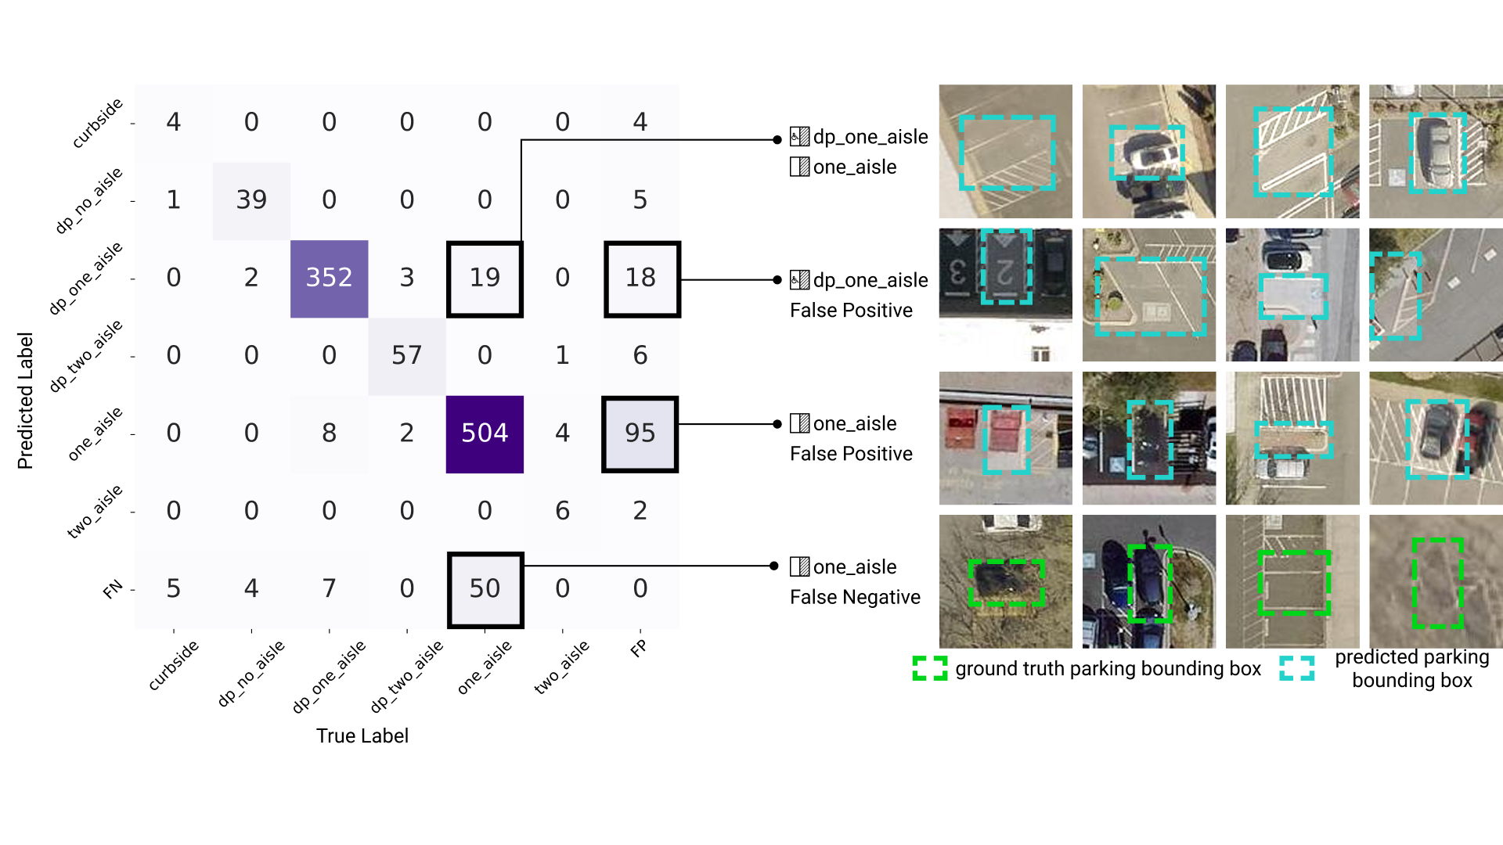

Slide 37
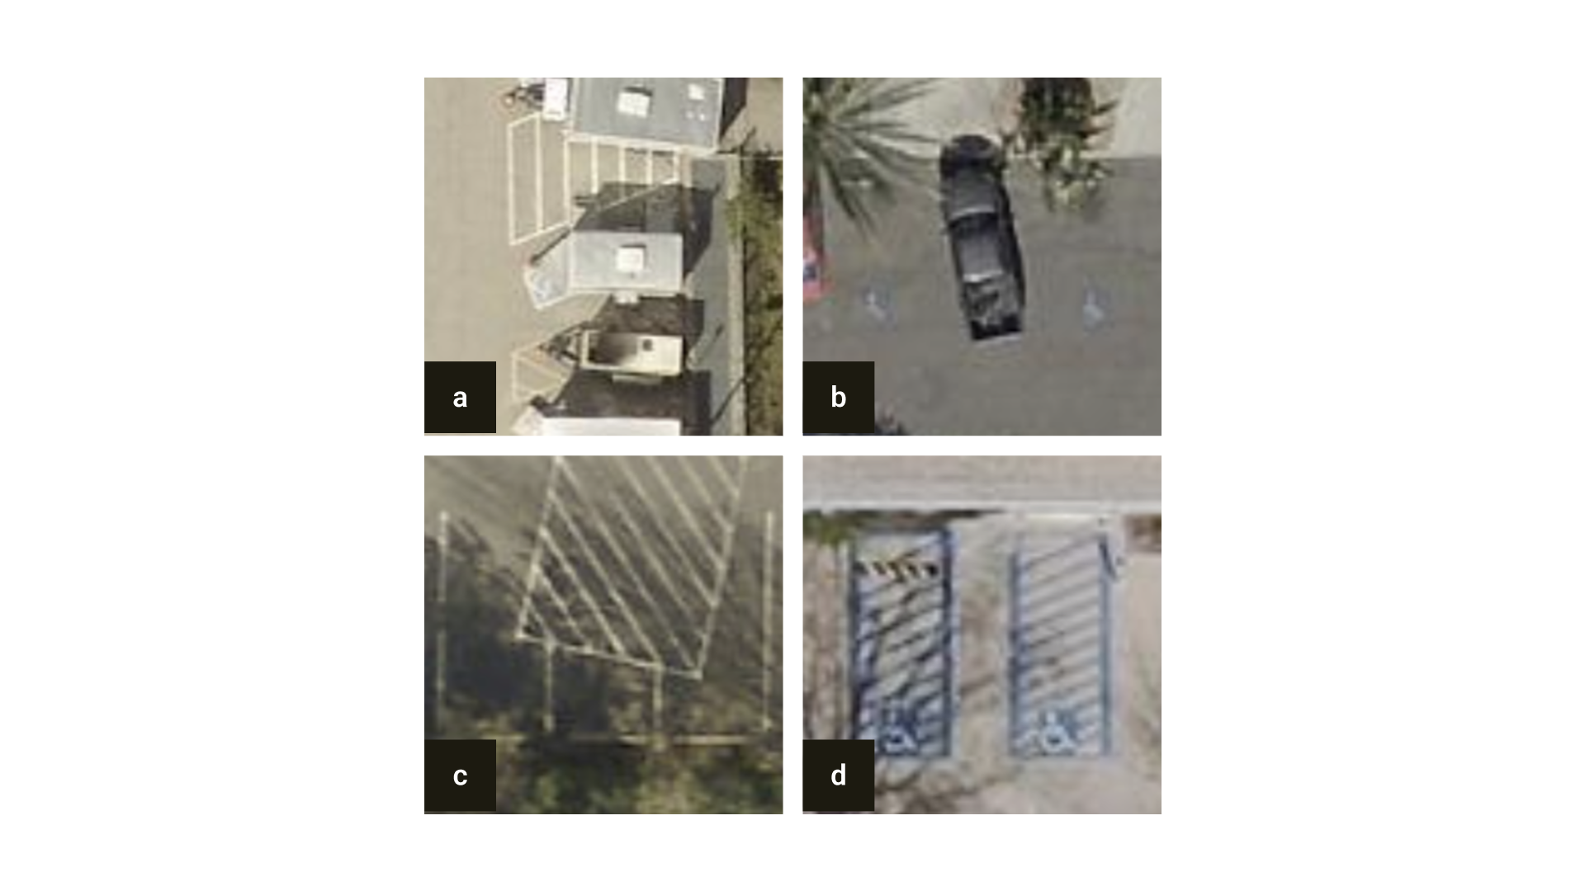

Slide 38
