Slide 1
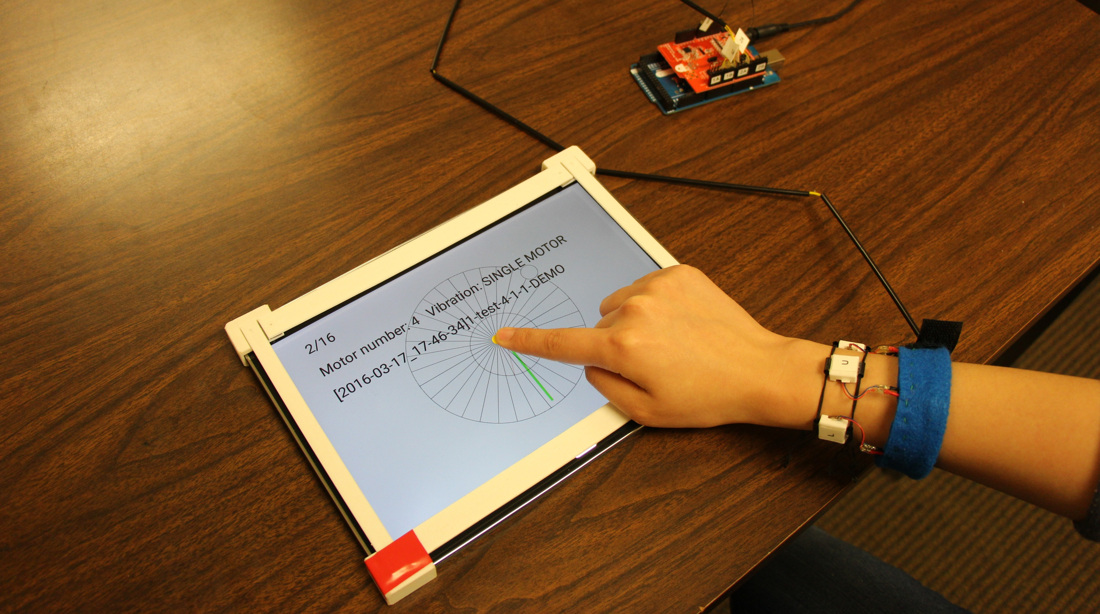
Evaluating Wrist-Based Haptic Feedback for Non-Visual Target Finding and Path Tracing on a 2D Surface
Jonggi Hong
Alisha Pradhan
Jon E. Froehlich
Leah Findlater
jhong12@umd.edu
alisha93@umd.edu
jonf@umd.edu
leahkf@umd.edu
Notes:
Thank you for coming to my talk.
I’m Jonggi Hong. I’m a PhD student at University of Maryland.
This presentation is about Evaluating Wrist-Based Haptic Feedback for Non-Visual Target Finding and Path Tracing on a 2D Surface.
I worked on this project with Alisha Pradhan, Professor Jon Froehlich, and my advisor Professor Leah Findlater.

Slide 2
What is hand guidance?
Notes:
Let’s start simple. We’re looking at how to guide users in moving their hand in a specific direction. This type of guidance could be useful in a variety of contexts. Let me give you some examples.

Slide 3
Ex. 1) tracing a text with finger-mounted camera
Notes:
Recently, wearable devices used a finger-mounted camera to provide information of text under the finger. In this case, physically tracing printed text to hear text-to-speech output needs a user’s hand to be guided.

Slide 4
Ex. 2) Learning touchscreen gestures
Notes:
When blind people use touchscreen devices, they need to learn touchscreen gestures which requires users to move the hand in the right direction.

Slide 5
Ex. 3) Learning handwriting
Notes:
Learning handwriting, visually impaired people need to know in which direction their hands should move.

Slide 6
Approach
Audio or haptic feedback have been used to provide visually impaired people with the hand guidance.
Smartwatches present new opportunities for directional hand guidance that is proximal to the hand.
Notes:
To provide this guidance, researchers have explored both audio feedback, such as sonification and verbal guidance, as well as haptics, such as finger-mounted vibromotors or force feedback
Smartwatches also recently present new opportunities for directional hand guidance that is proximal to the hand.

Slide 7
Problem
How should the haptic feedback around a wrist be designed?
How many haptic actuators do we need?
Is interpolated vibration stimulation able to provide more precise directional guidance?
Notes:
However, how to design this guidance is an open question. We focused on two design parameters.
(click)
One of them is number of haptic actuators around the wrist.
More motors around the wrist could make the feedback more precise but they also increase the weight and complexity
(click)
In addition, whether users can correctly perceive interpolated vibrations to indicate directions between motors was the other question.

Slide 8
Haptic feedback around a wrist
Motors
Notes:
To answer these questions, we conducted two studies with prototypes of haptic wristbands.
Here is one of the prototypes with four motors around a wrist.
[click] When the top motor vibrates, this indicates the user should move the hand forward.
[click] When the motor on the right of the wrist vibrates, the user should move the hand to the right.

Slide 9
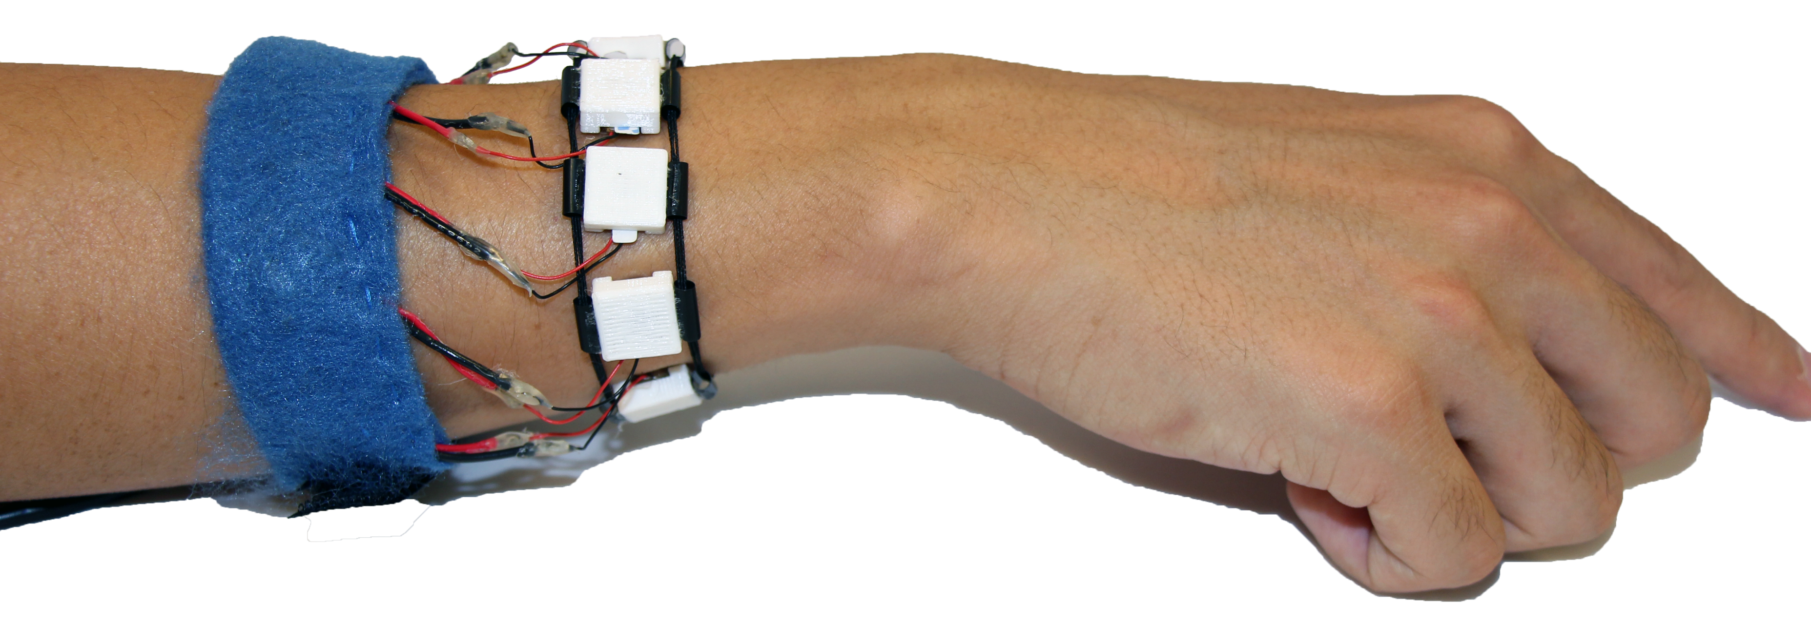
Number of Motors
4 motors
8 motors
Notes:
One wristband included four motors, placed at equal distances around the wrist, while the second one included 8 motors.

Slide 10
Interpolated Feedback (Phantom Sensation)
Two vibrotactile actuators placed closely together on the skin create the illusion of a single vibration between the two actuators.
The location of the phantom sensation is determined by the amplitude of the two vibrations.
[Alles, 1970]
Motor
Motor
Illusion of
a vibration
Notes:
We can also use vibrations in different ways. One way is interpolating the vibrations, which is called Phantom sensation.
(click)
Two vibrotactile actuators placed closely together on the skin
(click)
create the illusion of a single vibration between the two actuators.
(click)
And the location of the phantom sensation is determined by the amplitude of the two vibrations.
When a motor vibrates stronger than the other, (click)
the phantom sensation is closer to that motor.

Slide 11
Single-motor and Interpolated Feedback
Up-right
(diagonal)
Single-motor
Feedback
Interpolated
Feedback
(Phantom sensation)
Phantom
sensation
Notes:
So, we also compared two methods of haptic feedback.
One named single-motor feedback allows only one motor to vibrate at a time. For example, as I mentioned,
[click]
When the top motor vibrates, this indicates the user should move the hand forward.
Interpolated feedback indicates directions between two adjacent motors by interpolating two vibrations of them.
For example, with the four motor wristband, if we want to indicate a diagonal direction up and to the right,
[click]
the motors on the top and right sides of the wrist vibrate at equal amplitude, creating a phantom sensation in that direction.

Slide 12
Research Questions
4 motors
Simplicity
8 motors
High fidelity
vs.
Single-motor
feedback
Clear/discrete guidance
Interpolated
feedback
Continuous guidance
vs.
Notes:
More specifically, we have two research questions.
(click)
How many motors do we need to offer precise feedback for hand guidance in 2D space? Feedback from 4 motors is simpler than 8 motors, but 8 motors provide higher fidelity than 4 motors.
(click)
Does interpolated feedback enable users to move hands more precisely than single-motor feedback? Single-motor feedback is more clear than interpolated feedback, but interpolated feedback can provide continuous directional guidance.

Slide 13
Overview of Two Studies
Study 1 – Interpolation and Number of Motors
Comparing 4 and 8 motors as well as single-motor and interpolated feedback with 11 sighted and 2 blind participants.
Study 2 – Evaluating with Blind Participants
Comparing 4 and 8 motors using single-motor feedback with 14 blind participants.
Notes:
We conducted two studies to evaluate these designs.
(click)
In Study 1, we compared 4 and 8 motors as well as single-motor and interpolated feedback with sighted and blind participants to pare down the experimental conditions in Study 2.
(click)
In Study 2, we compared 4 and 8 motors with blind participants using single-motor feedback only because participants completed tasks faster and more accurately with single-motor feedback in Study 1.

Slide 14
Related work
Notes:
We focused on two types of related work: assistive uses of haptic feedback and hand or wrist-worn haptic feedback devices.

Slide 15
Haptic Feedback for Assistive Applications
Sensory Substitution of Visual Information
BrainPort by Sampaio et al., 2001
Optacon by Schoof, Loren, 1974
Whole Body Navigational Support
4x4 grid of tactile actuators on the back of a vest by Ertan et al., 1998
Wrist-worn haptic devices by Scheggi et al. 2014
Notes:
Haptic feedback has been used for a range of assistive applications for users with visual impairments.
(click)
Including sensory substitution, which maps visual information to alternative modalities.
(click)
More related to our work is whole body navigational support such as informing turns or obstacles in a route.
Body and wrist-worn haptic feedback has been studied here, but these tasks are different from moving a hand precisely in a small space.

Slide 16
Non-visual Directional Hand Guidance
Haptic Directional Guidance on a Hand
Vibromotors mounted on a smartphone by Kim et al., 2016
Haptic actuators on the finger by Stearns et al., 2016
Wrist-worn Directional Haptic Guidance
Haptic wristband for sighted users in virtual space by Weber et al., 2011
Haptic wristband using phantom sensation by Hong et al., 2016
Notes:
(click)
For non-visual directional hand guidance specifically, Vibromotors have been mounted on a smartphone or finger.
(click)
A couple of studies have looked at wrist-worn solutions with sighted users.
Weber et al. guided users in moving and rotating their arm in free space rather than on a 2D surface.
Our previous study showed that an 8-motor wristband resulted in small accuracy benefits over a 4-motor design but the experimental task was relatively simple, making a directional swipe, and our study did not include blind users.

Slide 17
User study 1
Comparing 4 and 8 motors as well as single-motor and interpolated feedback for haptic feedback around a wrist with sighted and blind participants.
4 conditions
4-motor + single-motor feedback
8-motor + single-motor feedback
4-motor + interpolated feedback
8-motor + interpolated feedback
Notes:
Let me explain the first controlled lab study which compared 4 and 8 motor-wristbands as well as single-motor and interpolated feedback.

Slide 18
Participants
11 sighted participants (6 female, 5 male)
25.3 years old on average
Blindfolded during the task
All right-handed
2 blind participants (1 female, 1 male)
53 years old male, right handed
63 years old female, left handed
Notes:
We recruited 11 sighted and 2 blind participants. Sighted participants were blindfolded during the task to isolate the effects of the haptic feedback.

Slide 19
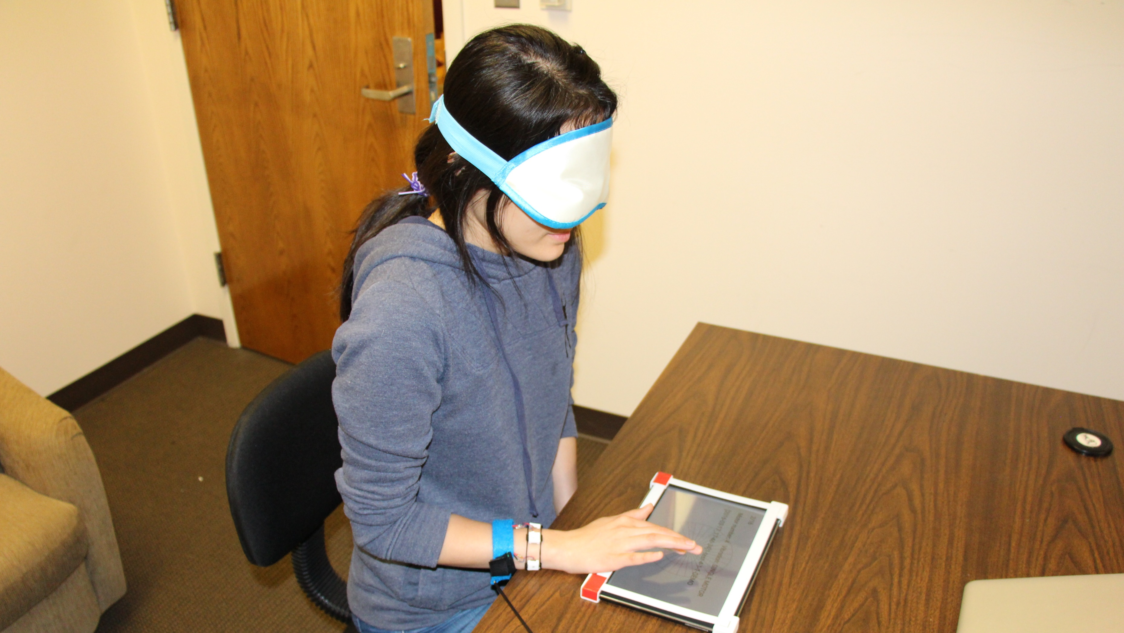
Notes:
This is the study setup. The tablet device was placed flat on a table in front the participant.

Slide 20
s
Notes:
Let me explain the devices used for our study.
We used a tablet to track the position of the finger and Arduino to control the vibration motors.
To isolate the motors and limit vibration transfer, we mounted the motors on a band separate from the wiring and housed them magnetically in 3D-printed cases connected only by thin elastic thread.

Slide 21
Procedure
Background
survey
Notes:
The study procedure included first a background questionnaire, then for each wristband condition,
there were introduction task, target-finding task, path-tracing task, and getting subjective feedback.

Slide 22
Procedure
Background
survey
Introduction
task
Notes:
The study procedure included first a background questionnaire, then for each wristband condition,
there were introduction task, target-finding task, path-tracing task, and getting subjective feedback.

Slide 23
Procedure
Background
survey
Target-finding
task
Introduction
task
Notes:
The study procedure included first a background questionnaire, then for each wristband condition,
there were introduction task, target-finding task, path-tracing task, and getting subjective feedback.

Slide 24
Procedure
Background
survey
Target-finding
task
Introduction
task
Path-tracing
task
Notes:
The study procedure included first a background questionnaire, then for each wristband condition,
there were introduction task, target-finding task, path-tracing task, and getting subjective feedback.

Slide 25
Procedure
Background
survey
Target-finding
task
Subjective
feedback
Introduction
task
Path-tracing
task
Notes:
The study procedure included first a background questionnaire, then for each wristband condition,
there were introduction task, target-finding task, path-tracing task, and getting subjective feedback.

Slide 26
Target-finding Task
Target
Start
Notes:
I’ll give you some explanations about target-finding and path-tracing tasks.
In a target finding task,
(click)
A participant started a trial by touching a sticker at the center of a touchscreen.
(click)
When a trial started, the target was randomly positioned on the touchscreen and a motor or motors started vibrating.
(click)
A trial ended when the finger of a participant enters the target bounds.
Audio feedback was provided when a trial started and ended.
There were 5 training trials plus 30 test trials.

Slide 27
Measures
Trial completion time
The time from the time a trial started until the finger entered the target bounds.
A
Movement error
B
$$=\frac{Actual distance the finger moved (B)}{Euclidian distance (A)}$$
Notes:
(click)
Trial completion time was computed from the time the vibration started until their finger entered the target.
(click)
Movement error was computed as the ratio of the actual distance the finger moved during the trial to the Euclidian distance between the start location and the closest point on the target, so lower values are better.

Slide 28
Path-tracing Task
Start
End
Notes:
The next task is path-tracing task.
(click)
A participant started a trial by touching a sticker at the center of a touchscreen.
(click)
When a trial started, a path was randomly selected from a set of 18 paths based on route features from a real university campus map
Here is one of the paths used in the study.
And a motor or motors around a wrist started vibrating.
Participants traced the path based on the guidance from the haptic wristband.
A trial ended when the finger reached the end of the path.
Audio feedback was provided when a trial started and ended
There were 5 training trials plus 10 test trials.

Slide 29
Path-tracing Task
Touch point
Touch point
Touch point
Start
End
Notes:
I’ll explain more about how the finger was guided along the path.
Each path consists of three segments.
(click)
For straight segments, the system guided the user to the segment end point.
(click)
For curved segments, the system guided the user to the tangent point of a line drawn from the curve to the finger.

Slide 30
Measures
Trial completion time
The time from the time the vibration started until the finger reach the last segment.
B
A
Movement error
Distance between the path (A) and the trace that finger moved (B) computed by dynamic time warping (DTW)
Notes:
(click)
Trial completion time was computed from the time the vibration started until their finger reached the end of the path.
(click)
The movement error was computed by measuring the distance between the presented path and the actual trace by dynamic time warping method.

Slide 31
Results of User Study 1
Target-finding task
Interpolated feedback was slower than single-motor feedback (p = .005)
Interpolated feedback resulted in higher error rate than single-motor feedback (p = .023)
Path-tracing task
Interpolated feedback was slower than single-motor feedback (p = .007)
Movement error was higher with interpolated feedback (p = .038)
Subjective feedback
Participants consistently rated the wristbands with interpolation worse than other conditions.
Notes:
I’m going to just briefly describe findings from study 1.
Interpolated feedback was slower and less accurate in target-finding task.
(click)
In path-tracing task, interpolated feedback was slower and less accurate as well.
(click)
Participants also rated the wristbands with interpolation worse than single-motor feedback.

Slide 32
Results of User Study 1
Single-motor feedback was faster and more accurate than interpolated feedback in both tasks
The clear vibration from 4-motor wristband resulted in better performance than 8-motor wristbands with higher fidelity.
There was no significant difference between 4 and 8-motor wristbands
Notes:
In both tasks, interpolated feedback was slower and less accurate than single-motor feedback. The clear vibration from 4-motor wristband resulted in better performance than 8-motor wristbands with higher fidelity.
(click)
There was no statistically significant difference between 4 and 8-motor wristbands.

Slide 33
User study 2
Comparing 4 and 8 motors of single-motor feedback with blind participants.
Notes:
In our first study, we observed that single-motor feedback clearly outperform the interpolated feedback,
so we focused only on single-motor feedback in Study 2 with blind and VI participants.

Slide 34
Participants
14 visually impaired participants (8 female, 6 male)
7 totally blind
2 blind with light perception
5 legally blind
25.3 years old on average
Handedness
12 were right handed
1 was left handed
1 reported using her left hand for writing and right hand for touchscreen devices (she used her right hand for study tasks)
Notes:
We recruited 14 visually impaired participants. 7 were totally blind, 2 were blind with light perception, and 5 were legally blind.
They were 25 years old on average.

Slide 35
Procedure
The same tasks as Study 1
Only 2 experimental conditions
Single-motor feedback with 4 motors
Single-motor feedback with 8 motors
More trials were provided in three tasks
Target-finding task 30→ 36 (2 blocks, 18 trials each)
Path-tracing task 10 → 12
Notes:
(click)
The study 2 was similar to study 1 but we had only 2 conditions.
Due to a steep learning curve during Study 1, we also provided more training and increased the number of test trials in the tasks.
The number of test trials for target finding increased from 30 in Study 1 to 36 here. To capture possible learning effects, we split the 36 trials in the target-finding task into two blocks of 18 trials each and included Block as an additional factor in the analysis of that task.
For the path-tracing task, participants completed 7 training trials and 12 test trials.

Slide 36
Results of User Study 2
Notes:
Here we have the result of Study 2.

Slide 37
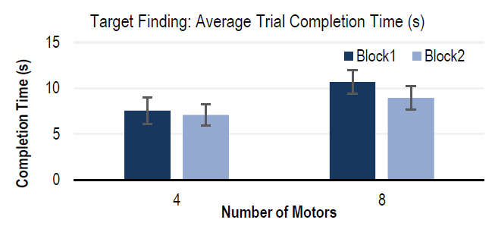
Target-finding Task
Participants were faster with the 4-motor wristband than 8-motor one (p < .001)
The main effect of Block was not statistically significant (p = .119).
Notes:
This graph shows the trial completion time of target-finding task.
(click)
On the x axis we have the number of motors, 4 and 8.
The colors indicate block 1 and 2.
On the y axis we have the trial completion time in second, so here lower numbers means faster speed.
(click)
Participants were faster with the 4-motor wristband than 8-motor one (p < .001)
The main effect of Block was not statistically significant (p = .119).

Slide 38
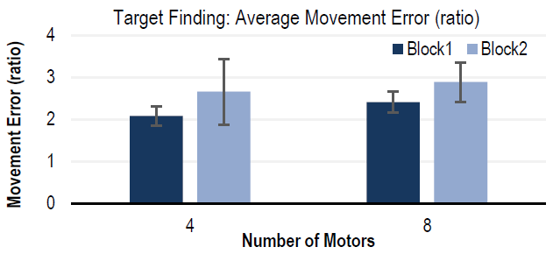
Target-finding Task
They were more accurate with the 4-motor wristband than 8-motor wristband (p = .029)
The main effect of Block was not statistically significant (p = .560).
Notes:
(click)
This graph shows the movement error.
(click)
They were more accurate with the 4-motor wristband than 8-motor wristband (p = .029)
The main effect of Block was not statistically significant (p = .560).

Slide 39
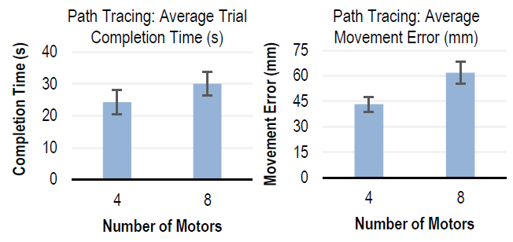
Path-tracing Task
Participants were not faster with either wristband (p = .091)
They were more accurate with 4-motor wristband than 8-motor wristband (p = .009).
Notes:
Here, we have the result of path-tracing task.
(click)
These two graphs shows the trial completion time and movement error on the y axis
And number of motors on the x axis.
(click)
In path tracing task,
Participants were not faster with either wristband (p = .091)
They were more accurate with 4-motor wristband than 8-motor wristband (p = .009).

Slide 40
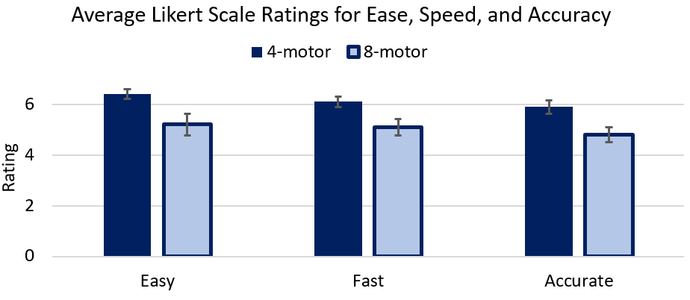
Subjective Feedback
Participants perceived the 4-motor wristband to be easier to understand and more accurate than the 8-motor wristband.
No differences were found in perceptions of speed.
Notes:
(click)
This graph shows ratings on the y axis of two conditions for three questions on the x axis.
(click)
Participants perceived the 4-motor wristband to be easier to understand and more accurate than the 8-motor wristband.
In statistical analysis, no differences were found in perceptions of speed.

Slide 41
Subjective Feedback
The most common reason cited for preferring 4-motor feedback was that it was easier to understand (6 participants).
“[4-motors] was easier to use and I felt less frustrated. I felt like I did better. I was more sure of […] which one was vibrating.”
Notes:
The most common reason cited for preferring 4-motor feedback was that it was easier to understand.

Slide 42
Subjective Feedback
Reasons for preferring 8-motor feedback included higher perceived accuracy and increased precision.
“The feedback is more fine-grained and I like that [...] Instead of a general direction I like precision.”
Notes:
Reasons for preferring 8-motor feedback included higher perceived accuracy and increased precision. However, it seems that the simplicity of 4-motor wristband had more advantage according to the result of this study.

Slide 43
Summary of Study 2
4-motor wristband outperformed 8-motor wristband in both tasks.
The subjective evaluation supported the performance results with positive feedback about the 4-motor wristband.
Notes:
In summary,
(click)
4-motor wristband outperformed 8-motor wristband in both tasks.
(click)
The subjective evaluation supported the performance results with positive feedback about the 4-motor wristband.

Slide 44
Discussion
1. Why does 4-motor outperform 8-motor?
2. Designing wristband haptics
3. Effect of age and technology experience
Notes:
(click)
We were SURPRISED that doubling the number of haptic actuators did not result in performance benefits.
A possible reason is vibration transfer between motors which is when one motor vibrates the adjacent motor may also vibrate a bit. Higher cognitive load of interpolated feedback, and perceptual limitations would also be possible reasons.
(click)
Creating wrist-worn directional hand guidance systems requires exploring a large design space in addition to the factors we considered in this study. Further work would improve the haptic feedback designs.
(click)
Age is an important variable given that older persons have lower sensitivity for perceiving vibration stimulus on the skin. Moreover, familiarity with haptic devices may have played a role in the performance.

Slide 45
Limitations and Future Work
1. Fatigue from using the haptic feedback
2. Learning to use the wristband
3. Performance in practice
Notes:
Limitations and Future work
(click)
Some participants mentioned fatigue from using the haptic feedback, which may be partly due to desensitization.
To limit fatigue, wrist-based haptic feedback may be most applicable to short tasks such as learning a new route rather than in-depth tasks such as reading a book line-by-line.
(click)
Some participants indicated needing more time to learn and effectively use our wristband prototypes. Though we examined learnability by splitting Study 2 into blocks,
future work should examine how performance changes with longer time.
(click)
While our study tasks were developed to model two common real-world tasks, finding a target and tracing a route, more work is necessary to understand whether the observed performance numbers are accurate enough to provide value in practice.

Slide 46
Questions?
Jonggi Hong
Alisha Pradhan
Jon E. Froehlich
Leah Findlater
jhong12@umd.edu
alisha93@umd.edu
jonf@umd.edu
leahkf@umd.edu
This work was supported by the Office of the Assistant Secretary of Defense for Health Affairs under Award W81XWH-14-1-0617
Notes:
This is end of my presentation.
Thank you for your attention.

Slide 47
End of presentation
The slides below are preserved just in case.

Slide 49
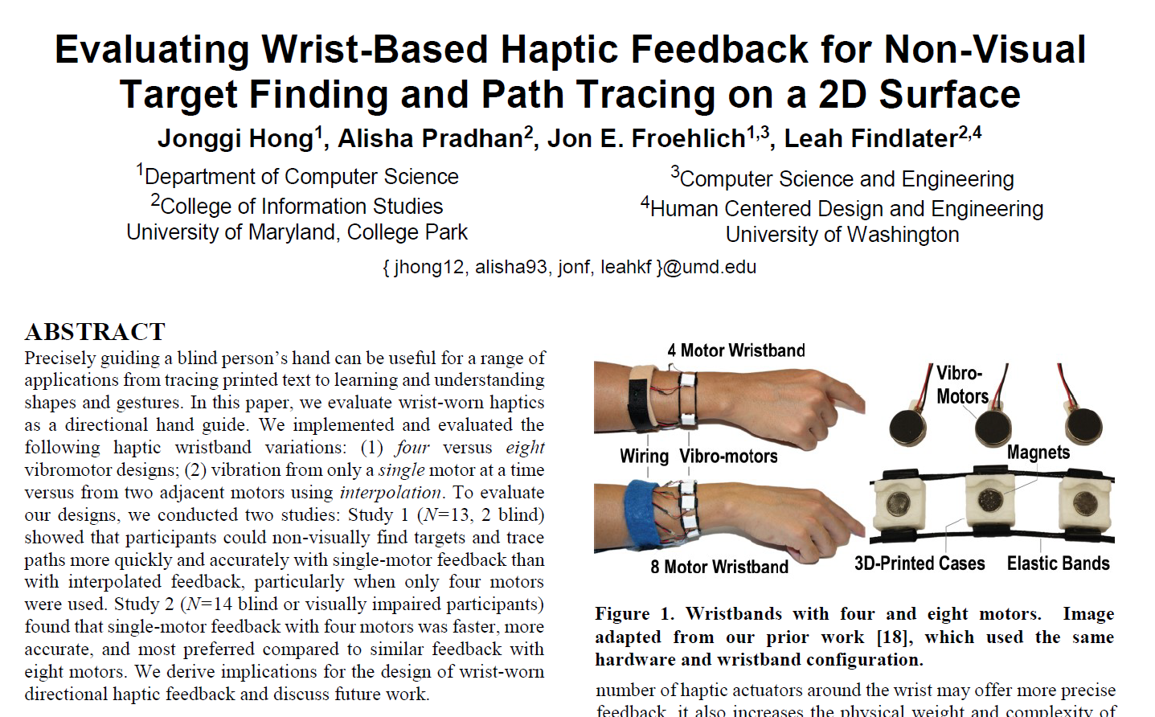
When is the hand guidance needed?

Slide 50
Target-finding Task
Start
Target
Right
Right
Up-right
(diagonal)
Up
Direction to
Center of the target
4-motor
Single-motor feedback
8-motor
Single-motor feedback
4, 8-motor
Interpolated vibration

Slide 51
Haptic Feedback for Assistive Applications
Sensory substitution of visual information
Hand-worn braille for deaf-blind people
Brainport translates images from a glasses-worn camera into electrical stimulations on the tongue
Optacon translates black and white areas on a printed page to dynamic tactile output
Whole body navigational support
4x4 grid of vibrotactile actuators on the back of a vest
Wrist-won devices with two haptic actuators controlled by a remote observer to help blind users avoid obstacles while walking
A haptic helmet combined with a depth camera to help blind users avoid collisions

Slide 52
Non-visual Directional Hand Guidance
Haptic directional guidance on a hand
Vibromotors mounted on a handheld smartphone
Haptic actuators mounted on the finger (Handsight)
Wrist-worn directional haptic guidance
Our GI paper
A study by Weber et al. Guiding sighted users in moving and rotating their arm

Slide 53
Wristband Placement
Placing the wristband on the participants’ wrist
The experimenter vibrated each one in turn and adjusted its position if the participant reported that it felt off.

Slide 54
Background survey
Age
Gender
Experience in using a touchscreen device
Experience in using haptic feedback

Slide 55
Procedure
Background
survey
Target-finding
task
Subjective
feedback
Introduction
task
Path-tracing
task
Notes:
This slide will be refined to have flow chart with icons.

Slide 56
Target-finding Task
The target was randomly positioned on the touchscreen.
A participant started a trial by touching a sticker at the center of a touchscreen on a tablet device.
A trial ends when the finger of a participant enters the target bounds.
Audio feedback was provided when a trial starts and ends.
There were 5 training trials plus 30 test trials.
Notes:
The target was randomly positioned on the touchscreen.
A participant started a trial by touching a sticker at the center of a touchscreen on a tablet device.
A trial ends when the finger of a participant enters the target bounds.
Audio feedback was provided when a trial starts and ends.
There were 5 training trials plus 30 test trials.

Slide 57
Path-tracing Task
Start
End
Each path consists of three segments.
Touch point
End of segment
End of segment
For straight segments, the system guided the user to the segment end point.
Touch point
Touch point
For curved segments, the system guided the user to the tangent point of a line drawn from the curve to the finger.
Notes:
Each path consists of three segments.
For straight segments, the system guided the user to the segment end point.
For curved segments, the system guided the user to the tangent point of a line drawn from the curve to the finger.

Slide 58
Path-tracing Task
Start
End
Ideal trace from start to target
based on vibrations
With single-motor feedback, the closest motor to the direction from the finger to the guided point vibrates.
4-motor
Single-motor feedback
8-motor
Single-motor feedback

Slide 59
Path-tracing Task
Start
End
Ideal trace from start to target
based on vibrations
With interpolated feedback, one or two motors vibrate at a time to allow the user to interpolate a direction to the guided point.
4, 8-motor
Interpolated feedback

Slide 60
Path-tracing Task
A path was randomly selected from a set of 18 paths based on route features from a real university campus map
A participant started a trial by touching a sticker at the center of a touchscreen on a tablet device
A trial ended when the finger of a participant reached the end of third segment
Audio feedback was provided when a trial started and ended
There were 5 training trials plus 10 test trials.

Slide 61
Introduction Task
An additional trial was appended every time a participant made two consecutive incorrect attempts.
Notes:
An additional trial was appended every time a participant made two consecutive incorrect attempts in a specific direction, up to a maximum of four or eight additional trials depending on the number of motors on the wristband.

Slide 62
Target-finding Task
There were at least 12 training trials
Additional training trials were added if the movement error (B / A) was greater than 3.0
The number of test trials also increased from 30 in Study 1 to 36 in Study 2.
To capture possible learning effects, we split the 36 trials in the target-finding task into two blocks of 18 trials each.
A
B

Slide 63
Path-tracing Task
Start
End
Participants completed 7 training trials and 12 test trials
(up from 5 and 10, respectively in Study 1)
B
A

Slide 64
Recap
Study 1 showed that single-motor feedback was faster and more accurate than interpolated feedback.
Study 2 showed that 4-motor wristband was faster, more accurate, and more preferred than 8-motor wristband.

Slide 65
Introduction task
Moving the finger in the direction of the vibration
16 trials
Audio Feedback
Exact (11.25° interval)
Chime + “Perfect!”
Approximate (45° interval)
Chime
Incorrect (Error > 45°)
Beep
Notes:
In this task, a motor vibrated, the participant attempted to move their finger in the direction of the vibration,
(click)
and the system provided feedback about how close the movement was to the presented angle of movement.
If the movement was incorrect, the direction was repeated until the participant moved correctly, with the experimenter giving verbal instructions after two incorrect attempts.

Slide 66
Subjective feedback
After finishing all tasks with each condition, participants rated the condition on 7-point Likert scales.
Overall experience
Ease
Accuracy
Speed
When all conditions were done, we asked participants to select
Easiest condition
Most preferred condition
Least preferred condition
Notes:
After each condition, we asked participants to rate overall experience, ease, accuracy, and speed on 7-point Likert scales.
When all conditions were done, we asked participants to select the easiest, fastest, most accurate, most preferred, and least preferred conditions.

Slide 67
Results of User Study 1
Notes:
We statistically analyzed the result of the studies.

Slide 68
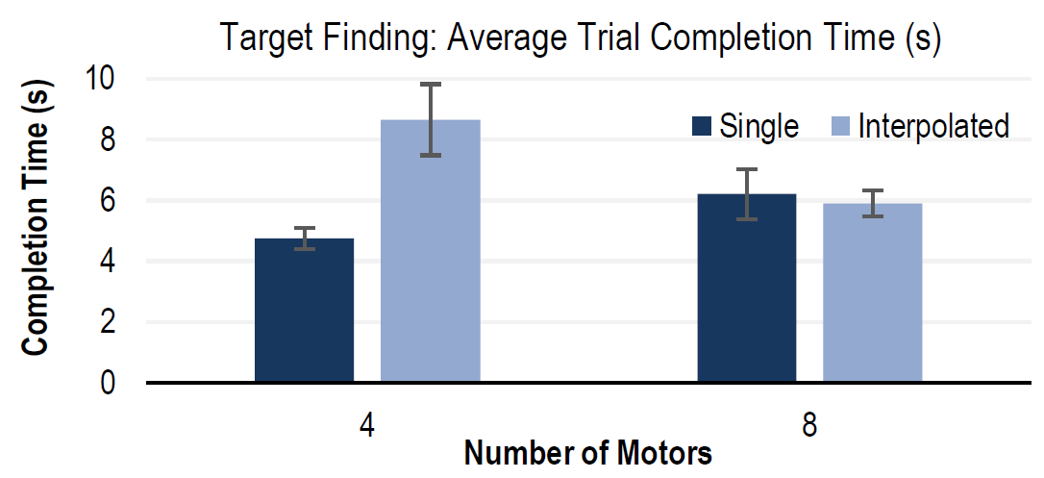
Target-finding Task – Study 1
Interpolated feedback was slower than single-motor feedback (p = .005)
There was no significant effect of Number of Motors (p = .530).
Notes:
In target-finding task,
Interpolated feedback was slower than single-motor feedback (p = .005)
There was no significant effect of Number of Motors (p = .530).

Slide 69
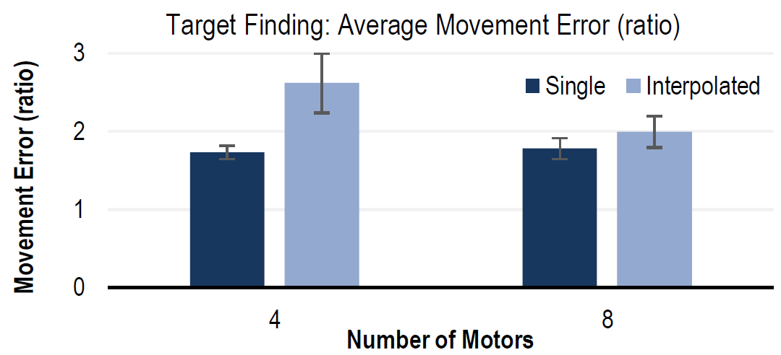
Target-finding Task – Study 1
Interpolated feedback resulted in higher error rate than single-motor feedback (p = .023)
There was no significant effect of Number of Motors (p = .200).
Notes:
Interpolated feedback also resulted in higher error rate than single-motor feedback (p = .023)
There was no significant effect of Number of Motors (p = .200).

Slide 70
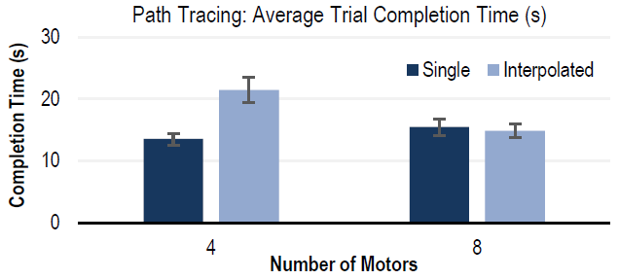
Path-tracing Task – Study 1
Interpolated feedback was slower than single-motor feedback (p = .007)
The number of motors did not have a significant effect on the trial completion time (p = .057).
Notes:
In path-tracing task,
Interpolated feedback was slower than single-motor feedback (p = .007)
The number of motors did not have a significant effect on the trial completion time (p = .057).

Slide 71
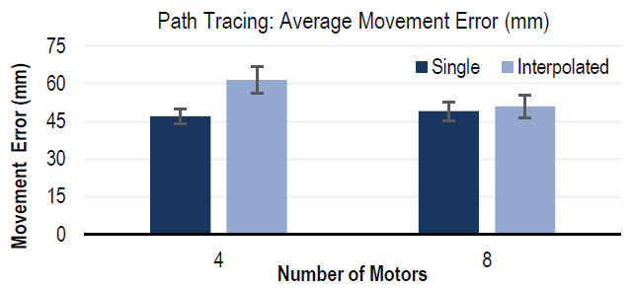
Path-tracing Task – Study 1
Movement error was higher with interpolated feedback (p = .038)
The main effect of Number of Motors was not significant (p = .147).
Notes:
Movement error was also higher with interpolated feedback (p = .038)
The main effect of Number of Motors was not significant (p = .147).

Slide 72
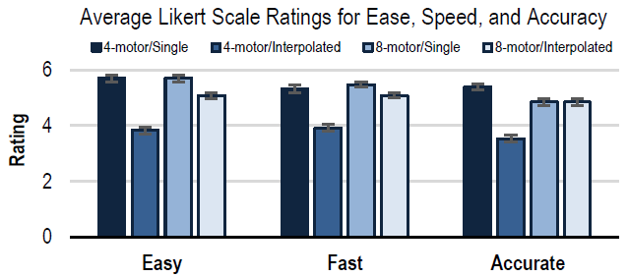
Subjective Feedback – Study 1
Participants consistently rated the 4-motor wristband with interpolation worse than other conditions.
Notes:
Subjective responses reflected the performance results. Participants consistently rated the 4-motor wristband with interpolation worse than other conditions.

Slide 73
Subjective Feedback – Study 1
The single-motor feedback options received more positive votes compared to interpolated feedback options.
Notes:
The single-motor feedback options received more positive votes compared to interpolated feedback options.

Slide 74
Summary of Study 1
Interpolated feedback was slower and less accurate in both tasks, but was particularly problematic with the 4-motor wristband.
Two blind participants were slower and less accurate with interpolated feedback than single-motor feedback.
Based on these results, we focused only on single-motor feedback in Study 2 with blind and VI participants.
Notes:
(click)
Interpolated feedback was slower and less accurate in both tasks, but was particularly problematic with the 4-motor wristband.
(click)
Two blind participants were slower and less accurate with interpolated feedback than single-motor feedback. Please read the paper for the detail of the result.
(click)
Based on these results, we focused only on single-motor feedback in Study 2 with blind and VI participants.

Slide 75
Procedure
More training and test trials were provided in three tasks
Introduction task had additional training trials up to a maximum of four or eight additional trials depending on the number of motors on the wristband
Target-finding task added training trials up to a maximum of 20. Test trials increased from 30 to 36.
Path tracing task had 7 training trials and 12 test trials (up from 5 and 10, respectively in Study 1).
Notes:
Due to a steep learning curve during Study 1, we also provided more training and increased the number of test trials in three tasks.
In introduction task, an additional trial was appended every time a participant made two consecutive incorrect attempts in a specific direction, up to a maximum of four or eight additional trials depending on the number of motors on the wristband.
For the target-finding task, participants completed at least 12 training trials. Additional training trials were added up to a maximum of 20 if the movement error is high in training trials. The number of test trials for target finding also increased from 30 in Study 1 to 36 here. To capture possible learning effects, we split the 36 trials in the target-finding task into two blocks of 18 trials each and included Block as an additional factor in the analysis of that task.
For the path-tracing task, participants completed 7 training trials and 12 test trials.

Slide 76
Target-finding Task
Finger position
Target
Direction of feedback
With single-motor feedback, the closest motor to the direction from the finger to the target vibrates.
Right
Right
Up-right
(diagonal)
Up
4-motor
Single-motor feedback
8-motor
Single-motor feedback
Notes:
This is how each haptic feedback condition worked in target-finding condition.
(click)
In single-motor feedback with 4-motor wristband, the feedback indicate only 4 directions. In this case, up and then right.
(click)
In single-motor feedback with 8-motor wristband, the feedback indicate 8 directions. In this case, up-right diagonal direction and then right.

Slide 77
Target-finding Task
Finger position
Target
Direction of feedback
With interpolated feedback, one or two motors vibrate at a time to allow the user to interpolate a direction to a target.
Direction to
Center of the target
4, 8-motor
Interpolated vibration
Notes:
(click)
With interpolated feedback, any direction was indicated by interpolating vibrations.

Slide 78
Research questions
Number of Motors Around a Wrist
Does eight motors around the wrist offer more precise feedback than four motors for hand guidance?
Single-motor and Interpolated Feedback
Does interpolated feedback enable users to move hands more precisely than single-motor feedback?
Notes:
More specifically, we have two research questions.
(click)
How many motors do we need to offer precise feedback for hand guidance in 2D space?
(click)
Does interpolated feedback enable users to move hands more precisely than single-motor feedback?

