Slide 1



Evaluating Angular Accuracy of Wrist-based Haptic Directional Guidance for Hand Movement
Jonggi Hong¹
Lee Stearns¹
Tony Cheng¹
Jon E. Froehlich¹
David Ross²
Leah Findlater¹
¹ University of Maryland, College Park
² Atlanta VA R&D Center of Excellence in Vision and Neurocognitive Rehabilitation (CVNR)
Notes:
Thank you for coming to my talk.
I’m Jonggi Hong. I’m a PhD student at University of Maryland.
This presentation is about evaluating angular accuracy of wrist-based haptic directional guidance for hand movement.
I worked on this project with Lee Stearns, Tony Cheng, Professor Jon Froehlich, David Ross, and my advisor Professor Leah Findlater.

Slide 2

Directional Guidance for Hand Movement
Notes:
Let’s start simple. We’re looking at how to guide users in moving their hand in a specific direction. This type of guidance could be useful in a variety of contexts. Let me give you some examples…

Slide 3
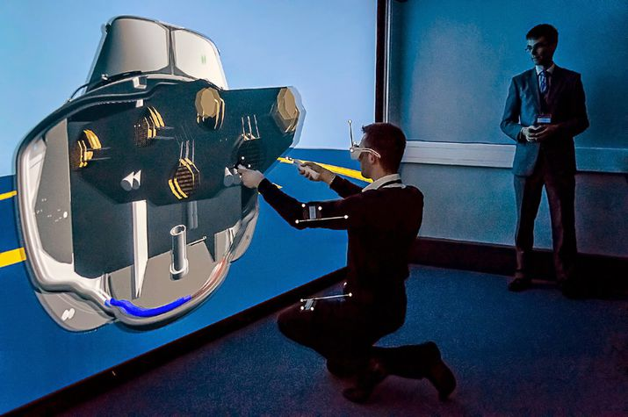
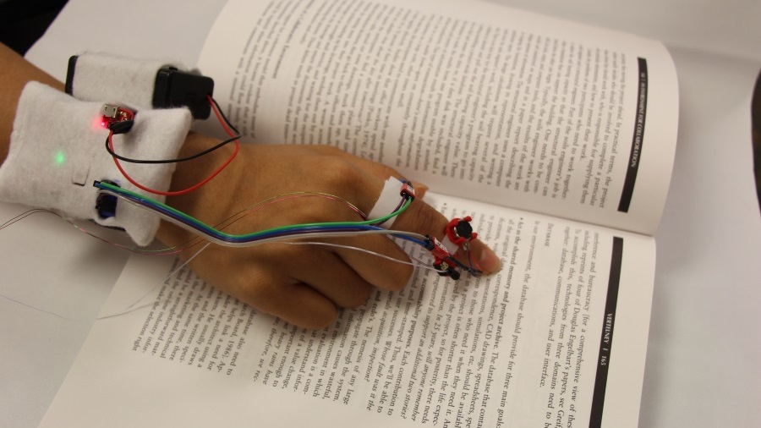
When is the hand guidance needed?
Virtual Reality
Assistive
Technology
Guiding human operators towards a specific target
Tracing a line of printed text while listening to text-to-speech
Notes:
In virtual reality, hand guidance can be useful to help human operators reach toward a target in virtual space, such as with robot-assisted surgery.
Hand guidance can be particularly useful in assistive technology for blind users. Imagine guiding a user to accurately trace a line of printed text while listening to text-to-speech output.

Slide 4
Problem
Visual or audio information channels are
overloaded or inaccessible
due to environmental factors.
Notes:
In many of these contexts, visual or audio information channels are overloaded or inaccessible due to environmental factors. This is obvious in the assistive technology example, and the robot-assisted surgery in virtual reality would be the case as well.

Slide 5
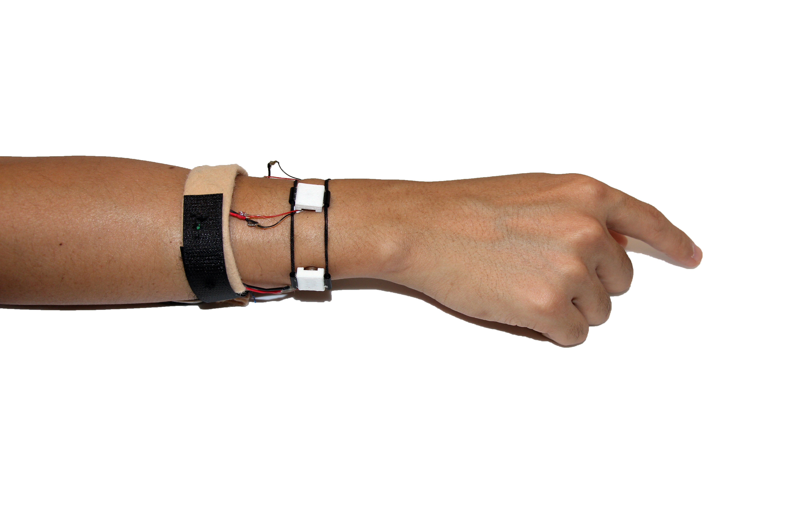
One Solution: Wrist-Based Haptic Feedback
Motors
Notes:
One solution is to use haptic feedback. (You navigate your hand based on vibro-tactile sensations generated by motors.)
For example, here’s one of the our prototypes that provides haptic feedback using four vibro-motors around the wrist.
[click] When the top motor vibrates, this indicates the user should move the hand up.
[click] When the motor on the right of the wrist vibrates, the user should move the hand to the right.

Slide 6
One Solution: Wrist-Based Haptic Feedback
Up-right
(diagonal)
Motors
Phantom sensation
Notes:
Moreover, this design also allows for precise guidance.
[click] By vibrating two adjacent motors, we can simulate a vibration between the motors, using something called phantom sensation.
For example, here, the user should move the hand up and to the right. I’ll come back to this later.

Slide 7
Related Work
Coarse-grained directional guidance
and finger-worn devices
Notes:
Haptic feedback has been used for coarse-grained directional guidance. Or a finger-worn device was used to make directional guidance.

Slide 8
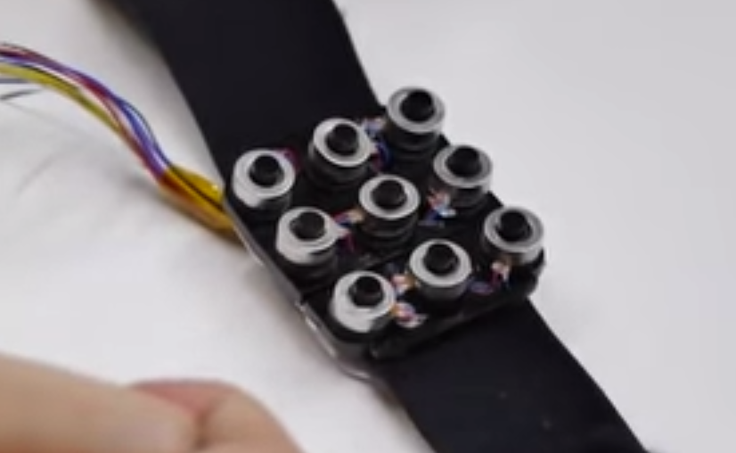
Existing studies: Wrist-based feedback
Grid layouts
Can be used for coarse-grained direction
(e.g., cardinal directions)
Lee et al. (2015)
Grid layouts offer lower tactile perception compared to motors placed on a band
Matscheko et al. (2010)
Band layouts
Notes:
Looking at previous work, studies have examined both grid layout of motors on the wrist as well as placing motors along a wristband, like in our approach.
[click]The grid layouts can be used for coarse-grained direction.
but, grid layouts offer lower tactile perception compared to motors placed on a band.

Slide 9
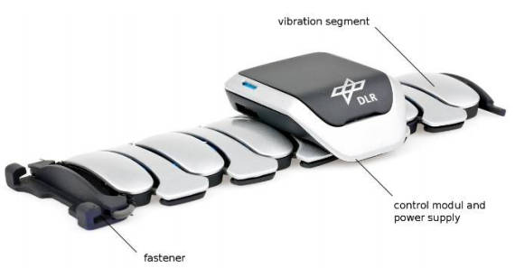
Existing studies: Wrist-based feedback
Grid layouts
Can be used for coarse-grained direction
(e.g., cardinal directions)
Lee et al. (2015)
Grid layouts offer lower tactile perception compared to motors placed on a band
Matscheko et al. (2010)
Band layouts
Have been used to guide translation and rotation of the arm using four or six motors
Six motors were more accurate than four motors and verbal guidance.
By Weber et al. (2011)
The study only included at most six angles of movement, not higher precision
Notes:
The band layout has been used to guide movement of the arm using four or six motors.
A study showed that six motors were somewhat more accurate than 4 motors and verbal guidance, but the study only included at most six angles of movement, not higher precision.
[click]

Slide 10
Existing studies: Wrist-based feedback
Grid layouts
Fine-grained directional guidance
has received less attention
Can be used for coarse-grained direction
(e.g., cardinal directions)
Lee et al. (2015)
Grid layouts offer lower tactile perception compared to motors placed on a band
Matscheko et al. (2010)
Band layouts
Have been used to guide translation and rotation of the arm using four or six motors or verbal instruction
Six motors were more accurate, but the difference was not significant.
By Weber et al. (2011)
The study only included at most six angles of movement, not higher precision
Notes:
In both layouts, the fine-grained directional guidance has received less attention.

Slide 11
Existing studies: Wrist-based feedback
Grid layouts
Fine-grained directional guidance
has received less attention
Can be used for coarse-grained direction
(e.g., cardinal directions)
Lee et al. (2015)
Grid layouts offer lower tactile perception compared to motors placed on a band
Matscheko et al. (2010)
Band layouts
Have been used to guide translation and rotation of the arm using four or six motors
Six motors were more accurate, but the difference was not significant.
By Weber et al. (2011)
The study only included at most six angles of movement, not higher precision
Notes:
Looking at previous work, studies have examined both grid layout of motors on the wrist as well as placing motors along a wristband, like in our approach.
[click]The grid layouts can be used for coarse-grained direction.
However, grid layouts offer lower tactile perception compared to motors placed on a band.
[click]The band layout has been used to guide movement of the arm using four or six motors.
A study showed that six motors were somewhat more accurate, but the study only included at most six angles of movement, not higher precision.
[click] In both layouts, the fine-grained directional guidance has received less attention.

Slide 12
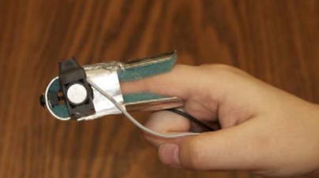
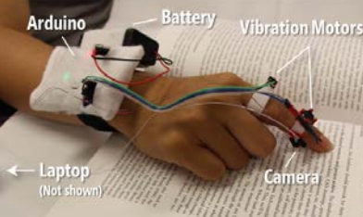
Existing studies: Finger-based feedback
By Horvath et al.
By Stearns et al.
Motors on the finger have been explored to guide visually impaired users in tracing a line or reading text
Notes:
Finger-worn device instead of the wrist-worn device was also used to make directional guidance.
They are mostly used to make a system that is providing information of contents under the finger for blind users.
[click] The haptic feedback on the finger was used for blind users to follow the edge or a line of text under the finger.
[click]

Slide 13
Existing studies: Finger-based feedback
By Horvath et al.
By Stearns et al.
Motors on the finger have been explored to guide visually impaired users in tracing a line or reading text
In contrast, a wrist-based approach:
Can be incorporated into a smartwatch band
Balances proximity to the finger, sensitivity, surface area, and social acceptability
Notes:
[click] In contrast, a wrist-based approach can be incorporated into a smartwatch band and balances proximity to the finger, sensitivity, surface area, and social acceptability

Slide 14
Advantages of Hand Guidance based on Haptic Feedback on Wrist
1
Proximity to the finger
2
Better sensitivity than other parts of forearm¹
3
Having larger surface area than a finger
4
Social acceptability
¹Cholewiak, R.W. and Collins, A.A. 2003. Vibrotactile localization on the arm: effects of place, space, and age. Perception & Psychophysics. 65, 7 (2003), 1058–1077.
Notes:
First, the wrist is close to the finger, so it is intuitive to guide the finger movement.
According to a study, the wrist has better sensitivity than other parts of the forearm.
And it has larger surface than the finger, so it would be better to deploy motors and identify the location of the vibrations.
Finally, a wearable device on the wrist is socially acceptable due to the popularity of the wrist-watch.

Slide 15
Research Questions
How accurately can people move their hand given fine-grained haptic guidance on a wristband?
How many motors are needed to achieve this level of accuracy?
Notes:
Our question was
How accurately can people move their hand given fine-grained haptic guidance on a wristband?
Another question was “How many motors are needed to achieve this level of accuracy.”

Slide 16
Wristband Prototypes
Providing fine-grained directional guidance
Notes:
To answer these research questions, we created two wristband prototypes

Slide 17
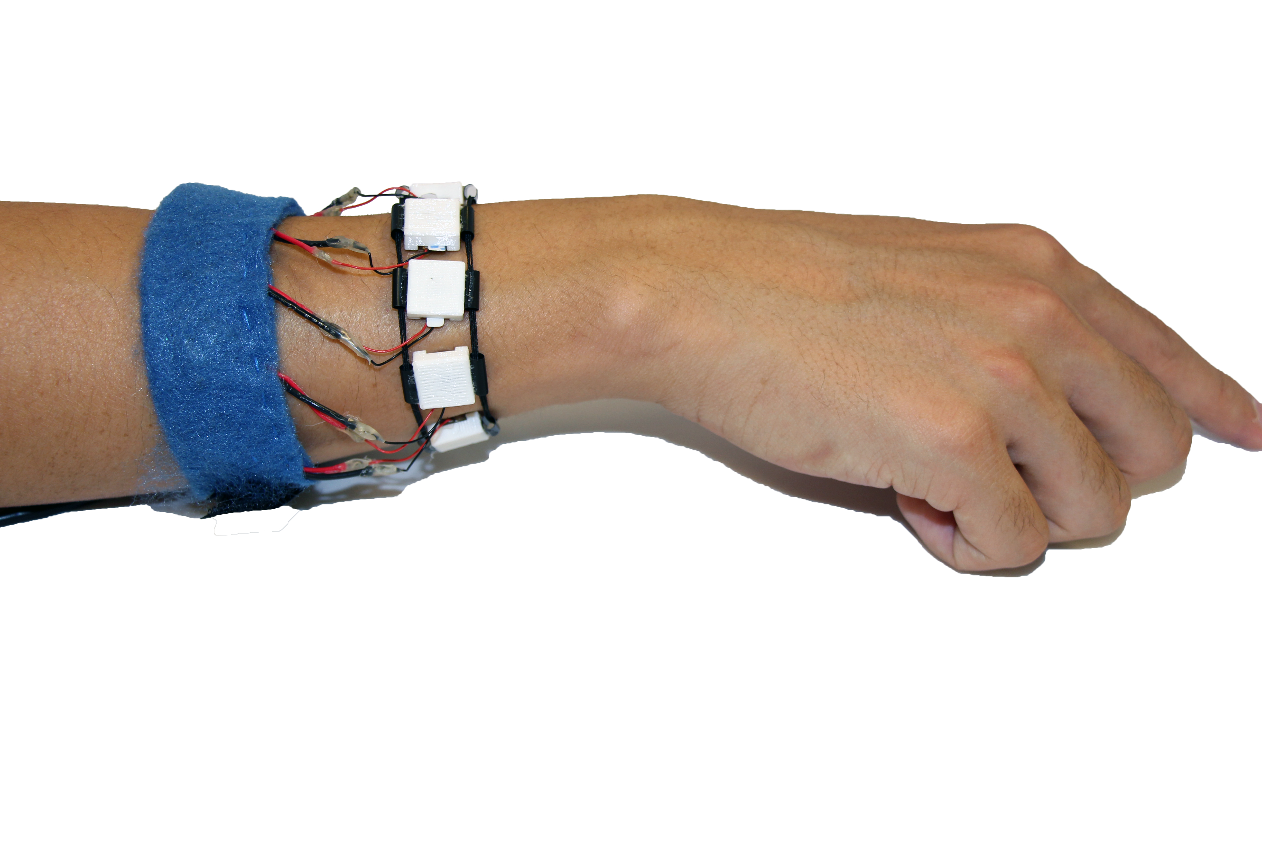
4-motor wristband
8-motor wristband
Notes:
One wristband included four motors, placed at equal distances around the wrist, while the second one included 8 motors.
So, how do these work?

Slide 18
Mapping the Vibration to a Direction
Up
Right
How to indicate angles
of direction between motors?
Motors
Notes:
As I showed before, each individual motor is mapped to a direction.
[click] For example, the motor at the top indicates up direction
[click] and the motor at the right indicates right direction on the surface.
[click] Then, how can we indicate angles of direction between motors, to provide fine-grained guidance?

Slide 19
Phantom Sensation
Two vibrotactile actuators placed closely together on the skin create the illusion of a single vibration between the two actuators.
The location of the phantom sensation is determined by the amplitude of the two vibrations.
[Alles, 1970]
Motor
Motor
Illusion of
a vibration
Notes:
The answer is through phantom sensations.
Two vibrotactile actuators placed closely together on the skin [click]
create the illusion of a single vibration between the two actuators. [click]
[click] And the location of the phantom sensation is determined by the amplitude of the two vibrations.
When a motor vibrates stronger than the other, [click]
the phantom sensation is closer to that motor.

Slide 20
Providing Fine-Grained
Directions
Up-right
(diagonal)
Four-motor wristband
Phantom sensation
Motors
Notes:
For example, with the four motor wristband, if we want to indicate a diagonal direction up and to the right,
[click] the motors on the top and right sides of the wrist vibrate at equal amplitude, creating a phantom sensation in that direction.
[click to show one motor vibrating a little more than the other, plus change the angle of the arrow a bit and change the text to 60 degrees]

Slide 21
Providing Fine-Grained
Directions
60°
Four-motor wristband
Phantom sensation
Motors
Notes:
To indicate a direction slightly off the diagonal, like 60 degrees, we change the amplitudes of the vibration accordingly.

Slide 22
Providing Fine-Grained
Directions
Up-right
(diagonal)
Eight-motor wristband
Notes:
With the eight-motor wristband, in comparison, to indicate the up-right diagonal direction,
[click] we only need to vibrate a single motor. But, again, to indicate more fine-grained directions,
[click to show two motors vibrating, with an arrow to indicate that direction]

Slide 23
Providing Fine-Grained
Directions
60°
Eight-motor wristband
Phantom sensation
Notes:
We still need to use phantom sensations

Slide 24
User Study
Comparing haptic feedback with four or eight motors around the wrist
Notes:
Let me explain how we compared these two wristbands in a controlled lab study.

Slide 25
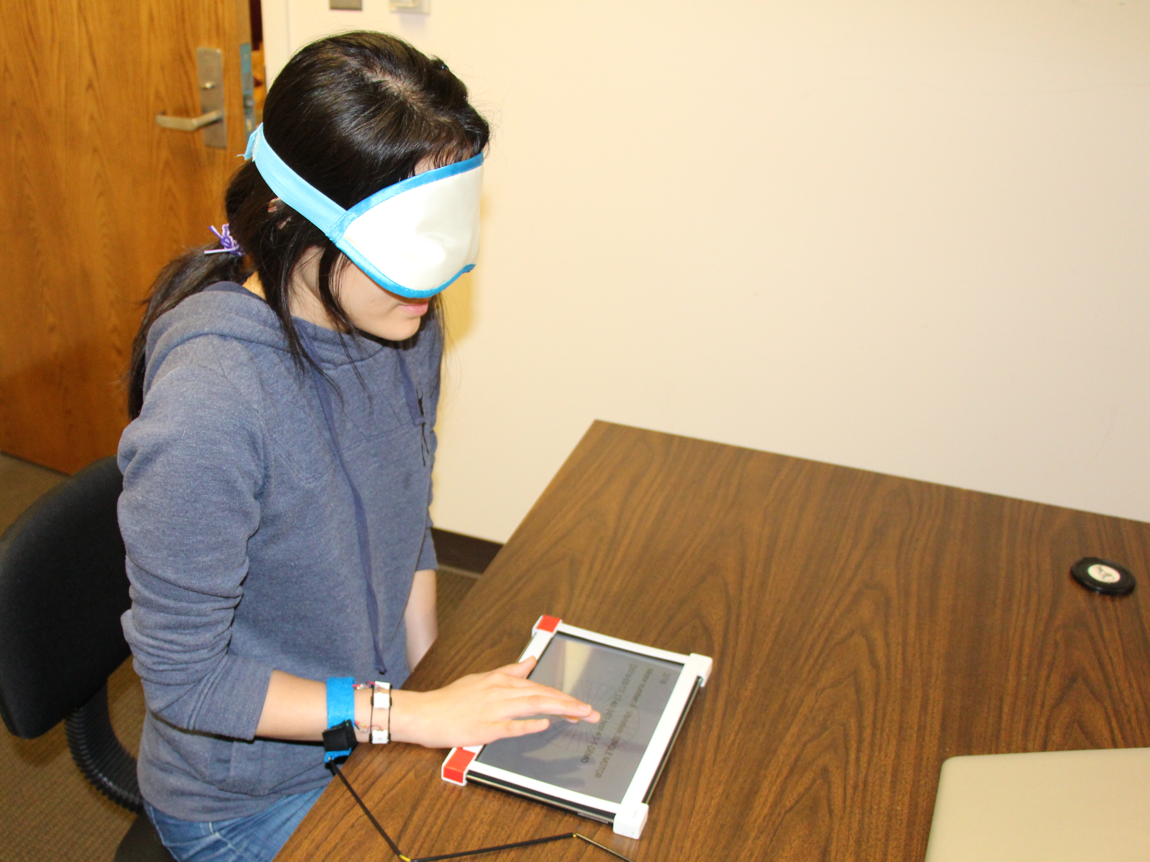
Method
Participants
20 participants (10 male, aged 19-58) They were blindfolded during the task
All participants used their right hand
Two conditions
Four or eight motors
Within-subjects design
Fully counterbalanced
Notes:
20 participants were recruited.
They were blindfolded to help simulate a non-visual context and limit distraction.
They used right hand to complete the task.
[click] Each participant completed tasks in two haptic feedback conditions, one with 4 motors and one with 8 motors.

Slide 26
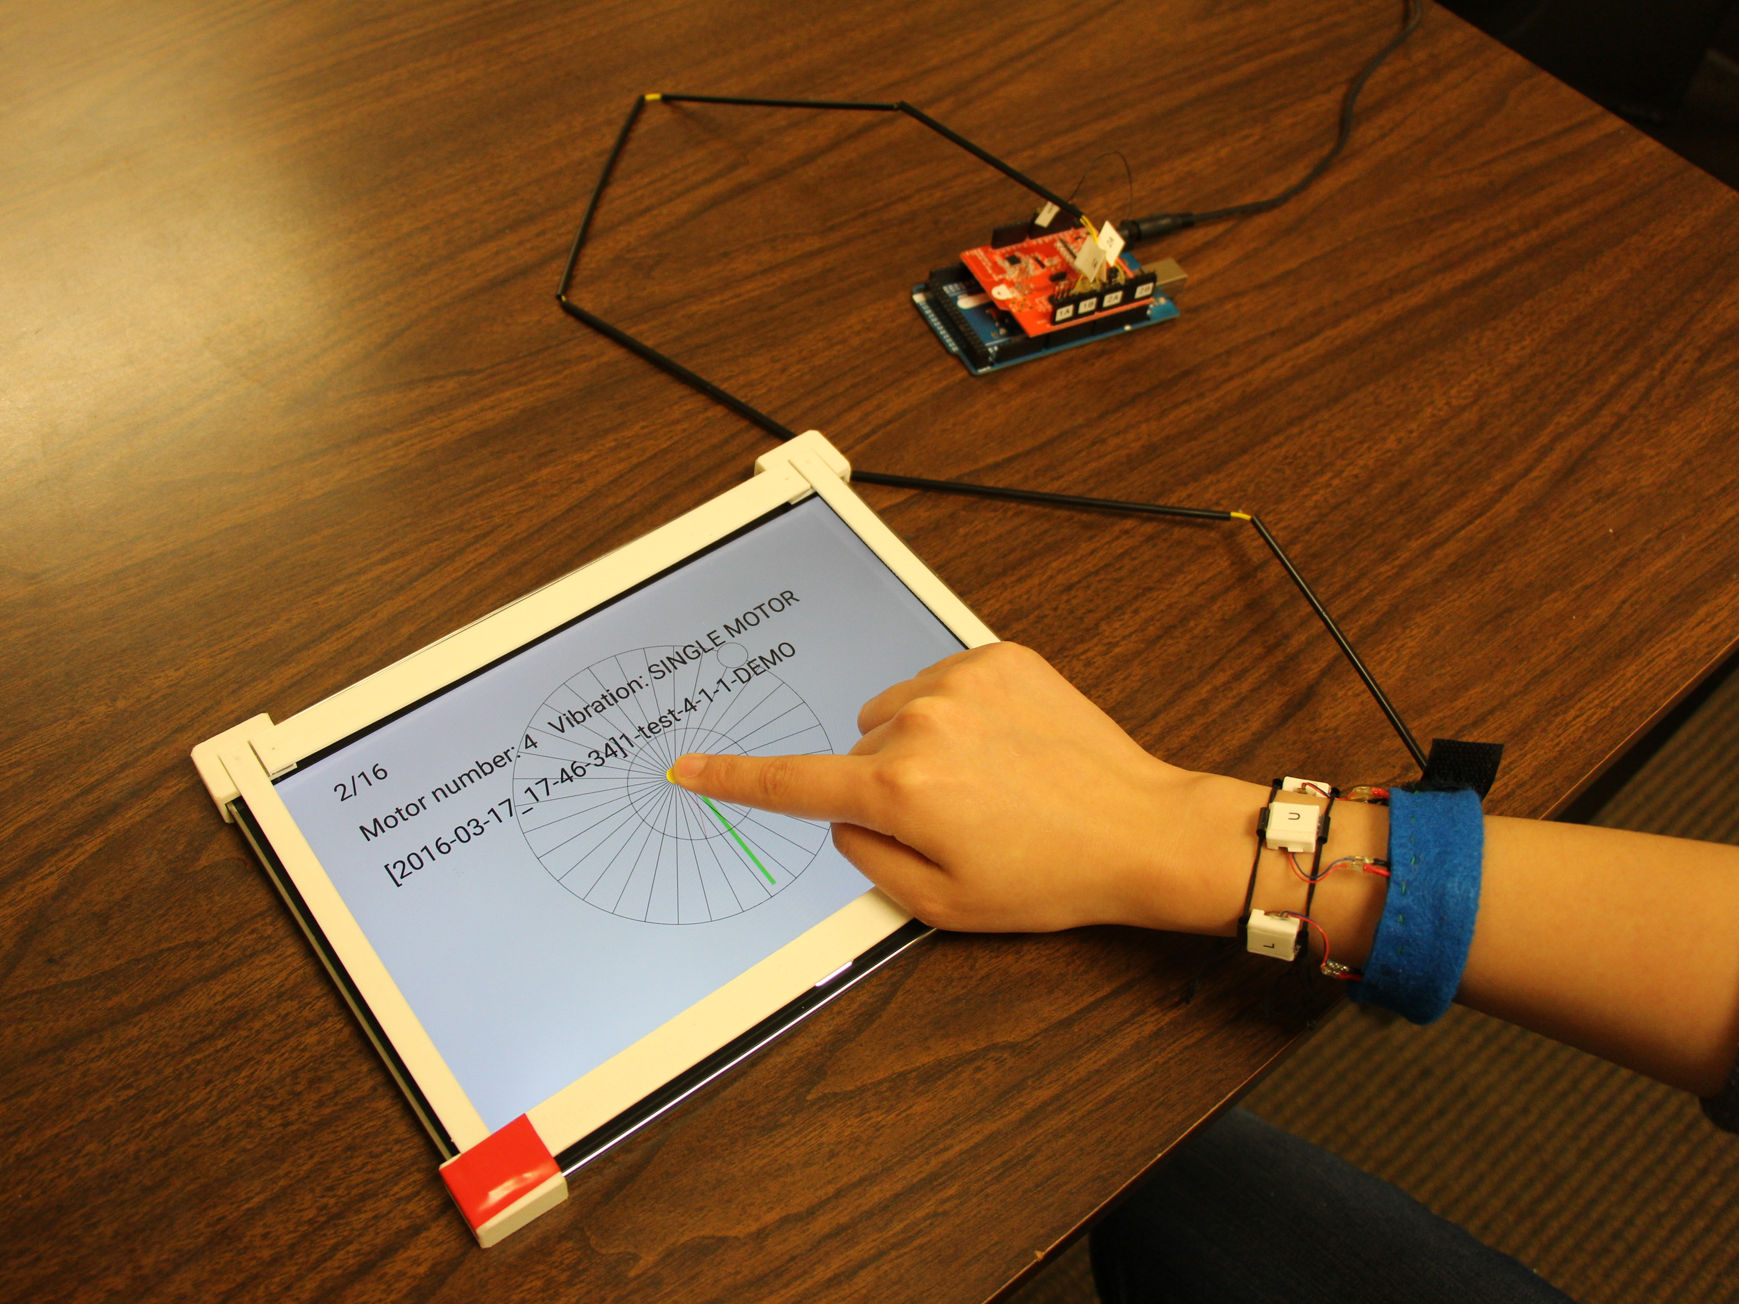
Apparatus
Arduino Mega
+ BLE Shield
Android tablet
Vibro-motor
Notes:
[click] The task software was implemented on a Android tablet.
[click] The Arduino and Bluetooth Shield were used to control the motors.
[click] We used vibro-motors covered with 3D printed cases.

Slide 27
Procedure
1. Background survey
Age, gender, experience in using a touchscreen device and haptic feedback.
2. Completing a task in two conditions
Moving the hand in the direction of the vibration.
3. Questionnaire
Comparing ease of use, accuracy, and preference between the two conditions.
Notes:
The user study consisted of three parts.
[click] We first asked questions about participants’ age, gender and experience in using a touchscreen device and haptic feedback.
[click] Participants completed the task of following the direction of the vibration in two conditions.
[click] Finally, they compared the two conditions on ease of use, accuracy, and preference.

Slide 28
Task
Each trial: move in one of 32 directions
(11.25° intervals)
51.2 mm
(300 px)
Notes:
In the task, participants followed the direction of the vibration.
[click] When a trial starts, the target direction is randomly selected from 32 uniformly distributed directions and the motors vibrate.
[click] The participant move the finger about 50 mm to the direction of the vibration.

Slide 29
Task
Each trial: move in one of 32 directions
(11.25° intervals)
Angular Error
Audio Feedback
Exact (11.25° interval)
Chime + “Perfect!”
Approximate (45° interval)
Chime
Incorrect (Error > 45°)
Beep
Notes:
Actually, participants may make error when they move their finger,
[click] so we measured the angular error and made audio feedback to let participants know how they did.
[click] For the exact hand movement, a chime followed by word “Perfect” sound was played.
[click] For the approximate movement, only a chime sound was played.
[click] In other cases, the trial was considered incorrect and beep sound was played.

Slide 30
Task
90°
Practice (16 trials)
8 directions counterclockwise
+ 8 random directions
180°
0°
Test (96 trials)
3 repetitions of 32 directions
in randomized order
270°
Notes:
For each condition, participants first completed 16 practice trials,
Next, they completed the 96 test trials of directions randomly selected from the 32 directions.

Slide 31
Hypotheses
H1
The 8-motor condition will be more accurate than the 4-motor condition.
Eight motors provide twice the fidelity of information.
The 8-motor and 4-motor conditions will impact trial completion time differently.
The 4-motor condition is simpler but the 8-motor condition may offer clearer intercardinal information.
H2
Notes:
Our experiment tested two hypotheses
[click] The 8-motor condition will be more accurate than the 4-motor condition because eight motors provide twice the fidelity of information.
[click] The 8-motor and 4-motor conditions will impact trial completion time differently. 4-motor condition could be faster because it is simpler, or the 8-motor condition could be faster because of the additional intercardinal information.

Slide 32
Results
Accuracy, time, and subjective responses
Notes:
We analyzed the accuracy, trial completion time, and subjective responses of the two conditions.

Slide 33
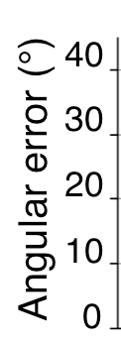
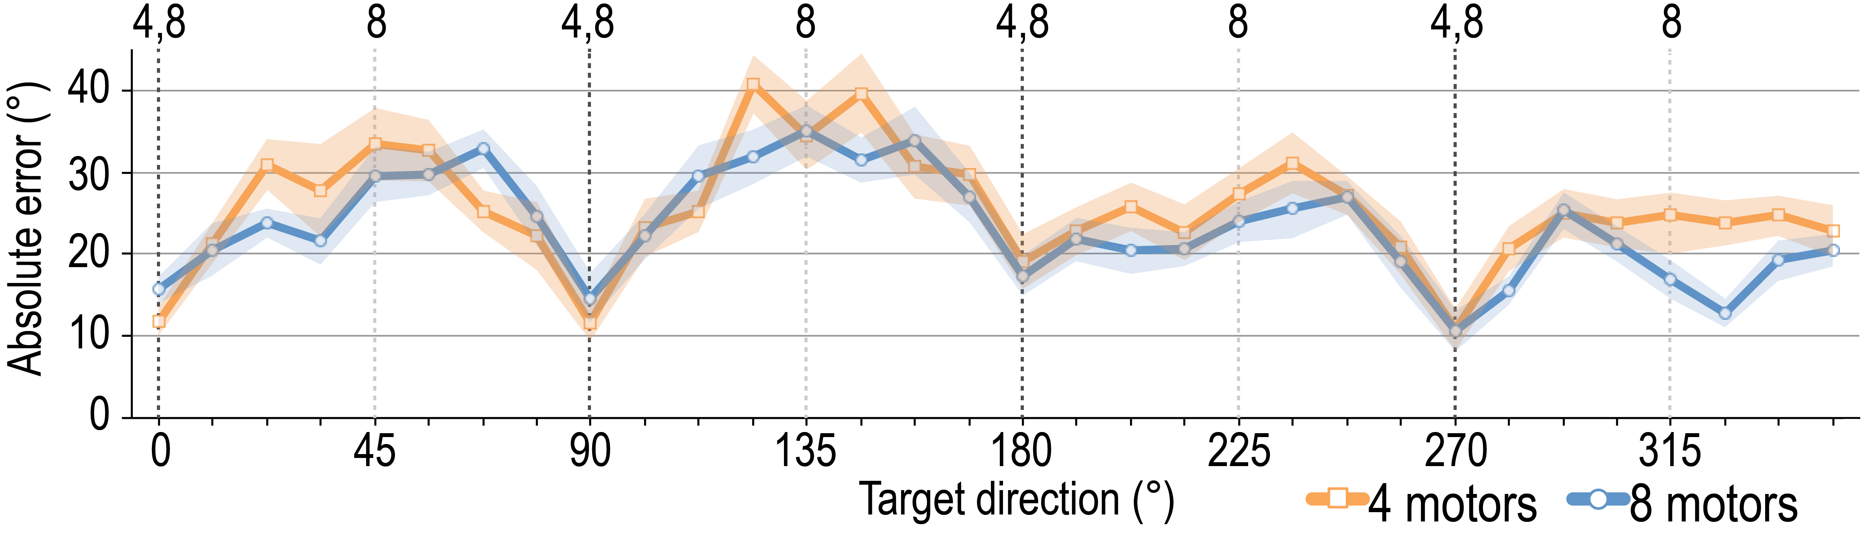

Cardinal Directions Most Accurate
40
30
Angular error (°)
20
10
0
0
45
90
135
180
225
270
315
Target direction (°)
Notes:
Let’s start by exploring accuracy. A main pattern was that the cardinal directions were the most accurate.
This graph shows the average angular error over all 32 directions.
On the x axis we have the angle of target directions, from 0 to 360 degree.
On the y axis we have the average angular error, so here lower numbers are better.
Shading indicates standard error.
The orange line shows the 4-motor results, while the blue line shows the 8-motor results.

Slide 34
Cardinal Directions Most Accurate
Right
Up-Right
Up
Up-Left
Left
Down-Left
Down
Down-Right
40
30
Angular error (°)
20
10
0
0
45
90
135
180
225
270
315
Target direction (°)
Notes:
The angular errors of cardinal directions were relatively lower than other directions.
That means, the participants moved hand more accurately when the target directions were cardinal directions.
[click]
On the other hand, you can see peaks in the intercardinal directions such as up-right and up-left directions here.
----- Meeting Notes (5/25/16 21:51) -----
The description would be too long.

Slide 35
8-motors More Accurate Than 4-motors
40
30
Angular error (°)
20
10
0
0
45
90
135
180
225
270
315
Target direction (°)
Average angular error across all directions
4-motor | 8-motor
25.4° | 23.2°
Statistically significant difference (p = .034, one-tailed t-test)
Hypothesis 1 is supported
Notes:
In general, participants were more accurate with the 8-motor condition than with the 4- motor condition,
[click] and the difference was significant, so hypothesis 1 is supported.
From this data, we empirically identified the angular accuracy with our approach, about 23-25° error.

Slide 36
Angular Accuracy by Quadrant
90°
Up
left
Up
right
180°
0°
Down
left
Down right
270°
Notes:
We also analyzed the average angular error for each quadrant [click] because some directions might be more accurate than others.

Slide 37
Upper-left Quadrant was Least Accurate
*
30
*
25
4 motors
20
8 motors
Angular error (°)
Angular error (°)
Angular error (°)
15
10
5
0
Quadrant
Quadrant
Upper-left quadrant was significantly worse than the two downward quadrants (p < .05)
Notes:
This graph shows the breakdown of error by quadrant.
On the x axis we have quadrants.
On the y axis we have the average angular error.
The error tended to be higher in the upper-left quadrant than in other directions.

Slide 38
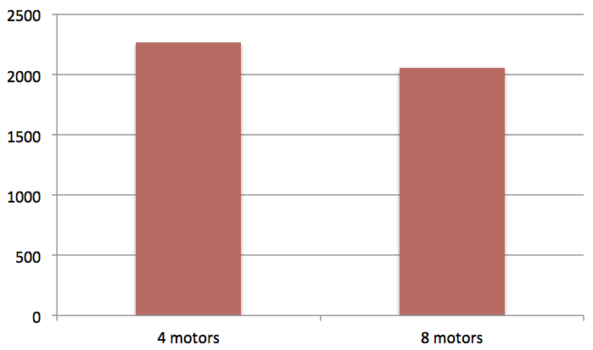
No Differences in Trial Completion Time
2500
2000
1500
Time (ms)
1000
2268.5
2058.2
500
0
4 motors
8 motors
No significant difference found between conditions using a Wilcoxon signed ranks test (Z = −.89, p = .372)
Hypothesis 2 is not supported
Notes:
Though there was a difference in angular accuracy, the difference in the trial completion time was not significant.
With both wristbands, a trial lasted about 2 seconds.
So The hypothesis 2 was not supported.
(In 10 minutes)

Slide 39
Subjective Response
Question | Answer
 | 4-motor | 8-motor
Accuracy | 5 | 13
Ease of use | 10 | 8
Preference | 9 | 9
Animation:
The white box disappears and show data one by one.
Notes:
In questionnaire,
[click] 13 participants chose the 8-motor wristband for accuracy, suggesting they perceived value in the extra information it provided over the 4-motor wristband.
[click] But, participants were divided [click] in terms of overall ease of use and preference

Slide 40
Recap and Discussion
1
Doubling the number of haptic motors increased accuracy, but not speed.
Notes:
In conclusion,
The results confirm one of our two hypotheses, showing that doubling the number of haptic motors from four to eight increases accuracy; however, speed was not impacted either way. In practice, whether to include four or more motors for directional guidance will depend on the accuracy needed for the task.

Slide 41
Recap and Discussion
1
Doubling the number of haptic motors increased accuracy, but not speed.
2
Empirically identified a potential lower bound on angular error: about 23-25°.
Notes:
We also empirically identified a potential lower bound on angular error of about 23-25°. This degree of error may not matter for some tasks but may make wrist-based haptic feedback inappropriate for tasks that require more accurate movement.

Slide 42
Recap and Discussion
1
Doubling the number of haptic motors increased accuracy, but not speed.
2
Empirically identified a potential lower bound on angular error: about 23-25°.
3
Movements in the upper-left quadrant were less accurate than other quadrants, perhaps because all participants used their right hand.
Notes:
Movements in the upper-left quadrant were less accurate than other quadrants. This could be because all participants used their right hand during the study, so the upper-left quadrant required the most gross motor movement to reach.

Slide 43
Future Work
1
Further investigate identified angular error limit such as how it affects more realistic tasks with continuously updated directional guidance (e.g., tracing a path)
2
Extend these findings to users with visual impairments
such as for finger-based reading of printed text or to gain spatial layout information of a printed page
Notes:
Future work should also investigate how our identified accuracy limit affects performance for more realistic tasks with continuously updated directional guidance such as finding a target and tracing a path.
[click] We’ll extend these findings to users with visual impairments such as for finger-based reading of printed text or to gain spatial layout information of a printed page.

Slide 44
Questions?
Jonggi Hong | jhong12@umd.edu
Lee Stearns | lstearns@umd.edu
Tony Cheng | tcheng1@terpmail.umd.edu
Jon E. Froehlich | jonf@umd.edu
David Ross | ross0128@bellsouth.net
Leah Findlater | leahkf@umd.edu
This work was supported by the Office of the Assistant Secretary of Defense for Health Affairs under Award W81XWH-14-1-0617
Notes:
This is end of my presentation.
Thank you for your attention.
----- Meeting Notes (5/25/16 21:51) -----
Device
No need to explain the screen size
Lee will send the funding information.
Cut out result part.
17 min.

Slide 45
Task Completion Time
& Success Rates
 | 4-motor | 8-motor
Task completion time | 2268.5 ms | 2058.2 ms
Exact trials¹ | 15.9 % | 16.3 %
Approximate trials² | 54.3 % | 56.4 %
Preference | 50% | 50%
Exact trial : Movement error < 11.25°
Approximate trial : Movement error < 45 °
Notes:
The difference in average completion times between conditions was not significant.
The second hypothesis, that there would be a speed difference between the two conditions, is not supported.
The difference in the movement error did not translate to significant differences in task success.
Participants were divided in terms of overall preference.

Slide 46
Evaluating Accuracy of Wrist-based Haptic Directional Guidance
The angular accuracy of haptic directional guidance around the wrist is evaluated.
The location of the vibration is mapped to the direction to move the hand.
The location of the vibration
The direction to move
Notes:
We conducted a controlled lab experiment to evaluate the impact of wrist-based vibro-motor feedback on hand movement.
The haptic feedback we evaluated is based on mapping the location of the vibration around the wrist to the direction to move the hand.
---
This slide is unnecessary. We don’t know the information here. Do the related work first and come back to this or have this slide and make it simpler
Bullet point is not necessary (visually not good). Move the texts below the text and simplify them
Right after the related work there should be research question.
Next, our wristband design.

Slide 47
Mapping the Vibration to a Direction
Motors around the wrist
Motor
The vibration from the motor at the top
indicates up direction on the surface.
Notes:
Basically, the vibration from a single motor indicates a direction mapped to the motor. Here, the vibration from the top indicates the up direction on the surface.
--
The figure is too abstract.

Slide 48
Mapping the Vibration to a Direction
Motors around the wrist
How is the direction in-between motors indicated?
Notes:
Then, how can we indicate the directions in-between the motors?

Slide 49
Mapping the Vibration to a Direction
Motors around the wrist
Phantom Sensation
Two vibrotactile actuators placed closely together on the skin create the illusion of a single vibration between the two actuators.
Notes:
We used phantom sensation effect to indicate all directions in 2D space.
When two close motors vibrate at the same time, a person feels only a single vibration somewhere in the middle of the two motors. It is called phantom sensation.
The location of the phantom sensation is determined by the amplitude of the two vibrations.
For example, when the motors at the top and right side vibrate.
they make a phantom sensation between top and right as shown in the figure.
---
Need citation.
The reason of using the phantom sensation is used. It is hard to read the center alined text (use left aligned.)

Slide 50
Research Goal
1
Comparing the haptic feedback around the wrist with 4 and 8 motors
2
Identifying the empirical maximum threshold of the accuracy in perceiving the haptic feedback on the wrist
Notes:
With this haptic feedback design, we wanted to compare the haptic feedback with 4 and 8 motors.
Another goal was to identify the empirical threshold of the accuracy in perceiving the haptic feedback on the wrist.
----
This goal is not clear. Second goal is not a goal. It is contribution.

Slide 51
Task
51.2 mm
(300 px)
Movement Error
Audio Feedback
Exact (Error < 11.25°) :
Chime + “Perfect!”
Approximate (11.25° < Error < 45°) :
Chime
Incorrect (Error > 45°) :
Beep
Notes:
In the task, participants followed the direction of the vibration.
The finger had to stay at the center of the screen for one second to start a trial.
When a trial starts, the target direction is selected from 32 uniformly distributed directions and the motors vibrate.
The participant move the finger about 50 mm to the direction of the vibration.
When a trial is completed, audio feedback was played to let participants know how they did.
We defined three levels of correctness. Participants got different audio feedback for the levels.

Slide 52
Angular Accuracy by Quadrant
Up
left
Up
right
Down
left
Down right
Notes:
We merged the target directions by quadrant and computed the average angular error for each quadrant.

Slide 53
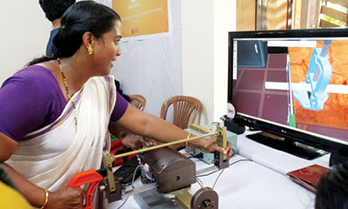
When is the hand guidance needed?
Virtual Reality
Teaching New
Motor Skills
Assistive
Technology
Guiding human operators towards a specific target
Providing physical guidance to help humans learn new motor skills
Tracing a line of printed text while listening to text-to-speech
Notes:
In virtual reality, hand guidance can be useful to help human operators reach toward a target in virtual space, such as with robot-assisted surgery.
In teaching new motor skills, physical guidance can be useful, for example, during rehabilitation exercises.
As a final example, hand guidance can be particularly useful in assistive technology for blind users. Imagine guiding a user to accurately trace a line of printed text while listening to text-to-speech output.

Slide 54
Task
51.2 mm
(300 px)
Each trial: move in one of 32 directions
(11.25° intervals)
Angular Error
Audio Feedback
Exact (Error < 11.25°) | Chime + “Perfect!”
Approximate (11.25° < Error < 45°) | Chime
Incorrect (Error > 45°) | Beep
Notes:
In the task, participants followed the direction of the vibration.
The finger had to stay at the center of the screen for one second to start a trial.
When a trial starts, the target direction is randomly selected from 32 uniformly distributed directions and the motors vibrate.
The participant move the finger about 50 mm to the direction of the vibration.
When a trial is completed, audio feedback was played to let participants know how they did.
Participants got different audio feedback for the levels based on the angular error.
For the exact hand movement, a chime followed by word “Perfect” sound was played.
For the approximate movement, only a chime sound was played.
In other cases, the trial was considered incorrect and beep sound was played.

Slide 55
Task
Practice (16 trials)
8 directions counterclockwise
+ 8 random directions
Notes:
For each condition, participants first completed 16 practice trials,
eight directions at 45° counterclockwise intervals, and eight more directions randomly selected from the 32 directions.
----- Meeting Notes (5/25/16 21:51) -----
May be shorter.

Slide 56
8-motor more accurate than 4-motor
Hypothesis 1 is supported.
H1
The 8-motor condition will result in lower movement error than the 4-motor condition.
Notes:
This result supports our first hypothesis that the 8-motor condition will result in lower movement error than the 4-motor condition.
---

Slide 57
No Significant Difference in
Trial Completion Time
Hypothesis 2 is not supported.
H2
The 8-motor and 4-motor conditions will impact trial completion time differently.
Notes:
This result supports our first hypothesis that the 8-motor condition will result in lower movement error than the 4-motor condition.
---

