Slide 1
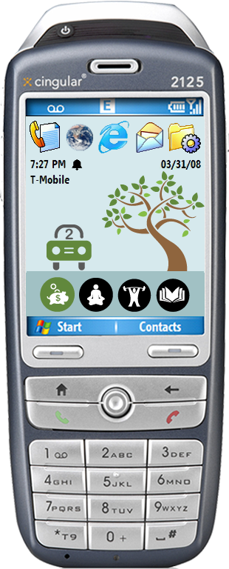



ubigreen
Using Mobile Phones as a Persuasive Technology to Affect Daily Transportation Practices
Jon Froehlich¹
Sunny Consolvo^{1,2}, Tawanna Dillahunt³,
Beverly Harrison², Pedja Klasnja^{1,2},
Jen Mankoff³, James Landay^{1,2}
design:
use:
build:
¹ university of washington
² Intel Research, Seattle
³ HCI Institute, CMU

Slide 2
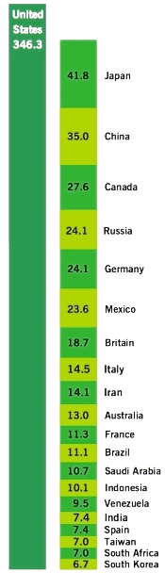
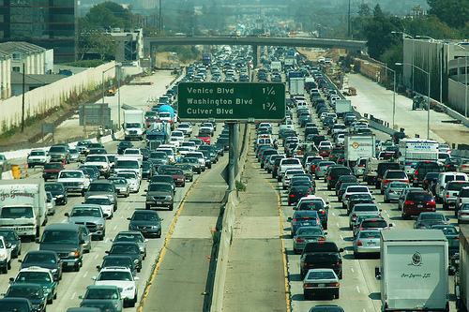
America is addicted to oil.
- President George W. Bush
State of the Union Address, January 2006
Metschies, Gerhard. Prime Numbers: Pain at the Pump, Foreign Policy, July/August 2007
Notes:
The United States consumes by far the most gasoline, a staggering 346 million gallons per day in 2003, the latest year for which data are available. By comparison, Japan and China, the next two biggest consumers, together use less than a quarter of that total.
More than half of the gasoline we put in our cars comes from oil imported from other countries. Petroleum imports cost us over $4.4 billion a week—that’s money that could be used to fuel our own economy.
http://www.foreignpolicy.com/story/cms.php?story_id=3862&page=1
http://www.fueleconomy.gov/feg/why.shtml

Slide 3
26% of CO₂
Weber, C.L., Matthews, H.S., Quantifying the global and distributional aspects of American household carbon footprint, Ecological Economics (2007)
Notes:
The top three areas responsible for energy consumption in American households:
Utilities, shopping and eating, and private transport. Transportation is the number one contributor, accounting for 26% of C02 emissions in the average American household
CO2 emissions (Mt/yr) from household consumption, in
13 consumption categories

Slide 4
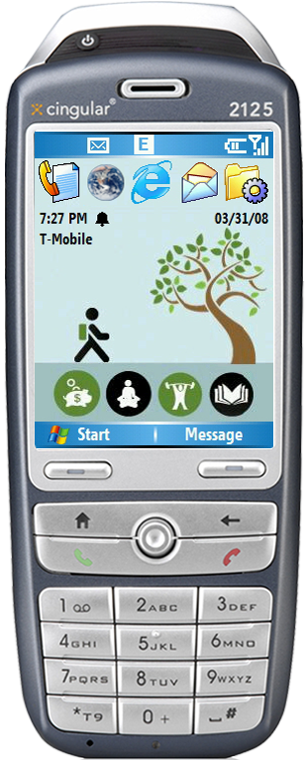
persuasive technology
technology that intentionally changes attitudes or behaviors through persuasion and social influence
- B.J. Fogg,
Persuasive Technology: Using Computers to
Change What We Think and Do, 2003
we’re interested in studying how mobile phones can be used as persuasive technologies to affect daily transportation practices

Slide 5

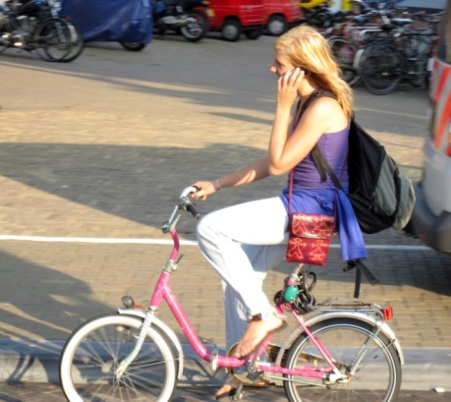
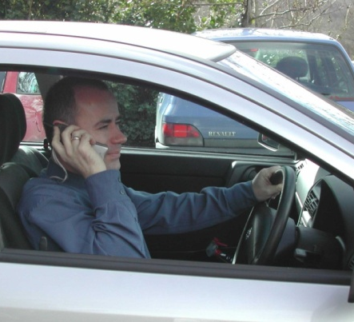

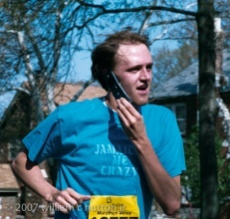
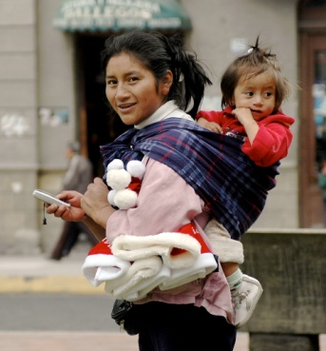
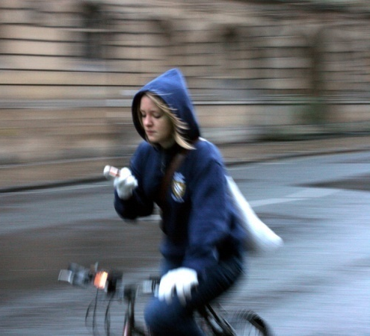
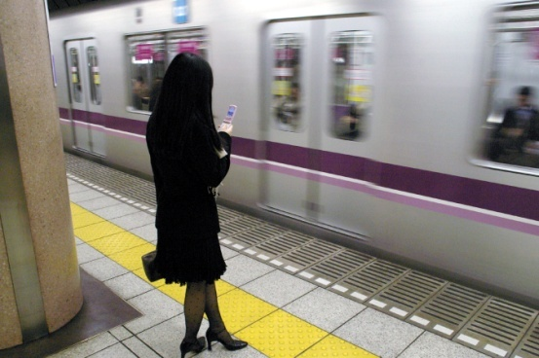
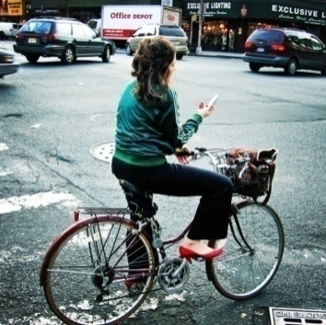
why mobiles?
always with you
always on
always connected
highly available display
sensing capabilities
advanced input/output
Notes:
Mobile persuasion is important to understand. We predict that in 10-15 years mobile phones will be the primary platform for changing people's attitudes and behaviors, surpassing the persuasive power of TV, radio, and the web — combined. The phone is perfectly suited for this as it is always with you and will have many capabilities like sensing and advanced input/output that make it the most accessible computing platform ever.
http://www.changetech.no/digital_therapy.php
http://captology.stanford.edu/

Slide 6
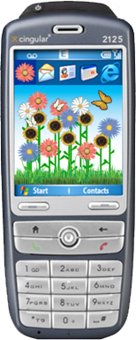











ubifit
runs on the background screen of mobile phones, so it’s frequently seen by the individual
fitness monitoring application
automatically senses activity
at-a-glance determination of
  active or inactive week
  variety in routine
  this week’s goal met
  recent goal met
strength
cardio
flexibility
walk
week’s goal met
recent goal met
Consolvo, S., et al. "Flowers or a Robot Army? Encouraging Awareness & Activity with Personal, Mobile Displays" UbiComp 2008, COEX, Seoul, South Korea, September 21-24, 2008.

Slide 7
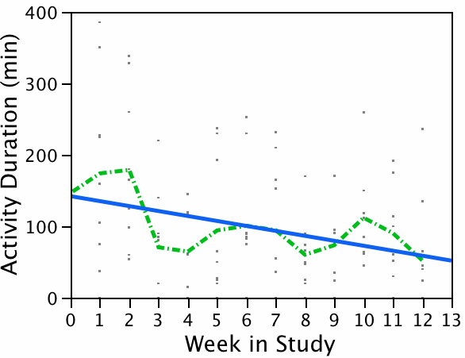
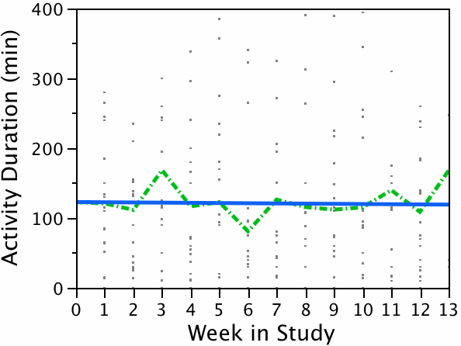
effectiveness of the ubifit glanceable display
Linear Trend
Best Fit
Linear Trend
Best Fit
No Glanceable Display
Glanceable Display
Study occurred over Thanksgiving, Christmas, and New Years.
Notes:
Twenty-eight individuals who were recruited by a market
research agency participated in the three-month field
experiment of UbiFit (15 female/13 male, aged 25 to 54)5.
All were regular mobile phone users who wanted to increase
their physical activity.

Slide 8
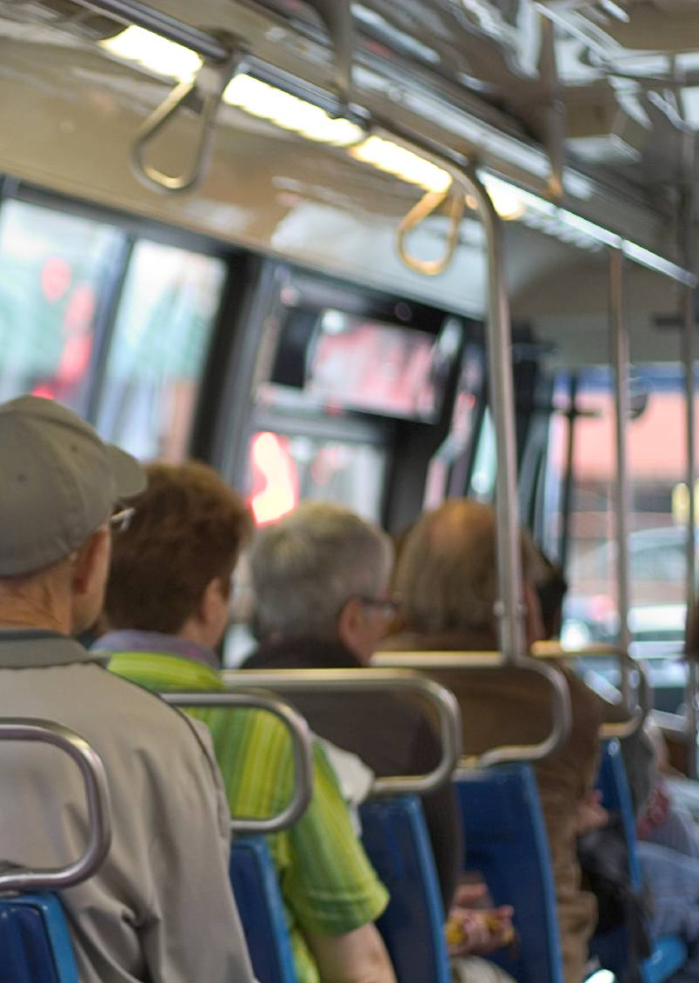
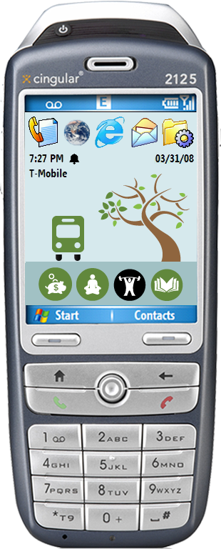
ubigreen
ubigreen combines sensors and user feedback to track transportation activity & “reward” green transit behaviors through ambient imagery on mobile phone.

Slide 9






transit activities
Drive Alone
Train
Carpool
Bus
Walk
Bike
“not-green”
“green”
Notes:
Sense five green transit activities

Slide 10
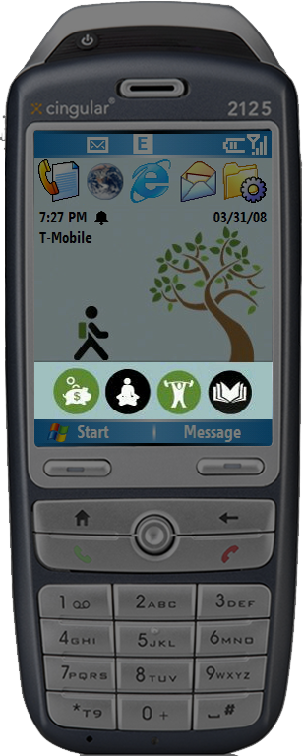
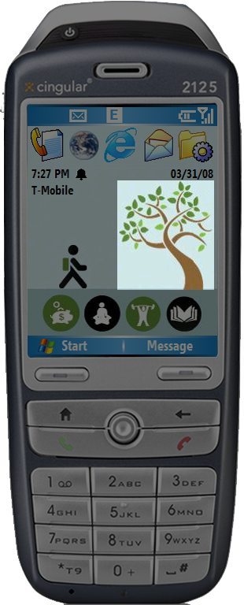
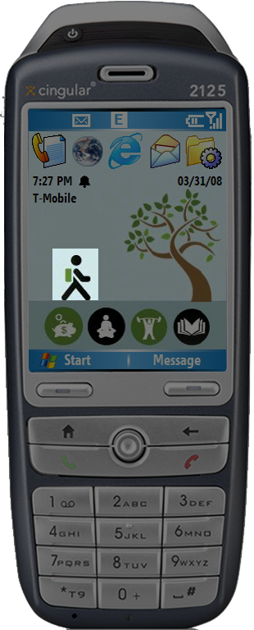
Phone
Background
(Wallpaper)
Current Activity
Evolving Image
Values Icon Bar

Slide 11


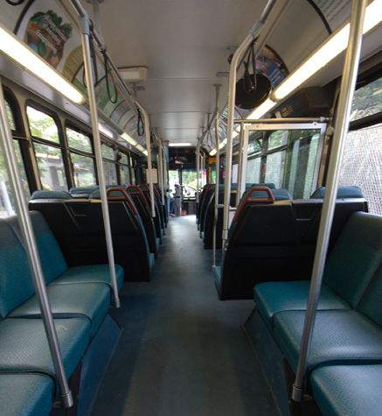
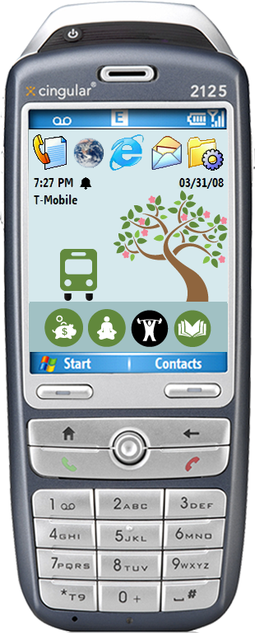
values icon bar
Money savings
Money savings
Relaxation
Relaxation
Exercise
Do other things
Do other things
Bus

Slide 12
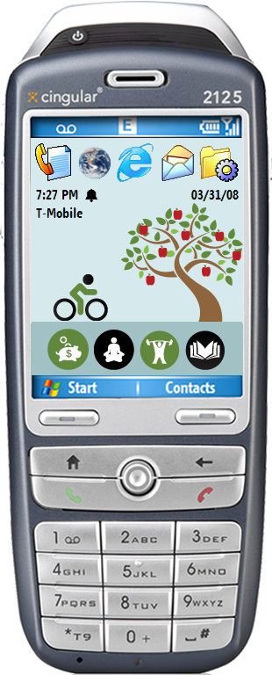
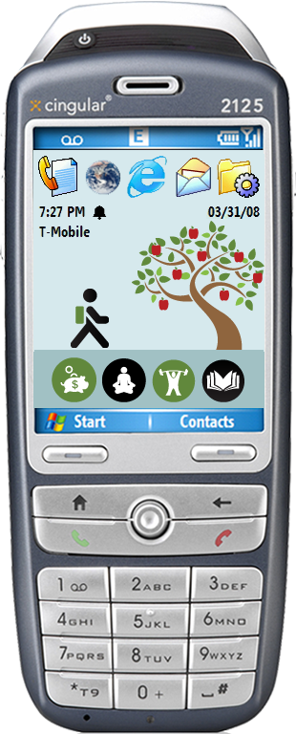
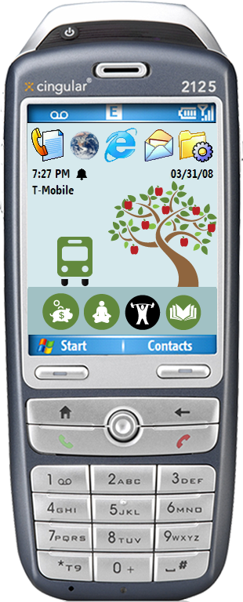
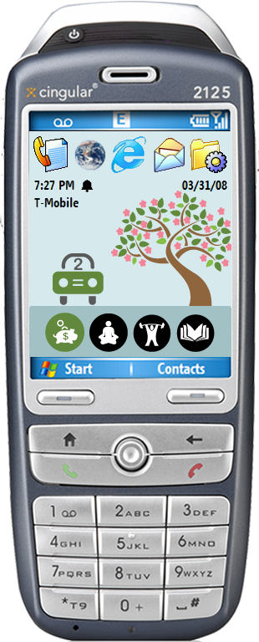
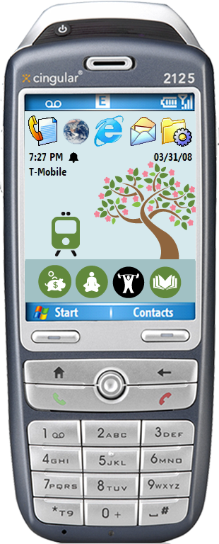
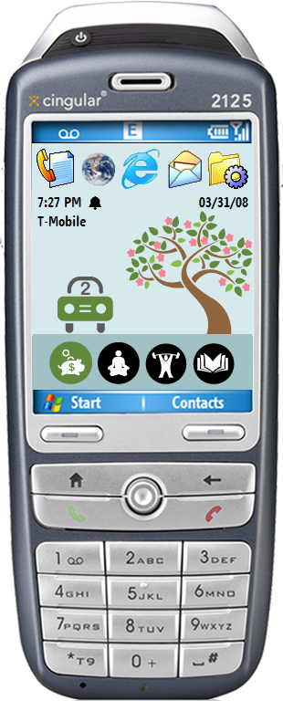
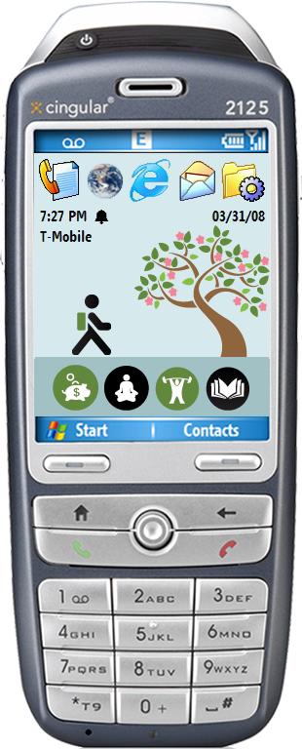



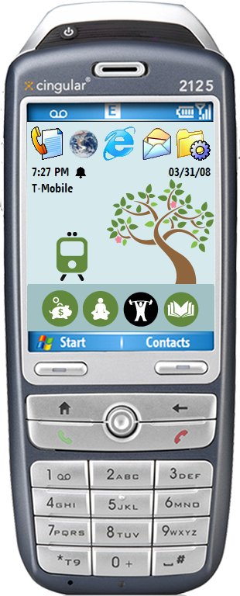
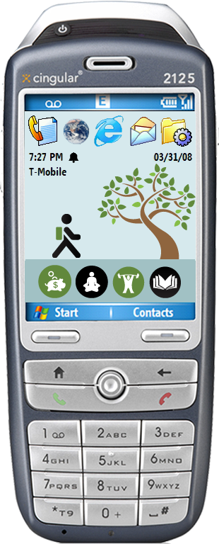
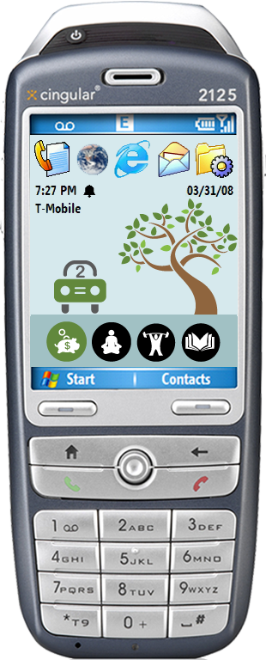
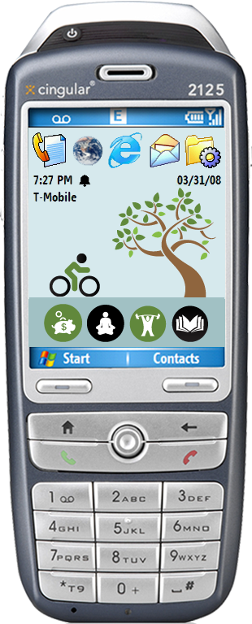

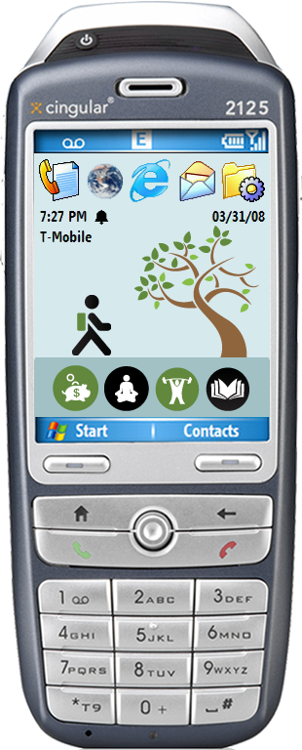
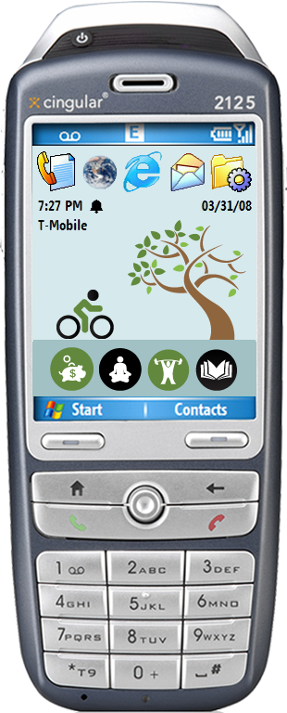
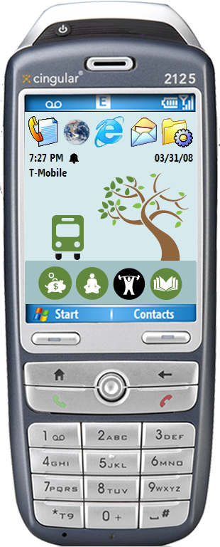


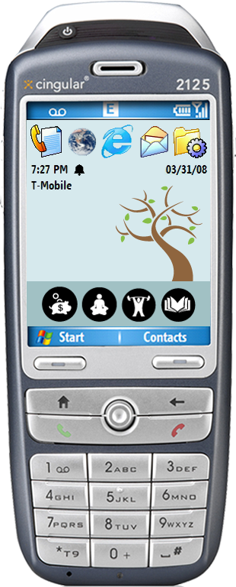

Slide 13
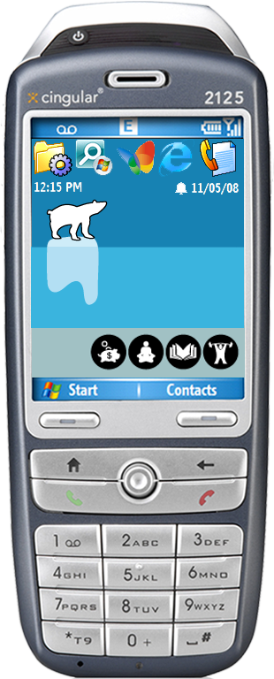
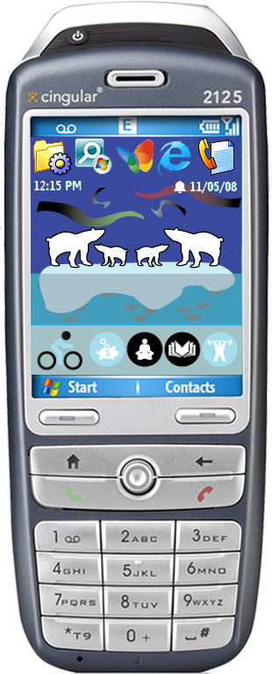

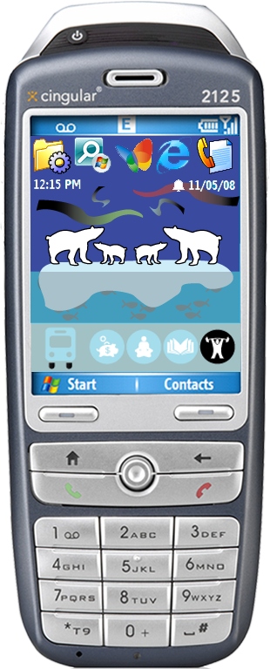
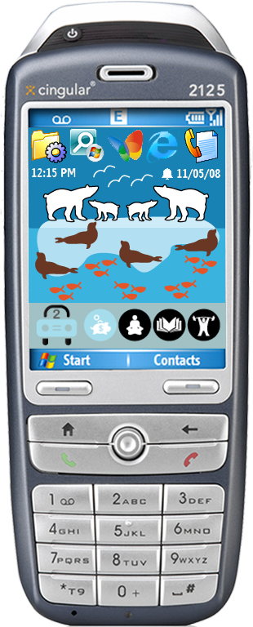
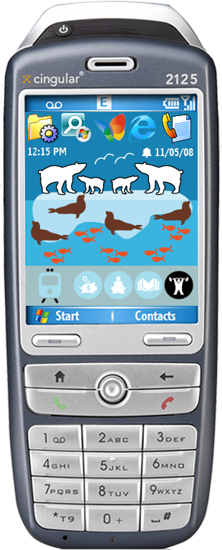


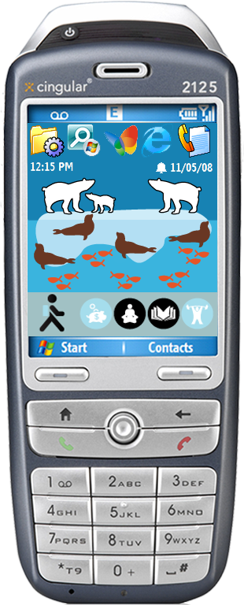

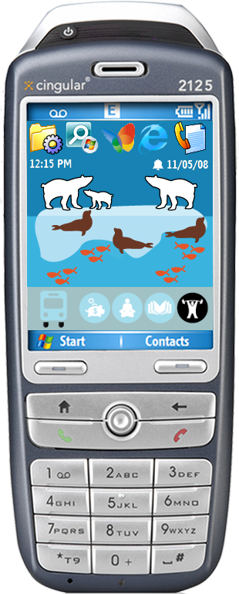
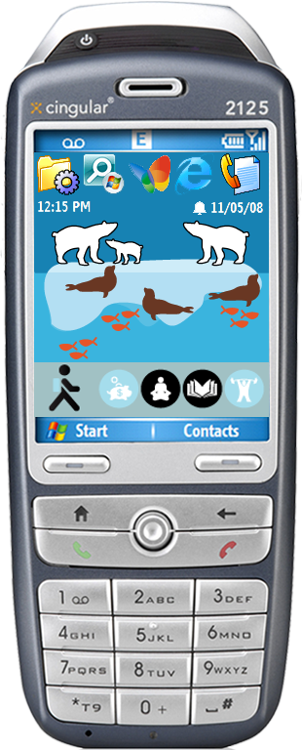
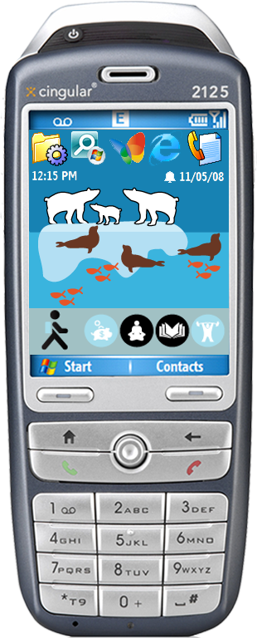
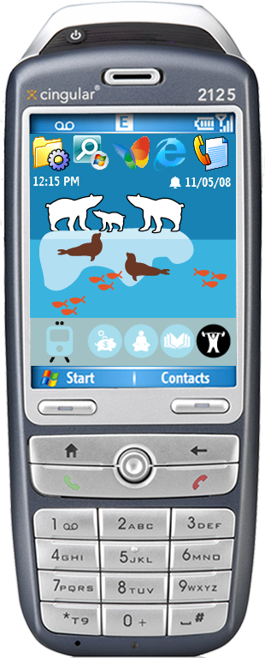
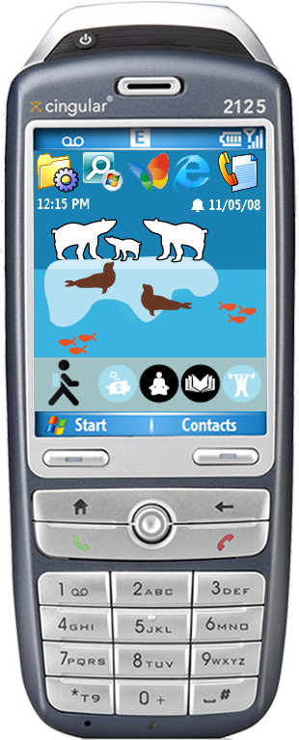
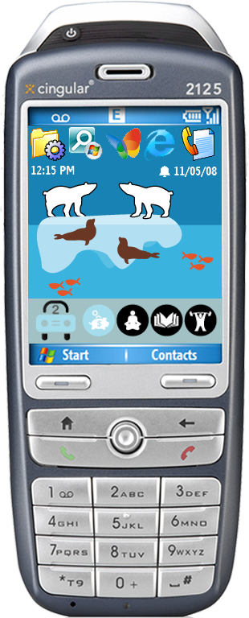
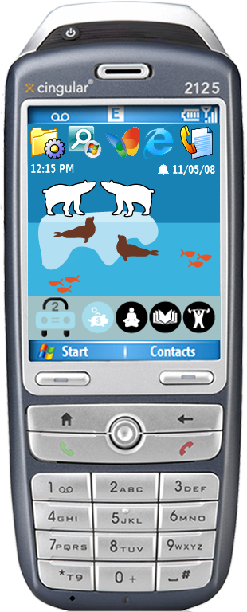
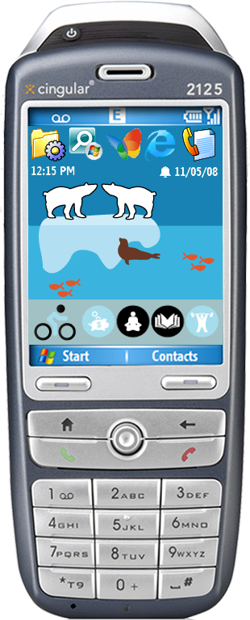








Slide 14




3 data sources
1
2
3
msp
cell towers
user
Drive Alone
Walk
Bike
Bus
Train
Carpool
minimum activity duration: 7 minutes

Slide 15


mobile sensing platform (msp)
automatically track physical actions throughout the day
  walking, bicycling, going up stairs, elevator, etc.
2-sided sensor board with
  3D acceleration
  digital compass
  audio (8kHz, 16bit)
  barometric pressure/temperature
  light: HF, ambient, IR
  humidity/temperature
packaged w/ processor, storage, Bluetooth
~90% accuracy detecting actions real-time
Choudhury, T., et al. The Mobile Sensing Platform: An Embedded System for Capturing and Recognizing Human Activities, IEEE Pervasive Computing, 7(2), (Apr-Jun 2008).
Notes:
Collaboration between Intel & UW

Slide 16



raw sensor data to transit activity
mean, median,
range, etc.
measure of confidence
for particular activities
collect raw
sensor readings
calculate
features
produce
margins
generated at varying rates
generated at ¼ second intervals
smooth margins into
meaningful actions
Send margins to phone
via bluetooth
smoothing is defined
by the application, not the MSP
Saponas, T., Lester, J., Froehlich, J, Fogarty, J., Landay, J. 2008. iLearn on the iPhone: Real-Time Human Activity Classification on Commodity Mobile Phones. University of Washington CSE Tech Report UW-CSE-08-04-02.

Slide 17
3 data sources
1
2
3
msp
cell towers
user
Drive Alone
Walk
Bike
Bus
Train
Carpool

Slide 18

gsm sensing
stationary
walking
driving / vehicle
Timothy Sohn, et. al. Mobility Detection Using Everyday GSM Traces UbiComp 2006. Irvine, California, September 2006

Slide 19





Slide 20
3 data sources
1
2
3
msp
cell towers
user
Drive Alone
Walk
Bike
Bus
Train
Carpool

Slide 21



Slide 22
3-week field study
obtain preliminary feedback on prototype
  visual design
  engagement
  potential for social use
  ideas for future designs
evaluate sensing algorithms for recording transit activities
  the eventual goal is to reduce/eliminate the need for explicit user feedback

Slide 23
participants
 | Location | Condition | Days | Occupation
P1 | Pittsburgh | Tree | 27 | Sales Clerk
*P2 | Pittsburgh | Tree | N/A | Attorney
P3 | Pittsburgh | Tree | 21 | Law Enforcement
P4 | Pittsburgh | Tree | 9 | Student
P5 | Pittsburgh | Polar Bear | 20 | Technical/Engineering
P6 | Pittsburgh | Polar Bear | 12 | Student
P7 | Pittsburgh | Polar Bear | 16 | Student
P8 | Seattle | Polar Bear | 6 | Student
P9 | Seattle | Tree | 42 | Office Admin
P10 | Seattle | Tree | 19 | Consultant
P11 | Seattle | Tree | 25 | Program Manager
P13 | Seattle | Polar Bear | 37 | Programmer
P14 | Seattle | Polar Bear | 30 | Consultant
P15 | Seattle | Polar Bear | 6 | Student
Participants had a pre-established interested in being “green”
Notes:
* Recruitment was done by posting to the Pittsburgh and the Seattle area Craigslists and using a Pittsburgh university’s online recruitment service.
* Participants were recruited from two major metropolitan cities, Seattle and Pittsburgh, to increase the diversity of perspectives in our resulting data
* Out of the 14 participants, 6 were from Seattle and 8 were from Pittsburgh
* Participation lasted from 1 to 4 weeks (average of 21 days, median=20).
* Participants were compensated between $100-300 depending on their length in the study

Slide 24


equipment
+

Slide 25



Slide 26
data collected
two online questionnaires
pre- and post-interview data
8.4 million logged sensor events
1,129 travel events (72% green)
4.2 travel events per participant per day
average trip length: 18 minutes
  23 minutes for green trips
Notes:
Of the 8.4 million logged sensor events, 1,129 were travel events, 872 (77%) of which were green. This is 4.2 transportation events per day on average across participants (3.2 of which were green). The average trip length was 18 minutes (23 minutes for green trips). The number of total trips per day is in line with previous research on daily transportation behavior [18][21], which provides evidence that we were accurately recording transportation behaviors

Slide 27
observed transit
Notes:
Walking was the number one form of transit, accounting for 31% of all observed transit events
Driving alone, however, was the second most popular form of travel accounting for 22% of observed transit events
Followed by carpooling at 19%

Slide 28
source of data
24.2%
35.3%
40.6%

Slide 29







visual design
“I liked the tree because it was, to my mind, a pretty progress bar. There was enough of a clear distance between each state that I could tell the difference at a glance.”
- Participant 11
“I would like to see some graph or raw data. Even some sort of notification of this is how often you took the bus this week. Something that provides some utility back to me.”
- Participant13
“I would like more information about carbon emission savings.”
- Participant 15
Participants liked visual design but requested more quantitative data and interfaces to explore that data

Slide 30
engagement
“It’s omnipresent”
- Participant 9
“I liked that we didn’t know what it was going to do. Like when your phone turned from leaves into flowers and then apples.”
- Participant 15
“I want to have different stories every week … to maintain curiosity in the app”
- Participant 8
“If you opened it up, people would generate their themes online and share them. It would be cool”
-Participant 10
How do we design for long-term engagement?

Slide 31
real-life game
Our real-world interactions as input to games
One participant complained that when a trip hadn’t been automatically recorded, “I felt like I was being cheated out of my ‘points’”
- Participant 15
“I think negative reinforcement would also be good. I think maybe my polar bear should drown though if I am bad.”
- Participant 14
Future designs could incorporate more overt gaming models
Notes:
Although we did not describe UbiGreen as a game to our participants, many began to perceive it as one. In interviews and in our freeform post-study survey data, participants would use game-like metaphors when describing the application.
For example, participants mentioned that engaging in green transit behaviors earned “points” and making it to the last screen was the “final level.” One participant even complained that when a trip hadn’t been automatically recorded, “I felt like I was being cheated out of my ‘points’” (P15).

Slide 32


social
“Some people at work knew about the polar bear and every day they asked me about it. ‘Did you get a seal today?’”
- Participant 14
“I would show my friends, ‘look at my tree, isn’t it cool, look at the flowers…’ They thought it was pretty cool.”
- Participant 9
How can we leverage online social networks to tap into social influence?
Mankoff, J, et al.. (2007). Leveraging social networks to motivate individuals to reduce their ecological footprints. HICSS ‘07
Notes:
We believe that exploring how social motivators like competition can be used to influence transportation behaviors is rich, open area of future research mention nike ipod?
Can also offer social support

Slide 33
real-time recommendations
post-study survey, “what could help you take more green trips”
  Reliable transportation (76.8%)
  Financial incentives (71.4%)
  Knowledge about alternatives (56%)
future designs could suggest alternative forms of transit based on trip history
recommendations could also come in form of neighborhood:
  “42% of the people who live in your neighborhood and work in Capitol Hill take the bus.”

Slide 34
potential for behavior change
“The motivation for me is more of the tracking and kind of seeing how I am doing and just the reminder factor of it. “
- Participant 11
“It really encourages you to analyze your own performance”
- Participant 8
“I feel I already travel in a relatively eco-friendly way and the study did not change that”
- Participant 15
“This can be connected with government incentives somehow… For example, government could encourage people with tax refund.”
- Participant 7

Slide 35
future work
longitudinal deployment focused on studying behavior change
interfaces for self-comparison
exploring social sharing/influence
real-time recommendations
quantitative carbon-tracking features
  ability to project footprint into the future
new types of story boards/themes
  ability to navigate story board in non-linear fashion
what about reward and punishment?

Slide 36

iphone

Slide 37

ecorio

Slide 38
How many generations in all of human history have had the opportunity to rise to a challenge that is worthy of our best efforts. A challenge that can pull from us more than we think we can do.
-Al Gore
TED Conference, March 2008

Slide 39



thankyou!
http://dub.washington.edu/projects/ubigreen
jonfroehlich@gmail.com
Behavior-based energy efficiency poster at a bus stop outside conference hotel.
Acknowledgements: We would like to thank Intel Research for providing financial support for this project and Microsoft Research for funding Jon Froehlich.
design:
use:
build:
university of washington
CSE, UW
Intel Research, Seattle
iSchool, UW
HCI Institute, CMU

