Slide 1
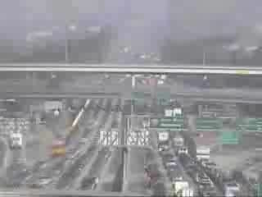
personal transportation is the greatest contributor of CO₂ emissions in the average u.s. household
the u.s. consumes by far the most gasoline, a staggering 346 million gallons / day
transportation accounts for more than two-thirds
of oil consumption in the u.s.
Weber, C. L. & Matthews, H. S. (2008). Quantifying the global & distributional aspects of American household carbon footprint. Ecological Economics, 66(2-3):379-391.
Metschies, Gerhard. Prime Numbers: Pain at the Pump, Foreign Policy, July/August 2007
Davis, S., Diegel, S., and Boundy, R. (2008). Transportation Energy Handbook: Edition 27. Center for Transportation Analysis, Energy and Transportation Science Division, US Department of Energy. Form ORNL-6981
Notes:
Driving is deeply embedded in our culture and has been for a long time. Cars are such a pivotal feature of daily life that many of us organize all of our activities around them. And they certainly provide tremendous value, but at what cost?
Personal transportation is the greatest individual contributor of CO₂ emissions (26%) in the average American household
The United States consumes by far the most gasoline, a staggering 346 million gallons per day
Transportation alone accounts for more than two-thirds of oil consumption in the US (highway vehicles were responsible for 80% of this).

Slide 2
we help people reflect on their transportation

Slide 3
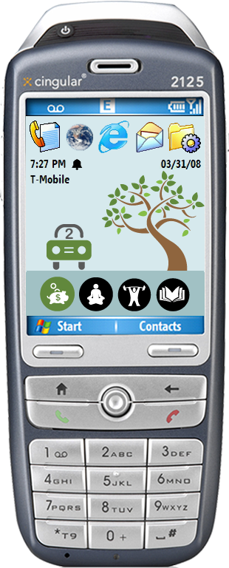
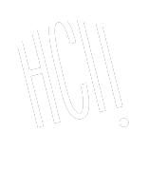


ubigreen
Investigating a Mobile Tool for Tracking and Supporting Green Transportation Habits
Jon Froehlich¹, Tawanna Dillahunt³,
Pedja Klasnja¹, Jen Mankoff³,
Sunny Consolvo^{1,2}, Beverly Harrison^{1,2},
James Landay^{1,2}
design:
use:
build:
¹ university of washington
² Intel Research, Seattle
³ HCI Institute, CMU
Notes:
Introduce self and Tawanna.
Read paper title.
The UbiGreen Transportation Display prototype is a mobile phone application that semi-automatically senses and feeds back information about transportation behavior using the background of the mobile phone.

Slide 4
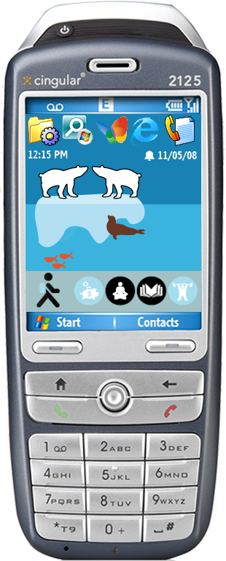
ubigreen
transportation display
design influences
activity-based computing
feedback literature
ubifit
formative studies
  an online survey
  an in situ (ESM) study
Notes:
The UbiGreen transportation display has two designs: a tree-based design and a polar-bear based design. Both are evolving, abstract representations of a person’s eco-friendly transportation habits
Our design was influenced by four major factors:
Activity-based computing
Existing work in the efficacy of feedback in increasing self-awareness and changing behavior
UbiFit, a mobile-phone based application for automatically tracking and feeding back information on fitness
Two formative studies: an online survey and an experiences sampling study to better understand how people make transportation decisions
I’ll go over each of these in turn.

Slide 5
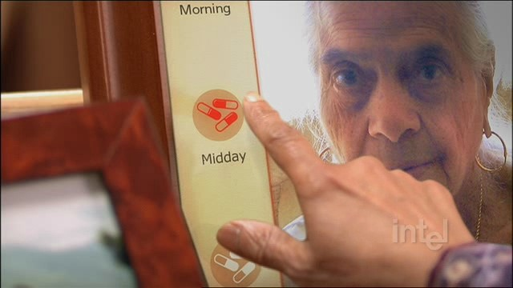
activity-based computing
long-lived activities in our everyday lives
  staying healthy, graceful aging, etc.
  high-level, physical, dynamic, high-value
key elements
  social
  natural interactions
  always at hand
[Li and Landay, CHI2008]
Notes:
Activity-based computing is focused on long-lived activities in our everyday lives such as staying healthy, graceful aging
The key application elements are providing social value, natural interactions, which let us interact with computing as we do the physical world, and always at hand, so having the information and capabilities everywhere we go

Slide 6
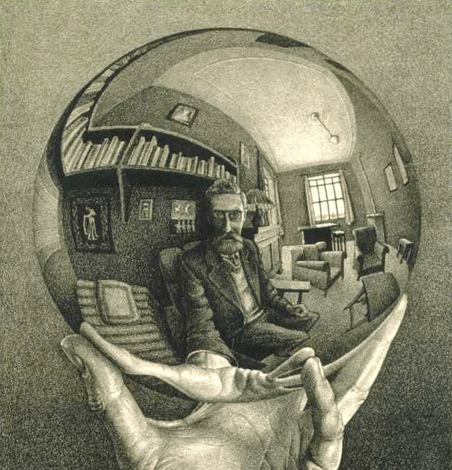
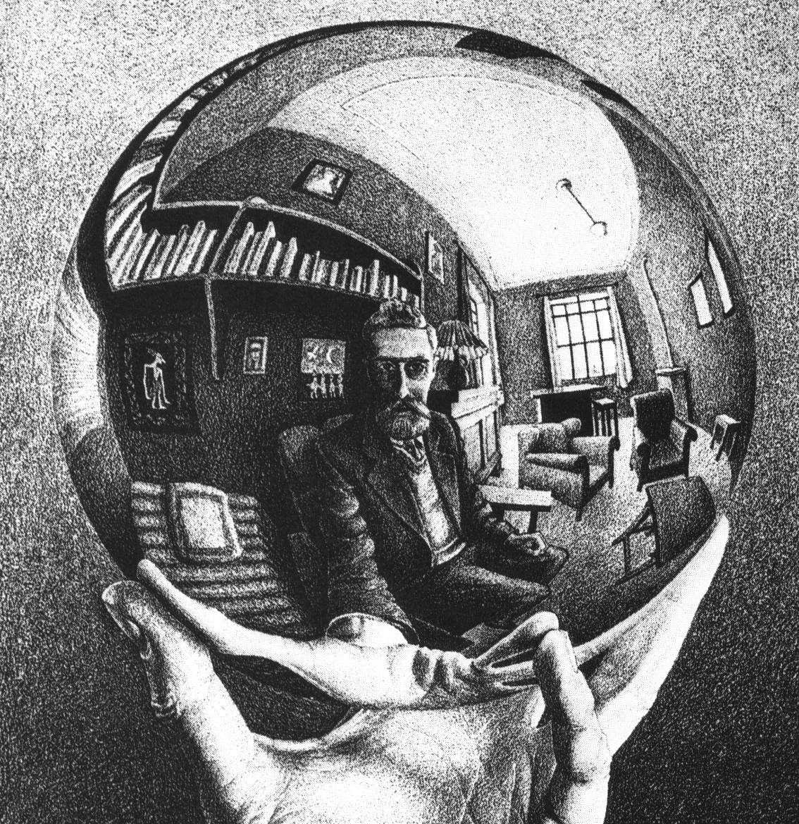
feedback
Notes:
Feedback provides a basic mechanism with which to monitor and compare behavior and allows an individual to better evaluate their performance.

Slide 7
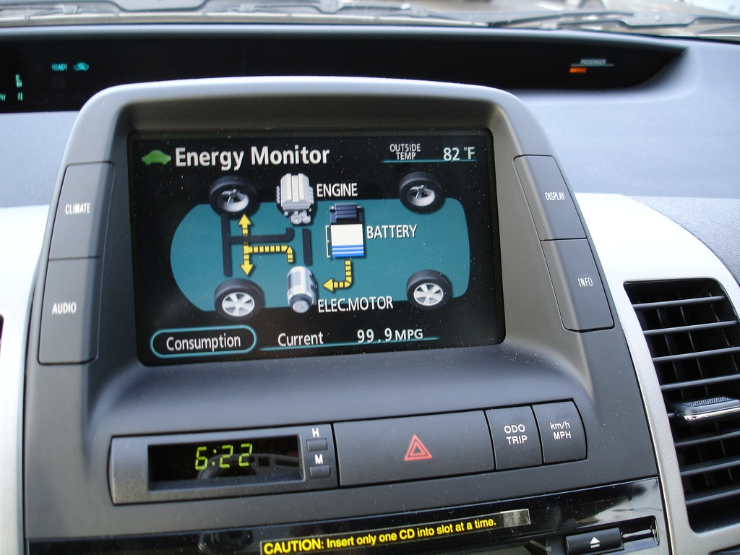
toyota prius
Notes:
The Toyota Prius, perhaps the canonical example of energy feedback displays, provides real-time information about combustion engine vs. electric motor usage and people are able to drive more efficiently as a result.

Slide 8
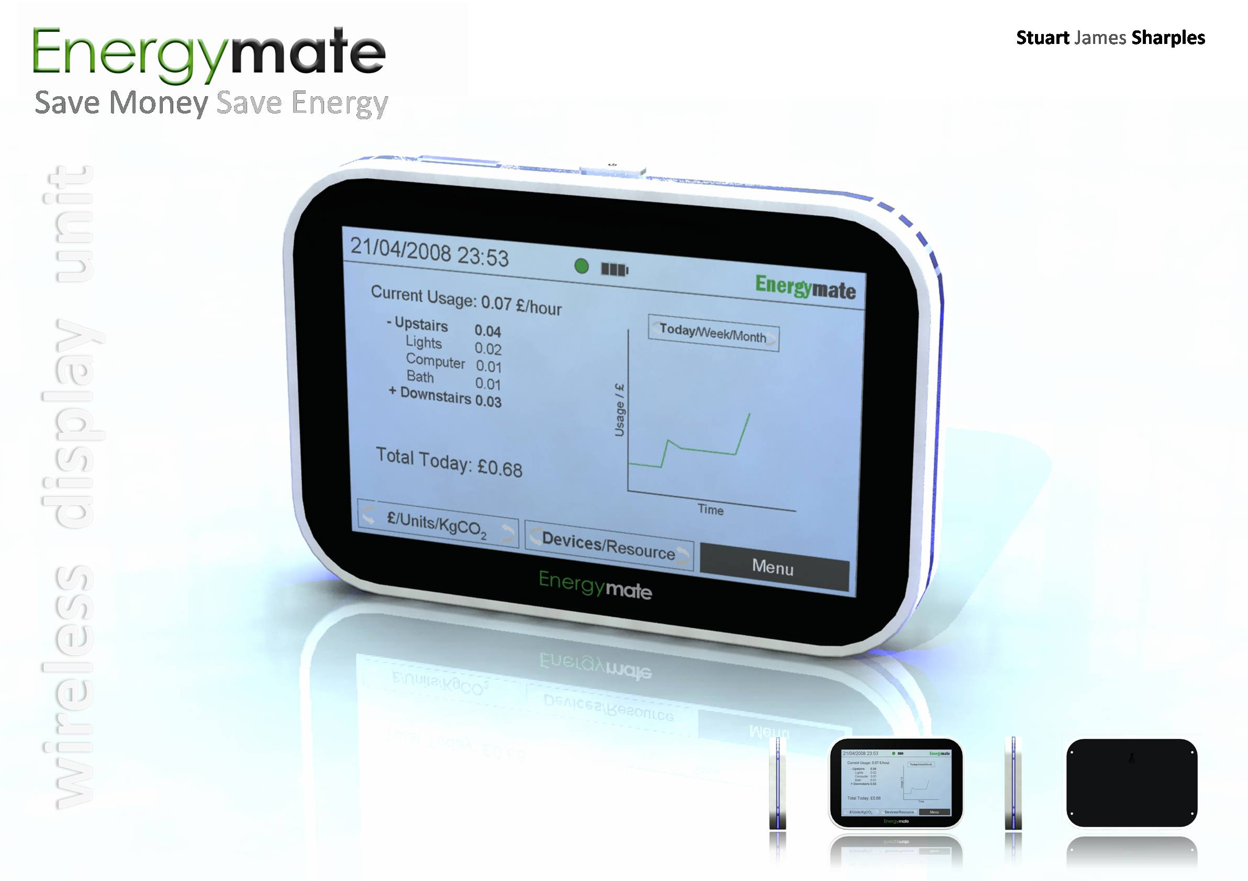
feedback
Talk about feedback intervention
Talk about energy savings from feedback studies
feedback resulted in typical energy savings of between 5 and 12%
[Fischer, 2008]
Notes:
Feedback technologies have been shown to be one of the most effective strategies in reducing energy consumption in the home, although they have not been comprehensively explored in the transportation domain.
Corinna Fischer reviewed approximately twenty studies exploring the effects of feedback on electricity consumption and found that typical energy savings were between 5 and 12%.

Slide 9
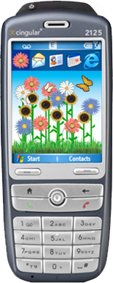








ubifit
fitness monitoring application
automatically senses activity
at-a-glance goal information
3-month study; those with ambient display outperformed those without
strength
cardio
flexibility
walk
week’s goal met
recent goal met
[Consolvo, CHI2008]
Notes:
So, there is a lot of past research in feedback displays indicating that it is effective at creating awareness and promoting certain behaviors. More recently such feedback techniques have become integrated into mobile phones.
Sunny Consolvo, a colleague and co-author of UbiGreen, created the UbiFit application, which semi-automatically senses a person’s fitness activities and relates them back to the user via a garden metaphor. The more flowers, the more fit.
Consolvo conducted a 3-month study with a control and experimental group and found that those with the ambient display outperformed those without.
So, past research provided a foundation for our designs but we wanted to obtain specific transportation user data as well. So we conducted two formative studies.

Slide 10
formative study #1
online survey
73 respondents
Determine people’s attitudes about transportation
Get feedback on early design concepts
Notes:
The first formative study was an online survey of 73 respondents to determine people’s attitudes regarding green transportation and to get feedback on early visual design concepts.

Slide 11
formative study #1
online survey
factors that influence
transportation choices
44%
23%
23%
16%
Notes:
One particular result of interest was the factors that influence transportation choices. Unsurprisingly, speed and flexibility are the two most frequently selected factors… but also note that cost, eco-friendliness, comfort and exercise play a role. These “secondary-concerns” were critical in leading us to design the value icon bar, which we will get into later.

Slide 12
formative study #2
experience sampling study
7 participants over 7 days
explore consistency of responses w/online survey
acquire in situ data on num trips/week
get additional feedback on revised visual designs
Notes:
The second formative study was an experience sampling study using mobile phones to
First, see whether people’s in-the-moment reasoning about their transportation choices were consistent with the results from the online survey
Second, to get in situ data on the # of trips people took per week
And third, to get additional feedback on revised visual designs

Slide 13
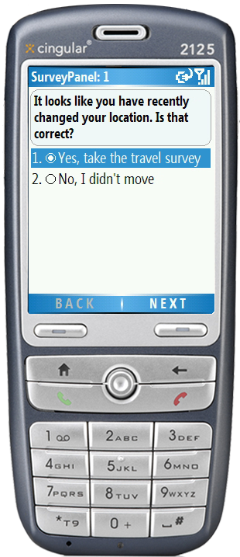
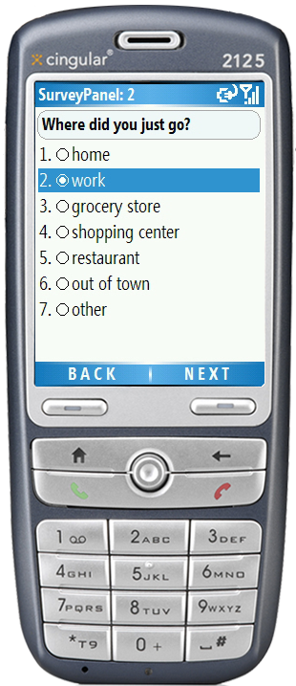
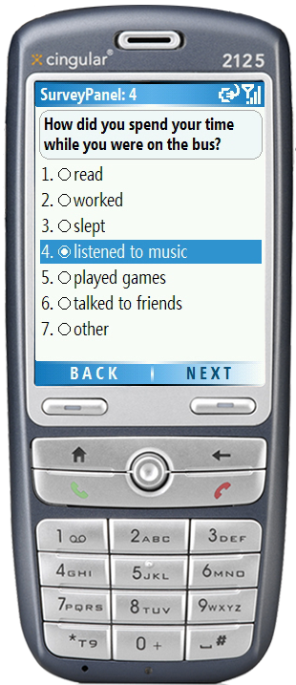
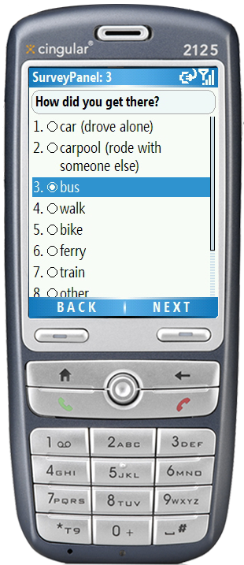
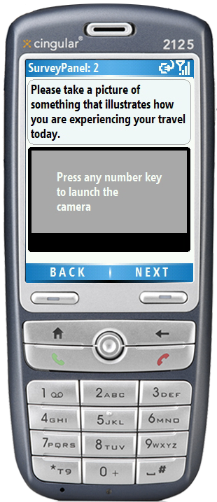
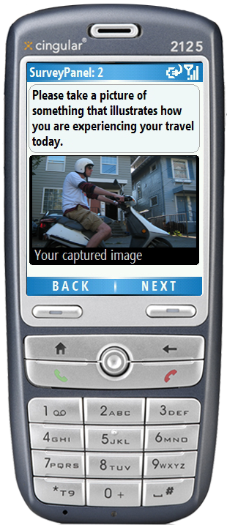
formative study #2
experience sampling study
[Froehlich, MobiSys 2007]
Notes:
Participants carried around mobile phones running the MyExperience tool, which would sample them whenever the end of a trip was detected.

Slide 14
formative study #2
experience sampling study
126 trips logged
for 73% of car trips, participants indicated that greener options existed
Notes:
In all, over the course of the 7 day period, 126 trips were logged. (then read slide)
So, the key here is that in situ, people recognized that there were alternative forms of travel available to them.

Slide 15
visual design

Slide 16






transit activities
Drive Alone
Train
Carpool
Bus
Walk
Bike
“not-green”
“green”
Notes:
We monitored five green transit activities: train rides, carpools, bus rides, walking and bicycling and one non-green activity: driving alone
Users were only rewarded for partaking in green (eco-friendly) transit activities.

Slide 17
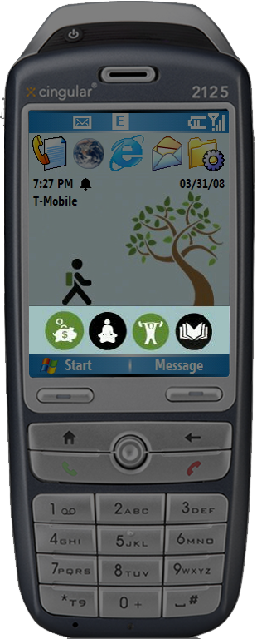
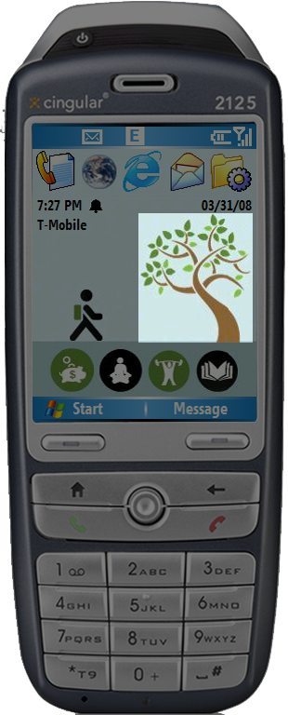
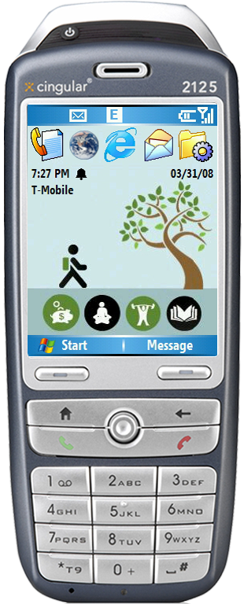
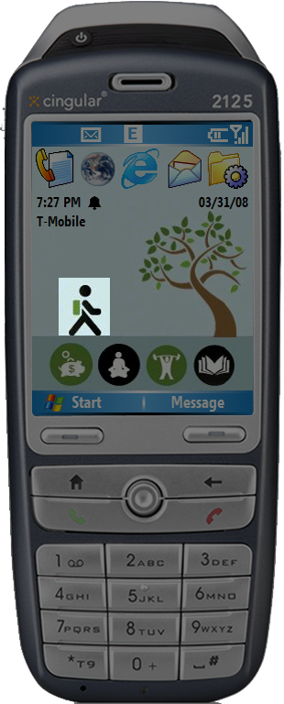
phone
background
(wallpaper)
current activity
evolving image
value
icon bar
Notes:
The interface is broken down into four parts. I’ll illustrate them using the tree design.
First, like UbiFit, we use the background of the mobile phone for our interface. Thus, interacting with our application is extremely low cost. The user is constantly able to see our display as they use their phone for everyday purposes like checking their text messages or making a phone call.
Second, we highlight the current activity in the lower left hand corner
Third, we show an evolving image, a tree that grows leaves and blooms flowers based on the number of green activities that have been taken for the week
Fourth, the value icon bar which highlights secondary values that influence transportation decisions

Slide 18


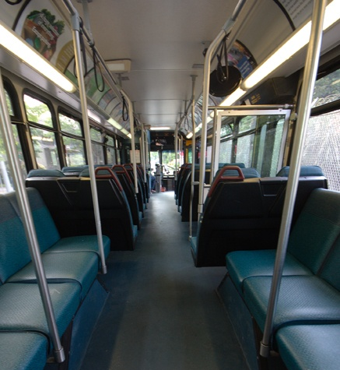
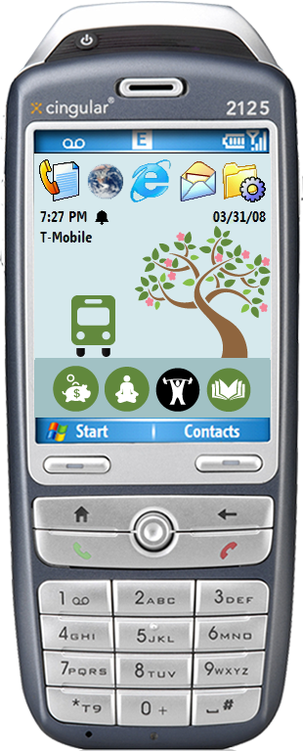
value icon bar
money savings
money savings
relaxation
relaxation
exercise
do other things
do other things
Notes:
The value icon bar came out of our formative work, which showed that people have different motivations for taking transportation modes.
For example, here the user is taking a bus ride, and so the money savings, relaxation and do other things icons are highlighted

Slide 19
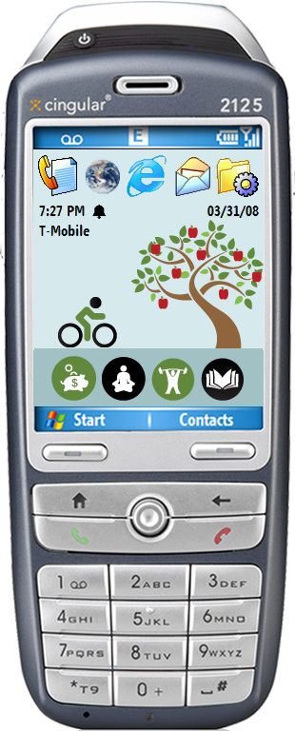
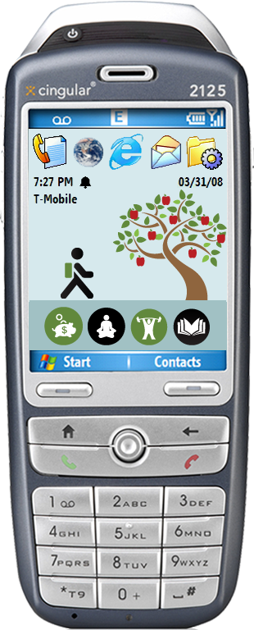
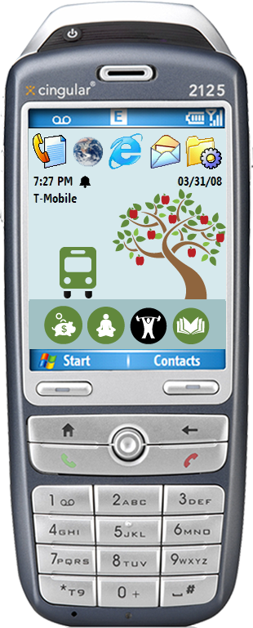
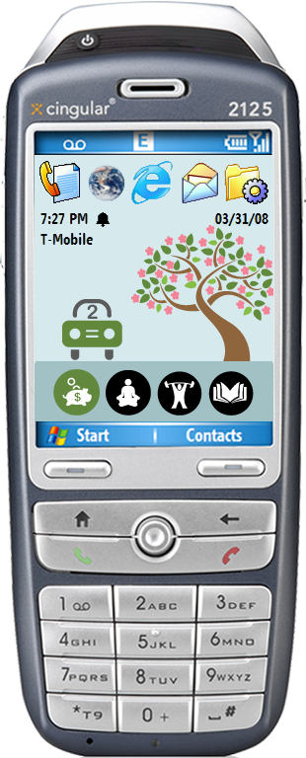
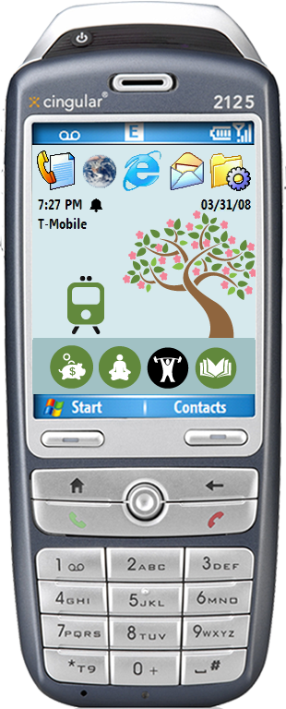
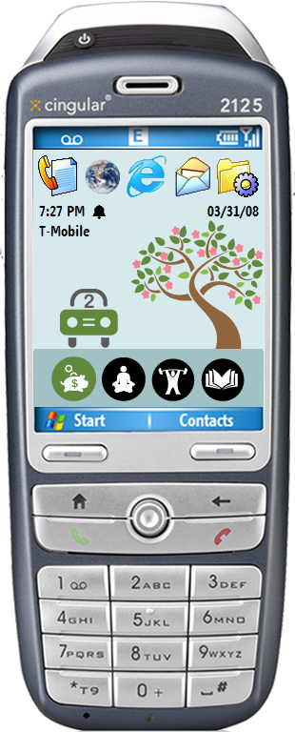
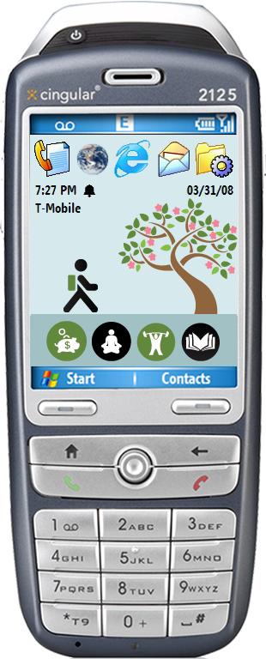



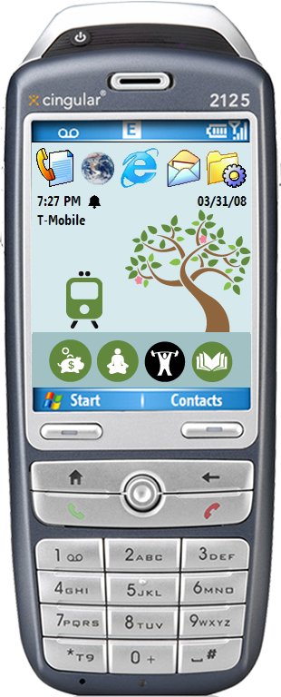
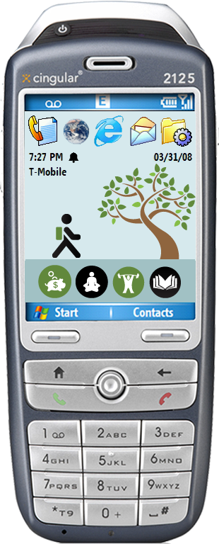
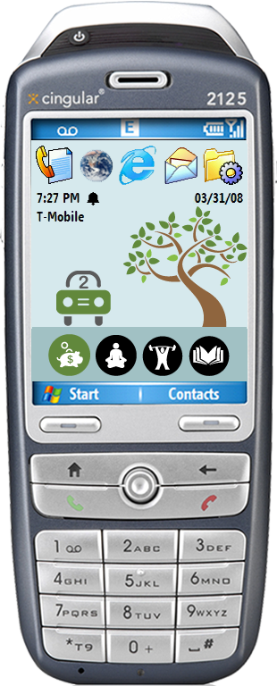
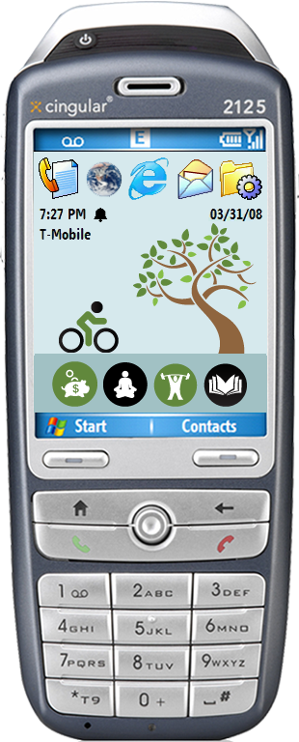

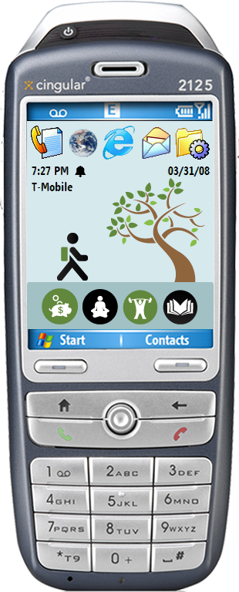
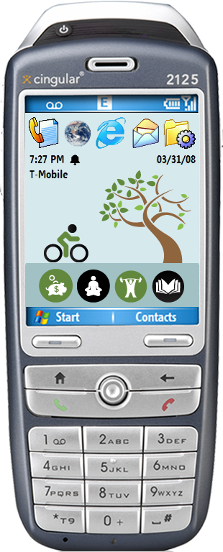
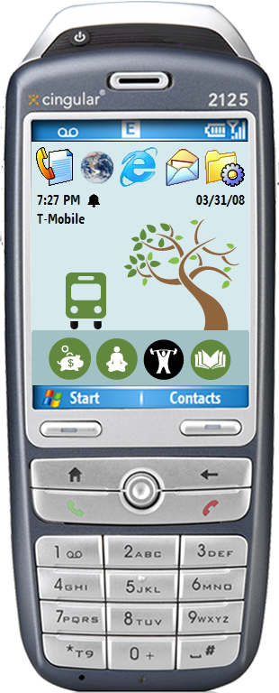

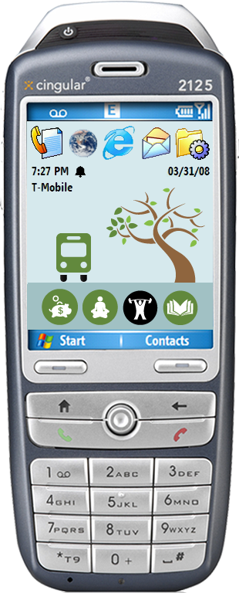

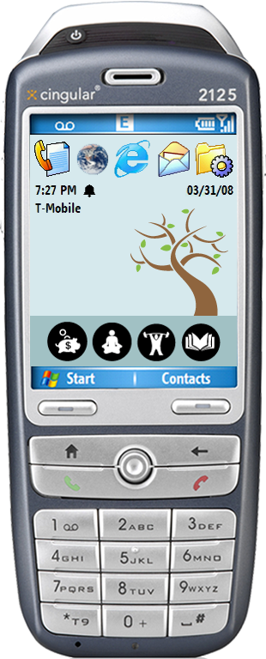
everything resets
on sunday
Notes:
Note that the users are unaware of this progression when they first start using the application and also that we do not use punishment; that is, once a reward icon is earned by taking green transit, it is never taken away.
In UbitFit, during exit interviews, participants explicitly commented that the use of punishment would have discouraged them from using the system.
----
Second, Robert Cialdini (Social psychologist who has done a lot of work on mechanisms of persuasion. There is a relatively new book he published last summer summarizing some of his findings. It’s called “Yes”.) has some data that negative representations are not effective in motivating behavior.
Also, there is data in eduction and behavioral pyschology—going back to the 50s—showing that punishment is not an effecitve way to encourage learning. Skinner (1952), for example. (Science and Human Nature)

Slide 20
implementation

Slide 21


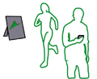








architecture
study data
sql server mobile 2005 on phone
transit data
activity data sent via BT
(sent over gprs)
wearable sensor
(intel msp)
ubigreen running as an extension of the myexperience tool
activityserver
new screen sent back to phone
logic applied
next screen generated
Notes:
UbiGreen users wear a sensing device around their waist, which automatically tracks transportation activities such as walking and bicycling.
This activity data is sent to the user’s phone over Bluetooth. UbiGreen takes this data and stores it locally on the phone as well as sends it over the cell network using GPRS to a backend server called ActivityServer. ActivityServer analyzes the data and generates the next screen to be displayed on the user’s device.
The highlighted part represents the part of the system designed and controlled by ActivityDesigner and ActivityServer.

Slide 22
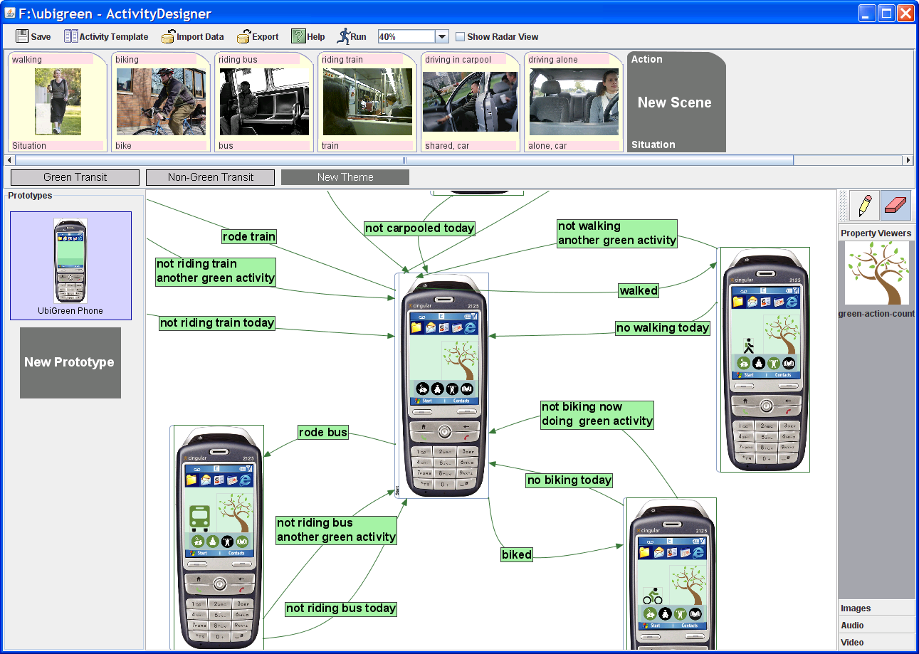
activitydesigner
[Li, CHI2008]
Notes:
The visualization logic for ubigreen was built by a tool called activity designer, which allows designers to quickly prototype interfaces using a visual language. These prototypes can be deployed and run by a second tool called activity server.

Slide 23
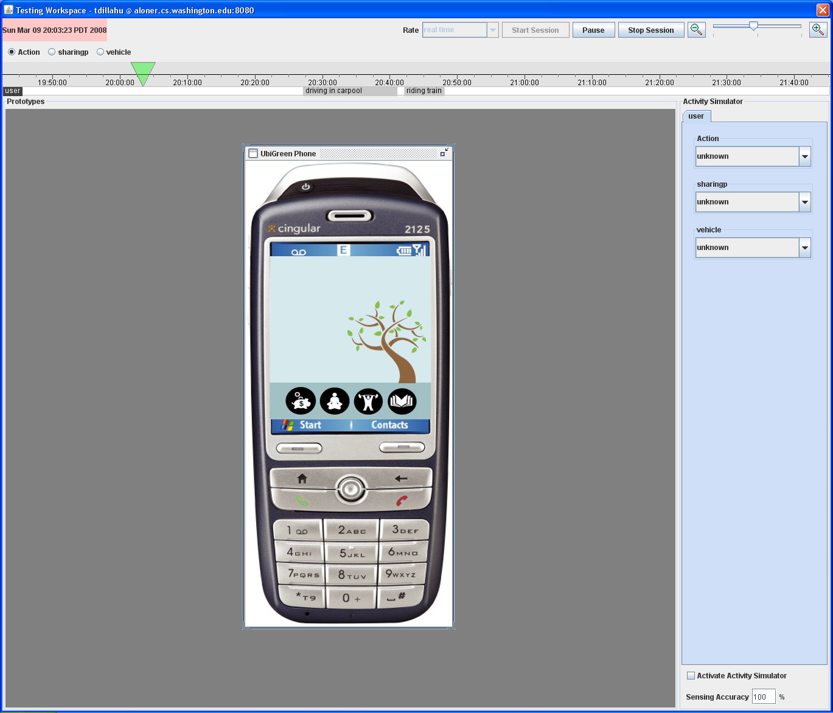
activityserver
Displays events chronologically as sent by user’s phone
Ability to scroll back in time and play through events received
The simulator displays the user’s screen at the selected moment in time
[Li, CHI2008]
Notes:
Activity designer can also deploy as a backend server called activity server.
This allowed us to gain a real-time look at participants data
to scroll back through time and play through the events received
The simulation screen displayed the participant’s screen at the selected moment in time

Slide 24
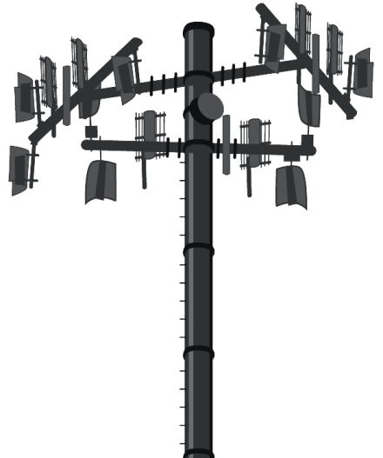
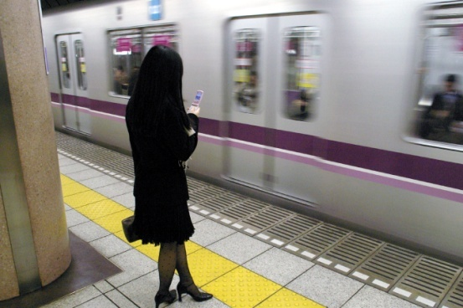
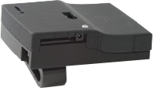

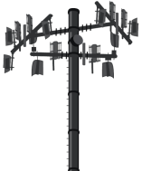
three data sources
1
2
3
msp
cell towers
user
Drive Alone
Walk
Bike
Train
Carpool
Bus
minimum activity duration: 7 minutes
Notes:
The UbiGreen transit tool has three separate data sources: the msp, cell towers, and the user themselves
The minimum activity duration in order to get awarded was 7 minutes, this was to reduce the amount of false positives in our system.
The MSP automatically tracked walking and bicycling events

Slide 25
three data sources
1
2
3
msp
cell towers
user
Drive Alone
Walk
Bike
Train
Carpool
Bus
minimum activity duration: 7 minutes
Notes:
Vehicle travel was automatically detected by changes in cell tower station ids; however, we could not differentiate between vehicles using this method nor whether someone was driving alone or carpooling.

Slide 26
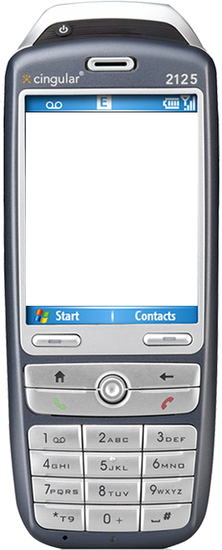
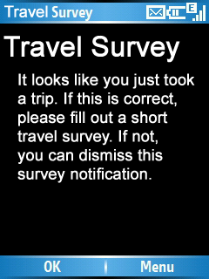
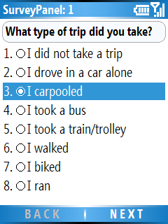
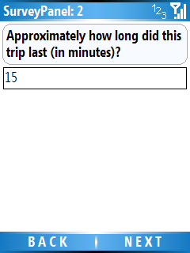
Notes:
So, after we detected the end of a trip made by vehicle, we asked a short questionnaire about what type of trip the user took and how approximately how long the trip lasted.
Of course, this is not how we envision the final ubigreen transportation system, but it allowed us to rapidly prototype a deployable solution.

Slide 27
study

Slide 28
3-week field study
obtain preliminary feedback on prototype
evaluate sensing algorithms for recording transit activities
Notes:
It has been acknowledged that situated data is important to understanding the value of ubiquitous systems. We rapidly prototyped our system as previously described specifically for the purpose of a situated deployment.
We conducted a 3-week in-situ qualitative field study to evaluate the feasibility and use of our application.
We wanted to obtain preliminary feedback on our prototype – and specifically evaluate the qualities of two visual designs, opportunities for engagement with the issue of sustainable transportation, collect ideas for future designs. Secondly, we wanted to determine the viability of using automatic sensing to detect transportation behaviors. Our ultimate goal would be to automatically detect all modes and eliminate the need for explicit user feedback.

Slide 29
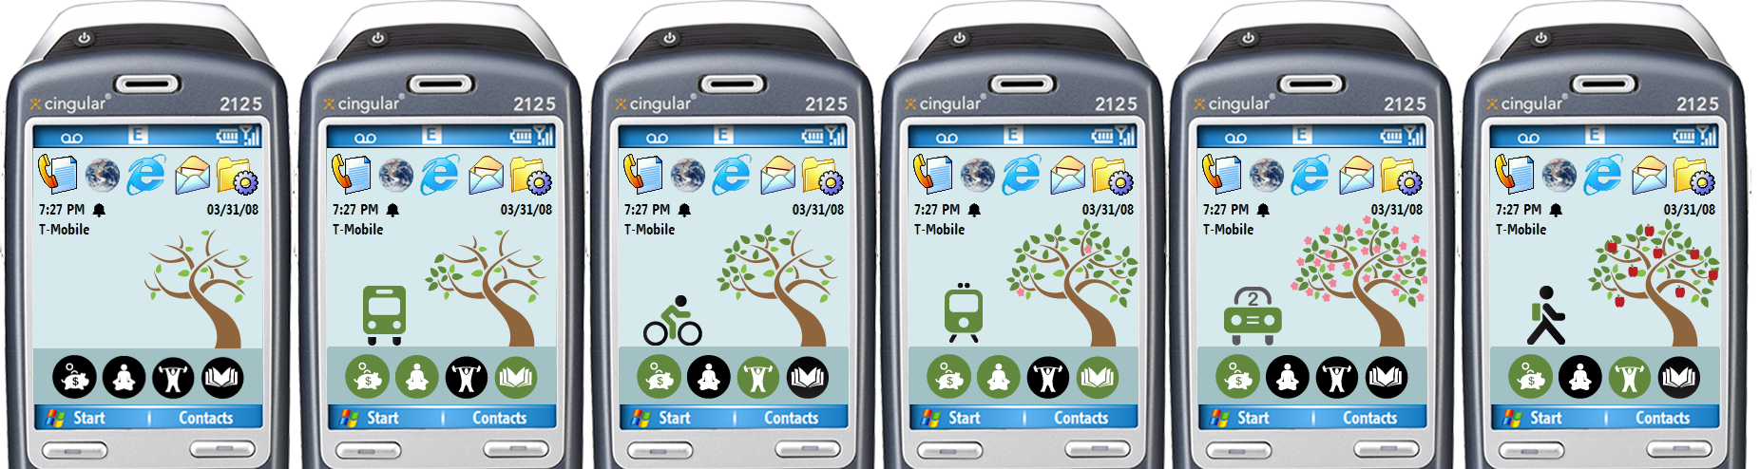

tree
polar bear
Notes:
We had two visual designs for our study: the tree design, which Jon covered, and a polar bear design.
At the start of each week, the polar bear is shown on a small iceberg. Over the week, the iceberg grows as green transportation actions are taken and the surrounding ecosystem improves. The final screen depicted the Northern Lights.
**** It’s important to note that none of our participants in the study knew what the progression of the visualizations would be. *****

Slide 30





seattle
pittsburgh
N=6
N=7
office admin
sales clerk
4 weeks
4 weeks
consultant
law enforcement
3
3
program manager
Level of environmental concern lower in Pittsburgh
Range of professions
Participation: 1-4 weeks
Compensation: $100-300
student
3
1
programmer
engineer
4
3
consultant
student
4
2
student
student
1
2
student
1
Notes:
We conducted the study across two cities, Seattle and Pittsburgh to increase the diversity of perspectives in our resulting data. We recruited participants via online forums like Craigslist in both cities.
Out of the 13 participants, 6 were from Seattle and 7 were from Pittsburgh, in each city half our participants used the tree-based design and the other half used polar bear-based design
Hit space bar!
* As you might expect given what we know about Seattle, our participants in Pittsburgh had a lower level of environmental concern according DeYoung’s measure of environmental concern
* They ranged in professions from a sales clerk to a law enforcement officer
* Participation lasted from 1 to 4 weeks (average of 21 days, median=20).
* Participants were compensated between $100-300 depending on their length in the study

Slide 31
study timeline
time
Study Begins
dispense equipment
application training
pre-study questionnaire
One Week Checkup
small software update
equipment check
Study Ends
post-study questionnaire
post-study interview
equipment returned
Notes:
Once participants were recruited, they received an MSP and the mobile phone running UbiGreen, which they used as their personal mobile phone throughout the study. Participants were given brief training on the equipment and a reference manual. They completed a pre-study questionnaire providing information on their demographics, environmental attitudes, and transportation behaviors.
Participants were told to go about their normal daily lives and use the cell phone normally.
We contacted participants about 1 week after they received the equipment and updated their software and verified that their equipment was operating as expected.
At the end of the study, participants completed a post-study questionnaire and participated in a semi-structured post-study interview.
Examples of interview questions:
Describe experiences
- How well did the travel detection work
- when did you notice changes to your visual design
- what additional information would you like to have
-did anyone see your background screen? What were their reactions?

Slide 32


Monday
Saturday
Notes:
As Jon mentioned, we had real time access to participant’s phone data so we could monitor the state of their phones in real time
This screen shot was taken on a Monday, towards the beginning of the week, and shows the initial stages of their transit behavior.
[next slide] Here, the shot was taken towards the end of the week; you can see how participants’ icons progressed throughout the week. At the bottom left you can see that one participant reached the final state of the progression and saw the Northern Lights.

Slide 33
results

Slide 34
mobile data
Over 8 million sensor events
Over 1,000 travel events (72% green)
  4 travel events/day
18 minute trips on average
  green trips 5 minutes longer
Notes:
During the course of the study, we collected over 8 million sensor events… (then just read slide)

Slide 35
observed transit
Num of Observed Events
Source of Transit Activity Data
Notes:
The bar graph on the left shows that a green transit mode, walking, was the number one form of transit, accounting for 31% of all observed transit events. However, the non-green transit event, driving alone, was the second most popular accounting for 22% of transit events.
As shown in the graph on the right, over half of the events (60%) were detected using the MSP or the cell tower

Slide 36
qualitative
results
Notes:
Now we will be presenting our qualitative results. Just a note: the next set of slides have a series of quotes from our participants.

Slide 37

visual design
images revealed progress
I liked the tree because it was, to my mind, a pretty progress bar. I could tell the difference at a glance.
- Participant 11
need for quantitative data
I would like to see some graph or raw data.
- Participant 13
I would like more information about carbon emission savings.
- Participant 15
Notes:
All participants really liked our visual designs; however, participants had no real preference for either display.
Participants noted that the evolving imagery allowed them to track their progress. Read quote participant 11.
Although participants found the abstract imagery evocative, some also wanted more quantitative information—for example, about the specific number of trips they’d taken or CO2 tracking. [don’t read quotes]

Slide 38

increased awareness
It’s omnipresent
- Participant 9
It definitely keeps you more aware of it [personal transportation] every single day. You use your phone every single day so you know.
- Participant 6
Notes:
UbiGreen is functioning effectively as an awareness display

Slide 39
engagement
anticipation
I liked that we didn’t know what it was going to do. Like when your phone turned from leaves into flowers and then apples.
- Participant 15
sustaining anticipation
I want to have different stories every week … to maintain curiosity in the app.
- Participant 8
If you opened it up, people would generate their themes online and share them. It would be cool.
-Participant 10
Notes:
We found that participants continued to be engaged with our application through the duration of our study in large part due to the anticipation of what would show next. Read participant 15 quote.
Our participants also had good ideas about how we could sustain this sense of anticipation in a real application. Read quotes from participant 8 and participant 10.
Segueway: this concept of sharing was a common theme amongst our participants.

Slide 40


social engagement
Some people at work knew about the polar bear and every day they asked me about it. ‘Did you get a seal today?’
- Participant 14
I would show my friends, ‘look at my tree, isn’t it cool, look at the flowers…’ They thought it was pretty cool.
- Participant 9
Leverage online social networks to tap into social influence
[Mankoff, HICSS 2007]
Notes:
Although we didn’t build a social mobile application specifically, we believe social engagement could be a critical piece to our future work. For example, we found during our study that our participant’s own social networks became involved in the ubigreen experience. [Read quotes from participant 14 and 9.]
We’re currently looking at integrating UbiGreen into Stepgreen.org, an environmental website using existing social networks such as Facebook to leverage social influence.

Slide 41

concept of gaming
our real-world interactions as input to games
I want to see the final stage I can get to…
- Participant 7
One participant stated that when a trip hadn’t been automatically recorded, “I felt like I was being cheated out of my ‘points’”
- Participant 15
I think negative reinforcement would also be good. I think maybe my polar bear should drown though if I am bad.
- Participant 14
Future designs could incorporate more overt gaming models
Notes:
Although we did not describe UbiGreen as a game to our participants, many began to perceive it as one. In interviews and in our freeform post-study survey data, participants would use game-like metaphors when describing the application. For example, participants mentioned that engaging in green transit behaviors earned “points” and making it to the last screen was the “final level.”
For example, participant 7 said [read quote participant 7]
One participant even complained that when a trip hadn’t been automatically recorded, “I felt like I was being cheated out of my ‘points’” (P15).
[Hit space bar] So, in the future, you could imagine a ubicomp application where our everyday interactions are actually inputs to the system to try and promote green behaviors.

Slide 42
ubigreen
transportation display
contributions
ubigreen prototype
semi-automatic transit detection
visual design capable of raising awareness and engaging users
implications for the design of future green applications based on 3-week field study
Notes:
In conclusion, we
Presented results from a set of formative studies exploring individual transportation, which led to the development of the UbiGreen Transportation prototype
Built a system that semi-automatically tracks transportation behaviors,
We described the results of a 3-week field study of the use of our prototype in two U.S. cities and found that our visual design was capable of raising awareness and engaging users
Provided implications for the design of future green applications.

Slide 43

future work
longitudinal deployment
social sharing
real-time recommendations
quantitative carbon-tracking
home resource usage
eliminate sensing device
[Saponas, UW TR 2008]
Notes:
For our future work,
We’d like to conduct a longer study to explore behavior change.
We’d also like to further explore social engagement – how can we leverage existing social networks to tap into social influence?
In order to make alternative transit more accessible, we’d like to offer real time recommendations about different forms of available transportation, highlighting factors such as cost, time of travel, and eco-friendliness.
We’d like to provide more quantitative data to the users. For example, can we provide an estimate of their carbon footprint based on travel?
We are currently working on a broad range of UbiGreen applications beyond transportation, for exaple, home resource usage monitoring for energy and water.
Work on the iPhone is also being done to eliminate the need for the wearable sensing device. The iPhone is equipped with a built-in accelerometer and GPS which will allow the use of similar techniques to detect transit behavior.

Slide 44

What if the 76 people in these cars…
Notes:
Segueway: In conclusion, we would like to close with some thought-provoking imagery from the Sightline Institute, which helps to captures the spirit of our work.

Slide 45

…rode buses
Notes:
sightline

Slide 46




thankyou!
This research was sponsored by Intel Research and NSF grants IIS-0205644 and IIS-0803733. Jon Froehlich is funded by a Microsoft Research fellowship. We thank designer Beth Corry for helping with the tree and polar bear designs.
http://dub.washington.edu/projects/ubigreen
design:
use:
build:
university of washington
CSE, UW
Intel Research, Seattle
iSchool, UW
HCI Institute, CMU
Notes:
Update with logos, take out MSR…

Slide 47
How many generations in all of human history have had the opportunity to rise to a challenge that is worthy of our best efforts. A challenge that can pull from us more than we think we can do.
-Al Gore
TED Conference, March 2008

Slide 48

ecorio
Notes:
Ecorio: GPS-based recommendations for transit for Android

Slide 49
source of data
24.2%
35.3%
40.6%

Slide 50
reasons why people drive
formative study #1
online survey results

Slide 51























Notes:
Pull this out and just do a sequence of images… move it to study

Slide 52
potential for behavior change
“The motivation for me is more of the tracking and kind of seeing how I am doing and just the reminder factor of it. “
- Participant 11
“It really encourages you to analyze your own performance”
- Participant 8
“I feel I already travel in a relatively eco-friendly way and the study did not change that”
- Participant 15
“This can be connected with government incentives somehow… For example, government could encourage people with tax refund.”
- Participant 7
Notes:
[add quote for someone to ride a bike]

