Slide 1
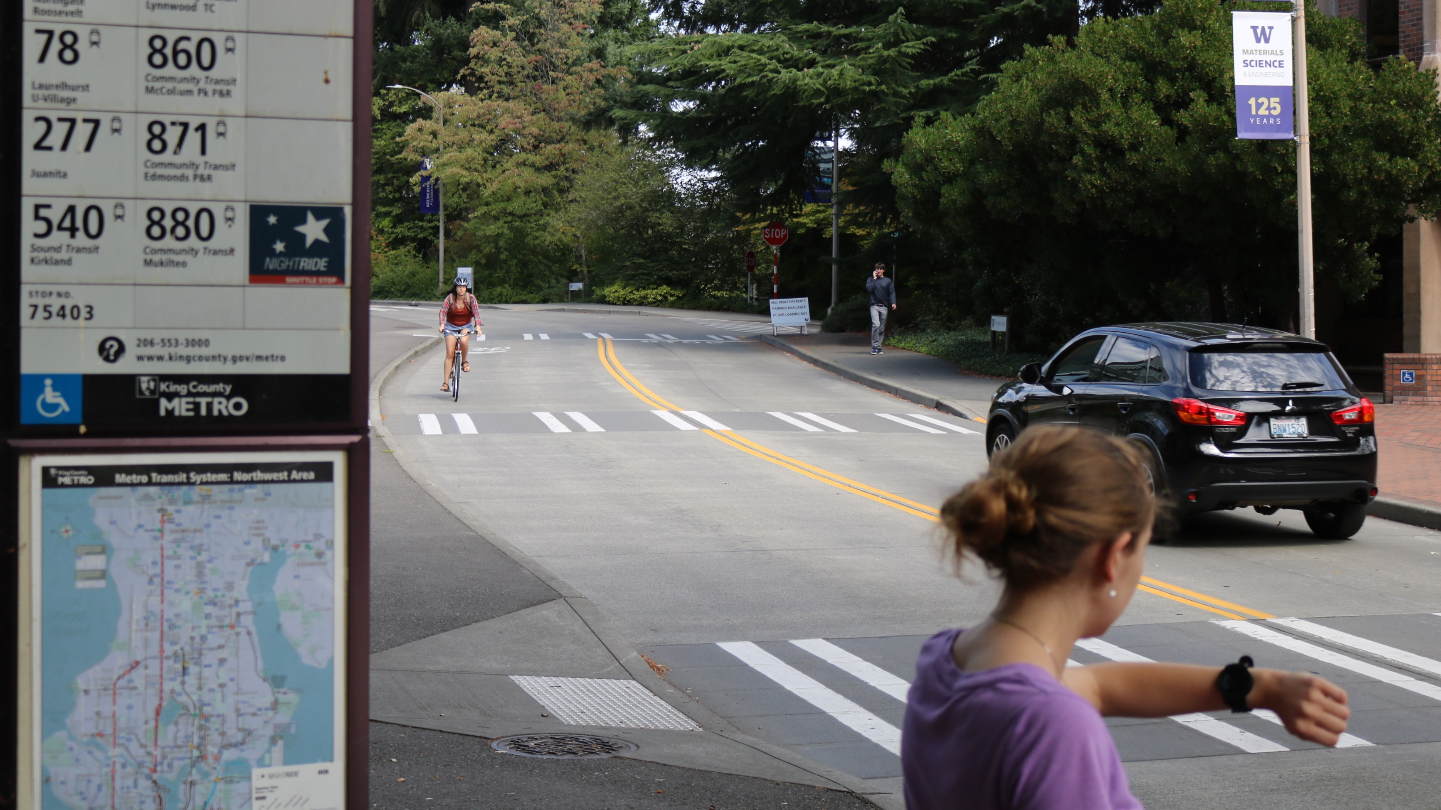




Evaluating Smartwatch-based Sound Feedback for Deaf and Hard-of-Hearing Users Across Contexts
Steven Goodman
Susanne Kirchner-Adelhardt
Rose Guttman
Dhruv Jain
Jon Froehlich
Leah Findlater
Notes:
Hello everyone. I’m going to be presenting our 2020 CHI paper on smartwatch-based sound awareness for people who are Deaf and Hard of Hearing. This is largely the same presentation I gave during my HCDE preliminary exam back in the fall, so it may be a repeat for a couple of you.

Slide 2
Introduction
Sound Awareness
(e.g., Matthews et al., BIT 2006)
Hearing people use sound to maintain situational awareness and respond to their surroundings.
For people who are Deaf and Hard of Hearing, however, sound awareness can be limited. Developing new tools that can communicate sound information in a non-auditory manner would be beneficial to many in this community.
Notes:
Sound is used by hearing people to maintain situational awareness and respond to their surroundings; think microwaves alerting that food is ready, to horns that warn of vehicles passing by.
(press)
For people who are Deaf or Hard of Hearing, however, sound awareness can be limited. Developing new tools that can communicate sound information in a non-auditory manner would be beneficial to many in this community.

Slide 3
Introduction
Sound Awareness Needs
(e.g., Matthews et al., ASSETS 2005; Bragg et al, ASSETS 2016; Findlater et al., CHI 2019)
Understanding the wide-ranging preferences of the Deaf and Hard of Hearing community is necessary to design effective sound awareness technology.
Surveys of this population have highlighted:
Desire for output through both visual and haptic modalities
Devices that filter some sounds out rather than informing of all
Cultural and contextual factors influencing sound awareness preferences
Notes:
Furthermore, understanding the wide-ranging preferences of the Deaf and Hard of Hearing community is necessary to design effective sound awareness technology.
(press)
Surveys of this population have highlighted a desire for output through both visual and haptic modalities;
Devices that filter some sounds out rather than inform of all;
And cultural and contextual factors influencing sound awareness preferences

Slide 4
Introduction
Sound Awareness
Hearing people use sound to maintain situational awareness and respond to their surroundings; from microwave beeps alerting that food is ready, to horns that warn of vehicles passing by.
For people who are Deaf and Hard of Hearing, however, sound awareness can be limited. Developing new tools that can communicate these sounds in a non-auditory manner would be beneficial to many in this community.
A note before continuing…
Notes:
I would like to note before continuing, however, that this opinion is not universal: some segments of this community are not interested in using this kind of technology. It’s important to consider their perspectives too when conducting this work.

Slide 5
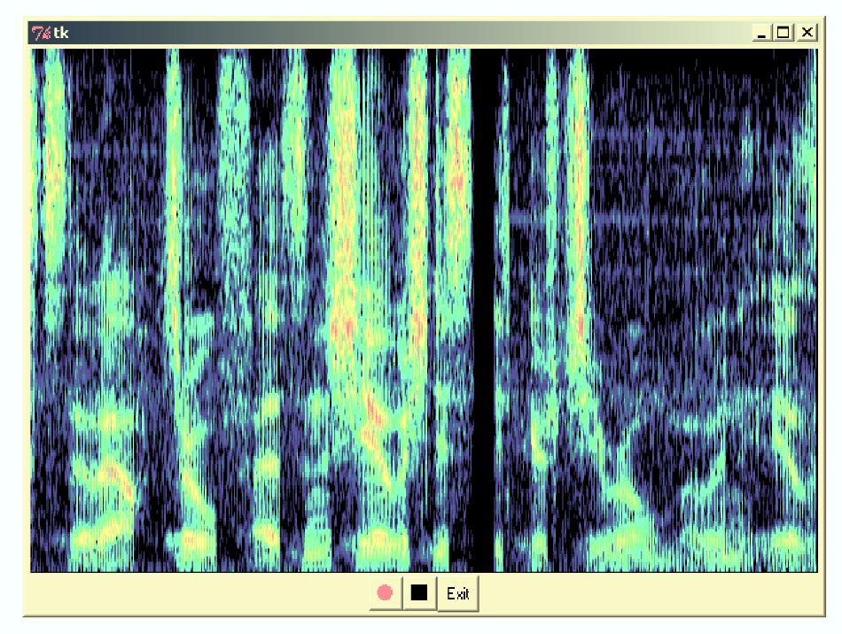
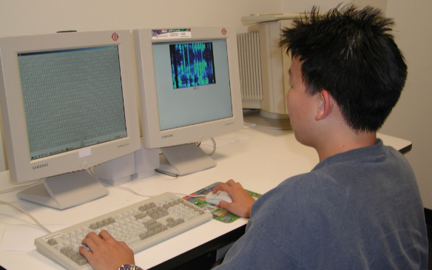
Introduction
Sound Awareness Tools
Ho-Ching et al., CHI 2003
Stationary
Notes:
To date, we’ve seen sound awareness tools commonly take three forms: Stationary, such as this desktop monitor displaying sound frequency;

Slide 6
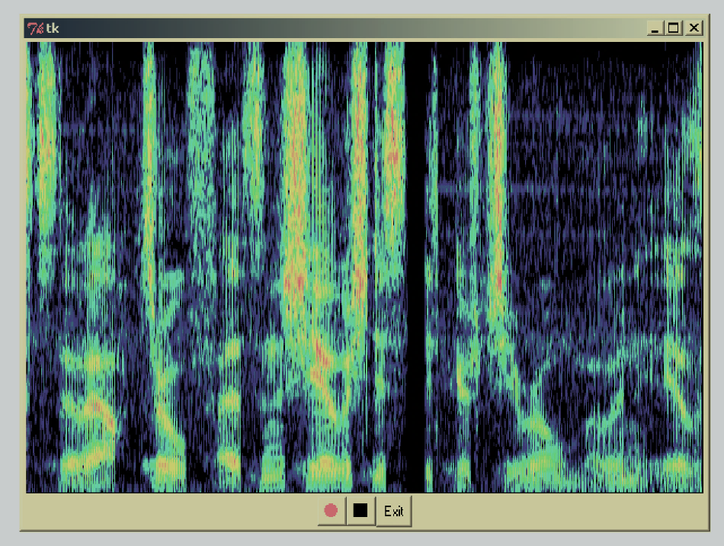
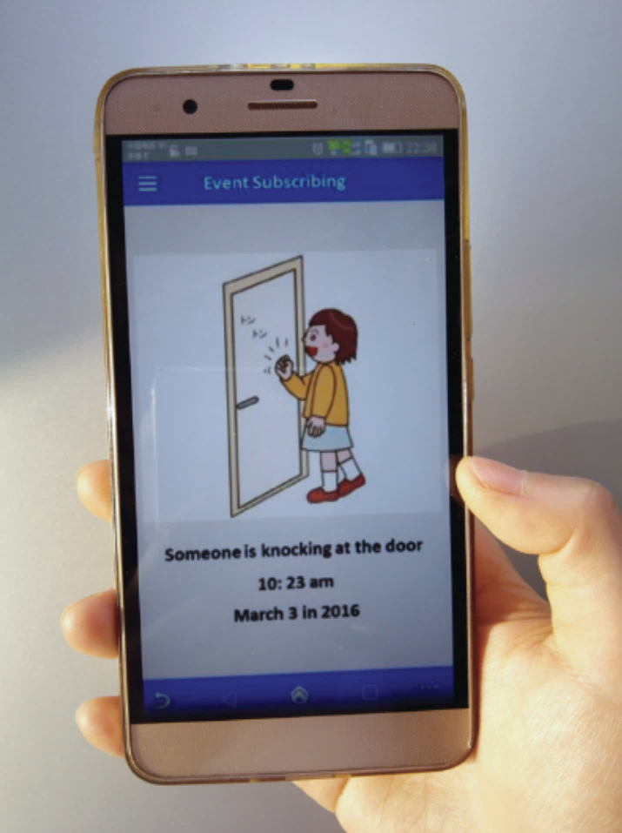
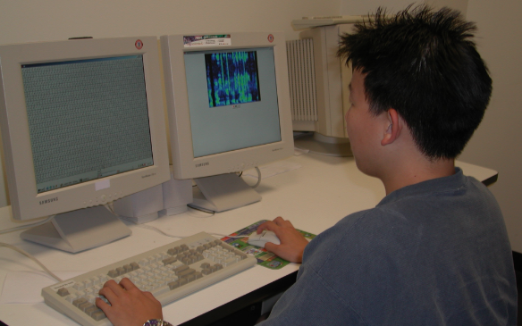
Introduction
Sound Awareness Tools
Ho-Ching et al., CHI 2003
Sicong et al., IMWUT 2017
Stationary
Smartphone/ handheld
Notes:
Smartphones and other handheld devices, like this application that alerts to specific sound events;

Slide 7
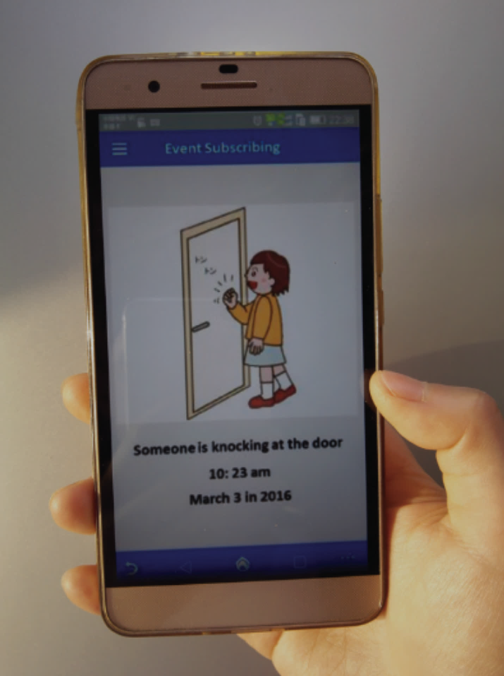
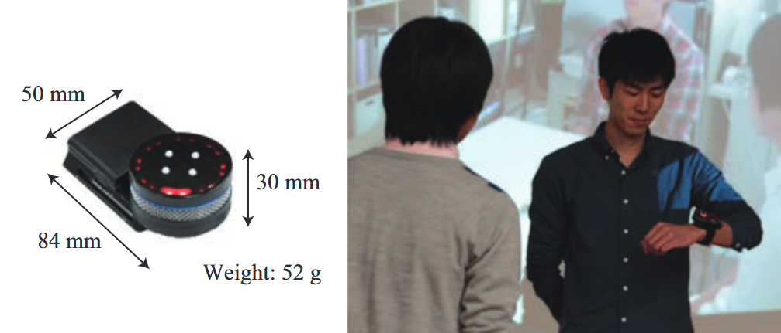
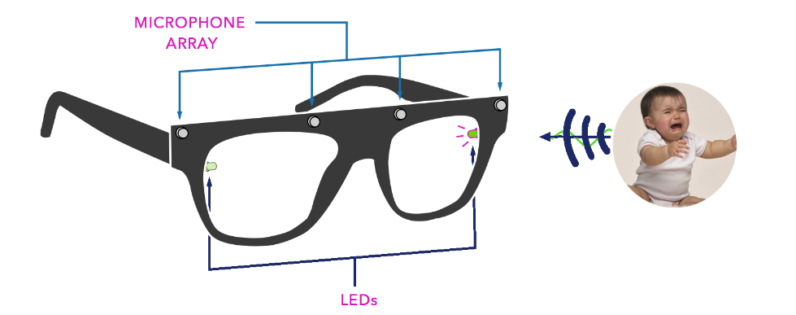
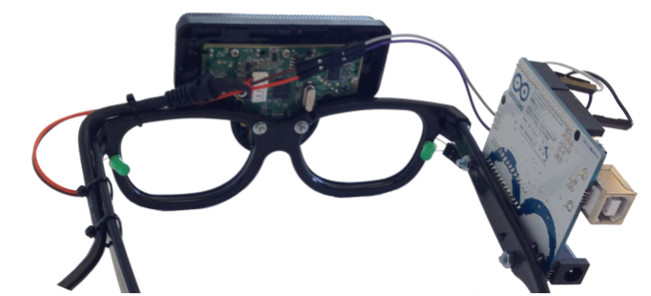
Introduction
Sound Awareness Tools
Kaneko et al., SMC 2013
Ho-Ching et al., CHI 2003
Sicong et al., IMWUT 2017
Gorman, ASSETS 2014
Stationary
Smartphone/ handheld
Wearable
Notes:
And wearables, like these wrist-worn and head-mounted devices that display sound direction with LEDs.

Slide 8
Introduction
Sound Awareness Tools
Most wearable devices have only displayed sound information through a single visual or vibrational modality.
In user evaluations of prototypes that have combined both, vibration has been limited to notifications that draw attention to the visual information.
Kaneko et al., SMC 2013
Gorman, ASSETS 2014
Wearable
Notes:
Most wearable devices, however, have only displayed sound information through a single visual or vibrational modality.
(press)
And in user evaluations of prototypes that have combined both, vibration has been limited to notifications that draw attention to the visual information.

Slide 9
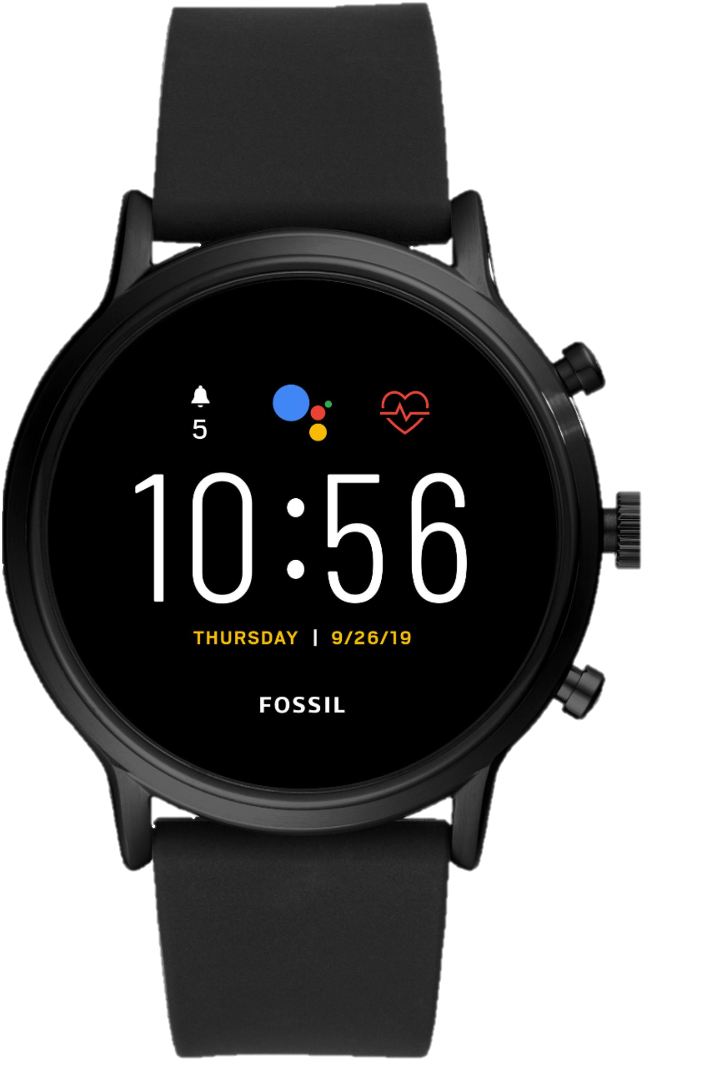
Introduction
Findlater et al. (CHI 2019)
Survey of 201 Deaf and Hard of Hearing participants:
Smartwatches are the most preferred portable device for sound awareness
  Seen as useful, socially acceptable, and glanceable
  Advantageous for both haptic and visual feedback
Prior work is limited to a short, lab-based study of six participants (Mielke & Brück, 2015)
Notes:
A recent survey of 201 Deaf and Hard of Hearing participants found that smartwatches are the most preferred portable device for sound awareness, as compared to head-mounted displays and smartphones.
(press)
They were seen as useful, socially acceptable, glanceable, and particularly advantageous for both haptic and visual feedback.
(press)
However, smartwatches are largely absent from existing sound awareness literature. Prior work is limited to a short, lab-based study of only six Deaf and Hard of Hearing participants.

Slide 10
Smartwatch-based Sound Awareness
Research Questions
How can a design most effectively combine visual and haptic feedback on a smartwatch?
Is there a role for haptic feedback that is more complex than simple vibration?
How should sound filtering be designed, and what are the implications for filtering in different contexts?
Notes:
Based on results from this survey and other prior work, we identified three research questions for this study: First, how can a design most effectively combine visual and haptic feedback on a smartwatch?
(press)
Second, is there a role for haptic feedback that is more complex than simple vibration?
(press)
And finally, how should sound filtering on a smartwatch be designed, and what are the implications for filtering in different contexts?

Slide 11
Method
Single-session study employing design probe methodology
Recruited 16 Deaf and Hard of Hearing participants
  Average age: 56 years old (SD=17.7, range=19-85)
  Choice of ASL interpreter (n=6) or real-time captioner (n=2)
Notes:
To begin to answer these questions, we designed a single-session study employing a design probe methodology.
We recruited 16 Deaf and Hard of Hearing participants for the study, with an average age of 56 years old. Participants were given the choice to communicate with an American Sign Language interpreter or real-time captioner present.

Slide 12
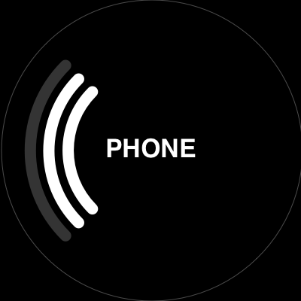
Method
Study Procedure
Lab-based Design Probe (30 min)
Wizard-of-Oz evaluation
Contextual Design Probe (25 min)
Exploration of three campus locations
Semi-Structured Interview (20 min)
Reflection on overall experience
Notes:
Our study was conducted in three stages:
The first stage was a lab-based design probe consisting of a Wizard-of-Oz evaluation with a smartwatch prototype.
The second was a contextual design probe that involved taking the participant to three different locations here on campus.
The third returned to the lab for a semi-structured interview and asked the participant to reflect on their overall experience.

Slide 13
Method
Study Procedure
Lab-based Design Probe (30 min)
Wizard-of-Oz evaluation
Contextual Design Probe (25 min)
Exploration of three campus locations
Semi-Structured Interview (20 min)
Reflection on overall experience
Notes:
I’ll briefly describe each portion of the study, starting with the Lab-based design probe.

Slide 14
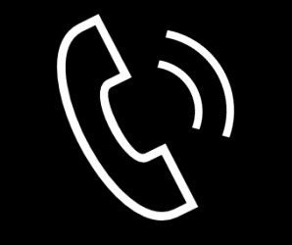


Method
Lab-based Design Probe
Discussed reactions to watch-based sound feedback
Presented different sound feedback designs by performing three example sounds around the room:
Door knock
Phone ring
Name call
Notes:
Upon the participants’ arrival to the lab on campus, we asked for their initial reactions to the idea of watch-based sound awareness.
(press)
The participant placed our smartwatch prototype on their preferred wrist, and we presented different sound feedback designs by performing three sounds around the room: a door knock, a phone ring, and a name call.

Slide 15
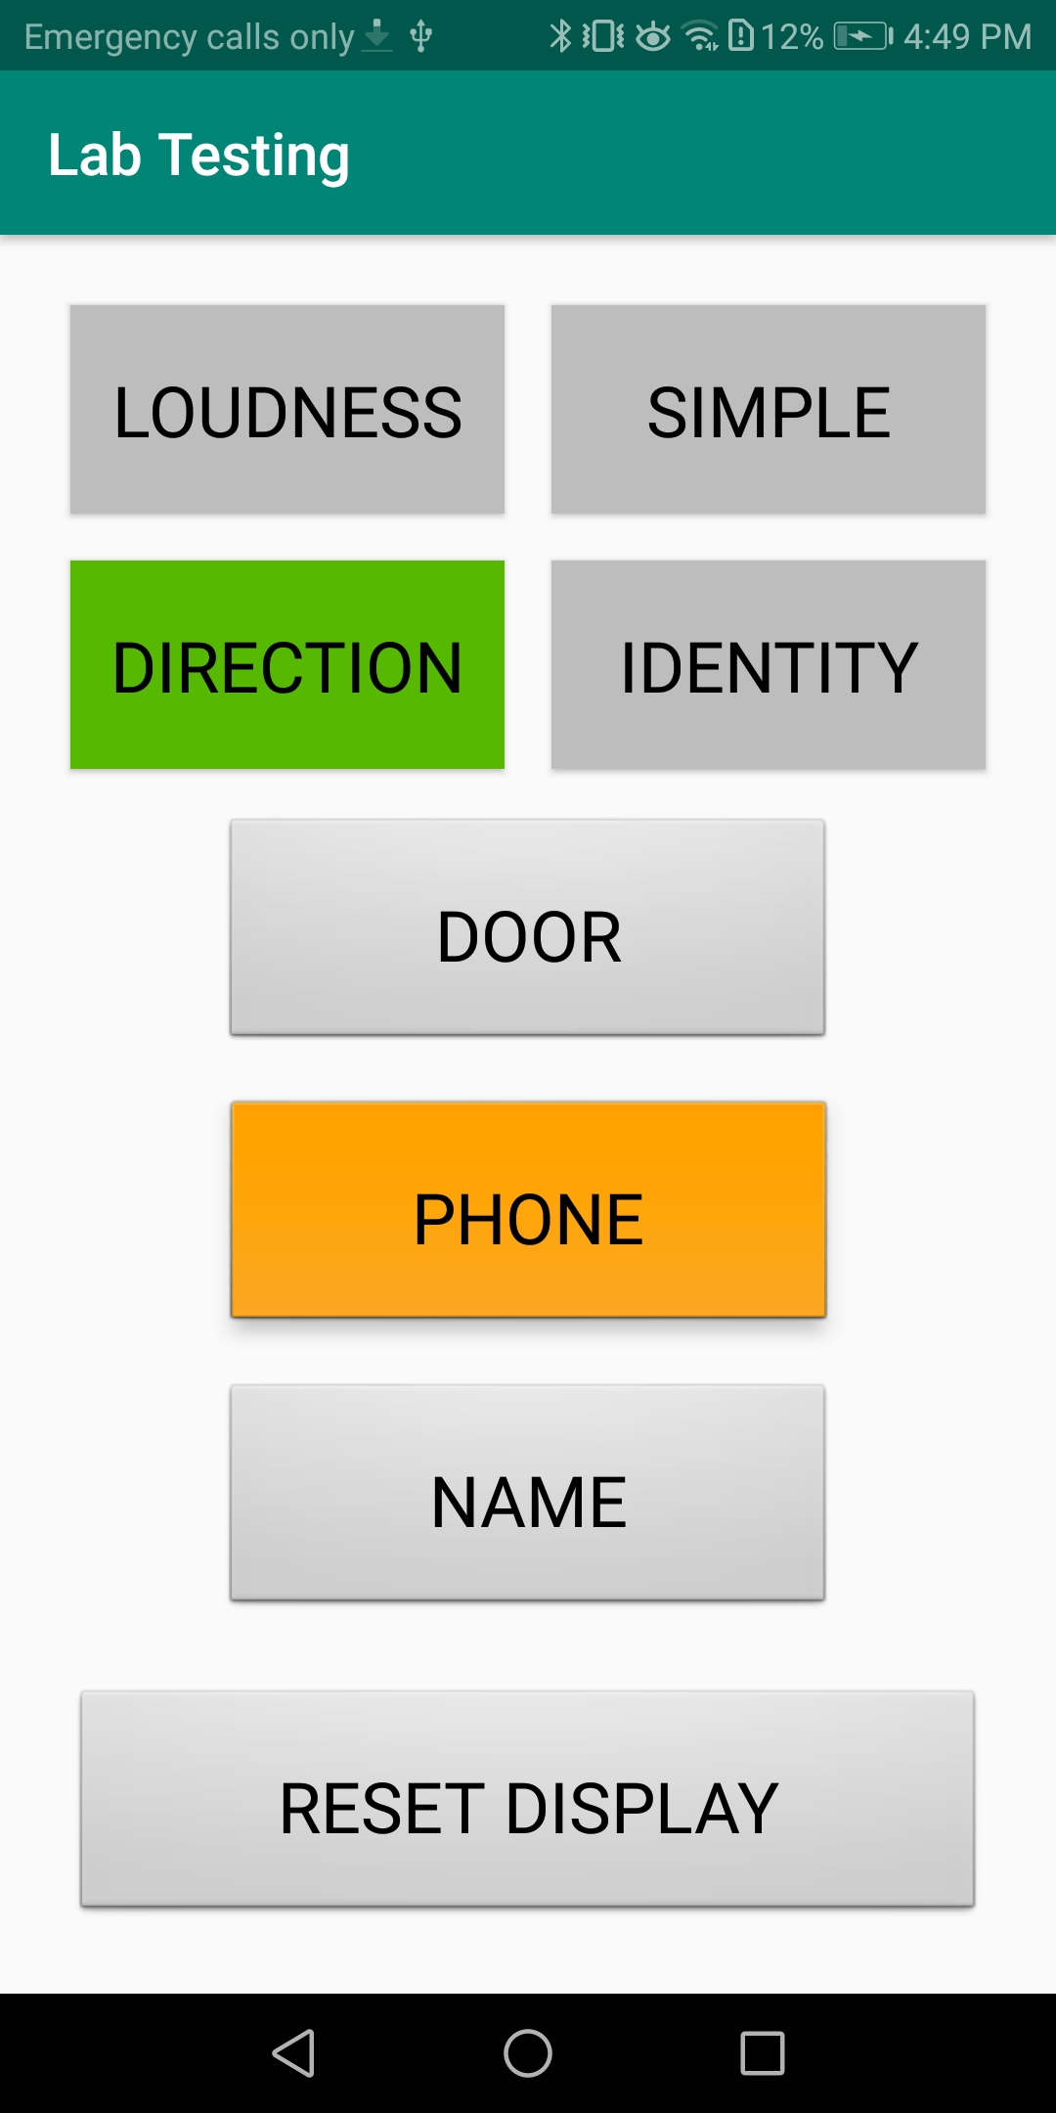
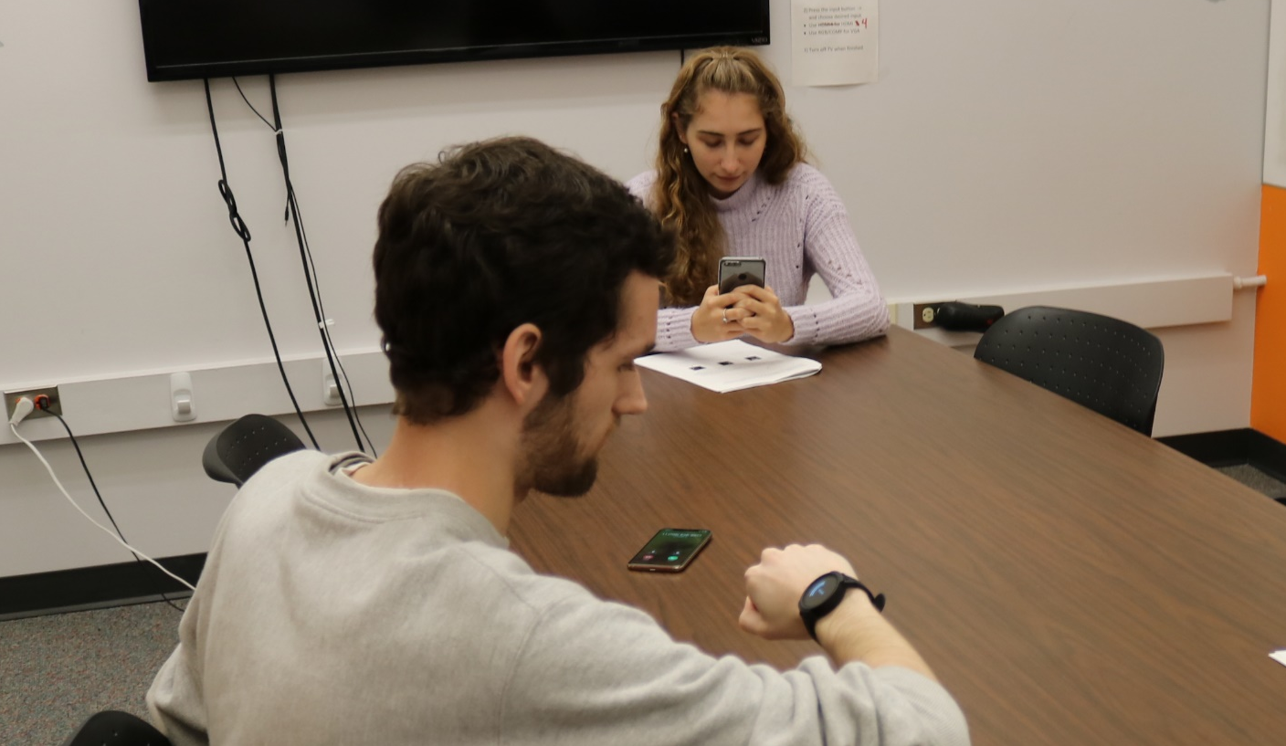
Lab-based Design Probe
Wizard-of-Oz Apparatus
Wizard
Participant
Notes:
We controlled the smartwatch prototype through a wizard-of-oz interface. In this image, I’ve taken the role of the participant, and a phone is ringing to my left. When this sound occurred during the study,
(press)
a second researcher in the role of the “wizard” selected the appropriate feedback setting on a smartphone and pressed the “phone” button, triggering visual and haptic sound feedback.

Slide 16
Lab-based Design Probe
Sound Feedback Designs
Each design included visual feedback designed with a high-contrast, glanceable aesthetic
Loudness
Direction
Identity
Notes:
Each design included visual feedback designed with a high-contrast, glanceable aesthetic to convey three properties of sound:
(press)
direction as three arcs pointed towards the sound source;
(press)
loudness, which filled the directional arcs depending on sound amplitude;
(press)
and the sound‘s identity, shown as text in the screen’s center.

Slide 17
Lab-based Design Probe
Sound Feedback Designs
We presented the visual alone, and with two haptic designs:
Simple vibration: a single vibration to notify the user a sound had occurred
Tactons: vibrational pattern to convey sound information.
Notes:
We presented the visual feedback alone, but also combined it with two haptic designs:
Similar to past work, we added a single vibration to notify the user that a sound had occurred.
We also explored using tactons, or vibrational patterns, to convey information about the sound.

Slide 18
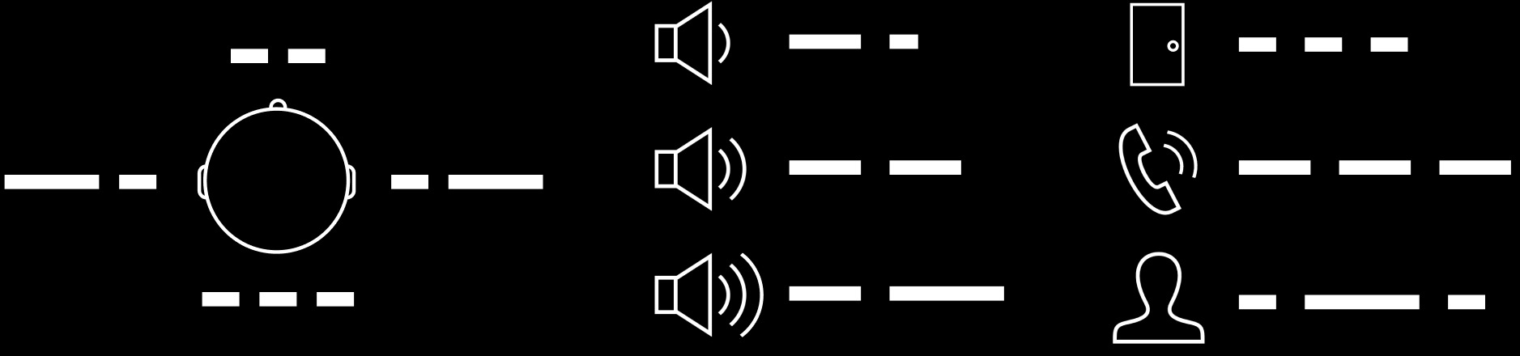
Lab-based Design Probe
Sound Feedback Designs
Tactons: vibrational pattern conveying sound information
On-and-off vibrations at a constant intensity
Direction
Loudness
Identity
Notes:
Our tactons used on and off vibrations at a constant intensity to convey the sound’s direction, loudness, or identity. They are shown here with lines that represent to the length of each vibration.
(press)
For example, a long-short pattern indicated a sound had occurred to the left of the participant, while a short-long pattern indicated a sound to the right.

Slide 19
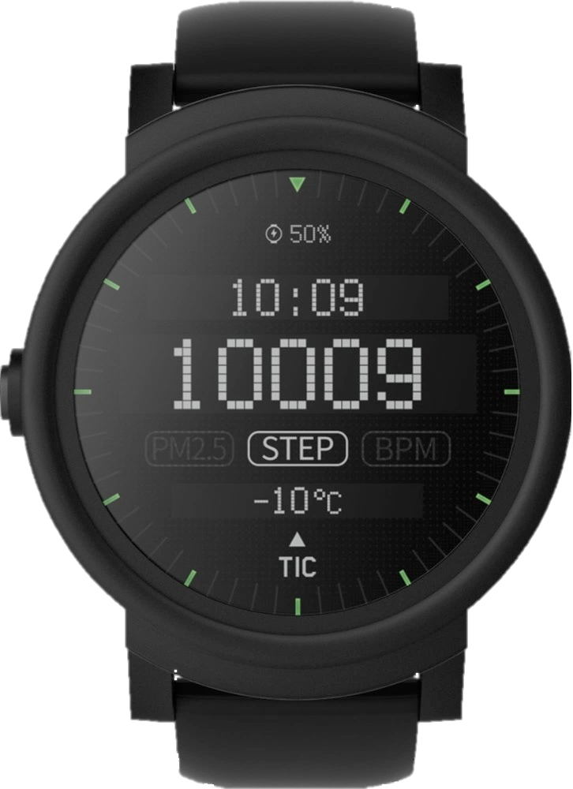
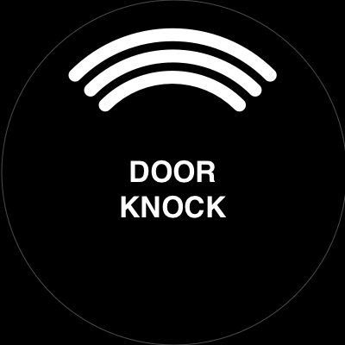
Lab-based Design Probe
Summary
Using three example sounds in the lab, we presented sound feedback designs in order of increasing haptic complexity:
Visual alone
Visual + simple vibration
Visual + tacton
Door knock
Phone ring
Name call
Notes:
To summarize this first portion of the study: using three example sounds in the lab, we presented sound feedback designs in order of increasing complexity: visual alone, visual + simple vibration, and visual + tactons.

Slide 20
Lab-based Design Probe
Summary
Visual alone
Visual + simple vibration
Visual + tacton (vibration pattern)
  Tacton for direction
  Tacton for loudness
  Tacton for identity
Door knock
Phone ring
Name call
Notes:
Our design featuring tactons, or vibration patterns, was presented three times with the example sounds, once for each sound characteristic represented: direction, loudness, and identity.

Slide 21
Method
Study Procedure
Lab-based Design Probe (30 min)
Wizard-of-Oz evaluation
Contextual Design Probe (25 min)
Exploration of three campus locations
Semi-Structured Interview (20 min)
Reflection on overall experience
Notes:
For the second portion of our study, we left the lab with the participants to perform an in situ exploration at three locations on campus.

Slide 22
Method
Contextual Design Probe
In situ scenario:
Imagine you are on your way home but forgot your water bottle in the student lounge upstairs. After you pick it up, you go to [the cafe] in the building next door to pick up some coffee and then go to the bus stop to catch the next bus home.
Notes:
Before leaving, we presented a scenario that would take them from the student lounge,
to the cafe in the building next door,
And finally to a nearby bus stop.

Slide 23
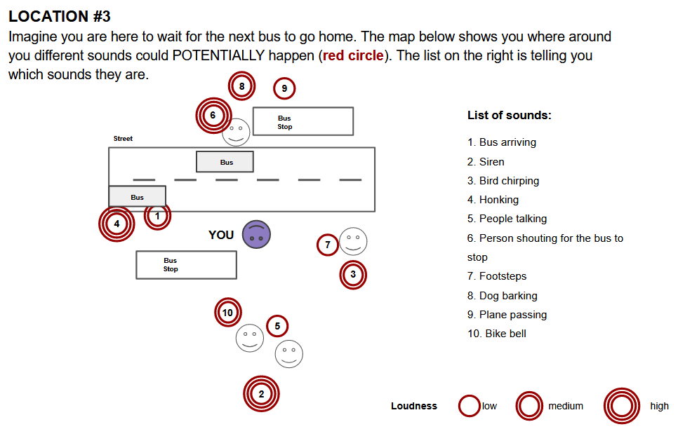
Contextual Design Probe
Notes:
In each location, we provided a map on an iPad that oriented participants to a preset sound scene.
(press)
The map included ten numbered sounds typical of the area and used concentric circles around each number to indicate loudness. For example, this sound map of the bus stop location read: “Imagine you are here to wait for the next bus to go home. The map below shows where around you different sounds could POTENTIALLY happen. The list on the right is telling you which sounds they are.” The sounds included a bus arriving, a bird chirping, and a bike bell.

Slide 24
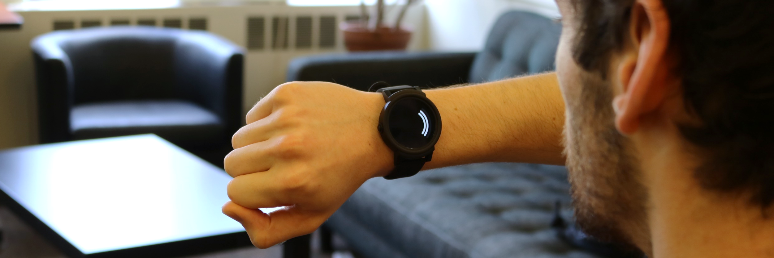
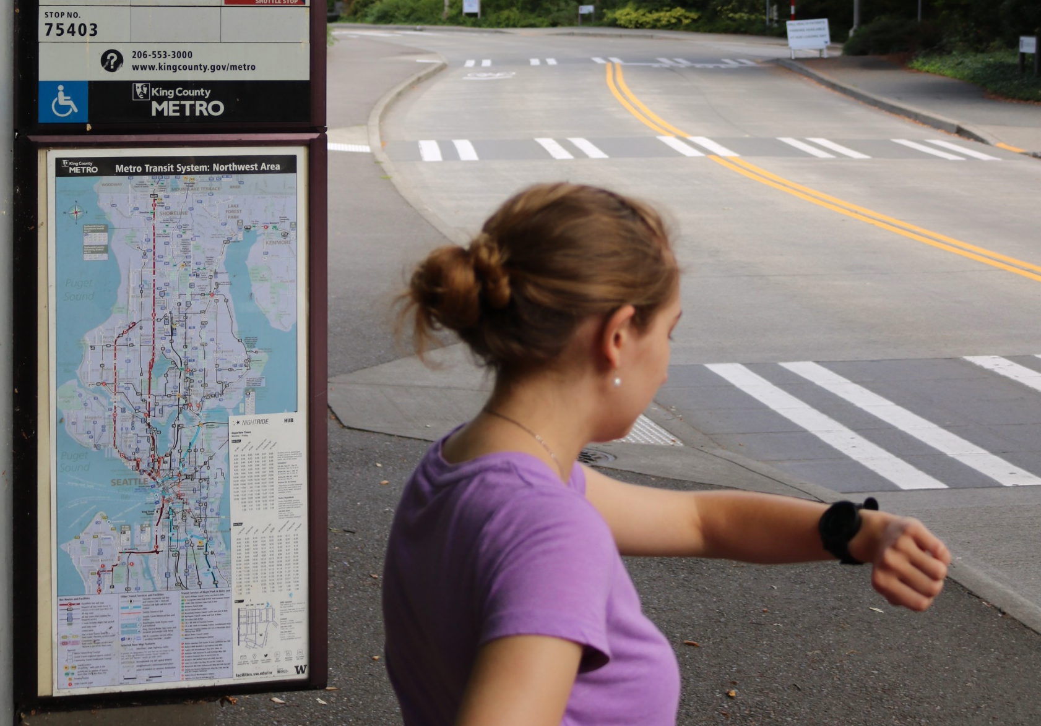
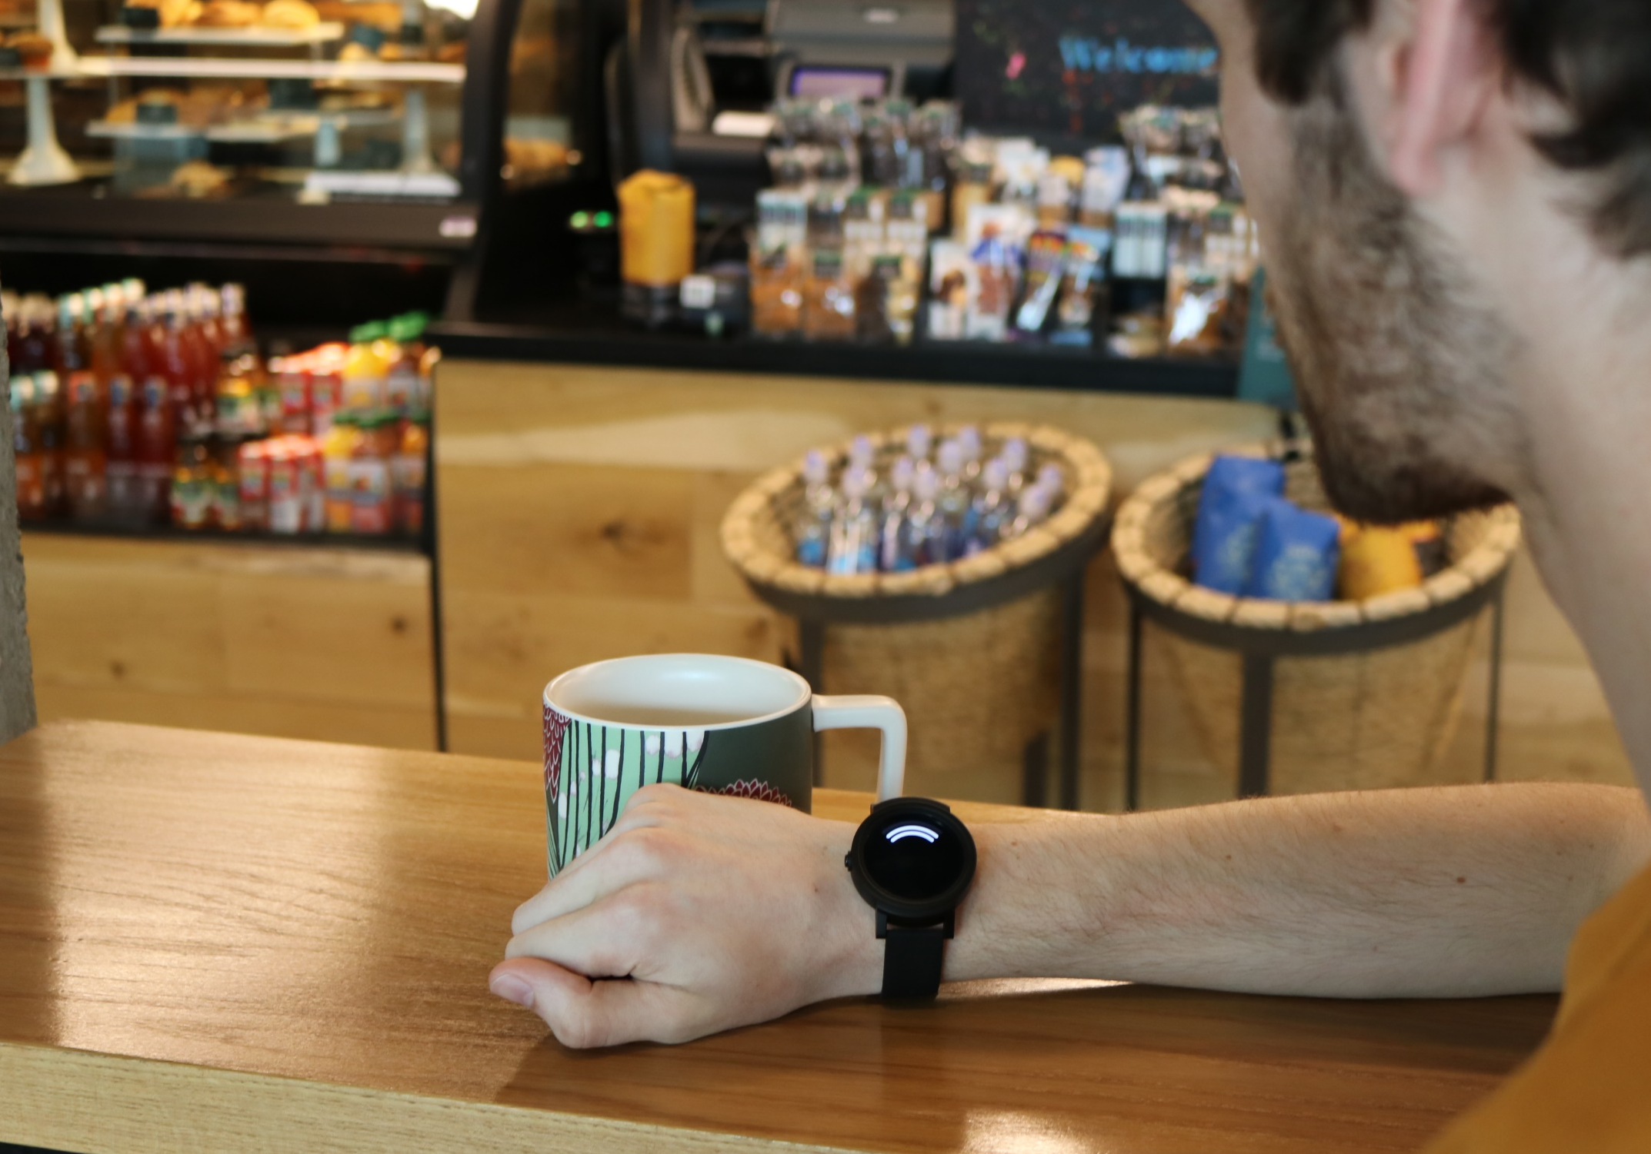
Contextual Design Probe
Feedback Simulation
Student Lounge
Bus stop
Café
Notes:
After the participant reviewed the map at each location, the wizard triggered the watch to provide feedback for each of the simulated sounds in sequence. We used similar visual feedback to that used in the lab stage, though the sound’s identity was removed from the center to represent existing limitations with open-ended sound classification.

Slide 25
Contextual Design Probe
Sound Filtering
To spur participants to consider different sound filtering options, we explored filtering vibrational feedback.
We added a single vibration to:
  the three loudest sounds
  three sounds occurring behind the participant
  three sounds the watch deemed most important
Notes:
To spur participants to consider different sound filtering options, we explored filtering vibrational feedback
(press)
So, instead of having all 10 sounds vibrate, we added a vibration to only the three loudest sounds,
the three sounds occurring behind the participant,
or the three most important sounds as identified by the watch.

Slide 26
Contextual Design Probe
Notes:
Returning to the map of the bus scenario, for example: after the sequence of ten sounds began, the participant would expect to receive visual feedback conveying each simulated sound with three seconds in between,
(press)
but might also expect a vibration on the three sounds occurring behind them:
number 2, a siren; number 5, people talking; and number 10, a bike bell.

Slide 27
Method
Study Procedure
Lab-based Design Probe (30 min)
Wizard-of-Oz evaluation
Contextual Design Probe (25 min)
Exploration of three campus locations
Semi-Structured Interview (20 min)
Reflection on overall experience
Notes:
Finally, we asked semi-structured questions on participants’ overall experience with the smartwatch system.

Slide 28
Method
Semi-structured Interview
We probed for: contextual factors, filtering options, social acceptability, and privacy issues.
We analyzed session transcripts using an iterative coding approach. [Braun, 2006]
  Two researchers developed a codebook to apply holistically
Notes:
Our protocol left questions open-ended, but we specifically probed for contextual factors, filtering options, social acceptability, and privacy issues surrounding smartwatch-based sound awareness.
We analyzed session transcripts using an iterative coding approach, with two researchers developing a codebook to apply holistically to the data.

Slide 29
Findings
Visual and haptic feedback have complementary roles in sound awareness.
Haptic patterns have potential to convey sound information.
Sound filtering may mitigate perceived awareness issues in complex soundscapes.
Notes:
I’ll focus on three key findings from this study:
The first: we learned that Visual and haptic feedback have complementary roles in sound awareness.

Slide 30
Findings
Complementary Modalities
Overall, participants responded positively to the idea of smartwatch-based sound feedback.
Participants desired visual feedback across all conditions:
  “It's nice to have visual and the sensory input as well [but] I mean without the visual, I feel like there's not really a point.” (P10)
Designs with vibration were more useful than without:
  For example, most participants (n=13/16) were concerned they would miss sounds without vibration
Notes:
Overall, participants responded positively to the idea of smartwatch-based sound feedback.
(press)
Participants desired visual feedback across all conditions. For example, from P10:
“It’s nice to have visual and the sensory input as well [but] I mean without the visual, I feel like there’s not really a point.”
(press)
In line with prior work, designs with vibration were more useful than without. Thirteen participants were concerned that without vibration, they would miss sounds.

Slide 31
Findings
Complementary Modalities
Visual and haptic feedback have different, but complementary, functions.
Visual feedback provides information at a higher throughput than haptic feedback (n=8)
Haptic feedback was appreciated for “alerting to a situation” (P9) and “trigger[ing] you to look at your watch” (P5)
Notes:
We found visual and haptic feedback have different, but complementary, functions.
(press)
The key advantage of visual feedback is that it provides information at a higher throughput than haptic, a point that eight participants mentioned unprompted.
(press)
Haptic feedback, on the other hand, was appreciated for: “alerting to a situation” according to P9, and “triggering you to look at your watch” according to P5.

Slide 32
Findings
Complementary Modalities
Past work shows Deaf and Hard of Hearing people make strong use of visual cues for environmental awareness [Matthews 2006]
Haptic feedback (simple or tactons) gets the users attention without interfering with visual awareness strategies:
  The user can respond to the environment immediately
  Or turn to the watch’s screen for more information
Notes:
Past work shows Deaf and Hard of Hearing people make strong use of visual cues for environmental awareness.
(press)
Haptic feedback is important, then, because it gets the user’s attention without interfering with existing visual awareness strategies.
(press)
After feeling a vibration, the user can respond to the environment immediately, or turn to the watch’s screen for more information about the sound.

Slide 33
Findings
Visual and haptic feedback have complementary roles in sound awareness.
Haptic patterns have potential to convey sound information.
Sound filtering may mitigate perceived awareness issues in complex soundscapes.
Notes:
Second: we learned that haptic patterns have potential to convey sound information.

Slide 34
Findings
Tactons’ Potential
Participants’ overall response to tactons was positive.
  Primary benefit was minimizing the need to look at the watch face
  Several participants (n=8) liked to improve their sound response time.
Potential for socially acceptable support:
  “Let’s say I'm at a meeting, and I'm trying to listen to somebody, but I don't want to be rude and look at my watch when they're talking. [...] ‘Ah-ha!’ Somebody is calling my name, and then I don't have to look [at the watch]” (P3)
Notes:
Participants overall response to tactons was positive.
They identified the primary benefit as minimizing the need to look at the watch face, which several participants thought would improve their sound response time.
(press)
To P3, tactons were especially useful for socially acceptable support.
Quote “Let’s say I'm at a meeting, and I'm trying to listen to somebody, but I don't want to be rude and look at my watch when they're talking. [...] ‘Ah-ha!’ Somebody is calling my name, and then I don't have to look [at the watch].”

Slide 35
Findings
Tactons’ Potential
Tactons were not without areas of concern.
Several (n=8) participants were concerned about time required:
  “I had to wait and wait and then the vibration had finished and by the time I finished decoding what it was [...] I'd missed whatever happened.” (P6)
Some (n=9) were concerned about effort required to learn each tactons meaning
  Some were prepared to undertake this process
  Others felt visual feedback would provide them with the same info
Notes:
However, tactons were not without areas of concern. Eight participants were concerned about the time required to use tactons, such as P6, who commented:
“I had to wait and wait and then the vibration had finished and by the time I finished decoding what it was [...] I'd missed whatever happened.”
(press)
Some were also concerned about the effort required to learn each tactons’ meaning, and while a few were content to undertake this process, others felt visual feedback would ultimately provide them with the same information.

Slide 36
Findings
Tactons’ Potential
To mitigate temporal issues and learning difficulty, participants recommended:
  Limiting tactons to a small, simple set.
  Designing more intuitive patterns, such as a set with semantic representations of sound.
Notes:
To mitigate temporal issues and learning difficulty, participants recommended limiting tactons to a small, simple set and designing more intuitive patterns, such as a set with semantic representations of sound.

Slide 37
Findings
Visual and haptic feedback have complementary roles in sound awareness.
Haptic patterns have potential to convey sound information.
Sound filtering may mitigate perceived awareness issues in complex soundscapes.
Notes:
Finally, we learned sound filtering may mitigate perceived awareness issues in complex soundscapes.

Slide 38
Findings
Filtering & Soundscape Complexity
Following our visits to different locations on campus, most participants (n=11/16) mentioned new use cases or increased interest in watch-based sound awareness
This often pertained to use complex soundscapes: areas with frequent, overlapping sound events
  Experienced in the café and bus stop
Notes:
Following our visits to different locations on campus, most participants mentioned new use cases or increased interest in watch-based sound awareness.
(press)
This often pertained to use in complex soundscapes, or areas with constant, overlapping sound events as experienced in the cafe and bus stop location.

Slide 39
Findings
Filtering & Soundscape Complexity
P14 returned feeling far more positive about the idea:
  “The [café] is just phenomenal because it's the thing that really gives people anxiety. “Are they going to hear me? Am I going to hear them?” There's so much ambient noise.
  In a place like [the student lounge] or in your house with the microwave and whatever, okay, it’s quiet.
  But when you go to a place outside, bus stop, [café], outside your home, this is just... and again in your car, this is just incredible.” (P14)
Notes:
P14, who was only slightly interested in our prototype during the lab evaluation, returned from the in situ exploration feeling far more positive about the idea:
“The [café] is just phenomenal because it's the thing that really gives people anxiety. “Are they going to hear me? Am I going to hear them?” There's so much ambient noise. In a place like [the student lounge] or in your house with the microwave and whatever, okay, it’s quiet. But when you go to a place outside, bus stop, [café], outside your home, this is just incredible.”

Slide 40
Findings
Filtering & Soundscape Complexity
Quotes like P14’s highlight the challenges, and necessity, of sound awareness in complex soundscapes.
One strategy for awareness may be through filtering sound.
  All participants in our study desired filtering due to exposure to realistically complex soundscapes.
Notes:
Quotes like P14’s highlight the challenges, and necessity, of sound awareness in complex soundscapes.
(press)
One possible mitigation strategy may be through filtering sound. All participants in our study desired filtering, a result we attribute to exposure to realistically complex soundscapes.

Slide 41
Findings
Filtering & Soundscape Complexity
Responses we split on how to implement filtering effectively.
Idea: visual always, but vibration only added to some sounds.
  “[Hearing people] have the ability to screen out the sounds because you guys are used to hearing. […] The vibration, I think, could be a lot for me because it doesn't actually have the ability to filter out the sounds , which is why I prefer to see the visual and I can pay attention to it and then decide.” (P7)
Notes:
However, responses were split on how to implement filtering effectively.
(press)
One idea was similar to our study’s filtering demonstration, with visual always on but vibration only added to certain sounds. P7 liked the idea because quote: ““[Hearing people] have the ability to screen out the sounds because you guys are used to hearing. […] The vibration, I think, could be a lot for me because it doesn't actually have the ability to filter out the sounds, which is why I prefer to see the visual and I can pay attention to it and then decide.”

Slide 42
Findings
Filtering & Soundscape Complexity
Questions also arose over the system making automatic decisions and whether to trust them.
  “You might be filtering out other awareness that you have built up over the years in favor of, ‘Well, this thing knows, and in fact this thing might know better than me, so I'm just gonna ignore my instinct, I'm not going to bother looking because this will tell me.’ […] I want to hear it all, and I want my own, I want to be able to choose what's more important.” (P4)
Notes:
Questions also arose over the system making automatic filtering decisions and whether to trust these decisions.
(press)
I’d like to highlight one participant, P4, who hesitated to add sound filtering to the watch,
Quote “You might be filtering out other awareness that you have built up over the years in favor of, ‘Well, this thing knows, and in fact this thing might know better than me, so I'm just gonna ignore my instinct, I'm not going to bother looking because this will tell me.’ […] I want to hear it all, and I want my own, I want to be able to choose what's more important.”

Slide 43
Findings
Summary
While past work has highlighted a preference for combined visual and haptic feedback, we identify the complementary benefits they provide for environmental awareness.
We provide evidence of the potential for small sets of haptic patterns (tactons) to convey sound information.
We characterize perceived issues with sound awareness in complex soundscapes and provide potential means of managing them through sound filtering.
Notes:
To summarize:
While past work has highlighted a preference for combined visual and haptic feedback, we identify the complementary benefits they provide for environmental awareness.
(press)
We provide evidence of the potential for small sets of haptic patterns (tactons) to convey sound information.
(press)
We characterize perceived issues with sound awareness in complex soundscapes and provide potential means of managing them through sound filtering.

Slide 44
What’s Next?
A note on participant diversity: our results may be biased toward individuals who want sound awareness technology.
Collecting longitudinal data through a field evaluation of a working prototype.
Notes:
To reiterate a point I made earlier, I’d like to add a note on our participant diversity: while we recruited Deaf and Hard of Hearing participants with a range of abilities, our results were likely biased toward individuals who would want sound awareness technology in the first place.
Furthermore, our exploration was brief, we did not sense real sounds, and it occurred within a small radius. While this setup allowed us to discover new implications that lab-based evaluations had not previously seen, collecting longitudinal data through a field evaluation of a fully working prototype is an important next step.

Slide 45
Concluding Quote
  “There's a huge variety of things that you could need to be aware of. [...] You're out there, you don't think about them. But in designing something that could be useful, you do have to think about it. And the complexity of it, of what the environment is, this is eye-opening.” (P15)
Notes:
I’ll conclude with a quote that I think really encapsulates this project. P15 said after returning from the in situ exploration, quote:
“There's a huge variety of things that you could need to be aware of. [...] You're out there, you don't think about them. But in designing something that could be useful, you do have to think about it. And the complexity of it, of what the environment is, this is eye-opening.”

Slide 46
Questions?
Steven Goodman
Ph.D. Student
Human Centered Design and Engineering
smgoodmn@uw.edu
Co-authors:
Susanne Kirchner-Adelhardt, Rose Guttman, Dhruv Jain, Jon Froehlich, Leah Findlater

Slide 47
Thank You
Steven Goodman
Ph.D. Student
Human Centered Design and Engineering
smgoodmn@uw.edu
Co-authors:
Susanne Kirchner-Adelhardt, Rose Guttman, Dhruv Jain, Jon Froehlich, Leah Findlater

