Slide 1



the design of
eco-feedback
technology
Jon Froehlich, Leah Findlater, James Landay
design:
use:
build:

Slide 2

eco-feedback
sensing behavior paired with feedback to reduce environmental impact
Notes:
The goal of eco-feedback is to provide feedback about individual or group behavior in order reduce environmental impact.

Slide 3
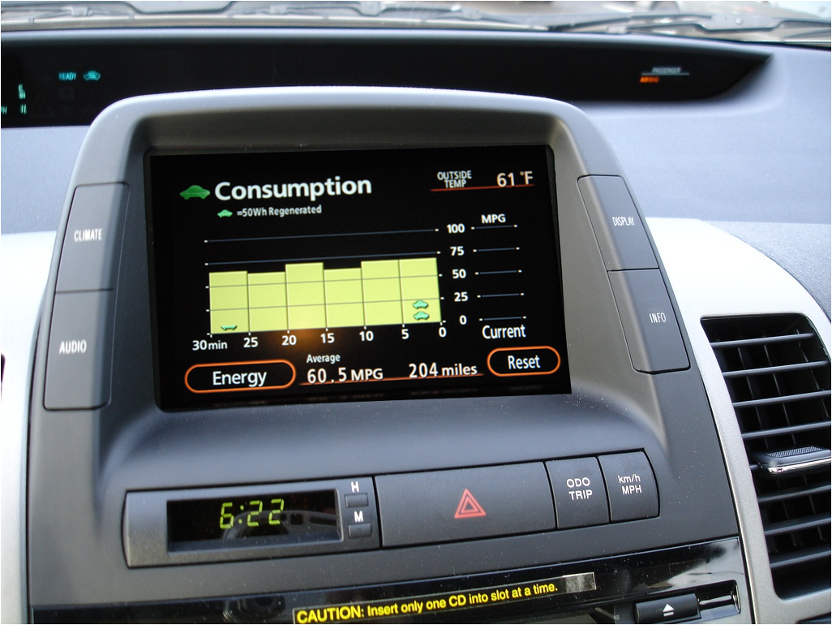
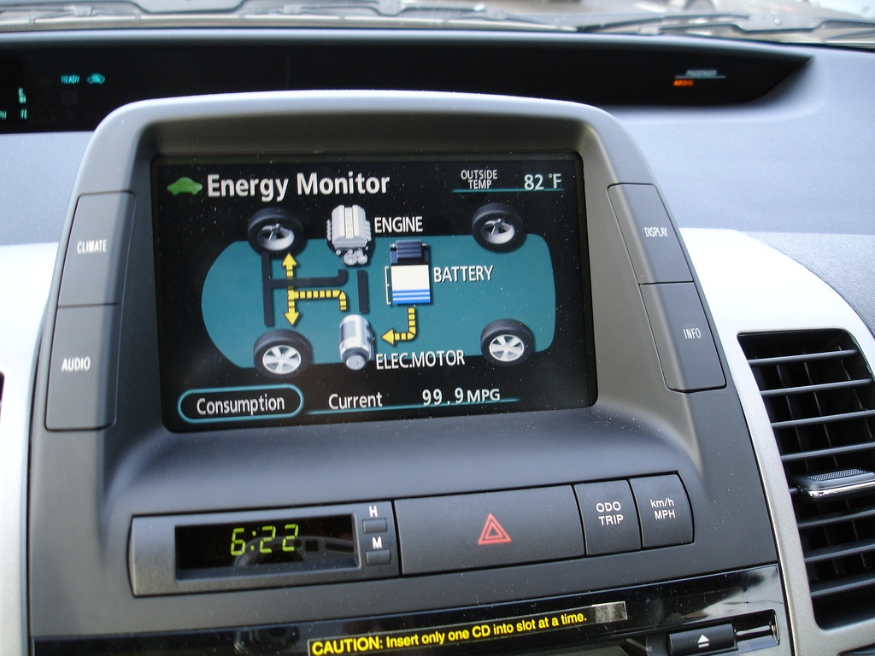
toyota prius
toyota prius
Notes:
The Toyota Prius is one popular example of eco-feedback…

Slide 4

hci
Notes:
Hot research area/lots of people involved in it/began to wonder whether our designs were effective

Slide 5
hci
environmental
psychology
Notes:
The take away message
1. 40 yrs env psych not well integrated into eco-feedback research in hci
2. Despite eco-feedback designed to change behavior, rarely eval in hci which leads us to question what the role of hci should be in the design of eco-feedback technology.
To begin let’s look at…

Slide 6

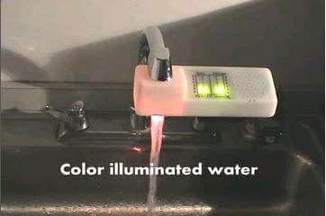
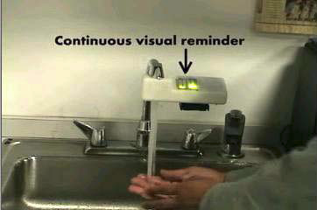
power-aware cord
cord light pulsates & varies in intensity based on power draw
Gustafsson and Gyllenswärd, CHI2005
Notes:
To begin let’s look at…
Gustafsson_ThePowerAwareCord_EnergyAwarenessThroughAmbientInformationDisplay_CHI2005.pdf

Slide 7
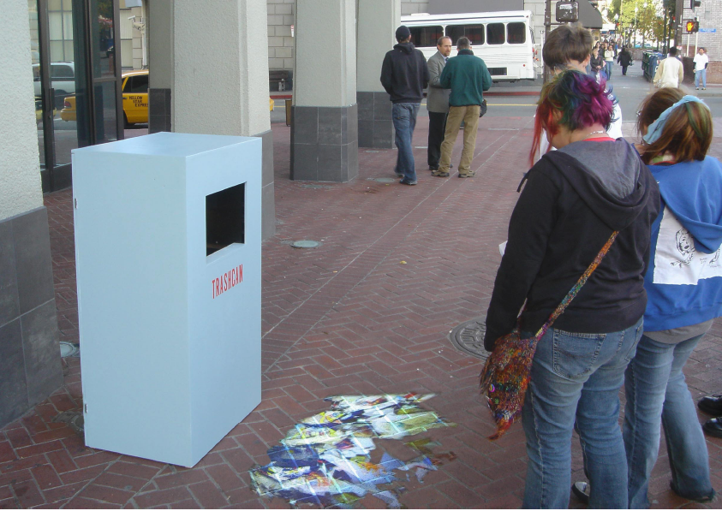
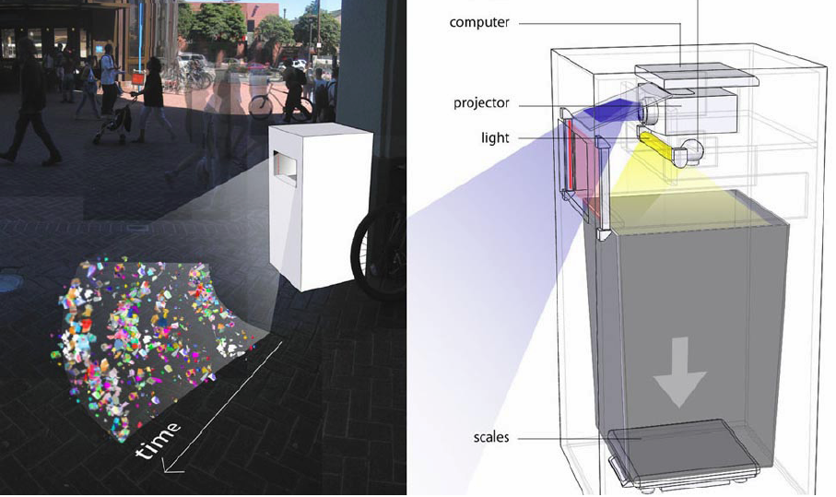
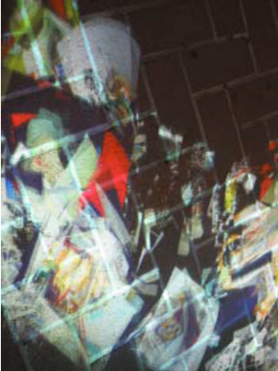
jetsam
visualization allows pedestrians to view amount and type of garbage at-a-glance
Paulos and Jenkins, CHI2005
Notes:
<exit transition> designs such as this one would not have been possible w/out new types of sensing which are only getting cheaper

Slide 8
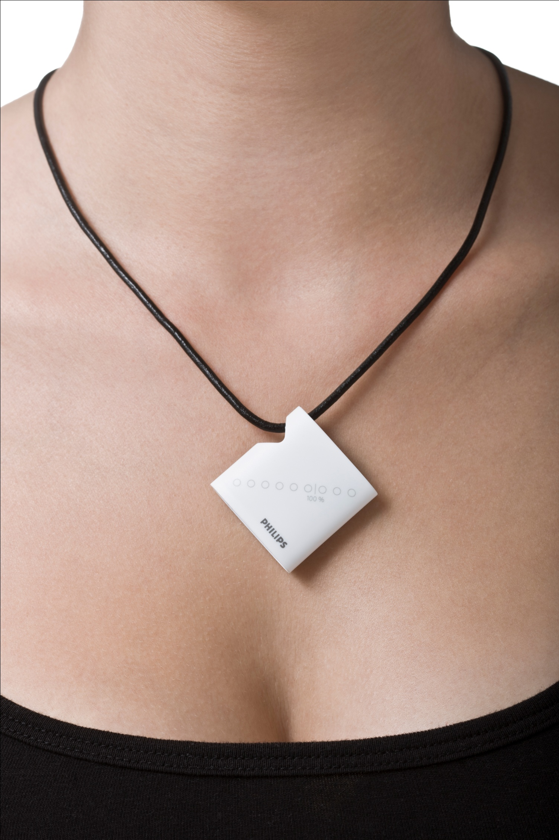
new sensing
Notes:
Indeed, new advances in sensing systems have allowed us to track many different types of new human activities that are relevant to eco-feedback like bus riding, bicycling, and disaggregated water consumption

Slide 9
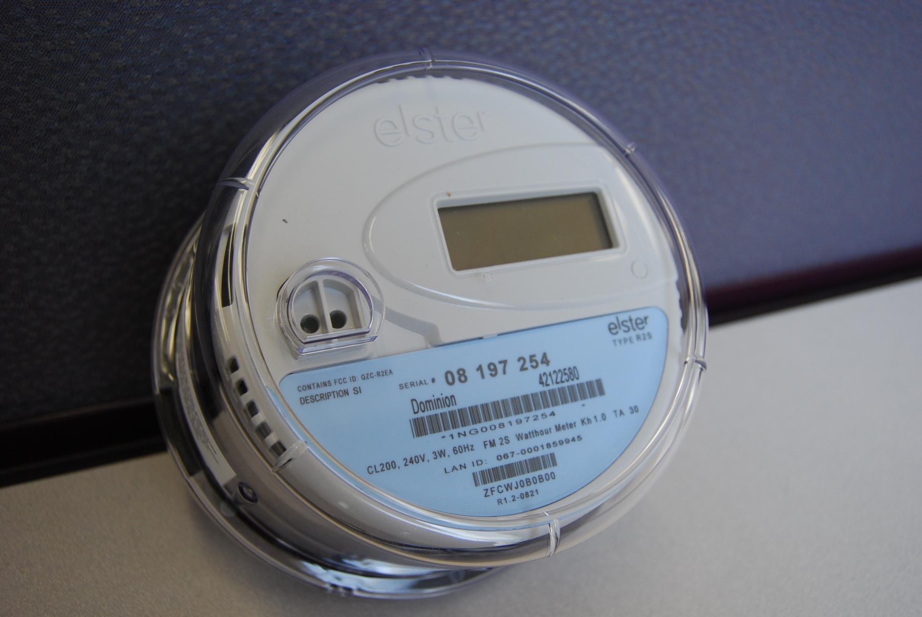
smart meters
Notes:
Moreover, the next generation of resource measurement systems (often referred to as “smart meters”) will soon provide real-time (or near real-time) data on electricity, gas, and water usage in homes and businesses.
This will produce tremendous amounts of data that can be analyzed and fed back to the user, creating even more
opportunities for eco-feedback technology research
<exit transition> so there’s a lot of technological momentum and interest in eco-feedback research within hci and ubicomp but let’s step back for a moment and see eco-feedback in its historical context

Slide 10
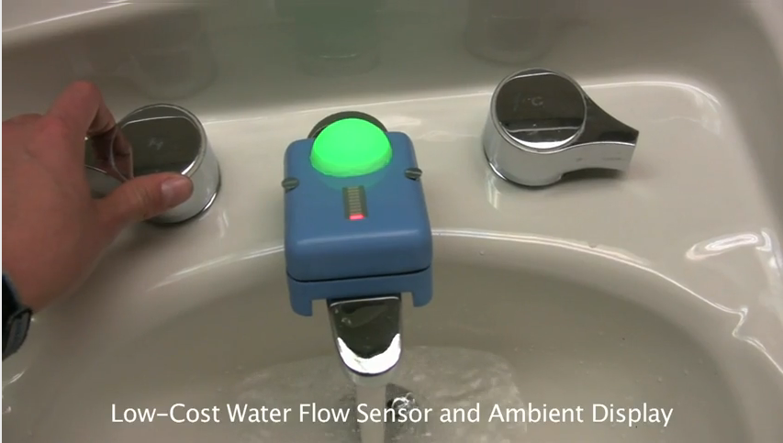
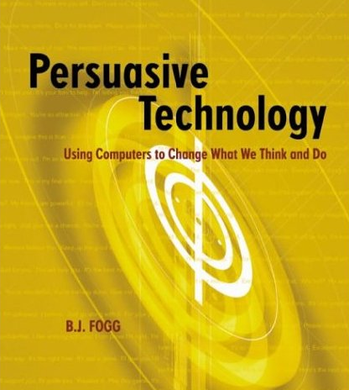
eco-feedback
Arroyo et al., CHI2005
a brief history
Kuznetsov et al., CHI2010
hci/ubicomp
2003
2010
Fogg, B.J., Persuasive Technology, 2003

Slide 11

eco-feedback
Arroyo et al., CHI2005
a brief history
Kuznetsov et al., CHI2010
Kohlenberg et al.,
J. Applied Behavior Analysis, 1976
environmental
psychology
hci/ubicomp
1970
1976
2003
2010
Fogg, B.J., Persuasive Technology, 2003
Notes:
In 1976 Kohlenberg et al. found that a light bulb, which illuminated when households were within 90% of their peak energy levels, changed energy usage behaviors [33].
Around that time, in the late 1960s and early 70s, environmental psychology was an emerging discipline that had grown out of the realization that environmental conservation was a twofold problem: partly technical and partly human.
Since this first study 40 years ago, environmental psychology has actively explored models of proenvironmental behavior, techniques to motivate behavior change, and studies of eco-feedback technology.
In comparison, HCI has only recently begun looking at eco-feedback; although some of the design elements are similar, even to the early work, the hci eco-feedback technologies are often evaluated not on their ability to change environmentally impactful behavior but rather on their aesthetic and overall understandability.

Slide 12
our focus
1. what can we learn from environmental psychology?
2. what should our role be in eco-feedback research?
3. how should we assess our contributions?

Slide 13
2. what techniques are used to motivate environmental behaviors?
1. why do people engage in environmental behavior?
hci
environmental
psychology
3. what is hci’s role?
Notes:
Talk broken into 3 parts
First two parts are about integrating finds from env psych
Last part is about trying to tease out what hci’s role is in eco-feedback research

Slide 14
1. why do people engage in environmental behavior?
hci
environmental
psychology
Notes:
Let’s begin with why do people engage in environmental behavior

Slide 15
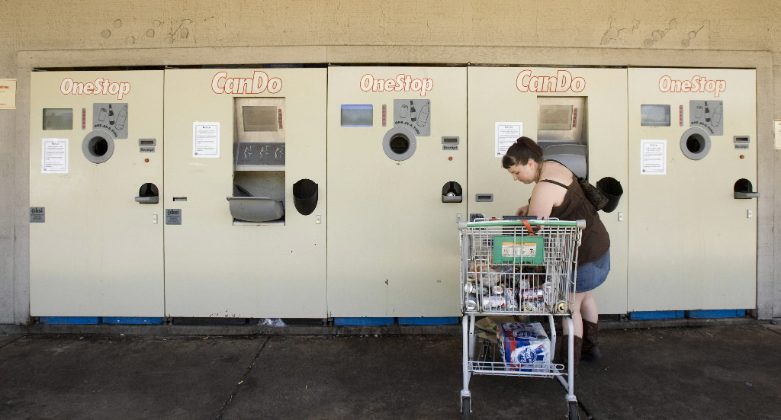
why?
Notes:
Why is this woman recycling, is it because she is getting paid?

Slide 16

why?
Notes:
Why is this guy recycling? He’s not getting paid.

Slide 17
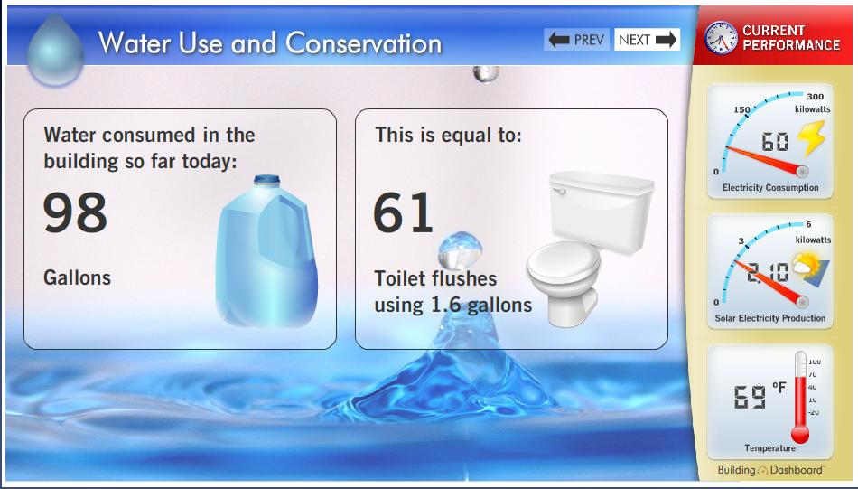
to design eco-feedback technology effectively, these are the very questions that we need to answer in the design process
Notes:
Fortunately, environmental psychologists have been exploring reasons for why people engage in environmental behaviors for 40 years.

Slide 18

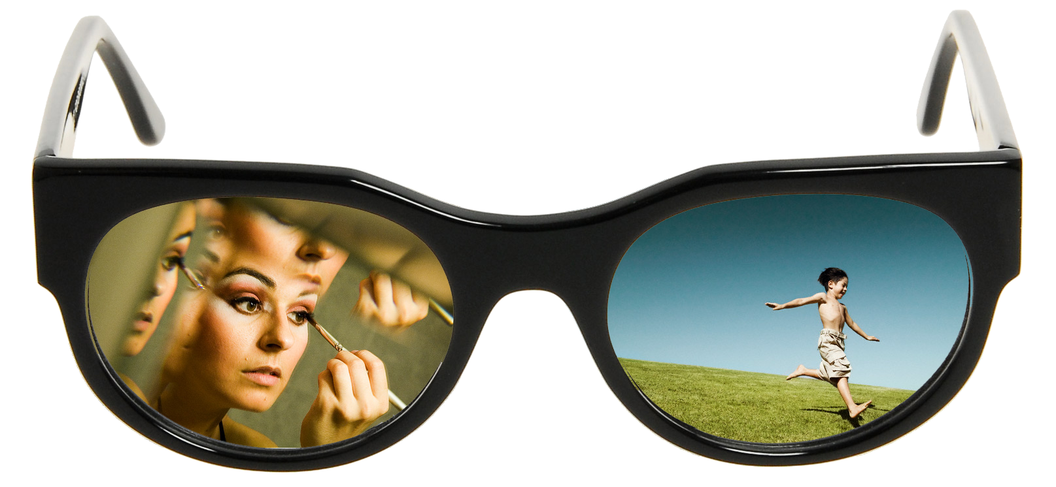
proenvironmental
behaviors
self-interest
concern for others
e.g., carpooling to make use of HOV lanes
e.g., using non-toxic cleaning chemicals out of respect for local watershed
Notes:
Pro-environmental behaviour is typically viewed as a mixture of self-interest and of concern for other people, future generations, other species, or whole ecosystems.
Some of this is drawn from Bamberg (below)
Bamberg_TwentyYearsAfterHinesHungerfordAndTomera-ANewMetaAnalysisOfPsychoSocialDeterminantsOfProEnvironmentalBehavior_JournalOfEnvironmentalPsychology2007

Slide 19
proenvironmental
behavior models
rational choice models
norm-activation models
self-interest
self-interest
concern for others
concern for others
e.g., carpooling to make use of HOV lanes
e.g., using non-toxic cleaning chemicals out of respect for local watershed
Notes:
This mixture of self-interest and pro-social motives is also reflected by the theoretical models most frequently used to explain proenvironmental behavior.
Bamberg_TwentyYearsAfterHinesHungerfordAndTomera-ANewMetaAnalysisOfPsychoSocialDeterminantsOfProEnvironmentalBehavior_JournalOfEnvironmentalPsychology2007

Slide 20
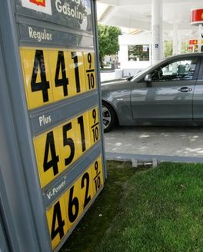
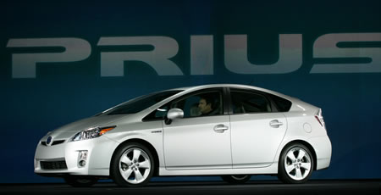

rational choice models
self-interest
behavior is regulated by systematic process of evaluating expected utility to self
rational choice models
Congressional Budget Office, Congress Report, 2008
Notes:
Rational choice models assume that behavior is regulated by a systematic process of evaluating expected utility
Often this is simplified
Bamberg_TwentyYearsAfterHinesHungerfordAndTomera-ANewMetaAnalysisOfPsychoSocialDeterminantsOfProEnvironmentalBehavior_JournalOfEnvironmentalPsychology2007

Slide 21
norm activation models
self-interest
proenvironmental behavior is altruistic or based on some perceived notion of good
rational choice models
help to conserve natural resources
a sense of responsibility and participation
DeYoung, Environment and Behavior, 1986
Notes:
In contrasts, norm-activation models do not focus on self-utility but rather assume that proenvironmental behavior is altruistic or based on some moral notion of good.
DeYoung, Environment and Behavior, 1986
Bamberg_TwentyYearsAfterHinesHungerfordAndTomera-ANewMetaAnalysisOfPsychoSocialDeterminantsOfProEnvironmentalBehavior_JournalOfEnvironmentalPsychology2007

Slide 22
models impact eco-feedback designs
designers build based on models, these fundamentally change their designs
we need to be more about explicit about questioning/exposing the theories used in our designs
Notes:
why do we care? <click>
HCI eco-feedback designers, whether conscious of it or not, imbue their designs with some theory of human behavior. How the technology presents this information is fundamentally based on how the designer believes humans behave and react. Subscribing to one model versus another could result in strikingly different choices about the type and presentation of information.
2. It is important, then, to begin questioning and exposing the theories used in our eco-feedback designs. Why were these design choices made, how are they grounded?

Slide 23
2. what techniques are used to motivate environmental behaviors?
1. why do people engage in environmental behavior?
hci
environmental
psychology
Notes:
While models of proenvironmental behavior provide us with a philosophical approach on which to base our designs, they do not offer specific strategies for changing behavior.
For this we turn towards specific behavior change techniques.

Slide 24
behavior change
techniques we can use
information
prompts
goal-setting
comparison
Geller et al., 1990
Health Education Research
commitment
incentives
feedback
Notes:
These techniques largely extend from behavioral psychology, not environmental psychology specifically. In the paper we provide examples of how each one of these has been applied in environmental behavior studies, but here we’ll highlight only a few of them to underscore how they can be used in general.
These are techniques from environmental psychology that you, as hci-designers, can use in your designs of eco-feedback technology.

Slide 25
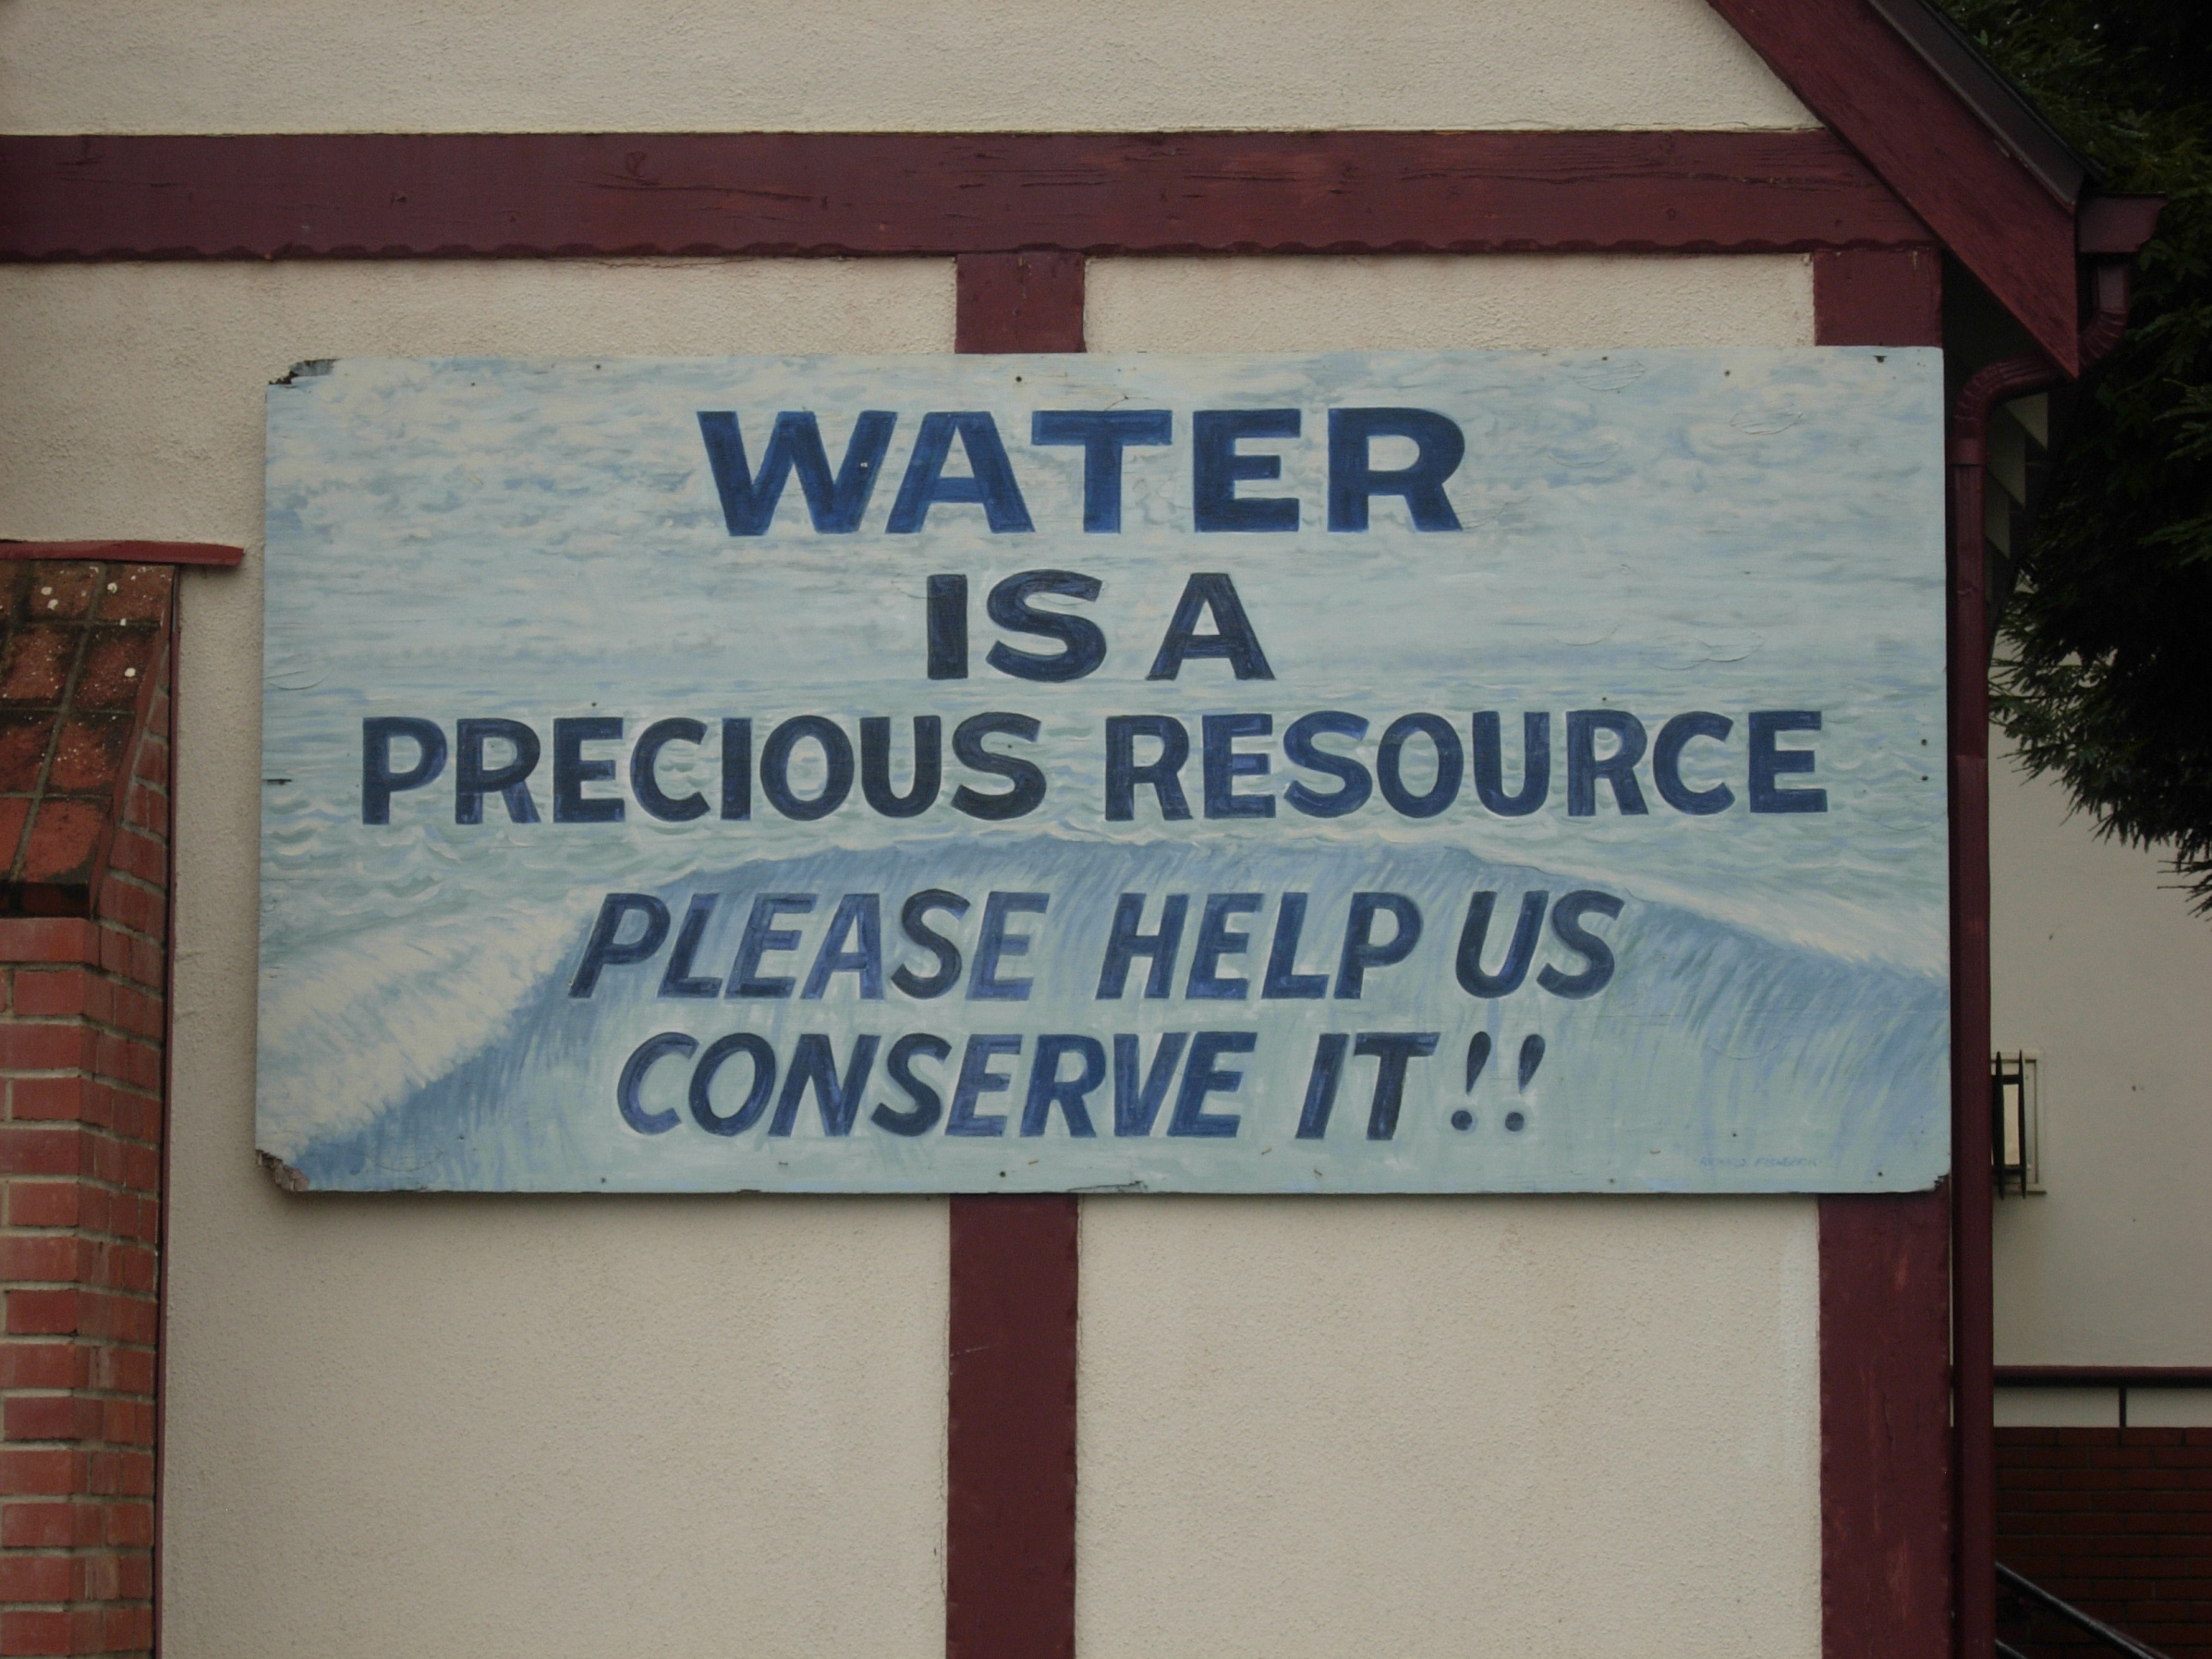
behavior change
techniques
information
prompts
goal-setting
comparison
commitment
incentives
feedback
Notes:
Many conservation programs use high-level written or verbal messages, called prompts, to promote conservation.
Investigations into general prompting strategies have shown that prompting has limited influence on behavior but can be made more effective by improving specificity, timing, and placement
Geller, E.S., Winett, R.A., & Everett, P.B. Preserving the environment: New strategies for behavior change. New York: Pergamon Press, 1982

Slide 26
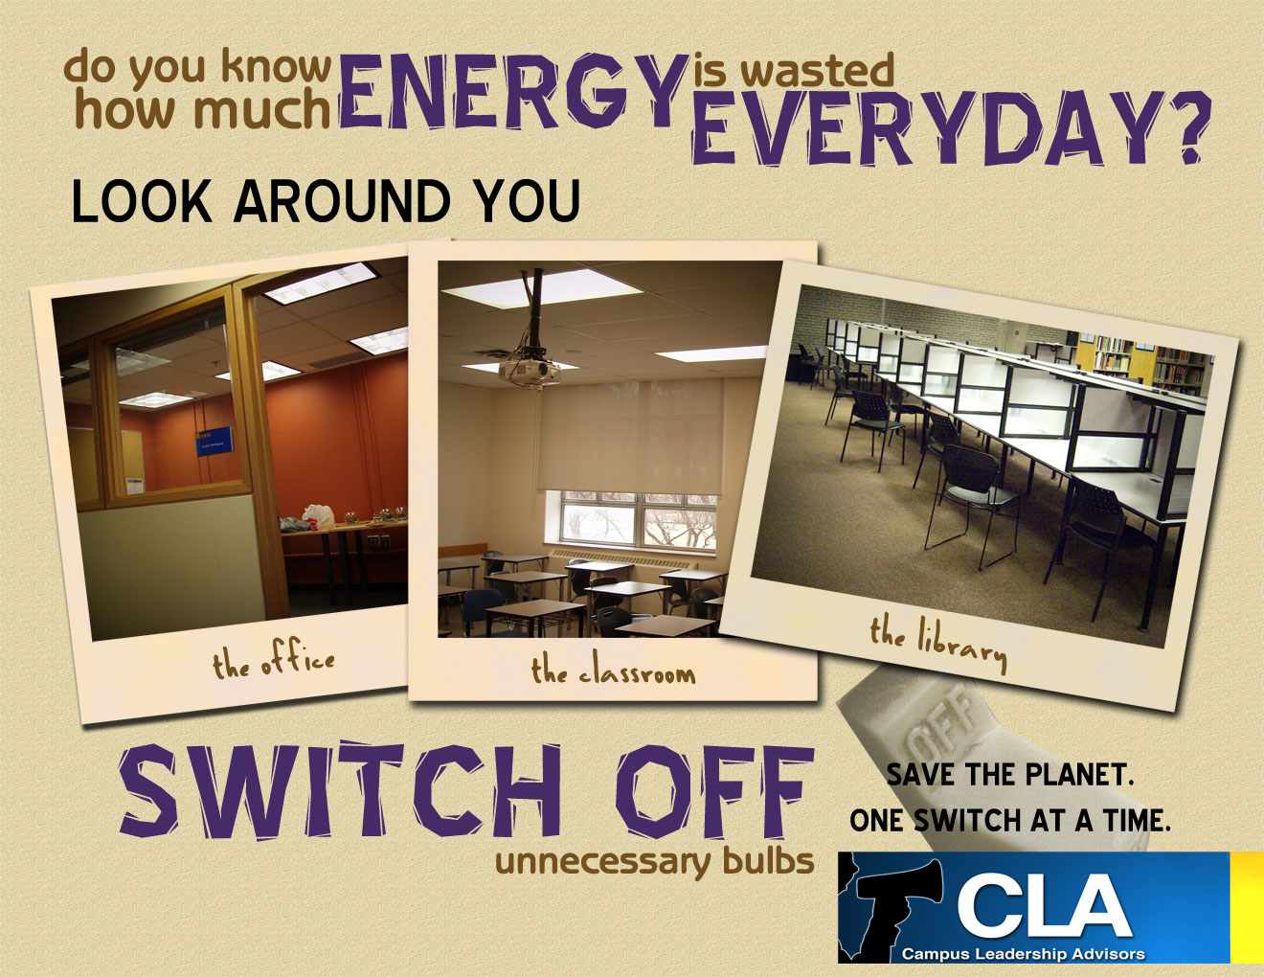
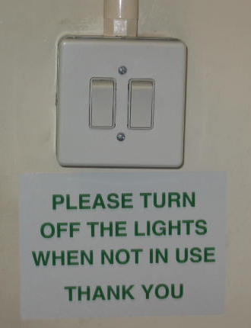
prompts
much more effective!
Winett et al., Journal of Applied Psychology, 1978
Notes:
Prompts that are disconnected from where the consumption action takes place are less effective than prompts that are closer in time and place.
So a poster reminding people to use energy wisely is much less effective at motivating people to turn off the lights than a label right on the light switch.

Slide 27
behavior change
techniques we can use
information
prompts
goal-setting
comparison
commitment
incentives
feedback

Slide 28
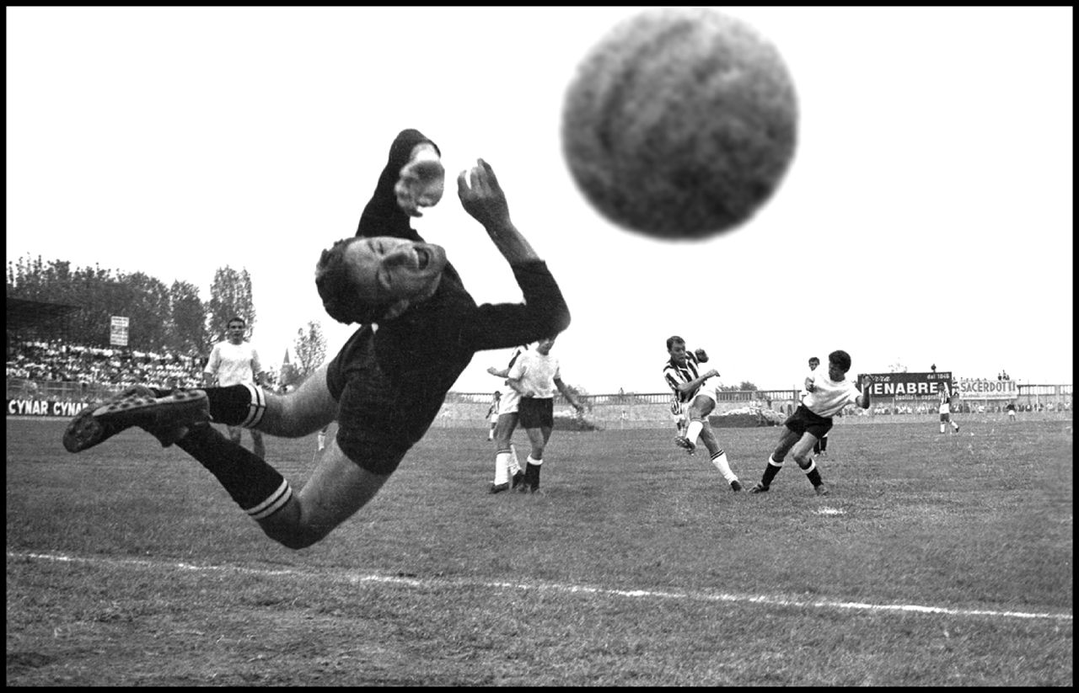
behavior change
techniques
information
prompts
goal-setting
comparison
commitment
directs attention
has energizing function
affects persistence
Locke & Latham, American Psychologist, 2002
incentives
feedback
Notes:
Locke and Latham summarize 35 years of research into the effect of goals on behavior:
Goals serve a directive function; they direct attention and effort toward goal-relevant activities
Goals have an energizing function. Hard goals lead to greater effort than easy goals.
Goals affect persistence. Hard goals prolong effort (LaPorte & Nath, 1976).
I’ll talk more about how goals have been used to motivate environmental behavior with eco-feedback technology in the next part of the talk.

Slide 29
behavior change
techniques we can use
information
prompts
goal-setting
comparison
integrate these techniques into our eco-feedback designs
commitment
incentives
feedback

Slide 30
2. what techniques are used to motivate environmental behaviors?
1. why do people engage in environmental behavior?
hci
environmental
psychology
3. what is hci’s role?
Notes:
So, while the first two parts of the talk were largely focused on what can we learn from environmental psychology and how can we apply them to our eco-feedback designs, we transition now to pursuing the question of what hci’s role might be?
To answer this question, we conducted comparative survey of the hci and environmental psychology literature on eco-feedback technology.

Slide 31
how are the eco-feedback interfaces presented?
what behaviors are targeted?
how are the eco-feedback interfaces evaluated?
hci
environmental
psychology
3. what is hci’s role?

Slide 32

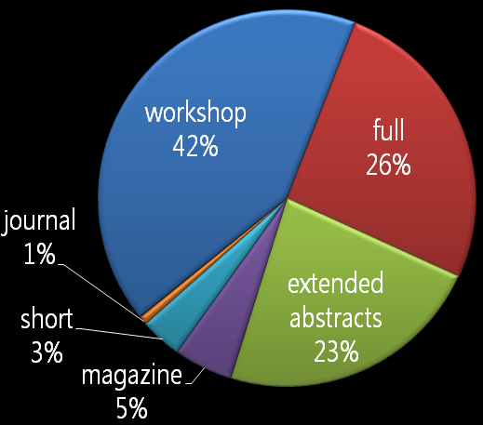
hci corpus
Sources: CHI, UbiComp, Persuasive
139 papers on “environment” or “sustainability.”
56 related to eco-feedback
92% published in last three years
44% in 2009 alone
Notes:
We used Google Scholar and ACM Portal to search for HCI/UbiComp papers that 139 hci papers included “environment” or “sustainability.”
58 workshop papers, 36 full papers, 32 papers found in extended abstracts (e.g., demos, works-in-progress, alt.chi), and 13 short papers, journal or magazine articles
44% of these papers were published in 2009 and 92% were published in the last three years.
Of the 139 papers, 56 were related to eco-feedback technology—44 of these provide a unique eco-feedback artifact, while the rest are essays

Slide 33
environmental
psychology corpus
Sources: Journals of Environmental Psychology, Consumer Research, Social Issues, Applied Social Psychology, Applied Experimental Psychology, Environment and Behavior
82 papers on effects of eco-feedback
12 on eco-feedback technology
Notes:
Given the long history in environmental psychology of exploring eco-feedback [1, 15], many of these studies were conducted before technology was seen as a practical feedback tool. Thus, most of these studies did not use eco-feedback technology in particular but rather other forms of feedback such as bill designs, media campaigns, pamphlets, and home audits.
Here, though, we focus solely on the 12 studies in environmental psychology that did use eco-feedback technology (often referred to as “computerized feedback” in this literature).

Slide 34
58%
hci
0%
environmental
psychology
Notes:
<click>
…which suggests that we have a way to go before making an impact outside of our community.

Slide 35
how are the eco-feedback interfaces presented?
hci
environmental
psychology
3. what is hci’s role?

Slide 36
presentation of the
eco-feedback interface
papers that provide a graphic of their eco-feedback interface
todo: add in environmental psychology vs hci
50% vs 85%
environmental
psychology
hci
Notes:
Now that I’ve given you an overview of the corpus, how hci and environmental psychology present their eco-feedback interfaces
Perhaps the most striking (and most immediate) contrast between the HCI and the environmental psychology literature is the emphasis (or lack of emphasis) on the visual design of the eco-feedback interface itself.

Slide 37
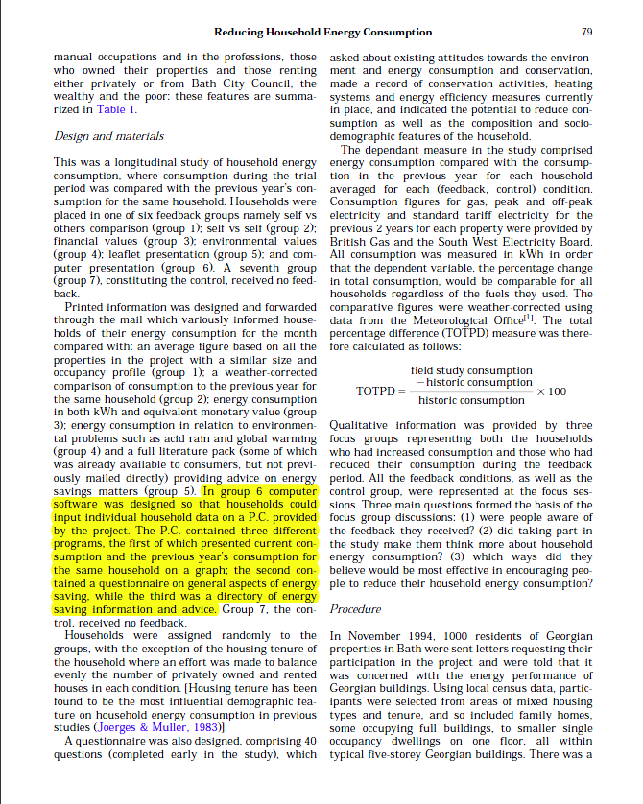
environmental psychology
used short written descriptions
½ paragraph
eco-feedback interface description in an
11 page paper
Brandon & Lewis, Environmental Psychology, 1999
Notes:
“The P.C. contained three different programs, the first of which presented current consumption and the previous year’s consumption for the same household on a graph; the second contained a questionnaire on general aspects of energy saving, while the third was a directory of energy saving information and advice.”
Slightly adapted for the slide
Brandon_ReducingHouseholdEnergyConsumptionAQualitativeAndQuantitativeFieldStudy_EnvironmentalPsychology1999

Slide 38
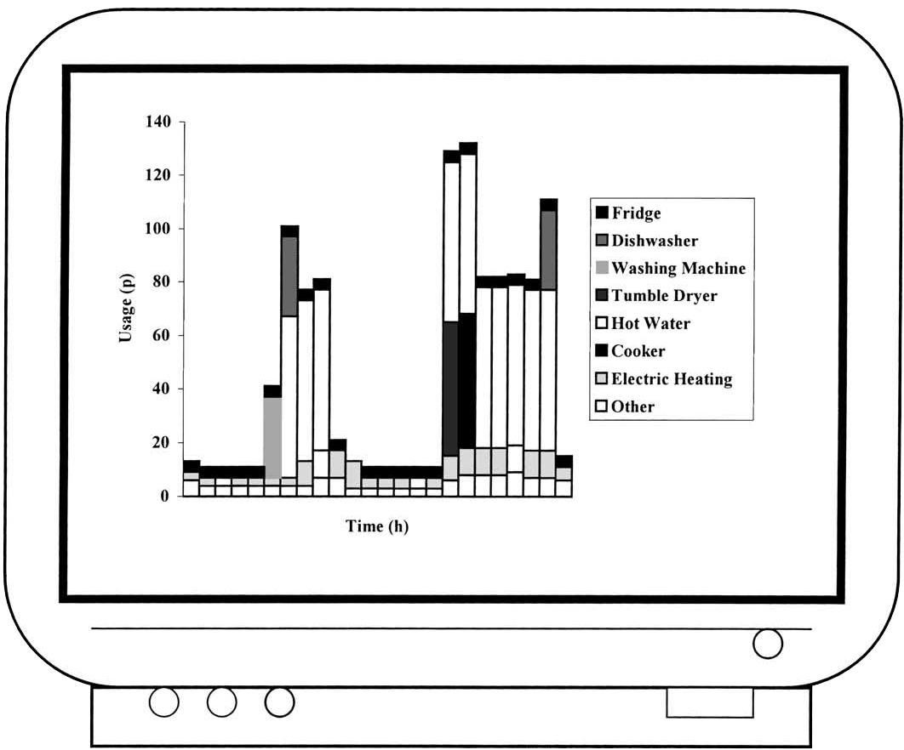

environmental psychology
common interfaces
Keirstead, Energy Policy, 2007
Dobson & Griffin, Proc of ACEEE, 1992
Notes:
These are the two most common types of feedback interfaces that we saw in the environmental psychology literature.
On the left, we have an interface which provides real-time energy usage information via a LED display. On the right, we have an interactive, computer-based interface that displays historical energy consumption information over time.
Both of these types of interfaces resulted in energy reductions.

Slide 39
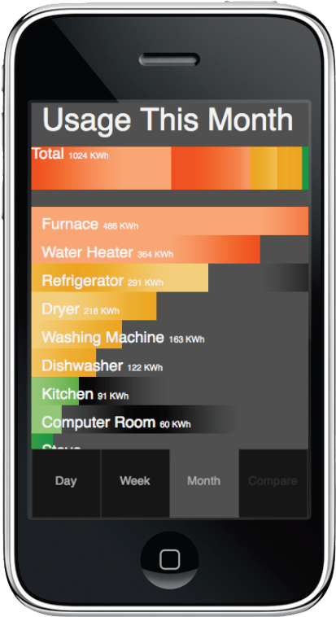
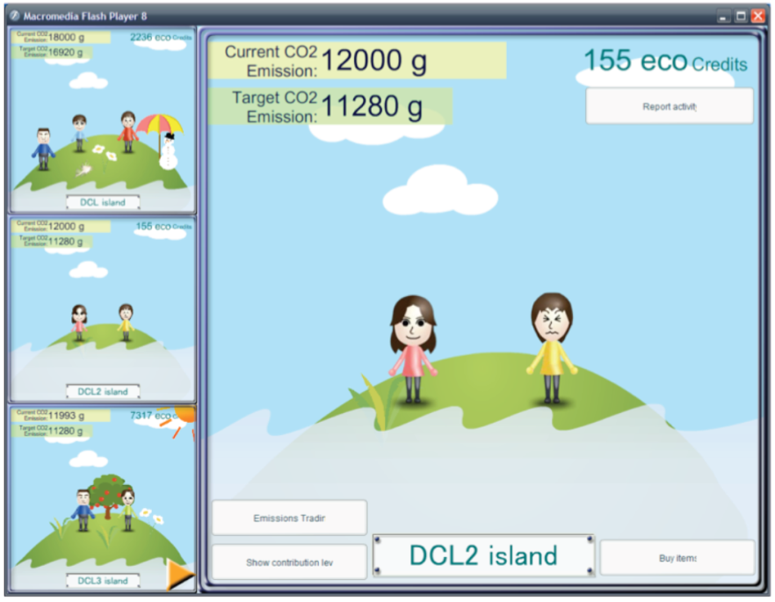
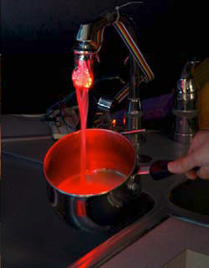
hci/ubicomp
range of interfaces
Shiraishi et al., Persuasive2009
Petersen et al., CHI 2009
Arroyo et al., CHI 2005
Notes:
Range of interfaces and output modalities
Describe them

Slide 40
simple interfaces were effective
lack of design focus
simple interfaces
yet…
significant reductions
Notes:
Despite the relatively simple interfaces and lack of focus on design, the environmental psychology studies have achieved impressive results…
a finding which should be cause for reflection by eco-feedback researchers in HCI

Slide 41
simple interfaces were effective
lack of design focus
simple interfaces
yet…
significant reductions
Notes:
So, I’m not advocating that we adopt environmental psychology designs but rather that we need to think deeply about what our goals are when we are designing new eco-feedback technologies and how those designs should be evaluated.

Slide 42
eco-feedback interfaces
what should be the role of hci?
exploring diverse presentation mediums
engaging users for sustained motivation
designing for least motivated users
Notes:
Given that environmental psychologists do not focus on the design and evaluation of the eco-feedback artifact itself, they cannot answer questions about the importance/effectiveness of certain interface or design characteristics.
These are questions we, as a community, are well suited to study and answer.
<click>

Slide 43
how are the eco-feedback interfaces presented?
what behaviors are targeted?
hci
environmental
psychology
3. what is hci’s role?

Slide 44

targeted behaviors
a majority of papers focus on electricity eco-feedback
high impact
easily sensed
Notes:
We have hci in blue/env psych in red. Describe axes.
The most common target for both hci and environmental psychology is residential electricity usage: 41% of the papers in HCI and 92% of the papers in environmental psychology.
This emphasis is both a reflection of the impact that electricity usage behaviors have on the environment as well as the ease with which energy usage can be automatically sensed

Slide 45
targeted behaviors
Notes:
However, while environmental psychology has largely focused on electricity, gas, and water

Slide 46
targeted behaviors
Notes:
HCI has explored eco-feedback technologies for a far larger set of behaviors
Including transportation, garbage disposal, automatic carbon emission tracking, and even paper usage.

Slide 47
targeted behaviors
diverse set
hci rewards novelty?

Slide 48
targeted behaviors
what should be the role of hci?
building sensing techniques for new behaviors
quickly testing/iterating new design ideas
rewarding follow-up research
Notes:
3. Now that we’ve been doing this research for a few years, we need to reward both novelty and longer-term evaluations, which brings us to…

Slide 49
how are the eco-feedback interfaces presented?
what behaviors are targeted?
how are the eco-feedback interfaces evaluated?
hci
environmental
psychology
3. what is hci’s role?

Slide 50
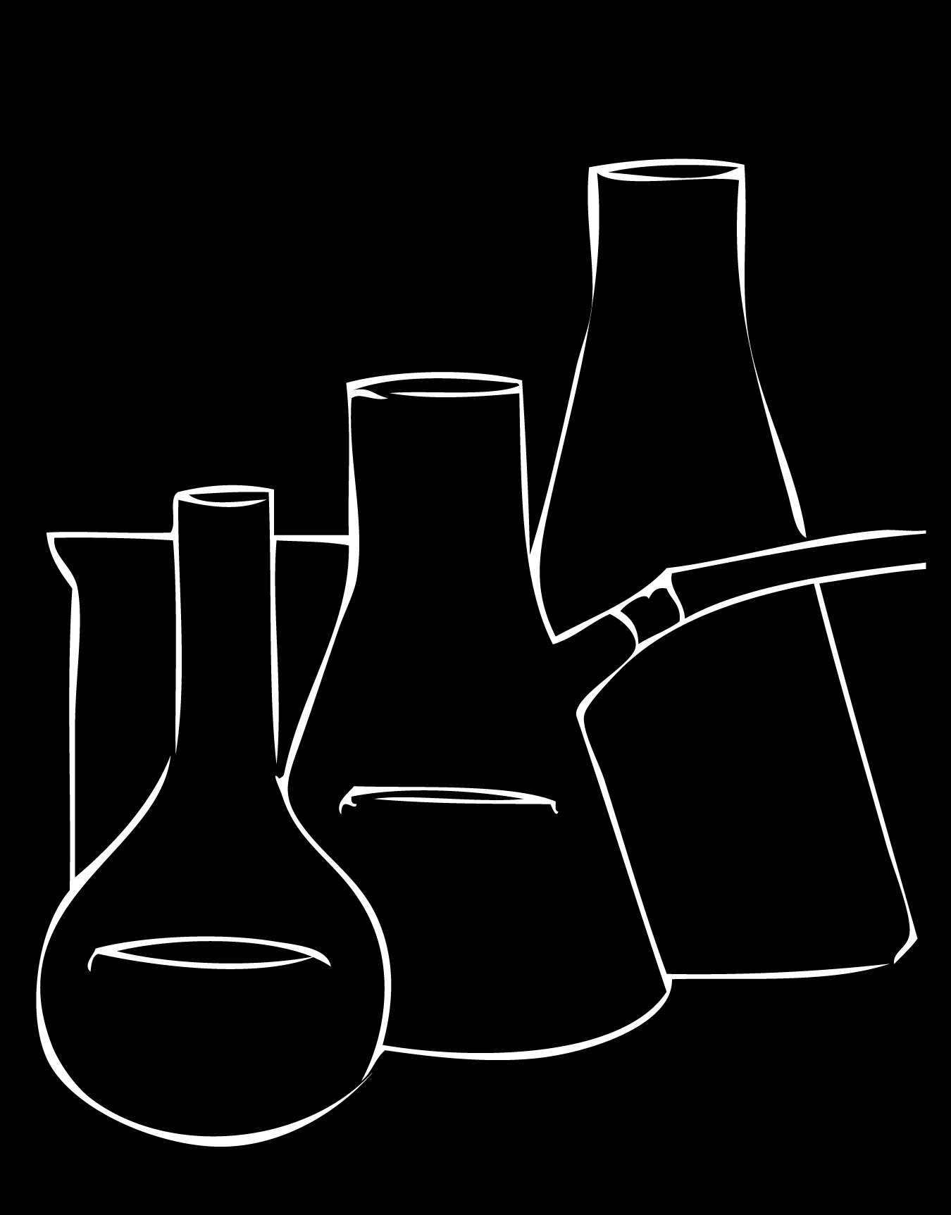


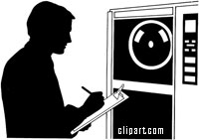
study methodology
hci
have largely focused on laboratory studies or qualitative field studies of eco-feedback technology
this is not to say that the designs are not evaluated. Of the 44 eco-feedback technology papers from HCI, only 17 of them do not provide some sort of user evaluation of their designs (and 9 of these were workshop papers).
e psych
laboratory study
qualitative study
field study
almost exclusively field studies (10/12), with one survey and one lab study.
hci
environmental
psychology
Notes:
Another important distinction between the two disciplines is in study methodology.
HCI researchers have largely focused on laboratory studies or qualitative field studies of eco-feedback technology.
The studies in the environmental psychology literature were almost exclusively field studies, with one survey and one lab study.

Slide 51
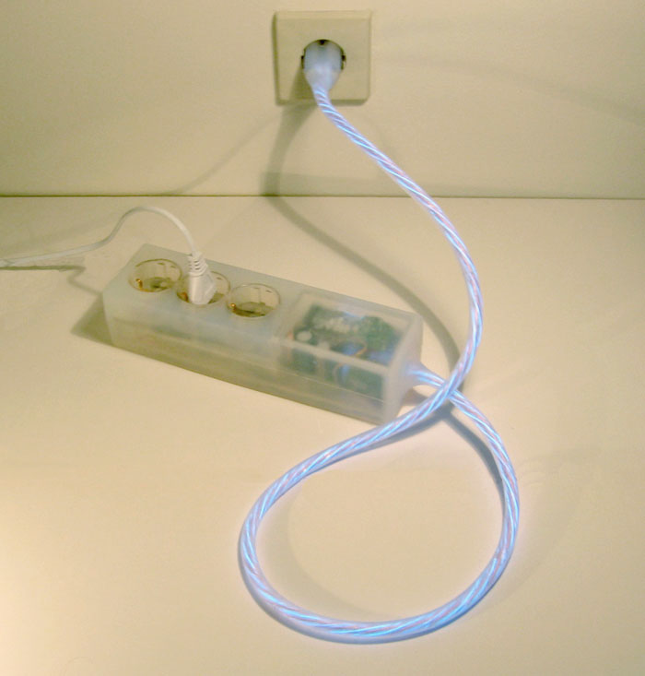

lab study
hci example
power-aware cord
investigate reactions to ambient display
wizard-of-oz study
15 participants
13 participants understood feedback without explanation
Gustafsson and Gyllenswärd, CHI EA, 2005
Notes:
The HCI laboratory studies tend to be informal in nature, seeking feedback about understandability, aesthetic, and perceived usefulness.
“At this stage, the Power-Aware Cord is meant to be a conceptual design statement, mostly used to test people’s reactions and provoke thoughts around the area of energy consumption.”
Gustafsson, A. and Gyllenswärd, M. The power-aware cord: energy awareness through ambient information display. CHI EA '05, 2005, 1423-1426.

Slide 52
lab studies in hci
are often qualitative
“
at this stage, the Power-Aware cord is meant to be a conceptual design statement, mostly used to test people’s reactions and provoke thoughts around the area of energy consumption.
”
Gustafsson and Gyllenswärd, CHI EA, 2005
Notes:
The HCI laboratory studies tend to be informal in nature, seeking feedback about understandability, aesthetic, and perceived usefulness.

Slide 53

lab study
environmental psychology example
feedback
interface
Wizard-of-Oz study
15 participants
Goal: investigate understandability, aesthetic, and perceived usefulness
13/15 participants understood the feedback without explanation
product-integrated feedback
100 participants
participants were told studying:
“improvements to the control panel”
4 experimental groups:
1. feedback w/no goal
2. feedback w/self-set goal
3. feedback w/assigned goal
4. baseline (no feedback/no goal)
McCalley & Midden, Journal of Economic Psychology, 2002
Notes:
Use comparative language!
Pro-self vs. pro-social test was called “The Measuring Instrument for Social Value Orientations”
McCalley, L. & Midden, C. Energy conservation through product-integrated feedback: the roles of goal-setting and social orientation. J. of Economic Psychology 23, (2002), 589-603.

Slide 54
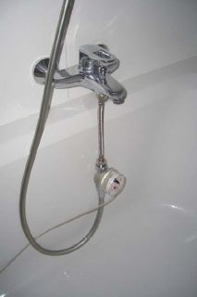
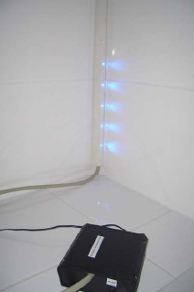
field study
hci example
“show-me” water display
4 households
3-week study
no control or baseline data
average reported water savings was 10 liters; no statistical analysis provided
Kappel and Grechenig, Persuasive, 2009
Notes:
show-me stands for shower water meter. it is a device that measures and displays the amount of water that is being used during a shower. The consumption information is visualized in the form of LEDs that are vertically assembled on a stick. During operation, one (additional) LED is lightened up for every five liters of water consumed
4 households (unclear how these were chosen)

Slide 55
field study
environmental psychology example
gas usage eco-feedback study
325 households
three year study (1 year baseline)
6 experimental groups
12.5% usage reduction with electronic eco-feedback condition
goal
current
use
Van Houwelingen, & Van Raaij, Journal of Consumer Research, 1989

Slide 56
field studies
hci (n=8 of 27)
environmental psychology (n=10 of 12)
avg number of participants
larger environmental psychology studies (avg=414) often partner with a utility

Slide 57

field studies
hci (n=8 of 27)
environmental psychology (n=10 of 12)
avg number of participants
studies collecting baseline data
baseline data
previous year’s consumption
pre-intervention period
1 study with 1 week baseline data
Holstius et al., DIS, 2004

Slide 58
field studies
hci (n=8 of 27)
environmental psychology (n=10 of 12)
avg number of participants
studies collecting baseline data
study length
7.5 mos
baseline

Slide 59
field studies
hci (n=8 of 27)
environmental psychology (n=10 of 12)
avg number of participants
studies collecting baseline data
difference in consumption
study length
4/8 reported behavior change data
0/8 had non-exposed control group
7.5 mos
baseline
?%

Slide 60
study methodology
hci
what incentives do hci researchers have to conduct longitudinal studies?
have largely focused on laboratory studies or qualitative field studies of eco-feedback technology
this is not to say that the designs are not evaluated. Of the 44 eco-feedback technology papers from HCI, only 17 of them do not provide some sort of user evaluation of their designs (and 9 of these were workshop papers).
what should be the role of hci?
e psych
almost exclusively field studies (10/12), with one survey and one lab study.
should this even be our goal?
moving beyond lab studies/short field studies
being more rigorous in our evaluations
partnering outside the community
Notes:
What should be the role of HCI in evaluating eco-feedback interfaces? If the goal is to change behavior <click>

Slide 61
2. what techniques are used to motivate environmental behaviors?
1. why do people engage in environmental behavior?
hci
environmental
psychology
3. what is hci’s role?

Slide 62
our focus
1. what can we learn from environmental psychology?
2. what should our role be in eco-feedback research?
3. how should we assess our contributions?
Notes:
Integrate env psych models and behavior change techniques
We’ve talked about what our role can be for rapidly prototyping new eco-feedback displays, building new types of eco-feedback sensors but really this comes down to the goal of eco-feedback technology, which is ostensibly to change behavior and if that’s the case we need to pursue a different evaluation approach.

Slide 63

eco-feedback
where are we going?
?
1970
1976
2003
2005
2010
the future
emergence of
environmental
psychology
Notes:
Ultimately, we need to decide as a community what kind of impact we want to make in the future.

Slide 64
the design of
eco-feedback
technology
@jonfroehlich
design:
use:
build:

Slide 65
other slides

Slide 66
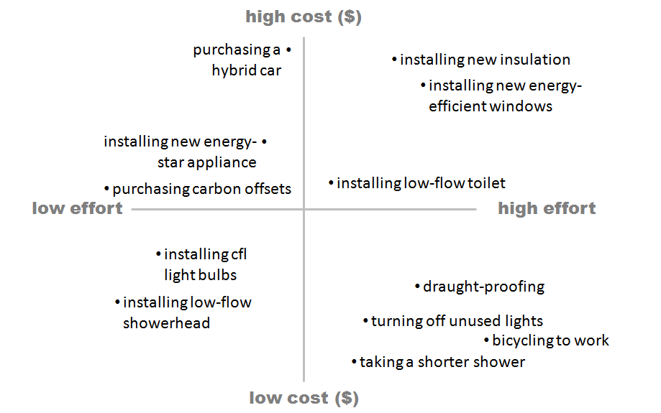
efficiency vs. curtailment
Notes:
Gardner and Stern (2002) divide behaviors related to resource conservation into two categories: efficiency and curtailment behaviors. Efficiency behaviors are one-time actions that are meant to provide a lasting reduction on a person’s environmental footprint without requiring behavioral change (e.g., buying a more fuel-efficient vehicle, installing low-flow showerheads, replacing old appliances with their energy-star equivalents). Curtailment behaviors involve forming new routines to reduce environmental impact (e.g., commuting to work by bicycle rather than car, taking shorter showers, only using the dishwasher or washing machine when completely full).
With feedback technology, there is potential to address both. With efficiency behaviors, the feedback technology could use sensing data to tailor a message about how a new appliance may save money (e.g., based on the amount of showering activity, you would save $20 each month by installing low-flow showerheads). The feedback technology could even link to specific appliances online (e.g., on homedepot.com) as well as how-to videos to help lower the burden of taking such an action. For curtailment behaviors, the feedback technology can show where the most energy or water usage is occurring in the home thus allowing the homeowner to try and take steps to reduce those usage behaviors.

Slide 67

u.s. energy utilities spent
$2 billion
in 2002 alone promoting energy conservation
Lin, J. Energy Policy, 2007.
Notes:
The search for what motivates proenvironmental responsible behavior has far-reaching consequences: in 2002 alone, US energy utilities invested over $2 billion in promoting energy conservation [36].
For example, Massachusetts and California spent 3% and 1.5% of electric revenues in 2002 to promote energy efficiency (Kushler et al., 2004).
[36] Lin, J. Energy conservation investments: A comparison between China & the US. Energy Policy, 35 (2007), 916-924.

Slide 68
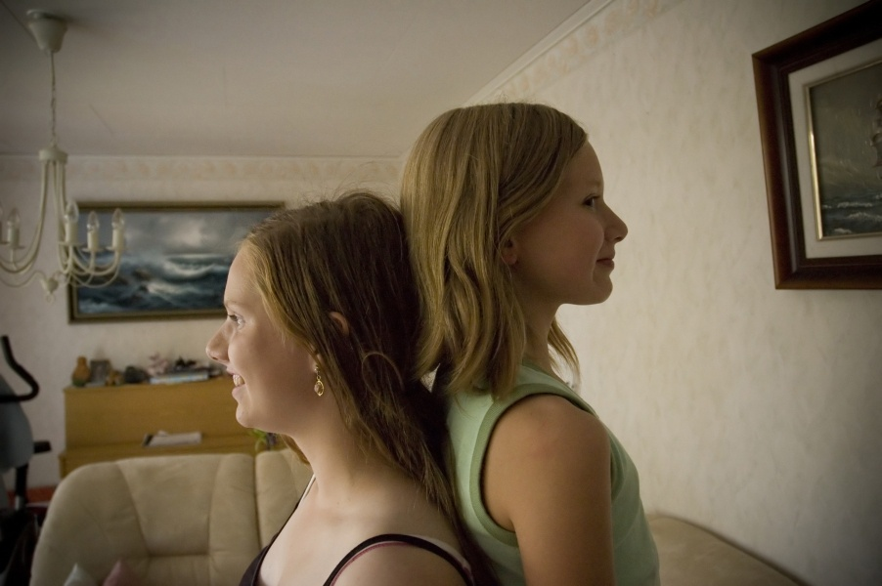
comparison
Notes:
A comparison between individuals or groups can be useful in motivating action, particularly when combined with feedback about performance.
Look at McColskey – Differential Effects of Norms

Slide 69
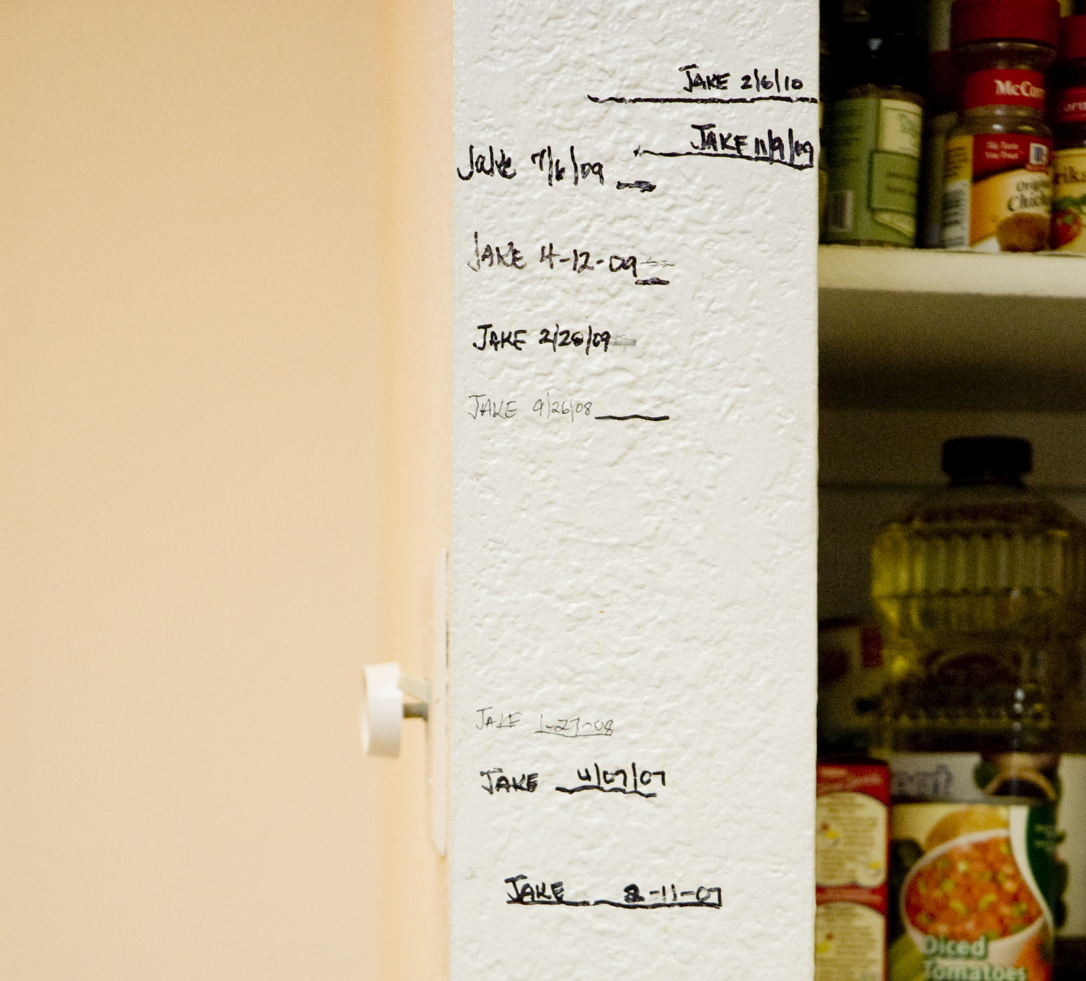
self comparison
Notes:
Even feedback that provides information comparing one’s current behavior to past behavior has been shown to be effective (i.e., self comparison).
Look at McColskey – Differential Effects of Norms

Slide 70

comparison
JOIN YOUR FELLOW GUESTS IN HELPING TO SAVE THE ENVIRONMENT. Almost 75% of guests who are asked to participate in our new resource savings program do help by using their towels more than once. You can join your fellow guests in this program to help save the environment by reusing your towels during your stay.
Notes:
Look at McColskey – Differential Effects of Norms

Slide 71
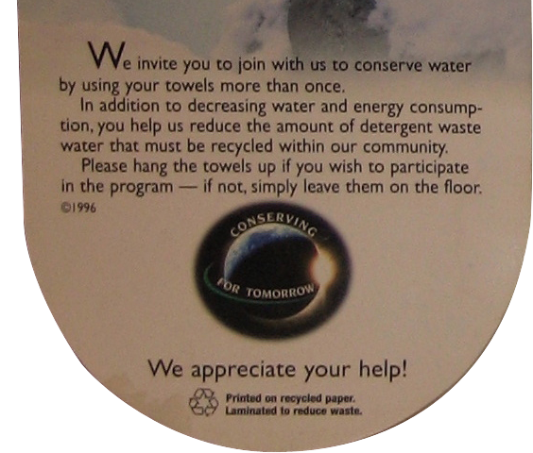

comparison
JOIN YOUR FELLOW GUESTS IN HELPING TO SAVE THE ENVIRONMENT. Almost 75% of guests who are asked to participate in our new resource savings program do help by using their towels more than once. You can join your fellow guests in this program to help save the environment by reusing your towels during your stay.
standard environmental message
descriptive norm message
35.1%
44.1%
Notes:
Look at McColskey – Differential Effects of Norms
25.6% increase
Marriott, a hospitality company that's demonstrated a real commitment to environmentalism, says it "saves an average of 11 per cent to 17 per cent on hot water and sewer costs at each hotel," through the linen-reuse program.

Slide 72

toyota prius
16.2 years
Notes:
This category creator doesn't have an equivalent gas-only version, so we compared it to the Toyota Corolla LE. It takes the Prius a shocking 16.2 years to catch up with the Corolla.

Slide 73
toyota prius
16.2 years
compared w/toyota corolla le
15,000 miles a year
$3.00/gal gas
w/tax credits
http://www.edmunds.com/advice/fueleconomy/articles/116513/article.html
Notes:
Edmunds Study: Do Hybrids Make Financial Sense Yet?, 2008
This category creator doesn't have an equivalent gas-only version, so we compared it to the Toyota Corolla LE. It takes the Prius a shocking 16.2 years to catch up with the Corolla.

Slide 74
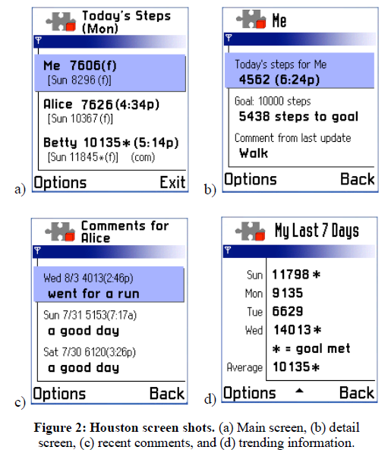
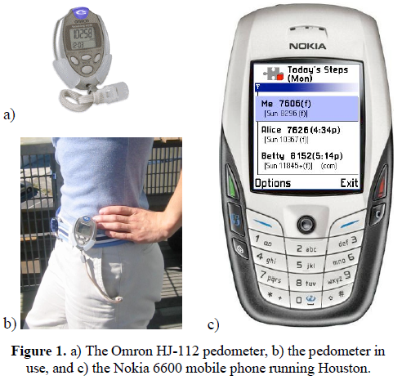
pedometer cell phone fitness study
Consolvo, S., et al. Design Requirements for Technologies that Encourage Physical Activity. CHI 2006
Notes:
For example, in a study conducted by one of my colleagues at the University of Washington, a pedometer (step-counter) was linked to a mobile phone. We found that the use of asterisks to reward step goals being met was enough to motivate more walking.

Slide 75
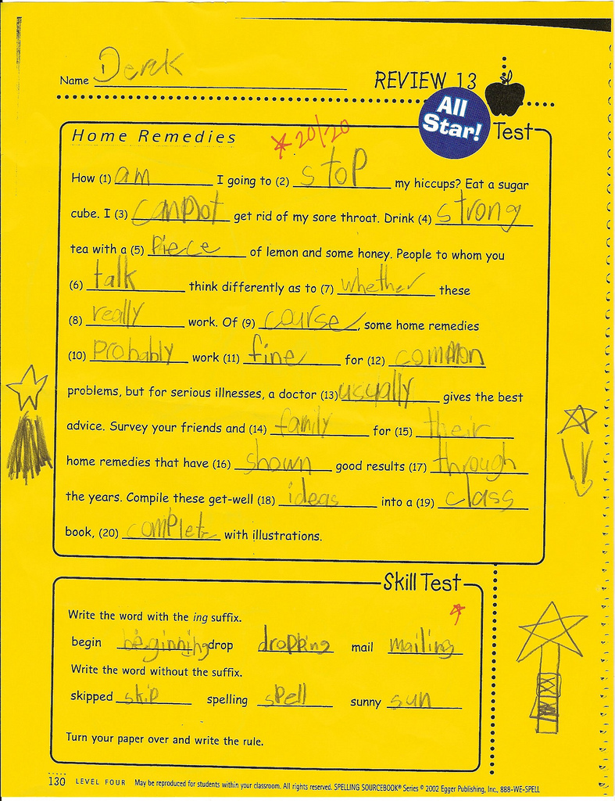
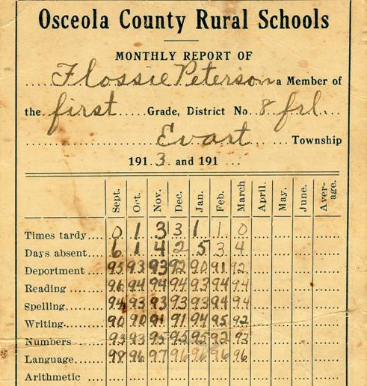
two types of feedback
low-level
high-level
Becker, L.J., J. of Applied Psychology 1978
Notes:
One of the best-established findings in psychology is the positive effect that information feedback can have on performance (Becker, 1978).
low-level feedback can provide explicit detail about how to change or improve specific behavior, e.g., which answers I got wrong on a test
high-level feedback can help improve performance by motivating a person to try harder or persist longer at a task, e.g., my current grade in the class
Becker, L. J. Joint Effect of Feedback and Goal Setting on Performance: A Field Study of Residential Energy Conservation. J. of Applied Psychology 63. 4(1978), 428-433.

Slide 76
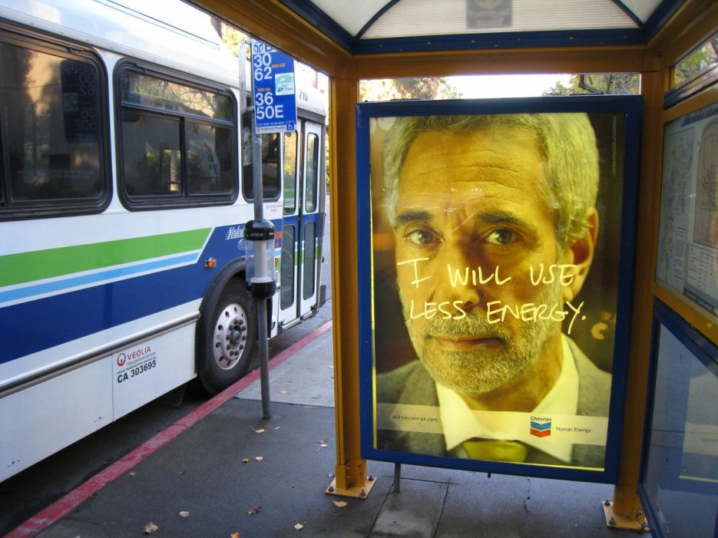
trust
Notes:
[could have second slide on EPA study of window stickers that found that many people thought that car companies or magazines were in charge of the stickering program]

Slide 77
why not increase costs?
Notes:
Why not increase costs to significantly manipulate environmental behavior: the short answer, it’s not practical.
1. the rational-economic model assumes that people understand whether a behavior or a device is cost effective. This is not always the case, e.g,. is it better for the environment and for you financially to immediately replace all of your working incandescent bulbs with cfls)
2. In some cases, price simply cannot be significantly manipulated to change behavior. For example, dramatically increasing the cost of water quickly becomes an ethical issue.

Slide 78
lab study
environmental psychology example
feedback
interface
drop in energy usage
overall reductions
pro-self vs. pro-social
McCalley & Midden, Journal of Economic Psychology, 2002
Notes:
McCalley, L. & Midden, C. Energy conservation through product-integrated feedback: the roles of goal-setting and social orientation. J. of Economic Psychology 23, (2002), 589-603.

Slide 79
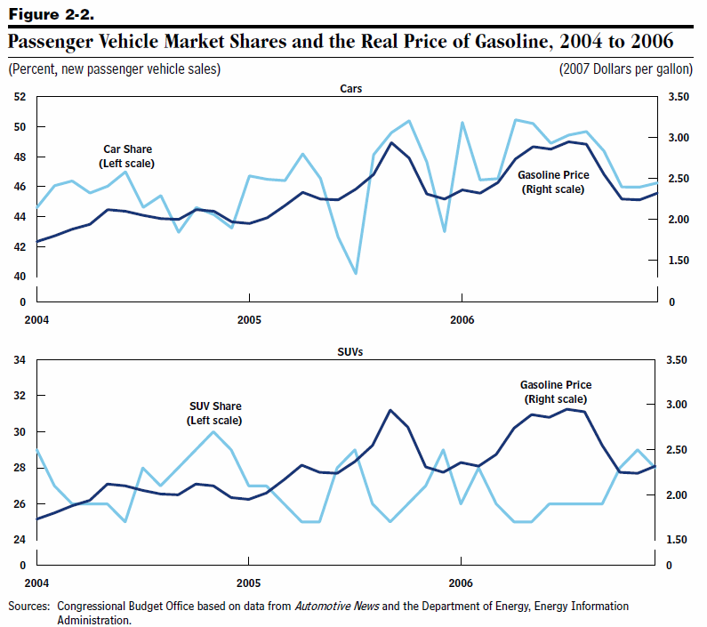
rational choice example
the price of gas affects vehicle purchases
$3.50
car market share
50%
$3.00
40%
$2.50
price of gas
vehicle market share
price of gas
$2.00
30%
$1.50
20%
truck market share
2004
2005
2006
2007
Congressional Budget Office, Congress Report, 2008
Notes:
There is strong evidence that price plays an important role in stimulating conservation behavior.
[briefly describe chart]

Slide 80
rational choice example
the price of gas affects vehicle purchases
$3.50
car market share
50%
$3.00
40%
$2.50
price of gas
vehicle market share
price of gas
$2.00
30%
$1.50
20%
truck market share
2004
2005
2006
2007
Congressional Budget Office, Congress Report, 2008
Notes:
When the price of gas is higher, people are more likely to buy fuel efficient cars

