Slide 1




Infrastructure-Mediated Single-Point Sensing of Whole-Home Water Activity
Jon Froehlich¹, Eric Larson², Tim Campbell³, Conor Haggerty⁴, James Fogarty¹, Shwetak N. Patel^{1,2}
¹Computer Science & Engineering, ²Electrical Engineering,
³Mechanical Engineering, ⁴Community, Environment, and Planning
design:
use:
computer science
and engineering
build:
univ. of washington
Notes:
Infrastructure-Mediated Single-Point Sensing of Whole-Home Water Activity

Slide 2
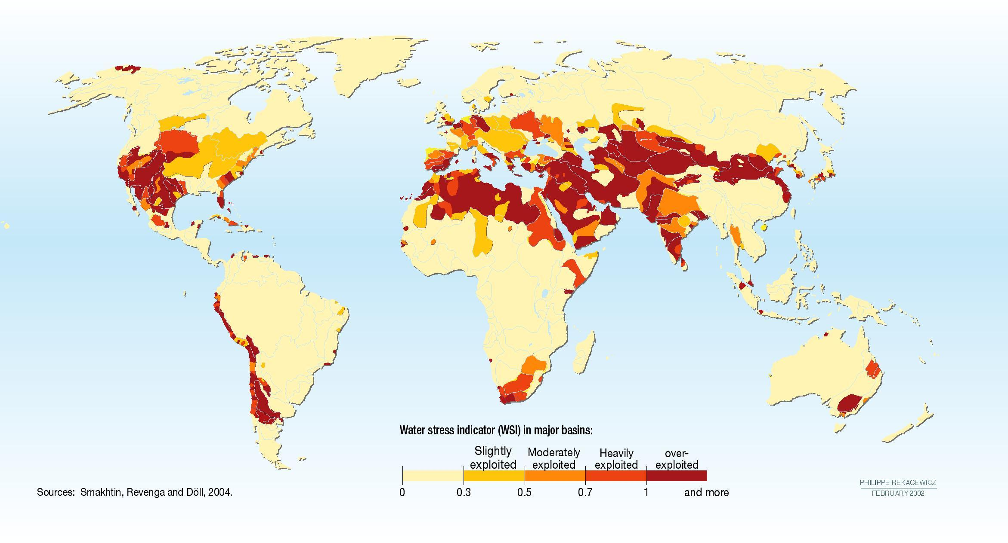
water scarcity
Notes:
Although energy usage and measurement has lately received a great deal of attention in the HCI and UbiComp communities, water has not.
And yet, the United Nations predicts that water will be the dominating issue over the next 20 years.
And, as you can tell from this map, this is a problem that affects every continent on earth including the US.
----
By 2025, more than 2.8 billion people living in 48 countries will face water shortages.
Environmental water stress is assessed as the percentage of available water resources
currently abstracted compared to environmental water requirements. Environmental water
requirements are defined as the volume of water needed by a river to maintain key ecosystem
functions and biodiversity. This is expressed as a % of the naturalised flow of a river, and can vary
under different conditions, notably between arid and non-arid river systems. In Figure 2 the red
depicts the systems under the highest environmental water stress.

Slide 3
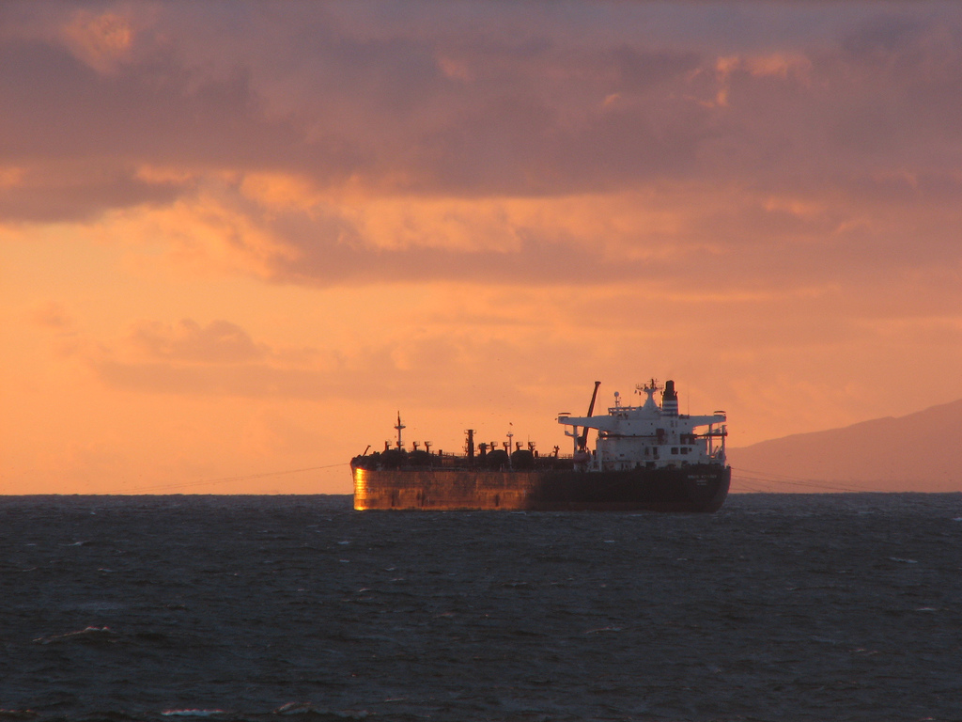
barcelona, spain
Notes:
Already, cities are going to unprecedented lengths to provide their residents with water.
For example, in April of last year, Barcelona, Spain took the unprecedented step of importing water by ship from neighboring nations at a cost of $35 million a month (Crawford, 2008).
Nearly 23m litres of drinking water - enough for 180,000 people for a day

Slide 4

lake mead, nevada
Notes:
The US is not immune from such problems either. According to US government estimates, 36 states will face serious water shortages in the next five years (EPA, 2008).
Lake Mead, which supplies 90% of Las Vegas’ water, is estimated to drop below existing intake pipes by 2012 (Lippert and Efstathiou, 2009).
The city of Las Vegas is paying people to remove their lawns at $1.50 per square foot of lawn replaced with desert-friendly plants for a maximum of $300,000 per year in rebates. (http://www.greenbiz.com/print/35667).
Many utilities invest millions of dollars into conservation programs meant to educate their customers about water and cost savings.
---

Slide 5
what are the most consuming water activities in your home?
average indoor household water usage per person/day (70 gpd)
Vickers, 2001
Notes:
Most residents have no idea how much water they use nor what the most water consuming activities are in the home.
So, ask yourself, what do you think the most water consuming activities are in your home?
Most people cannot accurately answer this question. We have been working with our local water utility, SPU…
Most customers believe they use 20 gallons a day (Al Dietemann) rather than roughly 70 and have no idea that toilets, clothes washers, and showers are the top water usage activities in the home. This is a striking disconnect considering that most of us have used modern plumbing all of our lives.
To close this gap, we have been working on new sensing techniques for water usage
---
According to a recent survey at our local water utility in Seattle, most customers believe they use 20 gallons a day (Al Dietemann) rather than roughly 70.

Slide 6
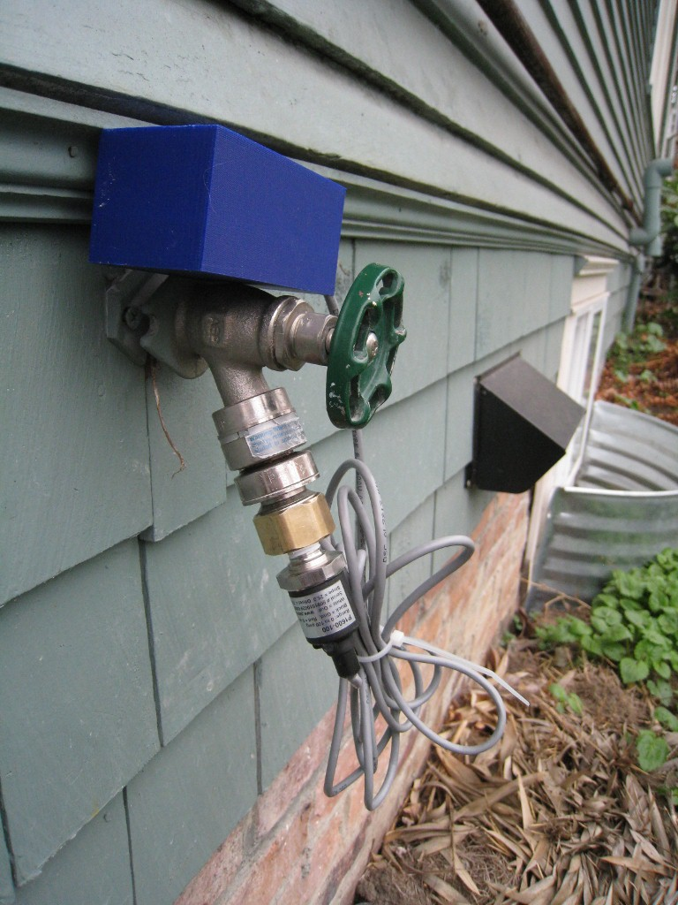
hydrosense
single-point pressure-based sensor of water usage
identifies water usage activity down to fixture level (e.g., toilet)
provides estimates of flow at each fixture
Notes:
We’ve been working on a water sensor called HydroSense, which is a pressure-based sensor capable of identifying water usage down to the individual fixture (e.g., dishwasher, toilet, faucet) and provide per-fixture flow estimates from a single sensing point

Slide 7
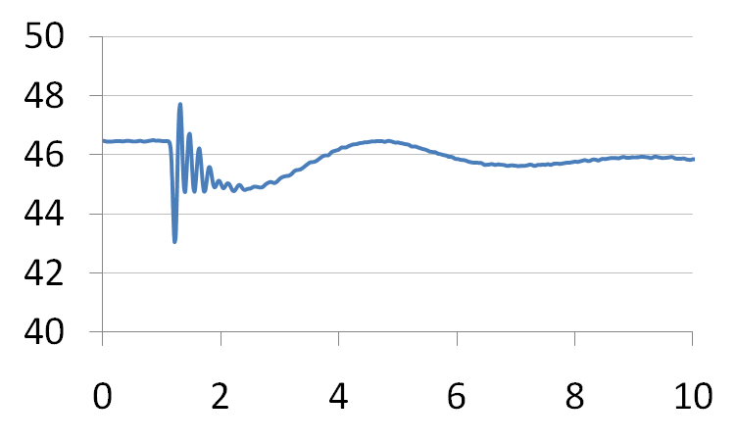
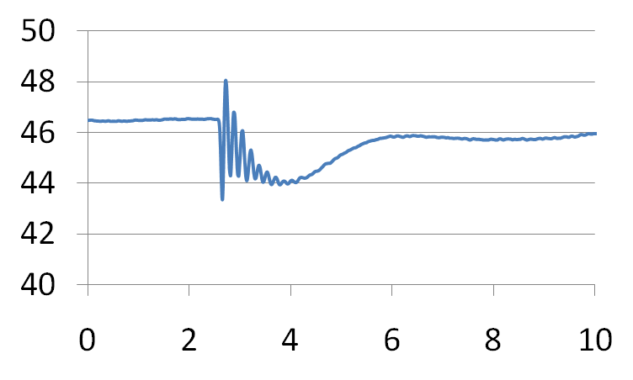
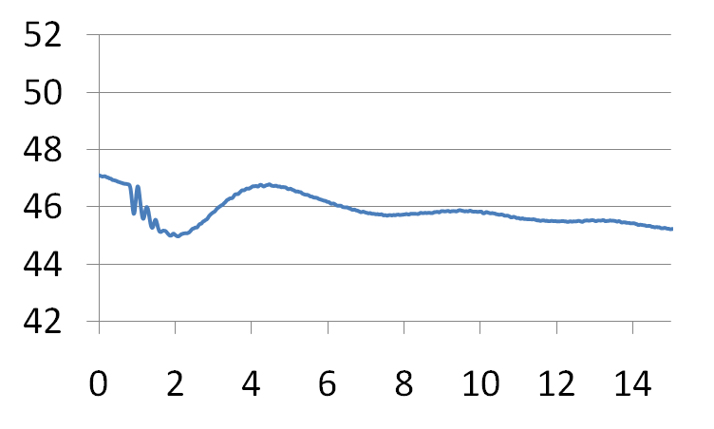
hydrosense
toilet
kitchen sink
shower
Notes:
We use the pressure sensor to continuously look at changes in pressure when you open and close valves in the home.
The key insight here is that when you use the toilet or wash your hands, a water pressure transient is generated that is unique to that particular fixture.

Slide 8
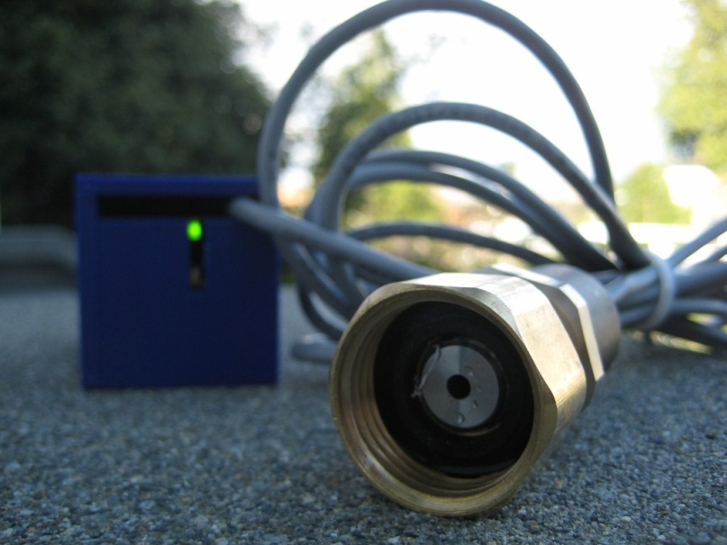
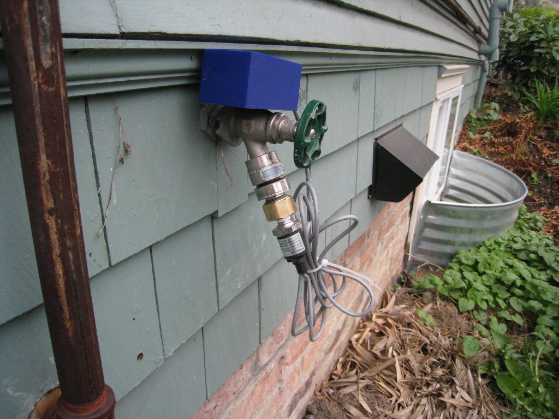
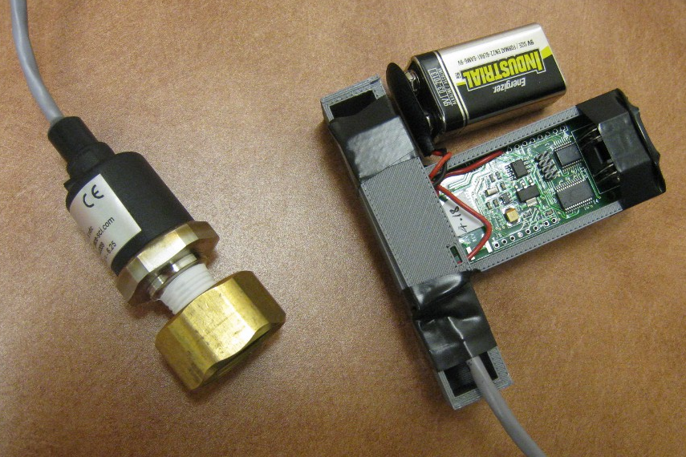
the hydrosensor prototype
Pressure Sensor
16-bit ADC
20 MHz
Microcontroller
Class 1 Bluetooth Radio
3D-Printed Enclosure
Notes:
Our prototype HydroSense sensor implementation consists of two primary parts:
a customized stainless steel pressure sensor
a 3d-printed encasement holding an analog to digital converter (ADC), a microcontroller, and a
Bluetooth wireless radio (see Figure 4), which communicates the raw pressure data to a computer.

Slide 9

brief plumbing primer
water tower
Notes:
To understand how HydroSense works, its useful to go over a brief primer of home water/pipe infrastructure.
Most households obtain water from a public water supply.
Public water is distributed by local utilities, relying on gravity and pumping stations to push water through major distribution pipes

Slide 10
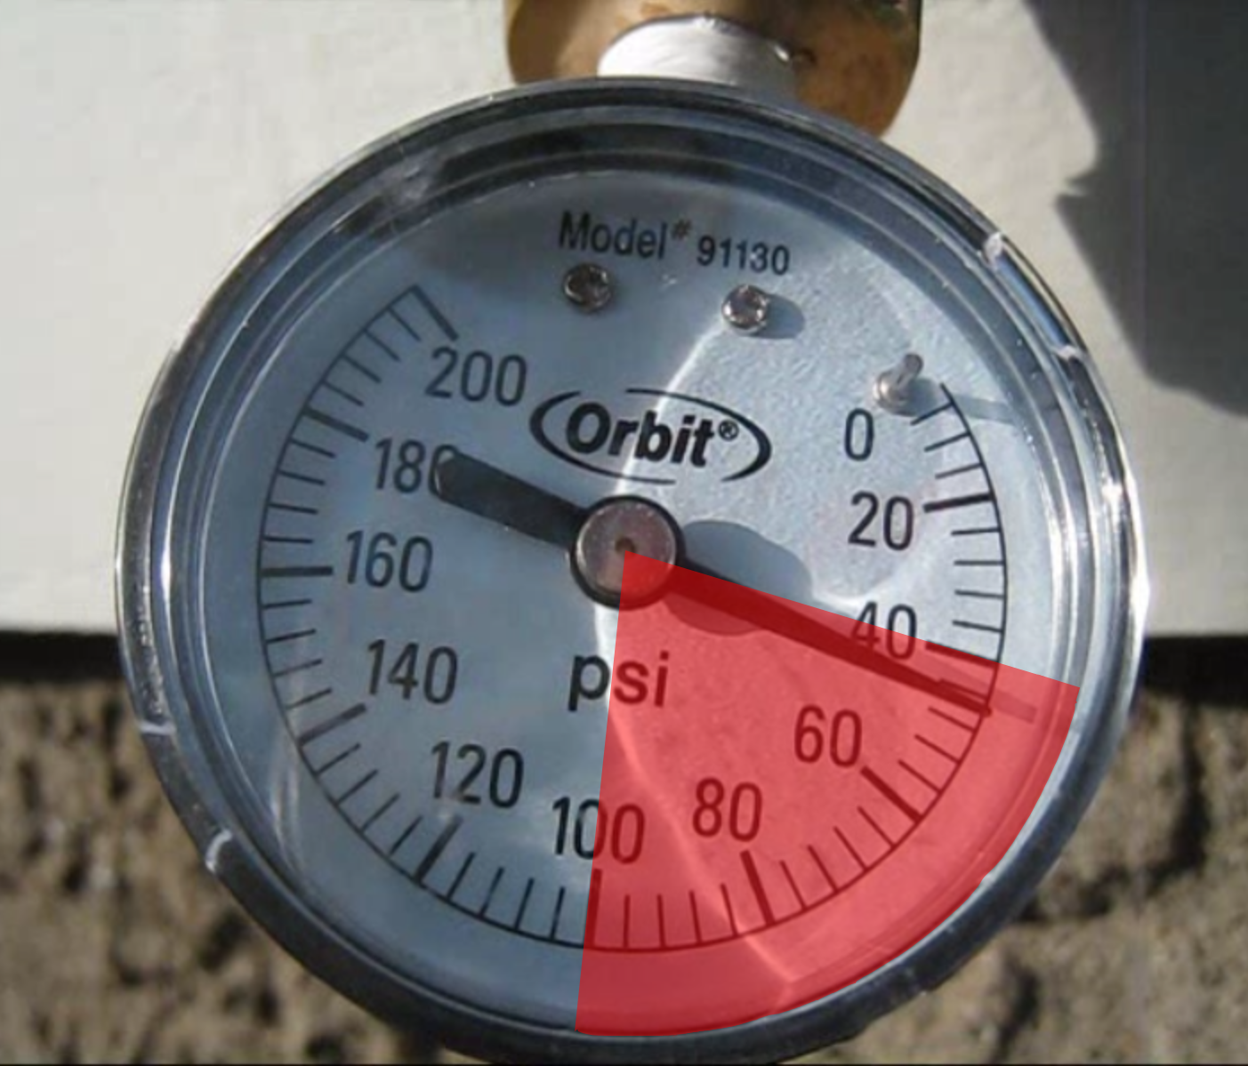
brief plumbing primer
water tower
1 psi = 6.89 kpa
incoming cold water from supply line
40 psi
100 psi
Notes:
Cold water enters the home through a service line, typically at 40-100 pounds per square inch (psi) depending on such factors as the elevation and proximity to a water tower or pumping station.
Pressure is important to the proper functioning of HydroSense because it’s a pressure-based sensing solution.
------
The pound per square inch or, more accurately, pound-force per square inch (symbol: psi or lbf/in² or lb_{f}/in²) is a unit of pressure or of stress based on avoirdupois units. It is the pressure resulting from a force of one pound-force applied to an area of one square inch:
1 psi (6.894757 kPa) : pascal (Pa) is the SI unit of pressure.
40 psi is 275.79 kilopascals
100 psi is 689.47 kilopascals

Slide 11
pipe layout
water tower
incoming cold water from supply line
pressure regulator
Notes:
Many homes have a pressure regulator that stabilizes the water pressure and also reduces the incoming water pressure to a safe level for household fixtures.
From the regulator, most homes contain a combination of series plumbed and branched piping.

Slide 12
closed pressure system
water tower
bathroom 1
hose
spigot
kitchen
thermal
expansion
tank
incoming cold water from supply line
dishwasher
pressure regulator
hot
water
heater
bathroom 2
laundry
Notes:
The cold water supply branches to the individual water fixtures (e.g., toilets/sinks/showers) and into the water heater.
The plumbing system forms a closed loop pressure system with water held at a relatively stable pressure throughout the piping.
This is why, when you open a faucet, water immediately flows out.

Slide 13
water tower
bathroom 1
hose
spigot
kitchen
thermal
expansion
tank
incoming cold water from supply line
dishwasher
pressure regulator
hot
water
heater
hot water heater drain valve
hot
water
heater
bathroom 2
laundry
Notes:
The hot water tank connects the cold water pipes to the hot water pipes.
So when you open a hot or cold water valve, the pressure signal is transmitted through the hot water heater thus allowing for a single-point pressure sensing solution.
Every hot water tank has a drain valve, which is of interest to us because it provides an easy potential installation point for our hydrosensor, particularly for locations like apartments which don’t have outdoor hose bibs.

Slide 14
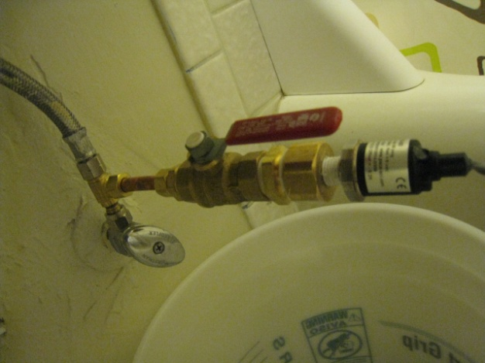
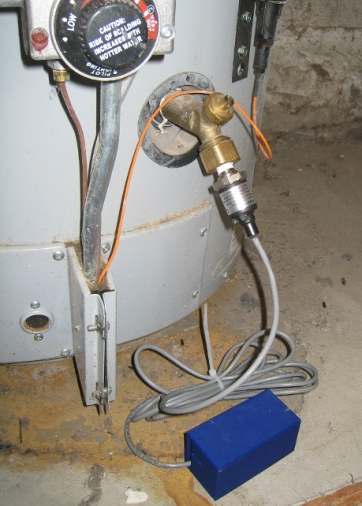
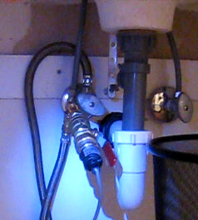
some possible installation points
water tower
bathroom 1
hose
spigot
kitchen
thermal
expansion
tank
incoming cold water from supply line
dishwasher
pressure regulator
hot
water
heater
bathroom 2
laundry
Notes:
We have investigated placing HydroSense at a variety of installation points including the drain valve on the hot water heater, the outdoor hose spigot and the 3/8” hot and cold water inlet lines to bathroom and kitchen sinks.
Note: remember this is a single point sensing solution; I’m just showing single installation points that we’ve investigated.

Slide 15
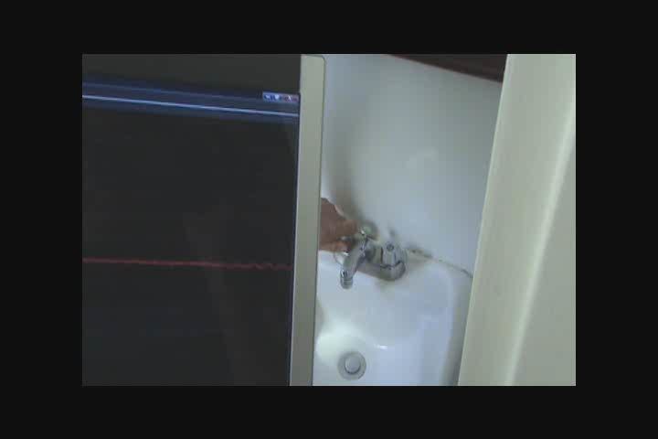
Notes:
So, now let’s see what the raw pressure waveform looks like when you use a fixture in your house. (click)
Take particular notice to the pressure spike (or transient) that occurs when the valve is opened and closed.
Note that the signal resembles a dampening sinusoidal wave—we take advantage of this in our classification algorithms.

Slide 16
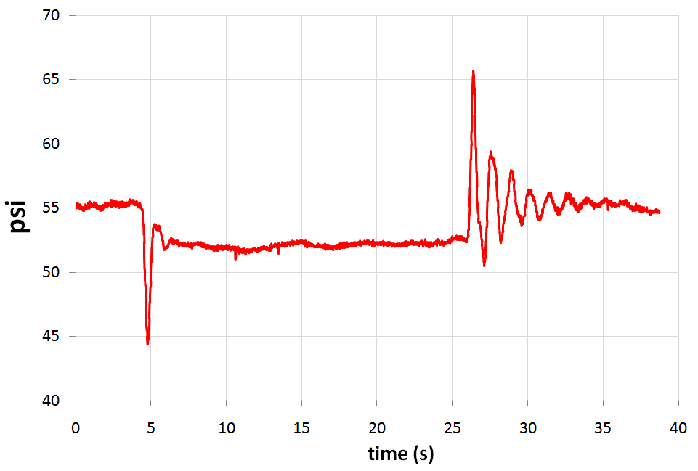
raw bathroom sink signal
open
valve
close
valve
stabilized
pressure drop
time (t)
Notes:
The instant a valve is opened or closed (be it a bathroom faucet or a mechanical valve in a dishwasher), a pressure change occurs and a pressure wave is generated in the home plumbing system.
The transient can have a positive or negative rate of change depending on whether a valve is being opened or closed.
The pressure drop is indicative of how much water is being used.

Slide 17
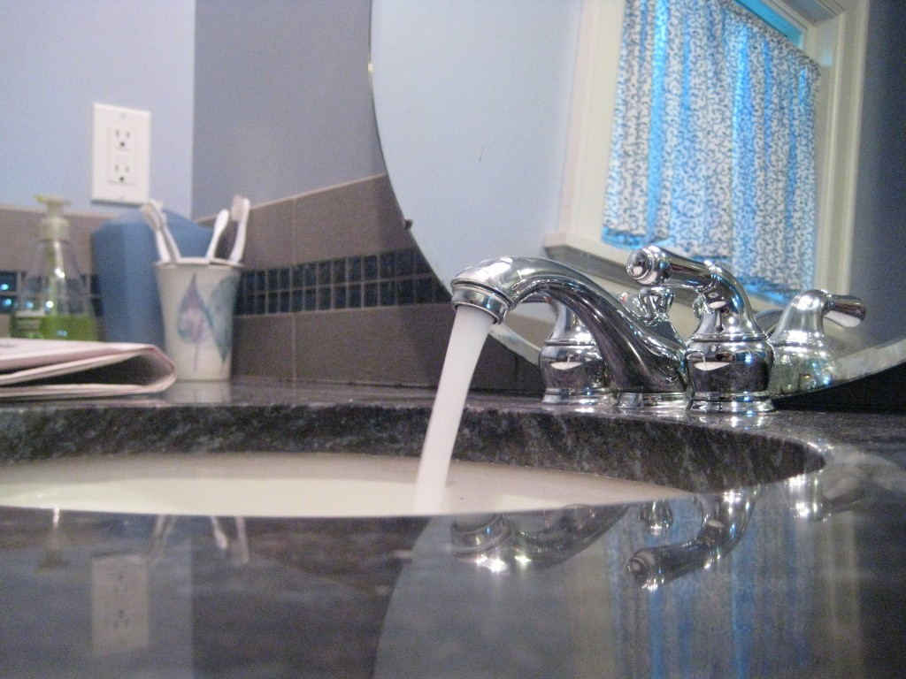
detecting water usage events
1. detect a water event
2. classify event as “open” or “close”
3. determine source of event (e.g., toilet, kitchen sink).
4. provide flow estimate
Notes:
So, how does this work exactly?

Slide 18
event detection
raw pressure (psi)
time (s)
smoothed pressure
derivative
Notes:
The raw pressure signal is smoothed using a low-pass filter. We then take the derivative of this smoothed signal to check for rapid changes in pressure (i.e., pressure transients).
These rapid changes in pressure (or pressure transients) are what indicate water usage.
----
The low pass filter is a low-pass linear phase finite impulse response filter.
The smoothed signal is the 1 Hz envelope of the signal, calculated using a discrete prolate spheroidal window filter of length 1 second.
The bandpass derivative has a cutoff of 1Hz and a linearly increasing frequency response, it is also 1 second long.
These parameters were chosen based on the bandwidth with the highest energy concentration for all the data we collected in all homes.

Slide 19
event detection
raw pressure (psi)
time (s)
smoothed pressure
derivative
critical change in pressure
!
time(s)
Notes:
So, let’s see how this works in practice.
As we run a 1 sec sliding window over the data, we flag the signal when the derivative exceeds a specified threshold relative to the home’s static pressure

Slide 20
event detection
raw pressure (psi)
time (s)
smoothed pressure
critical stabilization point
derivative
!
!
time(s)
Notes:
Then, we look for when the “amplitude” of the derivative goes below 5% of the original magnitude

Slide 21
event detection
automatically detected event
valve open event
raw pressure (psi)
time (s)
smoothed pressure
pressure decrease
and
negative initial
derivative
derivative
!
= valve open event
!
time(s)
Notes:
The direction of stabilized pressure change and the sign of derivative determines whether the event is an open or close event.
In this case, it’s a valve open event.

Slide 22
event detection
valve open event
raw pressure (psi)
smoothed pressure
!
derivative
!
time(s)
Notes:
Similarly, for a close event, we use the same process looking for the two critical points.

Slide 23
event detection
valve open event
raw pressure (psi)
automatically detected event
smoothed pressure
pressure increase
= valve close event
and
positive initial derivative
!
derivative
!
time(s)
Notes:
The difference here is that we have a pressure increase and a positive initial derivative.

Slide 24
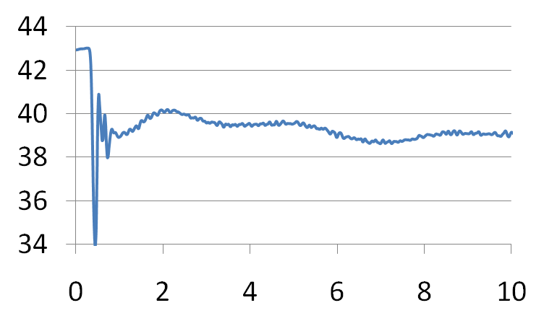
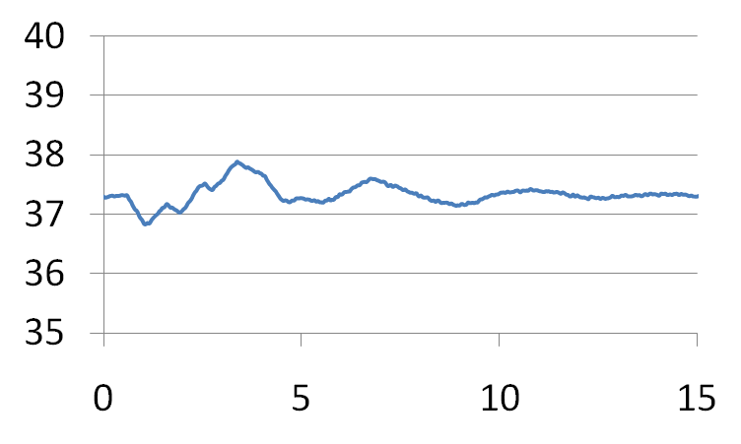
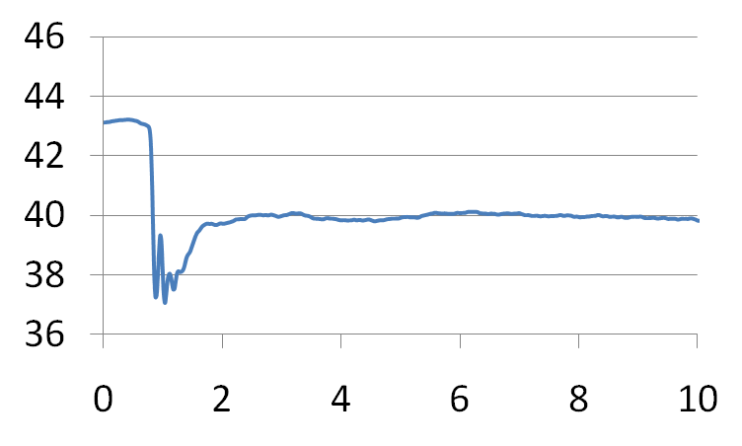
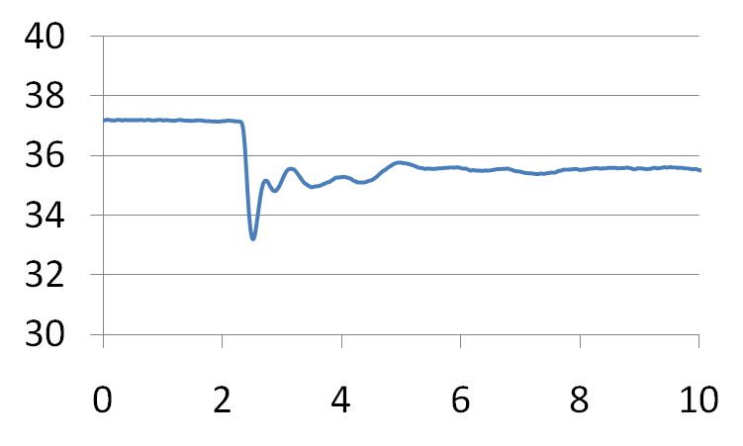
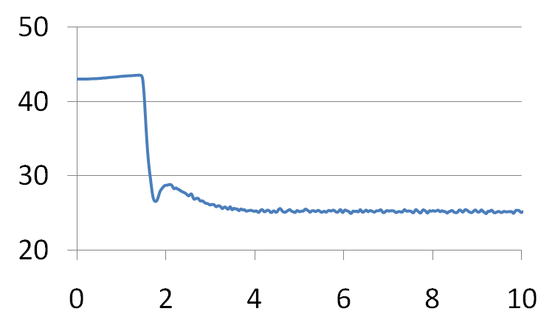
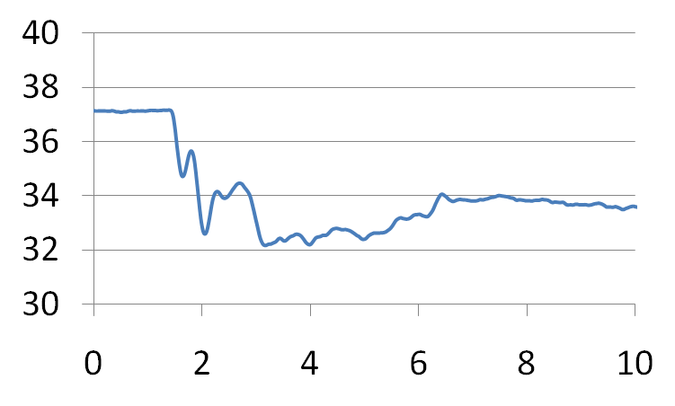
example open events
home 1
home 2
home 3
toilet
signature dependent on:
  fixture type
  valve type
  valve location in home
faucet
shower
Notes:
As you might imagine, the pressure signatures differ across fixture and valve types. However, the valve’s location in the home is also a strong determinant in shaping the signal. (click)
As a result we haven’t seen a lot of cross-home similarity between fixture event signals.
From this point forward, the vertical-axis will always refer to psi and the horizontal-axis will refer to time in seconds
----
First, note that the transients are unique across fixtures. (click)
---
Now, I’m showing data from three different homes. Note how the signals differ for like fixtures across homes; this is because the signal is influenced both by the valve type as well as the pipe pathway to the valve.
Therefore, while detection and distinguishing between open and close can be done with a drop-in system in any home, actual fixture classification and flow must be calibrated on a per home basis.

Slide 25
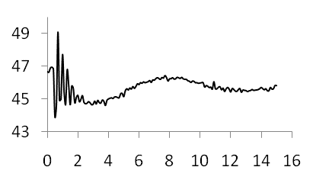
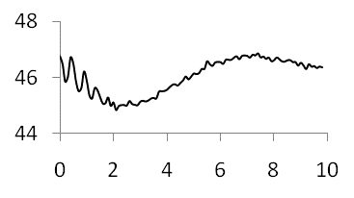
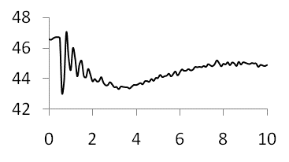
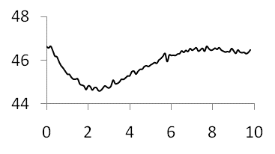
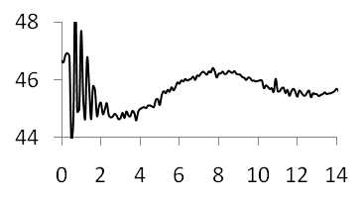
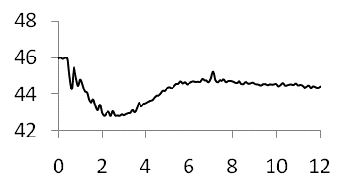
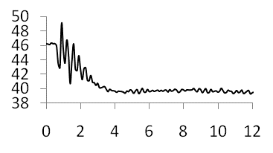
fixture classification
unclassified open event
open event library
shower
toilet
dishwasher
kitchen faucet
bath faucet
bath tub
Notes:
Now that we’ve automatically detected events and classified them as open or close, we need to determine where the events came from.
To do this we use a template matching approach and, in particular, we rely on matched filtering to compare our signals, which provides a measure of correlation between signals.

Slide 26
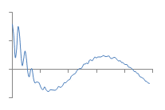
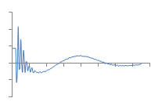
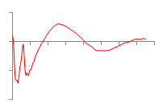
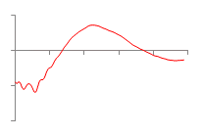
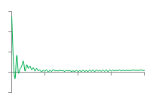
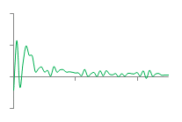
unclassified open event
open event library
shower
toilet
dishwasher
kitchen faucet
bath faucet
bath tub
detrended_{unclassified}
detrended_{shower}
derivative_{unclassified}
derivative_{shower}
cepstrum_{unclassified}
cepstrum_{shower}
Notes:
We chose three transformations in which to use the matched filter. (click)
1. The first transformation is the waveform with trending removed
2. The second transformation is the derivative waveform that we used in the open/close event detection step.
3. The final transformation is the cepstrum transformation, which is popular in the signal processing community and often used to separate a filter from its source.
---
The last space we chose was the Cepstral space. The real cepstrum is a transformation related to the Fourier transform and has been used in the speech recognition community for decades. It’s popular in the signal processing community to separate source from filter.
One property of the real cepstrum is that the space is highly orthogonal and thus is good fit for our application.

Slide 27

unclassified open event
open event library
shower
toilet
dishwasher
kitchen faucet
bath faucet
bath tub
test similarity
detrended_{unclassified}
detrended_{shower}
matched filter
derivative_{unclassified}
derivative_{shower}
possible events
matched filter
cepstrum_{unclassified}
cepstrum_{shower}
matched filter
Notes:
To test for similarity, we look at the transformations for each saved event in the library.
If the similarity is above a certain threshold in each subspace, we add the event to a list of possible events. The thresholds are learned using a leave one out cross validation of all other homes in our database.
--
We also use the mean squared error of the de-trended signal. If the MSE is above a cross validation threshold, it passes the similarity test.

Slide 28
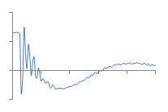
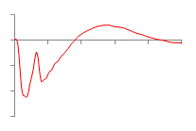
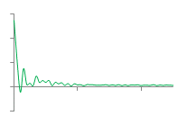
unclassified open event
open event library
toilet
dishwasher
kitchen faucet
bath faucet
bath tub
detrended_{unclassified}
detrended_{toilet}
derivative_{unclassified}
derivative_{toilet}
possible events
cepstrum_{unclassified}
cepstrum_{toilet}
Notes:
We repeat this process for every event in our library…

Slide 29

unclassified open event
open event library
toilet
dishwasher
kitchen faucet
bath faucet
bath tub
detrended_{unclassified}
detrended_{toilet}
matched filter
derivative_{unclassified}
derivative_{toilet}
possible events
matched filter
cepstrum_{unclassified}
cepstrum_{toilet}
matched filter
Notes:
Here a toilet subspace fails a similarity test and thus it is discarded from the pool of possible events.

Slide 30

unclassified open event
open event library
dishwasher
kitchen faucet
bath faucet
bath tub
detrended_{unclassified}
derivative_{unclassified}
possible events
cepstrum_{unclassified}
Notes:
this occurs for each event in the library.

Slide 31
unclassified open event
open event library
shower
detrended_{unclassified}
dishwasher
derivative_{unclassified}
possible events
kitchen faucet
cepstrum_{unclassified}
Notes:
If more than one possible event is in our possible event pool, we perform one additional comparison.

Slide 32
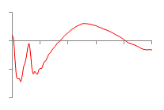
unclassified open event
open event library
derivative_{shower}
shower
shower
dishwasher
detrended_{unclassified}
derivative_{toilet}
dishwasher
derivative_{unclassified}
possible events
kitchen faucet
kitchen faucet
derivative_{kitchen} _{faucet}
cepstrum_{unclassified}
Notes:
on the derivative waveform, which is the most orthogonal subspace.

Slide 33
unclassified open event
open event library
derivative_{shower}
shower
derivative_{toilet}
dishwasher
nearest neighbor match
derivative_{unclassified}
possible events
kitchen faucet
derivative_{kitchen} _{faucet}
Notes:
We perform a nearest neighbor search on all remaining possible events using the matched filter similarity score in the derivative space.
Once the event is identified, we can assign flow, in gpm, using a calibrated fluid resistance value for the specific valve.

Slide 34
raw bathroom sink signal
open
close
this is ∆P
stabilized
pressure drop
time (t)
Notes:
To estimate flow, we turn back to our example waveform and look at the stabilized pressure drop—this is delta P.

Slide 35
using ∆pressure to estimate flow
∆P = change in pressure
L = length of pipe
r = radius of pipe
μ = viscosity of liquid
Q = volumetric flow rate
pipe
r
L
poiseuille’s law:
fluid resistance formula:
Notes:
Flow rate is related to pressure change via Poiseuille’s Law, which states that the volumetric flow rate of fluid in a pipe
Q is dependent on the radius of the pipe r, the length of the pipe L, the viscosity of the fluid μ and the pressure drop ΔP.
This can be simplified using the fluid resistance formulation, which states that the resistance of flow is proportional to the drop in pressure divided by the volumetric flow rate.
(click)
Simple substitution leads to: flow rate = change in pressure / fluid resistance

Slide 36
using ∆pressure to estimate flow
∆P = change in pressure
L = length of pipe
r = radius of pipe
μ = viscosity of liquid
Q = volumetric flow rate
pipe
r
L
Notes:
So, we know the change in pressure because that’s what HydroSense measures but we want to know flow rate. To do that, we have to find values for the fluid resistance, which differ according to fixture and fixture location.
---
This is analogous to ohms law, which relates voltage, resistance, and current.
HydroSense measures the change in pressure ΔP. However, in order to estimate flow rate we must know Rf.

Slide 37
acquiring R_{f}
water tower
bathroom 1
hose
spigot
kitchen
thermal
expansion
tank
incoming cold water from supply line
dishwasher
pressure regulator
hot
water
heater
bathroom 2
laundry
Notes:
One way to do this would be to measure Rf at every valve in the home and save this in a dictionary. Then, the fixture classification algorithms would look up this value and solve for Q.
---
To acquire Rf, one could measure the flow rate (Q) at each individual valve as well as the corresponding pressure change (∆P) at the hydrosense installation location. The division of these two values results in Rf.
We can then use the learned Rf values for each valve to estimate flow during an automatically detected water usage event.

Slide 38
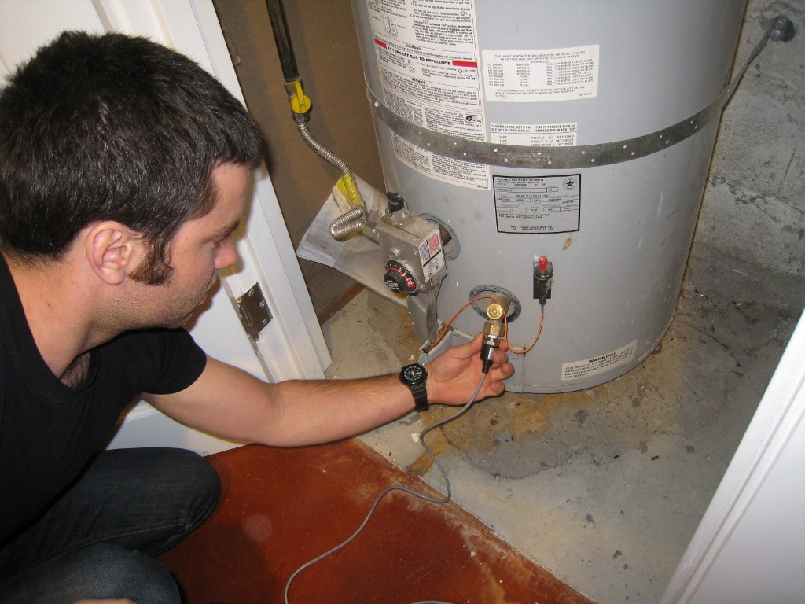
in-home data collection
Notes:
Now, I will go over our in-home data collection and experimental validation.

Slide 39
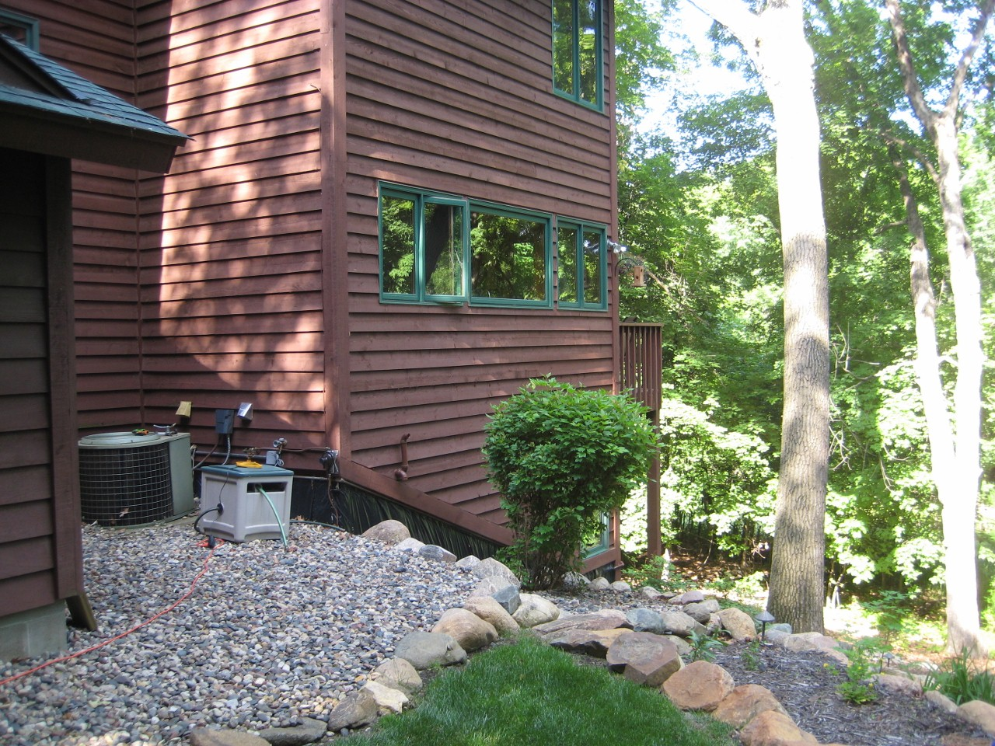
home profiles
ten locations
- 8 houses
- 1 apt / 1 cabin
size
- avg: 2,300 sq ft
- min: 750 sq ft
- max: 4,000 sq ft
install point:
- 8 hose bib
- 1 water heater
- 1 utility faucet
Notes:
We installed HydroSense in a variety of locations: 8 houses, 1 apartment, and 1 cabin with a range in size from 750 sq feet to 4,000 sq ft.
We also used three different installation points: 8 hose bib, 1 water heater, and 1 utility faucet connection.

Slide 40
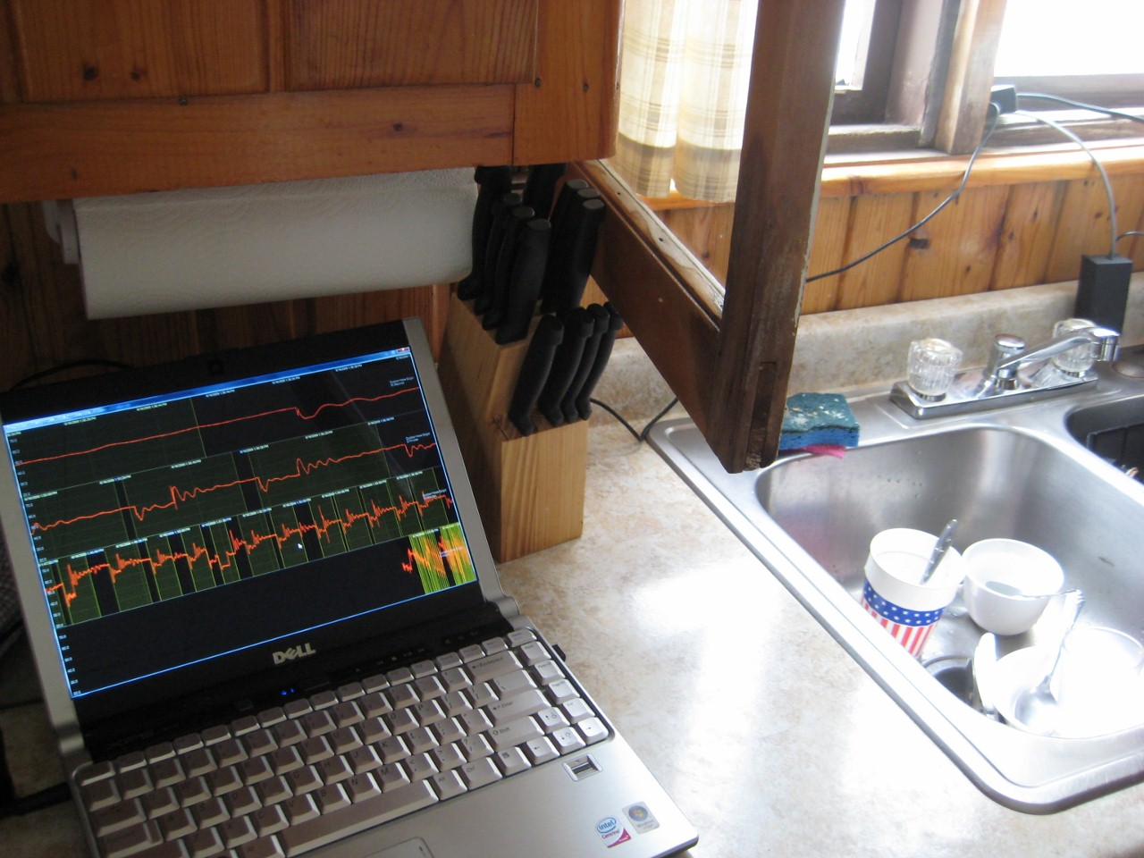
experimental protocol
controlled experiments
  2 researchers per site
5 trials per valve
  e.g., 5 cold / 5 hot for bathroom sink
for each trial, valve open for 5 seconds, then closed
Notes:
Each collection session was conducted by a pair of researchers: one would record the sensed pressure signatures to a laptop while the other activated the home’s water fixtures.
We recorded five trials per valve. A sink, for example, has two valves (one hot, and one cold) and thus would receive 10 trials—5 for hot and 5 for cold.
For each trial, the valve was open for ~5 seconds and then closed.

Slide 41
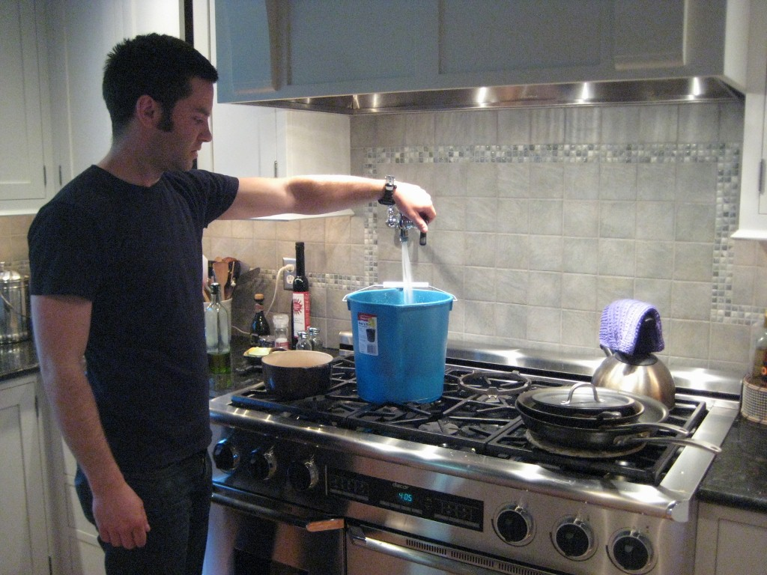
collecting flow data
4 / 10 homes gathered flow data
measure time to fill 1 gallon in a calibrated bucket
this provides Q, allowing us to solve for R_{f}
  R_{f} = ∆P / Q
Notes:
For 4 of the 10 homes we also gathered flow data. For the faucet and shower trials, we measured the time it took to fill 1 gallon of water into a calibrated bucket.
This provides Q (the flow rate) and allows us to solve for the fluid resistance at that valve and pipe pathway.

Slide 42
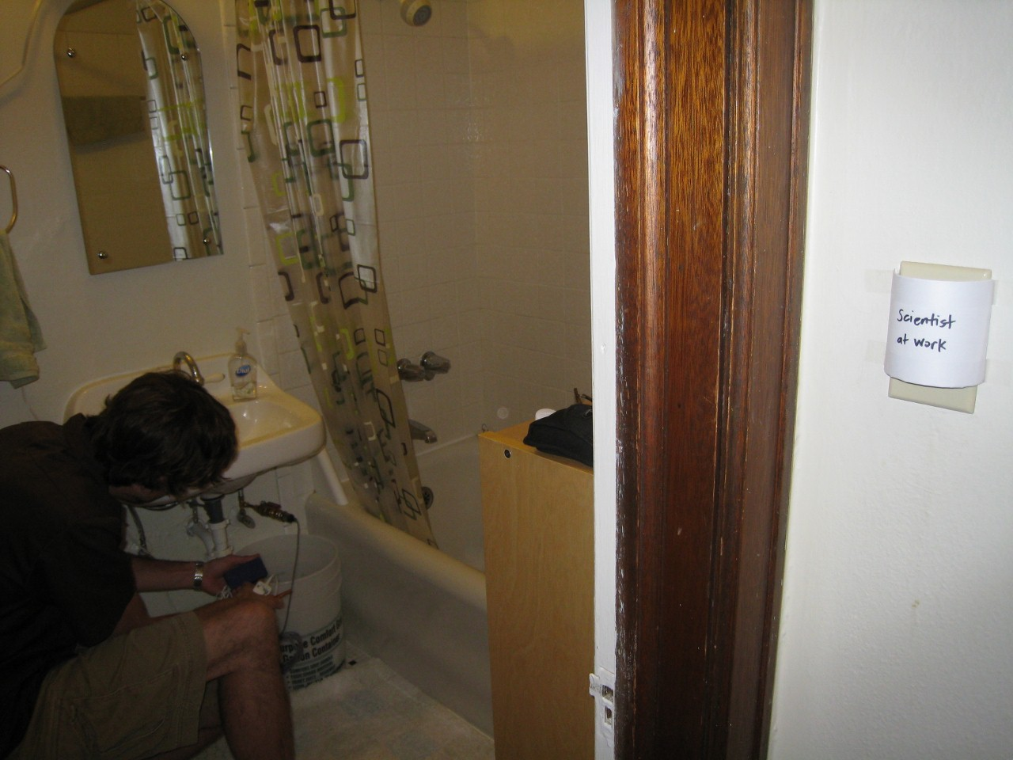
data collection stats
ten locations
706 trials
155 flow rate trials
84 total fixtures tested
Notes:
In all, we conducted experiments in 10 locations resulting in 706 trials with 155 flow rate trials and 84 total fixtures tested.

Slide 43
classification results across homes
cross validation experiment
learn similarity thresholds from test data
classify each event per home using a leave-one out method
Notes:
We conducted a cross-validation experiment that folds our data according to the home in which it was collected.
We learn the thresholds for a single home from the other nine homes in the database.
Then, we use those thresholds to build the possible events library for each "unknown" event in the database. We classify each “unknown” event in the test home using a leave-one-out method.

Slide 44
fixture classification results across homes
Notes:
This figure shows the accuracy of fixture-level identification of valve open and valve close events within each home as well as the aggregate 97.9% accuracy of fixture-level classification.
Many homes resulted in 100% open and close fixture classification.
The worst performing house, H10, was due to noise from the eleven cabins that share the same supply line at the resort.

Slide 45
fixture classification results across homes
97.9%
Notes:
This figure shows the accuracy of fixture-level identification of valve open and valve close events within each home as well as the aggregate 97.9% accuracy of fixture-level classification.
Many homes resulted in 100% open and close fixture classification.
The worst performing house, H10, was due to noise from the eleven cabins that share the same supply line at the resort.

Slide 46
fixture classification results across fixtures
Notes:
This graph shows the same data as before but categorized by fixture. Again, nearly all fixtures are above 95% or better.
Here, the worst performer is the hot water valve in showers at 89%--although this is still pretty good, we’re not sure why this is and it warrants further investigation.

Slide 47
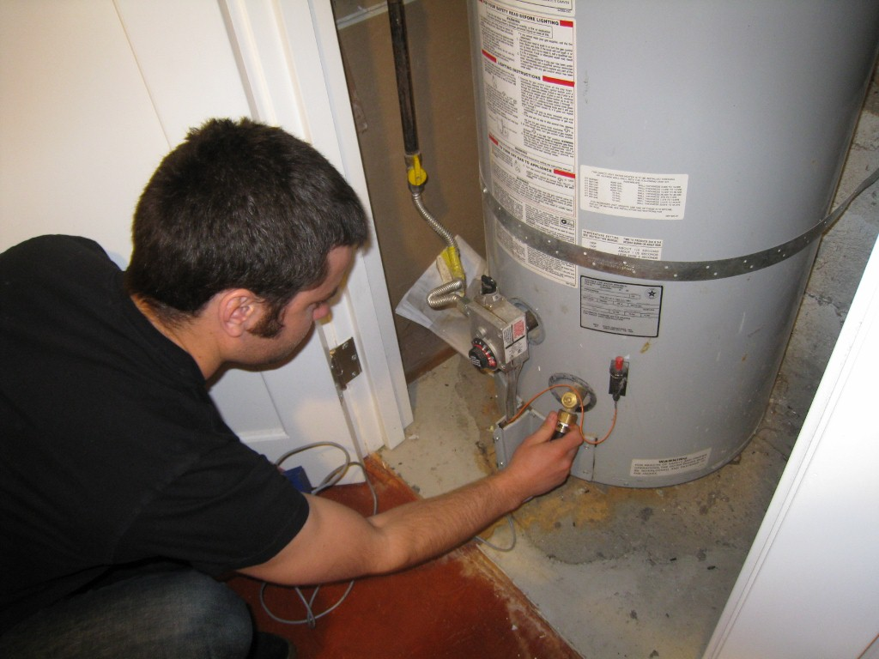
flow estimation results
Home | Avg Error (GPM) | Stdev Error (GPM) | Avg Error (%) | Stdev Error (%)
H1 (7 valves) | 0.17 | 0.13 | 7.3 | 6.7
H4 (6 valves) | 0.19 | 0.17 | 5.6 | 5.3
H5 (8 valves) | 0.13 | 0.11 | 4.5 | 5.5
H7 (8 valves) | 0.67 | 1.47 | 22.2 | 46.0
Notes:
For our flow estimate results, three of four houses tested (H1, H4, H5) have error rates below 8% (or approximately 0.16 GPM**), comparable to 10% error rates found in empirical studies of traditional utility-supplied water meters [1]. (click)
The fourth house (H7), however, had an error rate above 20%. We believe this is
due to the installation location of the sensor. Whereas the first three homes had HydroSense installed on an exterior water bib, H7’s installation used the hot water heater drain valve.
This results in two confounding pressure sources (the supply water main and the gravitational pressure of the water in the tank). It seems the cold water valves were particularly affected.

Slide 48
flow estimation results
Home | Avg Error (GPM) | Stdev Error (GPM) | Avg Error (%) | Stdev Error (%)
H1 (7 valves) | 0.17 | 0.13 | 7.3 | 6.7
H4 (6 valves) | 0.19 | 0.17 | 5.6 | 5.3
H5 (8 valves) | 0.13 | 0.11 | 4.5 | 5.5
H7 (4 valves) | 0.15 | 0.18 | 4.5 | 3.8
Notes:
When the cold water valves are removed, H7 flow estimation results are on par with the other homes.

Slide 49
acquiring R_{f}
water tower
bathroom 1
hose
spigot
kitchen
thermal
expansion
tank
incoming cold water from supply line
dishwasher
pressure regulator
hot
water
heater
bathroom 2
laundry

Slide 50
acquiring R_{f}
water tower
bathroom 1
hose
spigot
kitchen
thermal
expansion
tank
incoming cold water from supply line
dishwasher
pressure regulator
hot
water
heater
bathroom 2
laundry
Notes:
The previous results assumed that we had measured Rf values for every fixture but one can also obtain approximate estimates of Rf by sampling at only certain strategic valves around the home and then using this Rf value for proximal valves.

Slide 51
flow estimation using interpolated R_{f}
After 5 R_{f} samples, average error is 0.27 GPM
Notes:
Here we have flow data using interpolated Rf. The Y-Axis is the average error in GPM and the x-axis is the number of random Rf samples needed to obtain those error values.
As you can see, after randomly selecting five Rf values, the average error dropped 74% to 0.27 GPM.

Slide 52
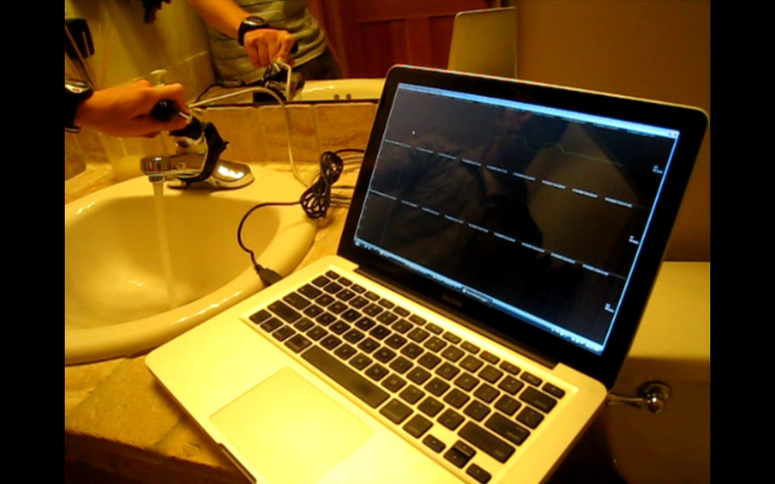
future work: hydrosense 2.0
Notes:
We have been working lately on a 2.0 version of HydroSense, which is focused primarily on naturalistic water usage.

Slide 53
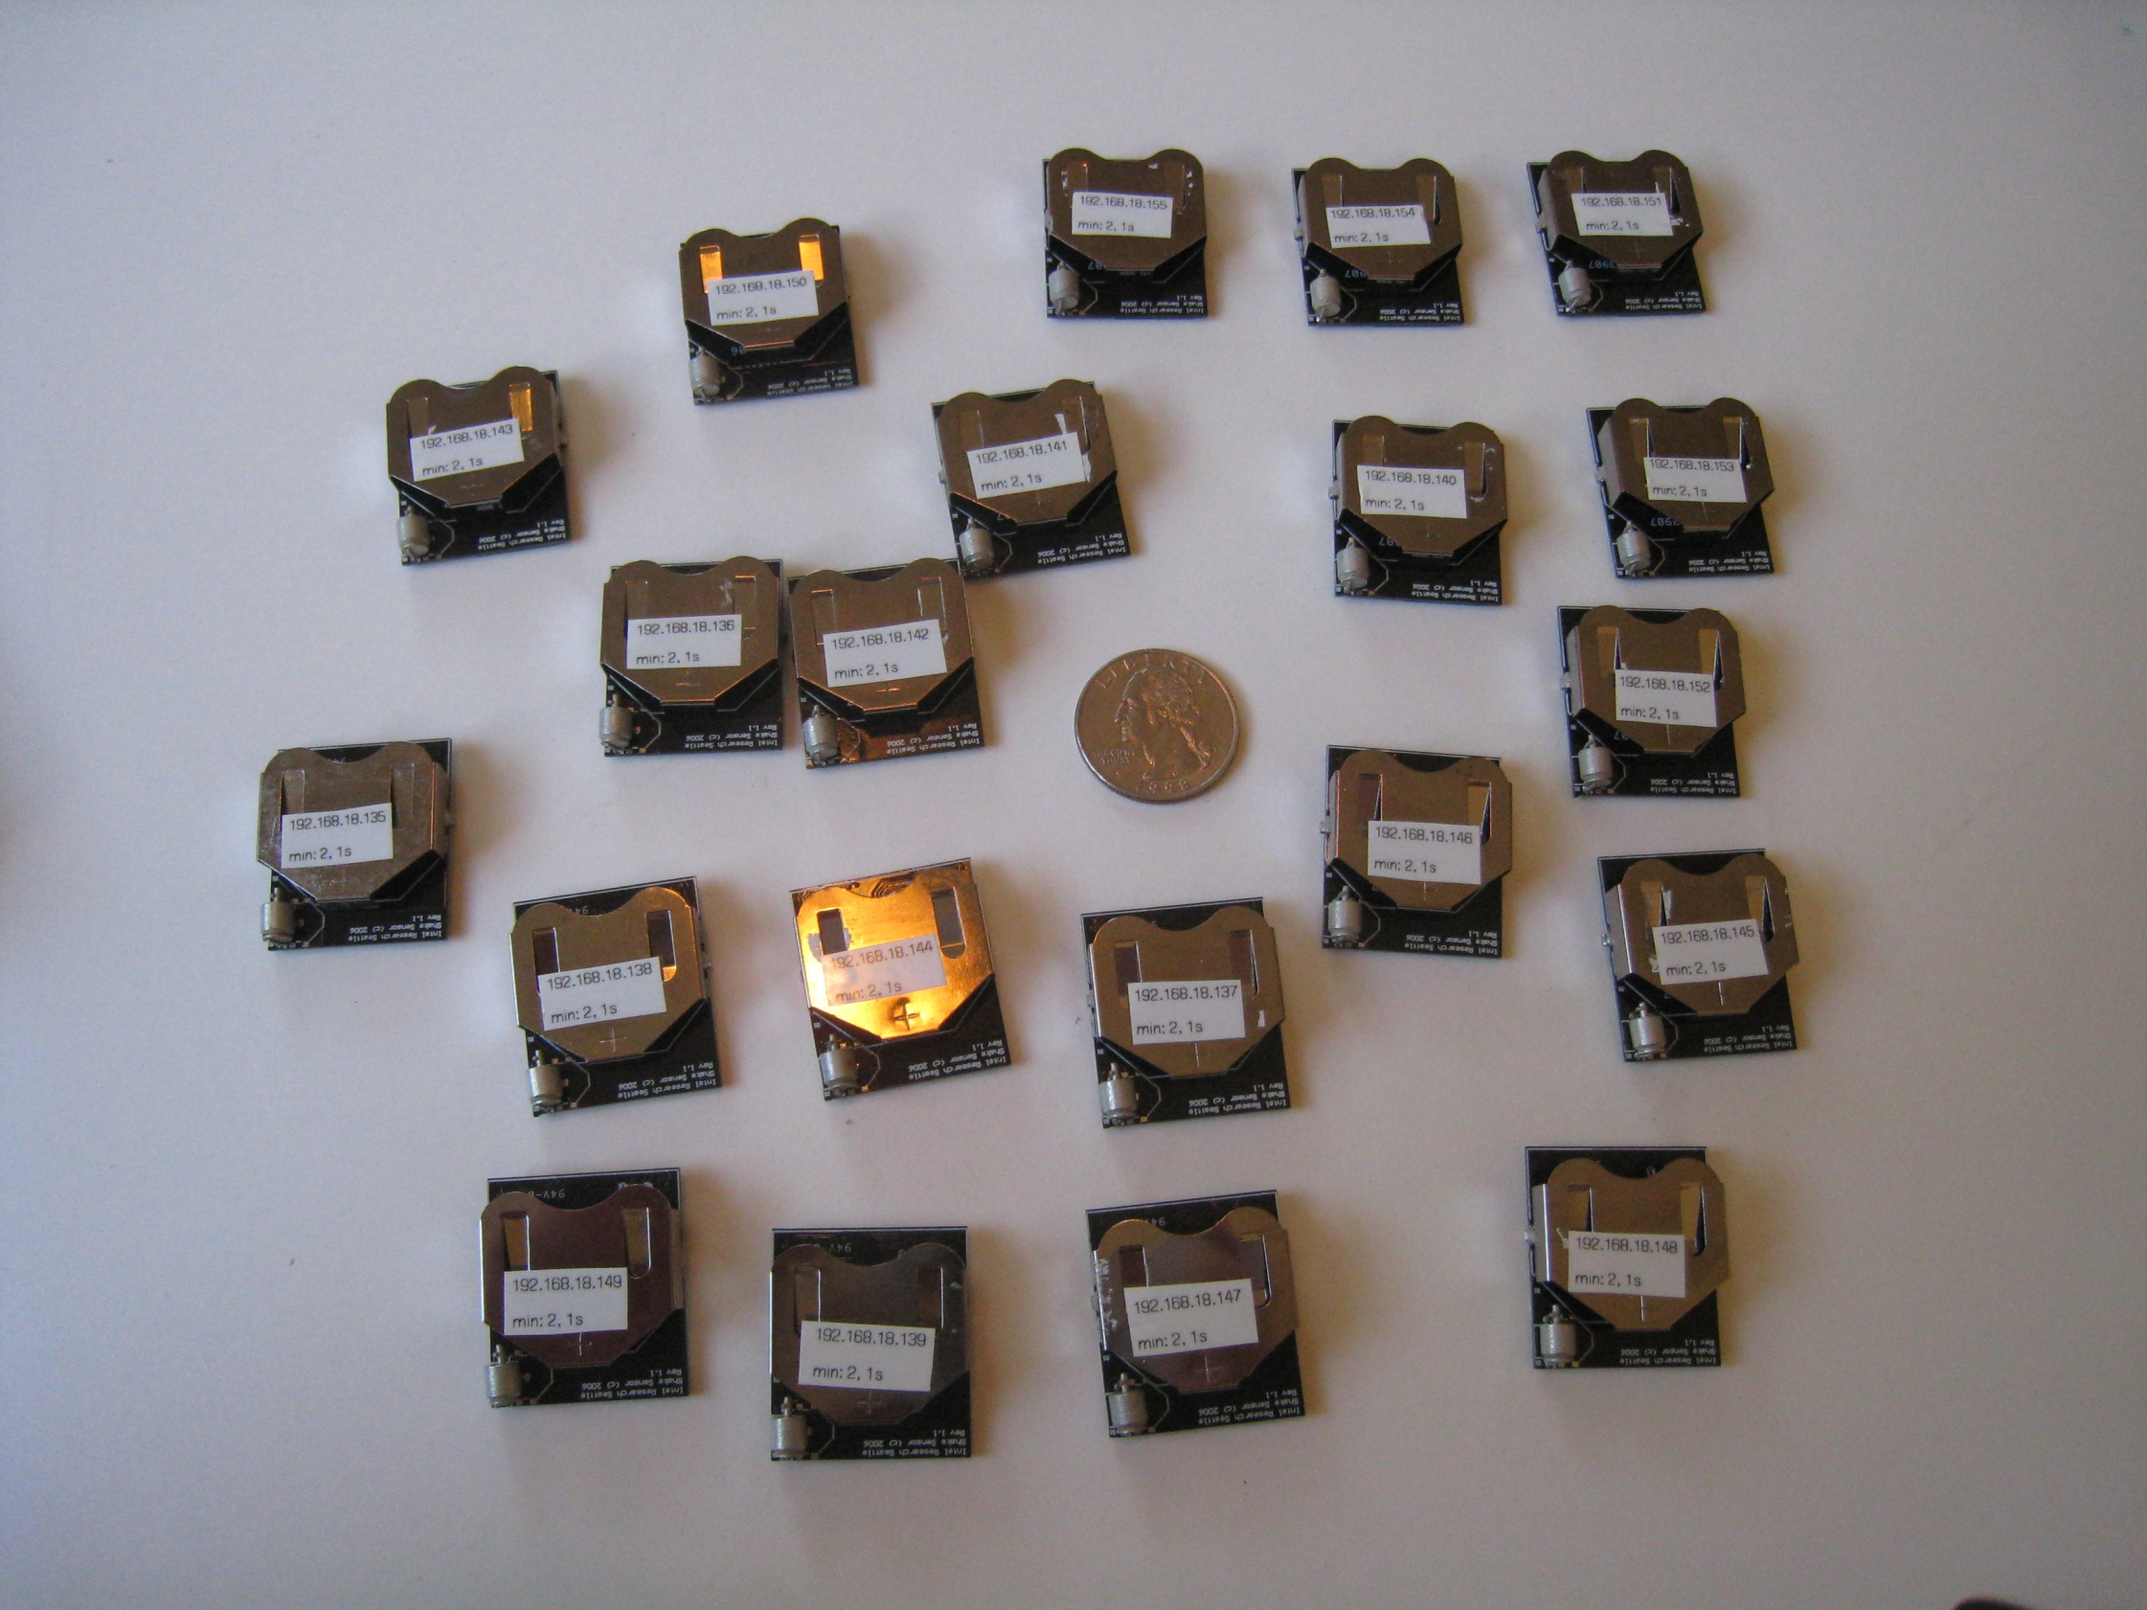
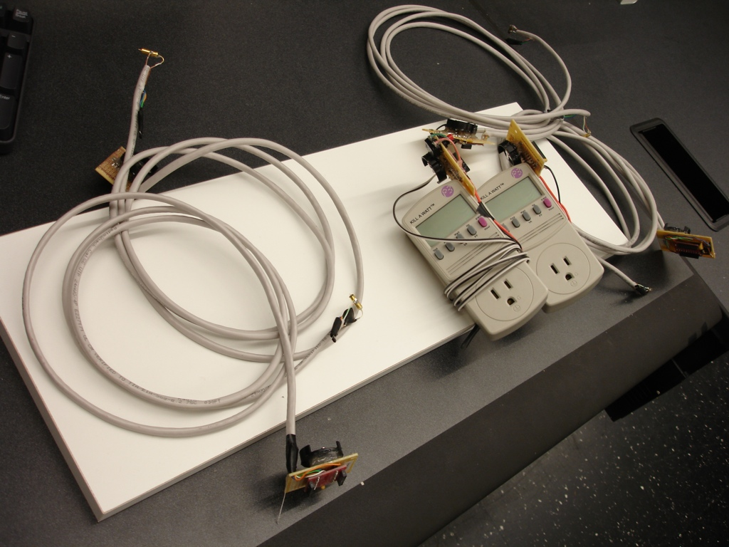
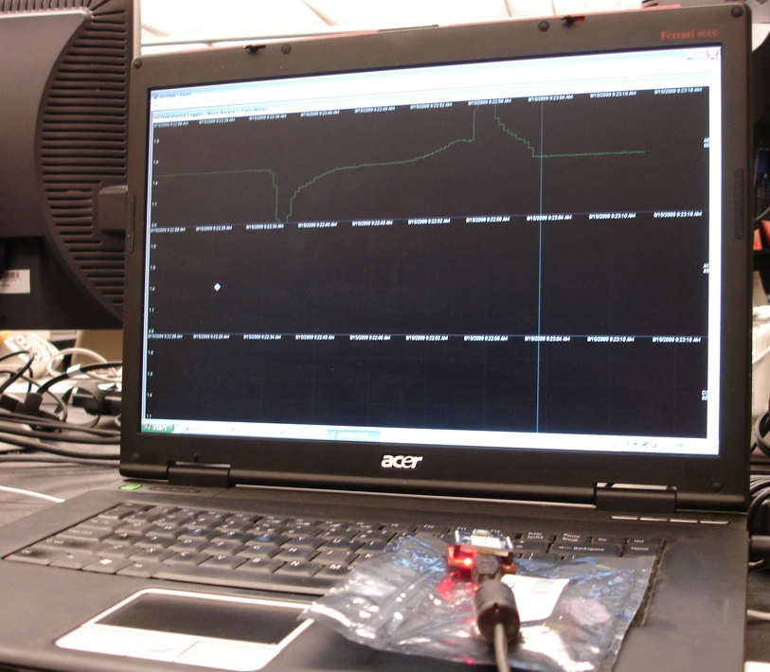
longitudinal data collection
Notes:
To do this, we’ve built a range of small, lightweight sensors to distribute around the home to collect ground truth data on water fixture usage.

Slide 54
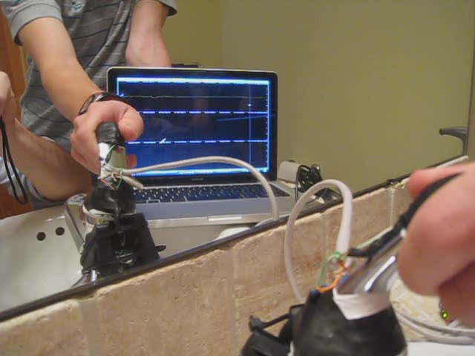

Slide 55



water feedback interfaces

Slide 56






Jon Froehlich
Eric Larson
Tim Campbell
Conor Haggerty
James Fogarty
Shwetak Patel

Slide 57
thank you
Infrastructure-Mediated Single-Point Sensing of Whole-Home Water Activity
Jon Froehlich¹, Eric Larson², Tim Campbell³, Conor Haggerty⁴, James Fogarty¹, Shwetak N. Patel^{1,2}
¹Computer Science & Engineering, ²Electrical Engineering,
³Mechanical Engineering, ⁴Community, Environment, and Planning
jonfroehlich@gmail.com
http://sustain.cs.washington.edu/blog
design:
use:
computer science
and engineering
build:
univ. of washington
Notes:
Infrastructure-Mediated Single-Point Sensing of Whole-Home Water Activity

Slide 58




Slide 59


Slide 60

flow estimation
Notes:
if time, go over slide

Slide 61


typical water meters
only provide aggregate information on water usage
require pipe modification for installation
traditional inline
water meter
Notes:
Typical water meters only provide aggregate information on water usage and require costly pipe modifications to install. (click)
In constrast, the HydroSensor can simply screws on to a hose water bib.

Slide 62



matched filtering
save maximum
similarity
similarity
Notes:
Match filtering allows us to compare two signals’ similarity using a pointwise correlation coefficient
(click) we save the maximum correlation as the degree to which the two signals are similar

Slide 63

matched filtering
new maximum
similarity
similarity
Notes:
And two very similar signals will have a higher similarity value,
We can perform matched filtering in a variety of signal subspaces. The more orthogonal the different fixture signals are in the subspace, the better.
The reason behind this is that orthogonal signals have a correlation of zero (and, thus, a matched filter comparison close to zero), while similar signals are unaffected.

Slide 64


Notes:
The current means that provide feedback about water usage are water meters, which tend to be outside and are not designed to be read by the average person and bills, which only provide aggregate information on consumption. This can be extremely problematic, for example, James leak.

