Slide 1
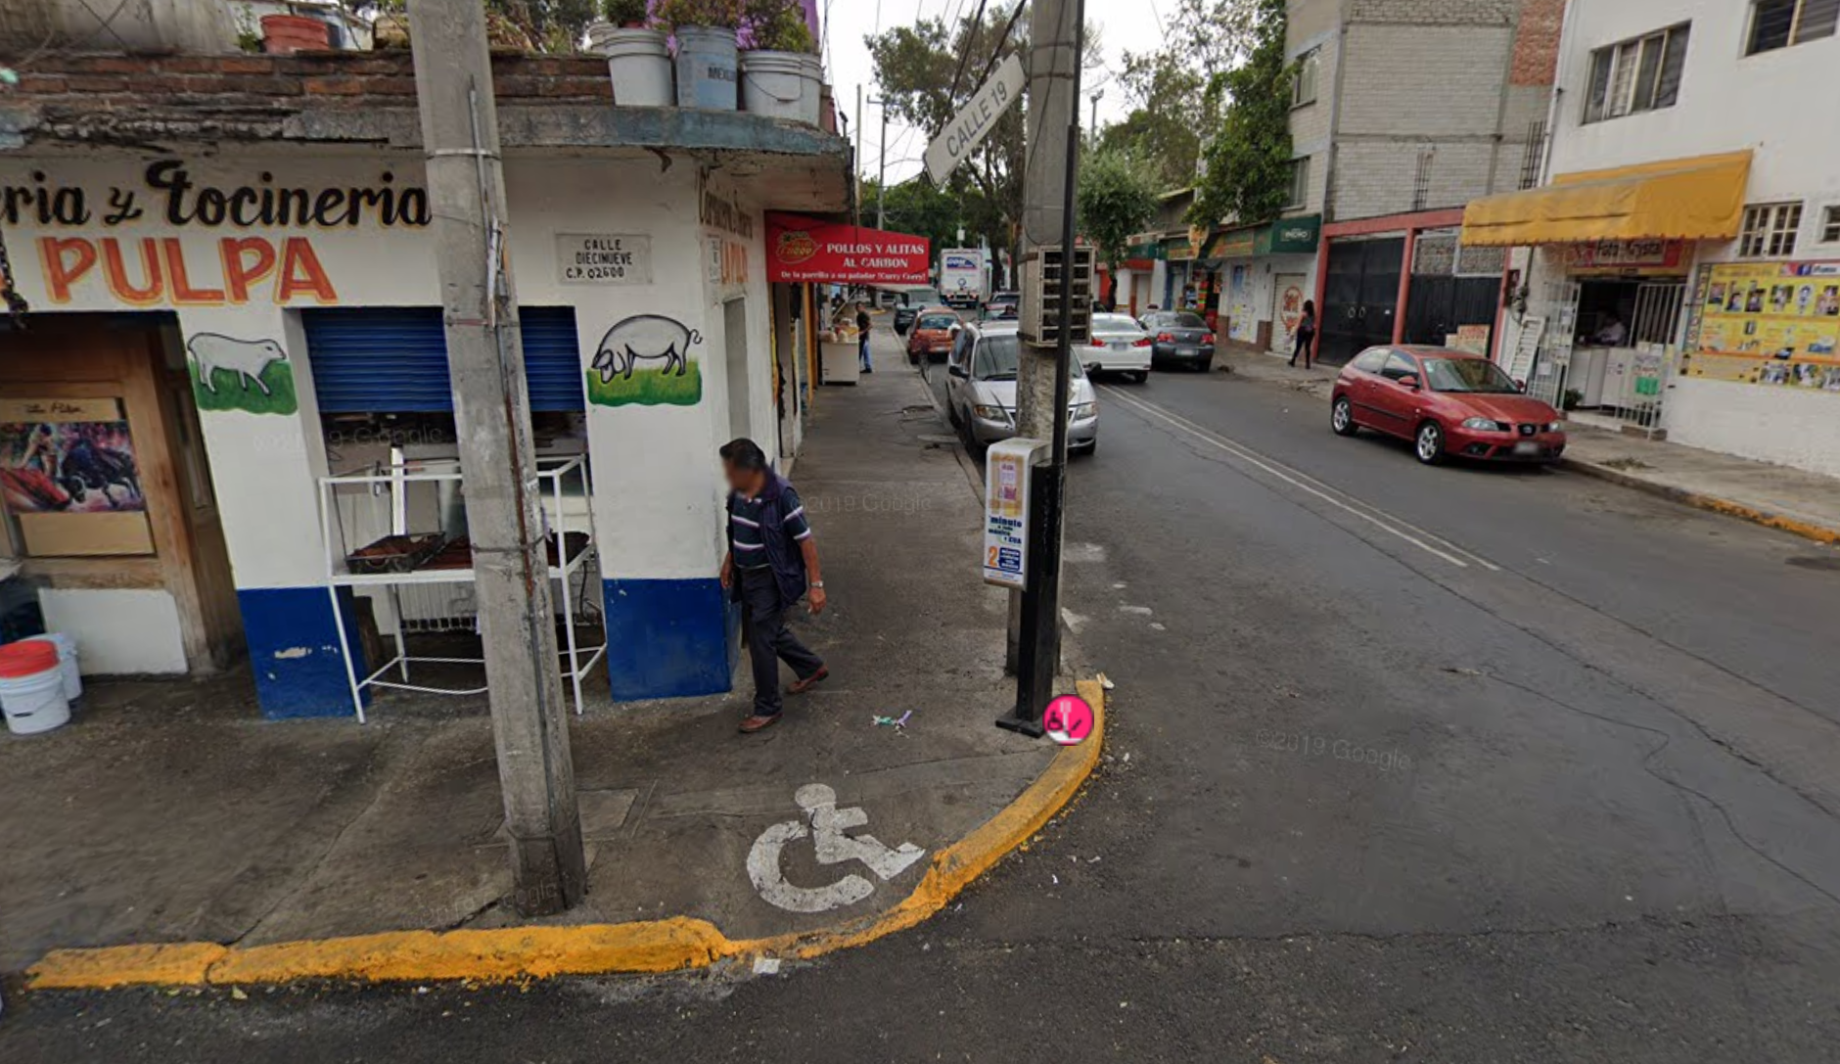
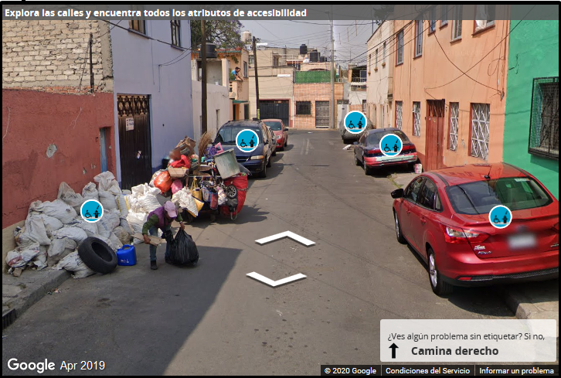
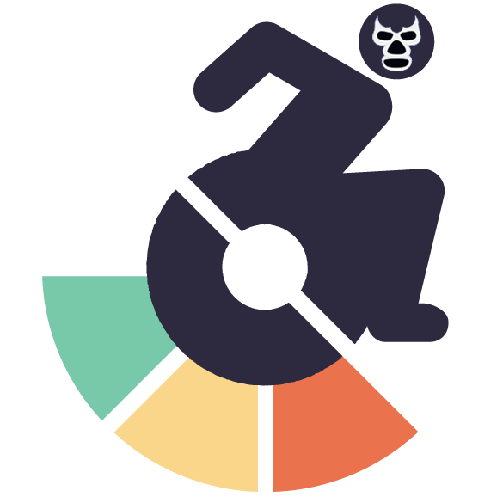









Crowd + AI Tools for scalable sidewalk assessment
Jon E. Froehlich
University of Washington
Spatial Data Science Symposium
Dec 13, 2021
Notes:
Hello from my basement in Seattle!

Slide 2
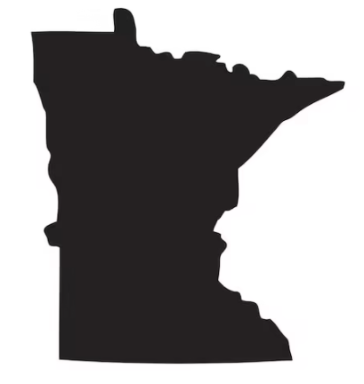




About Me
SDSS’21 Urban accessibility
Back to UW in 2017 as a CS Prof!
Minnesota
Childhood
Computer Engineering
Bachelors
Information & Computer Science
Masters
Computer Science
PhD
Computer Science
Professor (2012-2017)
Notes:
My name is Jon Froehlich. I grew up in Minnesota and my primary research discipline and training is in human-computer interaction. I started my faculty career as a Computer Science professor at the University of Maryland in 2012 before returning to UW in 2017

Slide 3
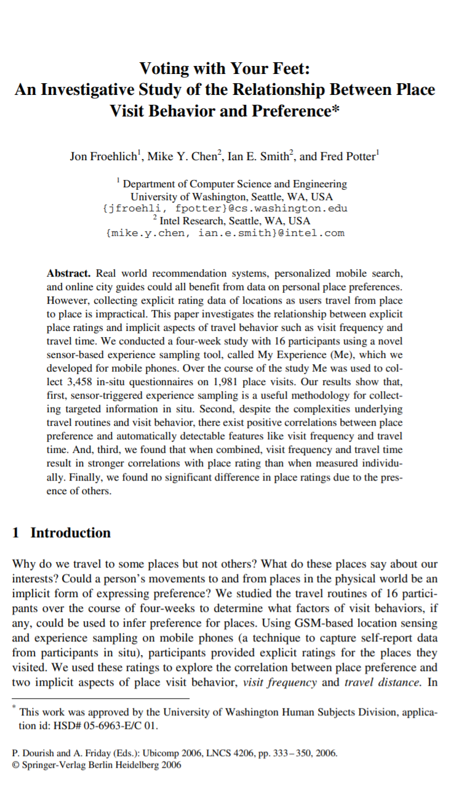
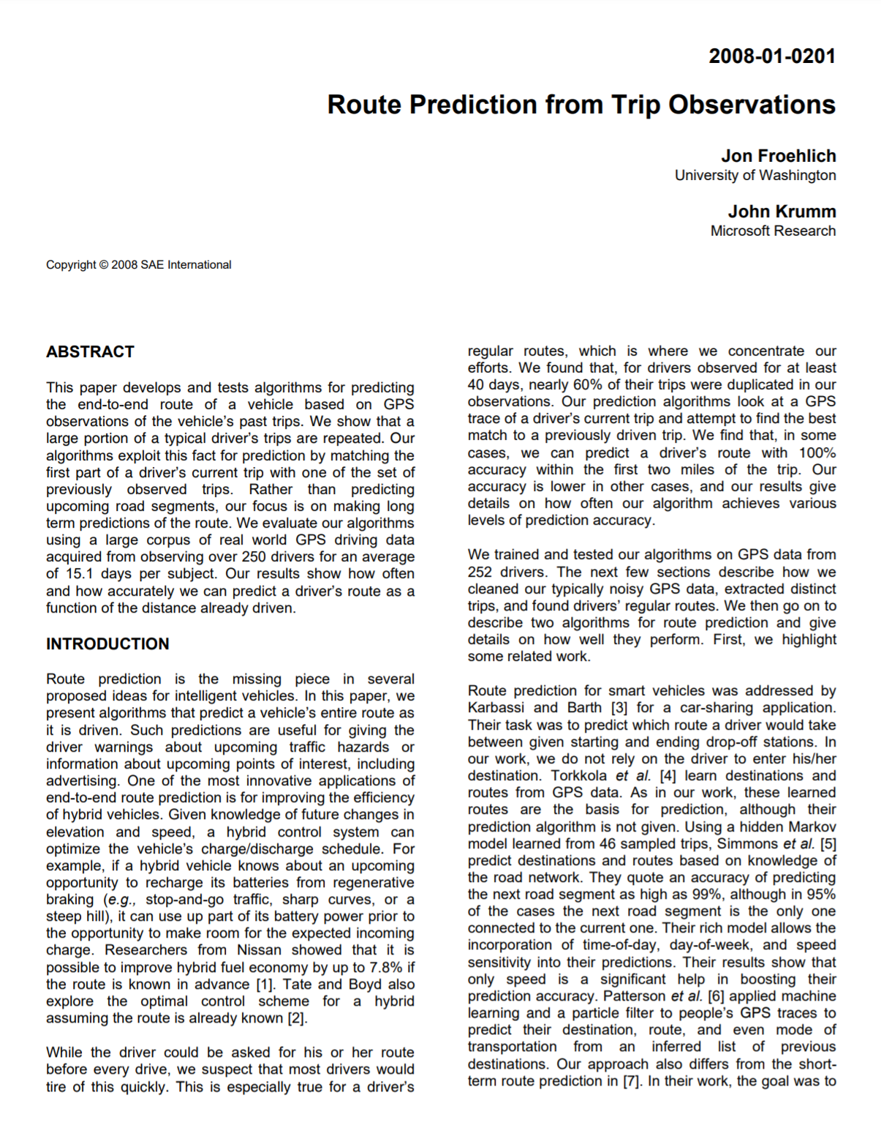
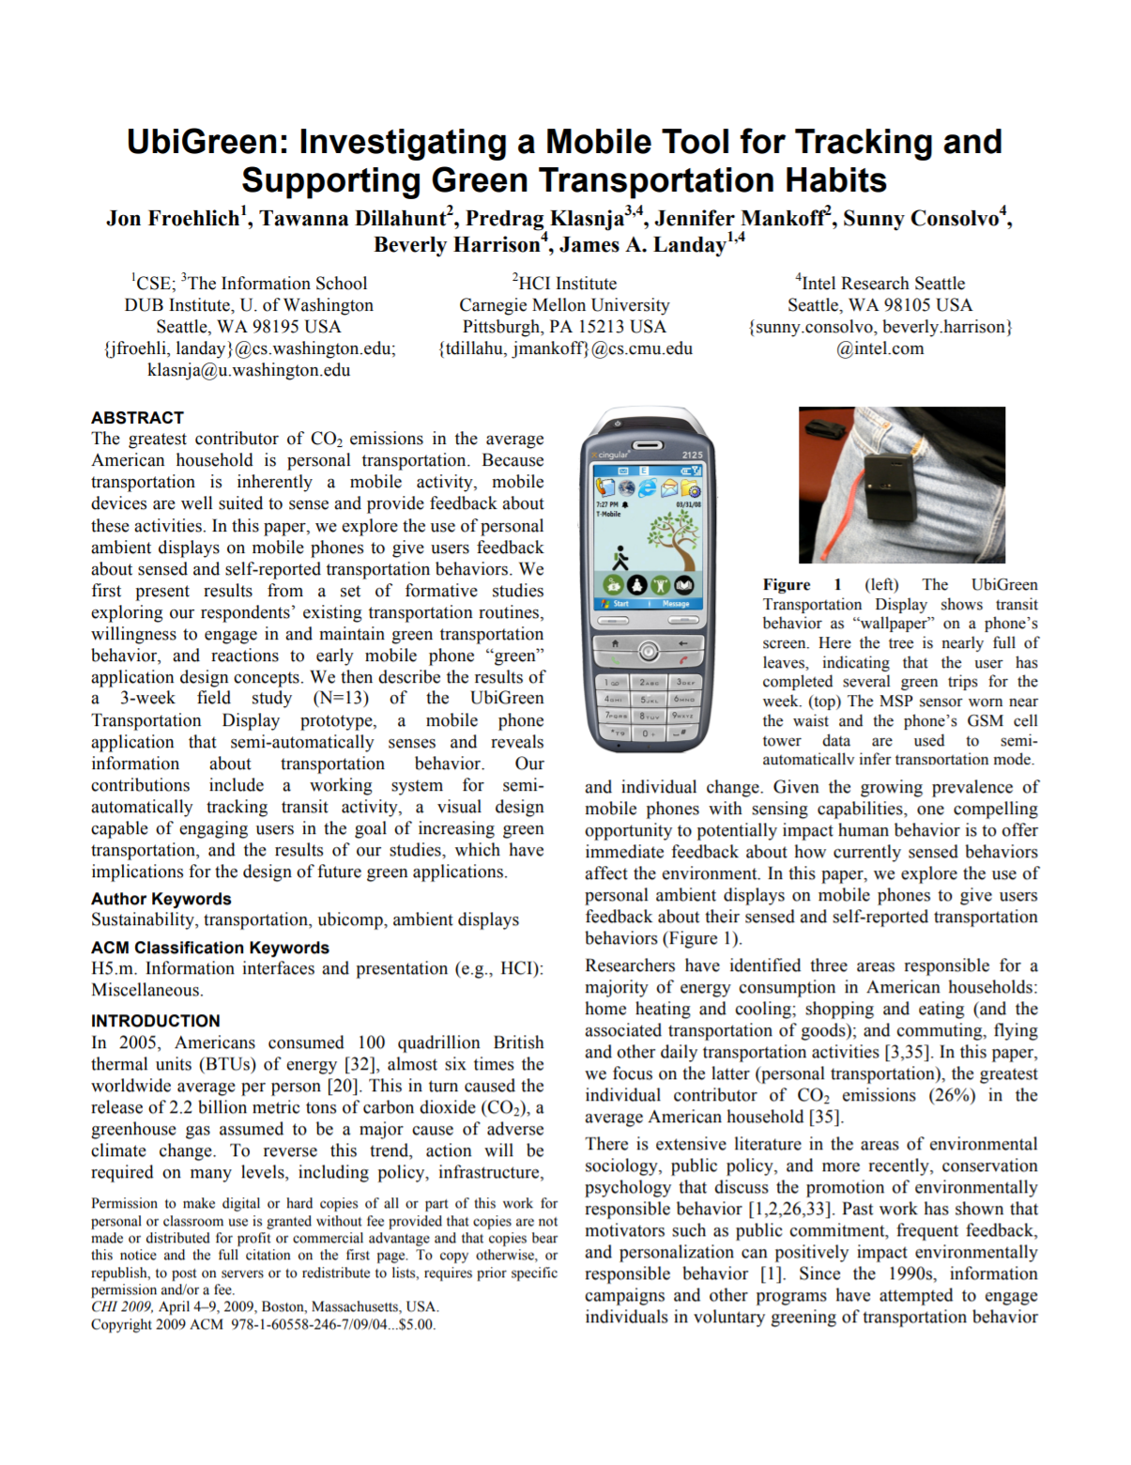
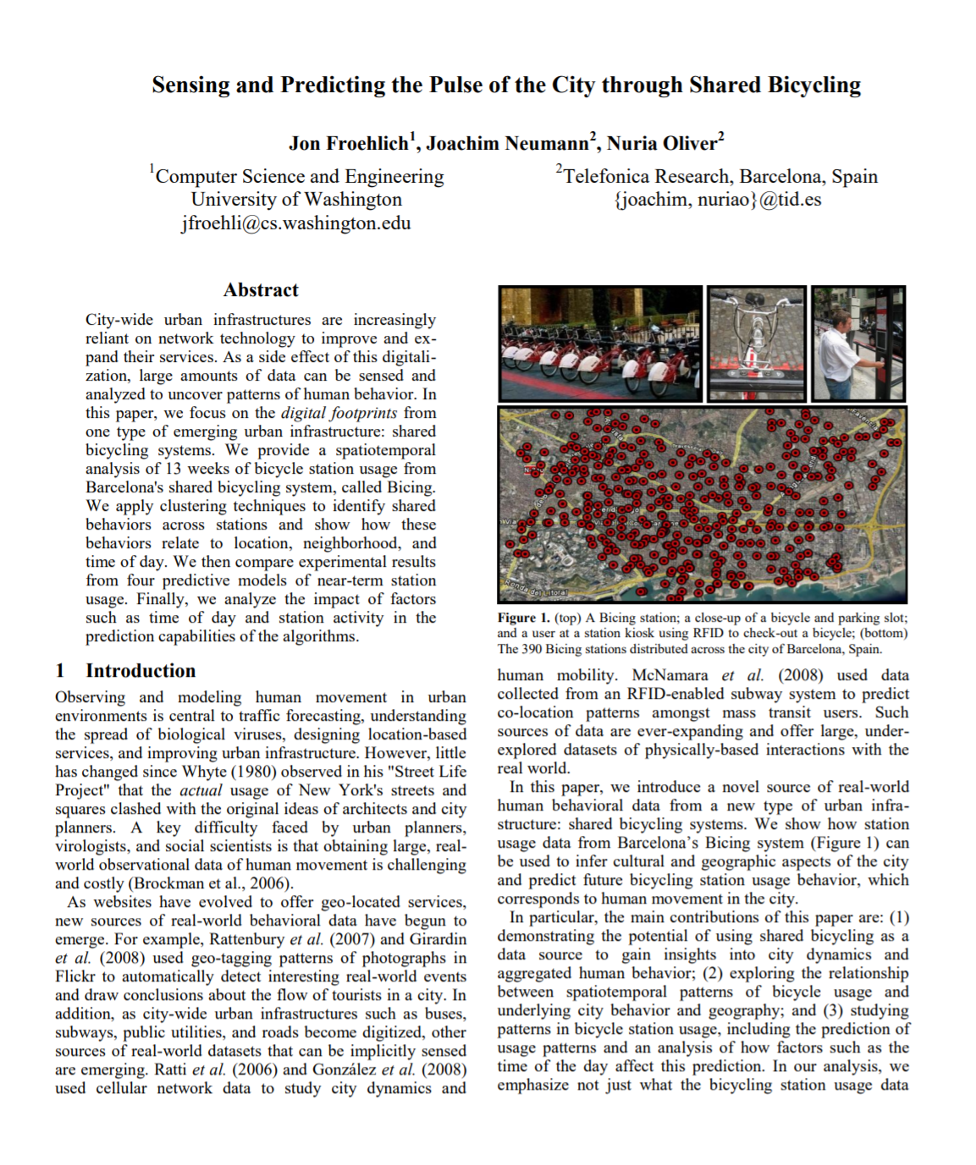
UbiComp’06
SAE’08
CHI’09
IJCAI’09
Notes:
I’ve long been interested in tools and questions related to human mobility, including place recommendation systems and route prediction based on automatically sensed travel patterns as well as tools to support and study more environmentally sustainable transit choices

Slide 4
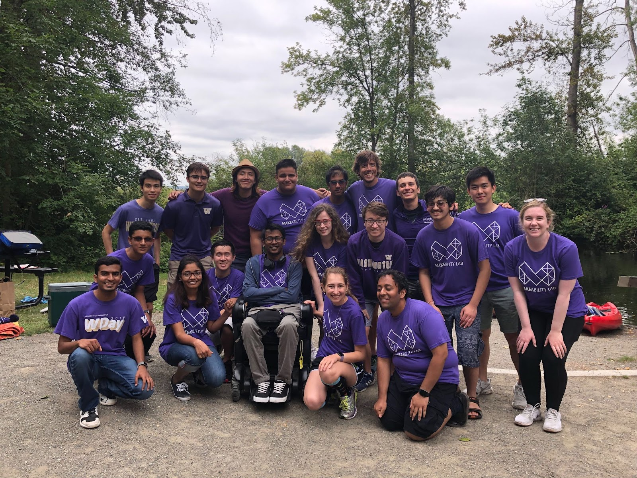

Makeability Lab
2019 Retreat
Notes:
At UW, I direct the Makeability Lab, a cross-disciplinary team of students and researchers studying human-computer interaction

Slide 5
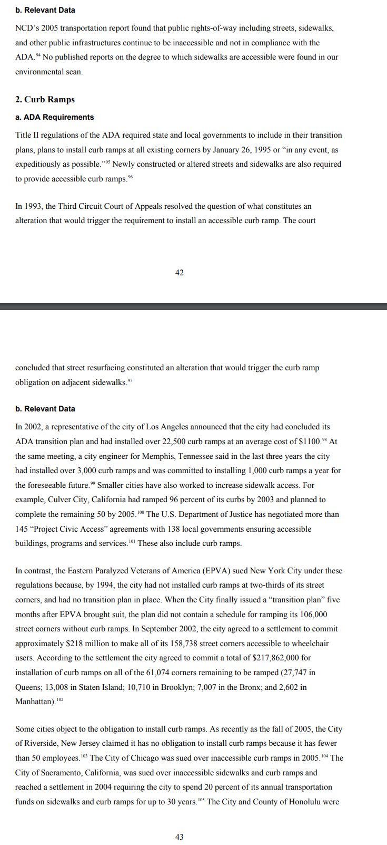

National Council on Disability
The National Council on Disability notes that there is no comprehensive information on “the degree to which sidewalks are accessible” in cities.
National Council on Disability, 2007
The impact of the Americans with Disabilities Act: Assessing the progress toward achieving the goals of the ADA
Notes:
One big problem we’ve been attempting to address is the lack of sidewalk information in GIS systems—both the location of sidewalks and their condition

Slide 6

Our overarching vision
Develop crowd+AI techniques to map and assess every sidewalk in the world
Notes:
Our overarching vision: develop crowd+AI techniques to map and assess every sidewalk in the world

Slide 7
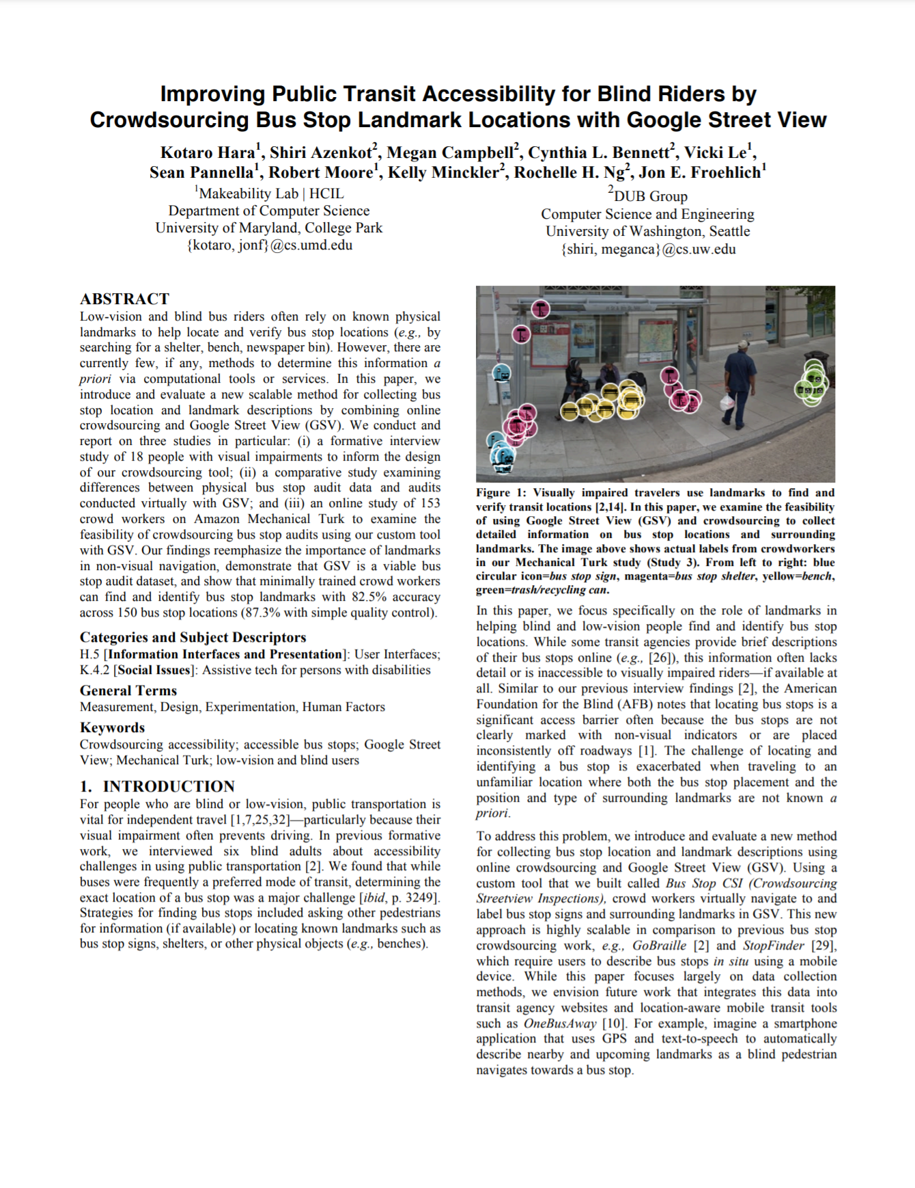
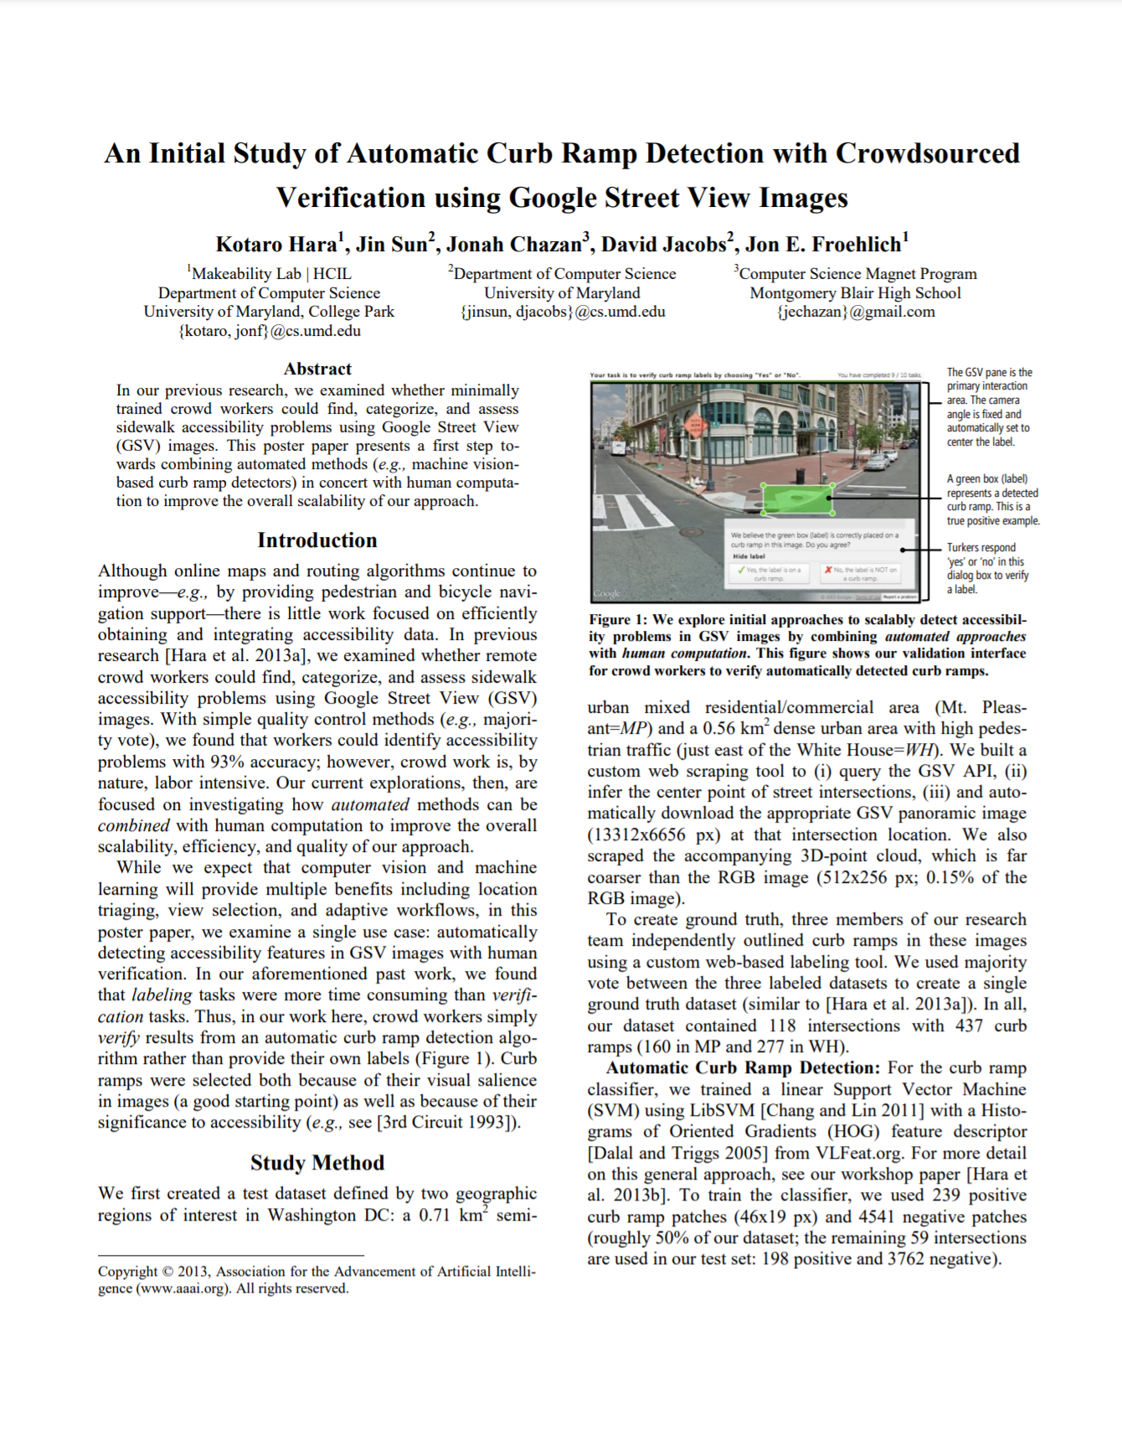
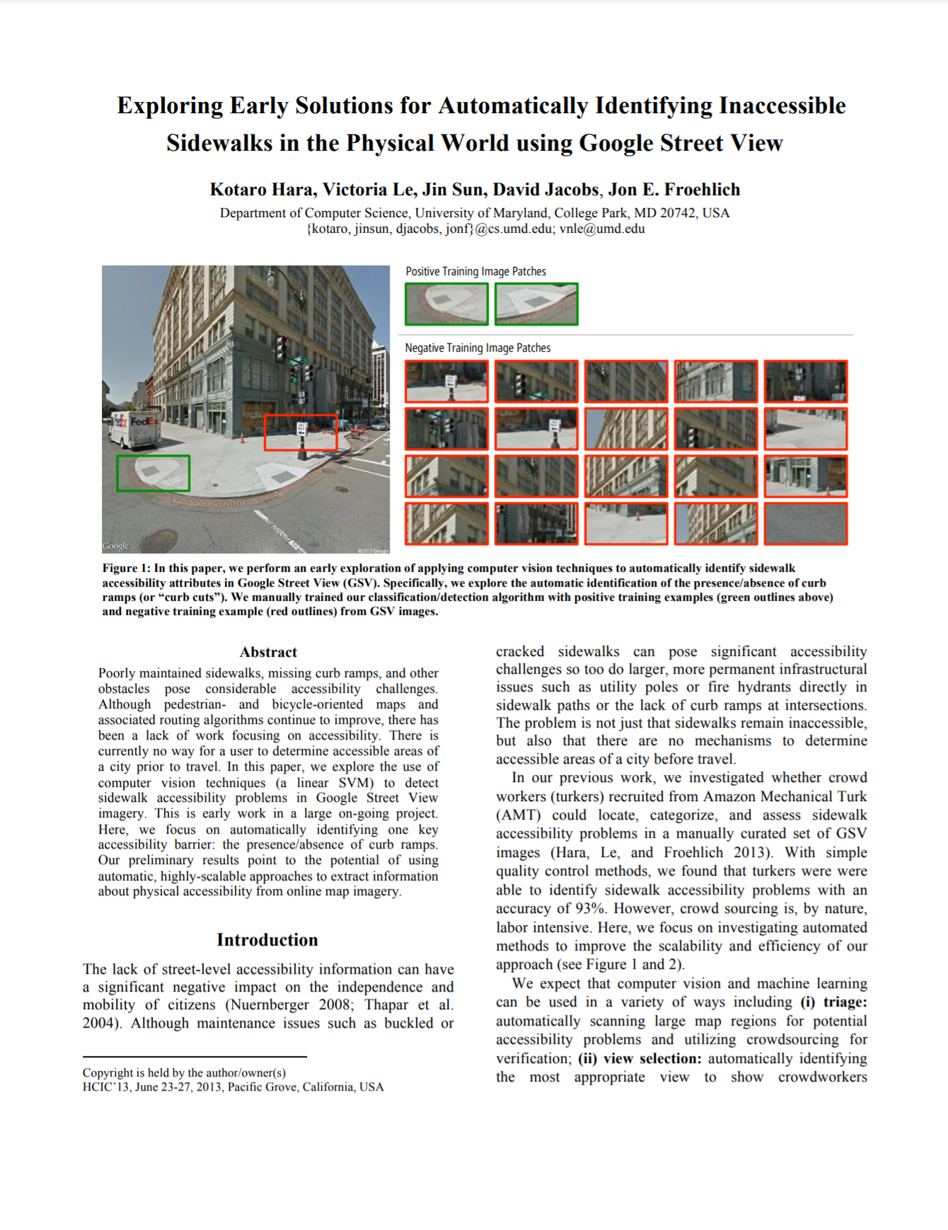
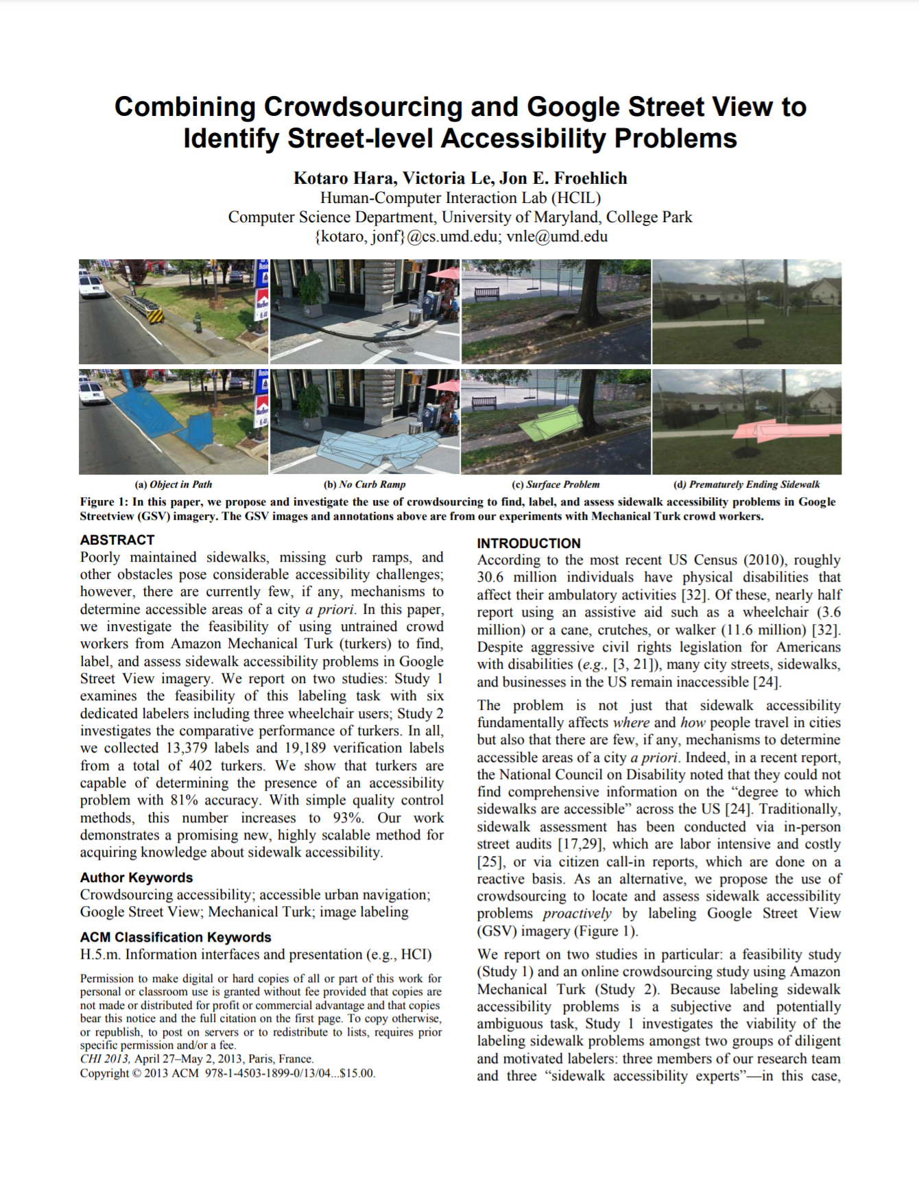
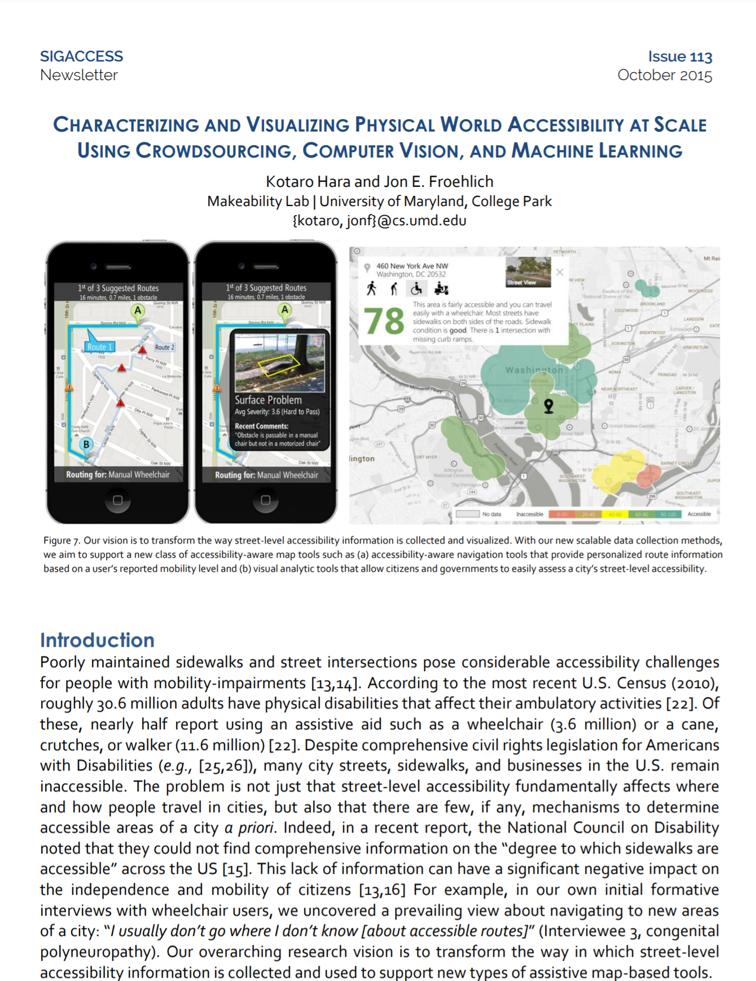
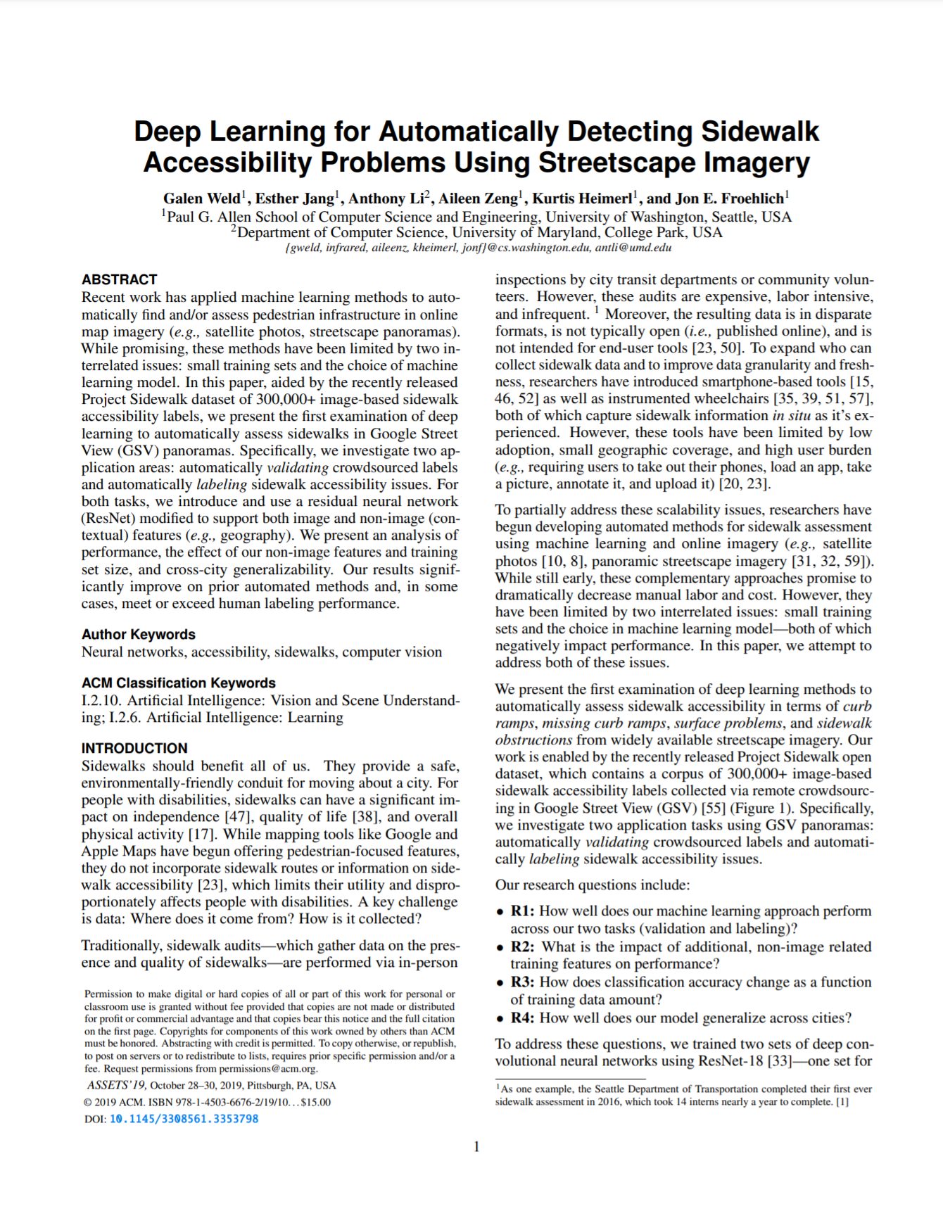
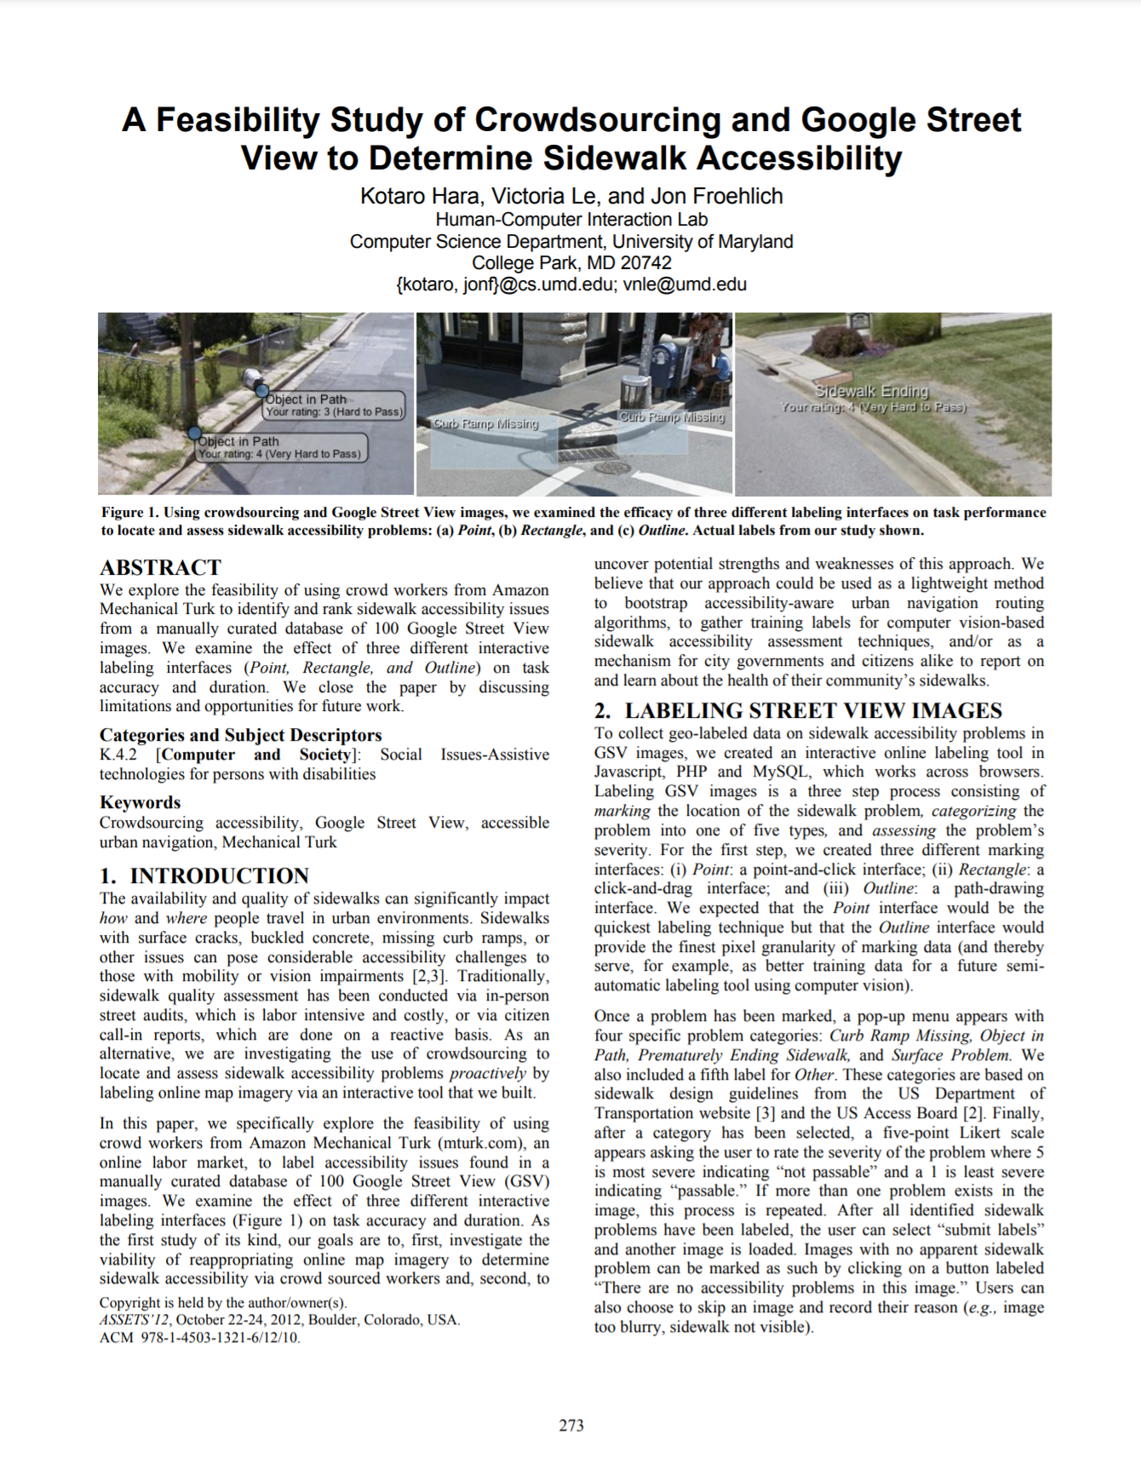
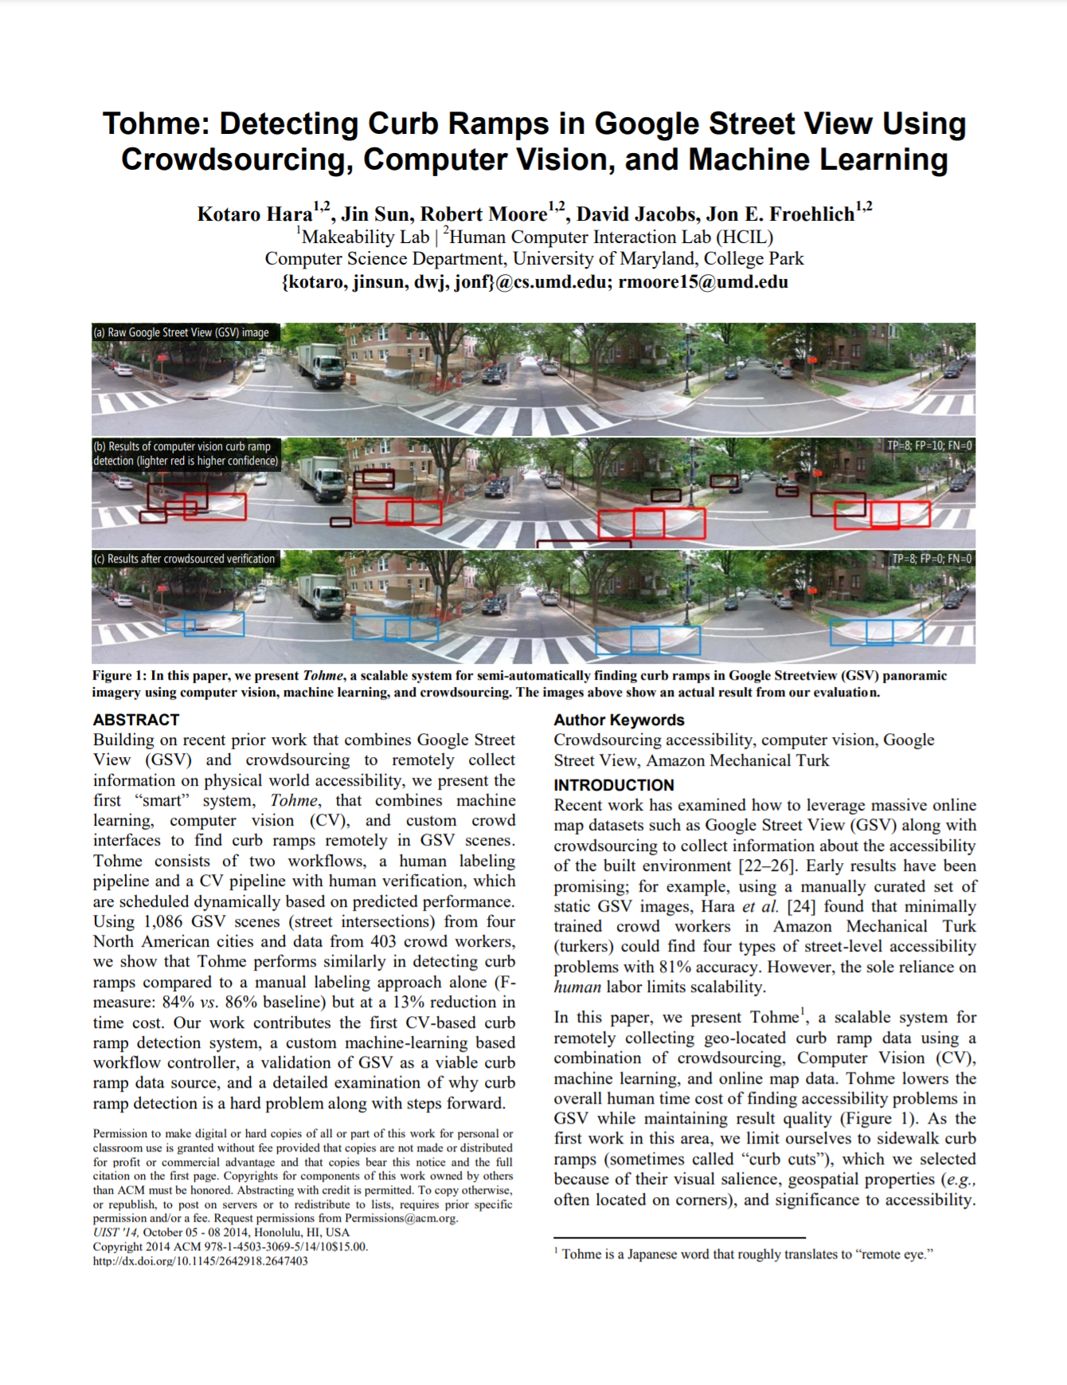
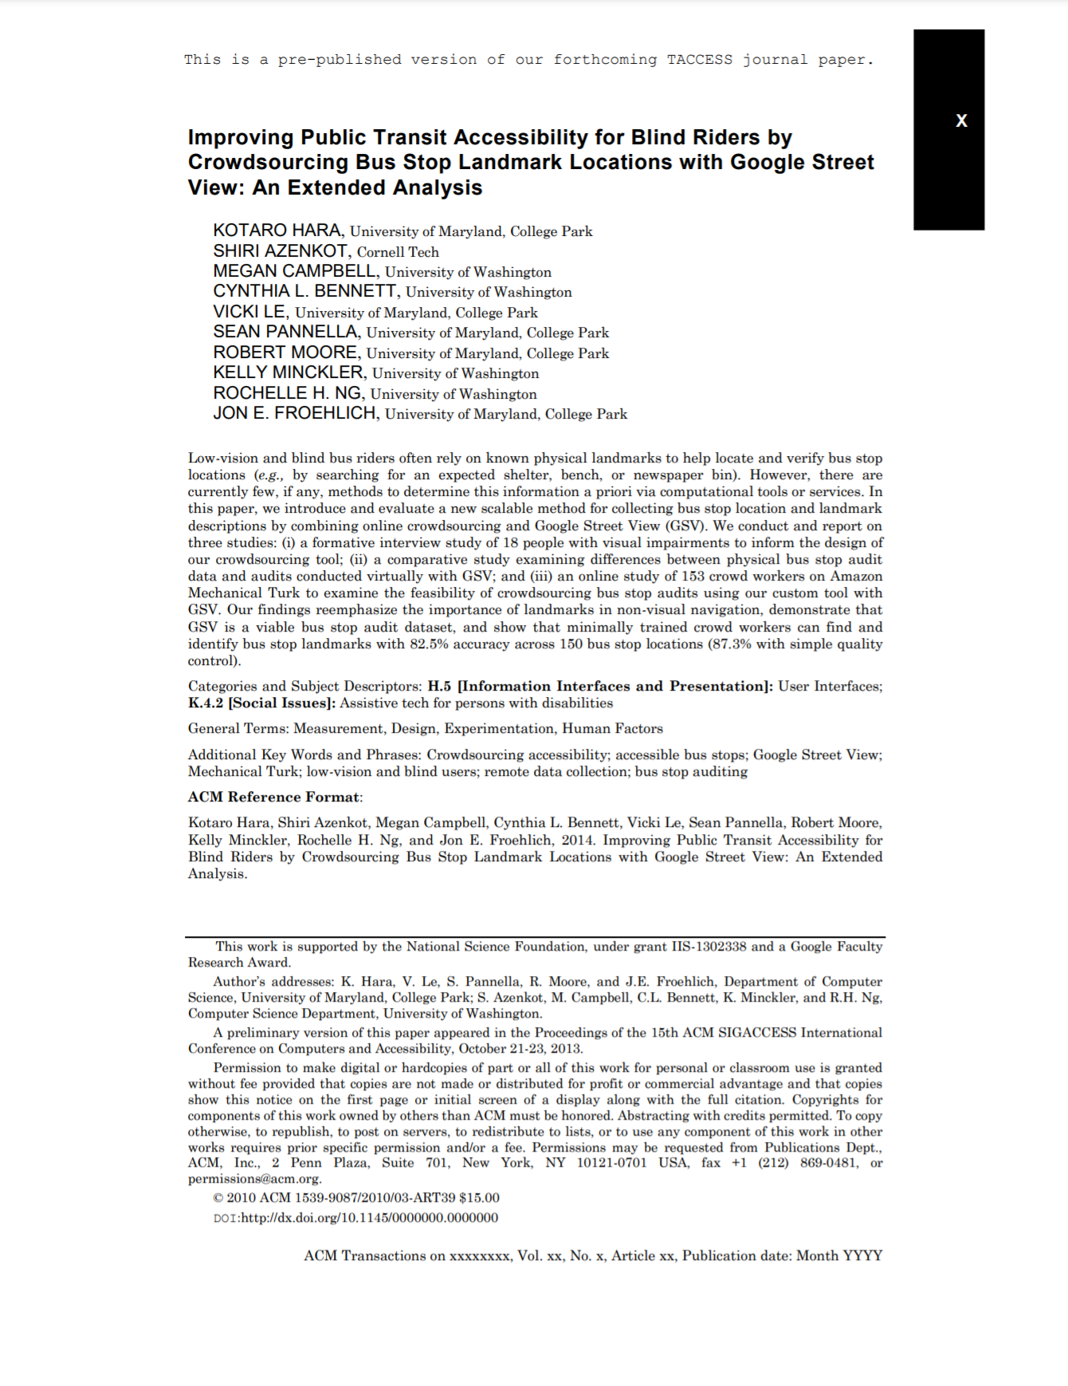
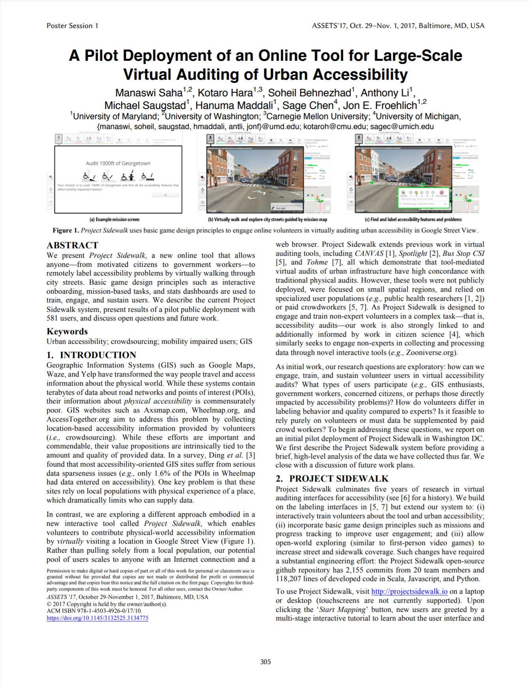
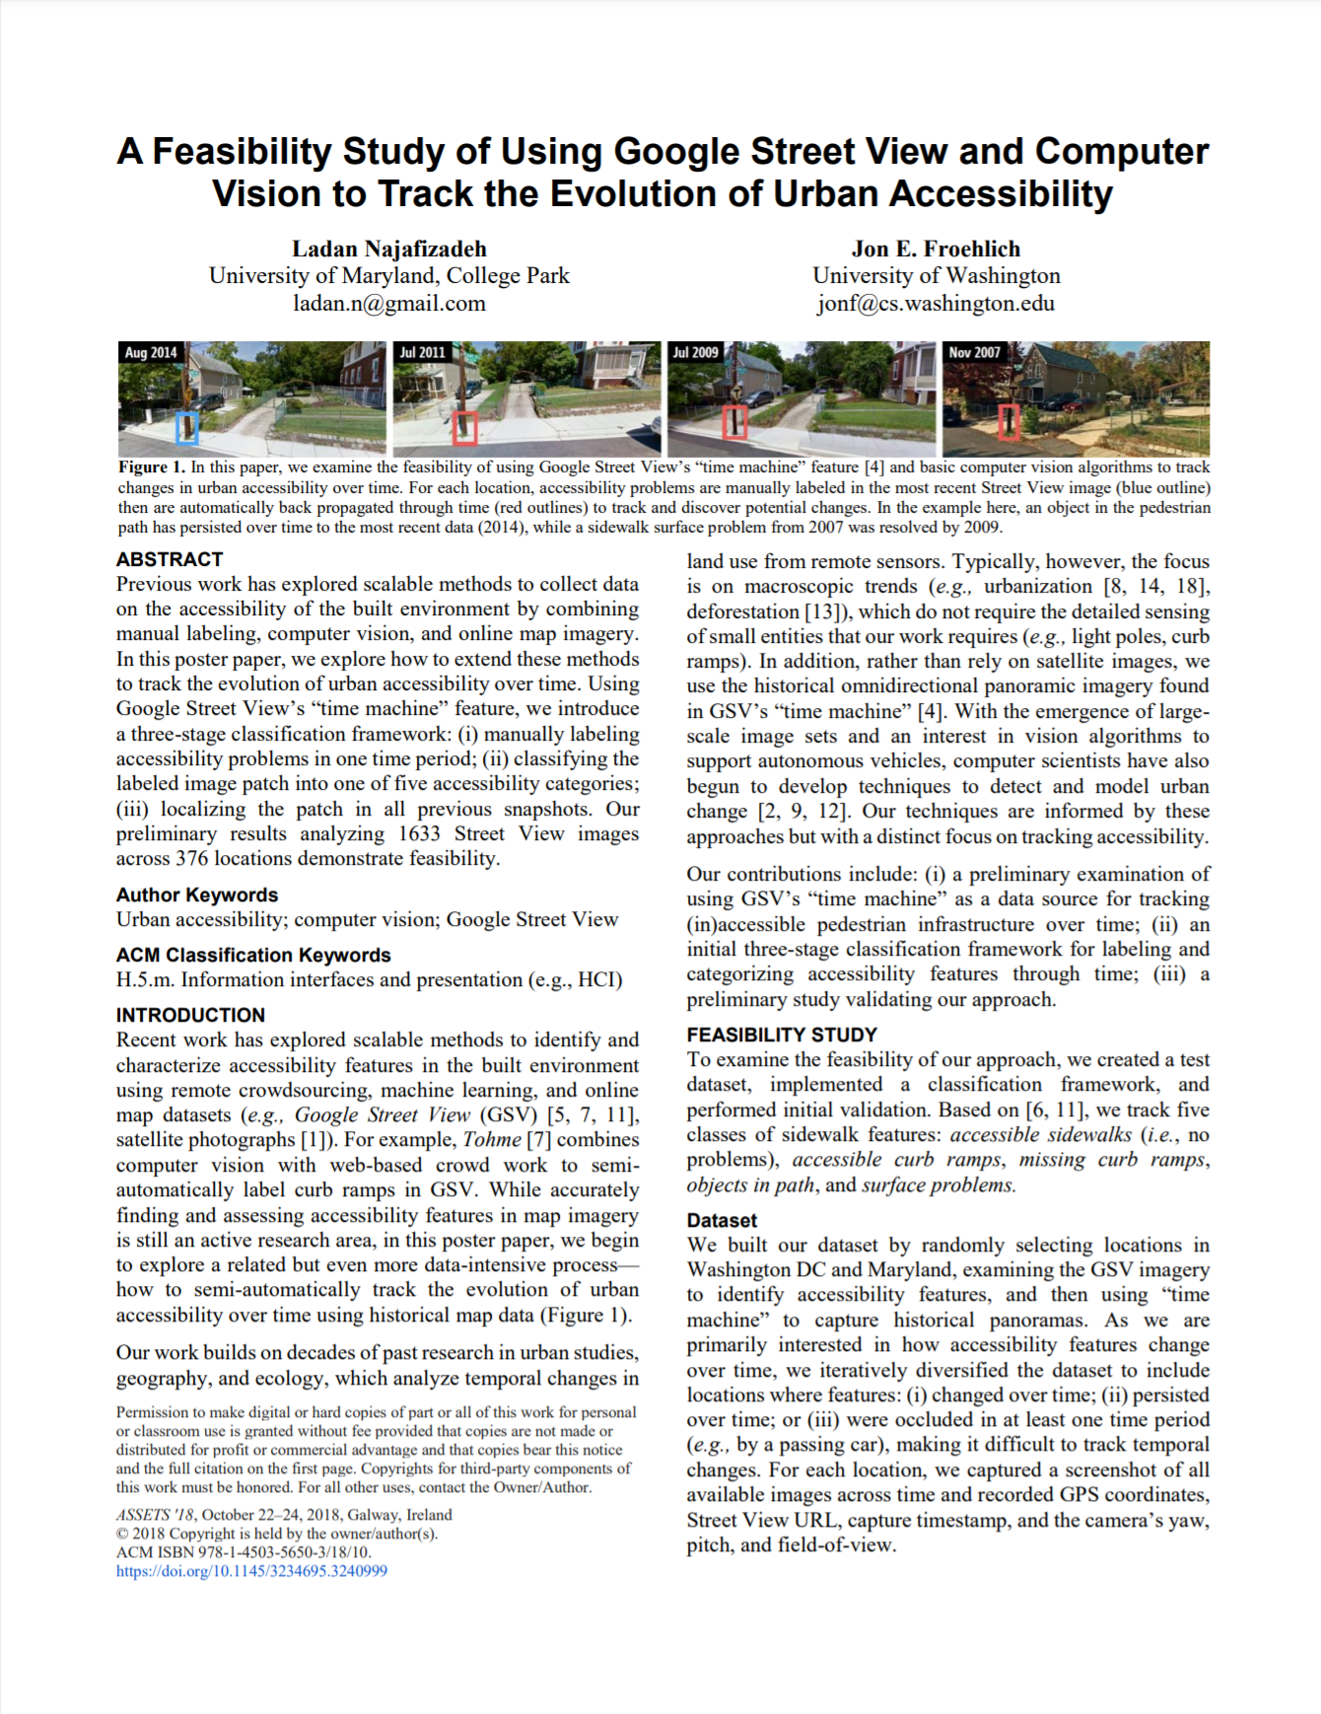
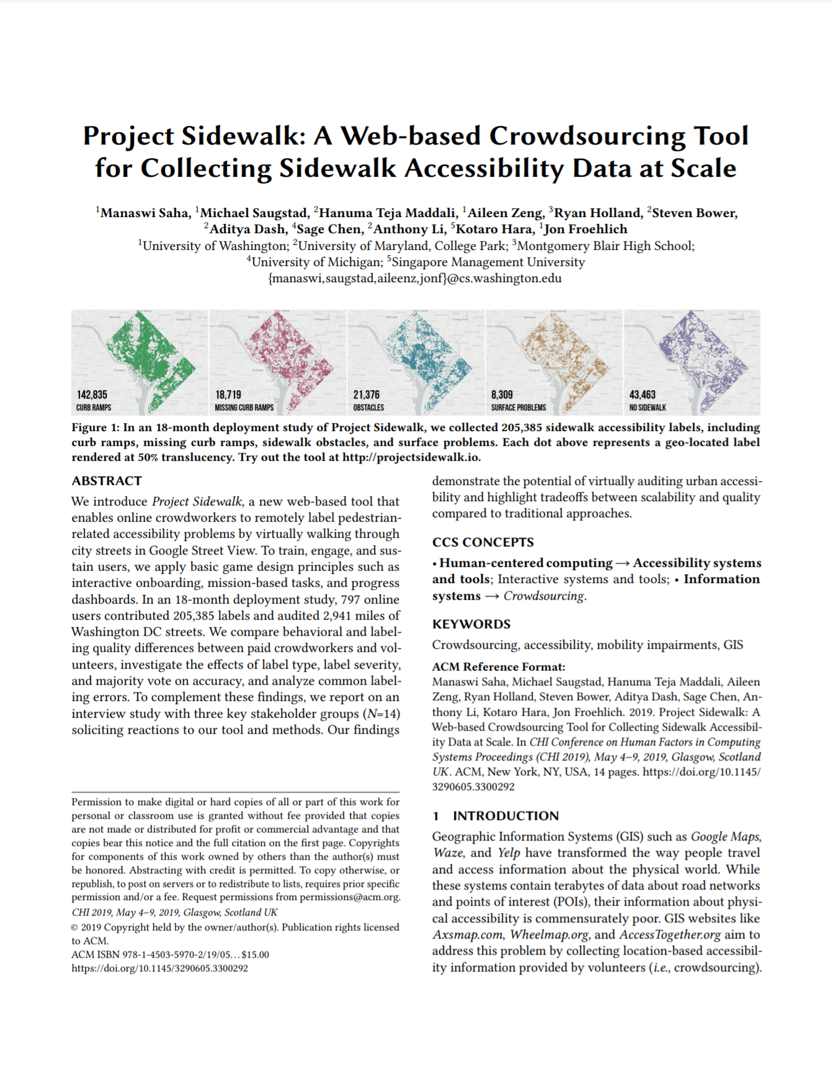
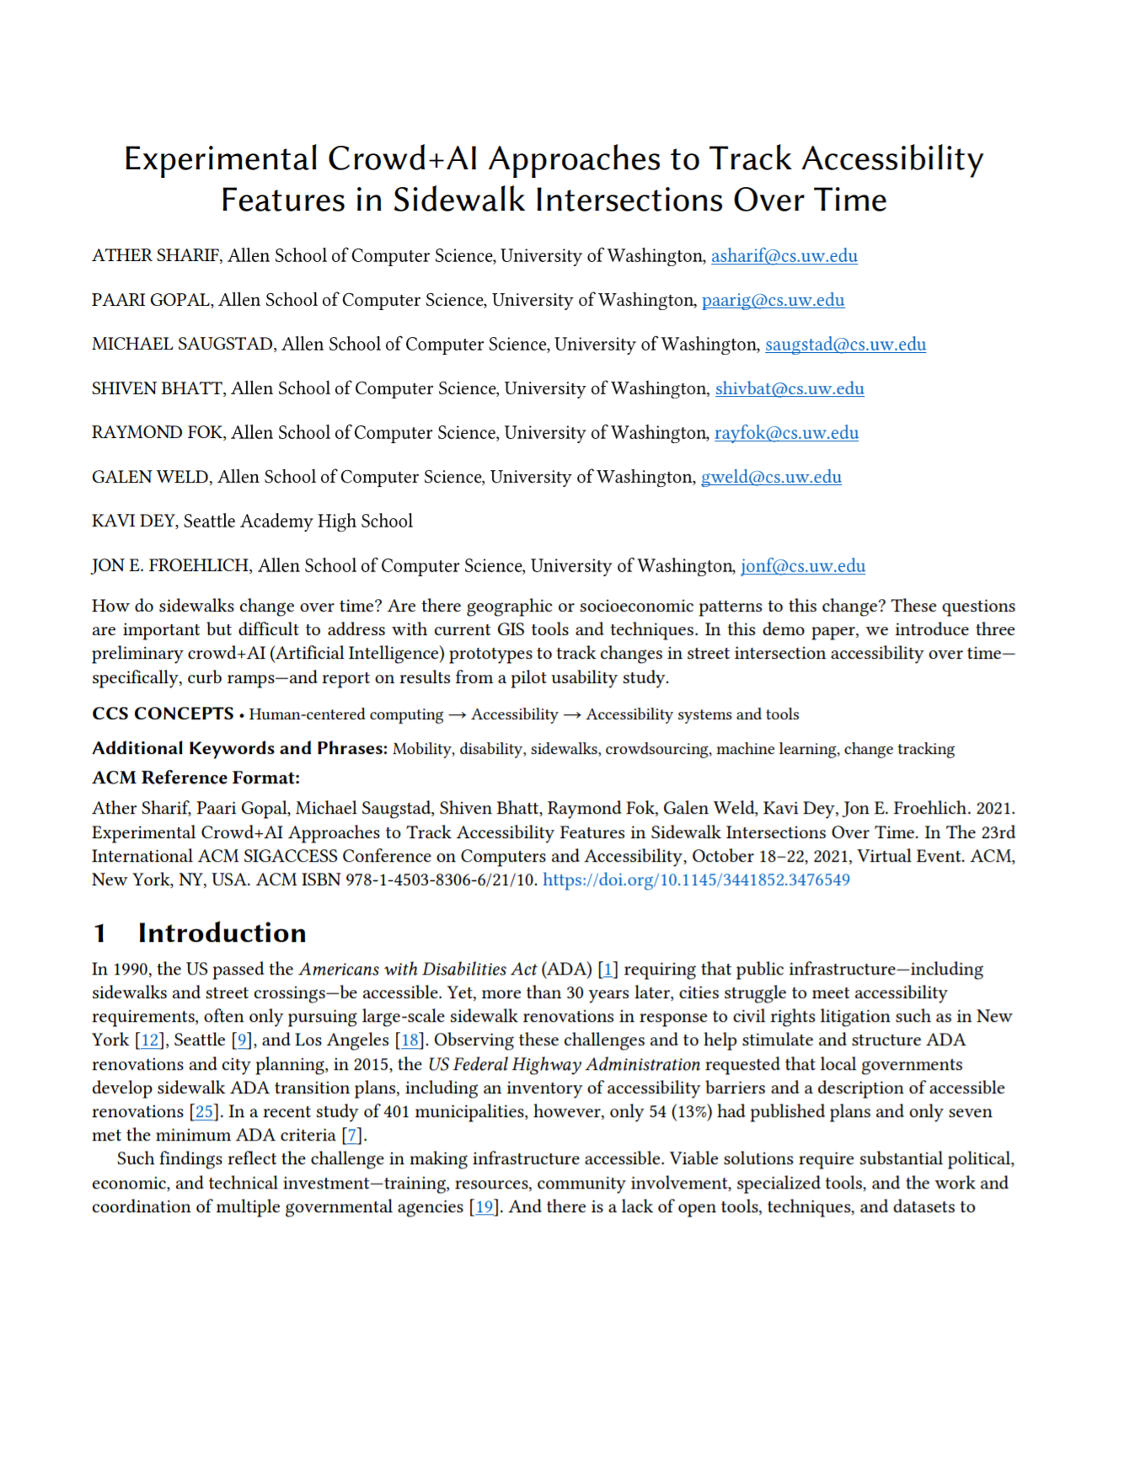
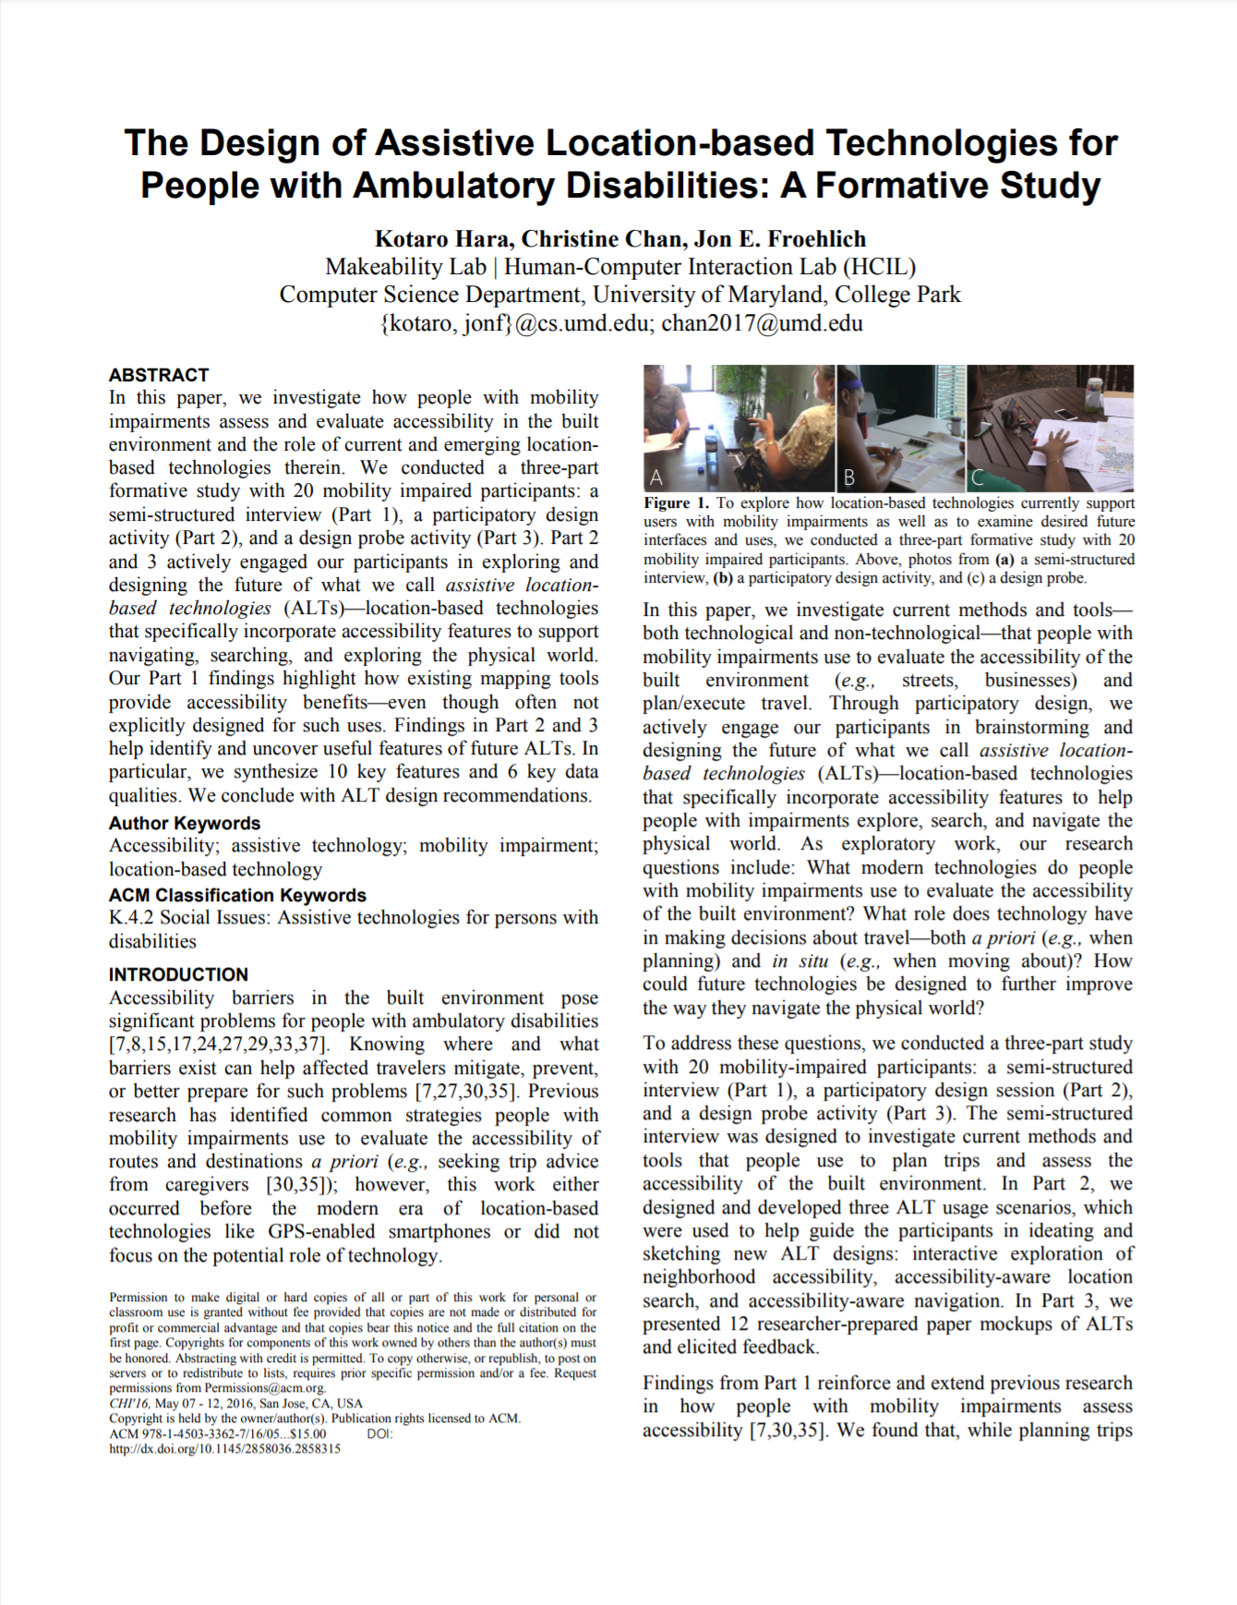
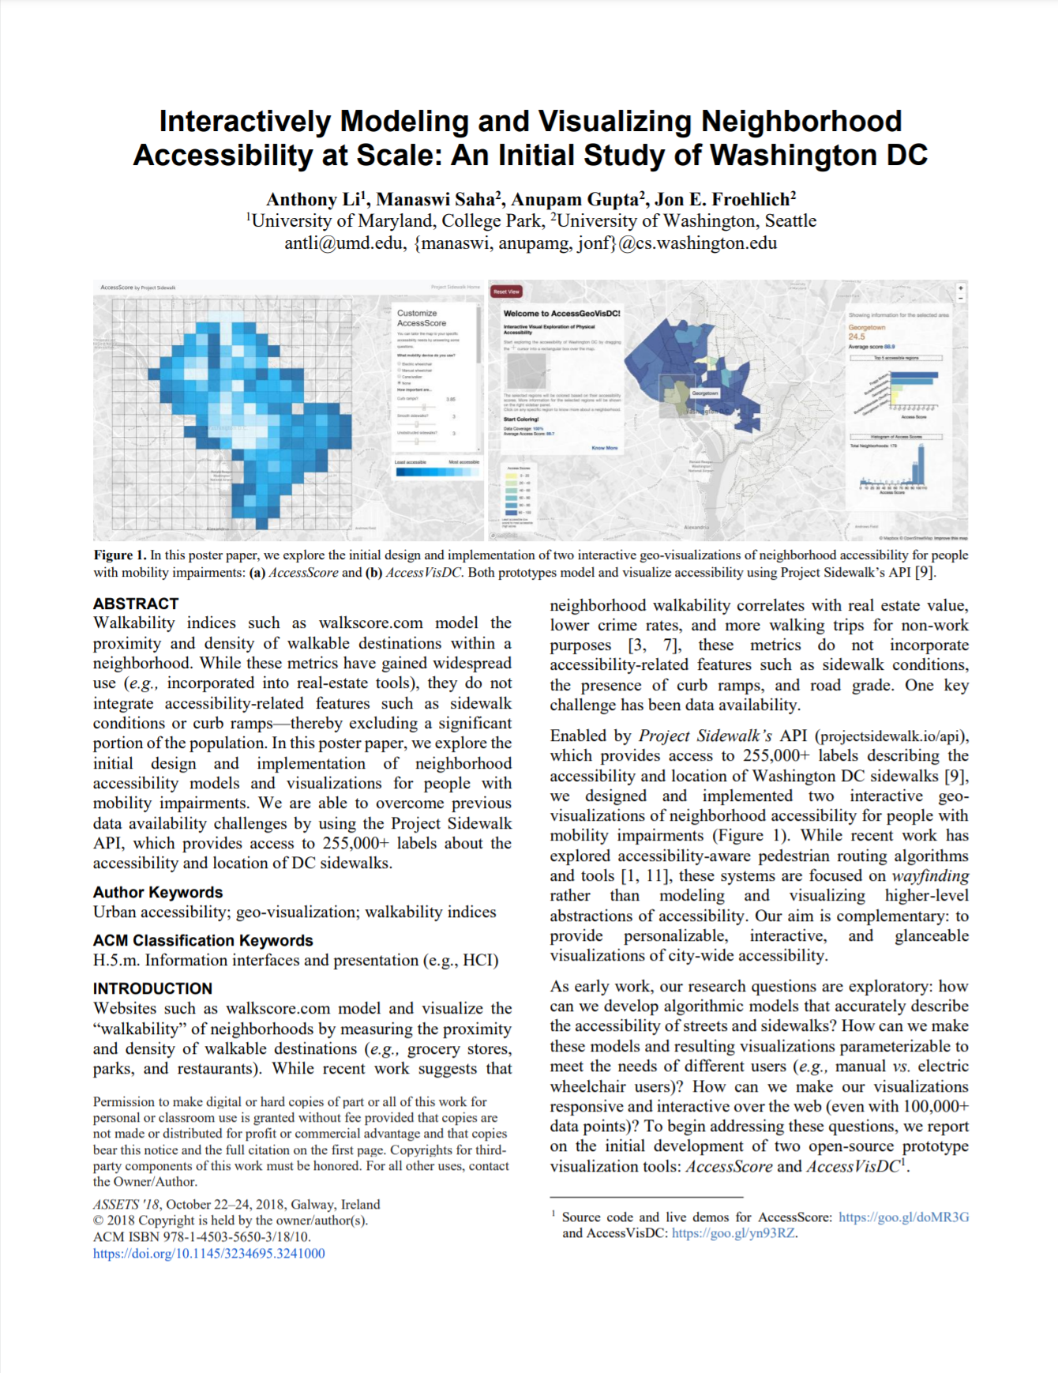
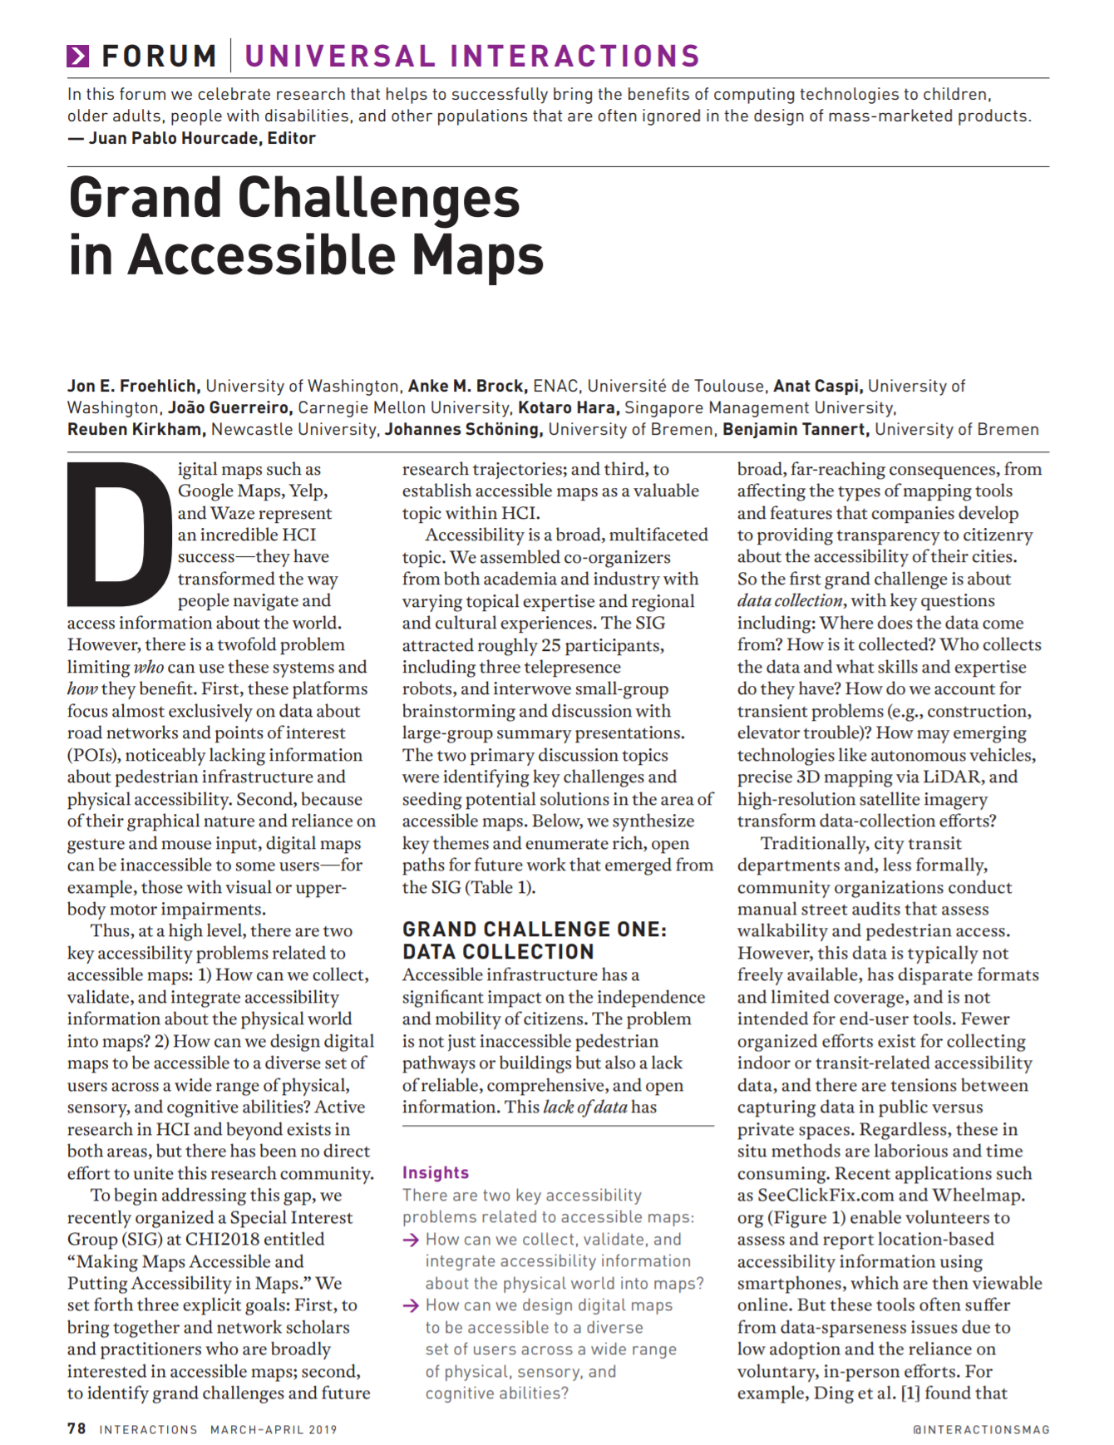
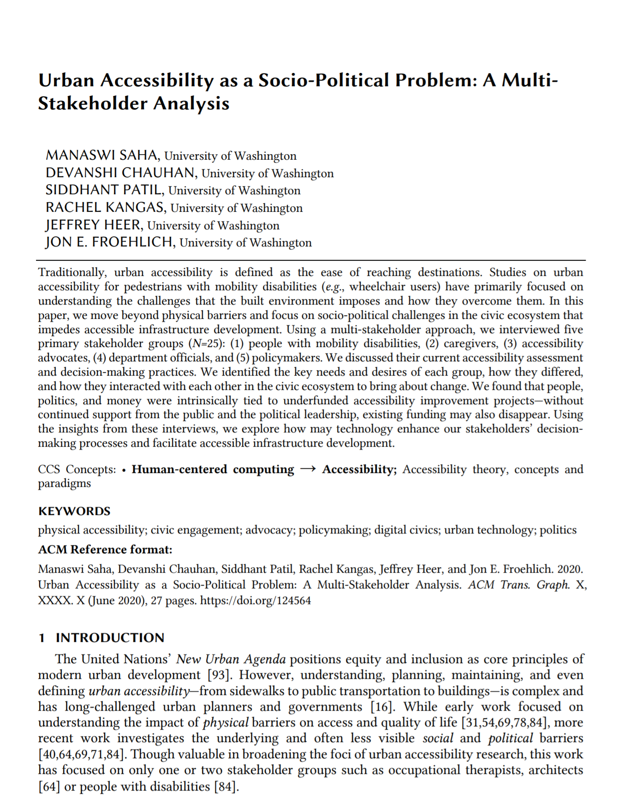
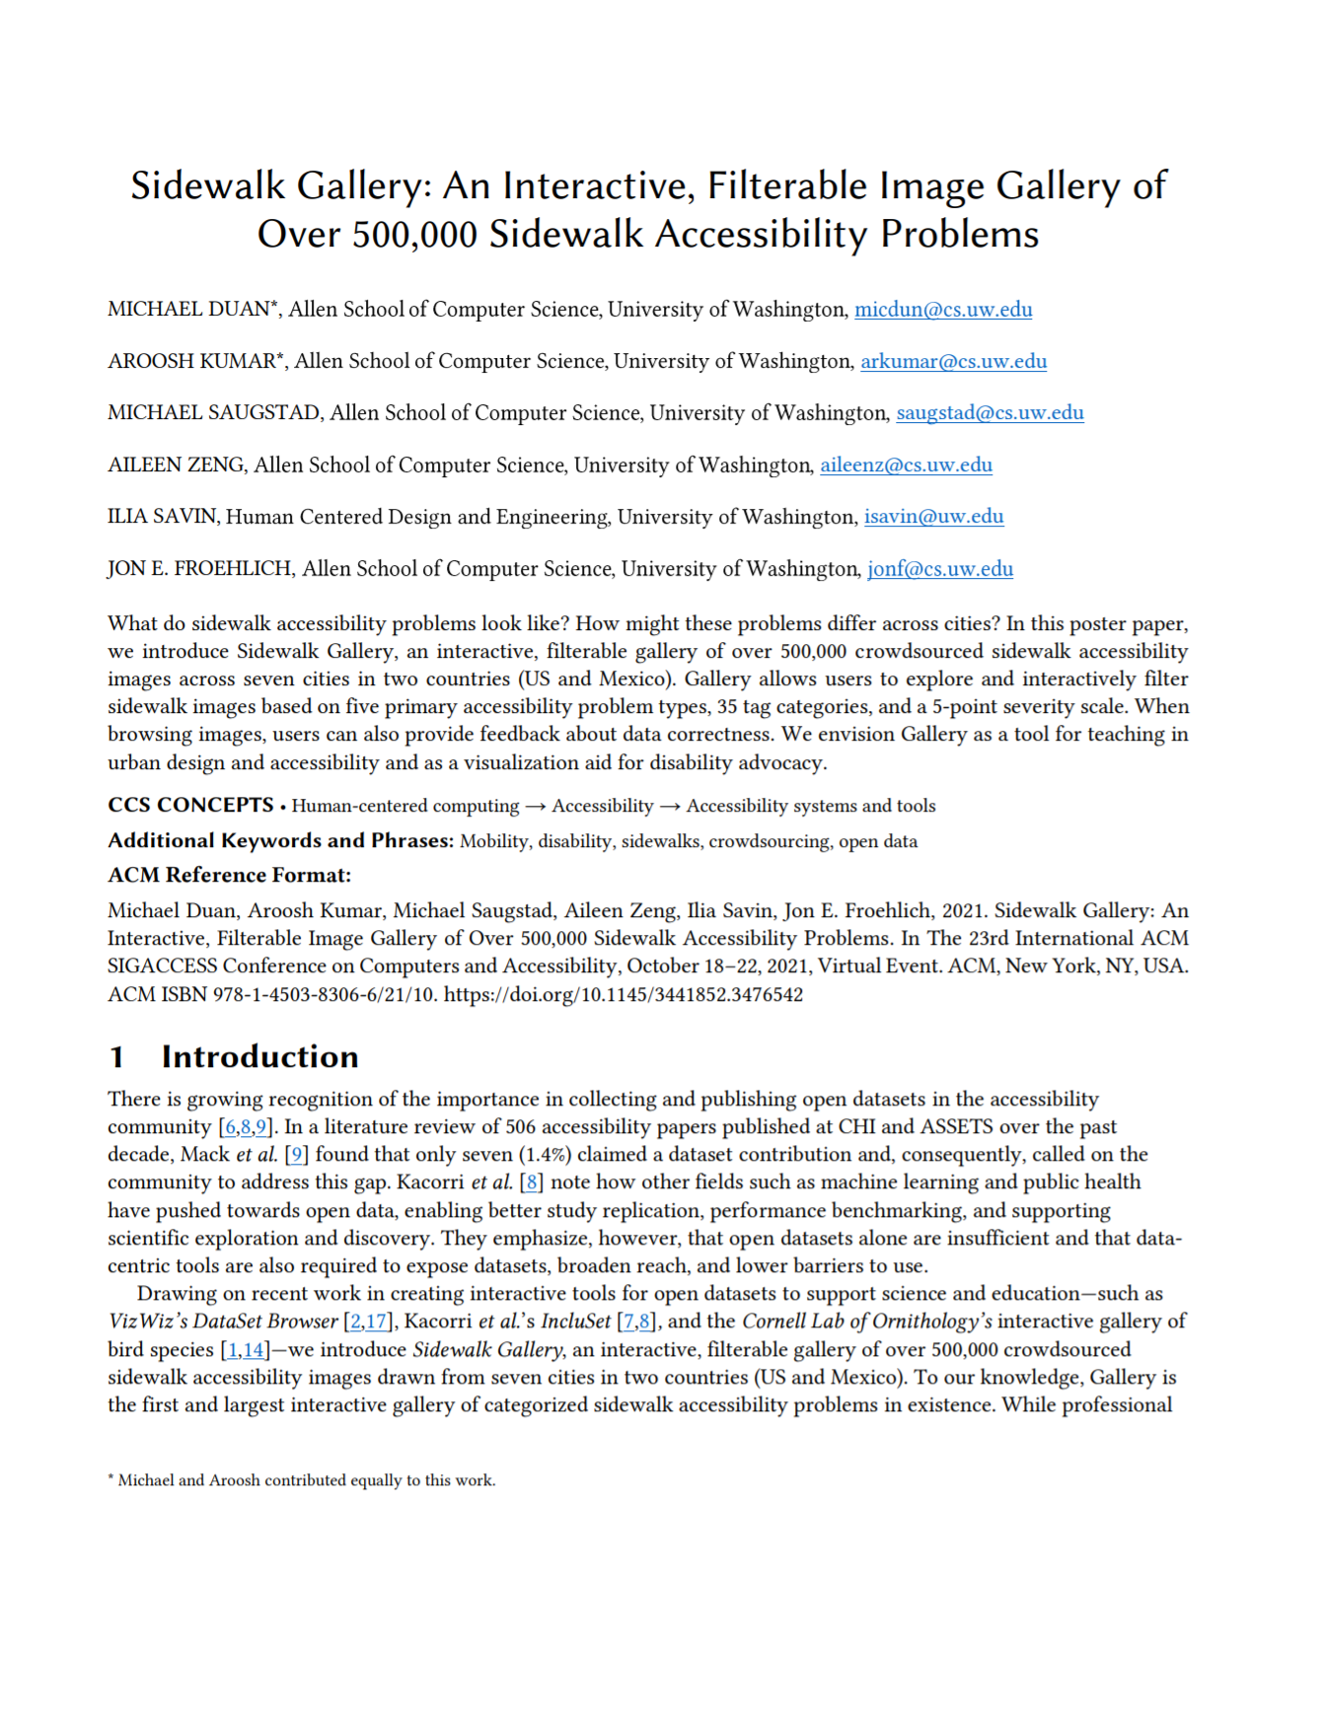
ASSETS’13
HCOMP’13
HCIC’13
CHI’13
SIGACCESS’15
ASSETS’19
ASSETS’12
UIST’14
TACCESS’15
ASSETS’17
ASSETS’18
CHI’19
ASSETS’21
2012
2013
2014
2015
2016
2017
2018
2019
2020
2021
CHI’16
ASSETS’18
Inter.’19
CSCW’20
ASSETS’21
Notes:
And we have been working on this problem for a long time...
---
from running formative interview sessions with stakeholder groups such as people with mobility disabilities and transit departments to building and evaluating data collection and visual analytic tools

Slide 8

http://projectsidewalk.org
Notes:
Work that has culminated in a tool called Project Sidewalk, which you can visit at projectsidewalk.org

Slide 9
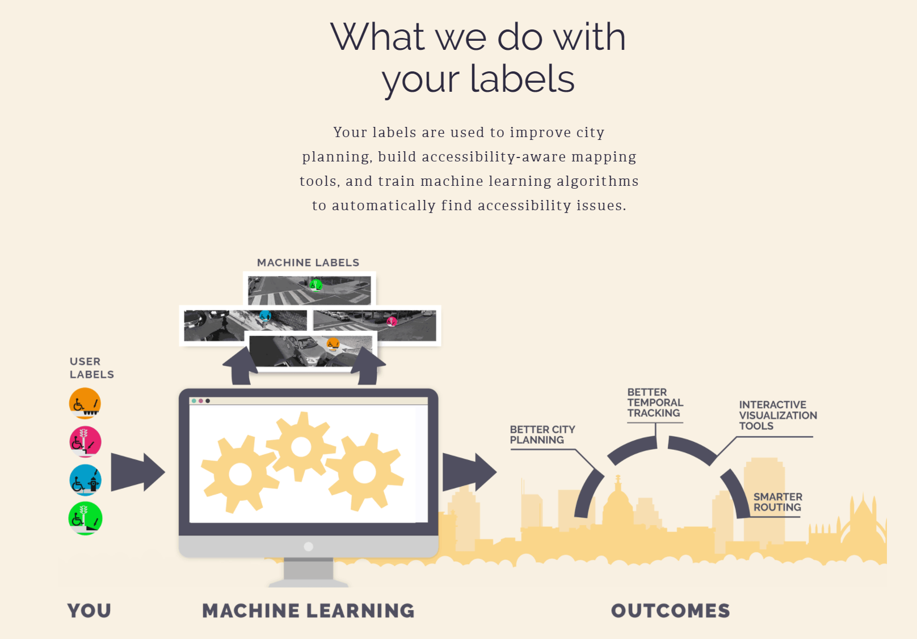
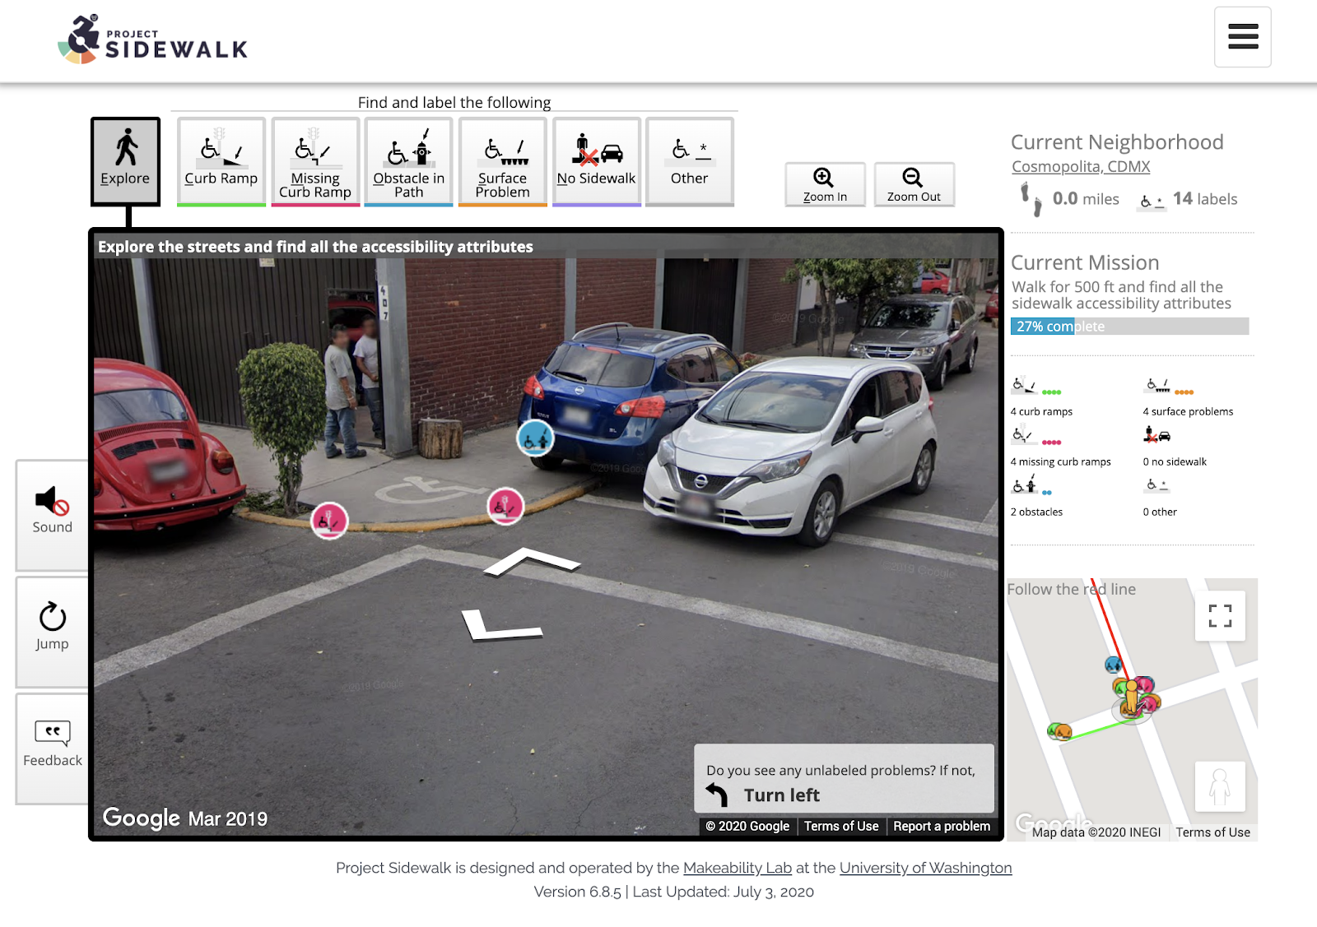
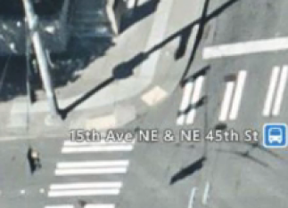
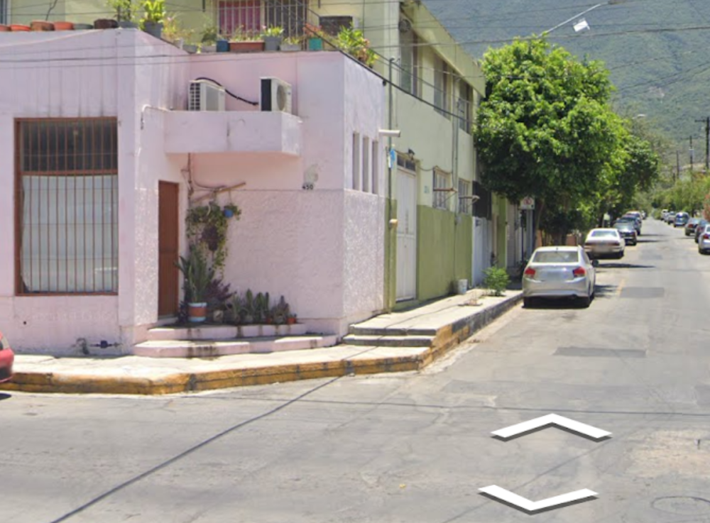
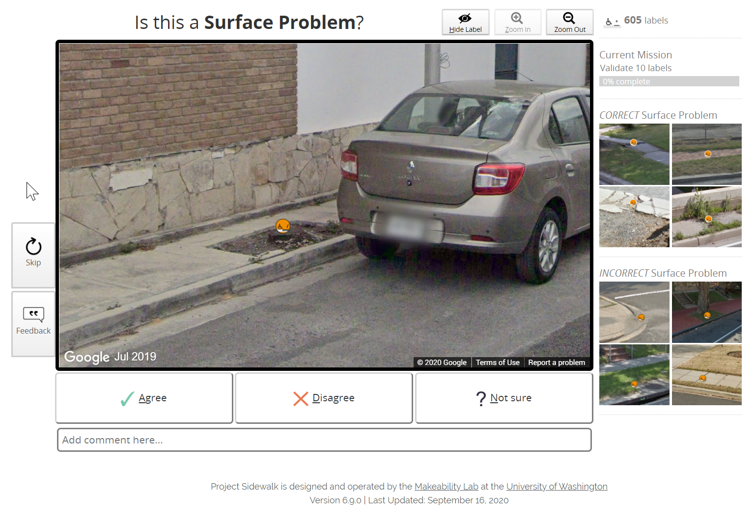
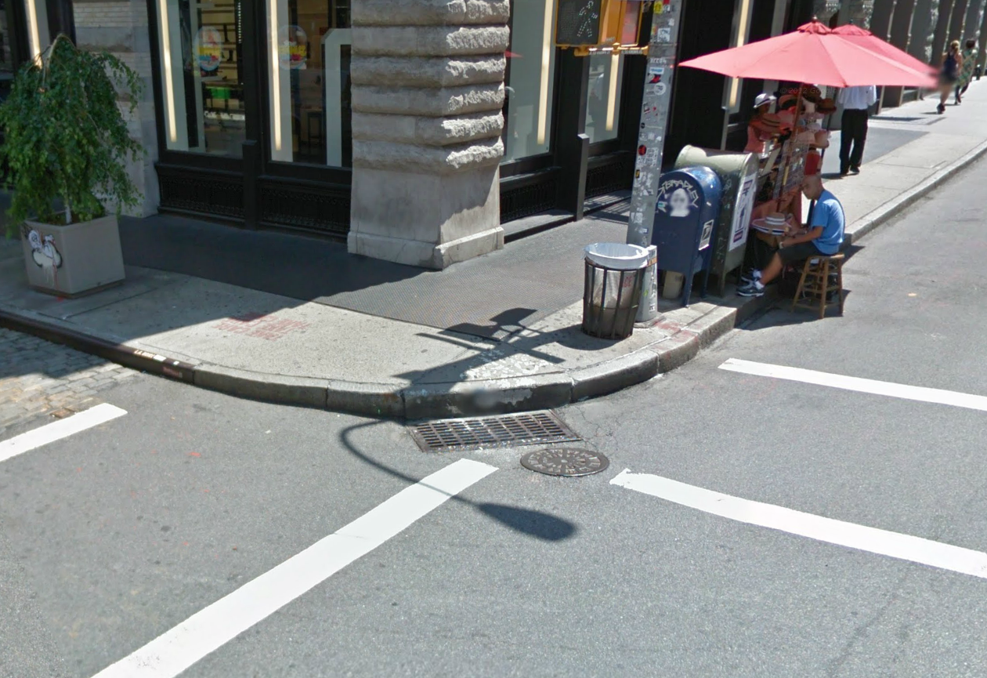
Remote Crowdsourcing
interfaces
outcomes
Online map
imagery
Machine
learning
Interactive visualization tools
New Urban Analytics
Improved urban planning
Labeling missions
Improved government accountability
Human
labels
Validation missions
Notes:
Project Sidewalk combines online map imagery <click>,
remote crowdsourcing interfaces for labeling and validation <click>,
and machine learning to scalably map and assess sidewalks

Slide 10
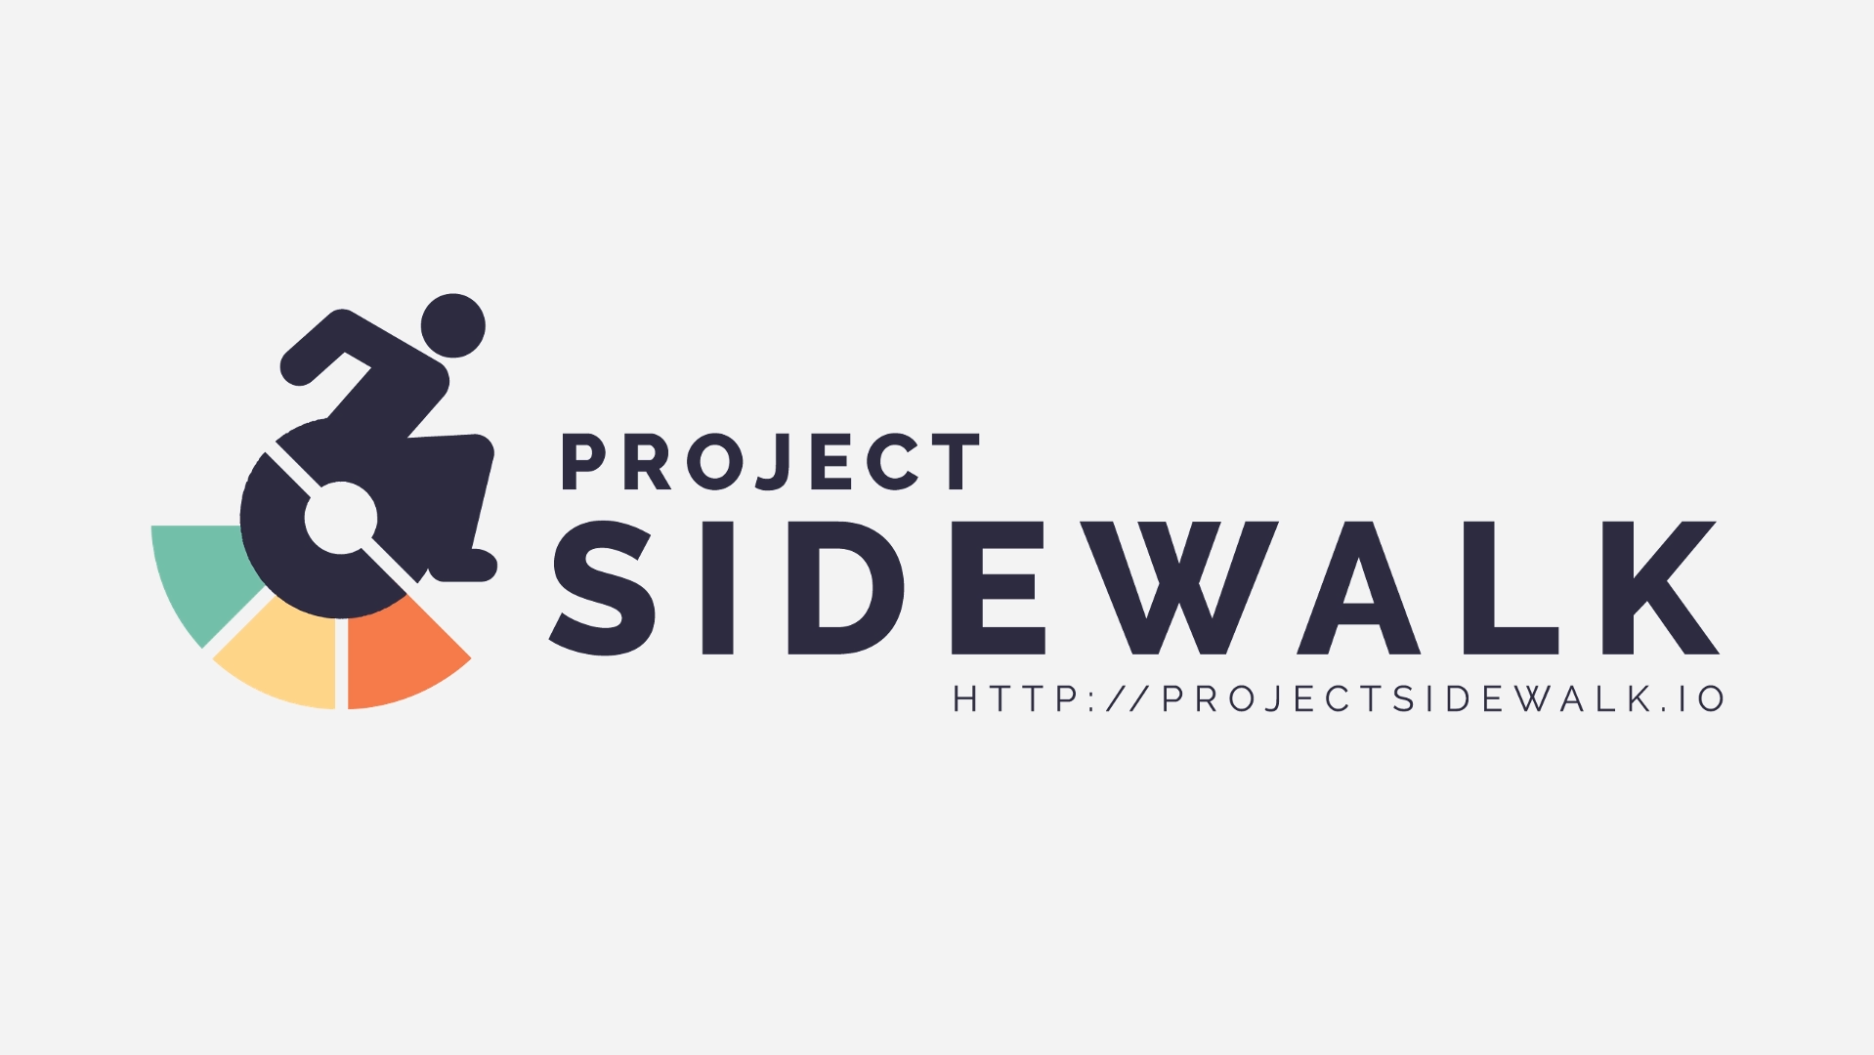
Notes:
Let’s take a look at a demo <click>…
With Project Sidewalk, online crowdworkers are given game-like missions to label and assess sidewalk accessibility by virtually walking through city streets using immersive omnidirectional street imagery (GSV) [4]—similar to a first-person video game.
Here, we are labeling a sidewalk surface problem: we click on the appropriate label type, rate the problem severity, and enter in a description

Slide 11
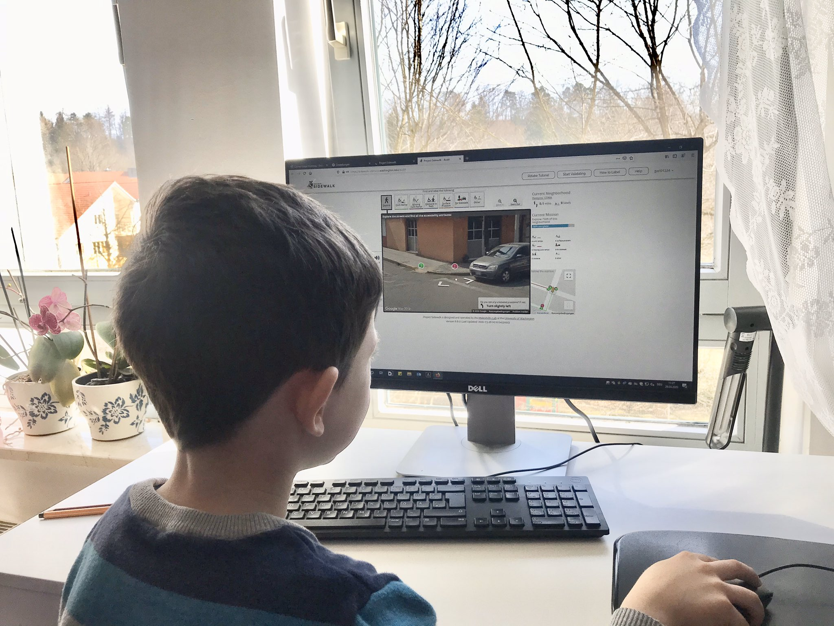
Project Sidewalk
Remote crowdsourcing
Labeling Mexico City from Germany!
Source: Edgar Martínez, Liga Peatonal
Notes:
Crucially, anyone can participate: you just need a computer and Internet connection.
----
Here, a child in Germany is labeling a neighborhood in Mexico City

Slide 12
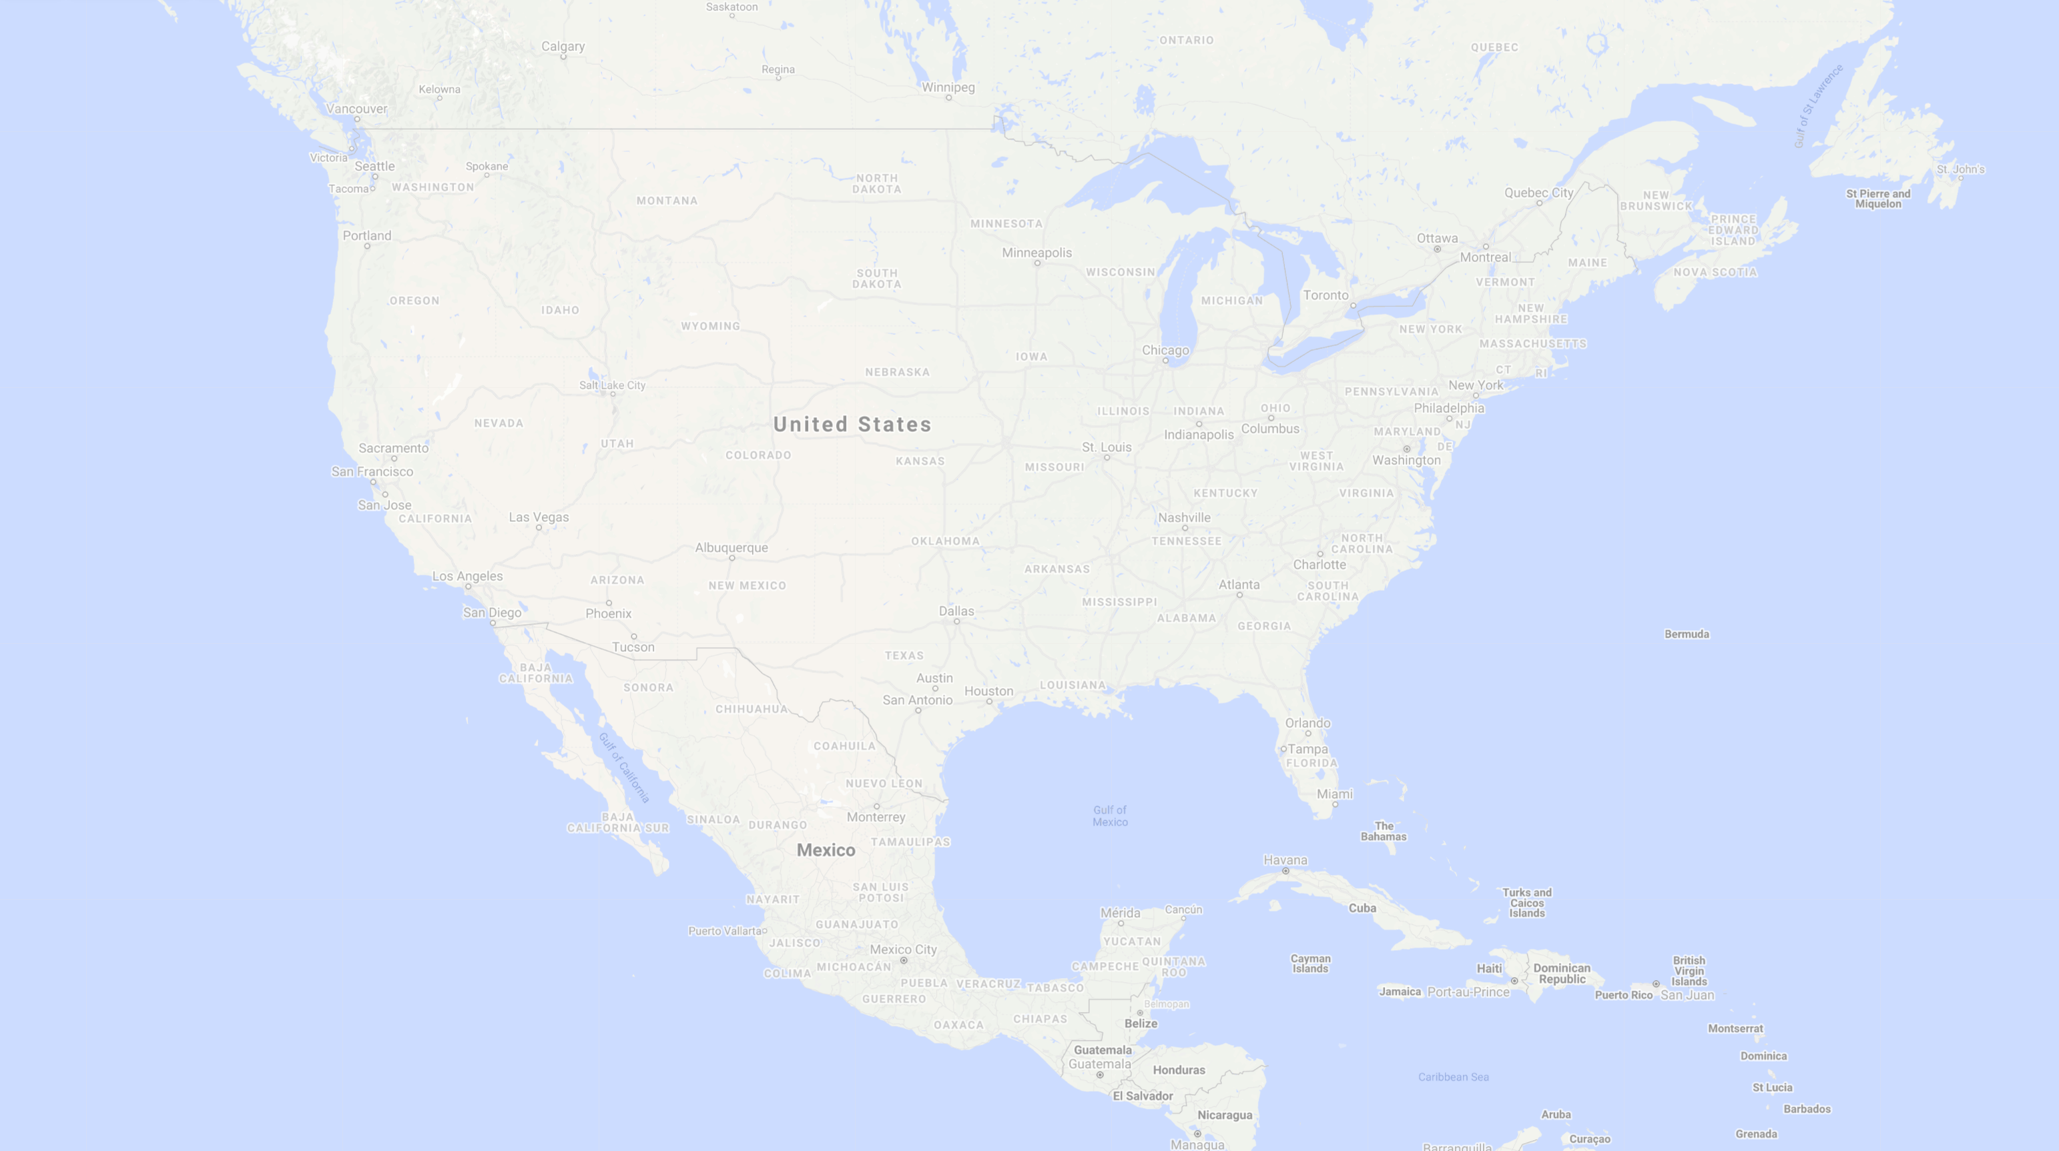
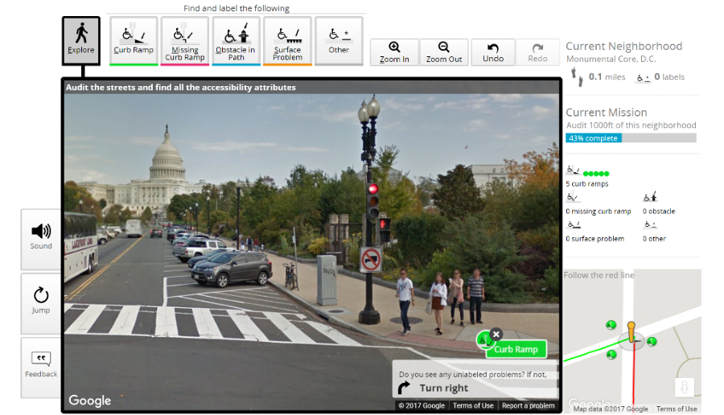
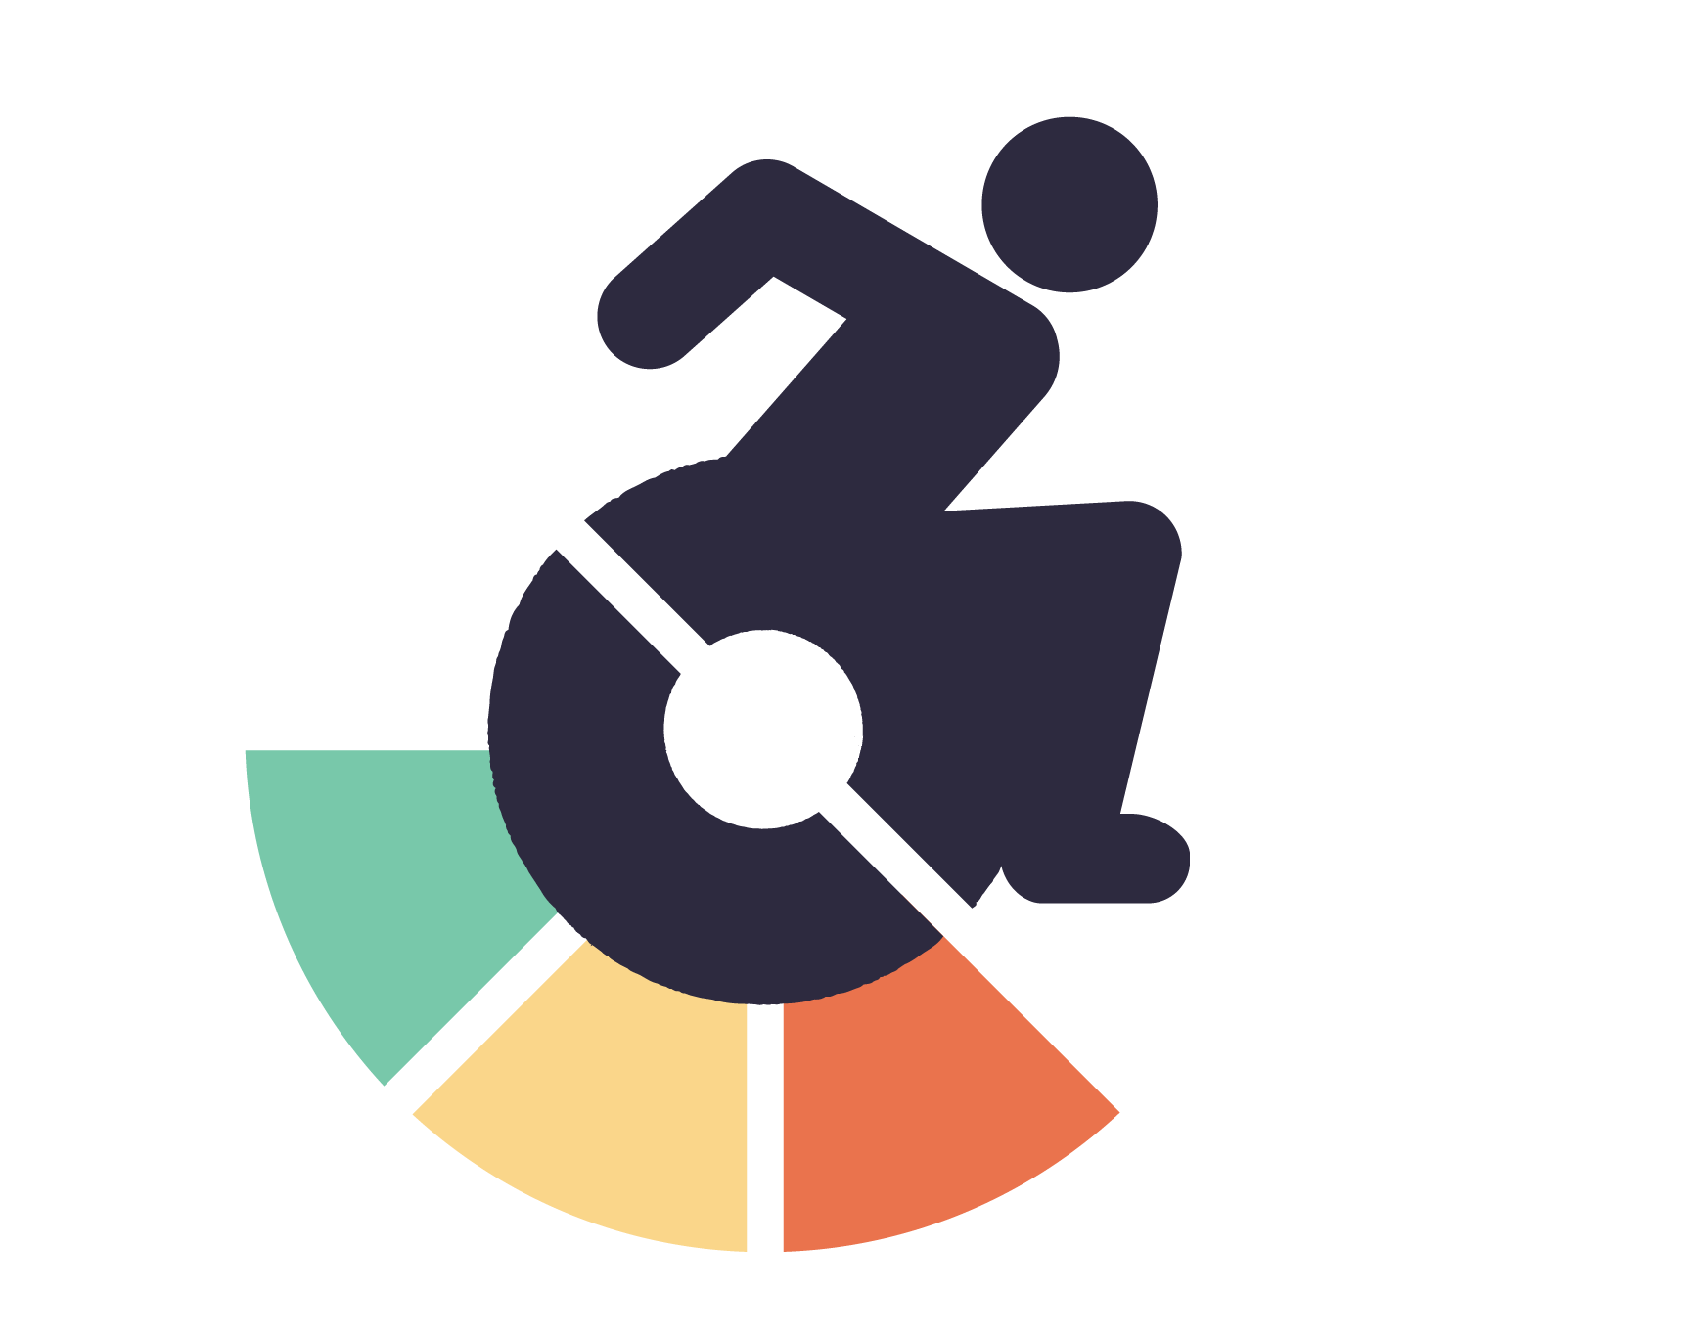

Pilot Deployment in 2017
Washington DC
Notes:
In 2017, we launched an initial pilot in Washington DC

Slide 13
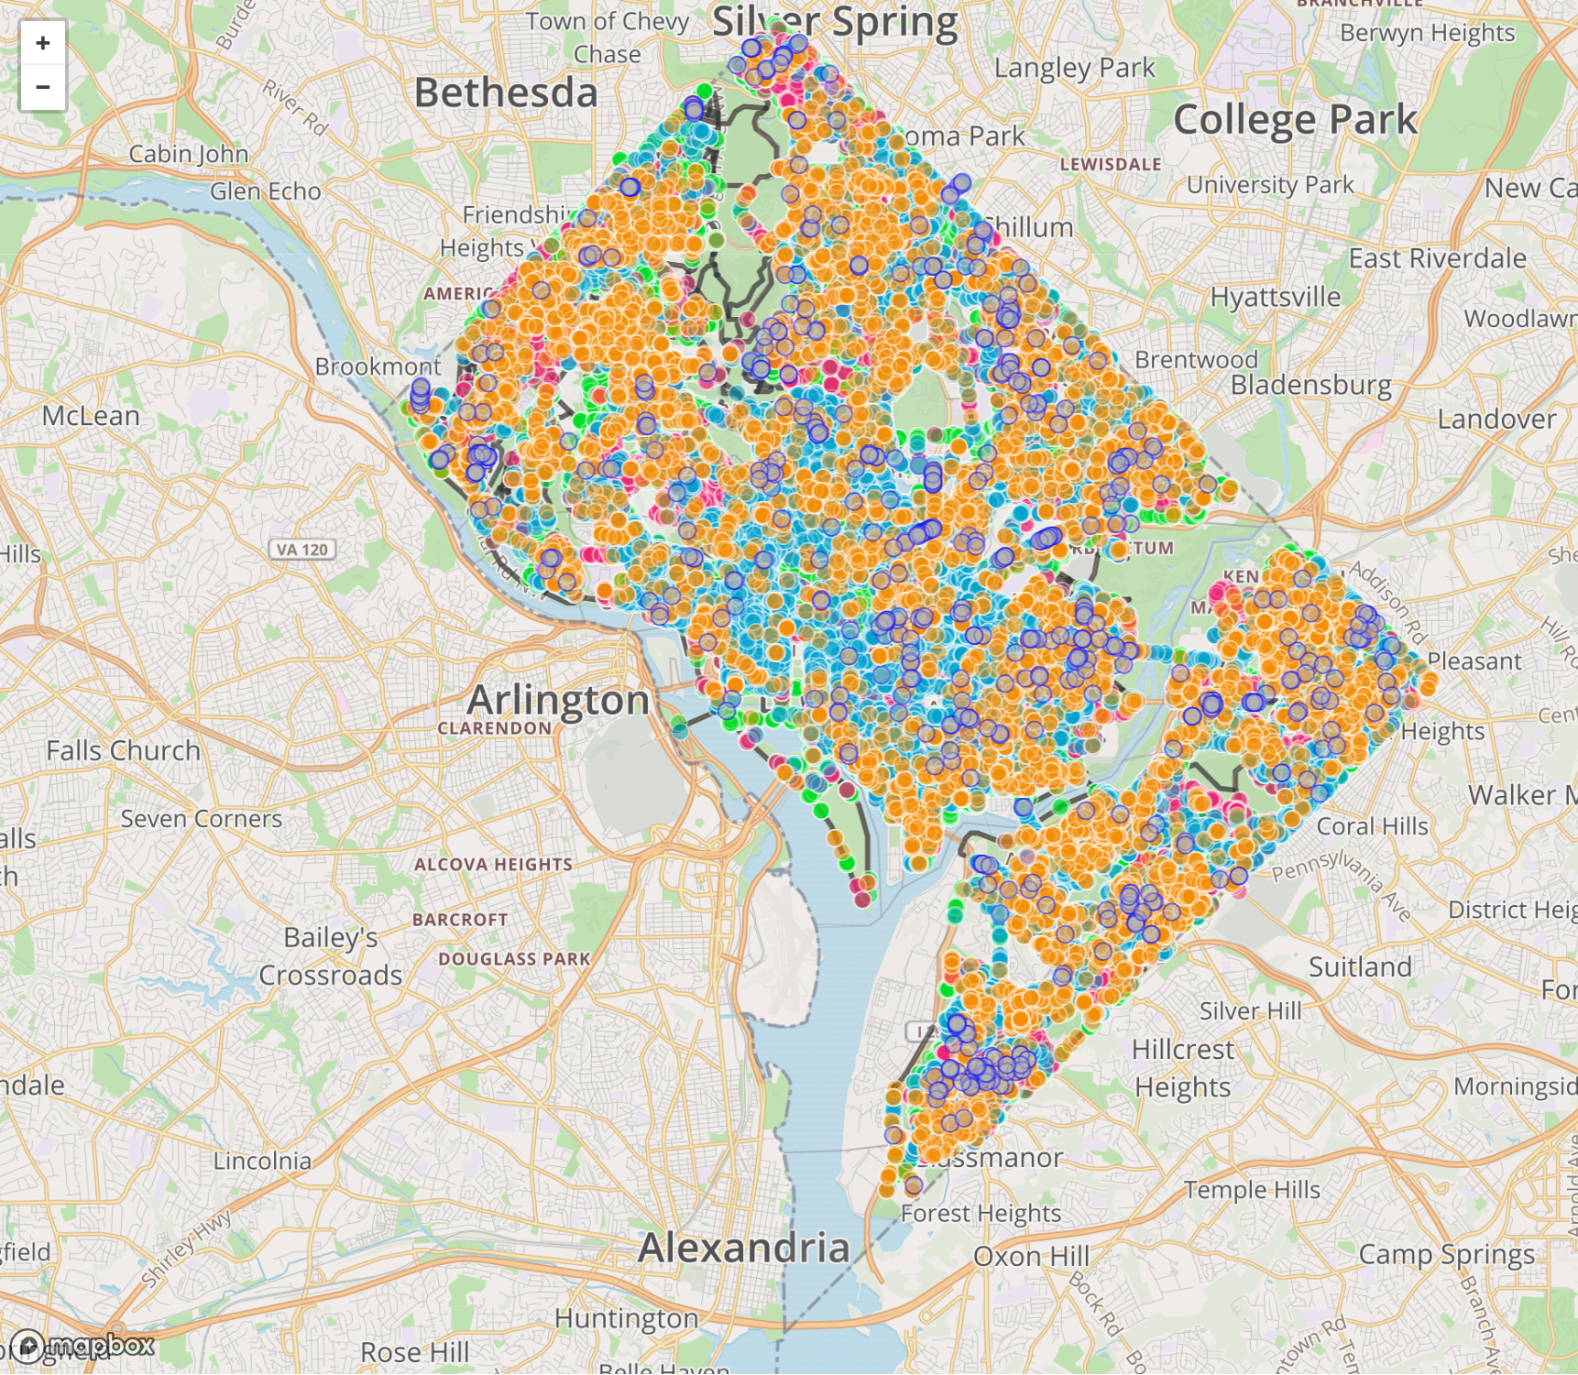
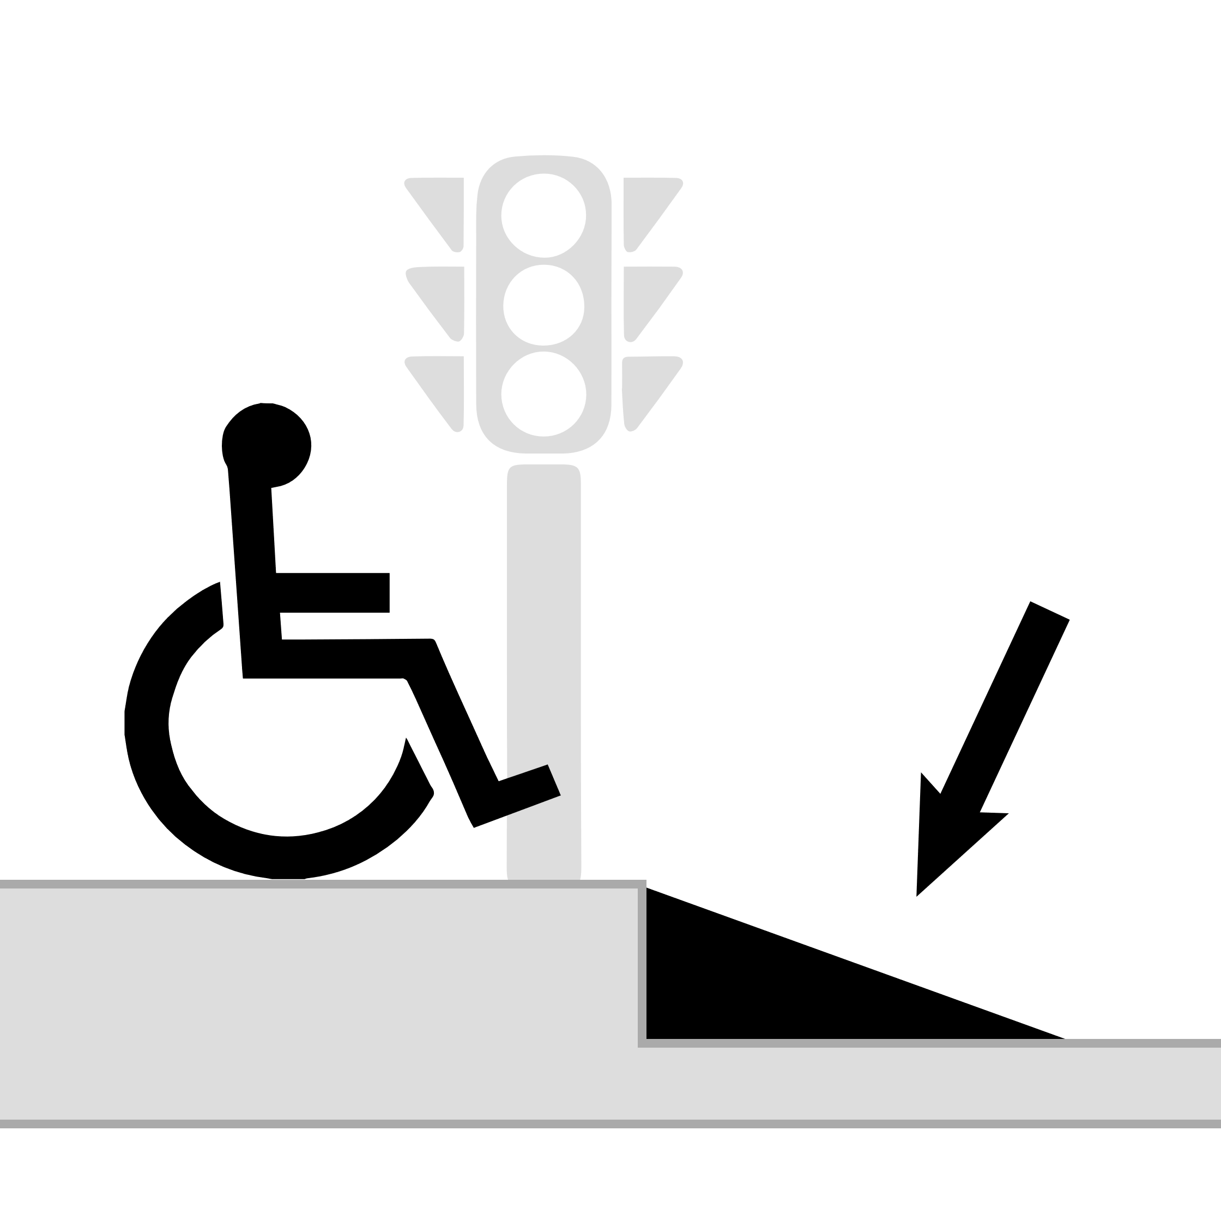
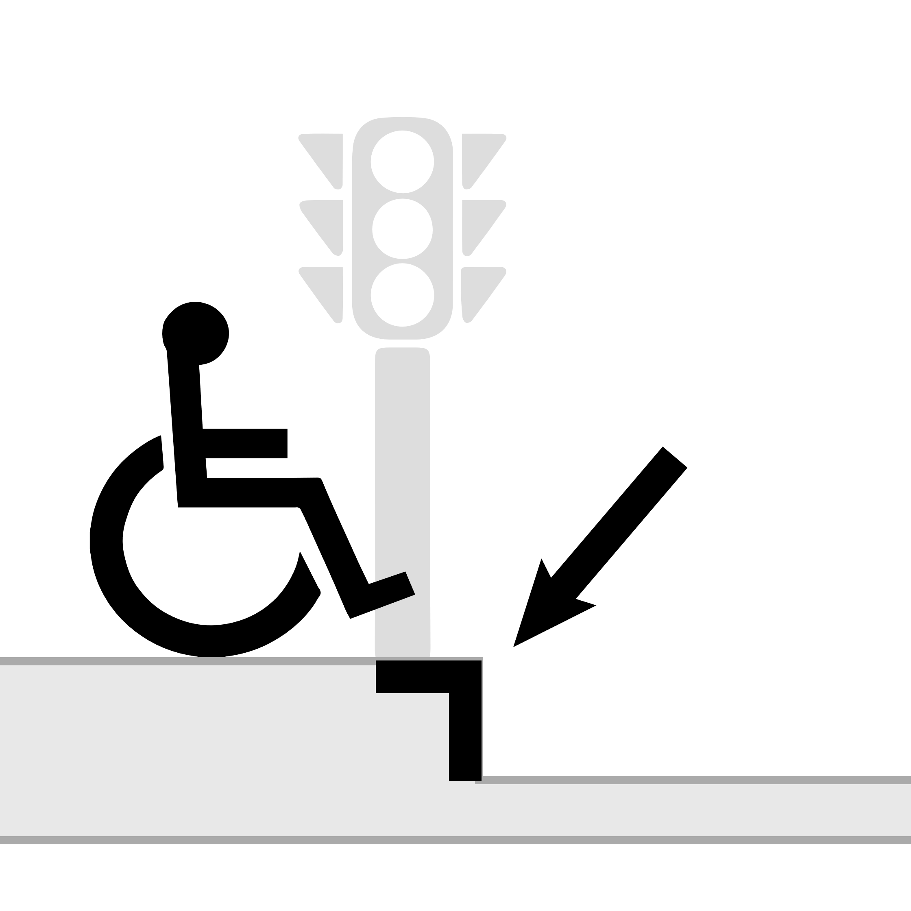
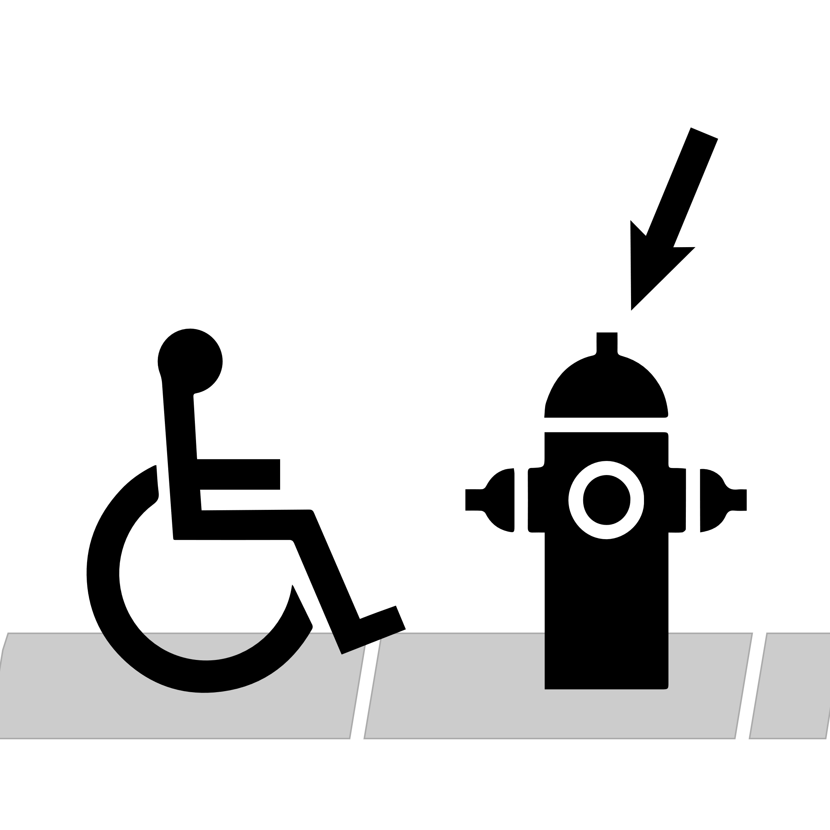
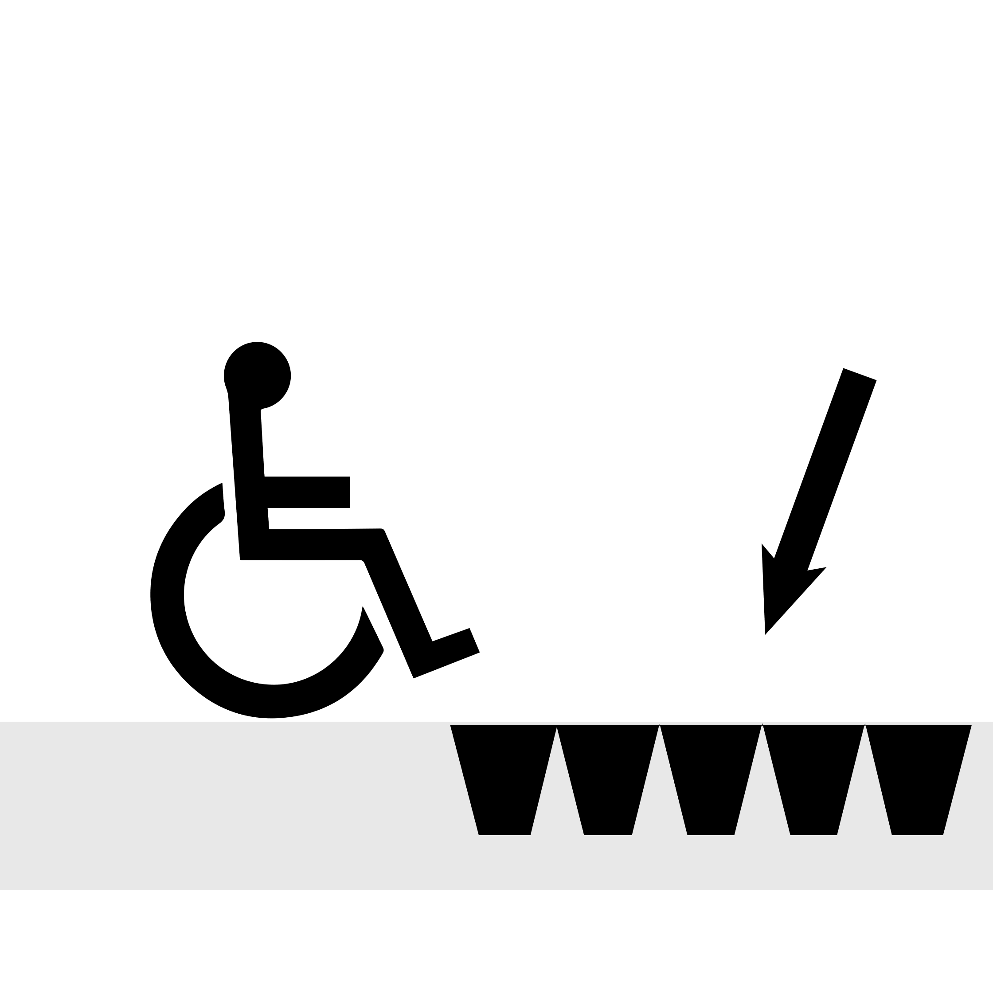
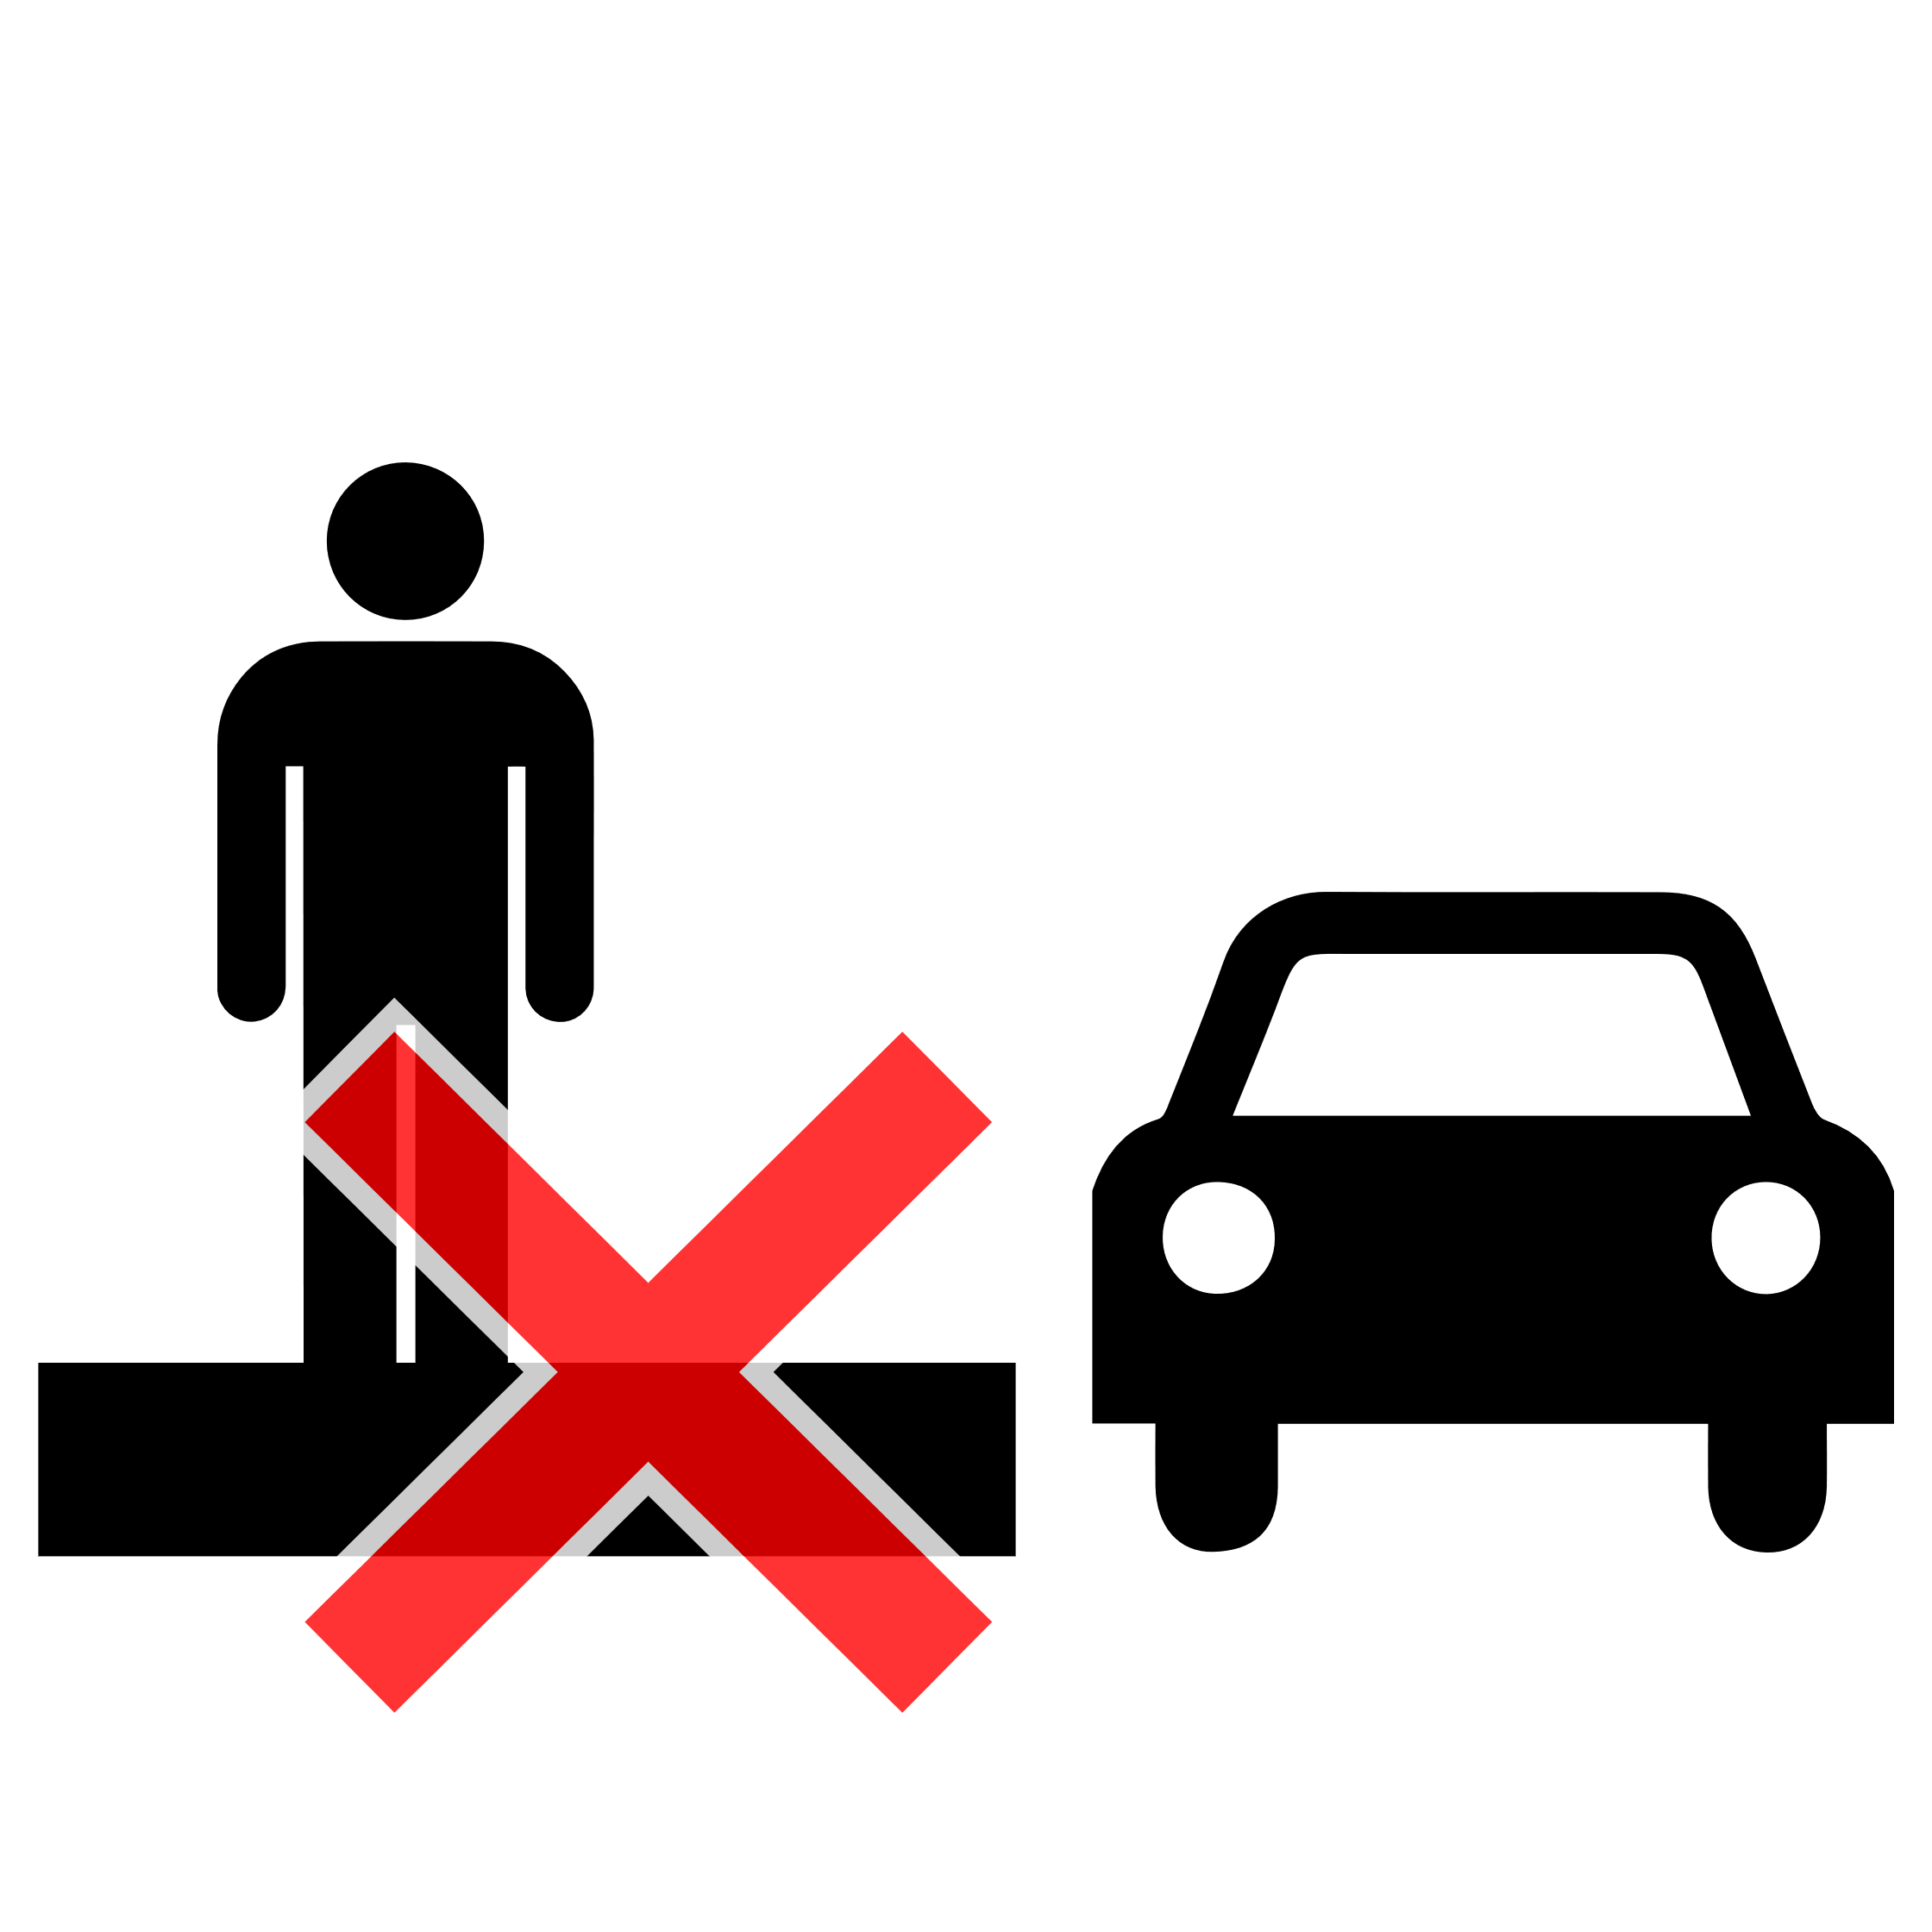
Map of Washington DC with Project Sidewalk data
Washington DC
1,400 Users
260,388 Labels
92% accuracy
Missing Sidewalks
Curb Ramps
Missing Curb Ramps
Surface Problems
Obstacles
Notes:
Over 1400 users participated, providing 260,000 labels with 92% accuracy.
----
The image shows a top-down map of all DC sidewalk labels colored by their label type, including purple for missing sidewalks, green for curb ramps, red for missing curb ramps, orange for surface problems, and blue for obstacles
---
The image shows a top-down map of all DC sidewalk labels colored by their label type, including purple for missing sidewalks, green for curb ramps, red for missing curb ramps, orange for surface problems, and blue for obstacles

Slide 14
Seattle, WA
Newberg, OR
Chicago, IL
Pittsburgh, PA
Columbus, OH
Washington DC
San Pedro Garza García, MX
Mexico City, MX
Notes:
Since our pilot, we’ve deployed seven additional cities
--- Map from
https://www.google.com/maps/d/u/0/edit?hl=en&mid=1yy-zQx_oXElkkEpcFrFxaGSb3ETqglMr&ll=32.10831686418564%2C-97.68625258281367&z=5

Slide 15



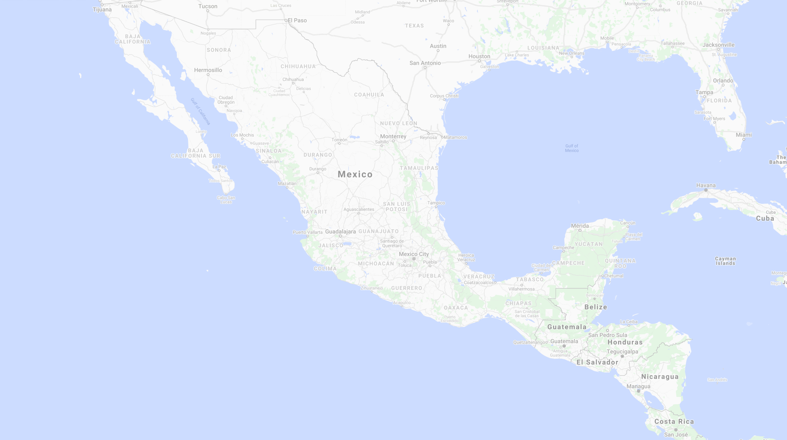
Seattle, WA
Newberg, OR
Chicago, IL
Pittsburgh, PA
GROWING DATA
Columbus, OH
Washington DC
10,000+
users
650,000
Labels
235,000
Validations
San Pedro Garza García, MX
Mexico City, MX
Notes:
Collecting over 650,000 labels with 235k validations
We believe this is the largest open sidewalk accessibility dataset in existence
---
And contributions have come from as far away as Europe, Korea, Russia, and Australia with the Project Sidewalk website receiving visitors from over 100 countries
--- Map from
https://www.google.com/maps/d/u/0/edit?hl=en&mid=1yy-zQx_oXElkkEpcFrFxaGSb3ETqglMr&ll=32.10831686418564%2C-97.68625258281367&z=5

Slide 16
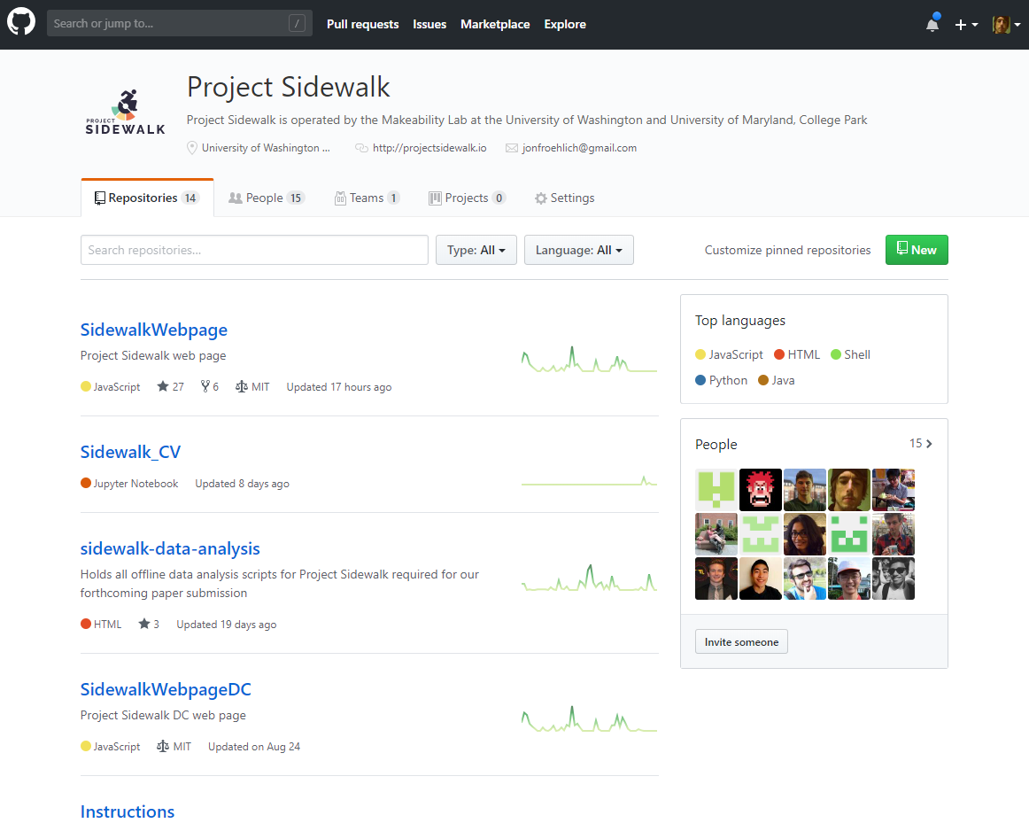
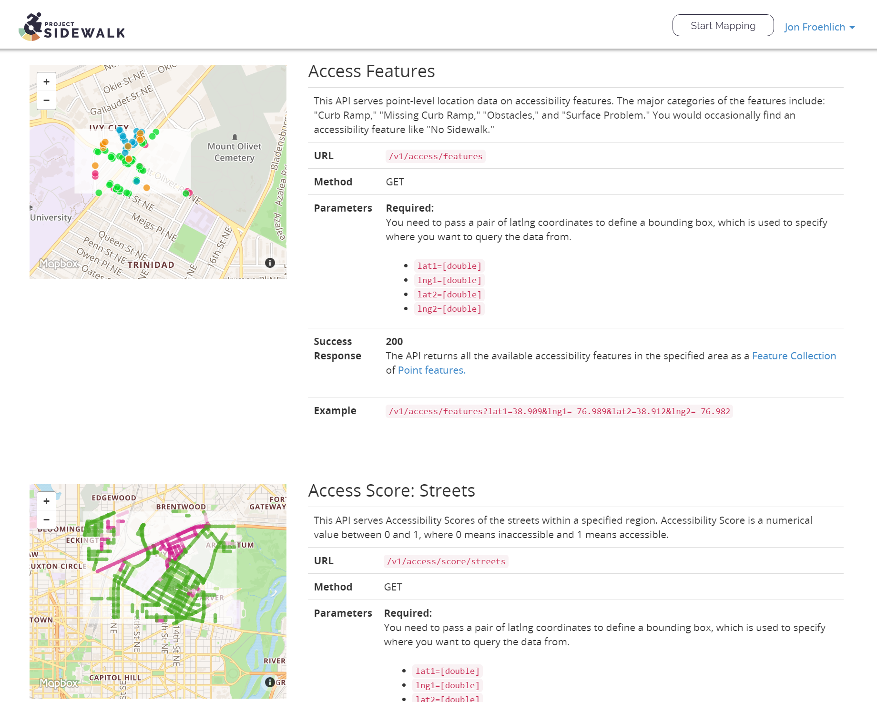
All our code + Data is 100% open source
Project Sidewalk
https://github.com/ProjectSidewalk
http://projectsidewalk.io/api
Notes:
All of our data and tools are open source, so others can build on our work

Slide 17
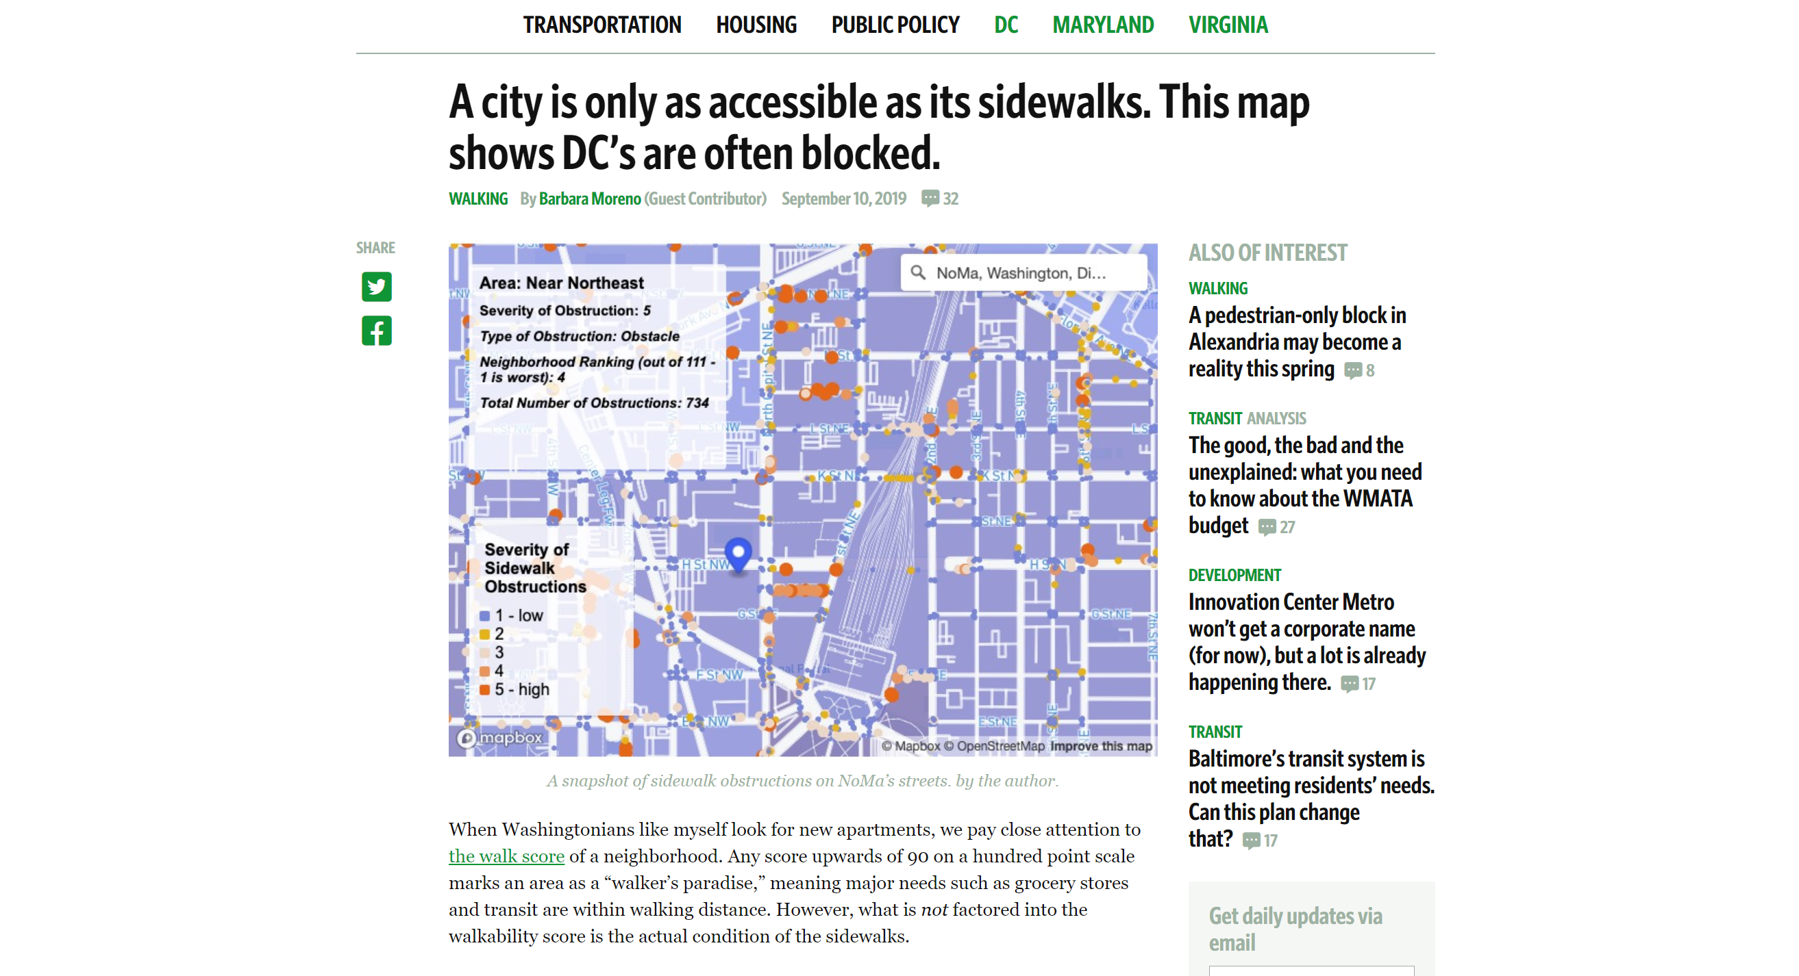
Barbara Moreno, https://ggwash.org/view/73794/washington-dc-walkable-scores-quality-of-sidewalks
Notes:
For example, a developer built an interactive tool visualizing sidewalk accessibility in DC from Project Sidewalk data, which received local press
---
https://ggwash.org/view/73794/washington-dc-walkable-scores-quality-of-sidewalks

Slide 18
questions
SDSS’21 Urban accessibility
How can we combine crowds + AI in new ways to improve sidewalk labeling efficacy and quality?
How can these emerging, cross-city datasets enable new urban science research and advocacy tools?
How is urban accessibility changing and where is it not?
Notes:
To close, we offer three key questions… <read>
First, how can we combine crowds+AI in new ways to improve sidewalk labeling efficacy and quality

Slide 19
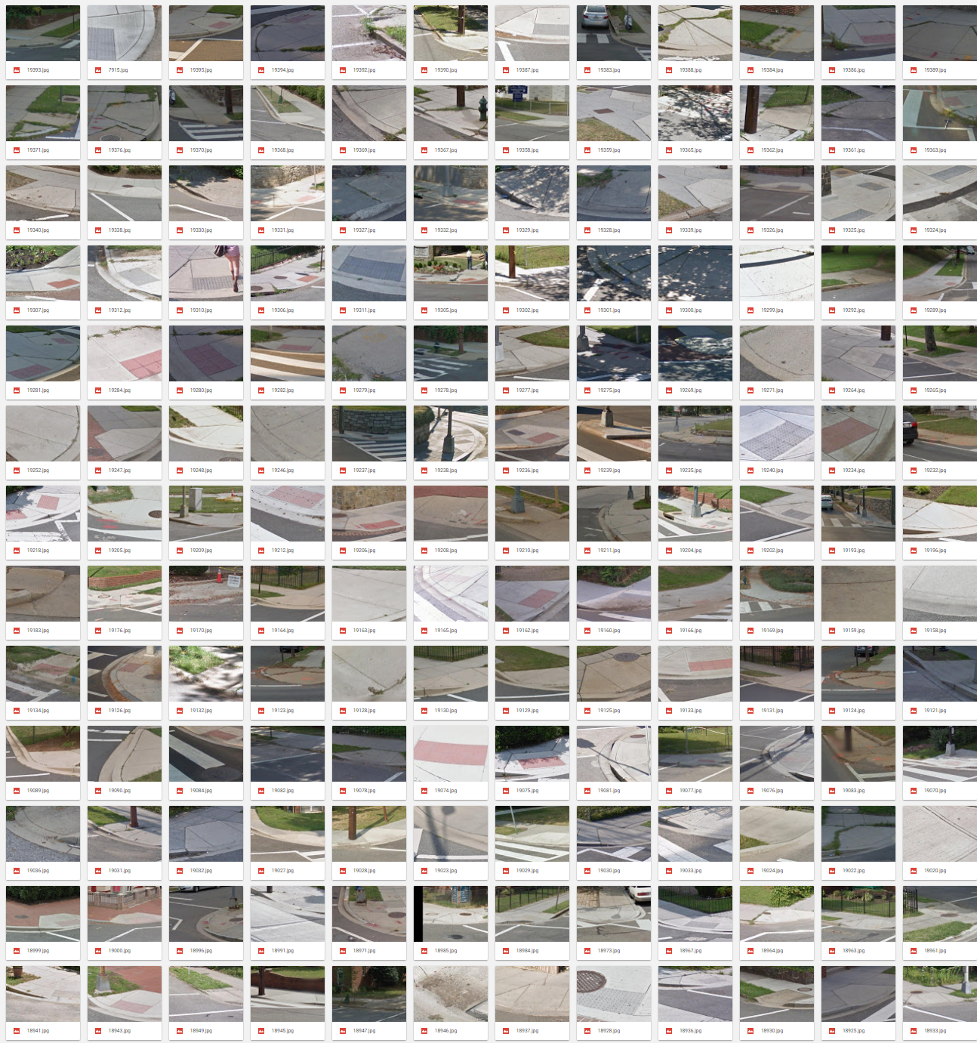

Source: @ericleeclark
Notes:
Now that our datasets have grown to over 600,000 labeled images, we have been experimenting with new machine learning techniques not previously possible
----
Crops: https://twitter.com/ericleeclark/status/1457399041495650307?s=20

Slide 20
Notes:
Some of which we explored in this recent paper
--
Our recent deep learning work showed that for some simple validation tasks—like validating curb ramp labels—computer vision can perform almost as well as humans

Slide 21
questions
SDSS’21 Urban accessibility
How can we combine crowds + AI in new ways to improve sidewalk labeling efficacy and quality?
How can these emerging, cross-city datasets enable new urban science research and advocacy tools?
How is urban accessibility changing and where is it not?
Notes:
Second, how can these emerging large-scale datasets enable new urban science research and advocacy tools

Slide 22


Support new urban science Explorations
Discussion
Problem Count
Low
High
What are the geo-spatial patterns and key correlates of sidewalk accessibility?
How does accessible infrastructure correspond to racial and socio-economic factors? How do these patterns compare across cities?
What do sidewalks look like across cities and countries? How does accessibility vary and why?
How does sidewalk accessibility reflect the socio-cultural and-political context of that region?
Notes:
For example, what are the geospatial patterns and key correlates of sidewalk accessibility? How do these patterns compare across cities?

Slide 23

Notes:
My PhD student, Manaswi Saha, has been creating and studying a variety of different types of urban accessibility visualizations and evaluating them with different stakeholder groups.
---
We just completed a formative study looking at how urban accessibility visualizations can aid awareness and address planning questions

Slide 24
questions
SDSS’21 Urban accessibility
How can we combine crowds + AI in new ways to improve sidewalk labeling efficacy and quality?
How can these emerging, cross-city datasets enable new urban science research and advocacy tools?
How is urban accessibility changing and where is it not?
Notes:
Finally, how is urban accessibility changing and where is it not?

Slide 25



Notes:
Google has a Street View feature that allows you to see all historic street view images at a location dating back to 2007

Slide 26




Prototype 1
Single View
Prototype 3
Panorama View
Prototype 2
Grid View
Notes:
We have been using that dataset to develop temporal tracking tools for urban accessibility that combine crowds + computer vision

Slide 27
Thank you!
Jon E. Froehlich | jonf@cs.uw.edu
Visit http://projectsidewalk.org/
Notes:
We would love to collaborate with you on this work.
Together, we can make sidewalks more accessible

