Slide 1



closing the gap between
action
& effect
using computers to sense and feedback resource consumption information in the home
for mobile persuasion
jfroehli@uw.edu
phd candidate in computer science
university of washington
oct 27, 2010
design:
ubicomp lab
use:
build:
university of washington
sustainability research
university of washington
Notes:
Closing the Gap Between Action and Effect: Using Computers to Sense and Feedback Resource Consumption Information in the HomeWhy is it that despite spending a fraction of the time in our cars compared to our homes, most of us know much more about the price of gas and the efficiency of our vehicles than we do about the cost of electricity and the energy efficiency of our homes? In this talk, I will introduce our recent work on sensing electricity, gas, and water usage in the home and show how with simple, user-installable sensors, we can provide itemized information to the homeowner about the consumption of specific electrical, gas, and water appliances and fixtures. Our ultimate goal is to inform and empower a wide variety of stakeholders from homeowners and building operators to utilities and policy makers with an unparalleled level of data on resource consumption. Our work promises to transform the ways in which we think about our own homes.
Picture modified from: http://www.flickr.com/photos/33511186@N00/78590477/sizes/z/in/photostream/

Slide 2
how do you react to this feedback? can we sense changes in your behavior?
you
sensing
feedback
how can we create sensors to sense and infer your behaviors?
how do we present this data back to you? what medium and interface is most effective?

Slide 3
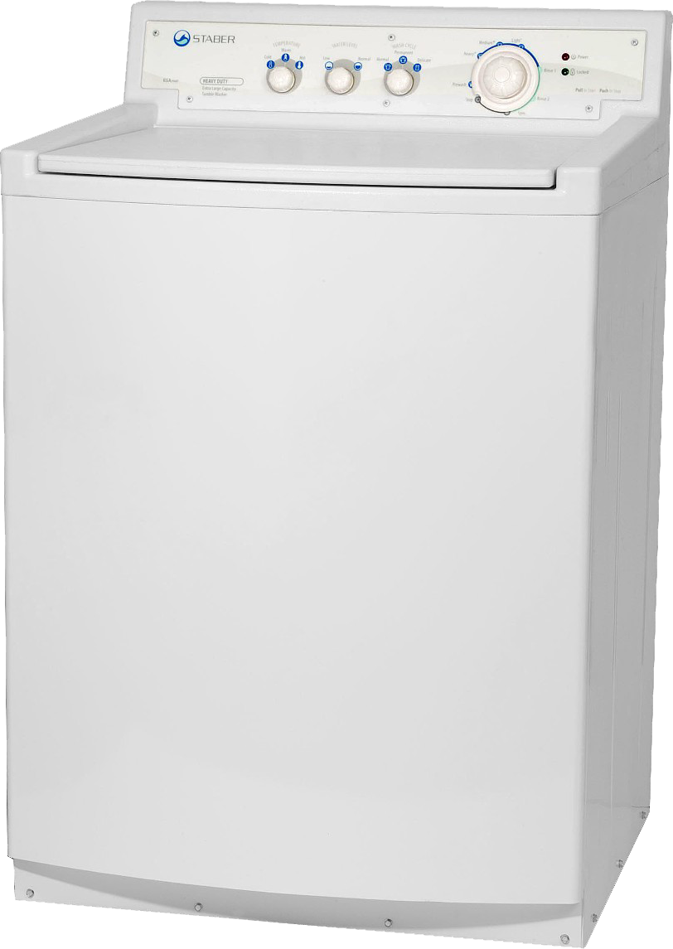
how much energy does a load of laundry use in the dryer?
Notes:
65.9 billion kWh
Dryer uses 5.8% of electricity in average home
7th most consuming activity behind: air conditioning, refrigeration, space heating, water heating, and lighting.

Slide 4
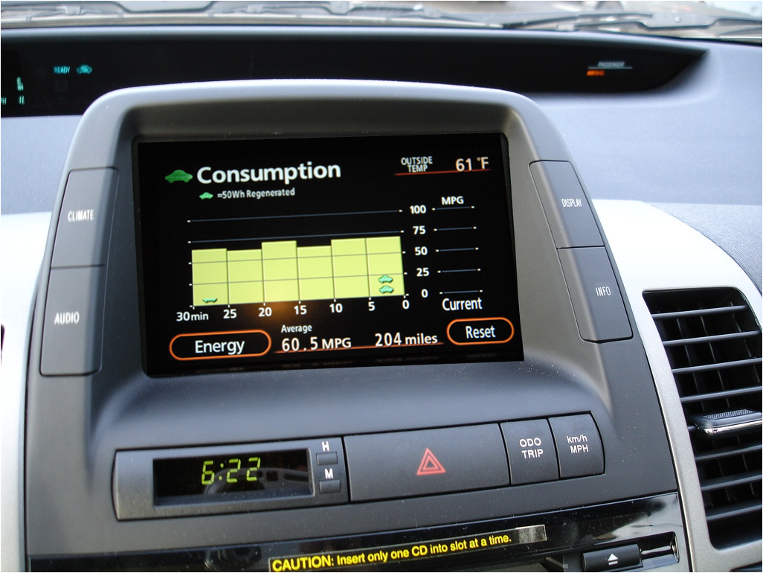
toyota prius

Slide 5
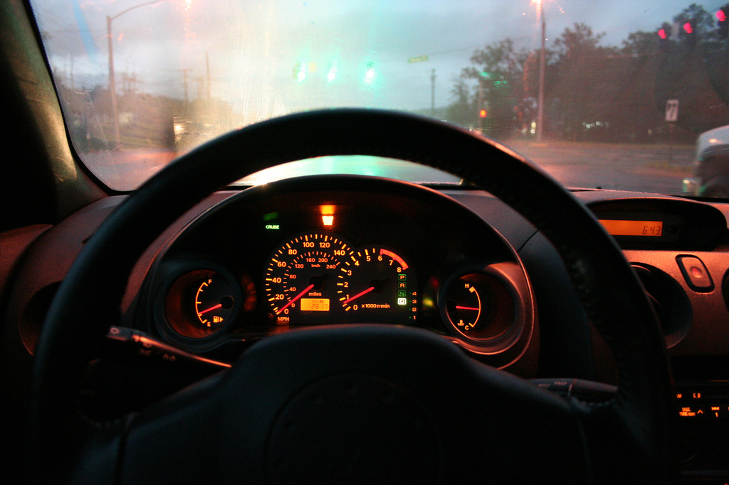
speedometer
gas gauge
Notes:
One of the best established findings in psychology is the role of feedback on performance. Think about how ingrained feedback is in our environment.
For example, driving:
this type of feedback is always available, passively given allowing us to sort of pre-attentively recognize it

Slide 6
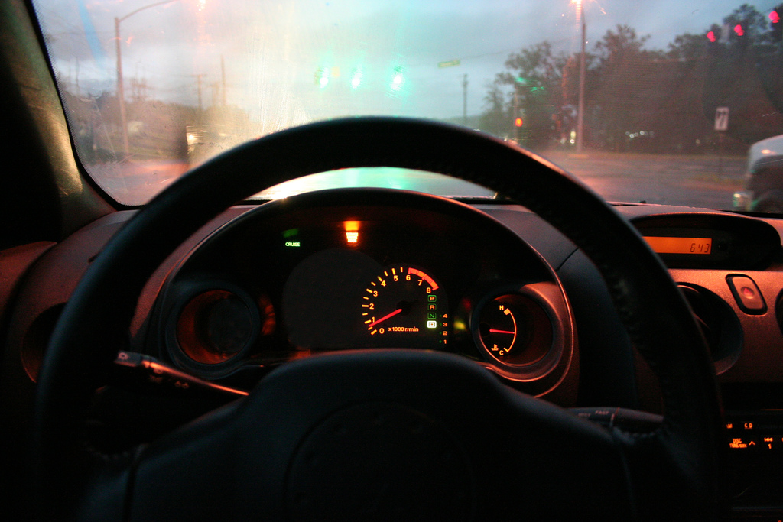
Notes:
We want to create these sorts of passive awareness systems.

Slide 7
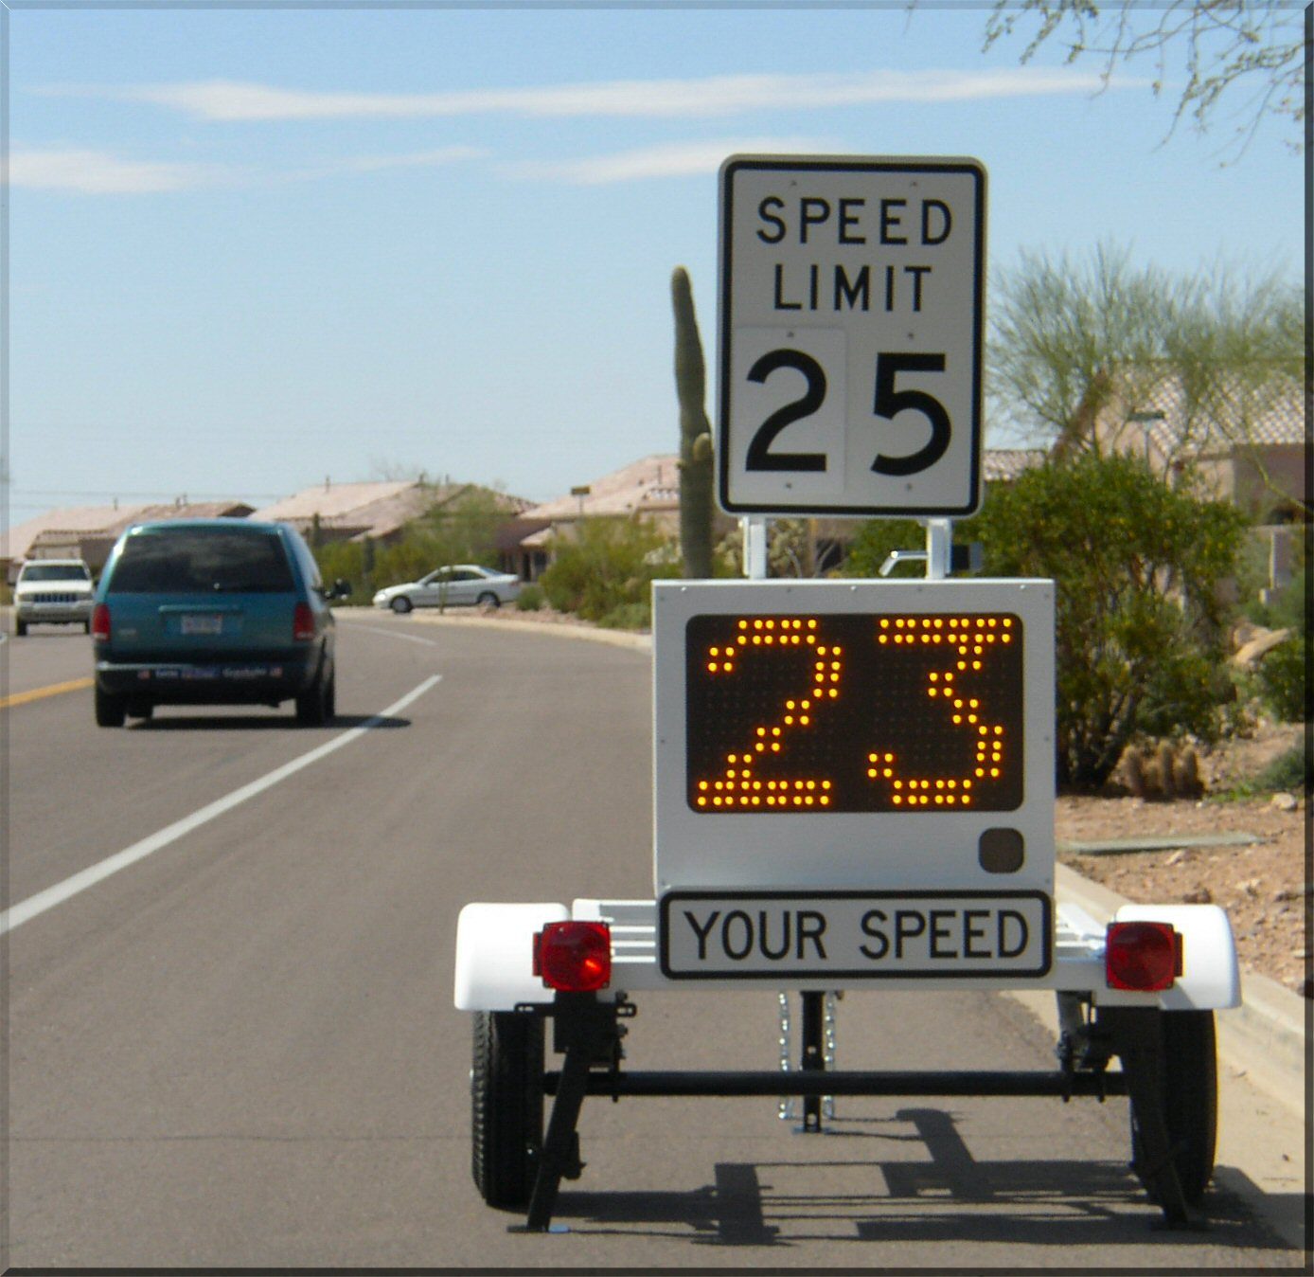
vehicle
activated
speed
signs
Notes:
Vehicle Activated Speed

Slide 8
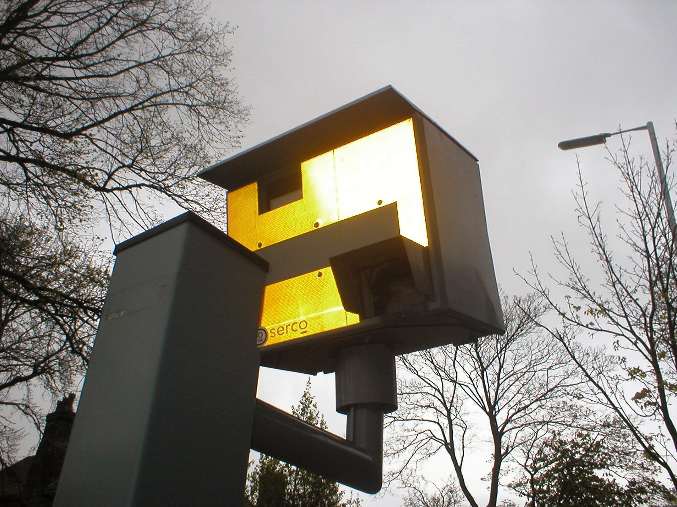

speed cameras
Notes:
Vehicle Activated Speed
In Britain, the VAS signs cost upwards of 90% less to operate annually than speed cameras while preventing more accidents
Sutherland, 2008

Slide 9
vehicle
activated
speed
signs
Notes:
Vehicle Activated Speed
In Britain, the VAS signs cost upwards of 90% less to operate annually than speed cameras while preventing more accidents
Sutherland, 2008

Slide 10
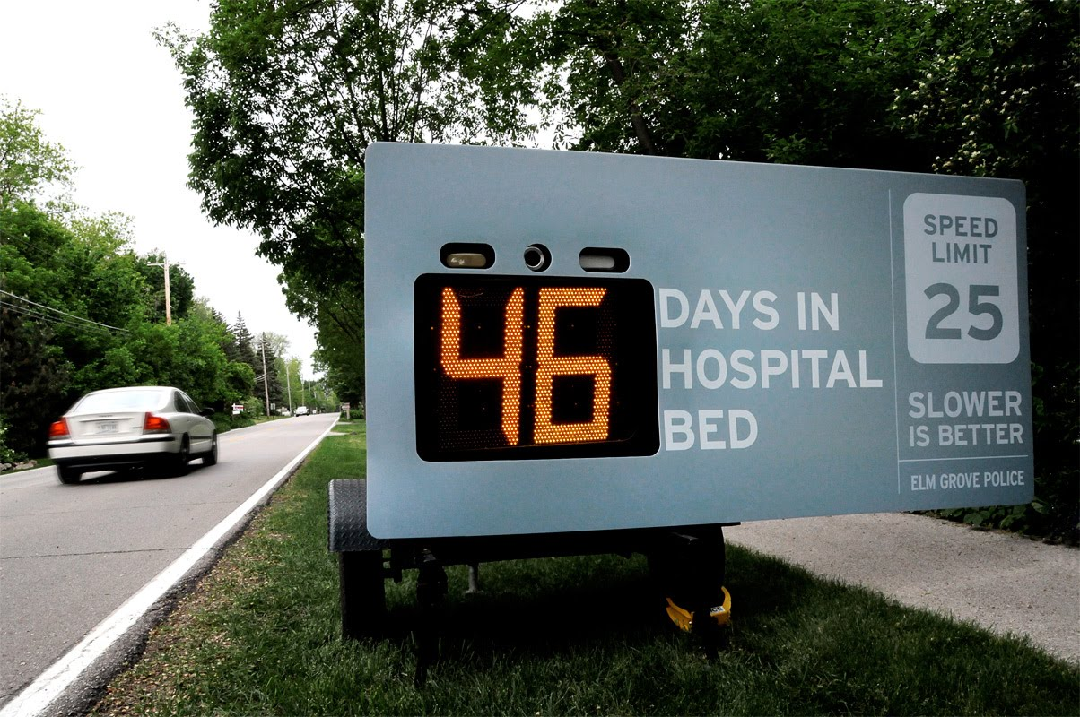
vas signs

Slide 11

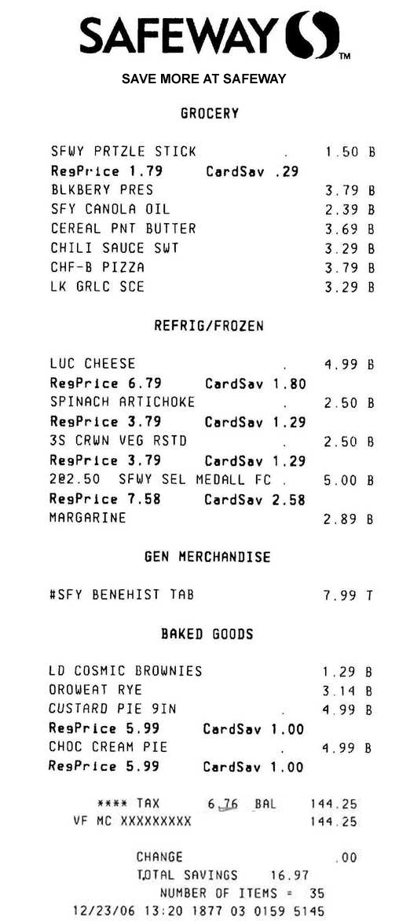
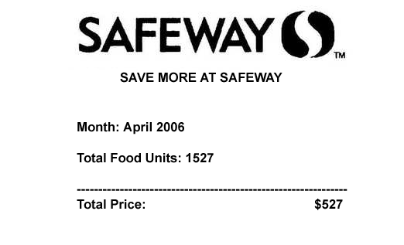

Slide 12
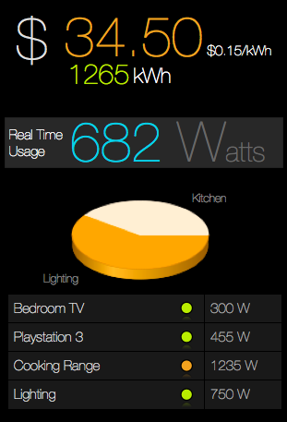
itemized energy feedback

Slide 13
At the flick of a switch: Detecting and Classifying Unique Electrical Events on the Residential Power Line.
Shwetak N. Patel, Thomas Robertson, Julie A. Kientz, Matthew S. Reynolds, and Gregory D. Abowd
UbiComp 2007

Slide 14
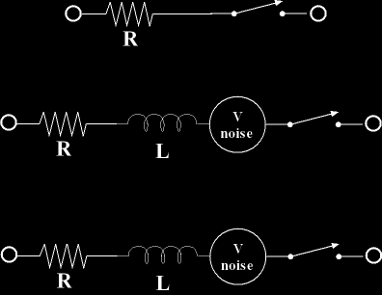

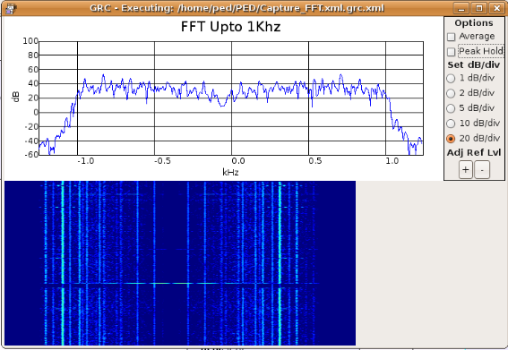

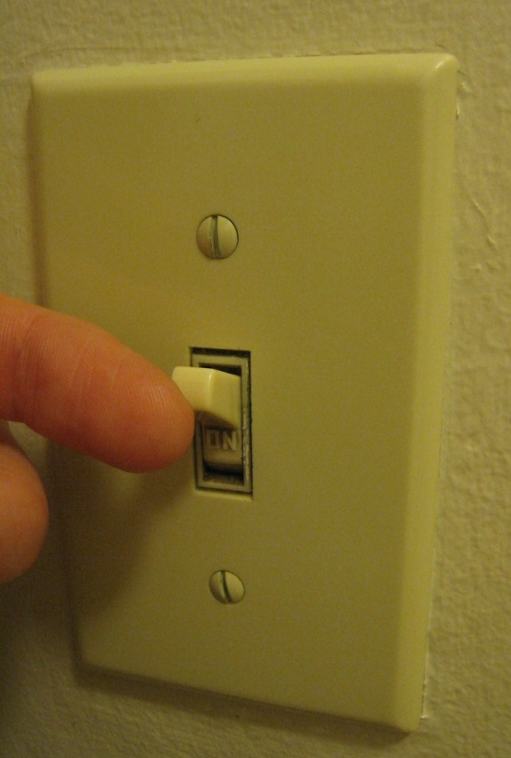
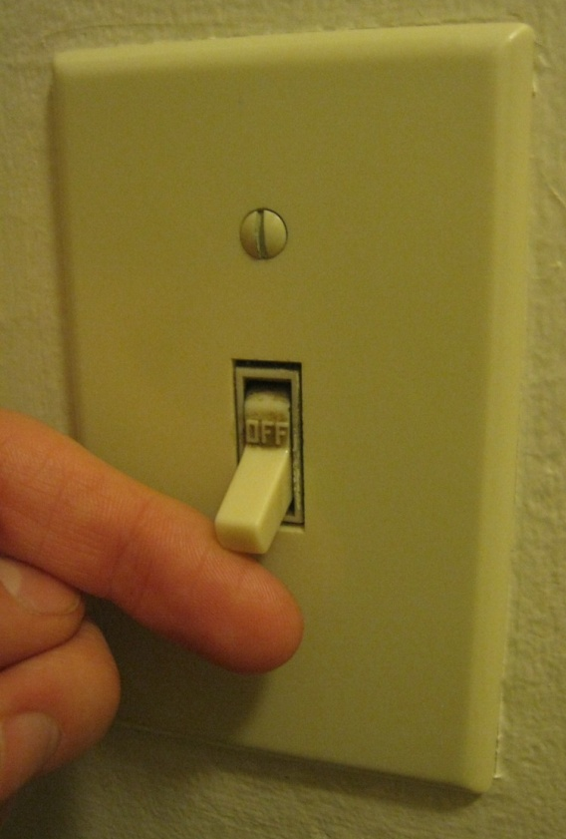
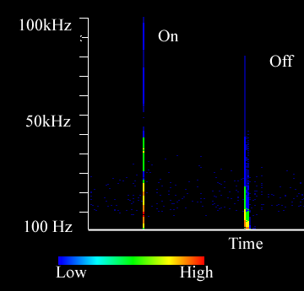
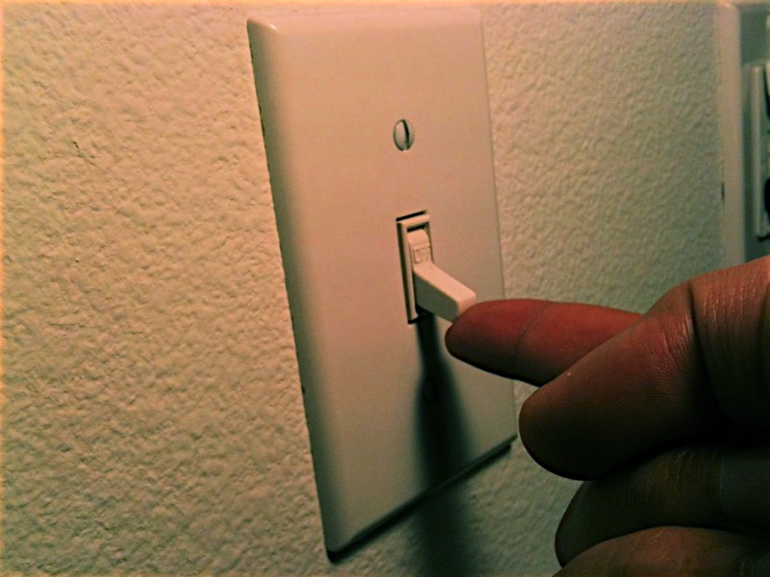
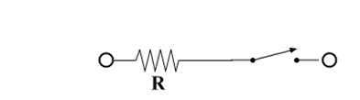
how flick of a switch works
mechanical switches
Off
electrical noise transient
R
R
Notes:
The transient typically last only a few microseconds and consist of a rich spectrum of frequency components, which can range from 10 Hz to 100 kHz. The noise signature of a particular device depends both on the device and the transmission line behavior of the interconnecting power line.

Slide 15
how flick of a switch works
mechanical switches
Off
electrical noise transient
R
R

Slide 16
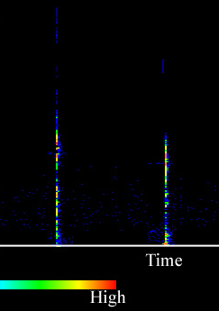

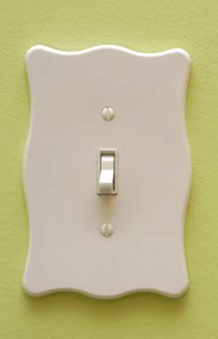
each switch has a unique transient signature
on
on
based on:
switching mechanisms
load characteristics
position on transmission line
off
off
switch 1
switch 2
Notes:
Depending on the switching mechanism, the load characteristics, and length of transmission line, these impulses can be very different.

Slide 17
transient noise is generated when a physical switch is turned on/off
key problem is signal depends on both the device and switch
most modern consumer electronics
have a soft-switch

Slide 18
switched mode power supply

Slide 19
smps based appliances are becoming increasingly prevalent

Slide 20
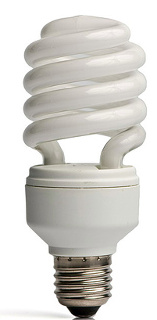


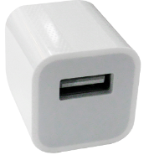

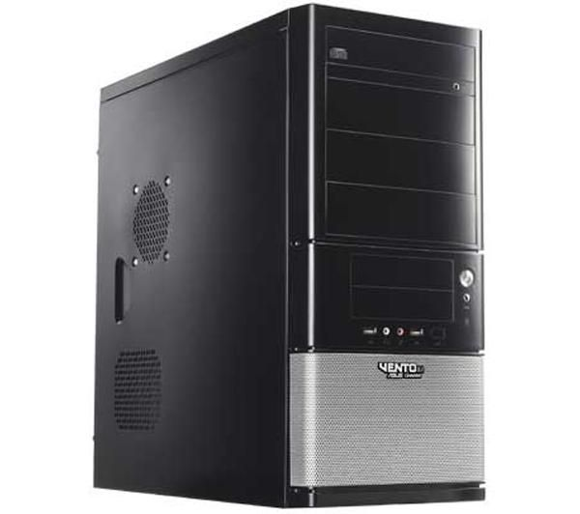



Slide 21
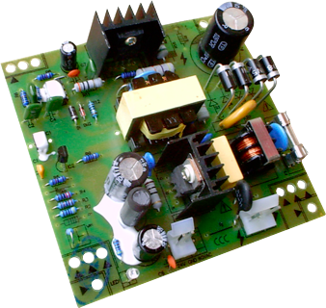
efficient and small in size.
stores energy in inductors & switches it in and out at high frequency.
Notes:
The reason for their efficiency is that instead of dissipating power as heat, they instead switch energy in and out

Slide 22
switching operation generates high frequency
electro magnetic interference (emi)
Supply
Load
Inductor
Notes:
Unlike a linear power supply, the pass transistor of a switching mode supply switches very quickly (typically between 50 kHz and 1 MHz) between full-on and full-off states, which minimizes wasted energy.
Voltage regulation is provided by varying the ratio of on to off time. In contrast, a traditional power supply must dissipate the excess voltage as heat to regulate the output. This higher efficiency is the chief advantage of a switch-mode power supply.
---
An inductor or a reactor is a passive electrical component that can store energyin a magnetic field created by the electric current passing through it. An inductor's ability to store magnetic energy is measured by its inductance
Well an inductor is like a capacitor. They both store electrical energy. The capacitor stores its energy in an electric field, whereas an inductor stores its energy in a magnetic filed. Like a capacitor, the inductor opposes changes in a variable in the circuit. The indictor likes to maintain a constant current. Whereas for a capacitor, it likes to maintain a constant volatge.

Slide 23

switching operation generates high frequency
electro magnetic interference (emi)
Supply
Load
EMI
Inductor
Notes:
This switching mechanism provides a large amount of emi and this is the signature that we use to identify devices
Since your device is physically plugged into the powerline, the emi gets coupled with the internal electrical power infrastructure in your home

Slide 24


EMI
Notes:
Since your home is one big connected electrical infrastructure, you can sense this emi from any outlet in the home

Slide 25
Movie Removed for Public Posting of Slides
Notes:
<end of video> so let’s look at what this signal is in more detail

Slide 26
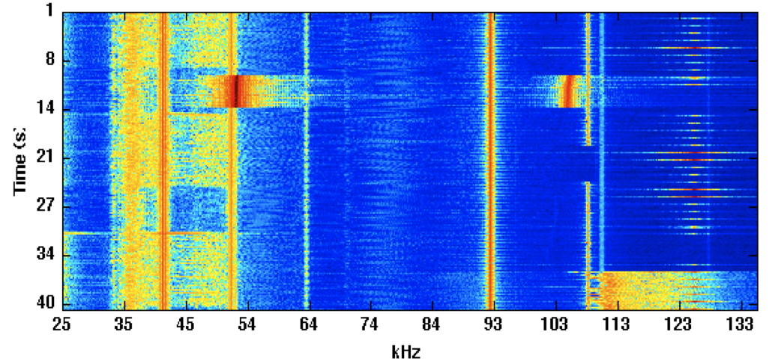
what emi on power line looks like
Time (s)
Frequency (kHz)
Notes:
Frequency domain waterfall plot
Describe x and y-axes
Color represents strength of signal
This is what powerline looks like to sensor

Slide 27
what emi on power line looks like
Time (s)
pc
lamp
Frequency (kHz)
Notes:
For clarity, I’ve highlighted two signals in particular: a pc and a cfl lamp
The key thing here is that the signal is available for as long as the device is on

Slide 28

capture system
Power Line Interface
(High Pass Filter)
Digitizer
&
Frequency Transform
Event Processor
&
Classifier
Any electrical outlet

Slide 29
event processing
1
2
3
Event Detection
&
Segmentation
Feature Extraction
Classification

Slide 30
1
event detection & segmentation
Movie Removed for Public Posting of Slides
Frequency (kHz)
Notes:
Lcd monitor. This is emi being coupled to the powerline
Turn it off, it goes away.

Slide 31
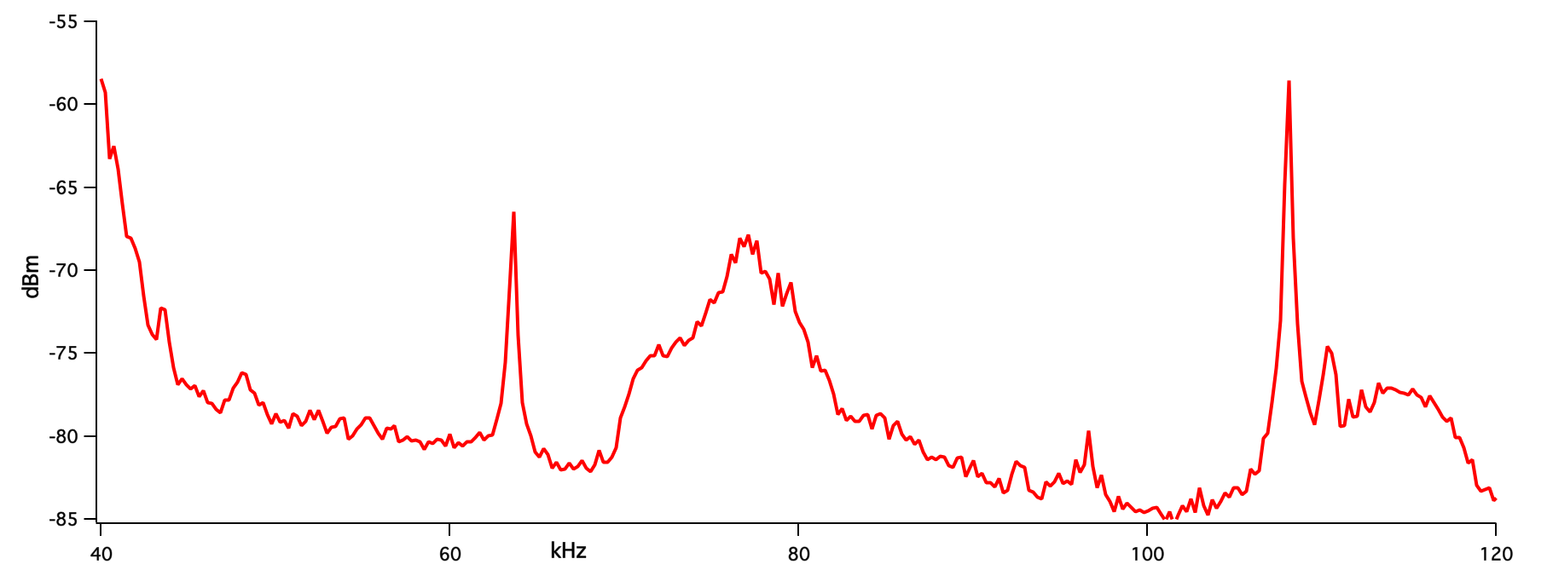
1
event detection & segmentation
baseline emi
Notes:
When the system boots up, it takes a snapshot of the emi noise on the powerline, it calls this the baseline emi
Every 100ms after that, a new snapshot is taken and compared to look for changes

Slide 32
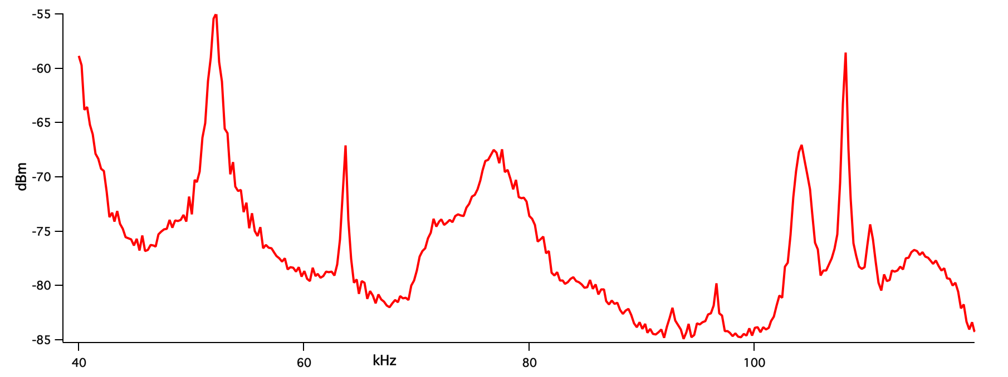

1
event detection & segmentation
baseline emi
new emi is added
Notes:
Let’s say you turn on a lamp, you see these new spikes

Slide 33
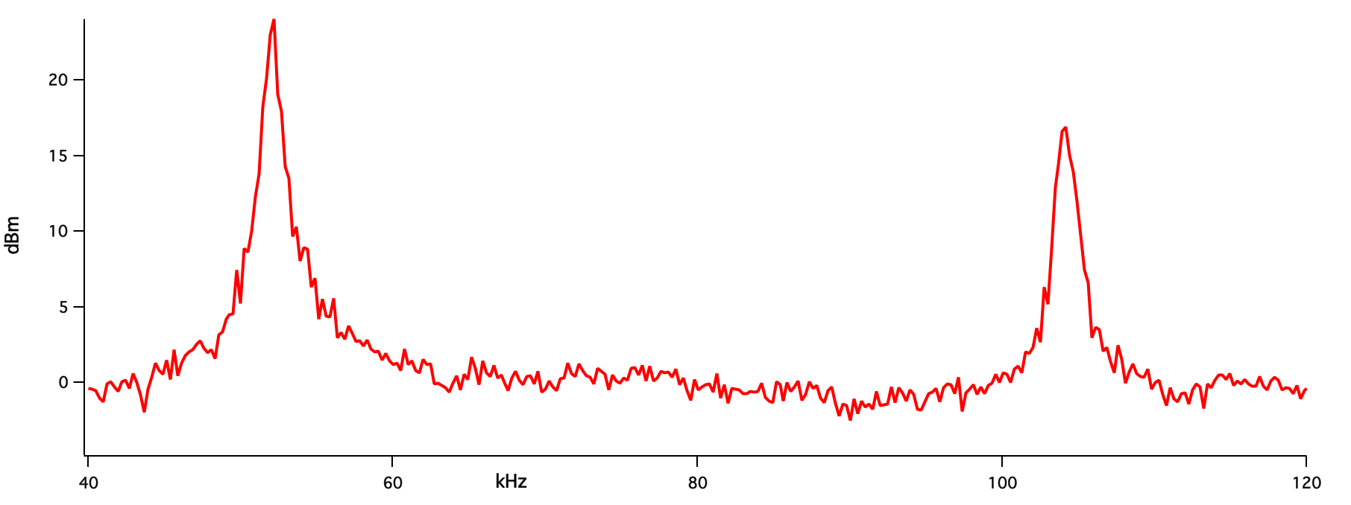
1
event detection & segmentation
baseline emi
difference vector
new emi is added
Notes:
Let’s say you turn on a lamp, you see these new spikes

Slide 34
2
Features
feature extraction
3 features
center frequency
bandwidth of signal
amplitude of signal
lamp
Time (s)
pc
tv
laptop
unplugged
Frequency (kHz)

Slide 35
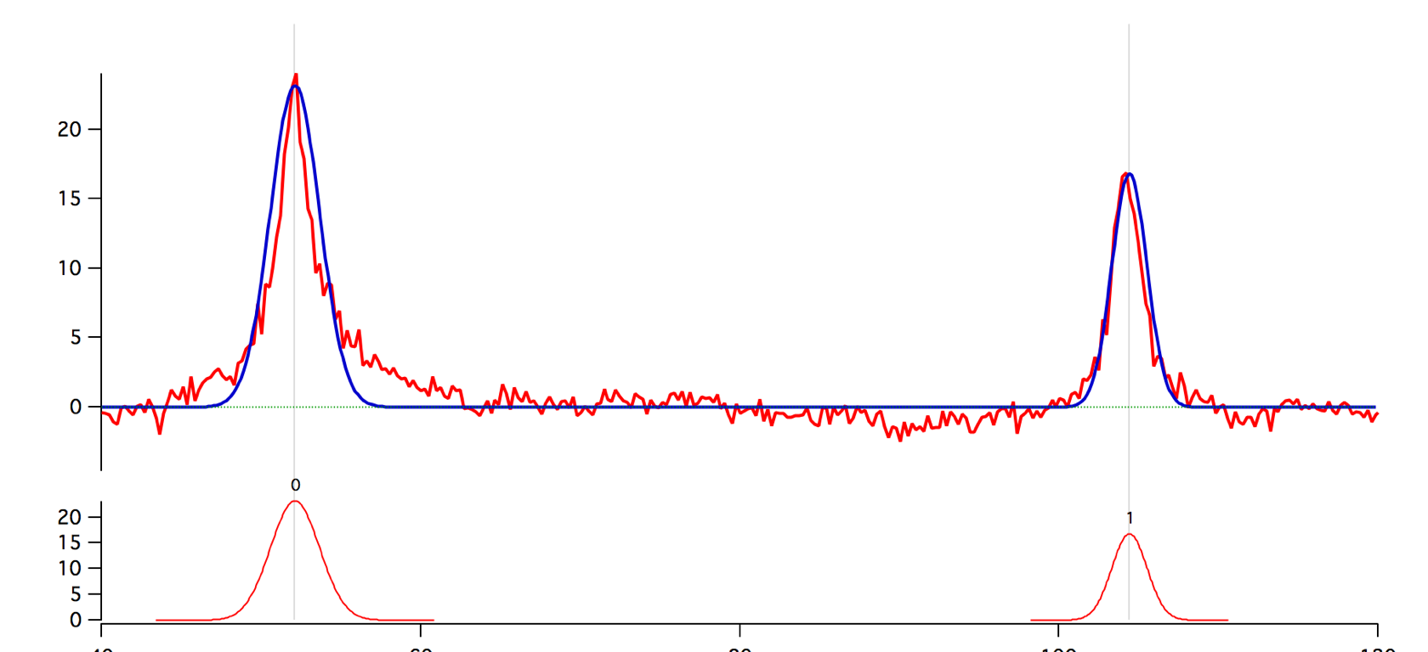
2
feature extraction
gaussian curve fitting
Difference Vector
Center: 52
Width: 2
Amplitude: 23
Center: 104
Width: 1.5
Amplitude: 16
three features are extracted for each peak

Slide 36
3
event classification
three
features from strongest peak
nearest neighbor
classifier
Notes:
@ end of slide : so now that we have our algorithm, we need to validate it.

Slide 37
(i) are these features good enough for accurate identification?

Slide 38
(ii) do signatures remain stable over long period of time?

Slide 39
(iii) can training be minimized by applying signature from one home to another?

Slide 40
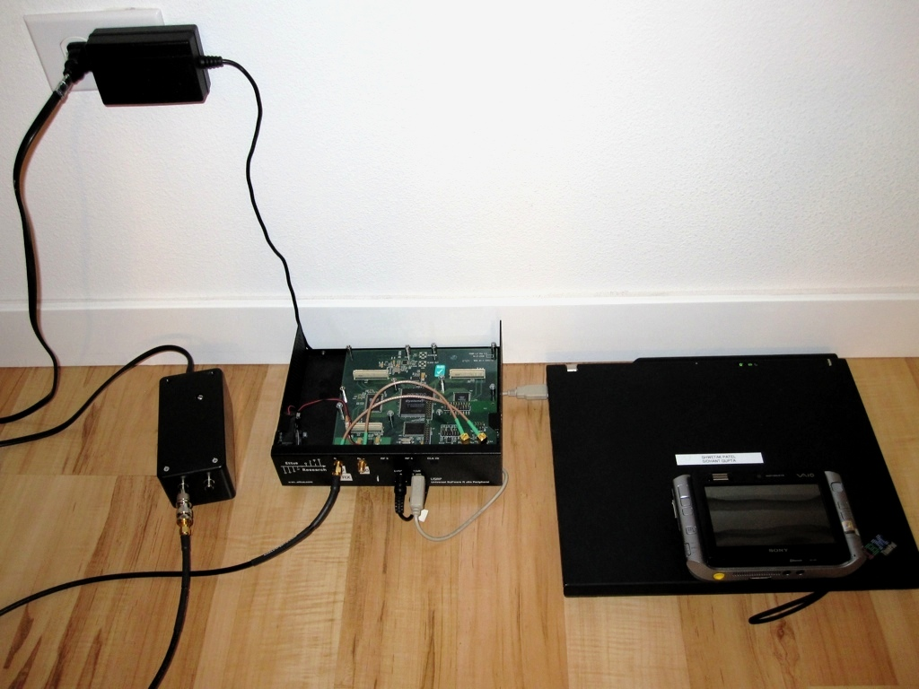
experiments in 7 homes
Notes:
In six of these homes, we would go in and conduct controlled experiments turning devices on and off and labeling the event in our system
In one of these homes, the system was installed for six months; however, we only have labels for certain points during that time.

Slide 41
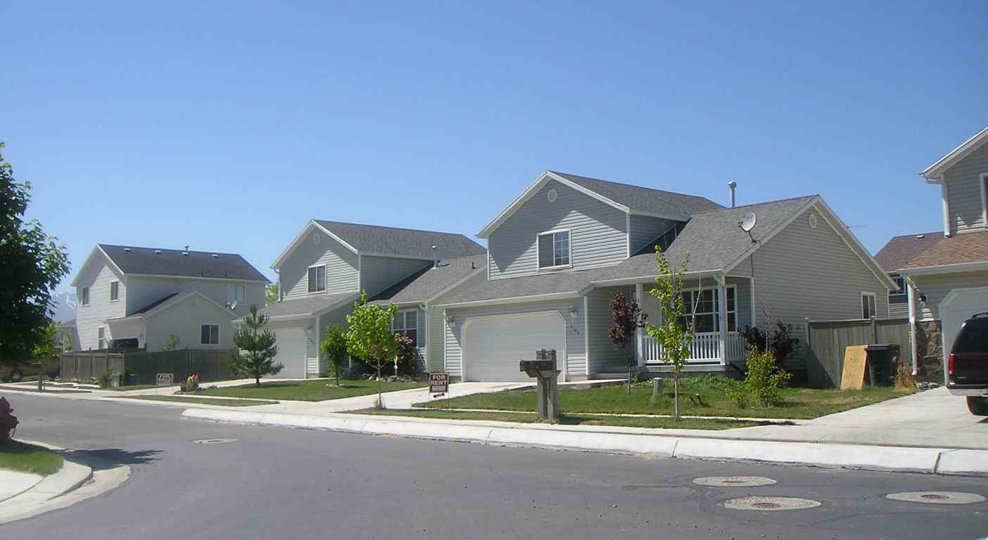
apartments & houses
home sizes: 650 - 3000 sq. ft.
a total of 2576 electrical events
94 different devices

Slide 42
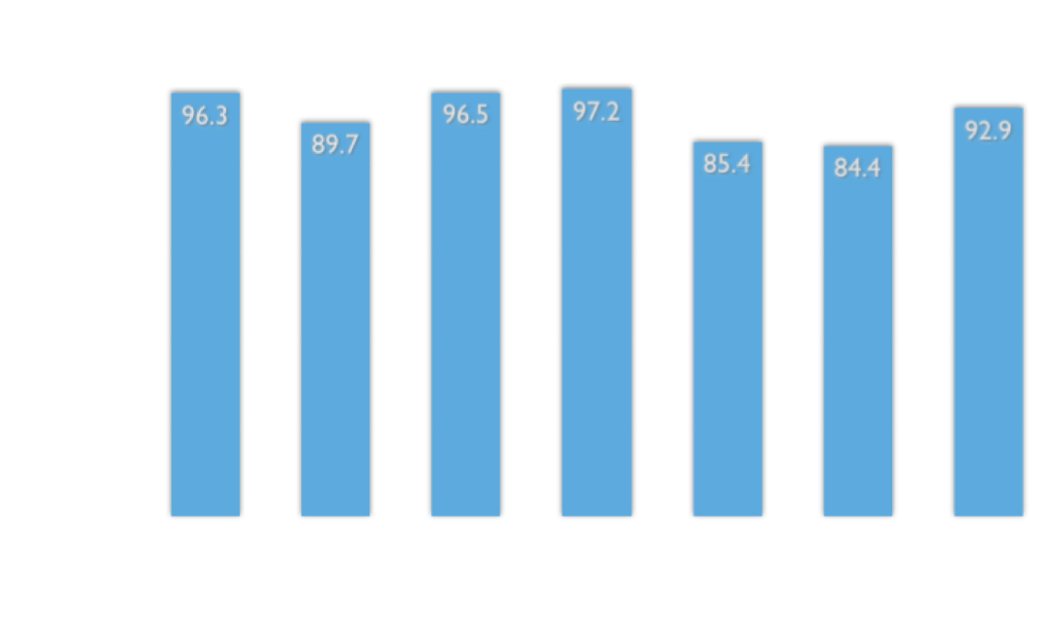
10 fold cross validation
average %: 91.75

Slide 43
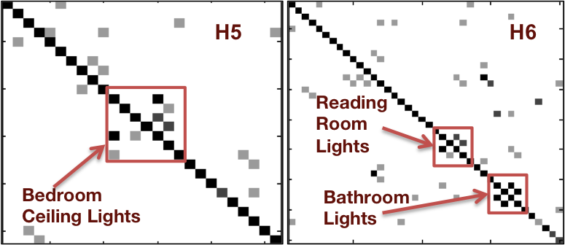
confusion matrices

Slide 44
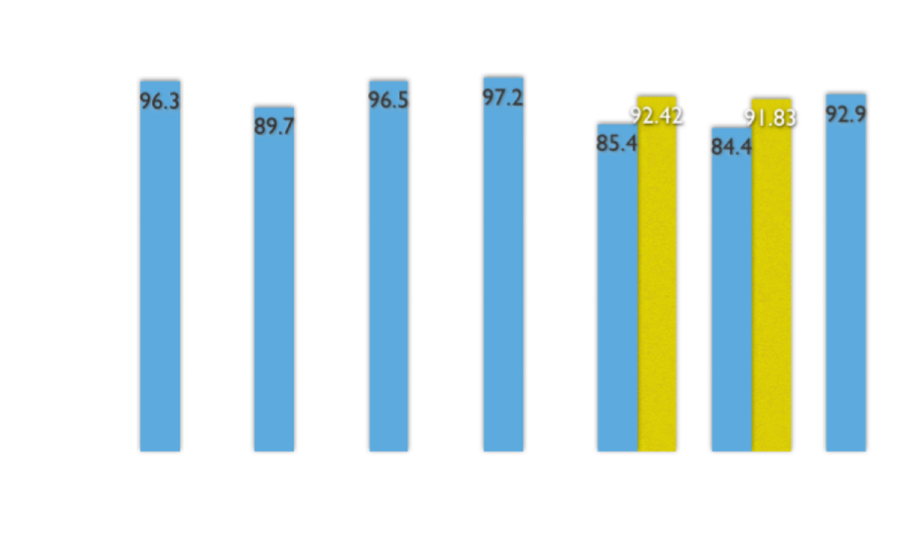
10 fold cross validation
Average %: 93.82

Slide 45
training on a single sample
for each event

Slide 46
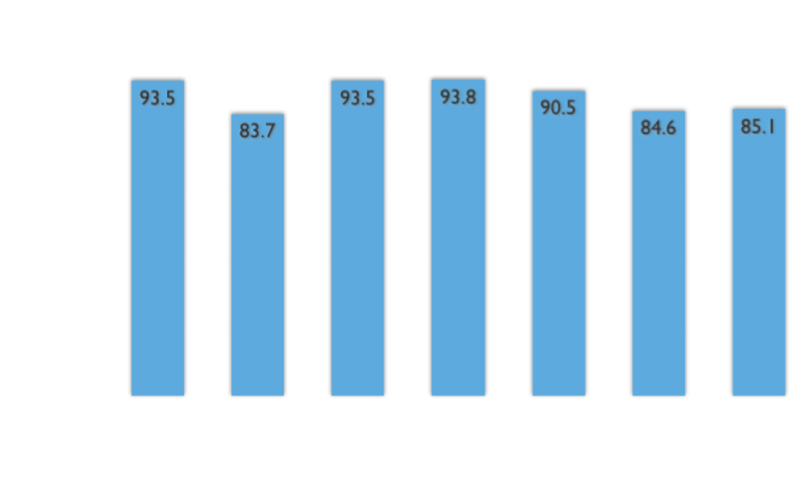
minimal training performance
Average %: 89.25
Notes:
From 91.75 to 89.25%

Slide 47
stability of signals over time

Slide 48
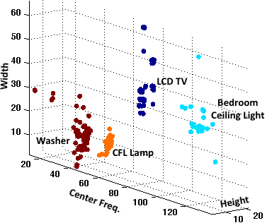
samples in feature space
Notes:
Took data from the six month deployment and graphed it in a 3d-plot where each axis is a feature.
The key takeaway here is that that there was hardly any overlap between devices.

Slide 49
potentially minimizing training by applying signatures across home

Slide 50
we collected data for four of our own devices that we brought to each home

Slide 51
two of the three features remain consistent

Slide 52
average accuracy: 100%

Slide 53
can signatures from one device be applied to another given they are similar models?

Slide 54
signature similar enough to yield an accuracy of 100%

Slide 55
Movie Removed for Public Posting of Slides

Slide 56
water

Slide 57
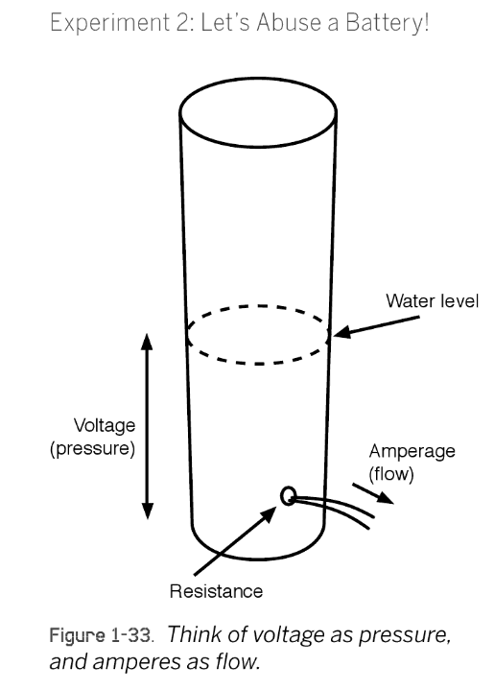
MAKE: Electronics: Learning Through Discovery , by Charles Platt
Notes:
The height of the water in a tank is proportionate to the pressure of the water and comparable to voltage.
The flow of water out of the tank is comparable to current.
The water flow is restricted by the size of the hole (i.e., the resistance).

Slide 58
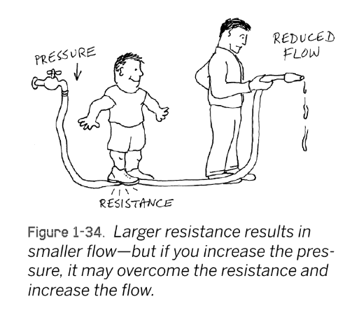
MAKE: Electronics: Learning Through Discovery , by Charles Platt

Slide 59
what are the most consuming water activities in your home?
average indoor household water usage per person/day (70 gpd)
Vickers, 2001
Notes:
Most residents have no idea how much water they use nor what the most water consuming activities are in the home.
So, ask yourself, what do you think the most water consuming activities are in your home?
Most people cannot accurately answer this question. We have been working with our local water utility, SPU…
Most customers believe they use 20 gallons a day (Al Dietemann) rather than roughly 70 and have no idea that toilets, clothes washers, and showers are the top water usage activities in the home. This is a striking disconnect considering that most of us have used modern plumbing all of our lives.
To close this gap, we have been working on new sensing techniques for water usage
---
According to a recent survey at our local water utility in Seattle, most customers believe they use 20 gallons a day (Al Dietemann) rather than roughly 70.

Slide 60
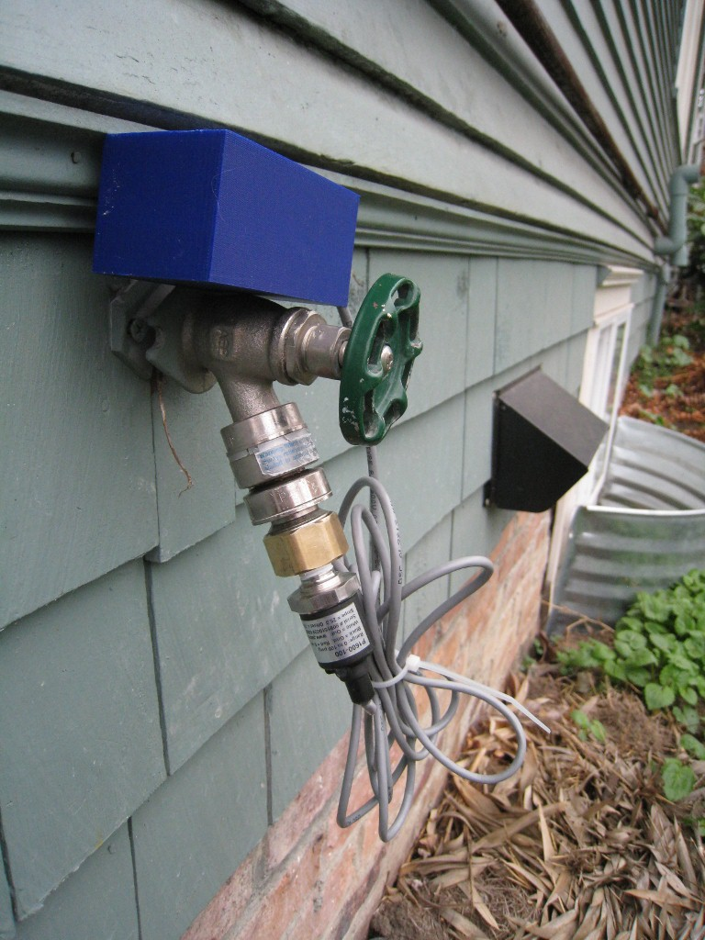
hydrosense
single-point pressure-based sensor of water usage
identifies water usage activity down to its source(e.g., toilet)
provides estimates of flow at each fixture
Notes:
We’ve been working on a water sensor called HydroSense, which is a pressure-based sensor capable of identifying water usage down to the individual fixture (e.g., dishwasher, toilet, faucet) and provide per-fixture flow estimates from a single sensing point

Slide 61
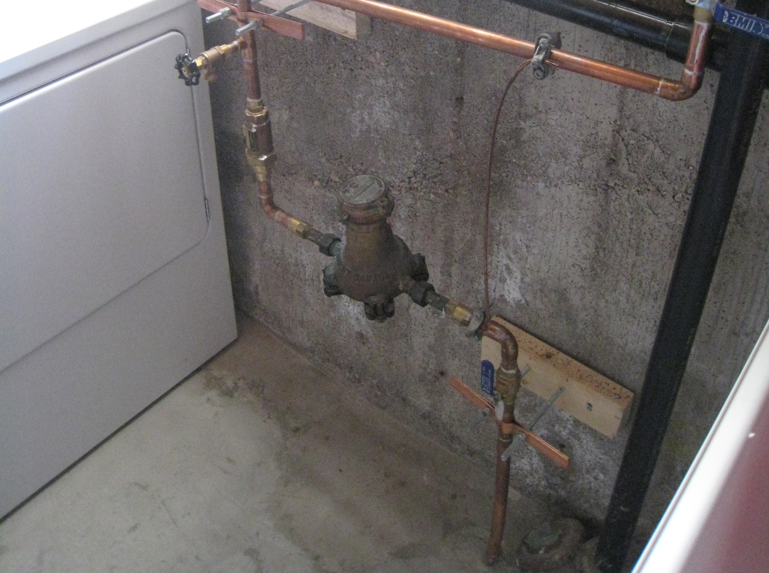
typical water meters
only provide aggregate information on water usage
require pipe modification for installation
traditional inline
water meter
Notes:
Typical water meters only provide aggregate information on water usage and require costly pipe modifications to install. (click)
In constrast, the HydroSensor can simply screws on to a hose water bib.

Slide 62

brief plumbing primer
water tower
water tower
Notes:
To understand how HydroSense works, its useful to go over a brief primer of home water/pipe infrastructure.
Most households obtain water from a public water supply.
Public water is distributed by local utilities, relying on gravity and pumping stations to push water through major distribution pipes

Slide 63
brief plumbing primer
water tower
water tower
incoming cold water from supply line
Notes:
Cold water enters the home through a service line, typically at 40-100 pounds per square inch (psi) depending on such factors as the elevation and proximity to a water tower or pumping station.
Pressure is important to the proper functioning of HydroSense because it’s a pressure-based sensing solution.
------
The pound per square inch or, more accurately, pound-force per square inch (symbol: psi or lbf/in² or lb_{f}/in²) is a unit of pressure or of stress based on avoirdupois units. It is the pressure resulting from a force of one pound-force applied to an area of one square inch:
1 psi (6.894757 kPa) : pascal (Pa) is the SI unit of pressure.
40 psi is 275.79 kilopascals
100 psi is 689.47 kilopascals

Slide 64
water meters
water tower
water tower
incoming cold water from supply line
utility water meter
Notes:
Cold water enters the home through a service line, typically at 40-100 pounds per square inch (psi) depending on such factors as the elevation and proximity to a water tower or pumping station.
Pressure is important to the proper functioning of HydroSense because it’s a pressure-based sensing solution.
------
The pound per square inch or, more accurately, pound-force per square inch (symbol: psi or lbf/in² or lb_{f}/in²) is a unit of pressure or of stress based on avoirdupois units. It is the pressure resulting from a force of one pound-force applied to an area of one square inch:
1 psi (6.894757 kPa) : pascal (Pa) is the SI unit of pressure.
40 psi is 275.79 kilopascals
100 psi is 689.47 kilopascals

Slide 65
pressure regulator
water tower
water tower
incoming cold water from supply line
utility water meter
pressure regulator
Notes:
Cold water enters the home through a service line, typically at 40-100 pounds per square inch (psi) depending on such factors as the elevation and proximity to a water tower or pumping station.
Pressure is important to the proper functioning of HydroSense because it’s a pressure-based sensing solution.
------
The pound per square inch or, more accurately, pound-force per square inch (symbol: psi or lbf/in² or lb_{f}/in²) is a unit of pressure or of stress based on avoirdupois units. It is the pressure resulting from a force of one pound-force applied to an area of one square inch:
1 psi (6.894757 kPa) : pascal (Pa) is the SI unit of pressure.
40 psi is 275.79 kilopascals
100 psi is 689.47 kilopascals

Slide 66
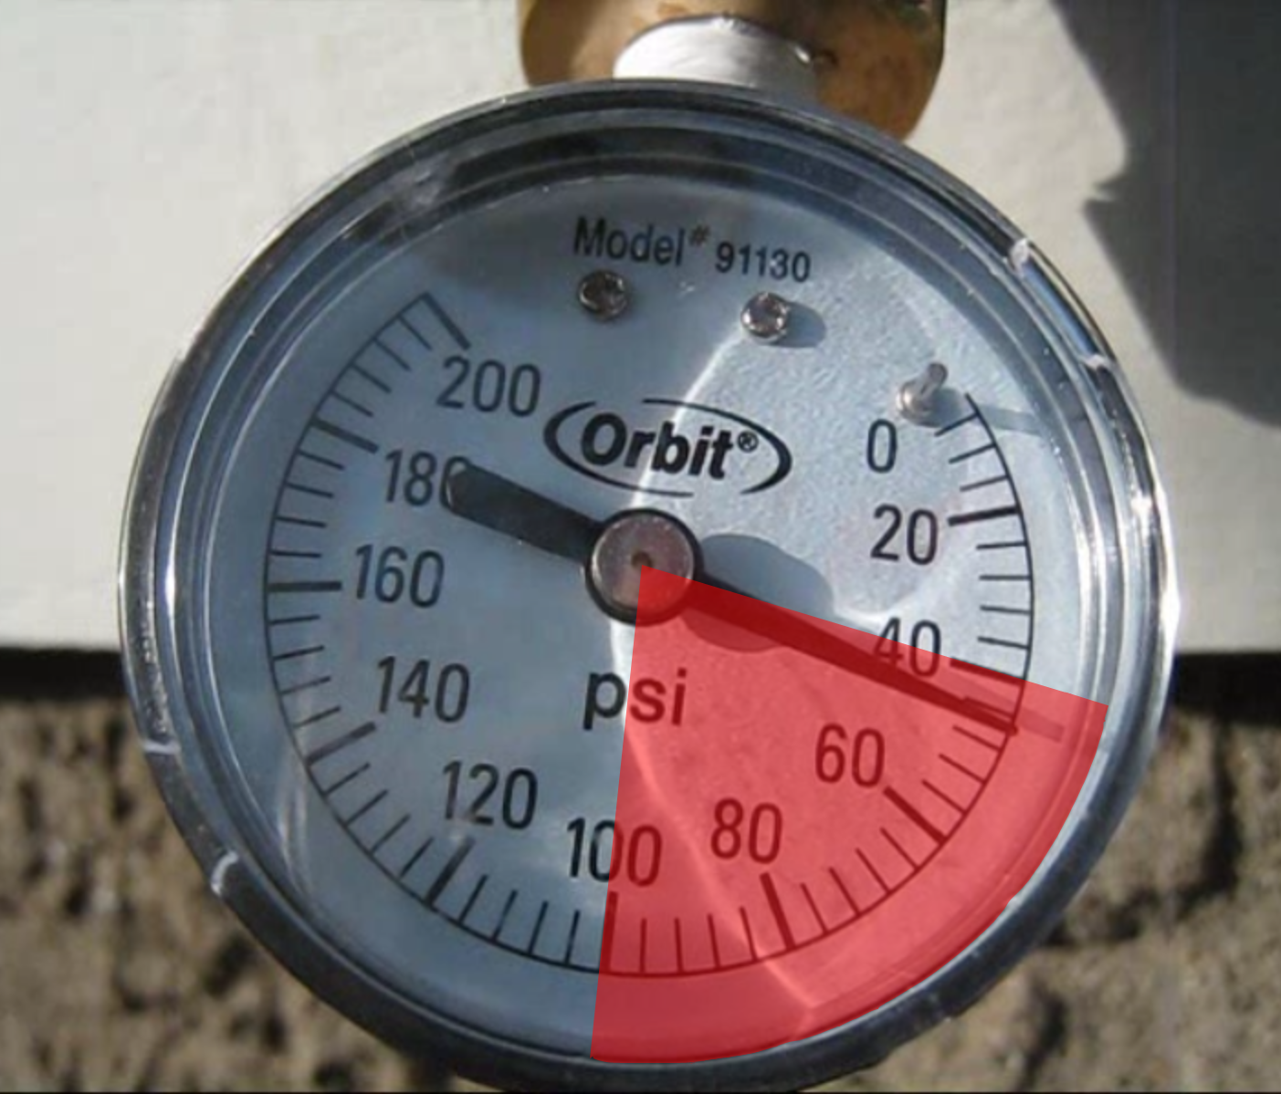
pressure regulator
water tower
water tower
incoming cold water from supply line
40 psi
utility water meter
pressure regulator
100 psi
Notes:
Cold water enters the home through a service line, typically at 40-100 pounds per square inch (psi) depending on such factors as the elevation and proximity to a water tower or pumping station.
Pressure is important to the proper functioning of HydroSense because it’s a pressure-based sensing solution.
------
The pound per square inch or, more accurately, pound-force per square inch (symbol: psi or lbf/in² or lb_{f}/in²) is a unit of pressure or of stress based on avoirdupois units. It is the pressure resulting from a force of one pound-force applied to an area of one square inch:
1 psi (6.894757 kPa) : pascal (Pa) is the SI unit of pressure.
40 psi is 275.79 kilopascals
100 psi is 689.47 kilopascals

Slide 67
plumbing layout
water tower
water tower
incoming cold water from supply line
utility water meter
pressure regulator
Notes:
Many homes have a pressure regulator that stabilizes the water pressure and also reduces the incoming water pressure to a safe level for household fixtures.
From the regulator, most homes contain a combination of series plumbed and branched piping.

Slide 68
closed pressure system
water tower
water tower
bathroom 1
hose
spigot
kitchen
incoming cold water from supply line
dishwasher
thermal
expansion
tank
utility water meter
pressure regulator
hot
water
heater
bathroom 2
laundry
Notes:
The cold water supply branches to the individual water fixtures (e.g., toilets/sinks/showers) and into the water heater.
The plumbing system forms a closed loop pressure system with water held at a relatively stable pressure throughout the piping.
This is why, when you open a faucet, water immediately flows out.

Slide 69
closed pressure system
water tower
water tower
bathroom 1
hose
spigot
kitchen
incoming cold water from supply line
dishwasher
thermal
expansion
tank
utility water meter
pressure regulator
hot
water
heater
hot
water
heater
bathroom 2
laundry
Notes:
The hot water tank connects the cold water pipes to the hot water pipes.
So when you open a hot or cold water valve, the pressure signal is transmitted through the hot water heater thus allowing for a single-point pressure sensing solution.
Every hot water tank has a drain valve, which is of interest to us because it provides an easy potential installation point for our hydrosensor, particularly for locations like apartments which don’t have outdoor hose bibs.

Slide 70
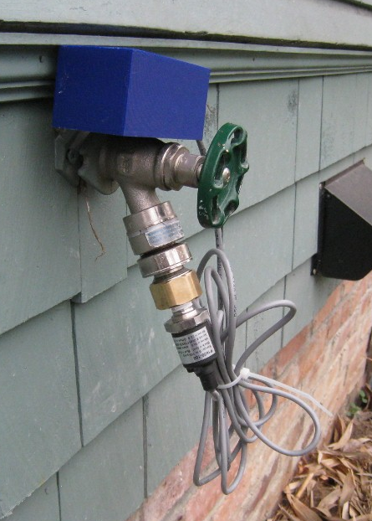
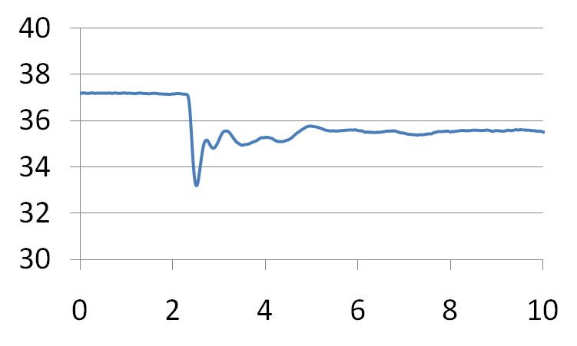
water tower
water tower
toilet flushed
bathroom 1
hose
spigot
toilet
kitchen
incoming cold water from supply line
dishwasher
thermal
expansion
tank
utility water meter
pressure regulator
hot
water
heater
bathroom 2
laundry
Notes:
The cold water supply branches to the individual water fixtures (e.g., toilets/sinks/showers) and into the water heater.
The plumbing system forms a closed loop pressure system with water held at a relatively stable pressure throughout the piping.
This is why, when you open a faucet, water immediately flows out.

Slide 71
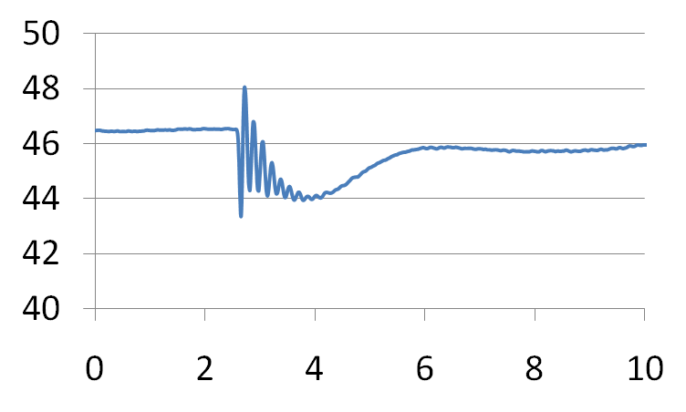
water tower
water tower
toilet
bathroom 1
hose
spigot
kitchen sink cold
kitchen sink cold open
kitchen
incoming cold water from supply line
dishwasher
thermal
expansion
tank
utility water meter
pressure regulator
hot
water
heater
bathroom 2
laundry
Notes:
The cold water supply branches to the individual water fixtures (e.g., toilets/sinks/showers) and into the water heater.
The plumbing system forms a closed loop pressure system with water held at a relatively stable pressure throughout the piping.
This is why, when you open a faucet, water immediately flows out.

Slide 72
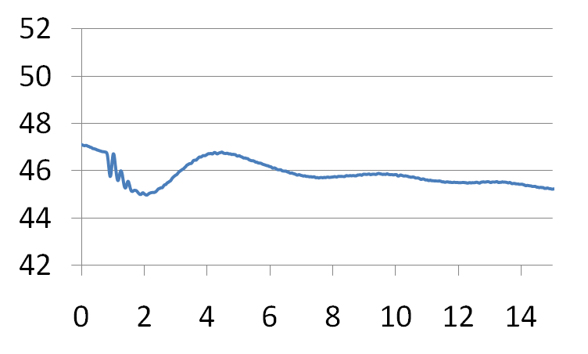
water tower
water tower
toilet
kitchen sink cold
bathroom 1
hose
spigot
kitchen sink hot
kitchen sink hot open
kitchen
incoming cold water from supply line
dishwasher
thermal
expansion
tank
utility water meter
pressure regulator
hot
water
heater
bathroom 2
laundry
Notes:
The cold water supply branches to the individual water fixtures (e.g., toilets/sinks/showers) and into the water heater.
The plumbing system forms a closed loop pressure system with water held at a relatively stable pressure throughout the piping.
This is why, when you open a faucet, water immediately flows out.

Slide 73
water tower
water tower
bathroom 1
hose
spigot
kitchen sink hot open
kitchen
incoming cold water from supply line
dishwasher
thermal
expansion
tank
utility water meter
pressure regulator
hot
water
heater
bathroom 2
laundry
Notes:
The cold water supply branches to the individual water fixtures (e.g., toilets/sinks/showers) and into the water heater.
The plumbing system forms a closed loop pressure system with water held at a relatively stable pressure throughout the piping.
This is why, when you open a faucet, water immediately flows out.

Slide 74
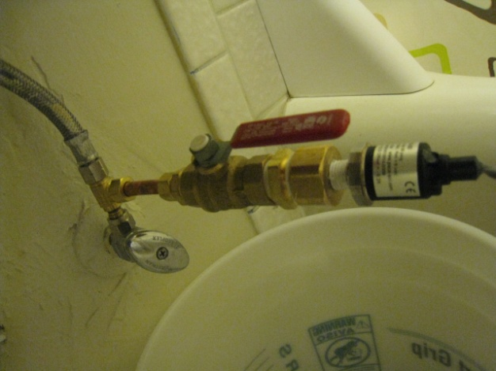
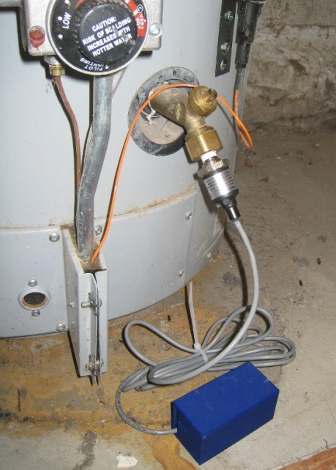
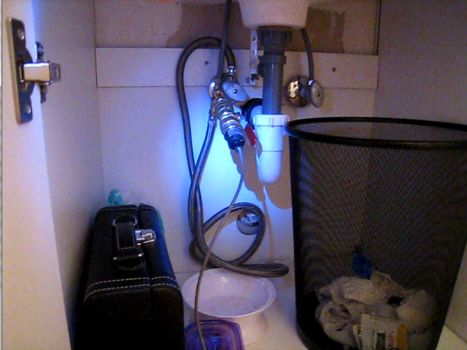
water tower
water tower
bathroom 1
hose
spigot
kitchen
incoming cold water from supply line
dishwasher
utility water meter
pressure regulator
hot
water
heater
bathroom 2
laundry
Notes:
The cold water supply branches to the individual water fixtures (e.g., toilets/sinks/showers) and into the water heater.
The plumbing system forms a closed loop pressure system with water held at a relatively stable pressure throughout the piping.
This is why, when you open a faucet, water immediately flows out.

Slide 75
bathroom sink pressure signal
psi
open
close
0
4.5
9
time (s)

Slide 76
bathroom sink pressure signal
psi
flow volume
open
close
0
4.5
9
time (s)

Slide 77
bathroom sink pressure signal
psi
flow volume
open
close
0
4.5
9
time (s)

Slide 78
Movie Removed for Public Posting of Slides

Slide 79
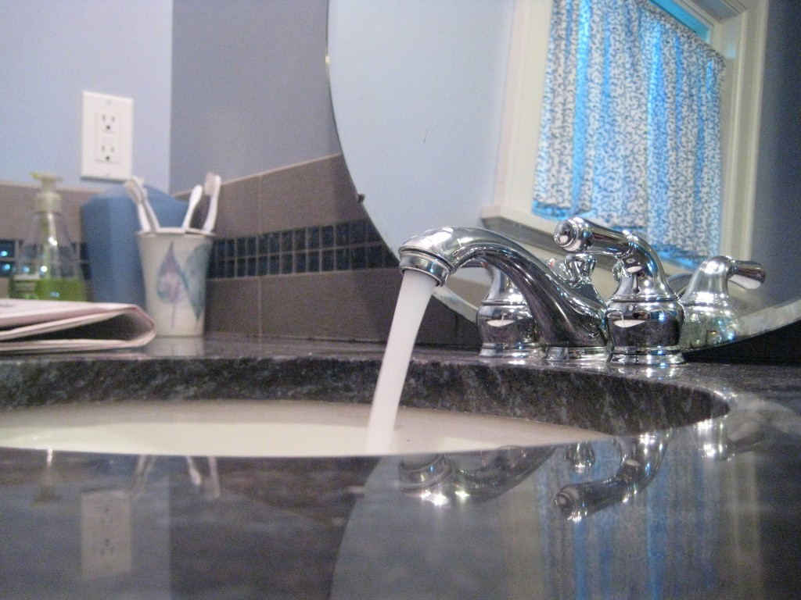
how it works
detect that a water event has occurred
classify event as “open” or “close”
determine source of event (e.g., toilet, shower).
provide flow estimate
Notes:
So, how does this work exactly?

Slide 80
event detection
raw pressure (psi)
time (s)
smoothed pressure
(psi)
derivative
(psi/s)
Notes:
The raw pressure signal is smoothed using a low-pass filter. We then take the derivative of this smoothed signal to check for rapid changes in pressure (i.e., pressure transients).
These rapid changes in pressure (or pressure transients) are what indicate water usage.
----
The low pass filter is a low-pass linear phase finite impulse response filter.
The smoothed signal is the 1 Hz envelope of the signal, calculated using a discrete prolate spheroidal window filter of length 1 second.
The bandpass derivative has a cutoff of 1Hz and a linearly increasing frequency response, it is also 1 second long.
These parameters were chosen based on the bandwidth with the highest energy concentration for all the data we collected in all homes.

Slide 81
event detection
raw pressure (psi)
time (s)
smoothed pressure
(psi)
derivative
(psi/s)
critical change in pressure
Notes:
So, let’s see how this works in practice.
As we run a 1 sec sliding window over the data, we flag the signal when the derivative exceeds a specified threshold relative to the home’s static pressure

Slide 82
event detection
raw pressure (psi)
time (s)
smoothed pressure
(psi)
critical stabilization point
derivative
(psi/s)
Notes:
Then, we look for when the “amplitude” of the derivative goes below 5% of the original magnitude

Slide 83
event detection
automatically
detected event
valve open event
raw pressure (psi)
time (s)
smoothed pressure
(psi)
pressure decrease
and
negative initial
derivative
derivative
(psi/s)
= valve open event
Notes:
The direction of stabilized pressure change and the sign of derivative determines whether the event is an open or close event.
In this case, it’s a valve open event.

Slide 84
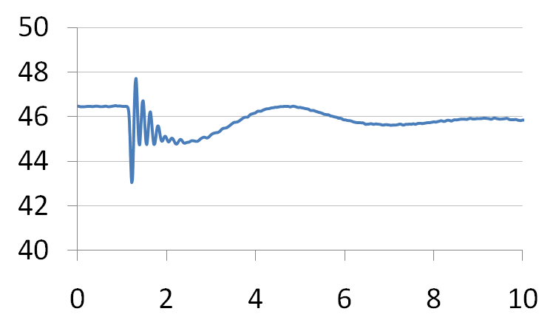
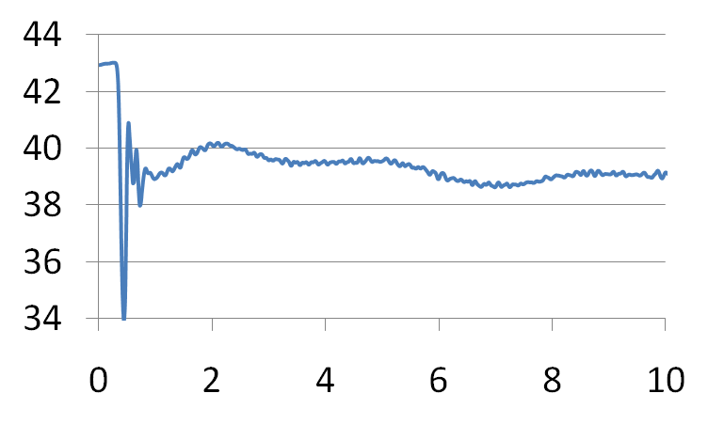




example open events
home 1
home 2
home 3
toilet
signature dependent on:
  fixture type
  valve type
  valve location in home
faucet
shower
Notes:
As you might imagine, the pressure signatures differ across fixture and valve types. However, the valve’s location in the home is also a strong determinant in shaping the signal. (click)
As a result we haven’t seen a lot of cross-home similarity between fixture event signals.
From this point forward, the vertical-axis will always refer to psi and the horizontal-axis will refer to time in seconds
----
First, note that the transients are unique across fixtures. (click)
---
Now, I’m showing data from three different homes. Note how the signals differ for like fixtures across homes; this is because the signal is influenced both by the valve type as well as the pipe pathway to the valve.
Therefore, while detection and distinguishing between open and close can be done with a drop-in system in any home, actual fixture classification and flow must be calibrated on a per home basis.

Slide 85



matched filtering
save maximum
similarity
similarity
Notes:
Match filtering allows us to compare two signals’ similarity using a pointwise correlation coefficient
(click) we save the maximum correlation as the degree to which the two signals are similar

Slide 86

matched filtering
new maximum
similarity
similarity
Notes:
And two very similar signals will have a higher similarity value,
We can perform matched filtering in a variety of signal subspaces. The more orthogonal the different fixture signals are in the subspace, the better.
The reason behind this is that orthogonal signals have a correlation of zero (and, thus, a matched filter comparison close to zero).

Slide 87







fixture classification
unclassified open event
open event library
shower
toilet
dishwasher
kitchen faucet
bath faucet
bath tub
Notes:
Now that we’ve automatically detected events and classified them as open or close, we need to determine where the events came from.
To do this we use a template matching approach and, in particular, we rely on matched filtering to compare our signals, which provides a measure of correlation between signals.

Slide 88






unclassified open event
open event library
shower
toilet
dishwasher
kitchen faucet
bath faucet
bath tub
detrended_{unclassified}
detrended_{shower}
derivative_{unclassified}
derivative_{shower}
cepstrum_{unclassified}
cepstrum_{shower}
Notes:
We chose three transformations in which to use the matched filter. (click)
1. The first transformation is the waveform with trending removed
2. The second transformation is the derivative waveform that we used in the open/close event detection step.
3. The final transformation is the cepstrum transformation, which is popular in the signal processing community and often used to separate a filter from its source.
---
The last space we chose was the Cepstral space. The real cepstrum is a transformation related to the Fourier transform and has been used in the speech recognition community for decades. It’s popular in the signal processing community to separate source from filter.
One property of the real cepstrum is that the space is highly orthogonal and thus is good fit for our application.

Slide 89

unclassified open event
open event library
shower
toilet
dishwasher
kitchen faucet
bath faucet
bath tub
test similarity
detrended_{unclassified}
detrended_{shower}
matched filter
derivative_{unclassified}
derivative_{shower}
possible events
matched filter
cepstrum_{unclassified}
cepstrum_{shower}
matched filter
Notes:
To test for similarity, we look at the transformations for each saved event in the library.
If the similarity is above a certain threshold in each subspace, we add the event to a list of possible events. The thresholds are learned using a leave one out cross validation of all other homes in our database.
--
We also use the mean squared error of the de-trended signal. If the MSE is above a cross validation threshold, it passes the similarity test.

Slide 90



unclassified open event
open event library
toilet
dishwasher
kitchen faucet
bath faucet
bath tub
detrended_{unclassified}
detrended_{toilet}
derivative_{unclassified}
derivative_{toilet}
possible events
cepstrum_{unclassified}
cepstrum_{toilet}
Notes:
We repeat this process for every event in our library…

Slide 91

unclassified open event
open event library
toilet
dishwasher
kitchen faucet
bath faucet
bath tub
detrended_{unclassified}
detrended_{toilet}
matched filter
derivative_{unclassified}
derivative_{toilet}
possible events
matched filter
cepstrum_{unclassified}
cepstrum_{toilet}
matched filter
Notes:
Here a toilet signal transform fails a similarity test and thus it is discarded from the pool of possible events.

Slide 92

unclassified open event
open event library
dishwasher
kitchen faucet
bath faucet
bath tub
detrended_{unclassified}
derivative_{unclassified}
possible events
cepstrum_{unclassified}
Notes:
this occurs for each event in the library.

Slide 93
unclassified open event
open event library
shower
detrended_{unclassified}
dishwasher
derivative_{unclassified}
possible events
kitchen faucet
cepstrum_{unclassified}
Notes:
If more than one possible event is in our possible event pool, we perform one additional comparison.

Slide 94

unclassified open event
open event library
derivative_{shower}
shower
shower
dishwasher
detrended_{unclassified}
derivative_{toilet}
dishwasher
derivative_{unclassified}
possible events
kitchen faucet
kitchen faucet
derivative_{kitchen} _{faucet}
cepstrum_{unclassified}
Notes:
on the derivative waveform, which is the most orthogonal subspace.

Slide 95
unclassified open event
open event library
derivative_{shower}
shower
derivative_{toilet}
dishwasher
nearest neighbor match
derivative_{unclassified}
possible events
kitchen faucet
derivative_{kitchen} _{faucet}
Notes:
We perform a nearest neighbor search on all remaining possible events using the matched filter similarity score in the derivative space.
Once the event is identified, we can assign flow, in gpm, using a calibrated fluid resistance value for the specific valve.

Slide 96

evaluation
Notes:
Now, I will go over our in-home data collection and experimental validation.

Slide 97


home profiles
ten test locations
8 houses / 1 apt / 1 cabin
avg size: 2,300 sq ft
1920s – 2000s
installation points
8 outdoor hose bibs
1 water heater
1 utility faucet
Notes:
We installed HydroSense in a variety of locations: 8 houses, 1 apartment, and 1 cabin with a range in size from 750 sq feet to 4,000 sq ft.
We also used three different installation points: 8 hose bib, 1 water heater, and 1 utility faucet connection.

Slide 98

experimental protocol
controlled experiments
2 researchers per site
5 trials per valve
experimental script
for each trial:
valve opened full stop
pause for ~5 seconds
valve closed
Notes:
Each collection session was conducted by a pair of researchers: one would record the sensed pressure signatures to a laptop while the other activated the home’s water fixtures.
We recorded five trials per valve. A sink, for example, has two valves (one hot, and one cold) and thus would receive 10 trials—5 for hot and 5 for cold.
For each trial, the valve was open for ~5 seconds and then closed.

Slide 99
example trial
Movie Removed for Public Posting of Slides

Slide 100

5 manually annotated bath trials

Slide 101

data collection stats
ten test sites
706 trials
155 flow trials
84 total fixtures tested
Notes:
In all, we conducted experiments in 10 locations resulting in 706 trials with 155 flow rate trials and 84 total fixtures tested.

Slide 102
fixture classification results
by home
Notes:
This figure shows the accuracy of fixture-level identification of valve open and valve close events within each home as well as the aggregate 97.9% accuracy of fixture-level classification.
Many homes resulted in 100% open and close fixture classification.
The worst performing house, H10, was due to noise from the eleven cabins that share the same supply line at the resort.

Slide 103
fixture classification results
by home
98.9%
96.8%
Notes:
This figure shows the accuracy of fixture-level identification of valve open and valve close events within each home as well as the aggregate 97.9% accuracy of fixture-level classification.
Many homes resulted in 100% open and close fixture classification.
The worst performing house, H10, was due to noise from the eleven cabins that share the same supply line at the resort.

Slide 104
fixture classification results
by home
98.9%
96.8%
97.9%
Notes:
This figure shows the accuracy of fixture-level identification of valve open and valve close events within each home as well as the aggregate 97.9% accuracy of fixture-level classification.
Many homes resulted in 100% open and close fixture classification.
The worst performing house, H10, was due to noise from the eleven cabins that share the same supply line at the resort.

Slide 105
fixture classification results
by fixture
Notes:
This graph shows the same data as before but categorized by fixture. Again, nearly all fixtures are above 95% or better.
Here, the worst performer is the hot water valve in showers at 89%--although this is still pretty good, we’re not sure why this is and it warrants further investigation.

Slide 106
first to show: pressure can be used to dissaggregate water usage
but….

Slide 107

brushing teeth

Slide 108

shaving

Slide 109

bathing

Slide 110

paw washing

Slide 111



water tower
water tower
bathroom 1
hose
spigot
compound events
kitchen
incoming cold water from supply line
dishwasher
thermal
expansion
tank
utility water meter
pressure regulator
hot
water
heater
bathroom 2
laundry
Notes:
The cold water supply branches to the individual water fixtures (e.g., toilets/sinks/showers) and into the water heater.
The plumbing system forms a closed loop pressure system with water held at a relatively stable pressure throughout the piping.
This is why, when you open a faucet, water immediately flows out.

Slide 112
how can we study naturalistic uses of water?

Slide 113
Movie Removed for Public Posting of Slides

Slide 114
how can we collect
“ground truth labels”?

Slide 115

our failed attempts

Slide 116

X10 buttons

Slide 117
how many times will the hot and cold water valves be opened and closed while washing these dishes?
Movie Removed for Public Posting of Slides
tracks the number of times hot and cold are turned on/off

Slide 118
Movie Removed for Public Posting of Slides

Slide 119

intel labs shake sensors

Slide 120
our solution

Slide 121

custom direct sensors
design goals
wireless
low-power
water resistant
detect fixture opens/closes
track hot only, cold only, mixed

Slide 122


challenge: fixture diversity
temperature
control
cold flow control
hot flow control
flow
control
single handle faucet
dual handle faucet

Slide 123



custom ground truth data collection system
push button
xbee wireless transmitter
placeholder
(I want a pic showing power supply)
fixture usage sensor board
xbee wireless modem
fixture usage sensor board
modified kill-a-watt
thermistor
hall
effect
reed switch
3-axis accelerometer
unidirectional ball switch
omnidirectional ball switch

Slide 124
Movie Removed for Public Posting of Slides

Slide 125

reed switch
(hidden)
ball switch
magnet
reed switch
ball switch
hot handle
movement
magnet

Slide 126

parent sensor board
accelerometer & ball switch

Slide 127

magnet & ball switch
magnet & ball switch
reed switch
(cold handle)
reed switch
(hot handle)

Slide 128

magnet
reed
switch
omni-directional ball switch

Slide 129

omni-directional
ball switch
accelerometer

Slide 130

reed switch
(hot handle)
reed switch
(tub/shower diverter)
reed switch
(cold handle)
magnet
magnet
magnet

Slide 131

xbee wireless transmitter
parent sensor board
modified kill-a-watt
thermistor cable for drain pipe
(in red)
washing machine plug
(connects to
kill-a-watt outlet)

Slide 132
five week deployment
2 apartments & 3 houses
103 water valves
a total of 14,960 water events

Slide 133
five week deployment
2 apartments & 3 houses
103 water valves
a total of 14,960 water events
75.5% valve
89.5% fixture
89.5% fixture category

Slide 134









Thank You!
jonfroehlich@gmail.com
twitter @jonfroehlich
http://ubicomplab.cs.washington.edu
http://dub.washington.edu/
faculty
students
Jon Froehlich Gabe Cohn Sidhant Gupta Eric Larson Tim Campbell
Shwetak Patel James Fogarty James Landay
design:
ubicomp lab
use:
build:
university of washington
sustainability research
university of washington

Slide 135

two pressure sensors per home

Slide 136
water tower
water tower
toilet
bathroom 1
hose
spigot
kitchen sink cold open
kitchen
thermal
expansion
tank
incoming cold water from supply line
dishwasher
utility water meter
pressure regulator
hot
water
heater
bathroom 2
laundry
Notes:
The cold water supply branches to the individual water fixtures (e.g., toilets/sinks/showers) and into the water heater.
The plumbing system forms a closed loop pressure system with water held at a relatively stable pressure throughout the piping.
This is why, when you open a faucet, water immediately flows out.

Slide 138

water scarcity
Notes:
Although energy usage and measurement has lately received a great deal of attention in the HCI and UbiComp communities, water has not.
And yet, the United Nations predicts that water will be the dominating issue over the next 20 years.
And, as you can tell from this map, this is a problem that affects every continent on earth including the US.
----
By 2025, more than 2.8 billion people living in 48 countries will face water shortages.
Environmental water stress is assessed as the percentage of available water resources
currently abstracted compared to environmental water requirements. Environmental water
requirements are defined as the volume of water needed by a river to maintain key ecosystem
functions and biodiversity. This is expressed as a % of the naturalised flow of a river, and can vary
under different conditions, notably between arid and non-arid river systems. In Figure 2 the red
depicts the systems under the highest environmental water stress.

Slide 139

barcelona, spain
Notes:
Already, cities are going to unprecedented lengths to provide their residents with water.
For example, in April of last year, Barcelona, Spain took the unprecedented step of importing water by ship from neighboring nations at a cost of $35 million a month (Crawford, 2008).
Nearly 23m litres of drinking water - enough for 180,000 people for a day

Slide 140

lake mead, nevada
Notes:
The US is not immune from such problems either. According to US government estimates, 36 states will face serious water shortages in the next five years (EPA, 2008).
Lake Mead, which supplies 90% of Las Vegas’ water, is estimated to drop below existing intake pipes by 2012 (Lippert and Efstathiou, 2009).
The city of Las Vegas is paying people to remove their lawns at $1.50 per square foot of lawn replaced with desert-friendly plants for a maximum of $300,000 per year in rebates. (http://www.greenbiz.com/print/35667).
Many utilities invest millions of dollars into conservation programs meant to educate their customers about water and cost savings.
---

Slide 141


feedback improves performance
low-level
high-level
Becker, J. of Applied Psychology 1978
Notes:
One of the best-established findings in psychology is the positive effect that information feedback can have on performance (Becker, 1978).
low-level feedback can provide explicit detail about how to change or improve specific behavior, e.g., which answers I got wrong on a test
high-level feedback can help improve performance by motivating a person to try harder or persist longer at a task, e.g., my current grade in the class
Becker, L. J. Joint Effect of Feedback and Goal Setting on Performance: A Field Study of Residential Energy Conservation. J. of Applied Psychology 63. 4(1978), 428-433.

Slide 142

face washing

