Slide 1
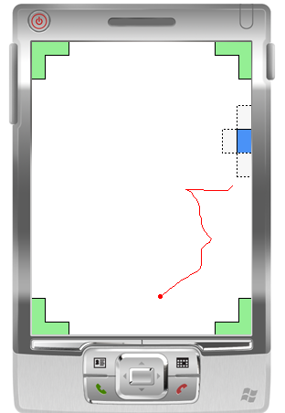
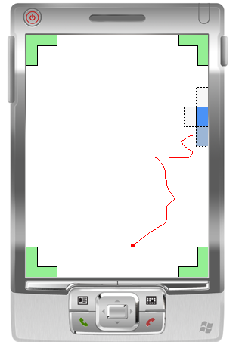
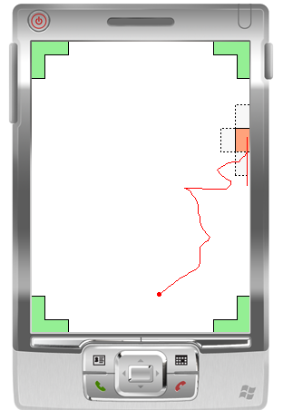
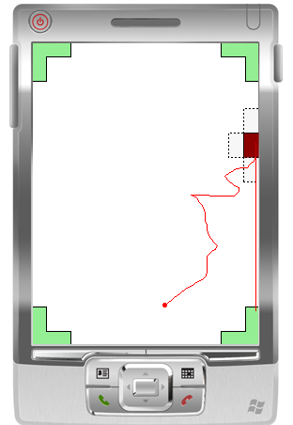



barrierpointing
Using Physical Edges to Assist Target Acquisition on Mobile Device Touch Screens
Jon Froehlich¹
Jacob O. Wobbrock^{1,2} and Shaun Kane²
¹Computer Science and Engineering
²The Information School
design:
use:
build:
Ninth International ACM SIGACCESS Conference on Computers and Accessibility
October 15th, 2007
university of washington

Slide 2
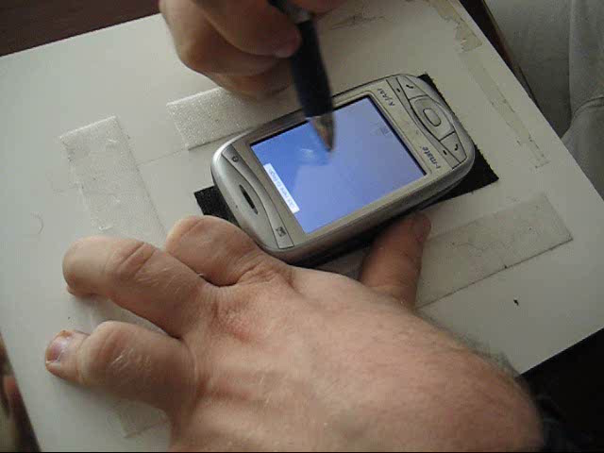
Notes:
Video length: 21 seconds

Slide 3
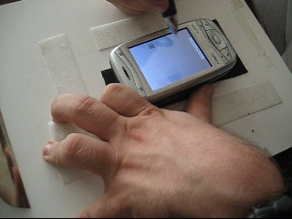
Traditional PDA touch screen interactions are challenging:
require flying-in directly to target
lift action requires fine motor skills
very little tactile feedback

Slide 4
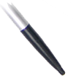
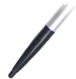
Utilize Screen, Edge & Corners
drag
drag
drag
Allow user to rely on screen surface to assist movement.
Use screen edge to guide movement.
Use screen corner to trap movement.
Notes:
And without any additional auxilliary hardware or hardware modification

Slide 5
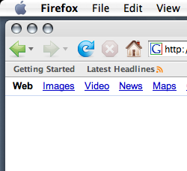
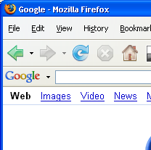
Virtual Edges
W
W
D
D
Walker, N. and Smelcer, J. B. CHI ‘90

Slide 6
Physical Edges
Wobbrock, J., Myers, B. A., and Kembel, J. A. UIST ’03

Slide 7
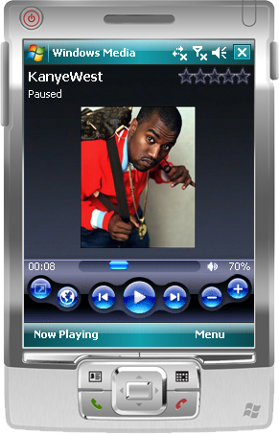
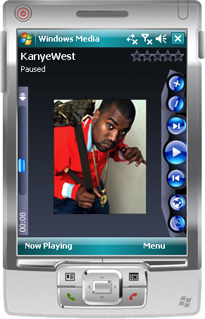
Barrier Targets
Targets placed around screen perimeter
Targets are stroked into rather than tapped
Existing Interface
Realigned Barrier Target Interface
Notes:
Software only manipulation
Targets can always be stroked into

Slide 8






Edge Stroke with
Lift Confirmation
Velocity Stroke with
Corner Confirmation
Reverse Stroke with
Corner Confirmation

Slide 9
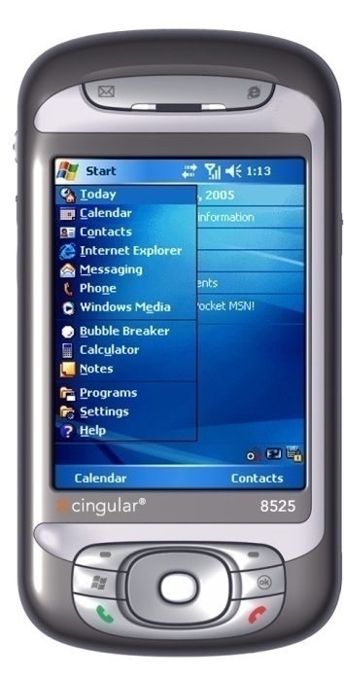
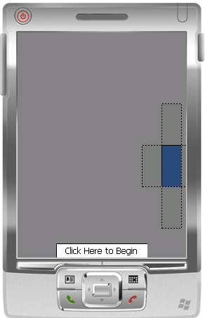
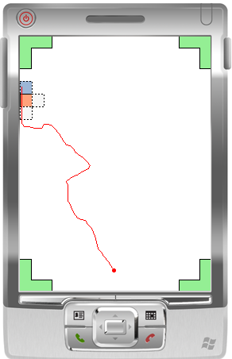
Initial Study
18 Subjects (9 Able Bodied / 9 Motor Impaired)
Recruited subjects from Seattle area using Craigslist, listservs and word-of-mouth
Broad Range of Motor Impairments
  Parkinson’s disease, low strength,
  tetraplegia, cerebral palsy

Slide 10
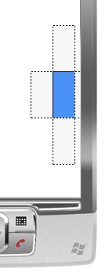
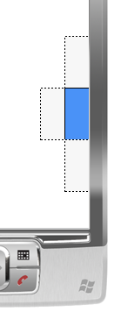
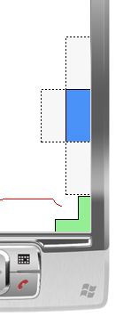
Five Conditions
1. Fly-in
and Tap
2. Edge Fly-in and Tap
3. Edge Stroke w/Lift Confirm
4. Velocity Stroke w/Corner Confirm
5. Reverse Stroke w/Corner Confirm
Baseline Conditions
Notes:
Mention target away from edge in condition 1
Mention distractor targets
MI subjects completed 45 trials per technique, AB 72 trials per technique

Slide 11
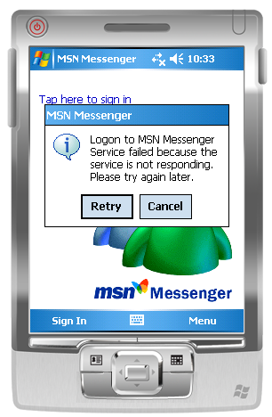
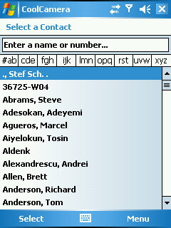
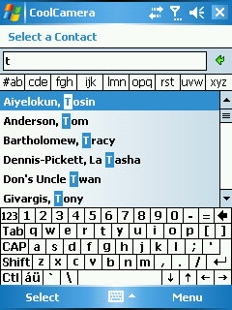
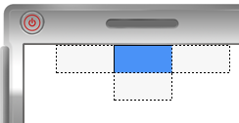
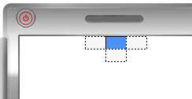

Target Sizes
Large: 59x28 pxls
Medium: 26x16 pxls
Small: 15x16 pxls

Slide 12
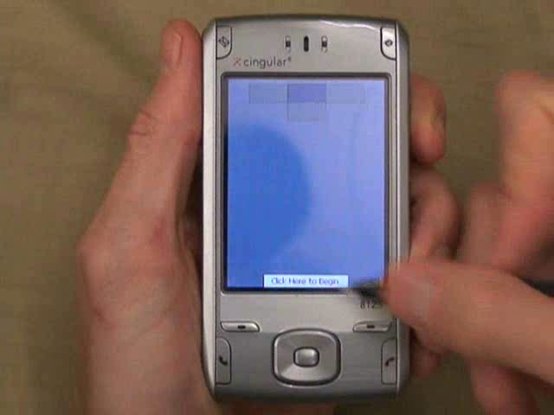
Notes:
Conditions were presented in random order
Video length: 1:49 seconds

Slide 13
Results
Overall target acquisition times were not statistically different for barrier pointing vs. traditional “fly-in and tap”
However…
Two of the most severely impaired subjects benefited greatly from the Barrier Pointing techniques

Slide 14
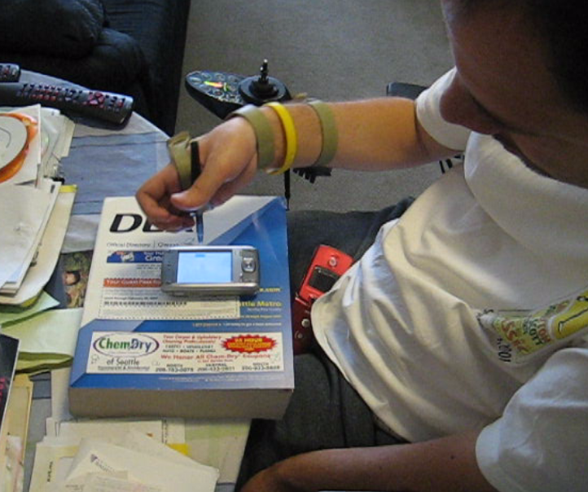
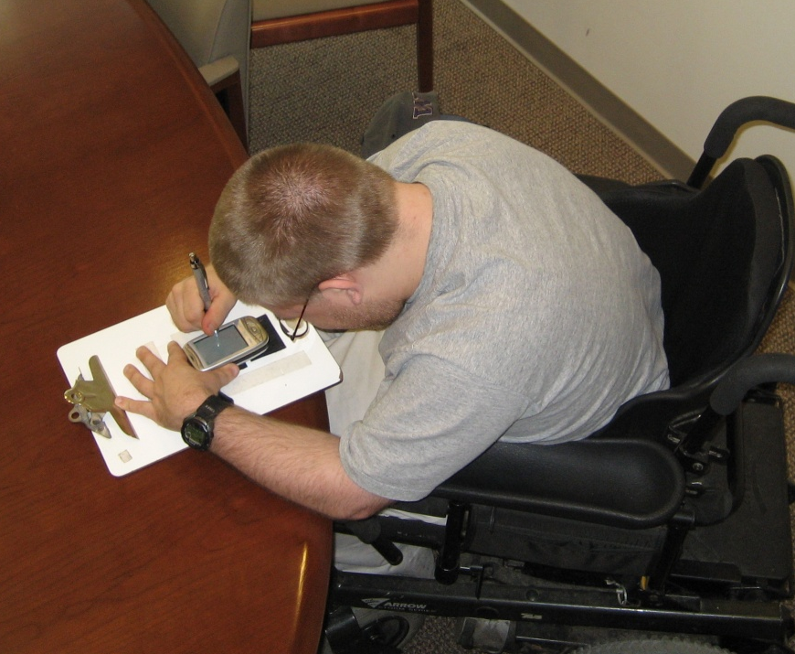
Case Studies
Subject: MI4
Condition:
Tetraplegia (SCI C5). No use of triceps, pectorals, hands.
Limited shoulder movement.
Subject: MI8
Condition:
Spastic Cerebal Palsy. Lack of fine motor skills. Spastic, uncontrollable movements.

Slide 15
Average Target Acquisition Times
Subject MI4
Subject MI8
5.2 seconds
4.2 seconds
1.6 seconds
1.8 seconds
2.8 seconds
1.1 seconds
Fly-in
and Tap
Edge
Fly-in
and Tap
Edge
Stroke
w/Lift
Confirm
Velocity
Stroke
w/Corner
Confirm
Reverse
Stroke
w/Corner
Confirm
Fly-in
and Tap
Edge
Fly-in
and Tap
Edge
Stroke
w/Lift
Confirm
Velocity
Stroke
w/Corner
Confirm
Reverse
Stroke
w/Corner
Confirm
Notes:
Conditions presented in random order
Technique #3, “edge stroke with lift confirmation,” performed well for both subjects. It was 40.5% and 48.5% faster for MI4 and MI8 respectively than technique #1, “fly-in-and-tap.”
The corner confirmation techniques (techniques 3 and 4) require the most movement, this has an adverse affect on MI4’s acquisition time (though it is still better than MI8)

Slide 16
Error Rates
Subject MI4
41.7%
Subject MI8
42.2%
38%
22.2%
12.5%
6.7%
Fly-in
and Tap
Edge
Fly-in
and Tap
Edge
Stroke
w/Lift
Confirm
Velocity
Stroke
w/Corner
Confirm
Reverse
Stroke
w/Corner
Confirm
Fly-in
and Tap
Edge
Fly-in
and Tap
Edge
Stroke
w/Lift
Confirm
Velocity
Stroke
w/Corner
Confirm
Reverse
Stroke
w/Corner
Confirm
Notes:
Both subjects had difficulty reaching the escape velocity threshold for technique #4, “velocity stroke with corner confirmation.” The other edge conditions outperformed technique #1. Error rates:
Condition1: MI4 37.5% MI8 22.2%
Condition5: MI4 12.5% MI8 6.7%

Slide 17
Miss Rates
Subject MI4
Subject MI8
67%
29%
4.2%
13.3%
Fly-in
and Tap
Edge
Fly-in
and Tap
Edge
Stroke
w/Lift
Confirm
Velocity
Stroke
w/Corner
Confirm
Reverse
Stroke
w/Corner
Confirm
Fly-in
and Tap
Edge
Fly-in
and Tap
Edge
Stroke
w/Lift
Confirm
Velocity
Stroke
w/Corner
Confirm
Reverse
Stroke
w/Corner
Confirm
Notes:
Technique #3, “edge stroke with lift confirmation,” had the lowest miss rate for both subjects: 4.2% and 13.3% for MI4 and MI8, respectively.

Slide 18
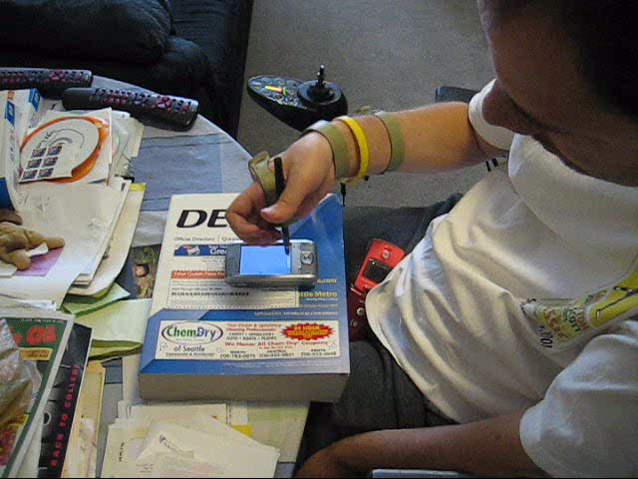
Condition 1: Fly-in and Tap
Subject MI4
Watch for:
High rate of wrong target acquisitions
Difficulty with all target sizes
High miss rate
Notes:
Video length: 26 seconds

Slide 19
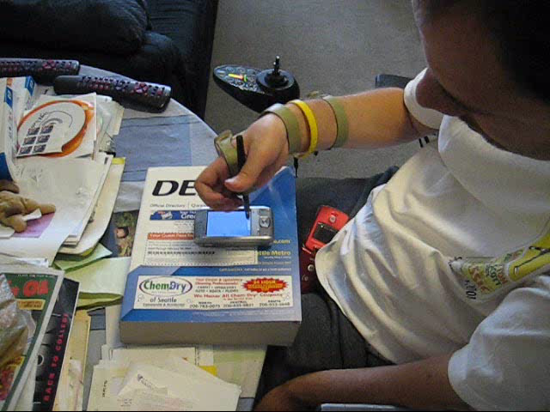

Slide 20
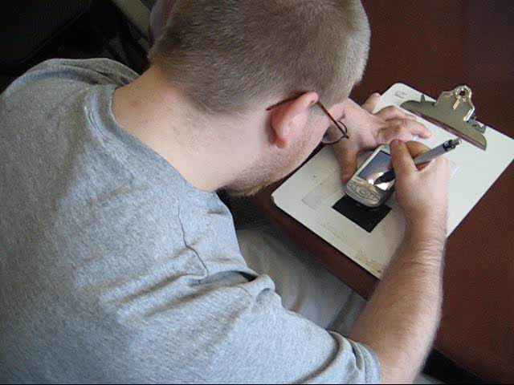
Condition 1: Fly-in and Tap
Subject MI8
Watch for:
Difficulty with fly-in motion
Large number of accidental taps
High rate of slippage
Notes:
Video length: 31 seconds

Slide 21
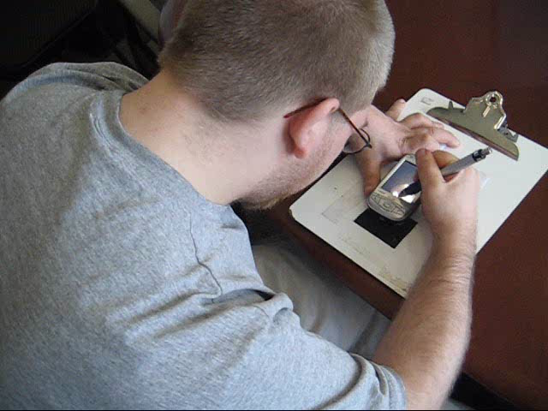

Slide 22
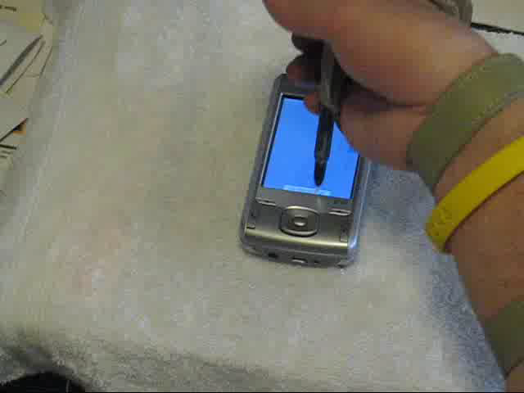
Condition 3: Edge Stroke w/Lift Confirmation
Subject MI4
Watch for:
The edge results in smoother motion
The lift causes jerkiness
Returning to screen after lift is difficult
Notes:
Video Length: 26 seconds

Slide 23


Slide 24
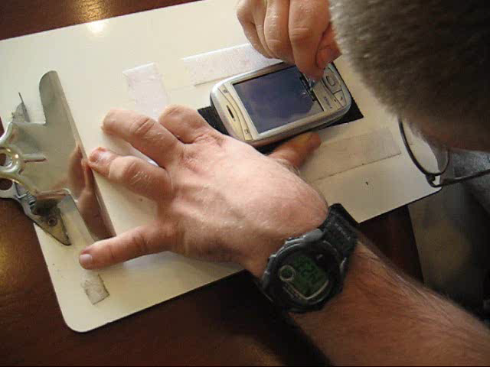
Condition 3: Edge Stroke w/Lift Confirmation
Subject MI8
Watch for:
Presses hard against screen and edge
Immediately moves toward edge
Notes:
Video Length: 33 seconds

Slide 25


Slide 26
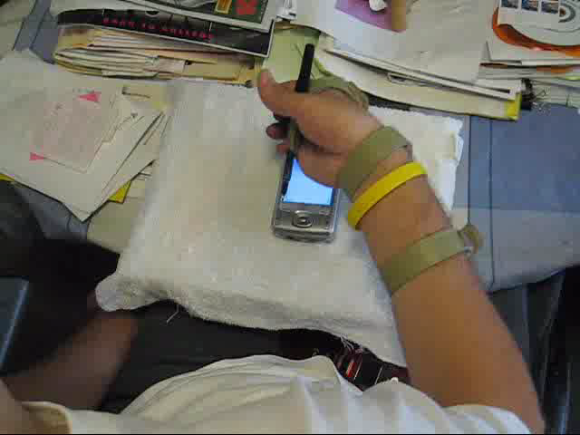
Condition 5: Reverse Stroke w/Corner Confirmation
Subject MI4
Watch for:
A nice smooth controlled stroke
Requires most movement (fatigue?)
Notes:
Video length: 32 seconds

Slide 27


Slide 28
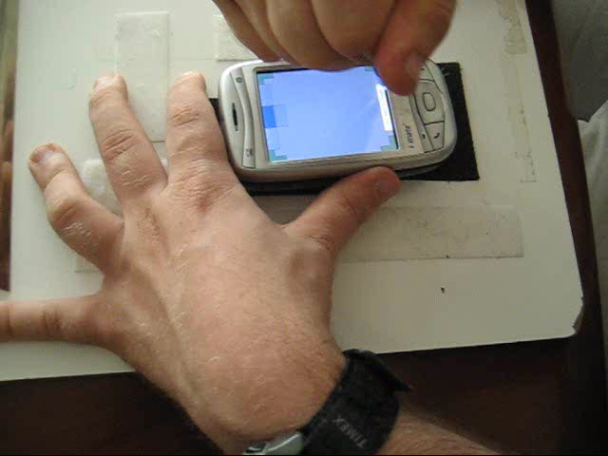
Condition 5: Reverse Stroke w/Corner Confirmation
Subject MI8
Watch for:
Edge allows a nice smooth controlled stroke
Ability to adjust to an incorrect selection
Notes:
Video length: 30 seconds

Slide 29
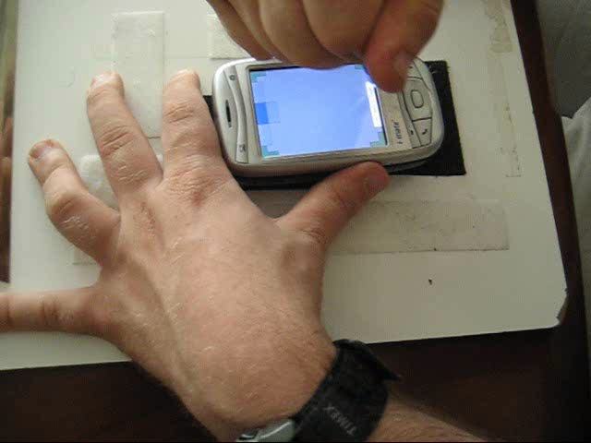

Slide 30
Table of Results
(lower is better) | Time |  | Error Rate |  | Miss Rate
 | MI4 | MI8 | MI4 | MI8 | MI4 | MI8
Condition 1 “Fly-in and Tap” | 1.6 sec | 4.2 sec | 37.5% | 22.2% | 29.2% | 66.7%
Condition 2 “Edge Fly-in and Tap” | 1.1 sec | 4.3 sec | 12.5% | 17.8% | 12.5% | 49%
Condition 3 “Edge Stroke w/Lift Confirm” | 1.1 sec | 2.8 sec | 25% | 17.8% | 4.2% | 13.3%
Condition 4 “Velocity Stroke w/Corner Confirm” | 1.9 sec | 5.1 sec | 41.7% | 42.2% | 29.2% | 40%
Condition 5 “Reverse Stroke w/Corner Confirm” | 2.8 sec | 3.1 sec | 12.5% | 6.7% | 41.7% | 20%

Slide 31
Table of Results
(lower is better) | Time |  | Error Rate |  | Miss Rate
 | MI4 | MI8 | MI4 | MI8 | MI4 | MI8
Condition 1 “Fly-in and Tap” | 1.6 sec | 4.2 sec | 37.5% | 22.2% | 29.2% | 66.7%
Condition 2 “Edge Fly-in and Tap” | 1.1 sec | 4.3 sec | 12.5% | 17.8% | 12.5% | 49%
Condition 3 “Edge Stroke w/Lift Confirm” | 1.1 sec | 2.8 sec | 25% | 17.8% | 4.2% | 13.3%
Condition 4 “Velocity Stroke w/Corner Confirm” | 1.9 sec | 5.1 sec | 41.7% | 42.2% | 29.2% | 40%
Condition 5 “Reverse Stroke w/Corner Confirm” | 2.8 sec | 3.1 sec | 12.5% | 6.7% | 41.7% | 20%

Slide 32
Table of Results
(lower is better) | Time |  | Error Rate |  | Miss Rate
 | MI4 | MI8 | MI4 | MI8 | MI4 | MI8
Condition 1 “Fly-in and Tap” | 1.6 sec | 4.2 sec | 37.5% | 22.2% | 29.2% | 66.7%
Condition 2 “Edge Fly-in and Tap” | 1.1 sec | 4.3 sec | 12.5% | 17.8% | 12.5% | 49%
Condition 3 “Edge Stroke w/Lift Confirm” | 1.1 sec | 2.8 sec | 25% | 17.8% | 4.2% | 13.3%
Condition 4 “Velocity Stroke w/Corner Confirm” | 1.9 sec | 5.1 sec | 41.7% | 42.2% | 29.2% | 40%
Condition 5 “Reverse Stroke w/Corner Confirm” | 2.8 sec | 3.1 sec | 12.5% | 6.7% | 41.7% | 20%

Slide 33
Future Work
Explore multiple target acquisitions per trial
Apply barrier pointing to finger/thumb based interaction
Begin creating barrier pointing widgets and interfaces
Notes:
What about fingers?
this is definitely a space worth exploring but found through some early investigation that some MI subjects may not have enough strength in movement to register their fingers
Continuous interaction where the pen is not lifted

Slide 34
Conclusion
drag
drag
Screen
drag
Edge
Corner
Notes:
Interaction techniques that rely on the screen, edge, corner may help some users with target acquisitions

Slide 35
thankyou!
Jon Froehlich
^{jonfroehlich@gmail.com}
Acknowledgements
I’d like to acknowledge my co-authors Jacob O. Wobbrock and Shaun Kane for a wonderful collaboration, UW Rehabilitative Medicine, the study participants, and Susumu Harada and Anna Talman for their helpful edits/comments on the paper.
design:
use:
build:
university of washington

Slide 36
OLD / BACKUP SLIDES

Slide 37
Our Approach
“fly-in”
“fly-in”
Can we utilize the device’s raised edge along the screen perimeter to assist the fly-in movement?

Slide 38
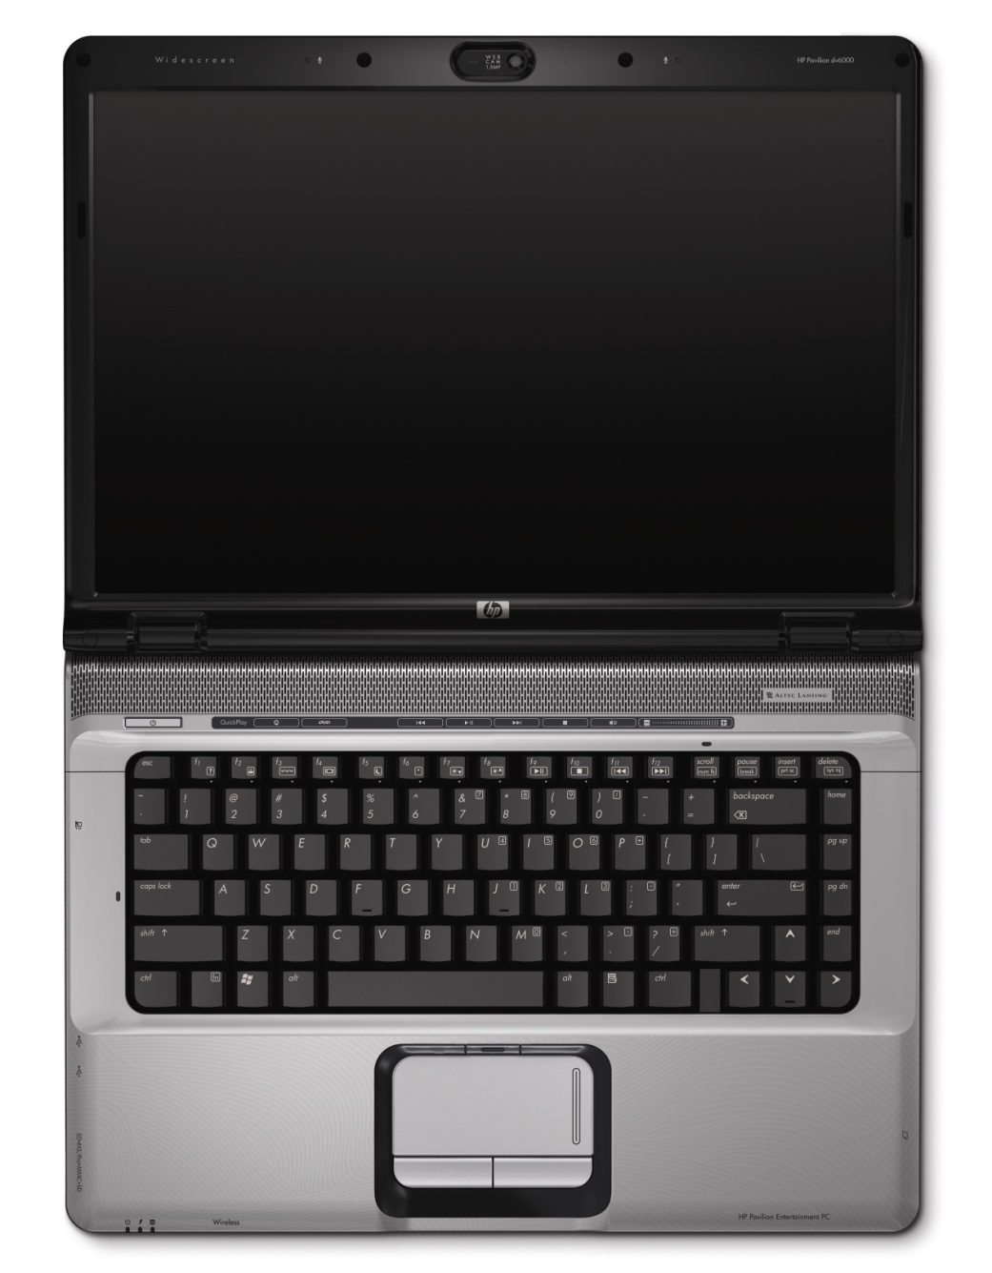
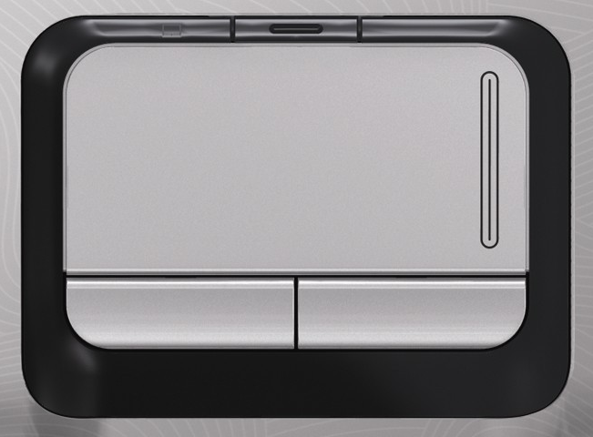
Edge Provides Tactile Feedback
Touchpad’s often utilize edge to shortcut access to functions such as scroll, maximize, etc.

Slide 39
Physical Edges
Wobbrock, J., Myers, B. A., and Kembel, J. A. UIST ’03
Wobbrock, J. CHI ‘03 Extended Abstracts

