Slide 1
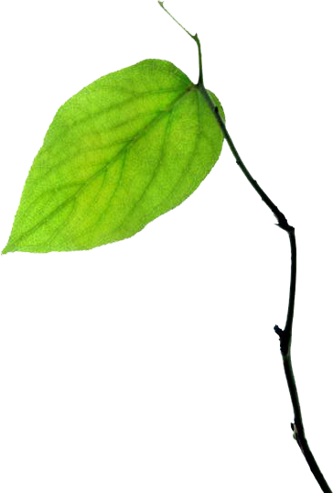
Behavior, Energy, & Climate Change Conference
Nov 13, 2012
Applying Iterative Design to the Eco-Feedback Design Process
Human Computer
Interaction
Laboratory
@jonfroehlich
Assistant Professor Computer Science
Notes:
My name is Jon Froehlich and I’m a new professor in Computer Science at the University of Maryland. My research is on designing and evaluating new types of eco-feedback systems

Slide 2
eco-feedback
sensing and visualizing behavior to reduce environmental impact
Notes:
These systems are commonly known as eco-feedback systems

Slide 3
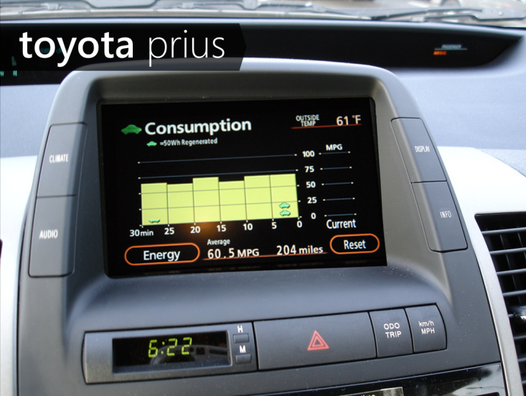
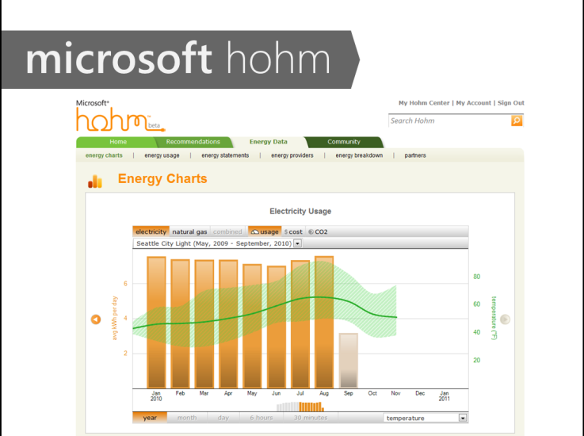
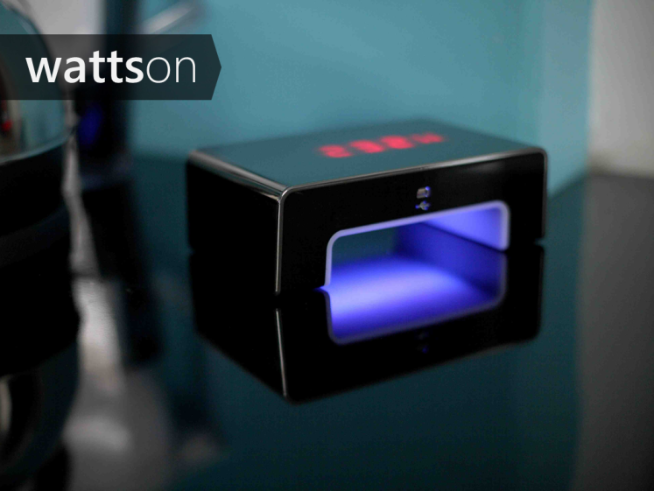
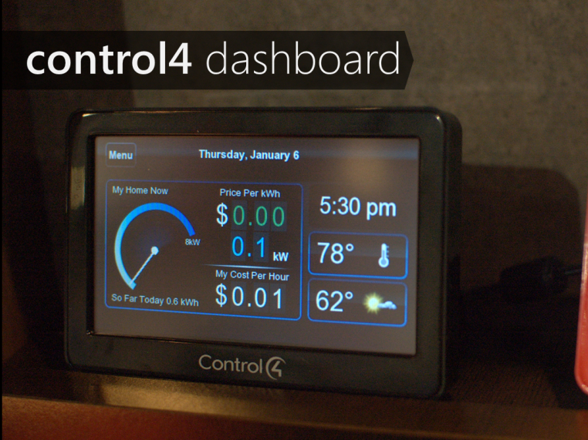
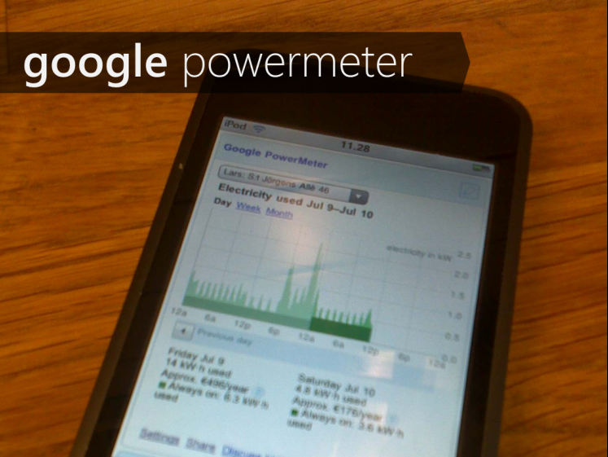
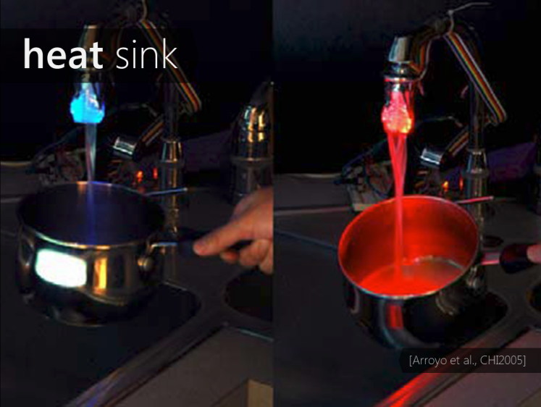
Notes:
There are countless examples of eco-feedback systems both in academia and in industry—and much of this conference has been dedicated to discussing them in one form or another

Slide 4
eco-feedback
sensing and visualizing behavior to reduce environmental impact
Talk focus: How can/should we create reusable design knowledge to support the eco-feedback design process
Notes:
The focus of this (short) talk is on how can/should we create reusable design knowledge to support the eco-feedback design and evaluation process

Slide 5
“
”
“Getting the design right and the right design.”
— Bill Buxton Sketching User Experiences
Notes:
That is, a process for helping to get the design right and the right design

Slide 6
Before moving forward, I want to ask a question…

Slide 7
The following eco-feedback paper is missing something. What is it?
Notes:
The following residential energy paper studies the effect of an eco-feedback display on consumption behavior in a field study of 120 households but it is missing something. What is it?

Slide 8
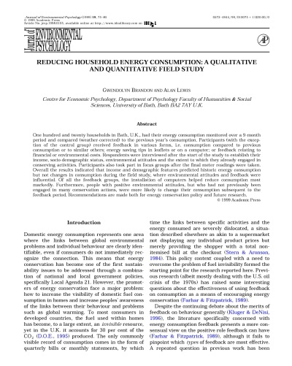
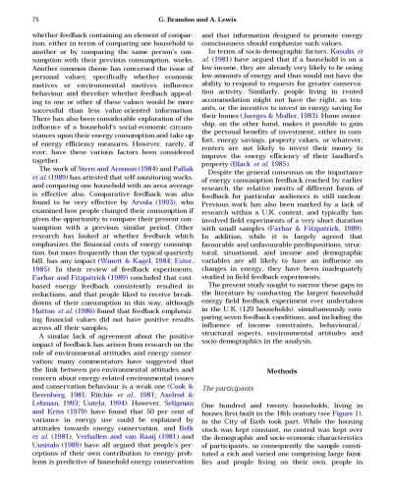
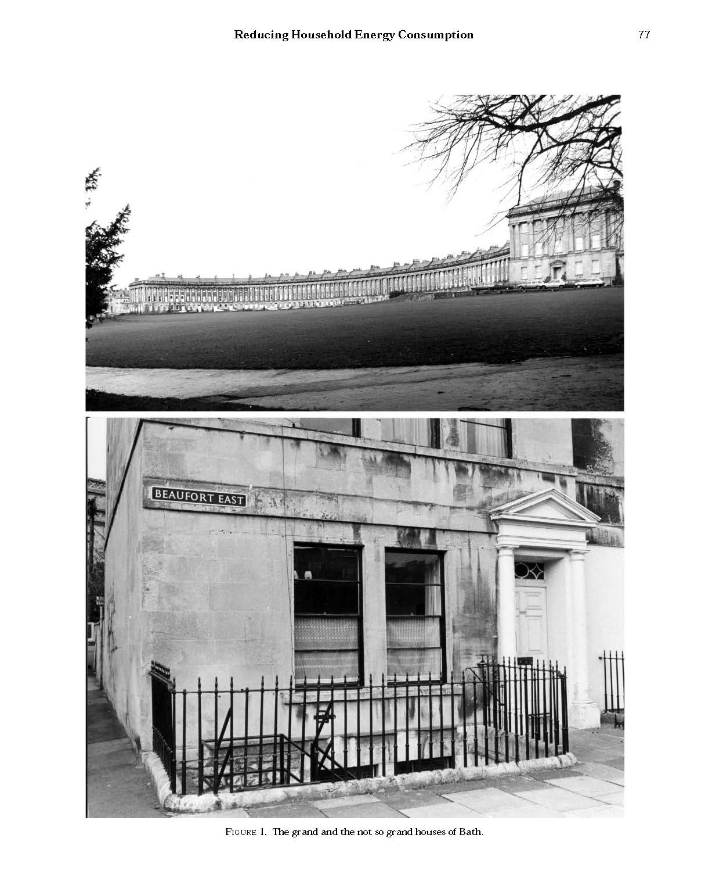
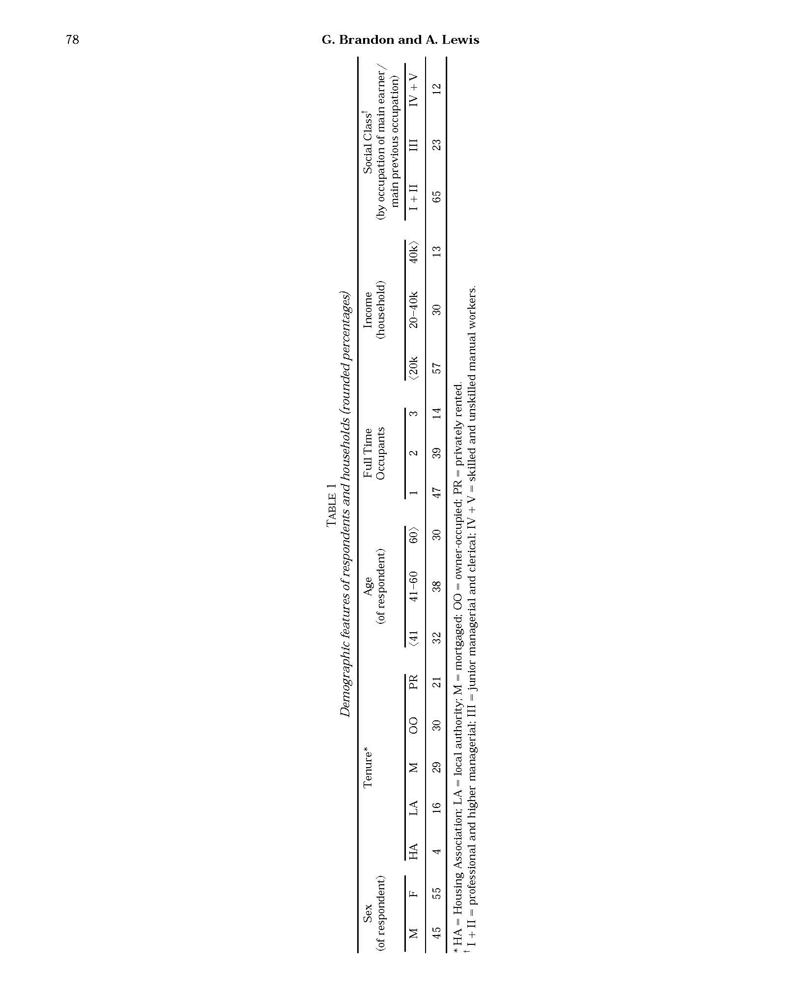
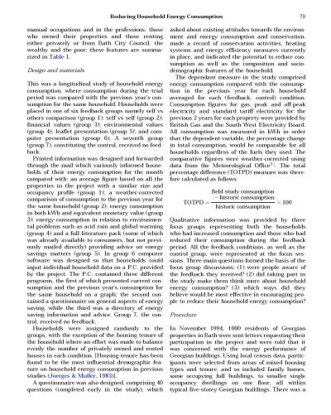
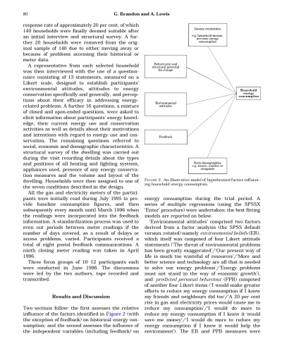
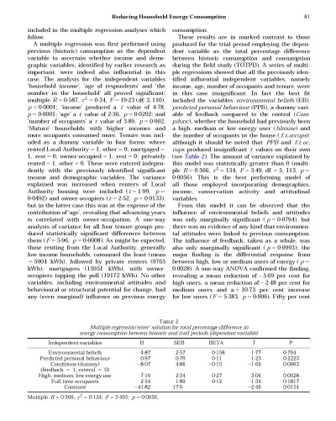
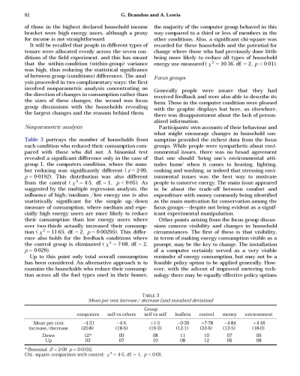
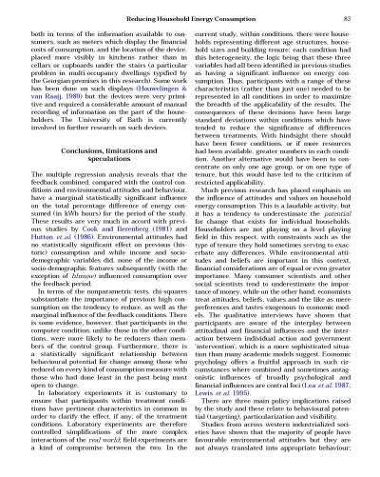
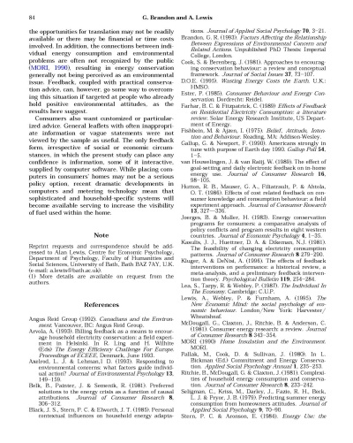
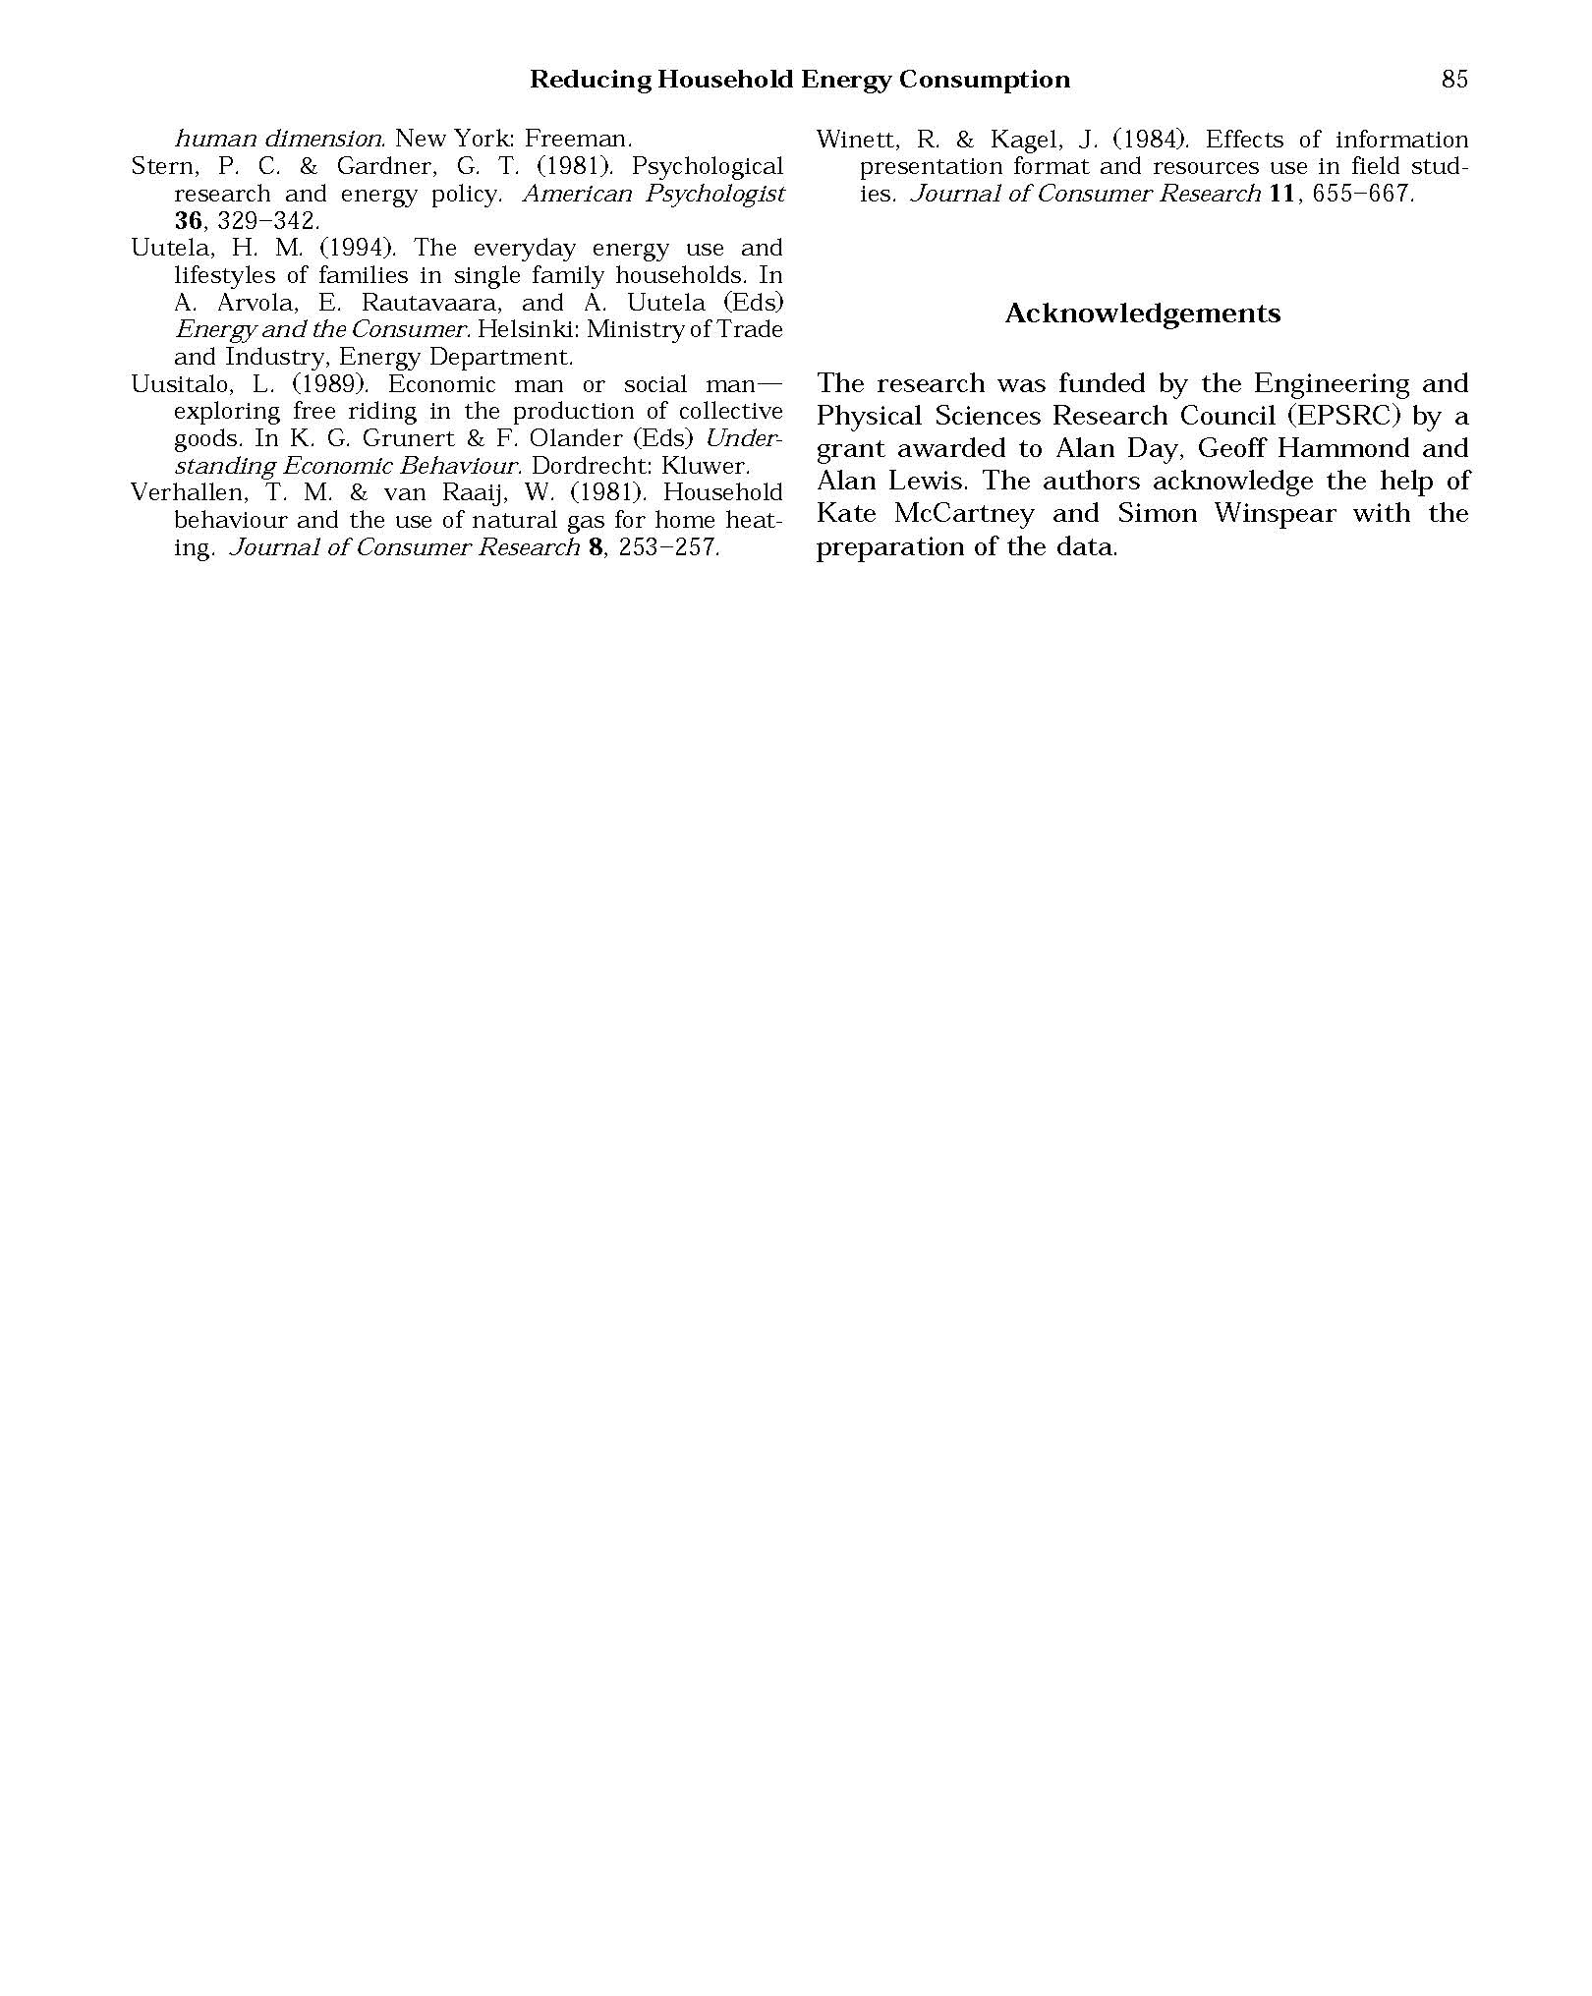
Brandon et al., Reducing Household Energy Consumption: A Qualitative & Quantitative Field Study, Environmental Psychology 1999

Slide 9
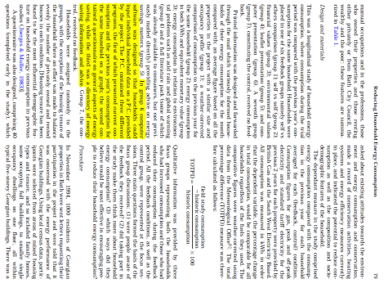
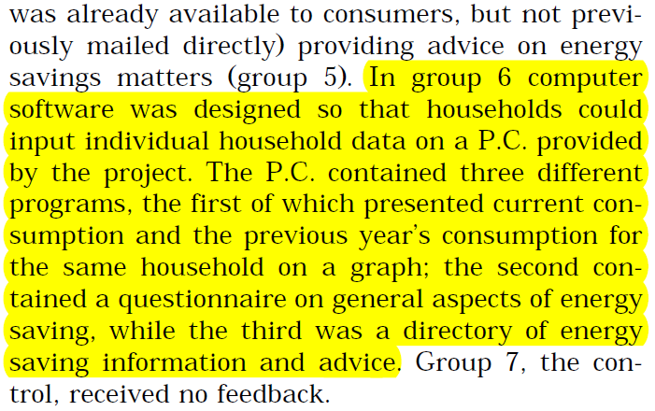
½ paragraph description of eco-feedback interface and no screenshots in 11 page paper
Brandon et al., Reducing Household Energy Consumption: A Qualitative & Quantitative Field Study, Environmental Psychology 1999

Slide 10
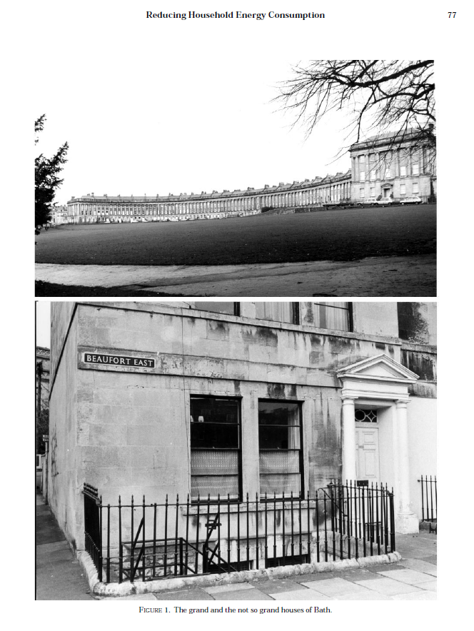
Brandon et al., Reducing Household Energy Consumption: A Qualitative & Quantitative Field Study, Environmental Psychology 1999

Slide 11
Well, but that was 1999.
Fair enough!

Slide 12
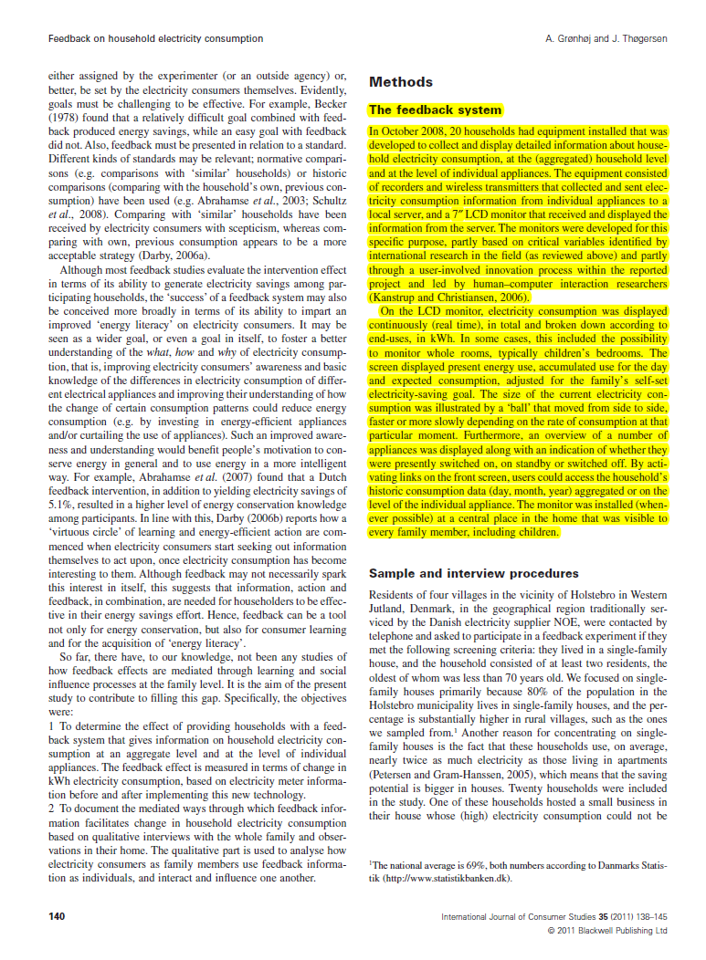
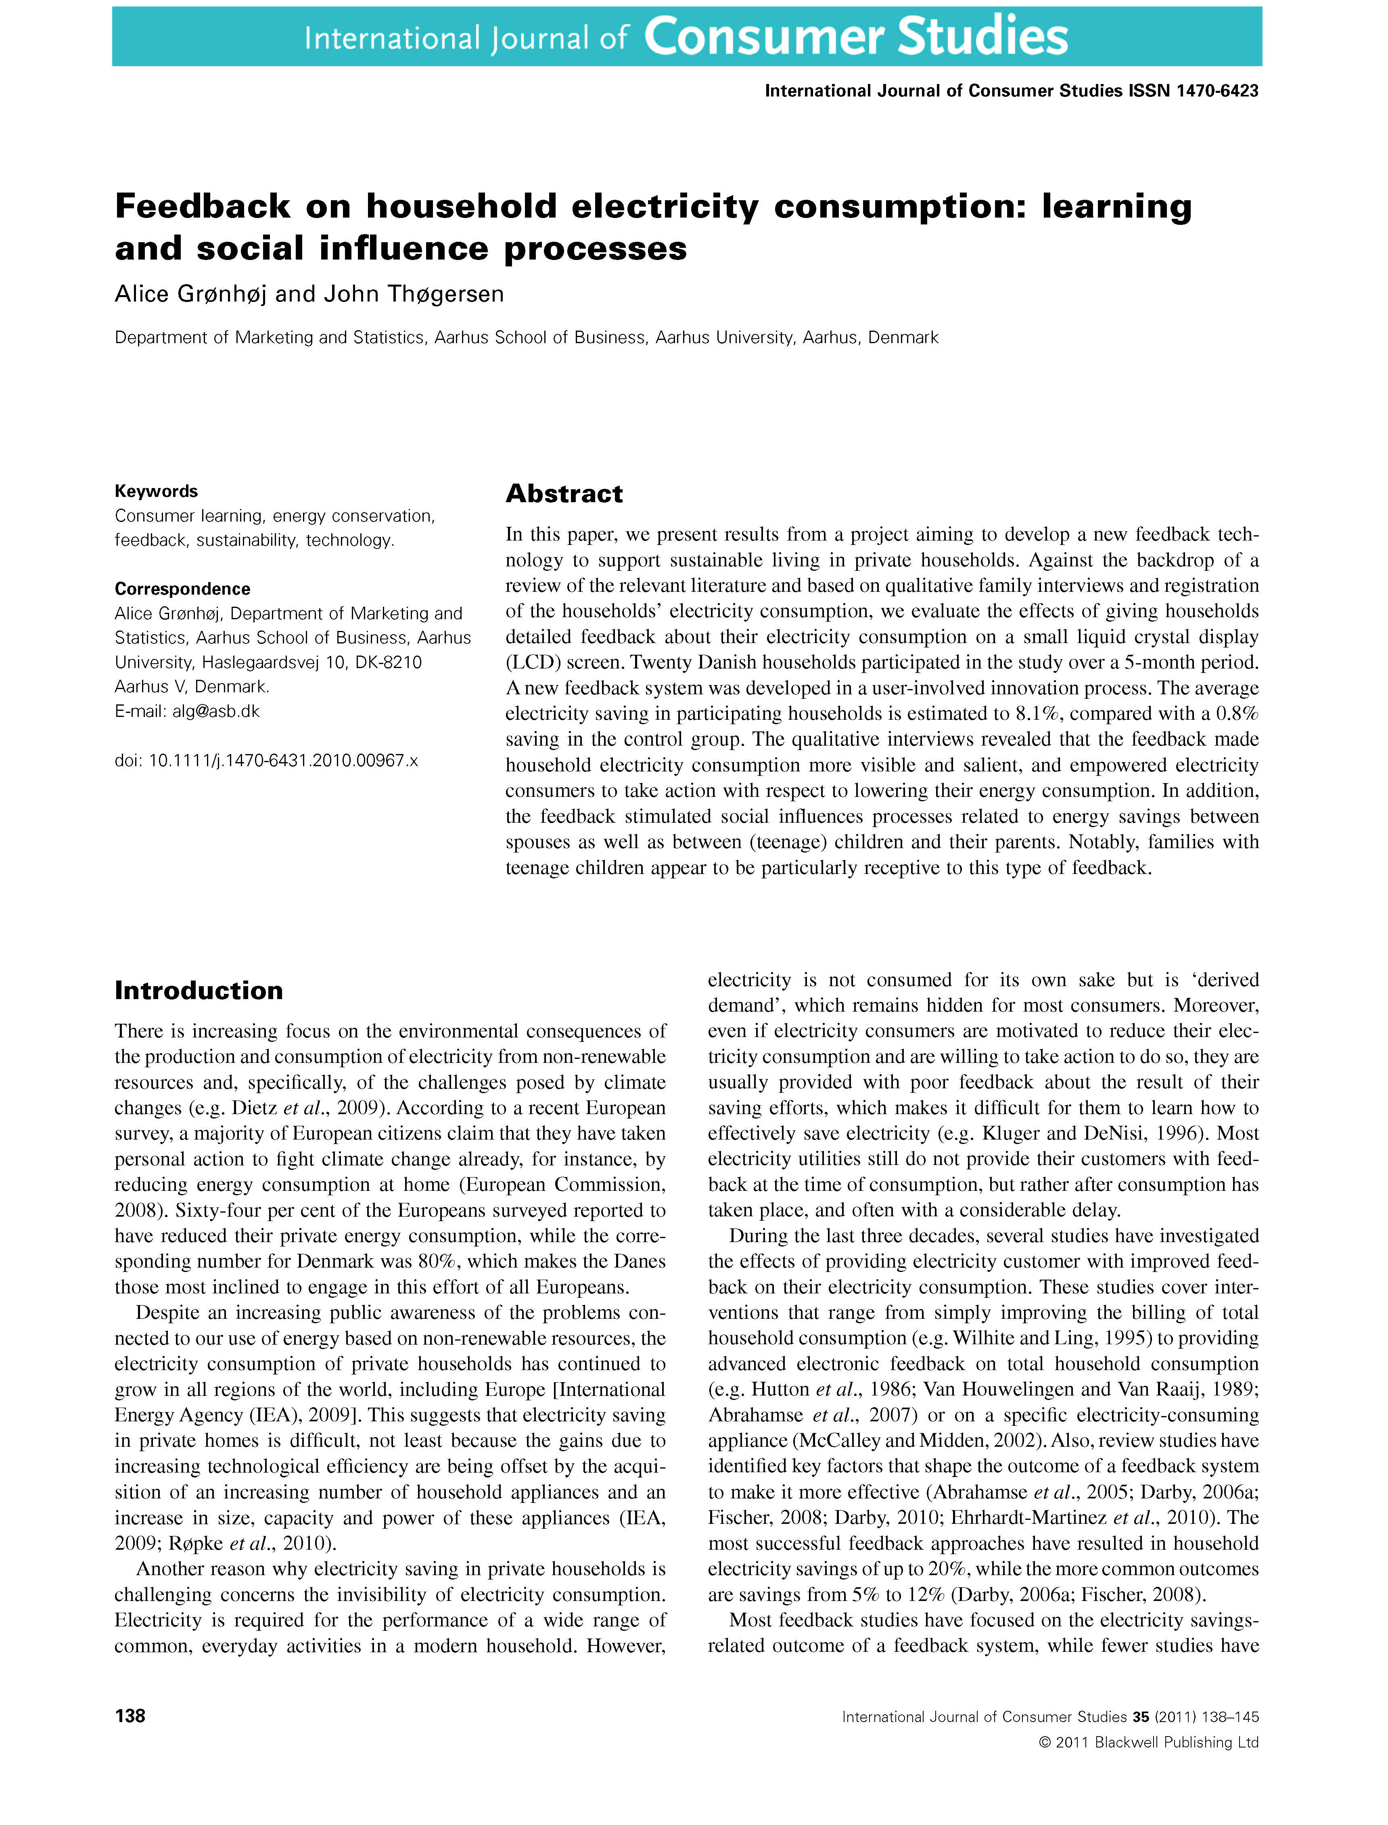
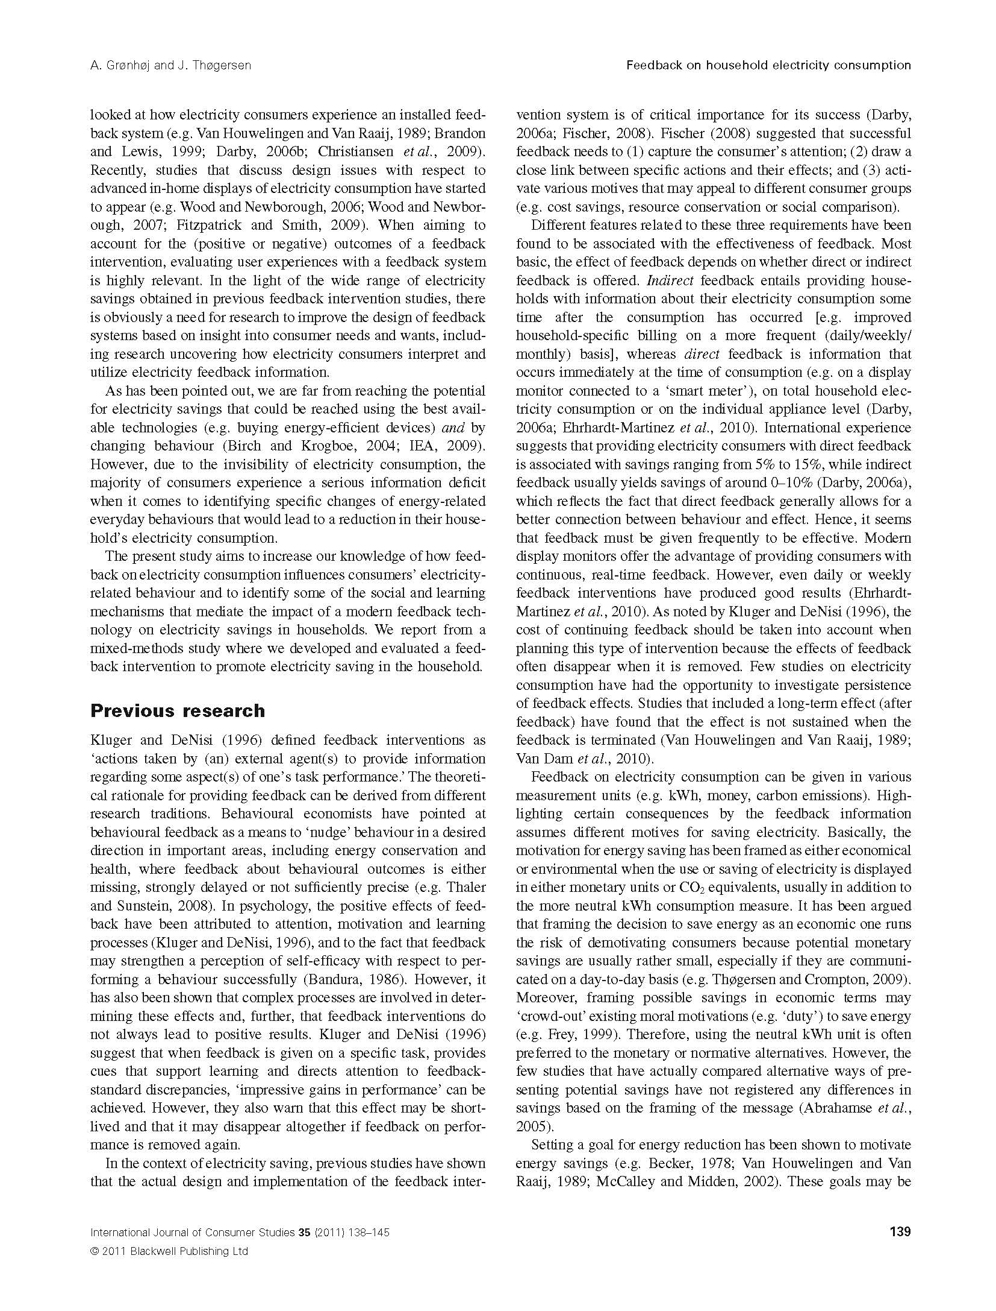
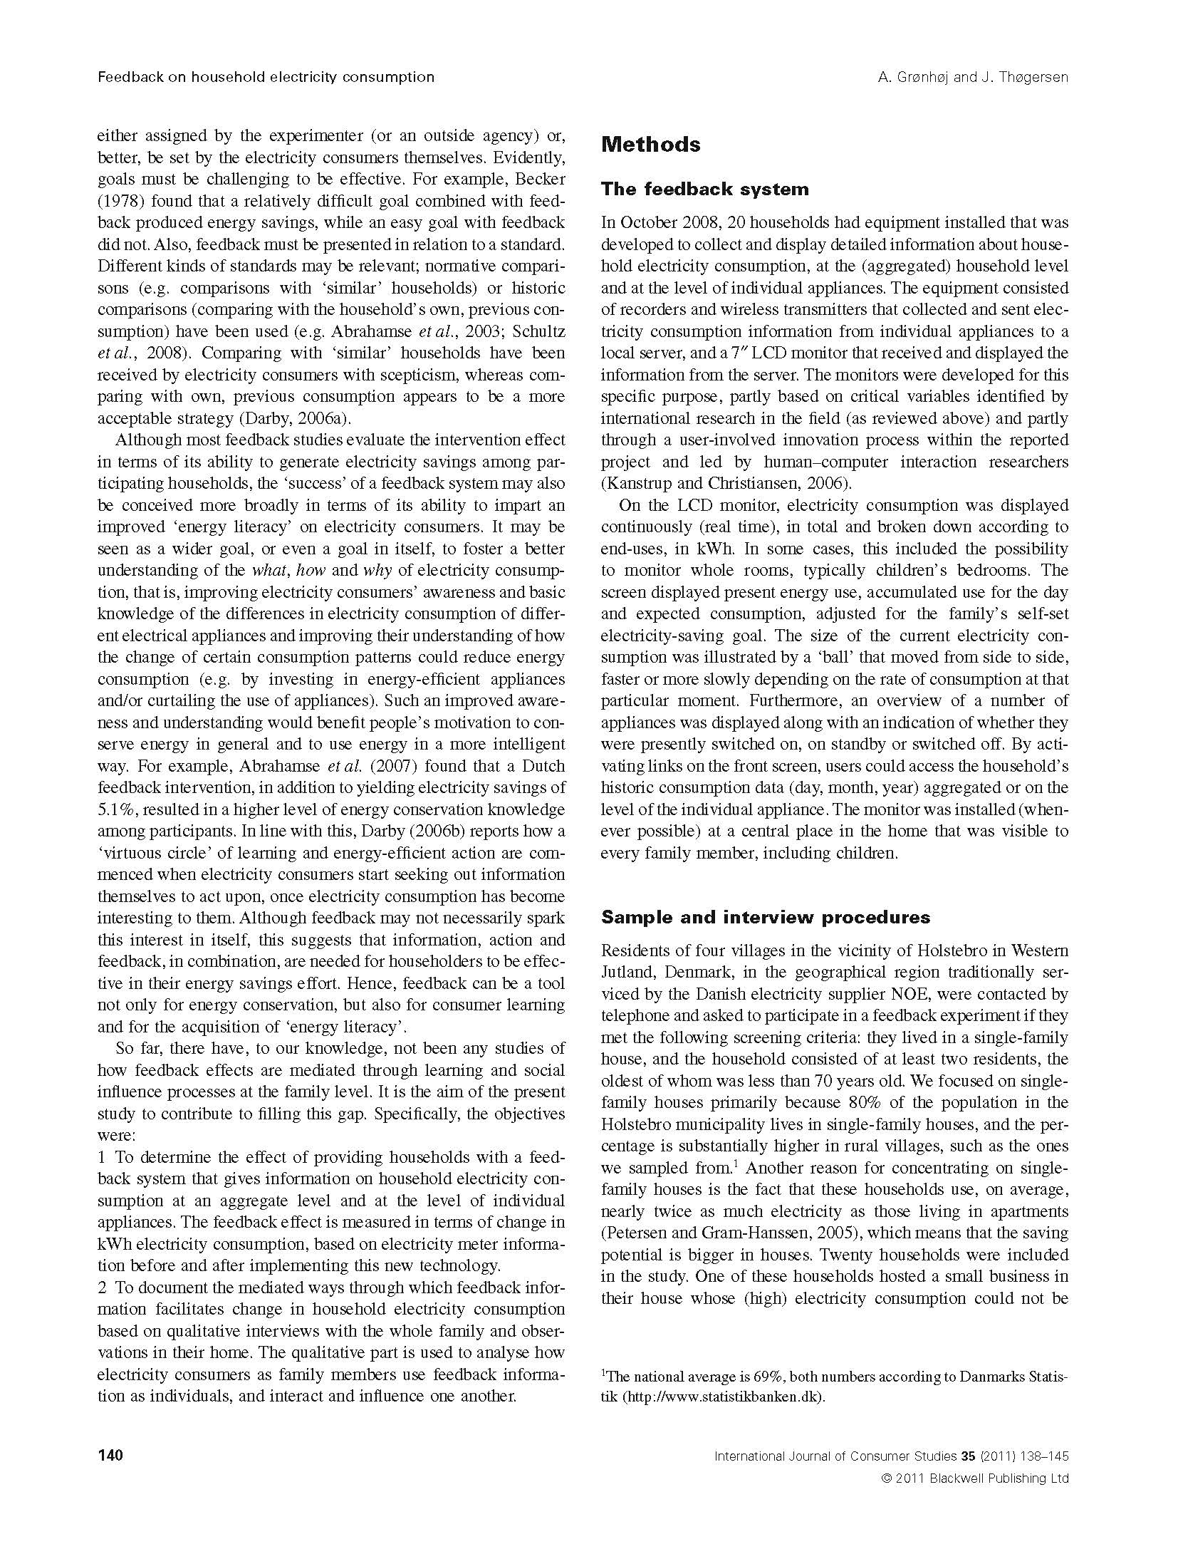
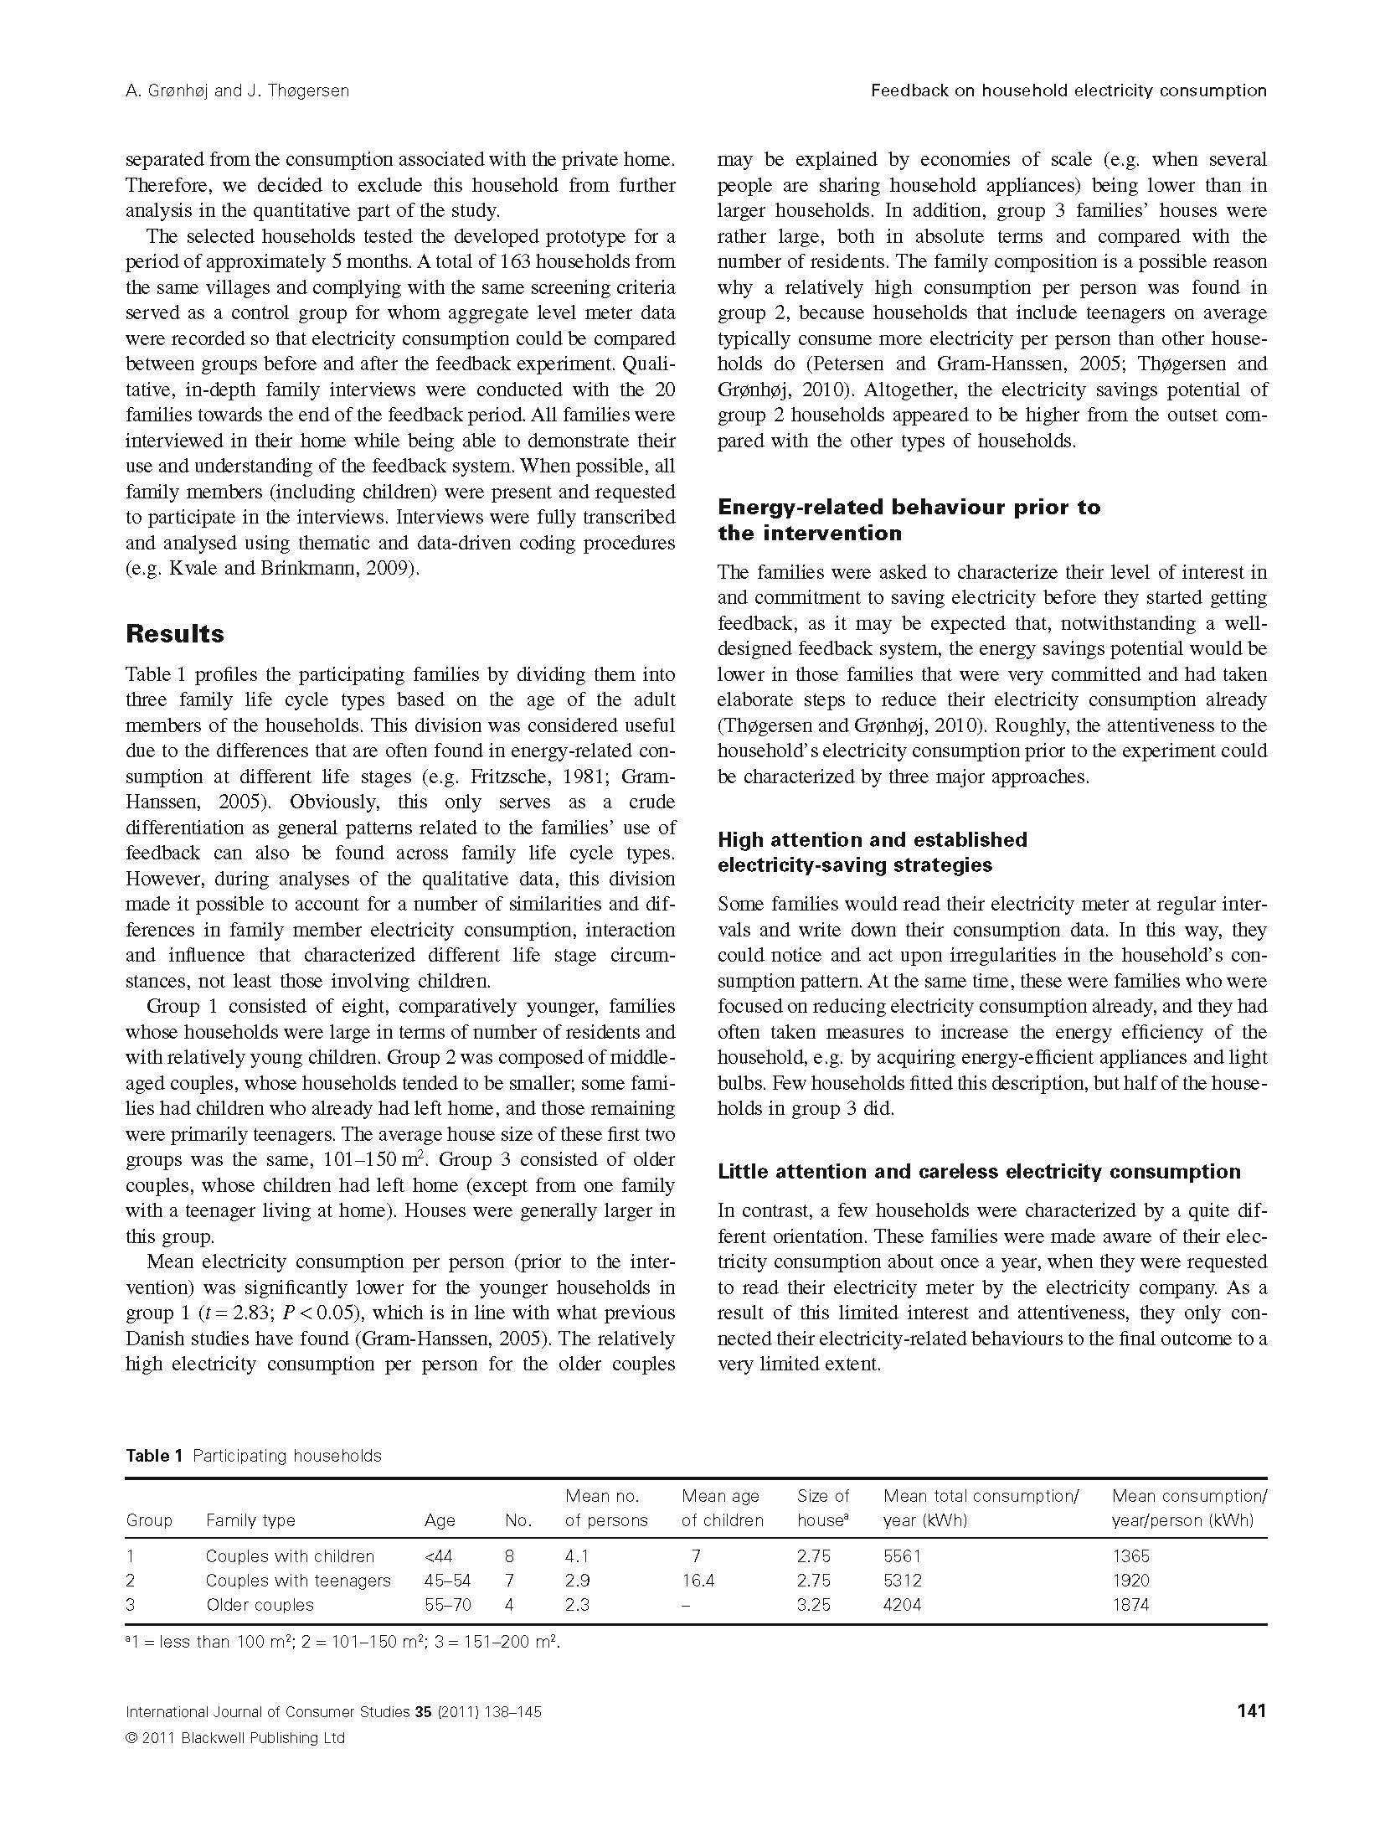
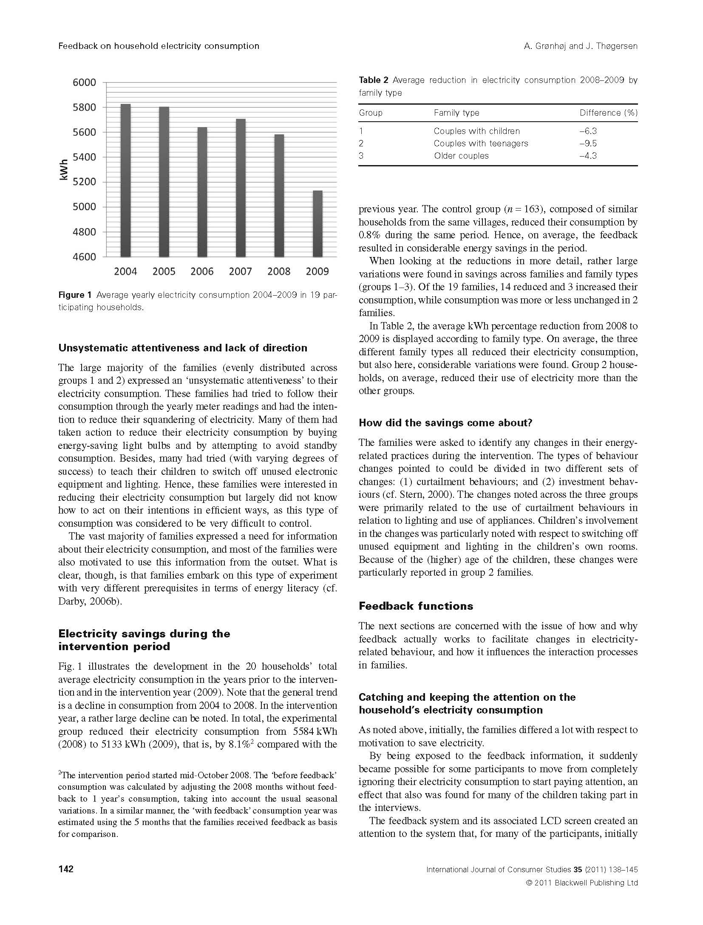
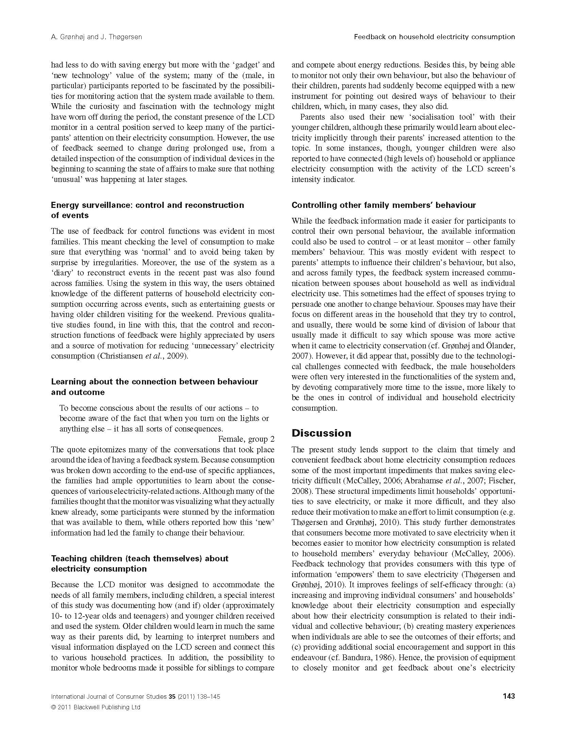
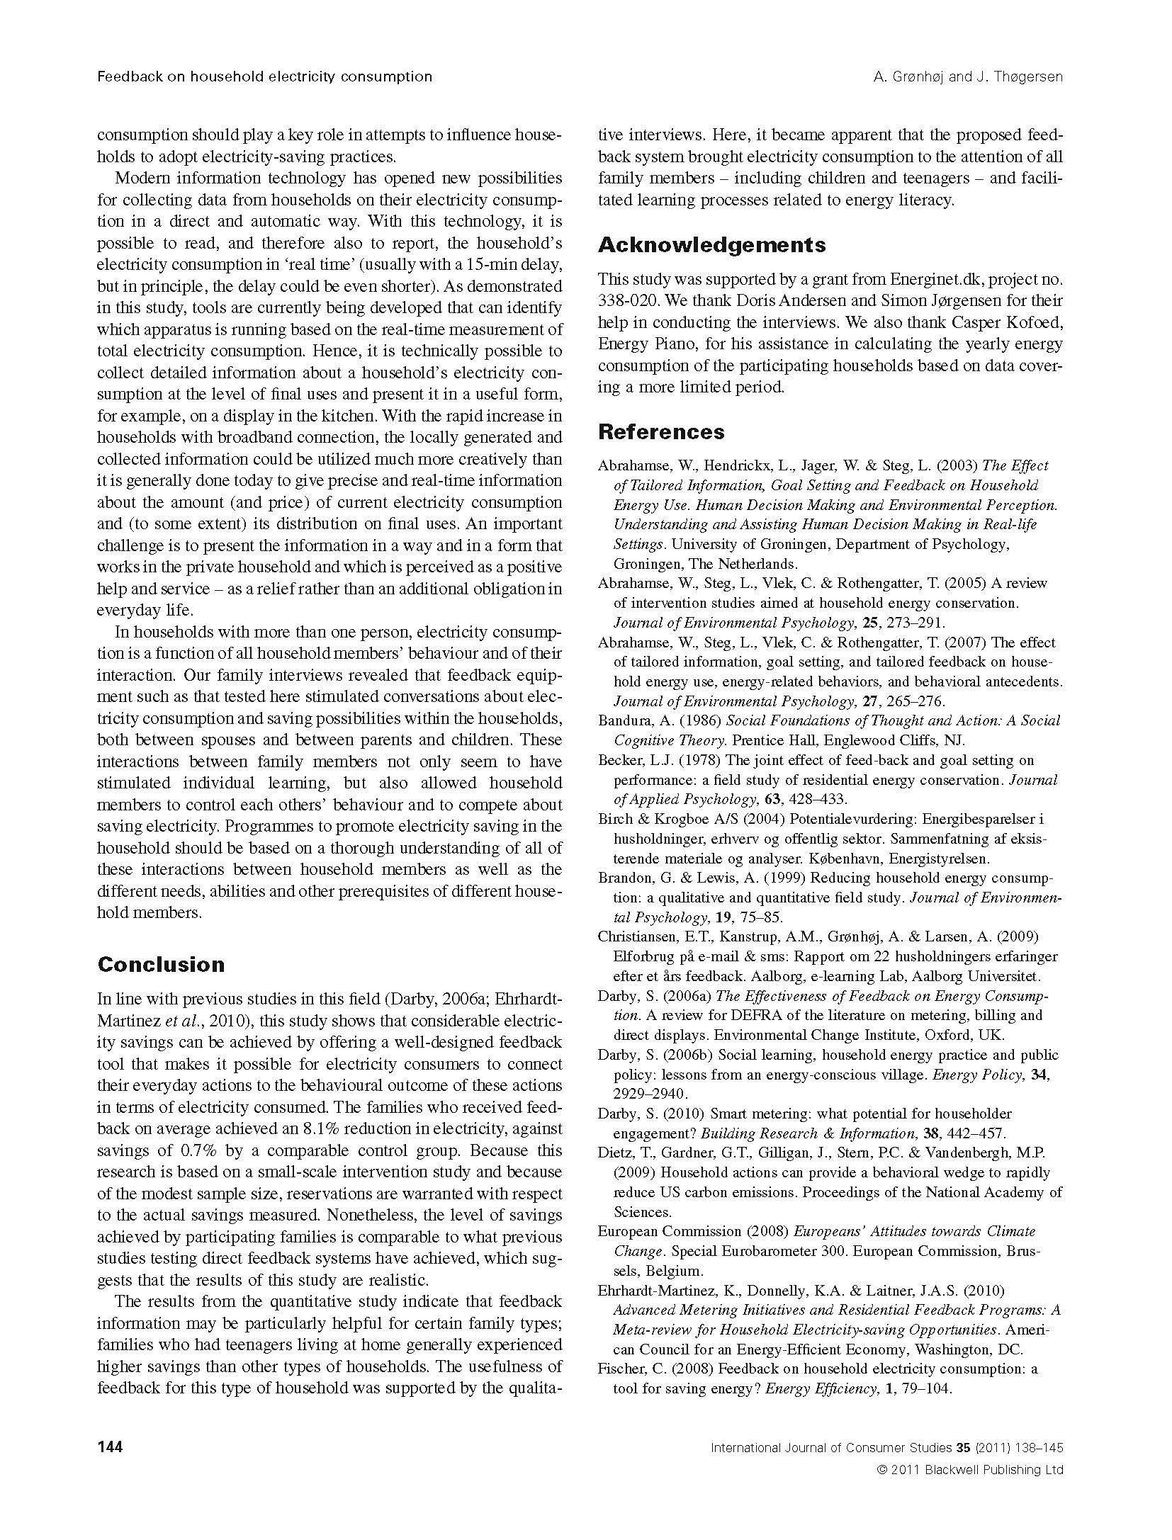
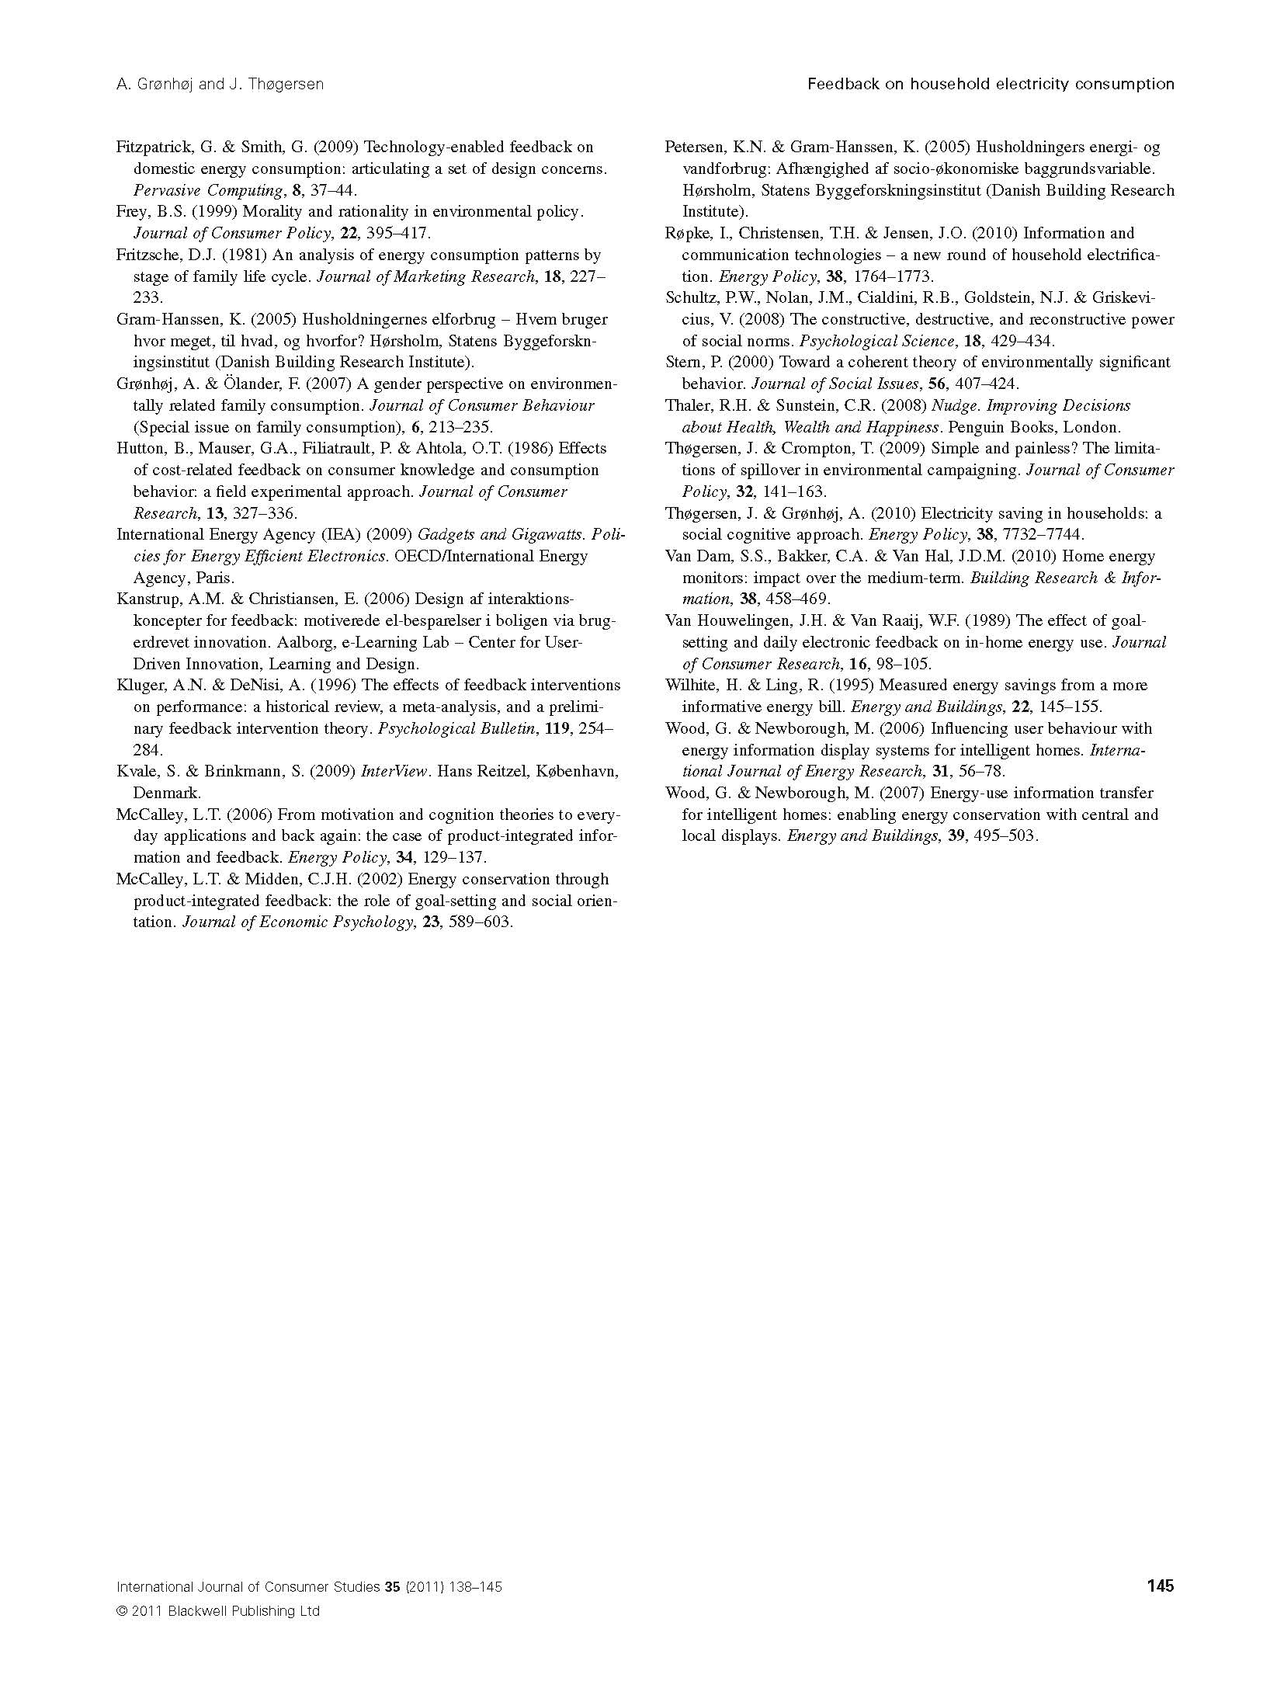
Grønhøj & Thøgersen, Feedback on Household Electricity Consumption: Learning & Social Influence Processes, IJCS2011

Slide 13
2 paragraph description of eco-feedback interface and no screenshots in 8 page paper
Grønhøj & Thøgersen, Feedback on Household Electricity Consumption: Learning & Social Influence Processes, IJCS2011

Slide 14
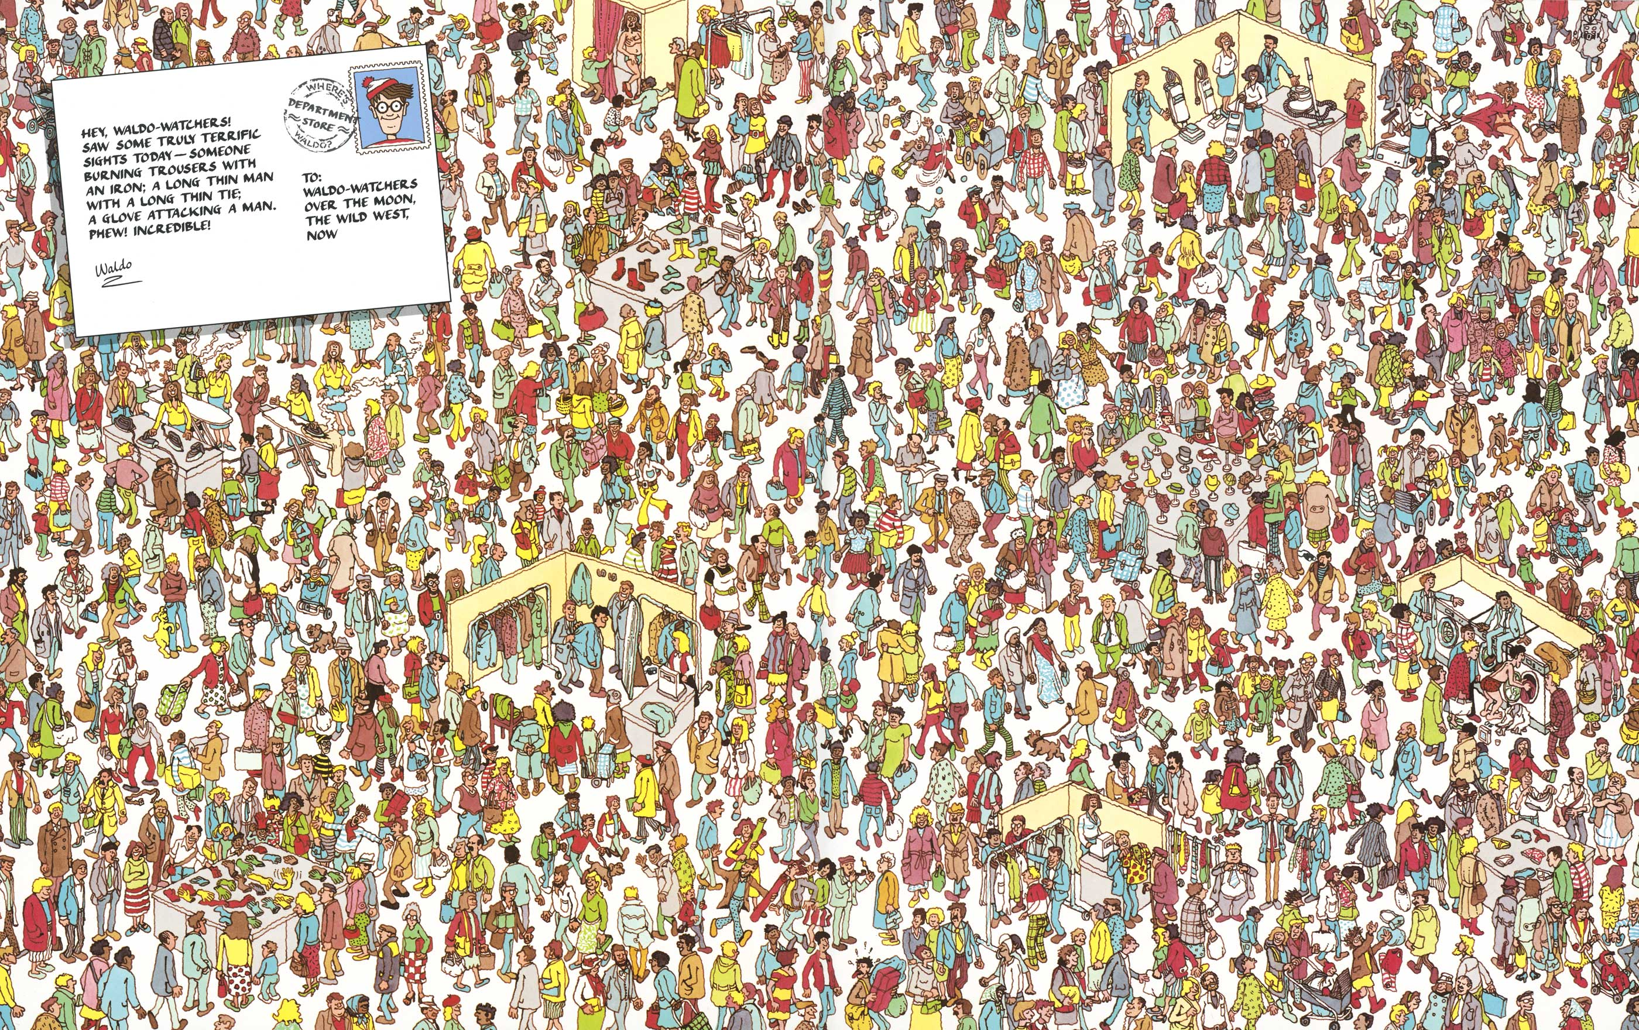

Slide 15
the Design?
Where’s Waldo?

Slide 16
So, clearly a disciplinary divide…
psychologists designers
engineers
economists
building scientists
others?
Notes:
So, clearly there is a disciplinary gap here between a number of fields, potentially, which is no surprise given that eco-feedback design is a multi-discipline practice

Slide 17
This oversight seems to reflect a lack of recognition about the critical role that particular design choices play in affecting behavior.
This unduly narrows and curbs potentially rich research directions
Notes:
For example, we know that a particular design resulted in X% change in consumption but we don’t necessarily know why

Slide 18
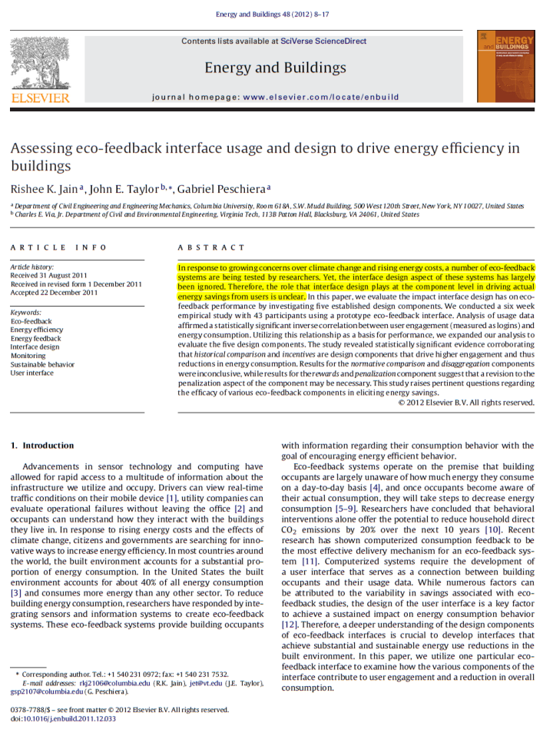
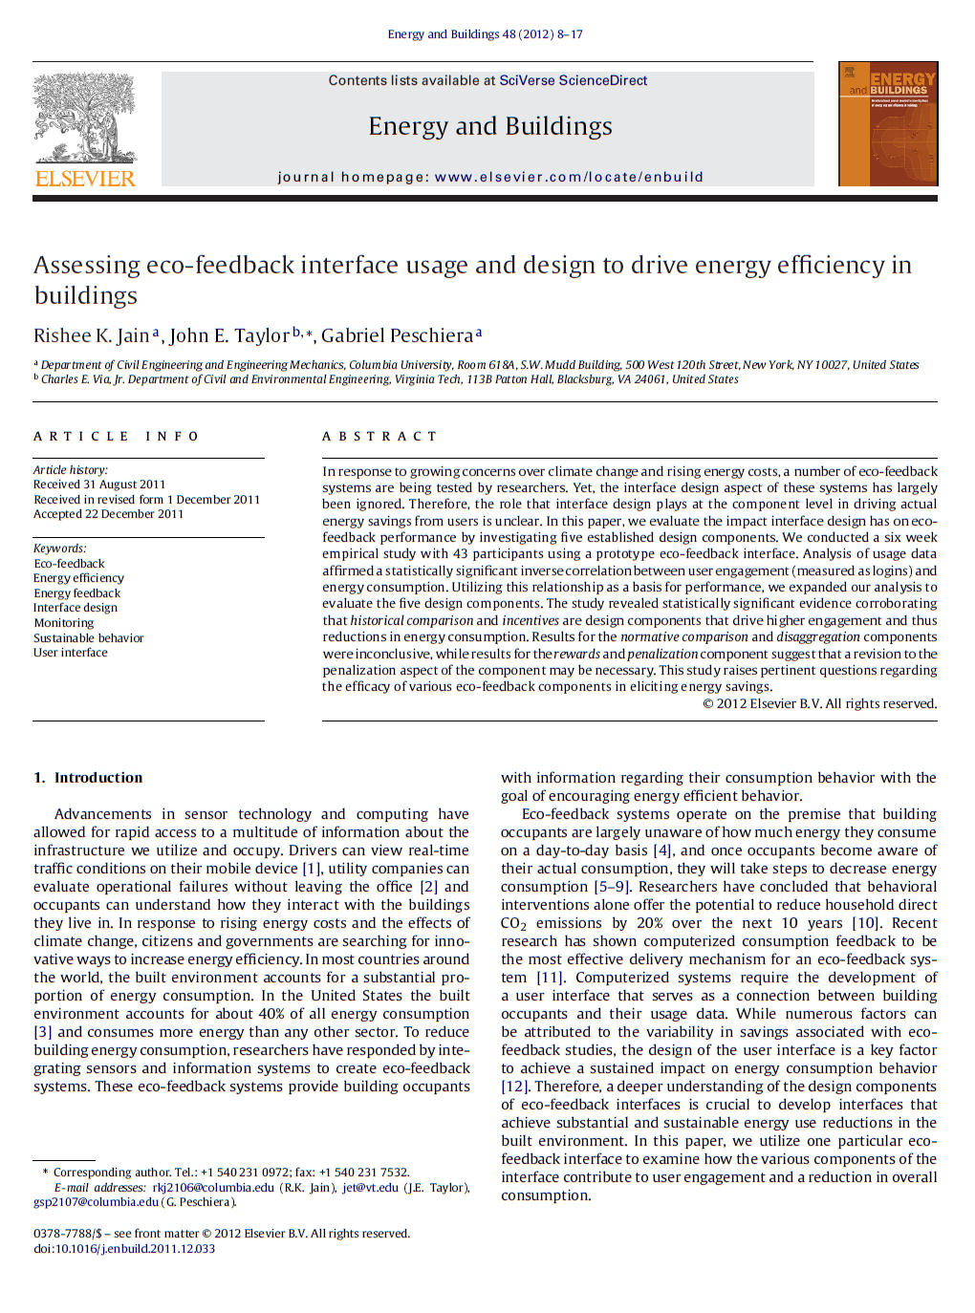
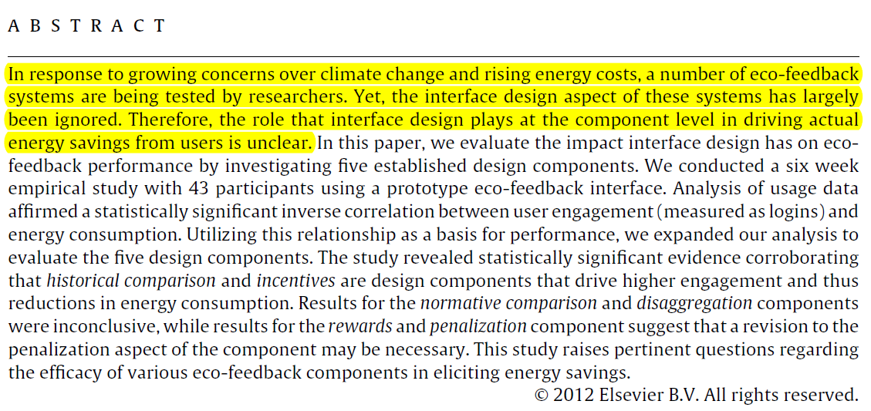
Jain et al., Assessing Eco-Feedback Interface Usage and Design to Drive Energy Efficiency in Buildings, Energy and Buildings 2012
Jain et al., Assessing Eco-Feedback Interface Usage and Design to Drive Energy Efficiency in Buildings, Energy and Buildings 2012
Notes:
Others have recently recognized this and are beginning to address this void. Moreover, however…

Slide 19
This is abigproblem
Perhaps because of the design de-emphasis, very few papers discuss the design process that led to the ultimate design artifact that was created and studied
Placing a focus on the design process will allow for reusable methodology and more principled approaches to the practice of design—the “science of design”

Slide 20
Overarching Question
How can we structure and support the design process to create and identify the most promising (and potentially most influential) aspects of an eco-feedback design robustly and in a cost-efficient manner?
In particular, before expending time, effort, and money on a randomized control trial (RCT)
Notes:
A key question

Slide 21
An Eco-Feedback Iterative Design Process
Large Randomized Control Trial(s)
A/B Design Ideas
A/B Testing
RCTs
Ideation
Data Gathering
Ideation / Sketch
Pilot Studies
Refinement
Formative
Evaluation
Refinement
Small Field Deployment(s)
Refinement
Pilot Studies
Refinement
Notes:
So, our approach has been to adapt the iterative design process to the creation of eco-feedback
You begin with data gathering, ideation, and design sketching (as you would for any design) but you end with randomized control behavioral trials to test the effectiveness of these designs

Slide 22
Gunel, A. The Halo Effect: Using Behavior to Upgrade Technology,BECC2012
Notes:
OPower is doing this very well (albeit now primarily with paper-based interventions but also with some electronic feedback)
---
Randomly split utility population into two statistically equivalent groups (e.g., based on previous household energy usage, household size, etc): a control group and an experimental group. Only difference between both groups is that the experimental group receives the treatment/intervention while the control group does not. If there are statistically significant differences in behavior, we have strong confidence that this is due to the intervention.
Bruce Ceniceros from SMUD and Patricia Thompson from SageView did a great job of talking about this as well.

Slide 23
An Eco-Feedback Iterative Design Process
A/B Testing is Ultimate Playground
Large Randomized Control Trial(s)
A/B Design Ideas
A/B Testing
RCTs
Data Gathering
Ideation / Sketch
Pilot Studies
Formative
Evaluation
Refinement
Small Field Deployment(s)
Refinement
Pilot Studies
Refinement
Ideation
Refinement
Notes:
And, what’s more, once the RCT infrastructure is in place, you can continue to create and test the effectiveness of various new design ideas (in an entirely new, sort of iterative design process loop)

Slide 24
A/B Testing is Ultimate Playground
Large Randomized Control Trial(s)
A/B Design Ideas
A/B Testing
RCTs
Data Gathering
Ideation / Sketch
Pilot Studies
Formative
Evaluation
Refinement
Small Field Deployment(s)
Refinement
Pilot Studies
Refinement
Ideation
Refinement
Notes:
And, what’s more, once the RCT infrastructure is in place, you can continue to create and test the effectiveness of various new design ideas (in an entirely new, sort of iterative design process loop)

Slide 25
But how do we choose and refine even these design variations before expending effort on the RCT?
Gunel, A. The Halo Effect: Using Behavior to Upgrade Technology,BECC2012
Notes:
So, for example, in the Opower talk yesterday (by Arhan Gunel), they saw a significant difference in behavior between two “promotional” messages used in their home billing reports. Even here, though there is still a question of “how do we choose and refine design ideas before expending effort and money on the RCT?” Ideally, we want to test only the most promising ideas…
OPower is uniquely positioned to do this sort of important work because it has an infrastructure in place and has been very effective at utilizing this to continuously run new types of A/B trials to test the effectiveness of various designs.

Slide 26
An Eco-Feedback Iterative Design Process
Evaluating early design ideas to prepare for field deployments
Ideation
Data Gathering
Ideation / Sketch
Pilot Studies
Refinement
Formative
Evaluation
Refinement
Small Field Deployment(s)
Refinement
Large Randomized Control Trial(s)
A/B Design Ideas
Pilot Studies
Refinement
A/B Testing
RCTs
Notes:
So, let’s zoom out for a moment to see an overview of the entire iterative design process.
Of course, there are different variations and representations that are possible here but the general idea is the same: rapid prototyping and evaluations grounded in user studies are critical.
For the rest of my talk, I want to discuss the first two phases here, which are critically important in preparing for field deployments, and I want to contextualize this discussion with

Slide 27
Jon Froehlich
Leah Findlater
Marilyn Ostergren
Solai Ramanathan
Josh Peterson
Inness Wragg
Eric Larson
Fabia Fu
Mazhengmin Bai
Shwetak N. Patel
James A. Landay
Froehlich et al., The Design & Evaluation of Prototype Eco-Feedback Displays for Fixture-Level Water Usage Data, CHI2012
Notes:
Hello, my name’s Jon Froehlich and I am a newly minted Assistant Professor at the University of Maryland, College Park. This talk is about work I did as a graduate student at the University of Washington as part of my dissertation research along with a fantastic set of collaborators including undergraduates, graduates, post-docs and my two co-advisors Shwetak Patel and James Landay

Slide 28
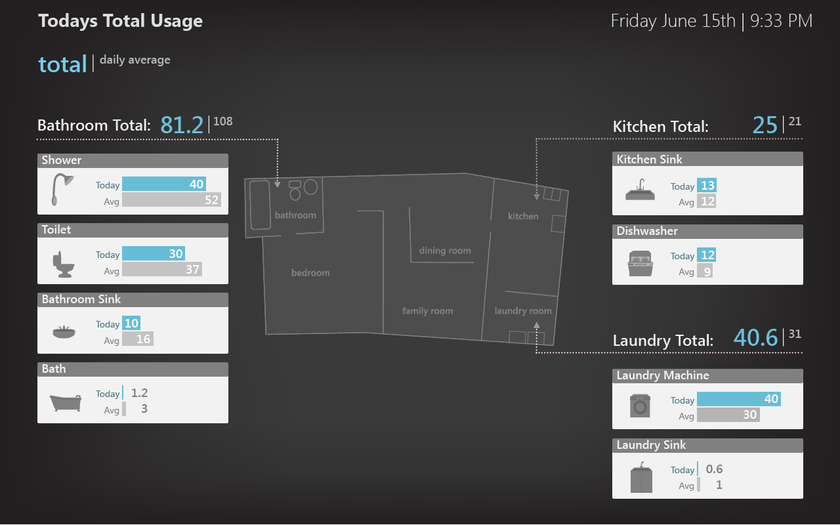
Notes:
Like this spatial display which shows fixture-level and room-level water usage using a blueprint paradigm…

Slide 29
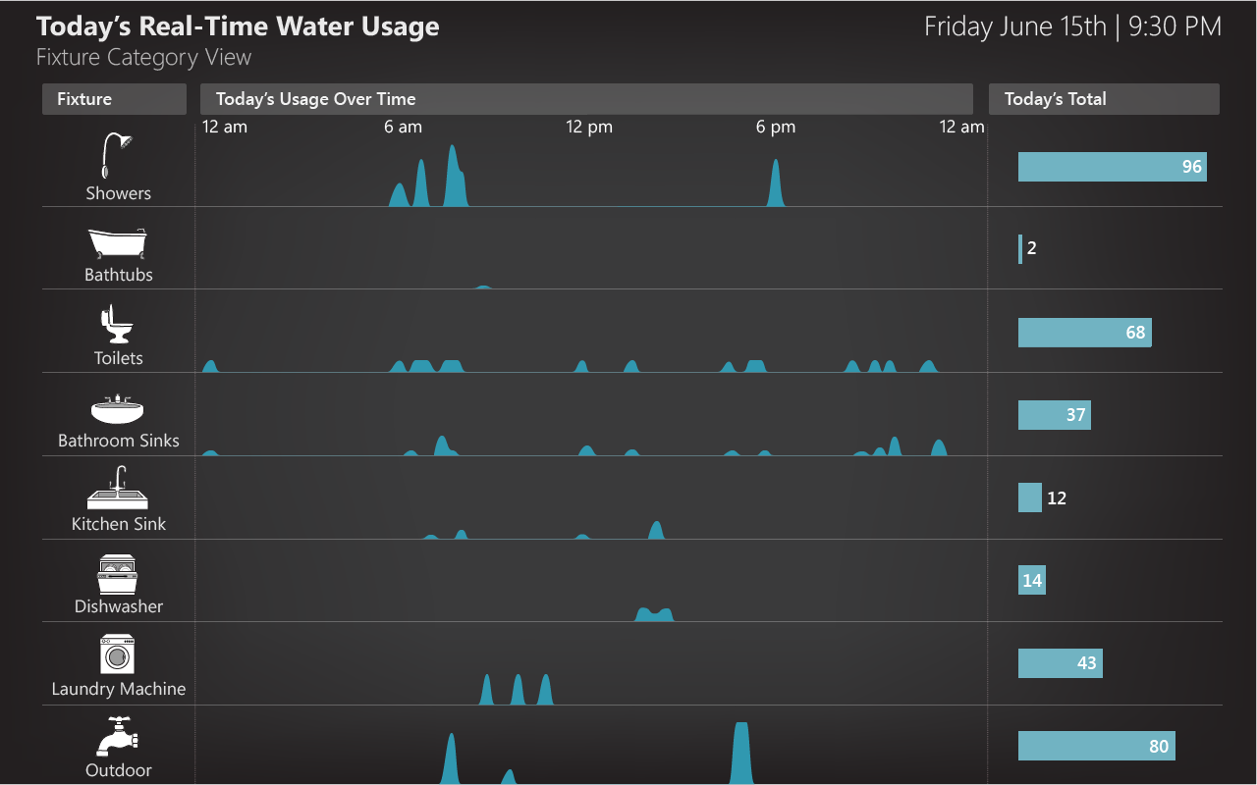
Notes:
Or this disaggregated, fixture-level time-series view…

Slide 30
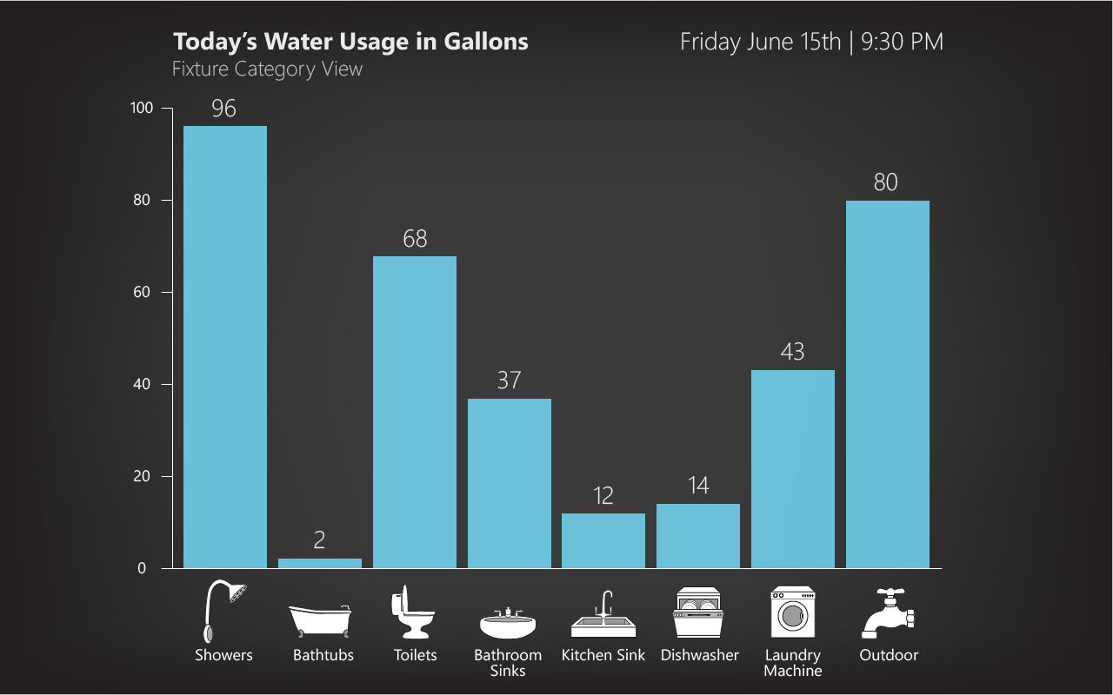
Notes:
Or this fixture-category bar graph view…

Slide 31
Notes:
Visualizes fixture-category water usage in a way that is analogous to the basic bar graph display (figure 2b) but in a more playful and fun manner.

Slide 32
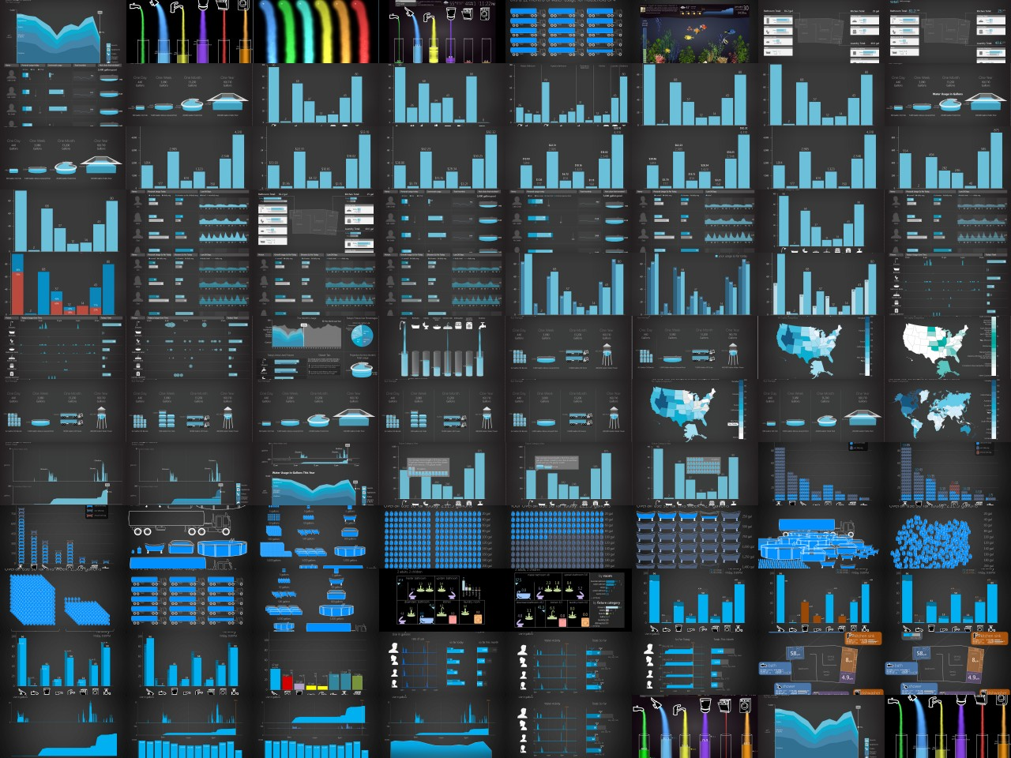
Notes:
The design space is huge—how does one structure the design process to effectively design for this data?

Slide 33
An Eco-Feedback Iterative Design Process
Large Randomized Control Trial(s)
Ideation
Data Gathering
Ideation / Sketch
Pilot Studies
Refinement
Formative
Evaluation
Refinement
Small Field Deployment(s)
Refinement
Goal: gather formative data and use as basis to create a set of early, promising designs
Inquiry Methods: ethnography, interviews, surveys, literature reviews

Slide 34
An Eco-Feedback Iterative Design Process
Informal interviews with water experts (e.g., SPU, Amy Vickers)
Literature review of water resource management, environmental psychology
Our own online survey of water usage attitudes & knowledge (N=656 respondents)
Large Randomized Control Trial(s)
Ideation
Data Gathering
Ideation / Sketch
Pilot Studies
Refinement
Formative
Evaluation
Refinement
Small Field Deployment(s)
Refinement
Goal: gather formative data and use as basis to create a set of early, promising designs
Inquiry Methods: ethnography, interviews, surveys, literature reviews

Slide 35
Poor Water Literacy
Respondents (N=651) dramatically underestimated the amount of water used in common everyday activities.
underestimate
toilet :
shower :
bath :
low-flow shower :
outdoor yard watering :
by 15%
by 30%
by 55%
by 60%
by 83% to 95%
[Froehlich, UW PhD Dissertation, 2011]
Notes:
Where, among other things, we found that people dramatically underestimated the amount of water used in common everyday activities.
----
For baths and showers, its by more than 50%

Slide 36
Challenge: how can we use gathered data to inform our designs?

Slide 37
Eco-Feedback Design Space
Information Access
Data Representation
Comparison
update frequency
aesthetic
comparison target
real-time
monthly or less
user poll
pragmatic
artistic
self
social
goal
spatial proximity to behavior
time window
comparison by time
co-located
remote
<hour
>year
past
projected
attentional demand
temporal grouping
social-comp. target
glanceable
high attention
≤sec
geographically proximal
demographically similar
selected social network
by hour
by day
by week
≥year
by month
effort to access
data granularity
goal-setting strategy
low
high
coarse-grain
fine-grain
self-set
system-set
externally-set
Interactivity
visual complexity
difficulty to reach comparison target
degree of interactivity
simple
complex
easy
hard
none
high
primary visual encoding
comparison variables
statistic
computation
interface customizability
textual
graphical
time window
@ this time [yest, last wk, mo, yr] [hrly, daily, wkly, monthly, yrly]
over past [X] days
this day type [weekday, weekend]
this day of week (e.g., mondays)
none
high
measurement unit
time granularity
raw value
resource
average
cost
environmental impact
time
user additions
activity
metaphor
data grouping
median
primary view
data granularity
mode
user annotations
user corrections
measurement unit
other
Display Medium
temporal
spatial
categorical
manifestation
data grouping
Social Aspects
by resource
by activity
by person
by time
webpage
by space
by consumption category
mobile phone app
wearable interface
custom display
in-home display
target
ambience
person
Motivational/Persuasive Strategies
household
community
state
country
not-ambient
ambient
persuasive tactics from psychology and applied social psychology disciplines:
persuasive tactics include:
private/ public
size
rewards
punishment
public commitment
written commitment
loss aversion
kairos
encouragement
descriptive norms
scarcity principle
framing anchoring bias defaults
goal-setting
narrative likeability reputation competition
social proof
authority
emotional appeals
door-in-face
unlock features
endowment effect
collection building
private
public
small
large
data sharing
Actionability/Utility
persuasive design persuasive technology
behavioral science/economics
environmental psychology
game design
social marketing
health behavior change
none
everyone
degree of actionability
social- comparison
(see Comparison)
low
high
available
unavailable
decision support
suggests
actions
suggests
purchase decisions
anomaly alerts
personal-ization
no personalization
highly personalized
information intent
Informs one action
informs many actions
automation/ control
[Froehlich et al., HCIC2009; CHI2010; UW PhD Dissertation 2011]
no control
system controls resource use
Notes:
the eco-feedback design space can be used not just in reasoning about and structuring design but also in the evaluation process—in empirically understanding how these design choices manifest themselves in user reactions and responses and behavior
I don’t intend for you to read or process this—I’ll go over a simplified version in a second.

Slide 38
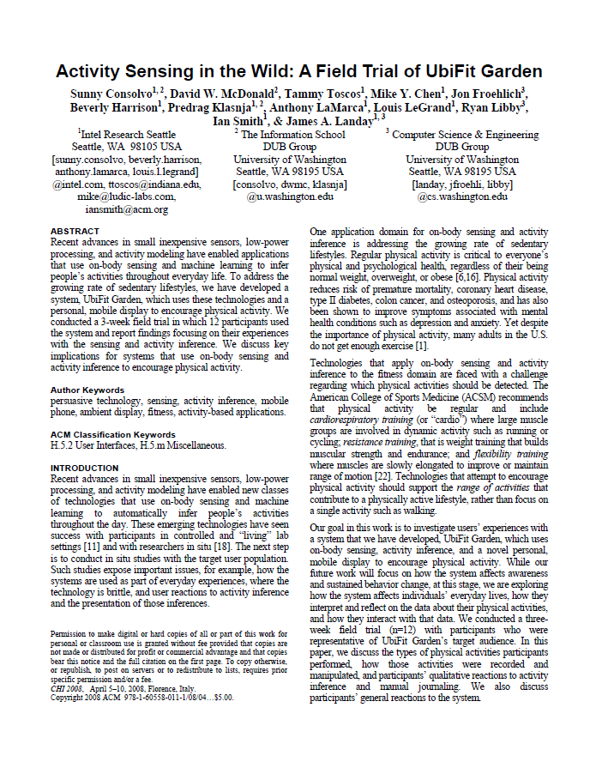
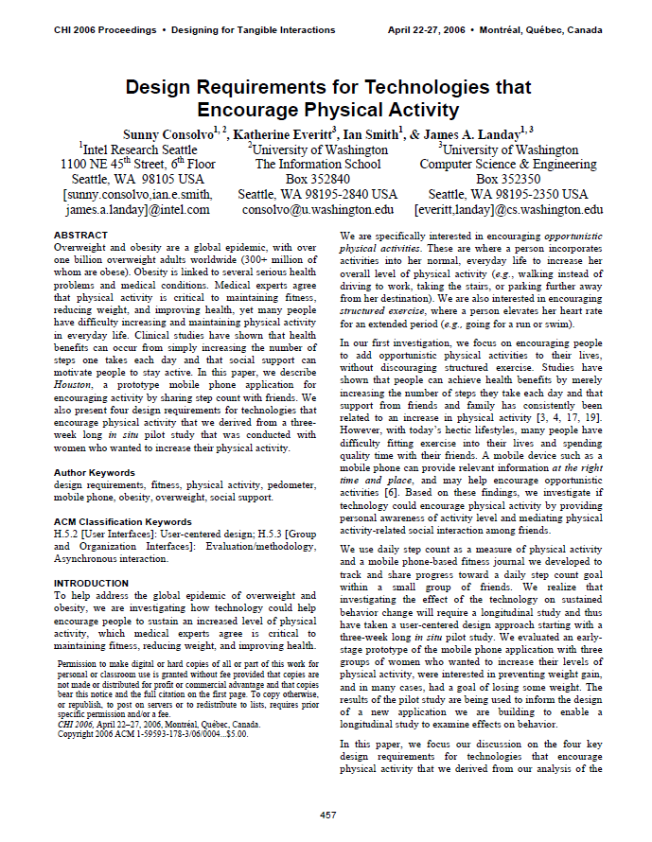
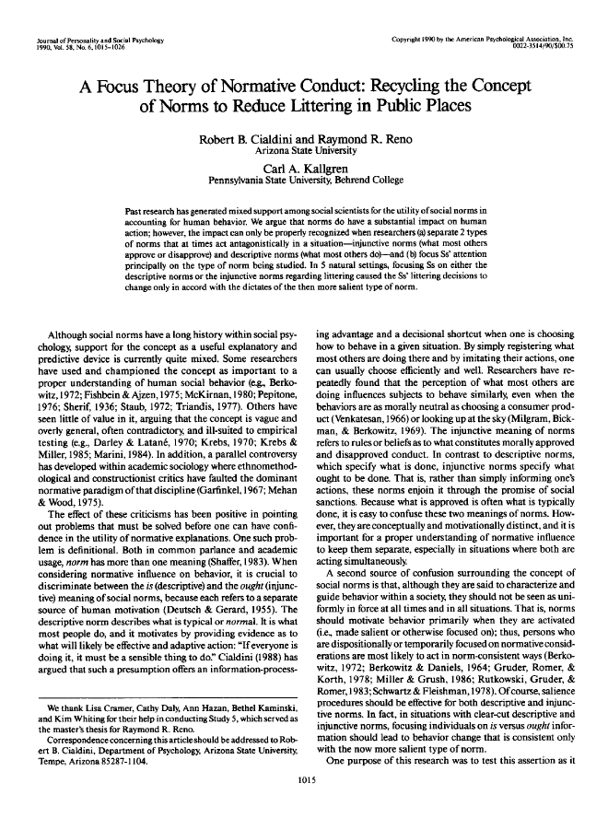
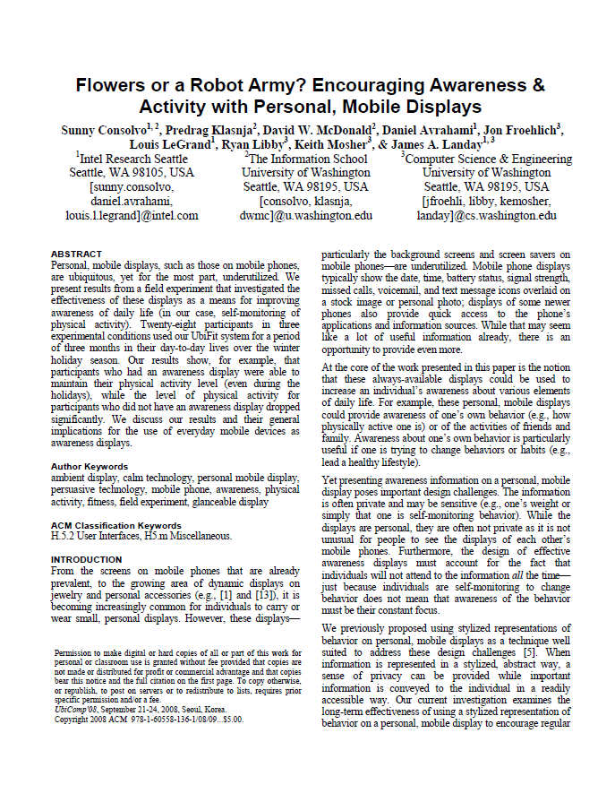
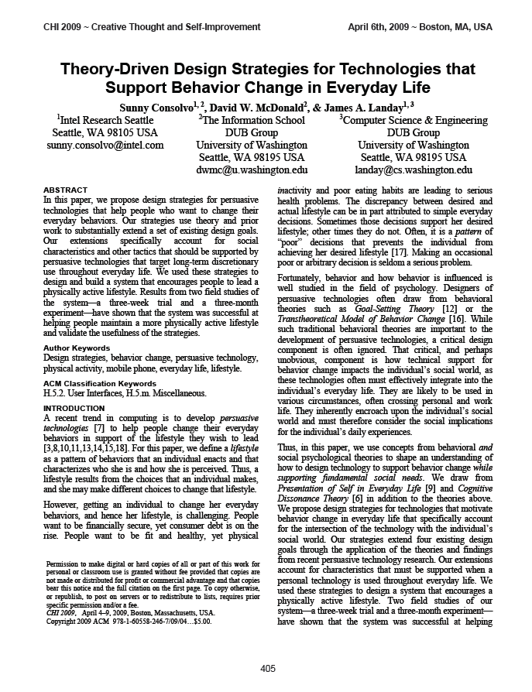
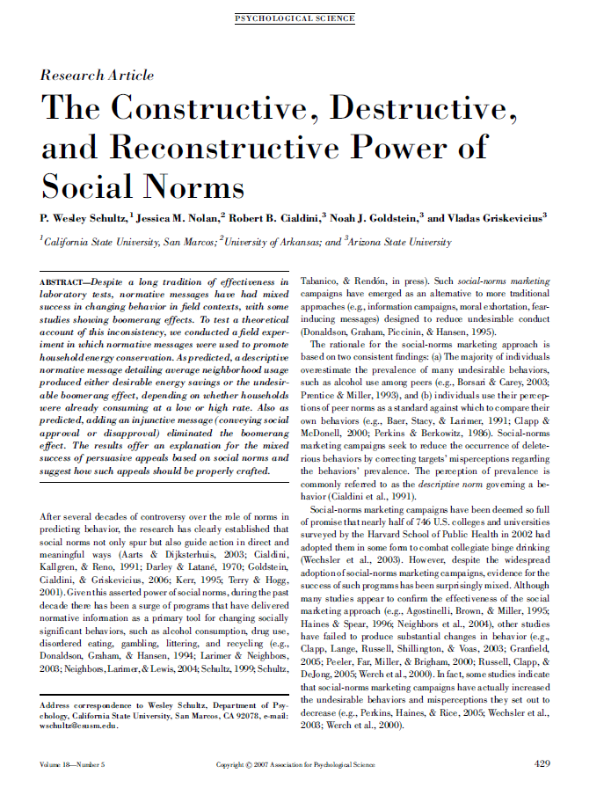
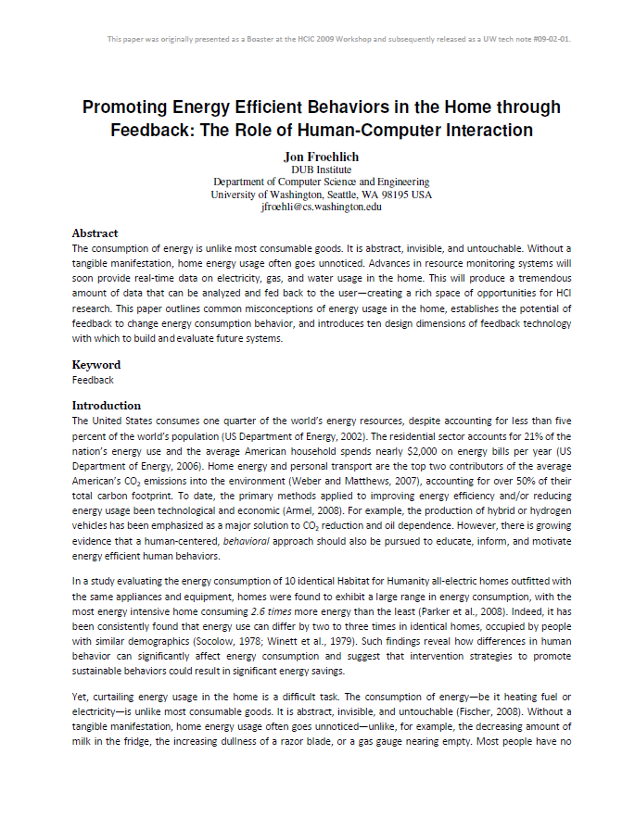
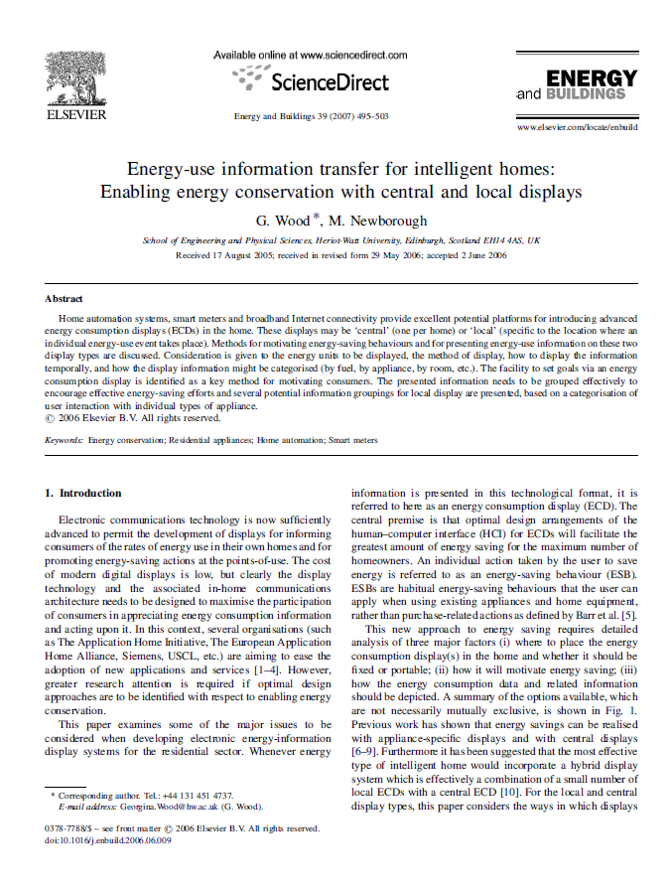
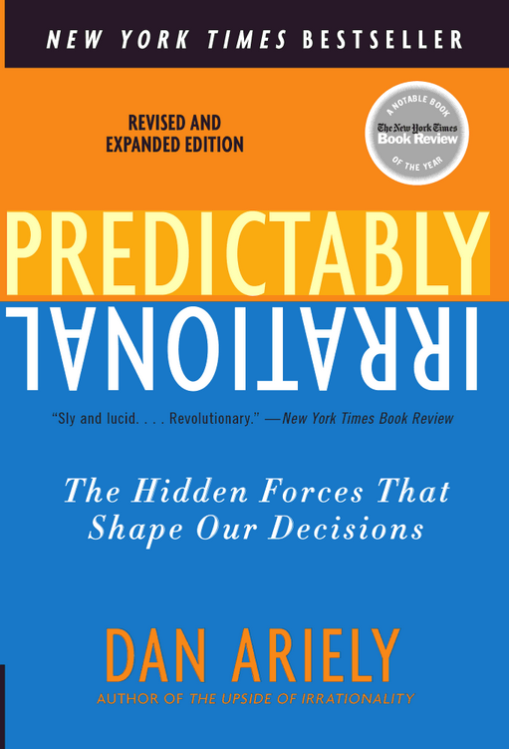
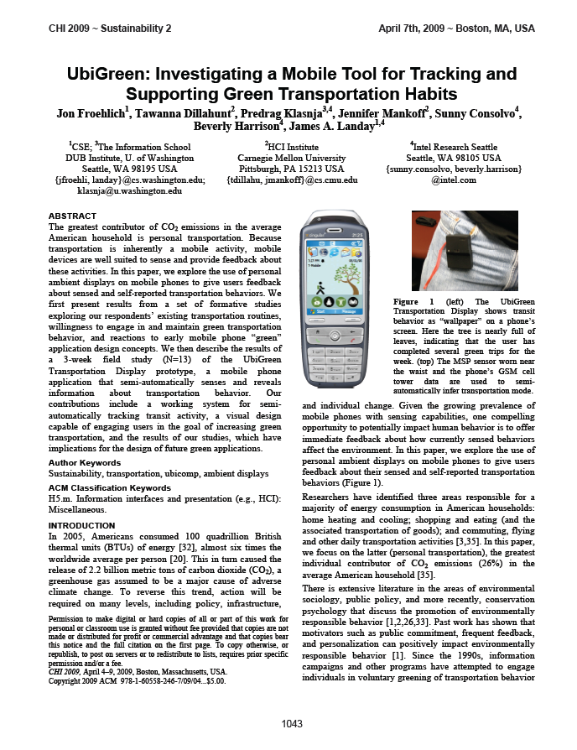
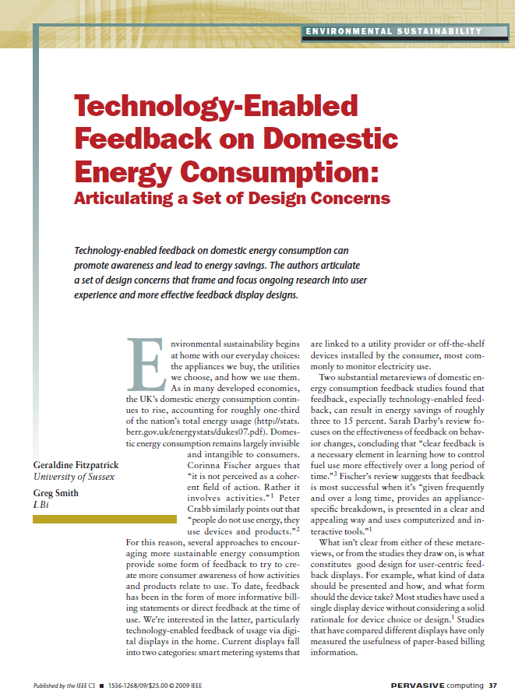
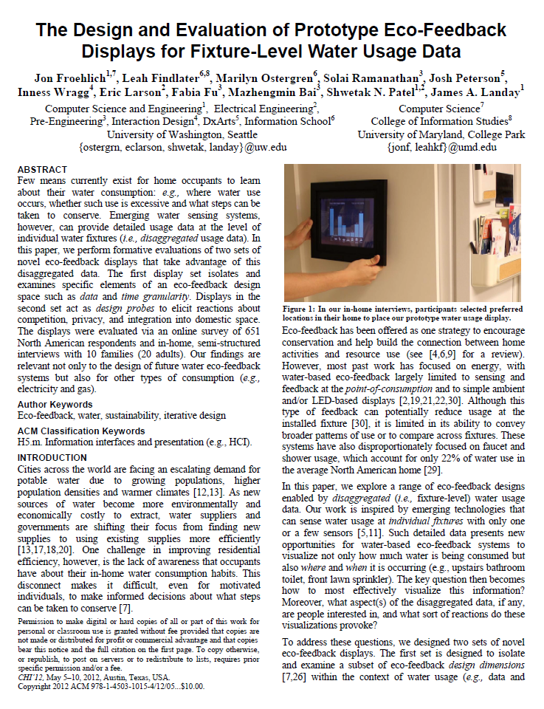
My own experiences
Existing frameworks
(e.g., persuasive tech, health informatics, other eco-feedback work, and infovis)
Psychology (e.g., environmental psychology, social psychology, behavioral economics)
Notes:
The design space itself is largely informed by three areas: my own experiences working on feedback technology for health and sustainability, existing design frameworks in those areas and in information visualization, and work in psychology—particulary behavioral economics and environmental psychology.

Slide 40
Notes:
We used these three information sources and iterative affinity diagramming to synthesize and create the design space

Slide 41
Notes:
We used these three information sources and iterative affinity diagramming to synthesize and create the design space

Slide 42
Eco-Feedback Design Space
Information Access
Data Representation
Comparison
update frequency
aesthetic
comparison target
real-time
monthly or less
user poll
pragmatic
artistic
self
social
goal
spatial proximity to behavior
time window
comparison by time
co-located
remote
<hour
>year
past
projected
attentional demand
temporal grouping
social-comp. target
glanceable
high attention
≤sec
geographically proximal
demographically similar
selected social network
by hour
by day
by week
≥year
by month
effort to access
data granularity
goal-setting strategy
low
high
coarse-grain
fine-grain
self-set
system-set
externally-set
Interactivity
visual complexity
difficulty to reach comparison target
degree of interactivity
simple
complex
easy
hard
none
high
primary visual encoding
comparison variables
statistic
computation
interface customizability
textual
graphical
time window
@ this time [yest, last wk, mo, yr] [hrly, daily, wkly, monthly, yrly]
over past [X] days
this day type [weekday, weekend]
this day of week (e.g., mondays)
none
high
measurement unit
time granularity
raw value
resource
average
cost
environmental impact
time
user additions
activity
metaphor
data grouping
median
primary view
data granularity
mode
user annotations
user corrections
measurement unit
other
Display Medium
temporal
spatial
categorical
manifestation
data grouping
Social Aspects
by resource
by activity
by person
by time
webpage
by space
by consumption category
mobile phone app
wearable interface
custom display
in-home display
target
ambience
person
Motivational/Persuasive Strategies
household
community
state
country
not-ambient
ambient
persuasive tactics from psychology and applied social psychology disciplines:
persuasive tactics include:
private/ public
size
rewards
punishment
public commitment
written commitment
loss aversion
kairos
encouragement
descriptive norms
scarcity principle
framing anchoring bias defaults
goal-setting
narrative likeability reputation competition
social proof
authority
emotional appeals
door-in-face
unlock features
endowment effect
collection building
private
public
small
large
data sharing
Actionability/Utility
persuasive design persuasive technology
behavioral science/economics
environmental psychology
game design
social marketing
health behavior change
none
everyone
degree of actionability
social- comparison
(see Comparison)
low
high
available
unavailable
decision support
suggests
actions
suggests
purchase decisions
anomaly alerts
personal-ization
no personalization
highly personalized
information intent
Informs one action
informs many actions
automation/ control
[Froehlich et al., HCIC2009; CHI2010; UW PhD Dissertation 2011]
no control
system controls resource use
Notes:
Rather than forcing you to look at this detailed slide, I’ll present an abstracted, beautified version…

Slide 43
data representation
information access
inputs
display medium
eco-feedback
the
behavioral models
design space
comparison
social
actionability
motivational strategies
Notes:
There are nine top-level dimensions; which I will go through very briefly.

Slide 44
data representation
information access
inputs
display medium
eco-feedback
the
behavioral models
design space
comparison
social
actionability
motivational strategies
Notes:
Inputs: how is the data sensed; what’s the sampling resolution; can the user also supply information or is it completely automated

Slide 45
data representation
information access
inputs
display medium
eco-feedback
the
behavioral models
design space
comparison
social
actionability
motivational strategies
Notes:
The next three dimensions: Data representation, information access, and display medium have to do with the way the data is rendered and fed back to the user.
For example, the encoding of the data as a time-series graph or the choice between an iphone application vs. in home ambient display

Slide 46
data representation
information access
inputs
display medium
eco-feedback
the
behavioral models
design space
comparison
social
actionability
motivational strategies
Notes:
The next five dimensions: Comparison, actionability, motivational strategies, social, behavioral models
influence how the data is perceived, internalized, and possibly acted upon.

Slide 47
data representation
information access
inputs
display medium
eco-feedback
the
behavioral models
design space
comparison
social
actionability
motivational strategies
Notes:
That was a brief overview of the design space, let me just briefly show you how it’s useful as a generative aid for design

Slide 48
data representation
information access
inputs
display medium
eco-feedback
the
behavioral models
design space
comparison
social
actionability
motivational strategies
Notes:
Data representation essentially seeks to address how sensed behaviors are encoded and visualized?
There are multiple sub-dimensions including aesthetic, visual complexity, time granularity, data granularity

Slide 49
motivational strategies
social
inputs
eco-feedback
actionability
the
behavioral models
design space
comparison
data representation
display medium
information access
aesthetic
pragmatic
artistic
visual complexity
simple
complex
time granularity
< hour
> year
data granularity
coarse-grain
fine-grain
measurement unit
resource
cost
environmental impact
time
activity
metaphor
primary view
temporal
spatial
categorical
Notes:
Data representation essentially seeks to address how sensed behaviors are encoded and visualized?
There are multiple sub-dimensions including aesthetic, visual complexity, time granularity, data granularity

Slide 50
motivational strategies
social
inputs
eco-feedback
actionability
the
behavioral models
design space
comparison
data representation
display medium
information access
aesthetic
pragmatic
artistic
visual complexity
simple
complex
time granularity
< hour
> year
data granularity
coarse-grain
fine-grain
measurement unit
resource
cost
environmental impact
time
activity
metaphor
primary view
temporal
spatial
categorical
Notes:
We specifically explored data and time granularity and measurement unit, let’s just dive into data granularity as an example

Slide 51
Data Granularity
coarse-grain
fine-grain
≥neighbor- hood
home
room
activity
fixture category
fixture
≤ valve
Notes:
Data granularity refers to the degree with which data is sub-divided or grouped. For residential water usage, there are seven main levels of granularity.

Slide 52
Prototype and Evaluate Across a Fidelity Spectrum
Iterative Design Fidelities
Sketches
Higher fidelity mockups
Sketch
Lo-to-Mid Fidelity Mockup
Higher Fidelity Mockup
Notes:
We used an iterative design process from sketches to high fidelity mockups
---
We iterated on ideas and sketches via design critiques and three sets of pilot tests to examine issues such as understandability, approachability, clutter, and aesthetics

Slide 53
An Eco-Feedback Iterative Design Process
Large Randomized Control Trial(s)
Ideation
Data Gathering
Ideation / Sketch
Pilot Studies
Refinement
Formative
Evaluation
Refinement
Small Field Deployment(s)
Refinement
Goal: gather formative data and use as basis to create a set of early, promising designs
Inquiry Methods: ethnography, interviews, surveys, literature reviews

Slide 54
An Eco-Feedback Iterative Design Process
Large Randomized Control Trial(s)
Ideation
Data Gathering
Ideation / Sketch
Pilot Studies
Refinement
Formative
Evaluation
Refinement
Small Field Deployment(s)
Refinement
Goal: test early design ideas, improve promising ideas, improve usability / aesthetic
Evaluation Methods: online interactive surveys, design probe-based interviews, lab studies
Challenge: the ultimate goal is to create a design that informs and, possibly, motivates behavior. The former is easier to evaluate with these methods than the latter.

Slide 55
Online Survey
Recruitment
Online postings and word-of-mouth
Survey Design
63 questions (10 optional)
Question and answer order randomized when possible
Collected Data
712 completed surveys (651 from US or Canada)
Nearly 6,000 qualitative responses
Notes:
We recruited respondents via online postings to craiglist and twitter and via word of mouth.
The survey had 63 questions (10 optional) and the question and answer order were randomized when possible. The surveys were designed to collect both quantitative data and qualitative data on questions about preference, comprehension, and interest.
In all, we had 712 completed surveys (651 from US and Canada, which is our focus) and over 6,000 qualitative responses.
-----
The recruitment materials invited respondents to take a “water usage display” survey and were entered into a drawing for $100 Amazon gift certificate upon completion

Slide 56
Notes:
Upon starting the survey you were greeted with a screen explaining what we meant by water usage feedback…
We also collected demographic data… and then the interactive part of the survey began

Slide 57
Notes:
…where respondents could mouse over designs and respond to our specific questions.
Here a respondent is indicating that she likes the hot vs. cold display because she realizes that hot water uses energy and is therefore more expensive.

Slide 58
Our online interactive survey allowed us to study a large N and gather both quantitative and qualitative data
Notes:
The advantages of a

Slide 59
Comparisons were the most uniformly desired pieces of information of all the dimensions
Notes:
A comparison between individuals or groups can be useful in motivating action, particularly when combined with feedback about performance.
Look at McColskey – Differential Effects of Norms

Slide 60
Self-comparison was most preferred
91%
Notes:
Self-comparison was most preferred, selected by 91% of our respondents
68% : goal-comparison
68% : social-comparison
------
Even feedback that provides information comparing one’s current behavior to past behavior has been shown to be effective (i.e., self comparison).
Look at McColskey – Differential Effects of Norms

Slide 61
Our in-home, design-probe interviews allowed us to explore how the display was received by families and how (and where) it fit in a domestic setting

Slide 62
In-Home Interviews
Recruitment
Online postings and word-of-mouth
Specifically recruited families
Interview Method
Semi-structured with two researchers
90-minutes, 3-phases
Data coded by two researchers into themes
Participants
10 households (20 adults)
11 female/9 male
Diff. socio-economic backgrounds & occupations
18 had college degrees
Notes:
While the survey quantitatively and qualitatively assessed reactions and preferences to the designs, the interviews served to contextualize the survey data, explore differences in perspective and preference across members of the same household, and investigate how a water feedback display may actually fit into domestic space
We recruited in a similar fashion to the survey but here specifically looked for families as we were interested in exploring differences in perspective across household members.
Each interview was conducted by two researchers. After demographic data was collected, the interviewees were provided with a touchscreen display with our designs. The interviewer used these as a basis for the interview.
In all, we conducted in-home interviews in 10 households across 20 adults. Interviewees had various socio-economic backgrounds and occupations. 18 had college degrees.

Slide 63
Display Location Preferences
kitchen
near thermostat
high traffic areas
accessible when needed
Notes:
Here’s a breakdown of the preferred display locations:
5 households wanted the display in the kitchen which is a shared location for the home and a place for gathering
3 households wanted the display near the thermostat, indicating that they perceived the display as another type of utility system for the home
2 households preferred the display in highly trafficked areas in their homes
Perhaps most interestingly though were the two households that wanted the display inaccessible on purpose: H8 wanted it in their storage closet next to their gas meter and H6 wanted the display mounted inside their kitchen cupboard. The reason given for these placements was that they did not want technology infiltrating all aspects of their life

Slide 64
Behavioral Lab Study
Notes:
Others have also done controlled experiments in the lab exploring how a design affects behavior; this is not something we have yet explored but we would like to. There is an interesting question, of course, of ecological validity and what aspects of the results may translate to a real-world setting.
Really, this is a relevant concern for all design evaluations that are not RCTs and I’m not yet sure how to reconcile this issue.

Slide 65
Integrate Findings & Revise Designs
Large Randomized Control Trial(s)
A/B Design Ideas
A/B Testing
RCTs
Ideation
Data Gathering
Ideation / Sketch
Pilot Studies
Refinement
Formative
Evaluation
Refinement
Small Field Deployment(s)
Refinement
Pilot Studies
Refinement

Slide 66
A Call
1
Place more emphasis on describing eco-feedback designs and how design choices may affect behavior in our research papers / white papers
Help generate reusable design knowledge by including information not just on the final eco-feedback design but the process used to achieve it
2

Slide 67
More detail and examples about the eco-feedback design process here: http://bit.ly/jonUMD
Froehlich et al., The Design & Evaluation of Prototype Eco-Feedback Displays for Fixture-Level Water Usage Data, CHI2012
Froehlich et al., The Design and Evaluation of Prototype Eco-Feedback Displays for Fixture-Level Water Usage Data, CHI2012, http://bit.ly/JonUMDPubs

Slide 68
Jon Froehlich, Sensing and Feedback of Everyday Activities to Promote Environmental Behaviors, PhD Dissertation 2011
Jon Froehlich, PhD Dissertation, 2011, http://www.cs.umd.edu/~jonf/publications.html

Slide 69
Jon Froehlich, Moving Beyond Line Graphs, BECC2010, http://www.cs.umd.edu/~jonf/talks.html

Slide 70
jonf@umd.edu
http://bit.ly/jonUMD
Applying Iterative Design to the Eco-Feedback Design Process
Human Computer
Interaction
Laboratory
@jonfroehlich
Assistant Professor Computer Science

