Slide 1
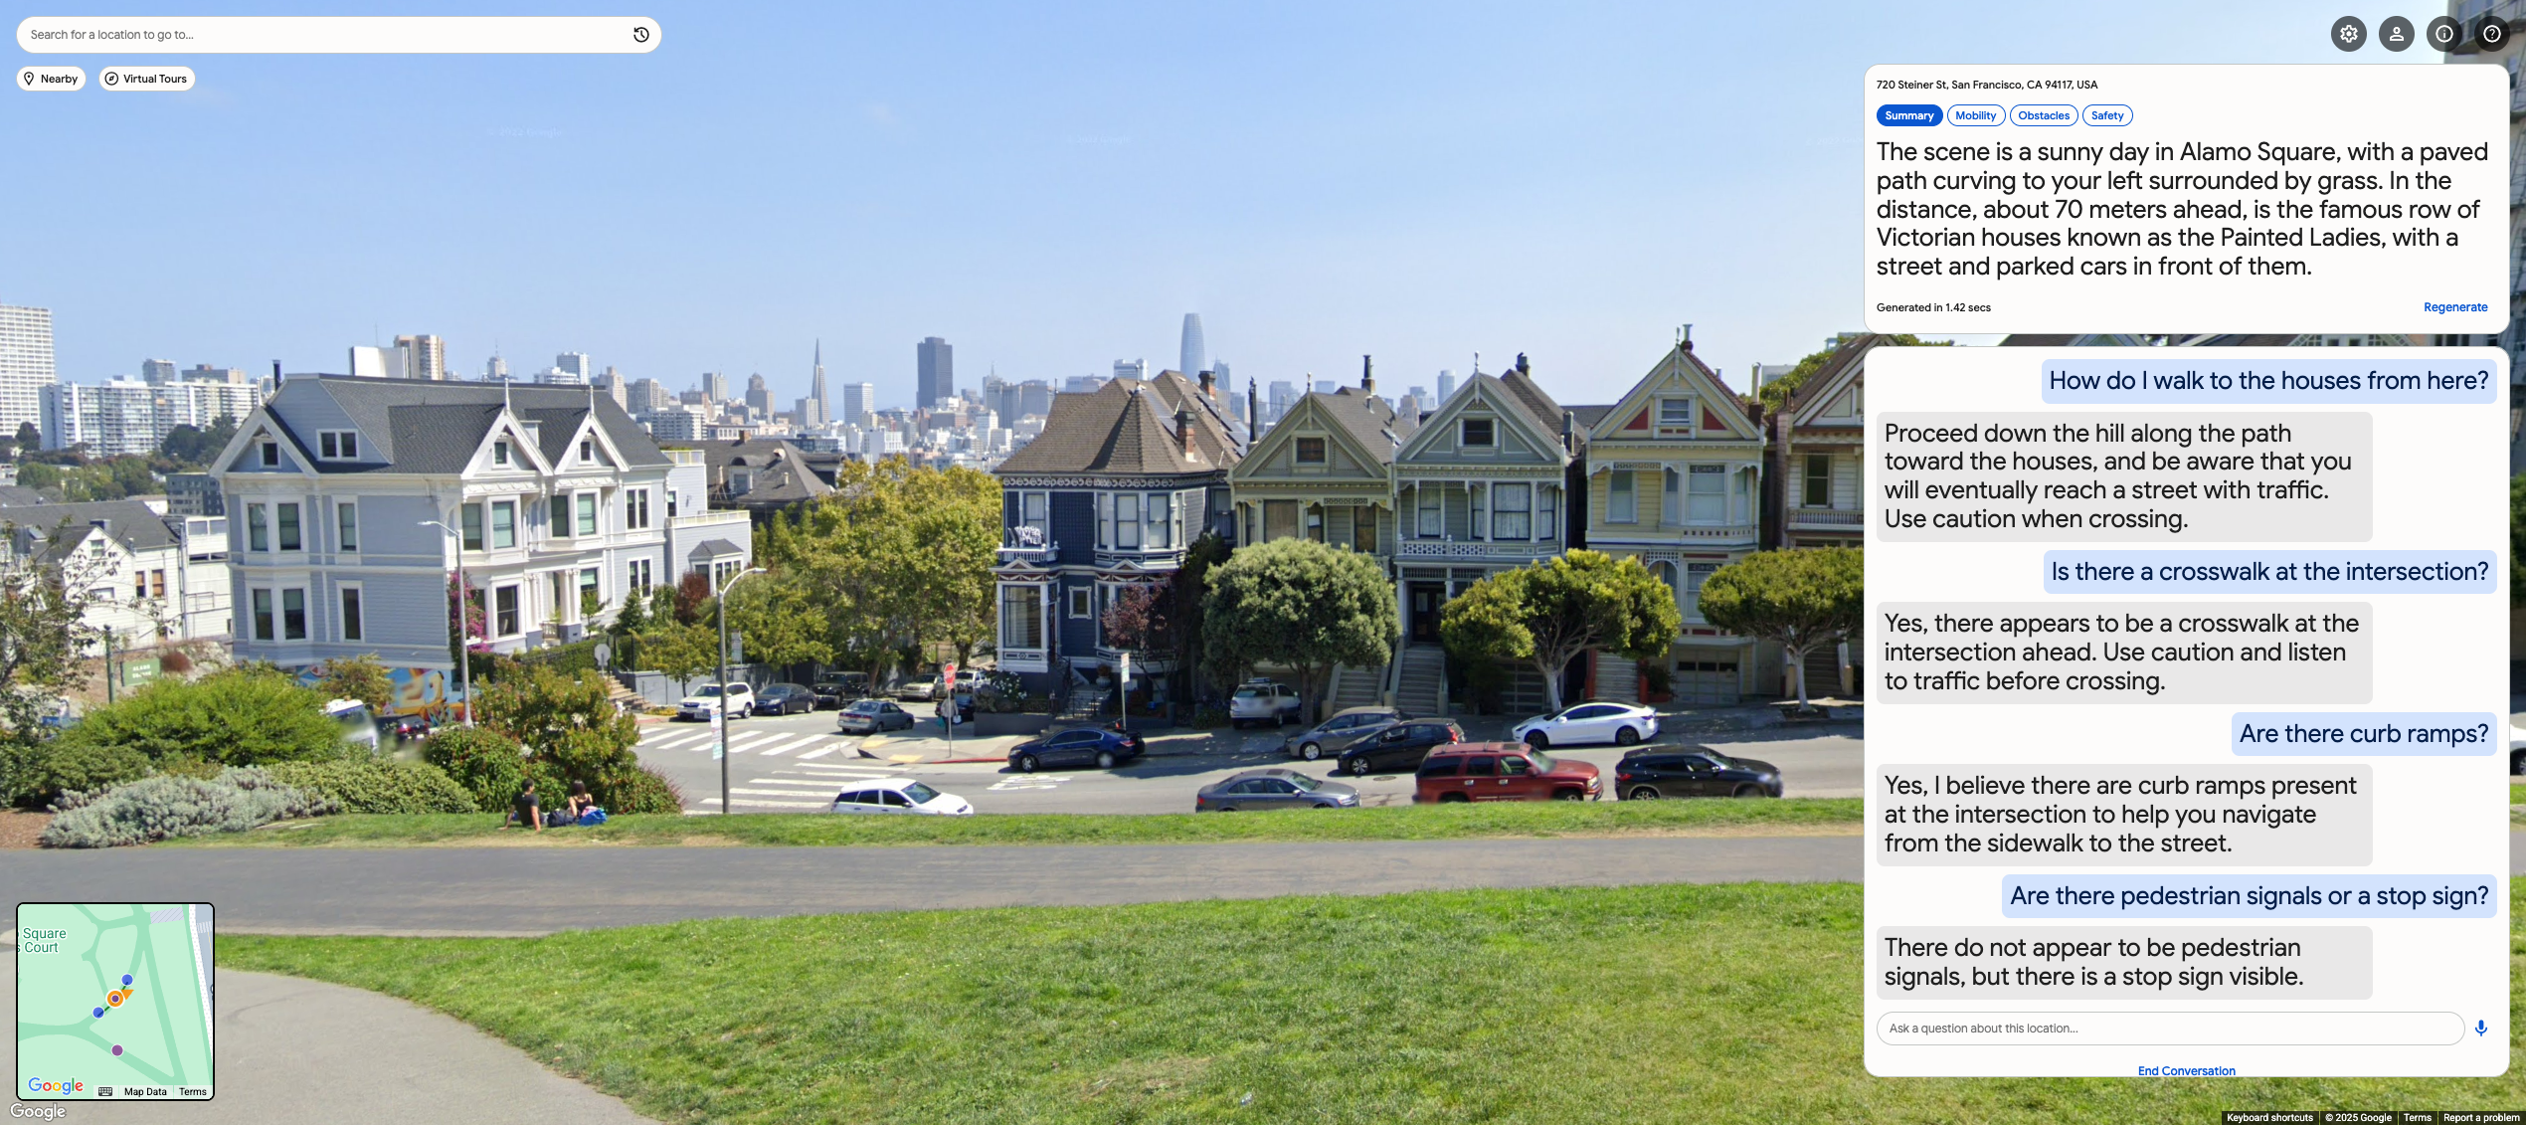
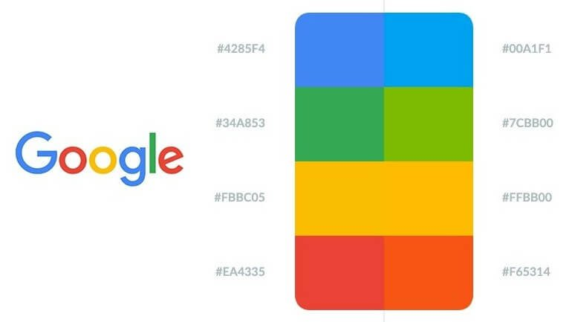
StreetReaderAI DEMO
Making Street View Accessible Using Context-Aware Multimodal AI

Slide 2
StreetReaderAI DEMO
Making Street View Accessible Using Context-Aware Multimodal AI

Slide 3

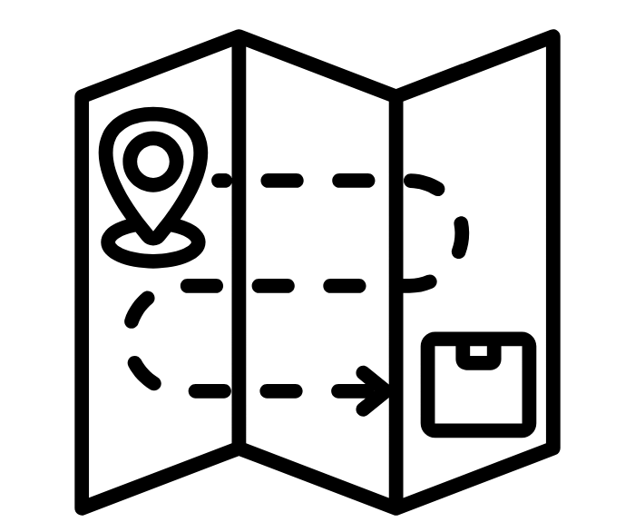













StreetReaderAI DEMO
Making Street View Accessible Using Context-Aware Multimodal AI
Four Core User Tasks
POI Investigations
Route Planning
Open-Ended Exploring
Virtual Tourism
What does a place look like?
What does my route look like?
I just want to explore…
I’ve always wanted to visit…
Technology AI Society and Culture
AI for Social Good
JON E. FROEHLICH
Google Research
ALEX FIANNACA
Google DeepMind
NIMER JABER
Google
VICTOR TSARAN
Google
SHAUN KANE
Google Research

Slide 4
StreetReaderAI DEMO
Making Street View Accessible Using Context-Aware Multimodal AI
Four Core User Tasks
POI Investigations
Route Planning
Open-Ended Exploring
Virtual Tourism
What does a place look like?
What does my route look like?
I just want to explore…
I’ve always wanted to visit…
Technology AI Society and Culture
AI for Social Good
JON E. FROEHLICH
Google Research
ALEX FIANNACA
Google DeepMind
NIMER JABER
Google
VICTOR TSARAN
Google
SHAUN KANE
Google Research

Slide 5







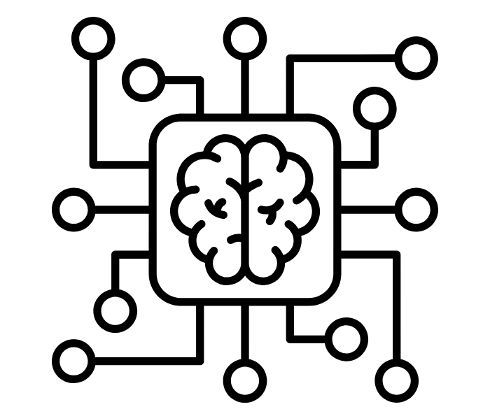


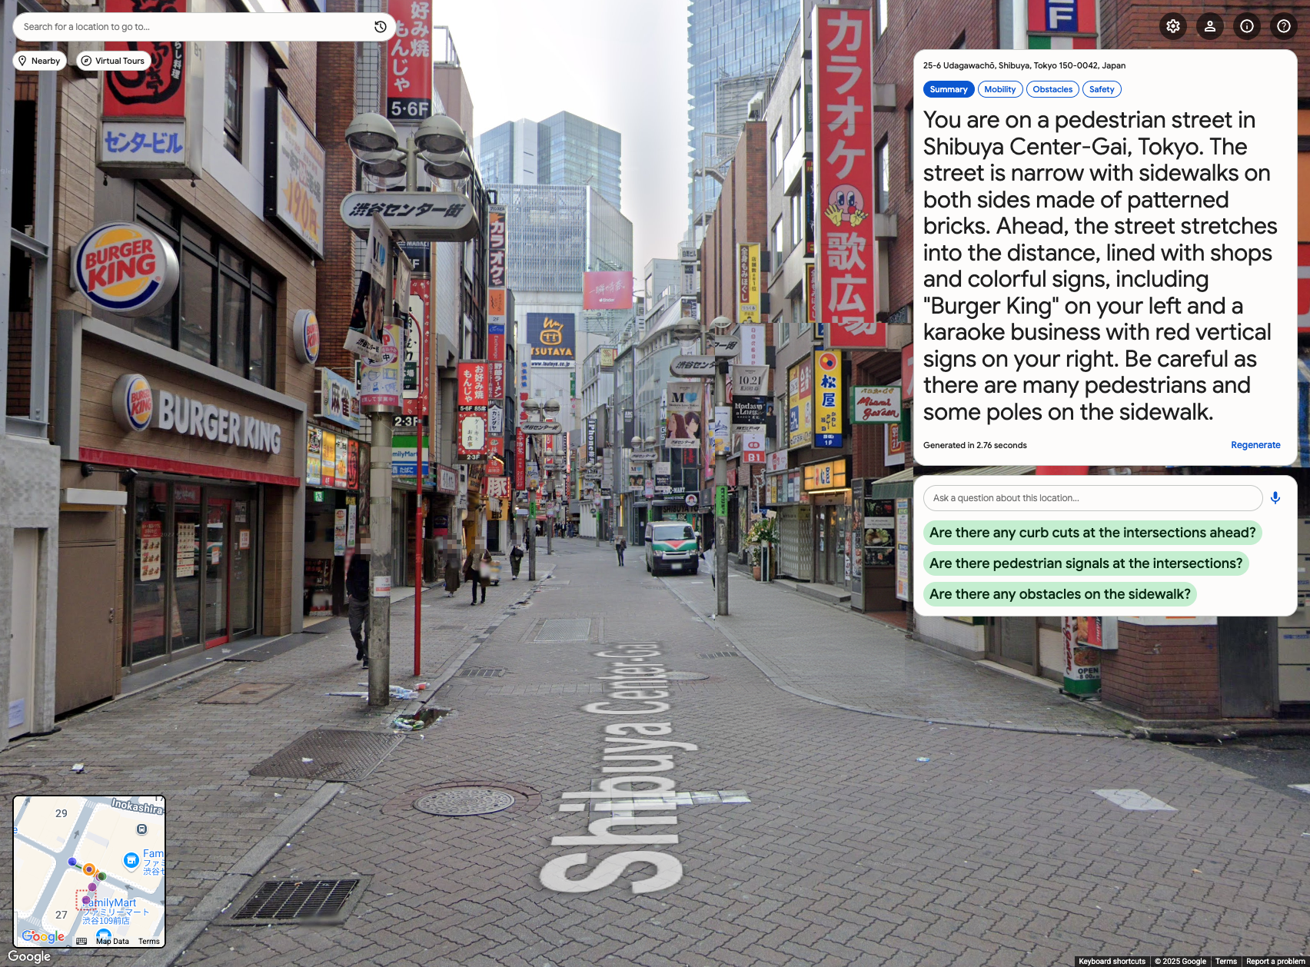
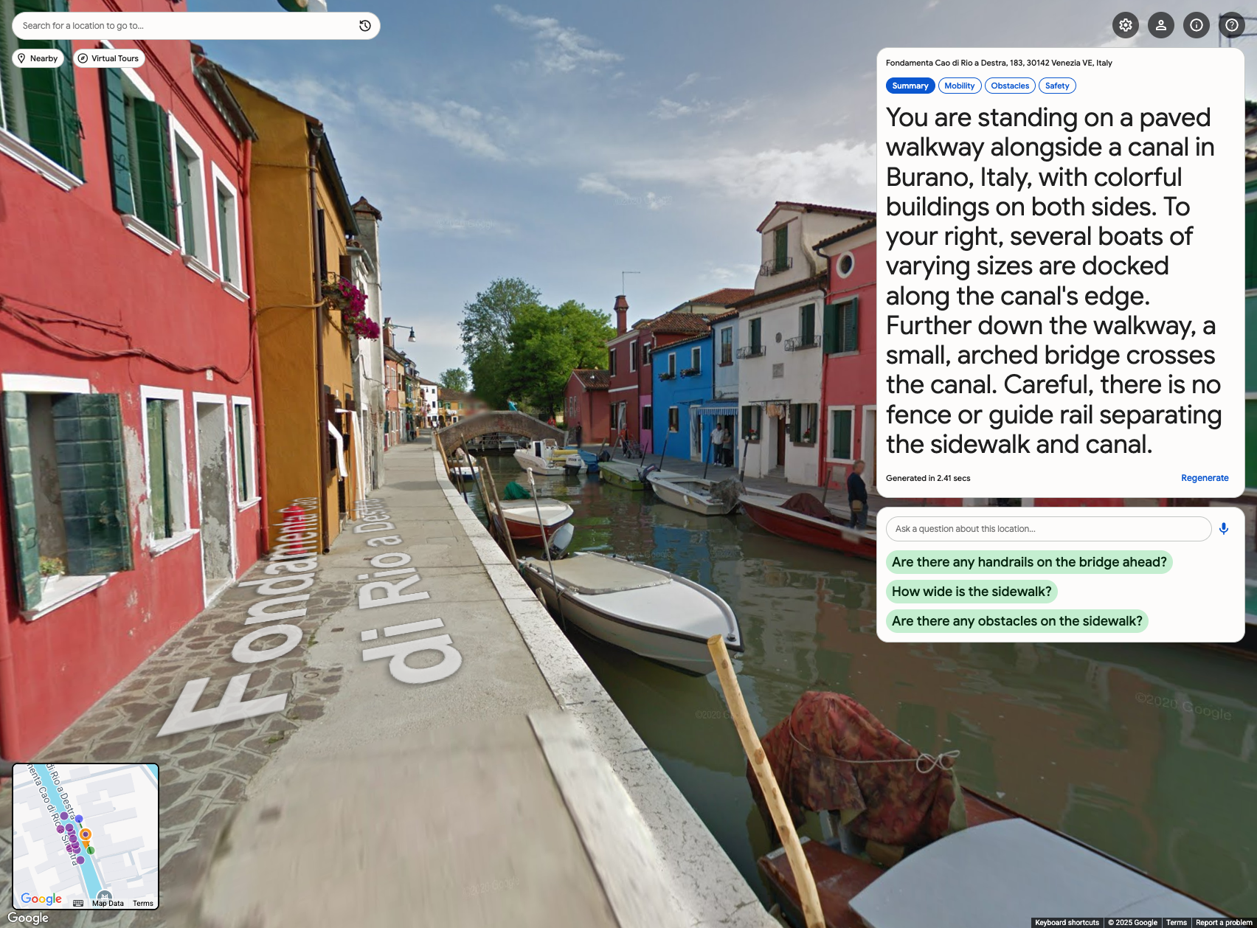
StreetReaderAI DEMO
Towards Making Street View Accessible Using Context-Aware Multimodal AI
Static Prompt
Dynamic Input
AI Describer Output
Prompt
Instructions
Dynamic
Geo-Context
MLLM
List of Mobility + Access Features
+
JSON
JSON
Optional User Profile
User’s Current View
Context-aware Description
GOAL: SUPPORT Four Core User Tasks
POI Investigations
Route Planning
Open-Ended Exploring
Virtual Tourism
What does a place look like?
What does my route look like?
I just want to explore…
I’ve always wanted to visit…
Static Prompt
Dynamic Input
Output
Prompt Instructions
Dynamic
Geo-Context
MLLM
Mobility +
Access Features
Optional User Profile
User’s Current View
JSON
JSON
Context-aware Description
Technology AI Society and Culture
AI for Social Good
JON E. FROEHLICH
Google Research
ALEX FIANNACA
Google DeepMind
NIMER JABER
Google
VICTOR TSARAN
Google
SHAUN KANE
Google Research

Slide 6
StreetReaderAI DEMO
Towards Making Street View Accessible Using Context-Aware Multimodal AI
Static Prompt
Dynamic Input
AI Describer Output
Prompt
Instructions
Dynamic
Geo-Context
MLLM
List of Mobility + Access Features
+
JSON
JSON
Optional User Profile
User’s Current View
Context-aware Description
GOAL: SUPPORT Four Core Mapping Tasks
POI Investigations
Route Planning
Open-Ended Exploring
Virtual Tourism
What does a place look like?
What does my route look like?
I just want to explore…
I’ve always wanted to visit…
12”
AI Describe
A context-aware scene description tool
Static Prompt
Dynamic Input
Output
Prompt Instructions
Dynamic
Geo-Context
MLLM
Mobility +
Access Features
Optional User Profile
User’s Current View
JSON
JSON
Context-aware Description
Examples
Technology AI Society and Culture
AI for Social Good
JON E. FROEHLICH
Google Research
ALEX FIANNACA
Google DeepMind
NIMER JABER
Google
VICTOR TSARAN
Google
SHAUN KANE
Google Research

Slide 7
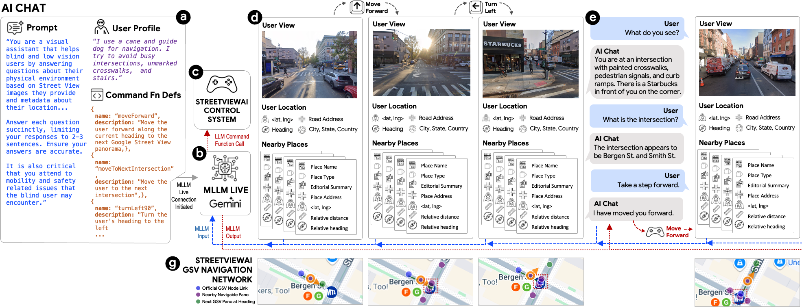
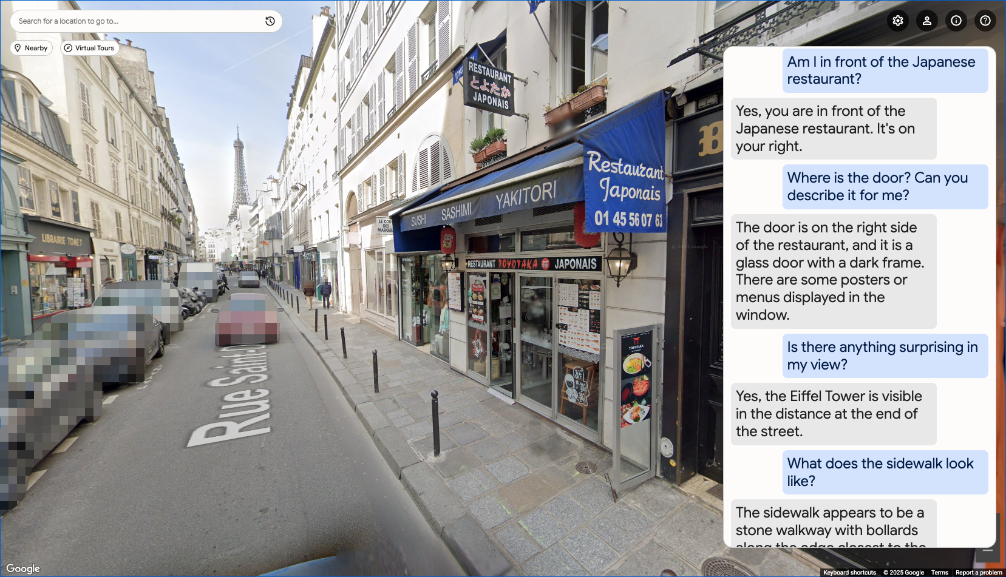
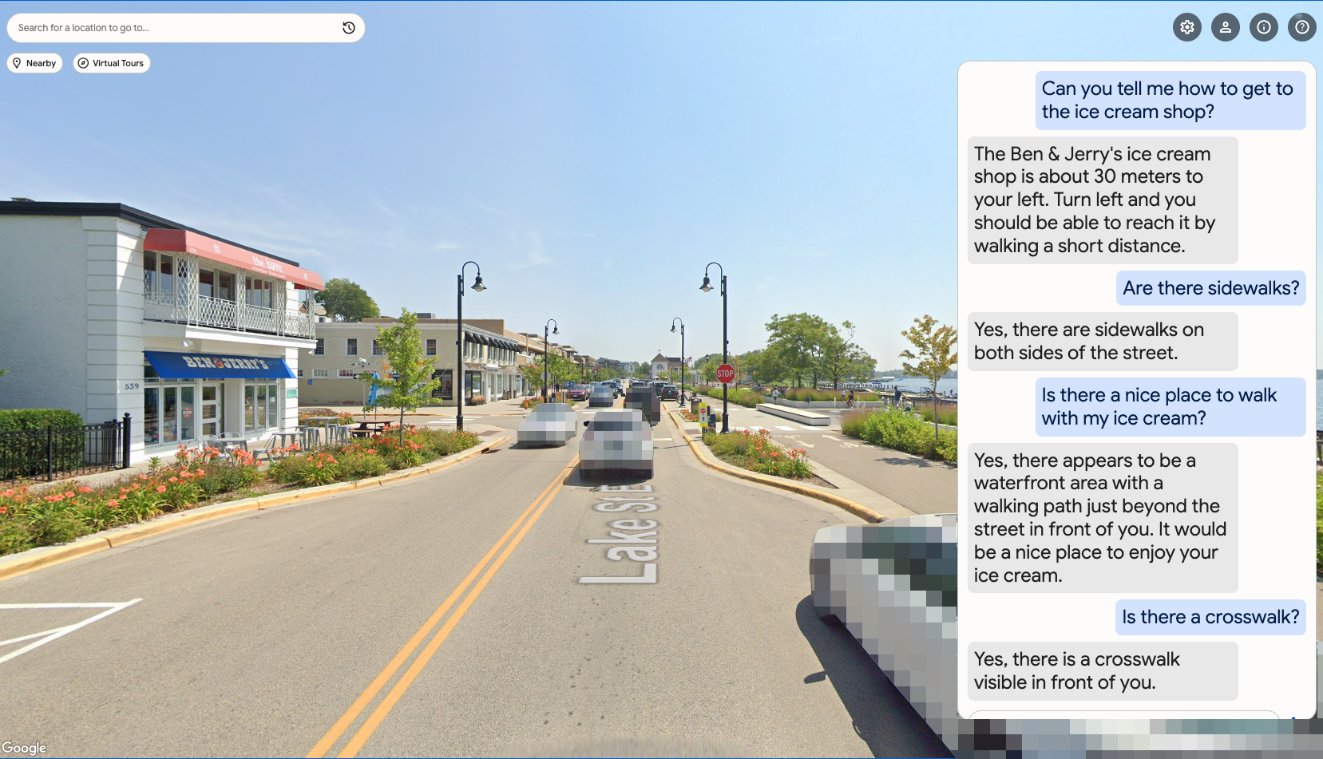
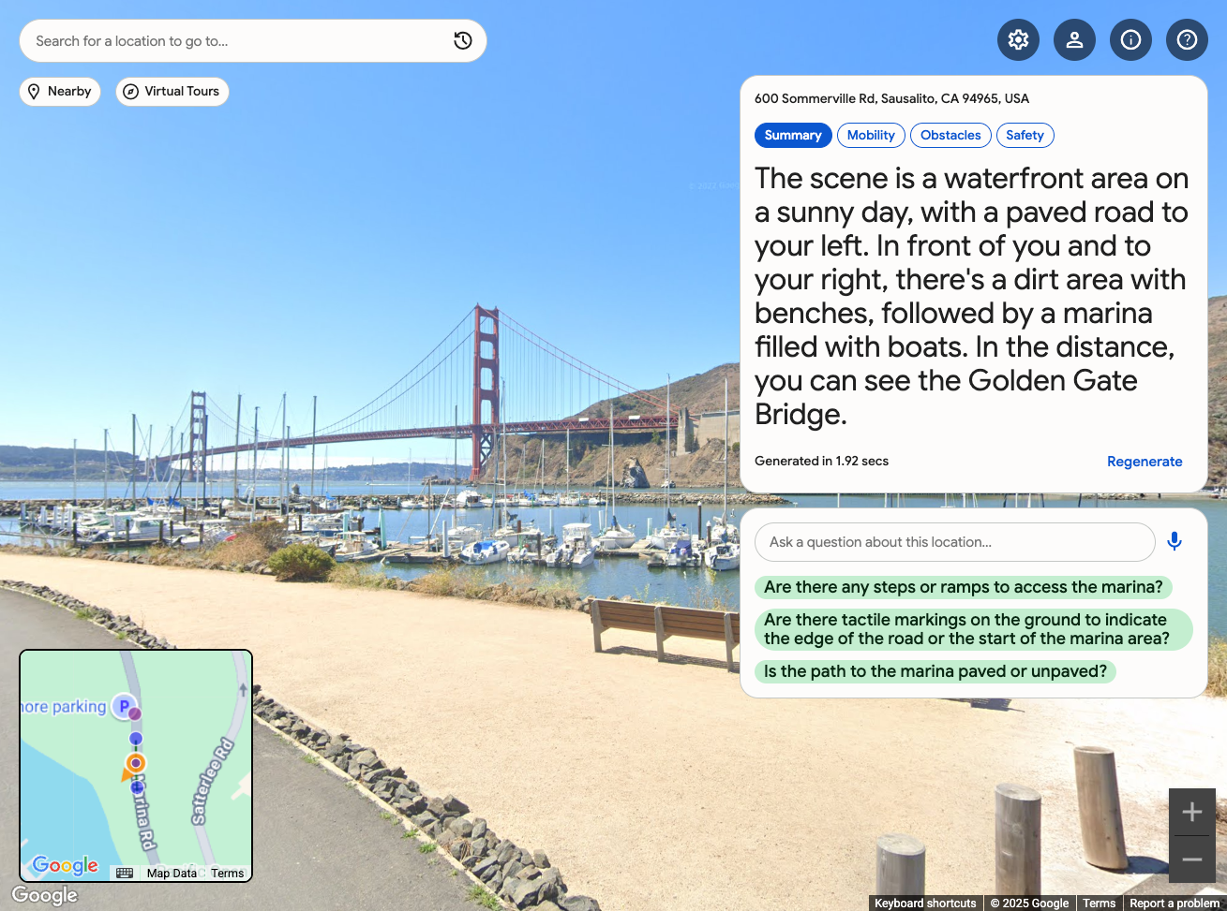
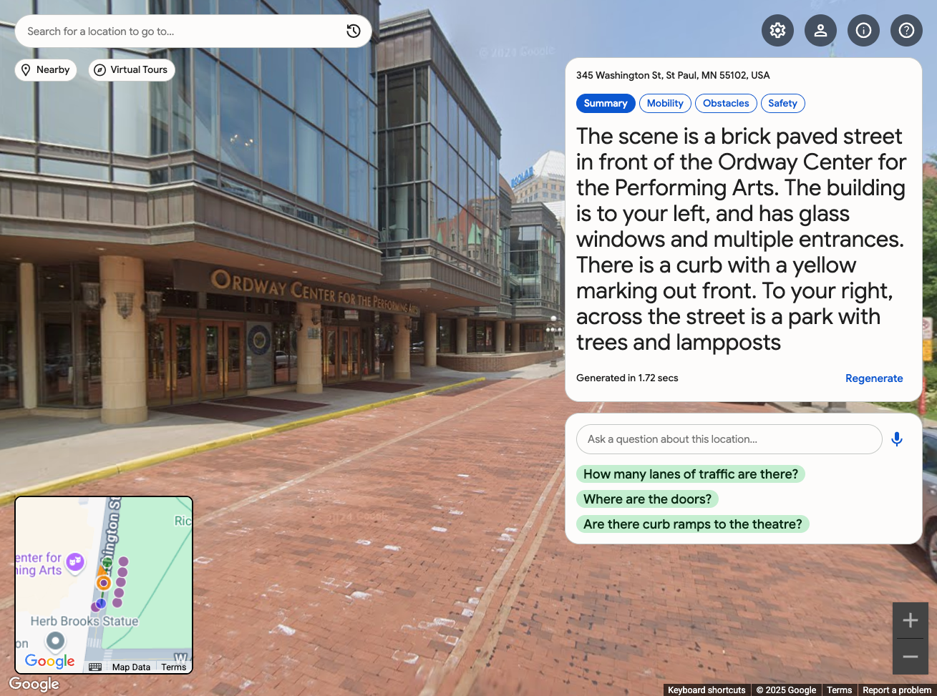
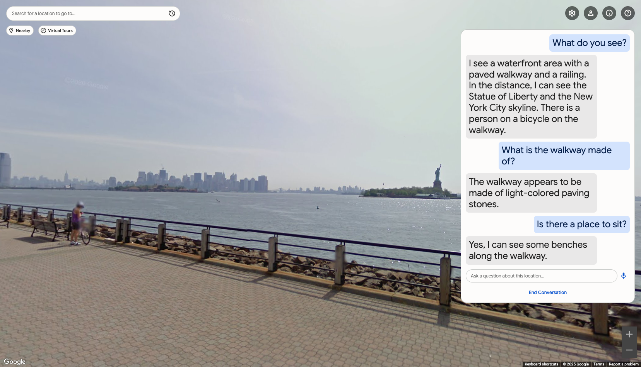
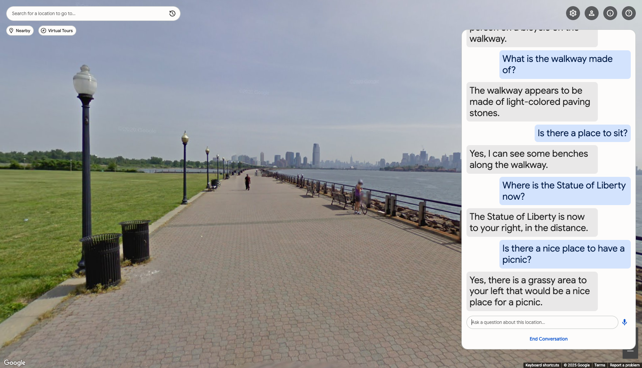
StreetReaderAI DEMO
Towards Making Street View Accessible Using Context-Aware Multimodal AI
Static Prompt
Dynamic Input
AI Describer Output
Prompt
Instructions
Dynamic
Geo-Context
MLLM
List of Mobility + Access Features
+
JSON
JSON
Optional User Profile
User’s Current View
Context-aware Description
GOAL: SUPPORT Four Core USER Tasks
POI Investigations
Route Planning
Open-Ended Exploring
Virtual Tourism
What does a place look like?
What does my route look like?
I just want to explore…
I’ve always wanted to visit…
AI Describe
AI CHAT
12”
12”
A context-aware scene description tool
A context-aware AI chat tool
Static Prompt
Dynamic Input
Output
Prompt Instructions
Dynamic
Geo-Context
MLLM
Mobility +
Access Features
AI Describe Architecture
AI Chat Architecture
Optional User Profile
User’s Current View
JSON
JSON
Context-aware Description
AI Describe Examples
AI Chat Examples
Technology AI Society and Culture
AI for Social Good
JON E. FROEHLICH
Google Research
ALEX FIANNACA
Google DeepMind
NIMER JABER
Google
VICTOR TSARAN
Google
SHAUN KANE
Google Research

Slide 8
StreetReaderAI DEMO
Towards Making Street View Accessible Using Context-Aware Multimodal AI
GOAL: SUPPORT Four Core USER Tasks
POI Investigations
Route Planning
Open-Ended Exploring
Virtual Tourism
What does a place look like?
What does my route look like?
I just want to explore…
I’ve always wanted to visit…
AI Describe
AI CHAT
A context-aware scene description tool
A context-aware AI chat tool
Static Prompt
Dynamic Input
Output
Prompt Instructions
Dynamic
Geo-Context
MLLM
Mobility +
Access Features
AI Describe Architecture
AI Chat Architecture
Optional User Profile
User’s Current View
JSON
JSON
Context-aware Description
AI Describe Examples
AI Chat Examples
Technology AI Society and Culture
AI for Social Good
JON E. FROEHLICH
Google Research
ALEX FIANNACA
Google DeepMind
NIMER JABER
Google
VICTOR TSARAN
Google
SHAUN KANE
Google Research

Slide 9
Ai describer
architecture
Static Prompt
Dynamic Input
AI Describer Output
Prompt
Instructions
Dynamic
Geo-Context
MLLM
List of Mobility + Access Features
+
JSON
JSON
Optional User Profile
User’s Current View
Context-aware Description
Notes:
So, how does this work?
AI Describer is composed of two prompts:
<click> a static prompt with prompt instructions and an optional user profile and
<click> dynamic input, including geographic context and the user’ current view
<click> which are fed into Gemini’s multimodal LLM
< click> We then receive structured JSON output, including a context-aware description
-----
Keyboard icons:
https://github.com/georgemblack/svg-keyboard-icons/tree/master

Slide 10
Ai describer
architecture
Static Prompt
Dynamic Input
AI Describer Output
Prompt
Instructions
Dynamic
Geo-Context
MLLM
List of Mobility + Access Features
+
JSON
JSON
Optional User Profile
User’s Current View
Context-aware Description
Notes:
So, how does this work?
AI Describer is composed of two prompts:
<click> a static prompt with prompt instructions and an optional user profile and
<click> dynamic input, including geographic context and the user’ current view
<click> which are fed into Gemini’s multimodal LLM
< click> We then receive structured JSON output, including a context-aware description
-----
Keyboard icons:
https://github.com/georgemblack/svg-keyboard-icons/tree/master

Slide 11



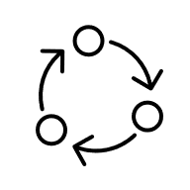
Ai CHAT: Live bidirectional updates
architecture
Static Prompt
Dynamic Input
Gemini Live
Connection
AI Chat Output
Prompt
Instructions
Dynamic
Geo-Context
MLLM
StreetReaderAI
Command
+
Optional User Profile
User Views
JSON
moveBackward
moveForward
moveToIntersection
turnLeft45
turnLeft90
…
Context-aware Description
Command Definitions
Available Movements
Notes:
AI Chat is more complex than AI Describe.
We establish a Gemini Live Connection for real-time assistance and then provide dynamic updates about user interactions and geo context
We also provide a list of commands that Gemini can call to control StreetReaderAI. These can be simple commands like turn me left or semantic commands like you heard before “turn me toward the bus stop” or “turn me to the park”
Keyboard icons:
https://github.com/georgemblack/svg-keyboard-icons/tree/master

