Slide 1
The Design and Evaluation of Prototype Eco-Feedback Displays for Fixture-Level Water Usage Data
Jon Froehlich^{1,2}, Leah Findlater^{1,2}, Marilyn Ostergren¹, Solai Ramanathan¹, Josh Peterson¹,
Inness Wragg¹, Eric Larson¹, Fabia Fu¹, Mazhengmin Bai¹, Shwetak N. Patel¹, James A. Landay¹
Jon Froehlich
Leah Findlater
Marilyn Ostergren
Solai Ramanathan
Josh Peterson
Inness Wragg
Eric Larson
Fabia Fu
Mazhengmin Bai
Shwetak N. Patel
James A. Landay
UNIVERSITY of
WASHINGTON
design:
use:
build:
Notes:
Hello, my name’s Jon Froehlich and I am a newly minted Assistant Professor at the University of Maryland, College Park. This talk is about work I did as a graduate student at the University of Washington as part of my dissertation research along with a fantastic set of collaborators including undergraduates, graduates, post-docs and my two co-advisors Shwetak Patel and James Landay

Slide 2
This talk is about eco-feedback displays for water usage in the home
Notes:
This talk is about eco-feedback displays for water usage in the home

Slide 3
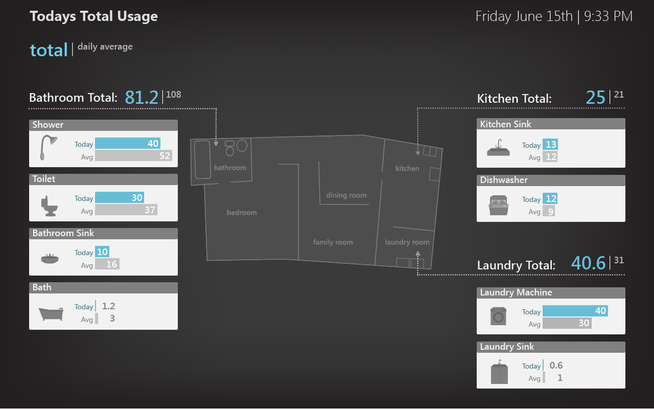
Notes:
Like this spatial display which shows fixture-level and room-level water usage using a blueprint paradigm…

Slide 4
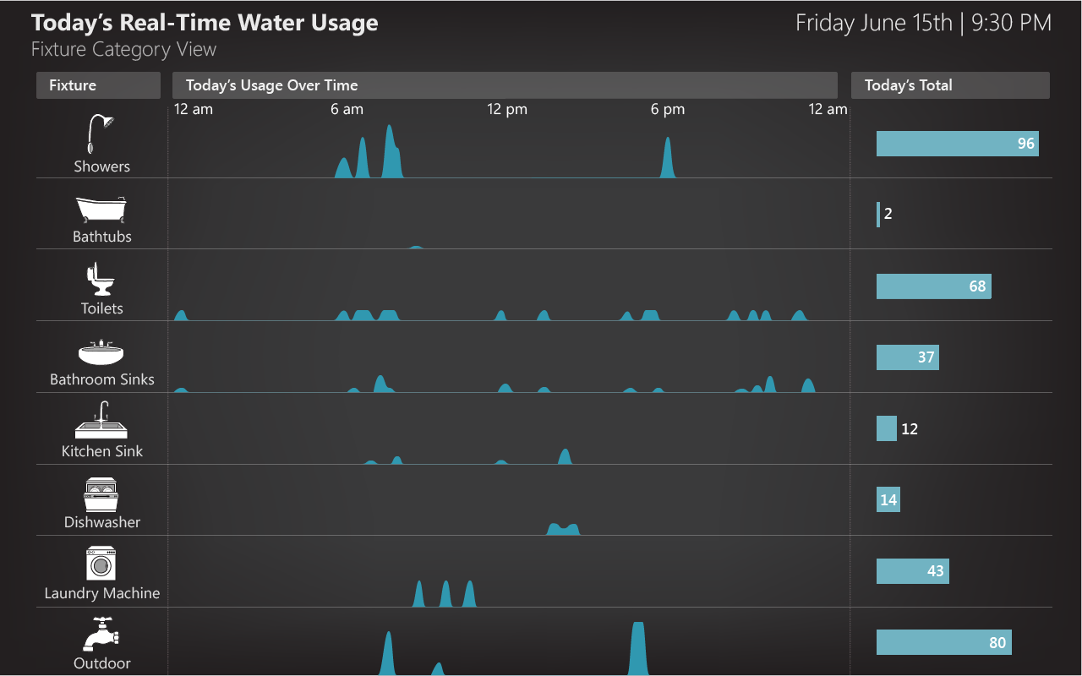
Notes:
Or this disaggregated, fixture-level time-series view…

Slide 5
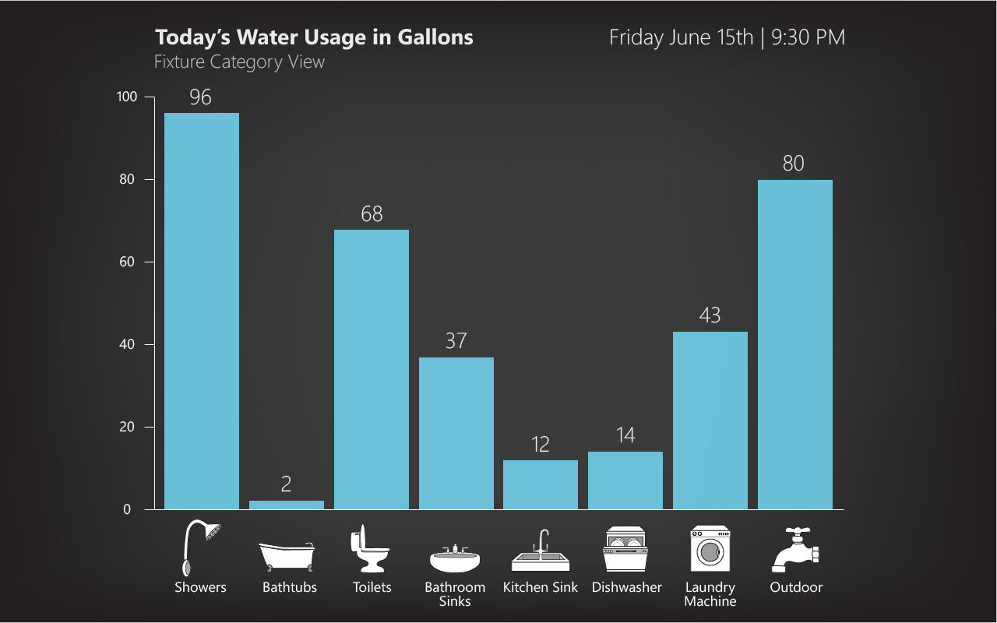
Notes:
Or this fixture-category bar graph view…

Slide 6
This talk is about eco-feedback displays for water usage in the home
This talk is also about the design process for eco-feedback visualizations
persuasive technology
personal informatics
quantified self
Notes:
This talk is also about the design process for building these sorts of eco-feedback visualizations or, more generally, visualizations in the domain of persuasive technology, personal informatics, or quantified self.
For example, how do we structure the visualization design process for new types of emergent data be it for water, health, etc.

Slide 7
But first, a quick primer on water

Slide 8
two-thirds
of the earth’s surface is covered by water
Notes:
Water is the most common substance on earth—two-thirds of the earth’s surface is covered by water.

Slide 9
Brackish
1%
Drinkable Water
0.8%
Polar Ice
1.7%
Ocean
96.5%
[Glennon, Unquenchable: America’s water crisis and what to do about it, 2009; Gleick,World Policy Journal, 2009]
Notes:
Less than one percent of this, however, is drinkable: in the form of surface water and aquifers
Although these percentages can change, you might be surprised to know that the total amount of water on the planet is fixed—neither growing nor shrinking
-----
Less than one percent of this, however, is drinkable: roughly 96.5% is ocean water, 1.7% is frozen in polar ice, and 1% is too brackish to drink, which leaves 0.8% in lakes, rivers, wetlands, in the ground and in the atmosphere (Glennon, 2009).

Slide 10
The amount of water on earth is not changing
but its location, quality and amount per person is changing
Notes:
So, the amount of water on earth is not changing… <click>
but its location, quality and amount per person is changing.

Slide 11
The amount of water on earth is not changing
but its location, quality and amount per person is changing
Notes:
but its location, quality and amount per person is changing.

Slide 12
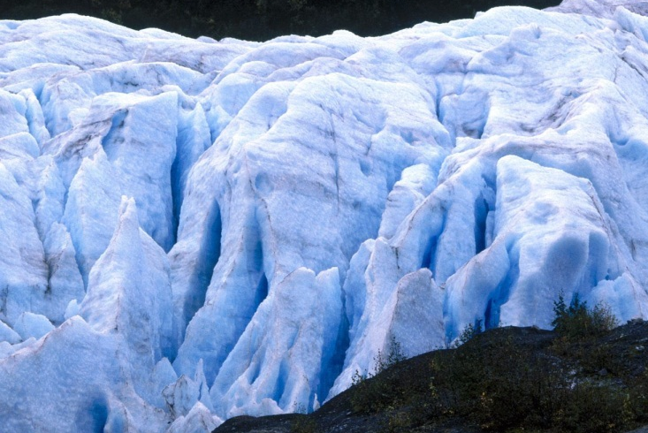
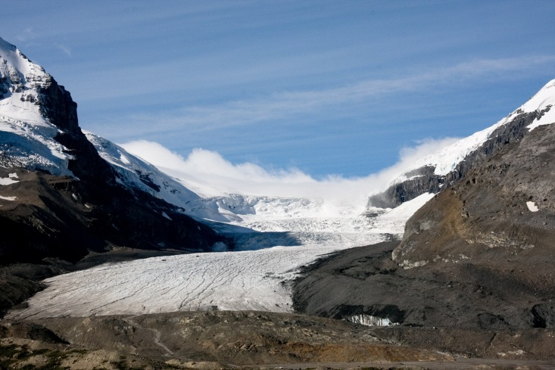
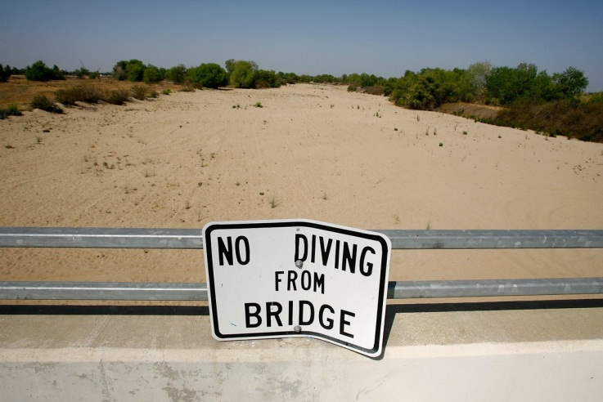
changing
As the ‘s climate changes…
precipitation patterns
glacial and ice snowpack
surface water availability
[Gleick, World Policy Journal, 2009]
Notes:
As the world’s climate changes, so too do precipitation patterns, glacial and ice snowpack, and the availability of surface water, which can greatly impact traditional water supply sources and further increase the cost of finding new ones

Slide 13
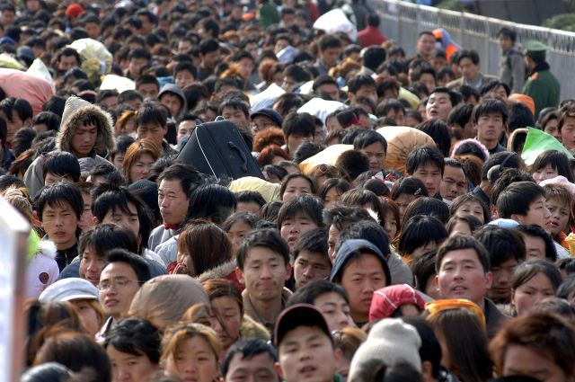
grow
As populations
per-capita water availability is
declining
Notes:
And, as populations grow, per-capita water availability is declining.

Slide 14
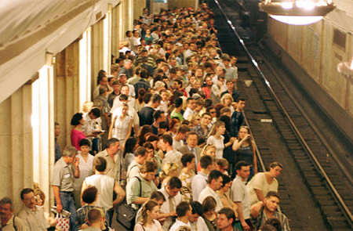
water availability disproportionately felt in urban environments
[Barlow, 2007]
Notes:
This is felt disproportionately in urban environments where for the first time in history, the number of people living in cities surpassed the number of people living in rural areas (Barlow, 2007). The rapid influx of rural populations to urban centers is only exacerbating water availability issues.

Slide 15
This places an enormous strain on drinkable water supplies
[Inman and Jeffery, 2006; Gleick et al., 2008 Vairavmoorthy, 2006]
Notes:
This places an enormous strain on drinkable water supplies, for example,
Inman and Jeffery, 2006; Gleick et al., 2008 Vairavmoorthy, 2006

Slide 16
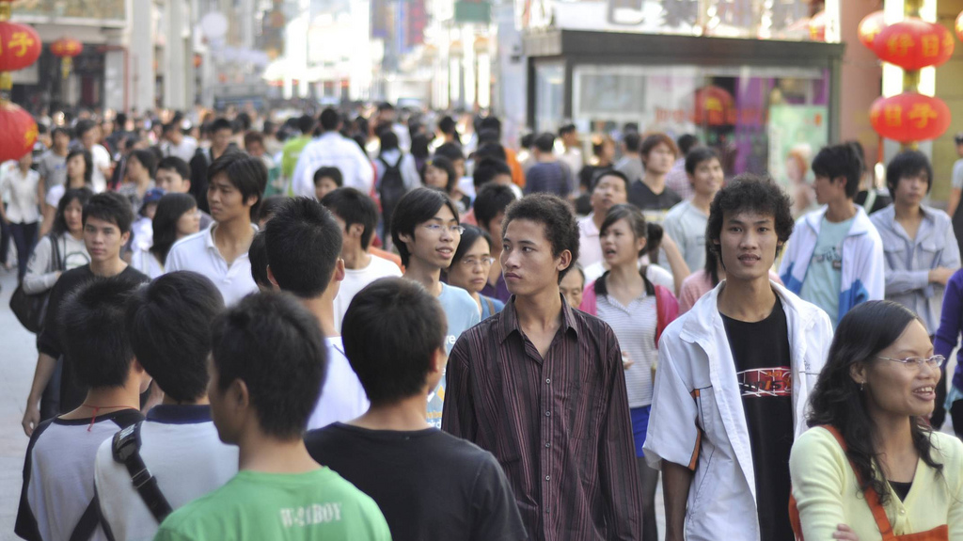
growing
demand
in 2010, water consumption rose to 938 billion gallons in beijing
water supply = 576 billion gallons
[Guardian, Dec 2010]
Notes:
Beijing has a population of 20 million and growing. Water consumption rose to 937 billion gallons in 2010, with a water supply at 576 billion gallons
350 billion gallon water deficit
---
3.55 billion cubic meters = 938 billion gallons
2.18 billion cubic meters = 576 billion gallons

Slide 17
“china melting snow to meet
freshwater demand”
[Guardian, Dec 2010]

Slide 18
lake mead expected to drop below intake pipes in next five years
[Bloomberg News, Feb 2009]
Notes:
According to US government estimates, 36 states will face serious water shortages in the next five years (EPA, 2008).
Cities in the southwestern United States are particularly at risk: Lake Mead, which supplies 65% of Las Vegas’ water, is estimated to drop below existing intake pipes by 2012 (Lippert and Efstathiou, 2009). Lippert, J. and Efstathiou, Jr. J. 2009. Las Vegas running out of water means dimming Los Angeles lights. Bloomberg News, 26 February.
Las Vegas is paying people to remove their lawns at $1.50 per square foot of lawn replaced with desert-friendly plants for a maximum of $300,000 per year in rebates. (http://www.greenbiz.com/print/35667)

Slide 19
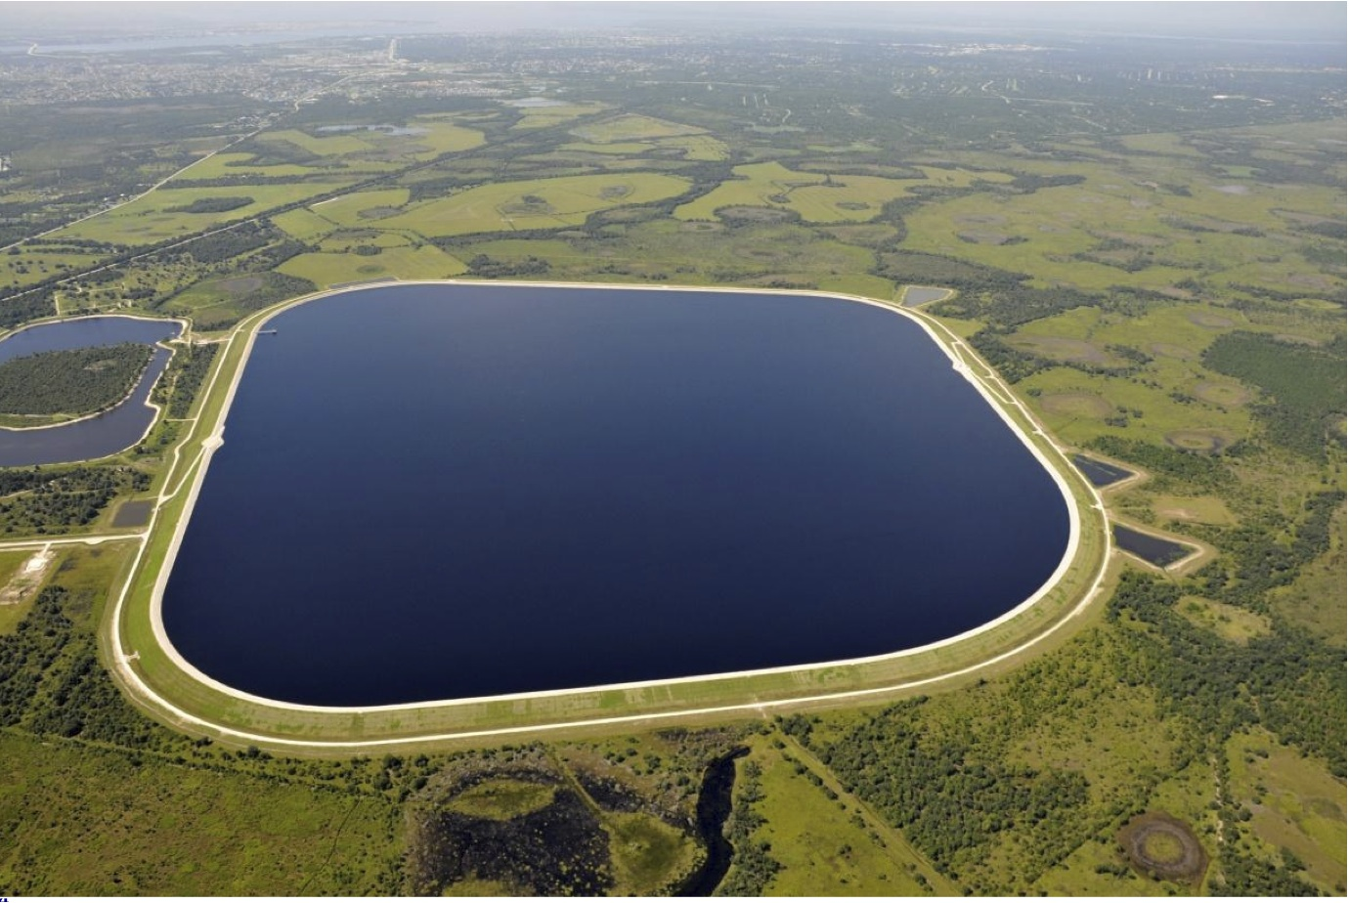
new sources of water
more costly to extract
Notes:
So, as new sources of water become more environmentally and economically costly to extract

Slide 20
water utilities governments
shift focus
Notes:
water suppliers and governments are shifting their focus from finding new supplies to using existing supplies more efficiently

Slide 21
This is an area where HCI researchers and designers can help

Slide 22
eco-feedback
sensing and visualizing behavior to reduce environmental impact
Notes:
In part, through designing and building water feedback systems at the commercial, industrial, and residential level.
This talk will be focusing on residential water usage feedback.
And there has been much recent work in this area…

Slide 23
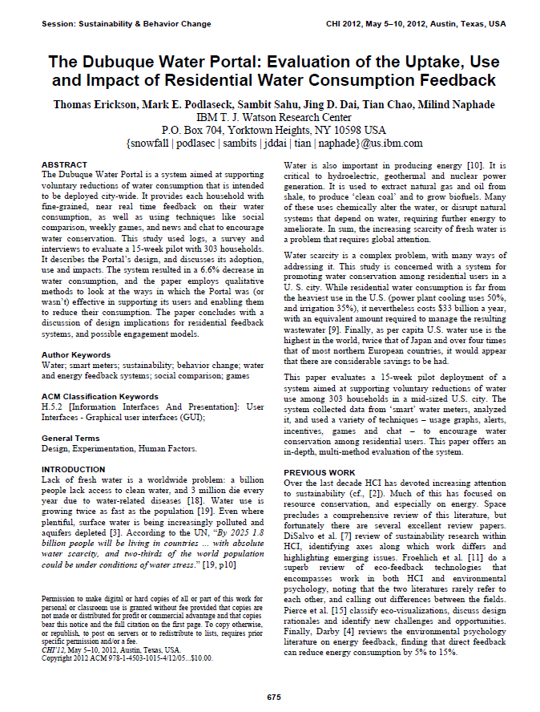
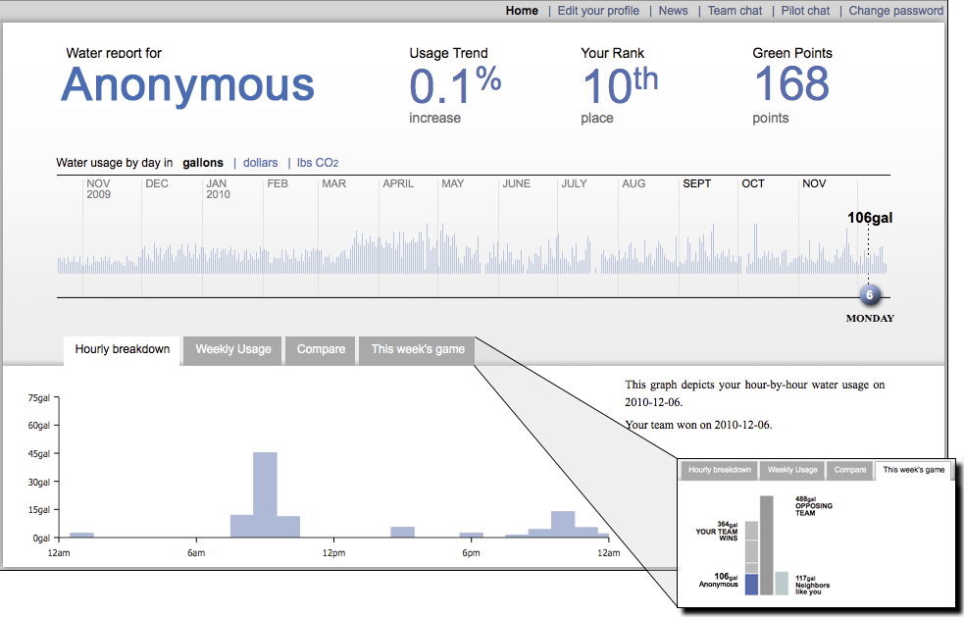
Dubuque Water Portal:
[Erickson et al., CHI 2012]
Notes:
On Monday of this week, Tom Erickson and colleagues presented the Dubuque Water Portal, which was effective in reducing water consumption
-----
which in a 15-week pilot of 303 households resulted in a 6.6% decrease in water consumption.

Slide 24
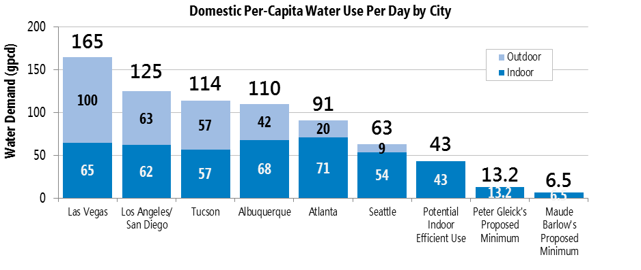
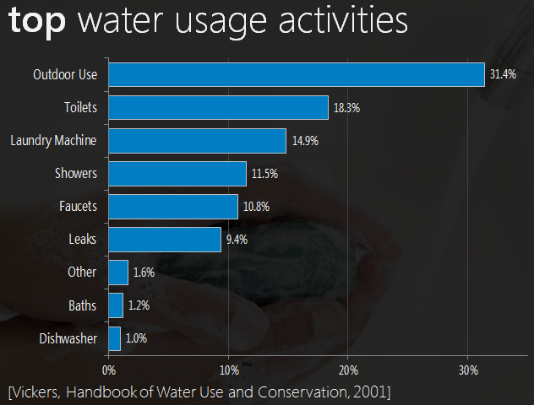
10,230
gallons
Notes:
The Dubuque Water Portal provides aggregate, whole home consumption data

Slide 25
Other
1248 gals
Dishwasher
102 gals
10,230
gallons
Faucets
1105 gals
Showers
1176 gals
Laundry
1,524 gals
Toilets
1,872 gals
Outdoor
3,212 gals
Notes:
However, this talk is focused on FIXTURE-LEVEL water usage feedback.
Typically, the way fixture-level feedback has been provided in past work is through point-of-consumption feedback like…

Slide 26
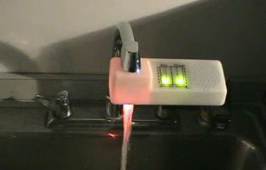
waterbot
[Arroyo et al., CHI 2005]
Notes:
Arroyo, E., Bonanni, L., and Selker, T. 2005. Waterbot: exploring feedback and persuasive techniques at the sink. In Proceedings of the SIGCHI Conference on Human Factors in Computing Systems (Portland, Oregon, USA, April 02 - 07, 2005). CHI '05. ACM, New York, NY, 631-639.

Slide 27
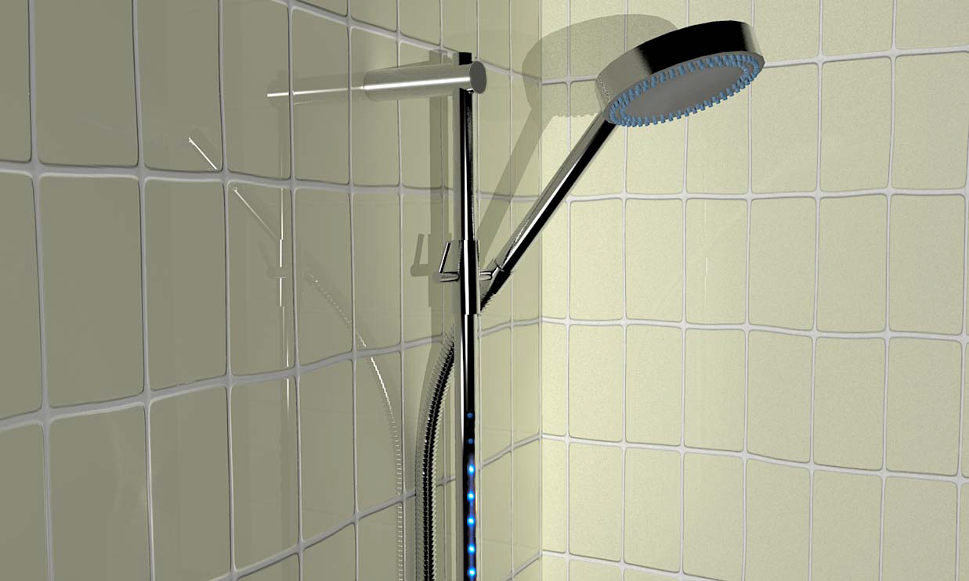
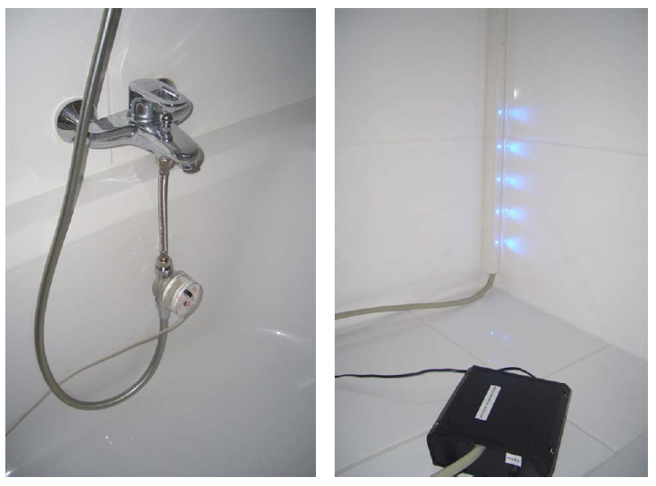
showme
[Kappel & Grechenig, Persuasive 2009]
Notes:
Kappel, K., & Grechenig, T. (2009). “show-me”: Water Consumption at a glance to promote Water Conservation in the Shower. Proceedings of the 4th International Conference on Persuasive Technology. New York: ACM, 6 pages.

Slide 28
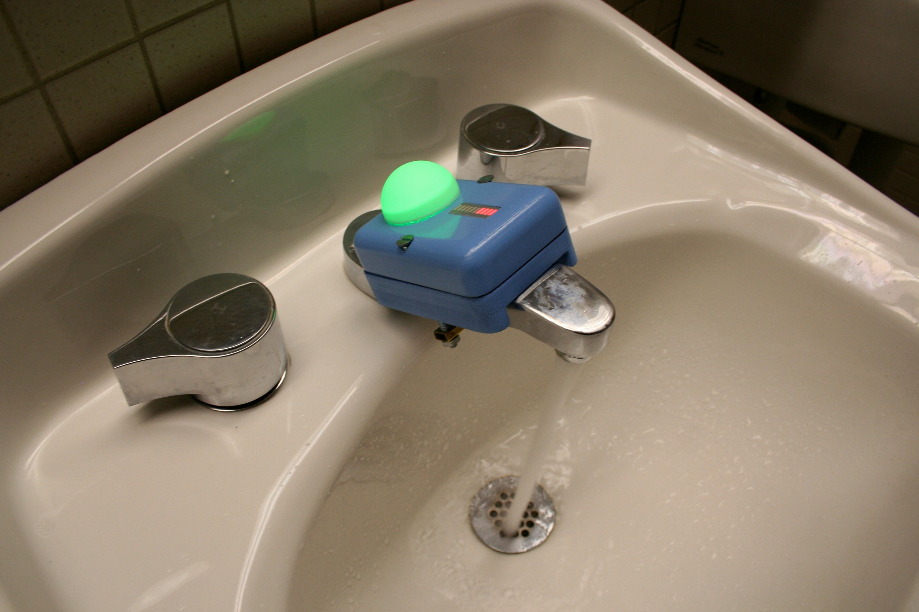
upstream
upstream
[Arroyo et al., CHI2005]
[Kuznetsov & Paulos, CHI 2010]
Notes:
Kuznetsov, S. and Paulos, E. (2010). UpStream: motivating water conservation with low-cost water flow sensing and persuasive displays. Proceedings of CHI 2010, 1851-1860.

Slide 29
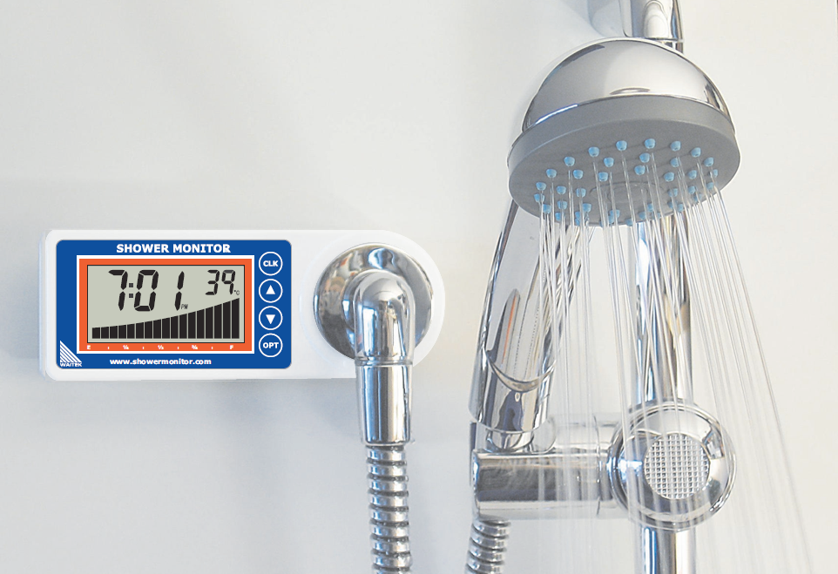
waitek shower monitor
http://www.waitek.co.nz/

Slide 30
Point-of-Consumption Eco-Feedback Displays
sensing and feedback unit co-located at fixture
provides real-time feedback on water usage
Notes:
Point-of-consumption displays contain both the sensing mechanism and the feedback visualization co-located at the fixture and provides real-time feedback on water usage.

Slide 31
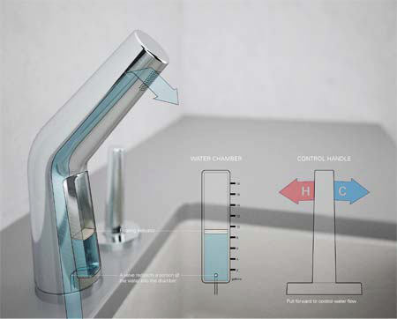
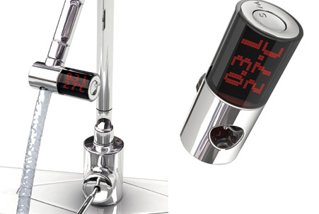
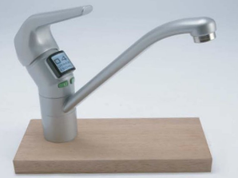
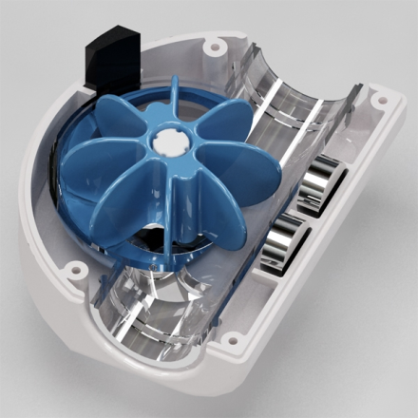
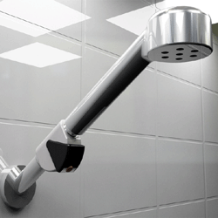
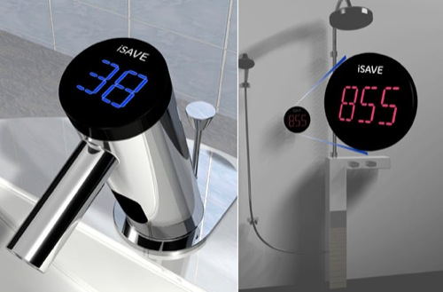
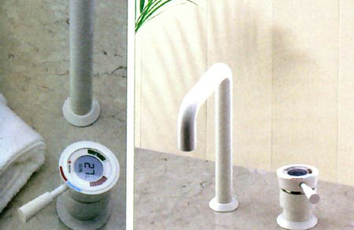
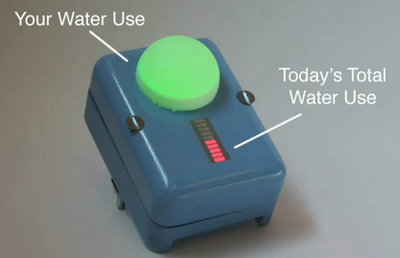
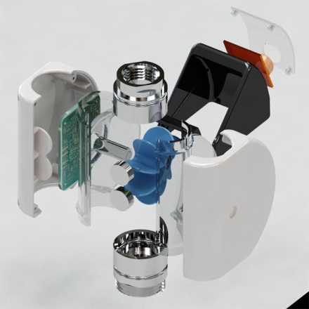
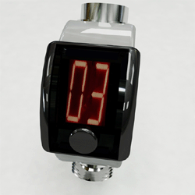
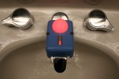
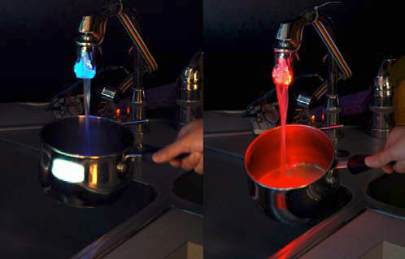
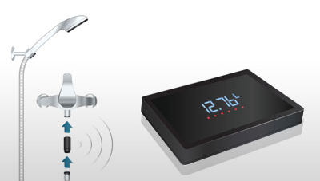
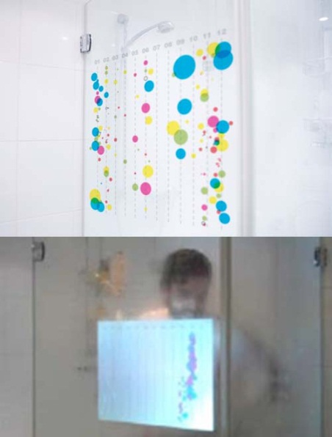
Notes:
water-based eco-feedback largely limited to sensing and
feedback at the point-of-consumption and to simple ambient
and/or LED-based displays [2,19,21,22,30]. Although this
type of feedback can potentially reduce usage at the
installed fixture [30], it is limited in its ability to convey
broader patterns of use or to compare across fixtures.

Slide 32
Point-of-consumption feedback is the prevailing method for providing water usage feedback at the fixture-level
Notes:
Point-of-consumption feedback is the prevailing method for providing water usage feedback at the fixture-level
And although this has been shown to be effective, there are a few limitations.

Slide 33
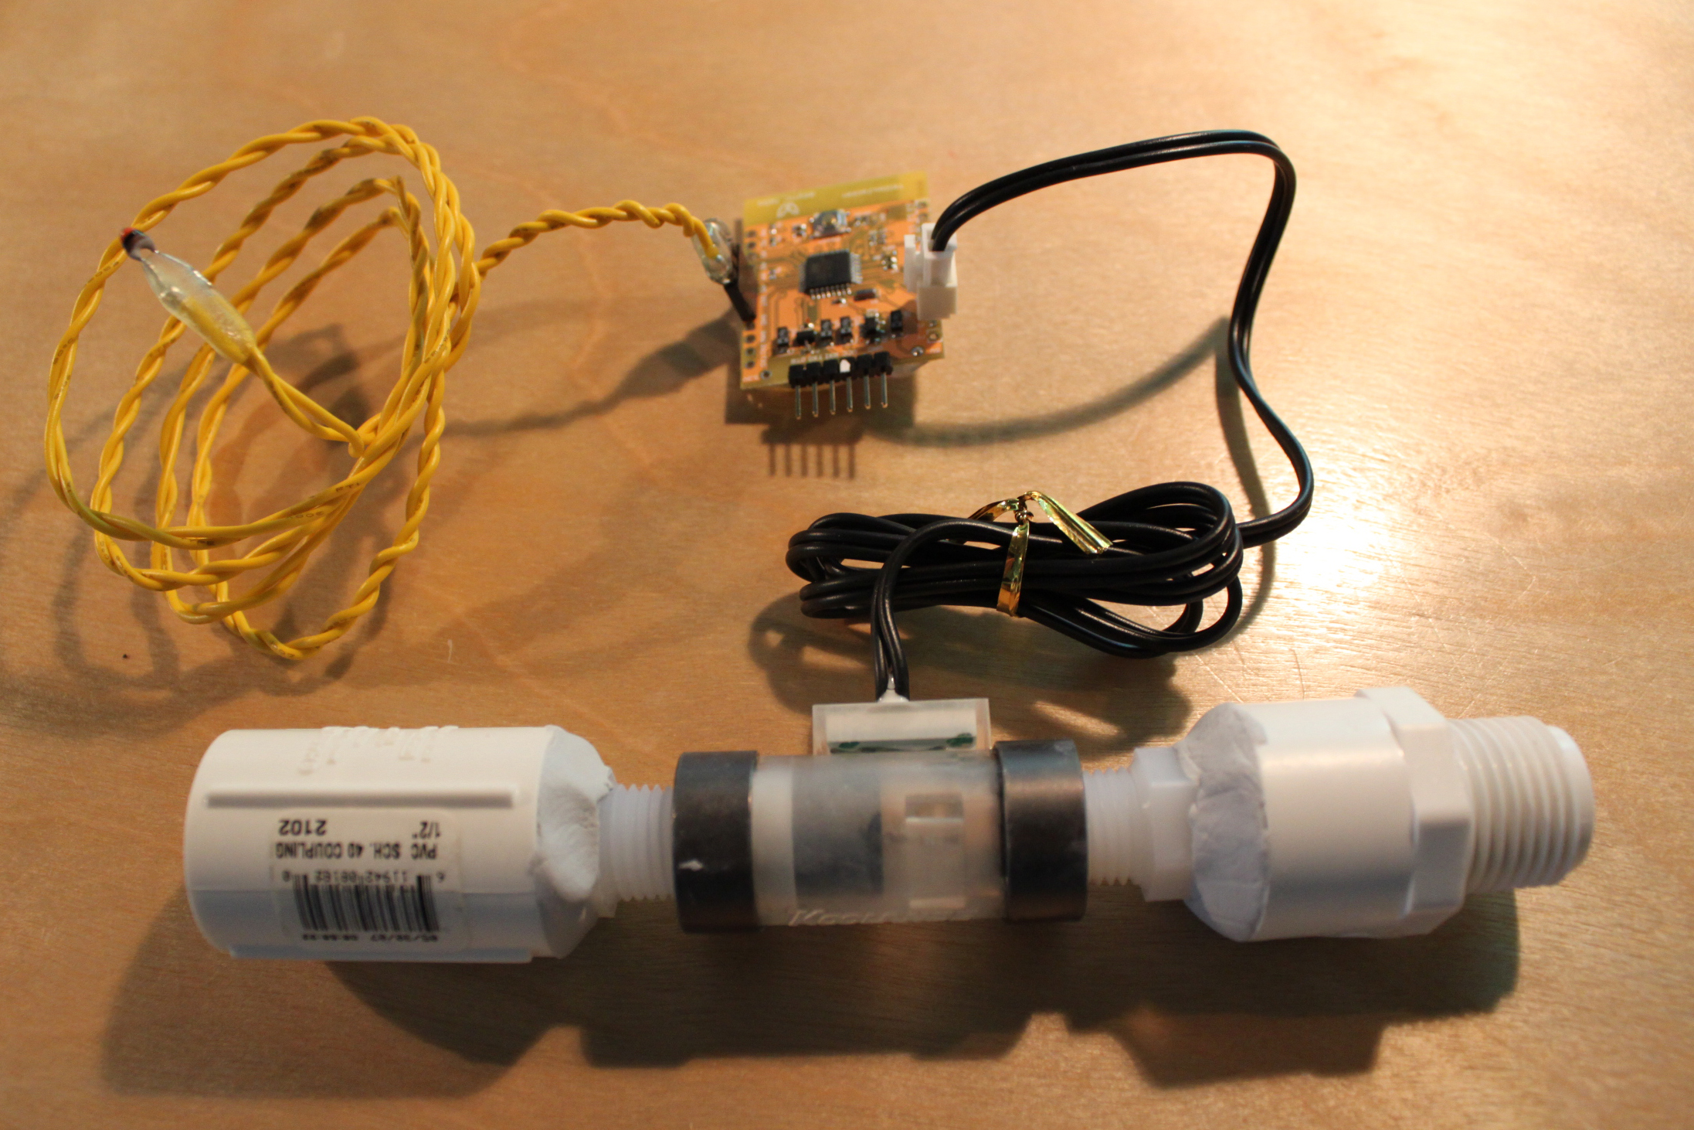
direct sensing
[Teague Labs, Arduino Water Meter, http://labs.teague.com/?p=722]
Notes:
First, point-of-consumption water feedback systems rely on direct sensing where as I already mentioned the sensing and feedback unit are co-located at the same fixture. The issue here, then is scalability, installation, cost, and maintenance overhead.

Slide 34
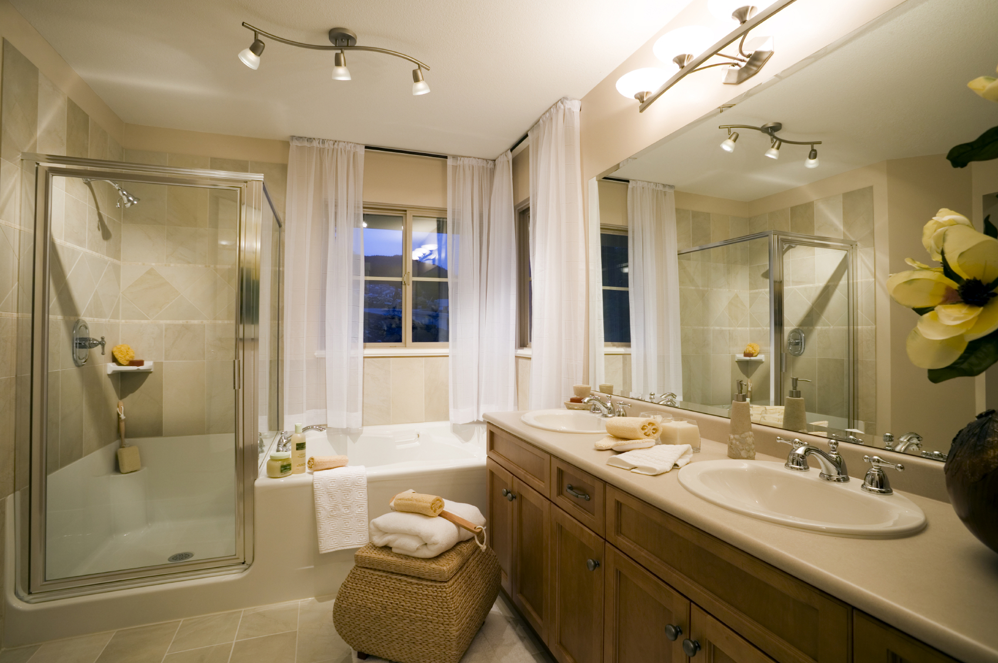
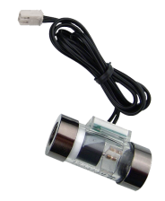
direct sensing
shower 62.4 gallons
bathroom sink 1 4.2 gallons
bathroom sink 2 0.8 gallons
bath
6.5 gallons
toilet
78.4 gallons
Notes:
For example, this is what a bathroom would look like with point-of-consumption feedback

Slide 35
direct sensing
shower 52.4 gallons
shower 62.4 gallons
bathroom sink 1 3.2 gallons
bathroom sink 1 4.2 gallons
bathroom sink 2 0.8 gallons
bath
6.5 gallons
bath
6.5 gallons
bathroom sink 2 2.4 gallons
toilet
78.4 gallons
Notes:
The problem becomes even more challenging if you want to track cold and hot water usage.
In addition, because thus far none of these systems have been networked, the data resides on each feedback unit and not in a central repository making it difficult for residents to compare usage across fixtures.

Slide 36
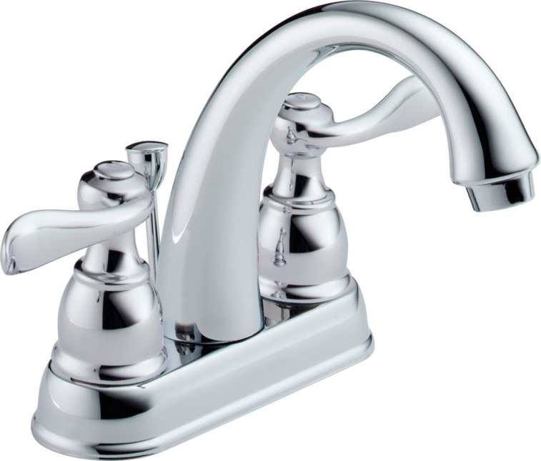
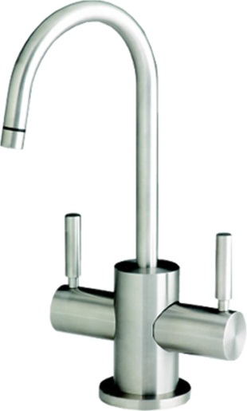
Showers and faucets account for ~22% of water use in the average North American home
[Vickers, 2001]
Notes:
Finally, these point-of-consumption systems have also disproportionately focused on faucet and shower usage, which account for only 22% of water use in the average North American home [29].

Slide 37
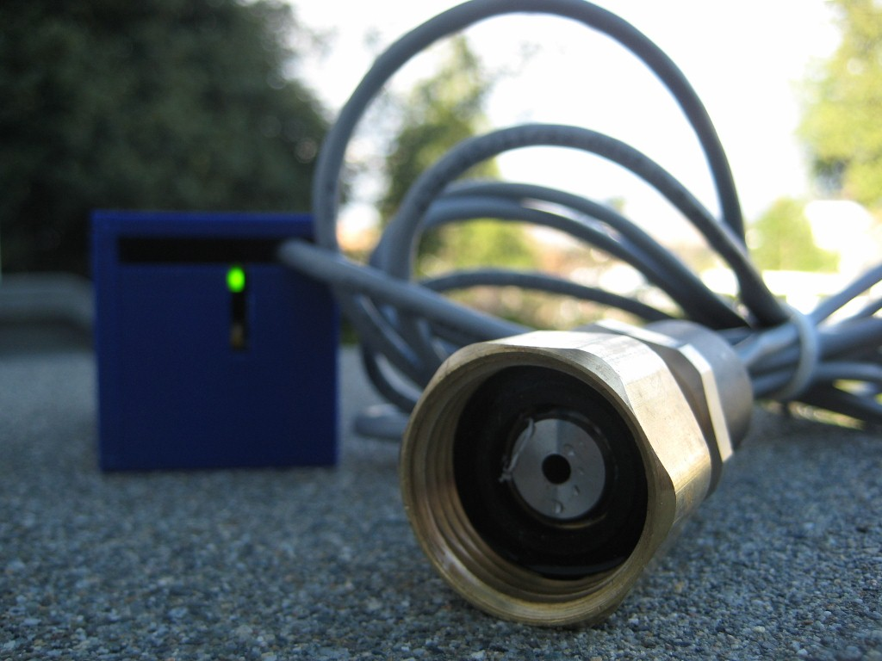
direct sensing
shower 52.4 gallons
shower 62.4 gallons
bathroom sink 1 3.2 gallons
bathroom sink 1 4.2 gallons
bathroom sink 2 0.8 gallons
bath
6.5 gallons
bath
6.5 gallons
bathroom sink 2 2.4 gallons
toilet
78.4 gallons
Notes:
However, there is an emerging trend in building new indirect water sensing methods that provide the same fixture-level granularity from only one or a few sensors.

Slide 38
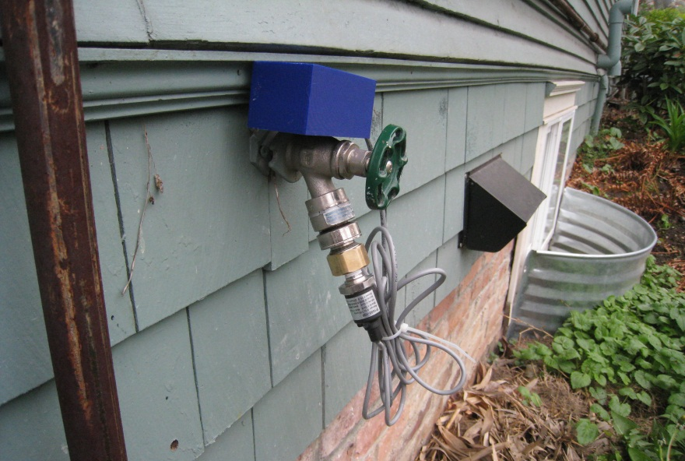
indirect sensing
shower 52.4 gallons
shower 62.4 gallons
bathroom sink 1 3.2 gallons
bathroom sink 1 4.2 gallons
bathroom sink 2 0.8 gallons
bath
6.5 gallons
bath
6.5 gallons
bathroom sink 2 2.4 gallons
toilet
78.4 gallons
[HydroSense, UbiComp 2009]
Notes:
However, there is an emerging trend in building new indirect water sensing methods that provide the same fixture-level granularity from only one or a few sensors.

Slide 39
A single sensor infers fixture-level usage for the entire home
[HydroSense, UbiComp 2009]
Notes:
However, there is an emerging trend in building new indirect water sensing methods that provide the same fixture-level granularity from only one or a few sensors.

Slide 40
A single sensor infers fixture-level usage for the entire home
This is often called disaggregated sensing

Slide 41
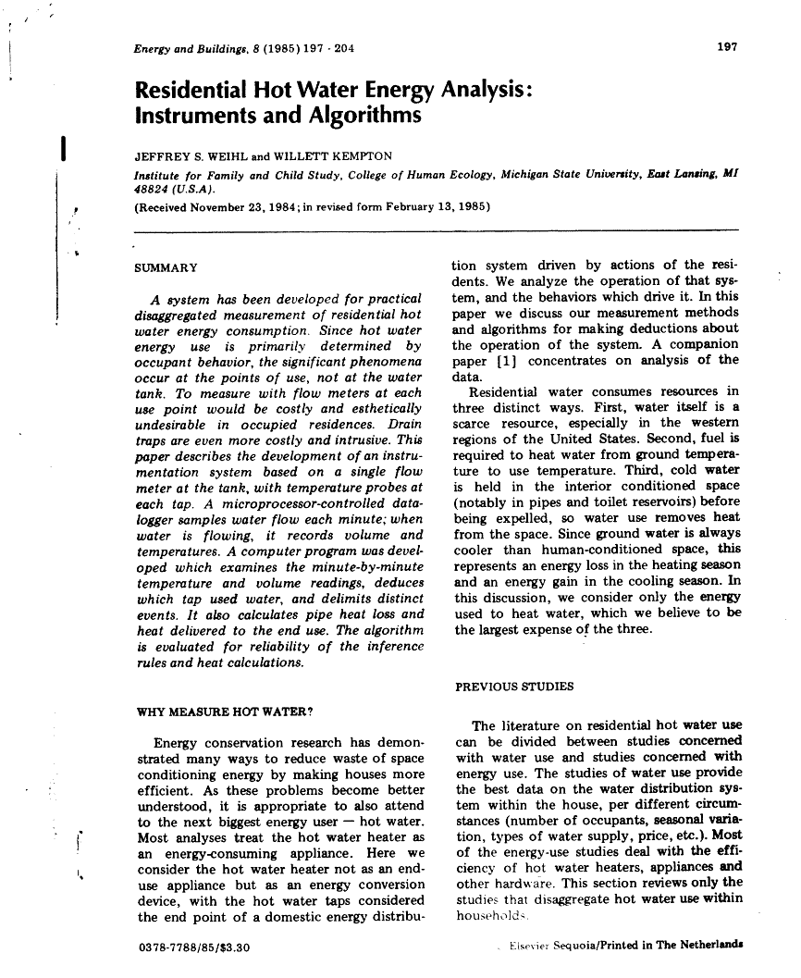
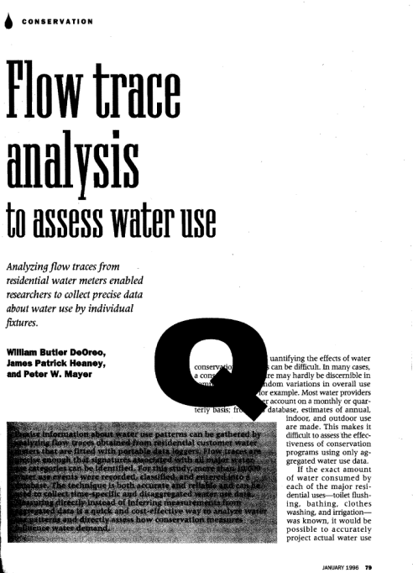
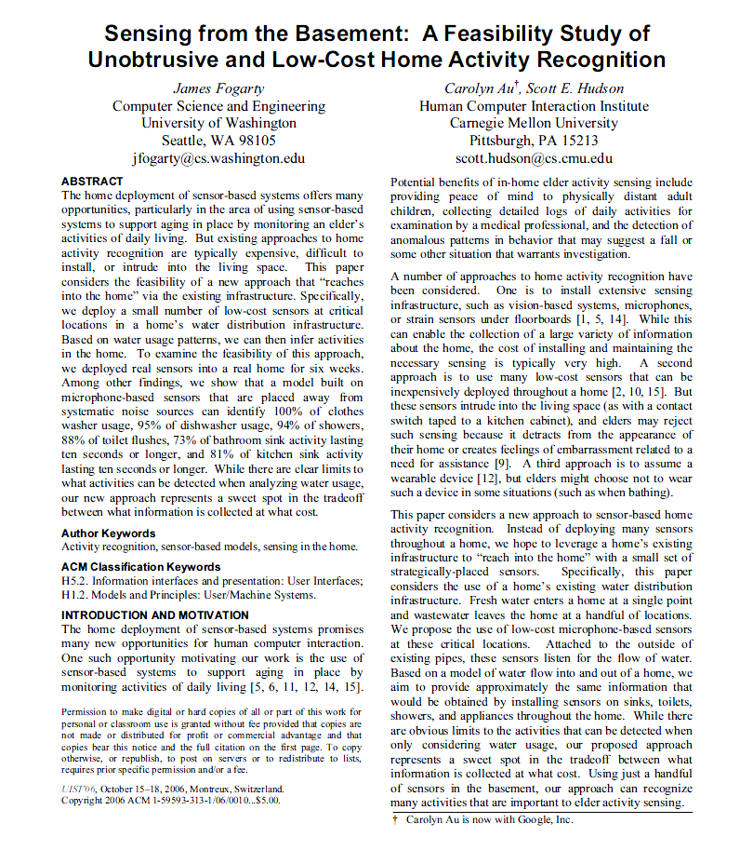
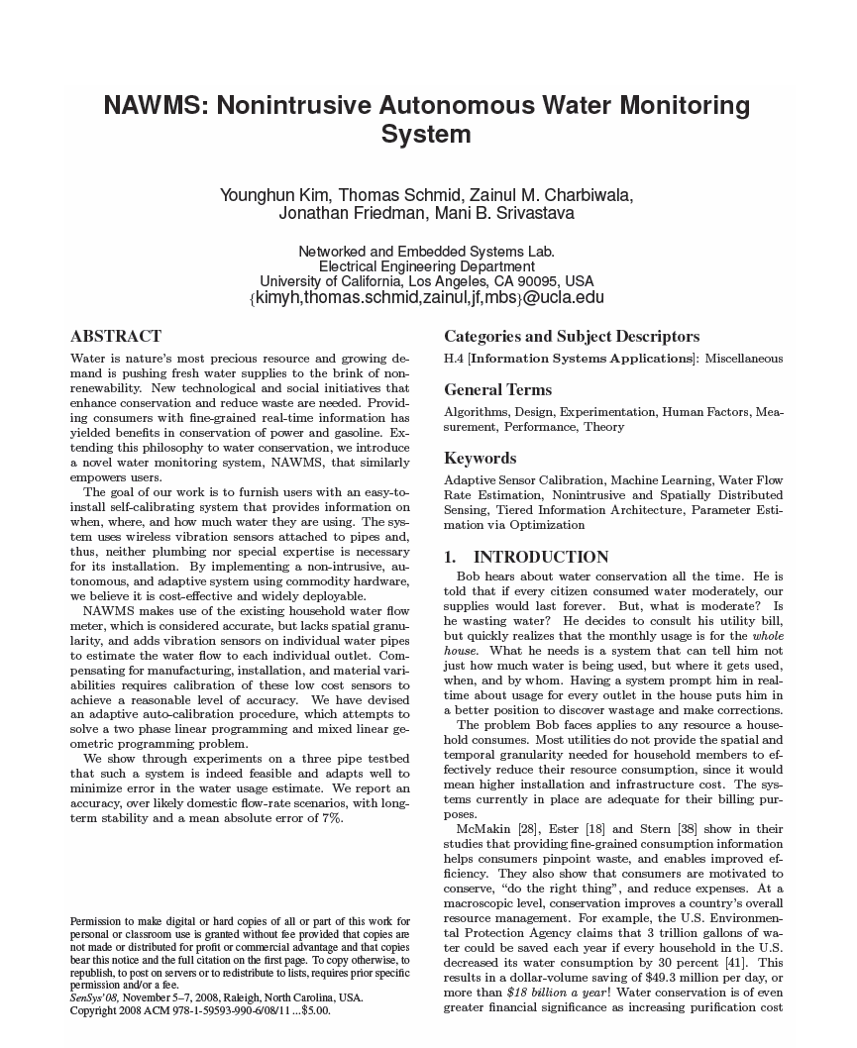
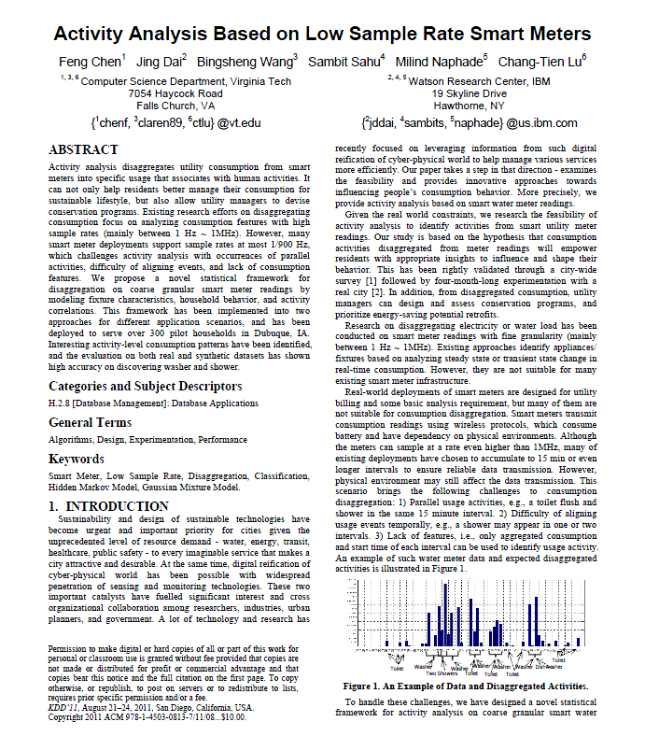
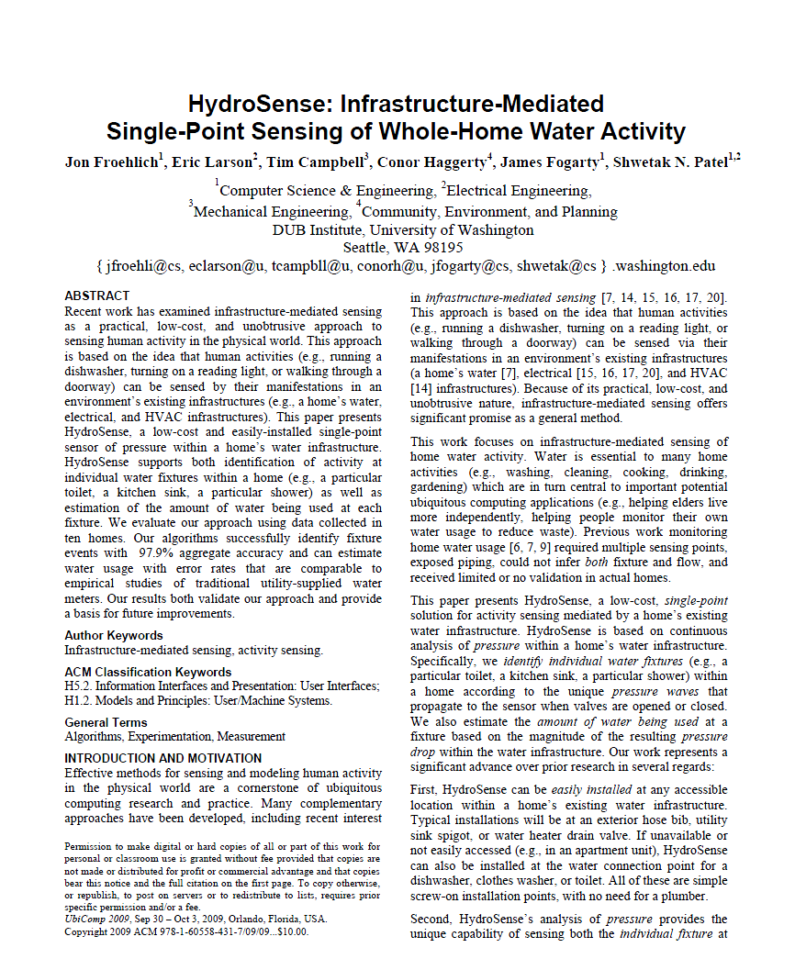
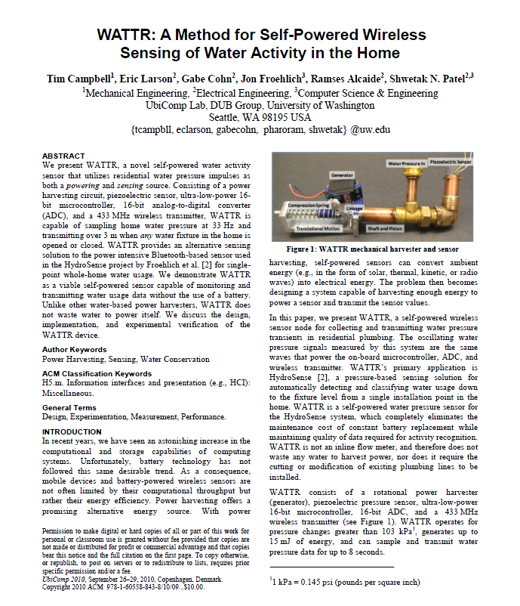
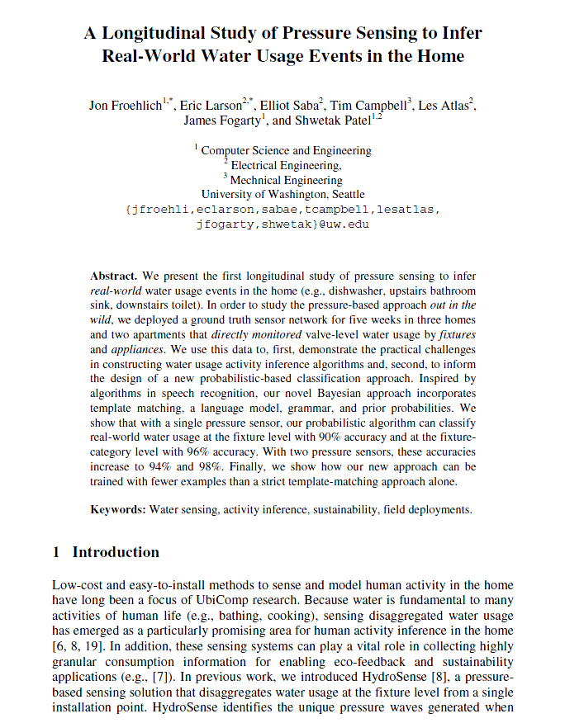
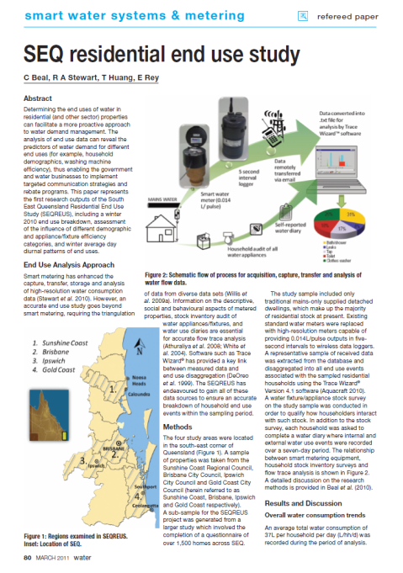
Emerging Water Sensing Disaggregation Methods
DeOreo et al., AWWA 1996
Fogarty et al., UIST 2006
Kim et al., SenSys 2008
Froehlich et al., UbiComp 2009
Campbell et al., UbiComp 2010
Froehlich et al., Pervasive 2011
Beal et al., Smart Water Sys 2011
Chen et al., KDD 2011
Notes:
There’s been a number of innovations here in the last 15 years, including some past work that my colleagues and I have done.
-----
Campbell_WATTr-AMethodForSelfPoweredWirelessSensingOfWaterActivityInTheHome_UbiComp2010.pdf
Chen_ActivityAnalysisBasedOnLowSampleRateSmartMeters_KDD2011.pdf
DeOreo_FlowTraceAnalysisToAssessWaterUse_AWWA1996.pdf
Fogarty_SensingFromTheBasement-AFeasibilityStudyOfUnobtrusiveAndLowCostHomeActivityRecognition_UIST2006.pdf
Kim_NAWMS-NonintrusiveAutonomousWaterMonitoringSystem_SenSys2008BestPaper.pdf
Froehlich_ALongitudinalStudyOfPressureSensingToInferRealWorldWaterUsageEventsInTheHome_Pervasive2011.pdf
Beal_SEQResidentialEndUseStudy_SmartWaterSystemsAndMetering2011.pdf
Froehlich_HydroSense-InfrastructureMediatedSinglePointSensingOfWholeHomeWaterActivity_UbiComp2009.pdf
Mayer_ResidentialWaterUseAndConservationEffectiveness-AProcessApproach_UColoradoMSThesis1995.pdf

Slide 42
This data presents new, rich opportunities for…
eco-feedback
sensing and visualizing behavior to reduce environmental impact
Notes:
Such detailed data presents new opportunities for water-based eco-feedback systems to visualize not only how much water is being consumed but also where and when it is occurring (e.g., upstairs bathroom toilet, front lawn sprinkler).

Slide 43
What do we do with all this data?
Notes:
What do we do with all this data?

Slide 44
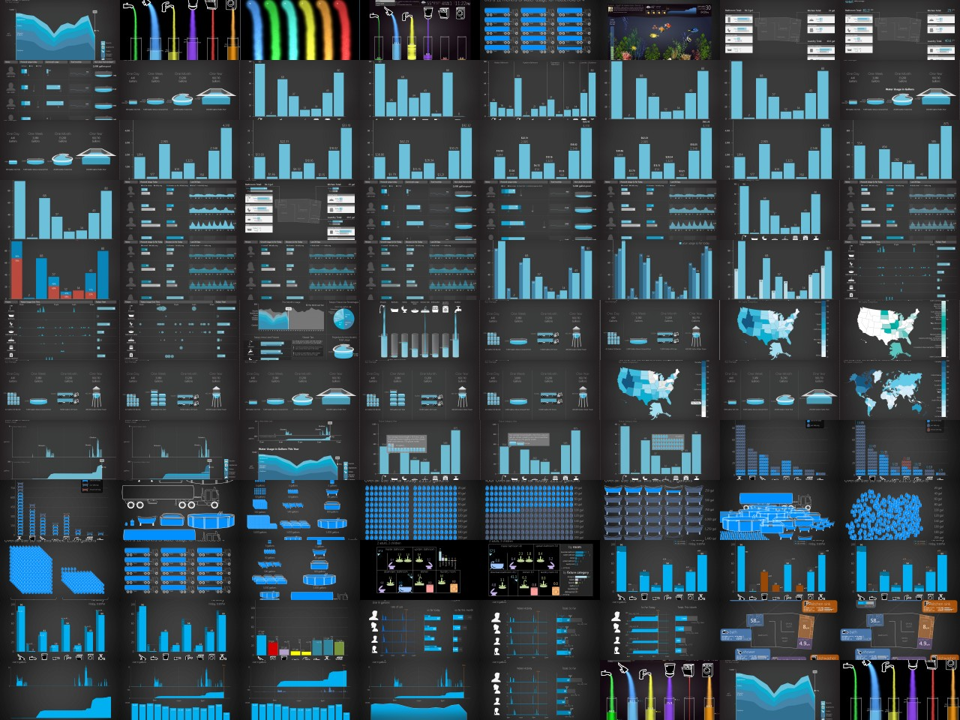
Notes:
The design space is huge—how does one structure the design process to effectively design for this data?

Slide 45
Key Questions
1
What are the key gaps in water usage understanding?
What aspects of disaggregated data are potential users interested in and what sort of reactions do the visualizations provoke?
How might these visualizations impact behavior?
2
3

Slide 46
Key Questions
1
What are the key gaps in water usage understanding?
What aspects of disaggregated data are potential users interested in and what sort of reactions do the visualizations provoke?
How might these visualizations impact behavior?
2
3

Slide 47
Two sets of designs:
1
Design Dimensions
Isolate eco-feedback design dimensions in the context of water usage
2
Design Probes
Meant to elicit reactions about how displays would fit within a household and investigate issues such as privacy, competition, family dynamics.
Notes:
To help answer these questions, we created two sets of eco-feedback water designs…
The first set were designed to isolate eco-feedback design dimensions in the context of water usage
The second set were meant to elicit reactions about how displays within a household and investigate issues such as privacy, competition, and family dynamics.

Slide 48
Informal interviews with water experts (e.g., SPU, Amy Vickers)
UW Environmental Practicum on water
Literature review of water resource management, environmental psychology
Our own online survey of water usage attitudes & knowledge (N=656 respondents)
Ideation
Data Gathering
Ideation / Sketch
Pilot Studies
Refinement
Evaluation
In-Home Interviews
Survey
Notes:
To create these two design sets we employed a multi-stage iterative design process
We first performed a breadth of formative inquiries including informal interviews with water experts and our own online survey of water usage attitudes, practices, and knowledge.

Slide 49
Poor Water Literacy
Respondents (N=651) dramatically underestimated the amount of water used in common everyday activities.
underestimate
toilet :
shower :
bath :
low-flow shower :
outdoor yard watering :
by 15%
by 30%
by 55%
by 60%
by 83% to 95%
[Froehlich, UW PhD Dissertation, 2011]
Notes:
Where, among other things, we found that people dramatically underestimated the amount of water used in common everyday activities.
----
For baths and showers, its by more than 50%

Slide 50
Informal interviews with water experts (e.g., SPU, Amy Vickers)
UW Environmental Practicum on water
Literature review of water resource management, environmental psychology
Our own online survey of water usage attitudes & knowledge (N=656 respondents)
Ideation
Data Gathering
Ideation / Sketch
Pilot Studies
Refinement
Formative
Evaluation
In-Home Interviews
Survey

Slide 51
Informal interviews with water experts (e.g., SPU, Amy Vickers)
UW Environmental Practicum on water
Literature review of water resource management, environmental psychology
Our own online survey of water usage attitudes & knowledge (N=656 respondents)
Ideation
Data Gathering
Ideation / Sketch
Pilot Studies
Refinement
Formative
Evaluation
In-Home Interviews
Informed by gathered data
Guided by eco-feedback design space
Survey
Notes:
Along with the data gathered from our formative inquiries, we used an eco-feedback design space to help inform our sketches and low-fidelity mockups

Slide 52
Iterative Design Fidelities
Iterative Design Process
Sketches
Higher fidelity mockups
Sketch
Lo-to-Mid Fidelity Mockup
Higher Fidelity Mockup
Notes:
We used an iterative design process from sketches to high fidelity mockups
---
We iterated on ideas and sketches via design critiques and three sets of pilot tests to examine issues such as understandability, approachability, clutter, and aesthetics

Slide 53
Informal interviews with water experts (e.g., SPU, Amy Vickers)
UW Environmental Practicum on water
Literature review of water resource management, environmental psychology
Our own online survey of water usage attitudes & knowledge (N=656 respondents)
Design critique sessions with team
Three sets of pilot studies
Ideation
Data Gathering
Ideation / Sketch
Pilot Studies
Refinement
Formative
Evaluation
In-Home Interviews
Informed by gathered data
Guided by eco-feedback design space
Survey
Notes:
These sketches and low-fidelity mockups were evaluated via design critique sessions and multiple on-campus pilot studies

Slide 54
Informal interviews with water experts (e.g., SPU, Amy Vickers)
UW Environmental Practicum on water
Literature review of water resource management, environmental psychology
Our own online survey of water usage attitudes & knowledge (N=656 respondents)
Design critique sessions with team
Three sets of pilot studies
Ideation
Data Gathering
Ideation / Sketch
Pilot Studies
Refinement
Formative
Evaluation
In-Home Interviews
Informed by gathered data
Guided by eco-feedback design space
Survey
Online interactive survey of designs (N=651 respondents)
In-home interviews (10 households, 20 adults)
Notes:
Finally, in the last iterative design phase, we conducted an online survey and in-home interviews
-----
An overarching goal here was to identify which displays and design elements seemed particularly promising for future research to explore in actual deployments.

Slide 55
Designing the Eco-Feedback Interfaces

Slide 56
How does one go about the process of designing interfaces for eco-feedback?

Slide 57
Eco-Feedback Design Space
Information Access
Data Representation
Comparison
update frequency
aesthetic
comparison target
real-time
monthly or less
user poll
pragmatic
artistic
self
social
goal
spatial proximity to behavior
time window
comparison by time
co-located
remote
<hour
>year
past
projected
attentional demand
temporal grouping
social-comp. target
glanceable
high attention
≤sec
geographically proximal
demographically similar
selected social network
by hour
by day
by week
≥year
by month
effort to access
data granularity
goal-setting strategy
low
high
coarse-grain
fine-grain
self-set
system-set
externally-set
Interactivity
visual complexity
difficulty to reach comparison target
degree of interactivity
simple
complex
easy
hard
none
high
primary visual encoding
comparison variables
statistic
computation
interface customizability
textual
graphical
time window
@ this time [yest, last wk, mo, yr] [hrly, daily, wkly, monthly, yrly]
over past [X] days
this day type [weekday, weekend]
this day of week (e.g., mondays)
none
high
measurement unit
time granularity
raw value
resource
average
cost
environmental impact
time
user additions
activity
metaphor
data grouping
median
primary view
data granularity
mode
user annotations
user corrections
measurement unit
other
Display Medium
temporal
spatial
categorical
manifestation
data grouping
Social Aspects
by resource
by activity
by person
by time
webpage
by space
by consumption category
mobile phone app
wearable interface
custom display
in-home display
target
ambience
person
Motivational/Persuasive Strategies
household
community
state
country
not-ambient
ambient
persuasive tactics from psychology and applied social psychology disciplines:
persuasive tactics include:
private/ public
size
rewards
punishment
public commitment
written commitment
loss aversion
kairos
encouragement
descriptive norms
scarcity principle
framing anchoring bias defaults
goal-setting
narrative likeability reputation competition
social proof
authority
emotional appeals
door-in-face
unlock features
endowment effect
collection building
private
public
small
large
data sharing
Actionability/Utility
persuasive design persuasive technology
behavioral science/economics
environmental psychology
game design
social marketing
health behavior change
none
everyone
degree of actionability
social- comparison
(see Comparison)
low
high
available
unavailable
decision support
suggests
actions
suggests
purchase decisions
anomaly alerts
personal-ization
no personalization
highly personalized
information intent
Informs one action
informs many actions
automation/ control
[Froehlich et al., HCIC2009; CHI2010; UW PhD Dissertation 2011]
no control
system controls resource use
Notes:
Our design process was guided and informed by an eco-feedback design space that I worked on as part of my dissertation.
I don’t intend for you to read or process this—I’ll go over a simplified version in a second.

Slide 58
My own experiences
Existing frameworks
(in persuasive tech and infovis)
Psychology (particularly behavioral economics and environ. psych)
Notes:
The design space itself is largely informed by three areas: my own experiences working on feedback technology for health and sustainability, existing design frameworks in those areas and in information visualization, and work in psychology—particulary behavioral economics and environmental psychology.

Slide 59
Notes:
We used these three information sources and iterative affinity diagramming to synthesize and create the design space

Slide 60
Notes:
We used these three information sources and iterative affinity diagramming to synthesize and create the design space

Slide 62
Eco-Feedback Design Space
Information Access
Data Representation
Comparison
update frequency
aesthetic
comparison target
real-time
monthly or less
user poll
pragmatic
artistic
self
social
goal
spatial proximity to behavior
time window
comparison by time
co-located
remote
<hour
>year
past
projected
attentional demand
temporal grouping
social-comp. target
glanceable
high attention
≤sec
geographically proximal
demographically similar
selected social network
by hour
by day
by week
≥year
by month
effort to access
data granularity
goal-setting strategy
low
high
coarse-grain
fine-grain
self-set
system-set
externally-set
Interactivity
visual complexity
difficulty to reach comparison target
degree of interactivity
simple
complex
easy
hard
none
high
primary visual encoding
comparison variables
statistic
computation
interface customizability
textual
graphical
time window
@ this time [yest, last wk, mo, yr] [hrly, daily, wkly, monthly, yrly]
over past [X] days
this day type [weekday, weekend]
this day of week (e.g., mondays)
none
high
measurement unit
time granularity
raw value
resource
average
cost
environmental impact
time
user additions
activity
metaphor
data grouping
median
primary view
data granularity
mode
user annotations
user corrections
measurement unit
other
Display Medium
temporal
spatial
categorical
manifestation
data grouping
Social Aspects
by resource
by activity
by person
by time
webpage
by space
by consumption category
mobile phone app
wearable interface
custom display
in-home display
target
ambience
person
Motivational/Persuasive Strategies
household
community
state
country
not-ambient
ambient
persuasive tactics from psychology and applied social psychology disciplines:
persuasive tactics include:
private/ public
size
rewards
punishment
public commitment
written commitment
loss aversion
kairos
encouragement
descriptive norms
scarcity principle
framing anchoring bias defaults
goal-setting
narrative likeability reputation competition
social proof
authority
emotional appeals
door-in-face
unlock features
endowment effect
collection building
private
public
small
large
data sharing
Actionability/Utility
persuasive design persuasive technology
behavioral science/economics
environmental psychology
game design
social marketing
health behavior change
none
everyone
degree of actionability
social- comparison
(see Comparison)
low
high
available
unavailable
decision support
suggests
actions
suggests
purchase decisions
anomaly alerts
personal-ization
no personalization
highly personalized
information intent
Informs one action
informs many actions
automation/ control
[Froehlich et al., HCIC2009; CHI2010; UW PhD Dissertation 2011]
no control
system controls resource use
Notes:
Rather than forcing you to look at this detailed slide, I’ll present an abstracted, beautified version…

Slide 63
data representation
information access
inputs
display medium
eco-feedback
the
behavioral models
design space
comparison
social
actionability
motivational strategies
Notes:
There are nine top-level dimensions; which I will go through very briefly.

Slide 64
data representation
information access
inputs
display medium
eco-feedback
the
behavioral models
design space
comparison
social
actionability
motivational strategies
Notes:
Inputs: how is the data sensed; what’s the sampling resolution; can the user also supply information or is it completely automated

Slide 65
data representation
information access
inputs
display medium
eco-feedback
the
behavioral models
design space
comparison
social
actionability
motivational strategies
Notes:
The next three dimensions: Data representation, information access, and display medium have to do with the way the data is rendered and fed back to the user.
For example, the encoding of the data as a time-series graph or the choice between an iphone application vs. in home ambient display

Slide 66
data representation
information access
inputs
display medium
eco-feedback
the
behavioral models
design space
comparison
social
actionability
motivational strategies
Notes:
The next five dimensions: Comparison, actionability, motivational strategies, social, behavioral models
influence how the data is perceived, internalized, and possibly acted upon.

Slide 67
data representation
information access
inputs
display medium
eco-feedback
the
behavioral models
design space
comparison
social
actionability
motivational strategies
Notes:
That was a brief overview of the design space, which I will utilize throughout the talk to help structure and situate our designs.
The design space is useful not just to structure the design process but also to critically analyze existing eco-feedback designs and to uncover underexplored areas.

Slide 68
Two sets of designs:
1
Design Dimensions
Isolate eco-feedback design dimensions in the context of water usage
2
Design Probes
Meant to elicit reactions about how displays would fit within a household and investigate issues such as privacy, competition, family dynamics.
Notes:
I’ll describe the first set now.

Slide 69
DESIGN SET 1: ISOLATING DESIGN DIMENSIONS
Design Dimensions Explored
1
Data Granularity
Time Granularity
Measurement Unit
Comparison
Part of “Data Representation” in the eco-feedback design space
2
3
4
Notes:
For the first design sets, we explored four design dimensions:
Data Granularity
Time Granularity
Measurement Unit
Comparison
As the first three dimensions are part of the “Data Representation”, it’s worthwhile to dive into this deeper

Slide 70
data representation
information access
inputs
display medium
eco-feedback
the
behavioral models
design space
comparison
social
actionability
motivational strategies
Notes:
Data representation essentially seeks to address how sensed behaviors are encoded and visualized?

Slide 71
data representation
information access
inputs
display medium
eco-feedback
the
behavioral models
design space
comparison
social
actionability
motivational strategies
Notes:
Data representation essentially seeks to address how sensed behaviors are encoded and visualized?
There are multiple sub-dimensions including aesthetic, visual complexity, time granularity, data granularity

Slide 72
motivational strategies
social
inputs
eco-feedback
actionability
the
behavioral models
design space
comparison
data representation
display medium
information access
aesthetic
pragmatic
artistic
visual complexity
simple
complex
time granularity
< hour
> year
data granularity
coarse-grain
fine-grain
measurement unit
resource
cost
environmental impact
time
activity
metaphor
primary view
temporal
spatial
categorical
Notes:
Data representation essentially seeks to address how sensed behaviors are encoded and visualized?
There are multiple sub-dimensions including aesthetic, visual complexity, time granularity, data granularity

Slide 73
motivational strategies
social
inputs
eco-feedback
actionability
the
behavioral models
design space
comparison
data representation
display medium
information access
aesthetic
pragmatic
artistic
visual complexity
simple
complex
time granularity
< hour
> year
data granularity
coarse-grain
fine-grain
measurement unit
resource
cost
environmental impact
time
activity
metaphor
primary view
temporal
spatial
categorical
Notes:
We specifically explored data and time granularity and measurement unit, so we’ll go over each in turn starting with data granularity

Slide 74
DESIGN SET 1: ISOLATING DESIGN DIMENSIONS
Data Granularity
coarse-grain
fine-grain
≥neighbor- hood
home
room
activity
fixture category
fixture
≤ valve
Notes:
Data granularity refers to the degree with which data is sub-divided or grouped. For residential water usage, there are seven main levels of granularity.
We explored four areas, which I will go over in turn

Slide 75
Notes:
A view of water usage by activity (e.g., cooking and dishes, lawn watering)

Slide 76
Notes:
This view shows water usage grouped by fixture category—so all showers grouped together, all bathroom sinks grouped together, and so on

Slide 77
Notes:
A view of water usage at each individual fixture (e.g., upstairs bathroom toilet, downstairs bathroom toilet);

Slide 78
Notes:
A fixture category version with hot and cold data where the hot water data is represented by red

Slide 79
DESIGN SET 1: ISOLATING DESIGN DIMENSIONS
Time Granularity
≤ hour
day
week
month
≥ year
Notes:
Time granularity refers to the time window with which data is calculated and presented.
Here we explored by day, by week and by month

Slide 80
DESIGN SET 1: ISOLATING DESIGN DIMENSIONS
Measurement Unit
resource
rate of consumption
cost
time
activity
metaphor
36 gallons of water
3 gpm
9 cents
12 minutes
1 shower
Notes:
The third design dimension: measurement unit refers to the metrics used to measure and present usage. For example, you could say that a shower used 36 gallons of water or cost 9 cents.
For our work, we explored resource, cost, time and metaphor. Again, I’d like to show you some example displays.
----
Water usage can be displayed in volume-based measures like CCFs, gallons, or liters, and flow-rate measures such as gallons- or liters-per minute, by cost, by time by activity or by the use of equivalence metaphors to make these more “scientific measurements” more engaging and understandable.

Slide 81
Notes:
Again, we used a bar chart that either showed gallons or cost or both

Slide 82
Notes:
Again, we used a bar chart that either showed gallons or cost or both

Slide 83
Notes:
Again, we used a bar chart that either showed gallons or cost or both

Slide 85
motivational strategies
social
inputs
eco-feedback
actionability
the
behavioral models
design space
DESIGN SET 1: ISOLATING DESIGN DIMENSIONS
comparison
data representation
display medium
information access
aesthetic
pragmatic
artistic
visual complexity
simple
complex
time window
< hour
> year
data granularity
coarse-grain
fine-grain
measurement unit
resource
cost
environmental impact
time
activity
metaphor
primary view
temporal
spatial
categorical
Notes:
Our last set of visualizations in the first design set explore comparisons

Slide 86
motivational strategies
social
inputs
actionability
behavioral models
DESIGN SET 1: ISOLATING DESIGN DIMENSIONS
comparison
data representation
display medium
information access
Notes:
Our last set of visualizations in the first design set explore comparisons

Slide 87
data representation
behavioral models
information access
inputs
eco-feedback
the
display medium
design space
social
DESIGN SET 1: ISOLATING DESIGN DIMENSIONS
comparison
Comparison
motivational strategies
comparison target
self
social
goal
actionability
comparison by time
past
projected
social-comp. target
geographically proximal
demographically similar
selected social network
comparison
target
goal-setting strategy
self-set
system-set
externally-set
self
social
goal
difficulty to reach comparison target
easy
hard
comparison variables
statistic
computation
comparison by time
time window
@ this time [yest, last wk, mo, yr] [hrly, daily, wkly, monthly, yrly]
over past [X] days
this day type [weekday, weekend]
this day of week (e.g., mondays)
time granularity
raw value
past
projected
average
data grouping
median
data granularity
mode
measurement unit
other
social comparison target
geographically proximal
demographically similar
selected social network
goal-setting strategy
self-set
system-set
externally set
difficulty to reach comparison target
easy
hard
Notes:
Comparison is often a fundamental part of any feedback display—whether it is comparison to self, others, or to a goal.
Comparisons can reveal whether usage is more or less than normal, which can increase motivation to conserve

Slide 88
data representation
behavioral models
information access
inputs
eco-feedback
the
display medium
design space
social
comparison
Comparison
motivational strategies
comparison target
self
social
goal
actionability
comparison by time
past
projected
social-comp. target
geographically proximal
demographically similar
selected social network
comparison
target
goal-setting strategy
self-set
system-set
externally-set
self
social
goal
difficulty to reach comparison target
easy
hard
comparison variables
statistic
computation
comparison by time
time window
@ this time [yest, last wk, mo, yr] [hrly, daily, wkly, monthly, yrly]
over past [X] days
this day type [weekday, weekend]
this day of week (e.g., mondays)
time granularity
raw value
past
projected
average
data grouping
median
data granularity
mode
measurement unit
other
social comparison target
geographically proximal
demographically similar
selected social network
goal-setting strategy
self-set
system-set
externally set
difficulty to reach comparison target
easy
hard
Notes:
We investigated three comparison targets: to self, to others, to a goal: which visually looked similar but differed in terms of the text included on the display.
We explored other aspects of comparison, which are in the paper

Slide 89
data representation
behavioral models
information access
inputs
eco-feedback
the
display medium
design space
social
comparison
Comparison
motivational strategies
comparison target
self
social
goal
actionability
comparison by time
past
projected
social-comp. target
geographically proximal
demographically similar
selected social network
comparison
target
goal-setting strategy
self-set
system-set
externally-set
self
social
goal
difficulty to reach comparison target
easy
hard
comparison variables
statistic
computation
comparison by time
time window
@ this time [yest, last wk, mo, yr] [hrly, daily, wkly, monthly, yrly]
over past [X] days
this day type [weekday, weekend]
this day of week (e.g., mondays)
time granularity
raw value
past
projected
average
data grouping
median
data granularity
mode
measurement unit
other
social comparison target
geographically proximal
demographically similar
selected social network
goal-setting strategy
self-set
system-set
externally set
difficulty to reach comparison target
easy
hard
Notes:
These comparisons were all in the context of past performance and not projected performance.
We also explored different social comparison targets such as geographically proximal vs. demographically similar targets
And different goal setting strategies: self-set goals vs. computer set goals vs. external set goals (e.g., by a water utility)

Slide 90
DESIGN SET 1: ISOLATING DESIGN DIMENSIONS
Design Dimensions Explored
Data
Granularity
Individual Fixture
Fixture Category
Activity
Hot and Cold
Time
Granularity
So Far Today
So Far This Week
So Far This Month
Comparison
Self Comparison
To Others
To A Goal
Social/Self
Measurement
Unit
In Gallons
In Dollars
Dollars / Gallons
Including Sewage
Notes:
As you’ve noticed, we used the same visual representation—bar graphs—to isolate the affect of each dimension on the designs

Slide 91
Two sets of designs:
1
Design Dimensions
Isolate eco-feedback design dimensions in the context of water usage
2
Design Probes
Meant to elicit reactions about how displays would fit within a household and investigate issues such as privacy, competition, family dynamics.
Notes:
Moving now onto the second design set:
The second set of designs integrate multiple design dimensions

Slide 92
DESIGN SET 2: DESIGN PROBES
Design Probes Explored
Time-
Series
Aquatic
Eco-system
Spatial
Rainflow
Per- Occupant
Other
Notes:
We explored six design probes

Slide 93
DESIGN SET 2: DESIGN PROBES
Design Probes Explored
Time-
Series
Aquatic
Eco-system
Spatial
Rainflow
Per- Occupant
Other
Notes:
Let’s look at time-series first

Slide 94
Daily Patterns of Water Usage
Washing Machine
Shower
Bath
Faucets
Toilets
Gallons
[Adapted from Butler, Building and Environment, 1993]
Notes:
Three major temporal trends exist for water consumption: (i) time of day (as shown here); (ii) day of week:; and (iii) season

Slide 95
DESIGN SET 2: DESIGN PROBES
Time-Series Views
Notes:
Our goal was to create displays that revealed these trends and, crucially, indicated what fixture or fixture category accounted for that usage in time

Slide 96
DESIGN SET 2: DESIGN PROBES
Design Probes Explored
Time-
Series
Aquatic
Eco-system
Spatial
Rainflow
Per- Occupant
Other

Slide 97
DESIGN SET 2: DESIGN PROBES
Spatial View
Notes:
Motivated by previous work by Riche et al. at CHI 2010, which explored spatial layouts for electricity, we present water usage overlayed within a blueprint view of a home that shows room-level and fixture-level usage

Slide 98
DESIGN SET 2: DESIGN PROBES
Design Probes Explored
Time-
Series
Aquatic
Eco-system
Spatial
Rainflow
Per- Occupant
Other

Slide 99
DESIGN SET 2: DESIGN PROBES
Per-Occupant View
Notes:
Shows water usage broken down by occupant rather than by fixture. This view allowed us to specifically explore particular themes of interest including competition, accountability, blame, and privacy.

Slide 100
DESIGN SET 2: DESIGN PROBES
Design Probes Explored
Time-
Series
Aquatic
Eco-system
Spatial
Rainflow
Per- Occupant
Other

Slide 101
two examples:
DESIGN SET 2: DESIGN PROBES
Aquatic Ecosystem Design Influences
ubifit
ubigreen
Consolvo et al., CHI2008
Consolvo et al., UbiComp2008
Froehlich et al., CHI 2009
Notes:
The aquatic ecosystem is the most abstract of our displays and was largely influenced by past work we did on ubifit and ubigreen

Slide 102
DESIGN SET 2: DESIGN PROBES
Aquatic Ecosystem View
Water savings goal met
“Frank” the fish meets his mate
New water savings goal met
water savings
tracker
display is also interactive so fish respond to touch
“Frank” the fish
Frank and his mate have children
and so on…
Notes:
The aquatic ecosystem uses fish and plant life to depict water usage information in an artistic and ambient manner.
The display is intended to be attractive and appealing to children and adults who prefer a less ‘data-centric’ design. Unlike our other designs, which focus on tracking consumption, this display focuses on water savings and reaching water savings goals for different fixtures in the home

Slide 103
DESIGN SET 2: DESIGN PROBES
Design Probes Explored
Time-
Series
Aquatic
Eco-system
Spatial
Rainflow
Per- Occupant
Other

Slide 104
DESIGN SET 2: DESIGN PROBES
Rainflow View
Notes:
Visualizes fixture-category water usage in a way that is analogous to the basic bar graph display (figure 2b) but in a more playful and fun manner.

Slide 105
DESIGN SET 2: DESIGN PROBES
Rainflow View Movie
Notes:
During the prototyping process, we created test frameworks that used previously collected disaggregated data as input to simulate how the displays would perform.
Here you can see me moving a time slider to change the time of day and the display reacts accordingly based on water used during that time.

Slide 106
DESIGN SET 2: DESIGN PROBES
Rainflow View Movie
Notes:
Visualizes fixture-category water usage in a way that is analogous to the basic bar graph display (figure 2b) but in a more playful and fun manner.
Water flows out of the fixture icons at the top of the display and into containers at the bottom, which fill according to use. Thus, the fill amount in the container is similar to a bar in a bar graph.
----
During the prototyping process, we created test frameworks that used previously collected disaggregated data as input to simulate how the displays would perform.
Here you can see me moving a time slider to change the time of day and the display reacts accordingly based on water used during that time.
Water flows out of the fixture icons at the top of the display and into containers at the bottom, which fill according to use. Thus, the fill amount in the container is similar to a bar in a bar graph.

Slide 107
DESIGN SET 2: DESIGN PROBES
Design Probes Explored
Time-
Series
Aquatic
Eco-system
Spatial
Rainflow
Per- Occupant
Other

Slide 108
DESIGN SET 2: DESIGN PROBES
Other Design Probes
Geographic Comparisons
Dashboards
Metaphorical Unit Designs
Recommendations
Notes:
Finally, we had other design probes including geographic-based comparisons, dashboard designs, metaphorical unit designs and recommendation systems. These are beyond the scope of this talk.

Slide 109
Evaluation

Slide 110
Informal interviews with water experts (e.g., SPU, Amy Vickers)
UW Environmental Practicum on water
Literature review of water resource management, environmental psychology
Our own online survey of water usage attitudes & knowledge (N=656 respondents)
Design critique sessions with team
Three sets of pilot studies
Ideation
Data Gathering
Ideation / Sketch
Pilot Studies
Refinement
Formative
Evaluation
In-Home Interviews
Informed by gathered data
Guided by eco-feedback design space
Survey
Online interactive survey of designs (N=651 respondents)
In-home interviews (10 households, 20 adults)
Notes:
Recall that we performed two types of formative evaluations: an online interactive survey of the designs and in-home interviews

Slide 111
Online Survey
Recruitment
Online postings and word-of-mouth
Survey Design
63 questions (10 optional)
Question and answer order randomized when possible
Collected Data
712 completed surveys (651 from US or Canada)
Nearly 6,000 qualitative responses
Notes:
We recruited respondents via online postings to craiglist and twitter and via word of mouth.
The survey had 63 questions (10 optional) and the question and answer order were randomized when possible. The surveys were designed to collect both quantitative data and qualitative data on questions about preference, comprehension, and interest.
In all, we had 712 completed surveys (651 from US and Canada, which is our focus) and over 6,000 qualitative responses.
-----
The recruitment materials invited respondents to take a “water usage display” survey and were entered into a drawing for $100 Amazon gift certificate upon completion

Slide 112
Notes:
Upon starting the survey you were greeted with a screen explaining what we meant by water usage feedback…
We also collected demographic data… and then the interactive part of the survey began

Slide 113
Notes:
…where respondents could mouse over designs and respond to our specific questions.
Here a respondent is indicating that she likes the hot vs. cold display because she realizes that hot water uses energy and is therefore more expensive.

Slide 114
In-Home Interviews
Recruitment
Online postings and word-of-mouth
Specifically recruited families
Interview Method
Semi-structured with two researchers
90-minutes, 3-phases
Data coded by two researchers into themes
Participants
10 households (20 adults)
11 female/9 male
Diff. socio-economic backgrounds & occupations
18 had college degrees
Notes:
While the survey quantitatively and qualitatively assessed reactions and preferences to the designs, the interviews served to contextualize the survey data, explore differences in perspective and preference across members of the same household, and investigate how a water feedback display may actually fit into domestic space
We recruited in a similar fashion to the survey but here specifically looked for families as we were interested in exploring differences in perspective across household members.
Each interview was conducted by two researchers. After demographic data was collected, the interviewees were provided with a touchscreen display with our designs. The interviewer used these as a basis for the interview.
In all, we conducted in-home interviews in 10 households across 20 adults. Interviewees had various socio-economic backgrounds and occupations. 18 had college degrees.

Slide 115
Notes:
For the interviews, we constructed frames to be placed around the touchscreens such that the displays themselves felt more domestic

Slide 116
Notes:
For example, this is one vision for how a feedback display might fit into the home

Slide 117
For both the survey and interviews, 90% of participants indicated an interest in conserving water
Average morning shower uses 400 gallons of water
Notes:
For both the survey and interviews, 90% of participants indicated an interest in conserving water. So, in this way, our participants likely represent early adopters of a feedback system. Highly motivated and green conscious.
Despite this interest, many had misconceptions about water usage in their homes. For example, in one interview a woman mentioned that her morning shower used 400 gallons of water (a normal shower takes ~20-35 gallons)

Slide 118
Findings
Notes:
I’m going to go briefly through some high level design dimension findings before describing some common themes that emerged from the design probes in our surveys and interviews

Slide 119
Data Granularity
coarse-grain
fine-grain
≥neighbor- hood
home
room
activity
fixture category
fixture
≤ valve
“
This display lets you more easily identify the specific areas that need attention
”
R536
Majority preferred the Individual Fixture Display
Notes:
A majority of respondents preferred the individual fixture display
Because, as one participant put it, “this display lets you more easily identify the specific areas that need attention”

Slide 120
Data Granularity
coarse-grain
fine-grain
≥neighbor- hood
home
room
activity
fixture category
fixture
≤ valve
“
This display lets you more easily identify the specific areas that need attention
”
R536
Majority preferred the Individual Fixture Display
Notes:
A majority of respondents preferred the individual fixture display
This display lets you more easily identify the specific areas that need attention

Slide 121
Data Granularity
coarse-grain
fine-grain
≥neighbor- hood
home
room
activity
fixture category
fixture
≤ valve
20% preferred the Activity Display
Notes:
Nearly 20% of respondents preferred the activity view because they felt the data was actionable and intuitive since it emphasized behaviors rather than fixtures

Slide 122
Measurement Unit
resource
rate of consumption
cost
time
activity
metaphor
“
71% of respondents preferred to see both gallons and cost
”
Seeing the gallon amount triggers the ‘save the environment’ impulse to conserve, while the dollar amount is helpful because almost everyone is motivated by money to some extent
“
”
R143
I don't think very well in ‘thousands of gallons’, but $20 I can understand. That’s a case of beer down the drain, if you will
R48
Notes:
A vast majority of our respondents preferred to see both gallons and cost as embodied by the quotes below:
Seeing the gallon amount triggers the ‘save the environment’ impulse to conserve, while the dollar amount is helpful because almost everyone is motivated by money to some extent
Those that selected cost often did so because of increased understandability:
I don't think very well in ‘thousands of gallons’, but $20 I can understand. That’s a case of beer down the drain, if you will

Slide 123
Time Granularity
≤ hour
day
week
month
≥ year
Majority of respondents wanted ability to switch between different time granularities
Notes:
Different time windows are amenable to different actions and interest levels. Designers should make it easy for users to explore different temporal ranges. These “drill-down” actions will likely be infrequent, so a reasonable default (e.g., week view) should be set

Slide 124
Comparisons were the most uniformly desired pieces of information of all the dimensions
Notes:
A comparison between individuals or groups can be useful in motivating action, particularly when combined with feedback about performance.
Look at McColskey – Differential Effects of Norms

Slide 125
Self-comparison was most preferred
91%
Notes:
Self-comparison was most preferred, selected by 91% of our respondents
68% : goal-comparison
68% : social-comparison
------
Even feedback that provides information comparing one’s current behavior to past behavior has been shown to be effective (i.e., self comparison).
Look at McColskey – Differential Effects of Norms

Slide 126
Emergent Themes
1
Competition and Cooperation
Accountability and Blame
Playfulness and Functionality
Sense of Privacy
Display Placement
2
3
4
5
Time-
Series
Aquatic
Eco-system
Spatial
Rainflow
Per- Occupant
Other
Notes:
Moving now to the analysis of the qualitative data that we gathered—we identified five themes

Slide 127
Competition and Cooperation
“
”
You can compare usage to others, and create friendly competition
“
”
R220
It pits the family members against each other rather than encouraging collaboration
“This display could set up a ‘competitive’ environment that we are trying not to create in our household.”
-R493
“
R485
”
[It] sets up a ‘competitive’ environment that we are trying not to create in our household
R493
Time-
Series
Spatial
Rainflow
Other
Notes:
Competition was a polarizing theme that arose most often with the Per-Occupant and Aquatic Ecosystem designs <click>
Those who liked it pointed to motivating properties of competition, notions of gaming (e.g., beating past low usage scores), and creating “friendly competition” with others. <click>
Those who disliked it felt household water savings was about cooperation rather than competition.

Slide 128
Accountability and Blame
“
”
It holds each individual accountable for water usage
“
”
R354
There’s no reason to add an element of ‘blame’ to conservation efforts within a family
“This display could set up a ‘competitive’ environment that we are trying not to create in our household.”
-R493
“
R98
”
Would seem to lead to plenty of arguments about usage
R144
Time-
Series
Spatial
Rainflow
Other
Notes:
As with competition, the ability to observe who used water was polarizing. This was the case with Spatial view, and, most particularly, the Per-Occupant view.
Some felt that this data could be used to hold people accountable for their behaviors and others felt that this would lead to blame and household conflict

Slide 129
Playfulness and Functionality
“
”
I like the idea of getting rewards for saving water
“
I8.2
”
It’s like unlocking badges in Foursquare. No matter how trivial it can be to make a fish appear on this screen, you still want to do it
“This display could set up a ‘competitive’ environment that we are trying not to create in our household.”
-R493
“
I4.1
”
It doesn’t appeal to me as much. I don’t do Foursquare. This distracts me a little bit and it doesn’t make me think about my usage
I4.2
Time-
Series
“
”
Would seem to lead to plenty of arguments about usage
R144
Spatial
Rainflow
Other
Notes:
Aquatic Ecosystem and Rainflow elicited responses about playfulness vs. utility. Most interviewees reacted positively to these designs
The tension between utility and playfulness is embodied with these two quotes from a spousal pair

Slide 130
Useful as an educational tool?
“This display could set up a ‘competitive’ environment that we are trying not to create in our household.”
-R493
Time-
Series
“
”
Would seem to lead to plenty of arguments about usage
R144
Spatial
Rainflow
Other
Notes:
In those households with children, many interviewees felt these two displays could be a useful educational tool in addition to getting their children involved in conservation at home
However, some worried their children might become overly involved in trying to earn rewards by not cleaning themselves or flushing. Others were also concerned about how their children would react if a fish died or what would happen “to the game” if a minimal level of usage in their home was reached. For Rainflow, some parents mentioned how it might actually encourage their children to use more water just to see the pretty water flows

Slide 131
Privacy Spectrum
Least
Invasive
Most Invasive
“This display could set up a ‘competitive’ environment that we are trying not to create in our household.”
-R493
Time-
Series
“
”
Would seem to lead to plenty of arguments about usage
R144
Spatial
Rainflow
Other
Notes:
Disaggregated water usage feedback can reveal information about otherwise latent patterns and routines about a household (e.g., where and when people are in the home).
Such revelations can be obscured by simple changes to the interface: e.g., a bar graph view of a day makes it more difficult to assess when an occupant wakes up, goes to work, and goes to bed, compared to a timeline view

Slide 132
“
It’s incredibly invasive. And other people’s water consumption is not my business.
”
R25

Slide 133
“
Water usage for many purposes can be very personal, and shouldn’t be automatically shared
”
R25
Notes:
water usage for many purposes can be very personal, and shouldn’t be automatically shared

Slide 134
Privacy Spectrum
Least
Invasive
Most Invasive
“This display could set up a ‘competitive’ environment that we are trying not to create in our household.”
-R493
Time-
Series
“
”
Would seem to lead to plenty of arguments about usage
R144
Spatial
Rainflow
Other
Notes:
Interestingly, some respondents recognized that similar information could be derived from other designs but that these did not feel as privacy invasive.
Privacy is an important aspect of future eco-feedback displays in the home, particularly as sensing systems become more granular

Slide 135
Display Location Preferences
Notes:
At the end of our interviews, we asked our participants to select one or two places in their home where they would want the display.

Slide 136
“
If we placed the display here, the kids couldn’t see it.
”
I2.1
Notes:
When selecting a location, most homes took into account who could see the display—either other householders or guests: “[if we placed it here], the kids couldn’t see it” (I2.1)

Slide 137
Display Location Preferences
kitchen
near thermostat
high traffic areas
accessible when needed
Notes:
Here’s a breakdown of the preferred display locations:
5 households wanted the display in the kitchen which is a shared location for the home and a place for gathering
3 households wanted the display near the thermostat, indicating that they perceived the display as another type of utility system for the home
2 households preferred the display in highly trafficked areas in their homes
Perhaps most interestingly though were the two households that wanted the display inaccessible on purpose: H8 wanted it in their storage closet next to their gas meter and H6 wanted the display mounted inside their kitchen cupboard. The reason given for these placements was that they did not want technology infiltrating all aspects of their life

Slide 138
Primary Contributions
1
First work to design and evaluate feedback visualizations for disaggregated water data
An iterative design roadmap for others working in the space of eco-feedback or other behavior change technologies
2
Notes:
First work to design and evaluate feedback visualizations for disaggregated water data. Our findings are relevant not only to HCI researchers interested in building future eco-feedback systems but also to utilities, billing services, and professional designers working in eco-feedback for electricity, gas, and water
Secondly, our iterative design process may offer a potential roadmap for designing and evaluating feedback visualizations for new types of emergent data.

Slide 139
Sensing and feedback for water quality not just consumption

Slide 140
Notes:
Commercial sector

Slide 141
Notes:
Commercial sector

Slide 142
Ideation
Data Gathering
Ideation / Sketch
Pilot Studies
Refinement
Formative
Evaluation
Refinement
Small Field Deployment(s)
Refinement
Large Behavioral Trial
Notes:
The next step now is to incorporate our findings into revised designs, evaluate them in small field deployments, and eventually perform a longitudinal behavioral trial

Slide 143
Closing Thought
Eco-feedback displays do not just visualize consumption, they document household activities
Notes:
One key insight that we had while performing this work is to realize that eco-feedback displays do not just visualize consumption, they document household activities
Consequently, designers have to account for how their designs expose otherwise latent household routines and how this may affect underlying social dynamics in a household. Our findings suggest that these issues could affect whether a display will be accepted into the home.

Slide 144
The Eco-Feedback Team!
Solai
Josh
Inness
Fabia
Mazhengmin
Marilyn
Eric
Leah
Shwetak
James
Acknowledgements:
Seattle Public Utilities: Ray Hoffman, Director; Al Diettemann, Water Conservation Expert; Bob Alpers Amy Vickers, Water Conservation Expert
Austin Polebitski, Assistant Professor of Civil and Environmental Engineering, UMass
David Hsu, Assistant Professor City and Regional Planning, UPenn
Sara Sheridan for her early design work

Slide 145
Questions?
@jonfroehlich
UNIVERSITY of
WASHINGTON
design:
use:
build:

