Slide 1
Urban Accessibility as a Socio-Political Problem: A Multi-Stakeholder Analysis
Manaswi Saha
Co-authors
PhD Student | Computer Science | University of Washington
Devanshi Chauhan
Jeffrey Heer
Siddhant Patel
Jon E. Froehlich
CSCW 2020
Rachel Kangas
Notes:
Hello everyone! I am Manaswi Saha, a Computer Science PhD student at the University of Washington and today I will present urban accessibility from a socio-political perspective using a multi-stakeholder approach. Before we understand why that’s important, let’s look at the definition of urban accessibility.
-----
Image Courtesy: https://americanhistory.si.edu/ar/blog/smashing-barriers-access-disability-activism-and-curb-cuts

Slide 2
Definitions!
motivation
Urban Accessibility
“
a product of a dynamic interaction of human and the environment
”
Trip rate
Proximity to destinations
(Hahn, 1985)
Mobility
Disability
Urban Planning and Transportation
Accessibility
Human Geography
“
Disability Studies
“
Urban Sociology
Interactions between human and lands
”
The ease or difficulty for people to reach opportunities and services
(Hansen, 1959)
”
(Dalvi and Martin, 1976
Wachs and Kumagai, 1973)
Notes:
Urban accessibility spans across several fields [read] and is a confluence of three elements:
[click] Accessibility
[click] Mobility
[click] Disability
Traditionally, accessibility is studied within the fields of urban planning and transportation, where it is broadly defined as the
[click] Interactions between human and lands.
And more specifically, it is
[click] The ease or difficulty for people to reach opportunities and services
Land use efficiency is the primary concenrwhere planners need to decide where should certain infrastructure (e.g., transit) be placed such that it increases accessibility.
What does that mean?
Accessibility is strongly tied to mobility - which is the ability of move around the cities. Thus, it is measured using metrics such as trip rate, proximity to destinations to answer ,how far can we reach using a given mode of transportation?
However, either of these definitions and metrics, do not account for the physical and mobility differences amongst people such as people with disabilities, which is largely exclusionary.
So we turn to disability studies. ßThere, disability is defined as
[click] a product of a dynamic interaction of human and the environment
Now that sounds familiar to our earlier broader defintions. We are on the right track here. Let’s look further.

Slide 3
Socio-political model of disability
motivation
Shifts the emphasis from “the individual” to “the broader social, cultural, economic, and political environment”
Notes:
Within this field, disability is described using the socio-political model of disability that [click] shifts the emphasis from “the individual” to “the broader social, cultural, economic, and political environment.
And this is socio-political environment is what we sought to understand today.

Slide 4
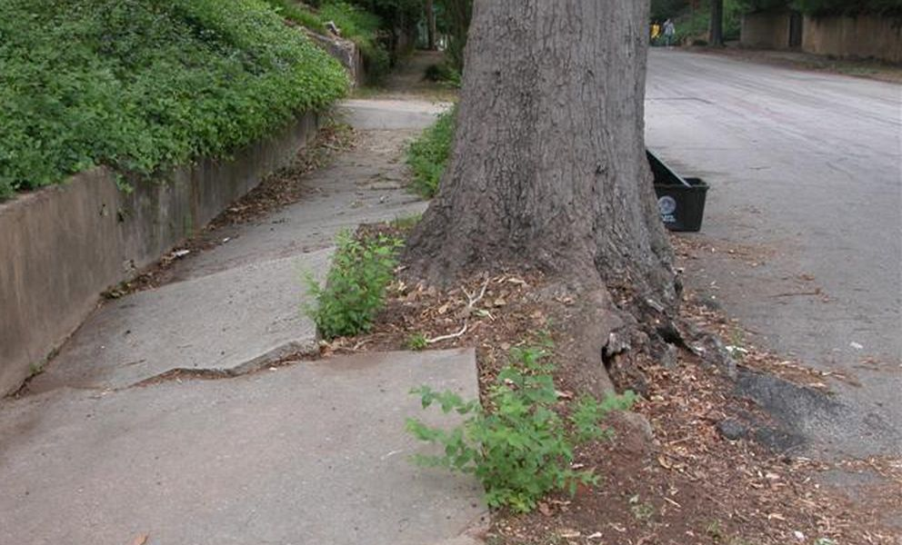
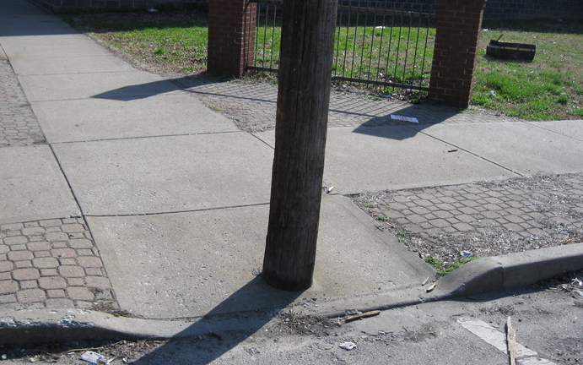
Our focus
motivation
Physical disability
Pedestrian infrastructure
Missing Curb Ramps
Surface Issues
Obstacles
No Sidewalks
People using Mobility Aids
Sidewalks
MI individuals
Notes:
Our focus will be people with physical disabilities, more specifically people with lower body impairments and who use some form of mobility aid such as wheelchairs or canes.
We refer to them as MI individuals from here on.
-----
Our focus for this paper is Sidewalks and more broadly pedestrian infrastructure, including ramps at intersections and quality of sidewalks such as cracks, obstacles so on.

Slide 5
What is the socio-political context of urban accessibility?
1
Notes:
We have two large vision questions: [read]

Slide 6
How do we enable change in the socio-political context of urban accessibility?
2
Notes:
….How do we enable change in the socio-political context of urban accessibility?
By change, we mean facilitate accessible infrastructure development → providing physical access

Slide 7
Key Research Questions
Interview study
Notes:
We break these overarching questions into three specific research questions which we studied: [click]

Slide 8
Key Research Questions
Interview study
Across stakeholder groups, what are the information needs and challenges for assessing and making decisions around urban accessibility and the role of data and technology?
RQ1
Notes:
First, [read]

Slide 9
Key Research Questions
Interview study
Across stakeholder groups, what are the information needs and challenges for assessing and making decisions around urban accessibility and the role of data and technology?
RQ1
RQ2
How do stakeholder groups communicate and interact together to assess priorities and make decisions?
Notes:
Second, [read]

Slide 10
Key Research Questions
Interview study
What are the information needs and challenges for assessing and making decisions around urban accessibility and the role of data and technology?
RQ1
RQ2
How do stakeholder groups communicate and interact together to assess priorities and make decisions?
RQ3
What are the future design opportunities to improve existing assessment and decision-making practices?
Notes:
Third, [read]

Slide 11
Interview study
method
25 participants across 3 cities
Multi-stakeholder approach with five stakeholder groups
Questions around practices around assessment approaches and decision-making practices
Notes:
To do these questions, we needed to understand the context of urban accessibility better and the challenges therein. So we conducted an interview study with 25 participants across five stakeholder groups (we will get to that in a bit) and analysed each of their perspectives and challenges within the civic ecosystem. The questions were around assessment approaches and the consequent decision-making practices for daily living, planning and maintenance, advocacy and policymaking.
Let’s look at our key stakeholder groups.
------
Image courtesy: https://uxdesign.cc/how-to-get-the-most-out-of-user-interviews-c5d0cd4499b5

Slide 12
Key stakeholders
METHOD
Policymakers
MI individuals
Elected Officials
.gov
Advocates
Department
Officials
Caregivers
DOTs
Notes:
These are our five stakeholders. Let’s go over each perspective before we focus on our findings.

Slide 13
Stakeholder perspective overview
findings
Safety and quality of physical access
Freedom and support to travel around a city
Policymakers
MI individuals
Elected Officials
.gov
Advocates
Department
Officials
Caregivers
Represent people in need
Fight for their rights and change the status quo
Closely engage with both citizens and government officials
DOTs
Notes:
MI individuals and caregivers
Shared similar goals so we describe them together
Cared about ….
safety and quality of physical access
Freedom and support to travel around a city
Understandably, their decision-making questions are around daily living such as “Is it going to be a smooth [curb ramp], is it going to end in a safe place, not out in the middle of the traffic?“, “Are there stairs?”, “Is there transit and where is it?”
Advocates
Represent people in need
Fight for their rights and change the status quo
Closely engage with both citizens and government officials

Slide 14
Stakeholder perspective overview
findings
Developing laws and policies
Prioritization and equitable distribution of resources
Manage funding amongst many competing issues
Policymakers
MI individuals
Elected Officials
.gov
Advocates
Execute policies and make accessibility improvements
Schedule and prioritize maintenance projects
Allocate available funds to specific projects
Conduct ground assessments of urban infrastructure
Department
Officials
Caregivers
DOTs
Notes:
Policymakers
Prioritization and equitable distributions of resources
Manage funding amongst many competing projects
Department Officials
Execute policies and make accessibility improvements, in this case, ADA compliant infrastructure
Schedule and prioritize maintenance and construction projects
Allocate available funds to specific projects: what are potentially the highest priority sidewalks?” (P12G).
Responsible for conduct ground assessments of urban infrastructure

Slide 15
Findings overview
findings
Data and Technology Practices for Accessibility Assessments
Interactions between Stakeholders for Accessible Infrastructure Development
Decision-Making Practices for Accessible Infrastructure Development
Challenges in Accessible Infrastructure Development
Notes:
We organize our findings into four parts: [read]

Slide 16
Findings overview
findings
Data and Technology Practices for Accessibility Assessments
Interactions between Stakeholders for Accessible Infrastructure Development
Decision-Making Practices for Accessible Infrastructure Development
Challenges in Accessible Infrastructure Development
Notes:
Today, we will focus on stakeholder interactions and the socio-political challenges

Slide 17
Interactions between Stakeholders
findings
City-scale decision making involves significant interactions between stakeholders
Focus on 3 groups
Policymakers
Department
Officials
Elected Officials
Advocates
DOTs
Notes:
For city-scale decision making, primarily we focus on three groups: [read]

Slide 18
Interactions between Stakeholders
findings
Policymakers
Legislator
Representative
Setting city agendas and priorities
Prioritize investments
Interaction Goals
Department
Officials
Advocates
Advisor
Investigator
Mediator
Educator
Litigator
Implementer
Investigator
Advisor
Notes:
Each stakeholder group has their own roles but they interaction with each other for two primary goals: setting city agendas and prioritize investments
Each interaction between two stakeholder is a manifestation of a different role. For example, as an advisor, an advocate talks to a policymaker who receives citizen feedback as a representative. To convert these feedback into policy decisions, policymakers interact with department officials to get more field-data and policy recommendations.

Slide 19
Challenges in Accessible Infrastructure Development
findings
Social, political, and economic challenges
Lack of political will
Lack of public interest
Conflicting responsibilities and priorities
Inconsistent regulations
Insufficient funding
Notes:
Within this decision-making structure, we found a number of social, political, and economic challenges such as [read]. We focus on the top three socio-political ones.

Slide 20
Challenges in Accessible Infrastructure Development
findings
Social-political challenges
Lack of political will
“Only if a legislator had a particular interest would you then request to have a [transportation] committee hearing on the state. We often didn't, in part because when I was there, the chair was not particularly interested in pedestrian issues so that was not a real focus of the committee.” (P18PM)
Public disinterest
“The challenge is that it's competing priorities and that pedestrian voices usually are low in number when people go to advocate for things because everybody wants to talk about the new bright, shiny thing.” (P11A)
Public disinterest influences Political will
“At the end of the day, it becomes a political discussion of how much money do we think the citizens are willing to vote for...at the end of the day, it's going to be nine council members and the mayor deciding, ‘here's what we think the population will bear’, and it becomes more of a political discussion and less of a policy.” (P17PM)
Notes:
Lack of political will such as politician’s interest in an issue is tied to public interest (e.g., whether they will pay taxes on:
“Only if a legislator had a particular interest would you then request to have a [transportation] committee hearing on the state. We often didn't, in part because when I was there, the chair was not particularly interested in pedestrian issues so that was not a real focus of the committee.” (P18PM)
Public disinterest:
“The challenge is that it's competing priorities and that pedestrian voices usually are low in number when people go to advocate for things because everybody wants to talk about the new bright, shiny thing.” (P11A).
Closely relates to public disinterest
“At the end of the day, it becomes a political discussion of how much money do we think the citizens are willing to vote for...at the end of the day, it's going to be nine council members and the mayor deciding, ‘here's what we think the population will bear’, and it becomes more of a political discussion and less of a policy.” (P17PM)

Slide 21
How do we enable change in the socio-political context of urban accessibility?
Notes:
Given these challenges, how do we enable change in this socio-political context?
We found that the several of the challenges were tied to either lack of interactions or communication gaps.

Slide 22
Key Observations
discussion
Tools and data enabled a lot of the decision-making process
Collective voice played a role in changing the status quo
Example: Disability activism, citizen complaints
Notes:
We make two observations from the current decision-making practices.
First, tools and data enabled a lot of the existing decision practices. A lot of manual effort goes into gathering data from different perspectives
Second, citizen’s voice plays an important.

Slide 23
Key Observations
discussion
Tools and data enabled a lot of the decision-making process
Collective voice played a role in changing the status quo
Example: Disability activism, citizen complaints
How do we facilitate civic interactions through technology?
Notes:
Thus, we see two opportunities to facilitate accessible infrastructure development
Enhancing Data-driven decision support tools
Facilitating richer civic interactions

Slide 24
Civic Interaction Space: Six Points of Civic Interactions
Policymakers
Interaction Goals
1
6
1
Raising Awareness (A $→$ PM)
Policy Recommendations (A $→$ PM)
Setting Priorities (A $↔$ PM)
Community Input (A $→$ PM)
Issue Resolution (PM $→$ A)
Issue Data Generation* (A $→$ PM)
4
Community Input (CM $→$ PM)
Issue Resolution (PM $→$ CM)
Issue Data Generation* (CM $→$ PM)
2
Department
Officials
Advocates
2
Raising Awareness (A $→$ D)
Setting Priorities (A $↔$ D)
Community Input (A $→$ D)
Issue Data Generation* (A $→$ D)
5
Raising Awareness (D $→$ CM)
Community Input (CM $→$ D)
Issue Resolution (D $→$ CM)
Issue Data Generation* (CM $→$ D)
3
4
5
Community
Includes MI individuals and Caregivers
3
Raising Awareness (A $→$ CM)
Building Capacity (A $→$ CM)
Community Input (CM $→$ A)
Investigating Issues (CM$↔$ A)
Issue Resolution (A $→$ CM)
6
Setting Priorities (D $↔$ PM)
Policy Recommendations (D $→$ PM)
Investigating Issues (D $→$ PM)
Legislative Oversight (PM $→$ D)
Issue Resolution (D $→$ PM)
Legend
More communication
Less communication
* Indirect Interactions through civic participation apps/tools
Notes:
In order to better understand those interactions and communication gaps, we synthesized our findings into a civic interaction space that
highlights the points of interaction between stakeholders
visualizes the similarities and differences in interaction goals
allows us to explore the role of civic tech to improve cross-stakeholder communication

Slide 25
2 Focus areas
Discussion: Facilitating civic interactions
Improving Community Input and Government Feedback (increase government feedback – more transparency)
Supporting Advocacy Efforts (providing tool support to organize efforts well – make data gathering easier)
Notes:
In the paper (this work), we describe two areas in urban accessibility space that needs strengthening to work towards a collaborative decision-making environment:
Improving Community Collaboration (increase feedback)
Enhancing Raising Awareness Efforts (providing tool support to do this well – gathering can made easy)
I would encourage everyone to refer the paper for more details and more findings.

Slide 26
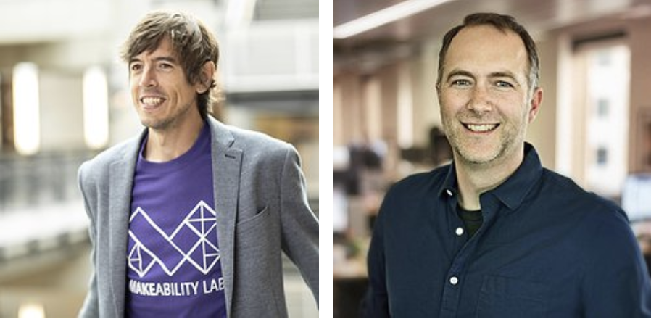
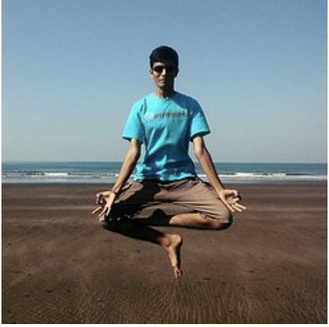
team
acknowledgements
Professors
Master Students
Jon Froehlich
Jeffrey Heer
Devanshi Chauhan
Rachel Kangas
Siddhant Patil
Notes:
This brings us to the end of talk. Thank you to my advisors on this project and my brilliant team, some of whom could make it today! Would not have been possible without any of you!

Slide 27
takeaways
conclusion
Any Questions?
Socio-political factors complicates things!
Facilitating civic interactions may hold the key!
Contact:
manaswi@cs.uw.edu
manaswisaha
Notes:
Thank you for your attention. Happy to take questions!

Slide 28
Background: legislations
motivation
Disability Rights Movement of 1960s, 70s and beyond
1968’s Architecture Barriers Act (ABA)
1990’s Americans with Disabilities Act (ADA)
Notes:
Some more terms to get out of the way. There were several legislations that were passed as a results of the disability rights movement in the 1960s, 1970s and beyond
ABA was first measure that Congress that required accessibility of federally funded buildings
ADA was the first civil rights law passed that was much broader and that prohibits discrimination against individuals with disabilities in all areas of life. In addition to access to programs, services, and employment opportunities, the ADA stipulates concrete guidelines on what constitutes an accessible built environment such as accessible sidewalks, which is brings to just that

Slide 29
Decision-Making Practices
findings
Prioritization Practices
Impact assessment is crucial: equity, gentrification
Notes:
Each method has its pros and cons. For example, citizen complaints in theory make sense. However, the major drawback is that voices of certain communities may never being heard. For example, time constraints, commonly seen in low income communities where people work multiple jobs or people have limited technology access hampering engagement

Slide 30
Decision-Making Practices
findings
Prioritization Practices
Impact assessment is crucial: equity, gentrification
“The city has a commitment, and I have a commitment personally, [...] to try to make our city more equitable. To the extent that inequities exist, and they exist massively in [City-name], we need to be making disproportionate investments to undo the disproportionate investments that were made by prior generations.” (P25PM )
Notes:
Each method has its pros and cons. For example, citizen complaints in theory make sense. However, the major drawback is that voices of certain communities may never being heard. For example, time constraints, commonly seen in low income communities where people work multiple jobs or people have limited technology access hampering engagement

Slide 31
Decision-Making Practices
findings
Prioritization Practices
Impact assessment is crucial: equity, gentrification
Several prioritization approaches used
infrastructure utilization
proximity to destinations
area demographics
citizen complaints
population density
accessibility comparison
Notes:
Each method has its pros and cons. For example, citizen complaints in theory make sense. However, the major drawback is that voices of certain communities may never being heard. For example, time constraints, commonly seen in low income communities where people work multiple jobs or people have limited technology access hampering engagement

Slide 32
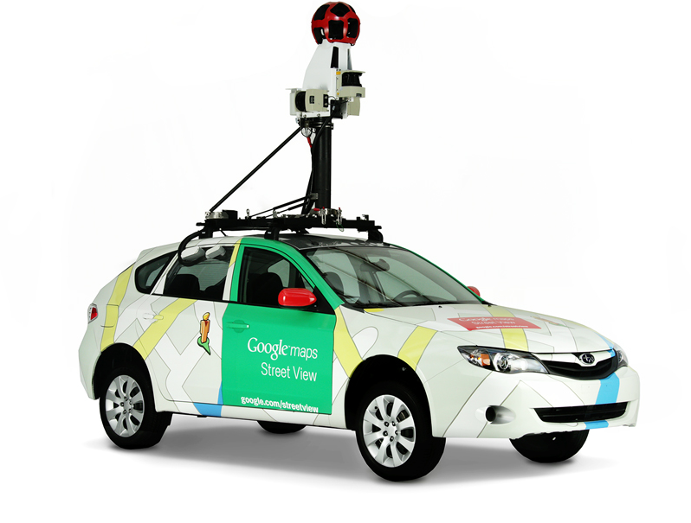
City infrastructure changes slowly
Is Google Street view a reasonable Dataset for accessibility audits?
Avg image age in Bus Stop Dataset
1.7 yrs (SD=0.7)
ρ
Avg image age in Intersection Dataset
1.5 yrs (SD=0.7)
Notes:
It turns out that physical infrastructure just doesn’t change that often. At least not within the time windows of Google driving their GSV cars through cities to refresh their data
---
Physical audit area for intersections:
DC Downtown: 0.65 sq km or 6.9 km: https://www.gmap-pedometer.com/?r=7042532
DC Residential: 0.58 sq km or 8.8 km: http://www.gmap-pedometer.com/?r=7042528
Baltimore Downtown: 0.45 sq km or 6.5 km: http://www.gmap-pedometer.com/?r=7042537
Baltimore Residential: 1.02 sq km or 10.70 km: http://www.gmap-pedometer.com/?r=7042540

Slide 33
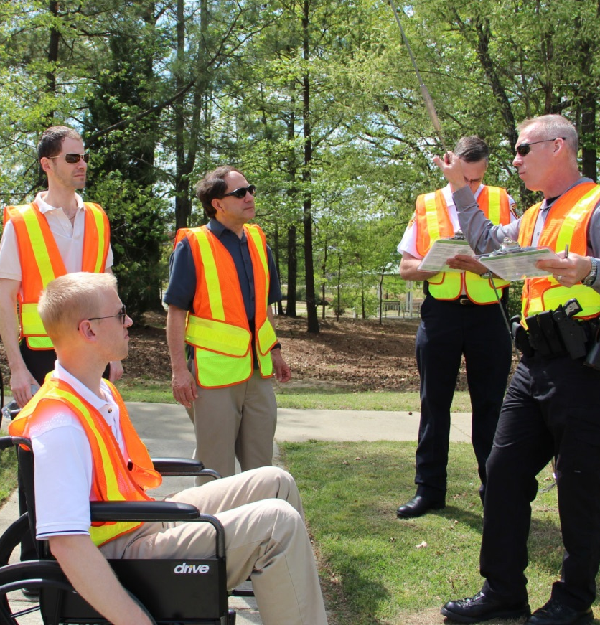
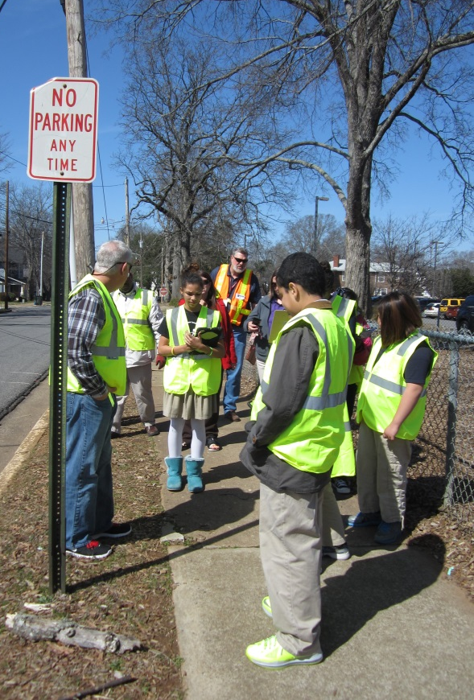
Traditional Physical Audits
Walkability Audit
Wake County, North Carolina
Walkability Audit
Wake County, North Carolina
Safe Routes to School Walkability Audit
Rock Hill, South Carolina
Notes:
Traditionally, this data comes from physical audits conducted by government and volunteer organizations.

Slide 34
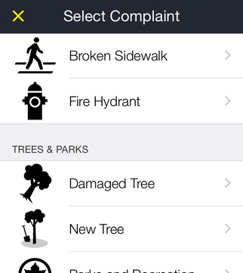
Mobile Reporting Solutions
http://www1.nyc.gov/311/index.page
Notes:
Another form data collecting is mobile reporting applications such as 311 and other similar mobile apps.

Slide 35
traditional data collection approaches
challenges
Slow, Manual, and Laborious
Huge Cost
Localized
Notes:
Both of the previous approaches needed a person to be physically present which can be [click].
[read out point one] slow, manual and a laborious process (OR time-consuming and cumbersome).
[click] These methods incur huge costs. As a result, it's very infrequent. For example, the city of Seattle completed their first-ever Sidewalk audit in 2017(!) which required ~15 employees working fulltime for 9 months
[click]. Finally, this process is very localized to a city requiring physically going out to do these audits.
-----
Image Courtesy:
https://sashat.me/2016/11/12/standalone-us-cities/

Slide 36
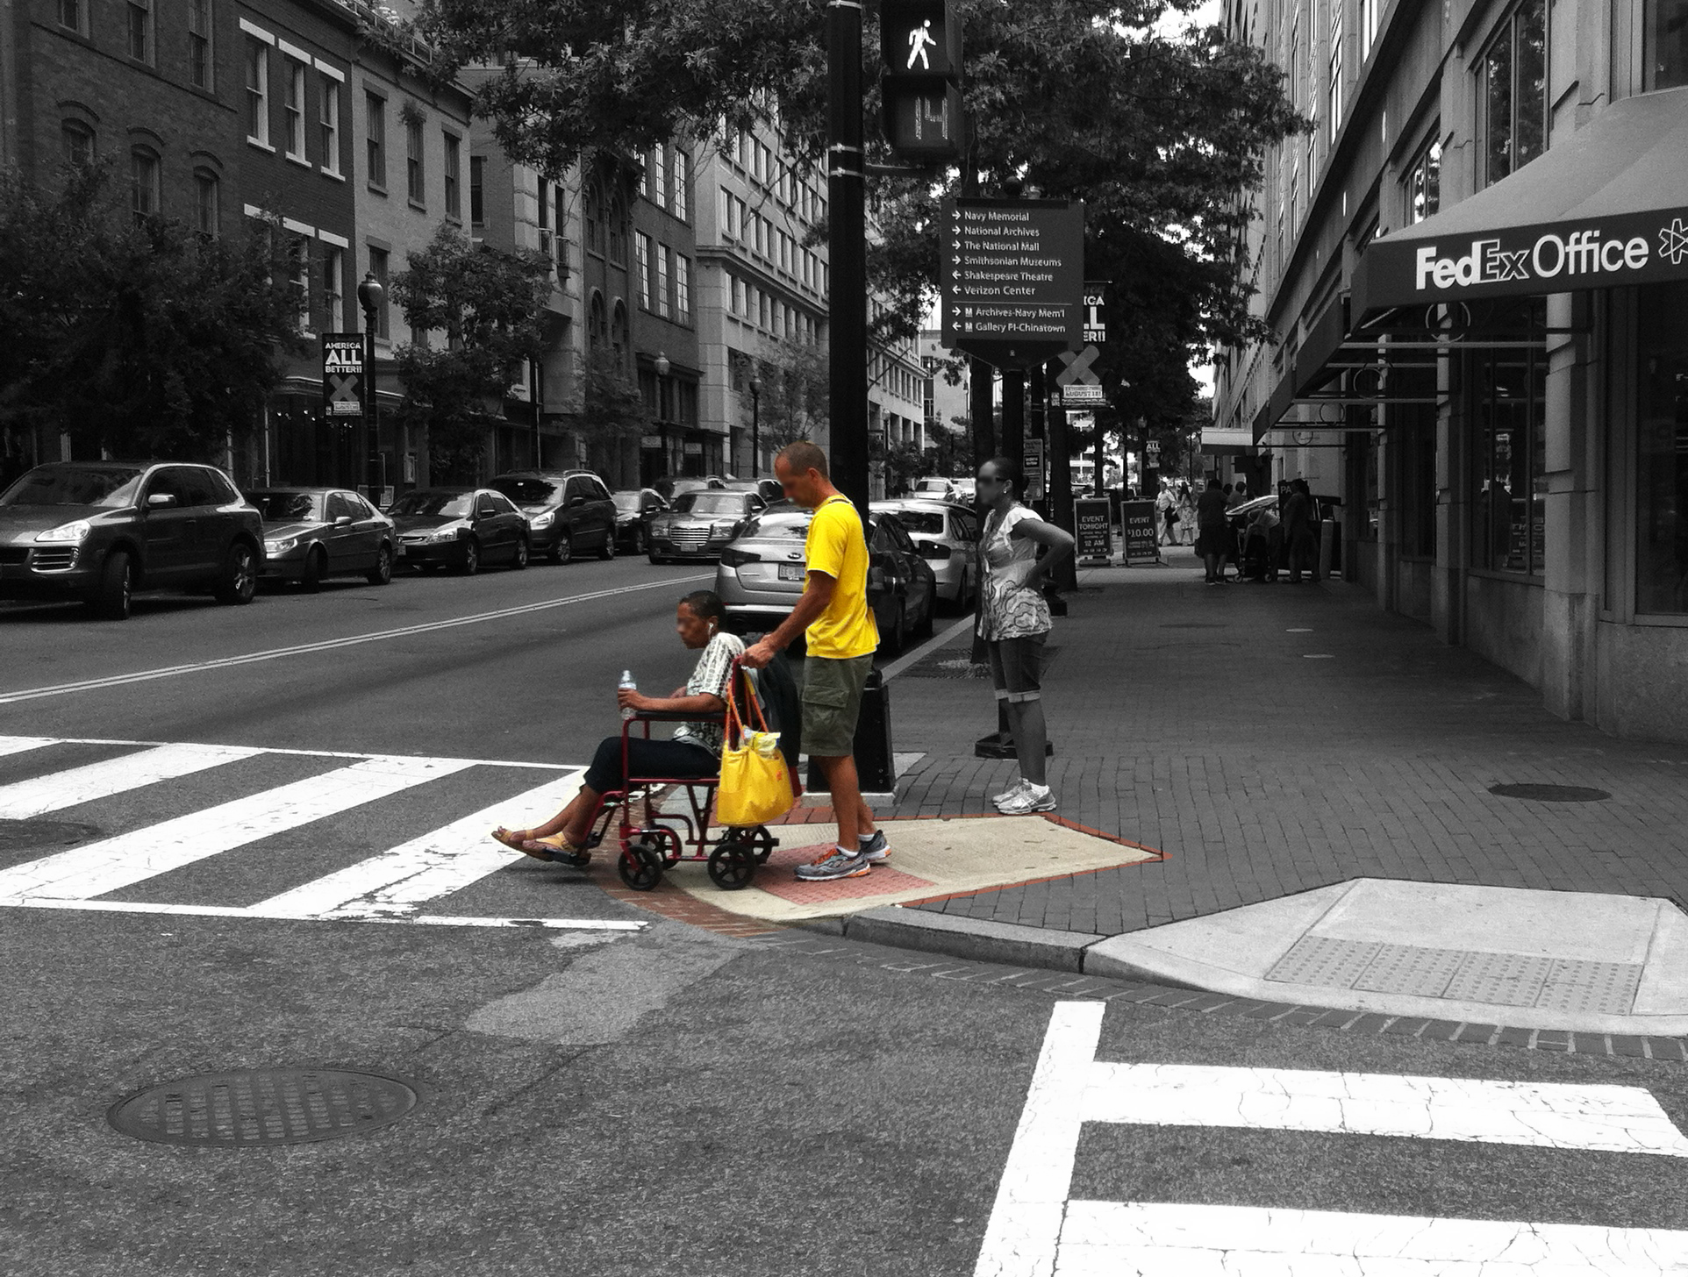
Computer vision can automatically find curb ramps
Notes:
Our initial work has focused on curb ramps, [click] we found that computer vision can detect curb ramps

Slide 37
Data and Technology Practices
findings
Two methods
In-person methods
Technology-based methods
Notes:
Two methods
In-persons methods include contact with locations and people
Technology-based methods allows for remote assessments

Slide 38
In-person methods
Findings: data and technology practices
Physical Inspections
Physically go out to assess conditions
Extensively used for all groups
“If it's too steep of an angle, I have to tip my chair back. Or if there's a big bump, I'd have to go extra slow” (P5M)
Notes:
Physical inspections involved going out to physically assess conditions. All groups extensively used this approach. For example,
MI individuals heavily used this approach to do –pre-trip planning. For example, an P5 explained how she understand the street dynamics with respect to her chair
Similarly, government officials went out to take precise measurements of infrastructure. This data is then used to inform a lot of the planning decision-making

Slide 39
In-person methods
Findings: data and technology practices
Engaging with People
Lived experiences
Rich qualitative experiences
Impact on quality of life
Notes:
Engaging with people involved talking to people and understanding their lived experiences. Allowed us to gather rich qualilative experiences and help understand the impact on quality of life.
This is the most trusted method used by MI individuals. Similarly, advocates heavily used this method, for example, to file a class action suit

Slide 40
In-person methods
Findings: data and technology practices
Physical Inspections
Engaging with People
“We'll do mayor's walk through […] that'll be a walk with the mayor and the community and all the agencies. Last year I went on a couple that were like two miles long. We walk for two miles and look at everything from signs to sidewalks to ramps to abandoned cars, vacant buildings. So, it's usually 30 or 40 government employees and anywhere from 30 to 100 citizens.” (P21G)
“We will do constituent service walks through certain neighborhoods. We'll pick a very concentrated section of the ward and say like there are potholes here, there's obstacles here and be reporting this.” (P23PM)
.gov
Policymakers
Notes:
On the other hand, policymakers do a combination of both visit locations and engage with people to understand issues

Slide 41
Technology-based methods
Findings: data and technology practices
Remote Assessments
“Nothing super sophisticated but city maps with dots saying, ‘There is a broken sidewalk here. There is a curb cut here.’” (P18PM)
Department
Officials
+ Caregivers
.gov
Policymakers
“As a legislator, we very rarely got briefed with visual tools. It was very sad.” (P18PM)
Notes:
In contrast, technology-based methods allow for remote assessments. This involves using analytical tools and specialized mapping tools by the department officials vs MI individuals who used commercial tools such as Google Maps or Google Street View.
Here, we observed severity disparity in access – dept. officials were tool/data rich vs other groups had to utilize repurpose what is available to them to fit their needs.
Additionally, with very few exceptions, most of the commercially available tools were not developed keeping accessibility needs in mind, so were insufficient during actual usage.

